Slide 1

Commerce – surveys
Stage 5 Commerce
The consumer and financial environment (core)
[Teacher name]
[Date]
Notes:
The following resource looks at how to create surveys with a focus on Commerce content.

Slide 2
Learning intentions and success criteria
We are learning to:
use Microsoft Forms to create, distribute, and analyse a survey to gather useful data.
We can:
design 5 to 10 clear survey questions
use Microsoft Forms to build our survey
share our survey link with others
interpret responses using basic data analysis.
Notes:
Notes for teachers:
Learning intentions and success are best co-constructed with students. Adapt the learning intention as required and add matching success criteria.
For more information See ⁠AITSL or the NSW Department of Education explicit teaching strategies, ⁠Sharing learning intentions and ⁠Sharing success criteria
LISC is not necessarily presented at the beginning of the lesson. Teacher needs to consider most effectual time to introduce
LISC should be revisited during the lesson to support students' evaluation of their learning

Slide 3

Survey (1)
Microsoft Forms
Go to forms.office.com
Add a title and short description of what your form is about
Add your questions, for example:
        How old are you?
        What is your occupation?
        What is your estimated income?
        Which product or service do you prefer? Why?
Notes:
Read through slide.
Walk students through creating a new form, including the title and description.
Explain that survey questions should be clear and easy to understand to ensure accurate responses.

Slide 4
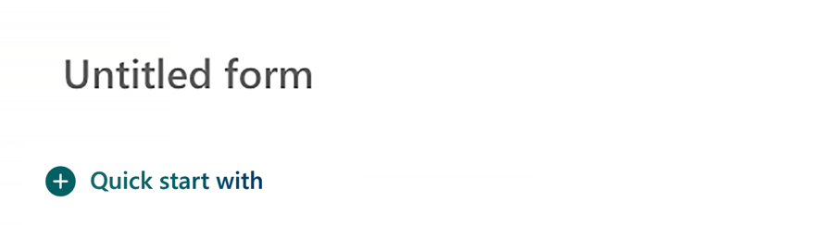
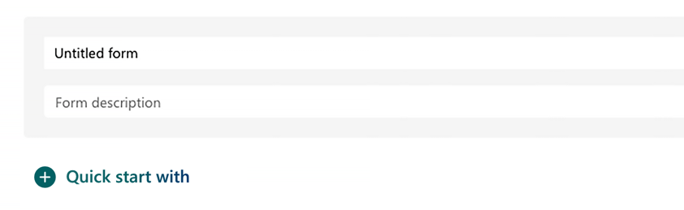


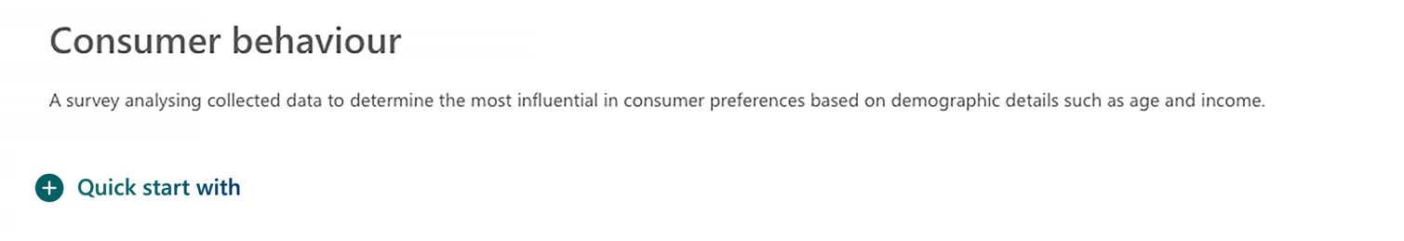
Visual demonstration (1)
1
2
3
Notes:
Run students through the steps involved.
You may either explain this from the screen or demonstrate this live.
Step 1 – click on ‘untitled form.’
Step 2 – fill in title and form description details.
Step 3 – click on ‘quick start with.’

Slide 5

Survey (2)
Microsoft Forms – question types
      Questions could either be:
        Multiple choice
        Text (short or long)
        Rating scale
        Likert (strongly agree to strongly disagree).
Notes:
Read through slide
Explain different question types, including multiple choice, text, rating scales, and Likert scales.
Provide a specific explanation of Likert scales.
These measure opinions or attitudes on a scale (e.g., strongly agree → strongly disagree).
Businesses use them in market research to understand consumer preferences.
Students convert one of their survey questions into a Likert scale format (e.g. my job role and income level impact my spending habits).

Slide 6
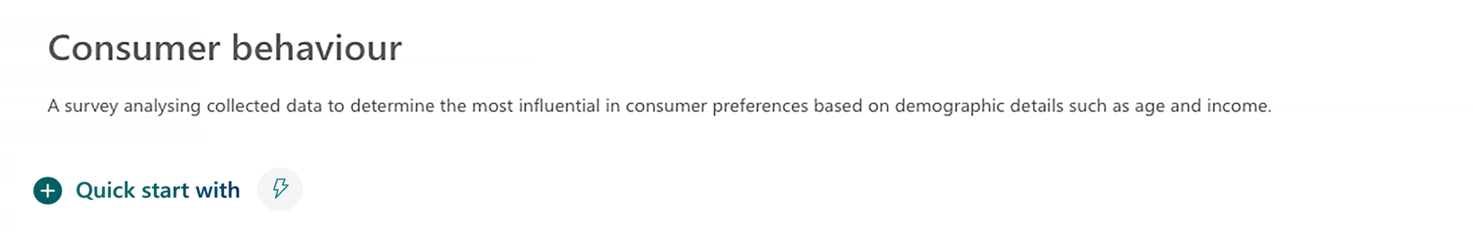
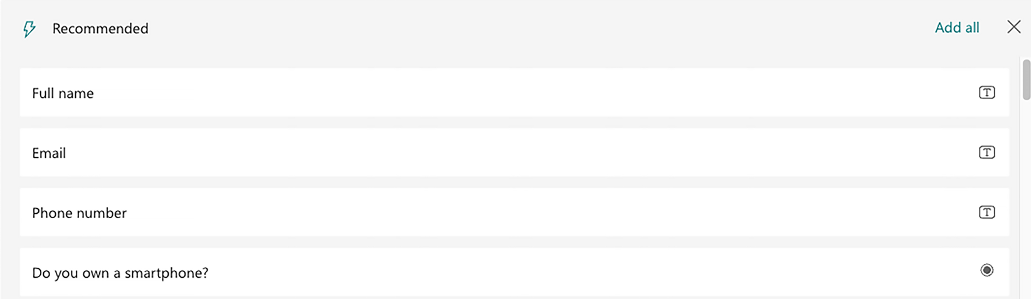
Visual demonstration (2)
1
2
Notes:
Run students through the steps involved.
You may either explain this from the screen or demonstrate this live.
After clicking on ‘quick start with’ choose preferred question type for survey question
You can alter this for each question

Slide 7

Share your survey
Microsoft Forms
Once students complete their survey design, they can click ‘Collect Responses’
Choose anyone with link can respond
Copy the link to share by email, Teams or QR code
Have 5 to 8 respondents complete the form.
Notes:
Read through slide.
Explain how to share the survey link via email, Teams, or QR codes.
Emphasise the importance of gathering a diverse set of responses for meaningful insights.
Students send their survey to at least 5 respondents and record observations on ease of use and response rates.

Slide 8
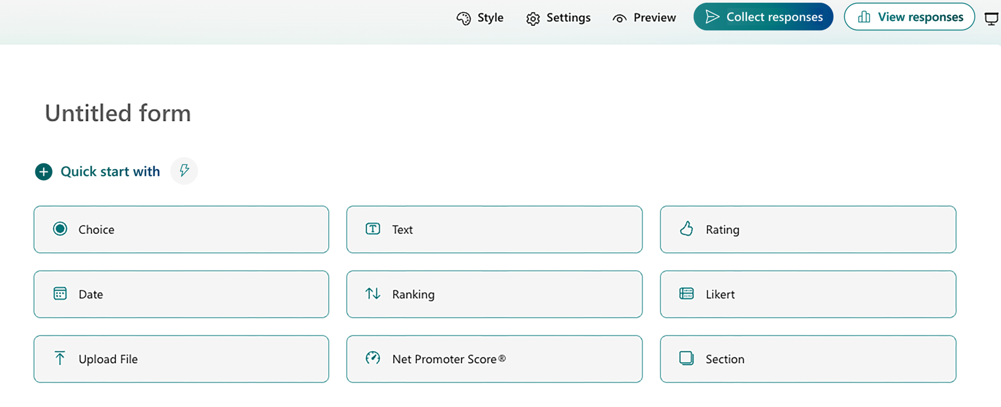
Visual demonstration (3)
Notes:
Run students through the steps involved.
You may either explain this from the screen or demonstrate this live.
Click ‘collect responses’.

Slide 9
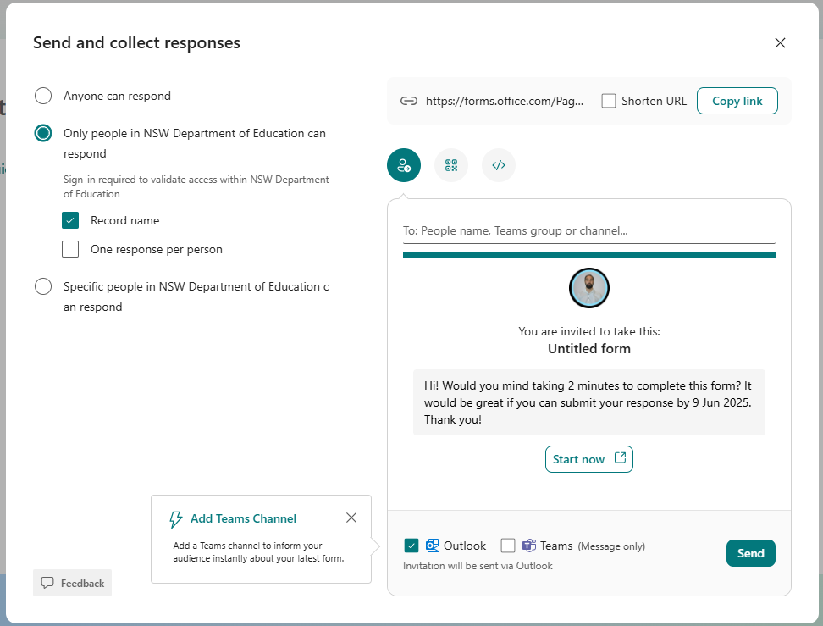



Visual demonstration (4)
Choose who
may response
You may send the link, share a QR code or embed the form in a document
Notes:
Run students through the steps involved.
You may either explain this from the screen or demonstrate this live.

Slide 10

View and interpret results
Microsoft Forms
Google forms produces automatic summaries in the form of Pie charts and individual responses.
      Click view responses to sort or filter your data.
      After collecting responses, summarise your findings.
Notes:
Explain how Microsoft Forms automatically generates graphs and charts to visualise survey responses.
Clarify what summarising findings looks like—students should identify patterns in responses, such as:
trends in consumer preferences (convenience, culture, advertising, customer service, ethical decision making)
differences based on age, occupation, or financial priorities.
Explain how businesses might adjust their strategies based on survey data.
Students write a summary of their survey results, highlighting one key trend or surprising insight.

Slide 11
Visual demonstration (5)
Notes:
Run students through the steps involved.
You may either explain this from the screen or demonstrate this live.
Click ‘view responses’ to see survey results.

Slide 12
References
This presentation contains NSW Curriculum and syllabus content. The NSW Curriculum is developed by the NSW Education Standards Authority. This content is prepared by NESA for and on behalf of the Crown in the right of the State of New South Wales. The material is protected by Crown copyright.
Please refer to the NESA Copyright Disclaimer for more information https://educationstandards.nsw.edu.au/wps/portal/nesa/mini-footer/copyright.
NESA holds the only official and up-to-date versions of the NSW Curriculum and syllabus documents. Please visit the NSW Education Standards Authority (NESA) website https://educationstandards.nsw.edu.au/wps/portal/nesa/home and the NSW Curriculum website https://curriculum.nsw.edu.au.
Commerce 7–10 Syllabus 2024 © NSW Education Standards Authority (NESA) for and on behalf of the Crown in right of the State of New South Wales, 2024.

Slide 13
Copyright
© State of New South Wales (Department of Education), 2024
The copyright material published in this resource is subject to the Copyright Act 1968 (Cth) and is owned by the NSW Department of Education or, where indicated, by a party other than the NSW Department of Education (third-party material).
Copyright material available in this resource and owned by the NSW Department of Education is licensed under a Creative Commons Attribution 4.0 International (CC BY 4.0) licence.
This licence allows you to share and adapt the material for any purpose, even commercially.
Attribution should be given to © State of New South Wales (Department of Education), 2024.
Material in this resource not available under a Creative Commons licence:
the NSW Department of Education logo, other logos and trademark-protected material
Material owned by a third party that has been reproduced with permission. You will need to obtain permission from the third party to reuse its material.
Links to third-party material and websites
Please note that the provided (reading/viewing material/list/links/texts) are a suggestion only and implies no endorsement, by the New South Wales Department of Education, of any author, publisher, or book title. School principals and teachers are best placed to assess the suitability of resources that would complement the curriculum and reflect the needs and interests of their students.
If you use the links provided in this document to access a third party’s website, you acknowledge that the terms of use, including licence terms set out on the third-party’s website apply to the use which may be made of the materials on that third-party website or where permitted by the Copyright Act 1968 (Cth). The department accepts no responsibility for content on third-party websites.

