Slide 1

Commerce – reflective speech
Stage 5 Commerce
The consumer and financial environment (core)
[Teacher name]
[Date]
Notes:
The following resource looks at how to write and prepare for a reflective speech with a focus on Commerce content.

Slide 2
Learning intentions and success criteria
We are learning to:
write and deliver a reflective speech that explores personal insights about consumer behaviour.
We can:
write a structured reflective speech with a clear introduction, body, and conclusion
express personal insights about consumer behaviour in a reflective and engaging manner
use specific examples to explain what influences spending decisions
analyse how thinking or habits have change over time.
Notes:
Notes for teachers:
Learning intentions and success are best co-constructed with students. Adapt the learning intention as required and add matching success criteria.
For more information See ⁠AITSL or the NSW Department of Education explicit teaching strategies, ⁠Sharing learning intentions and ⁠Sharing success criteria.
LISC is not necessarily presented at the beginning of the lesson. Teacher needs to consider most effectual time to introduce.
LISC should be revisited during the lesson to support students' evaluation of their learning.

Slide 3

Reflective speech (1)
Reflective speech
A reflective speech is personal and thoughtful. It generally explores:
        what you’ve learned
        what influenced you
        how your thinking or behaviour has changed.
Notes:
Read through slide.
Define reflective speech as personal and introspective
Highlight that reflection includes what students have learned, what influenced them, and how their behaviour has changed.
Discuss how reflective thinking helps consumers make informed financial choices.
Link the concept to resource allocation (encourage students to think about why they spent money on a particular item), prompting students to consider past, present, and future financial decisions.
Have students write two sentences explaining what they’ve learned about their spending habits.

Slide 4

Reflective speech (2)
Speech structure
Introduction – What’s your speech about?
Body – Explore what you learned and why it matters.
Conclusion – Sum up and reflect how this affects decision making.
Notes:
Read through slide.
Break down the three-part structure introduction, body and conclusion.
Students should begin with their personal experience, explain what they learned from it, and finish with how it affects decision making.
This creates a clear and logical flow in their reflective speech.
Have students outline their speech in three short bullet points.

Slide 5

Reflective speech (3)
Personal hook
Start with a relatable moment or question:
        Have you ever bought something because it made your life more convenient?
        I never understood why people ordered online until I realised how much time it saves me.
Notes:
Read through slide.
Explain that a strong hook makes the speech engaging and relatable.
Use sample hooks to demonstrate how convenience impacts spending decisions.
Have students draft two possible hook sentences for their speech.

Slide 6
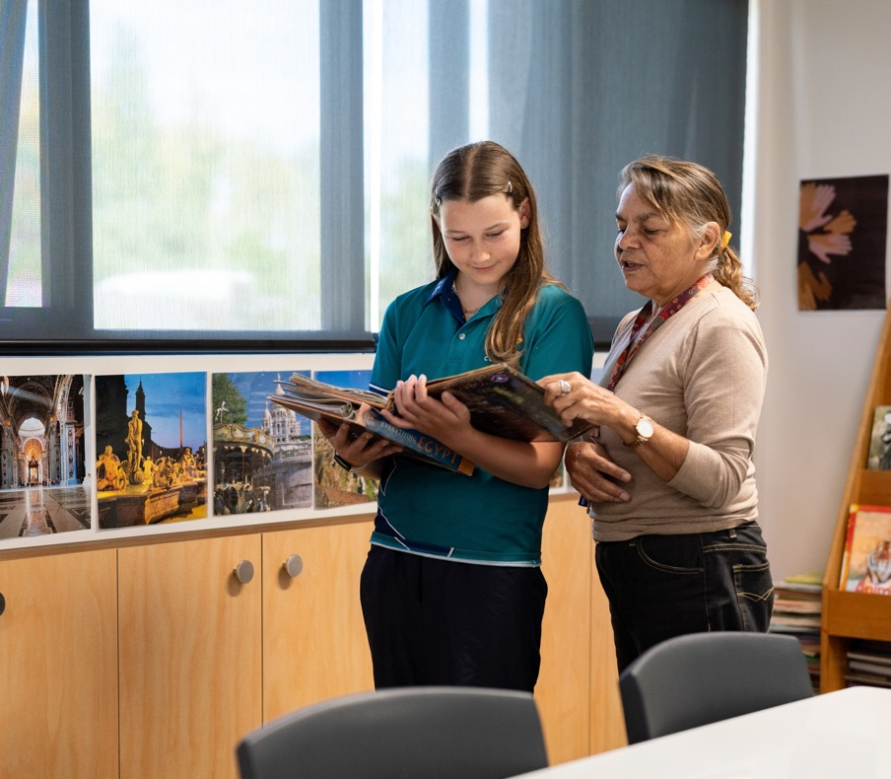
Reflective speech (4)
What new ideas did you learn?
For example:
I learned that those who earn a lot of money are more likely to spend more on items they consider important to them
I found that those who are older are more likely to spend money on their health than those who are younger.
Notes:
Read through slide.
Guide students in identifying key insights about consumer habits—for example how age and income influence spending priorities.
Encourage personal reflection by asking students how these insights relate to their spending behaviour.
Have students write one insight about how spending differs across age groups or income levels.

Slide 7
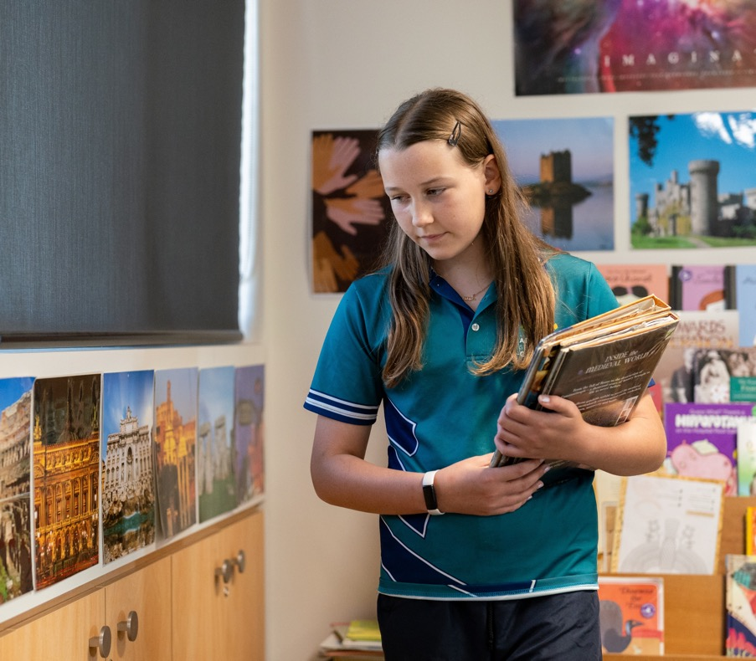
Reflective speech (5)
What influences you most?
Reflect on your own personal experience:
Are you more influenced by competing products, culture, advertising, customer service, or convenience?
Which one surprised you the most?
For example – I usually buy my clothes online because I find it difficult to go to the shops between work and school.
Notes:
Read through slide.
Inform students that first-person writing is not typically preferred in Commerce unless specified. For this speech, however, using first person is required to ensure a persona and reflective approach when presenting insights.
Encourage students to reflect on their influences — competing products, culture, advertising, customer service, or convenience.
Explain how businesses use targeted advertising to capitalise on these influences.
Have students rank the top three factors that influence their purchases.

Slide 8

Reflective speech (6)
How do you make buying decisions?
Do you plan your purchases, or buy on impulse?
Does your income or allowance affect whether you prioritise price or ease when shopping?
Has your thinking changed?
Notes:
Read through slide.
Challenge students to think about how their spending habits have evolved.
Ask students to consider whether they plan purchases or buy impulsively and whether budgeting plays a role in their decision-making.
Have students write one sentence about whether they plan purchases or buy impulsively and why.

Slide 9
References
This presentation contains NSW Curriculum and syllabus content. The NSW Curriculum is developed by the NSW Education Standards Authority. This content is prepared by NESA for and on behalf of the Crown in the right of the State of New South Wales. The material is protected by Crown copyright.
Please refer to the NESA Copyright Disclaimer for more information https://educationstandards.nsw.edu.au/wps/portal/nesa/mini-footer/copyright.
NESA holds the only official and up-to-date versions of the NSW Curriculum and syllabus documents. Please visit the NSW Education Standards Authority (NESA) website https://educationstandards.nsw.edu.au/wps/portal/nesa/home and the NSW Curriculum website https://curriculum.nsw.edu.au.
Commerce 7–10 Syllabus 2024 © NSW Education Standards Authority (NESA) for and on behalf of the Crown in right of the State of New South Wales, 2024.

Slide 10
Copyright
© State of New South Wales (Department of Education), 2024
The copyright material published in this resource is subject to the Copyright Act 1968 (Cth) and is owned by the NSW Department of Education or, where indicated, by a party other than the NSW Department of Education (third-party material).
Copyright material available in this resource and owned by the NSW Department of Education is licensed under a Creative Commons Attribution 4.0 International (CC BY 4.0) licence.
This licence allows you to share and adapt the material for any purpose, even commercially.
Attribution should be given to © State of New South Wales (Department of Education), 2024.
Material in this resource not available under a Creative Commons licence:
the NSW Department of Education logo, other logos and trademark-protected material
Material owned by a third party that has been reproduced with permission. You will need to obtain permission from the third party to reuse its material.
Links to third-party material and websites
Please note that the provided (reading/viewing material/list/links/texts) are a suggestion only and implies no endorsement, by the New South Wales Department of Education, of any author, publisher, or book title. School principals and teachers are best placed to assess the suitability of resources that would complement the curriculum and reflect the needs and interests of their students.
If you use the links provided in this document to access a third party’s website, you acknowledge that the terms of use, including licence terms set out on the third-party’s website apply to the use which may be made of the materials on that third-party website or where permitted by the Copyright Act 1968 (Cth). The department accepts no responsibility for content on third-party websites.

