Slide 1

Commerce – PEEL paragraphs
Stage 5 Commerce
The consumer and financial environment (core)
[Teacher name]
[Date]
Notes:
The following resource looks at how to write PEEL paragraphs with a focus on Commerce content.

Slide 2
Learning intentions and success criteria
We are learning to:
write clear and well-structured PEEL paragraphs to improve our writing.
We can:
identify the four parts of a PEEL paragraph
construct a PEEL paragraph on a given topic.
Notes:
Notes for teachers:
Learning intentions and success are best co-constructed with students. Adapt the learning intention as required and add matching success criteria.
For more information See ⁠AITSL or the NSW Department of Education explicit teaching strategies, ⁠Sharing learning intentions and ⁠Sharing success criteria.
LISC is not necessarily presented at the beginning of the lesson. Teacher needs to consider most effectual time to introduce.
LISC should be revisited during the lesson to support students' evaluation of their learning.

Slide 3

What is a PEEL paragraph?
PEEL stands for Point, Evidence, Explanation, Link
It’s a structure for writing clear and focused paragraphs.
Notes:
Begin by discussing why clear writing matters in Commerce, particularly in explaining economic, business, and consumer behaviour concepts.
Define the PEEL structure and provide real-world applications, such as writing reports, essays or speeches.
Throughout this slide show presentation students will be provided with a modelled response whilst being guided to write their own response to a separate question through teacher facilitation of the speaker notes section of this resource.

Slide 4
PEEL paragraph
Sample question
Explain how ‘brand image’ impacts consumer spending and the role of work in society.
NESA have in their Glossary of key words identified that an explain question requires student to:
  relate cause and effect
  make the relationship between things evident
  provide why and/or how.
Notes:
Deconstruct the question with students
First inform students that a PEEL paragraph does not need to have exactly four sentences—it requires four sections: Point, Evidence, Explanation, and Link.
Help students identify the key concepts – ‘Brand image,’ ‘consumer spending,’ and ‘role of work in society.’
Once students have identified the key concepts of the question help them:
Define brand image – explain that it shapes how consumers see and feel about products.
Show its influence on spending – give examples of popular brands and why consumers choose them.
Explain the connection to work – highlight how branding leads to job creation in marketing, design, and advertising.
Link everything together – show how brand image affects both buying habits and employment.

Slide 5

PEEL (1)
Point
Explain how ‘brand image’ impacts consumer spending and the role of work in society.
Start with your main idea
This is your topic sentence
Keep it clear and direct
Point – Brand image affects what people buy by shaping how they see a brand. A strong brand builds trust and makes people more likely to choose it. It also creates jobs in marketing, retail, and advertising, where people work to promote and maintain brand reputation.
Notes:
Read through slide and discuss how consumers' initial perceptions of a brand affect spending choices.
Emphasise that consumers make purchasing decisions based on influencing factors, such as age, advertising, or convenience.
Have students write a topic sentence explaining how convenience influenced a recent purchasing decision they made. For example – I recently bought running shoes online instead of in-store because fast delivery and easy checkout were more convenient than going to a shop.
Throughout the rest of this presentation, students will work through the modelled response on the slides and the guided response to the question - explain how convenience influenced a recent purchasing decision you made in the speaker notes.

Slide 6
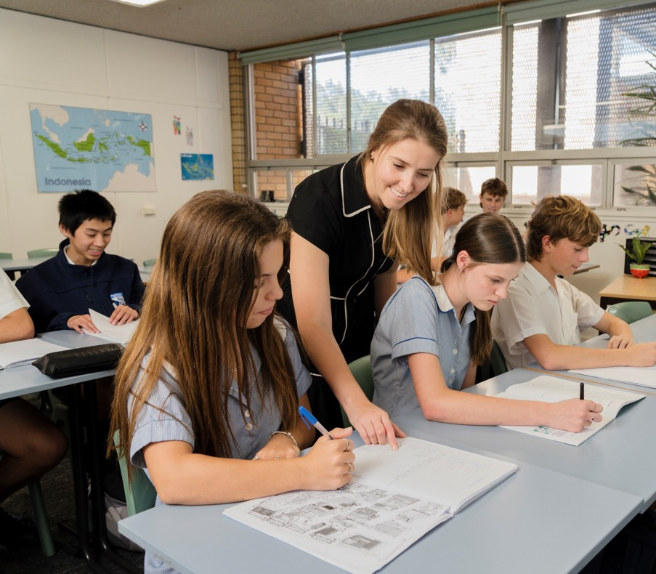
PEEL (2)
Evidence
Explain how ‘brand image’ impacts consumer spending and the role of work in society.
Add a fact, quote, or example to support your point
Make sure it's relevant and accurate
Evidence – For example, many teenagers prefer brands like Nike or Adidas because they are seen as cool, high-quality, and trendy. These brands are known for their logos and how they are marketed as popular and reliable.
Notes:
Read through slide and modelled response.
Guide students on choosing relevant facts, quotes, data, or examples to support their consumer and financial decisions.
Explain how businesses or consumers use data to justify financial decisions.
For the guided question where student explain how convenience influenced a recent purchasing decision they made, have them support their answer with a real-world example of consumer behaviour.
They can use a survey or study showing how convenience influences purchasing decisions and integrate it into their paragraph. For example, The Interactive Advertising Bureau Australia and Pureprofile released the Australian E-commerce Report 2023 which found that 67% of consumers cited convenience as the top reason for purchasing online.

Slide 7
PEEL (3)
Explanation
Explain how ‘brand image’ impacts consumer spending and the role of work in society.
Explain how your evidence supports your point
Add your own analysis
Show the importance of the evidence
Explain – This affects how much people are willing to spend, as they are more likely to pay extra for a brand that is well-known and trusted. Companies spend a lot of money on advertising to make sure their brand looks good, which creates jobs in marketing, design, and other creative industries. This shows how brand image connects to how people spend their money and supports the role of work in society.
Notes:
Read through slide and modelled response.
For the guided question where student explain how convenience influenced a recent purchasing decision they made, help students analyse why convenience played a role in their decision and how companies capitalise on this trend. For example, convenience influenced this purchase by removing the need to visit a store, wait in line, or search for sizes. Businesses cater to this demand with fast delivery, simple checkout, and flexible returns, ensuring customers needs are met.
Discuss how online shopping, and time-saving services shape consumer habits.
Have students explain how their chosen evidence directly influenced their spending decision. For example, I valued the ease of ordering from home and fast delivery over visiting a store.

Slide 8
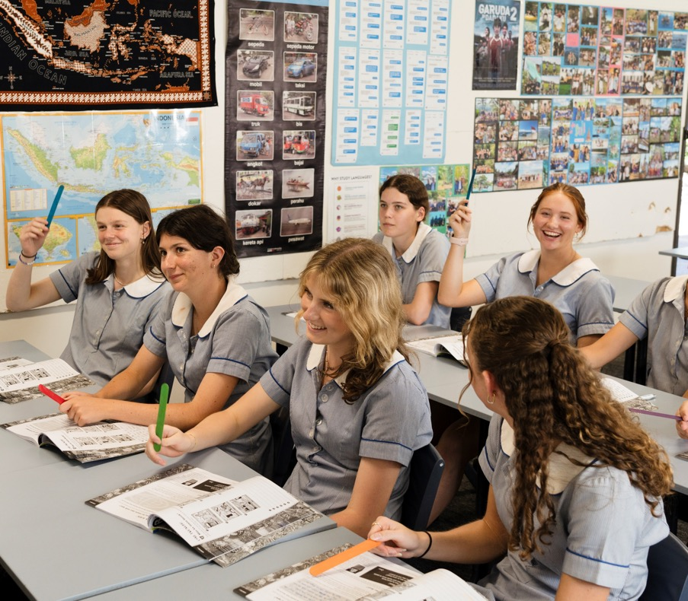
PEEL (4)
Link
Explain how ‘brand image’ impacts consumer spending and the role of work in society.
Link back to your main idea or thesis
Wrap up your paragraph
Show how it fits into the bigger argument
Link – Brand image not only affects what people buy but also supports industries and jobs that are needed to keep a brand popular and respected.
Notes:
Read through slide and modelled response.
Reinforce that consumer decisions influence industry strategies, as businesses adjust services and marketing to meet demand.
Discuss how companies adjust their offerings based on consumer spending habits.
Have students write a final sentence linking their purchase decision to broader consumer trends. For example - This shows that convenience strongly influences consumer decisions, encouraging people to favour seamless and efficient shopping experiences.

Slide 9
PEEL (5)
Sample response
Point – Brand image affects what people buy by shaping how they see a brand. A strong brand builds trust and makes people more likely to choose it. It also creates jobs in marketing, retail, and advertising, where people work to promote and maintain brand reputation.
Evidence – For example, many teenagers prefer brands like Nike or Adidas because they are seen as cool, high-quality, and trendy. These brands are known for their logos and how they are marketed as popular and reliable.
Explain – This affects how much people are willing to spend, as they are more likely to pay extra for a brand that is well-known and trusted. Companies spend a lot of money on advertising to make sure their brand looks good, which creates jobs in marketing, design, and other creative industries. This shows how brand image connects to how people spend their money and supports the role of work in society.
Link – Brand image not only affects what people buy but also supports industries and jobs that are needed to keep a brand popular and respected.
Notes:
Read through slide.
Walk through the full student response step by step, highlighting how the PEEL structure strengthens consumer analysis.
Discuss how structured reasoning helps consumers make informed purchasing decisions and how it applies to writing.

Slide 10
PEEL paragraph feedback proforma
Criteria
Answers the question
Uses key terminology
Gives clear reasons and examples
Supports ideas with evidence
Well-structured PEEL paragraph
Clear and accurate spelling; easy to follow
What to look for
Clearly explains how convenience influenced a recent purchasing decisions.
Consumer, spending, decision making, purchasing.
Explains motivations on purchasing decision with clear reasoning.
Includes facts or statistics to support points.
Ideas are ordered logically with linking sentences and a clear conclusion.
Uses correct grammar and spelling; easy to follow.
Feedback
Notes:
After students have responded to their question - explain how convenience influenced a recent purchasing decision you made, provide a step-by-step overview of this feedback proforma
Once overview is completed, have students swap their PEEL paragraphs with a partner and provide constructive feedback using the proforma to inform their feedback.

Slide 11
References
This presentation contains NSW Curriculum and syllabus content. The NSW Curriculum is developed by the NSW Education Standards Authority. This content is prepared by NESA for and on behalf of the Crown in the right of the State of New South Wales. The material is protected by Crown copyright.
Please refer to the NESA Copyright Disclaimer for more information https://educationstandards.nsw.edu.au/wps/portal/nesa/mini-footer/copyright.
NESA holds the only official and up-to-date versions of the NSW Curriculum and syllabus documents. Please visit the NSW Education Standards Authority (NESA) website https://educationstandards.nsw.edu.au/wps/portal/nesa/home and the NSW Curriculum website https://curriculum.nsw.edu.au.
[Subject] [Year–Year] © Syllabus NSW Education Standards Authority (NESA) for and on behalf of the Crown in right of the State of New South Wales, [Year of publication].
[Insert references consulted to produce the presentation being developed.]
[Include any other full attributions here.]

Slide 12
Copyright
© State of New South Wales (Department of Education), 2024
The copyright material published in this resource is subject to the Copyright Act 1968 (Cth) and is owned by the NSW Department of Education or, where indicated, by a party other than the NSW Department of Education (third-party material).
Copyright material available in this resource and owned by the NSW Department of Education is licensed under a Creative Commons Attribution 4.0 International (CC BY 4.0) licence.
This licence allows you to share and adapt the material for any purpose, even commercially.
Attribution should be given to © State of New South Wales (Department of Education), 2024.
Material in this resource not available under a Creative Commons licence:
the NSW Department of Education logo, other logos and trademark-protected material
Material owned by a third party that has been reproduced with permission. You will need to obtain permission from the third party to reuse its material.
Links to third-party material and websites
Please note that the provided (reading/viewing material/list/links/texts) are a suggestion only and implies no endorsement, by the New South Wales Department of Education, of any author, publisher, or book title. School principals and teachers are best placed to assess the suitability of resources that would complement the curriculum and reflect the needs and interests of their students.
If you use the links provided in this document to access a third party’s website, you acknowledge that the terms of use, including licence terms set out on the third-party’s website apply to the use which may be made of the materials on that third-party website or where permitted by the Copyright Act 1968 (Cth). The department accepts no responsibility for content on third-party websites.

