Slide 1
Instructions for use
This resource is not a teaching and learning program. It should be used in conjunction with sample program of learning – Depth study (option): ancient China.
Classroom teachers are encouraged to add and adapt slides as required to meet the needs of their students.
Save a copy of the file to make changes to the slide deck. Go to File > Download a Copy (this downloads a copy to the computer to edit in the PowerPoint app).
To convert the PowerPoint to Google Slides:
  Upload the file into Google Drive and open it.
  Go to File > Save as Google Slides.
  (Note – conversion may cause formatting changes in the slides.)

Slide 2
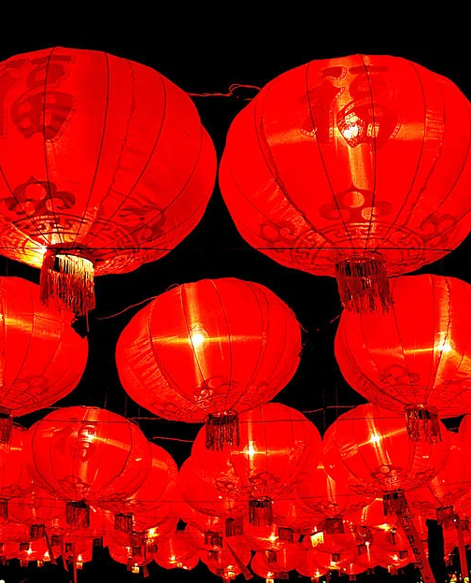
Using information from sources as evidence
Daily lives of men, women and children
Lantern Festival by gill_penney is licensed under CC BY

Slide 3
Learning intentions and success criteria
We are learning to
analyse a range of sources effectively
use information from sources as evidence.
We can
identify the type of source related to ancient Chinese daily life
extract evidence from a source to describe daily life in ancient China
explain the purpose and audience of sources on daily life in ancient China.

Slide 4
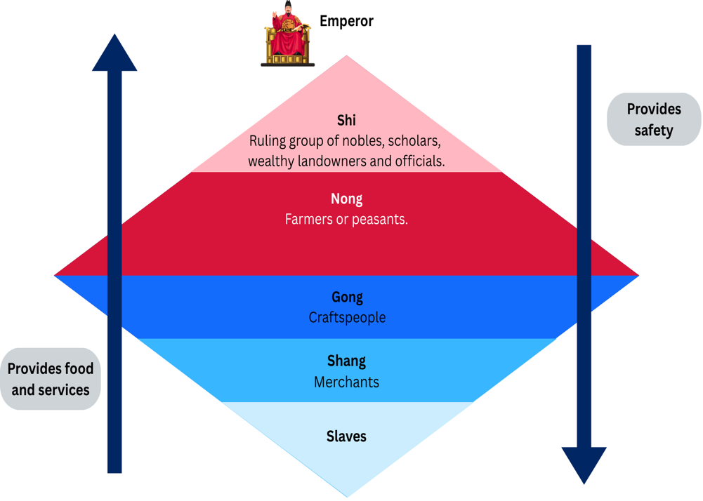
Social structure in ancient China
Steps for analysing and using sources
Identify the origin, context and purpose of the source
Locate, select and use information from the source as evidence
Draw conclusions about the value and limitations of the source
Notes:
Notes for teachers:
This slide has one animation.
Remind students of the ancient Chinese social structure and discuss the key features such as the largest and smallest groups in the social diamond and the most valued groups in society. Explain to students the reciprocal relationship that each group has with each other, on the one side you can see that those higher up provide safety for those on lower levels. Whilst those lower on the social structure provide food and services for those higher up. A person's social status heavily impacted on their daily life. Ask students to look at the social structure diamond they completed in previous lessons. In pairs ask students to answer the following questions:
What types of jobs did each social group do?
Why were the farmers/peasants more valued than the merchants?
CLICK
Discuss with students that we will now be looking at the daily lives of men women and children through the lens of ancient China’s social structure. Students will be using Resource 19 — ancient China daily life source analysis to answer the source based questions.

Slide 5
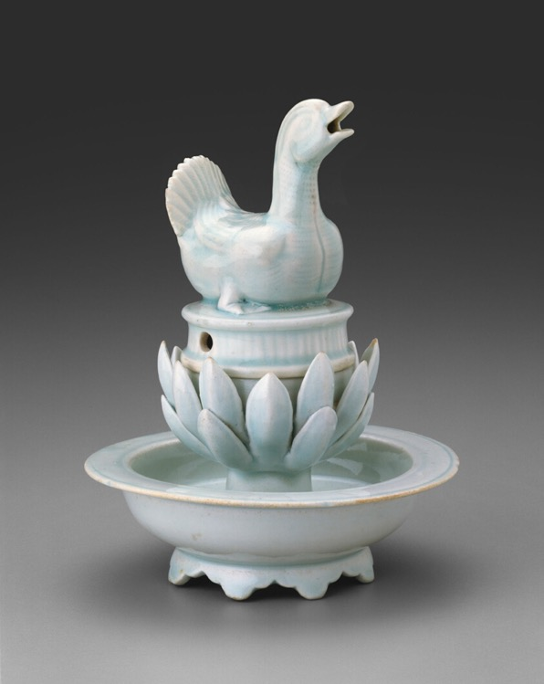
Modelled source analysis (I do)
Incense burner from Song Dynasty China
Source B – This incense burner reflects the Song dynasty China’s cultural elite—members of the imperial court as well as newly affluent and well-educated classes of merchants and government officials.
Incense Burner in the Form of a Duck by unknown artist is available on the public domain.
Notes:
Step 1: Identify the source
“Today, we are going to analyse a historical source to learn about daily life in ancient China.
This object is called an incense burner. An incense burner is used to hold incense, which produces scented smoke when burned.
This is an artefact. An artefact is a physical object from the past.
Historians study artefacts because they provide direct evidence of how people lived. Artefacts show us what people made, used, and valued in their society.
So already, we know this object can give us clues about people’s daily lives.”
(Pause. Let students look closely.)
Step 2: Observe (Teacher models observation)
“Now I’m going to look closely at the source and describe exactly what I can see.
I can see that the incense burner is very decorative. It is not plain or simple. It has been carefully designed.
I can also see that it is made from metal and has detailed craftsmanship. Someone has taken time and skill to make this object.
This tells me that this object was not quickly made. It was carefully constructed.”
(Pause)
“As historians, the first step is always observation. We must look carefully before we make conclusions.”
Step 3: Infer (Teacher models inference)
“Now I am going to use my observations to make an inference.
An inference is a logical conclusion based on evidence.
Because this incense burner is decorative and carefully made, I can infer that it was valuable.
Objects that require skill, time, and materials are usually owned by people who can afford them.
This suggests that the owner was probably wealthy or part of the upper class.
Incense burners were not necessary for survival like farming tools. They were used for comfort, religious ceremonies, or cultural practices.
This suggests that wealthy people had access to luxury items.”
Step 4: Conclude (Teacher links to historical understanding)
“Now I will use this evidence to reach a historical conclusion.
This source tells us that wealthy people in ancient China lived differently from peasants.
They had access to luxury objects that were decorative and valuable.
This shows us that ancient Chinese society had different social classes, and people in higher social classes lived more comfortable lives.
This artefact helps historians understand social structure and daily life in ancient China.”
Final modelling statement (important — show students the thinking structure)
“As historians, we always follow this thinking process:
First, we observe what we can see.
Second, we make inferences based on evidence.
Third, we use this to reach a conclusion about daily life in the past.
We do not guess. We use evidence to support our conclusions.”

Slide 6
‘What does this source tell us about the daily life of wealthy people in ancient China?’
Source B – This incense burner reflects the Song dynasty China’s cultural elite—members of the imperial court as well as newly affluent and well-educated classes of merchants and government officials.
Model paragraph
This source is an incense burner from ancient China. It is decorative and carefully crafted, which suggests it was valuable. This indicates it belonged to someone wealthy or part of the ruling class. Incense burners were used for comfort and ceremonies rather than survival. This source tells us that wealthy people in ancient China lived comfortable lives and had access to luxury objects.
Incense Burner in the Form of a Duck by unknown artist is available on the public domain.
Notes:
Remind students that they have already analysed the source by identifying what they could see and making inferences about the object.
Explain to students that historians use their observations and inferences as evidence to answer historical questions.
Say to students:
“We have already analysed this incense burner and identified important clues. We observed that it is decorative, carefully crafted, and made from metal. We also inferred that it was valuable and likely owned by someone wealthy.”
Explain that now you will use that evidence to answer the historical question.
Emphasise that historians do not guess. They use evidence from sources to support their conclusions.
Model how to turn the analysis into a historical answer by thinking aloud:
“I know this object is decorative and valuable. This suggests it belonged to someone wealthy. Because incense burners were used for comfort and ceremonies rather than survival, this tells me that wealthy people had access to luxury items. This helps me understand that wealthy people in ancient China lived comfortable lives and used decorative objects.”
Explain to students that this is how historians move from analysing a source to using it as evidence.
Modelled response
“This source is an incense burner from ancient China. It is decorative and carefully crafted, which suggests it was valuable. This indicates it was likely owned by someone wealthy. Incense burners were used for comfort and ceremonies rather than survival. This source tells us that wealthy people in ancient China lived comfortable lives and had access to luxury objects.”

Slide 7
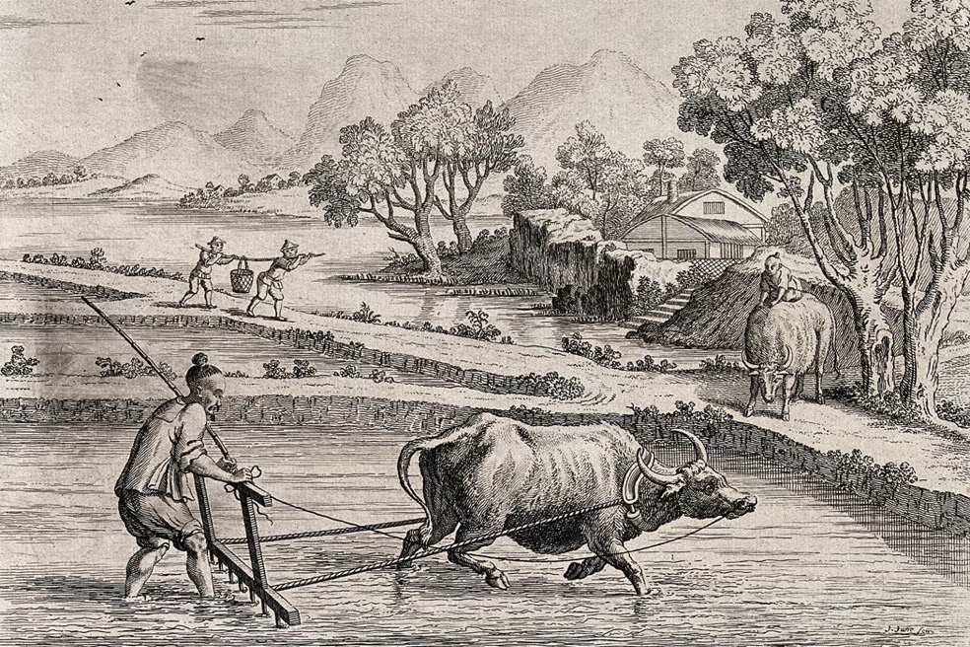
Using evidence to understand daily life of peasants (We do)
Question
What does this source tell us about the daily life of peasants in ancient China?
Source A – Engraving of ancient Chinese peasants raking rice paddies with ox-drawn plough.
Agriculture; raking rice paddies in China with an ox-drawn plough by J. June after A. Heckel is licensed under CC BY 4.0.
Notes:
“We are now going to answer this question together using this new source. This time, you will help me use evidence from the image to construct the answer.”
Give students time to observe the image carefully.
Say:
“First, let’s identify what we can see. This is called observation. We only describe what is visible.”
Ask students:
“What can you see in this image?”
Guide students toward observations such as:
a farmer
an ox
a plough
rice fields
the farmer working the land
Acknowledge responses and reinforce precise observation.
Say:
“These observations give us evidence.”
Now move to inference.
Ask:
“What does this suggest about the daily life of peasants?”
Guide students toward:
peasants worked in farming
farming required physical labour
peasants used animals to help them work
farming was part of their daily life
If needed, prompt further:
“Does this look like easy work or hard work?”
Pause.
Explain:
“This suggests peasants had to work hard to grow food.”

Slide 8
Question – What does this source tell us about the daily life of peasants in ancient China?
This secondary source shows…
    a peasant using an ox-drawn plough to work in the rice fields.
This suggests that…
peasants worked in agriculture and used tools and animals to help them farm.
This indicates that…
farming was an important part of peasants’ daily life.
This tells us that…
peasants worked hard to grow food and depended on farming for survival.
Notes:
Explain to students that you will now use sentence starters to help structure a historical response.
Say:
“We are going to use sentence starters to help us turn our observations and inferences into a clear historical answer. These starters help us organise our thinking like historians.”
Display sentence starters one at a time.
Read each starter and invite students to complete it.
Sentence starter 1: Identify the source and evidence
Ask students:
What can you see in this image?
Who is shown in the image?
What is the person doing?
What tools or animals can you see?
Where is this taking place?
Take responses. Affirm and refine.
Then reveal and read the sentence starter:
This secondary source shows
(Click) a peasant using an ox-drawn plough to work in the rice fields.
Sentence starter 2: Make an inference
Ask students:
If peasants are using ploughs in fields, what does this suggest about their job?
What type of work were peasants responsible for?
Why would they need tools and animals like this?
What does this suggest about how food was produced?
Guide toward agriculture and farming.
Then reveal sentence starter:
This suggests that.
(Click) peasants worked in agriculture and used tools and animals to help them farm.
Sentence starter 3: Link to daily life
Ask students:
If farming is their job, what would peasants likely do every day?
Would farming be occasional or regular work?
How important would farming be for their survival?
Take responses.
Then reveal sentence starter:
This indicates that…
(Click) farming was an important part of peasants’ daily life.
Sentence starter 4: Reach a historical conclusion
Say:
“Now we reach our historical conclusion. We ask: what does this tell us overall about how peasants lived?”
Ask students:
Does this look like easy work or hard work? Why?
Why was farming necessary in ancient societies?
What would happen if peasants did not farm?
What does this tell us about their lifestyle?
Take responses.
Then reveal final sentence starter:
This tells us that…
(Click) peasants worked hard to grow food and depended on farming for survival.

Slide 9
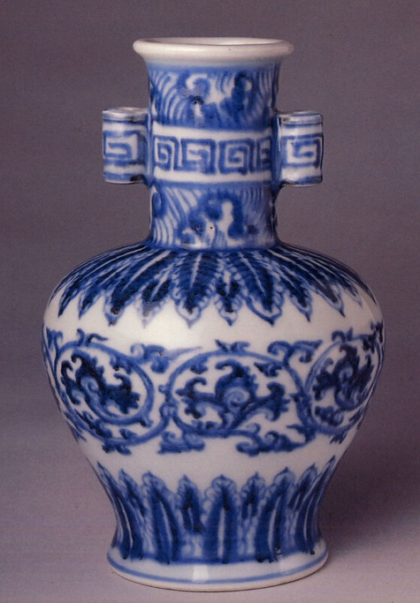
Using evidence to understand daily life of craftspeople (you do)
Source C – Porcelain vase, Ming Dynasty (1368–1644).
Step 1 – Observe
Answer these questions:
What type of source is this?
What can you see?
What materials and design features do you notice?
Step 2 – Infer
What does the design suggest about the skill of the craftsperson?
What does this suggest about their job?
Why would craftspeople create objects like this?
Step 3 – Conclude
Use the sentence starters to answer the historical question.
Vase by unknown artist, is available in the public domain.
Notes:
“You are now going to work independently as historians. You will analyse this source and use it as evidence to answer the historical question.”
Remind students of the thinking process –
Observe → Infer → Conclude
Explain that this porcelain vase is a primary source artefact, meaning it was created during ancient China and provides direct evidence of the past.
Tell students to answer the following questions to help them answer the overall question (What does this source tell us about the daily life of craftspeople in ancient China?
)
Step 1: Observe
Answer these questions:
What type of source is this?
What can you see?
What materials and design features do you notice?
Step 2: Infer
What does the design suggest about the skill of the craftsperson?
What does this suggest about their job?
Why would craftspeople create objects like this?
Step 3: Conclude
Use the sentence starters to answer the historical question.
Provide a list of sentence starters for students if needed
Sentence starters (student scaffold)
This primary source shows ______________________________
This suggests that craftspeople ___________________________
This indicates that _____________________________________
This tells us that craftspeople ___________________________

Slide 10
Sample response
What does this source tell us about the daily life of craftspeople in ancient China?
Source C – Porcelain vase, Ming Dynasty (1368–1644).
This primary source shows a porcelain vase with detailed decoration and careful design. This suggests that craftspeople had specialised skills and were able to create detailed and high-quality objects. This indicates that craftspeople played an important role in producing goods for society. This tells us that craftspeople in ancient China used their skills to create valuable objects and contributed to the economy.
Vase by unknown artist, is available in the public domain.
Notes:
Explain to students that this is a modelled historical response showing how evidence from the source can be used to answer the question.
Remind students that the porcelain vase is a primary source artefact, meaning it was created during ancient China and provides direct evidence of the past.
Say:
“This porcelain vase is a primary source artefact. It was created by craftspeople during ancient China. This means it gives us direct evidence of their skills and work.”
Explain that historians begin by identifying what they can see.
Say:
“We can observe that the vase has detailed decoration and careful design. It is not simple. It required skill, time, and effort to produce.”
Explain that historians then make inferences based on evidence.
Say:
“This suggests that craftspeople had specialised skills. They were trained and capable of producing detailed and high-quality objects.”
Explain that historians then link this evidence to daily life.
Say:
“This indicates that craftspeople spent their time creating goods. Their daily life involved using their skills to produce objects.”
Explain that historians then reach a conclusion about society.
Say:
“This tells us that craftspeople played an important role in ancient Chinese society. They created valuable objects that people used in daily life.”

Slide 11
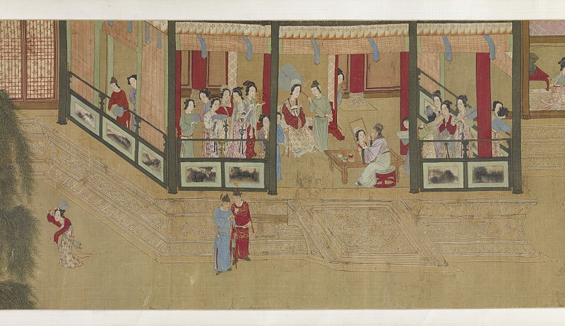
Daily life of the ‘Shi’ (ruling class)
Source A – A 17th century copy of Spring Morning in the Han Palace, a famous handscroll by the 16th century Ming Dynasty artist Qiu Ying. During the years of the Qing Dynasty, copies such of this of Qiu Ying's painting were popular because they were considered an excellent guide to elegant behaviour.
Spring morning in the Han Palace by Qiu Ying is available on the public domain.
Notes:
Notes for teachers
Provide students with information on the daily life of the ‘Shi’ or ruling class using the think aloud strategy below:
Think aloud: The daily life of the ruling class in ancient China was very different from that of ordinary people. Members of the ruling class, such as emperors, nobles, and high officials, lived in large, beautifully decorated homes or palaces. They wore fine silk clothes, enjoyed special foods and had servants to help them with daily tasks. Boys from ruling families were taught to read, write, and study important books, while girls learned music, art, and how to manage the home. The ruling class had the power to make decisions, create laws, and lead ceremonies and festivals. They often spent time meeting with advisors, attending banquets, and enjoying cultural activities like painting, poetry, and calligraphy also reflected in Source A.
Ask students to answer the following questions:
Source A
What type of source is Source A?
What does the source reveal about daily life for the ruling class?
Who would be the intended audience for this source? Why?

Slide 12

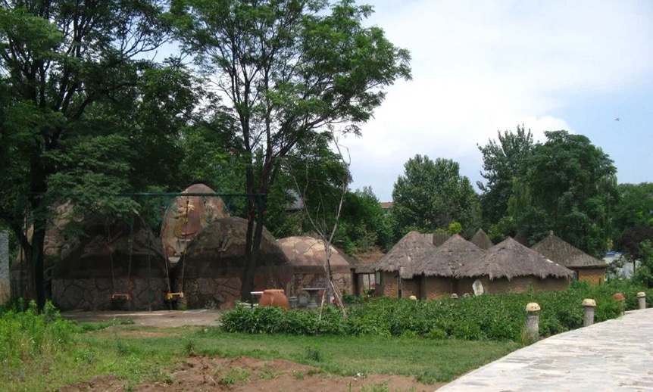
Daily life of the ‘Nong’ (farmers/peasants)
Source A – Engraving of ancient Chinese peasants raking rice paddies with ox-drawn plough.
Source B – Housing in Banpo village, Xi’an, China (5000–3,000 BCE).
Agriculture; raking rice paddies in China with an ox-drawn plough by J. June after A. Heckel is licensed under CC BY 4.0.
Banpo Village, Xian, China by Ian Armstrong, is licensed under CC BYSA.
Notes:
Notes for teachers
Provide students with information on the daily life of farmers and peasants using the think aloud strategy below.
Think aloud: Most people in ancient China were peasant farmers who lived in small villages with about 100 families, which source best reflects this? (wait for response, Source B). They worked very hard every day on their small family farms, often using simple tools and sometimes oxen or dogs to help with the work, as shown in Source A. Most farming was done by hand. Peasants grew crops like rice in the south as shown in Source A, and millet in the north. They also kept animals such as goats, pigs, and chickens. Their diet was simple, including grains, vegetables, and occasionally small amounts of meat or fish. Peasants had to pay taxes to the government by giving a portion of their crops and sometimes worked for the government for about a month each year, helping with projects like building canals or city walls, or serving in the military. Family life was important. Men did most of the farming work while women took care of the home and helped by weaving or sewing clothes. Life could be very tough, with peasants facing harsh weather and the risk of losing their land if they couldn’t pay debts or taxes. Despite their hard life, peasants were respected because they produced the food that everyone depended on.
Ask students to answer the following questions:
Source A:
How do the farmers prepare the land for planting crops, according to the scene in the picture?
What does the presence of other people carrying baskets tell us about the teamwork or community effort in farming?
What role does the water buffalo play in the farming process shown in the image?
Why do you think farming took long hours each day?
Source B:
Describe the housing shown in Source B.
What materials do you think were used to build these houses, and why were these materials chosen?
How is the housing of farmers/peasants different to that of the ruling class?

Slide 13
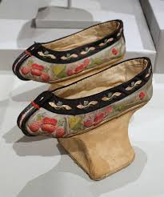
Daily life of the ‘Gong’ (craftspeople)
Source A – Manchu noblewoman shoes, Qing Dynasty, made from silk with a wooden platform.
Source B – Porcelain vase, Ming Dynasty (1368-1644).
Shoes for a Manchu Noblewoman by Daderot, is available in the public domain.
Vase by unknown artist, is available in the public domain.
Notes:
Notes for teachers
Provide students with information on the daily life of farmers and peasants using the think aloud strategy below.
Think aloud: Craftspeople in ancient China were skilled workers who made many important objects like pottery shown in Source C, silk clothes and textiles shown in Source B. They were part of a group called artisans and were respected for their skills, although they didn’t have as high a social status as nobles or officials. Most craftspeople worked in workshops. Some worked for the government making tools, weapons, and fancy objects for the nobles or the emperor. Others worked in private workshops creating things for everyday people and wealthy families. Their work was very detailed and could take a long time. Silk workers, often women, embroidered beautiful patterns on clothes and sometimes painted on silk, which was a special and valuable material. Craftspeople specialized in different trades, such as metalworking, pottery, weaving silk, and carving wood or stone. Some learned their skills from their parents and passed them down through generations. Highly skilled artisans could even run their own small businesses and employ others. While craftspeople didn’t own much land like farmers, their work was essential because they made the things everyone needed daily—from cooking pots and scissors to clothes and weapons.
Ask students to answer the following questions:
Source A:
What does Source B reveal about the quality of a craftsman's work?
For what purpose would these shoes be worn? Why?
Source B:
What social group would be most likely to purchase this vase?

Slide 14
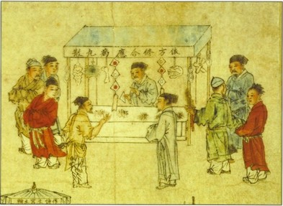
Daily life of the ‘Shang’ (merchants)
Source A – Chinese merchants of the first century CE.
Source B – Extract from Cha’o Ts’o, a Han Dynasty official, about the profiteering of merchants.
‘Though their men neither plough nor weed, though their women neither tend silkworms nor spin, yet their clothes are brightly patterned and coloured, and they eat only choice grain and meat. They have none of the hardships of the farmer.’
Chinese Merchants by unknown artist, is available in the public domain.
Memorial on the encouragement of agriculture by Ch’ao Ts’o is available in the public domain.
Notes:
Notes for teachers
Provide students with information on the daily life of farmers and peasants using the think aloud strategy below.
Think aloud: Merchants in Ancient China were people who bought and sold goods, as shown in Source A, like silk, tea, spices, porcelain. Their job was very important because they helped spread Chinese goods to other parts of the world, especially through trade routes like the Silk Road Even though they helped the economy, merchants were not always respected. In some dynasties, they were seen as lower in social status because they didn’t grow or make the goods—they only sold them as revealed in Source C. Still, many merchants became very rich and powerful through smart business deals. A merchant’s daily life involved traveling, bargaining, and meeting new people. Some worked in busy markets, while others went on long journeys by horse, cart, or ship. They had to deal with weather, bandits, and changing prices, but they also had the chance to see new lands and cultures. Some merchants also ran shops or worked with craftsmen to sell beautiful items like silk clothes or porcelain vases. They needed to be good at math, smart with money, and polite to customers.
Ask students to answer the following questions:
Source A:
Use details from Source A to describe how merchants sold their goods?.
What skills would a merchant need to sell items and manage the number of customers reflected in the source?
Source B:
What is the message Cha’o Ts’o is trying to convey to his audience?
Why would Cha’o Ts’o want to present merchants in this way?
How do all 3 sources reflect the role and status of merchants in Ancient China?

Slide 15
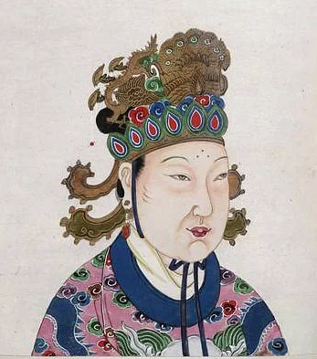
Daily life of women
Source A – 3rd Century poem by Fu Xuan about the role of women in China.
Source B – Empress Wu Zetian, was the first and only woman emperor of China. With her exceptional intelligence, extraordinary competence in politics, and inordinate ambition, she ruled as the “Holy and Divine Emperor” of the Second Zhou Dynasty (690–705) for fifteen years.
How sad it is to be a woman!
Nothing on earth is held so cheap.
Boys stand leaning at the door
Like Gods fallen out of Heaven.
Their hearts brave the Four Oceans,
The wind and dust of a thousand miles.
No one is glad when a girl is born:
By her the family sets no store.
When she grows up, she hides in her room
Afraid to look a man in the face.
Woman by Fu Xuan, is licensed under CC BY-SA 4.0
Empress Wu Zetian by unknown artist, is available in the public domain.
Notes:
Notes for teachers
Provide students with information on the daily life of farmers and peasants using the think aloud strategy below.
Think aloud: In Ancient China, women had fewer rights and were expected to follow the authority of men throughout their lives—first their fathers, then their husbands, and later their sons as revealed in Source A. This idea was part of a system called the "Three Followings." Life for women could be very strict and unfair, and many were treated poorly or had to compete with their husband’s concubines (mistresses). Confucian beliefs shaped how women were expected to behave—they had to be loyal, quiet, hardworking, and graceful. Marriages were usually arranged by parents and focused on family status rather than love. Women were expected to move into their husband’s home and become part of his family. In wealthier families, women managed the home and raised children, while in poorer families, they worked in the fields, or cared for silkworms. Some women even ran small businesses or worked as midwives. A few women became famous for their achievements. Ban Zhao was a respected scholar who believed women should be educated to help their families. Wu Zetian as shown in Source B became the only female emperor in Chinese history and ruled successfully by supporting Buddhism and strengthening the government. Although most women had limited freedom, these examples show that some still found ways to make a big impact.
Ask students to answer the following questions:
Source A:
How does the writer feel about being a woman, provide one piece of evidence to support your response.
What words or lines show that girls had fewer rights or freedom than boys?
Do you think a male or female wrote this source? Why?
Source B:
What kind of clothes and jewellery is the woman wearing? What does that tell you about her status?
Why do you think it was unusual for a woman to become emperor in Ancient China?
What challenges do you think she faced as a female ruler?

Slide 16
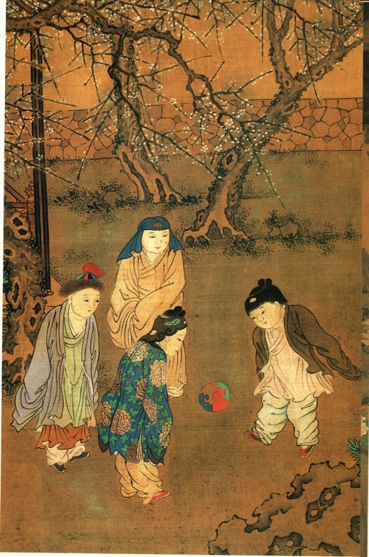
Daily life of children
Source A – Image extract from One Hundred Children in the Long Spring (1101–1161), depicts young boys playing a sport called Cuju (an early form of football).
One Hundred Children in the Long Spring by Su Han ch’en, is available in the public domain.
Notes:
Notes for teachers
Provide students with information on the daily life of farmers and peasants using the think aloud strategy below.
Think aloud: Most children lived with not just their parents, but also grandparents, aunts, uncles, and cousins—all under one roof. In the mornings, children helped with household chores. Boys might go with fathers to the fields or learn a trade, and in wealthier families, they could attend school to study reading, writing, and Confucian values. Girls helped their mothers with cooking, cleaning, weaving, and caring for younger siblings. Sometimes, girls learned music or embroidery and, in rare cases, received basic education at home. Play was important too, as you can see in Source A—children would play with toys like marbles or kites and sometimes join festivals or family celebrations. While boys were expected to take over family responsibilities one day, girls’ main roles were preparing for marriage, child rearing and managing households.
Ask students to answer the following questions:
Source A:
What social group do you think these children come from? What evidence in the source suggests this?
Why do you think sports like Cuju were popular, especially among boys?

Slide 17
References
This presentation contains NSW Curriculum and syllabus content. The NSW Curriculum is developed by the NSW Education Standards Authority. This content is prepared by NESA for and on behalf of the Crown in the right of the State of New South Wales. The material is protected by Crown copyright.
Please refer to the NESA Copyright Disclaimer for more information https://www.nsw.gov.au/education-and-training/nesa/copyright.
NESA holds the only official and up-to-date versions of the NSW Curriculum and syllabus documents. Please visit NESA https://www.nsw.gov.au/education-and-training/nesa and NSW Curriculum https://curriculum.nsw.edu.au.
History 7–10 © Syllabus NSW Education Standards Authority (NESA) for and on behalf of the Crown in right of the State of New South Wales, 2024.
Mark E (27 April 2016). Daily Life in Ancient China World History Encyclopedia, accessed 14 August 2025.
Mark JJ (18 December 2012) Ancient China World History Encyclopedia, accessed 14 August 2025.

Slide 18
Copyright
© State of New South Wales (Department of Education), 2026
The copyright material published in this resource is subject to the Copyright Act 1968 (Cth) and is owned by the NSW Department of Education or, where indicated, by a party other than the NSW Department of Education (third-party material).
Copyright material available in this resource and owned by the NSW Department of Education is licensed under a Creative Commons Attribution 4.0 International (CC BY 4.0) license.
This license allows you to share and adapt the material for any purpose, even commercially.
Attribution should be given to © State of New South Wales (Department of Education), 2026.
Material in this resource not available under a Creative Commons license:
the NSW Department of Education logo, other logos and trademark-protected material
Material owned by a third party that has been reproduced with permission. You will need to obtain permission from the third party to reuse its material.
Links to third-party material and websites
Please note that the provided (reading/viewing material/list/links/texts) are a suggestion only and implies no endorsement, by the New South Wales Department of Education, of any author, publisher, or book title. School principals and teachers are best placed to assess the suitability of resources that would complement the curriculum and reflect the needs and interests of their students.
If you use the links provided in this document to access a third-party’s website, you acknowledge that the terms of use, including licence terms set out on the third-party’s website apply to the use which may be made of the materials on that third-party website or where permitted by the Copyright Act 1968 (Cth). The department accepts no responsibility for content on third-party websites.

