Slide 1

History – PEEL paragraphs
Stage 4 History
Historical context 1 (core) – The ancient past
[Teacher name]
[Date]
Notes:
The following resource looks at how to write PEEL paragraphs with a focus on historical content.

Slide 2
Learning intentions and success criteria
We are learning to
write clear and well-structured PEEL paragraphs to improve our writing.
We can
identify the 4 parts of a PEEL paragraph
construct a PEEL paragraph on a given topic.
Notes:
Notes for teachers:
The learning intention and success criteria are derived from the syllabus outcomes and content and have been written in student-friendly language. Teachers may refine the wording to suit their class context, while ensuring alignment between the learning intention, success criteria and lesson activities.
For more information See ⁠AITSL or the NSW Department of Education explicit teaching strategies, ⁠Sharing learning intentions and ⁠Sharing success criteria.
LISC is not necessarily presented at the beginning of the lesson. The teacher needs to consider most effectual time to introduce.
LISC should be revisited during the lesson to support students' evaluation of their learning.

Slide 3

What is a paragraph?
A paragraph is a group of sentences that work together to explain one clear idea in response to a question.
Notes:
Explicitly teach the purpose of a paragraph before introducing any writing structure. State that a paragraph is a unit of meaning that communicates one clear idea in response to a question.
Model this idea orally by explaining a simple historical claim (for example, one idea about how we know about the past) and identifying it as a single paragraph focus. Emphasise that effective historical writing is not a list of facts, but an explanation supported by evidence.
Check for understanding by asking students to identify whether an example contains one clear idea or multiple ideas before progressing to the PEEL structure.

Slide 4

What is a PEEL paragraph? (1)
PEEL stands for:
Point – the main idea of the paragraph
Evidence – historical facts or sources that support the point
Explanation – how the evidence supports the point
Link – how the paragraph connects back to the question
We will now look at a modelled example of a PEEL paragraph answering a history question.
Notes:
Explicitly teach PEEL as a structural tool used to organise one clear idea in a paragraph. Reinforce that PEEL supports historical explanation and reasoning, rather than acting as a checklist or formula.
Explain the function of each component, emphasising that:
the Point directly answers the question,
evidence provides support from the past,
explanation clarifies how the evidence supports the claim,
the Link connects the paragraph back to the question and explains significance.
Explicitly point out that the two ‘E’ sections can change order.
Evidence does not always have to come before explanation.
Sometimes students may briefly explain an idea and then support it with evidence.
Clarify that while PEEL has 4 parts, some components—particularly Evidence and Explanation—may require more than one sentence to do their job effectively.
Check for understanding by asking students to explain why a paragraph should focus on only one main idea before moving to the modelled example.

Slide 5
What is a PEEL paragraph? (2)
Describe how archaeologists and historians work together to learn about the past.
P – Point
Archaeologists and historians work together to learn about how people lived in the past.
For example, an archaeologist might study a carved stone idol found in a layer at a site, while a historian might use cultural stories and records about beliefs and ceremonies to help understand what the idol was used for.
E – Evidence
This helps us learn more about people in the past because the carved stone idol shows what people made and used. Cultural stories and written records provide written evidence that helps explain what the idol meant to people and how it may have been connected to their beliefs or ceremonies. Using both types of evidence helps us understand daily life and culture more clearly, not just the objects that were found.
E – Explanation
L – Link
This shows that archaeologists and historians both play an important role in helping us learn about the past.
Notes:
Introduce this slide as a modelled example of a PEEL paragraph answering the question Describe how archaeologists and historians work together to learn about the past. State explicitly that students are not expected to write at this level yet; the purpose is to observe how the structure works in practice.
Guide students’ attention through the paragraph by referring to each colour-coded section and explaining its function:
The Point is one clear sentence that directly answers the question.
The Evidence uses a specific example of a carved stone idol and cultural stories and records to show what archaeologists and historians study.
The Explanation uses more than one sentence to describe what the object and the stories help us learn about people’s daily life, beliefs and culture.
The Link explains why this example is important and clearly reconnects the paragraph to the question, rather than simply restating what happened.
Model thinking aloud by explaining why each sentence belongs in its section and how all sentences work together to explain one main idea.
Check for understanding by asking:
Which part of the paragraph shows what evidence archaeologists and historians use?
Which part explains what this evidence helps us learn about people in the past?
Why does this paragraph stay focused on one main idea rather than multiple topics?
Use student responses to confirm readiness before moving to guided or independent writing.

Slide 6
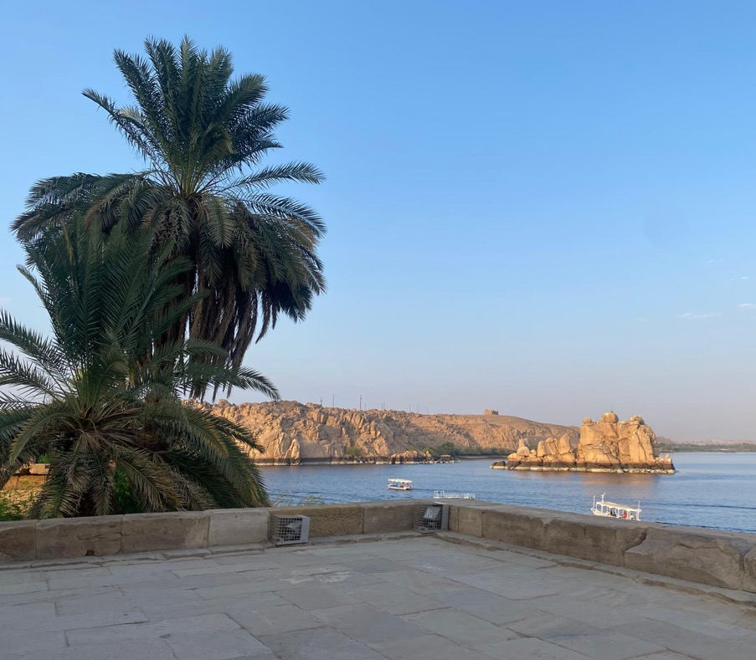
Examples and non-examples
The next paragraphs you will read are in answer to the question.
Describe the importance of the Nile River to the ancient Egyptian civilisation.
Read each paragraph and decide:
Is this a PEEL paragraph or a non-example?
What feature of a PEEL paragraph is missing or incorrect?
‘Nile River, Egypt’ photograph by Cimen Fevzi (2025). Used with permission.
Notes:
Explain that examples and non-examples are used deliberately to help clarify the defining features of a PEEL paragraph. State explicitly that each non-example has been carefully written to demonstrate a specific misconception, rather than being a “bad” or random response.
Before reading, remind students of the key features of a PEEL paragraph:
one clear idea
evidence used purposefully
explanation that links evidence to the point
a link back to the question.
Guide students through each paragraph one at a time. For non-examples, explicitly identify the misconception being illustrated, such as:
more than one main idea in a single paragraph
evidence included without explanation
explanation given without evidence
a link that repeats information rather than answering the question.
Model this thinking aloud for the first paragraph (I do), jointly analyse the next paragraph with students (We do), and then ask students to independently identify whether later paragraphs are examples or non-examples and justify their reasoning (You do).

Slide 7
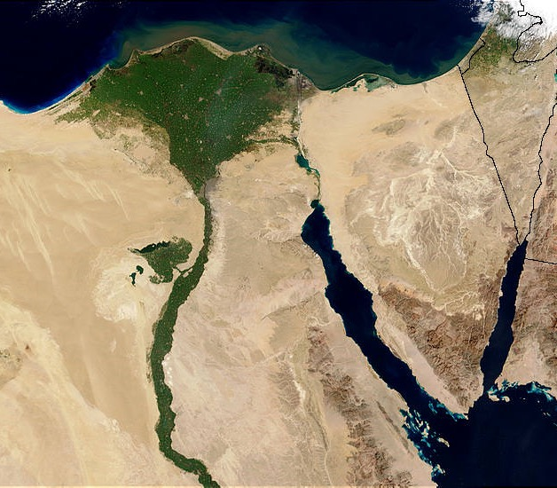
Is this a PEEL paragraph? (1)
Describe the importance of the Nile River to the Ancient Egyptian civilisation
The Nile River was vital to ancient Egypt because it supported farming and the annual floods deposited fertile soil, which allowed crops to grow and people to have a reliable food supply.
‘Nile Delta’ by World History Publishing (submitted by Mark Cartwright, 2016) is licensed under the Creative Commons Attribution-NonCommercial-ShareAlike (CC BY-NC-SA). Original image available at https://www.worldhistory.org/image/2319/nile-delta/
Notes:
I DO (modelled thinking aloud)
Model the evaluation of this paragraph explicitly. State that this paragraph contains accurate historical information, but explain why it is not a PEEL paragraph.
Think aloud to explain that although the ideas are correct, the paragraph combines the Point, Evidence and Explanation into one long sentence. Explain that this makes the writer’s thinking unclear for the reader.
Explicitly identify what is missing:
the Point is not clearly stated on its own
the Evidence is not developed or separated
there is no Link to the question explaining why this matters
Emphasise that structure matters because it helps the reader follow historical reasoning, even when the content is correct.

Slide 8
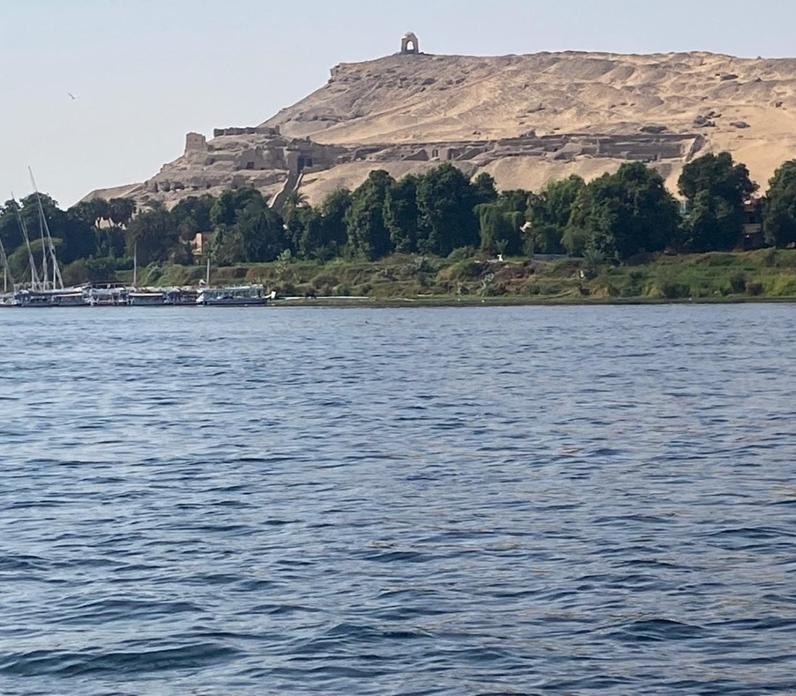
Is this a PEEL paragraph? (2)
Describe the importance of the Nile River to the Ancient Egyptian civilisation
The Nile River flooded every year. It helped farming. People lived near it. Egypt became successful.
‘Nile River, Egypt’ photograph by Cimen Fevzi (2025). Used with permission.
Notes:
WE DO (joint analysis)
Read the paragraph aloud with the class. Ask students to work with you to decide whether this is a PEEL paragraph or a non-example.
Prompt students with targeted questions:
Does this paragraph have one clear Point?
Are the ideas connected or explained?
Which parts of PEEL can we identify, if any?
Guide students to recognise that this response is a list of ideas, rather than a structured paragraph. Support students to articulate that while each sentence is related to the Nile River, the ideas are not connected through explanation, and there is no clear link back to the question.
Summarise the joint conclusion by stating that this paragraph is a non-example because it lacks structure, explanation and cohesion, even though it contains relevant information

Slide 9
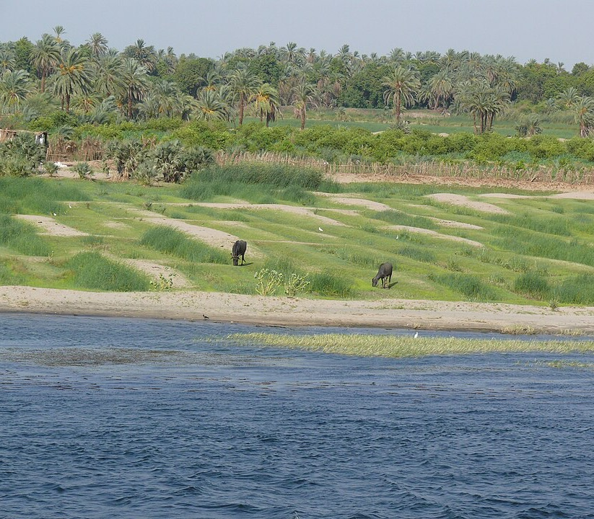
Is this a PEEL paragraph? (3)
Describe the importance of the Nile River to the Ancient Egyptian civilisation
This river flooded every year and left rich soil behind. Farmers used this soil to grow crops like wheat and barley, which helped Egypt survive. People depended on the river for food and water.
‘River Nile’ by Mattana (2008) is licensed under the Creative Commons Attribution-ShareAlike 3.0 Unported (CC BY-SA 3.0). Original image available at https://commons.wikimedia.org/wiki/File:River_Nile_21.jpg
Notes:
YOU DO (independent application)
Ask students to independently decide whether this paragraph meets the requirements of a PEEL paragraph. Students must justify their decision by referring explicitly to the Point, Evidence, Explanation and Link.
After students respond, confirm that this paragraph is a non-example and explain why.
Model the feedback by clarifying that although the paragraph contains relevant and accurate information, it does not begin with a clear Point that states what is being argued about the Nile River. As a result, the reader is given information but not a clear claim about why the Nile was important.
Emphasise that in a PEEL paragraph, the Point must come first to guide the reader’s understanding of the evidence and explanation that follow.
Use this discussion to reinforce that:
information alone is not enough
structure helps communicate historical reasoning clearly

Slide 10
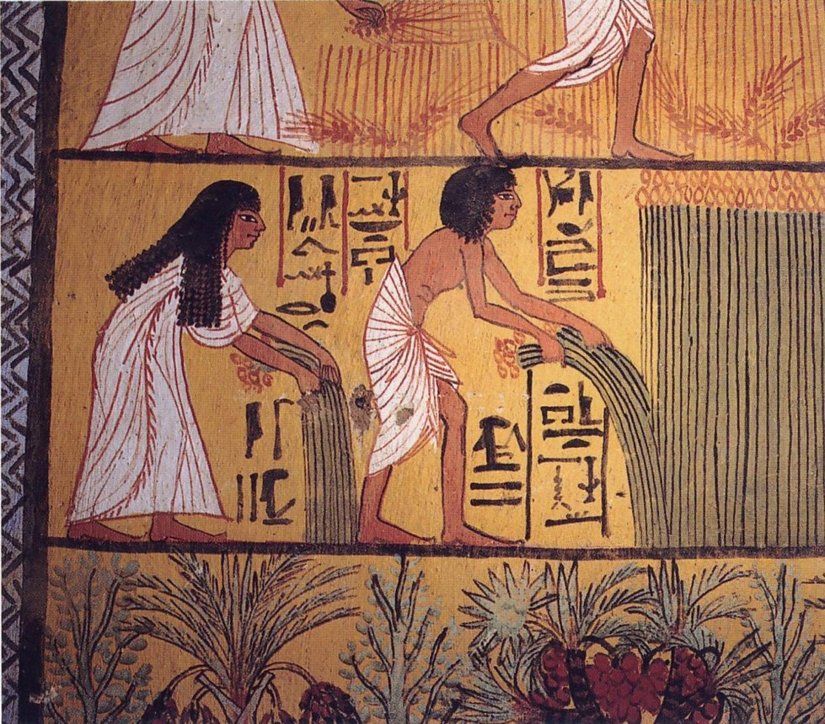
Source 1
‘Egyptian harvest’ by Jon Fender is licensed under the Creative Commons Attribution-ShareAlike 4.0 International (CC BY-SA 4.0). Original image available at https://commons.wikimedia.org/wiki/File:Egyptian_harvest.jpg

Slide 11
Is this a paragraph?
Using Source 1 and your own knowledge, describe the importance of the Nile River to Ancient Egyptian civilization.
The Nile River was important to Ancient Egyptian civilisation because it provided useful plants, including papyrus, that people depended on in daily life. For example, source one shows people harvesting papyrus, workers can be seen cutting and carrying tall papyrus plants beside the river. This shows that papyrus grew along the Nile and was collected for use by the community. Papyrus was important because it was used to make items such as paper for writing and other everyday materials, which helped people record information and manage daily life. This shows that the Nile River was important because it supplied natural resources such as papyrus that supported work and communication in Ancient Egypt.
Notes:
Explain that this paragraph is a strong example of a PEEL paragraph and will be used to model how all parts of PEEL work together to explain one clear idea.
Think aloud as you move through the paragraph, explicitly identifying each component:
The Point clearly states the main idea and directly answers the question about the importance of the Nile River.
The Evidence uses Source 1 to identify people harvesting papyrus beside the river.
The Explanation uses the source and the student’s own knowledge to describe how papyrus was used and why it was important in daily life.
The Link reinforces why this evidence matters by reconnecting to the question and summarising the importance of the Nile as a provider of natural resources.
Explicitly contrast this paragraph with the earlier non-examples, highlighting how this example:
begins with a clear topic sentence
connects ideas rather than listing them
explains why evidence matters
maintains focus on one main idea
State that this paragraph demonstrates the standard students should aim for when writing their own PEEL paragraphs.

Slide 12
Is this a paragraph? – yes
Describe the importance of the Nile River to the Ancient Egyptian civilisation
P
The Nile River was important to Ancient Egyptian civilisation because it provided useful plants, including papyrus, that people depended on in daily life.
E
For example, source one shows people harvesting papyrus, workers can be seen cutting and carrying tall papyrus plants beside the river.
E
This shows that papyrus grew along the Nile and was collected for use by the community. Papyrus was important because it was used to make items such as paper for writing and other everyday materials, which helped people record information and manage daily life
L
This shows that the Nile River was important because it supplied natural resources such as papyrus that supported work and communication in Ancient Egypt.
Notes:
Check for understanding
Q: what is the topic of the paragraph? - The Nile river was vital to the civilzation
Q: What words indicate I am explaining a reason? A: 'this meant' and 'so'

Slide 13
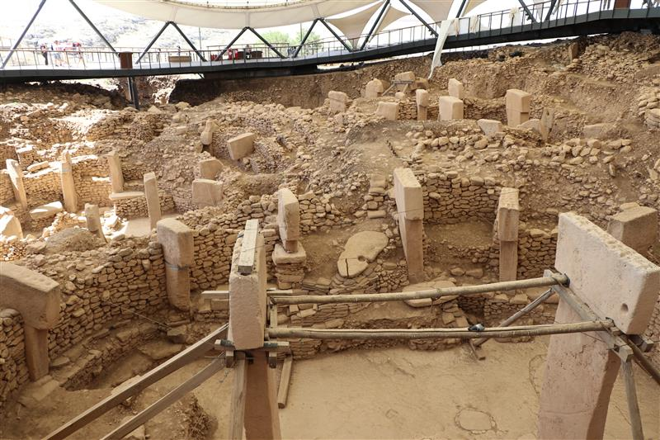
PEEL paragraph
Sample question
Describe how archaeologists and historians might work together to understand the past at Göbekli Tepe .
What do we need to describe?
archaeologists
historians
how they work together
how this helps us understand the past
‘Göbekli Tepe archaeological site’ photograph by Cimen Fevzi (2022). Used with permission.
Notes:
Explicitly deconstruct the question with students. State that the verb describe means students need to clearly state what something is like and give relevant information, not explain cause and effect.
Clarify that a PEEL paragraph does not need four sentences, but it must include four sections: Point, Evidence, Explanation and Link.
Guide students to identify the key concepts in the question:
archaeologists
historians
understand the past
At this stage, do not compare or evaluate roles. Focus only on identifying what information will be needed.
Explain that definitions and examples of archaeologists and historians will be taught separately before students are asked to write.

Slide 14
Answering questions in PEEL paragraphs (1)
Archaeologists have found pottery, tools and bones at the ancient site of Pompeii.
Question – How do archaeologists help understand the past?
P – Archaeologists help us learn about the past by studying objects left behind by people long ago
E – For example, archaeologists have discovered pottery tools and bones at the ancient site of Pompeii.
E – This shows that people used pottery in cooking and what tools they used in their work..
L – This helps us understand what life was like in the past, even when there are no written records.
Notes:
Deconstruct the question with students
First remind students that a PEEL paragraph does not need to have exactly four sentences—it requires four sections: Point, Evidence, Explanation, and Link.
Help students identify the key concepts ‘historians,’ and ‘understand the past.’
Once students have identified the key concepts of the question help them:
P- Make their point, defining what archaeologists do
– Archaeologists study physical remains such as artefacts, structures, and layers found at a site.
E- Help students to use the given information as the evidence
E- Help student unpack what this shows
L- Explain why the sentence given is a good link sentence

Slide 15
Answering questions in PEEL paragraphs (2)
Archaeologists have found stone structures, tools, vessels and bone fragments at the ancient site of Göbekli Tepe in Türkiye.
Question – How do archaeologists help us learn about the past?
P – Archaeologists help us learn about the past by studying objects and structures left behind by people long ago.
E – For example, at Göbekli Tepe in Türkiye, archaeologists have discovered large stone structures, stone tools, vessels and animal bone fragments.
E – This shows that people built special structures and used tools and animals in their daily life and activities.
L – This helps us understand what life was like in the past, even when there are no written records.
Notes:
Tell students that they are practising how to set out a PEEL paragraph.
Point out that the information at the top of the slide is there to help them. Students should use this information as their evidence.
Work through the paragraph with the class:
help students write a clear Point that answers the question
show how the Evidence comes from the sentence about Göbekli Tepe
talk through what the evidence shows in the Explanation
read the Link sentence and explain how it connects back to the question
Check student answers as they work and correct any mistakes straight away.
Remind students that they won’t always get sentence starters, but they are using them now to help learn the structure.

Slide 16
Answering questions in PEEL paragraphs (3)
Historians use research and written studies about sites where there are no original written records, such as Göbekli Tepe.
Question – How do historians help us learn about the past?
P –
E – For example, historians study research reports, drawings and written interpretations about the site of Göbekli Tepe in Türkiye.
E – Historians analyse
L – This shows that historians can help us understand the past even when there are no written records left by the people themselves.
Notes:
Deconstruct the question with students
Help students identify the key concepts – ‘historians,’ and ‘understand the past.’
Once students have identified the key concepts of the question help them:
• Define historians
– Historians study written and cultural records, including oral histories, documents, stories, and research about beliefs and daily life.
Clarify that in this example there are no original written records from the people of Göbekli Tepe. Explain that historians use:
– research reports
– published studies
– interpretations written by historians and archaeologists to help understand the site.
Explain that the Evidence and Explanation are already provided on the slide to support students.

Slide 17
Answering questions in PEEL paragraphs (4)
Historians use research and written studies about sites where there are no original written records, such as Göbekli Tepe
Question – How do historians help us learn about the past?
P – Historians help us learn about the past by studying and interpreting written research created by other historians and archaeologists.
E – For example, historians study research reports, drawings and written interpretations about the site of Göbekli Tepe in Türkiye.
E – Historians analyse this evidence to interpret what the stone structures, carvings and objects may tell us about people’s beliefs and activities in the past.
L – This shows that historians help us understand the past by explaining and interpreting evidence.
Notes:
Tell students that this slide shows how to use the PEEL structure to answer a question about historians.
Point out the information at the top of the slide and explain that this provides the context for the example about Göbekli Tepe, where there are no original written records.
Read the Point and explain that it answers the question directly by stating how historians help us learn about the past.
Show how the Evidence comes from the example of historians studying research reports, drawings and written interpretations about Göbekli Tepe in Türkiye.
Talk through the Explanation by discussing how historians use this evidence to interpret what the stone structures, carvings and objects may tell us about people’s beliefs and activities.
Read the Link and explain how it restates the main idea and connects back to the question.
Check students’ answers as they work and give quick feedback where needed.
Remind students that sentence starters are helping them practise the structure and will not always be provided.

Slide 18
Double Venn diagram
Archaeologists
Historians
Study written sources (letters, diaries, records)
Use photographs, maps and artworks
Read and interpret documents
Explain what evidence means
Combine different sources to tell a story
Write about the past and share explanations
Dig at sites to find artefacts
Study objects (tools, pottery, bones, buildings)
Work on excavation sites
Carefully record where objects are found
Use artefacts to learn how people lived
Work mainly with physical evidence
Study the past
Use evidence
Make interpretations from evidence
Try to be accurate and careful
Help us understand the past
Notes:
Explain that this Venn diagram shows the similarities and differences between archaeologists and historians.
Work through each section with the class:
start with archaeologists and read a few points aloud, explaining that they mainly work with physical evidence found at sites
move to historians and explain that they mainly work with written and visual sources
finish with the overlap, highlighting that both study the past, use evidence, make interpretations and try to be accurate
Pause regularly and ask students to give an example from earlier lessons (for example, Pompeii artefacts or written records).
Emphasise that archaeologists and historians often work together, using different types of evidence to build a fuller picture of the past.
Link this back to writing by explaining that these ideas can be used when answering PEEL questions about how archaeologists and historians help us understand the past.

Slide 19
PEEL – Point
Describe how archaeologists and historians might work together to understand the past.
Start with your main idea
This is your topic sentence
It should answer the question directly and clearly
Point – Archaeologists and historians work together to understand the past by using different types of evidence.
Is this our main idea?
Does it answer the question directly and clearly?
Notes:
This slide introduces the Point sentence of the PEEL paragraph.
Explain that the Point sentence must:
answer the question directly
clearly state the main idea
focus on how archaeologists and historians work together
Read through the slide and discuss, in simple terms, that:
archaeologists use physical evidence such as artefacts, structures and layers
historians use written and cultural sources such as records, letters and oral histories
Explain that working together means using different types of evidence to build a clearer picture of the past.
Have students orally suggest a Point sentence that answers the question clearly.
Model one example to show structure (not for students to copy):
Archaeologists and historians work together to understand the past by using different types of evidence.
Explain that the next slides will show how Evidence, Explanation and Link build on this Point.

Slide 20
PEEL – Evidence
Describe how archaeologists and historians might work together to understand the past.
Evidence – For example, archaeologists examine physical evidence such as artefacts, bones, tools, and structures found at excavation sites. Historians study a combination of written and cultural records, such as oral histories, photographs, letters and diaries, to explain the past.
Did we define the key terms and use examples to support our point?
Notes:
Read through the slide and explain that this section shows the Evidence part of a PEEL paragraph.
Remind students that evidence includes facts, examples and information that support the Point.
Talk through the examples on the slide:
archaeologists use physical evidence such as artefacts, bones, tools and structures
historians use written and cultural sources such as letters, diaries, photographs and oral histories
Explain that these examples describe the different types of evidence archaeologists and historians use to understand the past.
Check understanding by asking students how this evidence supports the Point sentence.

Slide 21
PEEL – Explanation
Describe how archaeologists and historians might work together to understand the past.
Explanation – This helps us understand the past more clearly because archaeologists and historians use different types of evidence. Archaeologists use objects to see what people made and used while historians look at written and cultural records to learn about people’s lives and beliefs. As a result, when they work together, we can understand both what people did and why they did it.
Have we explained how your evidence supports our point?
Which words explain how one thing causes another?
Notes:
Read through the modelled explanation with the class.
Explain that the Explanation section tells the reader what the evidence shows, not just lists it.
Point out how the paragraph:
describes what archaeologists learn from objects
describes what historians learn from written records
shows that using both gives a clearer picture of the past
Highlight the word because as a linking word, but explain that students are not required to explain causes in detail at this stage.
Check that students understand how this section builds on the Evidence.

Slide 22
PEEL – Link
Describe how archaeologists and historians might work together to understand the past.
Link – This shows that by archaeologists and historians working together with a wider range of evidence, our understanding of the past is stronger and more accurate.
Does this link back to the question?
Does it provide a clear conclusion to our paragraph?
Notes:
Read through the question and the modelled Link sentence with the class.
Explain that the Link sentence:
restates the main idea
connects back to the question
finishes the paragraph clearly
Point out that this sentence does not add new information. It reminds the reader what the paragraph has shown about archaeologists and historians working together.
Ask the check-for-understanding questions:
Does this sentence link back to the question?
Does it clearly finish the paragraph?
Explain that a good Link sentence helps the reader understand the overall point before moving on to the next paragraph.

Slide 23
PEEL – Sample response
Point – Archaeologists and historians work together to develop clearer interpretations of the past because they use different types of evidence that support each other.
Evidence – For example, archaeologists examine physical evidence such as artefacts, bones, tools, and structures found at excavation sites. Historians use written and cultural records, such as texts, oral histories, and traditions, to understand beliefs and daily life.
Explain – This helps us understand the past more clearly because archaeologists and historians use different types of evidence. Archaeologists use objects to see what people made and used while historians look at written and cultural records to learn about people’s lives and beliefs. As a result, when they work together, we can understand both what people did and why they did it.
Link – This shows that by archaeologists and historians working together with a wider range of evidence, our understanding of the past is stronger and more accurate.
Notes:
Read through the full sample response with the class.
Walk through the paragraph slowly, pointing out how each section matches a part of PEEL:
Point answers the question
Evidence gives examples
Explanation tells what the evidence shows
Link finishes the paragraph clearly
Explain that using the PEEL structure helps organise ideas so the reader can understand them easily.
Emphasise that this paragraph describes how archaeologists and historians work together, using information from different sources.
Clarify that students are not expected to write exactly like this, but this shows the standard and structure they are working towards.

Slide 24
PEEL paragraph feedback proforma
Criteria | What to look for | Feedback
Answers the question | The paragraph clearly describes how archaeologists and historians work together to understand the past.
Clear point | The first sentence clearly states the main idea and answers the question.
Relevant evidence | Examples of evidence used by archaeologists and historians are included.
Explanation of evidence | The paragraph explains what the evidence shows about understanding the past.
Clear link | The final sentence links back to the question and finishes the paragraph clearly.
PEEL structure | The paragraph follows the Point, Evidence, Explanation and Link structure.
Notes:
Explain to students that this feedback checklist is based on the check-for-understanding questions used throughout the PEEL lesson sequence.
Read through each criterion with the class and briefly link it back to where it was practised in the lesson (Point, Evidence, Explanation and Link).
Clarify that the checklist is designed to help students check their structure and clarity, not introduce new expectations.
Students then use the checklist to give focused feedback on their own or a peer’s PEEL paragraph before revising their work.

Slide 25
References
This presentation contains NSW Curriculum and syllabus content. The NSW Curriculum is developed by the NSW Education Standards Authority. This content is prepared by NESA for and on behalf of the Crown in the right of the State of New South Wales. The material is protected by Crown copyright.
Please refer to the NESA Copyright Disclaimer for more information https://educationstandards.nsw.edu.au/wps/portal/nesa/mini-footer/copyright.
NESA holds the only official and up-to-date versions of the NSW Curriculum and syllabus documents. Please visit the NSW Education Standards Authority (NESA) website https://educationstandards.nsw.edu.au/wps/portal/nesa/home and the NSW Curriculum website https://curriculum.nsw.edu.au.
History 7–10 Syllabus © Syllabus NSW Education Standards Authority (NESA) for and on behalf of the Crown in right of the State of New South Wales, [Year of publication].

Slide 26
Copyright
© State of New South Wales (Department of Education), 2024
The copyright material published in this resource is subject to the Copyright Act 1968 (Cth) and is owned by the NSW Department of Education or, where indicated, by a party other than the NSW Department of Education (third-party material).
Copyright material available in this resource and owned by the NSW Department of Education is licensed under a Creative Commons Attribution 4.0 International (CC BY 4.0) licence.
This licence allows you to share and adapt the material for any purpose, even commercially.
Attribution should be given to © State of New South Wales (Department of Education), 2024.
Material in this resource not available under a Creative Commons licence:
the NSW Department of Education logo, other logos and trademark-protected material
Material owned by a third party that has been reproduced with permission. You will need to obtain permission from the third party to reuse its material.
Links to third-party material and websites
Please note that the provided (reading/viewing material/list/links/texts) are a suggestion only and implies no endorsement, by the New South Wales Department of Education, of any author, publisher, or book title. School principals and teachers are best placed to assess the suitability of resources that would complement the curriculum and reflect the needs and interests of their students.
If you use the links provided in this document to access a third party’s website, you acknowledge that the terms of use, including licence terms set out on the third-party’s website apply to the use which may be made of the materials on that third-party website or where permitted by the Copyright Act 1968 (Cth). The department accepts no responsibility for content on third-party websites.

