Slide 1

Lesson 5 – topographic maps
Stage 4 geography
Landscapes and landforms
[TEACHER NAME]
[DATE]

Slide 2
Learning intentions and success criteria
We are learning to
identify features of topographic maps
calculate contour interval on topographic map
identify landforms using contour lines.
We can
recognise topographic maps
interpret topographic maps
use contour lines to identify landforms on topographic maps.
Notes:
Notes for teachers:
Learning intentions and success are best co-constructed with students. Adapt the learning intention as required and add matching success criteria.
For more information See ⁠AITSL or the NSW Department of Education explicit teaching strategies, ⁠Sharing learning intentions and ⁠Sharing success criteria
LISC is not necessarily presented at the beginning of the lesson. Teacher needs to consider most effectual time to introduce
LISC should be revisited during the lesson to support students' evaluation of their learning
Pre test and post test:
Set 93A - Geography – Maps
Set 93B - Geography - Maps

Slide 3
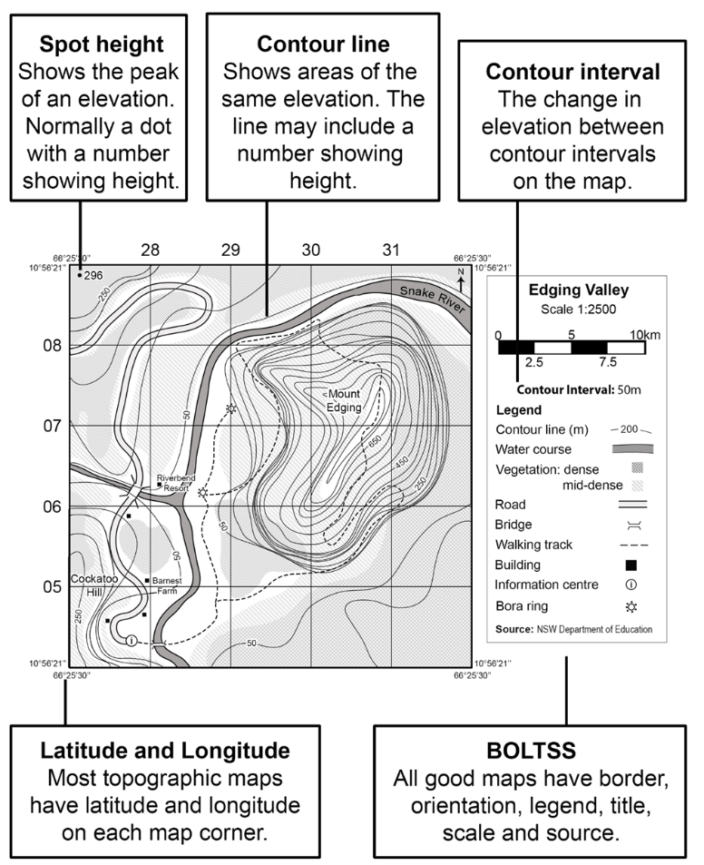
Key features of topographic maps
List the key features
Notes:
Note: A key feature of topographic maps is contour lines. These show areas of the same elevation above sea level. They give an indication of the height and shape of the land. The Australian Height Datum (AHD) is the standard measure of elevation used in Australia. Contour lines usually show this height in metres (m). Sometimes not all contour lines are numbered to improve legibility of the map, especially if the contours are close together. The contour interval is the change in elevation between each contour line. It will be consistent across the map and is usually provided in the legend. The contour interval can be determined by calculating the difference in elevation between two adjacent lines.

Slide 4
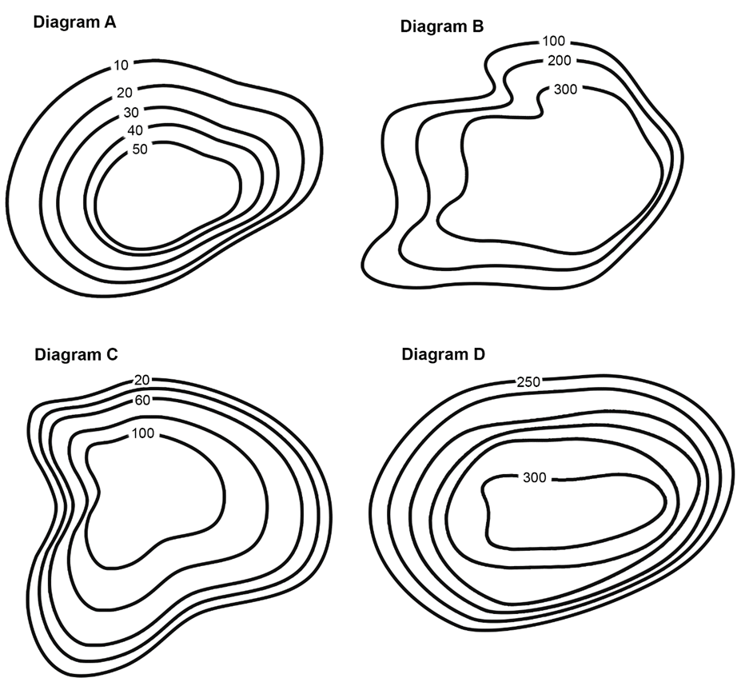
Topographic maps (1)
I do
What is the lowest point of topography on Diagram A?
What is the highest point of topography on Diagram A?
What is the contour interval of Diagram A?
Notes:
Answers:
10 m
50 m
10 m

Slide 5
Topographic maps (2)
We do
What is the lowest point of topography on Diagram C?
What is the highest point of topography on Diagram C?
What is the contour interval of Diagram C?
Notes:
Answers:
20 m
100 m
20 m

Slide 6
Topographic maps (3)
You do
What is the lowest point of topography on Diagram B?
What is the highest point of topography on Diagram B?
What is the contour interval of Diagram B?
Notes:
Answers:
100 m
300 m
100 m

Slide 7



Think-Pair-Share (1)
Topic –
My thoughts
My partner’s thoughts
What we will share

Slide 8
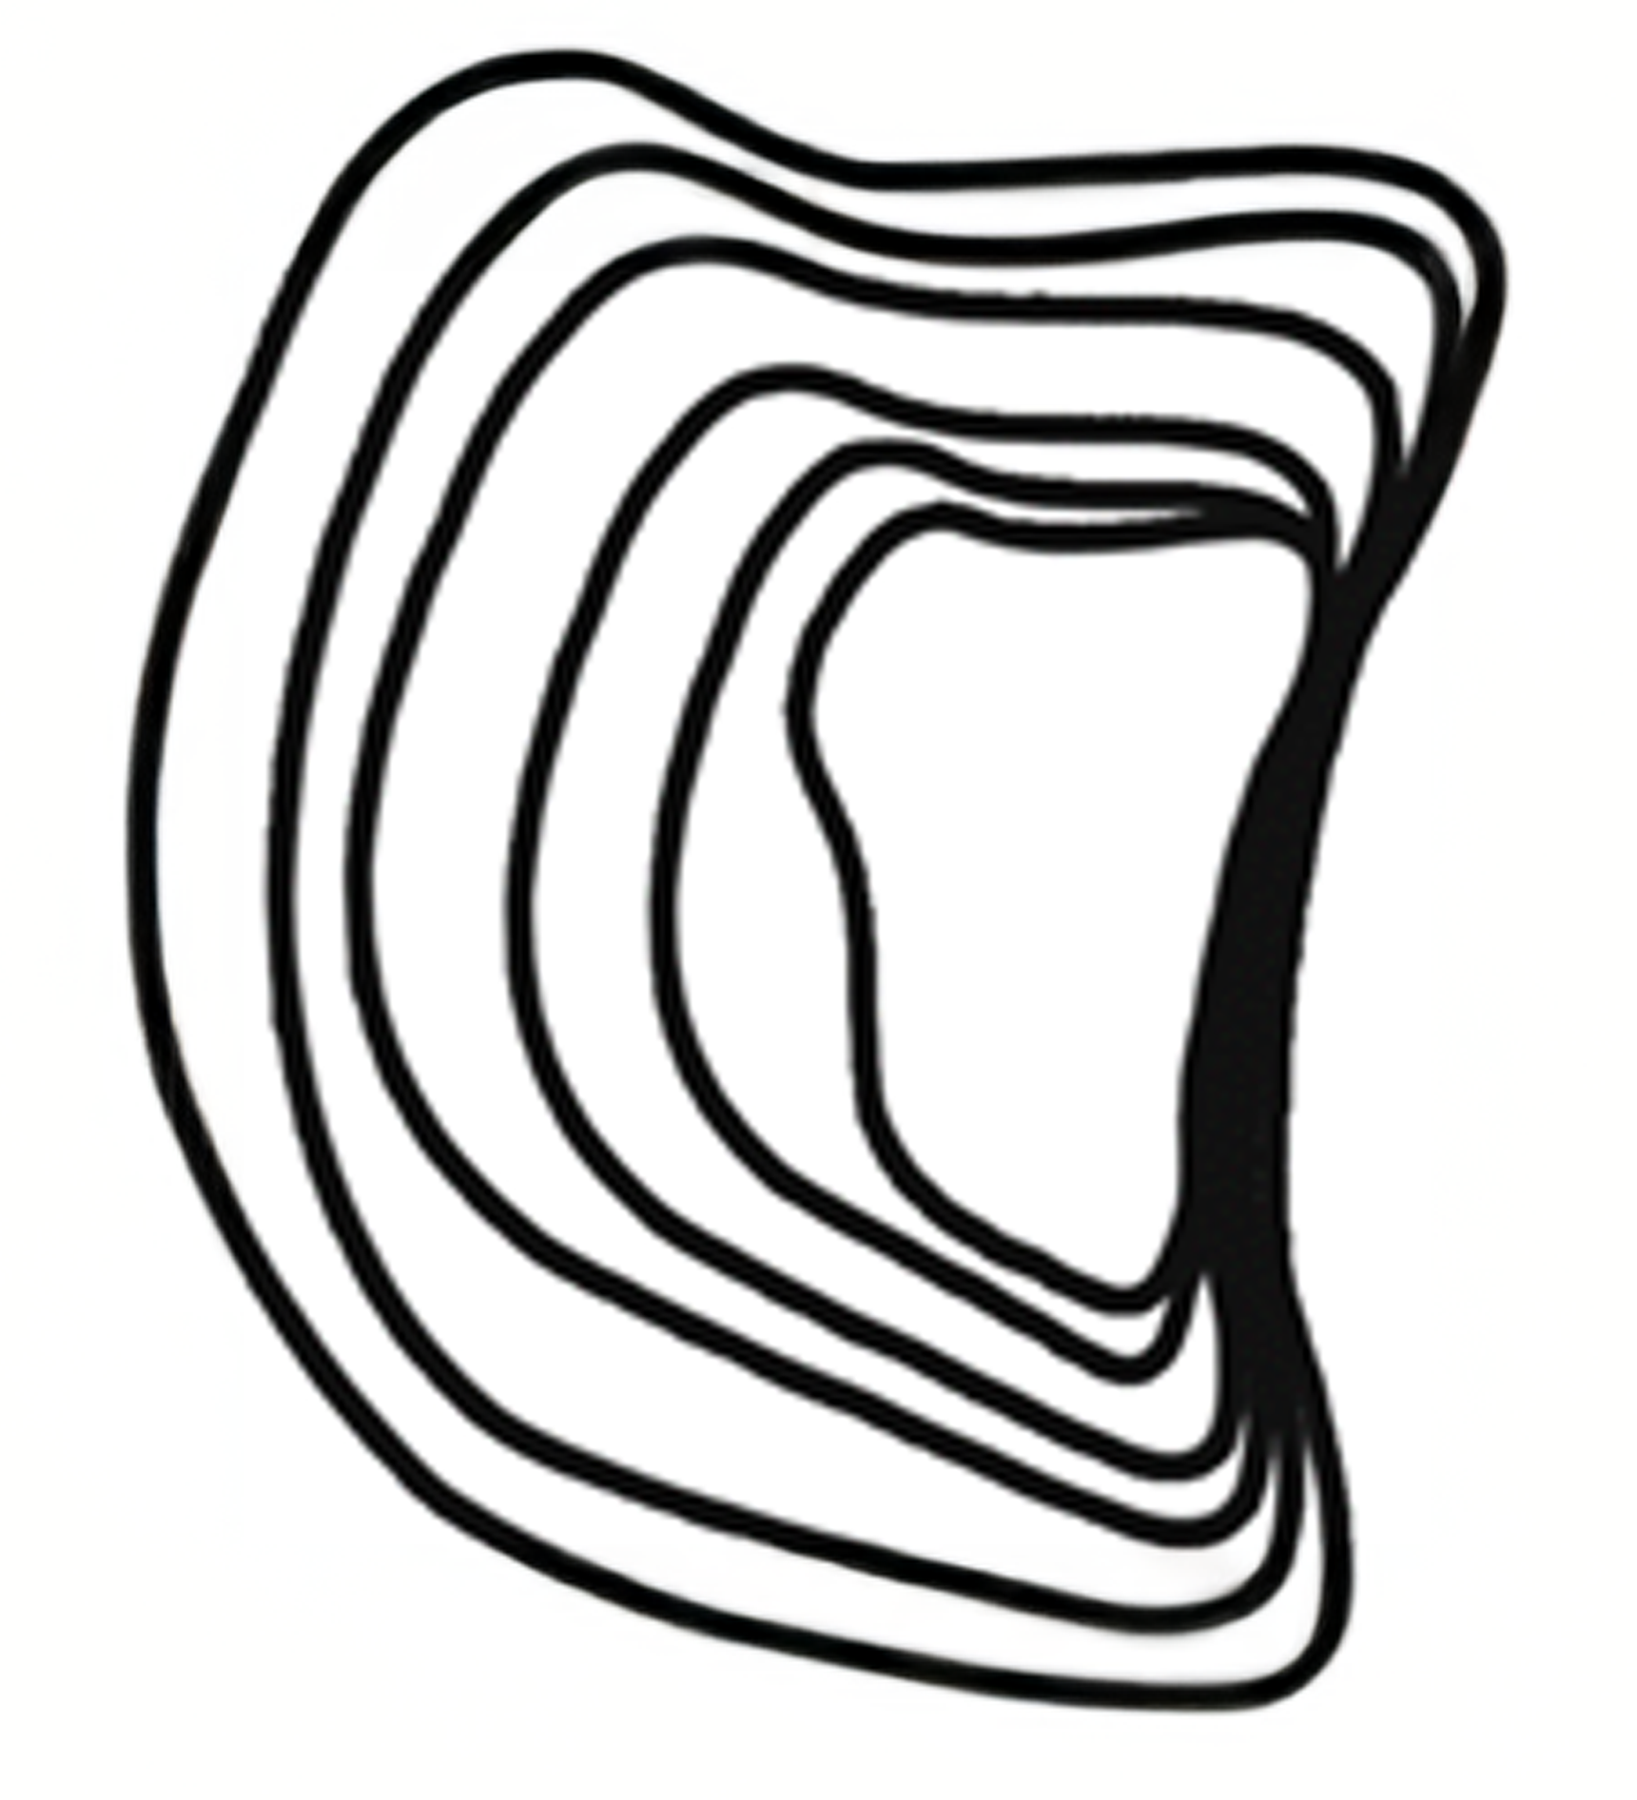
Think-Pair-Share (2)
Hint – contour lines closer together illustrate steeper slopes
What type of landscape would this contour pattern illustrate?
Sketch and scribble a ground level view of this landscape from a point of your choice.
Notes:
Answer: cliff.

Slide 9

Think-Pair-Share (3)
Hint – contour lines gradually and equally increase towards the top.
What type of landscape would this contour pattern illustrate?
Sketch and scribble a ground level view of this landscape from a point of your choice.
Notes:
Answer: hill.

Slide 10
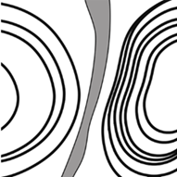
Think-Pair-Share (4)
Hint – contour lines gradually and equally decrease towards the centre.
What type of landscape would this contour pattern illustrate?
Sketch and scribble a ground level view of this landscape from a point of your choice.
Notes:
Answer: valley.

Slide 11
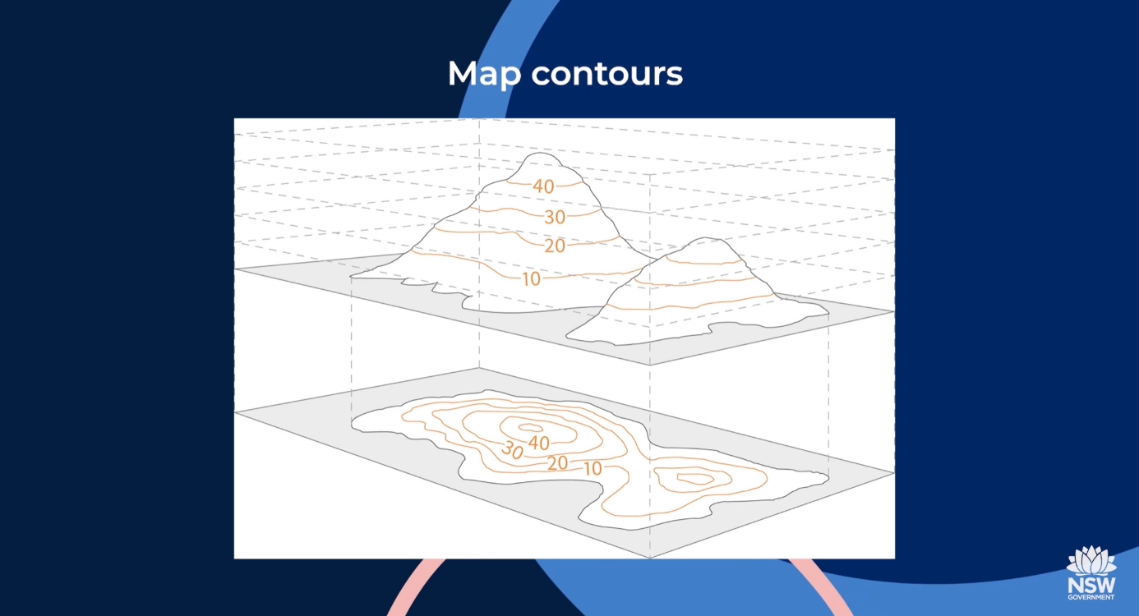

Need more explanation?
Topographic maps (duration 3:55)
Notes:
Check for understanding (video transcript)
True/False Questions
Contour lines connect points of different elevations on a topographic map.
Answer: False.
Explainer: Contour lines connect points of the same elevation above sea level, not different elevations.
A ridge is represented on a topographic map by a continuous sloping line of high ground.
Answer: True.
Explainer: Ridges are shown as elongated areas of high elevation between valleys or lower ground.
Contour intervals represent the distance on the ground between each contour line.
Answer: True.
Explainer: The contour interval indicates the change in elevation between lines, providing a clear measurement of height differences.
Topographic maps are only useful for travellers and bushwalkers.
Answer: False.
Explainer: While travellers and bushwalkers use them, topographic maps are also critical for industries like mining, land planning, and emergency management.
The closer the contour lines, the steeper the slope.
Answer: True.
Explainer: Closely spaced contour lines show a sharp rise or fall in elevation, indicating a steep slope.
Short Answer Questions
What do topographic maps show geographers about the landscape?
Answer: Topographic maps show the physical features of the land, including natural features like mountains, valleys, and rivers, as well as built features like roads and towns. They also provide information about elevation and the shape of the land using contour lines.
Explainer: Topographic maps are essential for understanding the layout of an area, including its natural and human-made elements.
What is the purpose of contour lines on a topographic map?
Answer: Contour lines represent elevation and connect places with the same height above sea level. They help geographers visualize the shape of the land, such as hills, valleys, and slopes.
Explainer: Contour lines give a 2D map the ability to represent a 3D landscape, showing changes in height and slope.
How can you tell if a slope is steep or gradual on a topographic map?
Answer: On a topographic map, a steep slope is shown by contour lines that are close together, while a gradual slope is indicated by contour lines that are spaced further apart.
Explainer: The spacing of contour lines directly reflects the steepness of the land: closer lines mean a rapid rise or fall, and wider spacing means a gentle incline.

Slide 12
3-2-1 things I learned today
List 3 things you learned today:
3
1.
2.
3.
List 2 questions you have about these things:
2
1.
2.
Give 1 reason why it’s important to learn about these things:
1
1.

Slide 13
References
This presentation contains NSW Curriculum and syllabus content. The NSW Curriculum is developed by the NSW Education Standards Authority. This content is prepared by NESA for and on behalf of the Crown in the right of the State of New South Wales. The material is protected by Crown copyright.
Please refer to the NESA Copyright Disclaimer for more information https://educationstandards.nsw.edu.au/wps/portal/nesa/mini-footer/copyright.
NESA holds the only official and up-to-date versions of the NSW Curriculum and syllabus documents. Please visit the NSW Education Standards Authority (NESA) website https://educationstandards.nsw.edu.au/wps/portal/nesa/home and the NSW Curriculum website https://curriculum.nsw.edu.au.
Geography 7-10 © Syllabus NSW Education Standards Authority (NESA) for and on behalf of the Crown in right of the State of New South Wales, 2024.

Slide 14
Copyright
© State of New South Wales (Department of Education), 2024
The copyright material published in this resource is subject to the Copyright Act 1968 (Cth) and is owned by the NSW Department of Education or, where indicated, by a party other than the NSW Department of Education (third-party material).
Copyright material available in this resource and owned by the NSW Department of Education is licensed under a Creative Commons Attribution 4.0 International (CC BY 4.0) licence.
This licence allows you to share and adapt the material for any purpose, even commercially.
Attribution should be given to © State of New South Wales (Department of Education), 2024.
Material in this resource not available under a Creative Commons licence:
the NSW Department of Education logo, other logos and trademark-protected material
Material owned by a third party that has been reproduced with permission. You will need to obtain permission from the third party to reuse its material.
Links to third-party material and websites
Please note that the provided (reading/viewing material/list/links/texts) are a suggestion only and implies no endorsement, by the New South Wales Department of Education, of any author, publisher, or book title. School principals and teachers are best placed to assess the suitability of resources that would complement the curriculum and reflect the needs and interests of their students.
If you use the links provided in this document to access a third party’s website, you acknowledge that the terms of use, including licence terms set out on the third-party’s website apply to the use which may be made of the materials on that third-party website or where permitted by the Copyright Act 1968 (Cth). The department accepts no responsibility for content on third-party websites.

