Slide 1
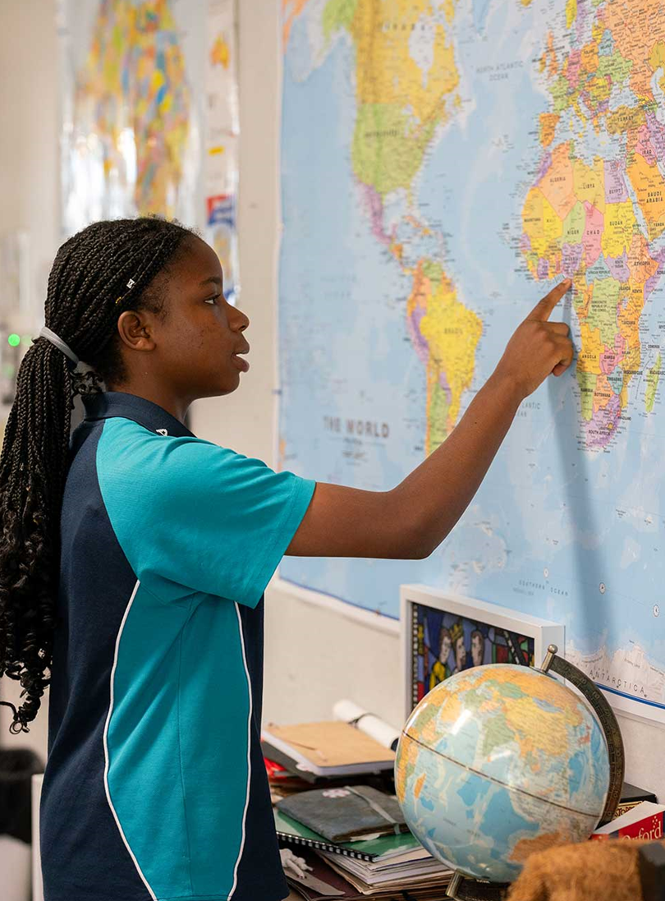
Lesson 3 – latitude and longitude
Stage 4 geography
Landscapes and landforms
[TEACHER NAME]
[DATE]

Slide 2
Learning intentions and success criteria
We are learning to
identify the 4 hemispheres that divide the earth
identify latitude and longitude on a map
locate places on maps
We can
locate place on earth by identifying their location in the hemispheres
describe the differences between lines of latitude and longitude on map
use lines of latitude and longitude to locate places.
Notes:
Notes for teachers:
Learning intentions and success are best co-constructed with students. Adapt the learning intention as required and add matching success criteria.
For more information See ⁠AITSL or the NSW Department of Education explicit teaching strategies, ⁠Sharing learning intentions and ⁠Sharing success criteria
LISC is not necessarily presented at the beginning of the lesson. Teacher needs to consider most effectual time to introduce
LISC should be revisited during the lesson to support students' evaluation of their learning

Slide 3
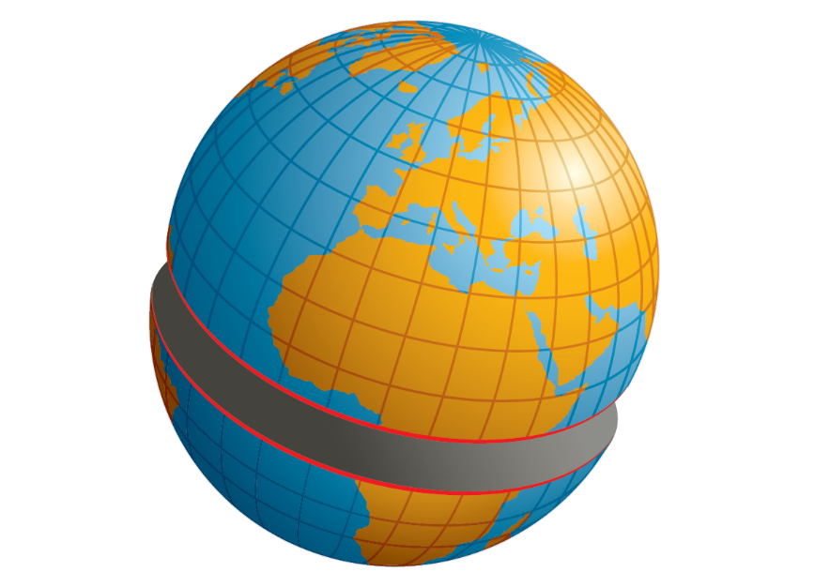

Earth’s divided into 4 hemispheres
Which hemispheres do we live in?
Northern Hemisphere
Eastern Hemisphere
Southern Hemisphere
Western Hemisphere

Slide 4
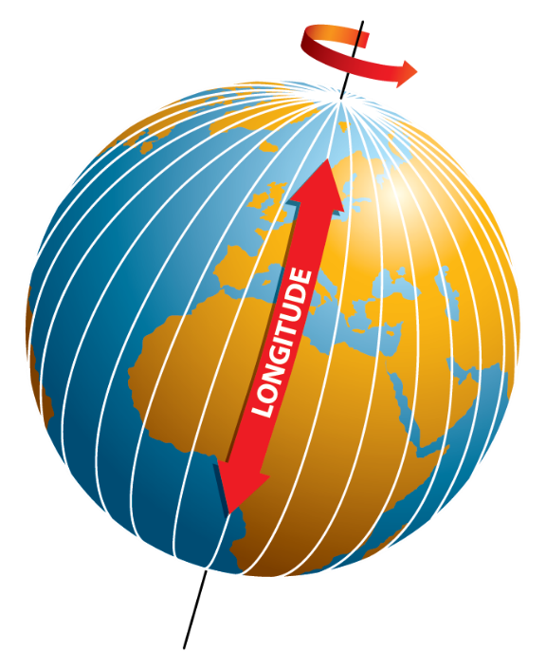
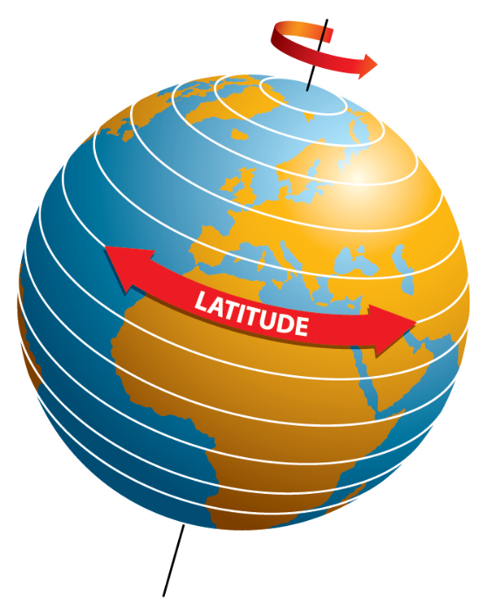
How imaginary lines help us locate places (1)
Coordinates help identify location
Latitude and longitude are imaginary lines across the globe used to provide coordinates for identifying the exact location of places.
They are measured in degrees (°), minutes (’) and seconds (”) that represent their angle from the centre of the Earth.
There are 60 minutes in every degree, and 60 seconds in every minute.

Slide 5
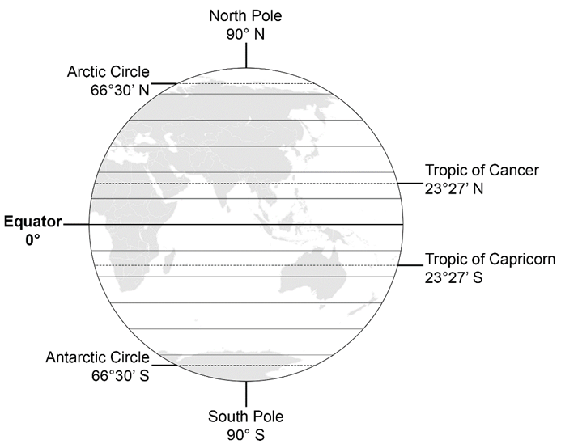
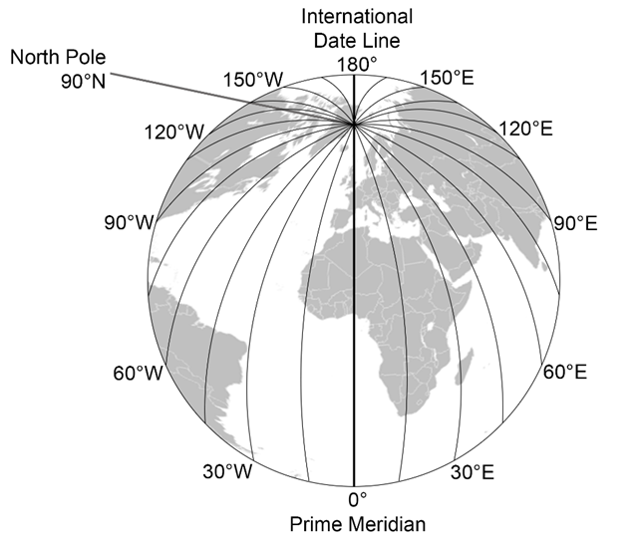
How imaginary lines help us locate places (2)
Lines of latitude and longitude
Lines of latitude
Lines of longitude
Notes:
Lines of latitude run horizontally across the world. They are known as parallels of latitude as they are parallel (equally distant and never touching). The most important latitudinal line is the equator (0°). It runs across the centre of the Earth, dividing it into the Northern and Southern hemisphere. All other lines of latitude are written with an N or S at the end to identify whether they are in the northern or southern hemisphere. 90°N (north pole) and 90°S (south pole) are the parallels of latitude furthest from the equator.
Lines of longitude run vertically across the globe. They are commonly known as meridians. All meridians of longitude meet at the north and south poles. Two important meridians are the prime meridian (0°) and international date line (180°). The prime meridian divides the earth into the eastern and western hemispheres. All other meridians of longitude are written with an E or W at the end to identify whether they are in the eastern or western hemisphere.

Slide 6
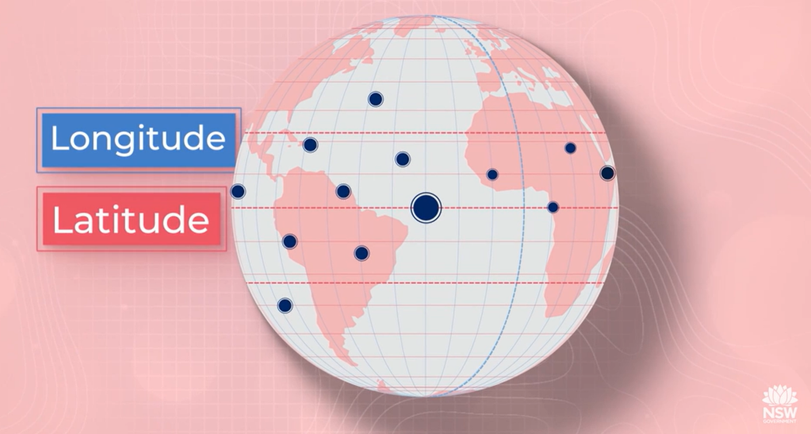

Need more explanation?
Latitude and longitude (duration 4:24)
Notes:
Possible teacher questions and responses based on the video that can be used to check for understanding:
True/False Questions
Latitude lines are sometimes called meridians.
Answer: False.
Explainer: Longitude lines are called meridians, not latitude lines.
The Prime Meridian runs through Greenwich, England.
Answer: True.
Explainer: The Prime Meridian is an important line of longitude that passes through Greenwich and is the reference point for measuring longitude.
Latitude is always written before longitude when giving coordinates.
Answer: True.
Explainer: Latitude comes before longitude, following the alphabetical order of "A" for latitude and "O" for longitude.
Longitude measures distances east and west of the equator.
Answer: False.
Explainer: Longitude measures distances east and west of the Prime Meridian, not the equator.
Each degree of latitude can be broken down into 60 minutes, and each minute into 60 seconds.
Answer: True.
Explainer: This system allows for very precise location measurements.
Short Answer Questions
What is the difference between latitude and longitude?
Answer: Latitude lines run parallel to the equator in an east-west direction and measure how far north or south a point is from the equator. Longitude lines run from the North Pole to the South Pole and measure how far east or west a point is from the Prime Meridian.
Explainer: Latitude is horizontal, while longitude is vertical, and they work together to pinpoint locations on Earth.
Why is the equator considered a significant latitude line?
Answer: The equator is significant because it divides the Earth into the northern and southern hemispheres and is the baseline for measuring latitude, marked as 0 degrees latitude.
Explainer: The equator is central to understanding the latitude system and helps define hemispheres.
Why are coordinates important in geography?
Answer: Coordinates are important in geography because they provide a precise system for identifying the exact location of any place on Earth using latitude and longitude.
Explainer: By combining latitude and longitude, geographers can accurately pinpoint locations, aiding in navigation, mapping, and spatial analysis.

Slide 7

Getting familiar with lines of latitude and longitude (1)
I do:
Write the latitude 29.67°S using degrees, minutes and seconds.
Step 1: 0.67 × 60 = 40.2
Step 2: 0.2 × 60 = 12
Therefore, 29.67°S is 29°40’12” S.
Notes:
Note: it helps to teach students the rule of alphabet applies when writing out latitude and longitude coordinates. Latitude is ‘la’ which is written before longitude ‘lo’.

Slide 8
Getting familiar with lines of latitude and longitude (2)
We do:
Write the latitude 5.85°N using degrees, minutes and seconds.
Step 1: 0.85 × 60 = 51
Step 2: 0’ so no need to write
Therefore, 5.85°N is
Notes:
Answer: 5°51’ N

Slide 9
Getting familiar with lines of latitude and longitude (3)
You do:
Write the latitude 130.5°W using degrees, minutes and seconds.
Step 1:
Step 2:
Therefore, 130.5°W is
Notes:
Answer: 130°30’ W

Slide 10
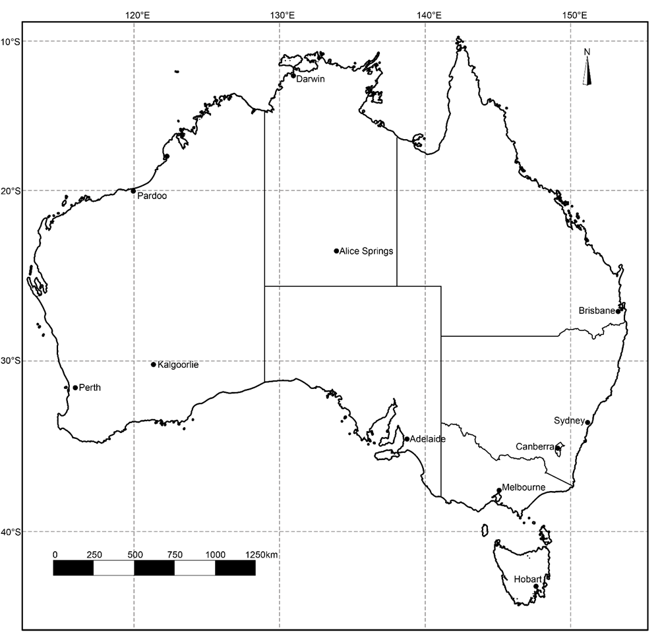


Getting familiar with lines of latitude and longitude (4)
I do:
Notes:
Teacher note: a printable version of this map is available in the Geography tools Mapping – Latitude and longitude guide.
When providing coordinates, we state the latitude then the longitude for the location. For example, Sydney is located at 33°52’8” S 151°12’33” E. The map of Australia is showing lines of latitude and longitude. It is easy to find a location on a map when it is directly located on a line of latitude and longitude, such as Pardoo which is located at 20°S 120°E. When a location is not directly on a provided line of latitude and longitude, we use a ruler to estimate the coordinates based on the lines provided on the map.

Slide 11
Getting familiar with lines of latitude and longitude (5)
We do:
Identify the town or city found at the following coordinates:
42°52’57” S 147°19’33” E
23°41’53” S 133°52’51” E
Notes:
Answers:
Hobart
Alice Springs

Slide 12
Getting familiar with lines of latitude and longitude (6)
You do:
Identify the town or city found at the following coordinates:
27°28’14” S 153°1’34” E
31°57’50” S 115°51’42” E
35°16’49” S 149°7’52” E.
Notes:
Answers:
Brisbane
Perth
Canberra

Slide 13
3-2-1 things I learned today
List 3 things you learned today:
3
1.
2.
3.
List 2 questions you have about these things:
2
1.
2.
Give 1 reason why it’s important to learn about these things:
1
1.

Slide 14
References
This presentation contains NSW Curriculum and syllabus content. The NSW Curriculum is developed by the NSW Education Standards Authority. This content is prepared by NESA for and on behalf of the Crown in the right of the State of New South Wales. The material is protected by Crown copyright.
Please refer to the NESA Copyright Disclaimer for more information https://educationstandards.nsw.edu.au/wps/portal/nesa/mini-footer/copyright.
NESA holds the only official and up-to-date versions of the NSW Curriculum and syllabus documents. Please visit the NSW Education Standards Authority (NESA) website https://educationstandards.nsw.edu.au/wps/portal/nesa/home and the NSW Curriculum website https://curriculum.nsw.edu.au.
Geography 7-10 © Syllabus NSW Education Standards Authority (NESA) for and on behalf of the Crown in right of the State of New South Wales, 2024.

Slide 15
Copyright
© State of New South Wales (Department of Education), 2024
The copyright material published in this resource is subject to the Copyright Act 1968 (Cth) and is owned by the NSW Department of Education or, where indicated, by a party other than the NSW Department of Education (third-party material).
Copyright material available in this resource and owned by the NSW Department of Education is licensed under a Creative Commons Attribution 4.0 International (CC BY 4.0) licence.
This licence allows you to share and adapt the material for any purpose, even commercially.
Attribution should be given to © State of New South Wales (Department of Education), 2024.
Material in this resource not available under a Creative Commons licence:
the NSW Department of Education logo, other logos and trademark-protected material
Material owned by a third party that has been reproduced with permission. You will need to obtain permission from the third party to reuse its material.
Links to third-party material and websites
Please note that the provided (reading/viewing material/list/links/texts) are a suggestion only and implies no endorsement, by the New South Wales Department of Education, of any author, publisher, or book title. School principals and teachers are best placed to assess the suitability of resources that would complement the curriculum and reflect the needs and interests of their students.
If you use the links provided in this document to access a third party’s website, you acknowledge that the terms of use, including licence terms set out on the third-party’s website apply to the use which may be made of the materials on that third-party website or where permitted by the Copyright Act 1968 (Cth). The department accepts no responsibility for content on third-party websites.

