Slide 1

Lesson 2 – photo sketch
Stage 4 geography
Landscapes and landforms
[TEACHER NAME]
[DATE]

Slide 2
Learning intentions and success criteria
We are learning to
identify key features of photo sketches
identify the purpose of drawing photo sketches in geography
We can
construct a photo sketch
explain the purpose of a photo sketch as a geographical tool.
Notes:
Notes for teachers:
Learning intentions and success are best co-constructed with students. Adapt the learning intention as required and add matching success criteria.
For more information See ⁠AITSL or the NSW Department of Education explicit teaching strategies, ⁠Sharing learning intentions and ⁠Sharing success criteria
LISC is not necessarily presented at the beginning of the lesson. Teacher needs to consider most effectual time to introduce
LISC should be revisited during the lesson to support students' evaluation of their learning
Pre test and post test:
Set 85A - Geography – Photographs
Set 85B - Geography - Photographs

Slide 3

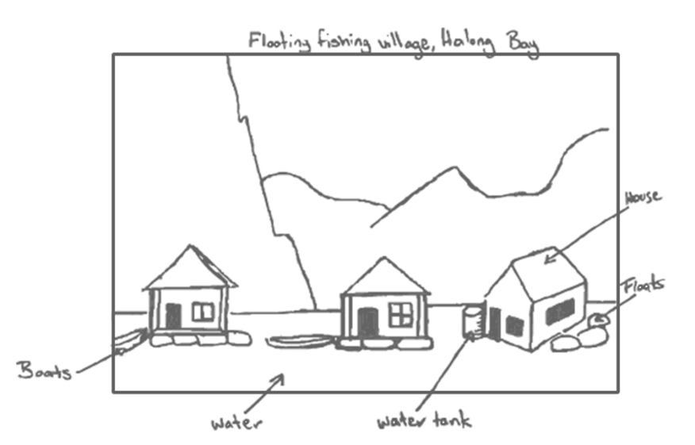
What is a photo sketch?
Definition and use
A drawing made from a photograph is called a photo sketch or line drawing.
Photo sketches can be used to:
ensure careful observation
assist in keeping an accurate record of what is observed in the field
assist in describing places to other people.
‘Floating fishing village, Halong Bay’ by Andrea Schaffer is licensed under CC BY-SA 2.0.

Slide 4
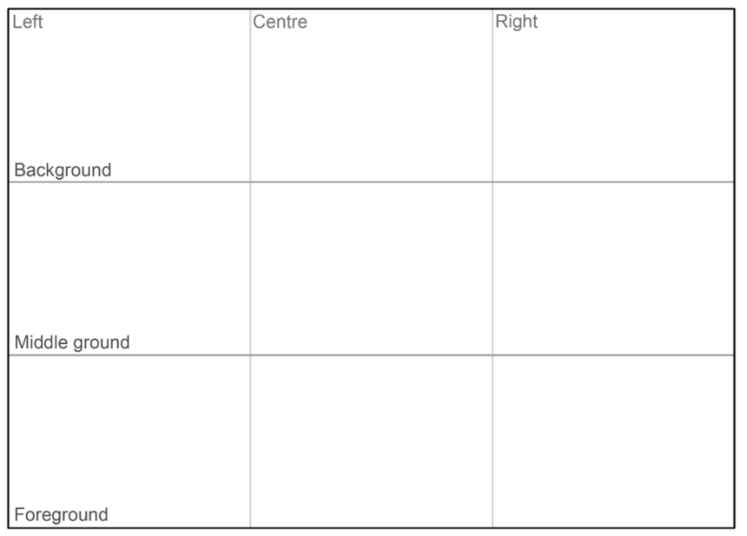
Drawing a photo sketch
Steps needed to complete a photo sketch
Rule up a frame the same size as the photograph.
Use a pencil to lightly draw 4 simple grid lines that divides the image into quadrants.
Using the gridlines as a guide lightly draw the outline of the land and the location of the relevant buildings and roads.
Draw in some of the details like fences, other roads, clouds, vegetation.
Add labels and a title.

Slide 5
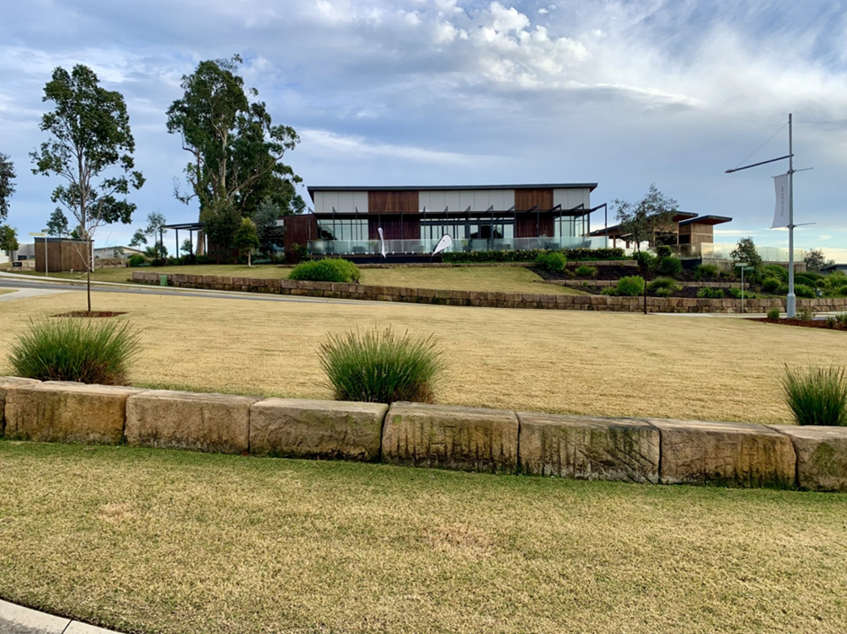

Draw a photo sketch (1)
We do:
Notes:
Teacher:
Step 1 - Rule up a frame the same size as the photograph.

Slide 6
Draw a photo sketch (2)
We do:
Left Background | Centre | Right
Middle ground
Foreground
Notes:
Teacher – Step 2 use a pencil to lightly draw 4 simple grid lines that divides the image into quadrants.

Slide 7
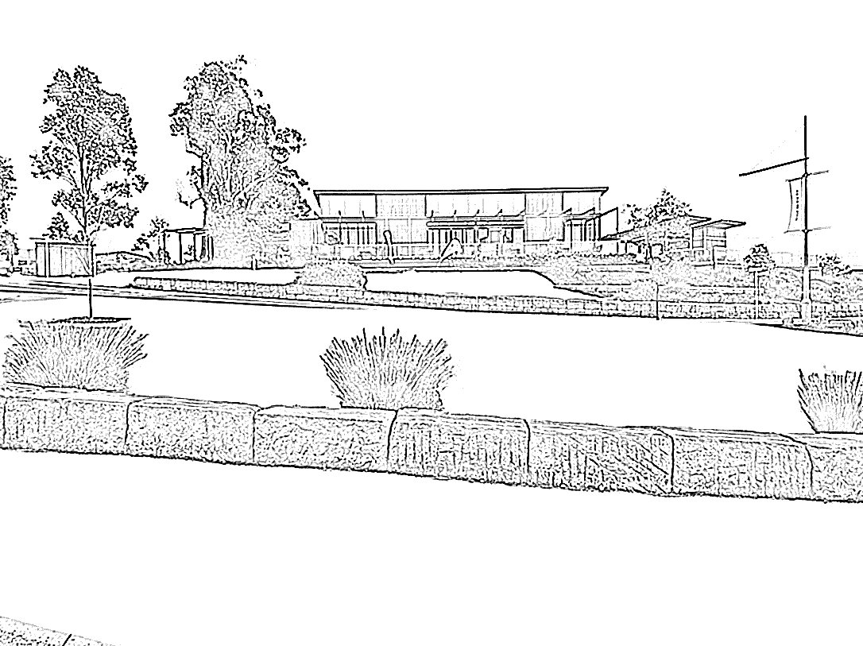
Draw a photo sketch (3)
We do:
Notes:
Teacher – Step 3 using the gridlines as a guide lightly draw the outline of the land and the location of the relevant buildings and roads.

Slide 8

Draw a photo sketch (4)
Title
Draw details like buildings, fences, roads
Label key features
We do
Notes:
Teacher – Step 4 draw in some of the details like fences, other roads, clouds, vegetation.
Step 5 Add labels and a title.

Slide 9

You do
Select from the photographs provided
1
Choose a photo
2
Draw a photo sketch
3
Submit for feedback
Notes:
Student select from a series of photographs. Teachers may have asked students to bring in a photograph from home or provide students with options.

Slide 10

What went well?
TAG – peer feedback activity
T
Tell something that you really liked. Explain why you liked it.
A
Ask a question to better understand the work presented.
G
Give a suggestion to help make the work presented even better.
Notes:
Students exchange photo sketch and complete a TAG peer feedback exercise.

Slide 11
Short response questions
What is a photo sketch?
Identify some advantages of using photo sketches to record information.
Identify some disadvantages of using photo sketches.

Slide 12
References
This presentation contains NSW Curriculum and syllabus content. The NSW Curriculum is developed by the NSW Education Standards Authority. This content is prepared by NESA for and on behalf of the Crown in the right of the State of New South Wales. The material is protected by Crown copyright.
Please refer to the NESA Copyright Disclaimer for more information https://educationstandards.nsw.edu.au/wps/portal/nesa/mini-footer/copyright.
NESA holds the only official and up-to-date versions of the NSW Curriculum and syllabus documents. Please visit the NSW Education Standards Authority (NESA) website https://educationstandards.nsw.edu.au/wps/portal/nesa/home and the NSW Curriculum website https://curriculum.nsw.edu.au.
Geography 7-10 © Syllabus NSW Education Standards Authority (NESA) for and on behalf of the Crown in right of the State of New South Wales, 2024.

Slide 13
Copyright
© State of New South Wales (Department of Education), 2024
The copyright material published in this resource is subject to the Copyright Act 1968 (Cth) and is owned by the NSW Department of Education or, where indicated, by a party other than the NSW Department of Education (third-party material).
Copyright material available in this resource and owned by the NSW Department of Education is licensed under a Creative Commons Attribution 4.0 International (CC BY 4.0) licence.
This licence allows you to share and adapt the material for any purpose, even commercially.
Attribution should be given to © State of New South Wales (Department of Education), 2024.
Material in this resource not available under a Creative Commons licence:
the NSW Department of Education logo, other logos and trademark-protected material
Material owned by a third party that has been reproduced with permission. You will need to obtain permission from the third party to reuse its material.
Links to third-party material and websites
Please note that the provided (reading/viewing material/list/links/texts) are a suggestion only and implies no endorsement, by the New South Wales Department of Education, of any author, publisher, or book title. School principals and teachers are best placed to assess the suitability of resources that would complement the curriculum and reflect the needs and interests of their students.
If you use the links provided in this document to access a third party’s website, you acknowledge that the terms of use, including licence terms set out on the third-party’s website apply to the use which may be made of the materials on that third-party website or where permitted by the Copyright Act 1968 (Cth). The department accepts no responsibility for content on third-party websites.

