Slide 1
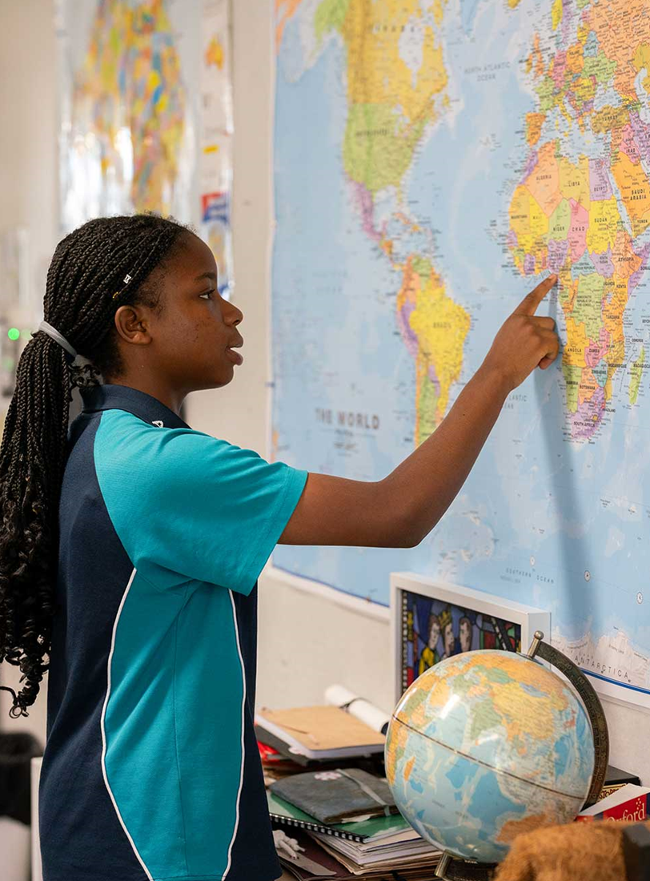
Lesson 1 – types of photographs used in geography
Stage 4 geography
Landscapes and landforms
[TEACHER NAME]
[DATE]

Slide 2
Learning intentions and success criteria
We are learning to
identify different types of photographs used in geography
We can
distinguish between different types of photographs used in geography.
Notes:
Notes for teachers:
Learning intentions and success are best co-constructed with students. Adapt the learning intention as required and add matching success criteria.
For more information See ⁠AITSL or the NSW Department of Education explicit teaching strategies, ⁠Sharing learning intentions and ⁠Sharing success criteria
LISC is not necessarily presented at the beginning of the lesson. Teacher needs to consider most effectual time to introduce
LISC should be revisited during the lesson to support students' evaluation of their learning
Pre test and post tests:
Set 85A - Geography – Photographs
Set 85B - Geography - Photographs

Slide 3
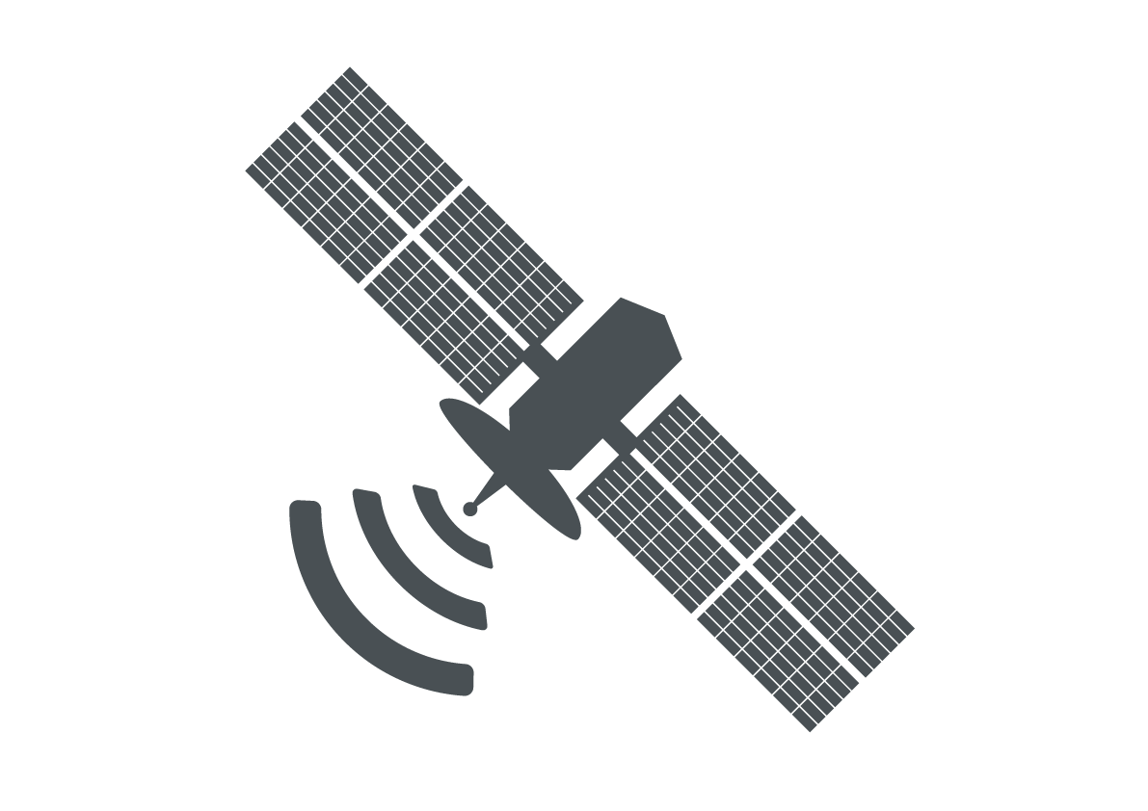
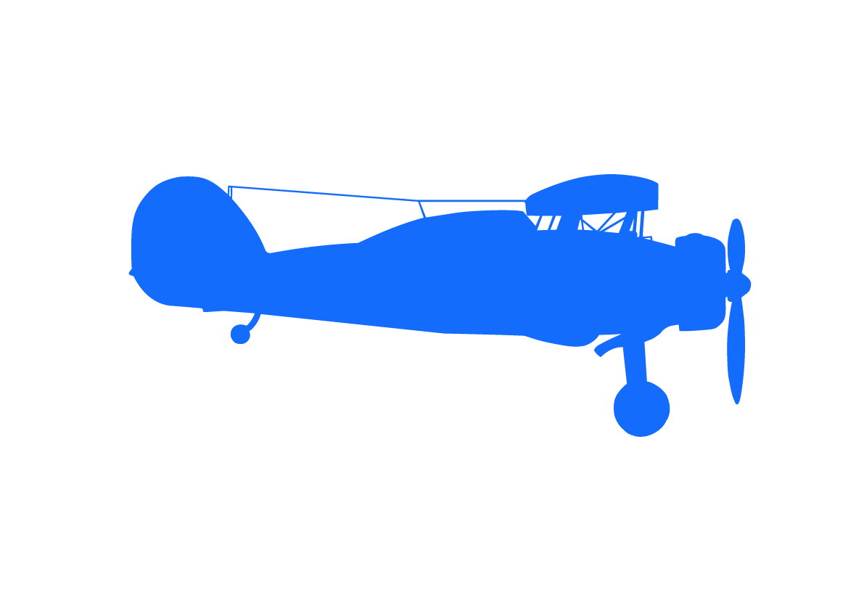
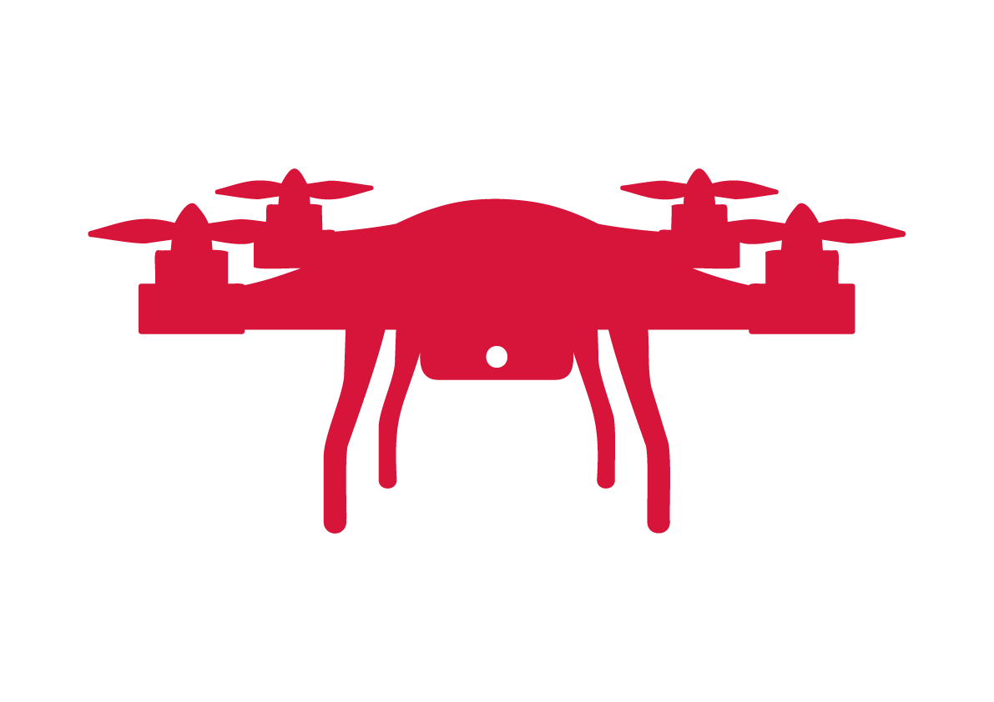
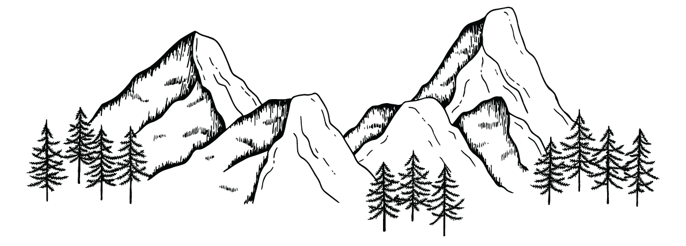

Types of photographs
Satellite
Geographers use 4 main types of photographs
Oblique
Aerial
Ground

Slide 4
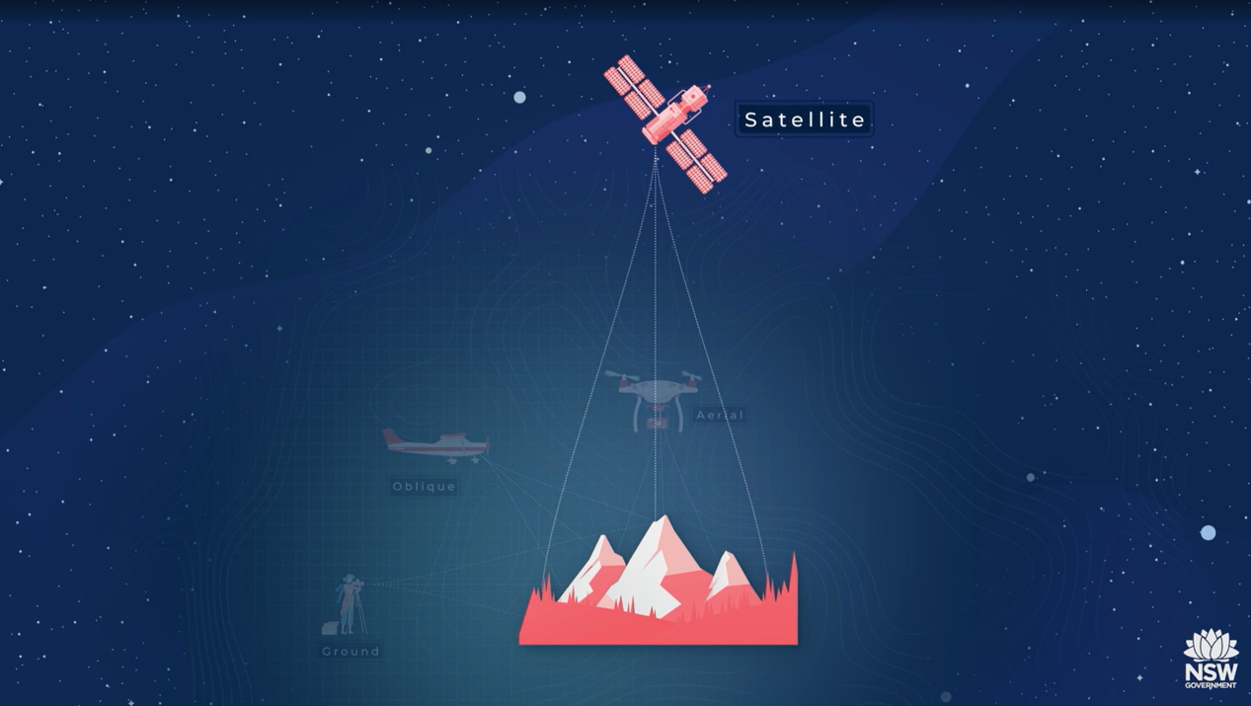

Need more explanation?
Types of photos (duration 3:21)
Notes:
Check for understanding questions (from video)
True/False Questions
Ground photographs are taken from above, looking down at an angle.
Answer: False.
Explainer: Ground photographs are taken from the ground, looking across the area, not from above.
Oblique air photographs are commonly taken from drones or aeroplanes.
Answer: True.
Explainer: Oblique photographs capture the area from above at an angle, making drones and aeroplanes suitable for this purpose.
Aerial photographs are the same as satellite photographs.
Answer: False.
Explainer: Aerial photographs are taken from a plane or drone directly above the site, while satellite photographs are taken from satellites in space.
Dark areas in satellite images are often bodies of water.
Answer: True.
Explainer: In satellite images, bodies of water commonly appear as dark shaded areas.
Satellite photographs are the best for showing changes over time.
Answer: True.
Explainer: Satellite images cover large areas and are frequently updated, making them ideal for tracking changes over time.
Short answer questions
What are the four types of photographs geographers use, and how are they taken?
Answer: The four types are:
Ground photographs: Taken at ground level, showing a place as if you are standing there.
Oblique photographs: Taken from above at an angle, usually by a plane or drone.
Aerial photographs: Taken from directly above a location, looking straight down.
Satellite photographs: Captured from space by satellites, looking straight down at the Earth's surface.
Explainer: These types of photographs provide different perspectives that geographers use to analyse physical and human features.
Why are satellite photographs useful in geography?
Answer: Satellite photographs are useful because they cover large areas, provide detailed and up-to-date information, and help geographers observe changes in the environment, land use, and urban development over time.
Explainer: Satellite images are ideal for monitoring patterns, trends, and changes on a global or regional scale.
How can you distinguish an oblique photograph from a ground photograph?
Answer: An oblique photograph is taken from above at an angle, offering a broader view, while a ground photograph is taken at ground level, showing the perspective of someone standing in the area.
Explainer: Oblique photographs give a bird’s-eye view at an angle, whereas ground photographs provide a close-up, horizontal perspective of a location.

Slide 5

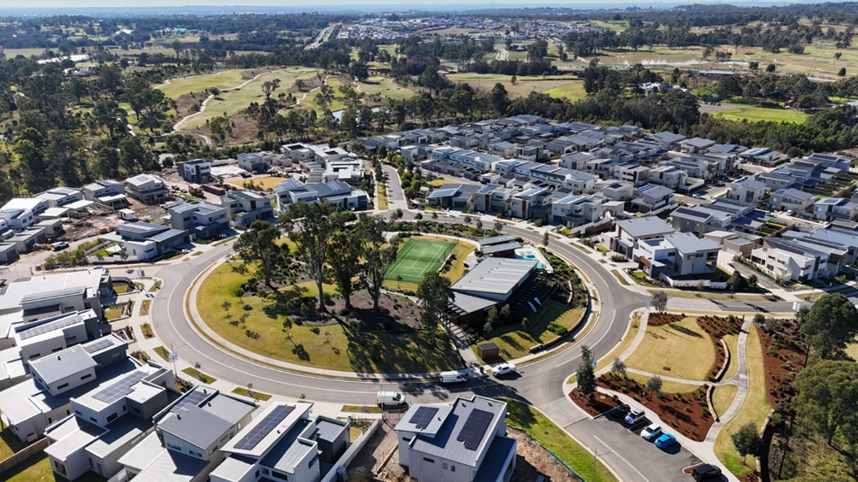
What type of photograph is this? (1)
Is this an aerial photograph?
Check for understanding
Notes:
Answer: No, this is an oblique aerial photograph.

Slide 6
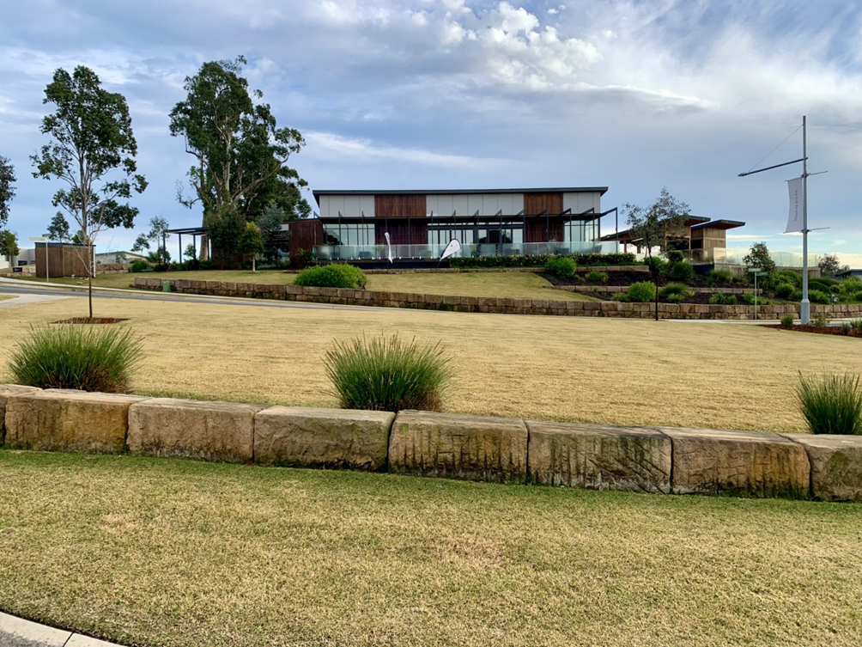
What type of photograph is this? (2)
Is this a ground photograph?
Check for understanding
Notes:
Answer: Yes.
This is a ground level photograph because it was taken from the ground.

Slide 7
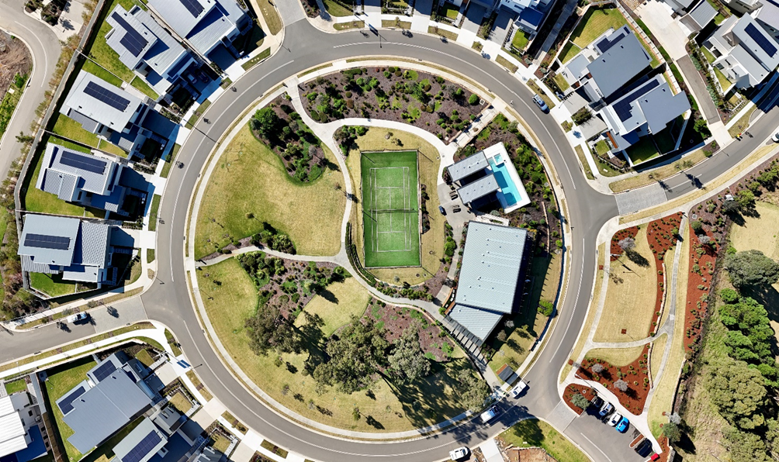
What type of photograph is this? (3)
Is this an oblique aerial photograph?
Check for understanding
Notes:
Answer: No, this is an aerial photograph.
This is an aerial photograph because it is not a satellite image and it is not taken from the air at an angle.

Slide 8
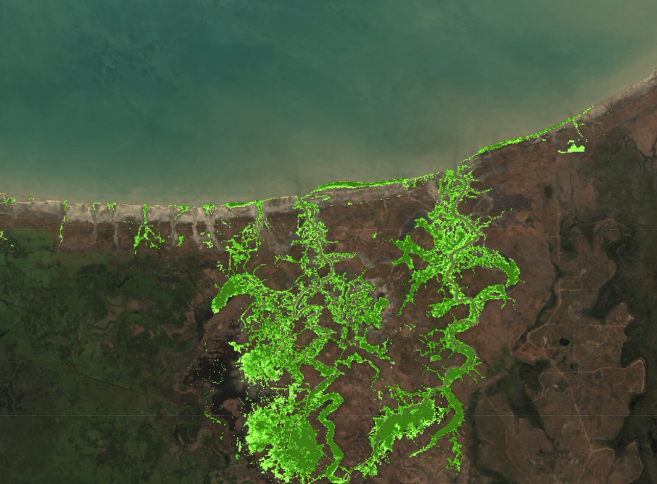
What type of photograph is this? (4)
Is this a satellite image?
Check for understanding
Australian Government Geoscience Australia
Notes:
Answer: Yes. Satellite image.
This is a satellite image because this scale of image could not be achieved with an aerial photograph.

Slide 9
References
This presentation contains NSW Curriculum and syllabus content. The NSW Curriculum is developed by the NSW Education Standards Authority. This content is prepared by NESA for and on behalf of the Crown in the right of the State of New South Wales. The material is protected by Crown copyright.
Please refer to the NESA Copyright Disclaimer for more information https://educationstandards.nsw.edu.au/wps/portal/nesa/mini-footer/copyright.
NESA holds the only official and up-to-date versions of the NSW Curriculum and syllabus documents. Please visit the NSW Education Standards Authority (NESA) website https://educationstandards.nsw.edu.au/wps/portal/nesa/home and the NSW Curriculum website https://curriculum.nsw.edu.au.
Geography 7-10 © Syllabus NSW Education Standards Authority (NESA) for and on behalf of the Crown in right of the State of New South Wales, 2024.
Australian Government 2024, DEA Mangrove Canopy Cover, Geoscience Australia. Accessed 3 December 2024.

Slide 10
Copyright
© State of New South Wales (Department of Education), 2024
The copyright material published in this resource is subject to the Copyright Act 1968 (Cth) and is owned by the NSW Department of Education or, where indicated, by a party other than the NSW Department of Education (third-party material).
Copyright material available in this resource and owned by the NSW Department of Education is licensed under a Creative Commons Attribution 4.0 International (CC BY 4.0) licence.
This licence allows you to share and adapt the material for any purpose, even commercially.
Attribution should be given to © State of New South Wales (Department of Education), 2024.
Material in this resource not available under a Creative Commons licence:
the NSW Department of Education logo, other logos and trademark-protected material
Material owned by a third party that has been reproduced with permission. You will need to obtain permission from the third party to reuse its material.
Links to third-party material and websites
Please note that the provided (reading/viewing material/list/links/texts) are a suggestion only and implies no endorsement, by the New South Wales Department of Education, of any author, publisher, or book title. School principals and teachers are best placed to assess the suitability of resources that would complement the curriculum and reflect the needs and interests of their students.
If you use the links provided in this document to access a third party’s website, you acknowledge that the terms of use, including licence terms set out on the third-party’s website apply to the use which may be made of the materials on that third-party website or where permitted by the Copyright Act 1968 (Cth). The department accepts no responsibility for content on third-party websites.

