Slide 1
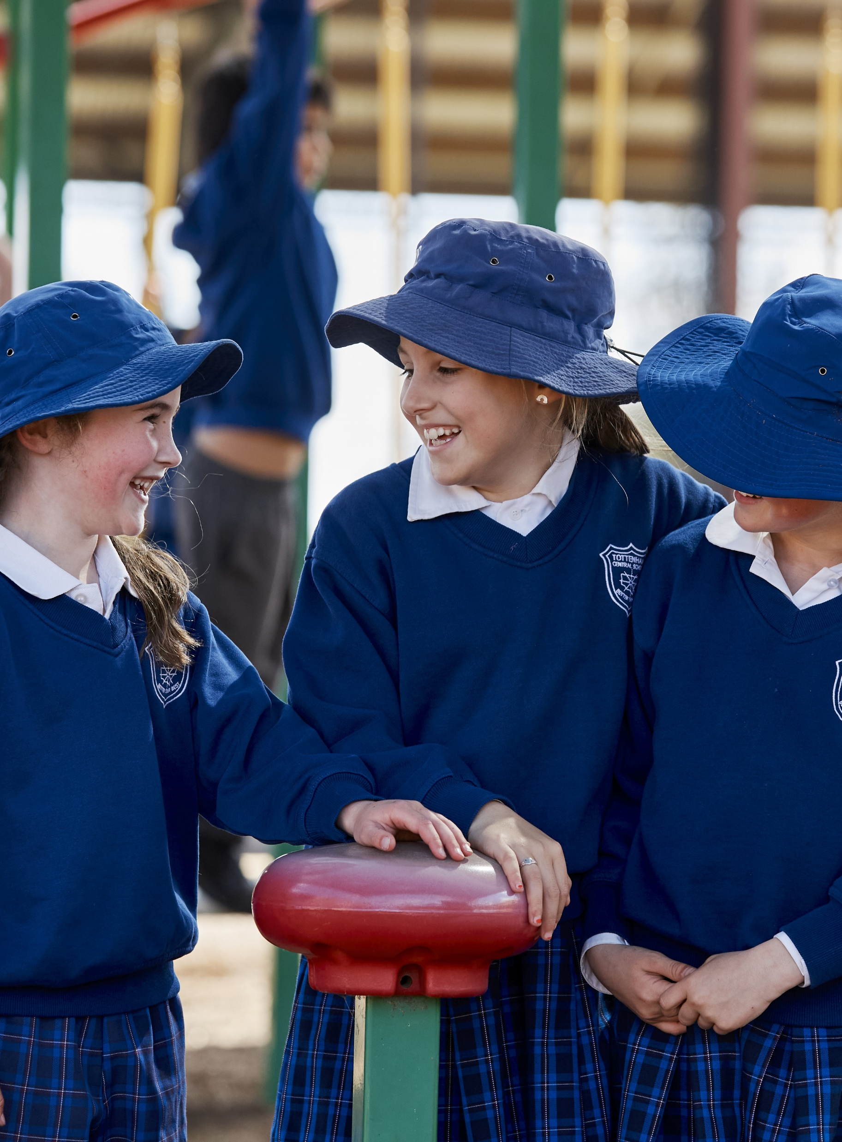
Human Society and its Environment K–6
Familiarisation resource

Slide 2
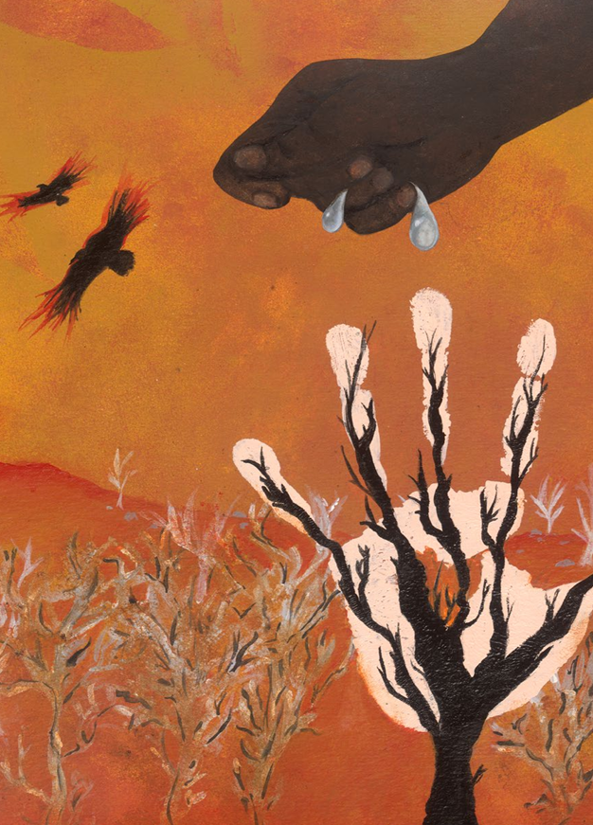
Acknowledgement of Country
We recognise the Ongoing Custodians of the lands and waterways where we work and live. We pay respect to Elders past and present as ongoing teachers of knowledge, songlines and stories. We strive to ensure every Aboriginal and Torres Strait Islander learner in NSW achieves their potential through education.
‘The Land Heals Us’ created by Sarah Whitfield from Winmalee High School as part of the 2016 Schools Reconciliation Challenge.

Slide 3
Information for use
The following slides build on the content covered in the familiarisation video. Schools may choose to engage with the activities on an individual, team or whole school basis. These activities are designed to facilitate familiarisation and engagement with the syllabus. Activities and discussions can occur in any order and cover the following areas:
Rationale
Aboriginal and Torres Strait Islander Priorities
The ancient past
Civics and citizenship
Using evidence and building skills.
Participants will need access to the Human Society and its Environment K–6 Syllabus.

Slide 4
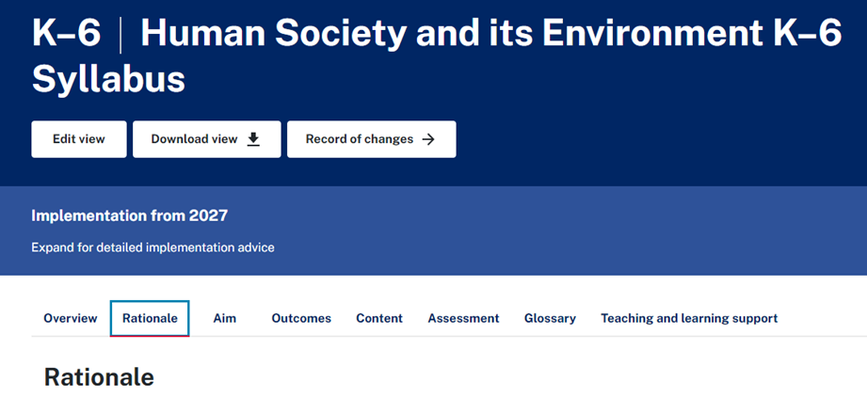
Rationale
Read the Rationale
Identify 3 understandings to discuss
Optional – combine responses to identify common elements
Notes:
The rationale forms the basis for understanding the core principles of the HSIE syllabus and guiding the development of teaching practices. Encourage staff to read the rationale to deepen their understanding of the syllabus' purpose and to reflect on how it shapes their teaching approach and supports student learning outcomes

Slide 5



Aboriginal and Torres Strait Islander Priorities
View the Aboriginal Cultures and Histories outcomes for each stage.
Explore the content, examples and teaching advice for your stage in the history and geography focus areas.
Read the Protocols for collaborating with Aboriginal and Torres Strait Islander Communities and engaging with Cultural and heritage works in the syllabus overview. What are some ways you can work in partnership with your local community?
Notes:
Here you may choose to have staff explore the outcomes for each stage, explore the content, and identify the progression of learning from Early Stage 1 to Stage 3. The syllabus also explains Protocols for collaborating with Aboriginal and Torres Strait Islander Communities and engaging with Cultural and heritage works.
Consider: content for each stage, progression of learning and protocols
Human Society and its Environment K–6 - Course overview | NSW Curriculum | NSW Education Standards Authority

Slide 6
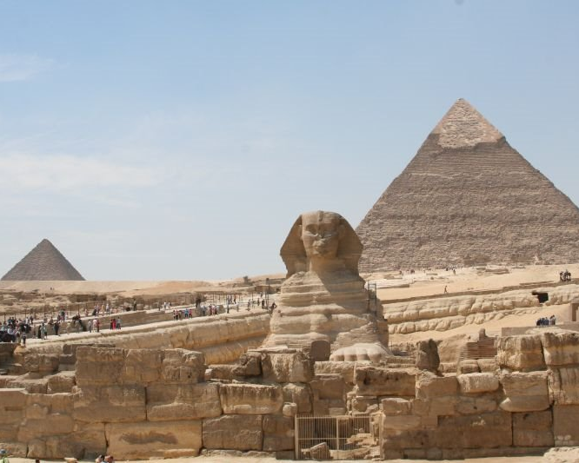
The ancient past
Explore the ancient past content and examples in Stage 1 and Stage 2
View the associated teaching advice. What else would you like to learn about?
What connections can you make between the ancient past and today e.g. Nike symbol
Notes:
As this is a new content area, it may be beneficial to allow teachers adequate time to explore the content and read the teaching advice which provides the necessary background knowledge.
Human Society and its Environment K–6 - Stage 1 - People learn about the past by engaging with stories, images, objects and sites | NSW Curriculum | NSW Education Standards Authority
Human Society and its Environment K–6 - Stage 2 - History uses sources to construct narratives of the past | NSW Curriculum | NSW Education Standards Authority

Slide 7
Civics and citizenship
Identify examples of ACTIVE citizenship in each stage of the syllabus
Explore the outcome, content and teaching advice for Stage 3 People in Australia have democratic roles and responsibilities
What support and further learning is required in order to teach this content? Where can you learn more?
Notes:
Civics and citizenship is found in every stage from Early Stage 1 to Stage 3.
Identify civics and citizenship content such as democracy, rights and responsibilities, and active citizenship. Reflect on how these concepts can help students understand their role in society and engage meaningfully as informed citizens
Stage 3 teams may like to spend some time exploring the resources found at the following sites:
Parliamentary Education Office (peo.gov.au)
AEC for schools - Australian Electoral Commission

Slide 8
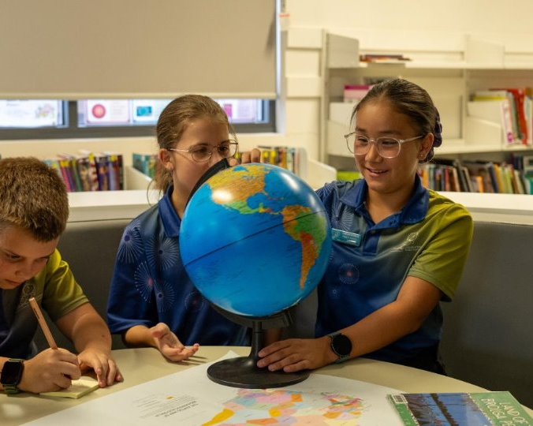
Evidence and skills
Find one example of using evidence. Find an example of using evidence that comes before and after this stage. What do you need to learn next? e.g. finding and analysing sources
Find one example of using a skill. Find an example of using a similar skill that comes before and after this stage. What do you need to learn next? e.g. Choropleth maps
Notes:
Understand skills and tools are embedded within the content so it is important that teachers focus on these AS WELL as the content. It is important teachers can see how students engage critically with sources, from historical documents to geographical data, how skills are embedded within the content and developed over time. In the geography focus area, students are asked to use geographical information and in the history focus area students use sources as evidence.

Slide 9
Where to next?
Further information and support
Complete the form to join the Primary Curriculum Statewide Staffroom to ask questions, receive advice and updates on the release of resources.
Read Human Society and its Environment K–6 Syllabus (2024) – information for school leaders
Visit the Curriculum K–12 and Planning, programming and assessing HSIE K–6 websites.
1
2
3
Notes:
So where to next?
Encourage staff to join the Primary Curriculum Statewide staffroom to access the HSIE channel.
Engage with the information for school leaders
Visit the syllabus website to engage with content, teaching advice and examples.
Please note: the Planning, programming and assessing HSIE K-6 website contains resources relevant to the History 2012 and Geography 2015 syllabuses. Resources and support package materials for the HSIE 2024 syllabus will be uploaded in due course.

Slide 10
References
This presentation contains NSW Curriculum and syllabus content. The NSW Curriculum is developed by the NSW Education Standards Authority. This content is prepared by NESA for and on behalf of the Crown in the right of the State of New South Wales. The material is protected by Crown copyright.
Please refer to the NESA Copyright Disclaimer for more information https://educationstandards.nsw.edu.au/wps/portal/nesa/mini-footer/copyright.
NESA holds the only official and up-to-date versions of the NSW Curriculum and syllabus documents. Please visit the NSW Education Standards Authority (NESA) website https://educationstandards.nsw.edu.au/wps/portal/nesa/home and the NSW Curriculum website https://curriculum.nsw.edu.au.
HSIE K–6 © Syllabus NSW Education Standards Authority (NESA) for and on behalf of the Crown in right of the State of New South Wales, 2024.
Images from canva.com and collaboro.com, accessed 20 September 2024.

Slide 11
Copyright
© State of New South Wales (Department of Education), 2024
The copyright material published in this resource is subject to the Copyright Act 1968 (Cth) and is owned by the NSW Department of Education or, where indicated, by a party other than the NSW Department of Education (third-party material).
Copyright material available in this resource and owned by the NSW Department of Education is licensed under a Creative Commons Attribution 4.0 International (CC BY 4.0) license.
This license allows you to share and adapt the material for any purpose, even commercially.
Attribution should be given to © State of New South Wales (Department of Education), 2024.
Material in this resource not available under a Creative Commons license:
the NSW Department of Education logo, other logos and trademark-protected material
material owned by a third party that has been reproduced with permission. You will need to obtain permission from the third party to reuse its material.
Links to third-party material and websites
Please note that the provided (reading/viewing material/list/links/texts) are a suggestion only and implies no endorsement, by the New South Wales Department of Education, of any author, publisher, or book title. School principals and teachers are best placed to assess the suitability of resources that would complement the curriculum and reflect the needs and interests of their students.
If you use the links provided in this document to access a third-party’s website, you acknowledge that the terms of use, including licence terms set out on the third-party’s website apply to the use which may be made of the materials on that third-party website or where permitted by the Copyright Act 1968 (Cth). The department accepts no responsibility for content on third-party websites.

