Slide 1
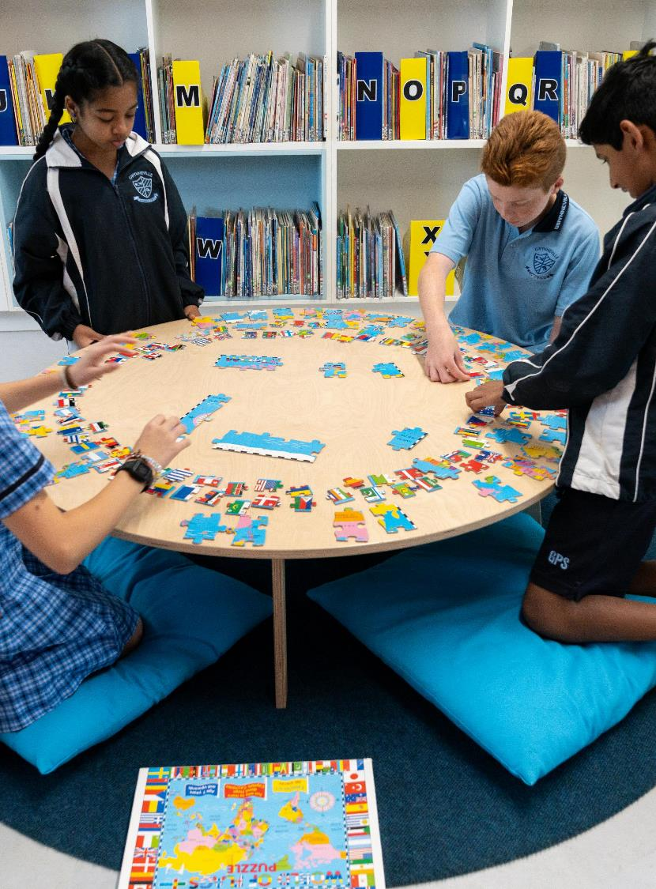
Human society and its environment
May 2025
Notes:
1. Purpose: HSIE title slide
Time: 15 sec
Presenter notes:
We are looking forward to working with you today to build knowledge and understanding of the NSW HSIE K-6 (2024) syllabus.
[NEXT SLIDE]

Slide 2

Acknowledgement of Country
We recognise the Ongoing Custodians of the lands and waterways where we work and live. We pay respect to Elders past and present as ongoing teachers of knowledge, songlines and stories. We strive to ensure every Aboriginal and Torres Strait Islander learner in NSW achieves their potential through education.
‘Kariong – Our meeting place’ created by Stella Haynes from Cammeray Public School on Eora Country as part of the 2022 Calendar for cultural diversity.
Notes:
2. Purpose: Acknowledgement of Country
Time: 30 sec
Presenter notes:
I would like to pay my respect and acknowledge the Ongoing Custodians of the lands on which we meet. I pay respect to Elders past and present and extend that respect to other Aboriginal and Torres Strait people with us here today.

Slide 3
Australian Professional Standards for Teachers
Standard descriptors
6.2 – Engage in professional learning and improve practice
6.2.2 – Participate in learning to update knowledge and practice, targeted to professional needs and school and/or system priorities.
6.3 – Engage with colleagues and improve practice
6.3.2 – Contribute to collegial discussions and apply constructive feedback from colleagues to improve professional knowledge and practice
Notes:
3. Purpose: To outline the teaching standards addressed in this professional learning.
Time: 15 sec
Presenter notes:
Here are the Australian Professional Standards for Teachers that today’s presentation will address. Please take a moment to read through them.
Pause 10 seconds
[NEXT SLIDE]

Slide 4


Learning intentions and success criteria
Learning intention
Success criteria
I will be successful if I can
We are learning to deepen our understanding of HSIE K–6 syllabus content.
identify and evaluate evidence in the HSIE K–6 Syllabus to draw evidence-based conclusions
Notes:
4. Purpose: To outline the learning intention and success criteria for the workshop
Time: 30 sec
Presenter notes:
We are learning to deepen our understanding of HSIE K-6 syllabus content.
By the end of this workshop, we will be successful if we can:
identify and evaluate geographical information and historical sources as evidence in the HSIE K-6 Syllabus to draw evidence-based conclusions
[NEXT SLIDE]

Slide 5

Rationale
…stories, images, objects and sites as evidence of the past…
Human Society and its Environment (HSIE) incorporates the study of people, places and environments, as well as how people and events from the past have shaped societies over time. Through the foundational knowledge, understanding and skills of geography and history, HSIE introduces students to the complex interconnections between people and places, past and present so they can become active, confident, engaged and valued members of Australia’s diverse community.
The HSIE syllabus acts as a mirror to reflect a student’s personal experiences and a window through which to view the world at different times and places.
By engaging with stories, images, objects and sites as evidence of the past and with geographical information presented in maps, globes and graphs students learn the essential schema by which people locate and understand themselves, the environment and others in the world and in time.
Students explore what it means to be Australian, and through civics and citizenship learn the roles and responsibilities which form the basis for Australia’s free, democratic and egalitarian society.
Students learn about Aboriginal Cultures and Histories, providing opportunities to broaden every student’s knowledge about Aboriginal Peoples by engaging with the oldest living, continuous Cultures in the world. Students develop an understanding of the sustainable practices developed and implemented by Aboriginal and Torres Strait Islander Peoples over millennia, the diversity of Aboriginal and Torres Strait Islander Peoples, the interdependence with Country and Place, and understandings of past and present.
…geographical information presented in maps, globes and graphs…
Notes:
5. Purpose: Where is evidence in the rationale?
Time: 45 sec
Presenter notes:
As you can see here, the rationale explains that the ‘...syllabus acts as a mirror to reflect a student’s personal experiences and a window through which to view the world at different times and places.
By [CLICK] engaging with stories, images, objects and sites as evidence of the past and with [CLICK] geographical information presented in maps, globes and graphs students learn the essential schema by which people locate and understand themselves, the environment and others in the world and in time...’
We’re now going to explore the use of evidence in the HSIE syllabus, including the role of geographical information and historical sources.
[NEXT SLIDE]

Slide 6

Geographical information
Notes:
6. Purpose: Introduce geography
Time: 5 sec
Presenter notes:
We’ll start by looking at geographical information.
[NEXT SLIDE]

Slide 7
Broaden geographical knowledge
Students are provided with opportunities to build and broaden their geographical knowledge, understanding and skills by using maps, images and observations to gather information about the location of places at local, national and international scales.
(NESA Stage 1 Teaching advice)
Notes:
7. Purpose: Why is geographical information as evidence important?
Time: 20 sec
Presenter notes:
The Stage 1 teaching advice articulates how "Students are provided with opportunities to build and broaden their geographical knowledge, understanding and skills by using maps, images and observations to gather information about the location of places at local, national and international scales."
[NEXT SLIDE]

Slide 8
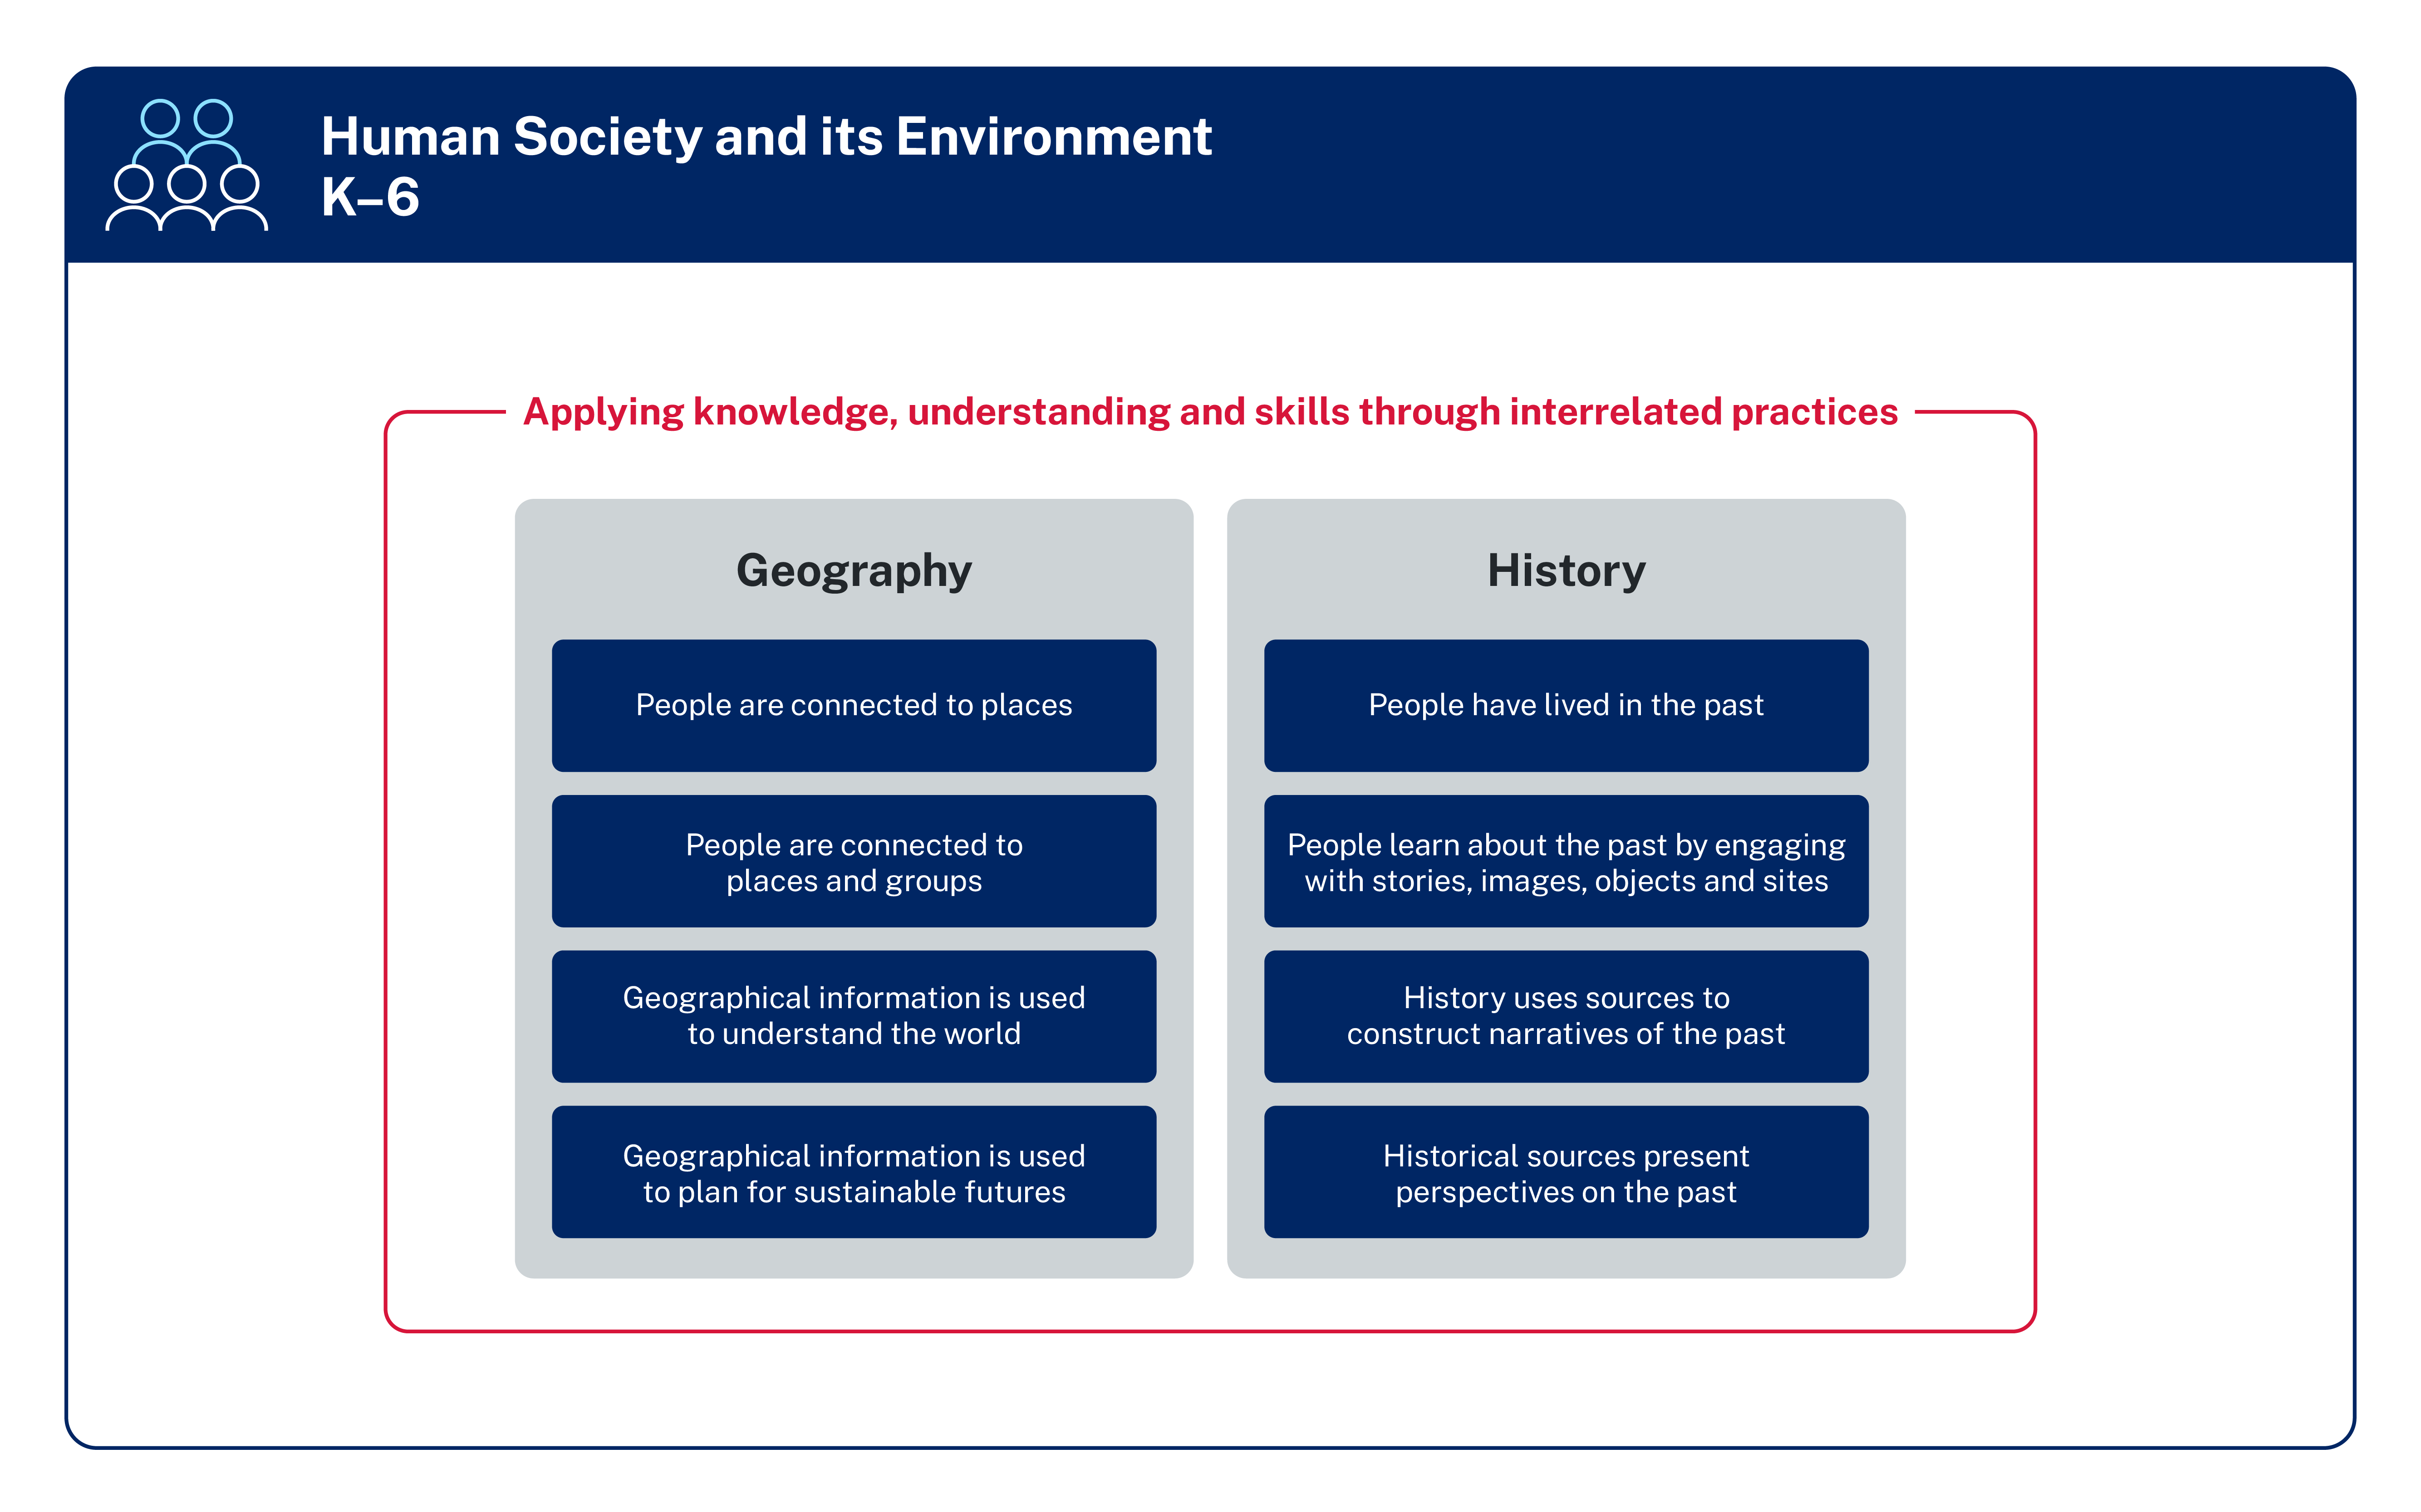
Geographical information in the syllabus
Geographical information is used to understand the world
Early Stage 1
Stage 1
Geographical information is used to plan for a sustainable future
Stage 2
Stage 3
Notes:
8. Purpose: To identify geographical information in the focus areas
Time: 10 sec
Presenter notes:
This image shows the focus area for each stage in geography.
[CLICK] We can see that geographical information is explicitly identified in stage 2 and stage 3.
[NEXT SLIDE]

Slide 9
Geographical information in outcomes
Early Stage 1
Stage 1
Stage 2
Stage 3
HSE-ACH-01
identifies ways that Aboriginal Peoples connect with Country, Culture and Community
HS1-ACH-01
describes interactions between Aboriginal Peoples and Country
HS2-ACH-01
describes Aboriginal Peoples’ obligations to Country, Culture and Community
HS3-ACH-01
describes Aboriginal Knowledges and Practices that care for Country and the importance of Aboriginal Languages revival
  HSE-GEO-01
identifies and locates places people connect with, using geographical information
HS1-GEO-01
describes ways people connect to and care for places, water environments and each other, using geographical information
HS2-GEO-01
explains how people care for Australia’s environments and participate in Australian society, using geographical information
HS3-GEO-01
examines global citizenship and how people organise, protect and sustainably use the environment, using geographical information
Notes:
9. Purpose: To identify geographical information in the outcomes
Time: 30 sec
Presenter notes:
We can also see that geographical information is included in every geography outcome.
I’ll give you a moment to read through the syllabus outcomes for each stage.
Pause 15 seconds
[NEXT SLIDE]

Slide 10
Geographical information in content groups
Early Stage 1
Places can be located and described using geographical information
Stage 1
People show
their connection to places using geographical information
Stage 2
People use geographical information to understand climates and environments
Stage 3
People organise and manage places using geographical information
Notes:
10. Purpose: To identify geographical information in the content groups
Time: 30 sec
Presenter notes:
[CLICK] Using geographical information is also referenced in content groups in each stage.
[NEXT SLIDE]

Slide 11
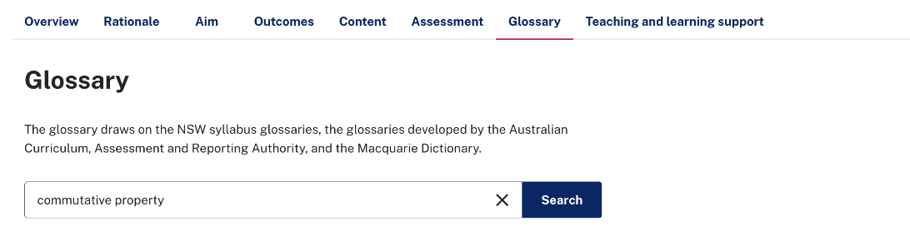

What is geographical information?
curriculum.nsw.edu.au/learning-areas/hsie/glossary
Geographical information
geographical information
quantitative or qualitative information about people, places and environments.
Notes:
11. Purpose: To define geographical information
Time: 20 sec
Presenter notes:
So, what is geographical information, and why does it matter?
According to the 2024 syllabus glossary, geographical information is quantitative or qualitative information about people, places and environments. It encompasses all the various forms of data and tools we use to understand our world
[NEXT SLIDE]

Slide 12


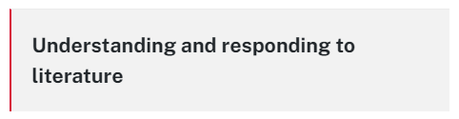
Why is using geographical information important?
curriculum.nsw.edu.au
Stage 2
Forming groups
Teaching advice for Geographical information is used to understand the world
Why is it important?
Geographical information can be presented in a range of forms including maps, data (in tables or graphs), images, charts and diagrams. Gathering, interpreting, explaining, and communicating geographical information is important as it supports students to:
connect new knowledge and understanding about the relationships between people, climates and environments to existing ideas, which helps them develop the ability to make generalisations and comprehend new information
think critically about information, preparing them for informed decision-making now and into the future.
Geographical information can be gathered by interpreting sources, conducting research or making firsthand observations. Observations can be made using a range of senses, as well as digital and non-digital tools that extend the senses.
Some students with disability may require adjustments to support access to maps, data, images, charts and diagrams. This could include using high colour contrast, ensuring text is provided to support the information conveyed using colour and tactile representations.
Copy, continue and create patterns
Copy and continue repeating patterns using sounds and/or actions
Copy, continue and create repeating patterns using shapes, objects, images or pictures (Reasons about patterns)
Investigate and form equal groups by sharing
Distribute a group of familiar objects into smaller groups and recognise whether the number in each group is equal or not
Group and share concrete materials by distributing objects one by one or using another method
Record grouping and sharing
Label the number of objects in a group
Record grouping and sharing using drawings, words and numerals, and explain their thinking (Reasons about relations)
Notes:
12. Purpose: Illustrate geographical information importance in the teaching advice
Time: 1 min 10 sec
Presenter notes:
As explained in the Stage 2 Teaching Advice, using geographical information develops students’ geographical understanding, by enabling them to:
make connections between people, places, and environments and their existing knowledge and understanding and,
examine and interpret different types of information to identify patterns, and think critically.
It is through learning to use geographical information that we teach students how to make evidence-based decisions and to propose solutions to real-world problems.
I will pause and let you read the on-screen content.
Pause 30 seconds
[NEXT SLIDE]

Slide 13



Examples of geographical information
Maps
Geographical information includes
Data
Fieldwork and observations
Notes:
13. Purpose: Identify examples of geographical information.
Time: 30 sec
Presenter notes:
Geographical information includes
Maps, as visual representations that show features such as roads, rivers, land use, and boundaries
[CLICK] Data, which is information related to geographical elements, such as population statistics, climate data, and economic indicators, and
[CLICK] Fieldwork and Observations, which are firsthand accounts or recorded observations of places, environments, and human interactions with those spaces.
[NEXT SLIDE]

Slide 14

Identifying geographical information in content points
curriculum.nsw.edu.au
People are connected to places
HSE-ACH-01
identifies ways that Aboriginal Peoples connect with Country, Culture and Community
HSE-GEO-01
identifies and locates places people connect with, using geographical information
Aboriginal Peoples are the Traditional Custodians of Country
  Identify the Traditional Custodians and Aboriginal Country where the school is located using images
  Describe natural features of land, water and sky Country by engaging with Aboriginal Dreaming
  Stories and Languages
Forming groups
Copy, continue and create patterns
Copy and continue repeating patterns using sounds and/or actions
Copy, continue and create repeating patterns using shapes, objects, images or pictures (Reasons about patterns)
Investigate and form equal groups by sharing
Distribute a group of familiar objects into smaller groups and recognise whether the number in each group is equal or not
Group and share concrete materials by distributing objects one by one or using another method
Record grouping and sharing
Label the number of objects in a group
Record grouping and sharing using drawings, words and numerals, and explain their thinking (Reasons about relations)
Notes:
14. Purpose: To demonstrate geographical information in ES1 content.
Time: 20 sec
Presenter notes:
By exploring the content points in each Stage, the integral nature of using geographical information to understand the content is evident.
[CLICK] This Early Stage 1 example highlights students' use of images as well as Aboriginal Dreaming Stories and Languages as sources of geographical information.
[NEXT SLIDE]

Slide 15




Activity – identifying geographical information
Your turn
  Locate the geography outcomes and content in the digital syllabus for one stage.
  Identify all sources of geographical information identified in content points students are expected to use. Record each source listed in your workbook.
  Discuss with a partner what you noticed.
Human Society and its Environment K–6 Syllabus
Notes:
15. Purpose: To provide instruction and time for participants to identify geographical information in content.
Time: 5 mins (30 sec min intro + 4 min and 30 sec activity)
Presenter notes:
Now it's your turn to investigate the geographical information for another Stage.
Open your HSIE K-6 digital syllabus and go to the content tab. A link for this is in your workbook.
Using the geography content look carefully at each content point and record each source of geographical information you find in your workbook.
Once you have filled out the table in your workbook, you may like to discuss this with the person next to you. Was there anything new or interesting?
You will have 4 minutes to complete this task. [CLICK TIMER]
[NEXT SLIDE]

Slide 16
Geographical information summary
Early Stage 1
Dreaming stories and languages
data displays
globes
images
world maps
Stage 1
data in lists, tables or picture graphs
globes
images
language maps
physical maps
political maps
Stage 2
choropleth map
column graph
compass directions
grid map
relief map
satellite images
Stage 3
choropleth map
climate graphs
freight maps
oblique aerial image
road maps
satellite images
vertical aerial image
Notes:
16. Purpose: To summarise geographical information.
Time: 2 mins (30 sec + 1 mins activity + 30 sec regroup)
Presenter notes:
Thank you for engaging in that task. On the screen you can see a summary of all the geographical information included in the syllabus, grouped by stage. I'll give you some time now to check how you did and you may like to fill in the other columns in your workbook.
Pause 1 minute
Some of this terminology may be new. In our next activity we will be looking at examples of some of these maps and images.
[NEXT SLIDE]

Slide 17


Activity – using maps and images as geographical information
Types of maps used
Your turn
  Open your digital workbook
  Match the title to the description to the image in the first column by copying and pasting the descriptions into the tables.
Notes:
17. Purpose: To provide instruction and time for participants to look at maps and images as sources of evidence and complete activity
Time: 10 mins (1 min intro + 9 mins activity)
Presenter notes:
In your digital workbook, find the next activity, ‘Using maps and images as geographical information’. On the first page you will find the names and descriptions which you need to match to the maps and images on the following pages.
Copy and paste the name and descriptions into the tables below.
Don’t worry if you are not 100% sure, this is just a chance to identify which maps and images you are already familiar with, and which you might want to learn more about. Following the activity, we will step you through the name and description of each image and map, as well as the stage it is introduced.
You will have 9 minutes to complete this.
[After 4 minutes – prompt that there is 5 minutes left.]
[At the end of the 9 minutes]
Thank you for engaging in that activity.
[NEXT SLIDE]

Slide 18

Maps in Early Stage 1
World maps
Globes
Notes:
18. Purpose: To provide answers and explanation for the activity completed.
Time: 2 mins
Presenter notes:
Let’s check how you went with matching the names and descriptions. We’ll look at each stage, and you may like to make any adjustments needed in your workbook.
From Early Stage One, students use world maps and globes as sources of geographical information.
[NEXT SLIDE]

Slide 19
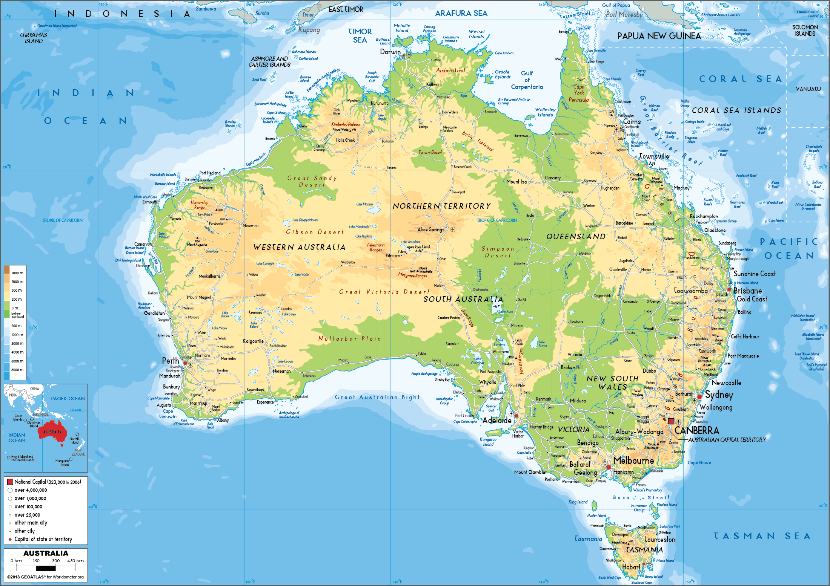
Maps introduced in Stage 1 (1)
Physical maps
Shows natural featured
e.g. oceans and deserts
Image sourced from canva.com (2025)
Notes:
19. Purpose: To provide answers and explanation for the activity completed.
Time: 2 mins
Presenter notes:
In Stage 1 students explore physical maps that show natural features
[NEXT SLIDE]

Slide 20
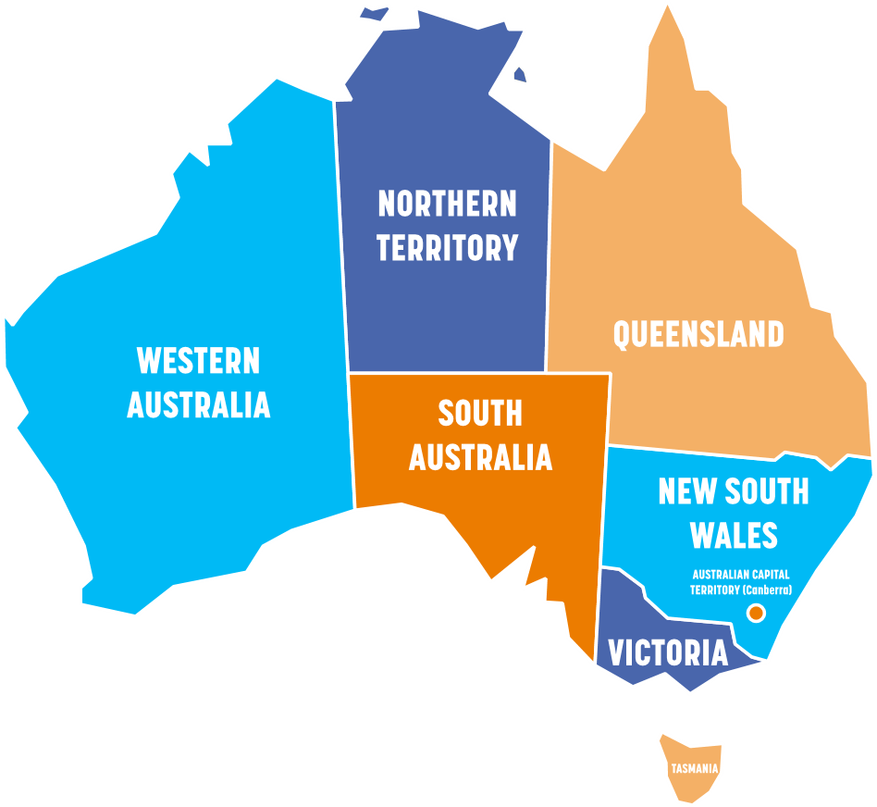
Maps introduced in Stage 1 (2)
Political maps
Shows human features
e.g. state borders
Image sourced from canva.com (2025)
Notes:
20. Purpose: To provide answers and explanation for the activity completed.
Time: 2 mins
Presenter notes:
and political maps with human features such as state borders.
[NEXT SLIDE]

Slide 21
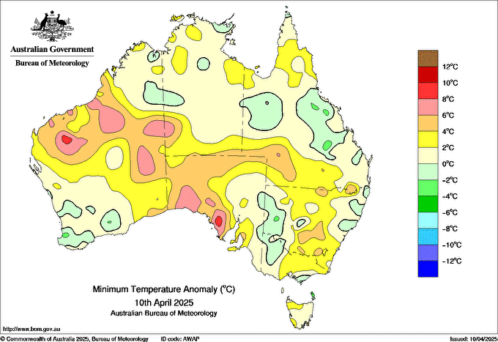
Maps and images introduced in Stage 2 (1)
Choropleth maps
Thematic map, shaded to show quantitative information across regions e.g. temperature across a country, rainfall or vegetation
Commonwealth of Australia, Bureau of Meteorology (2025)
Notes:
21. Purpose: To provide answers and explanation for the activity completed.
Time: 2 mins
Presenter notes:
Choropleth maps are introduced in Stage 2 which are maps of a thematic nature, shaded to show information such as temperature or rainfall.
[NEXT SLIDE]

Slide 22
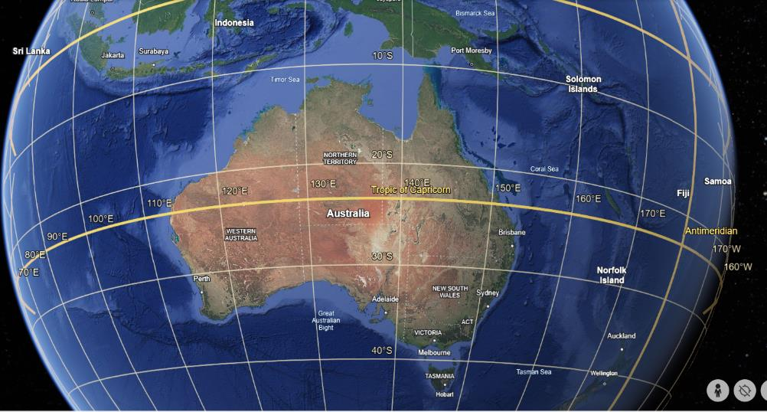
Maps and images introduced in Stage 2 (2)
Grid maps
Divided by vertical and horizontal lines
e.g. latitude and longitude
Map data by Google Earth (2021)
Notes:
22. Purpose: To provide answers and explanation for the activity completed.
Time: 2 mins
Presenter notes:
Grid maps are those divided up by a grid, including those which show latitude and longitude, and
[NEXT SLIDE]

Slide 23
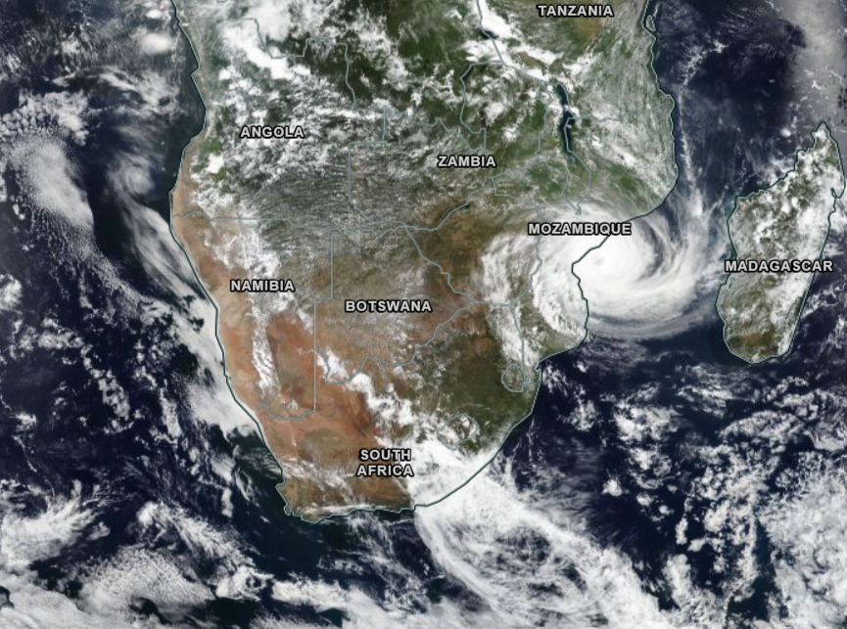
Maps and images introduced in Stage 2 (3)
Satellite images
Images of Earth collected by satellites
Worldview (2025)
Notes:
23. Purpose: To provide answers and explanation for the activity completed.
Time: 2 mins
Presenter notes:
satellite images are images of Earth collected by satellites.
[NEXT SLIDE]

Slide 24
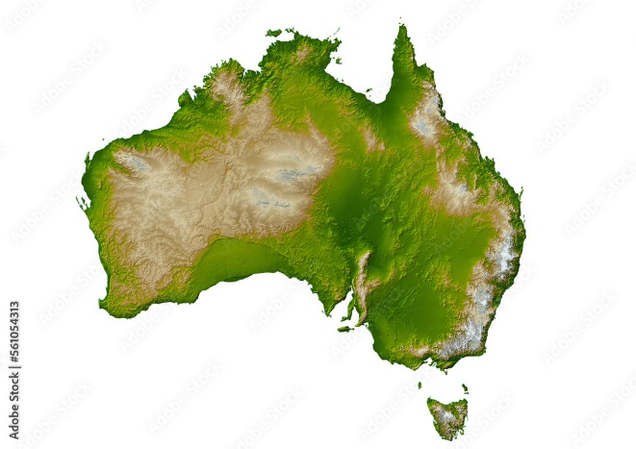
Maps and images introduced in Stage 2 (4)
Relief maps
Shows variation in the height of land, using colour, shading or pattern
M&M Baciu / Adobe Stock (2025)
Notes:
24. Purpose: To provide answers and explanation for the activity completed.
Time: 2 mins
Presenter notes:
Relief maps are our final map type, first introduced in stage 2.
[NEXT SLIDE]

Slide 25
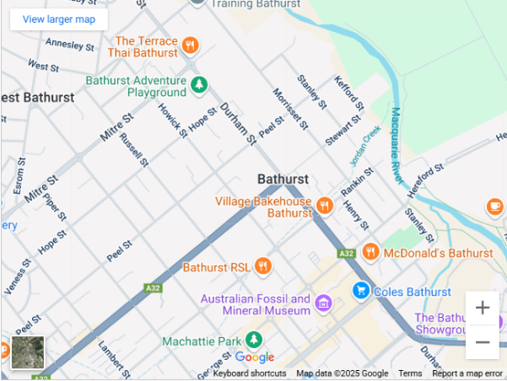
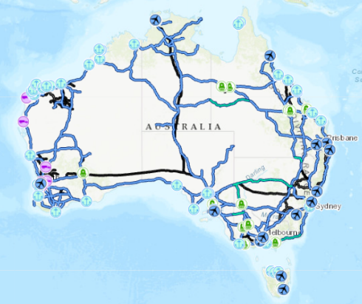
Maps and images introduced in Stage 3 (1)
Road maps
Shows the roads in an area
e.g. a street map
Map data by Google (2025)
Freight maps
Shows key freight routes, typically main roads and rail
Commonwealth of Australia (2021)
Notes:
25. Purpose: To provide answers and explanation for the activity completed.
Time: 2 mins
Presenter notes:
Moving into Stage 3, road maps and freight maps are introduced.
[NEXT SLIDE]

Slide 26

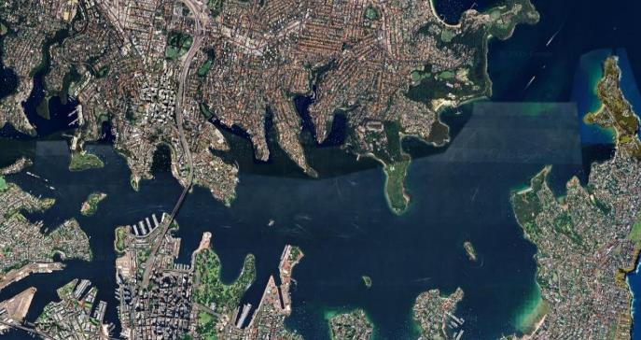
Maps and images introduced in Stage 3 (2)
Oblique aerial images
An aerial image taken at an angle, providing a more 3D perspective
Steve Munro / Adobe Stock (2025)
Vertical aerial images
An aerial image taken from directly above with equal scale
Map data by Google (2009)
Notes:
26. Purpose: To provide answers and explanation for the activity completed.
Time: 2 mins
Presenter notes:
We also have two types of images: Oblique, which are those taken on an angle to give a 3D perspective, and vertical images which are taken directly from above. These are familiar on google maps.
How did you go with that task? If you would like to make any changes, I will give you a moment now before we move into our next part.
[NEXT SLIDE]

Slide 27

Reflection
Notes:
27. Purpose: To provide time for reflection on geographical information.
Time: 2 mins
Presenter notes:
I’ll just give you a moment to reflect on how geographical information is included in the HSIE syllabus. You may like to record in the notes section of your workbook some of the possible implications for you and your staff in terms of resourcing, knowledge and skills that you might need to look further into given the information we explored today.
For example:
What resources do you currently have in your school?
Will staff require professional learning to be able to effectively teach the different types of maps and images?
Will you need to look at purchasing maps or globes to support syllabus implementation?
[NEXT SLIDE]

Slide 28

Historical sources
Notes:
28. Purpose: Transition into historical sources.
Time: 10 sec
Presenter notes:
Now let’s explore how historical sources are used as evidence.
[NEXT SLIDE]

Slide 29
Historical sources provide context
Through the study of history, students learn about when and where events happened and how these events shape cultural stories. Historical sources provide context for understanding past events, cultures, and generations.
(Carroll, 2020)
Notes:
29. Purpose: Why is using historical sources important?
Time: 15 sec
Presenter notes:
Through the study of history, students learn about when and where events happened and how these events shape cultural stories. Historical sources provide context for understanding past events, cultures, and generations.
[NEXT SLIDE]

Slide 30
Historical sources in focus areas
People learn about the past by engaging with stories, images, objects and sites
Early Stage 1
History uses sources to construct narratives of the past
Stage 1
Stage 2
Stage 3
Historical sources present perspectives on the past
Notes:
30. Purpose: To highlight historical sources in focus areas.
Time: 30 sec
Presenter notes:
This image shows the 4 focus areas for history, one for each stage.
[CLICK] We can see that using historical sources is called out in the stage 1, 2 and stage 3 focus areas.
By engaging with stories, images, objects and sites as evidence of the past, students learn the essential schema by which people locate and understand themselves, the environment and others in the world and in time.
[NEXT SLIDE]

Slide 31
Historical sources in outcomes
Early Stage 1
Stage 1
Stage 2
Stage 3
HSE-ACH-01
identifies ways that Aboriginal Peoples connect with Country, Culture and Community
HS1-ACH-01
describes interactions between Aboriginal Peoples and Country
HS2-ACH-01
describes Aboriginal Peoples’ obligations to Country, Culture and Community
HS3-ACH-01
describes Aboriginal Knowledges and Practices that care for Country and the importance of Aboriginal Languages revival
  HSE-HIS-01
identifies information about daily life and transport in the past, using stories, images and objects
HS1-HIS-01
describes the ancient past and changes in communication over time, using stories, images, objects and sites as evidence
HS2-HIS-01
Explains how people lived in the past, how navigation connected the world, and what life was like in the Sydney Cove penal settlement, using sources as evidence
HS3-HIS-01
examines and describes the development of Australian colonies and Australia as a nation, using sources as evidence
Notes:
31. Purpose: To highlight historical sources in outcomes.
Time: 10 sec
Presenter notes:
We can also see that the skill of using sources as evidence is explicitly called out in every history outcome from Early Stage 1 through to Stage 3.
We will give you a moment to read the outcomes on screen.
‘Pause 15 seconds]
[NEXT SLIDE]

Slide 32
Historical sources in content groups
Early Stage 1
People use stories, images and objects to show changes over time
Stage 1
People use stories, images, objects and sites to understand the ancient past
Stage 2
Sources provide evidence of how people lived in the past –Mesoamerica and the Andes
Sources provide evidence of how people lived in the first penal settlement at Sydney Cove
Stage 3
Sources show perspectives on how people established colonies in Australia
Notes:
32. Purpose: To highlight historical sources in content groups.
Time: 10 sec
Presenter notes:
[CLICK] Using historical sources is also embedded within each content group in every focus area. So, what are historical sources of information, and why do they matter?
[NEXT SLIDE]

Slide 33
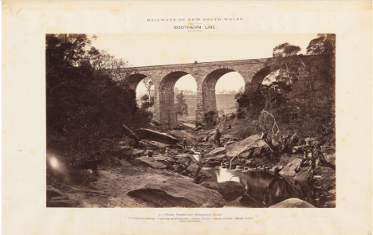
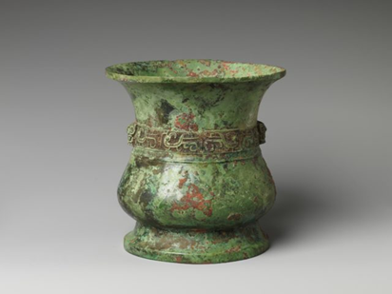
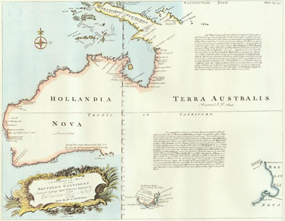
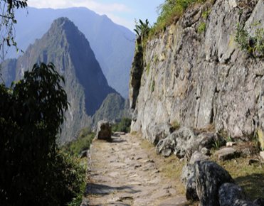
What are historical sources?
Figure 1
Figure 2
Sources are any written or non-written materials that can be used to investigate the past.
(K–6 HSIE glossary)
Figure 3
Figure 4
Figure 1 – Image credit – From the album ‘Photographic Views: The Railways of New South Wales (1875’), rediscovered and digitised by the State Library of NSW on behalf of Transport for NSW.
Figure 2 – Ancient Chinese bronze cup (Western Zhou dynasty (1046–771 BC), Metropolitan Museum of Art
Figure 3 – A complete map of the Southern Continent surveyed by Captain Abel Tasman, National Library of Australia
Figure 4 – This Photo by Unknown Author is licensed under CC BY-NC: https://global-geography.org/af/Geography/America/Peru/Pictures/Machu_Picchu/Intipunku_-_Inca_Trail_3
Notes:
33. Purpose: Explain what historical sources are.
Time: 20 sec
Presenter notes:
The HSIE syllabus glossary outlines that sources are any written or non-written materials that can be used to investigate the past.
It is important to note that in the HSIE K-6 syllabus, there is no reference to primary or secondary sources.
[NEXT SLIDE]

Slide 34
Using historical sources
curriculum.nsw.edu.au
Stage 2
History uses sources to construct narratives of the past
HS2-ACH-01
HS2-HIS-01
Forming groups
Sources provide evidence of how people lived in the past: Mesoamerica and the Andes
Locate places identified as ancient Maya, Aztec and Inca civilisations using maps, globes and images
Identify and describe objects, designs, sites and structures
from Mesoamerica and the Andes that endure today
Examine cultural works and inventions in art, astronomical observations, mathematics or writing of ancient Maya, Aztec
and Inca civilisations, using sources as evidence
Identify indigenous agricultural practices, animals, plants,
staple foods and trading systems
Sources provide evidence of how people lived in the past: Mesoamerica and the Andes
Locate places identified as ancient Maya, Aztec and Inca civilisations using maps, globes and images
Identify and describe objects, designs, sites and structures
from Mesoamerica and the Andes that endure today
Examine cultural works and inventions in art, astronomical observations, mathematics or writing of ancient Maya, Aztec
and Inca civilisations, using sources as evidence
Identify indigenous agricultural practices, animals, plants,
staple foods and trading systems
Copy, continue and create patterns
Copy and continue repeating patterns using sounds and/or actions
Copy, continue and create repeating patterns using shapes, objects, images or pictures (Reasons about patterns)
Investigate and form equal groups by sharing
Distribute a group of familiar objects into smaller groups and recognise whether the number in each group is equal or not
Group and share concrete materials by distributing objects one by one or using another method
Record grouping and sharing
Label the number of objects in a group
Record grouping and sharing using drawings, words and numerals, and explain their thinking (Reasons about relations)
Notes:
34. Purpose: To highlight the sources of evidence embedded within content points.
Time: 30 sec
Presenter notes:
By exploring the content points in each Stage, the integral nature of using historical sources to understand the content of the HSIE syllabus is evident.
[CLICK]
This Stage 2 example highlights students' use of maps, globes, images, objects, designs, sites and structures as well as cultural works and inventions as sources of evidence to construct narratives of the past.
[NEXT SLIDE]

Slide 35
Using sources across K–6
 |  |  | Documents
 |  |  | Emblems
 |  |  | Symbols
 |  | Cultural works | Cultural works
 |  | Personal accounts | Personal accounts
 | Globes | Globes | Globes
 | Maps | Maps | Maps
 | Sites | Sites | Sites
Objects | Objects | Objects | Objects
Images | Images | Images | Images
Stories | Stories | Stories | Stories
 |  | Sources as evidence | Sources as evidence
Early Stage 1 | Stage 1 | Stage 2 | Stage 3
Notes:
35. Purpose: To highlight the progression of historical sources K-6.
Time: 1 min
Presenter notes:
Here we can see how students' use of sources as evidence builds through each stage of learning.
I will give you a moment to review the sources and observe how they build progressively from Early Stage 1 to Stage 3. You may also note that some of the sources from geography, such as maps and globes, are also used in history.
Pause 30 seconds
[NEXT SLIDE]

Slide 36



Historical evidence (1)
Supporting students to select, record and organise key historical information
acquiring
provide access to appropriate sources
engage students in discussions to draw conclusions about how, where and why sites and artefacts were created
provide opportunities to pose and answer questions
processing
communicating
provide information scaffolds focusing on key questions and topics
Notes:
36. Purpose: To outline how the additional teaching advice suggests students are supported to select, record and organise key information.
Time: 1 min
Presenter notes:
Having explored the content, let’s now shift focus to using historical sources to support students' historical understanding. The additional teaching advice outlines how teachers can support students to select, record and organise key historical information by:
[CLICK]
Providing access to appropriate sources for students to acquire information
Engaging students in discussions and encouraging them to pose and answer questions about the sources to process information and draw conclusions
Supporting students to communicate their understanding with the use of scaffolds and prompts
As teachers, we need to explicitly teach students how to acquire and process evidence and communicate their understanding of what the evidence tells them. This provides a strong foundation for students and is built upon in the 7-10 History syllabus.
[NEXT SLIDE]
Additional information for presenters:
The text in the blue boxes has been sourced from NESA Teaching advice (additional): Stage 2 History

Slide 37
Historical evidence (2)
Supporting students to select, record and organise key historical information
acquiring
Engage in wide reading and select images and objects from different time periods
Explore sources about the same historical event and compare past and present objects, images, stories and sites
Review a range of evidence to determine the reliability of sources.
Notes:
37. Purpose: To outline how students can be supported to acquire information from historical sources.
Time: 35 sec
Presenter notes:
To support students to acquire information from sources, the 4 additional teaching advice documents suggest:
[CLICK] Engaging with a wide variety of sources and selecting images and objects from different time periods
[CLICK] Providing students with opportunities to explore and compare different sources that provide information about the same historical event as well as comparing past and present objects, images, stories and sites
[CLICK] Supporting students to review a range of evidence to determine the reliability of sources
[NEXT SLIDE]

Slide 38
Historical evidence (3)
Supporting students to select, record and organise key historical information
processing
Explore sources – encourage students to engage with each source and describe what they see
Pose questions – teach students to pose questions based on their sources to encourage them to think critically about the context and purpose of the sources
Answer questions – provide students with sources and a range of questions to answer. For example, how does this source relate to what we have learned about this time period/civilisation?
Notes:
38. Purpose: To outline how students can be supported to process information from historical sources
Time: 30 sec
Presenter notes:
We can support students to process the information that sources provide by:
[CLICK] Allowing students with time to explore the selected sources and describe what they see, notice and wonder
[CLICK] Teaching students to pose questions and think critically about the context and purpose of the source
[CLICK] Having students answer questions related to their prior knowledge and allow them to make connections and draw conclusions about the significance of historical sources.
[NEXT SLIDE]

Slide 39
Historical evidence (4)
Supporting students to select, record and organise key historical information
communicating
Use scaffolds to organise information – for example, using a 'what, when, where, who, how and why' scaffold can help students focus on and record important information
Provide prompts – to assist students in structuring oral narratives for example; 'I think... because I can see...' Or 'This sources tells us about... '
Use graphic organisers such as Venn diagrams, charts, timelines and tables as a scaffold for organising and comparing ideas
Creating written texts – students in Stage 2 use the information from sources to create compound and complex sentences describing life in the past
Notes:
39. Purpose: To outline how students can be supported to communicate their understanding.
Time: 35 sec
Presenter notes:
The additional teaching advice also outlines some of the ways in which we can support students to communicate their thinking. It is suggested that:
[CLICK] Students are provided with scaffolds to help organise information
[CLICK] Verbal or written prompts are provided to assist students in structuring oral or written narratives
[CLICK] A range of graphic organisers such as Venn diagrams, charts, timelines and tables are used to organise and compare ideas
[CLICK] Students use historical sources of evidence to create written texts
[NEXT SLIDE]

Slide 40
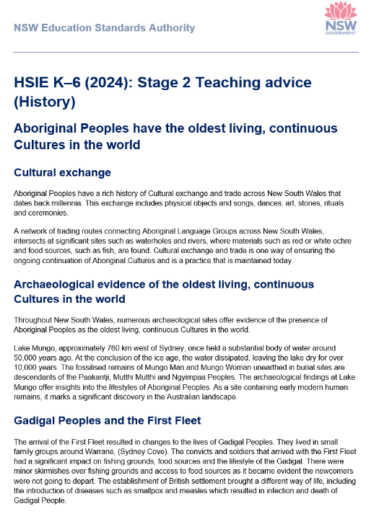

Teaching Advice (Additional)
Developing students' historical understanding
HSE-HIS-01 People use stories, images and objects to show changes over time
Compare features of daily life that have changed over time using stories, images and objects
Describe how transport has changed over time, using stories, images and objects
Acquire
limiting the number of images or objects
selecting from distinctly different time periods
inviting guest speakers
Process
compare objects
engage students in discussion
encourage careful observation
ask and answer questions
Communicate
draw conclusions
use prompts
  ‘Look closely at the image/object. Describe what you see.’
  ‘What are the similarities between these images/objects? What are the differences?’
  ‘What does this image/object tell us about life now or in the past?’
  ‘What could it have been used for? Why do you think that?’
Describing change over time
Support students to focus on identifying and describing change by limiting the number of images or objects being compared and selecting from distinctly different time periods where the changes can be more easily identified and described.
Inviting guest speakers to talk about their personal experiences of the past can support student engagement and highlight the significant changes that have occurred in the recent past. For example, changes to entertainment and transport.
Engage students in discussion, supporting them to ask and answer questions and draw conclusions by encouraging careful observation and active listening with regard to classmates and guest speakers, with prompts such as:
‘Look closely at the image/object. Describe what you see.’
‘What are the similarities between these images/objects? What are the differences?’
‘What does this image/object tell us about life now or in the past?’
‘What could it have been used for? Why do you think that?’
Teaching advice (additional) History
Notes:
40. Purpose: To highlight the additional teaching advice in regard to using evidence
Time: 1 min 45 sec
Presenter notes:
The additional teaching advice, available as downloadable word documents for each stage, provide examples and information regarding using historical sources in your classroom.
Take this Early Stage 1 extract for example.
The additional teaching advice provides explicit information and examples that can support teachers to acquire objects, images and stories, suggestions on how to support students to process the information these sources provide, as well as ideas on how students could communicate their understanding.
I will give you a moment to read this.
Click on the teaching advice (additional) history link to the Teaching and learning support tab in the syllabus. Show participants where the additional teaching advice documents for history can be located and downloaded.
[NEXT SLIDE]

Slide 41

Activity – using the additional teaching advice in history
Your turn
In your workbook, choose the content points and stage most appropriate
to you.
Refer to the teaching advice (additional) documents for evidence and
ideas to support these content points.
Reflect on how this helps students work with historical sources to
acquire, process, and communicate information.
Human Society and its Environment K–6 Syllabus
Notes:
41. Purpose: To provide instruction and time for participants to explore the additional teaching advice
Time: 20 mins (1 min intro + 19 mins activity)
Presenter notes:
We have just seen how the Additional Teaching Advice for Early Stage 1 provides information to support the teaching of essential content in history.
In this task you will be using the additional teaching advice for a Stage most appropriate to your teaching. We ask that you download the additional teaching advice document for your selected Stage from the teaching and learning tab in the syllabus.
Look at the content points in your workbook for your chosen stage and read the additional teaching advice thinking about how sources of evidence support students.
Reflect on how the teaching advice suggests students acquire, process and communicate information using historical sources. There is a space in your workbook and an additional notes
section if you would like to add anything else. You will have about 20 minutes to complete this activity. We will then come together and share our findings.
After 15 minutes let participants know, they have 5 minutes remaining or clearly call out end time.
Thank you I hope you have found that useful in supporting your understanding of how the additional teaching advice can support the teaching of History outcomes and content.
[NEXT SLIDE]
NOTE: wrap up activity 5 minutes before next session is due to start

Slide 42


Activity reflection
Share back
  What suggestions for acquiring, processing and communicating did you identify in the additional
  teaching advice for your stage?
Notes:
42. Purpose: To share reflections.
Time: 4 mins sharing time
Presenter notes:
Would anyone like to share back to the group?
Allow 4 minutes maximum for discussion.
[NEXT SLIDE]

Slide 43

Key takeaways (3)
Consider
How can you use the teaching advice and additional teaching advice to deepen your understanding of the knowledge, understanding and skills embedded in the HSIE syllabus?​
How might you use geographical information and historical sources to support students to draw evidenced based conclusions?
Notes:
43. Purpose: To reflect on the key takeaways of the HSIE presentation.
Time: 1 min
Presenter notes:
We would like you to take a moment to pause and reflect on HSIE.​
​
Think about your current context and your curriculum implementation journey so far. Consider where you are right now in terms of your planning for the engage phase.​
In your planning session, we would like you to think about:​
​
What's next?​
How can you use the teaching advice and additional teaching advice to deepen your understanding of the knowledge, understanding and skills embedded in the HSIE syllabus?​
How might you use geographical information and historical sources to support students to draw evidenced based conclusions?
[NEXT SLIDE]

Slide 44
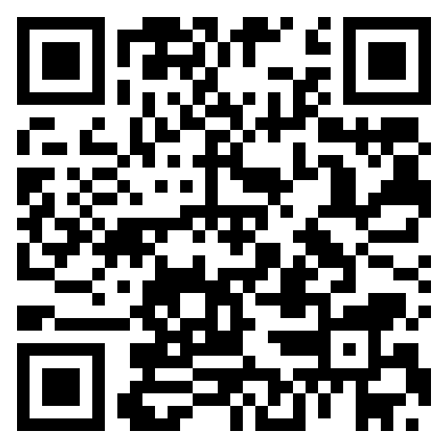
Contact us
Primary Curriculum Statewide Staffroom
primarycurriculum@det.nsw.edu.au
Notes:
44. Purpose: Contact details for the Primary Curriculum team
Time: 30 sec
Presenter notes:
If you have any questions or would like to reach out to the Primary Curriculum team, please contact us via this email address, or through the Statewide Staffroom.
This QR code takes you to the enrolment page to join the statewide staffroom.
[NEXT SLIDE]

Slide 45
Copyright
© State of New South Wales (Department of Education), 2025
The copyright material published in this resource is subject to the Copyright Act 1968 (Cth) and is owned by the NSW Department of Education or, where indicated, by a party other than the NSW Department of Education (third-party material).
Copyright material available in this resource and owned by the NSW Department of Education is licensed under a Creative Commons Attribution 4.0 International (CC BY 4.0) license.
This licence allows you to share and adapt the material for any purpose, even commercially.
Attribution should be given to © State of New South Wales (Department of Education), 2025.
Material in this resource not available under a Creative Commons licence:
the NSW Department of Education logo, other logos and trademark-protected material
Material owned by a third party that has been reproduced with permission. You will need to obtain permission from the third party to reuse its material.
Links to third-party material and websites
Please note that the provided (reading/viewing material/list/links/texts) are a suggestion only and implies no endorsement, by the New South Wales Department of Education, of any author, publisher, or book title. School principals and teachers are best placed to assess the suitability of resources that would complement the curriculum and reflect the needs and interests of their students.
If you use the links provided in this document to access a third party’s website, you acknowledge that the terms of use, including licence terms set out on the third-party’s website apply to the use which may be made of the materials on that third-party website or where permitted by the Copyright Act 1968 (Cth). The department accepts no responsibility for content on third-party websites.

