Slide 1

Lesson 5 – population profiles
Stage 4 geography
Liveability of places
[TEACHER NAME]
[DATE]
Notes:
Suggested teacher think-aloud
Today we are learning to read and interpret population profiles (population pyramids).
These graphs help us understand the age and gender structure of a population, and what that means for the future.

Slide 2
Learning intentions and success criteria
We are learning to
read population profiles
We can
interpret a population profile to draw conclusions about demographics.
Notes:
Suggested teacher think-aloud
Our learning intention is to read a population profile.
By the end of the lesson, you should be able to interpret a profile and make conclusions about demographics.
Prompt students to think: Why might governments and planners use this information?
Prompt question: Why might governments and planners use information from population profiles?
Suggested response: To plan for schools, hospitals, aged care, jobs, or infrastructure, depending on the age structure.
Additional notes for teachers:
Learning intentions and success are best co-constructed with students. Adapt the learning intention as required and add matching success criteria.
For more information See ⁠AITSL or the NSW Department of Education explicit teaching strategies, ⁠Sharing learning intentions and ⁠Sharing success criteria
LISC is not necessarily presented at the beginning of the lesson. Teacher needs to consider most effectual time to introduce
LISC should be revisited during the lesson to support students' evaluation of their learning

Slide 3
National Numeracy Progressions (1)
Interpreting and representing data (IRD)
IRD4
explains how data displays can be misleading (for example, whether a scale should start at zero; not using uniform intervals on the axes)
interprets data displayed using a multi-unit scale, reading values between the marked units.
IRD5
uses numerical and graphical representations relevant to the purpose of the collection of the data and explains their reasoning (for example, ‘I can’t use a frequency histogram for categorical data because there is no numerical connection between the categories’; converts their data to percentages in order to compare the girls results to that of the boys, as the total number of boys and girls who participated in the survey was different)
calculates simple descriptive statistics such as mode, mean or median as measures to represent typical values of a distribution.
Notes:
Notes for teachers:
This slide is for teacher reference only. When presenting to students, teachers may choose to hide the slide.
If slide is shown:
Suggested teacher think-aloud
These are the numeracy skills that link to population profiles.
Prompt students to think about how maths supports Geography – percentages, scales, descriptive statistics.
Reinforce that population pyramids combine geographical and mathematical thinking.

Slide 4
National Numeracy Progressions (2)
Interpreting and representing data (IRD)
IRD6
uses features of graphical representations to make predictions
summarises data using fractions, percentages and decimals (for example, 23 of a class live in the same suburb)
explains that continuous variables depicting growth or change often vary over time (for example, growth charts, temperature charts)
interprets and describes patterns in graphical representations in real-life situations (for example, rollercoasters, flight trajectory)
interprets the impact of changes to data (for example, the impact of outliers on a data set).
Notes:
Notes for teachers:
This slide is for teacher reference only. When presenting to students, teachers may choose to hide the slide.
If slide is shown:
Suggested teacher think-aloud
These are the numeracy skills that link to population profiles.
Prompt students to think about how maths supports Geography – percentages, scales, descriptive statistics.
Reinforce that population pyramids combine geographical and mathematical thinking.

Slide 5
Think, See, Wonder (1)
Notes:
Identify: title, vertical scale (age), horizontal axis (percent), legend, source.
Suggested teacher think-aloud
A population profile has clear features: title, vertical scale, horizontal scale, legend, and bars for male and female.
Prompt students to think: Why is it important to always include the source of the data?
Prompt question: Why is it important to always include the source of the data?
Suggested response: To check reliability and accuracy, and so others can find or verify the data.
Additional notes for teachers:
Conduct a See, Think, Wonder for the population profile displayed.
Key features of the population profile will be revealed over coming slides.
Suggested question sequence:
What do you wonder about this graph?
What do you see in it?
What do you think the blue bars represent?
What do you think the pink bars represent?
Make a prediction about what would go in the vertical axis.
Make a prediction about the type of graph this is.

Slide 6
Think, See, Wonder (2)
Notes:
Suggested teacher think-aloud
Here is an example profile
Prompt students to think about the balance between males and females and the shape of the profile. Left bars usually = males, right = females; bars extend to % values.
Prompt question: What do the vertical and horizontal axes show?
Suggested response: Vertical = age cohorts; horizontal = % of total population by sex.
Additional notes for teachers:
Conduct a See, Think, Wonder for the population profile displayed.
Suggested question sequence:
What do you wonder about this graph?
What do you see in it?
What do the numbers on the vertical axis represent?
Make a prediction on the title of the vertical axis.
Make a prediction on what would be on the horizontal axis.
Make a prediction about the type of graph this is.

Slide 7
Think, See, Wonder (3)
Notes:
Suggested teacher think-aloud
When analysing, describe what you see in order: the shape, any bulges or gaps, gender balance, and possible implications.
Prompt question: What does the bulge at ages 25–49 tell us?
Suggested response: That Australia has a strong working-age population now, but this group will age and need more aged care in the future.
Additional notes for teachers:
Conduct a See, Think, Wonder for the population profile displayed.
Suggested question sequence:
What do you wonder about this graph?
What do you see in it?
What do the numbers on the horizontal axis represent?
Make a prediction on the title of the horizontal axis.
Make a prediction about the type of graph this is.

Slide 8
Think, See, Wonder (4)
Notes:
Suggested teacher think-aloud
When analysing, describe what you see in order: the shape, any bulges or gaps, gender balance, and possible implications.
Write clear observations first, then conclusions (don’t jump straight to opinions).
Prompt question: What does a wide base vs a narrow base indicate?
Suggested response: Wide base → high birth rate/young population; narrow base → ageing/low births.
Prompt question: How do we know women live longer than men in this population pyramid?
Suggested response: The female bars extend further than the male bars in the older age groups.
Additional notes for teachers:
Conduct a See, Think, Wonder for the population profile displayed.
Suggested question sequence:
What are the blue bars showing?
What are the pink bars showing?
What do you think would make them form a pattern like that?
Based on the title of the horizontal graph, do the percentages of the population split evenly between males and females in each age group?
What would this graph look like with a population that had significantly more females in it?
Make a prediction of which country this population represents.
Why do you think it's this country?

Slide 9
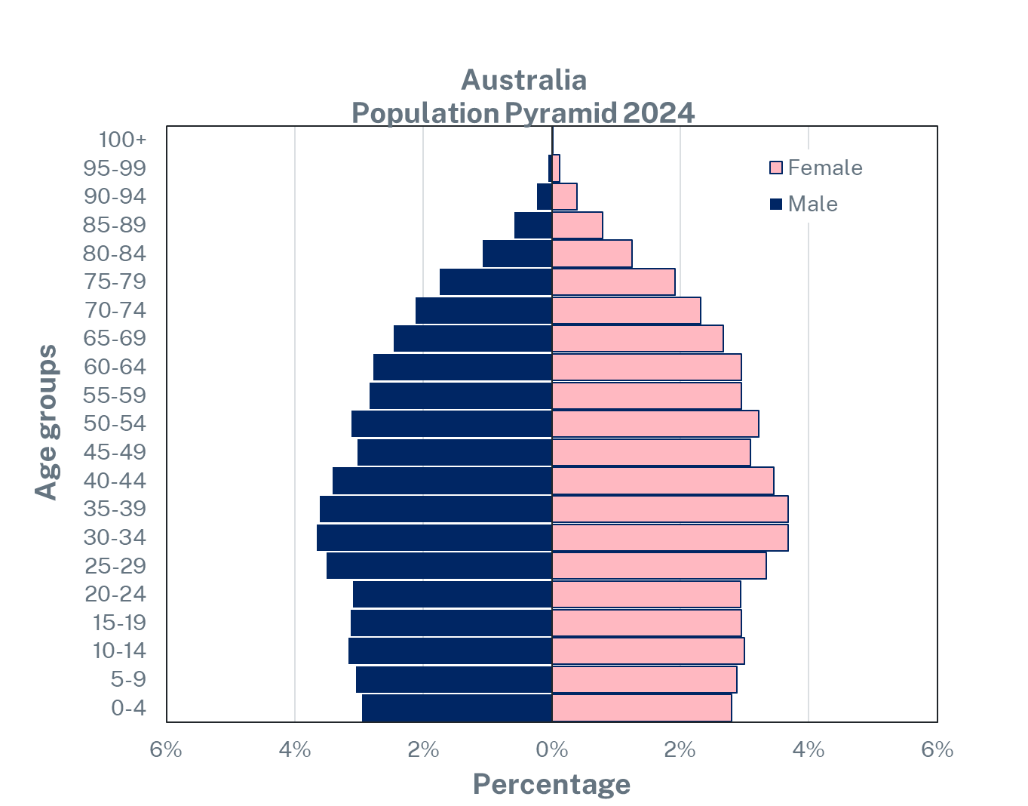
Features of a population profile (1)
Word bank
Title
Vertical axis scale
Horizontal axis label
Source
Legend
Bar graph
Source – populationpyramid.net
Notes:
Additional notes for teachers:
Print this slide out as a work sheet for your students. The answers are on the next slide.
Students use the word bank to label the key features of a population profile.
Differentiation options include:
Get students to work independently while the teacher gives assistance at the point of instructional need.
Pair students up and allow them to work independently while the teacher gives assistance at the point of instructional need.

Slide 10
Features of a population profile (2)
Title
Legend
Vertical axis scale
Bar graph
Horizontal axis label
Source
Source – populationpyramid.net
Notes:
Suggested teacher think-aloud
Here is a sample response about Australia in 2024.
Ask students to use short sentences describe the data: “There are two bar graphs… The shape shows a bulge… Women live longer than men.”
Prompt students to think about how these sentences can be joined into a paragraph.
Students could also check: Does my analysis describe the data and link to what it means for the future?
Prompt question: Does your conclusion connect to future planning needs?
Suggested response: Yes — e.g., ageing cohort → more aged care/workforce planning; youth bulge → schools/jobs.
Additional notes for teachers:
Answer slide with animations showing each answer.
Have students check their answers based on this slide.

Slide 11
Analysing population profiles
Notes:
Notes for teachers:
Now you know how to recognise a population profile we are going to learn how to interpret population profiles.

Slide 12
Analysing your population profile (1)
Notes:
Work through the following scaffold for interpreting the population profile:
Sentence starter – this graph shows [student response].
Sentence starter – there are two horizontal bar graphs that show [student response].
Sentence starter – the shape of the graph shows [student response].
Sentence starter – in the future Australia is likely to [student response].
Sentence starter – in Australia the gender balance is fairly equal except [student response].
Put these sentences together in the right order to construct a paragraph.

Slide 13
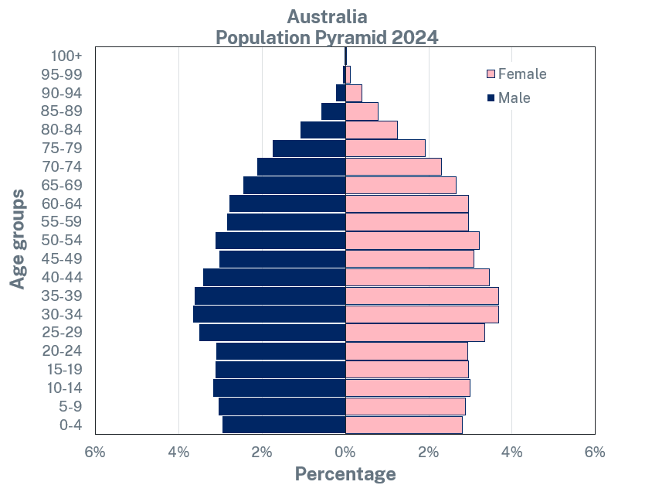
Analysing your population profile – sample answer
This graph shows the age and percentage of males and females in Australia, 2024.
There are two horizontal bar graphs that show male and female population at different age groups.
The shape of the graph shows a bulge in population at the middle-aged groups 25–49.
In the future Australia is likely to need more aged care infrastructure.
In Australia the gender balance if fairly equal except later in life, women are living longer than men.
If you put these sentences together in the right order you have a paragraph.
Notes:
Notes for teachers:
Read aloud each of the sentence starters for the students. Encourage students to respond when prompted. For example, this graph shows ‘the age and percentage of males and females in Australia’.
Sentence starter – this graph shows [student response]. CLICK reveal answer.
Sentence starter – there are two horizontal bar graphs that show [student response]. CLICK reveal answer.
Sentence starter – the shape of the graph shows [student response]. CLICK reveal answer.
Sentence starter – in the future Australia is likely to [student response]. CLICK reveal answer.
Sentence starter – in Australia the gender balance is fairly equal except [student response]. CLICK reveal answer.
Put these sentences together in the right order to construct a paragraph. CLICK reveal answer.

Slide 14
Analysing your population profile (2)
Notes:
Notes for teachers:
Have students calculate the percentage of Australia’s population aged between 30 – 39 using multiple steps:
Find the title of the vertical scale.
Identify the number of years the scale illustrates. 5 years
Identify the percentage (%) of Australia’s female population that has reached the age of 100 years. 0%
Identify the population aged between 30 – 39 years.
Total the percentage (%) of male population between the ages of 30 – 39 years by adding 3.66 and 3.62 together. Total male 7.28%.
Total the percentage (%) of female population aged between 30 – 39 years by adding 4 and 4 together. Total female 8%.
Total the percentage population in Australia aged between 10 – 39 by adding the number of males and females together (7.28 plus 8). Total Australian population aged between 30 – 39 years 15.28%.

Slide 15
References
This presentation contains NSW Curriculum and syllabus content. The NSW Curriculum is developed by the NSW Education Standards Authority. This content is prepared by NESA for and on behalf of the Crown in the right of the State of New South Wales. The material is protected by Crown copyright.
Please refer to the NESA Copyright Disclaimer for more information https://educationstandards.nsw.edu.au/wps/portal/nesa/mini-footer/copyright.
NESA holds the only official and up-to-date versions of the NSW Curriculum and syllabus documents. Please visit the NSW Education Standards Authority (NESA) website https://educationstandards.nsw.edu.au/wps/portal/nesa/home and the NSW Curriculum website https://curriculum.nsw.edu.au.
Geography 7-10 © Syllabus NSW Education Standards Authority (NESA) for and on behalf of the Crown in right of the State of New South Wales, 2024.
Population pyramid (2024), PopulationPyramid.net accessed 11 June 2025.

Slide 16
Copyright
© State of New South Wales (Department of Education), 2024
The copyright material published in this resource is subject to the Copyright Act 1968 (Cth) and is owned by the NSW Department of Education or, where indicated, by a party other than the NSW Department of Education (third-party material).
Copyright material available in this resource and owned by the NSW Department of Education is licensed under a Creative Commons Attribution 4.0 International (CC BY 4.0) licence.
This licence allows you to share and adapt the material for any purpose, even commercially.
Attribution should be given to © State of New South Wales (Department of Education), 2024.
Material in this resource not available under a Creative Commons licence:
the NSW Department of Education logo, other logos and trademark-protected material
Material owned by a third party that has been reproduced with permission. You will need to obtain permission from the third party to reuse its material.
Links to third-party material and websites
Please note that the provided (reading/viewing material/list/links/texts) are a suggestion only and implies no endorsement, by the New South Wales Department of Education, of any author, publisher, or book title. School principals and teachers are best placed to assess the suitability of resources that would complement the curriculum and reflect the needs and interests of their students.
If you use the links provided in this document to access a third party’s website, you acknowledge that the terms of use, including licence terms set out on the third-party’s website apply to the use which may be made of the materials on that third-party website or where permitted by the Copyright Act 1968 (Cth). The department accepts no responsibility for content on third-party websites.

