Slide 1
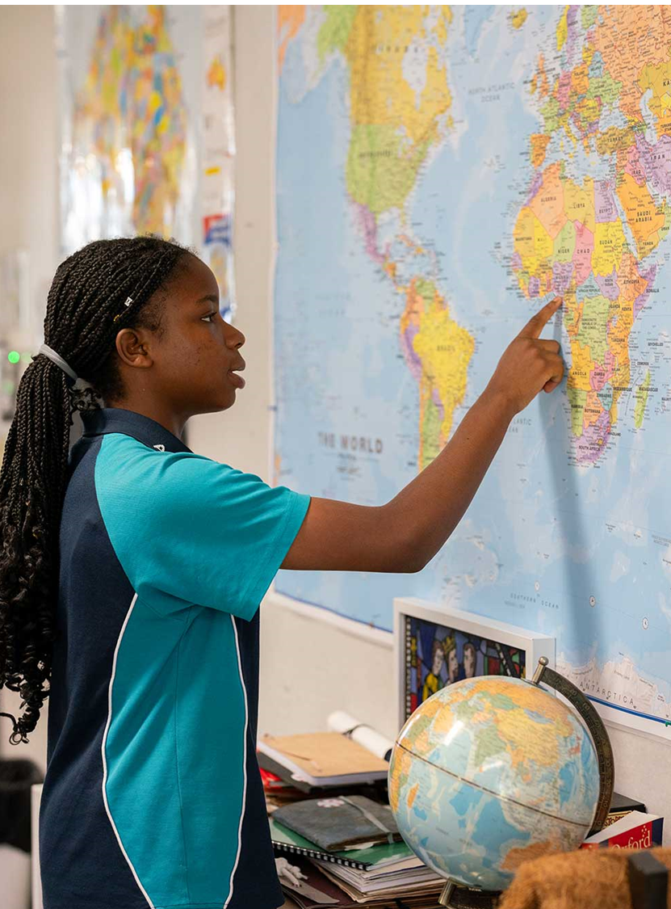
Lesson 4 – ratios and scale
Stage 4 geography
Liveability of places
[TEACHER NAME]
[DATE]
Notes:
Suggested teacher think-aloud
Today we’re learning about ratios and scale, both in everyday life and on maps.
Ratios help us compare parts of a group, while scale uses ratios to show real distances.

Slide 2
Learning intentions and success criteria
We are learning to
identify part-to-part ratio and part-to-whole ratio
use scale on a map.
We can
explain scale as a ratio
calculate ratio and scale factors to interpret a scale on a map and determine real distance
Notes:
Suggested teacher think-aloud
Our learning intention is to identify part-to-part and part-to-whole ratios, and use ratios to understand map scale.
By the end of the lesson you should be able to:
Explain scale as a ratio.
Calculate ratios and scale factors to find real distances.
Prompt students to think about where they’ve already seen ratios – maybe in recipes, sport, or maths.
Additional notes for teachers:
Learning intentions and success are best co-constructed with students. Adapt the learning intention as required and add matching success criteria.
For more information See ⁠AITSL or the NSW Department of Education explicit teaching strategies, ⁠Sharing learning intentions and ⁠Sharing success criteria
LISC is not necessarily presented at the beginning of the lesson. Teacher needs to consider most effectual time to introduce
LISC should be revisited during the lesson to support students' evaluation of their learning
The Literacy and Numeracy Learning Progressions
Number sense and algebra
Interpreting fractions - InF9
Multiplicative strategies - MuS10, MuS9
Number patterns and algebraic thinking - NPA6, NPA7
Proportional thinking - PrT3, PrT4, PrT5, PrT6, PrT7
Measurement and geometry
Understanding geometric properties - UGP6, UGP7

Slide 3
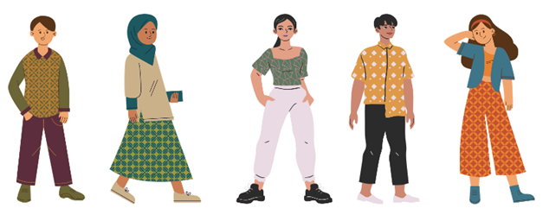
Ratios (1)
Scenario 1
The number of students wearing jumpers compared to those not wearing jumpers is called a part-to-part ratio. This can be written as 2:3 or as a fraction 2/3 and read as 2 to 3.
The number of students wearing jumpers compared to the number of students in the whole group, is called a part-to-whole ratio. This can be written as 2:5 or as a fraction 2/5 and read as 2 to 5.
Images licensed under the Canva Content License Agreement.
Notes:
Suggested teacher think-aloud
A part-to-part ratio compares two groups, e.g., students wearing jumpers compared to those not.
A part-to-whole ratio compares one group to the total.
Prompt students to think: Why might both comparisons be useful?
Prompt question: Why might both part-to-part and part-to-whole ratios be useful?
Suggested response: Part-to-part helps compare two groups (e.g., boys to girls), while part-to-whole helps show proportions in the total group.
Additional notes for teachers:
This presentation has been adapted from the Literacy and Numeracy teaching advice Part 3: Ratios. resources.education.nsw.gov.au.docx
Scenario 1: Invite 5 students to the front of the classroom. Ensure 2 of them are wearing a particular item and 3 are not, for example, 2 students wearing a jumper and 3 are not.
Discuss the group of 5 students and draw out the following information:
The number of students wearing jumpers compared to those not wearing jumpers is called a part-to-part ratio. That means for every 2 students with a jumper there are 3 without a jumper. This can be written as 2:3 or as a fraction 23 and read as 2 to 3.
The number of students wearing jumpers compared to the number of students in the whole group, is called a part-to-whole ratio. This can be written as 2:5 or as a fraction 25 and read as 2 to 5.
Teaching point: A part-to-part ratio can be written as a fraction. Students need to be aware that when the ratio is written as a fraction it does not always represent a part-to-whole relationship.

Slide 4
Ratios (2)
Scenario 2
We have added 2 new students wearing jumpers to our group of 5.
How many additional students without a jumper should be added to the group to keep the ratio the same as in scenario 1, 2:3?
Images licensed under the Canva Content License Agreement.
Notes:
Notes for teachers:
Scenario 2: Following on from scenario one, add 2 students wearing a jumper to the group of 5.
Suggested teacher think-aloud
We’ve added two more students wearing jumpers. How do we keep the same ratio?
Prompt students to think about equivalent ratios and scaling up fairly.
Prompt question: If we add two students with jumpers, how do we keep the ratio the same?
Suggested response: We also need to add three students without jumpers to keep the ratio 2:3.
Ask, how many additional students without a jumper should be added to the group to keep the ratio the same as in scenario 1, 2:3. Possible discussion points:
If 3 is given as a response, students are demonstrating multiplicative thinking as they are maintaining equivalent proportions.
If students use additive thinking they have answered that they added 2 students without a jumper to one part because 2 students with a jumper were added to the other part, demonstrate that this would not keep the ratio the same as 2:3.

Slide 5
Ratios (3)
Scenario 3
Using all the students in the class, create a ratio to simplify. For example, there are 20 students in a class and 8 are wearing a jumper and 12 are not. For every 8 students with a jumper, there are 12 students without a jumper, or 8 to 12.
Images licensed under the Canva Content License Agreement.
Notes:
Suggested teacher think-aloud
Ratios can always be simplified.
Prompt students to think: If 8 students have jumpers and 12 don’t, what’s the simplest ratio? (Answer: 2:3).
Reinforce: simplifying makes ratios easier to compare.
Discuss this ratio using the following prompts:
Does the ratio stay the same when halving the numbers? This means for every 4 students with a jumper there are 6 without a jumper, therefore the ratio is equivalent.
Is halving a multiplicative or additive process? It is multiplicative as halving refers to dividing by 2.
Does the ratio stay the same when halved again? Yes, for every 2 students with a jumper there are 3 without a jumper, therefore the ratio is equivalent.
Does the ratio stay the same when halved again? Yes, this would give an answer of 1 student wearing a jumper to 1.5 not wearing a jumper.
Teaching point: To simplify ratios divide each part by the highest common factor, for example, 8:12 = 2:3 by dividing both parts by 4.
Ratios are usually whole numbers with an exception occurring when using a scale factor.
Decimal numbers can be used and are commonly seen when using ratios for reducing or enlarging an image using scale factor.

Slide 6
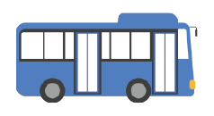
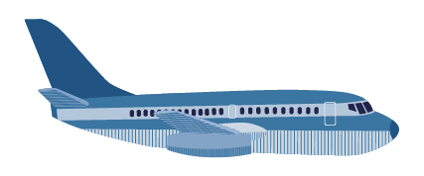
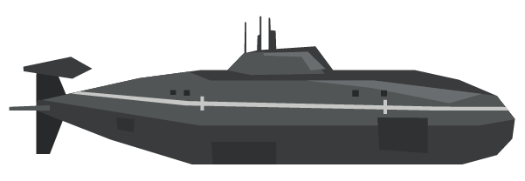
Comparing lengths
Explain how the ratio of the bus to the jet to submarine is 1:5:11.
Bus – 14 m
Jumbo jet – 70 m
Submarine – 154 m
Images licensed under the Canva Content License Agreement.
Notes:
Suggested teacher think-aloud
Ratios also compare sizes. The bus to jet to submarine ratio is 1:5:11.
Prompt students to think about what this means in real terms.
Prompt question: What does the bus:jet:submarine ratio of 1:5:11 mean?
Suggested response: The jet is five times the length of the bus, and the submarine is eleven times the length of the bus.
Additional notes for teachers:
Lead a class discussion ‘explain how the ratio of the bus to the jet to submarine is 1:5:11.
A jet is 5 times larger than a bus.
A submarine is 11 times larger than a bus.
To work this out to a ratio the bus is scaled at 1. The jet must be divided by 14. Calculate 70 divided by 14 equals 5. The submarine must be divided by 14. Calculate 154 divided by 14 equals 11.

Slide 7
Map scale (1)
Calculating ratio and scale factors to interpret a scale on a map and determine real distance
Use the Recreational bushland map to answer the following questions:
The distance from Montezuma Falls to Rosebery golf course is 6 kilometres. Measure the distance from Montezuma Falls to Rosebery Golf course on the map to create a scale. The scale can be simplified using the following prompts:
? cm = 6 km
? cm = 600 000 cm
1 cm = ? cm
1 : ?
Notes:
Suggested teacher think-aloud
On this bushland map, Montezuma Falls to Rosebery Golf Course = 6 km.
We measure the map distance, then build the scale step by step.
Prompt students to think: Why is it important to simplify the scale into something easy to use?
Prompt question: Why is it important to simplify a scale into something easy to use?
Suggested response: A simple scale (like 1 cm = 1 km) makes it faster and easier to calculate real distances.
Additional notes for teachers:
Students will need to be provided with Appendix 4: Recreational bushland map Literacy and Numeracy teaching advice Part 3: Ratios. resources.education.nsw.gov.au.docx.
When photocopying the Recreational bushland map check the length of the line between Montezuma Falls to Rosebery golf course is 6 cm or adjust based on printing.

Slide 8
Map scale (2)
Calculating ratio and scale factors to interpret a scale on a map and determine real distance
Use the Recreational bushland map to answer the following questions:
Use the scale to determine the corresponding real distance (Scale 1:100 000 on the map).
I do
If the distance on the map from Renison Bell to Rosebery is 8 cm, what is the real distance?
We do
If the distance on the map from Mount Dundas to Renison Bell going through Montezuma Falls is 6 cm + 5 cm, or 11 cm, what is the real distance?
You do
Identify 2 points on the map and find the scale distance. Convert to the real distance.
Notes:
Use a gradual release of responsibility to demonstrate how to real distance using scale on a map.
Suggested teacher think-aloud
I do - demonstrate to the students how to measure the distance on the map between Renison Bell to Rosebery. The scale on the map is 1:100000 this means 1 cm on the map represents 1 km on the ground in real distance. Answers: I do possible response: the real distance is 800 000 cm or 8 kilometres.
We do – discuss with the class steps involved in measuring the distance and how we calculate scale. Correct where required. Answer: We do possible response: the real distance is 1100 000 cm or 11 kilometres.
You do – answers based on the 2 points class choose to measure.
Prompt students to think about the process – measure, apply scale, calculate.
Additional notes for teachers:
Students will need to be provided with Appendix 4: Recreational bushland map Literacy and Numeracy teaching advice Part 3: Ratios. resources.education.nsw.gov.au.docx
When photocopying the Recreational bushland map check the length of the line between Montezuma Falls to Rosebery golf course is 6 cm or adjust based on printing.

Slide 9
References
This presentation contains NSW Curriculum and syllabus content. The NSW Curriculum is developed by the NSW Education Standards Authority. This content is prepared by NESA for and on behalf of the Crown in the right of the State of New South Wales. The material is protected by Crown copyright.
Please refer to the NESA Copyright Disclaimer for more information https://educationstandards.nsw.edu.au/wps/portal/nesa/mini-footer/copyright.
NESA holds the only official and up-to-date versions of the NSW Curriculum and syllabus documents. Please visit the NSW Education Standards Authority (NESA) website https://educationstandards.nsw.edu.au/wps/portal/nesa/home and the NSW Curriculum website https://curriculum.nsw.edu.au.
Geography 7-10 © Syllabus NSW Education Standards Authority (NESA) for and on behalf of the Crown in right of the State of New South Wales, 2024.
Proportional thinking: Ratios

Slide 10
Copyright
© State of New South Wales (Department of Education), 2024
The copyright material published in this resource is subject to the Copyright Act 1968 (Cth) and is owned by the NSW Department of Education or, where indicated, by a party other than the NSW Department of Education (third-party material).
Copyright material available in this resource and owned by the NSW Department of Education is licensed under a Creative Commons Attribution 4.0 International (CC BY 4.0) licence.
This licence allows you to share and adapt the material for any purpose, even commercially.
Attribution should be given to © State of New South Wales (Department of Education), 2024.
Material in this resource not available under a Creative Commons licence:
the NSW Department of Education logo, other logos and trademark-protected material
Material owned by a third party that has been reproduced with permission. You will need to obtain permission from the third party to reuse its material.
Links to third-party material and websites
Please note that the provided (reading/viewing material/list/links/texts) are a suggestion only and implies no endorsement, by the New South Wales Department of Education, of any author, publisher, or book title. School principals and teachers are best placed to assess the suitability of resources that would complement the curriculum and reflect the needs and interests of their students.
If you use the links provided in this document to access a third party’s website, you acknowledge that the terms of use, including licence terms set out on the third-party’s website apply to the use which may be made of the materials on that third-party website or where permitted by the Copyright Act 1968 (Cth). The department accepts no responsibility for content on third-party websites.

