Slide 1

Lesson 3 – large and small-scale maps
Stage 4 geography
Liveability of places
[TEACHER NAME]
[DATE]
Notes:
Suggested teacher think-aloud
Today we’re looking at map scale and how it affects what we can see.
We’ll focus on large-scale maps, which show a lot of detail in a small area, and small-scale maps, which show less detail across a larger area.

Slide 2
Learning intentions and success criteria
We are learning to
identify large and small-scale maps
identify the uses of large and small-scale maps
We can
use ratio scales to identify large and small-scale maps
select appropriate scaled maps to represent information and data.
Notes:
Suggested teacher think-aloud
Our learning intention is to identify the difference between large- and small-scale maps and when to use each.
By the end of the lesson you should be able to:
Use ratio scales to recognise if a map is large or small-scale.
Select the appropriate map to represent data and information.
Why might a city planner use a large-scale map but a pilot use a small-scale map?
Prompt: Why might a city planner use a large-scale map but a pilot use a small-scale map?
Suggested student response: A planner needs detail of streets and buildings; a pilot needs a broad overview of large areas.
Additional notes for teachers:
Learning intentions and success are best co-constructed with students. Adapt the learning intention as required and add matching success criteria.
For more information See ⁠AITSL or the NSW Department of Education explicit teaching strategies, ⁠Sharing learning intentions and ⁠Sharing success criteria
LISC is not necessarily presented at the beginning of the lesson. Teacher needs to consider most effectual time to introduce
LISC should be revisited during the lesson to support students' evaluation of their learning

Slide 3

Scale
The scale of the map tells the relationship between distances on the map and distances in real life. It provides the ratio of map distance to actual distance.
Small-scale maps show a small amount of detail over a large area (the detail is “small”).
Large-scale maps show a large amount of detail in a small area (the detail is “large”).
Notes:
Suggested teacher think-aloud
Scale tells us the relationship between distances on a map and distances in real life.
Prompt students to think: If 1 cm = 1 km, how far is 5 cm on the map?
Prompt question: If 1 cm = 1 km, how far is 5 cm on the map?
Suggested response: 5 km.
Reinforce: large-scale = lots of detail in a small area; small-scale = less detail, big area.
Additional notes for teachers:
Read aloud the text on screen. Clarify any new or unfamiliar terms for the class.

Slide 4

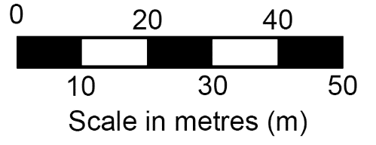
We show scale in geography by
Writing in words
For example, 1 centimetre to 10 metres
Showing it as a ratio
For example, 1:1000
Drawing a linear scale
Notes:
Suggested teacher think-aloud
Scale can be shown three ways: in words, as a ratio, or as a linear scale.
Prompt students to think about which is easiest to use and why.
Prompt question: Which way of showing scale might be easiest to use and why?
Suggested response: Linear scales — you can measure directly with a ruler; ratios often need calculation.
Additional notes for teachers:
Explain to the students that scale is shown in geography in several ways.
Ask students if they are familiar with any displayed on the slide.
Read aloud each example of how scale is represented in geography.

Slide 5
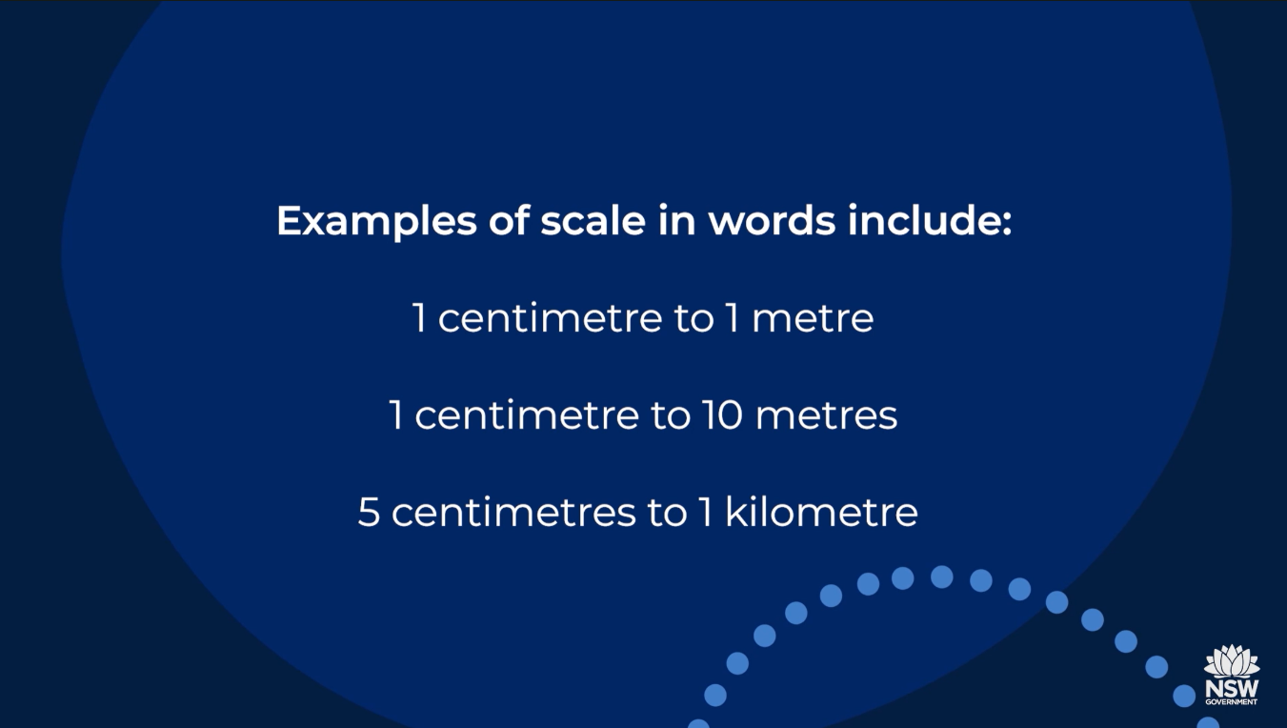

BOLTSS and scale
0:52 – 4:06
Notes:
Suggested teacher think-aloud
Watch carefully – this section explains how scale is linked to the other map elements in BOLTSS.
Prompt students to think: How does scale affect the amount of detail you see on a map?
Prompt question: How does scale affect the amount of detail you see on a map?
Suggested response: Larger scale shows more detail (e.g., houses, street names); smaller scale shows fewer details.
Additional notes for teachers:
Watch the video with the class.
Explain to the class that you will follow with some check for understanding questions.
Transcript:
Hello. This episode, we are revisiting some basic geography mapping rules.
[Presenter is standing in front of a decorative background. In the bottom right-hand corner of the screen, the text reads, ‘Melissa Ellis. HSIE Curriculum Support Project Officer.’]
Every map should include BOLTSS.
[Screen shows a street map of Katoomba – Leura. The text above the map reads, ‘BOLTSS’.]
A border, or a line around it.
[Screen zooms into the bottom-left corner of the map. An arrow points to the border that surrounds the street map. Text on the screen reads, ‘Border’.]
Orientation, a compass showing the direction.
[Screen pans and zooms to the top-right corner of the map. An arrow points to an image of a compass on the street map. Text on the screen reads, ‘Orientation’.]
Legend, showing a key to the symbols used on the map.
[Screen pans and zooms to the top-left corner of the map. An arrow points to a legend on the street map. Text on the screen reads, ‘Legend’.]
Title, or name of the map, scale, showing how small the map is compared to the real world. Source, where the information came from.
[Screen pans and zooms to the bottom middle of the map. An arrow points to the title of the map, which reads, ‘Katoomba – Leura’. Text on the screen reads, ‘Title’. The arrow then points to the scale on the street map. Text on the screen reads, ‘Scale’. The arrow then points to the source of the street map, which reads, ‘Issued by the publicity department. Blue Mountains City Council’. Text on the screen reads, ‘Source’.]
Something many students struggle with is understanding scale when reading maps. Let's run through some basic rules about scale. We are illustrating something large in a smaller way. Therefore, we use scale on maps. How much detail is shown on a map will depend on the scale that has been used to draw it.
The scale of a map is the ratio of map distance to actual distance. We show scale in many ways, writing in words, representative fraction, by drawing a line scale. An example of scaling words is 1 centimetre to 1 kilometre. This means that 1 centimetre on the map represents 1 kilometre in real life on the ground. Examples of scale in words include 1 centimetre to 1 metre, 1 centimetre to 10 metre, 5 centimetres to 1 kilometre.
The scale of a map can also be shown in numbers. A scale in representative fraction might be 1 to 100, 1 to 1,000, 1 to 10,000, 1 to 100,000, 1 to 250,000. If a map has a representative fraction of 1 to 1,000, then one distance on the map is 1,000 times bigger in real life. It often helps to start with representative fraction of 1 to 100,000. This is a common topographic mapping scale.
[Description not needed: The visuals in this part of the video only support what is spoken; the visuals do not provide additional information.]
Picture putting a line through the last two zeros in the 100,000. This leaves 1,000. We have converted the ratio from millimetres to metres.
[Text on screen reads, ‘1 to 100 000’. A red line appears on the screen to cross out the last 2 zeros.]
The scale then represents 1 centimetre to 1,000 metres or 1 centimetre to 1 kilometre. In words, a scale of 1 to 100,000 is 1 centimetre on the map represents 1 kilometre in real life.
Using this basic method, students should be able to convert ratio scales easily. Let's try this again. 1 to 250,000, 1 centimetre to 2,500 metres, or 1 centimetre represents 2.5 kilometres. One more example, 1 to 10,000. 1 centimetre to 100 metres, or 1 centimetre represents 0.1 kilometres. Line scales, also commonly known as linear scales, is a numbered line showing scale on a map.
[The screen shows a street map. There is a line scale on the bottom-right corner of the image. An arrow points to the scale. Text on the screen reads, ‘Linear scale – line scale’.]
Scale is about practice. Take some time to try all the types of scale presented on maps in geography. The more familiar you are with scale, the easier the skill becomes. All the best.
[Text on screen reads, ‘References
Katoomba Leura Tourist Directory, by E. Coleman at Flickr.com/photos/blue_mountains_library_local_studies/9206840596/in/photostream. Licensed under CC BY-SA 2.0v’.
Text on the screen reads, ‘Acknowledgements. NSW Geography K-10 syllabus © NSW Education Standards Authority (NESA) for and on behalf of the Crown in right of the State of New South Wales 2015. See the NESA website for additional copyright information. NSW Department of Education Curriculum Secondary Learners. Southern Cross School of Distance Education.’
Screen shows an Indigenous artwork. The artwork features a landscape with native Australian animals. It is titled, ‘Our Country’ by Garry Purchase. Text at the top of the screen reads, ‘Filming of these videos has taken place on Bundjalung land.’ Video concludes by displaying the NSW Government logo.]
[End of transcript]

Slide 6


True or False
Notes:
Notes for teachers:
Explain the next activity. We are going to answer true or false to the questions about the representation of scale used in geography on the next slide.
Each question will appear one at a time.
Establish a way of communicating true or false responses. For example, hands on heads for true and hands on table for false.

Slide 7
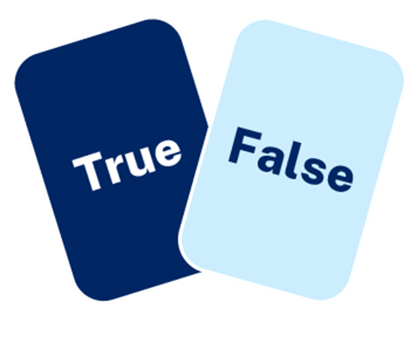

Checking for understanding (1)
True or false
1:100000 is an example of a ratio scale
1:250000 is an example of a linear scale
1 centimetre represents 5 kilometres is an example of scale in words
The following image is an example of scale in ratio
Notes:
Suggested teacher think-aloud
Let’s check our understanding with a quick quiz. Can you try and justify your answers?
Additional notes for teachers:
Read aloud each question to the class. Animations are used. Click for next question.
1:100000 is an example of a ratio scale = True.
1:250000 is an example of a linear scale = False
1 centimetre represents 5 kilometres is an example of scale in words = True
The following image is an example of scale in ratio = False

Slide 8
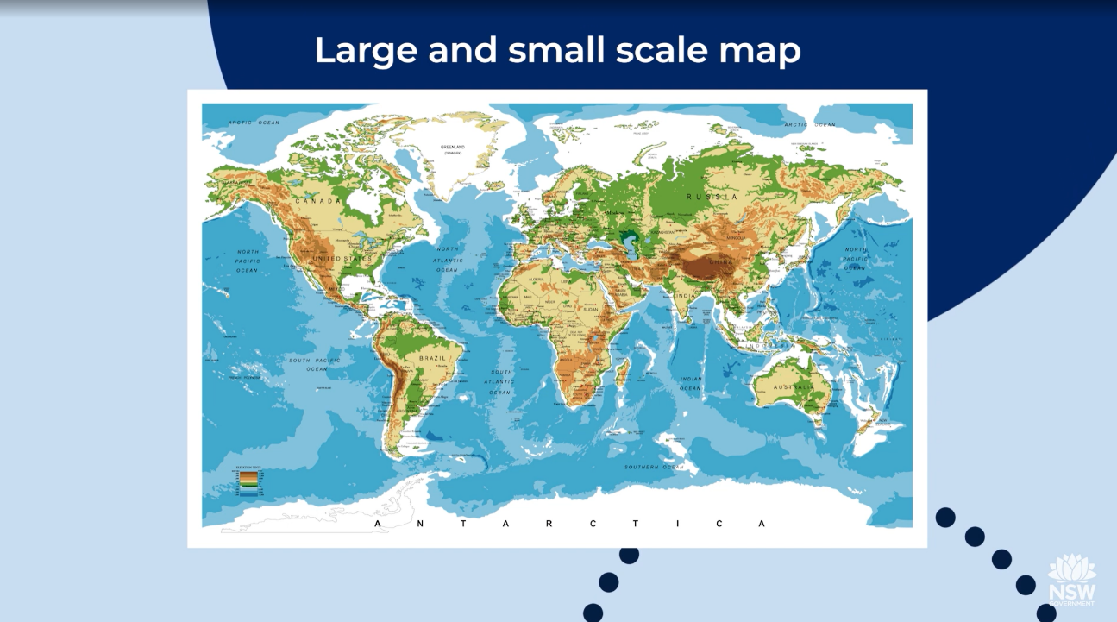
Small-scale maps
Introduction to maps (2:54 – 3:39)
Notes:
Additional notes for teachers:
Watch video Introduction to maps (2:54 – 3:39) with the class.
Explain that after the video you will conduct a check for understanding exercise using choral responses.
Transcript
Hello. In this video, we are learning about the many different types of maps.
[Presenter is standing in front of a decorative background. In the bottom right-hand corner of the screen, the text reads, ‘Melissa Ellis. HSIE Curriculum Support Project Officer’.]
Maps are used to locate, display, and record spatial data. Reference maps are used to show the location of physical features, boundaries, and cities. Thematic maps show themes, for example, the concentration of people in an area.
[Screen shows an image of a world map. The text above the image reads, ‘Globe map’.]
The best representation of a map in the world is a globe, but it's not convenient to carry a globe around. So the 3D globe is represented by projecting latitude and longitude onto a flat surface. There are some issues with these causing inaccuracies, though. For example, Mercator's projection distorts the size of the polar regions, Europe, and North America.
[Screen shows an image of a street map of Katoomba and Leura.]
A person who makes maps is a cartographer.
[The street map image moves to the right of the screen. On the left of the screen, the spoken words appear.]
Every map should have a border, orientation, legend, title, scale, and source. An easy way to remember this is using the acronym, BOLTSS.
[The screen shows an image of a relief map of the world. The text above the image reads, ‘Physical or relief map’.]
Physical or relief maps show the natural features of the Earth, like rivers, deserts, mountains, and lakes. They often use colours of the natural environment, like browns for mountains and hills, greens for land, and blues for water.
[The screen shows an image of a topographic map. The text above the image reads, ‘Topographic map’.]
Topographic maps show the shape of the Earth's surface by using contour lines. These lines join points of equal elevation. These maps also show some natural features, like lakes, and cultural features, like roads and bridges.
[The screen shows an image of a political map of Europe. The text above the image reads, ‘Political map’.]
Political maps use different colours to show countries, international borders, and often the major cities and oceans.
[The screen shows an image of a synoptic chart of Australia. The text above the image reads, ‘Synoptic chart’.]
Synoptic charts are maps that summarize atmospheric conditions, including air pressure, precipitation, wind speed and direction. Isobars are the lines on these maps that join places of equal air pressure.
[Screen shows an image of a choropleth map of Western Australia. The text above the image reads, ‘Choropleth map’.]
A choropleth map is a thematic map used to represent the density of values or objects in an area, for example, population density. The darker shading normally shows higher values, and the lighter shading indicates lower values.
[The screen shows an image of a cadastral map of Queensland. The text above the image reads, ‘Cadastral map’.]
Cadastral maps show property boundaries, as well as some information about the property for landowners and local councils.
[The screen shows an image of a flowline map of the world. Text on the image reads, ‘Movements of people: migration and tourism.’ The text above the image reads, ‘Flowline map’.]
Flowline maps are a type of thematic map that use lines or arrows to show movement between places, for example, the movement of people, animals, goods, or money.
[The screen shows an image of a world map. The text above the image reads, ‘Large and small scale map’.]
Finally, you might hear the term, ‘large and small scale map.’ Large scale maps show a lot of detail for a small area, for example, a small town. And small scale maps show a larger geographic area, like a country, with fewer details on them. The map shown here is a small scale map.
That concludes this video. Happy map reading.

Slide 9
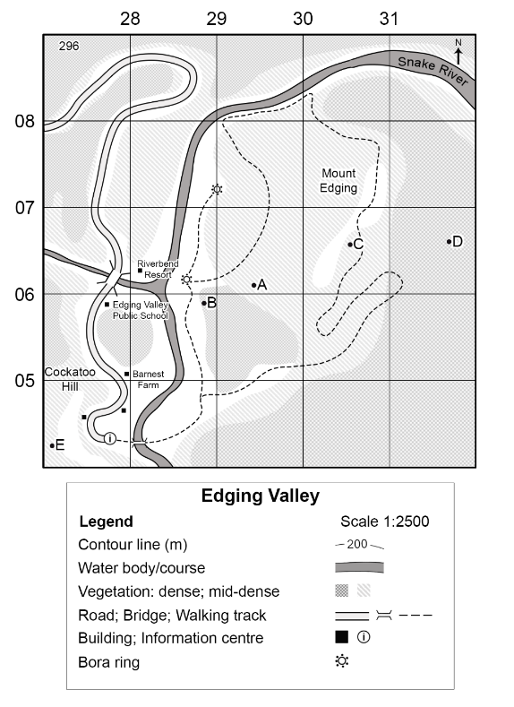
Checking for understanding (2)
Choral responses – this is an example of …………… scale map
Answer – large scale map
Why?
the geographic area covered is small
more detail is shown on the map (the detail is “large”)
the scale ratio number is small (1:2500)
examples – map of a city, map of a local area, map of a neighbourhood
Notes:
Suggested teacher think-aloud
This is an example of a large-scale map.
Prompt students to think: What makes the detail ‘large’?
Reinforce: small ratio number, more local detail, e.g., city maps.
Prompt question: What makes the detail “large” in a large-scale map?
Suggested response: The small ratio makes features appear larger, so you can see streets, parks, and buildings.
Additional notes for teachers:
Read aloud the sentence and ask student to respond as a choral response ‘this is an example of [student response] scale map.
Read aloud the answer. This is an example of a large-scale map
Why?
the geographic area covered is small
more detail is shown on the map (the detail is “large”)
the scale ratio number is small (INSERT SCALE OF EDGING VALLEY)
examples – map of a city, map of a local area, map of a neighbourhood.

Slide 10
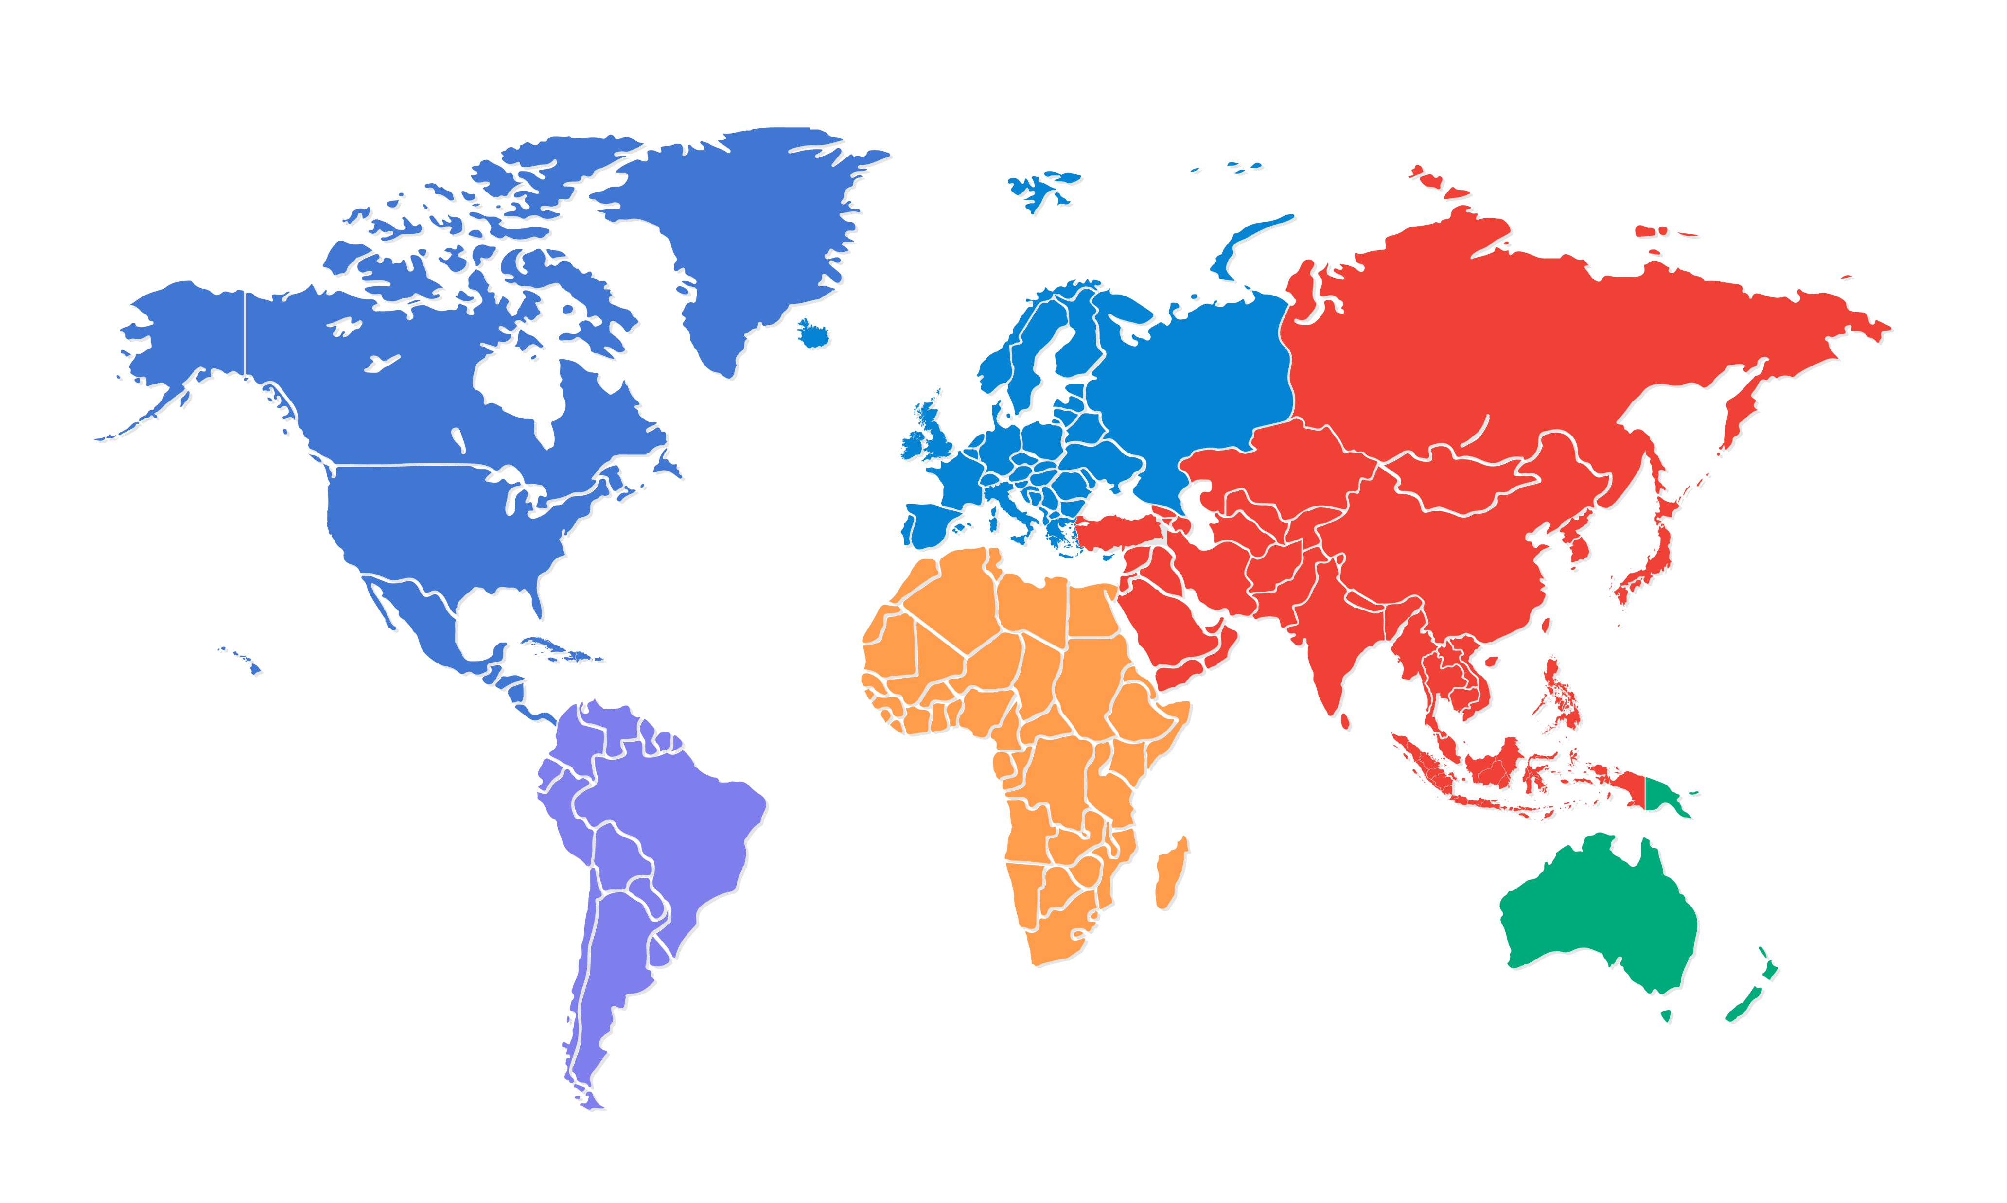
Checking for understanding (3)
Choral responses – this is an example of …………… scale map
Answer – small scale map
Why?
the geographic area covered is larger
only significant features are show (the detail is ‘small’)
the scale ratio number is large
examples – map of the world, map of Australia, map of a state or territory.
Notes:
Suggested teacher think-aloud
This is an example of a small-scale map.
Prompt students to think: Why does it only show big features like continents or states, not small details?
Reinforce: the ratio number is larger, the detail is smaller.
Prompt question: Why do small-scale maps only show continents, countries, or states?
Suggested response: The area is huge, so small features would be too tiny to show clearly.
Additional notes for teachers:
Read aloud the sentence and ask student to respond as a choral response ‘this is an example of [student response] scale map.
Read aloud the answer:
Small scale map
Why = larger geographic area or region BUT with less detail.

Slide 11
You do
1
Choose a map
2
Identify and explain if the map is large or small-scale
3
Submit for feedback
Notes:
Suggested teacher think-aloud
Choose the best scale for each task and explain why.
Prompt question: Which would you use to plan a bushwalk route vs a drive across NSW?
Suggested response: Bushwalk → large-scale (track detail); long drive → small-scale (state overview).
Additional teacher notes:
Students may be given time in class for this learning activity or submit at the beginning of next lesson as a homework exercise.

Slide 12
References
This presentation contains NSW Curriculum and syllabus content. The NSW Curriculum is developed by the NSW Education Standards Authority. This content is prepared by NESA for and on behalf of the Crown in the right of the State of New South Wales. The material is protected by Crown copyright.
Please refer to the NESA Copyright Disclaimer for more information https://educationstandards.nsw.edu.au/wps/portal/nesa/mini-footer/copyright.
NESA holds the only official and up-to-date versions of the NSW Curriculum and syllabus documents. Please visit the NSW Education Standards Authority (NESA) website https://educationstandards.nsw.edu.au/wps/portal/nesa/home and the NSW Curriculum website https://curriculum.nsw.edu.au.
Geography 7-10 © Syllabus NSW Education Standards Authority (NESA) for and on behalf of the Crown in right of the State of New South Wales, 2024.

Slide 13
Copyright
© State of New South Wales (Department of Education), 2024
The copyright material published in this resource is subject to the Copyright Act 1968 (Cth) and is owned by the NSW Department of Education or, where indicated, by a party other than the NSW Department of Education (third-party material).
Copyright material available in this resource and owned by the NSW Department of Education is licensed under a Creative Commons Attribution 4.0 International (CC BY 4.0) licence.
This licence allows you to share and adapt the material for any purpose, even commercially.
Attribution should be given to © State of New South Wales (Department of Education), 2024.
Material in this resource not available under a Creative Commons licence:
the NSW Department of Education logo, other logos and trademark-protected material
Material owned by a third party that has been reproduced with permission. You will need to obtain permission from the third party to reuse its material.
Links to third-party material and websites
Please note that the provided (reading/viewing material/list/links/texts) are a suggestion only and implies no endorsement, by the New South Wales Department of Education, of any author, publisher, or book title. School principals and teachers are best placed to assess the suitability of resources that would complement the curriculum and reflect the needs and interests of their students.
If you use the links provided in this document to access a third party’s website, you acknowledge that the terms of use, including licence terms set out on the third-party’s website apply to the use which may be made of the materials on that third-party website or where permitted by the Copyright Act 1968 (Cth). The department accepts no responsibility for content on third-party websites.

