Slide 1

Lesson 2 – area and grid reference
Stage 4 geography
Liveability of places
[TEACHER NAME]
[DATE]
Notes:
Suggested teacher think-aloud
Today we are learning how to find places and identify features on maps using coordinates.
We’ll begin with area references, which give us a general square on the map, and then move into grid references, which are much more precise.
These skills are essential for fieldwork and topographic mapping.

Slide 2
Learning intentions and success criteria
We are learning to
find places and identify features on maps using coordinates.
We can
use 4-figure area references to find and describe features on maps
use 6-figure grid references to find and describe features on maps.
Notes:
Suggested teacher think-aloud
Our learning intention is to accurately use map references.
By the end of the lesson, you should be able to:
Use four-figure area references to find and describe features.
Use six-figure grid references to find and describe features precisely.
Prompt students to think about how being able to use coordinates will help them not only in Geography, but also in navigation and problem-solving tasks in real life.
Prompt question: Why do we need both systems?
Suggested response: Area references are quick for general locations; grid references are more precise when detail is needed.
Additional notes for teachers:
Learning intentions and success are best co-constructed with students. Adapt the learning intention as required and add matching success criteria.
For more information See ⁠AITSL or the NSW Department of Education explicit teaching strategies, ⁠Sharing learning intentions and ⁠Sharing success criteria
LISC is not necessarily presented at the beginning of the lesson. Teacher needs to consider most effectual time to introduce
LISC should be revisited during the lesson to support students' evaluation of their learning

Slide 3
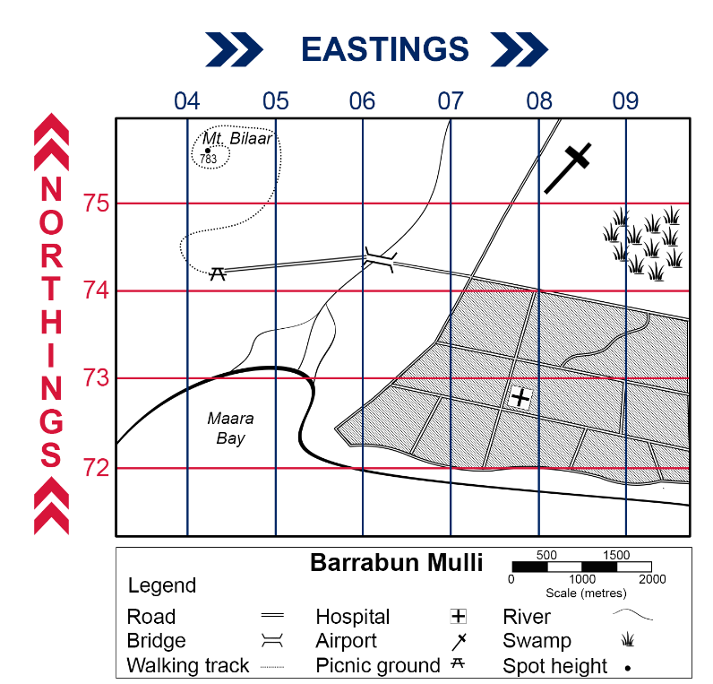
Area reference (1)
I do
Mt Bilaar is located in area reference 0475
Easting 04
Northing 75
Notes:
Suggested teacher think-aloud
An area reference uses four numbers: the first two are eastings, the second two are northings.
Example: Mt Bilaar is located at AR0475. This means Mt Bilaar is inside the square formed by easting 04 and northing 75.
Prompt students to think about the rule: “along the corridor, up the stairs.” This ensures eastings are always read first.
Prompt question: Why do we always read eastings before northings?
Suggested response: It creates a consistent method – “along the corridor, up the stairs” – and avoids confusion.
Stress that area references give a square, not an exact point.
Additional notes for teachers:
Maps are used in geography to communicate information about places.
Geographers use many different types of maps.
They are used as a tool to find places, understand the patterns of natural and human features, and discover relationships between features.
Imaginary grid lines are used with numbers and letters to assist in finding features and places more easily.
Alphanumeric grid systems use letters and numbers to form a reference point.
Area reference also known as 4-figure grid reference is a set of 4 numbers which can be used to find places on a topographic map.
Teacher support:
For more detail explanation and support for teaching area and grid reference teachers may like to access Area and grid reference video and Area and grid reference, geography 7–10.

Slide 4

Area reference (2)
Easting 08
We do
What is located at:
AR0875?
AR0772?
Northing 75
Notes:
Suggested teacher think-aloud
Let’s practise together: What is located at AR0875? What about AR0772?
Prompt students to think about how they are reading the map: eastings first, then northings.
Prompt question: How do you know you’ve chosen the right square?
Suggested response: By checking the intersection of the easting and northing lines, and ensuring the feature sits inside that square.
Encourage students to respond in full sentences: “At AR0875 there is a …”
Additional notes for teachers:
Teacher leads the class to find AR 0875 CLICK
Easting top row numbers are always recorded before northings left side numbers. CLICK
Teacher leads the class to find AR0772.
Answers:
R0875 – Airport
AR0772 – Hospital.

Slide 5
Area reference (3)
You do
What is the area reference for:
Maara Bay?
the bridge?
the main area of the swamp?
Notes:
Suggested teacher think-aloud
Now it’s your turn. Find the area references for Maara Bay, the bridge, and the swamp.
Prompt students to double-check which square the feature falls into before writing their answer.
This activity helps students consolidate the “eastings first, northings second” routine.
Prompt question: Why is it important to double-check your square before answering?
Suggested response: A single digit mistake could place the feature in the wrong square.
Additional notes for teachers:
Students independently respond. Cold call students to check for student understanding. Correct where required.
Answers:
Maara Bay – AR0472
Bridge – AR0674
Swamp area – AR0974.

Slide 6
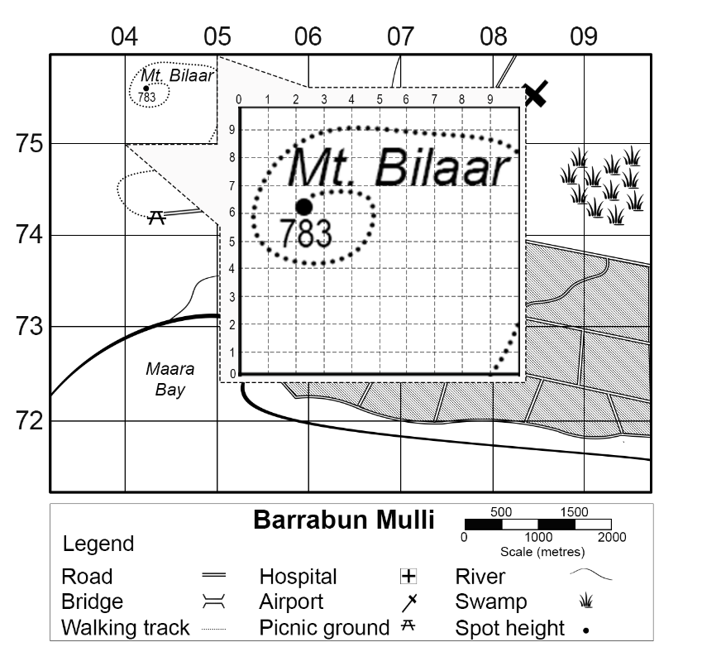
Grid reference (1)
Easting 042
I do
Mt Bilaar is located at grid reference 042756
Northing 756
Notes:
Suggested teacher think-aloud
Grid references give us a precise location by using six numbers.
Example: Mt Bilaar is located at GR042756. The first three digits are the easting, and the last three digits are the northing.
Prompt students to think about how the extra digit makes the location more precise within the square.
Prompt question: What do the extra digits add to our accuracy?
Suggested response: They tell us exactly how far across and up within the square the feature is located.
Stress the importance of accuracy – grid references are how we pinpoint features exactly.
Additional notes for teachers:
A 6-figure grid reference is used to give the exact location of a place on a map. A 6-figure grid reference has 6 digits.
The first 2 digits tell us the easting on the left-hand side of the location.
The third digit tells us how many tenths to the right of the easting the feature is located.
The fourth and fifth digits are the northing below the location. The final digit tells us how many tenths above the northing this point is.
The grid reference for Mt. Bilaar is GR042756.

Slide 7
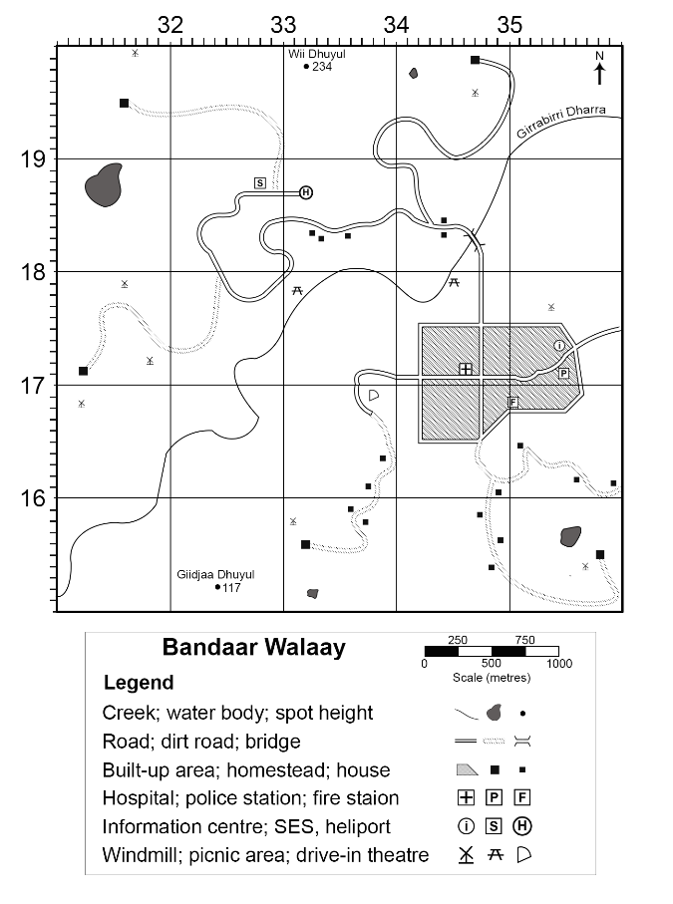
Grid reference (2)
We do
What is located at:
GR328188?
GR332198?
GR345179?
GR357154?
Notes:
Suggested teacher think-aloud
Let’s try together: GR328188, GR332198, GR345179, GR357154.
Prompt students to think step by step: find the correct square first, then use the third digit to judge how far across and up within the square the feature is located. Remind students the most common mistake is reversing eastings and northings.
Prompt question: What’s the most common mistake in grid references?
Suggested response: Mixing up eastings and northings, or forgetting to measure inside the square.
Additional notes for teachers:
Students require a printed copy of the Bandaar Walaay map to complete this learning activity.
Answers:
GR328188 – SES
GR332198 – Wii Dhuyul peak
GR345179 – Picnic area
GR357154 – Windmill.

Slide 8
Grid reference (3)
You do
Give a 6-figure grid reference for the following features on the Bandaar Walaay map:
Police station
Fire station
Hospital
Heliport
Notes:
Suggested teacher think-aloud
Now it’s your turn. Find the six-figure grid references for the police station, fire station, hospital, and heliport on the Bandaar Walaay map.
Prompt students to verbalise their process out loud: “I go across first, then up.” This reinforces the routine and builds confidence in accuracy.
Prompt question: How can saying “across first, then up” help you avoid errors?
Suggested response: It reinforces the correct sequence every time.
Additional notes for teachers:
Teachers may want to consider providing students with a printed copy of the Bandaar Walaay map. hsie-geography-7-10-mapping-area-grid-reference.docx
Students independently respond. Cold call students to check for student understanding. Correct where required.
Answers:
Police station – GR355171
Fire station – GR350168
Hospital – GR346171
Heliport – GR332187.

Slide 9



Traffic light reflection
I need some help!
I need to improve on…
I’m getting there!
I am still working on…
I get it!
I am most proud of…
Notes:
Suggested teacher think-aloud
Let’s finish with a reflection on your learning.
Red: I need help – I’m still confused.
Amber: I understand parts, but need more practice.
Green: I’m confident – I can use both area and grid references.
Prompt students to think honestly about their learning progress. This is both a self-check and quick feedback for the teacher.
Notes for teachers:
Students to reflect on their learning.
Red light I need more help with…
Orange light I am getting there but I need clarification on…
Green light YES I get it give me something more challenging or apply the knowledge to a new situation.

Slide 10
References
This presentation contains NSW Curriculum and syllabus content. The NSW Curriculum is developed by the NSW Education Standards Authority. This content is prepared by NESA for and on behalf of the Crown in the right of the State of New South Wales. The material is protected by Crown copyright.
Please refer to the NESA Copyright Disclaimer for more information https://educationstandards.nsw.edu.au/wps/portal/nesa/mini-footer/copyright.
NESA holds the only official and up-to-date versions of the NSW Curriculum and syllabus documents. Please visit the NSW Education Standards Authority (NESA) website https://educationstandards.nsw.edu.au/wps/portal/nesa/home and the NSW Curriculum website https://curriculum.nsw.edu.au.
Geography 7-10 © Syllabus NSW Education Standards Authority (NESA) for and on behalf of the Crown in right of the State of New South Wales, 2024.

Slide 11
Copyright
© State of New South Wales (Department of Education), 2024
The copyright material published in this resource is subject to the Copyright Act 1968 (Cth) and is owned by the NSW Department of Education or, where indicated, by a party other than the NSW Department of Education (third-party material).
Copyright material available in this resource and owned by the NSW Department of Education is licensed under a Creative Commons Attribution 4.0 International (CC BY 4.0) licence.
This licence allows you to share and adapt the material for any purpose, even commercially.
Attribution should be given to © State of New South Wales (Department of Education), 2024.
Material in this resource not available under a Creative Commons licence:
the NSW Department of Education logo, other logos and trademark-protected material
Material owned by a third party that has been reproduced with permission. You will need to obtain permission from the third party to reuse its material.
Links to third-party material and websites
Please note that the provided (reading/viewing material/list/links/texts) are a suggestion only and implies no endorsement, by the New South Wales Department of Education, of any author, publisher, or book title. School principals and teachers are best placed to assess the suitability of resources that would complement the curriculum and reflect the needs and interests of their students.
If you use the links provided in this document to access a third party’s website, you acknowledge that the terms of use, including licence terms set out on the third-party’s website apply to the use which may be made of the materials on that third-party website or where permitted by the Copyright Act 1968 (Cth). The department accepts no responsibility for content on third-party websites.

