Slide 1

Lesson 1 – dot maps
Stage 4 geography
Liveability of places
[TEACHER NAME]
[DATE]
Notes:
Suggested teacher think-aloud
Today we are exploring dot maps, one of the key geographical skills in Stage 4.
Dot maps are a visual way of showing how people or phenomena are distributed across space.
We’ll move from understanding what a dot map is, to constructing one, and then interpreting it.
Remember that maps are geographers’ tools – they make complex information easier to understand.

Slide 2
Learning intentions and success criteria
We are learning to
identify dot map
create dot maps
We can
recognise the key features of a dot map
construct a dot map using statistical data
interpret a dot map using a legend.
Notes:
Suggested teacher think-aloud:
Our learning intention is to identify and construct dot maps.
By the end of the lesson, you should be able to:
Recognise the features of a dot map.
Construct one using data.
Interpret a dot map using its legend.
Think of these as your checklist for success today.
Prompt question: Why would geographers choose a dot map instead of another type of graph?
Suggested response: Because dot maps clearly show distribution and clustering, which might be hidden in other types of maps.
Additional notes for teachers:
Learning intentions and success are best co-constructed with students. Adapt the learning intention as required and add matching success criteria.
For more information See ⁠AITSL or the NSW Department of Education explicit teaching strategies, ⁠Sharing learning intentions and ⁠Sharing success criteria
LISC is not necessarily presented at the beginning of the lesson. Teacher needs to consider most effectual time to introduce
LISC should be revisited during the lesson to support students' evaluation of their learning

Slide 3
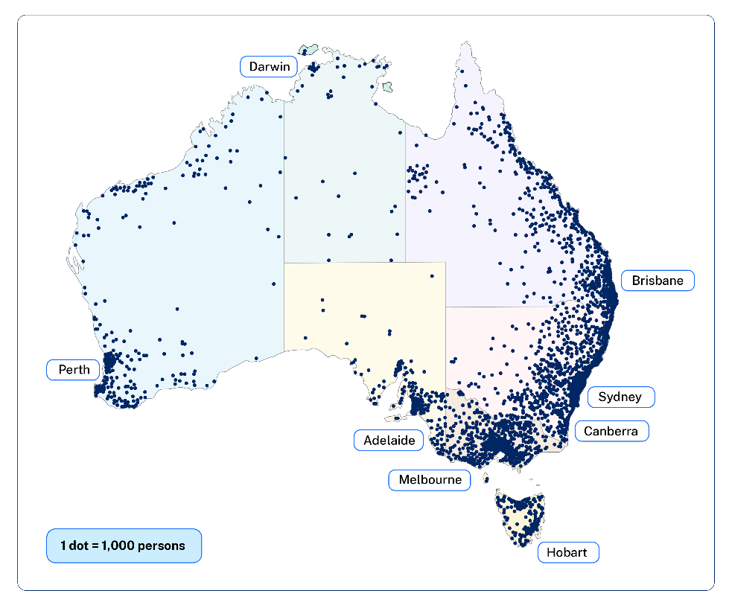

Features of a dot map
Density of a particular phenomenon
The phenomenon on this map is the density of people in an area
Low density = few dots or none
High density = a lot of dots close together
1 dot = 1000 people
Notes:
Suggested teacher think-aloud:
Dot maps use dots to show the density or frequency of something.
In this example, each dot represents 1,000 people.
The term phenomenon may need unpacking for students - something that exits and can be seen, felt, tasted, etc., especially something unusual or interesting.
Prompt question: Why do we use dots rather than shading?
Suggested response: Dots make it easier to see clusters and spread, rather than just colouring in areas.
Emphasise that the ratio matters, as it defines what each dot means.
Additional notes for teachers:
Dot maps are a form of map design that uses dots to show the density of a particular phenomenon in an area.
While more dots within a given area represent a higher value, fewer dots indicate a lower value or density.
Dot maps do not show the exact location of the phenomena. Instead, this type of map places dots randomly within an area to show density.
The term phenomenon may be unfamiliar to students. Define and unpack where required ‘Phenomenon – a fact or situation that is observed to exist or happen, especially one whose cause or explanation is in question’.

Slide 4

Dot density map ratios
Type of ratio | Rank
1:1 | One dot represents a single phenomenon. In this case, one dot might represent one person.
1:M | One dot represents multiple phenomena. For instance, one dot might represent 1,000 people.
Notes:
Suggested teacher think-aloud:
Ratios make a dot map meaningful.
We might use 1 dot = 100, or 1 dot = 10,000, depending on the scale.
As geographers, we make decisions about ratios to balance clarity and accuracy.
When reading the type of ratio 1:M this represents 1 to multiple phenomena. It will change according to the phenomena being represented. In this instance 1 dot represents 1000 people.
Prompt students to think: if there are too few dots, what happens? If there are too many, what happens?
Prompt question: What happens if we choose too few or too many dots?
Suggested response: Too few dots make the map unclear and hide detail; too many dots make the map cluttered and hard to read.
Additional notes for teachers:
When cartographers are building a dot map, the first thing they need to consider is the relationship between dots and area.
Typically, there are two approaches to dot density ratios on a map, as seen on the slide.
Because each dot represents a quantity, you can expect that when you see more dots, density will also increase.
Sometimes dot maps use different colours to show different categories.

Slide 5
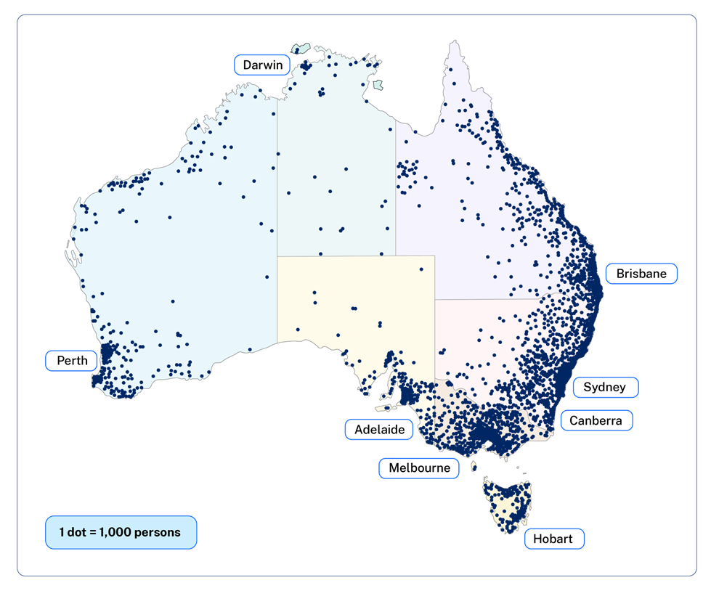
What type of map is this?
Why is this a dot map?
Notes:
Suggested teacher think-aloud:
Why is this a dot map and not another type of map?
Prompt students to think about what defines a dot map: identical dots, each representing the same quantity, placed in specific locations.
Prompt question: What defines a dot map?
Suggested response: Identical dots, each representing the same quantity, placed where the phenomenon occurs.
Reinforce that recognising map types is a key skill.
Additional notes for teachers:
Why is this a dot map?
Answers may include:
There are dot showing the distribution of people (phenomenon)
Each dot shows the distribution of 1000 people
The maps has a key that shows a ratio of 1 dot : 1,000 people.
What important features is this map missing?
BOLTSS – missing border, orientation, title and scale.
BOLTSS – included legend although not clearly labelled and source.
What population number does each dot represent on the map?
1:1000
Where do the majority of Australians live?
In capital cities and along the eastern coastline.
Suggest reasons why Australian’s live in these locations and not central Australia.
The centre of Australia is isolated and arid. It lacks access to facilities such as hospitals and schools.

Slide 6
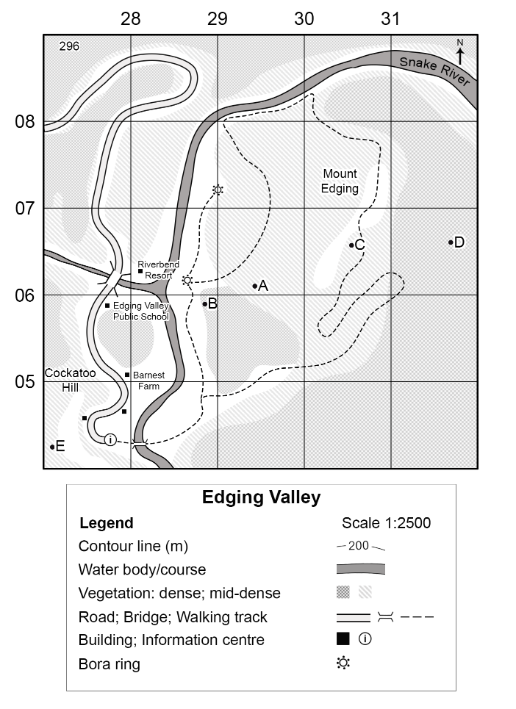
Edging Valley School (1)
Student population distribution
Construct a dot map to illustrate the student population distribution of Edging Valley School.
use a ratio of 1:1
1 dot represents 1 student
use student data on the next slide and Edging Valley map in the Resource booklet – liveability of places.
Notes:
Suggested teacher think-aloud:
Now it’s your turn to construct a dot map.
Use the ratio 1 dot = 1 student to map the distribution of Edging Valley School students.
Prompt students to think carefully about dot placement – accuracy matters.
Prompt question: Why is accuracy important here?
Suggested response: If dots aren’t placed carefully, the map could give a false impression of where students live.
Remind them that geographers use data like this for decisions about liveability, transport, and planning.
Notes for teachers:
This learning activity is designed to be taught after explicit teaching of area and grid referencing Planning, programming and assessing geography 7–10 (2024) Lesson 3 – liveability of places.
If students already have confidence in identifying area and grid references teachers may choose to proceed at this point in time with this activity.

Slide 7
Edging Valley School (2)
Student population distribution
Location | Student population
Mount edging AR3007 | 25
Cockatoo Hill AR2705 | 15
Riverbend Resort AR2806 | 40
Snake River AR3008 | 5
Notes:
Suggested teacher think-aloud:
Here is the data that you need to create a dot map.
Prompt students to think about how they can turn numbers in a table into a visual map. Stress that each dot must be placed correctly to represent one student.
Prompt question: Why might a map be more useful than just looking at this table?
Suggested response: A map shows patterns visually, making it easier to interpret than raw numbers.
Additional notes for teachers:
Students locate the AR and place 1 dot for every student recorded in the data sheet on the map.
Area reference is provided to support finding the locations. The focus of this lesson is a dot distribution map, not the location of placed using AR.
Teachers may like to draw attention to the use of Area Reference to help locate places on a map. Emphasise to students that Area Reference is not latitude and longitude.
For a full guide to teaching Area and Grid Reference teachers may like to access Mapping – area and grid reference (2024 Syllabus) Area and grid reference, geography 7–10.
Area reference will be explicitly taught at other times in the 7-10 program.

Slide 8

Interpreting dot maps
Where do most Edging Valley School students live?
Describe the proximity of Snake River students to Edging Valley school.
Notes:
Suggested teacher think-aloud:
Once you have created the map, we interpret it.
Prompt students to think: Where do most students live? What patterns do you see?
Prompt question: Where do most students live? What patterns do you see?
Suggested response: Most students live close to the centre, while Snake River students are further away.
Guide them to notice differences, such as proximity to Snake River versus central areas.
Connect this back to liveability – access to education is affected by where people live.
Additional notes for teachers:
Instruct students to use the dot map they developed to respond to the interpreting dot maps questions.
Where do most Edging Valley School students live?
Describe the proximity of Snake River students to Edging Valley School.

Slide 9
References
This presentation contains NSW Curriculum and syllabus content. The NSW Curriculum is developed by the NSW Education Standards Authority. This content is prepared by NESA for and on behalf of the Crown in the right of the State of New South Wales. The material is protected by Crown copyright.
Please refer to the NESA Copyright Disclaimer for more information https://educationstandards.nsw.edu.au/wps/portal/nesa/mini-footer/copyright.
NESA holds the only official and up-to-date versions of the NSW Curriculum and syllabus documents. Please visit the NSW Education Standards Authority (NESA) website https://educationstandards.nsw.edu.au/wps/portal/nesa/home and the NSW Curriculum website https://curriculum.nsw.edu.au.
Geography 7-10 © Syllabus NSW Education Standards Authority (NESA) for and on behalf of the Crown in right of the State of New South Wales, 2024.

Slide 10
Copyright
© State of New South Wales (Department of Education), 2024
The copyright material published in this resource is subject to the Copyright Act 1968 (Cth) and is owned by the NSW Department of Education or, where indicated, by a party other than the NSW Department of Education (third-party material).
Copyright material available in this resource and owned by the NSW Department of Education is licensed under a Creative Commons Attribution 4.0 International (CC BY 4.0) licence.
This licence allows you to share and adapt the material for any purpose, even commercially.
Attribution should be given to © State of New South Wales (Department of Education), 2024.
Material in this resource not available under a Creative Commons licence:
the NSW Department of Education logo, other logos and trademark-protected material
Material owned by a third party that has been reproduced with permission. You will need to obtain permission from the third party to reuse its material.
Links to third-party material and websites
Please note that the provided (reading/viewing material/list/links/texts) are a suggestion only and implies no endorsement, by the New South Wales Department of Education, of any author, publisher, or book title. School principals and teachers are best placed to assess the suitability of resources that would complement the curriculum and reflect the needs and interests of their students.
If you use the links provided in this document to access a third party’s website, you acknowledge that the terms of use, including licence terms set out on the third-party’s website apply to the use which may be made of the materials on that third-party website or where permitted by the Copyright Act 1968 (Cth). The department accepts no responsibility for content on third-party websites.

