Slide 1

What is explicit teaching?
Workshop 1 of 3

Slide 2

Acknowledgement of Country
We recognise the Ongoing Custodians of the lands and waterways where we work and live. We pay respect to Elders past and present as ongoing teachers of knowledge, songlines and stories. We strive to ensure every Aboriginal and Torres Strait Islander learner in NSW achieves their potential through education.
‘Stronger together’ created by 2P from Glendore Public School on Darkinjung Country as part of the 2021 School Reconciliation Challenge.
Notes:
Speaking notes:
[00:30]
Stronger together
'Stronger together' represents the importance of supporting each other through difficult times. The painting features wombat footprints, as wombats represent determination and strength. Created by Class 2P from Glendore Public School on Awabakal Country. The class was supported by Mrs Kerry Patterson, a teacher from the Darkinyung people.

Slide 3

Reflecting on current practice
1
What practices are we already doing that deliver success in learning?
2
How do we know these practices are successful?
Notes:
Speaking notes:
[Allow maximum 5 minutes for this slide]
Ask, “What practices are we already doing that deliver success in learning?”.
Let’s start with what we know. What pedagogical practices are we using in our context?
What evidence do we have to measure success? (Observations, qualitative/quantitative data)
How do we know if these practices are successful for every student?
We will come back to these examples later in our session.

Slide 4

Explicit teaching is one of three priority areas for 2024
“Explicit teaching helps all learners. We want it in 95,000 classrooms each and every day.”
Murat Dizdar
Secretary, NSW Department of Education
NSW Department of Education (2024) Delivering our plan together (Staff only)
Notes:
Speaking notes:
[00:30]
The Plan for NSW Public Education commits us to ensure every learner receives a high-quality education that enables them to excel.
The plan calls for the delivery of effective teaching practices, and calls out explicit teaching, specifically.
Explicit teaching helps all learners reach their full potential. This practice is equitable for all students, of all ages, from all backgrounds, and of all abilities.
It is a vital tool to create equity within and across schools.

Slide 5

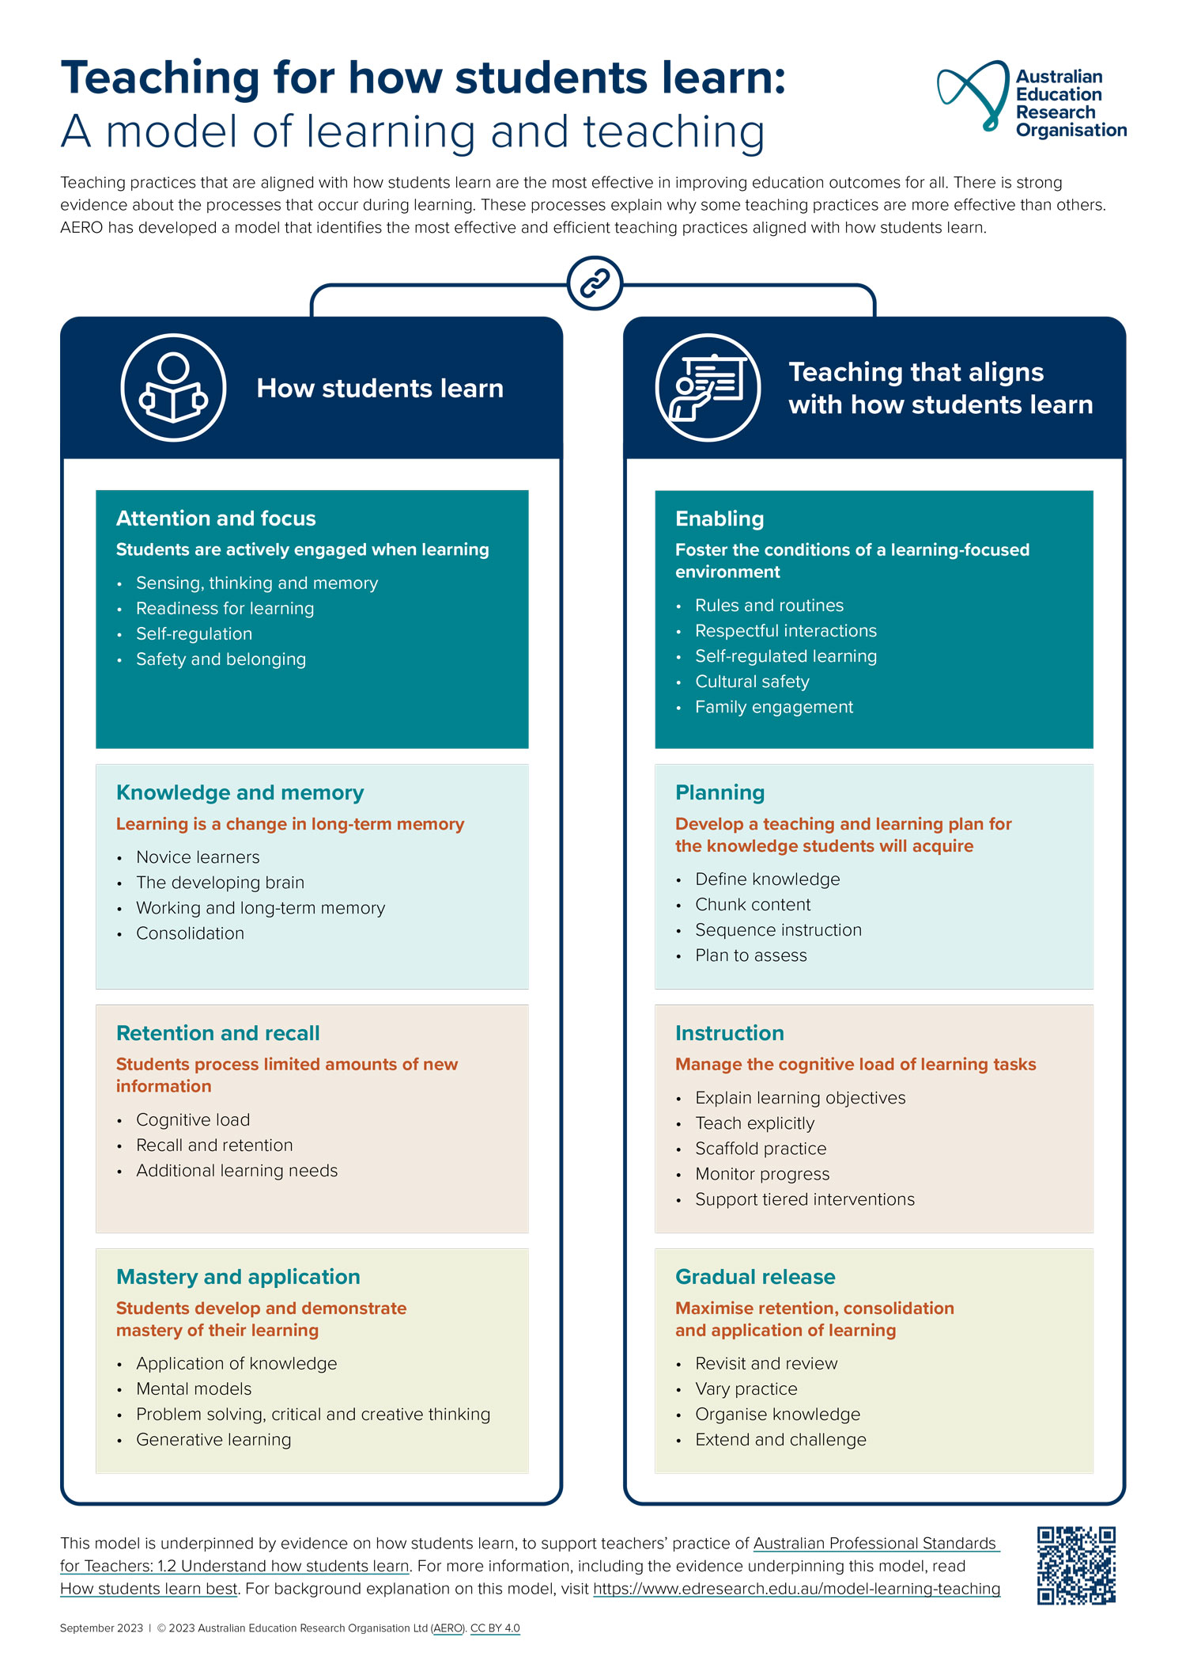
What explicit teaching is and why it works
Explicit teaching works because it aligns with how students learn ^{1,2}
Students | Teachers
learn when knowledge is transferred to long-term memory | develop a teaching and learning plan for the knowledge students will acquire
process limited amounts of new information | manage the cognitive load of learning tasks
develop and demonstrate mastery of their learning | maximise retention, consolidation and application of learning
are actively engaged when learning | foster the conditions of a learning-focused environment
1. What works best – 2020 update (CESE 2020)
2. Teaching for how students learn: A model of learning and teaching (AERO 2023)
Notes:
Speaking notes:
[1:00]
Explicit teaching is supported by longstanding evidence from cognitive science and educational psychology.
The importance of this evidence has been called out in CESE’s What Works Best resources since 2015.
More recent work from the Australian Education Research Organisation (AERO), the national education evidence body, continues to build on our understanding about why it is effective.
This evidence tells us that the approach of explicit teaching suits how the brain processes, stores and retrieves information. ​
From this slide, we can see that teachers design effective learning based on knowledge of how students learn. For example, we as teachers manage cognitive load by sequencing information in small chunks.
​
Explicit teaching can be thought of as a professional practice that consists of a set of principles that inform the use of a range of dynamic and responsive teaching strategies.
Facilitator prompts:
[2:00]
How have we engaged with CESE’s What Works Best and/or AERO’s research?

Slide 6


A deepening of professional expectations
New professional knowledge requirements for Initial Teacher Education programs
The large body of evidence from cognitive science and educational psychology continues to indicate that explicit teaching aligns with how students process, store, and retrieve information.
Although always present in Standard 1 ‘Know students and how they learn’ of the Australian Professional Standards for Teachers, recent changes to the requirements for initial teacher education highlight the importance of this as core professional knowledge for all teachers.
Notes:
Speaking notes:
[00:50]
There have been recent federal changes to Initial Teacher Education program requirements described in the AITSL Addendum that are important for us all to understand.
These changes mean a shift in our understanding of Standard 1 ‘Know students and how they learn’ of the Australian Professional Standards for Teachers.
Schedule 2 of the addendum calls out core knowledge expectations in areas such the brain and learning, effective pedagogical practices including explicit teaching and multi-tiered systems of support, as well as whole school approaches in a number of areas.
As educators, this clarity on our professional standards, is pivotal to our understanding and implementation of explicit teaching as a professional practice.
Facilitator prompts:
[2:00]
What does this change to initial teacher education mean for us? Why?

Slide 7
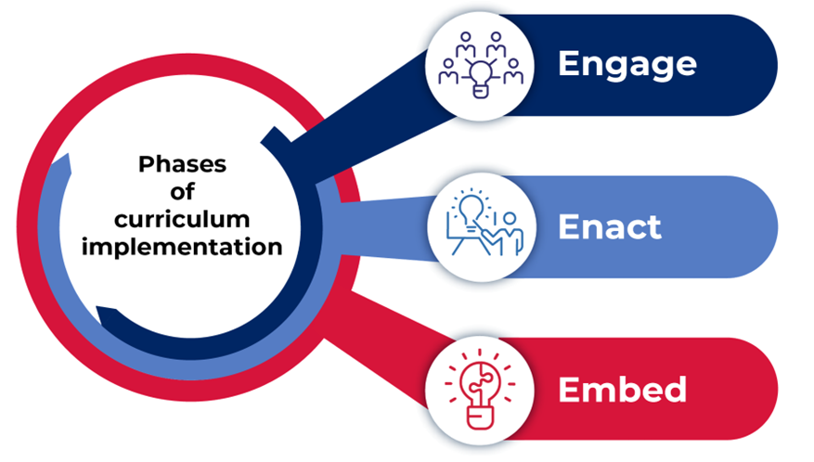
The opportunity of a new curriculum
Embedding explicit teaching
Notes:
Speaking notes:
[00:20]
Understanding the power of explicit teaching as we engage* with new syllabus content can help us to identify where, when and how to teach explicitly.
We have an opportunity to build explicit teaching strategies in our programs and teaching practice.
The first step is for us to develop our shared understanding of explicit teaching.
*Across K–12 each KLA is at different phase of curriculum implementation.

Slide 8

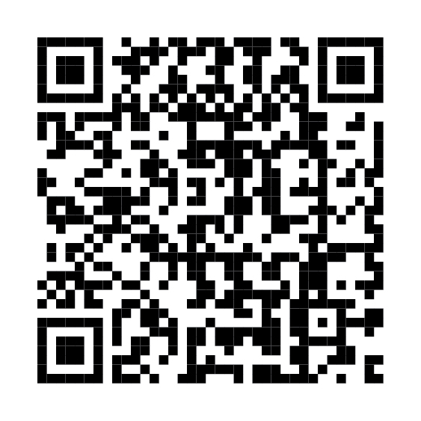
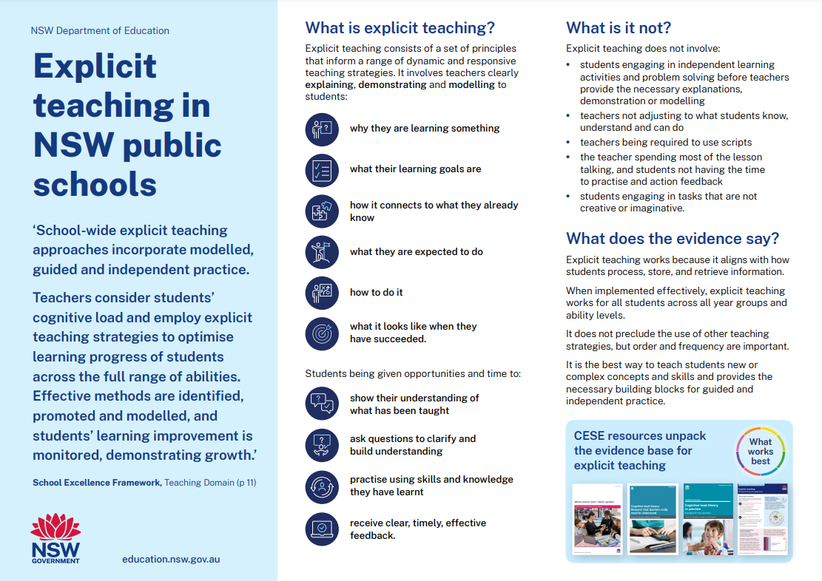
Explicit teaching in NSW public schools (1)
https://edu.nsw.link/explicit-teaching
Notes:
Speaking notes:
[00:50]
Webpage URL – https://education.nsw.gov.au/teaching-and-learning/curriculum/explicit-teaching
Short link – https://edu.nsw.link/explicit-teaching
During Term 1, the department released the statement on ‘Explicit teaching in NSW public schools’. The statement can be downloaded on the explicit teaching webpage – https://education.nsw.gov.au/teaching-and-learning/curriculum/explicit-teaching – use the QR code on the slide to take you to the webpage.
The intent of this statement is to provide clarity on explicit teaching and develop our shared understanding.
This presentation gives us an overview of the principles and strategies of explicit teaching as shown in the statement and explicit teaching webpage.
After this overview, we will/might have a chance to explore the website and engage in discussion about the content.

Slide 9

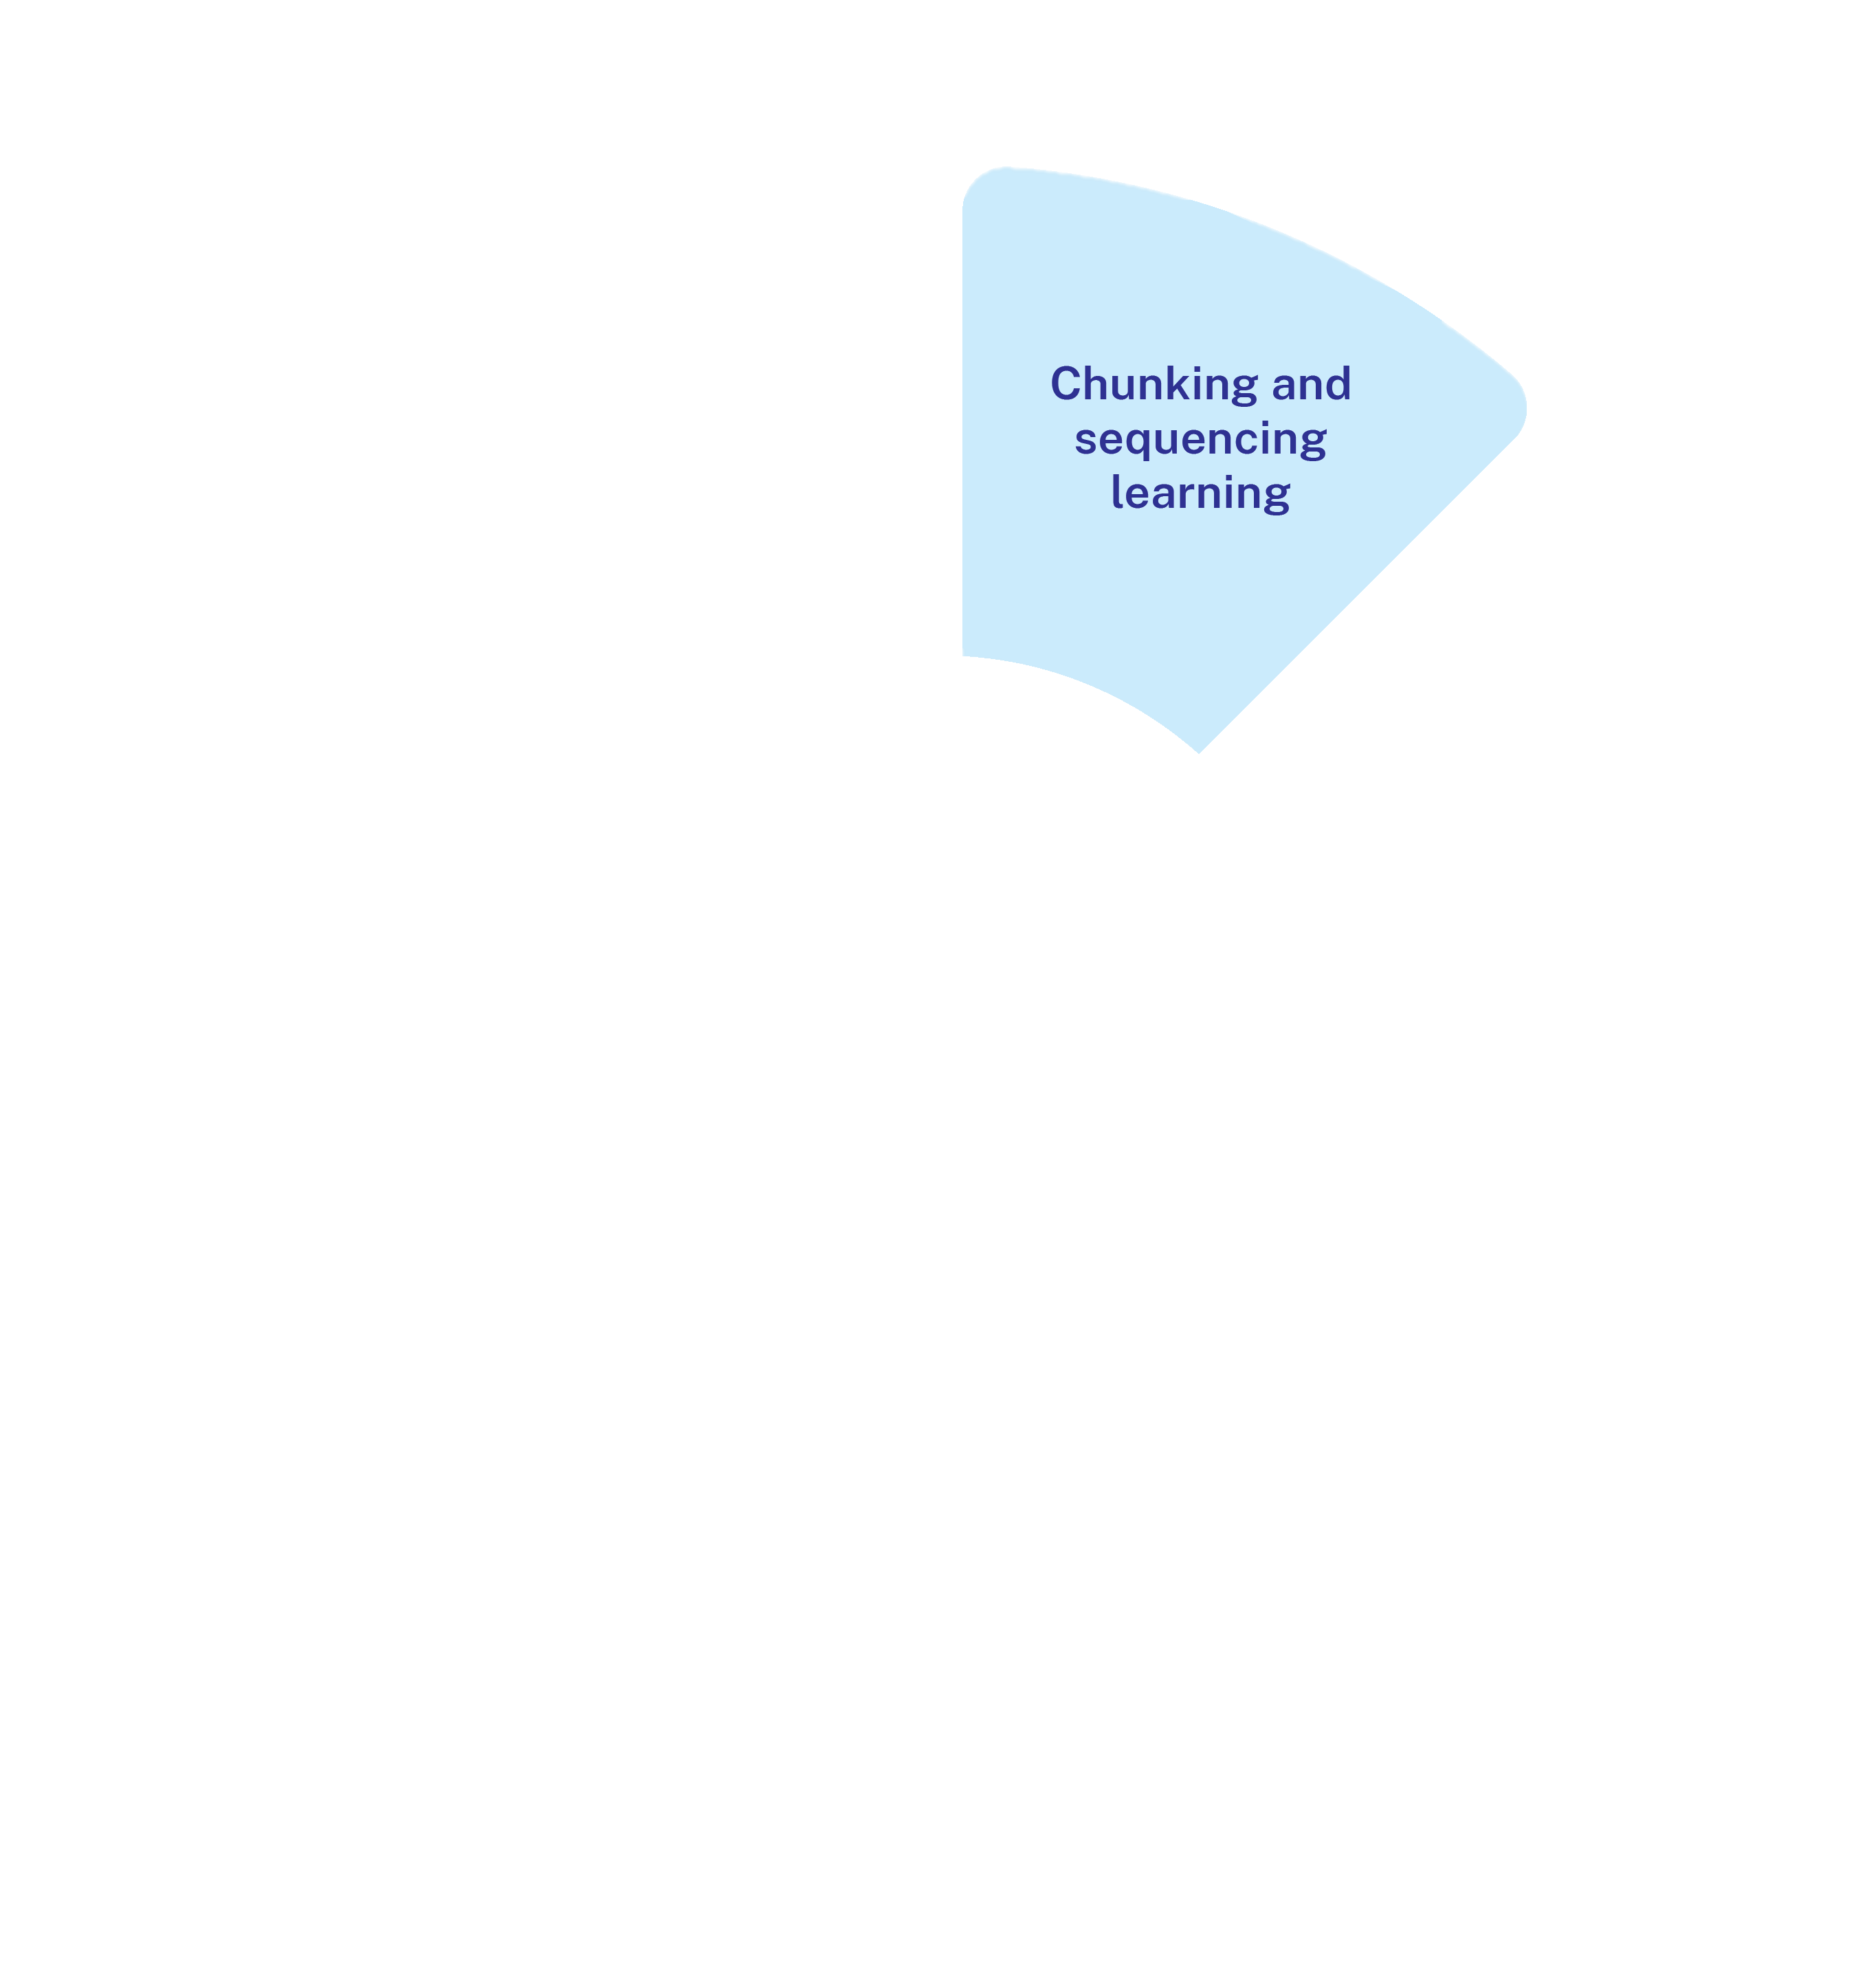
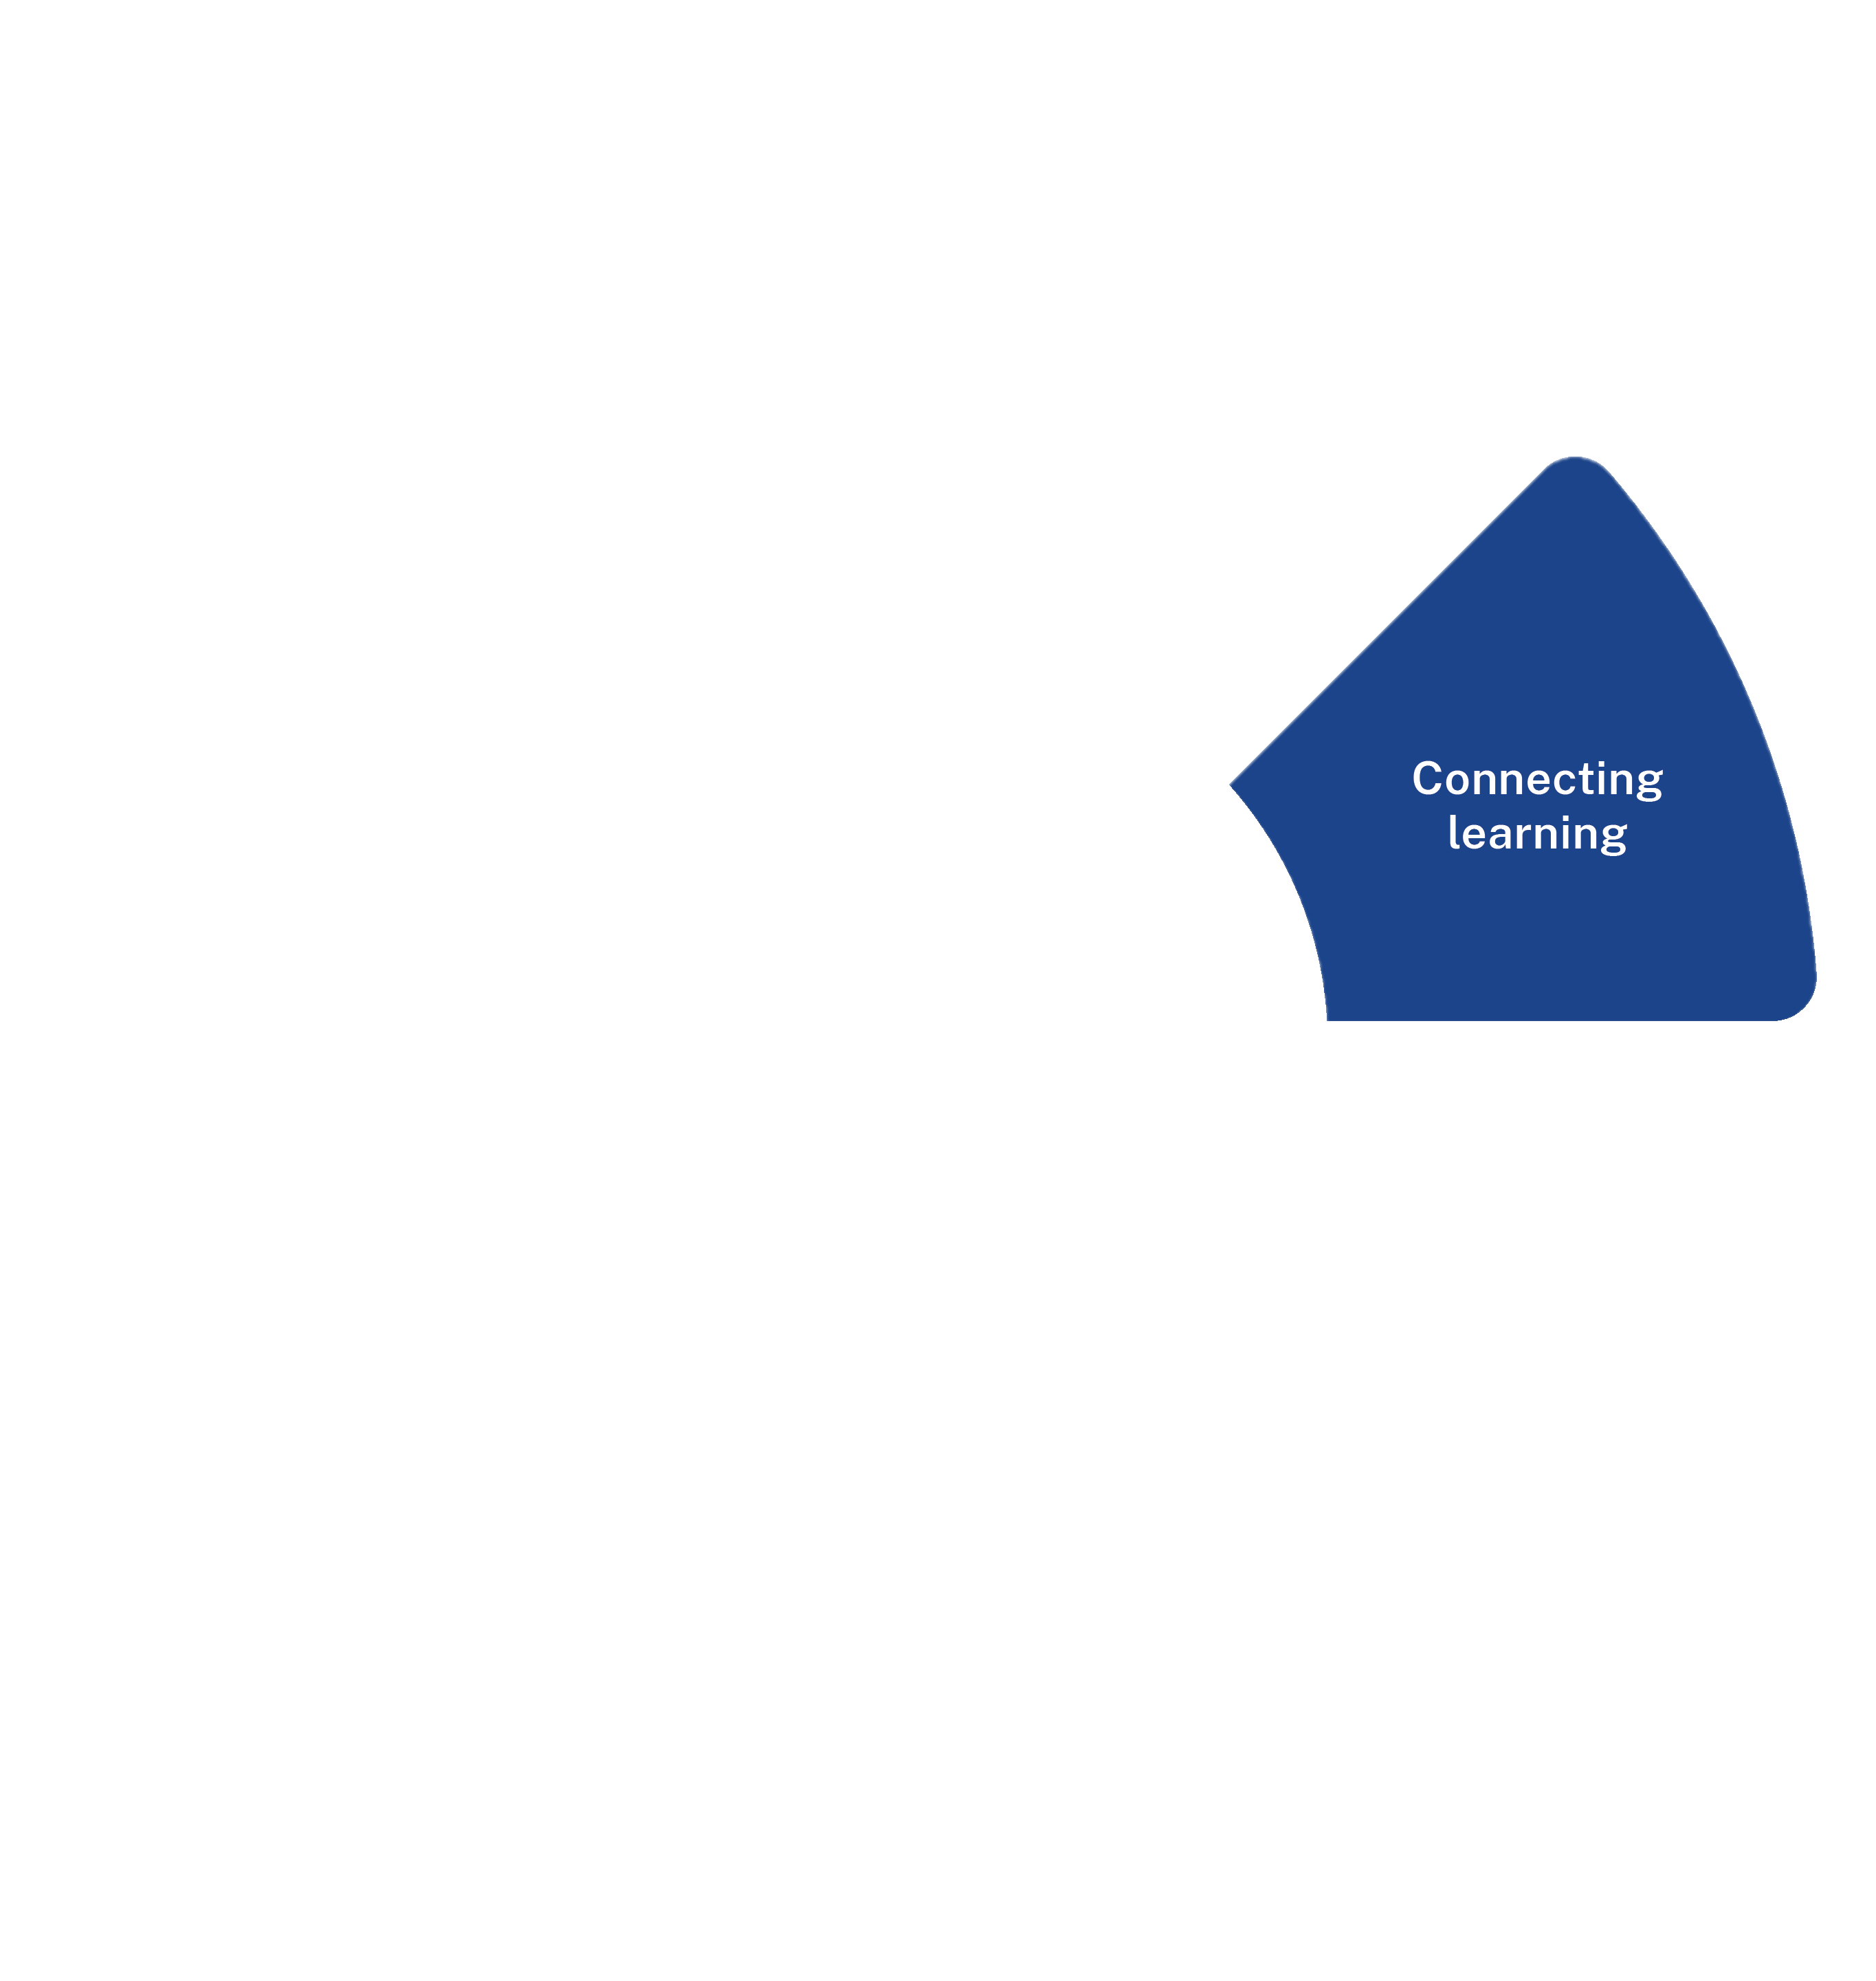
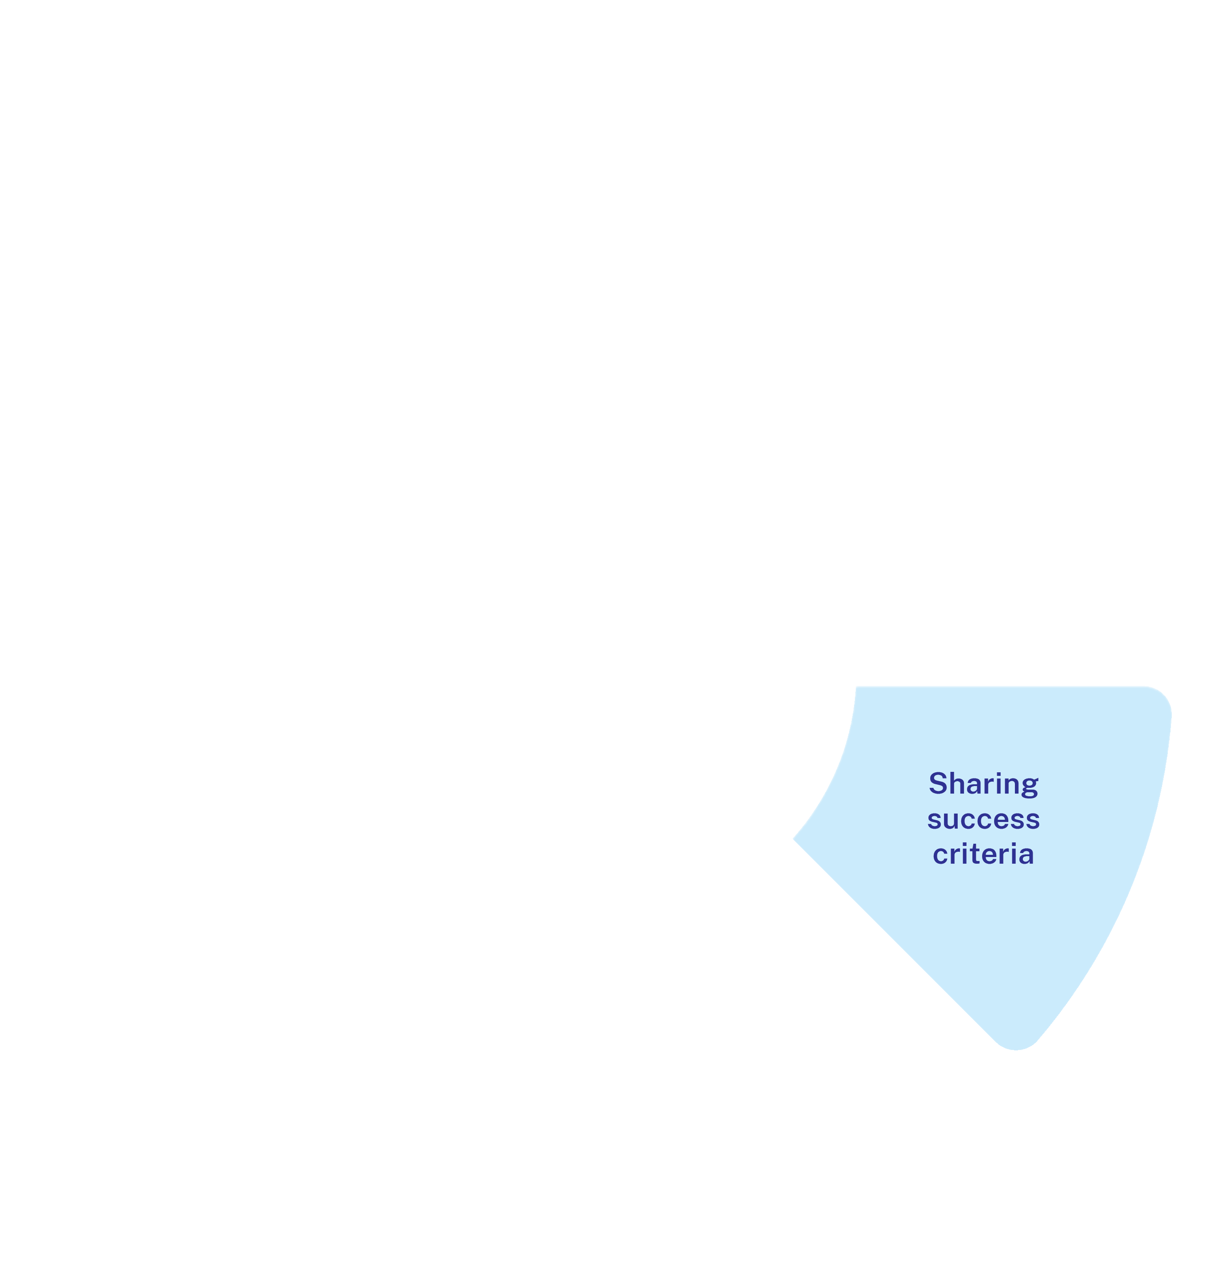


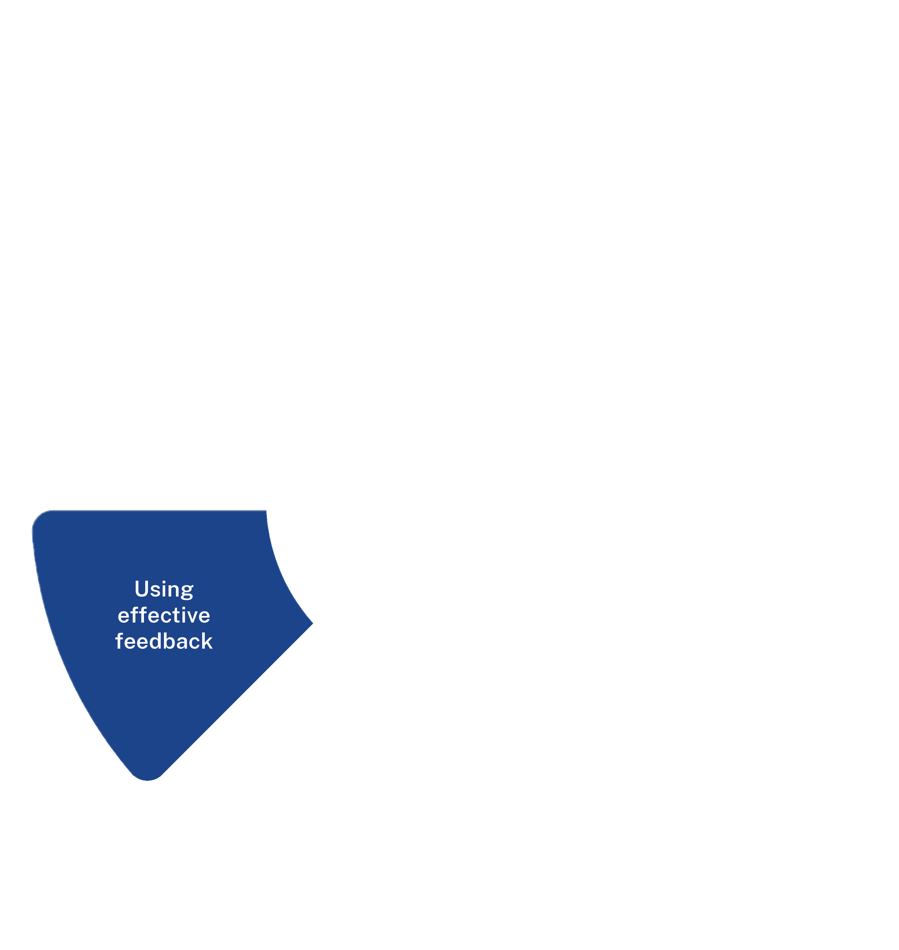
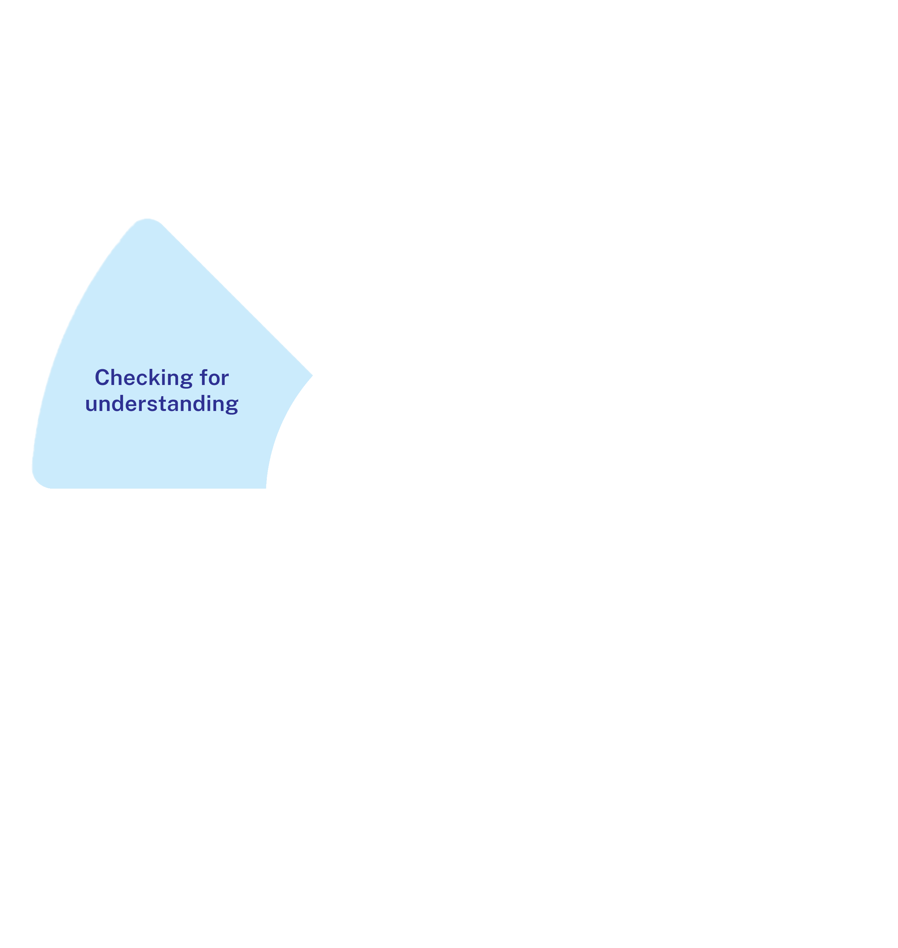
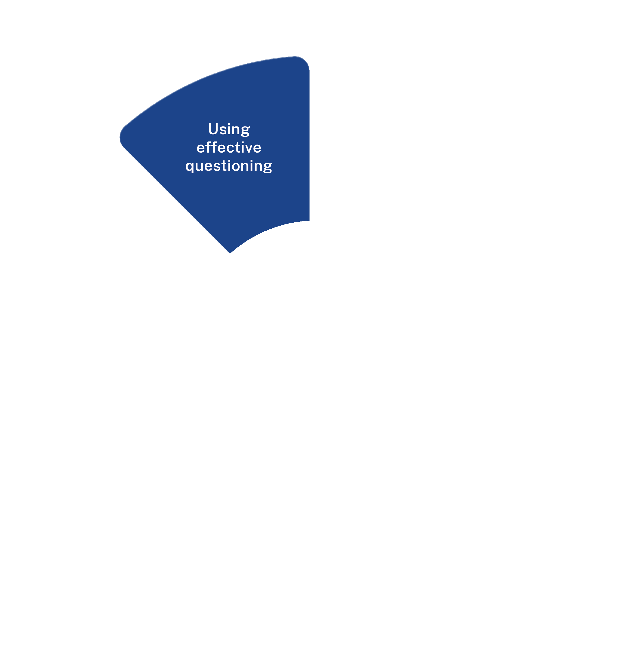



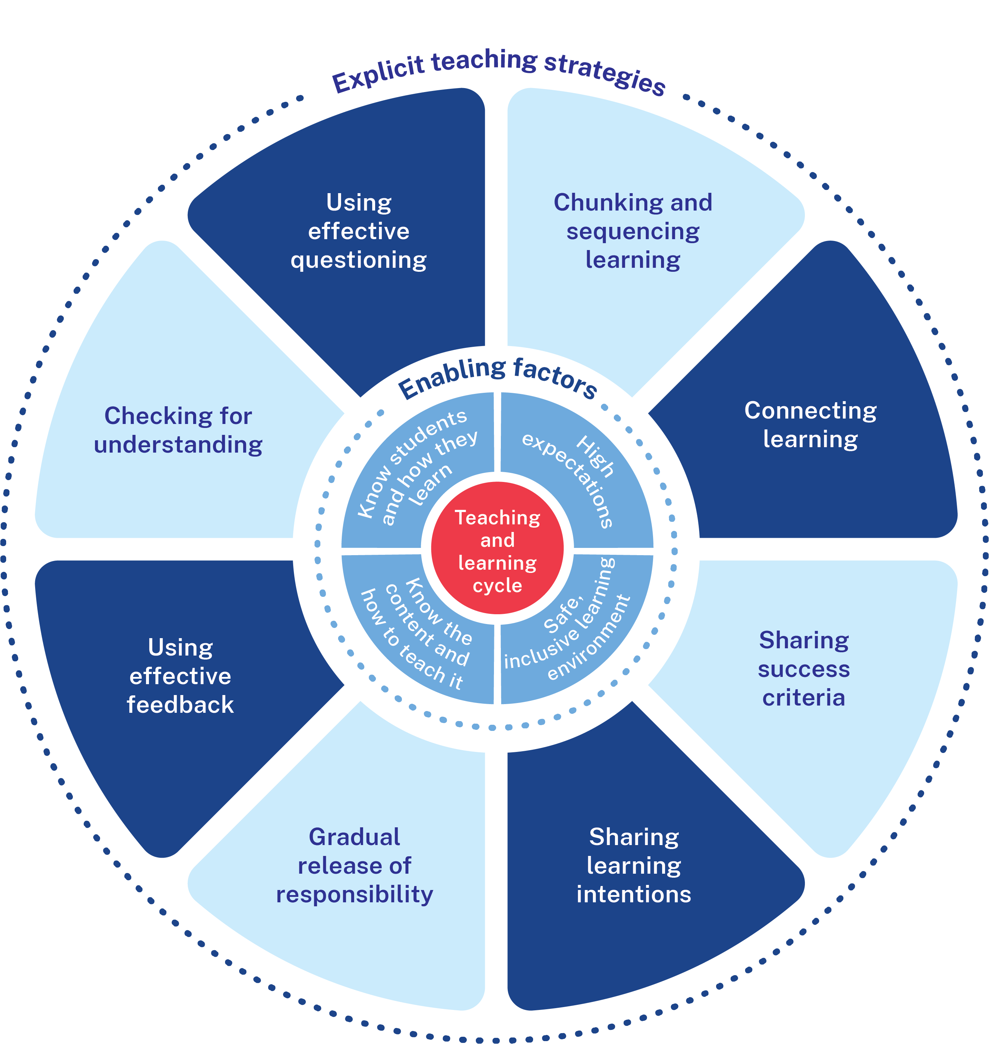
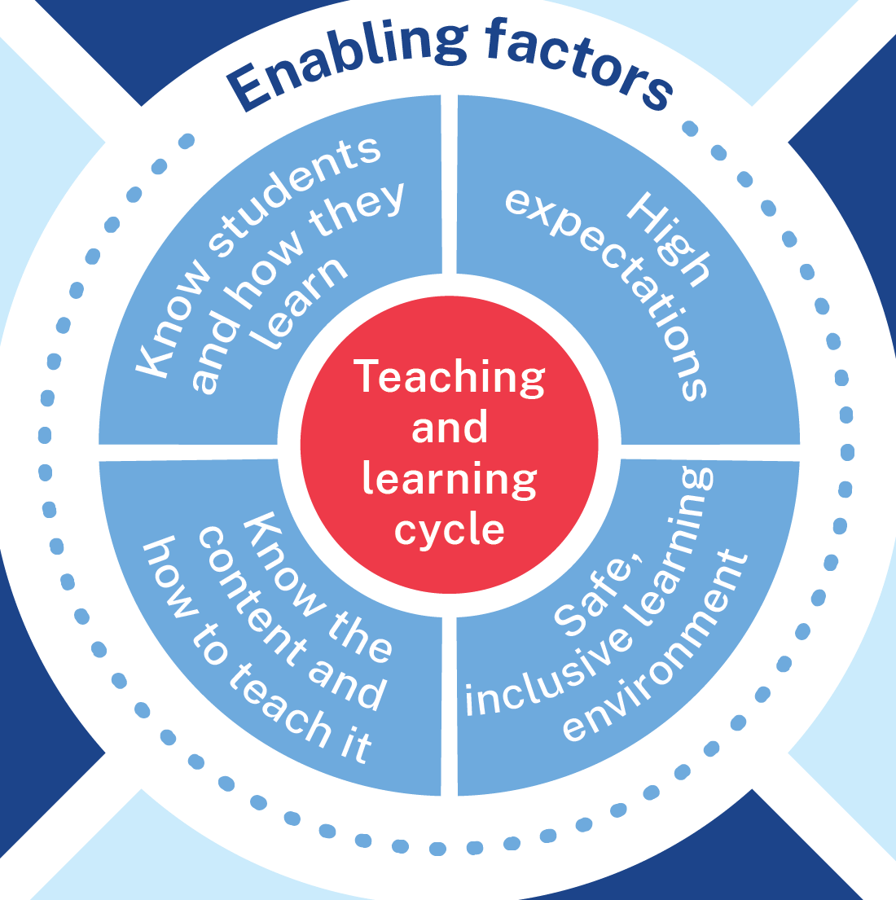

Effective explicit teaching
Notes:
Speaking notes:
[00:30]
Explicit Teaching is a professional practice that aligns with how students process, store, and retrieve information.
The strategies of Explicit Teaching work dynamically, allowing us to be responsive to how our students learn.
It is essential to have a holistic understanding of both the enabling factors and the strategies for teaching explicitly. This graphic reminds us of how these work together to make Explicit Teaching a powerful practice.

Slide 10
Enabling factors
Know students and how they learn
Know the content and how to teach it
High expectations
Safe, inclusive learning environments
Notes:
Speaking notes:
[00:40]
At the centre:
Teaching and Learning cycle anchors explicit teaching as a practice that is iterative and invites us to plan for, and be responsive to, learning within our classrooms.
Enabling factors are the preconditions required for Explicit Teaching to work. Students learn best in safe and inclusive environments that consider the cultural, social, emotional, behavioural and physical aspects of learning. Teachers hold high expectations of learning for their students. We use our deep knowledge of curriculum and our understanding of how learning happens to plan effective learning for all students.

Slide 11
Explicit teaching strategies
Notes:
Speaking notes:
[00:20]
Explicit Teaching strategies benefit all students when the learning is new or complex. We select the right strategies, at the right time, for the right purpose to optimise learning for our students.
Explicit Teaching is more than a list of strategies, rather it is a significant body of professional knowledge we, as teachers, use to inform our practice.

Slide 12
Chunking and sequencing learning
What is it?
Learning is a cumulative and systematic process.
Working memory is optimised when new content is
broken into a sequence and manageable steps, each
consolidated when students practise. This helps students build on what they already know, understand and can do. Sequencing intentionally orders learning to manage students’ cognitive load. Chunking breaks complex concepts, strategies or skills into smaller, more manageable components (AERO 2024a).
AERO (2024a) Teach explicitly
Notes:
Speaking notes:
[00:50]
Learning is a cumulative and systematic process.
With this knowledge ‘Chunking and sequencing learning’ is an important strategy for both designing and implementing learning in the classroom.
Sequencing intentionally orders learning.
Chunking breaks complex concepts, strategies or skills into smaller, more manageable components.
Using the strategy of ‘Chunking and sequencing learning’ is informed by our understanding of cognitive load theory and working memory limitations.
This understanding enables instructional decisions that best support students using their working memory to process information and store learning in long-term memory.

Slide 13
Connecting learning
What is it?
Teachers actively support students to make
connections to prior learning and across knowledge,
skills and understanding as well as to prior learning
experiences. This is important because students
need to connect new learning to their
existing knowledge (AERO 2023).
AERO (2023) Explicit instruction optimises learning
Notes:
Speaking notes:
[1:00]
The strategy of ‘Connecting learning’ describes teachers actively supporting students to make connections within and across knowledge, skills and understanding as well as to prior learning experiences.
We know that learning is actually a change to long-term memory.
Long-term memory can be thought of as a network of overlapping information with many connections, which are called schemas or sometimes ‘mental models’.
Making connections within and across learning helps students to develop increasingly complex schemas.
When previous learning is retrieved, it returns into working memory where connections to new or other previously learnt information can be made or strengthened.
This helps students retain learning and add complexity to their existing skills knowledge and understanding.
Interestingly, there is no limit to how complex a schema may become.
Schemas help manage cognitive load because they only occupy one 'space' in working memory, even though they may be infinitely complex.

Slide 14
Sharing success criteria
What is it?
Success criteria are the measures used to determine
whether, and how well, learners have met the
learning intentions. They are aligned to the syllabus,
use language students understand and can be
co-constructed with students. They are referred to
throughout a lesson or sequence (AERO 2024b).
Success criteria provide the basis for feedback
(Wiliam 2011), help teachers understand the impact
of their teaching and help students have clarity
about their learning (AITSL n.d).
AERO (2024b) Explain learning objectives
Wiliam D (2011) Embedded Formative Assessment, Solution Tree Press, Bloomington IN.
Notes:
Speaking notes:
[1:00]
Success criteria communicate to students what it looks like to achieve the learning intention.
They are aligned to the syllabus and break the learning intention into smaller and more manageable actions.
‘Sharing success criteria’ is a strategy used to show students what they must do, say, make, create or perform to demonstrate their learning.
We use language students understand and success criteria can be differentiated depending on the starting point of different students.
Success criteria form the basis for feedback, which may be from teacher, peers, or self-reflection.
They give students a framework to communicate with the teacher and their peers about their learning. This can help students identify and ask for help as needed.

Slide 15
Sharing learning intentions
What is it?
Learning intentions are statements aligned to the syllabus which clearly describe what students should know, understand or be able to do following an activity, lesson, or series of lessons. Effective learning intentions are written in student-friendly language, modelled by the teacher and shared in ways that make sense to students to ensure they know what they are learning and why (Clarke, Timperley & Hattie 2003). The teacher uses the learning intentions throughout a lesson and series of lessons to guide their decision making.
Clarke S, Timperley H and Hattie J (2003) Unlocking Formative Assessment: Practical Strategies for Enhancing Students’ Learning in the Primary and Intermediate Classroom, Hodder, London.
Notes:
Speaking notes:
[00:20]
Classrooms are busy places with lots of activities that can divide the attention of our students.
Sharing learning intentions supports students to know what to pay attention to and helps them to focus on the intended learning.

Slide 16
Gradual release of responsibility
What is it?
Informed by evidence of student learning, teachers intentionally support new learning. This is most effective when teachers break down new information by explaining, demonstrating and modelling (AERO 2024a). Skills and concepts are modelled, and teachers provide opportunities for students to apply their understanding in guided and independent practice. Teachers respond to student understanding by moving backwards and forwards between teacher modelling, guided practice and independent practice (NESA 2022; Fisher and Frey 2021).
Fisher and Frey (2021) Better Learning Through Structured Teaching: A Framework for the Gradual Release of Responsibility, 3rd Edition
Notes:
Speaking notes:
[1:00]
Understanding how learning happens, we can deliver a structured and sequenced approach to explicitly teaching new content.
Learning is most efficient when we break new information down and teach it explicitly using explanation, demonstration and modelling.
We need to emphasise that the strategy of ‘Gradual release of responsibility’ is not linear.
Teachers move between modelling, guided and independent practise throughout lessons and across learning sequences.
We make decisions based on student understanding and readiness as we ‘Check for understanding’ to move students between modelled, guided, and independent practise.
Gradual release is sometimes referred to as ‘I do, we do, you do’ or ‘modelled, guided, independent practice’. However, it is important to recognise that students may fluidly move 'forwards' and 'backwards' in this process.

Slide 17
Using effective feedback
What is it?
Feedback is effective when it is both timely and
task focussed (CESE 2020). It focuses on growth
and improving understanding for future learning
experiences. Feedback is effective when planned
for and students are given the opportunity to
reflect and act on the feedback they’re provided.
Notes:
Speaking notes:
[00:40]
The strategy of ‘Using effective feedback’ is used to cause students to think and act in ways that will help them to bridge the gap between their current state and the intended demonstration of learning.
Feedback is most useful when it is aligned to the learning intentions and success criteria of a lesson or learning experience.
It is focused on growth and improving understanding for future learning experiences.
Importantly, students are given the opportunity to reflect and act on the feedback they’re provided.

Slide 18
Checking for understanding
What is it?
Teachers check for understanding throughout the
lesson to establish where all students are in their
learning. Checking for understanding is crucial to
identify gaps and adjust teaching before moving to
independent practice or removing scaffolds. When
every student’s learning is monitored it helps create
a safe learning environment where students feel
supported to be active participants (AERO 2024c).
AERO (2024c) Monitor progress
Notes:
Speaking notes:
[00:50]
When every student’s learning is monitored it helps create a safe learning environment where students feel supported to be active participants.
Teachers check for understanding throughout the lesson to establish where all students are in their learning.
We regularly check student understanding using a variety of strategies including effective questioning.
We analyse the information we collect to make evidence-based instructional decisions.
This includes when to move between modelled, guided and independent practise.
Checking for understanding is a crucial strategy for us to identify gaps and adjust our teaching before moving students to independent practise or removing scaffolds.

Slide 19
Using effective questioning
What is it?
Teachers use questioning to deepen student thinking and to gather information about what students know (CESE 2020). Student responses inform effective decisions about teaching and learning. Teachers intentionally employ structures that support all students to participate and share their thinking.
Notes:
Speaking notes:
[00:30]
Teachers use questioning to deepen student thinking and to gather information about what students know.
Student responses inform our effective decisions to progress student learning.
We intentionally employ structures that support all students to participate and share their thinking.
Effective questioning strategies cause all students to think. This creates high engagement classroom environments which improve student achievement.

Slide 20
Circling back
Thinking back to our examples of success:
1
What connections can you make between your example and explicit teaching?
2
What are you curious to know more about?
Notes:
Speaking notes:
[Allow maximum 5 minutes for this slide]
Think back to the example of a practice that delivers success in learning, from earlier in the presentation.
Consider the connections we can make with our current practices and explicit teaching. What is similar? What is different?
What are you curious to know more about?

Slide 21
Explicit teaching in NSW public schools (2)
Time to explore
https://edu.nsw.link/explicit-teaching
Notes:
Speaking notes:
[00:20]
Webpage URL – https://education.nsw.gov.au/teaching-and-learning/curriculum/explicit-teaching
Short link – https://edu.nsw.link/explicit-teaching
Now that we have started thinking about explicit teaching in the context of our school*, we can explore the website and engage in further discussion**.
*It is important we have a shared understanding of explicit teaching as a whole, as well as a shared understanding of each of the strategies. While this workshop provides time to explore the website, additional time will be required to engage more deeply with the strategies and their implementation.
**The facilitator will share questions from the discussion guide for teachers to reflect on as they explore the ‘Explicit teaching in NSW public schools’ statement and explicit teaching webpage.

Slide 22
Additional workshops
Workshop 2 – How learning happens
This workshop provides:
clarity on the expectations of teacher and leader professional knowledge
time to engage with key research concepts and their implications for teaching.
Notes:
Speaking notes:
[00:40]
Additional workshops will provide further clarity on the evidence-base used to inform explicit teaching and the enabling factors and strategies of this practice.
Workshop 2 is designed to refresh our understanding of the AITSL Initial Teachers Education Addendum, identify the implications for expectations of professional knowledge and provide us with time to collectively engage with key research about how learning happens.

Slide 23
Further resources about explicit teaching
CESE resources:
What works best suite of resources (CESE 2020)
Cognitive load theory (CESE 2017) and Cognitive load theory in practice (CESE 2018)
Explicit teaching drives student motivation, engagement, and achievement in NSW public schools (CESE 2024)
AERO resources:
How students learn best: An overview of evidence (AERO 2023)
Explicit instruction optimises learning (AERO 2023)
Managing cognitive load optimises learning (AERO 2023)
Knowledge is central to learning (AERO 2023)
Explicit instruction: Guides and resources (AERO 2022)
Notes:
To find out more about the evidence-base for explicit teaching, we recommend these key CESE and AERO resources for further reading.
There are also reports that use TTFM data that are available in Scout that could be useful for conversations about explicit teaching.

Slide 24
Do you have any questions?
ContactCurriculumReform@det.nsw.edu.au

Slide 25
Copyright
© State of New South Wales (Department of Education), 2024
The copyright material published in this resource is subject to the Copyright Act 1968 (Cth) and is owned by the NSW Department of Education or, where indicated, by a party other than the NSW Department of Education (third-party material).
Copyright material available in this resource and owned by the NSW Department of Education is licensed under a Creative Commons Attribution 4.0 International (CC BY 4.0) licence.
This licence allows you to share and adapt the material for any purpose, even commercially.
Attribution should be given to © State of New South Wales (Department of Education), 2024.
Material in this resource not available under a Creative Commons licence:
the NSW Department of Education logo, other logos and trademark-protected material
Material owned by a third party that has been reproduced with permission. You will need to obtain permission from the third party to reuse its material.
Links to third-party material and websites
Please note that the provided (reading/viewing material/list/links/texts) are a suggestion only and implies no endorsement, by the New South Wales Department of Education, of any author, publisher, or book title. School principals and teachers are best placed to assess the suitability of resources that would complement the curriculum and reflect the needs and interests of their students.
If you use the links provided in this document to access a third party’s website, you acknowledge that the terms of use, including licence terms set out on the third-party’s website apply to the use which may be made of the materials on that third-party website or where permitted by the Copyright Act 1968 (Cth). The department accepts no responsibility for content on third-party websites.

