Slide 1
About this presentation
Facilitator instructions
This slide deck contains 3 parts that require some preplanning.
Part A – Strategy overview, approach and impact – opportunity to collect data that could be used in Part C. The presenter will need to facilitate this. Part A includes an activity relating to technique guides that can be found on the using effective questioning webpage.
Part B – Implementing the strategies through techniques – the group activity requires pre-planning.
Part C – Evaluating a whole-school approach – opportunity to link to the School Excellence Plan.
Leaders should engage with Part C before implementing the professional learning with staff.
It is recommended that schools engage with Checking for understanding strategy learning module and technique guides before commencing this module.
Slides are repeated across strategy modules so they can be implemented with the same structure. Note: some slides contain animations indicated by [click] in the presenter notes.

Slide 2

Effective questioning
Strategy learning module

Slide 3

Acknowledgement of Country
We recognise the Ongoing Custodians of the lands and waterways where we work and live. We pay respect to Elders past and present as ongoing teachers of knowledge, songlines and stories. We strive to ensure every Aboriginal and Torres Strait Islander learner in NSW achieves their potential through education.
‘Kariong – Our meeting place’ created by Stella Haynes from Cammeray Public School on Eora Country as part of the 2022 Calendar for cultural diversity.
Notes:
Purpose: Acknowledgement of Country
Speaker notes:
[00:30]
I would like to acknowledge the traditional custodians of the land on which we meet today. We pay our respects to their Elders past and present. We recognise their continuing connection to land, water, and culture, and we are committed to continuing to learn from their wisdom and traditions.

Slide 4
Introduction
Notes:
Purpose: Introduction slide

Slide 5
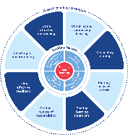
Enabling factors
Know students and how they learn
High expectations
Teachers understand how learning happens, and this informs their practice.
Students benefit from teachers holding high expectations for their learning.
Know the content and how to teach it
Safe, inclusive learning environments
Teachers know how the knowledge builds and connects to create learning that is strategic, sequenced and cumulative.
Explicit teaching both relies on, and brings about, a safe and inclusive learning environment.
Notes:
Purpose: Revisiting core knowledge
Speaker notes:
[00:30]
Let’s remind ourselves that explicit teaching is an optimal way to teach knowledge and skills that are new or complex.
There are important enabling factors for explicit teaching that relate to the technique we are focusing on. Let’s revisit them.
Note to presenter: you may wish for participants to read these to themselves
Our understanding of the how learning happens informs our practice
We know how knowledge builds across syllabuses
We hold high expectations for our students’ learning
And, explicit teaching both relies on, and brings about a safe, inclusive learning environment
References:
CESE (Centre for Education Statistics and Evaluation) (2024) Explicit teaching drives student motivation, engagement, and achievement in NSW public schools – a What Works Best research update, NSW Department of Education.
Resources:
Leading explicit teaching – school-facilitated workshops 1–3 on core content and the enabling factors of explicit teaching – https://education.nsw.gov.au/teaching-and-learning/curriculum/explicit-teaching/leading-explicit-teaching
Classrooms of Possibility – https://education.nsw.gov.au/inside-the-department/teaching-and-learning/classrooms-of-possibility
Explicit instruction – implementing evidence-based teaching practices for students with disability - https://resources.education.nsw.gov.au/detail/IPR-LD230526144351
Strong Strides Together: Meeting the educational goals for Aboriginal and/or Torres Strait Islander students – https://education.nsw.gov.au/teaching-and-learning/aec/universal-resources---aboriginal-education/strong-strides-together--meeting-the-educational-goals-for-abori

Slide 6
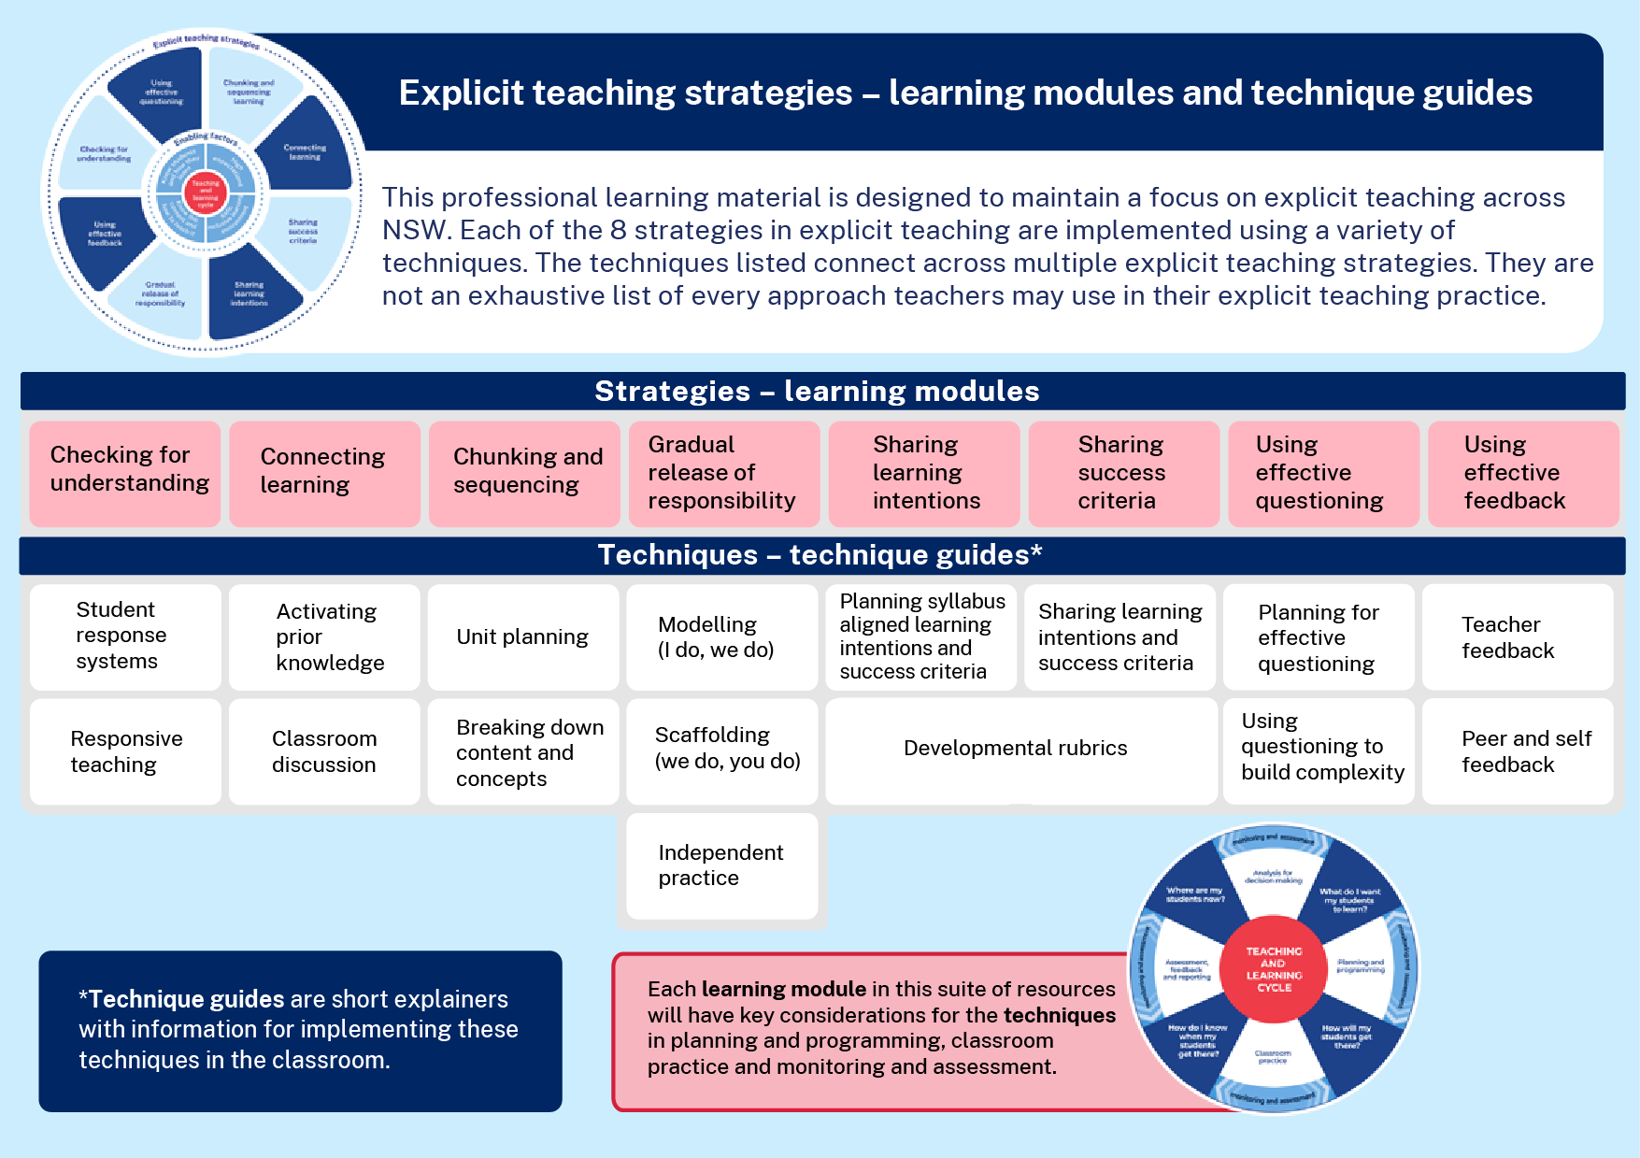
Learning modules and technique guides
Notes:
Purpose: To highlight where this module fits with other current and future modules and technique guides.
Speaker notes:
[00:30]
This module looks at one of the 8 explicit teaching strategies, using effective questioning. We will present some techniques for this strategy, using questions to build complexity and then how we plan for effective questioning. You will have an opportunity to look at these technique guides shortly.
Note to presenter:
Technique guides are available to supplement this presentation. For the activity on slide 24, it is expected that teachers have seen and read the guides.
Using effective questioning resources:
https://education.nsw.gov.au/teaching-and-learning/curriculum/explicit-teaching/explicit-teaching-strategies/using-effective-questioning

Slide 7

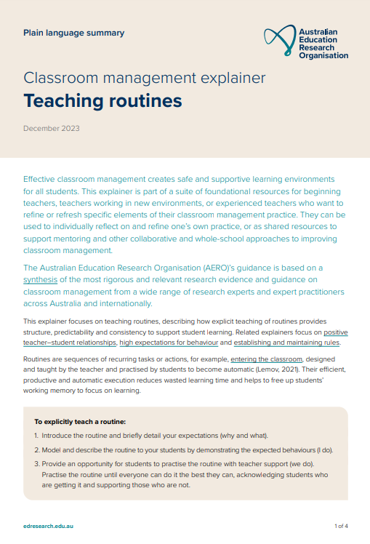
The importance of all moving together (1)
Saves learning time¹
Frees up students’ working memory²
Certain and consistent expectations for students³
Students learn the routine more quickly when it is done in the same way across the school⁴
Fosters a strong sense of belonging⁵
Notes:
Purpose: to restate why a whole school teaching routine is powerful
Speaker notes:
[00:50]
These modules use the power of whole school teaching routines. When a group of expert teachers from across the school come together and create a whole school approach, they are far more effective than when they go it alone. Teaching routines:
[click] save learning time
[click] can free up students’ working memory
[click] provide certainty and expectations for students to contribute to a learning environment where they’re safe to participate.
[click] they’re efficient, because when done the same way across the school, students can learn the routine more quickly.
[click] and they foster a strong sense of belonging.
As we go through the learning module here, and other learning modules for explicit teaching we will revisit the idea of the whole school teaching routines.
References:
Archer AL and Hughes CA (2011) Explicit instruction: effective and efficient teaching, Guilford Press.
AREO (Australian Education Research Organisation) (2021) Focused classrooms: managing the classroom to maximise learning, AERO, accessed 11 February 2025.
AERO (Australian Education Research Organisation) (2023a) Teaching routines, AERO, accessed 20 February 2025.
McCrea P (2020) Motivated teaching: harnessing the science of motivation to boost attention and effort in the classroom, Createspace Independent Publishing Platform.
McCrea P (2020) Motivated teaching: harnessing the science of motivation to boost attention and effort in the classroom, Createspace Independent Publishing Platform.
Further reading:
Tharby A (12 May 2023) ‘We are what we do: the case for explicit and consistent school-wide routines’, Class Teaching, find the bright spots, accessed 20 November 2024. https://classteaching.wordpress.com/2023/05/17/we-are-what-we-do-the-case-for-explicit-and-consistent-school-wide-routines/

Slide 8
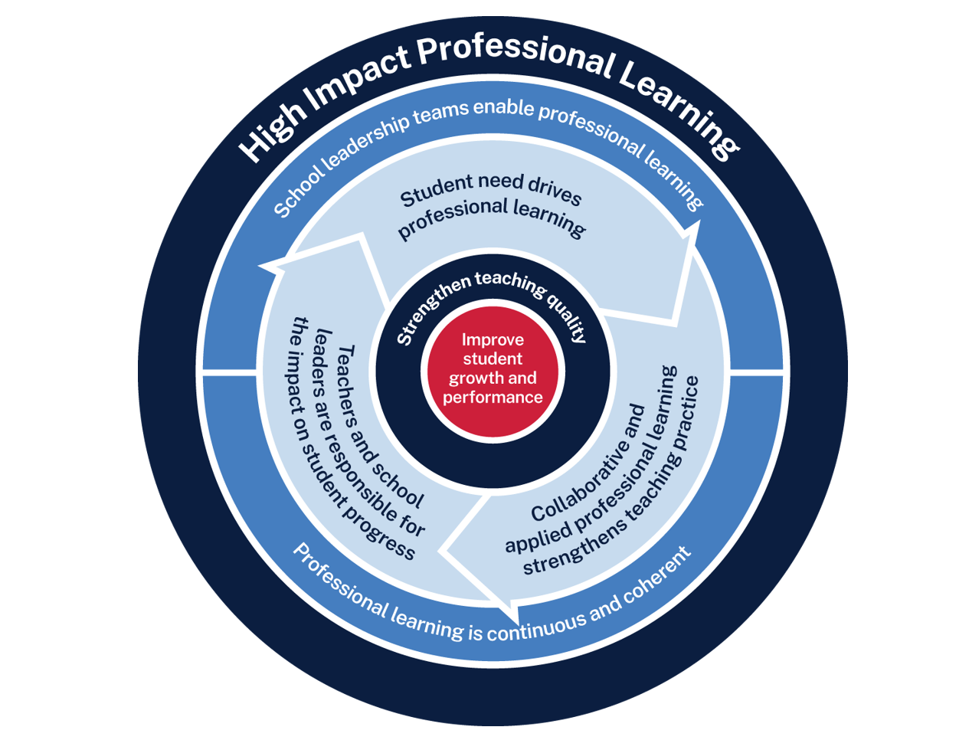
Effective feedback professional learning
Measure baseline student data and set a goal
Analyse data to determine further cycles
Use the whole school teaching approach and plan for instruction
Implement the teaching routine in the classroom and measure impact
Rehearse and give feedback to each other
8
Notes:
Purpose: Familiarising High Impact Professional Learning model (HIPL) and how it may inform our implementation of explicit teaching.
[01:00]
Speaker notes:
The High Impact Professional Learning (HIPL) model forms the basis of this professional learning. This model has five elements.
Professional learning is driven by identified student needs - https://education.nsw.gov.au/teaching-and-learning/professional-learning/high-impact-professional-learning/what-is-hipl/student-needs-drive-teacher-learning
School leadership teams enable professional learning - https://education.nsw.gov.au/teaching-and-learning/professional-learning/high-impact-professional-learning/what-is-hipl/leadership-that-prioritises-learning
Collaborative and applied professional learning strengthens teaching practice - https://education.nsw.gov.au/teaching-and-learning/professional-learning/high-impact-professional-learning/what-is-hipl/collaboration-that-improves-classroom-practice
Professional learning is continuous and coherent - https://education.nsw.gov.au/teaching-and-learning/professional-learning/high-impact-professional-learning/what-is-hipl/a-culture-of-continuous-learning
Teachers and school leaders are responsible for the impact of professional learning on student growth and performance - https://education.nsw.gov.au/teaching-and-learning/professional-learning/high-impact-professional-learning/what-is-hipl/accountability-for-impact-on-student-progress
The actions and steps we take to enact each of these elements will be shaped by our increasing shared understanding of check for understanding strategy and how specific check for understanding techniques can be used to optimise the learning of our students.

Slide 9
Initial reflection point (1)
Teacher observation | 0 | 1 | 2 | 3 | 4
Students demonstrate their thinking by actively responding with an answer during effective questioning throughout each lesson. | Not yet observable | Minimal students actively respond to effective questioning | Some students demonstrate their thinking by actively responding to effective questioning | Most students demonstrate their thinking by actively responding to effective questioning | All students demonstrate their thinking by actively responding to effective questioning
Notes:
Purpose: Initial teacher collected data as an early indicator.
Speaker notes:
[01:00]
An initial indicator is an observable change in student learning. It can help teachers to understand how effective their use of a technique may be. Initial indicators are important because they can give teachers insights into what parts of the instruction may need to be refined.
Here is an example of a tool that could be used for teacher reflection. This is one way to measure one aspect of the effectiveness of questioning.
Think about one class you taught today. What parts of the scale would best describe your students?
(Allow time for teachers to reflect and share. Recording some ideas here would be beneficial as an initial point of reflection as we focus on effective questioning as a strategy.)
We will be able to refer to our early indicator observations when we evaluate our impact in Part C.
Note to presenter: There is an opportunity to use this data in the final session. This measure is not the only consideration, and schools should select a model that is right for them.
This data could be collated and compared to other “school and classroom data about growth and performance.”
For example:
NAPLAN report overview accessed through Scout
https://education.nsw.gov.au/about-us/education-data-and-research/scout/training/digital-learning-centre/naplan-report-overview
NAPLAN report overview
Learn more about the NAPLAN reports in Scout.
https://education.nsw.gov.au/technology/scout/scout-training/digital-learning-centre/naplan-for-teachers
Class report
The Class report shows the distribution of students’ scaled scores across domains and proficiency levels for NAPLAN 3, 5, 7 or 9.
References:
AERO (Australian Education Research Organisation) (2023b) How students learn best: an overview of the learning process and the most effective teaching practices, AERO, accessed 27 February 2025.

Slide 10




Planning and rehearsing (1) (1)
Plan
Rehearse
Feedback
Evidence for Learning (2022) Effective Professional Development, Sydney: Evidence for Learning.
Notes:
Purpose of slide: To explain the process of rehearsing
Speaker notes:
[00:50]
Planning, rehearsing and getting feedback are crucial when we are working to develop techniques for implementing strategies. When we say rehearse, we mean:
[click] plan number of suitable questions or get activities ready
[click] deliver the instruction as if doing it in class.
[click] then partners can provide feedback - what may need to be added, changed, enhanced or deleted?
Note to presenter: it is advisable to prepare the leaders beforehand if modelling and rehearsing are not yet established practices in the school.
Further reading on this research:
AERO (Australian Education Research Organisation) (2023c) Gaining all students’ attention, AERO, accessed 27 February 2025.
Evidence for Learning (2022) Effective professional development, Evidence for Learning.
Sims S, Fletcher-Wood H, O’Mara-Eves A, Cottingham S, Stansfield C, Van Herwegen J and Anders J (2021) What are the characteristics of teacher professional development that increase pupil achievement? A systematic review and meta-analysis, Education Endowment Foundation.

Slide 11


Rehearsal (1) (1)
Notes:
Purpose of slide: To explain why rehearsing is so important
Speaker notes:
[01:00]
Application is a real key to success in professional learning.
Why might professional learning not be applied in the classroom, despite our best intentions?
[click] Research from Evidence for Learning (2022) found that rehearsing was among the key mechanisms for success in the application of PL.
New teachers often have practices described to them – but it is much clearer to have lead teachers model the practice (out of the classroom, without students) while the observer uses prompts to reflect on what made that practice successful.
Teaching is a habit-forming practice. By necessity, teaching requires us to automate a number of behaviours. The cognitive load on teachers to introduce a new behaviour is high and so we often rely on those previously formed habits.
Rehearsal (out of the classroom, without students) makes our PL a habit. When we try a rehearsed routine in a classroom, our cognitive load is reduced because we have one thing to think about, rather than 4 or 5.
This is why rehearsing is a key mechanism for success in professional learning.
References:
Evidence for Learning (2022) Effective professional development, Evidence for Learning.

Slide 12
Overview of this module
Part A – Understanding the strategy
Part B – Implementing the strategies through techniques
Part C – Evaluating a whole-school approach
Notes:
Purpose: Outline the learning sequence in this module.
Speaker notes:
[00:40]
In this module, the focus is on effective questioning and selecting the optimal techniques for students in your class.
We will then develop teaching routines as a whole school to reduce cognitive load for our students, giving them the best opportunity for routines to benefit their learning outcomes.
We will evaluate the impact of our work in terms of how effectively the approach has met the student need we've identified as the focus for our professional learning. We will do this by considering the short-term outcomes and the potential longer term learning outcomes for our students.

Slide 13
Understanding the strategy
Part A

Slide 14
Purpose and outcome (1)
Purpose
To understand the mechanisms of effective questioning in the context of schema development, optimising student learning, engagement and participation.
Outcome
We can articulate how and why we deliberately plan questioning to build complexity for all students.
Notes:
Purpose: Purpose and outcome of Part A
Speaker notes:
[00:30]
This learning module focuses on teachers understanding of the mechanisms of effective questioning in the context of optimising student learning, engagement and participation.
The purpose of Part A is:
To understand the mechanisms of effective questioning in the context schema development, optimising student learning, engagement and participation.
Working towards the outcome that:
We can articulate how and why we deliberately plan questioning to build complexity for all students.

Slide 15




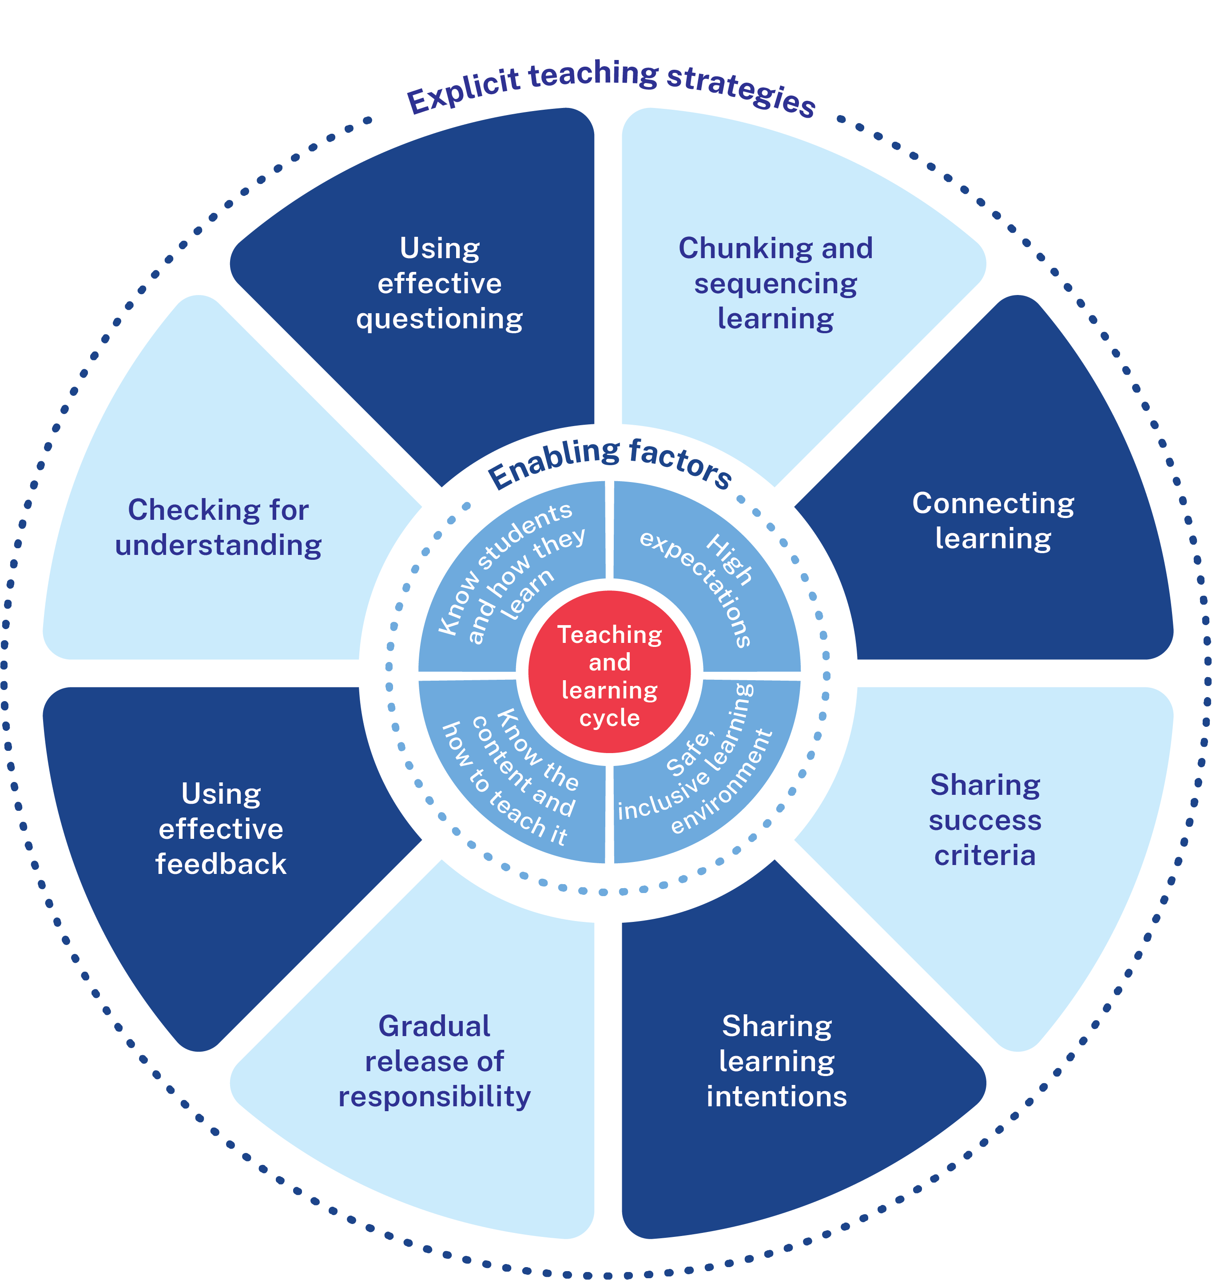
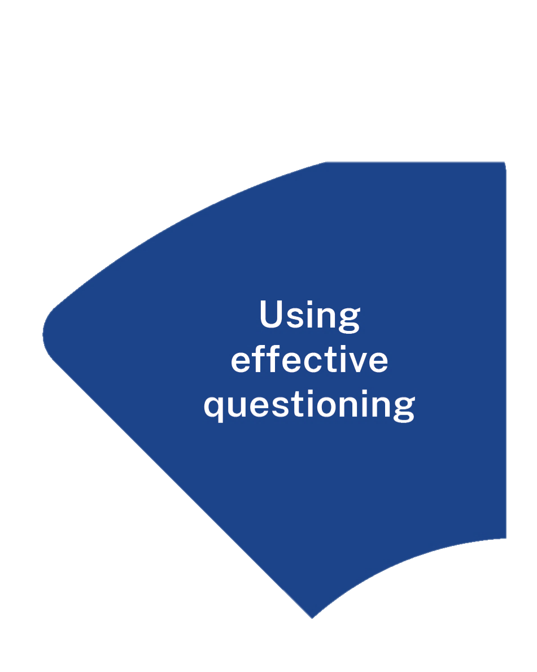
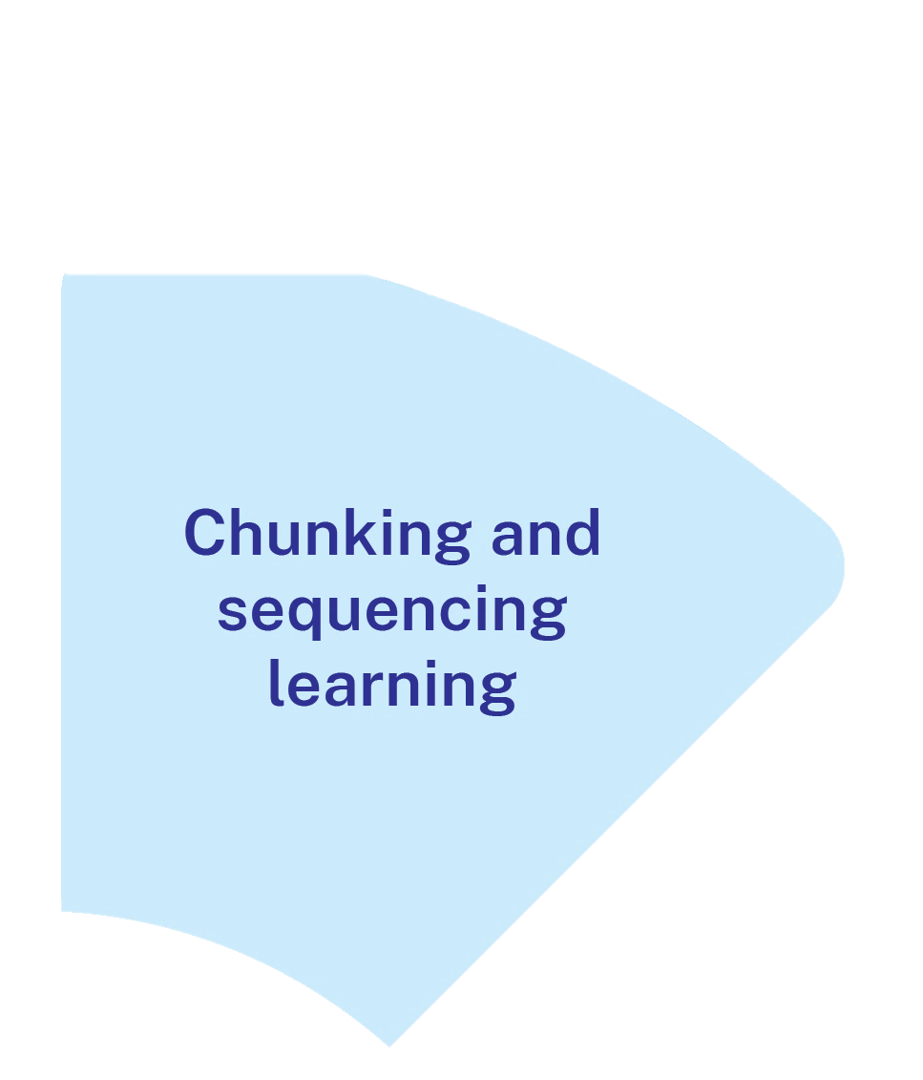

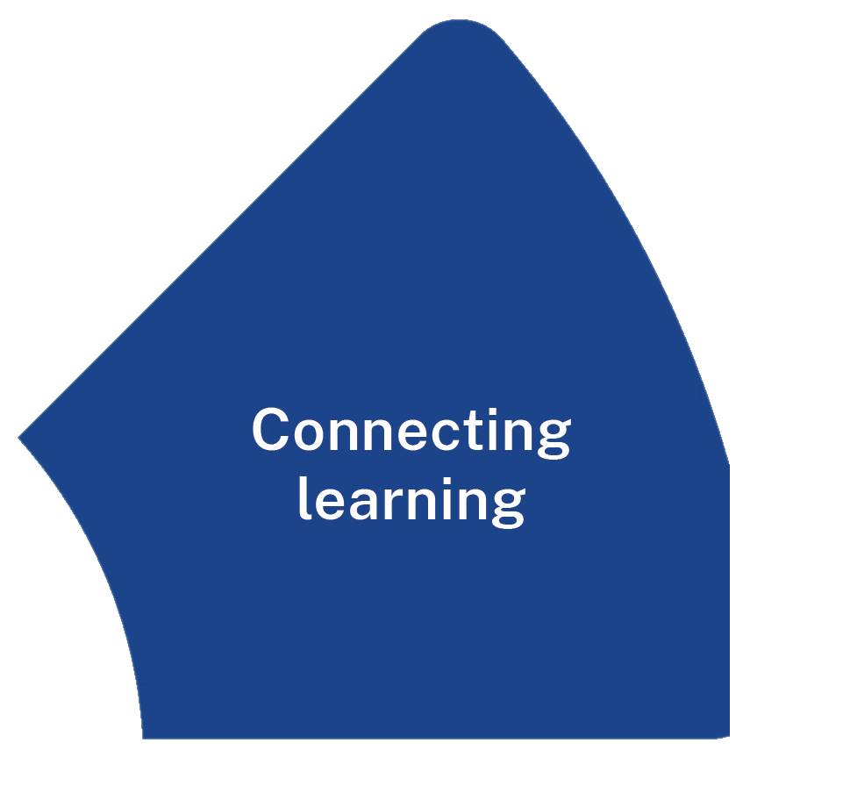
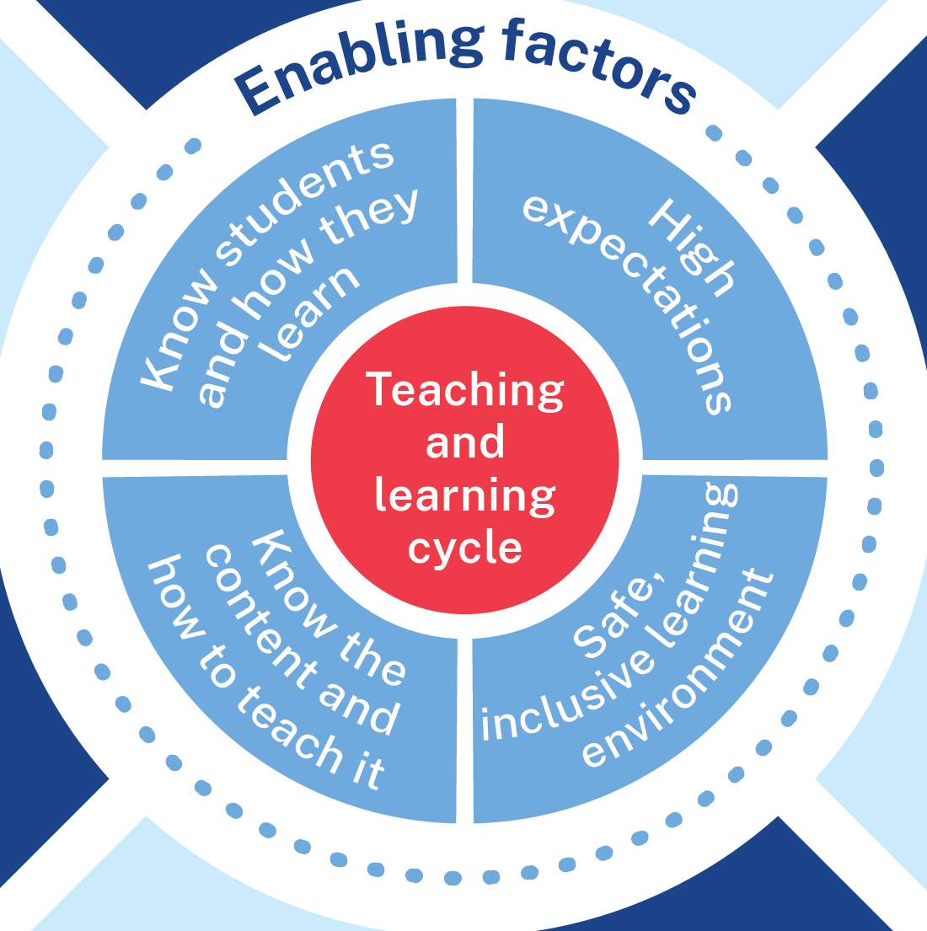

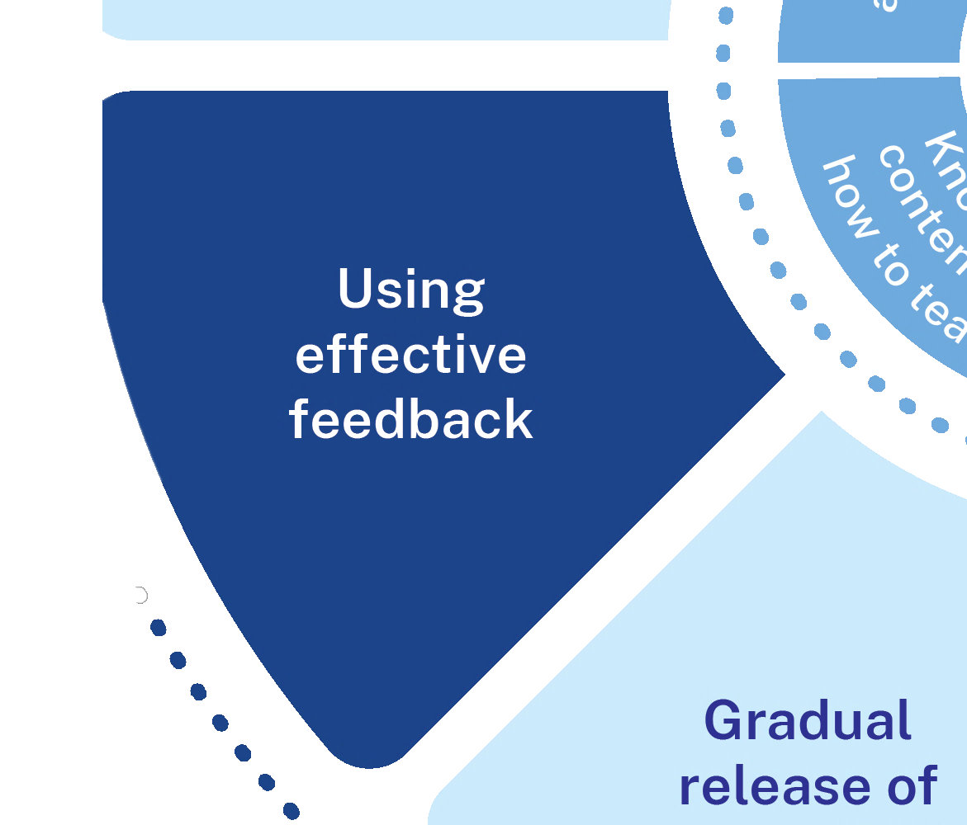


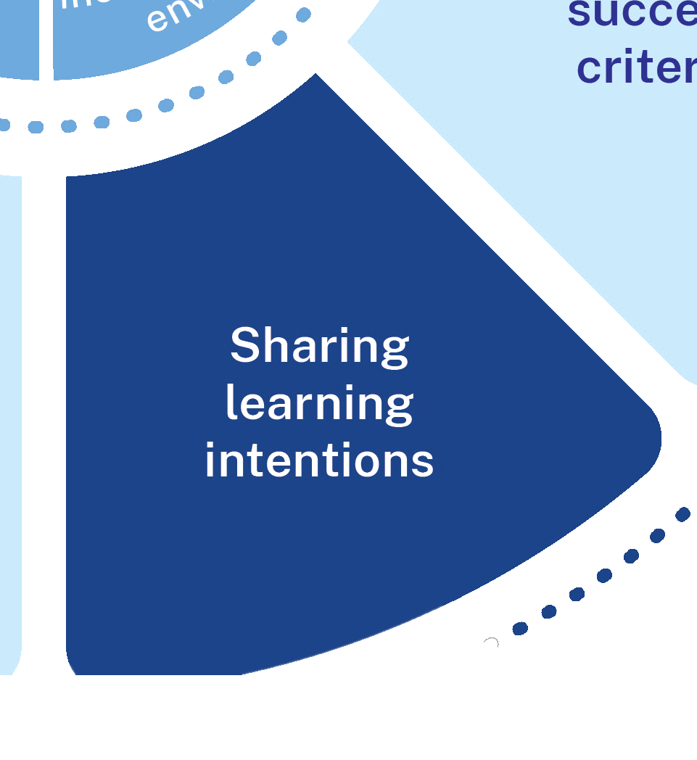
What it is (1)
Effective questioning:
activates prior knowledge
prompts practice and retrieval
helps correct misconceptions
scaffolds thinking to build complexity
engages students in thinking.
Notes:
Purpose: What is effective questioning?
Speaker notes:
[01:00]
Teachers use questioning to activate prior knowledge, prompt retrieval and gather information about what students know, understand, and can do, reinforcing memory retention.
Student responses to questions inform the decisions teachers make during the learning to clarify misconceptions.
Teachers use effective questioning to scaffold learning to meet the needs of all learners to develop increasing complexity.
Effective questioning requires all students to be engaged in thinking (Wiliam 2011; Wiliam and Leahy 2015). Questions need to be at the right level of challenge and the use of student response techniques such as mini-whiteboards, think-pair-share, and cold calling can help establish classroom routines and expectations of engagement.
Positive responses to student answers are essential as they enable a sense of trust and safety between students and teachers.
When students provide incorrect responses, these are helpful indicators for teachers that students require additional teaching of content. Following a student's response, teachers choose to either redirect or probe their thinking.
References:
Rosenshine B (2012) ‘Principles of instruction: research-based strategies that all teachers should know’, American Educator, 36(1):12–39.
Wiliam D (2011) Embedded formative assessment, Solution tree press.
Wiliam D and Leahy S (2015) Embedding formative assessment: practical techniques for F-12 classrooms, Hawker Brownlow Education.

Slide 16
Prompt retrieval
Prior knowledge is activated when it is retrieved from long term memory ready to be used in working memory.
Practice promotes better recall of information.
Well crafted questions can be used to:
        prompt students to retrieve previously taught material
        check for successful retrieval.
Activate prior knowledge
Retrieval practice
Notes:
Purpose: Activating prior learning, prompting practice and retrieval
Speaker notes:
[01:20]
Learning is a change in long term memory (AERO 2023; Kirschner, Sweller and Clark 2006).
Questions can be useful prompts for students to retrieve previously learned information so that connections can be made to the new learning during the lesson. These questions are not ‘checking for understanding’ questions, they are designed to prompt all students to be successful in retrieving what they have been previously taught. It may be necessary to check that retrieval has been successful by using response systems that allows the teacher to gather all student answers.
Repeated practice retrieving information from long-memory makes future retrieval easier (CESE 2018; AERO 2023).
A ‘daily review’ is one way to routinely practice this retrieval to develop fluency and automaticity (Rosenshine 2012). In a daily review no new knowledge is introduced, rather retrieval of prior learning is practiced. Each time a student retrieves information to their working memory to answer a question, that information becomes more easily accessible in the future (CESE 2018; AERO 2023). Rosenshine (2012) calls this ‘rehearsal’, and states that ‘good questions require students to process and rehearse the material’ (Rosenshine 2012:16).
Resources:
More information on the successful activation of prior knowledge, and the importance of making connections between what students already know and what they are about to learn, is outlined in the ‘Connecting learning’ module – https://education.nsw.gov.au/teaching-and-learning/curriculum/explicit-teaching/explicit-teaching-strategies/connecting-learning.
References:
AERO (Australian Education Research Organisation) (2023b) How students learn best: an overview of the learning process and the most effective teaching practices, AERO, accessed 27 February 2025.
CESE (Centre for Education Statistics and Evaluation) (2018) Cognitive load theory in practice: examples for the classroom, NSW Department of Education.
Kirschner PA, Sweller J and Clark RE (2006) ‘Why minimal guidance during instruction does not work: an analysis of the failure of constructivist, discovery, problem-based, experiential, and inquiry-based teaching’, Educational Psychologist, 41(2):75–86, doi:10.1207/s15326985ep4102_1.
Rosenshine B (2012) ‘Principles of instruction: research-based strategies that all teachers should know’, American Educator, 36(1):12–39.

Slide 17

Correct misconceptions
Identify misconceptions
Redirect or reteach
Notes:
Purpose: Correct misconceptions
Speaker notes:
[00:40]
It is important for teachers to understand the accuracy or inaccuracy of the knowledge students are learning to develop their schema.
Teachers use their subject matter expertise to pre-empt misconceptions to avoid inaccurate information being used by students that could lead to incorrect schema development.
Skillfully planned questions are used to identify misconceptions so they can be corrected immediately, with an explanation of why the misconception is incorrect followed by an explanation of the correct answer.
Student understanding should be checked again later in the lesson with additional questions to ensure students have understood the correct explanation. Re-teaching of the material may be needed (Nuthall 2007).
References:
Nuthall G (2007) The hidden lives of learners, New Zealand Council for Educational Research.
Madgwick H (14 July 2021) 'Exploring the evidence: prior knowledge and pupil misconceptions', Education Endowment Foundation, accessed 4 October 2024.

Slide 18
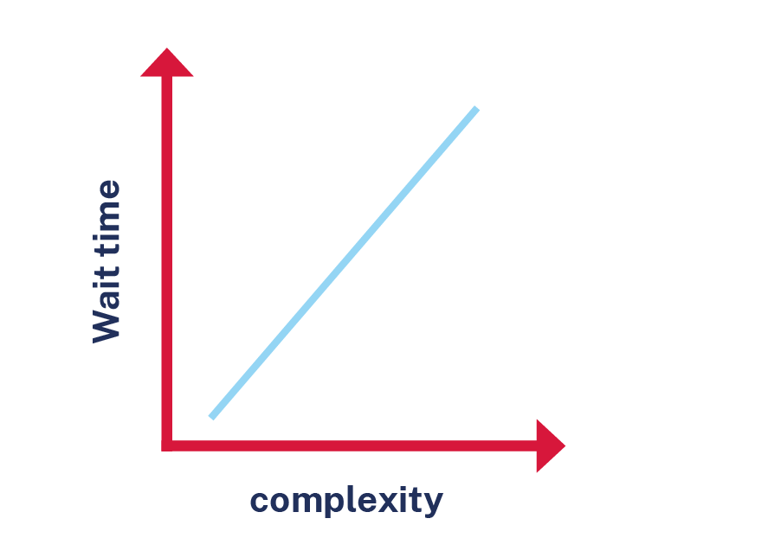
Develop complexity
Questioning can be used to develop increasing complexity in student thinking and understanding.
For example, questioning can be used to prompt students to:
Recall information
Deepen thinking
Make connections
Justify and reflect
Notes:
Purpose: Develop complexity
Speaker notes:
[01:10]
Some key considerations when using questioning to build complexity include:
Plan question sequences at the right challenge level to illicit thinking. Build complexity over time so that students experience success, which improves motivation (Martin 2002).
Use a variety of questioning techniques to prompt students to:
recall previously learned information
deepen their thinking
make connections between ideas, including between new and prior knowledge and skills
engage in higher order thinking, such as justifying an answer or reflecting on a process.
Wait time is essential for all questions. This is the time students are given to think of a response. Simple questions with quick responses, such as in choral response, should still allow a short period of wait time before students respond to a signal so that all students respond together, not just the “fastest” students (Rosenshine 2012). As questions become more complex, the amount of wait time given to students should increase. If more than 5 seconds is needed for sufficient thinking, consider using think-pair-share responses or have students jot down their thinking.
References:
AERO (Australian Education Research Organisation) (2023) How students learn best: An overview of the evidence, AERO.
Martin AJ (2002) ‘Motivation and academic resilience: developing a model of student enhancement’, Australian Journal of Education, 46:34-49, doi: 10.1177/000494410204600104.
Rosenshine B (2012) ‘Principles of instruction: research-based strategies that all teachers should know’, American Educator, 36(1):12–39.
Stahl RJ (1994) ‘Using think time and wait time skilfully in the classroom’, ERIC Digest, accessed 19 February 2025.
Wiliam D (2014) ‘The right questions, the right way’, Educational Leadership, 71(6):16–19.

Slide 19


Engage students in thinking
Notes:
Purpose: Engage all students in thinking
Speaker notes:
[00:30]
Effective questioning requires all students to be engaged in thinking of an answer (Wiliam 2011; Wiliam and Leahy 2015). There are many response systems teachers may use to encourage this. ‘No hands up’ or ‘cold call’ is one example, where a question is posed to the class and wait time is provided before the teacher selects a student at random to provide an answer. Choral response, mini-whiteboards, pose-pause-pounce-bounce and think-pair-share are other examples.
References
AERO (Australian Education Research Organisation) (2023) How students learn best, AERO.
Wiliam D (2011) Embedded formative assessment, Solution tree press.
Wiliam D (2014) ‘The right questions, the right way’, Educational Leadership, 71(6):16–19.
Wiliam D and Leahy S (2015) Embedding formative assessment: practical techniques for F-12 classrooms, Hawker Brownlow Education.

Slide 20
Why effective questioning is important
Teachers use questioning to:
gather information about what students know, understand, and can do
‘Questions allow a teacher to determine how well the material has been learned and whether there is a need for additional instruction.’ (Rosenshine 2012:14)
deepen student understanding.
‘Effective questioning strategies cause all students to think. This creates high engagement classroom environments which improve student achievement.’ (Black and Wiliam 2018)
Notes:
Purpose: How effective questions works
Speaker notes:
[0:40]
Effective questioning acts as a formative assessment tool, allowing teachers to gauge understanding and identify misconceptions in real-time (Wiliam 2011). Teachers are responsive to student answers, generating questions to deepen students' thinking based on the way they are responding to planned questions.
Effective questioning can scaffold student learning by guiding them through the thinking. By starting with simpler questions and gradually increasing complexity, teachers can help students build on their existing knowledge. In answering questions, students ‘elaborate on the material they have learned and augment connections to other learning in their long-term memory’ (Rosenshine 2012).
References:
Rosenshine B (2012) ‘Principles of instruction: research-based strategies that all teachers should know’, American Educator, 36(1):12–39.
Black P and Wiliam D (2018) 'Classroom assessment and pedagogy', Assessment in Education: Principles, Policy & Practice, 25(6):551–575.

Slide 21
Questioning in safe and inclusive learning environments
Students learn best in safe and inclusive environments that consider the cultural, social, emotional, behavioural and physical aspects of learning.
Notes:
Purpose: Considering safe and inclusive learning environments
Speaker notes:
[00:40]
Questioning is a strategy that requires teachers to consider how they can shape a safe and inclusive learning environment.
When introducing new routines, including questioning routines, teachers should consider the cultural, social and emotional contexts of their classroom.
Although this is not the focus of this learning module, it is important to keep in mind the context of classrooms and schools in order to make informed decisions about how students of all backgrounds and abilities can be supported to engage with effective questioning. Culturally responsive, culturally safe environments and positive relationships are important for all students, including Aboriginal and Torres Strait Islander students (CESE 2017).
Resources:
A list of resources has been provided that you can consider based on your context:
To support Aboriginal and Torres Strait Islander students please reach out to your local Aboriginal Education Team for contextualised support. Schools can determine their team through adding My Essentials – School Support Contacts.
To support EALD students, NSW Department of Education offer guidance on their Multicultural Education site – https://education.nsw.gov.au/teaching-and-learning/multicultural-education/culture-and-diversity/cultural-inclusion
To support communicating with students who have disabilities – Australian Institute for Teaching and School Leadership – https://www.aitsl.edu.au/research/spotlights/inclusive-education-teaching-students-with-disability
To support creating a safe and inclusive learning environment for students with disabilities, NSW Department of Education offer guidance at their Inclusion Hub- https://education.nsw.gov.au/schooling/school-community/inclusive-education-for-students-with-disability/commitment_to_Inclusive_Education
References:
AITSL (Australian Institute for Teaching and School Leadership) (2023) Teacher standards, AITSL, accessed 12 February 2025.
CESE (Centre for Education Statistics and Evaluation) (2017) Cognitive load theory: research that teachers really need to understand, NSW Department of Education.

Slide 22
What it isn’t
Not sufficiently planned
Asking students to simply recall information
Too easy or too challenging
Asked and answered quickly without sufficient wait time
Always quizzes or written responses
Too general
Notes:
Purpose: what effective questioning isn’t
Speaker notes:
[00:40]
Here are some non-examples of effective questioning:
Asking questions that are not sufficiently planned or reflected on
Asking students to simply recall information rather than getting them to think deeper
Asking questions that are too easy or challenging to meet the various needs of learners
Not providing enough wait time for students to process, think then respond
Always in the form of quizzes or written responses
Asking questions that are too general ‘Does everybody understand?’ or ‘any other questions?’ – most students will not reply even if they do understand.
References:
Wiliam D and Leahy S (2015) Embedding formative assessment: practical techniques for F-12 classrooms, Hawker Brownlow Education.

Slide 23
The mechanisms of effective questioning (2)
Planned at the right level of challenge
Increase in complexity
Develop increasingly complex schema
Retrieve prior learning
All students are thinking of an answer
Notes:
Purpose: The mechanisms of effective questioning
Speaker notes:
[00:50]
When using effective questioning:
1. Ensure questions are planned as part of the narrative of the lesson or unit of work.
2. Use a variety of questioning techniques and allow for wait time to give students the opportunity to retrieve prior knowledge, connect to new learning and think through their response.
3. Consider the needs of all learners. There may be several levels of challenge needed to cater for the learning needs of all students.
4. Create a safe and inclusive classroom culture with high expectations where all students expect to be called on and feel safe to make and learn from their mistakes
Through these mechanisms, we provide multiple opportunities for students to think deeper and develop increasingly complex schema – their mental framework that helps them organise and understand information.

Slide 24


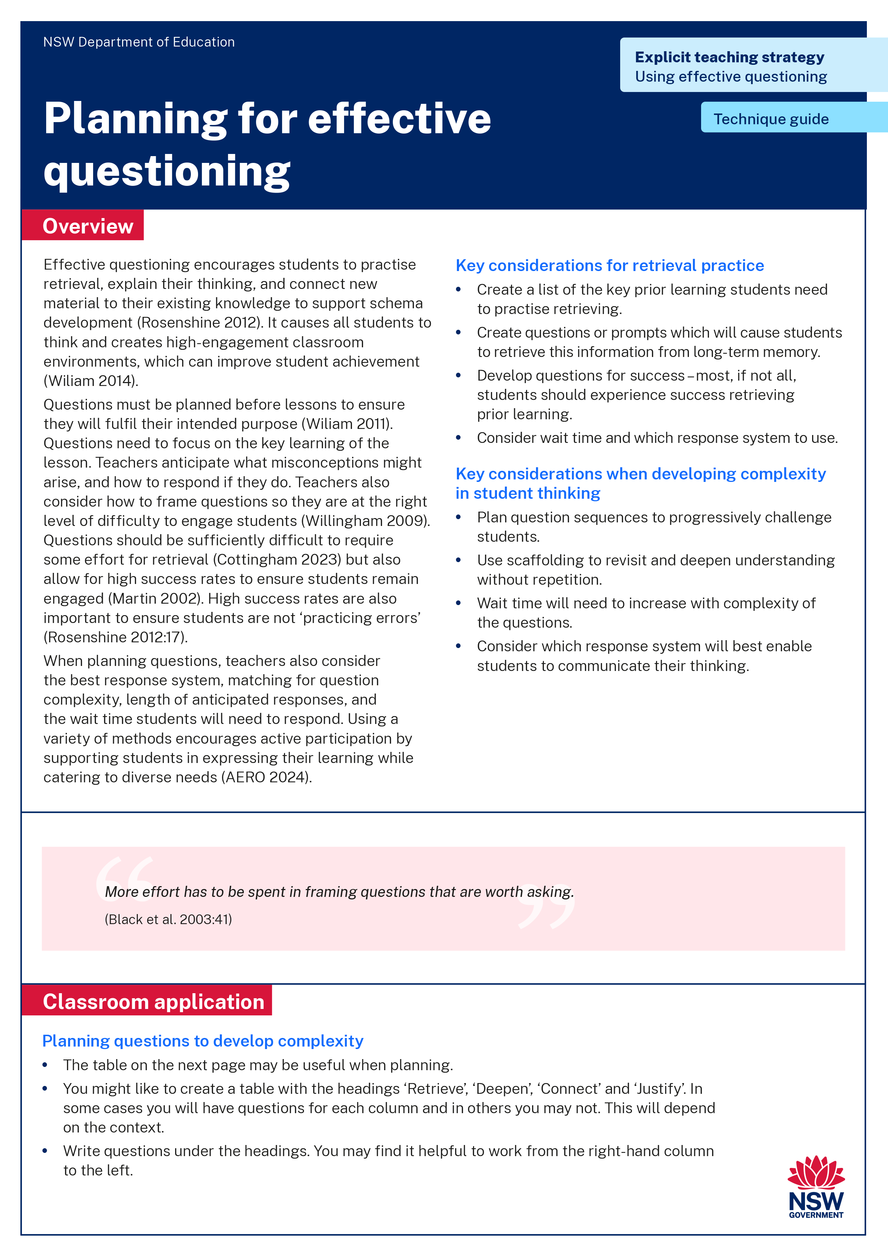
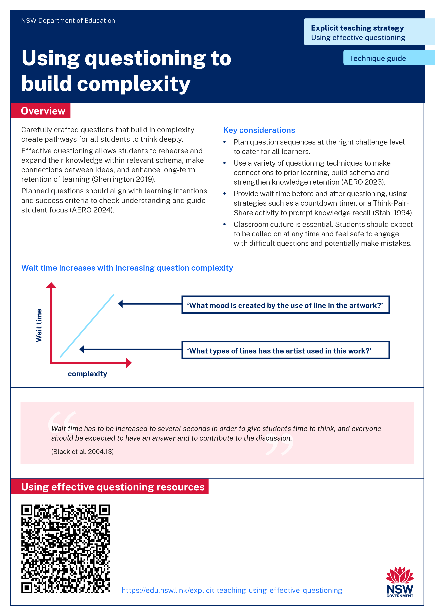
Activity 1 – technique guide discussion
Read or revise – 10 min
Discuss – 10 min
Identify the key points in Planning for effective questioning technique guide
or the Using questioning to build
complexity
technique
guide.
Describe the connections between the technique guide and the learning in Part A.
Notes:
Purpose: Deepen knowledge using effective questioning resources
Speaker notes:
[20:00]
We have had the opportunity to read Planning for effective questioning technique guide and/or the Using questioning to build complexity technique guide/s.
Revisit that reading and identify the key points you observed.
Discuss with your groups the connections you can make between the readings and the learning we have done in Part A so far.
Note to presenter: use your knowledge of you school context to decide which technique guide to have participants read. You may choose both, or have half of the participants read one and the other half the other.

Slide 25
In the next part of this module, we will work on implementing the strategies through techniques. We will have the opportunity to plan and rehearse making connections.
Notes:
Purpose of slide: To orient into the next part of the module.
Speaker notes:
[00:20]
In the next part of this module, we will work on implementing the strategies through techniques. We will have the opportunity to plan and rehearse making connections.

Slide 26
Implementing the strategies through techniques
Part B

Slide 27
Part B instructions
Facilitator instructions
Part B contains multiple techniques. To use Part B:
it is recommended teachers engage with the Planning for effective questioning and Using questioning to build complexity’ technique guides
select a lesson to apply the techniques
plan and rehearse with a colleague
get feedback from your colleague.
Notes:
Purpose: To provide instructions on using Part B of the module.
[00:20]

Slide 28
Purpose and outcome (2)
Purpose
To develop an understanding of techniques supporting effective questioning that optimise student understanding, engagement and participation.
Outcome
We can articulate how and why we deliberately plan and facilitate questioning.
We have whole-school teaching principles for effective questioning that are ready to use in our classrooms.
Notes:
Purpose of slide: Purpose and outcome of Part B
Speaker notes:
[00:20]
In this part, we're going to develop effective questioning techniques and routines.

Slide 29
The mechanisms of effective questioning (1)
Planned at the right level of challenge
Increase in complexity
Develop increasingly complex schema
Retrieve prior learning
All students are thinking of an answer
Notes:
Purpose: The mechanisms of effective questioning
Speaker notes:
[00:50]
When using effective questioning:
1. Ensure questions are planned as part of the narrative of the lesson or unit of work.
2. Use a variety of questioning techniques and allow for wait time to give students the opportunity to retrieve prior knowledge, connect to new learning and think through their response.
3. Consider the needs of all learners. There may be several levels of challenge needed to cater for the learning needs of all students.
4. Create a safe and inclusive classroom culture with high expectations where all students expect to be called on and feel safe to make and learn from their mistakes
5. Through these mechanisms, we provide multiple opportunities for students to think deeper and develop increasingly complex schema – their mental framework that helps them organise and understand information.

Slide 30
Using questioning to build complexity
Technique A

Slide 31
What it is (2)
Carefully crafted questions that build in complexity create pathways for all students to think deeply.
This ensures that every learner has opportunities to stretch their thinking in ways that challenge them.
Notes:
Purpose: What is Using questioning to build complexity
Speaker notes:
[00:30]
Carefully crafted questions that build in complexity create pathways for all students to think deeply, ensuring that every learner has opportunities to stretch their thinking in ways that challenge and inspire them.
Questioning allows students to rehearse and expand on their knowledge within relevant schema, strengthen connections between ideas, and enhance long-term retention (Sherrington 2019).
It is crucial that teachers plan key questions. The planned questions should align with learning intentions and success criteria to check understanding and guide student focus (AERO 2024).
References:
Australian Education Research Organisation (AERO) (2024) Monitor progress, AERO, accessed 25 February 2025.
Sherrington T (2019) Rosenshine’s principles in action, John Catt Educational Limited.

Slide 32
Key considerations
Pose questions at the right level of challenge.
Use a variety of question types to promote deeper thinking.
Provide wait time before and after questioning.
Check for understanding as you build complexity.
Create a culture that values asking questions and participation.
Notes:
Purpose: Key considerations for planning for effective questioning to build complexity
Speaker notes:
[01:00]
Some key considerations when using questioning to build complexity include:
Pose questions at the right challenge level to cater for the needs of all learners. Pose questions in a way that allows students to engage with the question at a number of different levels.
Use a variety of questioning types to make connections to prior learning, build schema and strengthen knowledge retention (AERO 2023b).
Provide wait time before and after questioning, to allow students to process and think and consider their responses. Use strategies such as a countdown timer, or a ‘think, pair, share’ activity to prompt knowledge recall (Stahl 1994).
‘Checking for understanding regularly during a lesson allows you to identify misunderstandings as they develop, rather than allowing students to repeat mistakes, practice incorrectly and commit misconceptions to memory’ (AERO 2024).
Create a classroom culture that values asking questions and participation. Students should expect to be called on at any time to engage with difficult questions and feel safe make mistakes and adjust thinking, in front of their peers.
References
AERO (Australian Education Research Organisation) (2023b) How students learn best: an overview of the learning process and the most effective teaching practices, AERO, accessed 27 February 2025.
Australian Education Research Organisation (AERO) (2024) Monitor progress, AERO, accessed 25 February 2025.
Stahl RJ (1994) ‘Using think time and wait time skilfully in the classroom’, ERIC Digest, accessed 19 February 2025.

Slide 33
Wait time – student benefits
Notes:
Purpose: the importance of wait time for students
Speaker notes:
[01:30]
Wait time is essential for all questions. This is the time students are given to think of a response. Questions that require quick responses, such as in choral responses, should still allow a short period of wait time before students respond to a signal so that all students respond together, not just the ‘fastest’ students (Rosenshine 2012). As questions become more complex, the amount of wait time given to students should increase. If more than 5 seconds is needed for sufficient thinking, consider using think-pair-share responses or have students jot down their thinking.
The graph on screen illustrates wait time required for a student to process the different question types. For example, a student will require less time to answer, ‘What types of lines has the artist used in this work?’ but a longer time to reflect and justify in questions like ‘What mood is created by the use of line in the artwork?’
We also need to allow wait time AFTER a student gives an answer and before we speak again. Students need time to absorb what their peer has just said and consider sharing a response of their own (Stahl 1994).
Implementing wait-time requires the development of new habits and opens the door for more student-driven interactions in class.
References
Rosenshine B (2012) ‘Principles of instruction: research-based strategies that all teachers should know’, American Educator, 36(1):12–39.
Stahl RJ (1994) ‘Using think time and wait time skilfully in the classroom’, ERIC Digest, accessed 19 February 2025.

Slide 34

Wait time – teacher benefits
When teachers practice wait time, positive changes occur in their own behaviour: Their questioning strategies tend to be more varied and flexible. They decrease the quantity and increase the quality and variety of their questions. They ask additional questions that require more complex information processing and higher-level thinking on the part of students.
(Stahl 1994:2)
Notes:
Purpose: the importance of wait time for teachers
Speaker notes:
[00:30]
Research tells us when we, as teachers, practice wait time, positive changes occur in their own behaviour:
Their questioning strategies tend to be more varied and flexible.
They decrease the quantity and increase the quality and variety of their questions.
They ask additional questions that require more complex information processing and higher-level thinking on the part of students. (Stahl 1994)
Reference
Stahl RJ (1994) ‘Using think time and wait time skilfully in the classroom’, ERIC Digest, accessed 19 February 2025.

Slide 35

Inviting answers – creating the right climate
Promote a risk-taking culture.
Create a community of inquiry.
Demonstrate a commitment to learning for all.
Giving students wait time.
Notes:
Purpose: the importance of creating a conducive classroom climate
Speaker notes:
[00:50]
As teachers, it is essential to ‘create a classroom culture that fosters trust, supports students’ participation, is accepting of mistakes, and supports improvement’ (AERO 2024). When students feel psychologically safe, they will be more inclined to attempt to answer questions.
We need to be genuinely interested not only in what learners are thinking, but in how they are thinking, in what connections they are making and not making. We also need to consider whether our responses to student answers are inviting or discouraging students to respond.
Effective classroom environments allow students to prioritise thinking about what they are learning, while minimising distractions that can contribute to cognitive load (AERO 2023)
Reference
AERO (Australian Education Research Organisation) (2023b) How students learn best: an overview of the learning process and the most effective teaching practices, AERO, accessed 27 February 2025.
Australian Education Research Organisation (AERO) (2024) Monitor progress, AERO, accessed 25 February 2025.

Slide 36
Scaffold thinking to build complexity
Justify and reflect
Connect
Deepen
Recall
Notes:
Purpose: introduce types of questions that build in complexity
Speakers notes:
[01:00]
Teachers use questions that build in complexity to develop and deepen student understanding of knowledge, ideas and skills.
These include questions that provide opportunities for students to:
Recall knowledge
Elaborate their thinking
Make connections
Justify and reflect.
When students access their learning and apply their knowledge in different ways, including in response to conceptual and higher-order thinking questions, this also provides the opportunity for retrieval and associated consolidation of long-term memory (AERO 2023).
Asking questions that build in complexity can help students apply and transfer their knowledge, but it requires us to be flexible and responsive to student needs.
Teachers may move back and forth between a variety of question types to support student learning. For example, teachers asking a series of questions and may need to reframe these questions in response to student understanding.
We will now unpack each of these question types in more detail.
References
AERO (Australian Education Research Organisation) (2023b) How students learn best: an overview of the learning process and the most effective teaching practices, AERO, accessed 27 February 2025.
NCTM (National Council of Teachers of Mathematics) (2014) Principles to actions: ensuring mathematical success for all, NCTM.

Slide 37
Recall
Teachers expect a high success rate when asking these questions.
Examples
When you write an equation, what does the equal sign tell you?
What is the formula for finding the area of a rectangle?
Who was the main character in the story?
What did the author say about the importance of teamwork?
Notes:
Purpose: examples of retrieval questions
Speakers notes:
[01:00]
Practice recalling information is known to build and strengthen connections in long-term memory (AERO 2024). Teachers ask questions that support students to actively retrieve what they already know. By processing this information in their working memory, it is then encoded back into long term memory with new as well as strengthened connections (AERO 2023). Questions designed for recall practice are generally not overly complex and require a high success rate, they help to gather information such as facts and definitions (NCTM 2014) from students’ long-term memory.
Recall means more than ‘do you remember the synoptic chart from last lesson?’ or even ‘do you remember Force = mass x acceleration?’ These prompts cause recognition, not recall. Recall requires active retrieval of previously learnt information into working memory. Sometimes additional prompts will be needed for students to accurately recall prior learning.
Each time information is retrieved from long term memory it makes it easier to retrieve it in the future (CESE 2018). Automaticity occurs after extensive practice (Sweller, van Merrienboer and Paas 1998).
References
AERO (Australian Education Research Organisation) (2023b) How students learn best: an overview of the learning process and the most effective teaching practices, AERO, accessed 27 February 2025.
Australian Education Research Organisation (AERO) (2024) Monitor progress, AERO, accessed 25 February 2025.
CESE (Centre for Education Statistics and Evaluation) (2018) Cognitive load theory in practice: examples for the classroom, NSW Department of Education.
NCTM (National Council of Teachers of Mathematics) (2014) Principles to actions: ensuring mathematical success for all, NCTM.
Sweller J, van Merrienboer J and Paas F (1998) ‘Cognitive architecture and instructional design’, Educational Psychology Review, 10(3):251–296.

Slide 38
Deepen
Teachers ask probing questions to encourage students to explain, elaborate or clarify their thinking.
Examples
How do you know this?
Can you give me an example of that?
That’s interesting, what makes you say that?
Does anyone else agree? Why?
What evidence supports this assumption?
What additional details could make this argument stronger?
What led you to this conclusion?
Notes:
Purpose: examples of questions to deepen thinking
Speakers notes:
[00:30]
Teachers can probe thinking to develop complexity by asking a series of questions, 'probing for understanding, checking for misconceptions, adding extra challenge and providing scaffolding to engineer success’ (Sherrington 2019:30).
When students are encouraged to explain, elaborate or clarify their thinking (NCTM 2014) it helps them to consolidate the learning in their long term memory (Rosenshine 2012).
Take some time to read the examples on the slide. Can you think of any more examples of questions we can use to deepen student thinking?
References:
NCTM (National Council of Teachers of Mathematics) (2014) Principles to actions: ensuring mathematical success for all, NCTM.
Rosenshine B (2012) ‘Principles of instruction: research-based strategies that all teachers should know’, American Educator, 36(1):12–39.
Sherrington T (2019) Rosenshine’s principles in action, John Catt Educational Limited.

Slide 39
Connect
Teachers support students to make connections to structures and among ideas and relationships.
Examples
What are some other ways to show ……… that are different than these models?
How is your new model similar to the other models of one half?
How are … and … similar?
Using what you know about ... , how would you … ?
What are some advantages/disadvantages to … ?
Notes:
Purpose: examples of questions to make connections
Speakers notes:
[00:30]
Questions that make connections could encourage students to
compare and contrast new and existing knowledge (Cottingham 2023; Rosenshine 2012)
identify and explore conflicting ideas (Cottingham 2023).
In the context of making meaningful learning connections, students need opportunities to integrate new ideas with the related existing knowledge and reconcile it with conflicting or confusable ideas (Cottingham 2023).
‘Answering these questions could encourage students to ‘augment connections to other learning in their long-term memory’ (Rosenshine 2012)
References:
Cottingham S (2023) Ausubel’s meaningful learning in action, Hodder Education Group.
NCTM (National Council of Teachers of Mathematics) (2014) Principles to actions: ensuring mathematical success for all, NCTM.
Rosenshine B (2012) ‘Principles of instruction: research-based strategies that all teachers should know’, American Educator, 36(1):12–39.

Slide 40
Justify and reflect
Teachers support students to show their reasoning and actions, including making an argument for the validity of their thinking.¹
Examples
What conclusions can you draw about…?
What are some potential contradictions in these theories?
What else could account for this?
How extensive were the effects of…?
How would you solve this problem?
1. NCTM (National Council of Teachers of Mathematics) (2014) Principles to actions: ensuring mathematical success for all, NCTM.
Notes:
Purpose: examples of questions to justify
Speakers notes:
[00:50]
These types of questions require students to analyse, synthesize, evaluate, and interpret at complex levels (NCTM 2014). Students are required to process, make judgements, elicit meaning, make critical interpretations and demonstrate high levels of insight in their thinking. They are required to make inferences, draw relevant and insightful conclusions, use their knowledge in new situations to solve problems.
Once students have mastered a set of knowledge and built a mental model that connects relevant information together, they are able to apply this to solve unfamiliar problems, extend their mental models further and generate new critical and creative ideas (AERO 2023).
Effective questioning provides students with the opportunity to rehearse and elaborate on the knowledge in relevant schema, strength connections between ideas and improve long-term retention (Sherrington 2019).
References:
AERO (Australian Education Research Organisation) (2023b) How students learn best: an overview of the learning process and the most effective teaching practices, AERO, accessed 27 February 2025.
Bogdanovich P (28 October 2014) Higher-order Questions, Dataworks Educational Research, accessed 25 March 2025.
NCTM (National Council of Teachers of Mathematics) (2014) Principles to actions: ensuring mathematical success for all, NCTM.
Sherrington T (2019) Rosenshine’s principles in action, John Catt Educational LTD.

Slide 41
Turn and talk
Record one key takeaway you could apply in your next lesson and why.
Share your answer with a colleague.
Notes:
Purpose: Activity
[02:00]
Notes to presenter: This activity could be followed by selecting non-volunteers to share their dialogue.

Slide 42
Examples
The following slides will show an example of a series of questions that build in complexity.
Notes:
Purpose: Examples
Notes to presenter: The following slides contain both a primary and secondary example, you may show all examples or choose one to present to your audience. Slides 44–45 steps out a primary mathematics example, slides 46–47 step out a secondary visual arts example and slides 48–49 step out a secondary mathematics example.

Slide 43
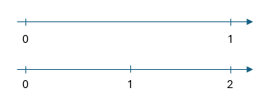
Primary example – mathematics
Students have marked the location of one-quarter on a 0–1 number line and a 0–2 number line.
The teacher:
asks students to recall 'How did you locate one-quarter on the 0–2 number line?' (wait time).
deepens thinking by asking 'How did you know to do this?' (wait time).
supports students to make connections by asking 'Using what you know about locating one-quarter, how would you locate one and one-quarter?' Students turn and talk to share their strategies.
encourages students to justify and reflect by asking 'If zero, one-half and 2 were marked on a number line, would you still need to locate one-whole to accurately mark one-quarter?' (wait time). Students think-pair-share.
Mathematics K-10 Syllabus (2022) - MAO-WM-01, MA2-PF-01
Notes:
Purpose: Primary example of using questioning to build complexity: Stage 2 mathematics
Speaker notes:
[00:40]
Let’s take a look at this primary classroom example.
Students at the end of Stage 2 have been learning how to determine the relative location of one-quarter and one-half when a number line extends beyond one (Partitioned Fractions B: MAO-WM-01 and MA2-PF-01). Students have had a high success rate locating one-half on number lines that extend beyond one. Today, students have marked the location of one-quarter on a 0-1 number line and a 0-2 number line.
As you read, note the types of questions asked and the planning of wait time. I will give you a few moments to read this.
References:
Mathematics K–10 Syllabus © NSW Education Standards Authority (NESA) for and on behalf of the Crown in right of the State of New South Wales, 2022.

Slide 44
Primary mathematics example unpacked
Justify and reflect
'If zero, one-half and 2 were marked on a number line, would you still need to locate one-whole to accurately mark one-quarter?'
Make connections
‘Using what you know about locating one-quarter, how would you locate one and one-quarter?'
Deepen thinking
‘How did you know to do this?'
Recall
‘How did you locate one-quarter on the 0–2 number line?'
Check for understanding as you build complexity
Notes:
Purpose of slide: key considerations when planning questions to build in complexity.
Notes to presenter : It is recommended that teachers refer to the Using questioning to build complexity technique guide to reference the mathematics example
Speaker notes:
[2:00]
Let’s unpack this example and highlight the two key considerations the teacher has employed when planning these questions to build in complexity;
-the types thinking the questions cause
-the wait time allocated and how it increases as the questions build in complexity to promote deeper thinking
The first question the teacher asks ‘How did you locate one-quarter on the 0-2 number line?’ requires students to recall knowledge, including how to locate one-quarter on a fraction strip and a 0-1 number line, as well as how to locate one-half on the 0-2 number line in the previous lesson. The teacher would confirm that the repeated halving strategy could be used, starting at one whole, then halving to locate one-half and halving again to locate one-quarter. This is the same strategy used to find quarters on fraction strips which students are highly familiar with and have previously connected to marking quarters on the 0-1 number line.
The second question ‘How did you know to do this?’ requires students to deepen thinking by elaborating on and explaining their process. This elaborates on their fractional understanding, with students referring to knowing that one whole can be partitioned into two halves or four quarters and that one half of one half is one-quarter.
Following on, the teacher encourages students to make connections by asking 'Using what you know about locating one-quarter, how would you locate one and one-quarter?’ After students have the opportunity to turn and talk, the teacher confirms that one-whole can be represented by any two consecutive whole numbers, 0 and 1, 1 and 2, etc.
The teacher prompts students to justify and reflect by asking 'If zero, one-half and 2 were marked on a number line, would you still need to locate one-whole to accurately mark one-quarter?’ A Think-pair-share opportunity allows students to explain, justify and test their thinking with a partner. Students could justify that one-quarter could be accurately found by knowing where zero and one half were located, as one half is always equivalent to two quarters, no matter how large the whole is.
While using questioning that builds in complexity, it is important that we check for student understanding frequently throughout the lesson. ‘Checking for understanding regularly during a lesson allows you to identify misunderstandings as they develop, rather than allowing students to repeat mistakes, practice incorrectly and commit misconceptions to memory’ (AERO 2024:4). Technique B will unpack checking for understanding in more detail.
Note:
*Wait time is an example of a ‘talk move’. 'Talk moves' are the tools used by teachers to support rich, meaningful classroom discussion in mathematics. See https://education.nsw.gov.au/teaching-and-learning/curriculum/literacy-and-numeracy/teaching-and-learning-resources/numeracy/talk-moves
**For more information about checking for understanding, refer to Checking for understanding module – https://education.nsw.gov.au/teaching-and-learning/curriculum/explicit-teaching/explicit-teaching-strategies/checking-for-understanding.
References:
Australian Education Research Organisation (AERO) (2024) Monitor progress, AERO, accessed 25 February 2025.
Mathematics K–10 Syllabus © NSW Education Standards Authority (NESA) for and on behalf of the Crown in right of the State of New South Wales, 2022.

Slide 45
Secondary example – visual arts
The teacher shows a sample artwork. Students are then given time to examine the artwork and apply prior learning
The teacher:
asks students to recall prior learning by asking ‘What types of lines has the artist’s used in this work?’ and then “How can line create mood?”
prompts students to deepen thinking by asking ‘‘Why do you think has the artist used 3 different types of lines?’ (wait time)
The teacher then shows another artwork by a different artist. This artwork is significantly different to the first artwork.
The teacher:
encourages students to make connections between two artists by asking ‘How does the artist’s use of line compare to the use of line in the previous artwork?’ (wait time) Students turn and talk
asks students to reflect by asking ‘What mood does the use of lines create in this work?’
Visual Arts 7-10 Syllabus (2025) – VA4-CHV-01
Notes:
Purpose: Secondary example of using questioning to build complexity: Stage 4 Visual Arts
Speaker notes:
[01:00]
Let’s take a look at this example from a stage 4 Visual Arts lesson.
Students are at the start of stage 4 have been learning about the visual qualities of lines. They are now applying their knowledge to artworks and required to interpret how the symbolic language of lines can be read and understood (VA4-CHV-01) explains meaning in artworks and the artworld using Viewpoints).
As you read, note the types of questions asked and the planning of wait time. I will give you a few moments to read this.
Syllabus reference: VA4-CHV-01
Art critical and historical studies: Viewpoints
Structural
Investigate how artworks represent systems of signs, symbols, codes and forms of visual and/or multisensory language to structure and communicate meaning
References:
Visual Arts 7–10 Syllabus © NSW Education Standards Authority (NESA) for and on behalf of the Crown in right of the State of New South Wales, 2025.

Slide 46
Visual arts example unpacked
Justify and reflect
‘What mood does the use of lines create in this work?’
Make connections
‘How does the artist’s use of line compare to the use of line in the previous artwork?’
Deepen thinking
‘Why do you think the artist has used 3 different types of lines?’
Recall
‘What types of lines has the artist’s used in this work?’
Check for understanding as you build complexity
Notes:
Purpose of slide: key considerations when planning questions to build in complexity.
Notes to presenter: It is recommended that teachers refer to the Using questioning to build complexity technique guide to reference to visual arts example
Speaker notes:
[2:00]
Let’s unpack this example and highlight the key considerations the teacher has employed when planning these questions to build in complexity;
-the types of questions asked,
-the wait time allocated and how it increases incrementally as the questions build in complexity to promote deeper thinking
In the first question the teacher asks the students to retrieve knowledge from the previous lesson about the qualities of lines ‘what types of lines has the artist’s used in this work?’
The teacher deepens student thinking by asking ‘Why do you think has the artist used 3 different types of lines?’
The next question, ‘How does the artist’s use of line compare to the use of line in the previous artwork?’ requires students to make connections between two artworks. The teacher checks for understanding by actively listening to the discussions and then asks the final question, ‘What mood does the use of lines create in this work?’ revealing their reasoning and actions.
While using questioning that builds in complexity, it is important that we check for student understanding* frequently throughout the lesson. ‘Checking for understanding regularly during a lesson allows you to identify misunderstandings as they develop, rather than allowing students to repeat mistakes, practice incorrectly and commit misconceptions to memory’ (AERO 2024:4). Technique B will unpack checking for understanding in more detail.
Note:
*For more information about checking for understanding, refer to Checking for understanding module – https://education.nsw.gov.au/teaching-and-learning/curriculum/explicit-teaching/explicit-teaching-strategies/checking-for-understanding.
References:
Australian Education Research Organisation (AERO) (2024) Monitor progress, AERO, accessed 25 February 2025.
Visual Arts 7–10 Syllabus © NSW Education Standards Authority (NESA) for and on behalf of the Crown in right of the State of New South Wales, 2025.

Slide 47
Secondary example 2 – mathematics
Students have been learning about Pythagoras’ Theorem.
To support students to recall prior learning, the teacher:
draws an image of a triangle and asks ‘Which side is the hypotenuse of the triangle?’ (wait time)
deepens thinking by asking ‘How do you know?’ (wait time)
Students are encouraged to make connections between commutative property* and Pythagoras’ Theorem by asking ‘I notice that Ben has labelled the vertical side as ‘a’ whereas Frida has labelled the horizontal side as ‘a’. Does this matter?’ Students deepen thinking by sharing their reasoning with a partner.
After students share their responses, the teacher displays a completed example, and
deepens thinking by asking ‘How can you prove that a triangle contains a right angle?’ (wait time)
then ask ‘If I know the length of the hypotenuse and one of the sides, could I use Pythagoras’ Theorem to work out the length of the other side?’ the after providing wait time, asking students to justify their reasoning by asking ‘How?’
*The commutative property states that the order of adding or multiplying two numbers does not change the result. For example, in addition, 3+5=5+33+5=5+3.
Mathematics K-10 Syllabus (2022) - MAO-WM-01, MA4-PYT-C-01
Notes:
Purpose: Secondary example of using questioning to build complexity: Stage 4 mathematics
Speaker notes:
[01:00]
Let’s take a look at another example from a stage 4 mathematics lesson (MAO-WM-01 and MA4-PYT-C-01). As you read, note the types of questions asked, the wait allocated and the type of responses the teacher has planned to check for understanding. I will give you a few moments to read this.
Mathematics syllabus content:
Identify and describe the hypotenuse as the side opposite the right angle and the longest side in any right-angled triangle
Establish the relationship between the lengths of the sides of a right-angled triangle
Apply Pythagoras’ theorem to find the unknown length of a side in a right-angled triangle, giving answers in an exact form or as decimal approximations
Apply the converse of Pythagoras’ theorem to establish whether a triangle is right angled
References:
Mathematics K–10 Syllabus © NSW Education Standards Authority (NESA) for and on behalf of the Crown in right of the State of New South Wales, 2022.

Slide 48
Mathematics example unpacked
Justify and reflect
Justify answer to this question:
‘If I know the length of the hypotenuse and one of the sides, could I use Pythagoras’
‘How?’
Make connections
‘Does it matter which side of the triangle I label ‘a’?’
Deepen thinking
‘How do you know?’
Recall
‘Which side is the hypotenuse of the triangle?’
Check for understanding as you build complexity
Notes:
Purpose of slide: - key considerations when planning questions to build in complexity.
Notes to presenter : It is recommended that teachers refer to the Using questioning to build complexity technique guide to reference to visual arts example
Speaker notes:
[2:00]
Let’s unpack this example and highlight the key considerations the teacher has employed when planning these questions to build in complexity;
-the types of questions asked,
-the wait time allocated and how it increases incrementally as the questions build in complexity to promote deeper thinking
In the first question the teacher asks the students to retrieve knowledge from the previous lesson about the hypotenuse of a triangle by drawing a triangle and asking ‘Which side is the hypotenuse of the triangle?’
The teacher deepens thinking by asking ‘How do you know?’ and provides wait time* to allow students time to think of an answer.
Students are encouraged to make connections between commutative property and Pythagoras’ Theorem by asking ‘Does it matter which side of the triangle I label ‘a’?’
The teacher further develops complexity in student thinking by asking them to justify and reflect on how they might apply Pythagoras’ Theorem in a different situation. They ask ‘If I know the length of the hypotenuse and one of the sides, could I use Pythagoras’ Theorem to work out the length of the other side?’ The teacher then asks students to justify their reasoning by asking ‘How?’ Wait time* is adjusted based on the complexity of the questions and the context of the class.
While using questioning that builds in complexity, it is important that we check for student understanding* frequently throughout the lesson. ‘Checking for understanding regularly during a lesson allows you to identify misunderstandings as they develop, rather than allowing students to repeat mistakes, practice incorrectly and commit misconceptions to memory’ (AERO 2024:4). Technique B will unpack checking for understanding in more detail.
Note:
*Wait time is an example of a ‘talk move’. 'Talk moves' are the tools used by teachers to support rich, meaningful classroom discussion in mathematics. See https://education.nsw.gov.au/teaching-and-learning/curriculum/literacy-and-numeracy/teaching-and-learning-resources/numeracy/talk-moves
**For more information about checking for understanding, refer to Checking for understanding module – https://education.nsw.gov.au/teaching-and-learning/curriculum/explicit-teaching/explicit-teaching-strategies/checking-for-understanding.
References:
AERO (Australian Education Research Organisation) (2024) Monitor progress, AERO.
Mathematics K–10 Syllabus © NSW Education Standards Authority (NESA) for and on behalf of the Crown in right of the State of New South Wales, 2022.

Slide 49
Responsive questioning
Justify and reflect
Make connections
Deepen thinking
Recall
Check for understanding as you build complexity
Notes:
Purpose of slide: summary slide of key considerations
Speaker notes:
[01:20]
Let’s consolidate our learning and revise the key considerations when using questions that build in complexity.
Start with questions which prompt recall of prior knowledge followed by questions that gradually build in complexity to deepen student thinking.
(Click) Include wait time after asking a question and also after a student answers.
As questions build in complexity, longer wait time needs to be provided to allow students to process, think and plan their responses.
Check for student understanding regularly during a lesson. Use a variety of student response systems such choral response, cold call mini whiteboards to check for every student’s understanding. These checks allow for quick responses and fast interpretation by the teacher.
(click) Asking questions that build in complexity can help students apply and transfer their knowledge, but it requires us to be flexible and responsive to student needs.
Teachers may move back and forth between a variety of question types to support student learning. For example, teachers asking a series of questions to deepen thinking or make connections and may need to reframe these questions in response to student understanding and go back and ask retrieval type questions .
Note:
For more information about checking for understanding, refer to Checking for understanding module – https://education.nsw.gov.au/teaching-and-learning/curriculum/explicit-teaching/explicit-teaching-strategies/checking-for-understanding
References:
AERO (Australian Education Research Organisation) (2023b) How students learn best: an overview of the learning process and the most effective teaching practices, AERO, accessed 27 February 2025.
CESE (Centre for Education Statistics and Evaluation) (2017) Cognitive load theory: research that teachers really need to understand, NSW Department of Education.
Stahl RJ (1994) ‘Using think time and wait time skilfully in the classroom’, ERIC Digest, accessed 19 February 2025.

Slide 50
Planning for effective questioning
Technique B

Slide 51
What it is
‘[Teachers] generally plan … the kinds of activities in which they will engage the students… It's far less common for teachers to plan the questions they will use to determine whether the instruction has succeeded’ (Wiliam 2014:19).
Effective questions require planning to:
cause thinking in all students
incorporate response systems which match the complexity of the question.
Notes:
Purpose: What is planning for effective questioning
Speaker notes:
[01:30]
Effective questions cause all students to think. To do this they need to be posed at the right level of challenge, that is, not too difficult, nor too easy. Effective questions can be used for many purposes, including identifying misconceptions and developing complexity in student thinking. To be effective, questions must be planned before the lesson begins (Wiliam 2011). Questions should be aligned to the key learning of the lesson, and the learning intentions and success criteria. They can be written into lesson plans, with consideration given to possible student answers and what your response should be if these are provided, particularly corrections for expected misconceptions. Questioning is a responsive technique with teachers using prompts, probing and follow up questions to maximise student thinking and engagement, while providing feedback on responses.
Additionally, for each question, teachers consider what response system will work best to ensure all students participate in the thinking. The type of response system will vary depending on the complexity of the question. It is advised that while varied response methods are useful to prompt all students to participate, it is important to use predictable routines (AERO 2024). Once established routines can create an environment in which students feel “safe taking risks, making mistakes and learning from them” (AERO 2024:5).
References:
AERO (Australian Education Research Organisation) (2023b) How students learn best: an overview of the learning process and the most effective teaching practices, AERO.
Australian Education Research Organisation (AERO) (2024) Monitor progress, AERO, accessed 25 February 2025.
Wiliam D (2011) Embedded formative assessment, Solution tree press.
Wiliam D (2014) The right questions, the right way, Educational Leadership, 71(6):16–19.

Slide 52


Key considerations when planning
Key considerations when planning:
response systems
questions to activate prior learning
questions to identify misconceptions
questions for retrieval, and
questions to scaffold thinking to build complexity
‘More effort has to be spent in framing questions that are worth asking’ (Black et al. 2003:41).
Notes:
Purpose: Introduction to the key considerations
Speaker notes:
[00:30]
For planning effective questions, it is important to consider how we plan:
response systems
questions to activate prior knowledge
questions to identify misconceptions
questions for retrieval, and
questions to scaffold thinking to build complexity.
The key considerations for each will be explored in the following slides.
References:
Black P, Harrison C, Lee C, Marshall B and Wiliam D (2003) Assessment for learning: putting it into practice, Open university Press.

Slide 53





Response systems
Response cards
Gesture voting
Choral response
Mini whiteboards
Cold calling
Notes:
Purpose: Response systems
Speaker notes:
[01:10]
Plan the student response systems you intend to use. Some response systems are introduced in the Checking for Understanding learning module are depicted on this slide. If students are already familiar with these systems keep using them. If you have to introduce a new system to students ensure it taught and modelled to students as it is introduced and work towards consistent routines for using this response system.
[Note to presenter: if your participants are unfamiliar with the systems on this slide you may use the following notes]
Response cards: preprinted cards enable students to give quick individual responses to multiple choice questions
Mini whiteboards: all students respond individually and then show their answers to the teacher simultaneously
Choral response: on a signal, all students give the answer at the same time
Gesture voting: all students use a gesture to respond, such as thumbs up or down for true or false, or a number of fingers to represent multiple choice answers
Cold calling: the teacher poses the question, pauses and then chooses a non-volunteer to answer.
References:
AERO (Australian Education Research Organisation) (2024) Monitor progress, AERO.

Slide 54
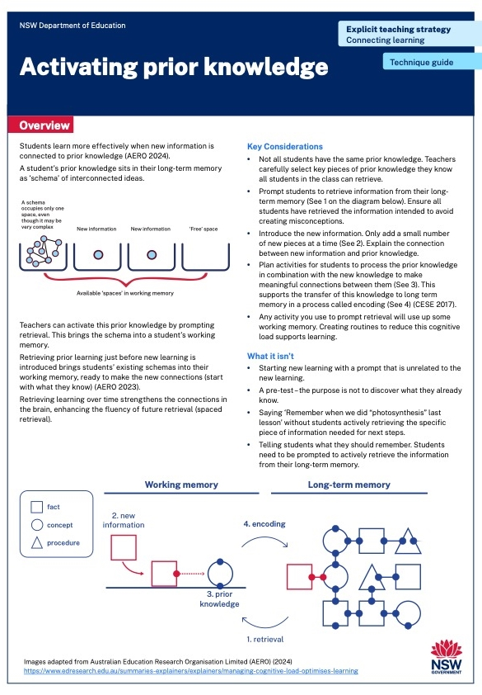
Planning questions to activate prior learning
Plan questions to:
prompt students to retrieve previously taught material
check for successful retrieval.
Notes:
Purpose: Planning questions to activate prior learning
Speaker notes:
[01:10]
Plan questions to begin a lesson with activation of prior knowledge by prompting students to actively retrieve previously taught material. The purpose of this retrieval is to connect prior learning to the new learning to be introduced.
It is important to check that students have recalled the correct information, to avoid misconceptions and help them develop an accurate schema in their long-term memory.
When designing questions to activate prior knowledge, ensure the knowledge is something you expect they should know. These questions are not the same as checks for understanding because the answers are not used by the teacher to redirect the learning. These questions are designed to support students to retrieve what they have already learnt, to do something new with it to connect it to new learning, and consolidate the learning into long-term memory.
The key in developing these questions is to balance effort and success, where students must use some effort to successfully retrieve information they need to know – ‘too many errors or failures to retrieve could consolidate the wrong information and be demotivating’ (Cottingham 2023:94).
References:
Cottingham S (2023) Ausubel's meaningful learning in action, Hodder Education Group.

Slide 55
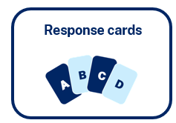
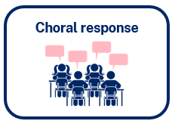



Planning questions for recall
Focus on the key information you want students to retrieve.
Develop questions or prompts to support students to retrieve this information from their long-term memory.
Develop questions so most or all students can be successful in recall.
Retrieval practice builds and strengthens connections in long term memory (AERO 2023).
Notes:
Purpose: Planning for retrieval
Speaker notes:
[01:40]
When using questions for recall, focus only on the key information you want students to retrieve. Start by writing a list of the key information. Then formulate questions that will prompt students to recall each piece of information from long-term memory. We want most if not all students to be successful when asking recall questions. We should be asking questions about things that we have previously taught them. Sometimes additional prompts may be needed for successful retrieval, but remember, the purpose of these recall questions is for students to practice accessing information in long-term memory, as practicing makes future retrieval easier (CESE 2018).
Remember to also plan which response system students will use - ABCD cards, choral response, mini-whiteboard, gesture voting and cold calling can all be useful for retrieval questions. For example, after learning about the water cycle in a previous lesson, a teacher plans a multiple-choice question for recall, ‘What is the term we use to describe water that falls from the sky in forms like rain, snow, or hail? A: Condensation B Precipitation C: Evaporation’. Students use ABCD cards to show their response to the question.
You may decide to make a ‘daily review’ a feature of your lessons, in which the first few minutes of a lesson is dedicated to retrieval practice of previously learned material. Consider this insight from Rosenshine ‘The most effective teachers in the studies of classroom instruction understood the importance of practice, and they began their lessons with a five to eight-minute review of previously covered material’ (2012).
Many questions you will use will require students to recall information, for example questions used to identify misconceptions or to develop complexity in student thinking, but the primary purpose of recall questions is to give students opportunities to practice retrieving key information.
References:
AERO (Australian Education Research Organisation) (2023) How students learn best: An overview of the learning process and the most effective teaching practices, AERO.
CESE (Centre for Education Statistics and Evaluation) (2018) Cognitive load theory in practice: examples for the classroom, NSW Department of Education.
Rosenshine B (2012) ‘Principles of instruction: research-based strategies that all teachers should know’, American Educator, 36(1):12–39.

Slide 56
Planning questions to identify misconceptions
Identify possible misconceptions in the planning phase.
Develop questions that will identify these misconceptions.
Prepare responses for each misconception if they are identified, including a check for understanding to ensure accurate understanding following the intervention.
Notes:
Purpose: Planning questions to identify misconceptions
Speaker notes:
[00:50]
All questions students respond to, or fail to respond to, may reveal gaps in knowledge or misconceptions. When planning to teach a new concept, as a subject matter expert, you will be aware of common misconceptions held by students (Madgwick 2021). In some faculties or stage groups it might be useful to work collaboratively to determine possible misconceptions. Plan responses to possible misconceptions, which may include some reteaching of material (Nuthall 2007). After taking the corrective action, complete further checks for understanding to confirm the accuracy of schema construction.
Responses from all students should be collected to identify misconceptions, so ABCD cards, choral response and mini-whiteboards can be useful response systems.
For example, a teacher is planning a lesson on the water cycle and knows that students may hold the misconception that there is no water in the air. The teacher plans a question to check for this misconception ‘Is there water in the air around us?’ The teacher plans a gesture vote to check students' responses. If students answer no, then the teacher prepares a response demonstrating condensation using a cold object and plans a question to check for understanding.
References:
Nuthall G (2007) The hidden lives of learners, New Zealand Council for Educational Research.
Madgwick H (14 July 2021) 'Exploring the evidence: prior knowledge and pupil misconceptions', Education Endowment Foundation, accessed 4 October 2024

Slide 57
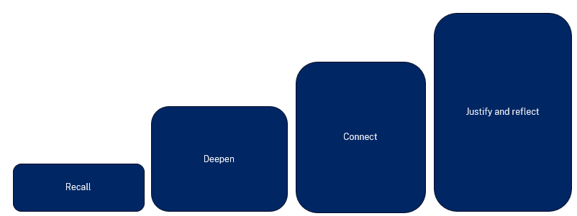
Planning questions to scaffold thinking to build complexity
Recall | Deepen | Connect
What is a force? What is a contact force? What is a non-contact force? | Explain why magnetic attraction is a non-contact force. | How is magnetic attraction similar to electrostatic attraction? How is it different?
Questions that prompt complex thinking:
need even more wait time
require the response method to be modelled
may require students to refine their answers following feedback
are done after key knowledge is consolidated.
Notes:
Purpose: Planning questions to scaffold thinking to build complexity
Speaker notes:
[01:40]
Questions can be used to build increasingly complex thinking. In addition to pre-planned questions for developing this complexity, teachers can respond to student answers with probing questions asking students to ‘explain the process they used to answer the question, to explain how the answer was found’ (Rosenshine, 2012:14). To plan questions using the model described in technique A you might consider using a table such as the one shown on this slide. It is not necessary to use all four of the items in the model, and it may be necessary to move between the ‘levels’ when student responses indicate gaps in learning or misconceptions.
When planning, it may be useful to start at the right-hand side of the table and work your way backwards, i.e. determine the higher order question you want students to be able to answer, and how can you build their thinking to that point. We do this to plan for students to be most likely to experience success. This involves ensuring students have had sufficient practice at each level before moving to the next (Rosenshine 2012). In other words, to ask students at the start of a lesson “How is magnetic attraction similar to electrostatic attraction?” may be too challenging for many students. By scaffolding their thinking with retrieval practice and some deeper thinking they are better prepared to answer this higher order question to connect the learning about magnets to prior learning about electrostatic attraction.
As questions become increasingly complex the amount of wait time, or thinking time, provided to students should increase.
When using questions to deepen student thinking and develop increasingly complex schemas you will need to consider the response system you used in relation to the complexity of the question asked. A choral response or ABCD response card is not likely to be useful to respond to questions such as ‘Justify your answer’, ‘What makes you say that?’ or ‘Explain your thinking’, for instance.
Think-pair-share (or ‘turn and talk’) can be a useful strategy to allow students sufficient time to elaborate their thinking while engaging all students in thinking. It is also useful as a simple routine that does not in itself create additional cognitive load. Other possible response systems include extended written responses, debates and class discussion*.
The Science example has been expanded to include these considerations [click to next slide].
Further reading
*For more information about class discussions see the Making meaningful connections through discussions – technique guide in the Connecting learning module available here: https://education.nsw.gov.au/teaching-and-learning/curriculum/explicit-teaching/explicit-teaching-strategies/connecting-learning
References:
Rosenshine B (2012) ‘Principles of instruction: research-based strategies that all teachers should know’, American Educator, 36(1):12–39.
Science 7–10 Syllabus © NSW Education Standards Authority (NESA) for and on behalf of the Crown in right of the State of New South Wales, 2023.

Slide 58
Planning questions and response systems when developing complexity
Recall | Deepen | Connect
What is a force? What is a contact force? What is a non-contact force? Wait time: 3 seconds Response system: Choral response | Explain why magnetic attraction is a non-contact force. Wait time: 5 seconds Response system: Think-pair-share | How is magnetic attraction similar to electrostatic attraction? How is it different? Wait time: 5 seconds before first response Response time: 3 minutes Response system: Class discussion
Notes:
Purpose: Planning questions and response systems when developing complexity
Speaker notes:
[00:50]
In this expanded example of planning questions to develop more complex thinking, consideration has also gone into the wait time for each question as well as the response system to use. As the questions become increasingly complex the wait time needed is longer. This allows students to process, think and plan their responses. It is essential to include wait time after you ask each question and after a student answers (Stahl 1994; Wiliam 2011).
If questions require a justification or reflection, wait time might be better conceived of as ‘response time’ with students taking time to think and respond as they prepare their answer, which might be in the form of an extended response, for example.
On the next slide you will see a summary of considerations for planning questions to build complexity.
Syllabus content:
SC4-FOR-01 Forces:
Forces in action
Explain forces as either direct (contact) or indirect (non-contact)
Describe the electrostatic and gravitational forces exerted between objects
Magnets in everyday life
Describe how magnets attract or repel each other based on their polarity
References:
Stahl RJ (1994) ‘Using think time and wait time skilfully in the classroom’, ERIC Digest, accessed 19 February 2025.
Wiliam D (2011) Embedded formative assessment, Solution tree press.
Science 7–10 Syllabus © NSW Education Standards Authority (NESA) for and on behalf of the Crown in right of the State of New South Wales, 2023.

Slide 59
Planning to build complexity
Recall
What, who, when questions
Expect success
Shorter wait time
(3 seconds)
Response systems can include:
Choral response
ABCD cards
Cold calling
Deepen
How, why, explain questions
Give prompts if needed for success
Longer wait time
(5 or more seconds)
Response systems can include:
Cold calling
Mini whiteboards
Think-Pair-Share
Extended written response
Connect
Cause and effect, how
is x similar (or different) to y
Give prompts if needed for success
Longer time needed for thinking and working
Response systems can include:
Class discussions
Concept maps
Extended written response
Justify and reflect
Do you agree or disagree with this statement? Why do you say that? How do you know?
Longer time needed to prepare responses
Response systems can include:
Class discussions
Debate
Extended written response
Notes:
Purpose of slide: Planning to build complexity
Speaker notes:
[00:50]
You will notice these are the same headings used in Part A, with the ‘complexity’ of the questions increasing from left to right.
The small circles in each box again represent the wait time the teacher provides after each question is asked. As questions build in complexity, longer wait time is provided.
Each box starts with examples of question stems and key considerations when planning these questions, including wait time. Below this are some response systems which could be useful for these question types. Neither the lists are exhaustive, this slide attempts to show an overview of considerations when planning questions to develop complexity in student thinking. Teachers may find this diagram useful when planning questions.
This diagram is reproduced in the Building complexity technique guide.
References:
AERO (Australian Education Research Organisation) (2023b) How students learn best: an overview of the learning process and the most effective teaching practices, AERO
Rosenshine B (2012) ‘Principles of instruction: research-based strategies that all teachers should know’, American Educator, 36(1):12–39.
Stahl RJ (1994) ‘Using think time and wait time skilfully in the classroom’, ERIC Digest, accessed 19 February 2025.
Wiliam D (2011) Embedded formative assessment, Solution tree press.

Slide 60
Activity
Plan a series of questions that build in complexity for a lesson using the diagram on the previous slide. Consider the wait time and response systems you will use.
It will be useful to refer to the technique guides.
Notes:
Purpose: Activity
[10:00]
Note to presenter: Teachers are given 10 minutes to practise applying their learning to a class they are teaching. Give approximately 6 minutes for writing and 2 mins each for a ‘turn and share’.
Refer to the Using questions to build complexity and Planning for effective questioning technique guide.

Slide 61
Planning, rehearsing and developing routines
Notes:
Speakers notes:
[00:20]

Slide 62
Creating agreed whole-school principles
Draft whole-school teaching principles for effective questioning techniques.
Notes:
Purpose: Consider how you can use the techniques in this learning module to create a whole-school principles for effective questioning
[1:00] + additional time for the activity
Note to presenter: consideration needs to be given as to how a routine is created, for example, in small groups, cross-stage or cross-faculty, etc. If working with a larger staff group, form smaller groups.
Speaker notes:
Today we will be doing an activity in groups to develop possible whole-school principles for effective questioning.
In your groups, draft a consensus on some effective questioning routines that align with effective teaching practices. Remember, these should be routines that can be applied across the school.
After drafting, the group leader will model the routine using the routine for feedback. This step is crucial as it allows the group to reflect and refine the process based on the feedback prompts provided.
Once refined, we’ll come back together and share these principles as a whole. The goal is to adopt a cohesive approach that supports all teachers to use effective questioning.
Example principle:
Planned questions to increase in complexity.
Purpose – planned questions and response systems can support teachers to scaffold student thinking to build complexity
Principles:
Plan questions for retrieval
Plan questions that align with the learning intentions and success criteria of the lesson.
Plan a series of questions to deepen student thinking, to make connections between learning and to allow students to justify and reflect.
Plan the response systems to check for understanding (these can be part of your whole-school checking for understanding routines).
Plan for wait time.

Slide 63
Planning and rehearsing (2) (1)
Plan
Rehearse
Feedback
Evidence for Learning (2022) Effective Professional Development, Sydney: Evidence for Learning.
Notes:
Purpose of slide: To explain the process of rehearsing
Speaker notes:
[00:30]
Now that we have our routine, we have some time to plan, rehearse, and get feedback from each other. When we say rehearse, we mean:
plan number of suitable questions or get activities ready
deliver the instruction as if doing it in class.
Then your partners
will use the feedback prompts on the next slide to refine the teaching routine. What may need to be added, changed, enhanced or deleted?
Note to presenter: it is advisable to prepare the leaders beforehand if modelling and rehearsing are not yet established practices in the school.
References:
Evidence for Learning (2022) Effective professional development, Evidence for Learning.
Further reading on this research:
AERO (Australian Education Research Organisation) (2023c) Gaining all students’ attention, AERO, accessed 27 February 2025.
Sims S, Fletcher-Wood H, O’Mara-Eves A, Cottingham S, Stansfield C, Van Herwegen J and Anders J (2021) What are the characteristics of teacher professional development that increase pupil achievement? A systematic review and meta-analysis, Education Endowment Foundation.

Slide 64
Rehearsal steps and feedback prompts
Use your learning sequence, or the lesson plan to:
select an effective questioning technique
decide on an agreed routine
plan your instructions for the class
rehearse the teaching for this technique with a partner
use the feedback and modelling from your partner to improve your approach
swap with your partner for their rehearsal
Feedback prompts
Did the teacher prompt recall of essential prior knowledge?
Has the routine been successful in retrieving knowledge?
Do the planned questions develop in complexity?
Notes:
Purpose of slide: to give the steps and feedback prompts for the activity
Speaker notes:
[00:20]
Take a minute to go through the rehearsal steps and the prompts for feedback.
If you are giving feedback, we have provided a list of prompts for you to think about how the routine could be refined.
Note to presenter: this slide and the activity slide could be provided to the groups as handouts.
At step 1, one technique is suggested. This may relate to Using questioning to build complexity or Planning for effective questioning. The group may be structured so that half work on one while the other half do the other, or the time could be split so everyone does both. This is a school based decision.

Slide 65
In the next part of this module, we will work on evaluating our approach to implementing the strategies through techniques
Notes:
Note to presenter: Select a technique to focus on with a cycle of planning, rehearsing and developing routines. This will support developing sustainable routines in the school.

Slide 66
Evaluating a whole-school approach
Part C

Slide 67
Purpose and outcome (3)
Purpose
To apply effective professional development structures, reflect on and evaluate our implementation of an explicit teaching technique.
Outcome
Refine the whole-school practices of effective questioning and plan for future success and activities.
Notes:
Purpose: Purpose and outcome
Speaker notes:
[00:30]
In this part, the focus is on reflection and evaluation. We will consider the early indicators of success and use this to plan for evaluation of longer term impact. There is also a good opportunity to refine principles that guide how we implement effective questioning across the whole school.

Slide 68
A whole school approach

Slide 69
Initial reflection point (2)
Teacher observation | 0 | 1 | 2 | 3 | 4
Students demonstrate their thinking by actively respond with an answer during ‘effective questioning’ throughout each lesson. | Not yet observable | Minimal students actively respond to ‘effective questioning’ | Some students demonstrate their thinking by actively responding to ‘effective questioning’ | Most students their thinking by actively responding to ’effective questioning’ | All students demonstrate their thinking by actively responding to ‘effective questioning’
Notes:
Purpose: Reflecting on initial observations
Speaker notes:
[00:30]
In the beginning, we established a baseline for where our students are now.
We looked at this example of a tool that could be used for teacher reflection. This was one way to measure one aspect of effective questioning.
We asked: Think about one class you taught today. What parts of the scale would best describe your students?
Note to presenter: In the beginning we noted that there is an opportunity to use this data in the final session. This measure is not the only consideration, and schools should select a model that is right for them.
This data could be collated and compared to other “school and classroom data about growth and performance.”
For example:
NAPLAN report overview accessed through Scout
https://education.nsw.gov.au/about-us/education-data-and-research/scout/training/digital-learning-centre/naplan-report-overview
NAPLAN report overview
Learn more about the NAPLAN reports in Scout.
https://education.nsw.gov.au/about-us/education-data-and-research/scout/scout-overview/apps-and-reports/naplan---doe/class-report#tabs0
Class report
The Class report shows the distribution of students’ scaled scores across domains and proficiency levels for NAPLAN 3, 5, 7 or 9.
References:
AERO (Australian Education Research Organisation) (2023b) How students learn best: an overview of the learning process and the most effective teaching practices, AERO, accessed 27 February 2025.
AERO (Australian Education Research Organisation) (2023d) Explicit instruction optimises learning, AERO, accessed 15 February 2025.
Martin AJ and Evans P (2018) 'Load reduction instruction: exploring a framework that assesses explicit instruction through to independent learning', Teaching and Teacher Education, 73:203–214, doi:10.1016/j.tate.2018.03.018.

Slide 70
The mechanisms of effective questioning (2)(2)
Planned at the right level of challenge
Increase in complexity
Develop increasingly complex schema
Retrieve prior learning
All students are thinking of an answer
Notes:
Purpose: The mechanisms of effective questioning
Speaker notes:
[00:50]
When using effective questioning:
1. Ensure questions are planned as part of the narrative of the lesson or unit of work.
2. Use a variety of questioning techniques and allow for wait time to give students the opportunity to retrieve prior knowledge, connect to new learning and think through their response.
3. Consider the needs of all learners. There may be several levels of challenge needed to cater for the learning needs of all students.
4. Create a safe and inclusive classroom culture with high expectations where all students expect to be called on and feel safe to make and learn from their mistakes
5. Through these mechanisms, we provide multiple opportunities for students to think deeper and develop increasingly complex schema – their mental framework that helps them organise and understand information.

Slide 71
The importance of all moving together (2)
Saves learning time¹
Frees up students’ working memory²
Certain and consistent expectations for students³
Students learn the routine more quickly when it is done in the same way across the school⁴
Fosters a strong sense of belonging⁵
Notes:
Purpose: to restate why a whole school teaching routine is powerful
Speaker notes:
[00:50]
These modules use the power of whole school teaching routines. When a group of expert teachers from across the school come together and create a whole school approach, they are far more effective than when they go it alone. Teaching routines:
[click] save learning time
[click] can free up students’ working memory
click] provide certainty and expectations for students to contribute to a learning environment where they’re safe to participate.
[click] they’re efficient, because when done the same way across the school, students can learn the routine more quickly.
[click] and they foster a strong sense of belonging.
As we go through the learning module here, and other learning modules for explicit teaching we will revisit the idea of the whole school teaching routines.
Note to presenter: it is advisable to prepare school leaders beforehand if modelling and rehearsing are not yet established practices in the school.
References:
Evidence for Learning (2022) Effective professional development, Evidence for Learning, accessed 12 September 2024.
Further reading on this research:
AERO (Australian Education Research Organisation) (2023c) Gaining all students’ attention, AERO, accessed 27 February 2025.
Sims S, Fletcher-Wood H, O’Mara-Eves A, Cottingham S, Stansfield C, Van Herwegen J and Anders J (2021) What are the characteristics of teacher professional development that increase pupil achievement? A systematic review and meta-analysis, Education Endowment Foundation.

Slide 72
Planning and rehearsing (3) (1)
Plan
Rehearse
Feedback
Evidence for Learning (2022) Effective Professional Development, Sydney: Evidence for Learning.
Notes:
Purpose: to explain the process of rehearsing
Speaker notes:
[00:30]
Planning, rehearsing and getting feedback are crucial when we are working to develop techniques for implementing strategies. When we say rehearse, we mean:
plan number of suitable questions or get activities ready
deliver the instruction as if doing it in class.
Then your partners
will use the feedback prompts on the next slide to refine the teaching routine. What may need to be added, changed, enhanced or deleted?
Note to presenter: it is advisable to prepare the leaders beforehand if modelling and rehearsing are not yet established practices in the school.
References:
Evidence for Learning (2022) Effective professional development, Evidence for Learning.
Further reading on this research:
AERO (Australian Education Research Organisation) (2023c) Gaining all students’ attention, AERO, accessed 27 February 2025.
Sims S, Fletcher-Wood H, O’Mara-Eves A, Cottingham S, Stansfield C, Van Herwegen J and Anders J (2021) What are the characteristics of teacher professional development that increase pupil achievement? A systematic review and meta-analysis, Education Endowment Foundation.

Slide 73
Rehearsal (2) (1)
Notes:
Purpose of slide: To explain why rehearsing is so important
Speaker notes:
[01:10]
Application is a real key to success in professional learning.
Why might professional learning not be applied in the classroom, despite our best intentions?
Research from Evidence for Learning (2022) found that rehearsing was among the key mechanisms for success in the application of PL.
New teachers often have practices described to them – but it is much clearer to have lead teachers model the practice (out of the classroom, without students) while the observer uses prompts to reflect on what made that practice successful.
Teaching is a habit-forming practice. By necessity, teaching requires us to automate a number of behaviours. The cognitive load on teachers to introduce a new behaviour is high and so we often rely on those previously formed habits.
Rehearsal (out of the classroom, without students) makes our PL a habit. When we try a rehearsed routine in a classroom, our cognitive load is reduced because we have one thing to think about, rather than 4 or 5.
This is why rehearsing is a key mechanism for success in professional learning.
References:
Evidence for Learning (2022) Effective professional development, Evidence for Learning.

Slide 74
Evaluating impact on students

Slide 75
'When implementing a new evidence-based practice, school personnel should measure fidelity early and often to provide timely and responsive professional development and maximise student outcomes.'
(Harn et al. 2013:186)
Notes:
Purpose:
Speaker notes:
[00:00]
Reference:​
Harn B, Parisi D and Stoolmiller M (2013) ‘Balancing fidelity with flexibility and fit: what do we really know about fidelity of implementation in schools?’ Exceptional Children, 79:181–193.

Slide 76
Measures of impact
Short term
Increased ability to articulate connections between pieces of knowledge.
Longer term
Increased understanding
Increased learning
Student data indicates learning gains
Notes:
Purpose of slide: Measuring success
Speaker notes:
[0:30]
When we try something new in the classroom and our students experience it for the first time, it may not have the desired impact. Over time, the impact of the approach should show signs of success.
Measure fidelity early and often to provide maximise student outcomes and be responsive in the approach.

Slide 77
Data sources to measure impact
Short term
Increased engagement
Increased number of students actively responding with an answer during checks for understanding
Longer term
Increased understanding
Increased learning
Student data indicates learning gains
Teacher observation | 0 | 1 | 2 | 3 | 4
Students demonstrate their thinking by actively respond with an answer during ‘effective questioning’ throughout each lesson. | Not yet observable | Minimal students actively respond to ‘effective questioning’ | Some students demonstrate their thinking by actively responding to ‘effective questioning’ | Most students their thinking by actively responding to ’effective questioning’ | All students demonstrate their thinking by actively responding to ‘effective questioning’
Notes:
Purpose: Reflecting on initial observations and considering long term measures
Note to presenter: timing for this slide will be dependent on your own allocated time and the number of staff in attendance.
Speaker notes:
[0:50]
In Part A, we identified the level of students’ ability to actively respond to questions in class.
We could choose a different measure, but it's important it is proximal to the teaching. It should be an immediately observable/collectable indicator of change in students’ knowledge, skills, motivation, self-belief, or teacher practice. This information of what is successful helps us plan for longer term outcomes.
Activity:
What observations can you make about effective questioning techniques in the classroom?
What observations can be made about what has been successful so far, while we’ve focused on effective questioning in classrooms?
How will we measure longer term outcomes?
How can we scale our success by refining and building the techniques and routines we’ve been developing?
Note to presenter: You may wish to display the data from the first session if it was collected. If there has been no shift identified using the early measure, discuss the barriers to success and if an adjustment to the whole-school routine is needed.
Further reading on High Impact Professional Learning:
https://education.nsw.gov.au/teaching-and-learning/professional-learning/high-impact-professional-learning
References:
McCrea P (2020) Motivated teaching: harnessing the science of motivation to boost attention and effort in the classroom, Createspace Independent Publishing Platform.

Slide 78
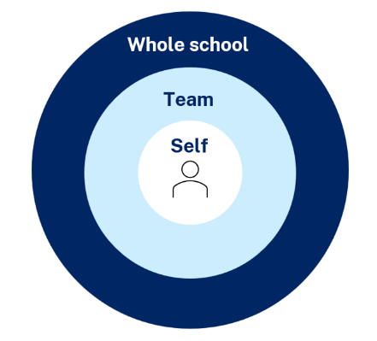
Maintaining a whole school approach through data
Video observation and reflection
Peer observation and feedback
Teacher and student survey
Growth in assessment data
Notes:
Purpose of slide: collating and using data
Speaker notes:
[1:00]
Evaluating data is a way we can consider the extent to which we are being effective in achieving long term goals. Data can be collected from many perspectives, including individual teachers and students, teams and whole school. Data can include a range of things, such as observational/instructional rounds, student work samples (such as exit tickets), student self-reports, teacher reflections and assessments. Data can be quantitative and qualitative.
Reflecting on data helps us consider how efficient and effective we are being in achieving our instructional goals. It also provide key insights to inform the next steps of professional learning and whole school strategic planning.
Activity:
What data have we accessed so far and what have we learnt?
How can we select and measure data over time to consider our impact?
Further reading:
For more information about using data to evaluate the curriculum aligned to the School Excellence Framework
See Module 5 of LECI on this page: https://education.nsw.gov.au/teaching-and-learning/curriculum/leading-curriculum-k-12/leading-curriculum-middle-leaders/leading-effective-curriculum-implementation

Slide 79
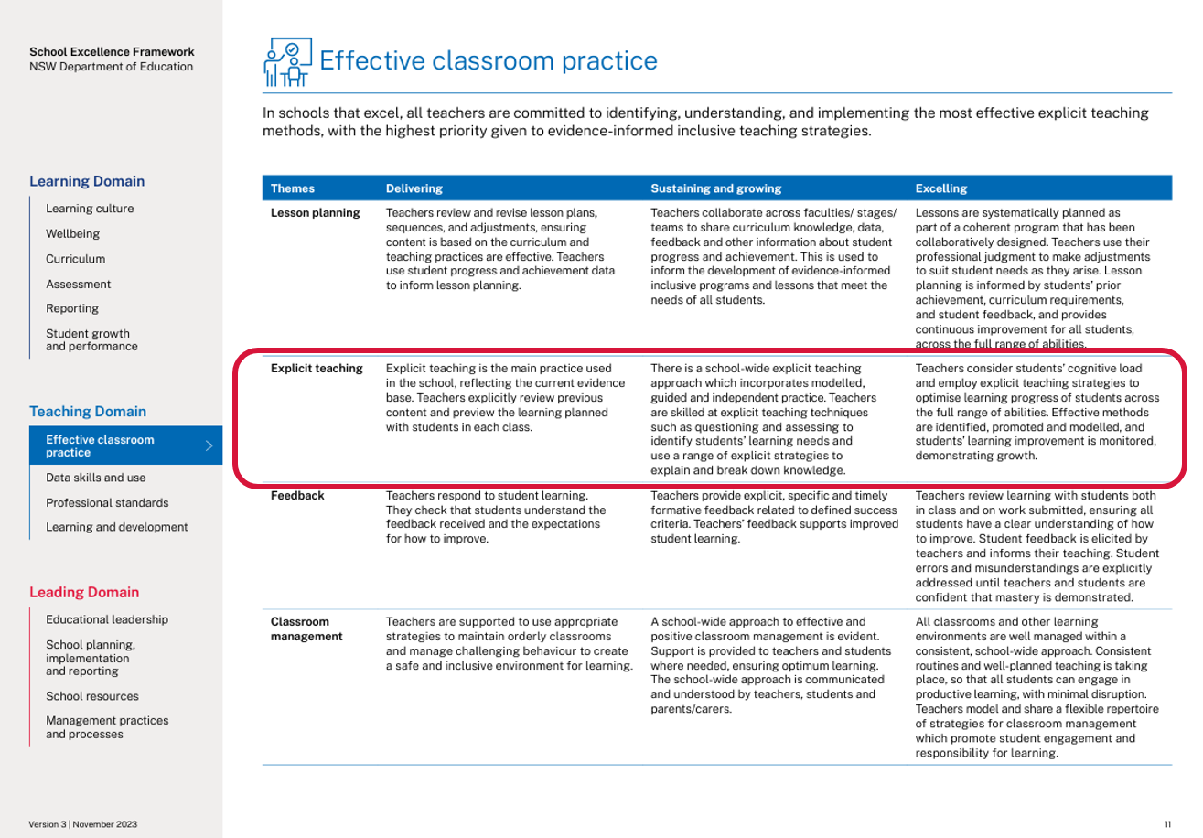
Connecting to the School Excellence Framework
‘School-wide explicit teaching approaches incorporate modelled, guided and independent practice.
Teachers consider students’ cognitive load and employ explicit teaching strategies to optimise learning progress of students across the full range of abilities. Effective methods are identified, promoted and modelled, and students’ learning improvement is monitored, demonstrating growth.’
School Excellence Framework, Teaching Domain (p 11)
79
Notes:
Purpose of slide: Aligning the practice to the SEFv3
Speaker notes:​
​[2:30]
Linking to longer term outcomes, the SEF is an excellent way to measure whole-school impact over time.
Effective questioning relates to themes from the SEFv3​.
​
For example, in the teaching domain, under the element of effective classroom management, this practice aligns with the descriptors for the theme of explicit teaching and classroom management.
Activity:
Access and identify key features from delivering, sustaining and growing and excelling for the explicit teaching theme.
Access and identify key features from delivering, sustaining and growing and excelling for the classroom management theme.
Describe how our classrooms would look, feel and sound if we were to move to 'sustaining and growing' or move to 'excelling’.
Discuss how this would align with the strategic direction already in place in your school?
As a whole school, how are we ensuring we continue to reflect on and share our practice?
What actions can we take to promote our effective explicit teaching practice to the wider school community?
How can the SEF be integrated in our school’s professional learning in an ongoing way?
Discussion points:
In ‘sustaining and growing’ the practice looks like a whole school approach to positive classroom management:
​
This extends to learning routines in ‘excelling’ where there are consistent school-wide approaches to learning routines that enable student engagement. ​
​

Slide 80
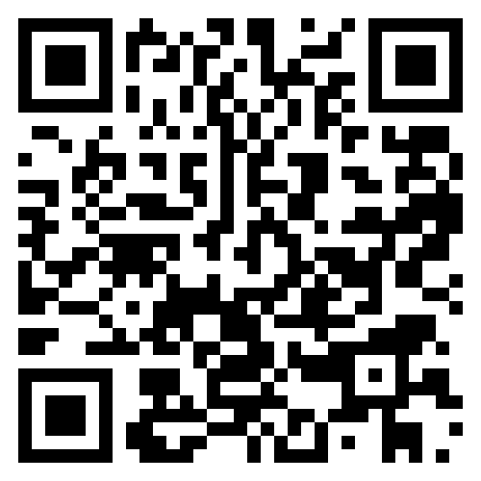

Feedback
Please complete the Effective questioning module survey to help us improve future professional learning and provide further support.
Contact us
ContactCurriculumImplementation@det.nsw.edu.au

Slide 81

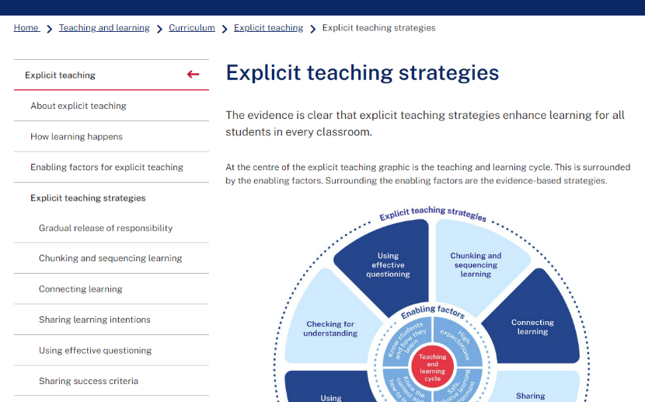
Explicit teaching strategies and resources
More information is available about:
​explicit teaching
how learning happens
the enabling factors
the explicit teaching strategies
https://education.nsw.gov.au/teaching-and-learning/curriculum/explicit-teaching
Notes:
Purpose of slide: Next steps
Speaker notes:
[0:30]
The evidence on explicit teaching is clear, it shows us how important it is to align our teaching pedagogy with how learning occurs. Ongoing information to support this is available on the department's website.
This includes information about the enabling factors, how learning happens and the explicit teaching strategies. The website will continue to be updated as new resources are released in future.
https://education.nsw.gov.au/teaching-and-learning/curriculum/explicit-teaching

Slide 82
Reference list (1)
Archer AL and Hughes CA (2011) Explicit instruction: effective and efficient teaching, Guilford Press.
AREO (Australian Education Research Organisation) (2021) Focused classrooms: managing the classroom to maximise learning, AERO, accessed 11 February 2025.
AERO (Australian Education Research Organisation) (2023a) Teaching routines, AERO, accessed 20 February 2025.
AERO (Australian Education Research Organisation) (2023b) How students learn best: an overview of the learning process and the most effective teaching practices, AERO, accessed 27 February 2025.
AERO (Australian Education Research Organisation) (2023c) Gaining all students’ attention, AERO, accessed 27 February 2025.
AERO (Australian Education Research Organisation) (2023d) Explicit instruction optimises learning, AERO, accessed 15 February 2025.
Australian Education Research Organisation (AERO) (2024) Monitor progress, AERO, accessed 25 February 2025.
AITSL (Australian Institute for Teaching and School Leadership) (2023) Teacher standards, AITSL, accessed 12 February 2025.
Black P, Harrison C, Lee C, Marshall B and Wiliam D (2003) Assessment for learning: putting it into practice, Open university Press.
Black P and Wiliam D (2018) 'Classroom assessment and pedagogy', Assessment in Education: Principles, Policy & Practice, 25(6):551–575.
Bogdanovich P (28 October 2014) Higher-order questions, Dataworks Educational Research, accessed 25 February 2025.
CESE (Centre for Education Statistics and Evaluation) (2017) Cognitive load theory: research that teachers really need to understand, NSW Department of Education, accessed 21 February 2025.
CESE (Centre for Education Statistics and Evaluation) (2018) Cognitive load theory in practice: examples for the classroom, NSW Department of Education, accessed 21 February 2025.

Slide 83
Reference list (2)
Cottingham S (2023) Ausubel's meaningful learning in action, Hodder Education Group.
Harn B, Parisi D and Stoolmiller M (2013) ‘Balancing fidelity with flexibility and fit: what do we really know about fidelity of implementation in schools?’ Exceptional Children, 79:181–193.
Kirschner PA, Sweller J and Clark RE (2006) 'Why minimal guidance during instruction does not work: an analysis of the failure of constructivist, discovery, problem-based, experiential, and inquiry-based teaching’, Educational Psychologist, 41(2): 75–86, doi:10.1207/s15326985ep4102_1.
Martin AJ and Evans P (2018) 'Load reduction instruction: exploring a framework that assesses explicit instruction through to independent learning', Teaching and Teacher Education, 73:203–214, doi:10.1016/j.tate.2018.03.018.
Martin AJ (2002) ‘Motivation and academic resilience: developing a model of student enhancement’, Australian Journal of Education, 46:34-49. doi: 10.1177/000494410204600104.
McCrea P (2020) Motivated teaching: harnessing the science of motivation to boost attention and effort in the classroom, CreateSpace Independent Publishing Platform.
Madgwick H (14 July 2021) ‘Exploring the evidence: prior knowledge and pupil misconceptions', Education Endowment Foundation, accessed 4 October 2024.
NCTM (National Council of Teachers of Mathematics) (2014) Principles to actions: ensuring mathematical success for all, NCTM.
Nuthall G (2007) The hidden lives of learners, New Zealand Council for Educational Research.
Sherrington T (2019) Rosenshine’s principles in action, John Catt Educational Limited.
Stahl RJ (1994) 'Using think time and wait time skilfully in the classroom', ERIC Digest, accessed 19 February 2025. RJ (1994) 'Using think time and wait time skilfully in the classroom', ERIC Digest, accessed 19 February 2025.

Slide 84
Reference list (3)
Rosenshine B (2012) ‘Principles of instruction: research-based strategies that all teachers should know’, American Educator, 36(1):12–39.
Sims S, Fletcher-Wood H, O’Mara-Eves A, Cottingham S, Stansfield C, Van Herwegen J and Anders J (2021) What are the characteristics of teacher professional development that increase pupil achievement? A systematic review and meta-analysis, Education Endowment Foundation.
Wiliam D (2011) Embedded formative assessment, Solution tree press, accessed 3 February 2025.
Wiliam D (2014) ‘The right questions, the right way’, Educational Leadership, 71(6):16–19.
Wiliam D and Leahy S (2015) Embedding formative assessment: practical techniques for F-12 classrooms, Hawker Brownlow Education.
Visual Arts 7–10 Syllabus © NSW Education Standards Authority (NESA) for and on behalf of the Crown in right of the State of New South Wales, 2025.
Mathematics K–10 Syllabus © NSW Education Standards Authority (NESA) for and on behalf of the Crown in right of the State of New South Wales, 2022
Science 7–10 Syllabus © NSW Education Standards Authority (NESA) for and on behalf of the Crown in right of the State of New South Wales, 2023.

Slide 85
Copyright
© State of New South Wales (Department of Education), 2024
The copyright material published in this resource is subject to the Copyright Act 1968 (Cth) and is owned by the NSW Department of Education or, where indicated, by a party other than the NSW Department of Education (third-party material).
Copyright material available in this resource and owned by the NSW Department of Education is licensed under a Creative Commons Attribution 4.0 International (CC BY 4.0) license.
This license allows you to share and adapt the material for any purpose, even commercially.
Attribution should be given to © State of New South Wales (Department of Education), 2024.
Material in this resource not available under a Creative Commons license:
the NSW Department of Education logo, other logos and trademark-protected material
Material owned by a third party that has been reproduced with permission. You will need to obtain permission from the third party to reuse its material.
Links to third-party material and websites
Please note that the provided (reading/viewing material/list/links/texts) are a suggestion only and implies no endorsement, by the New South Wales Department of Education, of any author, publisher, or book title. School principals and teachers are best placed to assess the suitability of resources that would complement the curriculum and reflect the needs and interests of their students.
If you use the links provided in this document to access a third-party’s website, you acknowledge that the terms of use, including licence terms set out on the third-party’s website apply to the use which may be made of the materials on that third-party website or where permitted by the Copyright Act 1968 (Cth). The department accepts no responsibility for content on third-party websites.

