Slide 1
About this presentation
Facilitator instructions
This slide deck contains 3 parts that require some preplanning.
Part A – Strategy overview, approach and impact – opportunity to collect data that could be used in Part C. The presenter will need to facilitate this. Part A includes an activity relating to technique guides that can be found on the sharing learning intentions webpage.
Part B – Implementing the strategies through techniques – the group activity requires pre-planning.
Part C – Evaluating a whole-school approach – opportunity to link to the School Excellence Plan.
Leaders should engage with Part C before implementing the professional learning with staff.
Slides are repeated across strategy modules so they can be implemented with the same structure. Note: some slides contain animations indicated by [click] in the presenter notes.

Slide 2

Effective feedback
Strategy learning module

Slide 3

Acknowledgement of Country
We recognise the Ongoing Custodians of the lands and waterways where we work and live. We pay respect to Elders past and present as ongoing teachers of knowledge, songlines and stories. We strive to ensure every Aboriginal and Torres Strait Islander learner in NSW achieves their potential through education.
‘Reflections’ created by Zara Marulanda from Blaxland High School as part of the 2021 Schools Reconciliation Challenge.
Notes:
Purpose: Acknowledgement of Country
[00:30]
Speaker notes:
I would like to acknowledge the traditional custodians of the land on which we meet today. We pay our respects to their Elders past and present. We recognise their continuing connection to land, water, and culture, and we are committed to continuing to learn from their wisdom and traditions.

Slide 4
Introduction
Notes:
Purpose: Placeholder for the introduction to the module

Slide 5
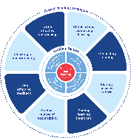
Enabling factors
Know students and how they learn
High expectations
Teachers understand how learning happens, and this informs their practice.
Students benefit from teachers holding high expectations for their learning.
Know the content and how to teach it
Safe, inclusive learning environments
Teachers know how the knowledge builds and connects to create learning that is strategic, sequenced and cumulative.
Explicit teaching both relies on, and brings about, a safe and inclusive learning environment.
Notes:
Purpose: Revisiting core knowledge
[00:30]
Presenter note: THERE ARE ANIMATIONS ON THIS SLIDE. You may wish for participants to read the slide content to themselves.)
Speaker notes:
Explicit teaching is an optimal way to teach knowledge and skills that are new or complex.
There are important enabling factors for explicit teaching that relate to the technique we are focusing on. Let’s revisit them.
[click] 1.Our understanding of the how learning happens informs our practice
[click] 2.We know how knowledge builds across syllabuses
[click] 3.When we hold high expectations for our students’ learning, we support and scaffold them to achieve higher levels of learning
[click] 4.And, explicit teaching both relies on, and brings about a safe, inclusive learning environment. When the pace of the class is such that students can follow with success, they are more likely to feel they belong and develop self-efficacy (CESE 2024)
Resources:
NSW Department of Education (2023) Classrooms of possibility, NSW Department of Education – https://education.nsw.gov.au/inside-the-department/teaching-and-learning/classrooms-of-possibility
NSW Department of Education (2024a) Explicit instruction: implementing evidence-based teaching practices for students with disability, NSW Department of Education. https://resources.education.nsw.gov.au/detail/IPR-LD230526144351
NSW Department of Education) (2024b) Leading explicit teaching – school-facilitated workshops 1–3 on core content and the enabling factors of explicit teaching, NSW Department of Education. – https://education.nsw.gov.au/teaching-and-learning/curriculum/explicit-teaching/leading-explicit-teaching
NSW Department of Education (2024c) Strong strides together: meeting the educational goals for Aboriginal and/or Torres Strait Islander students, Universal Resources Hub, NSW Department of Education. – https://education.nsw.gov.au/teaching-and-learning/c/universal-resources---aboriginal-education/strong-strides-together--meeting-the-educational-goals-for-abori
Reference:
CESE (Centre for Education Statistics and Evaluation) (2024) Explicit teaching drives student motivation, engagement, and achievement in NSW public schools: a What Works Best research update, NSW Department of Education, accessed 12 December 2024.

Slide 6
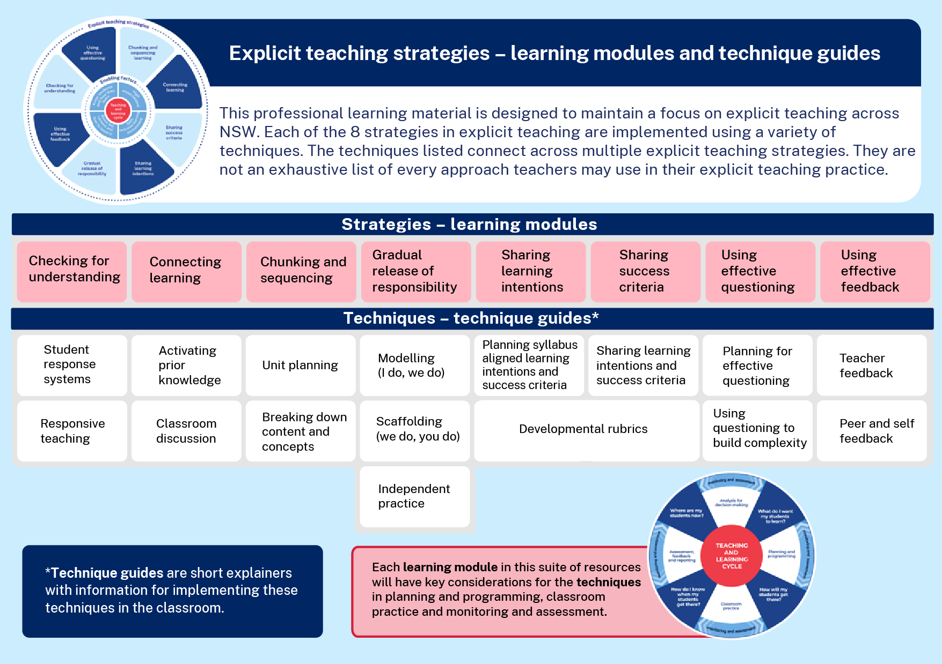
Learning modules and technique guides
Notes:
Purpose: To highlight where this module fits with other current and future modules and technique guides.
[0:30]
(Presenter note: Technique guides are available to supplement this presentation. For the activity on slide 28, it is expected that teachers have seen and read the guides.)
Speaker notes:
This module looks at one of the 8 explicit teaching strategies, Using effective feedback, and the techniques for this strategy. These are Teacher feedback and Peer and self feedback. You will have an opportunity to look at these technique guides shortly.
Using effective feedback resources:
State of New South Wales (Department of Education) (2024a) ‘Leading explicit teaching’, Explicit Teaching, NSW Department of Education – https://education.nsw.gov.au/teaching-and-learning/curriculum/explicit-teaching/leading-explicit-teaching

Slide 7


The importance of all moving together
Saves learning time¹
Frees up students’ working memory²
Certain and consistent expectations for students³
Students learn the routine more quickly when it is done in the same way across the school⁴
Fosters a strong sense of belonging⁵
Notes:
Purpose: To restate why a whole school teaching routine is powerful
[00:30]
(Presenter note: THERE ARE ANIMATIONS ON THIS SLIDE.)
Speaker notes:
These modules use the power of whole school teaching routines. Teaching routines:
[click] 1.save learning time
[click] 2.frees up students’ working memory
[click] 3.provide certainty and consistent expectations for students to contribute to a focused learning environment where they’re safe to participate.
When a group of expert teachers from across the school come together and create a whole school approach, they are far more effective than when they go it alone.
[click] 4.This is because students learn the routine more quickly when it is done in the same way across the school.
This also [click] 5.fosters a strong sense of belonging.
As we work through the learning module here, and other learning modules for explicit teaching, we will revisit the idea of the whole school teaching routines.
References:
1.Archer A and Hughes C (2011) Explicit instruction: Effective and efficient teaching. Guilford Press.
2.AERO (Australian Education Research Organisation) (2021) Focused classrooms: managing the classroom to maximise learning, AERO, accessed 19 March 2025.
3.AERO (Australian Education Research Organisation) (2023a) Teaching routines, AERO, accessed 4 October 2024.
4 and 5. McCrea P (2020) Motivated teaching: harnessing the science of motivation to boost attention and effort in the classroom, Createspace Independent Publishing Platform.
Further reading:
Tharby A (17 May 2023) ‘What are we to do: the case for explicit and consistent school-wide routines’, Class Teaching Find the bright spots, accessed 19 March 2025.

Slide 8
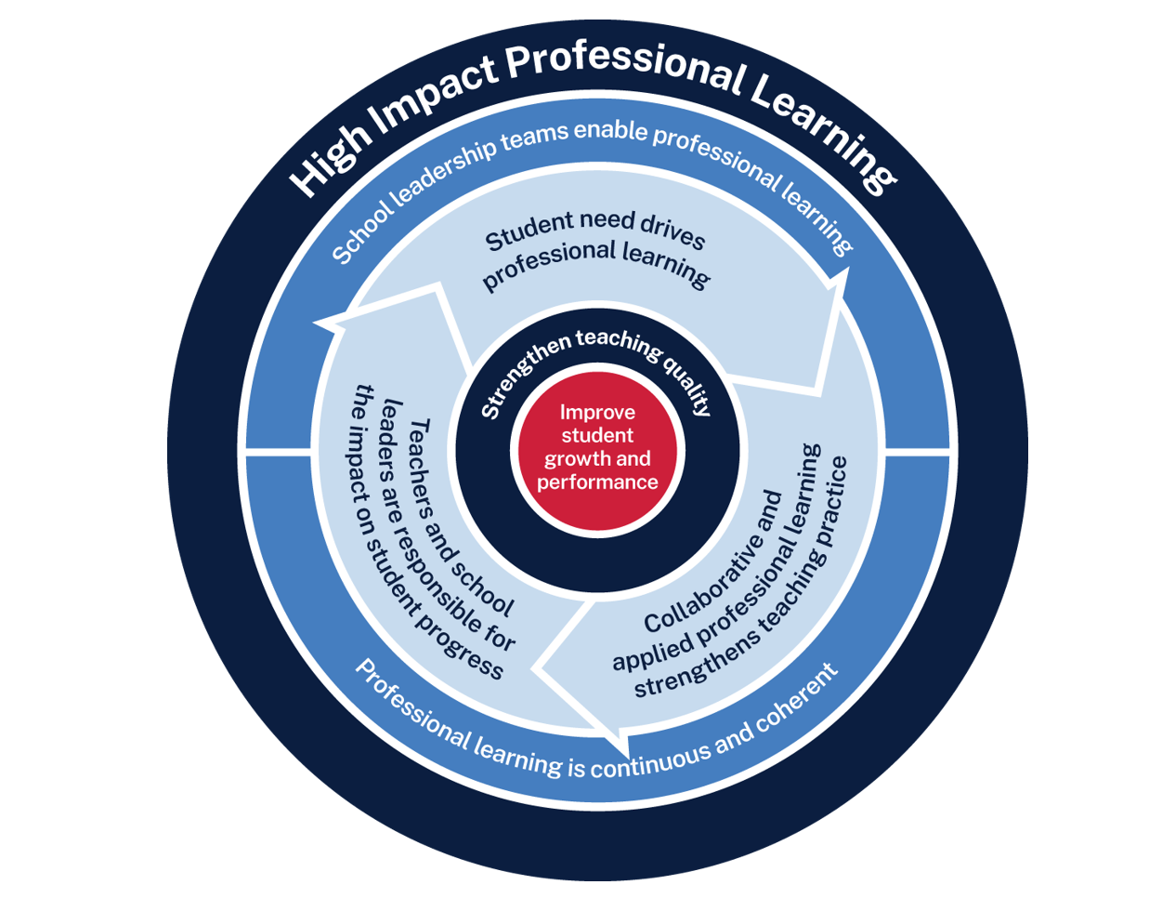
Effective feedback professional learning
Measure baseline student data and set a goal
Analyse data to determine further cycles
Use the whole school teaching approach and plan for instruction
Implement the teaching routine in the classroom and measure impact
Rehearse and give feedback to each other
8
Notes:
Purpose: Familiarising High Impact Professional Learning model (HIPL) and how it may inform our implementation of explicit teaching.
[01:00]
Speaker notes:
The High Impact Professional Learning (HIPL) model forms the basis of this professional learning. This model has five elements.
Professional learning is driven by identified student needs - https://education.nsw.gov.au/teaching-and-learning/professional-learning/high-impact-professional-learning/what-is-hipl/student-needs-drive-teacher-learning
School leadership teams enable professional learning - https://education.nsw.gov.au/teaching-and-learning/professional-learning/high-impact-professional-learning/what-is-hipl/leadership-that-prioritises-learning
Collaborative and applied professional learning strengthens teaching practice - https://education.nsw.gov.au/teaching-and-learning/professional-learning/high-impact-professional-learning/what-is-hipl/collaboration-that-improves-classroom-practice
Professional learning is continuous and coherent - https://education.nsw.gov.au/teaching-and-learning/professional-learning/high-impact-professional-learning/what-is-hipl/a-culture-of-continuous-learning
Teachers and school leaders are responsible for the impact of professional learning on student growth and performance - https://education.nsw.gov.au/teaching-and-learning/professional-learning/high-impact-professional-learning/what-is-hipl/accountability-for-impact-on-student-progress
The actions and steps we take to enact each of these elements will be shaped by our increasing shared understanding of check for understanding strategy and how specific check for understanding techniques can be used to optimise the learning of our students.

Slide 9
Initial reflection point
Teacher observation | 0 | 1 | 2 | 3 | 4
When provided with feedback, can students apply it to the learning accurately and effectively? | Not yet observable | Student/s acknowledges feedback but does not yet apply. | Some students apply feedback accurately and effectively. | Most students can apply feedback accurately and effectively. | All students can apply it accurately and effectively.
Notes:
Purpose: Initial teacher collected data as an early indicator.
[02:00]
(Presenter note: There is an opportunity to use this data in the final session. This measure is not the only consideration, and schools should select a model that is right for them. This data could be collated and compared to other 'school and classroom data about growth and performance'.)
Speaker notes:
An initial indicator is an observable change in student learning. It can help teachers to understand how effective their use of a technique may be. Initial indicators are important because they can give teachers insights into what parts of the instruction may need to be refined.
Here is an example of a tool that could be used for teacher reflection. This is one way to measure effective feedback.
Think about one class you taught today. What parts of the scale would best describe your students?
(Presenter note: ww time for teachers to reflect and share. Recording some ideas here would be beneficial as an initial point of reflection as we focus on effective feedback as a strategy.)
We will be able to refer to our early indicator observations when we evaluate our impact in Part C.
For example:
NAPLAN report overview accessed through Scout:
https://education.nsw.gov.au/about-us/education-data-and-research/scout/training/digital-learning-centre/naplan-report-overview
Learn more about the NAPLAN reports in Scout –
https://education.nsw.gov.au/about-us/education-data-and-research/scout/scout-overview/apps-and-reports/naplan---doe/class-report#tabs0
The Class report shows the distribution of students’ scaled scores across domains and proficiency levels for NAPLAN 3, 5, 7 or 9.
References:
AERO (Australian Education Research Organisation) (2023b) How students learn best: an overview’ of the learning process and the most effective teaching practices, AERO, accessed 4 October 2024.

Slide 10




Planning and rehearsing (1)
Plan
Rehearse
Feedback
Evidence for Learning (2022) Effective Professional Development, Sydney: Evidence for Learning.
Notes:
Purpose of slide: To explain the process of rehearsing
[0:30]
(Presenter note: THERE ARE ANIMATIONS ON THIS SLIDE. It is advisable to prepare the leaders beforehand if modelling and rehearsing are not yet established practices in the school.)
Speaker notes:
Research from Evidence for Learning shows teachers are more likely to put professional learning into practice when they plan and rehearse during professional learning, before implementing techniques in the classroom. This is enhanced by feedback from colleagues.
Reference:
Evidence for Learning (2022) Effective professional development, Evidence for Learning.
Further reading:
AERO (Australian Education Research Organisation) (2023c) Planning for classroom management, AERO, accessed 10 March 2025.
Evidence for Learning (2022) Effective professional development, Evidence for Learning.

Slide 11
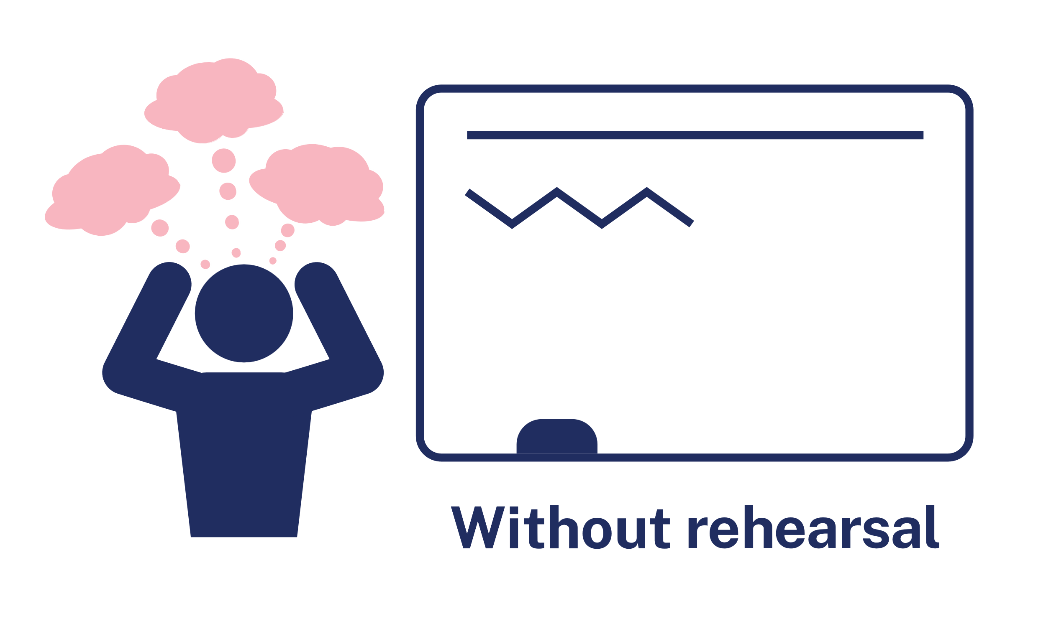

Rehearsal (1)
Notes:
Purpose of slide: To explain why rehearsing is so important
[01:10]
Speaker notes:
Application is a real key to success in professional learning.
Why might professional learning not be applied in the classroom, despite our best intentions?
[click] Research from Evidence for Learning (2022) found that rehearsing was among the key mechanisms for success in the application of PL.
New teachers often have practices described to them – but it is much clearer to have experienced teachers model the practice (out of the classroom, without students) while the observer uses prompts to reflect on what made that practice successful.
Teaching is a habit-forming practice. By necessity, teaching requires us to automate a number of behaviours. The cognitive load on teachers to introduce a new behaviour is high and so we often rely on those previously formed habits.
Rehearsal (out of the classroom, without students) makes our PL a habit. When we try a rehearsed routine in a classroom, our cognitive load is reduced because we have one thing to think about, rather than 4 or 5.
This is why rehearsing is a key mechanism for success in professional learning.
References:
Evidence for Learning (2022) Effective professional learning, Evidence for Learning.

Slide 12
Overview of this module
Part A – Understanding the strategy
Part B – Implementing the strategies through techniques
Part C – Evaluating a whole-school approach
Notes:
Purpose: Outline the learning sequence in this module.
[00:30]
Speaker notes:
In this module, the focus is on the effective feedback and selecting the optimal techniques for students in your class.
We will then develop principles as a whole school to reduce cognitive load for our students, giving them the best opportunity for routines to benefit their learning outcomes.
We will evaluate the impact of our work in terms of how effectively the approach has met the student need we've identified as the focus for our professional learning. We will do this by considering the short-term outcomes and the potential longer term learning outcomes for our students.

Slide 13
Understanding the strategy
Part A

Slide 14
Purpose and outcome (1) (1)
Purpose
To understand the way feedback is modelled, demonstrated and explained during the lesson.
Outcome
We can articulate how modelling, demonstrating and explaining feedback during the lesson strengthens the development of schema.
Notes:
Purpose: Purpose and outcome of Part A
[00:30]
Speaker notes:
This strategy learning module focuses on teachers making purposeful decisions in their design and facilitation of feedback so that it develop schema efficiently and effectively.
The purpose of Part A is:
To understand the way feedback is modelled, demonstrated and explained during the lesson.
We are working towards the outcome that:
We can articulate how modelling, demonstrating and explaining feedback during the lesson strengthens the development of schema.

Slide 15
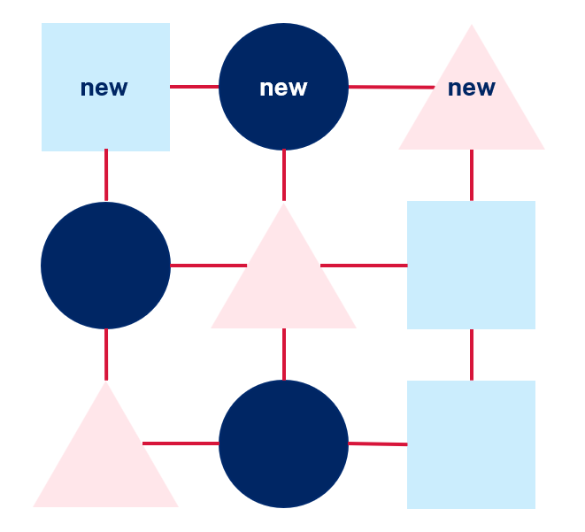
What is feedback and why it works
As students learn about a topic,
they form a schema.
Notes:
Purpose of slide: The connection between feedback and schema development
[01:00]
Speaker notes:
As students learn about a topic, they form a schema - connected knowledge about that topic.
For example, when learning about rainforests, students are forming their schema about rainforests, adding and consolidating new information about rainforests into their schema as they go.
If students have incorrect or incomplete knowledge, it is harder to correct these misconceptions from a more complete schema. It is easier to correct these misconceptions while students are learning new skills and knowledge.
Feedback given during the lesson is essential to the forming of a correct schema.
​
References:​
AERO (Australian Education and Research Organisation) (2023) How students learn best: an overview of the learning process and the most effective teaching practices, AERO, accessed 13 March 2025.
​
​

Slide 16
Effective feedback is specific, timely, and goal-oriented information that helps individuals understand their current performance in relation to a desired outcome, enabling them to close the gap between where they are and where they need to be. It focuses on actionable insights to support learning and improvement while fostering motivation and self-regulation.
Hattie and Timperley (2007)
16
Notes:
Purpose of slide: To outline what effective feedback is.
[01:00]
Speaker notes:
Let's take a moment to read a summary of Effective feedback from Hattie and Timperley, as it offers us an insightful overview of feedback.
Archer and Hughes express this as “feedback offers essential scaffolding, enabling students to refine their skills and understanding incrementally" (Archer and Hughes 2011:121).
​
A focus for professional learning about feedback commonly highlights things like:
Sources- Who gives the feedback? Is it going to be teacher, peer, self?
Types – Will it be written and verbal?
​
References:​
​Archer A and Hughes C (2011) Explicit instruction: effective and efficient teaching, Guilford Press.
Hattie J and Timperley H (2007) ‘The power of feedback’, Review of Educational Research, 77(1):81–112.
​
​

Slide 17
Key ideas of effective feedback through an explicit teaching lens
Feedback:
assists in forming correct schema during learning.
provides the right amount of scaffolding depending on the development of a student’s schema
is modelled – teach students to recognise, understand and use all types feedback.
links to success criteria.
is timely
requires a safe and inclusive learning environment
Notes:
Purpose: Key ideas of effective feedback
[00:30]
Speaker notes:
Feedback assists in forming correct schema: When the learning is new or complex, teachers give effective feedback during the learning as the schema is being formed.
More scaffolding is provided for students with less formed schema. Less scaffolding may be necessary for students with more developed schema.
Teachers model, explain and demonstrate how to understand and use feedback. This is necessary for feedback to be effective for the learner (Brookhart 2017:59).
Feedback linked to success criteria provides clarity and directs students what to pay attention to (Wiliam 2018).
Timely feedback requires teachers to consider when and how frequently student receive feedback.
Safe and inclusive environments support effective feedback practices.
References:
Brookhart S (2017) How to give effective feedback to your students, ASCD.
Wiliam D (2018) Embedded formative assessment, 2nd edn, Solution Tree Press.

Slide 18

Focusing an explicit teaching lens on feedback
Feedback as learning is happening to develop schema
Modelling, demonstrating and explaining feedback as the learning is happening
Notes:
Purpose of slide: Refined focus of the explicit teaching lens on feedback
[00:45]
(Presenter note: Consider whether some revision on schema from Workshop 2 – ‘How learning happens’ is required. https://education.nsw.gov.au/teaching-and-learning/curriculum/explicit-teaching/leading-explicit-teaching.)
Speaker notes:
[click] 1: The focus of this strategy learning module is distinct and specific. In this learning we are specifically focusing on feedback that guides learner’s in developing accurate and complex schema as the schema is being formed.
[click] 2: Put simply the module focuses on:
Feedback that happens as the learning is happening.
Modelling, demonstrating and explaining feedback as the learning is happening.

Slide 19

Less developed and more developed schema
Less developed schema
Stronger schema
More scaffolded feedback
Less scaffolded feedback
Notes:
Purpose of slide: Examples of scaffolding feedback for schemas
[01:00]
(Presenter note: THERE ARE ANIMATIONS ON THIS SLIDE.)
Speaker notes:
Some learners in a class may be just starting to develop a schema within a topic, while other learners have a more developed schema.
[click] 1- Students who have a less developed schema need more scaffolding. They may, perhaps, have made an error frequently within the task, have little or no recognition of what the error is, indicate confusion or a lack of confidence in knowing how to fix it.
[click] 2- Students who have a more developed schema of knowledge needed in this task, need less scaffolding. They need guidance as to the error but have, perhaps, demonstrated an understanding of the skills and associated knowledge required in the task. They may be capable of self-identifying errors, and the actions required to fix the error do not need to be explained.

Slide 20
Same task, same error, different feedback
Less developed schema
Stronger schema
More scaffolded feedback
Less scaffolded feedback
"
"You have not used a verb, so it's not a complete sentence. Select a verb from the verb list and re-write."
"A complete sentence needs a subject, object and verb. You are missing the verb. Re-write to be a complete sentence.
"Is that a complete sentence? Check what is incorrect and try again"
Notes:
Purpose of slide: Examples of scaffolding feedback for schemas
[01:15]
(Presenter note: THERE ARE ANIMATIONS ON THIS SLIDE.)
Speaker notes:
Learners within a class may undertake the same task, but there will be variation in how developed each student’s schema is with regards to the knowledge required to complete the task.
[click] Let's look at an example of feedback a student might hear from a teacher as they are circulating. "You have not used a verb, so it's not a complete sentence. Select a verb from the verb list and re-write."
[click] Here is another example of feedback for the same error in the same task, but the feedback is different. "A complete sentence needs a subject, object and verb. You are missing the verb. Re-write to be a complete sentence."
[click] Finally, once again, the feedback relates to same task and same error. "Is that a complete sentence? Check what is incorrect and try again?"
The first example of feedback is more scaffolded because it indicates the error, tells the learner how to fix it and what they need to do. The second example of feedback indicates the error and the action needed (re-write) but does not indicate how ("use your verbs list" from first example). The third and final example on the right is less scaffolded because it only hints at the error and prompts learners to self-correct.

Slide 21

Teacher expertise in feedback
Teachers have the expert knowledge to provide reliable feedback as learning is happening.
Notes:
Purpose of slide: A refined focus of the explicit teaching lens on feedback
[00:45]
Speaker notes:
A fundamental principle of explicit teaching is - when the learning is new or complex, teachers are best placed to teach knowledge.
Teachers have the expert knowledge to give feedback that is accurate, clear and actionable. This is critical to the efficient and effective forming of schema and is needed as the schema is developing – as opposed to after.
Feedback given after a task is useful and serves a particular purpose. However, this learning module is focusing on practices of feedback that assist developing schema as the schema is forming. Throughout Part B you will see familiar feedback techniques, but they have been presented through the explicit teaching lens and require us to renew the way we see those techniques.
Reference
Kirschner P, Sweller J and Clark R (2006) 'Why minimal guidance during instruction does not work: an analysis of the failure of constructivist, discovery, problem-based, experiential, and inquiry-based teaching', Educational Psychologist, 41(2):75–86.

Slide 22
Feedback as learning is taking place
The AITSL Addendum: Accreditation of initial teacher education programs in Australia content 2.3.5 is:
How to provide feedback as learning is taking place that is specific, honest, constructive, and clear, and uses explicit teaching strategies to re-teach concepts, scaffold, or correct misconceptions as necessary (AITSL 2023:8)
AITSL (Australian Institute for Teaching and School Leadership) (2023) Addendum: Accreditation of initial teacher education programs in Australia: standards and procedures, AITSL.
Notes:
Purpose of slide: Considering feedback as new knowledge
[00:45]
Speaker notes:
Explicit teaching is supported by feedback that happens frequently throughout learning, not just when the task is complete. Let’s take a moment to read the quote on the screen.
The quote is from the AITSL Addendum: Initial Teacher Education Programs in Australia: Standards and Procedures. Learning outcome 2.3.5, from core content 2- ‘effective pedagogical practices’. It highlights the interrelatedness of feedback to other explicit teaching strategies and techniques.
Even when teachers are facilitating peer and self feedback, they are using scaffolds, correcting misconceptions, modelling and refining the structure of tasks to be specific and relevant.
The guidance in this module has been developed through logical and well-reasoned conclusions, informed by the body of evidence pertaining to explicit teaching, including ithe research listed below.
References
AITSL (Australian Institute for Teaching and School Leadership) (2023) Addendum: accreditation of initial teacher education programs in Australia: standards and procedures, AITSL.

Slide 23
Modelling feedback
Teachers model, explain and demonstrate how to understand, recognise, and use feedback effectively. This includes:
structured opportunities for students to understand the feedback
modelling how to use the feedback
modelling how to give and receive peer feedback
modelling how to use learning intentions and success criteria to evaluate learning.
Notes:
Purpose: Elaborate on modelling feedback
[00:30]
Speaker notes:
Teachers model, explain and demonstrate how to understand, recognise, and use feedback effectively. This includes modelling how to give and receive peer feedback, teaching self- and peer-assessment skills, being clear on the success criteria and designing tasks that allow time for students to apply the feedback (Brookhart 2017).
Structured opportunities include – time to post clarifying questions, time for reading, listening and/or discussing, ways to document their understanding (eg: templates, graphic organisers, task/goal list).
Model how to use the feedback by – applying the feedback in front of the class (perhaps from a de-identified example) including what to do and how to do it. Students need to understand the purpose of feedback and then HOW to apply it.
Model how to give and receive peer feedback.
Model how to use learning intentions and success criteria to evaluate learning.
Using rubrics, marking guidelines and work samples can support students with self assessment. This could include breaking down the rubric or marking guidelines into language that is more appropriate and accessible for students, so that they can self assess their work.
References
Brookhart S (2017) How to give effective feedback to your students, 2nd edn, ASCD.

Slide 24

Linking feedback to success criteria
When feedback is aligned with success criteria:
Feedback is specific and directly addresses the defined criteria, ensuring clarity and relevance.
Students gain a clear understanding of which aspects of their work meet expectations and where improvements are needed.
.
Notes:
Purpose: Linking feedback to success criteria
[01:00]
Speaker notes:
When feedback is aligned with success criteria:
Feedback is specific and directly addresses the defined criteria, ensuring clarity and relevance (Wiliam 2018).
Students gain a clear understanding of which aspects of their work meet expectations and where improvements are needed. When students receive feedback that is directly linked to what they are being taught, they know exactly what they are doing well and where they need to improve. This clarity reduces confusion and helps students approach revision or next steps with confidence (Almarode and Vandas 2018).
Reference:
Almarode J and Vandas K (2018) Clarity for learning: five essential practices that empower students and teachers, Corwin Press.
Wiliam D (2018) Embedded formative assessment, 2nd edn, Solution Tree Press.

Slide 25
'Timely’ feedback
Timely feedback is about making informed decisions based on the student’s ability relative to the newness and/or complexity of the task.
Some questions to consider before providing feedback:
Have I identified parts of the learning within a lesson where corrective feedback might be necessary?
If the task contains several steps, which steps will I need to check for understanding and give feedback on?
Will the source of feedback I have selected (teacher, peer, self) be appropriate for the students' schema?
Notes:
Purpose: Understanding the concept of 'timely feedback'.
[0:30]
(Presenter note: THERE ARE ANIMATIONS ON THIS SLIDE.)
Speaker notes:
The term 'timely feedback' does not mean – immediate or quick. It refers to making informed decisions based on the student’s ability relative to the newness and/or complexity of the task.
When learning is new or complex, teacher-given feedback may be needed early and frequently to avoid misconceptions and inaccurate schema. It is harder to correct a misinformed schema than it is to build it accurately the first time.
Whereas, feedback may be delayed or may be offered by peer or self, if the student’s schema is well developed.
[click] You can see some questions that could be considered before providing feedback.
Feedback should be frequent and a feature of every lesson, however, the type and source will vary depending on the student's proficiency and knowledge.
Reference:
Brooks C, Carroll A, Gillies RM and Hattie J (2019) ‘A matrix of feedback for learning’, Australian Journal of Teacher Education, 44(4).

Slide 26
Feedback in safe, inclusive learning environments
Students learn best in safe and inclusive environments that consider the cultural, social, emotional, behavioural and physical aspects of learning.
Notes:
Purpose: Considering safe and inclusive learning environments
[01:00]
Speaker notes:
Feedback is a strategy that particularly requires teachers to consider how they can shape a safe and inclusive learning environment.
When introducing new routines, including feedback routines, teachers should consider the cultural, social and emotional contexts of their classroom.
Although this is not the focus of this learning module, it is important to keep in mind the context of classrooms and schools in order to make informed decisions about how students of all backgrounds and abilities can be supported to engage with effective feedback. Culturally responsive, culturally safe environments and positive relationships are important for all students, including Aboriginal and Torres Strait Islander students (CESE 2017).
Resources:
A list of resources has been provided that you can consider based on your context:
To support Aboriginal and Torres Strait Islander students please reach out to your local Aboriginal Education Team for contextualised support. Schools can determine their team through adding My Essentials – School Support Contacts.
To support EALD students, NSW Department of Education offer guidance on their Multicultural Education site – https://education.nsw.gov.au/teaching-and-learning/multicultural-education/culture-and-diversity/cultural-inclusion
To support communicating with students who have disabilities – Australian Institute for Teaching and School Leadership – https://www.aitsl.edu.au/research/spotlights/inclusive-education-teaching-students-with-disability
To support creating a safe and inclusive learning environment for students with disabilities, NSW Department of Education offer guidance at their Inclusion Hub- https://education.nsw.gov.au/schooling/school-community/inclusive-education-for-students-with-disability/commitment_to_Inclusive_Education
References:
AITSL (Australian Institute for Teaching and School Leadership) (2023) Teacher standards, AITSL, accessed 12 December 2024.
CESE (Centre for Education Statistics and Evaluation) (2017) Cognitive load theory: research that teachers really need to understand, NSW Department of Education, accessed 12 December 2024.

Slide 27

The mechanisms of effective feedback (1)
Students recognise it as feedback
Feedback is given to every student as the learning is happening
Right type of feedback at right time
Time for students to understand and apply
Strong knowledge and skills develop over time
Notes:
Purpose: to summarise what makes the use of feedback effective
[02:00]
(Presenter note: THERE ARE ANIMATIONS ON THIS SLIDE.)
Speaker notes:
[click 1] Students must recognise the interaction they are having with you is feedback. A study done in a secondary school found that one -third of the English and maths students interviewed did not identify an interaction as feedback (Van der Kleij and Adie 2020). Even the students who did recognise it as feedback did not necessarily have an accurate perception of what was being said or why it was being said. A check for understanding of whether the student has accurately perceived the feedback can be ideal. For example, Hattie and Clarke (2019) suggest asking students what they understood from the feedback just given.
[click 2] Feedback occurs during learning, not just after. Ensuring every student is given some form of feedback during lessons is important for reliable schema to form (Wiliam 2018; Hattie and Clarke 2019).
[click 3] Different types of feedback serve different functions depending on the learning sequence (Almarode and Vandas 2018:144). The 'right type' of feedback is determined by how developed a student's schema is. If they have less developed schema, highly scaffolded feedback from the teacher is necessary early in the learning and during the learning. If their schema is more developed, less scaffolded feedback from a range of sources may be appropriate.
[click 4] Feedback is explained, modelled and demonstrated by the teacher to ensure they understand it. Adequate time and support must be offered for students to apply the feedback (Brookhart 2017; Hattie and Clarke 2019).
When all of these mechanisms work together, (click 5) effective feedback allows students to develop strong knowledge and skills over time.
References:
Almarode J and Vandas K (2018) Clarity for Learning: five essential practices that empower students and teachers, Corwin Press.
Brookhart S (2017) How to give effective feedback to your students, 2nd edn, ASCD.
Hattie J and Clarke S (2019) Visible learning: feedback, Routledge.
Van der Kleij F and Adie L (2020) 'Towards effective feedback: an investigation of teachers' and students' perceptions of oral feedback in classroom practice', Assessment in Education: Principles, Policy and Practice, 27(3):252–270, doi:10.1080/0969594X.2020.1748871.
Wiliam D (2018) Embedded formative assessment, 2nd edn, Solution Tree Press.

Slide 28



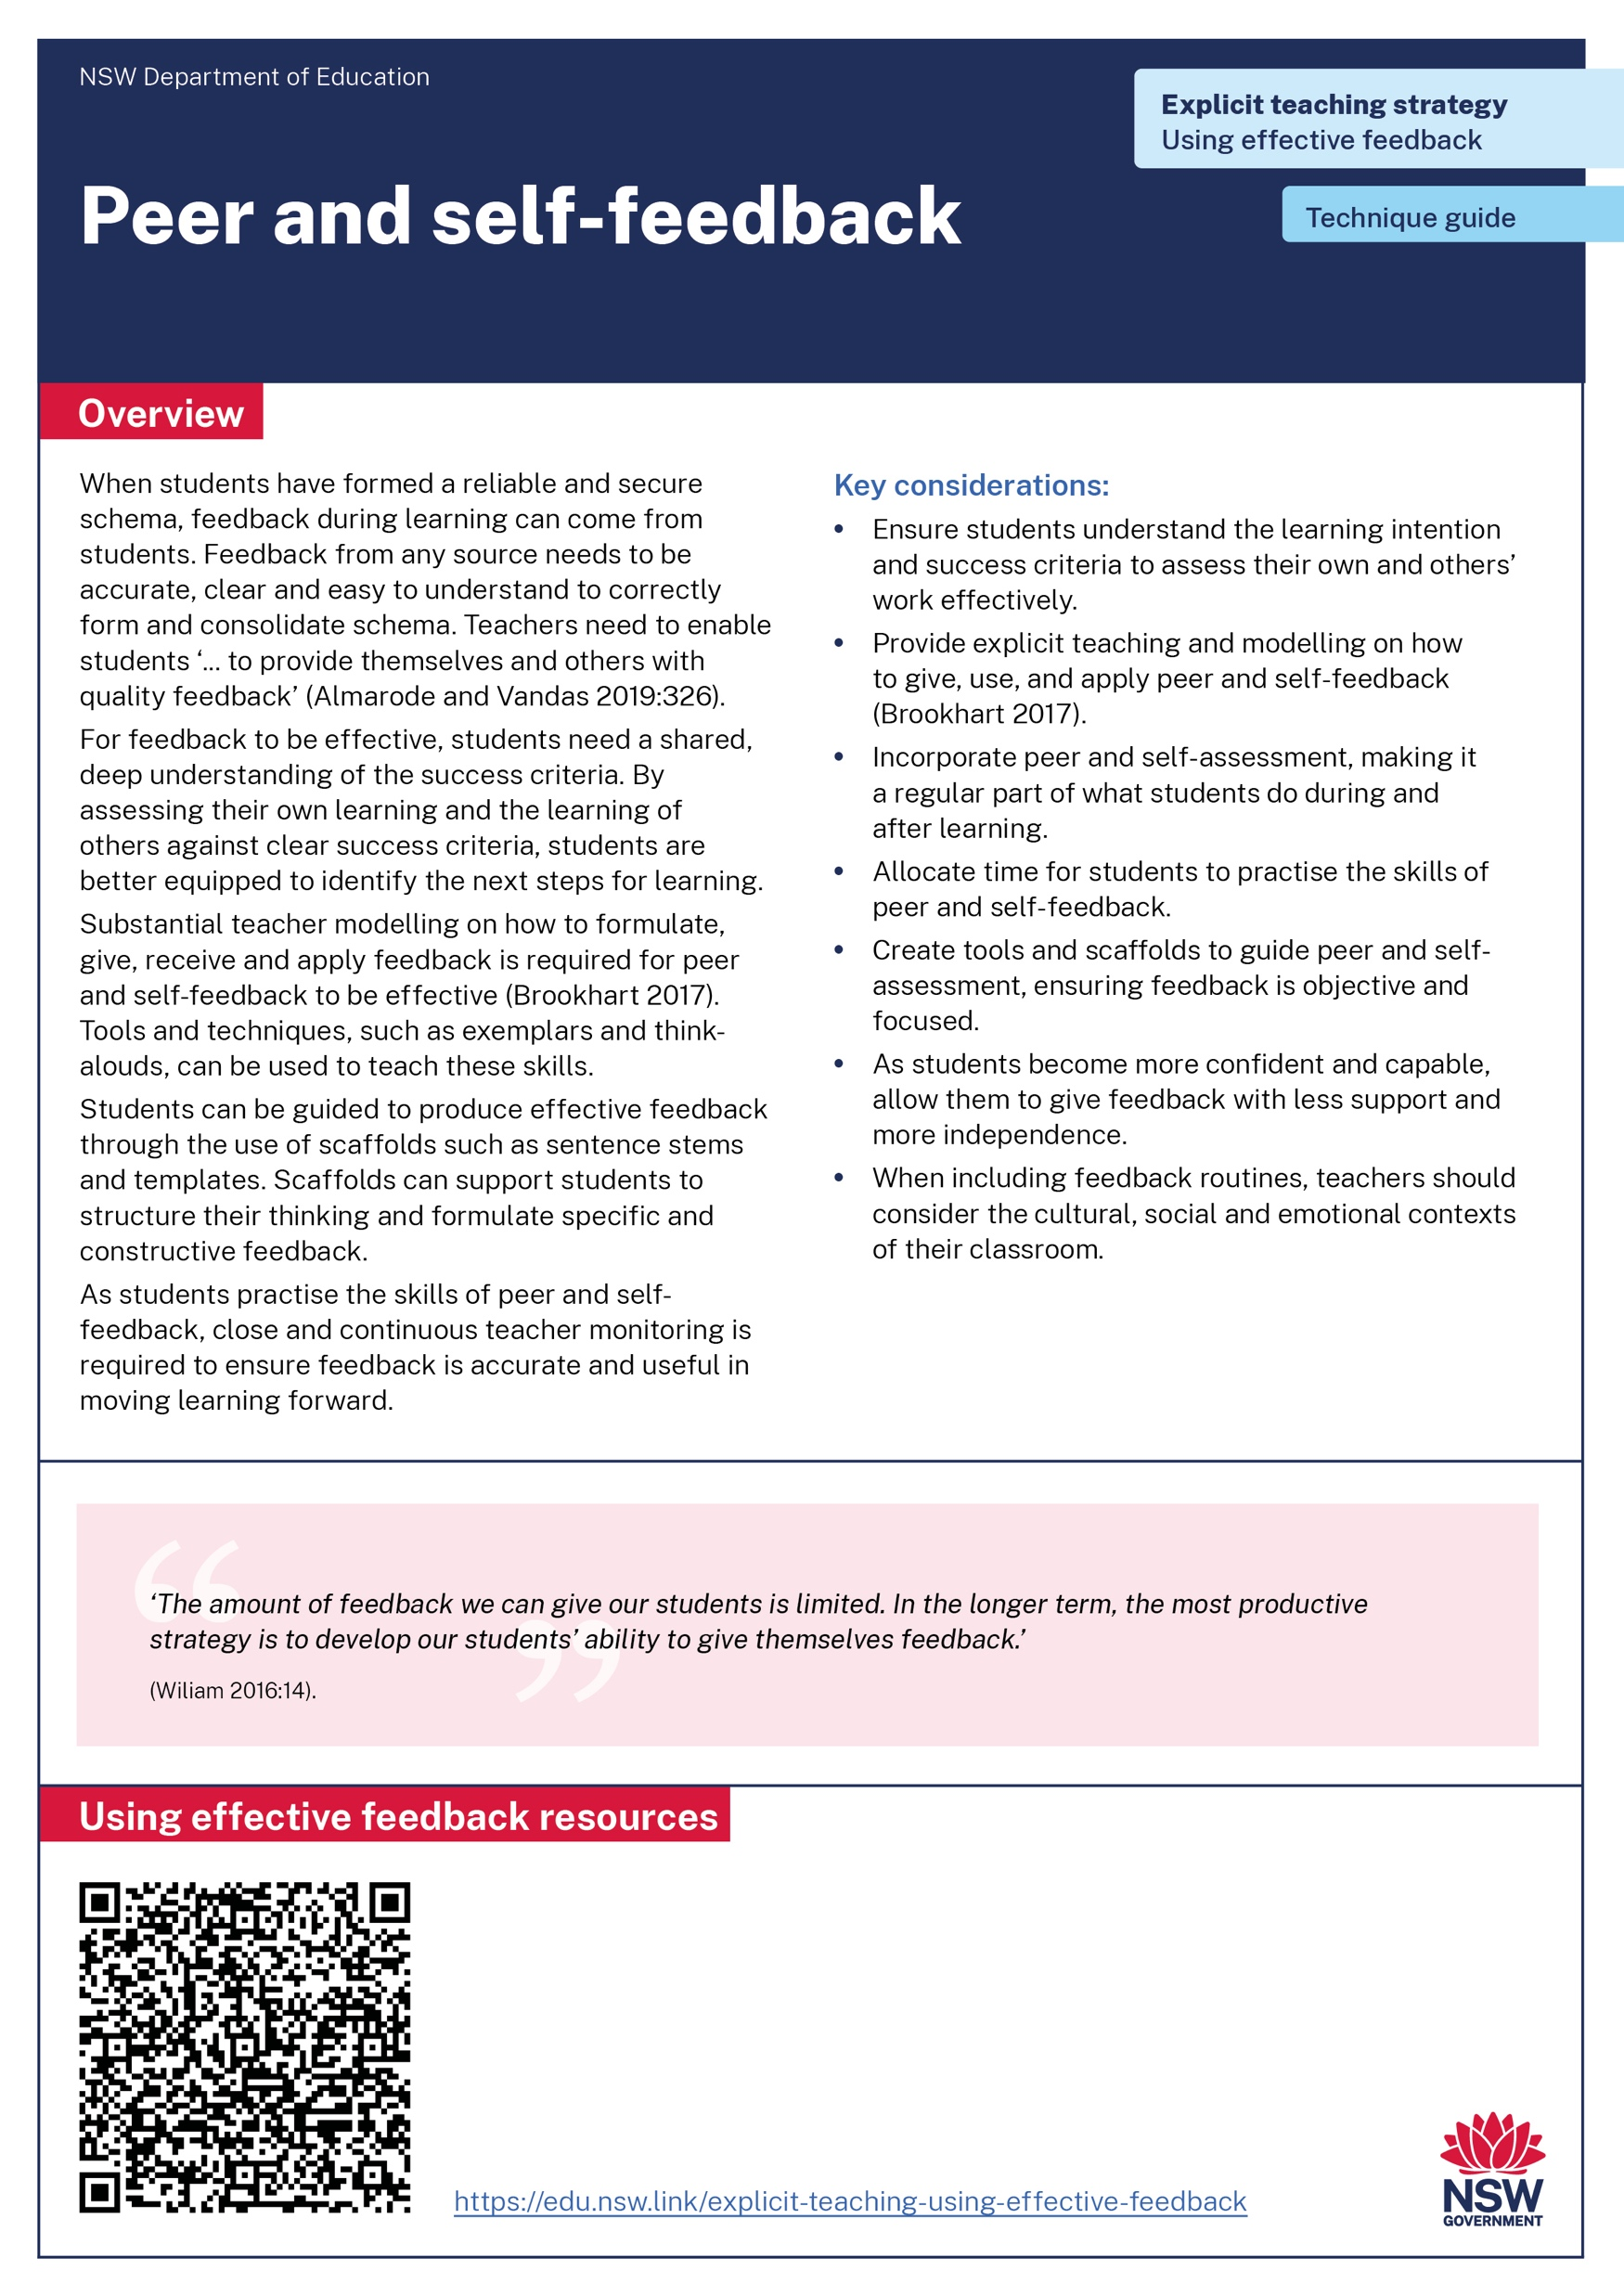
Activity 1 – technique guide discussion
Read or revise – 10 min
Discuss – 10 min
Identify the key points in either the teacher feedback or Peer and self feedback technique guide.
Report back to the group to describe the connections between the technique guide and the learning in Part A.
Notes:
Purpose: Make connections between check for understanding resources to deepen knowledge.
[10:00]
(Presenter note: use your knowledge of you school context to decide which technique guide to have participants read. You may choose both or have half of the participants read one and the other half the other. )
Speaker notes:
Across our group we have had the opportunity to read the teacher and peer and self feedback technique guides.
Revisit that reading and identify the key points you observed.
Discuss with your groups the connections you can make between the readings and the learning we have done in Part A so far.

Slide 29
In the next part of this module, we will work on implementing the strategies through techniques. We will have opportunity to plan and rehearse for using effective feedback.
Notes:
Purpose of slide: To orient into the next part of the module.
[00:10]

Slide 30
Implementing the strategies through techniques
Part B

Slide 31
Part B instructions
Part B contains multiple techniques. To use Part B:
It is recommended teachers engage with teacher, peer and self feedback
Select a lesson to apply using effective feedback
Plan and rehearse with a colleague
Get feedback from your colleague
Notes:
Purpose: To provide instructions on using Part B of the module.
[00:20]

Slide 32
Purpose and outcome (2) (2)
Purpose
To understand the ways feedback can be facilitated to develop schema.
Outcome
We can articulate how to model, demonstrate and explain feedback throughout lessons.
Notes:
Purpose: Purpose and outcome of Part B
[00:15]
Speaker notes:
The purpose of Part B is: To understand how to apply explicit teaching approaches to feedback.
The intended outcome is: We can articulate the ways feedback can be facilitated to develop schema during the lesson and/or task.

Slide 33
The mechanisms of effective feedback (2)
Students recognise it as feedback
Feedback is given to every student as the learning is happening
Right type of feedback at right time
Time for students to understand and apply
Strong knowledge and skills develop over time
Notes:
Purpose: to summarise what makes the use of feedback effective
[02:00]
(Presenter note: THERE ARE ANIMATIONS ON THIS SLIDE.)
Speaker notes:
[click 1] Students must recognise the interaction they are having with you is feedback. A study done in a secondary school found that one -third of the English and maths students interviewed failed to identify an interaction as feedback (Van der Kleij and Adie 2020). Even the students who did recognise it as feedback did not necessarily have an accurate perception of what was being said or why it was being said. A check for understanding of whether the student has accurately perceived the feedback can be ideal. For example, Hattie and Clarke (2019) suggest asking students what they understood from the feedback just given.
[click 2] Feedback occurs during learning, not just after. Ensuring every student is given some form of feedback during lessons is important for reliable schema to form (Wiliam 2018; Hattie and Clarke 2019).
[click 3] Different types of feedback serve different functions depending on the learning sequence (Almarode and Vandas 2018:144). The 'right type' of feedback is determined by how developed a student's schema is. If they have less developed schema, highly scaffolded feedback from the teacher is necessary early in the learning and during the learning. If their schema is more developed, less scaffolded feedback from a range of sources may be appropriate.
[click 4] Feedback is explained, modelled and demonstrated by the teacher to ensure they understand it. Adequate time and support must be offered for students to apply the feedback (Brookhart 2017; Hattie and Clarke 2019).
When all of these mechanisms work together, (click 5) effective feedback allows students to develop strong knowledge and skills over time.
References:
Almarode J and Vandas K (2018) Clarity for Learning: five essential practices that empower students and teachers, Corwin Press.
Brookhart S (2017) How to give effective feedback to your students, 2nd edn, ASCD.
Hattie J and Clarke S (2019) Visible learning: feedback, Routledge.
Van der Kleij F and Adie L (2020) 'Towards effective feedback: an investigation of teachers' and students' perceptions of oral feedback in classroom practice', Assessment in Education: Principles, Policy and Practice, 27(3):252–270, doi:10.1080/0969594X.2020.1748871.
Wiliam D (2018) Embedded formative assessment, 2nd edn, Solution Tree Press.

Slide 34
Teacher feedback
Technique A

Slide 35

Teacher provides feedback when learning is new or complex
Less developed schema
Stronger schema
More scaffolded feedback
Less scaffolded feedback
35
Notes:
Purpose of slide: Examples of scaffolding feedback for schema
[0:20]
Speaker notes:
When the learning is new or complex, teachers should give the feedback. They have the skills and knowledge necessary to ensure the schema is formed correctly and misconceptions are addressed as the learning is happening.
It is important to note that teachers give feedback to all students at all stages of their schema development. It is not the case that once students' schemas are developed, the teacher then relies on only peer and self feedback. However, this focus of this learning module is to highlight the specific ways in which teacher feedback is essential to secure the accurate forming of schema as new or complex learning is introduced.

Slide 36
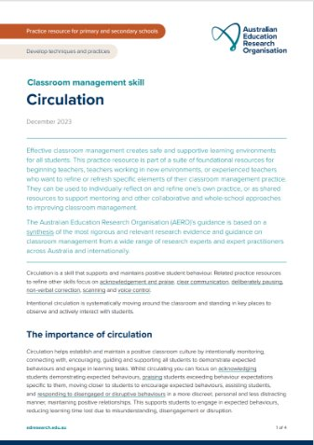
Circulation – classroom application example
Systematically moving through the classroom to give feedback about learning and behaviour.
Providing feedback related to learning intention and success criteria during the learning.
A teaching skill that creates enabling factors of safe and inclusive learning environments.
AERO (Australian Education Research Organisation) (2023d) Circulation
Notes:
Purpose of the slide: Circulation classroom application example
[01:00]
Speaker notes:
Circulation is broadly defined as moving through the classroom to give feedback on learning and behaviour. Verbal feedback can be a time-efficient mode of feedback delivery as it can be delivered in the moment and offers the opportunity for students to ask questions and teachers to adapt their feedback accordingly (Elliot et al. 2020).
Circulation is not watching students learn. Although it may offer the opportunity for influencing behaviour it is not reaching its potential as a strategy when we are walking around without a reason or plan.
Doug Lemov (2016) describes the need for ‘Tracking, not watching’. By this, he means – we are circulating to track the progress of the specific learning being undertaken. Tracking how they are progressing requires knowing precisely what you want them to do and understanding the step along the way.
References:
AERO (Australian Education Research Organisation) (2023d) Circulation, AERO, accessed 20 November 2024.
Elliott V, Randhawa A, Ingram J, Nelson-Addy L, Griffin C and Baird J (2020) Teacher feedback to improve pupil learning, Education Endowment Foundation, accessed 20 November 2024.
Lemov D (21 June 2016) ‘Tracking not watching: a field guide 2.0 excerpt’ Teach like a champion, accessed 20 November 2024.

Slide 37
Circulation feedback1)
Plan
Trim
Verb
Identify the mistakes and misconceptions students are likely to make
Create feedback statements that are short and precise
Ensure the feedback starts with an imperative verb so students know what to do
Lovell O (host) (16 January 2024) ‘Josh Goodrich on instructional coaching’ [podcast], The education research reading room.
Notes:
Purpose of the slide: Key considerations
[02:00]
(Presenter note: THERE ARE ANIMATIONS ON THIS SLIDE.)
Speaker notes:
To provide feedback efficiently whilst circulating, Josh Goodrich, an instructional coach, suggests teachers shape their circulation feedback using the steps of – plan, trim, verb.
[click] Plan means to take time to anticipate the mistakes and misconceptions students are likely to make. Then create 1 to 2 sentences of feedback that addresses that.
[click] Trim means to trim down the language of the sentences so that it is short, precise and easy to understand.
[click] Verb means to begin the sentence with an imperative verb (such as fix, check, add) so to make the feedback easy to do.
Let's see some examples on the next slide.
Reference:
Lovell O (host) (16 January 2024) ‘Josh Goodrich on instructional coaching’ [podcast], The Education Research Reading Room, accessed 20 November 2024.

Slide 38
Examples of circulation feedback
“Check the example we looked at, fix your use of [……….].” ​
“Read question [four] again, include an example.”​
“Increase your use of [tension] by [removing language].” ​
“Show your reasons for that choice with reference to [….......].” ​
“Replay bar 5, fix your minim so it holds for two counts.”
Notes:
Purpose of the slide: Key considerations
[1:00]
Speaker notes:
Here are some examples we would hear teachers say. As we read through these examples, note how each opens with a verb followed by an indication of the exact action the student needs to do.
“Check the example we looked at, fix your use of [……….].”
“Read question [four] again, include an example.”
“Increase your use of [tension] by [removing language].”
“Show your reasons for that choice with reference to [….......].”
“Replay bar 5, fix your minim so it holds for two counts.”
Making feedback in circulating economical in one or two sentences means teachers can be effective in providing feedback to every student as they are developing new knowledge and skills.
Another benefit of circulating is that it serves as an opportunity for formative assessment by the teacher. Once the teacher has circulated the whole class, they are in a position to determine the number of students who have developed an accurate understanding of the knowledge and skills. Teachers are then in a position to use whole-class feedback.

Slide 39
Whole-class feedback example
The teacher:
identifies a common error many students have made
shares and/or displays the error and asks students how to fix it
confirms or re-teaches as needed
instructs students to identify that same error in their own work and provides time to correct.
‘The dog run with the pack and barked happily’.
(Christodoulou 2019)
Notes:
Purpose of the slide: Whole class feedback classroom application example
[02:00]
(Presenter note: THERE ARE ANIMATIONS ON THIS SLIDE.)
Speaker notes:
A way to ensure all students receive feedback during the lesson is to implement whole class feedback. Dylan Wiliam has advocated that whole class feedback could account for as much as 25% of the feedback we give (Wiliam in Hendrick and MacPherson 2017).
We're going to talk through a suggestion of how to give whole class feedback. This suggestion is from education writer and researcher – Daisy Christodoulou. On balance, facilitating whole class feedback in the way she has suggested, aligns with an evidenced-informed approach to explicit teaching.
Let’s look at this example [click 1]
[click 2]: After circulation, a teacher identifies a common error.
[click 3]: Let's imagine a teacher has identified most students have made an error with tense. She shares and/or displays an example "The dog run with the pack and barked happily …....." Teachers asks students to identify the error and how it can be fixed.
[click 4]: She confirms the correct answer or re-teaches.
[click 5]: The teacher prompts students to locate that kind of error in their own work and provide time to correct it.
In this example, the common practice of simply restating learning after noticing a trend is extended to include key pedagogical manoeuvres that increase the impact of the feedback. Not only has the teacher given herself an opportunity to check for understanding, she also has the opportunity to re-teach if needed.
Whole class feedback is effective for students and is efficient for teachers (Christodoulou 20 March 2019).
References:
Christodoulou D (20 March 2019) ‘Whole class feedback: saviour or fad?’,, accessed 24 February 2025. The No More Marking Blog.
Christodoulou D (29 March 2019) ‘Whole class feedback: a recipe, not a statement’, The No More Marking Blog, accessed 24 February 2025.
Hendrick C and Macpherson R (2017) What does this look like in the classroom?: bridging the gap between research and practice, John Catt Educational Ltd.

Slide 40
Think-alouds to model whole-class feedback
Teacher writes error on board and reads aloud. Then:
‘Now, I am going to re-read what I have written.’
‘Next, I am going to review my sentence checking the punctuation, spelling and grammar’.
‘My punctuation and spelling is okay but when I read the sentence out loud I can tell that there is a problem with my grammar. I can see that I have mixed tenses. The verb ‘run’ ‘needs to be expressed in the past tense. It should say ‘ran’, because verbs in a sentence must be consistent when the actions happen at the same time.’
‘So I rewrite the full sentence correctly. The dog ran with the pack and barked happily.
Notes:
Purpose: To show examples of think-alouds for modelling
Presenter note: Modelling think-alouds
[1:00]
Speaker notes:
Think-alouds can be a way to model the thinking the student will need to identify errors and correct them.
The teacher puts a sentence that mirrors a common error on the board. The teacher explains that verbs in a sentence must be consistent when the actions happen at the same time. In this instance, the verb ‘run’ is problematic as it is expressed in present tense while the other verb, barked, is in the past tense.
The teacher checks that all students understand how to identify and address the error, re-teaching if needed.
Resources:
Checking for understanding strategy learning module –State of New South Wales (Department of Education) (2024d) Checking for understanding – learning module, NSW Department of Education – https://education.nsw.gov.au/teaching-and-learning/curriculum/explicit-teaching/explicit-teaching-strategies/checking-for-understanding
References:
AERO (Australian Education Research Organisation) (2024a) Rules and routines, AERO, accessed 13 March 2025.
Fisher D, Frey N and Lapp D (2011) ‘Coaching middle-level teachers to think aloud improves comprehension instruction and student reading achieving’, The Teacher Educator, 46(3):231–243, doi:10.1080/08878730.2011.580043.
Rosenshine B (2012) ‘Principles of instruction: research-based strategies that all teachers should know’, American Educator, 36(1):12–19.

Slide 41
Turn and talk (1)
Turn to the person next to you and explain how circulation followed by whole class feedback can facilitate effective feedback for all students in the class.
Notes:
Purpose: Turn and talk activity
[02:00]
Notes to presenter: This activity could be followed by selecting non-volunteers to share their dialogue.

Slide 42
Peer feedback
Technique B

Slide 43
Peer feedback (2)
Peer feedback is the process in which students give and receive feedback on each other's work based on specific criteria.
Notes:
Purpose of the slide: Introduction to peer feedback
[0:10]
Speaker notes:
I’ll give you a moment to read the slide…

Slide 44
Teaching peer feedback once schema is developed
Less developed schema
Stronger schema
More scaffolded feedback
Less scaffolded feedback
44
Notes:
Purpose of slide:
[0:20]
Speaker notes:
When students have demonstrated an understanding of the knowledge, skills and task, they have formed a reliable schema. Once a reliable schema has been formed, peer to peer feedback is effective.

Slide 45
Key considerations
Scaffolding from the teacher is required if peer feedback is to be effective.
Students need to believe in their peers’ abilities to provide quality feedback that is useful.
Clarifying what success looks like with exemplars in relation to the success criteria is important.
Notes:
Purpose of the slide: key considerations
[1:00]
Speaker notes:
Let’s take a minute to read these three points.
Scaffolded guidance from the teacher is required if peer feedback is to be effective. This includes scaffolding interpersonal interactions (Brookhart 2017).
Creating a culture of trust is important for students to believe in the quality and usefulness of their peers’ feedback.
Students are supported to engage with feedback through understanding what success looks like (Brooks et al. 2021).
References
Brookhart S (2017) How to give effective feedback to your students, 2nd edn, ASCD.
Brooks C, Burton R, van der Kleij F, Ablaza C, Carroll A, Hattie J and Neill S (2021) ‘Teachers activating learners: the effects of a student-centred feedback approach on writing achievement’, Teaching and Teacher Education, 105, doi.org/10.1016/j.tate.2021.103387.
Smith J, Lipnevich A and Guskey T (2023) Instructional feedback: the power, the promise, the practice, Corwin.

Slide 46
How to model and demonstrate peer feedback
Set clear expectations and guidelines
Model giving feedback
Model receiving feedback
Model applying feedback
Practice
Reflect
Provide continuous support
Notes:
Purpose of slide: How to model peer feedback
[2:00]
(Presenter note: THERE ARE ANIMATIONS ON THIS SLIDE.)
Speaker notes:
[click]
1. Set clear expectations and guidelines
Clarify success criteria
Provide feedback guidelines such as:
Focus on the work, not the person.
Be respectful, specific and constructive.
Use positive language and suggest improvements.
Introduce feedback structures like "Two Stars and a Wish" (two positive comments and one suggestion for improvement) or The TAG Method (Tell something positive, Ask a question, Give a suggestion).
[click]
2. Model giving feedback (I Do)
Choose a piece of student work or a sample that represents the type of feedback you want students to provide.
Think aloud as you review the work, showing students how you analyse the work and identify strengths and areas for improvement.
Demonstrate the balance: Acknowledge the good aspects of the work before moving on to areas for growth.
Provide specific, actionable suggestions for improvement.
[click]
3. Model receiving feedback (I Do)
After giving feedback, you can show how to receive feedback as well. Demonstrate how to listen actively and reflect on the feedback.
Model reflection by saying something like, “I understand that the argument needs more examples, so I’ll revise it by adding more evidence.”
Encourage a growth mindset by demonstrating that feedback is an opportunity for improvement, not a judgment.
[click]
4. Model applying feedback (I Do)
Demonstrate how to use feedback to improve a piece of work in real time.
Think aloud as you make specific revisions based on feedback received.
Show how to re-read the revised work to check if improvements align with the feedback.
[click]
5. Practice with the class (We Do)
Have students work in pairs or small groups to give feedback to each other. Circulate and offer support as needed.
Walk them through a few examples, and guide them in following the feedback structure.
Encourage students to ask clarifying questions if they don’t understand the feedback they receive.
[click]
6. Encourage reflection (You Do)
Once students have practiced peer feedback, ask them to reflect on the process:
What did they learn about the work they reviewed?
How will they apply the feedback to improve their own work?
What did they find challenging or helpful in the feedback process?
[click]
7. Provide continuous support
Continually model feedback in future lessons, both in peer-to-peer contexts and in teacher-student interactions.
Encourage peer feedback regularly, making it a routine part of learning.
Gradually transfer responsibility: As students become more confident, allow them to give feedback with less support and more independence.

Slide 47
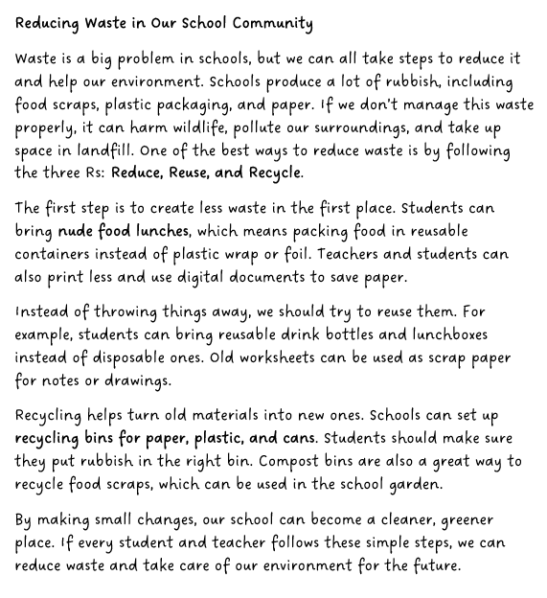
Peer feedback (3)
Learning intention:
We are learning to present a clear argument to persuade an audience
Success Criteria:
I can –
use modal verbs and expressions to strengthen or soften my arguments. For example, must, should, likely, definitely.
blend personal opinions with facts or evidence to make my writing more convincing.
use rhetorical devices that connect with my target audience. For example, repetition, rhetorical questions, and emotive language.
English K-10 Syllabus (2022) - EN3-CWT-01
Notes:
Purpose of the slide: Peer feedback
[2:00]
Speaker notes:
I’m going to use a think aloud to model how I want my students to use peer feedback
"Today we are going to use sentence stems to provide feedback to a peer.
I will model what this may look like, then you will have a go.
This is the work sample I am going to provide feedback on – I have read through it carefully.
[click] We know that our feedback must be related to the success criteria so let’s review that together."
(Read the LISC from the screen – this will not be new to the students. It would have been introduced at the beginning of the lesson sequence and referred to regularly)
Reference
English K–10 Syllabus © NSW Education Standards Authority (NESA) for and on behalf of the Crown in right of the State of New South Wales, 2022.

Slide 48
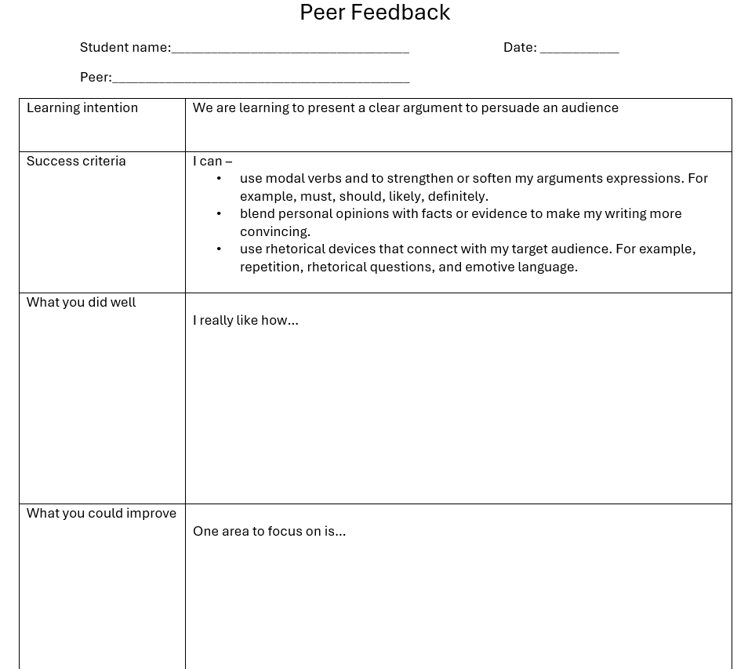
How to model feedback
Notes:
Purpose of slide: How to model peer feedback
[1:30]
(Presenter note: THERE ARE ANIMATIONS ON THIS SLIDE.)
Speaker notes:
While students are learning to give and receive feedback I will use a scaffold like this one, I have prefilled the learning intention and the success criteria for the students to refer to.
Also in the scaffold there are some suggested sentence stems.
A bank of sentence stems that students can refer to helps them structure their thinking and scaffold their feedback.
Sentence stems encourage students to phrase their feedback in a way that is respectful, specific and constructive.
They also build student confidence by giving students a starting point making the feedback process more equitable.
If I want students to use those sentence stems effectively, they need to know how to finish the sentence so the feedback they give is clear, concise and actionable.

Slide 49
Peer feedback – Sentence stems(1)
What you did well | What you could improve | How you could do this (actions based on feedback)
I really liked how you… You did a great job with… One strength of your work is… It’s clear that you put effort into… Your use of (specific skill/technique) was effective because… You explained (concept/idea) well by… | You could improve your… One area to focus on is… Your work could be even better if you… I found (specific part) a little unclear because… I noticed that you didn’t include…. | If you work on (specific area mentioned in feedback), you could… To address (specific issue), try… To improve (area for improvement), start by… It would help if you added more detail to… To make (specific aspect) stronger, your next step is to…
Notes:
Purpose of the slide: Sentence stems – classroom application example
[0:30]
Speaker notes:
I’ll give you a moment to read through these sentence stem examples.

Slide 50
Effective peer feedback
Unhelpful feedback | Effective feedback
I really liked how you… wrote neatly and spelled most words correctly. | I really liked how you… used emotive language to highlight the hard waste can cause to wildlife and the environment.
One area to focus on … make your writing more interesting | One area to focus on…. is using a wider range of modal verbs to strengthen your arguments and engage the audience more effectively.
You have some good ideas, but overall, it could be better | To make (your writing even more persuasive), you could… include statistics or facts about how much waste is saved by using these methods.
Feedback not related to the success criteria
Feedback related to the success criteria using specific examples from the text
Feedback vague and unhelpful
Feedback is specific showing what can be improved
Feedback is subjective and offers no advice for improvement
Feedback is specific showing actionable steps for improvement
50
Notes:
Purpose of the slide: Sample feedback
[1:00]
(Presenter note: THERE ARE ANIMATION ON THIS SLIDE.)
Speaker notes:
Let’s have a look at some feedback:
I really liked how you… wrote neatly and spelled most words correctly.
This student has finished the sentence stem with some things they have noticed about the text. [click] However, this feedback does not relate to the success criteria for the task.
I really liked how you… used emotive language to highlight the hard waste can cause to wildlife and the environment. [click] This feedback, using the same sentence stem, is effective as it relates to the success criteria and uses specific examples from the text.
[click] Make your writing more interesting, [click] is vague and unhelpful whereas, One area to focus on…. is using a wider range of modal verbs to strengthen your arguments and engage the audience more effectively.. – [click] is specific and clearly shows what can be improved.
[click] Finally, You have some good ideas, but overall, I think it could be better – [click] is subjective and unhelpful, while To make (your writing even more persuasive), you could… include statistics or facts about how much waste is saved by using these methods, [click] provides feedback that shows actionable steps for improvement.

Slide 51
Turn and talk (2)
Turn to the person next to you and explain how you can use the success criteria to enhance effective peer feedback.
Notes:
Purpose: Turn and talk activity
[02:00]
Notes to presenter: This activity could be followed by selecting non-volunteers to share their dialogue.

Slide 52
Self feedback
Technique C

Slide 53
Self feedback (1)
Self feedback involves students assessing their own work by comparing it to specific criteria.
Notes:
Purpose of the slide: Introduction of self feedback
[0:30]
Speaker notes:
I’ll give you a moment to read the slide.

Slide 54
Teaching self feedback once schema is developed
Less developed schema
Stronger schema
More scaffolded feedback
Less scaffolded feedback
Notes:
Purpose of slide: Examples of scaffolding feedback for schema
[0:30]
Speaker notes:
When the student has demonstrated an understanding of the knowledge, skills and task, structured self feedback can be effective.

Slide 55
Key considerations (2)
Teach, model and scaffold how to self-evaluate with the success criteria.
Self-feedback occurs throughout the learning process.
Self-feedback encourages self-regulation and helps students identify next steps.
Notes:
Purpose of the slide: Key considerations for self feedback
[1:00]
(Presenter note: THERE ARE ANIMATIONS ON THIS SLIDE.)
Speaker notes:
Self-assessment and evaluation is a potentially powerful technique because of its impact on student performance through enhanced self-efficacy and increased intrinsic motivation (Rolheiser and Ross 2001).
[CLICK] Modelling is crucial. Students need to be taught ‘how’ to use learning intentions and success criteria to reflect on and analyse the effectiveness of their efforts. Exemplars can be used to show students ‘what a good one looks like’ (Hattie and Timperley 2007)
[CLICK] It’s important to be aware that self-feedback needs to be used throughout a unit of work, rather than waiting for the end of the unit, or after the summative assessment task. Consistent self-feedback helps to strengthen and deepen understanding.
[CLICK] Self-feedback encourages students to reflect on their learning processes, which is crucial for developing self-regulation skills. By assessing their own strengths and weaknesses, students can set realistic goals, plan effective strategies to achieve those goals, and adapt their approach as needed. Students can become more aware of their learning journeys, which enhances their motivation and engagement. Teachers play a critical role in facilitating this process.
References:
Hattie J and Timperley H (2007) ‘The power of feedback’, Review of Educational Research, 77(1):81–112.
Rolheiser C and Ross J (2001) ‘Student self-evaluation: what research says and what practice shows’ in Small RD and Thomas A (eds) Plain talk about kids, Covington Center for Development and Learning.
Sanchez C, Atkinson K, Koenka A, Moshontz H and Cooper H (2017) ‘Self-grading and peer-grading for formative and summative assessments in 3rd through 12th grade classrooms: a meta-analysis’, Journal of Educational Psychology, 109(8):1049–1066.
Sherrington T (10 January 2019) ‘Revisiting Dylan Wiliam’s five brilliant formative assessment strategies’, teacherhead blog, accessed 12 September 2024.

Slide 56
Modelling self-feedback (1)
Question: How do magnets attract or repel each other based on their polarity?
Learning intention:
We are learning to describe the effects of forces in everyday situations.
Success criteria – I can:
describe how magnets interact with each other
use relevant scientific terms including north pole, south pole, attract, repel.
Science 7-10 Syllabus (2023) - SC4-FOR-01-01
Notes:
Purpose of the slide: Modelling self-feedback
[1:00]
Speaker notes:
Teachers model for students how to use the learning intention and success criteria to self-assess.
In the example on the slide, students in a Stage 4 science class are learning the effects of forces, specifically, magnetic force. In previous lessons, they have investigated how magnets interact with each other, by posing questions, making predictions and analysing data. They have shared their scientific findings in a class discussion, with the teacher recording thinking on using diagrams and labelling with relevant scientific terms.
Today, students are writing a response to the question - How do magnets attract or repel each other based on their polarity?
The teacher will model self-feedback during the lesson using the lesson success criteria.
Reference:
Science 7–10 Syllabus © NSW Education Standards Authority (NESA) for and on behalf of the Crown in right of the State of New South Wales, 2023.

Slide 57
Modelling self-feedback (2)
Magnets have two poles. When two magnets go together with opposite poles, they stick together. But when the same poles are together, they push away from each other, because
of the invisible force between them.
Learning intention:
We are learning to describe the effects of forces in everyday situations.
Success criteria – I can:
describe how magnets interact with each other
use relevant scientific terms including north pole, south pole, attract, repel.
I have described how magnets push away and stick together.
I have used some scientific words but I haven't used north, south, attract, repel.
Notes:
Purpose of the slide: Modelling self-feedback
[1:00]
(Presenter note: THERE ARE ANIMATIONS ON THIS SLIDE.)
Speaker notes:
The teacher displays a de-identified response to model how to use the learning intention and success criteria to self assess.
I'll give you a moment to read the response.
The teacher verbalises her thoughts and actions as she works through the process.
A think-aloud might look like this:
Now, let's evaluate my description: 'Magnets have two poles. When two magnets go together with opposite poles, they stick together. But when the same poles are together, they push away from each other, because of the invisible force between them.'
I'll use the success criteria to guide my self-feedback.
Firstly,
[click]
Have I described how magnets interact with each other? Yes, I have described how magnets interact with each other because I have described how the poles either stick together or push away from each other.
[click]
2. Have I used relevant scientific terms, including north pole, south pole, attract and repel? Well I can see that I have used some scientific words, such as pole and force. But I haven't included north and south pole because I used the terms opposite poles and same poles. I can see how referring to North and south pole would better describe the interaction. I didn't use the terms attract and repel because I'm a bit confused about what the terms mean and I need to check the meaning to make sure I am using them accurately.

Slide 58


Modelling self-feedback (3)
Magnets have two poles. When two magnets go together with opposite poles (north–south), they attract. But when the same poles are together (north-north or south-south), they repel each other, because of the invisible force between them.
Magnets have two poles. When two magnets go together with opposite poles, they stick together. But when the same poles are together, they push away from each other, because of the invisible force between them.
Self assessment against the learning intention and success criteria | YES | NO | How can I improve this?
Have I described how magnets interact with each other?
Have I used relevant scientific terms?
Have I used the words north pole, south pole, attract, repel? |  |  | Add the terms north pole and south pole to 'opposite pole' and the 'same poles' Replace 'stick together' with attract Replace 'push away' with repel
Notes:
Purpose of the slide: Working with Learning intention and success criteria – classroom application example
[01:00]
Speaker notes:
(Presenter note: THERE ARE ANIMATIONS ON THIS SLIDE.)
The teacher further scaffolds students to self-assess by using a pre-filled checklist aligned to the learning intention and success criteria. They model how to use the success criteria, recording a tick if the criteria is evident in their response and a cross if the criteria is incomplete or incorrect.
When criteria is not evident or incomplete, the teacher models how to articulate specific and actionable steps. In the example on the slide, instead of simply writing 'add the word attract', the teacher has modelled the specific action 'replace 'stick together' with attract'.
The teacher models how to apply the self-feedback, by verbalising their thinking while editing the original response or rewriting it.
[click]
Displayed is the improved response after feedback has been applied.
Students would then practise self-assessing their response using the checklist to record actionable feedback which they will then apply this in their work. The teacher could circulate to support students and provide feedback on their self-assessment practice.

Slide 59
Releasing responsibility
Science checklist
Have I: described how magnets interact with each other used relevant scientific terms used the words north pole, south pole, attract, repel Something I need to improve is … because For example: Something I need to improve is using correct scientific terms because it adds precision to my written response. To do this, I need to: For example: Refer to the anchor chart when planning my response. After I do this, I will re-check my work with:
Notes:
Purpose of the slide: To focus on releasing responsibility
[01:00]
Speaker notes:
After modelling how to effectively use a success-criteria, the teacher can then move to releasing responsibility to the students.
To support self-regulated and independent work (you do), students can use a pre-filled scaffold such as a checklist. When students engage with a pre-filled scaffold, they actively review their work and reinforce their understanding of the criteria.
You can see here how the pre-filled scaffold is accompanied by reflection points. Including an open-ended self-reflection questions can support students to think more deeply about their work and identify the next steps in their learning (Responsive Classroom 2018).
References:
Responsive Classroom (2018) ‘Self-Assessment: students as active learners’, Center for Responsive Schools, Inc.

Slide 60
Turn and talk (3)
Turn to the person next to you and explain how and when you might embed self-feedback in your teaching and learning programs.
Notes:
Purpose: Turn and talk activity
[02:00]
Notes to presenter: This activity could be followed by selecting non-volunteers to share their dialogue.

Slide 61
In summary
Less developed schema
Stronger schema
More scaffolded feedback
Less scaffolded feedback
Notes:
Purpose of slide: Examples of scaffolding feedback for schema
[01:00]
Speaker notes:
In summary –when determining the source and type of feedback, consider how developed a student’s schema is.

Slide 62
Planning, rehearsing and developing the techniques

Slide 63
A whole school approach
What it is
Teachers construct a shared understanding of the purpose of feedback in schema development.
Teachers agree to implement consistent routines around peer and self feedback.
Teachers agree to whole class feedback routine – which may include specific cues.
What it isn't
Our school decides only to give feedback at a certain time - 'Feedback Friday'.
In our school feedback is only given at the end of lessons or the end of the summative assessment.
Notes:
Purpose: A whole school approach
[01:00]
Speaker notes:
To create a whole school approach to effective feedback, it is ideal to have a number of whole school teaching routines that teachers can choose from to implement for the right purpose at the right time. Rules and routines structure the learning environment, helping to manage cognitive load with a consistent and predictable approach to support students’ focus, engagement and efficient information processing.
[click] A whole school approach to effective feedback begins with developing a shared understanding of the purpose of feedback in the development of the students' schemas.
From here, teachers agree to implement consistent routines or structures for peer and self feedback. They may consider selecting or customising a routine for whole class feedback.
[click] A whole school approach is not making choices that restrict a teachers in using the right feedback at the right time.
Shortly you and your group will have an opportunity to come up with a whole school teaching routine for an effective feedback technique.
References:
AERO (Australian Education Research Organisation) (2024a) Rules and routines, AERO, accessed 13 March 2025.

Slide 64
Creating agreed whole-school routines
Draft whole-school teaching routines for effective feedback.​
Share the revised teaching routines.​
Agree on whole-school routines for effective feedback.
Notes:
Purpose: Creating a whole school routine
[1:00] + additional time for the activity
(Note to presenter: consideration needs to be given as to how a routine is created, for example, in small groups, cross-stage or cross-faculty, etc. If working with a larger staff group, form smaller groups.​)
​
Speaker notes: ​
Today we will be doing an activity in groups to develop a possible whole-school routines for effective feedback.
​
In your groups, draft a routine that aligns with effective feedback.
Remember, this should be a routine that can be applied across the school.​
After drafting, the group leader will model the routine using the routine for feedback. This step is crucial as it allows the group to reflect on and refine the process based on the feedback prompts provided.​
Once refined, we’ll come back together and share these routines as a whole. The goal is to adopt a cohesive approach that supports all teachers and ensures students benefit from effective feedback.
​
Example routine:​
Create a routine around how a teacher signals they are circulating.
Create a routine around how teachers use a particular part of the board or classroom space to give whole class feedback.
Create a routine around how to display and use learning intentions and success criteria in peer and self feedback.

Slide 65
Planning and rehearsing
Plan
Rehearse
Feedback
Evidence for Learning (2022) Effective Professional Development, Sydney: Evidence for Learning.
Notes:
Purpose of slide: To explain the process of rehearsing
[01:10]
(Presenter note: it is advisable to prepare the leaders beforehand if modelling and rehearsing are not yet established practices in the school.)
Speaker notes:
Now that we have our routine, we have some time to plan, rehearse, and get feedback from each other. When we say rehearse, we mean:
[click] plan a number of suitable questions or get activities ready
[click] deliver the instruction as if doing it in class.
Then your partners
[click] will use the feedback prompts on the next slide to refine the teaching routine. What may need to be added, changed, enhanced or deleted?
Further reading:
AERO (Australian Education Research Organistion) (2023e) Gaining all students’ attention, AERO, accessed 4 October 2024, https://www.edresearch.edu.au/guides-resources/practice-guides/gaining-all-students-attention
Evidence for Learning (2022) ‘Effective professional development’, Evidence for Learning, https://evidenceforlearning.org.au/education-evidence/guidance-reports/effective-professional-development
Sims S, Fletcher-Wood H, O’Mara-Eves A, Cottingham S, Stansfield C, Van Herwegen J and Anders J (2021) ‘What are the characteristics of teacher professional development that increase pupil achievement? A systematic review and meta-analysis’, Education Endowment Foundation, accessed 20 March 2025, https://educationendowmentfoundation.org.uk/education-evidence/evidence-reviews/teacher-professional-development-characteristics

Slide 66
Rehearsal steps and feedback prompts
Use your learning sequence or lesson plan to:
Select a technique for effective feedback.
Plan your instructions for the class.
With a partner, rehearse the teaching for this technique.
Use the feedback and modelling from your partner to improve your approach.
Swap with your partner for their rehearsal.
Feedback prompts
Is the feedback linked to the Learning intention and Success criteria?
Is the modelling clear and specific?
Are there actionable steps for students to improve?
Notes:
Purpose of slide: To give the steps and feedback prompts for the activity
[00:20]
(Presenter note: this slide and the activity slide could be provided to the groups as handouts.)
Speaker notes:
Take a minute to go through the rehearsal steps and the prompts for feedback.
If you are giving feedback, we have provided a list of prompts for you to think about how the routine could be refined.

Slide 67
In the next part of this module, we will work on evaluating our approach to implementing the strategies through techniques.
Notes:
Purpose of slide: Introduction to Part C of the module
[00:10]
(Presenter note: Develop principles for using gradual release of responsibility in the school. Select a technique to focus on with a cycle of planning and rehearsing. )

Slide 68
Evaluating a whole-school approach
Part C

Slide 69
Purpose and outcome
Purpose
To apply effective professional development structures, reflect on and evaluate our implementation of an explicit teaching technique.
Outcome
Refine the whole-school practices of effective feedback and plan for future success and activities.
Notes:
Purpose: To outline the purpose of the next part of the module.
[00:30]
Speaker notes:
In this part, the focus is on reflection and evaluation. We will consider the early indicators of success and use this to plan for evaluation of longer term impact. There is also a good opportunity to refine principles that guide how we implement effective feedback across the whole school.

Slide 70
A whole-school approach

Slide 71
Initial reflection point (2)
Teacher observation | 0 | 1 | 2 | 3 | 4
When provided with feedback, can students apply it to the learning accurately and effectively? | Not yet observable | Student/s acknowledges feedback but does not yet apply. | Some students apply feedback accurately and effectively. | Most students can apply feedback accurately and effectively. | All students can apply it accurately and effectively.
Notes:
Purpose: Reflecting on initial observations
[02:00]
Speaker notes:
In the beginning, we looked at an example of a tool that could be used to establish a baseline for where our students are now.
We will be able to refer to our early indicator observations when we evaluate our impact.

Slide 72
The mechanisms of effective feedback (3)
Students recognise it as feedback
Feedback is given to every student as the learning is happening
Right type of feedback at right time
Time for students to understand and apply
Strong knowledge and skills develop over time
Notes:
Purpose: To revise mechanisms of feedback
[02:00]
(Presenter note: THERE ARE ANIMATIONS ON THIS SLIDE.)
Speaker notes:
[click 1] Students must recognise the interaction they are having with you is feedback. A study done in a secondary school found that one -third of the English and maths students interviewed failed to identify an interaction as feedback (Van der Kleij and Adie 2020). Even the students who did recognise it as feedback did not necessarily have an accurate perception of what was being said or why it was being said. A check for understanding of whether the student has accurately perceived the feedback can be ideal. For example, Hattie and Clarke (2019) suggest asking students what they understood from the feedback just given.
[click 2] Feedback occurs during learning, not just after. Ensuring every students is given some form of feedback every lesson is important for reliable schema to form (Wiliam 2018; Hattie and Clarke 2019).
[click 3] Different types of feedback serve different function depending on the learning sequence (Almarode and Vandas 2018:144). The 'right type' of feedback is determined by how developed a student's schema is. If they have less developed schema, highly scaffolded feedback from the teacher is necessary early in the learning and during the learning. If their schema is more developed, less scaffolded feedback from a range of sources may be appropriate.
[click 4] Feedback is explained, modelled and demonstrated by the teacher to ensure they understand it. Adequate time and support must be offered for students to apply the feedback (Brookhart 2017; Hattie and Clarke 2019).
When all of these mechanisms work together, (click 5) effective feedback allows students to develop strong knowledge and skills over time.
References:
Almarode J and Vandas K (2018) Clarity for Learning: five essential practices that empower students and teachers, Corwin Press.
Brookhart S (2017) How to give effective feedback to your students, 2nd edn, ASCD.
Hattie J and Clarke S (2019) Visible learning: feedback, Routledge.
Van der Kleij F and Adie L (2020) 'Towards effective feedback: an investigation of teachers' and students' perceptions of oral feedback in classroom practice', Assessment in Education: Principles, Policy and Practice, 27(3):252-270, doi:10.1080/0969594X.2020.1748871.
Wiliam D (2018) Embedded formative assessment, 2nd ed, Solution Tree Press.

Slide 73
The importance of all moving together (2)
Saves learning time¹
Frees up students’ working memory²
Certain and consistent expectations for students³
Students learn the routine more quickly when it is done in the same way across the school⁴
Fosters a strong sense of belonging⁵
Notes:
Purpose: to restate why a whole school teaching routine is powerful
[00:30]
(Presenter note: THERE ARE ANIMATIONS ON THIS SLIDE.)
Speaker notes:
These modules use the power of whole school teaching routines:
We know that teaching routines
[click] save learning time
[click] free up students’ working memory
[click] provide certainty and consistent expectations for students to contribute to a focused learning environment where they’re safe to participate.
When a group of expert teachers from across the school come together and create a whole school approach, they are far more effective than when they go it alone.
[click] This is because students learn the routine more quickly when it is done in the same way across the school.
This also [click] fosters a strong sense of belonging.
As we go through this part of the learning module, and other learning modules for explicit teaching we revisit the idea of the whole school teaching routines.
References:
1.Archer A and Hughes C (2011) Explicit instruction: Effective and efficient teaching, Guilford Press.
2.Australian Education Research Organisation (AERO) (2021) Focused classrooms: managing the classroom to maximise learning, AERO, accessed 4 October 2024, https://www.edresearch.edu.au/guides-resources/practice-guides/focused-classrooms-practice-guide-full-publication
3.Australian Education Research Organisation (AERO) (2023a) Teaching routines: their role in classroom management, AERO, accessed 4 October 2024, https://www.edresearch.edu.au/summaries-explainers/explainers/teaching-routines-their-role-classroom-management
4. McCrea P (2020) Motivated Teaching: harnessing the science of motivation to boost attention and effort in the classroom, Createspace Independent Publishing Platform.
5.McCrea (2020) Motivated Teaching: harnessing the science of motivation to boost attention and effort in the classroom, Createspace Independent Publishing Platform.
Further reading:
‘
Tharby A (17 May 2023) ‘We are what we do: the case for explicit and consistent school wide routines’, Class Teaching, Find the bright spots, accessed 4 October 2024, https://classteaching.wordpress.com/2023/05/17/we-are-what-we-do-the-case-for-explicit-and-consistent-school-wide-routines/

Slide 74

Planning and rehearsing (3)
Plan
Rehearse
Feedback
Evidence for Learning (2022) Effective Professional Development, Sydney: Evidence for Learning.
Notes:
Purpose: to explain the process of rehearsing
[01:00]
(Presenter notes: It is advisable to prepare school leaders beforehand if modelling and rehearsing are not yet established practices in the school
THERE ARE ANIMATIONS ON THIS SLIDE.)
Speaker notes:
Planning, rehearsing and getting feedback are crucial when we are working to develop techniques for implementing strategies. When we say rehearse, we mean:
[click] plan the lessons, models, think-alouds, worked examples and/ or activities
[click] deliver the instruction as if doing it in class.
Then partners can
[click] provide feedback - What may need to be added, changed, enhanced or deleted?
Note to presenter: it is advisable to prepare school leaders beforehand if modelling and rehearsing are not yet established practices in the school.
Further reading:
AERO (Australian Education Research Organisation) (2023e) Gaining all students’ attention, AERO, accessed 4 October 2024, https://www.edresearch.edu.au/guides-resources/practice-guides/gaining-all-students-attention
Evidence for Learning (2022) Effective professional development, Evidence for Learning, accessed 12 December 2024, https://evidenceforlearning.org.au/education-evidence/guidance-reports/effective-professional-development
Sims S, Fletcher-Wood H, O’Mara-Eves A, Cottingham S, Stansfield C, Van Herwegen J and Anders J (2021) ‘What are the characteristics of teacher professional development that increase pupil achievement? A systematic review and meta-analysis’, Education Endowment Foundation, accessed 20 March 2025, https://educationendowmentfoundation.org.uk/education-evidence/evidence-reviews/teacher-professional-development-characteristics

Slide 75
Rehearsal (3)
Notes:
Purpose: To explain why rehearsing is so important
(Presenter note: THERE ARE ANIMATIONS ON THIS SLIDE.)
[01:10]
Speaker notes:
Application is a real key to success in professional learning.
Why might professional learning not be applied in the classroom, despite our best intentions?
[click] Research from Evidence for Learning (2022) found that rehearsing was among the key mechanisms for success in the application of PL.
New teachers often have practices described to them – but it is much clearer to have lead teachers model the practice (out of the classroom, without students) while the observer uses prompts to reflect on what made that practice successful.
Teaching is a habit-forming practice. By necessity, teaching requires us to automate a number of behaviours. The cognitive load on teachers to introduce a new behaviour is high and so we often rely on those previously formed habits.
Rehearsal (out of the classroom, without students) makes our PL a habit. When we try a rehearsed routine in a classroom, our cognitive load is reduced because we have one thing to think about, rather than 4 or 5.
This is why rehearsing is a key mechanism for success in professional learning.
References:
Evidence for Learning (2022) Effective professional development, Evidence for Learning.

Slide 76
Evaluating impact on students

Slide 77
'When implementing a new evidence-based practice, school personnel should measure fidelity early and often to provide timely and responsive professional development and maximise student outcomes.'
(Harn et al. 2013:186)
Notes:
Purpose: Why it is important to measure impact on students early and often
[00:30]
Speaker notes:
I’ll give you a moment to read the quote.
Reference:
Harn B, Parisi D and Stoolmiller M (2013) ‘Balancing fidelity with flexibility and fit: what do we really know about fidelity of implementation in schools?’ Exceptional Children, 79(3):181–193.

Slide 78
Data sources to measure impact
Short term
Increased engagement
Increased ability to apply feedback accurately and effectively.
Longer term
Increased understanding
Increased learning
Student data indicates learning gains
Teacher observation | 0 | 1 | 2 | 3 | 4
When provided with feedback, can students apply it to the learning accurately and effectively? | Not yet observable | Student/s acknowledges feedback but does not yet apply. | Some students apply feedback accurately and effectively. | Most students can apply feedback accurately and effectively. | All students can apply it accurately and effectively.
Notes:
Purpose: Reflecting on initial observations and considering long term measures
(Presenter note: timing for this slide will be dependent on your own allocated time and the number of staff in attendance. You may wish to display the data from the first session if it was collected. If there has been no shift identified using the early measure, discuss the barriers to success and if an adjustment to the whole-school routine is needed.)
Speaker notes:
In Part A, we identified the level of students’ ability to implement feedback.
We could choose a different measure, but it's important it is proximal to the teaching. It should be an immediately observable/collectable indicator of change in students’ knowledge, skills, motivation, self-belief, or teacher practice. This information of what is successful helps us plan for longer term outcomes.
Activity:
What observations can you make about effective feedback techniques in the classroom?
What observations can be made about what has been successful so far, while we’ve focused on effective feedback in classrooms?
How will we measure longer term outcomes?
How can we scale our success by refining and building the techniques and routines we’ve been developing?
Further reading on High Impact Professional Learning:
NSW Department of Education (2025), High Impact Professional Learning, NSW Department of Education, accessed 4 October 2024,
https://www.google.com/search?q=high+impact+professional+learning&rlz=1C1GCEA_enAU1042AU1042&oq=High+Impact+Professional+Learning&gs_lcrp=EgZjaHJvbWUqBwgAEAAYgAQyBwgAEAAYgAQyCAgBEAAYFhgeMgoIAhAAGAoYFhgeMg0IAxAAGIYDGIAEGIoFMg0IBBAAGIYDGIAEGIoFMgoIBRAAGKIEGIkFMgYIBhBFGDwyBggHEEUYPNIBCDExMjVqMGozqAIAsAIB&sourceid=chrome&ie=UTF-8&sei=YqT0Z-CgGe2B2roP3LHf-Ao
References:
AERO (Australian Education Research Organisation) (2023e) Explicit instruction optimises learning, AERO, accessed 4 October 2024, https://www.edresearch.edu.au/summaries-explainers/explainers/explicit-instruction-optimises-learning
AERO(Australian Education Research Organisation) (2023b) How students learn best: an overview of the evidence, AERO, accessed 4 October 2024, https://www.edresearch.edu.au/research/research-reports/how-students-learn-best-overview-evidence.
Martin A and Evans P (2018) 'Load reduction instruction: exploring a framework that assesses explicit instruction through to independent learning', Teaching and Teacher Education, 73:203–214.
McCrea P (2020) Motivated Teaching: harnessing the science of motivation to boost attention and effort in the classroom, Createspace Independent Publishing Platform.

Slide 79
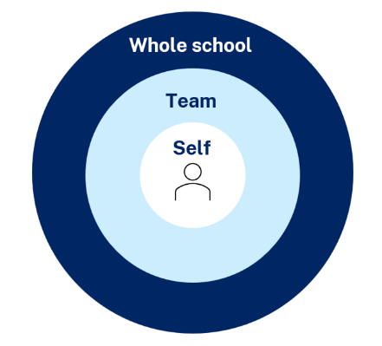
Maintaining a whole school approach through data
Video observation and reflection
Peer observation and feedback
Teacher and student survey
Growth in assessment data
Notes:
Purpose of slide: Collating and using data - suggested for school leadership team
[05:00]
Speaker notes:
Evaluating data is a way we can consider the extent to which we are being effective in achieving long term goals. Data can be collected from many perspectives, including individual teachers and students, teams and whole school. Data can include a range of things, such as observational/instructional rounds, student work samples (such as exit tickets), student self-reports, teacher reflections and assessments. Data can be quantitative and qualitative.
Reflecting on data helps us consider how efficient and effective we are in achieving our instructional goals. It also provides key insights to inform the next steps of professional learning and whole school strategic planning.
Activity:
What data have we accessed so far and what have we learnt?
How can we select and measure data over time to consider our impact?
Further reading:
More information about using data to evaluate the curriculum aligned to the School Excellence Framework –
LECI: Module 5: Using data to effectively evaluate the curriculum, https://education.nsw.gov.au/teaching-and-learning/curriculum/leading-curriculum-k-12/leading-curriculum-middle-leaders/leading-effective-curriculum-implementation

Slide 80
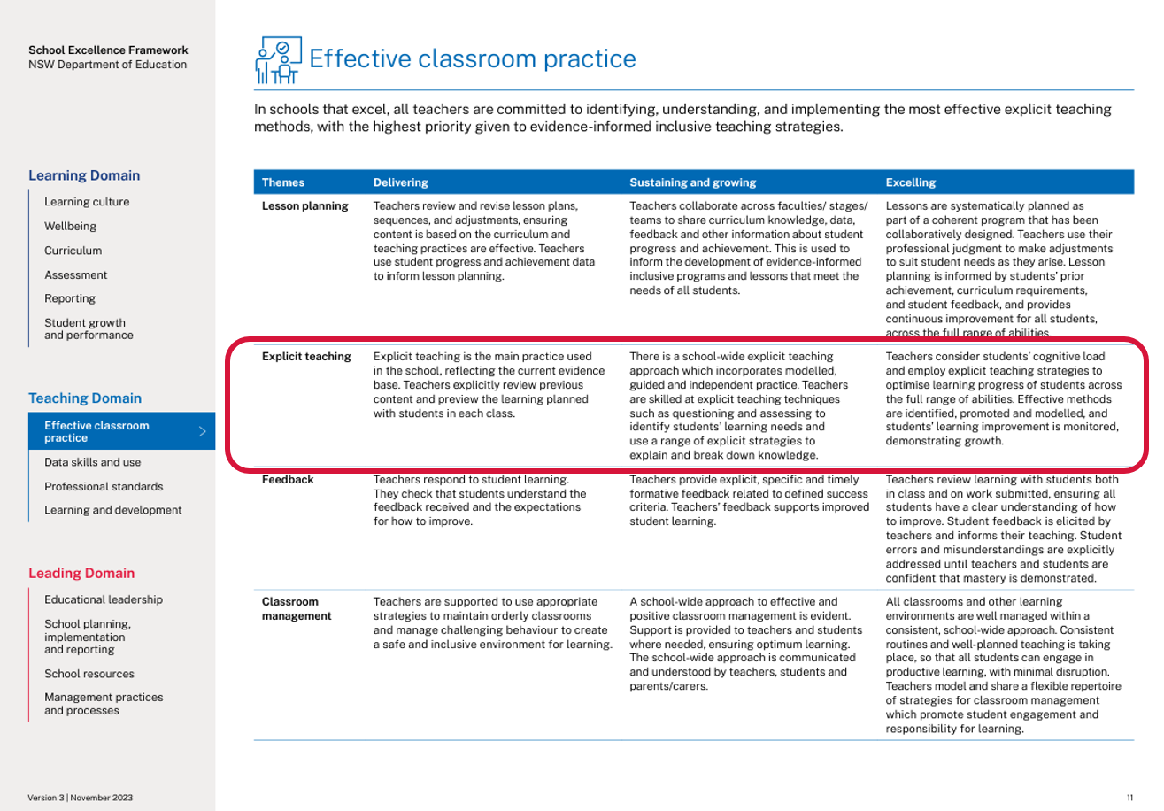
Connecting to the School Excellence Framework
‘School-wide explicit teaching approaches incorporate modelled, guided and independent practice.
Teachers consider students’ cognitive load and employ explicit teaching strategies to optimise learning progress of students across the full range of abilities. Effective methods are identified, promoted and modelled, and students’ learning improvement is monitored, demonstrating growth.’
School Excellence Framework, Teaching Domain (p 11)
80
Notes:
Purpose of slide: Aligning the practice to the SEFv3
[05:00]
Discussion points:
In ‘sustaining and growing’ the practice looks like a whole school approach to positive classroom management. This extends to learning routines in ‘excelling’ where there are consistent school-wide approaches to learning routines that enable student engagement. ​
Speaker notes:​
​Linking to longer term outcomes, the SEF is an excellent way to measure whole-school impact over time.
Checking for understanding relates to themes from the SEFv3​
​
For example, in the teaching domain, under the element of effective classroom management, this practice aligns with the descriptors for the theme of explicit teaching and classroom management.
Activity:
Access and identify key features from delivering, sustaining and growing and excelling for the explicit teaching theme.
Access and identify key features from delivering, sustaining and growing and excelling for the classroom management theme.
Describe how our classrooms would look, feel and sound if we were to move to 'sustaining and growing' or move to 'excelling’.
Discuss how this would align with the strategic direction already in place in your school?
As a whole school, how are we ensuring we continue to reflect on and share our practice?
What actions can we take to promote our effective explicit teaching practice to the wider school community?
How can the SEF be integrated in our school’s professional learning in an ongoing way?
​

Slide 81

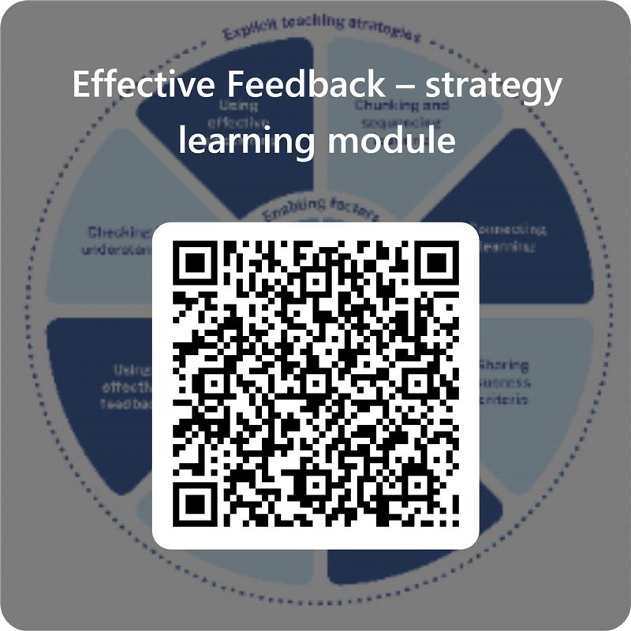
Feedback
Please complete the Effective feedback learning module to help us improve future professional learning and provide further support.
Contact us
ContactCurriculumReform@det.nsw.edu.au

Slide 82


Explicit teaching strategies and resources
More information is available about:
​explicit teaching
how learning happens
the enabling factors
the explicit teaching strategies.
https://education.nsw.gov.au/teaching-and-learning/curriculum/explicit-teaching
Notes:
Purpose: Next steps
Speaker notes:
[0:40]
The evidence on explicit teaching is clear, it shows us how important it is to align our teaching pedagogy with how learning occurs. Ongoing information to support this is available on the department’s website.
This includes information about the enabling factors, how learning happens and the explicit teaching strategies. The website will continue to be updated as new resources are released in the future.
Reference:
NSW Department of Education (2024) Explicit teaching, NSW Department of Education, accessed 10 March 2025.

Slide 83
References
This presentation contains NSW Curriculum and syllabus content. The NSW Curriculum is developed by the NSW Education Standards Authority. This content is prepared by NESA for and on behalf of the Crown in the right of the State of New South Wales. The material is protected by Crown copyright.
Please refer to the NESA Copyright Disclaimer for more information https://educationstandards.nsw.edu.au/wps/portal/nesa/mini-footer/copyright.
NESA holds the only official and up-to-date versions of the NSW Curriculum and syllabus documents. Please visit the NSW Education Standards Authority (NESA) website https://educationstandards.nsw.edu.au/wps/portal/nesa/home and the NSW Curriculum website https://curriculum.nsw.edu.au.
AERO (Australian Education Research Organisation) (2021) Focused classrooms: managing the classroom to maximise learning, AERO, accessed 19 February 2025.
AERO (Australian Education Research Organisation) (2023d) Circulation, AERO, accessed 20 November 2024.
AERO (Australian Education Research Organisation) (2023f) Explicit instruction optimises learning, AERO, accessed 4 October 2024
AERO (Australian Education Research Organisation) (2023e) Gaining all students’ attention, AERO, accessed 4 October 2024.
AERO (Australian Education Research Organisation) (2023b) How students learn best: an overview of the evidence, AERO, accessed 4 October 2024.
AERO (Australian Education Research Organisation) (2023a) Teaching routines, AERO, accessed 4 October 2024.
AERO (Australian Education Research Organisation) (2023c) Planning for classroom management, AERO, accessed 10 March 2025.
AERO (Australian Education Research Organisation) (2024a) Rules and routines, AERO, accessed 13 March 2025.
Almarode J and Vandas K (2018) Clarity for learning: five essential practices that empower students and teachers, Corwin Press.

Slide 84
References (2)
Archer A and Hughes C (2011) Explicit instruction: effective and efficient teaching, Guilford Press.
AITSL (Australian Institute for Teaching and School Leadership) (2023) Addendum – Accreditation of initial teacher education programs in Australia: Standards and Procedures, AITSL.
AITSL (Australian Institute for Teaching and School Leadership) (2023) Teaching standards, AITSL.
Brookhart S (2017) How to give effective feedback to your students, 2nd edn, ASCD.
Brooks C, Carroll A, Gillies RM and Hattie J (2019) ‘A matrix of feedback for learning’, Australian Journal of Teacher Education, 44(4).
Brooks C, Burton R, van der Kleij F, Ablaza C, Carroll A, Hattie J and Neill S (2021) ‘Teachers activating learners: the effects of a student-centred feedback approach on writing achievement’, Teaching and Teacher Education, 105.
CESE (Centre for Education Statistics and Evaluation) (2017) Cognitive load theory: research that teachers really need to understand, CESE, NSW Department of Education, accessed 12 December 2024.
CESE (Centre for Statistics and Evaluation) (2024) Explicit teaching drives student motivation, engagement, and achievement in NSW public schools: a What Works Best research update, CESE, NSW Department Education, accessed 12 December 2024.
Christodoulou D (20 March 2019) ‘Whole class feedback: saviour or fad?’, The No More Marking Blog, accessed 24 February 2025.
Christodoulou D (29 March 2019) ‘Whole class feedback: a recipe, not a statement’, The No More Marking Blog, accessed 24 February 2025.
Elliott V, Randhawa A, Ingram J, Nelson-Addy L, Griffin C and Baird J (2020) Teacher feedback to improve pupil learning: guidance report, Education Endowment Foundation, accessed 20 November 2024.

Slide 85
References (3)
English K–10 Syllabus © NSW Education Standards Authority (NESA) for and on behalf of the Crown in right of the State of New South Wales, 2022.
Evidence for Learning (2022) Effective professional development, Evidence for Learning, accessed 12 December 2024.
Fisher D, Frey N and Lapp D (2011) ‘Coaching middle-level teachers to think aloud improves comprehension instruction and student reading achieving’, The Teacher Educator, 46(3):231–243, doi:10.1080/08878730.2011.580043.
Harn B, Parisi D and Stoolmiller M (2013) ‘Balancing fidelity with flexibility and fit: what do we really know about fidelity of implementation in schools?’ Exceptional Children, 79(3):181–193.
Hattie J and Clarke S (2019) Visible learning: feedback, Routledge.
Hattie J and Timperley H (2007) ‘The power of feedback’, Review of Educational Research, 77(1):81–112.
Hendrick C and Macpherson R (2017) What does this look like in the classroom?: Bridging the gap between research and practice, John Catt Educational Ltd.
Kirschner P, Sweller J and Clark R (2006) ‘Why minimal guidance during instruction does not work: an analysis of the failure of constructivist, discovery, problem-based, experiential, and inquiry-based teaching’, Educational Psychologist, 41(2):75–86.
Lemov D (21 June 2016) 'Tracking not watching: a field guide 2.0 excerpt', Teach like a champion, accessed 20 November 2024.
Lovell O (host) (16 January 2024) ‘Josh Goodrich on instructional coaching’ [podcast], The Education Research Reading Room, accessed 20 November 2024.
McCrea P (2020) Motivated teaching: harnessing the science of motivation to boost attention and effort in the classroom, Createspace Independent Publishing Platform.

Slide 86
References (4)
Martin A and Evans P (2018) ‘Load reduction instruction: exploring a framework that assesses explicit instruction through to independent learning’, Teaching and Teacher Education, 73:203–214.
NSW Department of Education (2023a) Classrooms of possibility, NSW Department of Education, accessed 12 September 2024.
NSW Department of Education (2024a) Explicit instruction: implementing evidence-based teaching practices for students with disability, NSW Department of Education, accessed 12 September 2024.
NSW Department of Education (2024b) Leading explicit teaching: school-facilitated workshops 1–3 on core content and the enabling factors of explicit teaching, NSW Department of Education, accessed 12 September 2024.
NSW Department of Education (2024c) 'Strong strides together: meeting the educational goals for Aboriginal and/or Torres Strait Islander students', Universal Resources - Aboriginal Education, NSW Department of Education, accessed 12 September 2024.
NSW Department of Education (2025a) What is high impact professional learning?, NSW Department of Education, accessed 13 March 2025.
NSW Department of Education (2025b) Peer and self-assessment for students, NSW Department of Education, accessed 10 March 2025.
Responsive Classroom (2018) ‘Self-Assessment: students as active learners’, Center for Responsive Schools, Inc.
Rosenshine B (2012) 'Principles of instruction: research-based strategies that all teachers should know', American Educator, 36(1):12–19.
Sanchez C, Atkinson K, Koenka A, Moshontz H and Cooper H (2017) ‘Self-grading and peer-grading for formative and summative assessments in 3rd through 12th grade classrooms: a meta-analysis’, Journal of Educational Psychology, 109(8):1049–1066.

Slide 87
References (5)
Sherrington T (28 November 2020) 'The art of modelling it’s all in the handover​’ teacherhead blog, accessed 12 September 2024.
Sherrington T (10 January 2019) ‘Revisiting Dylan Wiliam’s five brilliant formative assessment strategies’, teacherhead blog, accessed 12 September 2024.
Science 7–10 Syllabus © NSW Education Standards Authority (NESA) for and on behalf of the Crown in right of the State of New South Wales, 2023.
Sims S, Fletcher-Wood H, O’Mara-Eves A, Cottingham S, Stansfield C, Van Herwegen J and Anders J (2021) ‘What are the characteristics of teacher professional development that increase pupil achievement? A systematic review and meta-analysis’, Education Endowment Foundation, accessed 20 March 2025.
Smith J, Lipnevich A and Guskey T (2023) Instructional feedback: the power, the promise, the practice, Corwin.
Rolheiser C and Ross J (2001) ‘Student self-evaluation: what research says and what practice shows’ in Small RD and Thomas A (eds) Plain talk about kids, Covington Center for Development and Learning.
Tharby A (17 May 2023) 'We are what we do: the case for explicit and consistent school-wide routines’ Class Teaching – Find the bright spots blog, accessed 4 October 2024.
Van der Kleij F and Adie L (2020) 'Towards effective feedback: an investigation of teachers' and students' perceptions of oral feedback in classroom practice', Assessment in Education: Principles, Policy and Practice, 27(3):252-270, doi:10.1080/0969594X.2020.1748871.
Wiliam D (2018) Embedded formative assessment, 2nd ed, Solution Tree Press.

Slide 88
Copyright
© State of New South Wales (Department of Education), 2025
The copyright material published in this resource is subject to the Copyright Act 1968 (Cth) and is owned by the NSW Department of Education or, where indicated, by a party other than the NSW Department of Education (third-party material).
Copyright material available in this resource and owned by the NSW Department of Education is licensed under a Creative Commons Attribution 4.0 International (CC BY 4.0) license.
This license allows you to share and adapt the material for any purpose, even commercially.
Attribution should be given to © State of New South Wales (Department of Education), 2025.
Material in this resource not available under a Creative Commons license:
the NSW Department of Education logo, other logos and trademark-protected material
Material owned by a third party that has been reproduced with permission. You will need to obtain permission from the third party to reuse its material.
Links to third-party material and websites
Please note that the provided (reading/viewing material/list/links/texts) are a suggestion only and implies no endorsement, by the New South Wales Department of Education, of any author, publisher, or book title. School principals and teachers are best placed to assess the suitability of resources that would complement the curriculum and reflect the needs and interests of their students.
If you use the links provided in this document to access a third-party’s website, you acknowledge that the terms of use, including licence terms set out on the third-party’s website apply to the use which may be made of the materials on that third-party website or where permitted by the Copyright Act 1968 (Cth). The department accepts no responsibility for content on third-party websites.

