Slide 1
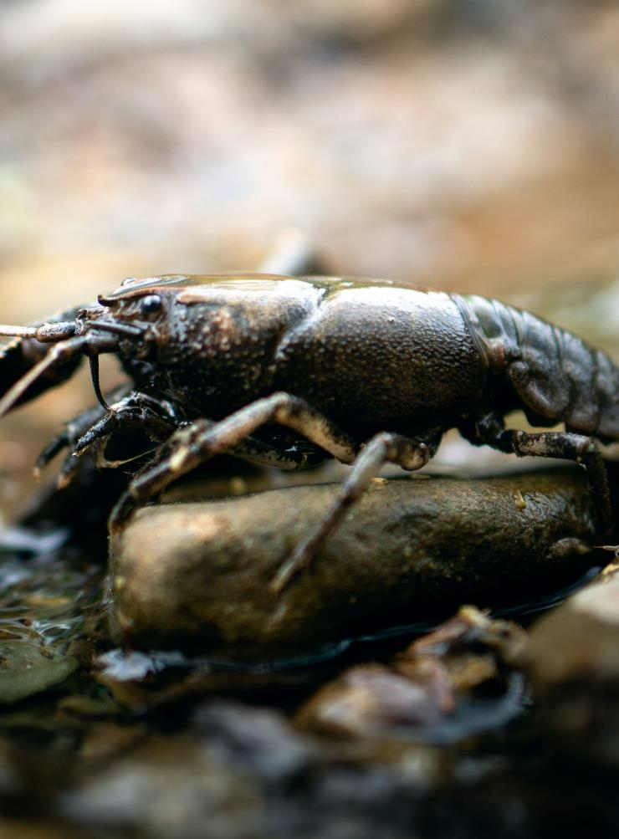
Text annotations – ‘The Marron’ – Zoe Norton-Lodge
NSW Department of Education
Stage 6 – English Studies – 11.1
‘Reading to write: Transition to English Studies’ – Year 11
Term 1
Photo by Autumn Bradley on Unsplash
Notes:
Teacher note: the purpose of this PowerPoint is to provide support for Phase 4, sequence 3 – using grammar to create representations and Phase 3, sequence 4 – understanding how noun groups can be used to develop a personal writing voice.
It should be used in conjunction with the program and the resource booklet.
It is important to make frequent connections to real-world application of the learning for English Studies students. When exploring noun groups, ask students where this skill may support effective communication. It may be useful to look at advertisements for second-hand items, reviews for businesses, instruction manuals, recipes etcetera.

Slide 2
Instructions for use
This resource is not a teaching and learning program. It should be used in conjunction with ‘Reading to write: Transition to English Studies’ – 11.1
Classroom teachers are encouraged to add and adapt slides as required to meet the needs of their students.
Save a copy of the file to make changes to the slide deck. Go to File > Download a Copy (this downloads a copy to the computer to edit in the PowerPoint app).
To convert the PowerPoint to Google Slides:
  Upload the file into Google Drive and open it.
  Go to File > Save as Google Slides.
  (Note – conversion may cause formatting changes in the slides.)
Notes:
Teacher note: there are a number of slides included in this deck that have been hidden because the content may lead to cognitive overload for students. These slides are designed to support the delivery of the grammar content and are a valuable resource for teachers. Use your professional judgement when deciding whether to use these slides with students.

Slide 3
Text complexity details
This hybrid text contains a range of sentence structures, including complex sentences with several subordinate clauses, and the inclusion of some Japanese words. The text offers multiple reading paths through images that supplement and extend meaning of the text which aligns to the complex level of the Text Complexity scale as per ‘Literacy: About the general capability’ document which can be downloaded on the General capabilities downloads page of the Australian Curriculum webpage. (Appendix 2: Text complexity).
The text helps meet the Text requirements for the English Studies 11–12 Syllabus as students are provided the opportunity to engage with an Australian text that explores popular and youth cultures. This text also provides an opportunity for students to engage with integrated modes of reading and viewing and representing.

Slide 4
Licence agreement details
Norton-Lodge Z (2015) ‘The Marron’ in Almost Sincerely, The Giramondo Publishing Company Pty Ltd, Artarmon. ISBN: 9781922146854.
Reproduced and made available for copying and communication by NSW Department of Education for its educational purposes with the permission of The Giramondo Publishing Company Pty Ltd.

Slide 5
Sharing learning intentions and success criteria
Notes:
Teacher note: this slide has been used to identify the explicit teaching strategies sharing learning intentions and sharing success criteria. This slide could be deleted or hidden when using this content in a classroom setting. Alternatively, the teacher could discuss the educational benefit of the process of sharing learning intentions and success criteria and discussing the significance of this learning process.
Sharing learning intentions allows a teacher to effectively communicate the learning goal with students. They allow students to connect new learning to existing knowledge, skills and understanding.
When learning intentions are used with success criteria, students have a clear idea of the learning goal and how to get there (AERO 2024).
The success criteria break the learning intention into smaller and more manageable actions. They show students what they must do, say, make, create or perform to demonstrate their learning (Griffin 2018).
Success criteria are communicated to students in ways they understand. Teachers use their expertise to guide student thinking and often model and use exemplars to show students what success 'looks like’ (DoE 2025).
The sample learning intentions and success criteria (LISC) on the following slide are aligned to the syllabus.
When designing LISC for students working above or below stage level, or towards Life Skills outcomes, draw on the collaborative curriculum planning process to ensure LISC is differentiated and aligned with the relevant syllabus outcomes.
For more information, see:
AITSL: https://www.aitsl.edu.au/docs/default-source/feedback/aitsl-learning-intentions-and-success-criteria-strategy.pdf?sfvrsn=382dec3c_2
Sharing learning intentions: https://education.nsw.gov.au/teaching-and-learning/curriculum/explicit-teaching/explicit-teaching-strategies/sharing-learning-intentions
Sharing success criteria: https://education.nsw.gov.au/teaching-and-learning/curriculum/explicit-teaching/explicit-teaching-strategies/sharing-success-criteria
Collaborative curriculum planning: https://educationstandards.nsw.edu.au/wps/portal/nesa/k-10/diversity-in-learning/special-education/collaborative-curriculum-planning

Slide 6
Learning intentions and success criteria
We are learning to
understand how codes and conventions of language are used to create representations in texts
be able to create ordinary and extraordinary representations through noun groups
understand how noun groups can be used to add detail and precision to writing.
We can
[classroom teacher to insert sample success criteria]
[classroom teacher to insert sample success criteria]
[classroom teacher to insert sample success criteria].
Notes:
Teacher note: adapt the provided learning intention and below sample success criteria, as required, to suit the needs of your students.
- identify extraordinary and ordinary events in the core text
- explain how language can be used to create representations of events
- use noun groups to compose representations that are ordinary and extraordinary
- evaluate the work of their peers and justify the judgement made.
LISC is usually shared first or early in the lesson and is explained by the teacher who checks for understanding (DoE 2025).
LISC is referred to regularly to check for understanding, provide feedback or as a self-assessment tool (Wiliam and Leahy 2015).
Learning intentions and success criteria can be supported by exemplars, such as 'What A Good One Looks Like' (WAGOLL) or exemplars to demonstrate success criteria (Clarke 2021).
For more information, see:
Sharing learning intentions and success criteria: https://education.nsw.gov.au/content/dam/main-education/documents/teaching-and-learning/curriculum/explicit-teaching/explicit-teaching-technique-guide-lisc-sharing.pdf
Planning learning intentions and success criteria: https://education.nsw.gov.au/content/dam/main-education/documents/teaching-and-learning/curriculum/explicit-teaching/explicit-teaching-technique-guide-lisc-planning.pdf

Slide 7
Phase 4, sequence 4 – Connecting learning
Notes:
Teacher note: this slide is to be used in conjunction with/to support Phase 4, sequence 4. This slide has been used to identify the explicit teaching learning strategy and should be deleted or hidden when used in a classroom setting. The strategy of connecting learning involves making connections within and across learning.
Teachers actively support students to make connections within and across knowledge, skills and understanding as well as to prior learning experiences. Learning is a change to long term memory. Long term memory is a network of overlapping information with many connections (AERO 2024b), which are called schemas (CESE 2017).

Slide 8

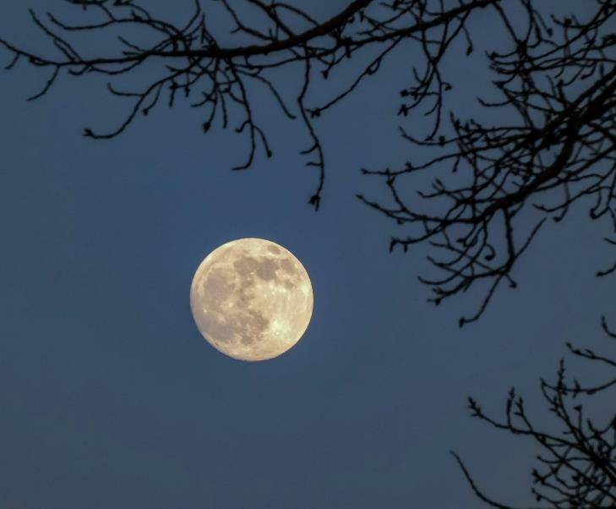
Representing events
Ordinary and extraordinary
Photo by Jongsun Lee on Unsplash
Photo by Kym MacKinnon on Unsplash
Notes:
Teacher note: this slide is to be used in conjunction with/to support Phase 4, sequence 4. The teacher discusses with students how the first image represents an extraordinary event (solar eclipse) and the second image represents an ordinary event (regular full moon)

Slide 9
Ordinary and extraordinary (1)
Freyer diagram
Definition
Facts and characteristics
Ordinary
Examples
Non-examples
Notes:
Teacher note: complete the Freyer diagram with the class to ensure students’ understanding of the terms ‘ordinary’ and ‘extraordinary’.
Suggested responses:
Definition: common, everyday occurrence, usual.
Characteristics: regular or typical, average, standard, lacking uniqueness.
Examples: a regular day at school or work. Everyday activities like catching the bus or brushing teeth.
Non-examples: a once-in-a-lifetime event like travelling into space.

Slide 10
Ordinary and extraordinary (2)
Freyer diagram
Definition
Facts and characteristics
Extraordinary
Examples
Non-examples
Notes:
Teacher note: complete the Freyer diagram with the class to ensure students’ understanding of the terms ‘ordinary’ and ‘extraordinary’.
Suggested responses:
Definition: very unusual, remarkable, exceptional.
Characteristics: unique or rare. Not normal or expected.
Examples: a rare phenomenon like a comet or a solar eclipse. An unexpected result like breaking a world record. Unprecedented weather such as a heatwave in winter.
Non-examples: An expected test score. Common weather patterns. Everyday routines such as getting up and going to school during the week.

Slide 11

Statement to cause thinking
Ordinary and extraordinary
Think / Pair / Share
This image shows an extraordinary event
Image courtesy of Viktor Hanacek of picjumbo
Notes:
Teacher note: this slide is to be used in conjunction with/to support Phase 4, sequence 3. Present students with the following statement ‘This image shows an extraordinary event’. This statement is designed to cause students to think and to facilitate them to react and debate about the accuracy of the statement. (Wiliam, 2014).
Students respond to the statement using the Think-Pair-Share thinking routine.
As a class, discuss reasons why the image is extraordinary or ordinary and revisit the definition of ordinary and extraordinary.

Slide 12
Definitions of essential terminology (1)
Noun
Noun – a noun is a word used to represent people, places, ideas and things. Nouns may be common (for example, 'teacher' or classroom', proper (for example, 'Mr Smith' or 'Sydney’), collective (for example, 'herd' or 'team') or abstract (for example 'sadness' or 'joy’).
Notes:
Teacher note: this slide is to be used in conjunction with/to support Phase 4, sequence 4. It is important that students understand essential terminology before building on their knowledge. The following slides are designed to support students in learning new subject-specific vocabulary to improve their academic writing. They are designed to support students in activating their prior knowledge about nouns and noun groups which they may have already learned about in previous units or introducing them to these key concepts.
These slides should be used as a reference point for students and may be referred back to throughout the unit as required. Where possible, please support students with further explanations and examples of key terms, if they are still feeling unsure. These slides are not intended for students to merely copy from the board.
More definitions can be found in the English K–10 Syllabus Glossary, which draws on the NSW Syllabus, ACARA and the Macquarie Dictionary: https://curriculum.nsw.edu.au/learning-areas/english/english-k-10-2022/glossary.
Student note: this slide has a definition for nouns. It is important that you understand the purpose and function of nouns, so that you can build on nouns in your writing.

Slide 13
Definitions of essential terminology (2)
Adjective
Adjective – and adjective is a word that describes, identifies, modifies of gives more information about a noun or pronoun. Adjective provide information about qualities, quantities, colours, shapes, sizes and other characteristics of a noun in a sentence.
Notes:
Teacher note: this slide is to be used in conjunction with/to support Phase 4, sequence 4. It is important that students understand essential terminology before building on their knowledge. The following slides are designed to support students in activating their prior knowledge about nouns, noun groups, appositives and modifiers, which they may have already learned about in previous units or introducing them to these key concepts.
These slides should be used as a reference point for students and may be referred back to throughout the unit as required. Where possible, please support students with further explanations and examples of key terms, if they are still feeling unsure. These slides are not intended for students to merely copy from the board.
More definitions can be found in the English K–10 Syllabus Glossary, which draws on the NSW Syllabus, ACARA and the Macquarie Dictionary: https://curriculum.nsw.edu.au/learning-areas/english/english-k-10-2022/glossary.
Student note: this slide has a definition for noun groups. Noun groups can help you improve your writing by providing more description, explanation, detail or interpretation.

Slide 14
Warm up (1)
Ordinary and extraordinary
Complete this noun group by adding an ‘ordinary’ noun
The red shiny …
Notes:
Teacher note: this slide is to be used in conjunction with/to support Phase 4, sequence 4. Students use mini whiteboards to perform a 'quick write' by completing the noun group 'The red shiny...'
This provides the teacher the opportunity to check for understanding in terms of the concepts of ‘ordinary’ and simple noun group construction:
are students adding appropriate nouns?
are they using common or abstract nouns?
do students include pre modifiers before the noun such as additional adjectives?
do students include post modifiers after the noun to provide additional information, such as adverbial or prepositional phrases?

Slide 15
Warm up (2)
Ordinary and extraordinary
Complete this noun group by adding an ‘extraordinary’ noun
The red shiny …
Notes:
Teacher note: this slide is to be used in conjunction with/to support Phase 4, sequence 3. Students use mini whiteboards to perform a 'quick write' by completing the noun group 'The red shiny...'
This provides the teacher the opportunity to check for understanding in terms of the concepts of ‘extraordinary’ and simple noun group construction:
are students adding appropriate nouns?
are they using common or abstract nouns?
do students include pre modifiers before the noun such as additional adjectives?
do students include post modifiers after the noun to provide additional information, such as adverbial or prepositional phrases?

Slide 16
Warm up (3)
Grammar features
The red shiny …
adjective
adjective
noun
Notes:
Teacher note: this slide is to be used in conjunction with/to support Phase 4, sequence 3. The teacher reviews with students how the word/s used to complete the noun groups are nouns and 'red' and 'shiny' are adjectives modifying / describing the noun. Explore post modifiers if appropriate and if students used them in the activity
*No need to explore 'the' as an article – this will come later in the slide deck.

Slide 17
Gradual release of responsibility
Notes:
Teacher note: this slide is to be used in conjunction with/to support Phase 4, sequence 4. This slide has been used to identify the explicit teaching learning strategy and should be deleted or hidden when using in a classroom setting. The strategy of gradual release of responsibility is a flexible process moving between modelled, guided and independent teaching practice responsive to student learning. Students should be supported to move between each practice based on their capabilities and requirements. ​
​
Teachers deliver a structured and sequenced approach to explicitly teaching new content. Learning is most effective when teachers break new information down and teach it explicitly using explanation, demonstration and modelling. This is especially relevant when students are new to an area (AERO 2024a).​

Slide 18
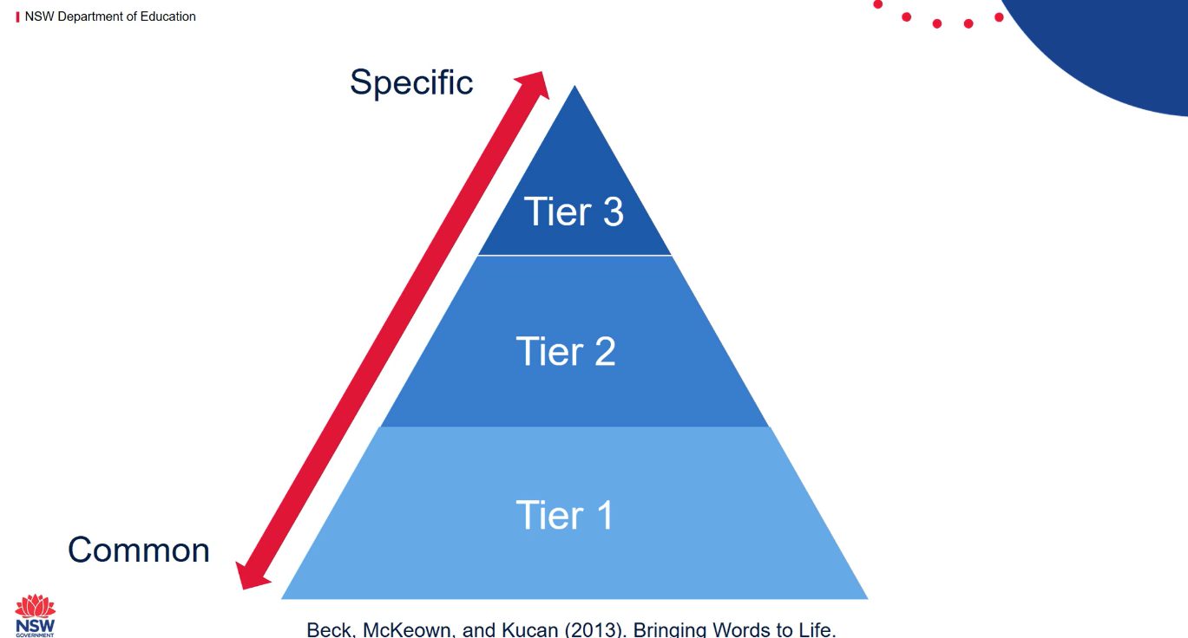

Tiers of vocabulary (1)
Tier 1, 2 and 3 words
Notes:
Teacher note: this slide is to be used to introduce / review (depending on your class context) Tier 1, 2 and 3 vocabulary. Prior to viewing the video, activate student thinking by asking:
Is this visual familiar to you? If so, what do you know?
What does the size of the Tier 1 section tell us about Tier 1 vocabulary?
What does the size of the Tier 3 section tell us about Tier 1 vocabulary?
Students view the video (04:50) to explore definitions and examples of Tier 1, 2 and 3 vocabulary. The teacher can pause the video intermittently to check for student understanding or clarify key points.
For more information, see Vocabulary (https://education.nsw.gov.au/teaching-and-learning/curriculum/literacy-and-numeracy/teaching-and-learning-resources/literacy/effective-reading-in-the-early-years-of-school/vocabulary

Slide 19
Tiers of vocabulary (2)
Tier 1, 2 and 3 words in the text ‘The Marron’
Amongst the evening's take-away diners, potential trivia guests lolling into the pub, and the late night patients off to see the Johnston Street doctor with varying imagined and real middle-class diseases, amongst them all, and Georgia and me, walking down the street was a shiny black shellfish.
Specific
Tier 3
Tier 2
potential
trivia, patients,
varying, amongst, lolling, imagined, middle-class diseases, shellfish
Tier 1
evening, take-away, guests, see, late, doctor, me, them, black, street
Common
Notes:
Teacher note: use a gradual release of responsibility approach to explore with students the tier 1, 2 and 3 words in the core text.
Explore last paragraph of text ( on slide) to identify Tier 1, 2 and 3 words with students. Teachers may wish to annotate with students.
Reveal sample Tier 1 words (CLICK)
Tier 1 words (common, everyday words)
evening
take-away
guests
see
late
doctor
me
them
black
street
Tier 2 words (more complex words that are commonly used across various contexts):
potential
trivia
patients
varying
amongst
lolling
imagined
middle-class
diseases
shellfish
Tier 3 words (subject-specific vocabulary that is often used in specific disciplines) – while there are no examples in this paragraph, you could explore with students some tier 3 vocabulary that could be included. Examples include ‘nocturnal’ (instead of ‘evening’s’), ‘hypothetical’ (instead of ‘imagined’) and ‘obsidian mollusc’ (instead of ‘black shellfish’)

Slide 20
Tiers of vocabulary (3)
Tier 1, 2 and 3 words in the text ‘The Marron’
Specific
Tier 3
vegetarian crustacean
‘To this day, Georgia remains a vegetarian. And though she can recite a catalogue of ethical reasons informing her lifestyle choice, I'm pretty sure it's a simple matter of crustacean-trauma.’
Tier 2
remains
recite
catalogue
ethical
lifestyle
Tier 1
day, reasons, choice, pretty sure, simple matter
Common
Notes:
Teacher note: explore last paragraph of text ( on slide) to identify Tier 1, 2 and 3 words with students. Teachers may wish to annotate with students.
Reveal sample Tier 1 words (CLICK)
Tier 1 words (common, everyday words)
day
reasons
choice
pretty sure
simple matter
Tier 2 words (more complex words that are commonly used across various contexts):
"remains" - suggests a state of continuing to be.
"recite" - means to repeat aloud from memory.
"catalogue" - refers to a list or collection of items.
"ethical" - relates to moral principles.
"lifestyle" - refers to the way a person lives.
Tier 3 words (subject-specific vocabulary that is often used in specific disciplines):
"vegetarian" - refers to a person who does not eat meat.
"crustacean" - refers to a class of animals that includes crabs, lobsters, and shrimp.
If appropriate, students may move to independent practice using a different extract from the core text.

Slide 21
Precise language (1)
Adjective choices
Identify the adjective(s) in the phrase
The shiny red balloon
What happens when ‘red’ is replaced with ‘crimson’?
The shiny crimson balloon

Slide 22
Precise language (2)
Adjective choices
This noun group uses the common adjective ‘red’ to describe the balloon
The shiny red balloon
This noun group replaces ‘red’ with a more precise adjective to describe the balloon
The shiny crimson balloon
Notes:
Teacher note: this slide is to be used in conjunction with/to support Phase 4, sequence 4. The teacher models the use of more precise and (or) sophisticated adjectives to add clarity and precision to writing. Discuss with students the effect of using a more precise adjective ‘crimson’ to describe the balloon.
*If appropriate for the class, the teacher may refer to ‘red’ as Tier 1 vocabulary and ‘crimson’ as Tier 2 vocabulary.

Slide 23
Precise language (3)
Adjective choices
This noun group replaces ‘red’ with a more precise adjective that is not related to colour to describe the balloon
The shiny helium-inflated balloon
This noun group combines the identified precise adjectives to describe the balloon
The shiny crimson helium-inflated balloon
Notes:
Teacher note: this slide is to be used in conjunction with/to support Phase 4, sequence 4. The teacher models the use of more precise and(or) sophisticated adjectives that are not related to colour to add clarity and precision to writing. Discuss with students the effect of using a more precise adjective ‘helium-inflated’ to describe the balloon. This is a classifying adjective.

Slide 24
Spider map
helium-inflated
crimson
Precise language 'red'.
Notes:
Teacher note: this slide is to be used in conjunction with/to support Phase 4, sequence 4. The teacher brainstorms with the class precise adjectives that could replace 'red' to make the noun group more precise and elaborate.
Possible adjectives include:
scarlet
plump
cheerful
cherry
deflated
blood-red

Slide 25
Examples of essential terminology (1)
Nouns in the text 'The Marron'
Common
school
street
Proper
Georgia
Annandale
Collective
comrades
diners
Abstract
freedom
bliss
Notes:
Teacher note: this slide is to be used in conjunction with/to support Phase 4, sequence 4. Explore different types of nouns in the text ‘The Marron’
Common nouns
‘school’ – the name of a place
‘street’ – the name of a place
Proper nouns
‘Georgia’ – the name of a person
‘Annandale’ – the name of a place (may need to provide context depending on school setting)
Collective nouns
‘comrades’ - refers to a group of friends or peers
‘diners’ - refers to a group of people eating in a restaurant or take-away
Abstract nouns
‘freedom’ - represents the state of being free.
‘bliss’ - represents a state of extreme happiness or joy.

Slide 26
Text search
Nouns in the text 'The Marron'
In pairs, highlight your assigned type of noun in the text 'The Marron'.
Common
Examples
school
street
Proper
Examples
Georgia
Annandale
Collective
Examples
comrades
diners
Abstract
Examples
freedom
bliss
Notes:
Teacher note: this slide is to be used in conjunction with/to support Phase 4, sequence 4. In pairs, students are provided with a copy of the text ‘The Marron’. Assign each pair a type of noun to search for and highlight in the text.
A suggested differentiation approach when assigning types of nouns is:
Level 1: Proper nouns
Level 2: Common nouns
Level 3: Collective nouns
Level 4: Abstract nouns

Slide 27
Text search – answers
Nouns in the text 'The Marron'
You may have found these nouns... what other nouns did you find?
Common
creature
shellfish
journey
hair
man
finger
chicken
Proper
Mamma
Glebe Town Hall
Salvador Dali
Booth Street
Trafalgar Street
Hunter Baillie Church
Collective
guests
patients
children
kids
apartment blocks
years
catalogue
Abstract
opportunity
mind
adventure
protest
wishes
joy
moment
Notes:
Teacher note: this slide is to be used in conjunction with/to support Phase 4, sequence 4. Possible answers:
Common
creature
shellfish
journey
hair
man
finger
chicken
Proper
Mamma
Glebe Town Hall
Salvador Dali
Booth Street
Trafalgar Street
Hunter Baillie Church
Collective
guests
patients
children
kids
apartment blocks
years
catalogue
Abstract
opportunity
mind
adventure
protest
wishes
joy
moment

Slide 28
Describing nouns
Adjectives for precision and clarity
How can we describe these nouns to provide precision and clarity using precise adjectives?
patients
adjective
adjective
collective noun
protest
adjective
adjective
abstract noun
Notes:
Teacher note: this slide is to be used in conjunction with/to support Phase 4, sequence 4. The teacher jointly constructs with students adjectives that can be used to provide precision and clarity to the nouns ‘patients’ and ‘protest’.
Examples include:
elderly, frail patient
young, nervous patient
long-term, chronic patient
anxious, first-time patient
peaceful, organised protest
large, vocal protest
silent, symbolic protest
student-led, energetic protest

Slide 29
Definitions of essential terminology (3)
Noun group
Noun group – a noun group is a group of words relating to, or building on, a noun. Noun groups usually begin with an article (the, a or an) or determiner (this, that, these, those, my, your, his, her, their, its or our) and may have more than one adjective. They may also include adjectival phrases or adjectival clauses to add further description, explanation or detail.
Notes:
Teacher note: this slide is to be used in conjunction with/to support Phase 4, sequence 4. It is important that students understand essential terminology before building on their knowledge. The following slides are designed to support students in activating their prior knowledge about nouns, noun groups, appositives and modifiers, which they may have already learned about in previous units or introducing them to these key concepts.
These slides should be used as a reference point for students and may be referred back to throughout the unit as required. Where possible, please support students with further explanations and examples of key terms, if they are still feeling unsure. These slides are not intended for students to merely copy from the board.
More definitions can be found in the English K–10 Syllabus Glossary, which draws on the NSW Syllabus, ACARA and the Macquarie Dictionary: https://curriculum.nsw.edu.au/learning-areas/english/english-k-10-2022/glossary.
Student note: this slide has a definition for noun groups. Noun groups can help you improve your writing by providing more description, explanation, detail or interpretation.

Slide 30
Examples of essential terminology (2)
Noun groups in the text 'The Marron'
a shiny black shellfish
article
adjective
adjective
noun
a miniature top hat and cane
article
adjective
noun
noun
Notes:
Teacher note: this slide is to be used in conjunction with/to support Phase 4, sequence 4. These extracts are from Core text 3 – ‘The Marron’ by Zoe Norton-Lodge and are examples of noun groups. The teacher models to students how extract is a noun group:
a (article) shiny (adjective) black (adjective) shellfish (noun)
a (article) miniature (adjective) top hat (noun) and cane (noun)

Slide 31
Checking for understanding (1)
Notes:
Teacher note: this slide is to be used in conjunction with/to support Phase 4, sequence 4. This slide has been used to identify the explicit teaching learning strategy of using effective questioning and should be deleted or hidden when using in a classroom setting. If students cannot adequately respond to this type of question, they should be provided with either whole class instruction in another delivery mode or example, or if only some students are lacking confidence, they could be assisted individually when the class move on to the next stage of learning.
Teachers analyse the information they collect to make evidence-based instructional decisions. This includes when to move between modelled, guided and independent practice.
Checking understanding requires teachers to collect the responses of all students (William 2014).

Slide 32
Checking for understanding (2)
Identify the noun groups
A tall, suited man with oily hair and little eyes had stepped out of his shiny black car.
Notes:
Teacher note: this slide is to be used in conjunction with/to support Phase 4, sequence 4. Using mini whiteboards, students identify the noun groups within the sentence from Core text 3 – ‘The Marron’ by Zoe Norton-Lodge:
A tall, suited man with oily hair and little eyes had stepped out of his shiny black car.

Slide 33
Checking for understanding – answers (1)
Identify the noun groups
A tall, suited man with oily hair and little eyes had stepped out of his shiny black car.
Notes:
Teacher note: this slide is to be used in conjunction with/to support Phase 4, sequence 4.
Green – article / determiner
Pink – adjective
Aqua – noun
In the sentence "A tall, suited man with oily hair and little eyes had stepped out of his shiny black car," the individual noun groups are:
A tall, suited man - This includes the article "A," the adjectives "tall" and "suited," and the noun "man."
oily hair - This includes the adjective "oily" and the noun "hair."
little eyes - This includes the adjective "little" and the noun "eyes."
his shiny black car - This includes the determiner "his," the adjectives "shiny" and "black," and the noun "car.“

Slide 34
Types of noun groups (1)
Notes:
Teacher note: this slide is to be used in conjunction with/to support Phase 4, sequence 4. This section explores succinct and elaborated noun groups.

Slide 35
Types of noun groups (2)
Succinct noun groups
A noun group can be a single noun. For example, ‘bag', ‘eyes’
A noun group can also contain a single proper noun. For example, 'Georgia', ‘Annandale’
A noun group may also just contain an article or determiner and a noun. For example, 'the bag', ‘his eyes’
A noun group can also contain an article or determiner, an adjective and a noun. For example, ‘the shopping bag’, ‘his little eyes'
These are succinct noun groups. Succinct noun groups add simplicity to writing.
Notes:
Teacher note: this slide is to be used in conjunction with/to support Phase 4, sequence 4. The teacher explores with students the definition of a succinct noun group and examples from Core text 3 – ‘The Marron’ by Zoe Norton-Lodge.
A succinct noun group can be:
a single noun
a single Proper noun
an article or determiner and a noun
an article or determiner, adjective and noun
The purpose of succinct noun groups is to provide clear and concise descriptions that enhance understanding and communication.

Slide 36
Types of noun groups (3)
Elaborated noun groups
Elaborated noun groups are complex structures in English grammar that consist of a main noun along with additional words or phrases that modify or describe the noun in more detail.
These groups help to provide more information about the noun, making the meaning more specific.
Examples of elaborated noun groups in ‘The Marron’ are
‘his long index finger.’
determiner
adjective
adjective
noun
‘a handsome creature with significant black pincers’
article
adjective
noun
adjective
adjective
noun
Notes:
Teacher note: this slide is to be used in conjunction with/to support Phase 4, sequence 4. The teacher explores with students the definition of an elaborated noun group and examples from Core text 3 – ‘The Marron’ by Zoe Norton-Lodge:
his (determiner) long (adjective) index (adjective) finger (noun)
a (article) handsome (adjective) creature (noun) with significant (adjective) black (adjective) pincers (noun)

Slide 37
Checking for understanding (3)
Identify the succinct and elaborated noun groups
‘The tall man bent down and stroked the back of the creature with his long index finger.’
Notes:
Teacher note: this slide is to be used in conjunction with/to support Phase 4, sequence 4. The teacher provides students with mini whiteboards for students to identify the succinct and elaborated noun groups in the sentence – ‘The tall man bent down and stroked the back of the creature with his long index finger.’

Slide 38
Checking for understanding – answers (2)
Identify the succinct and elaborated noun groups
‘The tall man bent down and stroked the back of the creature with his long index finger.’
Notes:
Teacher note: this slide is to be used in conjunction with/to support Phase 4, sequence 4. Answers
Yellow – succinct noun group
The (article) tall (adjective) man (noun)
the (article) back (noun)
the (article) creature (noun)
Pink – elaborated noun group
his (determiner) long (adjective) index (adjective) finger (noun)
*Underlined: two succinct noun groups combined to form an elaborated noun group that contains the prepositional phrase ‘of the creature’ (teacher may chose to focus on this if appropriate for their class context)

Slide 39
Venn diagram
Succinct noun group
Elaborated noun group
the shellfish
this thing
Marron
A shiny black shellfish
A shellfish in Annandale
Notes:
Teacher note: this slide is to be used in conjunction with/to support Phase 4, sequence 4. Explore examples of succinct and elaborated noun groups used in ‘The Marron’.
Students complete the Venn diagram provided in Phase 4, activity 4 (integrated Phase 5) – creating succinct and elaborated noun groups to identify the succinct and elaborated noun groups in Core text 3 – ‘The Marron’ by Zoe Norton-Lodge. Students add 2 of their own succinct and elaborated noun groups to describe the marron. In their writing journal, they use at least one succinct noun group and one elaborated noun group to rewrite the opening of ‘The Marron’ from the point of view of the marron – how did it end up on the streets of Annandale?

Slide 40
What is the effect of noun groups?
Identify noun groups that convey meaning
It walked with a sense of purpose, as though it should have been carrying a miniature top hat and cane.
This noun group gives us more information about the shellfish, implying that it may possess human-like traits such as elegance and style or a unique personality that sounds out.
Without it, we are unable to develop a clear image of the shellfish or gain an insight into its personal characteristics.
Notes:
Teacher note: this slide is to be used in conjunction with/to support Phase 4, sequence 4. The noun group ‘a miniature top hat and cane’ gives us more information about the shellfish, implying that it may possess human-like traits such as elegance and style or a unique personality that sounds out. Without it, we are unable to develop a clear image of the shellfish or gain an insight into its personal characteristics.
humour: The mention of a "miniature top hat and cane" introduces a playful and whimsical element. It implies that the shellfish has a charming or comical appearance, enhancing the overall image in a light-hearted way.
imaginary Scenario: The phrase suggests an imaginary or fanciful scenario where the shellfish is imagined to be dressed up. This adds a layer of creativity to the description, inviting the reader to visualise the shellfish in a humorous context.
character traits: By suggesting that the shellfish might be carrying these items, it implies that the creature may possess traits such as elegance or style, or even a quirky personality that stands out.
Overall, this noun group contributes to a vivid and entertaining portrayal of the shellfish, enhancing its character and making the description memorable.

Slide 41
Writing with clarity and precision
Elaborated noun groups
Re-write this sentence removing words (the adjectives) from the elaborated noun groups creating less descriptive sentences . The first example in the sentence has been done for you.
Example sentence with elaborated noun groups
Amongst the evening's take-away diners, potential trivia guests lolling into the pub, and the late night patients off to see the Johnston Street doctor with varying imagined and real middle-class diseases, amongst them all, and Georgia and me, walking down the street was a shiny black shellfish.
The sentence with words removed from elaborated noun groups
Amongst the diners, guests lolling into the pub, and patients off to see the doctor with diseases, amongst them all, and Georgia and me, walking down the street was a shellfish.
What is the impact on the reader without the elaborated noun groups in this sentence?
Notes:
Teacher note: this slide is to be used in conjunction with/to support Phase 4, sequence 4. To remove the elaborated noun groups from the sentence, we would simplify the parts that include modifiers, leaving only the core nouns. The revised sentence would look like this: Amongst the diners, guests lolling into the pub, and patients off to see the doctor with varying diseases, amongst them all, and Georgia and me, walking down the street was a shellfish.
Changes made:
‘evening’s take-away': ‘the diners' (removing the adjectives ‘evening’s take away' from the collective noun ‘diners')
‘potential trivia' : ‘guests' (removing the adjectives ‘potential trivia' from the collective noun ‘guests’)
‘the late night’: ‘patients’ (removing ‘the late night’ from the collective noun ‘patients’)
‘Johnston Street’ : ‘the doctor’ (removing ‘Johnston Street’ from the common noun ‘doctor’)
‘varying imagined and real-middle class’: ‘diseases’ (removing ‘varying imagined and real-middle class’ from the collective noun ‘diseases’)
‘shiny black’: ‘shellfish’ (removing ‘black shiny’ from the common noun ‘shellfish’.
This version removes the additional descriptors, simplifying the sentence. Without these elaborated noun groups, meaning is reduced for the reader. In particular, context is reduced for the sentence ‘off to see the doctor with diseases’.

Slide 42
Annotating ‘The Marron’ (1)
Notes:
Teacher note: this slide is to be used in conjunction with/to support Phase 4, sequence 4. The following slides provide text annotations for Core text 3 – ‘The Marron’ by Zoe Norton-Lodge focusing on noun groups.

Slide 43
Annotating ‘The Marron’ (2)
Succinct noun groups and elaborated noun groups
This section has been annotated for character description using succinct noun groups and elaborated noun groups.
One evening at the age of ten, Georgia had been assigned hunting and gathering duties. Up until I finished Year Six, Mamma had insisted on walking me to school in the mornings and picking me up in the afternoons. This was a school that could be seen perfectly well from the vantage point of our house. She also used to watch me playing in the park, from the window in the lounge room, and would make me come inside ours before any of my comrades were summoned for dinner. Somewhat predictably Georgia's world was a lot more relaxed than mine, and, at the age of ten she was deemed perfectly capable of the financial and physical responsibilities involved in a solo trip to the fish-and chip-shop. I was sixteen at the time, and wading through an entirely new swamp of Mamma's overprotective tendencies. At any rate, the unfairness was not lost on me, and out of pettiness I insisted on going with her. Whilst it promised no particular joy to me, minimising Georgia's freedom was a little pleasure unto itself. And it was on this particular adventure that Georgia and I happened upon a shellfish walking down the street.
Notes:
Teacher notes: this slide is to be used in conjunction with/to support Phase 4, sequence 4. Elaborated noun groups include adjectives, articles / determiners, and other modifiers that provide additional detail about the noun.
Here are some examples:
the age of ten (article 'the'; common noun 'age' modified by the prepositional phrase 'of ten' to provide more detail about the age)
hunting and gathering duties (adjectives 'hunting and gathering'; collective noun 'duties')
the vantage point of our house (article 'the'; adjective 'vantage'; common noun 'point' modified by the prepositional phrase 'of our house')
the window in the lounge room (article 'the'; common noun 'window'; modified by the prepositional phrase 'in the lounge room') *Prepositional phrase also contains a noun group: 'the lounge room'
the financial and physical responsibilities (article 'the'; adjectives 'financial and physical'; collective noun 'responsibilities')
Mamma's overprotective tendencies (determiner 'Mamma's'; adjective 'overprotective'; collective abstract noun 'tendencies')
an entirely new swamp (article 'an'; adjectives 'entirely' 'new'; noun 'swamp' )
These extended noun groups provide richer descriptions and context within the text.
The succinct noun groups in the provided text consist of a noun and its immediate modifiers, without additional phrases. Here are the succinct noun groups:
One evening (adjective 'one'; common noun 'evening')
Georgia (single proper noun)
Mamma (single proper noun)
Year Six (noun 'Year'; adjective 'Six')
the park (article 'the'; common noun 'park')
the unfairness (article 'the'; abstract noun 'park')
pettiness (single abstract noun)
a shellfish (article 'a'; common noun 'shellfish')
the street (article 'the'; common noun 'street’)
These groups are more straightforward and generally consist of a noun with minimal or no modification.

Slide 44
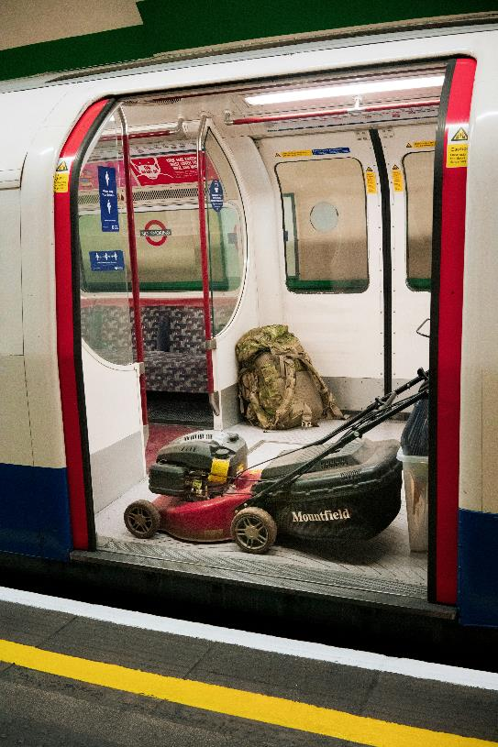
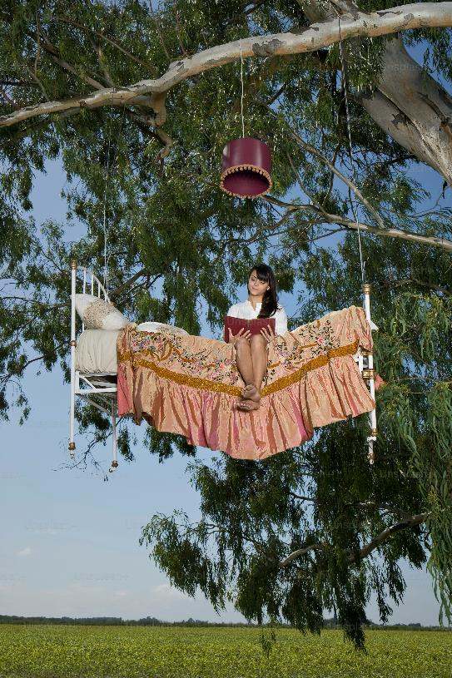
Applying understanding of noun groups
Consolidating your understanding
Develop elaborated noun groups for each of the stimulus images that show an extraordinary event in an ordinary setting.
Choose one of the images to inspire a short piece of imaginative writing (100 words). In your writing, you need to apply elaborated noun groups to add precision and detail in your descriptions.
Photo by john crozier on Unsplash
Photo by Getty images for Unsplash
Notes:
Teacher note: this slide is to be used in conjunction with/to support Phase 4, sequence 4. It may be beneficial to take a gradual release of responsibility approach to this task. For example, in image 1, demonstrate to students how to elaborate the nouns 'mower’, ‘train’, into 'the black and red lawn mower’, ‘the solar-powered, bullet train'
In the guided instruction stage, provide students with the nouns to extend in the second image – ‘tree', 'bed' and 'woman'. As students offer contributions to build the noun groups, write these on the board around the image.

Slide 45
Returning to the learning intentions and success criteria
Notes:
Teacher note: learning intentions and success criteria are not just usually delivered first or early in the lesson – teachers explain and check that students have understood them. They are referred to throughout the lesson to guide and formatively assess learning (DoE 2025).

Slide 46
Learning intentions and success criteria (2)
We are learning to
understand how codes and conventions of language are used to create representations in texts
be able to create ordinary and extraordinary representations through noun groups
understand how noun groups can be used to add detail and precision to writing.
We can
[classroom teacher to insert success criteria]​
[classroom teacher to insert success criteria]​
[classroom teacher to insert success criteria].
Notes:
Teacher note: returning to the learning intention and success criteria allows for students to reflect on what they have learned, while checking for understanding. If individual whiteboards are available, have students indicate the success criteria that they have achieved by writing 1, 2 or 3 on them. Otherwise, consider using the three-finger system – 1 finger for level 1, 2 fingers for level 2, 3 fingers for level 3 – or traffic lights – green for understands and can apply without help, yellow for understands but still needs help to apply, red for needs help to understand.​
​
Sample success criteria (this may have been adapted by the classroom teacher): ​
- identify extraordinary and ordinary events in the core text
- explain how language can be used to create representations of events
- use noun groups to compose representations that are ordinary and extraordinary
- evaluate the work of their peers and justify the judgement made.

Slide 47
3-2-1 things I learned today
List 3 things you learned today:
3
1.
2.
3.
List 2 questions you have about these things:
2
1.
2.
Give 1 reason why it’s important to learn about these things:
1
1.
Notes:
Teacher note: students complete the 3-2-1 exit ticket to provide feedback to the teacher on their level of understanding of the content covered in the lesson.

Slide 48
References (1)
This presentation contains NSW Curriculum and syllabus content. The NSW Curriculum is developed by the NSW Education Standards Authority. This content is prepared by NESA for and on behalf of the Crown in the right of the State of New South Wales. The material is protected by Crown copyright.
Please refer to the NESA Copyright Disclaimer for more information https://educationstandards.nsw.edu.au/wps/portal/nesa/mini-footer/copyright.
NESA holds the only official and up-to-date versions of the NSW Curriculum and syllabus documents. Please visit the NSW Education Standards Authority (NESA) website https://educationstandards.nsw.edu.au/wps/portal/nesa/home and the NSW Curriculum website https://curriculum.nsw.edu.au.
English Studies 11–12 © Syllabus NSW Education Standards Authority (NESA) for and on behalf of the Crown in right of the State of New South Wales, 2024.
Australian Education Research Organisation (AERO) (2024a) Explain learning objectives, AERO, accessed 16 April 2024.
AERO (Australian Education Research Organisation) (2024b) Why explicit instruction works, AERO website, accessed 16 April 2024.
Black P and Wiliam D (2018) ‘Classroom assessment and pedagogy’, Assessment in Education Principles Policy and Practice, 25(1):1–25.
CESE (Centre for Education Statistics and Evaluation) (2017) Cognitive load theory: Research that teachers really need to understand, NSW Department of Education, accessed 16 April 2024.
Clarke S (2014) Outstanding formative assessment: culture and practice, Hodder Education, Great Britain.
Clarke S, Timperley H, Hattie J (2003) Unlocking formative assessment: Practical strategies for enhancing students’ learning in the primary and intermediate classroom, Hodder Moa Beckett, Auckland NZ, 2003.

Slide 49
References (2)
Griffin P (2018) Assessment for teaching, Cambridge University Press.
NESA (NSW Education Standards Authority) (n.d.) Collaborative curriculum planning, NESA website, accessed 19 May 2025.
Norton-Lodge Z (2015) ‘The Marron’ in Almost Sincerely, The Giramondo Publishing Company Pty Ltd, Artarmon. ISBN 9781922146854 Reproduced and made available for copying and communication by NSW Department of Education for its educational purposes with the permission of The Giramondo Publishing Company Pty Ltd.
State of New South Wales (Department of Education) (2024.) Explicit teaching strategies, NSW Department of Education website, accessed 5 April 2024.
State of New South Wales (Department of Education) (2024) the Explicit teaching – Driving learning and engagement, Centre for Education Statistics and Evaluation website, accessed 5 April 2024.
State of New South Wales (Department of Education) (n.d.) Digital Learning Selector, NSW Department of Education website, accessed 5 April 2024.
Wiliam D (2014) ‘The right questions, the right way ’, Educational Leadership, 71(6).

Slide 50
Copyright
© State of New South Wales (Department of Education), 2025
The copyright material published in this resource is subject to the Copyright Act 1968 (Cth) and is owned by the NSW Department of Education or, where indicated, by a party other than the NSW Department of Education (third-party material).
Copyright material available in this resource and owned by the NSW Department of Education is licensed under a Creative Commons Attribution 4.0 International (CC BY 4.0) license.
This license allows you to share and adapt the material for any purpose, even commercially.
Attribution should be given to © State of New South Wales (Department of Education), 2025.
Material in this resource not available under a Creative Commons license:
the NSW Department of Education logo, other logos and trademark-protected material
Material owned by a third party that has been reproduced with permission. You will need to obtain permission from the third party to reuse its material.
Links to third-party material and websites
Please note that the provided (reading/viewing material/list/links/texts) are a suggestion only and implies no endorsement, by the New South Wales Department of Education, of any author, publisher, or book title. School principals and teachers are best placed to assess the suitability of resources that would complement the curriculum and reflect the needs and interests of their students.
If you use the links provided in this document to access a third-party’s website, you acknowledge that the terms of use, including licence terms set out on the third-party’s website apply to the use which may be made of the materials on that third-party website or where permitted by the Copyright Act 1968 (Cth). The department accepts no responsibility for content on third-party websites.

