Slide 1
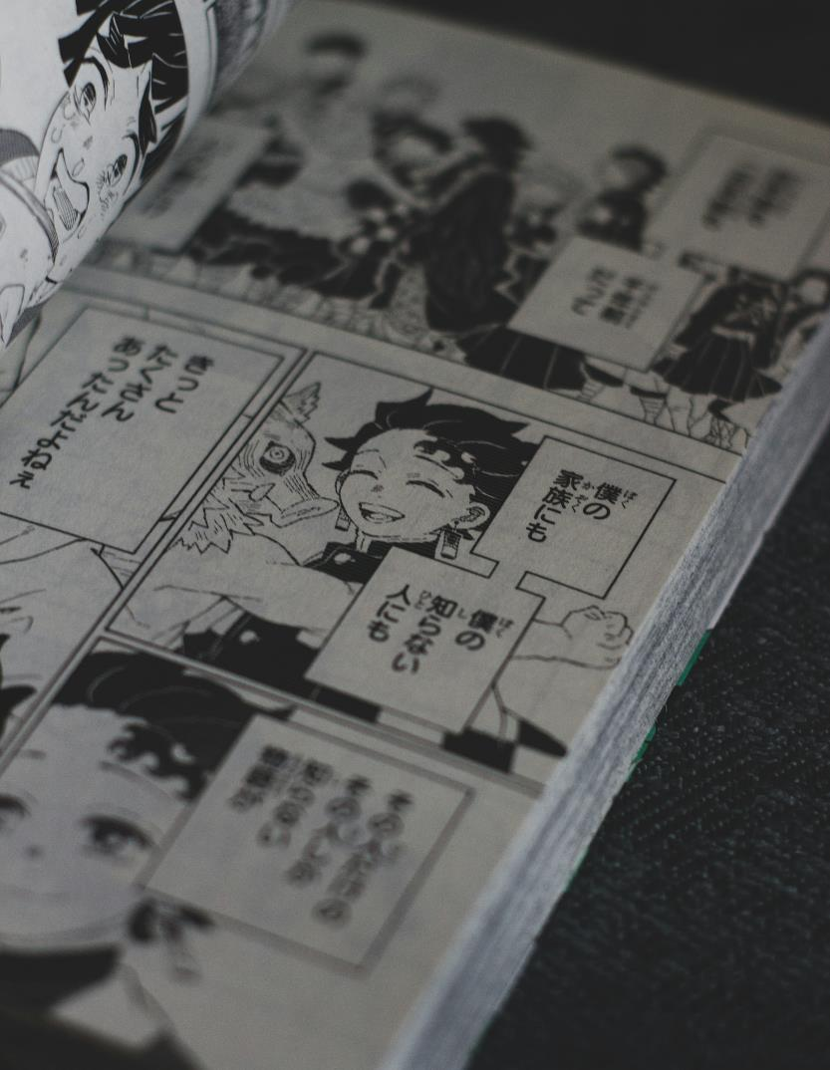
Phase 3 – Literal and figurative representation
Stage 6 – English Studies – 11.1
‘Reading to write: Transition to English Studies’
Term 1
Photo by Alexander Zalan on Unsplash
Notes:
Teacher note: the purpose of this PowerPoint is to provide support for Phase 3, sequence 1 – engaging with a hybrid text.
​
It should be used in conjunction with the program and the resource booklet.

Slide 2
Instructions for use
This resource is not a teaching and learning program. It should be used in conjunction with ‘Reading to write: Transition to English Studies’ – 11.1.
Classroom teachers are encouraged to add and adapt slides as required to meet the needs of their students.
Save a copy of the file to make changes to the slide deck. Go to File > Download a Copy (this downloads a copy to the computer to edit in the PowerPoint app).
To convert the PowerPoint to Google Slides:
  Upload the file into Google Drive and open it.
  Go to File > Save as Google Slides.
  (Note – conversion may cause formatting changes in the slides.)

Slide 3
Text complexity details
This print text contains extended noun groups and examples of complex punctuation. Throughout the text, inferred and implicit meanings support the development of the main idea which aligns to the complex level of the Text Complexity scale as per the ‘Literacy: About the general capability’ document which can be downloaded on the General capabilities downloads page of the Australian Curriculum webpage. (Appendix 2: Text complexity).
The text helps Text requirements for the English Studies 11–12 Syllabus as students are provided the opportunity to engage with an Australian prose fiction text.

Slide 4
Licence agreement details
Chan Q (2016) ‘What the doctor recommended’ in Ridge J (ed) The Book That Made Me, Walker Books Australia Pty Ltd, Newtown.
Reproduced and made available for copying and communication by NSW Department of Education for its educational purposes with the permission of Queenie Chan. This resource is licensed up until June 30 2030.

Slide 5
Sharing learning intentions and success criteria
Notes:
Teacher note: this slide has been used to identify the explicit teaching strategies sharing learning intentions and sharing success criteria. This slide could be deleted or hidden when using this content in a classroom setting. Alternatively, the teacher could discuss the educational benefit of the process of sharing learning intentions and success criteria and discussing the significance of this learning process.
Sharing learning intentions allows a teacher to effectively communicate the learning goal with students. They allow students to connect new learning to existing knowledge, skills and understanding.
When learning intentions are used with success criteria, students have a clear idea of the learning goal and how to get there (AERO 2024).
The success criteria break the learning intention into smaller and more manageable actions. They show students what they must do, say, make, create or perform to demonstrate their learning (Griffin 2018).
Success criteria are communicated to students in ways they understand. Teachers use their expertise to guide student thinking and often model and use exemplars to show students what success 'looks like’ (DoE 2025).
The sample learning intentions and success criteria (LISC) on the following slide are aligned to the syllabus.
When designing LISC for students working above or below stage level, or towards Life Skills outcomes, draw on the collaborative curriculum planning process to ensure LISC is differentiated and aligned with the relevant syllabus outcomes.
For more information, see:
AITSL: https://www.aitsl.edu.au/docs/default-source/feedback/aitsl-learning-intentions-and-success-criteria-strategy.pdf?sfvrsn=382dec3c_2
Sharing learning intentions: https://education.nsw.gov.au/teaching-and-learning/curriculum/explicit-teaching/explicit-teaching-strategies/sharing-learning-intentions
Sharing success criteria: https://education.nsw.gov.au/teaching-and-learning/curriculum/explicit-teaching/explicit-teaching-strategies/sharing-success-criteria
Collaborative curriculum planning: https://educationstandards.nsw.edu.au/wps/portal/nesa/k-10/diversity-in-learning/special-education/collaborative-curriculum-planning

Slide 6
Learning intention and success criteria (1)
We are learning to
understand how composers use a range of literal and figurative meanings in hybrid texts.
We can
[classroom teacher to insert sample success criteria]
[classroom teacher to insert sample success criteria]
[classroom teacher to insert sample success criteria].
Notes:
Teacher note: adapt the provided learning intention and below sample success criteria, as required, to suit the needs of your students.
understand the difference between literal and figurative language
identify literal and figurative meanings in common figures of speech
analyse visual representations of literal and figurative meaning.
LISC is usually shared first or early in the lesson and is explained by the teacher who checks for understanding (DoE 2025).
LISC is referred to regularly to check for understanding, provide feedback or as a self-assessment tool (Wiliam and Leahy 2015).
Learning intentions and success criteria can be supported by exemplars, such as 'What A Good One Looks Like' (WAGOLL) or exemplars to demonstrate success criteria (Clarke 2021).
For more information, see:
Sharing learning intentions and success criteria: https://education.nsw.gov.au/content/dam/main-education/documents/teaching-and-learning/curriculum/explicit-teaching/explicit-teaching-technique-guide-lisc-sharing.pdf
Planning learning intentions and success criteria: https://education.nsw.gov.au/content/dam/main-education/documents/teaching-and-learning/curriculum/explicit-teaching/explicit-teaching-technique-guide-lisc-planning.pdf

Slide 7
Connecting learning
Notes:
Teacher note: this slide is to be used in conjunction with/to support Phase 3, sequence 1. This slide has been used to identify the explicit teaching learning strategy and should be deleted or hidden when used in a classroom setting. The strategy of connecting learning involves making connections within and across learning.
Teachers actively support students to make connections within and across knowledge, skills and understanding as well as to prior learning experiences. Learning is a change to long term memory. Long term memory is a network of overlapping information with many connections (AERO 2024b), which are called schemas (CESE 2017).

Slide 8
Activating prior knowledge
Sketch to stretch
Sketch this statement
‘It is raining cats and dogs'
Notes:
Teacher note: this slide is to be used in conjunction with/to support Phase 3, sequence 1. Provide students with mini whiteboards and blank paper to sketch the statement 'It's raining cats and dogs'. Teacher provides students 5 minutes for this activating prior knowledge activity. The purpose of this activity to pique student engagement and for the teacher to gauge student understanding of figurative language – do students' sketches depict heavy rain (figurative meaning) or cats and dogs falling from the sky like rain (literal interpretation)?

Slide 9
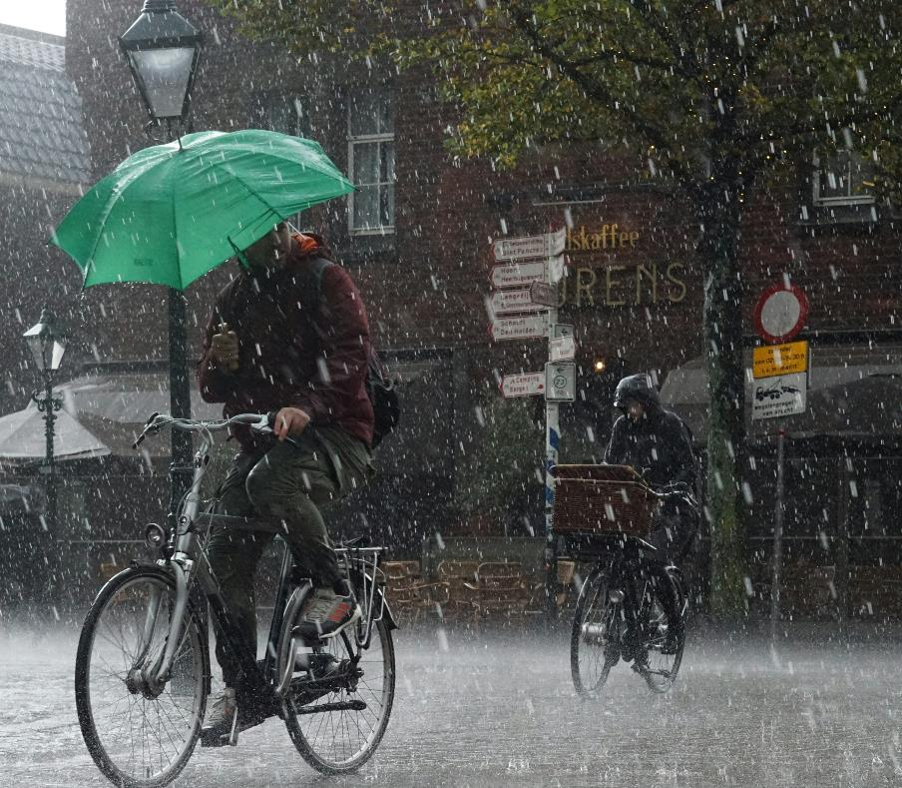









Literal and figurative representations
It is raining cats and dogs
Photo by Sven Brandsma on Unsplash
Photo by Steve Johnson on Unsplash
Notes:
Teacher note: this slide is to be used in conjunction with/to support Phase 3, sequence 1. Students share their sketches with the class or a partner. The teacher explains to students that the saying ‘It’s raining cats and dogs’ is a figure of speech that means heavy rainfall. Students can compare their sketches with the images provided on the slide.

Slide 10
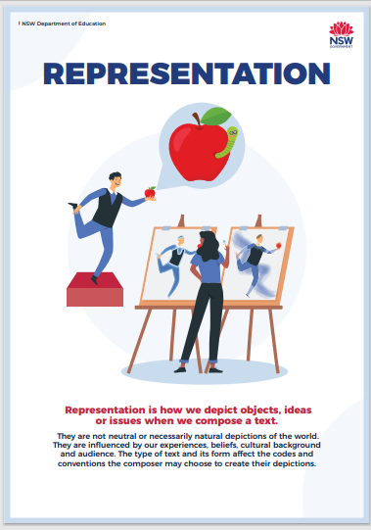
Representation
What is it?
Representation is the depiction or portrayal of a thing, person, idea or event in a text.
All representations carry personal and cultural meaning and have personal and social effects.
Representations are ‘versions of reality’ (Moon 1992)
Representations are constructed through language and shaped by perspective and context.
Notes:
Teacher note: revise the textual concept of Representation. Refer to Novel voices – 10.1, Shakespeare retold – 10.3 and Digital stories – 10.4 to connect to student’s prior learning about this textual concept.

Slide 11
Checking for understanding
Notes:
Teacher note: this slide is to be used in conjunction with/to support Phase 3, sequence 1. This slide has been used to identify the explicit teaching learning strategy of using effective questioning and should be deleted or hidden when using in a classroom setting. If students cannot adequately respond to this type of question, they should be provided with either whole class instruction in another delivery mode or example, or if only some students are lacking confidence, they could be assisted individually when the class move on to the next stage of learning.
Teachers analyse the information they collect to make evidence-based instructional decisions. This includes when to move between modelled, guided and independent practice.
Checking understanding requires teachers to collect the responses of all students (William 2014).

Slide 12
Check for understanding
Matching activity
Match each figurative saying with its literal meaning
Figurative saying | Literal meaning
You hit the nail on the head | You cannot stop thinking about me
Spill the tea | I have endless opportunities
I am living rent-free in your mind | You are exactly right
You are giving main character vibes | You did that perfectly with no mistakes
The world is my oyster | Tell me the gossip
You ate and left no crumbs | You are the centre of attention and everyone likes you
Notes:
Teacher note: this slide is to be used in conjunction with/to support Phase 3, sequence 1. To check for understanding, place students in pairs or small groups to match the figurative sayings with their literal meanings. Modern figures of speech have been included to increase student engagement and connect to prior knowledge.

Slide 13
Check for understanding (answers)
Matching activity
Match each figurative saying with its literal meaning
Figurative saying | Literal meaning
You hit the nail on the head | You are exactly right
Spill the tea | Tell me the gossip
I am living rent-free in your mind | You cannot stop thinking about me
You are giving main character vibes | You are the centre of attention and everyone likes you
The world is my oyster | I have endless opportunities
You ate and left no crumbs | You did that perfectly with no mistakes
Notes:
Teacher note: this slide is to be used in conjunction with/to support Phase 3, sequence 1. Answers to matching activity.
You hit the nail on the head – to get something exactly right
Spill the tea – reveal a secret or gossip
I’m living rent-free in your mind - when someone can’t stop thinking about you
You are giving main character vibes – to be the centre of attention and well-liked
The world is my oyster– to have endless opportunities
You ate and left no crumbs – to do something perfectly

Slide 14
Gradual release of responsibility
Notes:
Teacher note: this slide is to be used in conjunction with/to support Phase 3, sequence 1. This slide has been used to identify the explicit teaching learning strategy and should be deleted or hidden when using in a classroom setting. The strategy of gradual release of responsibility is a flexible process moving between modelled, guided and independent teaching practice responsive to student learning. Students should be supported to move between each practice based on their capabilities and requirements. ​
​
Teachers deliver a structured and sequenced approach to explicitly teaching new content. Learning is most effective when teachers break new information down and teach it explicitly using explanation, demonstration and modelling. This is especially relevant when students are new to an area (AERO 2024a).​

Slide 15
Literal language
What is it?
'Having only the most direct meaning'
(NESA 2024)
Notes:
Teacher note: this slide is to be used in conjunction with/to support Phase 3, sequence 1. The teacher defines literal language as ‘having the only most direct meaning’ (NESA 2024). Connect this to the sketch to stretch activity and how the literal meaning is for dogs and cats to literally be raining from the sky.

Slide 16
Figurative language
What is it?
'Word groups/phrases used differently from the expected or everyday usage to express an idea in a non-literal way for a particular effect'
(NESA 2024)
Notes:
Teacher note: this slide is to be used in conjunction with/to support Phase 3, sequence 1. The teacher defines figurative language as ‘word groups/phrases used differently from the expected or everyday usage to express an idea in a non-literal way for a particular effect’. (NESA 2024) Connect this to the sketch to stretch activity and how the figurative meaning is for it to be raining heavily.

Slide 17
Double Venn diagram
Literal
Figurative
uses words that are strict in their meaning
uses words with multiple meanings
used in literature
used in both spoken and written language
used in texts that contain direct, technical information
can be complex and sometimes difficult to understand
simple, direct and easy to understand
uses figures of speech
does not use figures of speech
Notes:
Teacher note: this slide is to be used in conjunction with/to support Phase 3, sequence 1. The teacher uses the double Venn diagram to make clear the differences between literal and figurative language.

Slide 18
Literal representation in visual images (1)
'What the doctor recommended'
This manga frame is a literal representation as it:
uses words that are direct and simple to understand
uses labels and arrows to identify Munn and the author (Queenie)
supports the direct meaning of its supporting text by introducing Munn and Queenie.
Manga frame from ‘What the doctor recommended’
'In order to talk about the book that made me , I must first talk about my cousin Munn.'
Notes:
Teacher note: this slide is to be used in conjunction with/to support Phase 3, sequence 1. This example of literal representation is from Core text 2 – ‘What the doctor recommended’ by Queenie Chan. The teacher guides students in identifying how the manga frame provides a literal representation of its supporting text as it:
uses words that are direct and simple to understand
uses labels and arrows to identify Munn and the author (Queenie)
supports the direct meaning of its supporting text by introducing Munn and Queenie.
The teacher may wish to discuss with students how the manga frame provides more information about how the subjects view themselves. For example, Queenie Chan views Munn as her cousin and Munn views himself as a doctor with an official title.

Slide 19
Literal representation in visual images (2)
'What the doctor recommended'
This manga frame is a literal representation as it:
aligns with the direct meaning of its supporting text
portrays a calm, 'mild-mannered' doctor in an emergency room setting
represents a medical professional treating a patient.
Manga frame from ‘What the doctor recommended’
'By day, Doctor Munn is a mild-mannered emergency room (ER) doctor working at Queen Mary Hospital, in Pok Fu Lam, Hong Kong.'
Notes:
Teacher note: this slide is to be used in conjunction with/to support Phase 3, sequence 1. This example of literal representation is from Core text 2 – ‘What the doctor recommended’ by Queenie Chan. The teacher guides students in identifying how the manga frame provides a literal representation of its supporting text as it:
aligns with the direct meaning of its supporting text
portrays a calm, 'mild-mannered' doctor in an emergency room setting
represents 3 medical professionals that are typical of a hospital setting.
The teacher may wish to discuss with students how the manga frame provides more information about Cousin Munn. By placing Munn at the focal point of the frame and making him appear larger in size than his medial colleagues, the visual image infers Munn’s high status as a doctor.

Slide 20
Semi-literal representation in visual images
'What the doctor recommended'
Literal
Figurative
night sky
Munn giving information
people listening intently to Munn
Munn
represented as
a superhero
'Manga man' on Munn's shirt
Manga frame from ‘What the doctor recommended’
'By night, he is a wellspring of information on manga, anime and video games. He’s the type of guy who is always “in the know”.'
Notes:
Teacher note: this slide is to be used in conjunction with/to support Phase 3, sequence 1. This example of semi-literal representation is from Core text 2 – ‘What the doctor recommended’ by Queenie Chan. The teacher guides students in identifying how the manga frame provides a semi-literal representation of its supporting text as it:
Provides a literal meaning through showing:
the night sky (‘By night’)
Munn giving information (‘he is a wellspring of information on manga’)
people listening intently to Munn (He’s the type of guy who is always “in the know”)
Provides a figurative meaning through showing:
Munn represented as a superhero with his ‘Manga man’ shirt and superhero style ‘POW’ style callout box behind him.

Slide 21
Figurative representation in visual images
'What the doctor recommended'
Each of these frames contains elements of figurative representation.
Frame 1 – the protagonist is not literally in the surgery. It metaphorically represents being immersed in a text.
Frame 2 – ‘Black Jack’ as a monopoly-style character – he does not actually look like this. The allusion to this character aligns with the focus on money. It also uses the visual of ‘raining money’ – it is not literally ‘raining money’. It is a figurative representation of character’s values.
Manga frame from ‘What the doctor recommended’
Notes:
Teacher note: this slide is to be used in conjunction with/to support Phase 3, sequence 1. This example of figurative representation is from Core text 2 – ‘What the doctor recommended’ by Queenie Chan. The teacher guides students in identifying how the manga frame provides a figurative representation of its supporting text as it:
brings to life the visual of the surgery which is immersed in the text
portrays ‘Black Jack’ as a monopoly-style character
uses the visual of raining money to represent the character’s inclination to compromise their ethics in order to make money.

Slide 22
Figurative representation analysis
'What the doctor recommended'
In small groups, annotate the figurative representations in this series of manga frames.
Manga frame from ‘What the doctor recommended’
Manga frame from ‘What the doctor recommended’
Notes:
Teacher note: this slide is to be used in conjunction with/to support Phase 3, sequence 1. In small groups, students annotate the figurative representations in the series of manga frames. Provide groups with butchers paper or mini whiteboards to do this.

Slide 23
Returning to the learning intentions and success criteria
Notes:
Teacher note: this slide is to be used in conjunction with/to support Phase 3, sequence 1. Learning intentions and success criteria are not just usually delivered first or early in the lesson – teachers explain and check that students have understood them. They are referred to throughout the lesson to guide and formatively assess learning (DoE 2025).

Slide 24
Learning intentions and success criteria (2)
We are learning to
understand how authors use a range of literal and figurative meanings in hybrid texts.
We can
[classroom teacher to insert success criteria]
[classroom teacher to insert success criteria]
[classroom teacher to insert success criteria].
Notes:
Teacher note: this slide is to be used in conjunction with/to support Phase 3, sequence 1. Returning to the learning intention and success criteria allows for students to reflect on what they have learned, while checking for understanding. If individual whiteboards are available, have students indicate the success criteria that they have achieved by writing 1, 2 or 3 on them. Otherwise, consider using the three-finger system – 1 finger for level 1, 2 fingers for level 2, 3 fingers for level 3 – or traffic lights – green for understands and can apply without help, yellow for understands but still needs help to apply, red for needs help to understand.
Sample success criteria (this may have been adapted by the classroom teacher):
understand the difference between literal and figurative language
identify literal and figurative meanings in common figures of speech
analyse visual representations of literal and figurative meaning.

Slide 25
References
This presentation contains NSW Curriculum and syllabus content. The NSW Curriculum is developed by the NSW Education Standards Authority. This content is prepared by NESA for and on behalf of the Crown in the right of the State of New South Wales. The material is protected by Crown copyright.
Please refer to the NESA Copyright Disclaimer for more information https://educationstandards.nsw.edu.au/wps/portal/nesa/mini-footer/copyright.
NESA holds the only official and up-to-date versions of the NSW Curriculum and syllabus documents. Please visit the NSW Education Standards Authority (NESA) website https://educationstandards.nsw.edu.au/wps/portal/nesa/home and the NSW Curriculum website https://curriculum.nsw.edu.au.
English Studies 11–12 © Syllabus NSW Education Standards Authority (NESA) for and on behalf of the Crown in right of the State of New South Wales, 2024.
AERO (Australian Education Research Organisation) (2024a) Explain learning objectives, AERO website, accessed 16 April 2024.
AERO (Australian Education Research Organisation) (2024b) Why explicit instruction works, AERO website, accessed 16 April 2024.
Black P and Wiliam D (2018) ‘Classroom assessment and pedagogy’, Assessment in Education Principles Policy and Practice, 25(1):1–25.
Chan Q (2016) ‘What the doctor recommended’ in Ridge J (ed) The Book That Made Me, Walker Books Australia Pty Ltd, Newtown.
Moon B (1992) Literary Terms Chalkface Press P/L, Cottesloe, WA.
NSW Education Standards Authority (NESA) (2024) ‘Glossary’, NSW Curriculum, NSW Education Standards Authority website, accessed 27 May 2024.
State of New South Wales (Department of Education) (2024) Explicit teaching strategies, NSW Department of Education website, accessed 5 April 2024.
Wiliam D (2014) The right questions, the right way, Educational Leadership, 71(6):16–19.

Slide 26
Copyright
© State of New South Wales (Department of Education), 2025
The copyright material published in this resource is subject to the Copyright Act 1968 (Cth) and is owned by the NSW Department of Education or, where indicated, by a party other than the NSW Department of Education (third-party material).
Copyright material available in this resource and owned by the NSW Department of Education is licensed under a Creative Commons Attribution 4.0 International (CC BY 4.0) license.
This license allows you to share and adapt the material for any purpose, even commercially.
Attribution should be given to © State of New South Wales (Department of Education), 2025.
Material in this resource not available under a Creative Commons license:
the NSW Department of Education logo, other logos and trademark-protected material
Material owned by a third party that has been reproduced with permission. You will need to obtain permission from the third party to reuse its material.
Links to third-party material and websites
Please note that the provided (reading/viewing material/list/links/texts) are a suggestion only and implies no endorsement, by the New South Wales Department of Education, of any author, publisher, or book title. School principals and teachers are best placed to assess the suitability of resources that would complement the curriculum and reflect the needs and interests of their students.
If you use the links provided in this document to access a third-party’s website, you acknowledge that the terms of use, including licence terms set out on the third-party’s website apply to the use which may be made of the materials on that third-party website or where permitted by the Copyright Act 1968 (Cth). The department accepts no responsibility for content on third-party websites.

