Slide 1
Instructions for use
This resource is not a teaching and learning program. It should be used in conjunction with ‘Reading to write: Transition to English Studies’ – 11.1. Classroom teachers are encouraged to add and adapt slides as required to meet the needs of their students.
Save a copy of the file to make changes to the slide deck. Go to File > Download a Copy (this downloads a copy to the computer to edit in the PowerPoint app).
To convert the PowerPoint to Google Slides:
  Upload the file into Google Drive and open it.
  Go to File > Save as Google Slides.
  (Note – conversion may cause formatting changes in the slides.)

Slide 2
Text complexity details
This print text contains extended noun groups and examples of complex punctuation. Throughout the text, inferred and implicit meanings support the development of the main idea which aligns to the complex level of the Text Complexity scale as per the ‘Literacy: About the general capability’ document which can be downloaded on the General capabilities downloads page of the Australian Curriculum webpage. (Appendix 2: Text complexity).
The text helps Text requirements for the English Studies 11–12 Syllabus as students are provided the opportunity to engage with an Australian prose fiction text.

Slide 3
Licence agreement details
Chan Q (2016) ‘What the doctor recommended’ in Ridge J (ed) The Book That Made Me, Walker Books Australia Pty Ltd, Newtown.
Reproduced and made available for copying and communication by NSW Department of Education for its educational purposes with the permission of Queenie Chan.

Slide 4
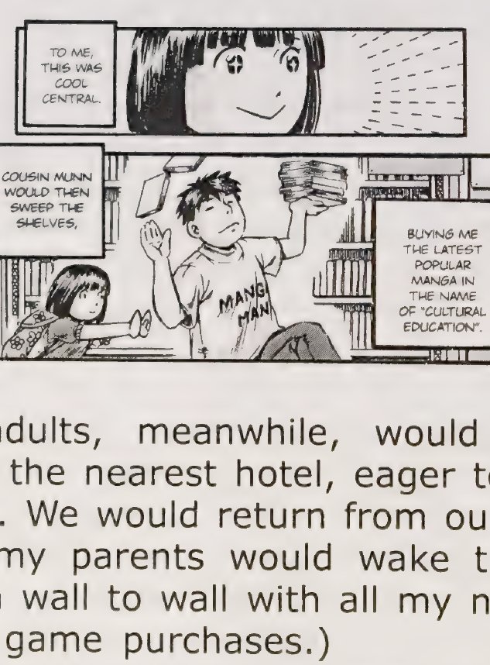
Phase 3 – Hybrid texts
NSW Department of Education
Stage 6 – English Studies – 11.1
‘Reading to write: Transition to English Studies’ – Year 11
Term 1
Image from ‘What the doctor recommended’
Notes:
Teacher note: the purpose of this PowerPoint is to provide support for Phase 3, sequence 2 – deepening understanding of textual hybridity.
​
It should be used in conjunction with the program and the resource booklet.

Slide 5
Sharing learning intentions and success criteria
Notes:
Teacher note: this slide has been used to identify the explicit teaching strategies sharing learning intentions and sharing success criteria. This slide could be deleted or hidden when using this content in a classroom setting. Alternatively, the teacher could discuss the educational benefit of the process of sharing learning intentions and success criteria and discussing the significance of this learning process.
Sharing learning intentions allows a teacher to effectively communicate the learning goal with students. They allow students to connect new learning to existing knowledge, skills and understanding.
When learning intentions are used with success criteria, students have a clear idea of the learning goal and how to get there (AERO 2024).
The success criteria break the learning intention into smaller and more manageable actions. They show students what they must do, say, make, create or perform to demonstrate their learning (Griffin 2018).
Success criteria are communicated to students in ways they understand. Teachers use their expertise to guide student thinking and often model and use exemplars to show students what success 'looks like’ (DoE 2025).
The sample learning intentions and success criteria (LISC) on the following slide are aligned to the syllabus.
When designing LISC for students working above or below stage level, or towards Life Skills outcomes, draw on the collaborative curriculum planning process to ensure LISC is differentiated and aligned with the relevant syllabus outcomes.
For more information, see:
AITSL: https://www.aitsl.edu.au/docs/default-source/feedback/aitsl-learning-intentions-and-success-criteria-strategy.pdf?sfvrsn=382dec3c_2
Sharing learning intentions: https://education.nsw.gov.au/teaching-and-learning/curriculum/explicit-teaching/explicit-teaching-strategies/sharing-learning-intentions
Sharing success criteria: https://education.nsw.gov.au/teaching-and-learning/curriculum/explicit-teaching/explicit-teaching-strategies/sharing-success-criteria
Collaborative curriculum planning: https://educationstandards.nsw.edu.au/wps/portal/nesa/k-10/diversity-in-learning/special-education/collaborative-curriculum-planning

Slide 6
Learning intentions and success criteria (1)
We are learning to
understand what makes a text hybrid
identify elements of textual hybridity in the core text
be able to experiment with textual hybridity.
We can
[classroom teacher to insert sample success criteria]
[classroom teacher to insert sample success criteria]
[classroom teacher to insert sample success criteria].
Notes:
Teacher note: adapt the provided learning intention and below sample success criteria, as required, to suit the needs of your students.
identify the codes and conventions of manga used in the core text
explain textual hybridity
experiment with textual hybridity in their own composition.
LISC is usually shared first or early in the lesson and is explained by the teacher who checks for understanding (DoE 2025).
LISC is referred to regularly to check for understanding, provide feedback or as a self-assessment tool (Wiliam and Leahy 2015).
Learning intentions and success criteria can be supported by exemplars, such as 'What A Good One Looks Like' (WAGOLL) or exemplars to demonstrate success criteria (Clarke 2021).
For more information, see:
Sharing learning intentions and success criteria: https://education.nsw.gov.au/content/dam/main-education/documents/teaching-and-learning/curriculum/explicit-teaching/explicit-teaching-technique-guide-lisc-sharing.pdf
Planning learning intentions and success criteria: https://education.nsw.gov.au/content/dam/main-education/documents/teaching-and-learning/curriculum/explicit-teaching/explicit-teaching-technique-guide-lisc-planning.pdf
Suggested success criteria

Slide 7






Connecting to prior learning (1)
What do we mean when we say ‘hybrid’?
hybrid
Notes:
Teacher note: students brainstorm where they may have heard this term before (teacher should organise student contributions into categories where relevant, e.g. machinery, cars, plants, etc.).
Note for differentiation: Where appropriate, you may wish to include some alternative images related to the word ‘hybrid’ on screen to prompt and support students engage with the brainstorm. Remind students that textual hybridity was addressed in ‘Exploring the speculative’ – 9.4, ‘Novel voices’ – 10.1 and ‘Digital stories’ – 10.4

Slide 8
Definition (1)
What does ‘hybrid’ mean?
Based on the brainstorm and your own knowledge, write a definition of the word ‘hybrid’.
Compare your definition with your peers. Take note of any commonly occurring features of your definitions.
Re-write your definition if you choose and share with the class.
Collins Dictionary
Hybrid – ‘You can use hybrid to refer to anything that is a mixture of other things, especially two other things.’
Notes:
Teacher note: this activity could be completed in pairs or small groups, edit the slide to reflect the chosen format. Facilitate a class discussion after 3. where students share their definitions and make a point of calling our the commonly occurring features of these definitions.
Then reveal to students the Collins Dictionary definition [click for the animation to reveal the definition] and ask students to copy this into their books.

Slide 9










Connecting to prior learning (2)
What do we mean when we say ‘text’?
text
Notes:
Teacher note: students brainstorm their understanding of ‘text’. You may choose to replace or delete the images on screen depending on the needs of your students, these could be used as prompts to stimulate and guide discussion.

Slide 10
Definition (2)
What does ‘text; mean
Based on the brainstorm and your own knowledge, write a definition of the word ‘text’.
Compare your definition with your peers. Take note of any commonly occurring features of your definitions.
Re-write your definition if you choose and share with the class.
How has our understanding of 'text' evolved over time? What might it look like in 2035?
NESA Glossary definition
Any written, spoken/signed, nonverbal, visual, auditory or multimodal communication. Texts may be extended unified works, a series of related pieces or a single, simple piece of communication. (NESA, 2024)
Notes:
Teacher note: this activity could be completed in pairs or small groups, edit the slide to reflect the chosen format. Facilitate a class discussion after 3. where students share their definitions and make a point of calling our the commonly occurring features of these definitions.
Then reveal to students the NESA Glossary dictionary [click for the animation to reveal the definition] and ask students to copy this into their books.

Slide 11
Making connections
What do we mean when we talk about ‘hybrid texts’?
Visual text
Written text
Hybrid texts
Notes:
Teacher note: students copy their definitions of ‘hybrid’ and ‘text’ into the 2 circles. They then in light of these, consider what their definition of a ‘hybrid text’ in the context of English would be and write this in the circle below. Students may work in pairs or small groups to complete this activity. Share and compare definitions as a class. Students can then read definitions in Resource 1 – What is a hybrid text? To compare their definition. If you substitute Core text 2 – ‘What the doctor recommended’ by Queenie Chan with a different hybrid text, change the headings in the top circles as appropriate. For example, you may choose to look at hybridity using a text that integrates poetry and prose.
Additional resources to support student engagement with and understanding of hybrid texts can be found in Stage 3 – Second year – Unit 16 – Theme, specifically Lessons 9 – 12, and Transport me to the ‘real’ – Year 8, Term 2, specifically Phase 4, resource 1 – hybrid non-fiction texts and Phase 4, activity 3 – the ‘real’ in ‘Swimming with Dolphins’.

Slide 12
Hybrid texts (1)
Components of hybrid writing
Form
Style
Hybrid texts
Genre
Mode
A hybrid text is a composite text resulting from combining elements from different genres, styles and modes.
Notes:
Teacher note: allow a reading of the definition of hybrid texts on screen as provided by the NESA glossary. Depending on the needs of your class, you may choose to facilitate a class discussion around what students already know about each of these components before moving on to an explanation of each on the next slide.
Definition – composite: something that is made of various different parts.

Slide 13
Hybrid texts (2)
Components of hybrid writing
Genre
Form
Style
Mode
Genre includes the categories into which texts are grouped based on similarities in premise, structure and function.
The ‘genre’ of a text describes larger recurring patterns of subject matter and textual structures observable between texts, such as typical plots, characters and setting.
Form is how we classify texts based on the way the text is written, or the category or type of text.
For instance, examples of form can include film or poetry.
Style is the way in which the effects of distinctive language forms and features of a text, often including those specific to its medium, combine to generate an overall impression.
Mode is the process of communication.
For example, sounds, music, printed or spoken words, images and gestures.
Notes:
Teacher note: an explanation of each form is animated and will appear in the order on the screen when you click.
To determine prior knowledge of these components and students understanding of these explanations, you may like to ask probing questions and for examples of texts students may be familiar with that align with each of these.
Note for differentiation: depending on the language needs of your students, it may be necessary to define: premise, observable, recurring, classify, generate, impression, gestures, distinctive, etc.

Slide 14
Checking for understanding (1)
Notes:
Teacher note: this slide has been used to identify the explicit teaching learning strategy and should be deleted or hidden when using in a classroom setting.
If students cannot adequately respond to questions or complete activities, they should be provided with either whole class instruction in another delivery mode or example, or if only some students are lacking confidence, they could be assisted individually when the class move on to the next stage of learning.
Teachers analyse the information they collect to make evidence-based instructional decisions. This includes when to move between modelled, guided and independent practice.
Checking understanding requires teachers to collect the responses of all students (William 2014).

Slide 15

Checking for understanding (2)
Hybrid texts
A hybrid text is …
Notes:
Teacher note: to check for student understanding of hybrid text, ask students to complete the sentence on screen using figurative language devices to creatively demonstrate their understanding.
For example:
A hybrid text is like a melting pot of ideas, that when stirred together produce a complex meal to be consumed.
A hybrid text is a garden of ideas, where different genres bloom side by side, each contributing its unique fragrance to the overall landscape.
A hybrid text is a feast for the senses, combining the savoury flavours of storytelling with the delicate spices of poetic language, leaving readers both satisfied and craving more.
A hybrid text is a journey without a single map, where the traveller navigates between genres, discovering new landscapes of thought and emotion along the way.
You may ask students to write their response on a sticky note that can be shared on a wall in the classroom for reference.

Slide 16
Hybrid structural and language features
‘What the doctor recommended’ by Queenie Chan
Manga frames using a combination of illustrations and written text for visual storytelling
Panels and frames complement the written narrative and reflection
Dialogue and captions in the manga frames tell the story and comment on the written text
Variation in tone – reflective, earnest, thoughtful, enthusiastic and cheerful
Use of humour – ‘I gave Cousin Munn a huge smile, thanked him, and then shoved Black Jack right to the bottom of my reading pile’.
Conversational and informal register
Use of figurative and literal language to represent ideas and events.
Notes:
Teacher note: consider animating the features on the slide to appear one at a time. Students could find examples of each of the features in the core text.

Slide 17
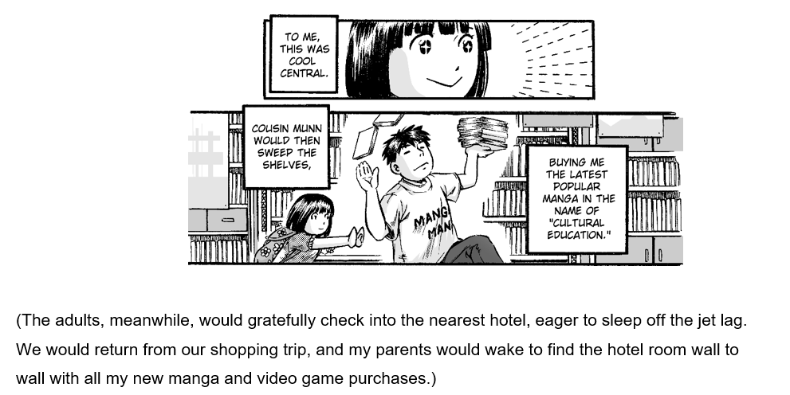
‘What the doctor recommended’ (1)
by Queenie Chan
Image from ‘What the doctor recommended’
Notes:
Teacher note: using the extract on the slide, discuss with the class why Core text 2 – ‘What the doctor recommended’ by Queenie Chan is a hybrid text. Highlight:
the elements of different forms it integrates – written and visual text (manga frames)
storytelling through both the narration and manga dialogue boxes
the blending of writing styles from personal and discursive exploration in the written text to narrative and recount in the manga frames.

Slide 18
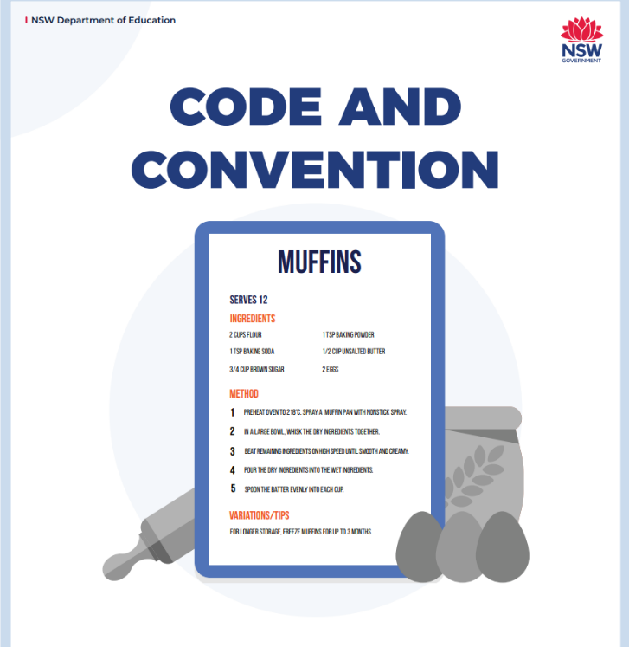
Code and convention
What is it?
Codes and conventions form the basic elements of speech, writing and visual language to convey meaning.
Codes and conventions combine in commonly understood arrangements or patterns.
‘Code’ refers to the language devices used to create meaning while ‘convention’ refers to the elements of a text that an audience expects such as a happy ending in a romantic comedy.
Notes:
Teacher note: revise the textual concept of code and convention with students. They may recall addressing this in Digital Stories – 10.4. Invite students to contribute codes and conventions of texts with which they are familiar such as:
Film
Code: the use of lighting to create mood and suspense in a horror film
Convention: an isolated setting for a horror film.
Poetry
Code: the use of symbolism to convey ideas such as ‘bathe me clean’ in Core text 1 – ‘I run’ by Melanie Mununggurr- Williams conveying the idea of renewal.
Convention: economy of language – poetry uses few words to say a lot through layers of meaning.
Graphic novels
Code: the use of panel size and layout to influence pacing – bigger panels highlight dramatic moments while smaller panels can create a sense of intimacy or urgency.
Convention: using speech bubbles to convey dialogue or thought.

Slide 19
‘What the doctor recommended’ (2)
Codes and conventions of manga
Manga is a Japanese style of comic book or graphic novel. Distinctive features of this text type include:
Layout – typically arranged in panels that should be read from right to left
Characters have exaggerated features – large eyes, small mouths, very expressive faces
Visual symbols – question marks to indicate confusion, speed lines to show movement, ‘bursts’ to indicate significant moments
Dialogue – typically communicated through speech bubbles
Narrative conventions – often employs a blend of humour, drama and action.
Notes:
Teacher note: take students through the list of codes and conventions of manga. Students identify examples of each in Core text 2 – ‘What the doctor recommended’ by Queenie Chan.

Slide 20
‘What the doctor recommended’ – ‘I do’
Codes and conventions of manga
Conventional manga layout of panels is used
Symbolism – an explosion of light behind Cousin Munn indicates his transformation
Panels juxtaposed to emphasise the different sides to Cousin Munn
Humour is created through the intertextuality replacing a typical superhero name such as ‘Superman’ with ‘Manga Man’ on the t-shirt
Manga convention of exaggerated facial expressions create excitement
Annotate Core text 2 – ‘What the doctor recommended’ by Queenie Chan by identifying the codes and conventions of manga that are used in the text.
Notes:
Teacher note: Use the gradual release of responsibility to model the analysis of the codes and conventions of manga used in the extract on the slide. Consider animating the annotations to support students to manage cognitive load.

Slide 21
‘What the doctor recommended’ – ‘We do’
Codes and conventions of manga
Notes:
Teacher note: Use guided instruction to support students to identify the codes and conventions of manga in the extract on the slide. Guide students to identify the following features:
layout organised in panels
exaggerated facial features – eyes far apart, mouth and nose very small.
use of humour through the upside down book
use of symbolism – the teddy bear represents childhood and innocence
written text integrated with visual text to communicate meaning – ‘China’ and ‘Here’.
Student note: work in small groups to annotate an allocated extract from the text to identify the codes and conventions of manga that are used.

Slide 22
Experimenting with hybridity
In your writing journal
Using the text you composed for Core formative task 1 (integrated Phase 5) – developing a personal metaphor, experiment with hybridity. You may like to incorporate visual text to enhance the meaning of your written text. Or, if you composed a performance poem, you could use parts of this integrated with narrative.
For example
When the world is windy and I am a candle I dance to make my flame bright again.
She stood backstage in the soft glow of the stage lights listening to the gentle hum of the audience sitting in anticipation. The curtain rose. The music began to swell. She stepped forward, not only onto the stage but into her future and the life that she was desperate to create.
I dance to find my feet and find my feet to find my voice and find my voice to find myself.
Notes:
Teacher note: students experiment with textual hybridity by drawing on their composition from Core formative task 1.

Slide 23
Returning to the learning intentions and success criteria
Notes:
Teacher note: learning intentions and success criteria are not just usually delivered first or early in the lesson – teachers explain and check that students have understood them. They are referred to throughout the lesson to guide and formatively assess learning (DoE 2025).

Slide 24
Learning intentions and success criteria (2)
We are learning to
understand what makes a text hybrid
identify elements of textual hybridity in the core text
be able to experiment with textual hybridity.
We can
[classroom teacher to insert success criteria]
[classroom teacher to insert success criteria]
[classroom teacher to insert success criteria].
Notes:
Teacher note: returning to the learning intention and success criteria allows for students to reflect on what they have learned, while checking for understanding. If individual whiteboards are available, have students indicate the success criteria that they have achieved by writing 1, 2 or 3 on them. Otherwise, consider using the three-finger system – 1 finger for level 1, 2 fingers for level 2, 3 fingers for level 3 – or traffic lights – green for understands and can apply without help, yellow for understands but still needs help to apply, red for needs help to understand.
Sample success criteria (this may have been adapted by the classroom teacher):
identify the codes and conventions of manga used in the core text
explain textual hybridity
experiment with textual hybridity in their own composition.

Slide 25
References (1)
This presentation contains NSW Curriculum and syllabus content. The NSW Curriculum is developed by the NSW Education Standards Authority. This content is prepared by NESA for and on behalf of the Crown in the right of the State of New South Wales. The material is protected by Crown copyright.
Please refer to the NESA Copyright Disclaimer for more information https://educationstandards.nsw.edu.au/wps/portal/nesa/mini-footer/copyright.
NESA holds the only official and up-to-date versions of the NSW Curriculum and syllabus documents. Please visit the NSW Education Standards Authority (NESA) website https://educationstandards.nsw.edu.au/wps/portal/nesa/home and the NSW Curriculum website https://curriculum.nsw.edu.au.
[English Studies 11–12 © Syllabus NSW Education Standards Authority (NESA) for and on behalf of the Crown in right of the State of New South Wales, 2024.
Australian Education Research Organisation (AERO) (2024a) Explain learning objectives, AERO, accessed 16 April 2024.
AERO (Australian Education Research Organisation) (2024b) Why explicit instruction works, AERO website, accessed 16 April 2024.
Black P and Wiliam D (2018) ‘Classroom assessment and pedagogy’, Assessment in Education Principles Policy and Practice, 25(1):1–25.
CESE (Centre for Education Statistics and Evaluation) (2017) Cognitive load theory: Research that teachers really need to understand, NSW Department of Education, accessed 16 April 2024.
Chan Q (2016) ‘What the doctor recommended’ in Ridge J (ed) The Book That Made Me, Walker Books Australia Pty Ltd, Newtown.
Clarke S (2014) Outstanding formative assessment: culture and practice, Hodder Education, Great Britain.

Slide 26
References (2)
Clarke S, Timperley H, Hattie J (2003) Unlocking formative assessment: Practical strategies for enhancing students’ learning in the primary and intermediate classroom, Hodder Moa Beckett, Auckland NZ, 2003.
Griffin P (2018) Assessment for teaching, Cambridge University Press.
NESA (NSW Education Standards Authority) (n.d.) Collaborative curriculum planning, NESA website, accessed 19 May 2025.
State of New South Wales (Department of Education) (2024.) Explicit teaching strategies, NSW Department of Education website, accessed 5 April 2024.
State of New South Wales (Department of Education) (2024) the Explicit teaching – Driving learning and engagement, Centre for Education Statistics and Evaluation website, accessed 5 April 2024.
State of New South Wales (Department of Education) (n.d.) Digital Learning Selector, NSW Department of Education website, accessed 5 April 2024.
Wiliam D (2014) ‘The right questions, the right way ’, Educational Leadership, 71(6).

Slide 27
Copyright
© State of New South Wales (Department of Education), 2025
The copyright material published in this resource is subject to the Copyright Act 1968 (Cth) and is owned by the NSW Department of Education or, where indicated, by a party other than the NSW Department of Education (third-party material).
Copyright material available in this resource and owned by the NSW Department of Education is licensed under a Creative Commons Attribution 4.0 International (CC BY 4.0) license.
This license allows you to share and adapt the material for any purpose, even commercially.
Attribution should be given to © State of New South Wales (Department of Education), 2025.
Material in this resource not available under a Creative Commons license:
the NSW Department of Education logo, other logos and trademark-protected material
Material owned by a third party that has been reproduced with permission. You will need to obtain permission from the third party to reuse its material.
Links to third-party material and websites
Please note that the provided (reading/viewing material/list/links/texts) are a suggestion only and implies no endorsement, by the New South Wales Department of Education, of any author, publisher, or book title. School principals and teachers are best placed to assess the suitability of resources that would complement the curriculum and reflect the needs and interests of their students.
If you use the links provided in this document to access a third-party’s website, you acknowledge that the terms of use, including licence terms set out on the third-party’s website apply to the use which may be made of the materials on that third-party website or where permitted by the Copyright Act 1968 (Cth). The department accepts no responsibility for content on third-party websites.

