Slide 1
Instructions for use
This resource is not a teaching and learning program. It should be used in conjunction with (Insert unit name and link).
Classroom teachers are encouraged to add and adapt slides as required to meet the needs of their students.
Save a copy of the file to make changes to the slide deck. Go to File > Download a Copy (this downloads a copy to the computer to edit in the PowerPoint app).
To convert the PowerPoint to Google Slides
  Upload the file into Google Drive and open it.
  Go to File > Save as Google Slides.
  (Note – conversion may cause formatting changes in the slides.)

Slide 2

Phase 1 – understanding the English Studies course
NSW Department of Education
Stage 6 – Year 11 English Studies – 11.1
‘Reading to write: Transition to English Studies’ – Year 11
Term 1
Notes:
Teacher note – on this activity, students explore key information in the English Studies syllabus by completing Phase 1, activity 2 – understanding the English Studies course. Once students have completed the activity, use this slides to review the answers as a class. The slides are designed to facilitate discussion, clarify misconceptions, and consolidate understanding. Teachers may choose to unpack or extend answers further by linking back to syllabus documents or classroom experiences.
Student note – in this activity, you explored the English Studies (2024) syllabus to learn about how the course is structured, the content, and how you will be assessed. Your teacher will now go through the answers with you to check your responses, help explain any tricky parts, and make sure everyone understands how the course works.

Slide 3
Sharing learning intentions and success criteria
Notes:
Teacher note – this slide has been used to identify the explicit teaching strategies sharing learning intentions and sharing success criteria. This slide could be deleted or hidden when using this content in a classroom setting. Alternatively, the teacher could discuss the educational benefit of the process of sharing learning intentions and success criteria and discussing the significance of this learning process.
Sharing learning intentions allows a teacher to effectively communicate the learning goal with students. They allow students to connect new learning to existing knowledge, skills and understanding.
When learning intentions are used with success criteria, students have a clear idea of the learning goal and how to get there (AERO 2024).
The success criteria break the learning intention into smaller and more manageable actions. They show students what they must do, say, make, create or perform to demonstrate their learning (Griffin 2018).
Success criteria are communicated to students in ways they understand. Teachers use their expertise to guide student thinking and often model and use exemplars to show students what success 'looks like’ (DoE 2025).
The sample learning intentions and success criteria (LISC) on the following slide are aligned to the syllabus.
When designing LISC for students working above or below stage level, or towards Life Skills outcomes, draw on the collaborative curriculum planning process to ensure LISC is differentiated and aligned with the relevant syllabus outcomes.
For more information, see –
AITSL – https –//www.aitsl.edu.au/docs/default-source/feedback/aitsl-learning-intentions-and-success-criteria-strategy.pdf?sfvrsn=382dec3c_2
Sharing learning intentions – https –//education.nsw.gov.au/teaching-and-learning/curriculum/explicit-teaching/explicit-teaching-strategies/sharing-learning-intentions
Sharing success criteria – https –//education.nsw.gov.au/teaching-and-learning/curriculum/explicit-teaching/explicit-teaching-strategies/sharing-success-criteria
Collaborative curriculum planning – https –//educationstandards.nsw.edu.au/wps/portal/nesa/k-10/diversity-in-learning/special-education/collaborative-curriculum-planning

Slide 4
Learning intentions and success criteria
We are learning to
understand the structure and purpose of the English Studies course
use reading strategies to locate information in a text.
We can
[classroom teacher to insert sample success criteria]
[classroom teacher to insert sample success criteria]
[classroom teacher to insert sample success criteria].
Notes:
Teacher note – adapt the provided learning intention and below sample success criteria, as required, to suit the needs of your students. It is recommended that the teacher completes the activity before the students do so they can assist students to navigate to the relevant areas of the digital syllabus.
- confidently navigate the English Studies 11–12 digital syllabus
- skim and scan text to locate information.
LISC is usually shared first or early in the lesson and is explained by the teacher who checks for understanding (DoE 2025).
LISC is referred to regularly to check for understanding, provide feedback or as a self-assessment tool (Wiliam and Leahy 2015).
Learning intentions and success criteria can be supported by exemplars, such as 'What A Good One Looks Like' (WAGOLL) or exemplars to demonstrate success criteria (Clarke 2021).
For more information, see –
Sharing learning intentions and success criteria – https –//education.nsw.gov.au/content/dam/main-education/documents/teaching-and-learning/curriculum/explicit-teaching/explicit-teaching-technique-guide-lisc-sharing.pdf
Planning learning intentions and success criteria – https –//education.nsw.gov.au/content/dam/main-education/documents/teaching-and-learning/curriculum/explicit-teaching/explicit-teaching-technique-guide-lisc-planning.pdf

Slide 5
Organisation of English Studies 11–12
Check your answer
Question 1 – In Year 11, you will complete Elective focus areas and which other focus area?
Answer – Reading to Write: Transition to English Studies
Question 2 – In Year 12, what are the names of the 2 focus areas that are NOT elective focus areas?
Answer – Narrative and human experiences and Writing for purpose
Notes:
Teacher note – this slide is to be used in conjunction with/to support Phase 1, sequence 2. The slide has been animated so that the correct answer appears after students have had a chance to contribute their answers.

Slide 6
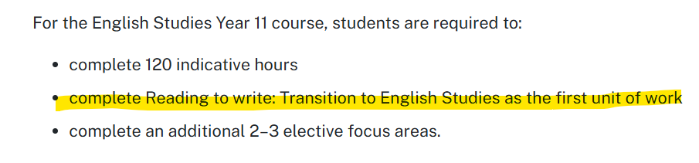
Course description (1)
Check your answer
Question 3 – Reading to write: Transition to English Studies must be completed at the first unit of work in Year 11.
True
False
Image 1 – screenshot of Course description section of English Studies 11–12 syllabus
Notes:
Teacher note – this slide is to be used in conjunction with/to support Phase 1, sequence 2. Consider animating the slide so that the correct answer appears after students have had a chance to contribute their answers.

Slide 7

Course description (2)
Check your answer
Question 4 – You will study 3 prescribed texts in Year 11.
True
False
Image 2 – screenshot of Course description section of English Studies 11–12 syllabus
Notes:
Teacher note – this slide is to be used in conjunction with/to support Phase 1, sequence 2. Consider animating the slide so that the correct answer appears after students have had a chance to contribute their answers.

Slide 8
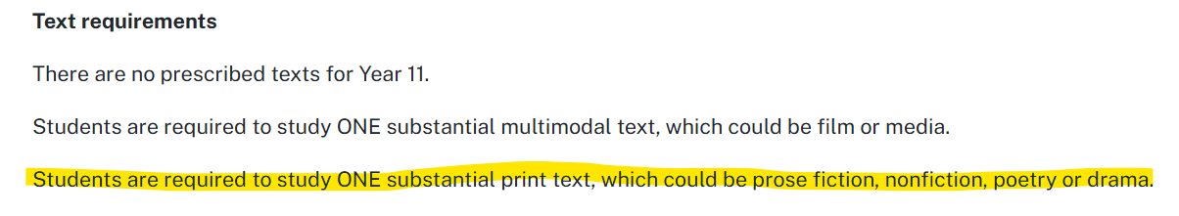
Course description (3)
Check your answer
Question 5 – You will be required to study a print text. This could be prose fiction, nonfiction, poetry or drama.
True
False
Image 3 – screenshot of Course description section of English Studies 11–12 syllabus
Notes:
Teacher note – this slide is to be used in conjunction with/to support Phase 1, sequence 2. Consider animating the slide so that the correct answer appears after students have had a chance to contribute their answers.

Slide 9
Elective focus areas
Question 6 and 7
Elective A – Voices of Australia
Elective B – Media and influence
Elective C – On the road
Elective D – Playing the game
Elective E – Lyrical voices
Elective F – Everyday heroes
Elective G – Part of a family
Elective H – Uncovering the truth
Elective I – The Big Screen
Elective J – Representing the past
Elective K – Achieving through English – English in education, work and community
Notes:
Teacher note – this slide is to be used in conjunction with/to support Phase 1, sequence 2. Invite students to share responses. Use this opportunity to understand the interests of they class. Consider using a mentimeter or the Socrative tool available in the Digital Learning Selector Learning Tools to create a visual representation of the areas of interest across the class. Alternatively, keep a record of numbers by writing them on the board while displaying this slide.

Slide 10
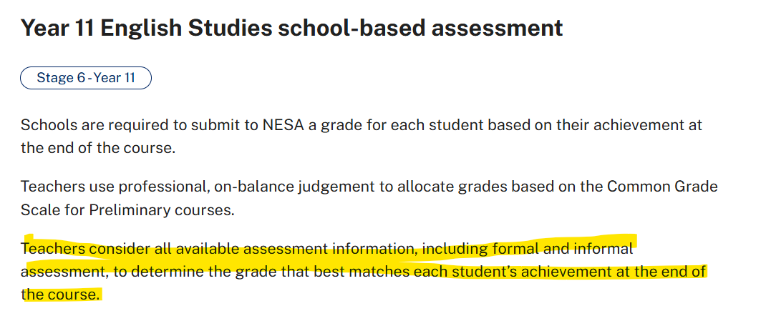
Assessment (1)
Check your answer
Question 8 – Grades awarded at the end of the Year 11 English Studies are based on formal assessment only.
True
False
Image 4 – screenshot of Year 11 English Studies school-based assessment section of English Studies 11–12 syllabus
Notes:
Teacher note – this slide is to be used in conjunction with/to support Phase 1, sequence 2. Consider animating the slide so that the correct answer appears after students have had a chance to contribute their answers.

Slide 11
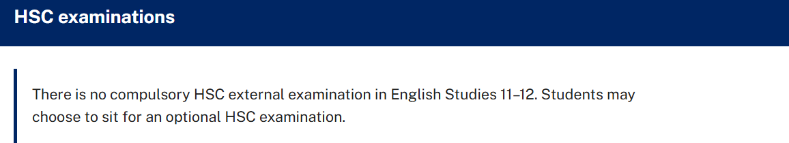
Assessment (2)
Check your answer
Question 9 – There is no compulsory HSC external examination in English Studies 11–12.
True
False
Image 5 – screenshot of the HSC examination section of English Studies 11–12 syllabus
Notes:
Teacher note – this slide is to be used in conjunction with/to support Phase 1, sequence 2. Consider animating the slide so that the correct answer appears after students have had a chance to contribute their answers.

Slide 12
Assessment (3)
Check your answer
Question 10 – English Studies students may choose to complete an optional HSC examination.
True
False
Image 6 – screenshot of the HSC examination section of English Studies 11–12 syllabus
Notes:
Teacher note – this slide is to be used in conjunction with/to support Phase 1, sequence 2. Consider animating the slide so that the correct answer appears after students have had a chance to contribute their answers.

Slide 13
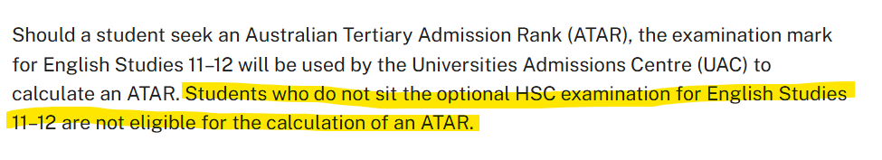
Assessment (4)
Check your answer
Question 11 – Students who do not sit the optional HSC examination are still eligible for an Australian Tertiary Admission Rank (ATAR).
True
False
Image 7 – screenshot of the HSC examination section of English Studies 11–12 syllabus
Notes:
Teacher note – this slide is to be used in conjunction with/to support Phase 1, sequence 2. Consider animating the slide so that the correct answer appears after students have had a chance to contribute their answers.

Slide 14
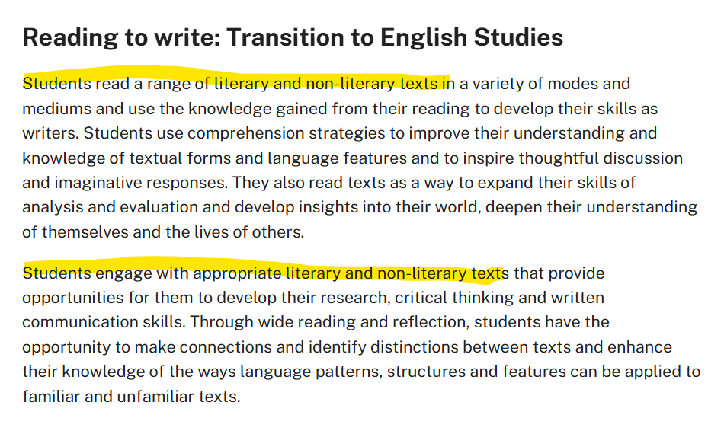
Reading to write: Transition to English Studies (1)
Check your answer
Question 12 – Students read only literary texts in English Studies
Image 8 – screenshot of the Reading to write: Transition to English Studies section of English Studies 11–12 syllabus
True
False
Notes:
Teacher note – this slide is to be used in conjunction with/to support Phase 1, sequence 2. Consider animating the slide so that the correct answer appears after students have had a chance to contribute their answers.

Slide 15
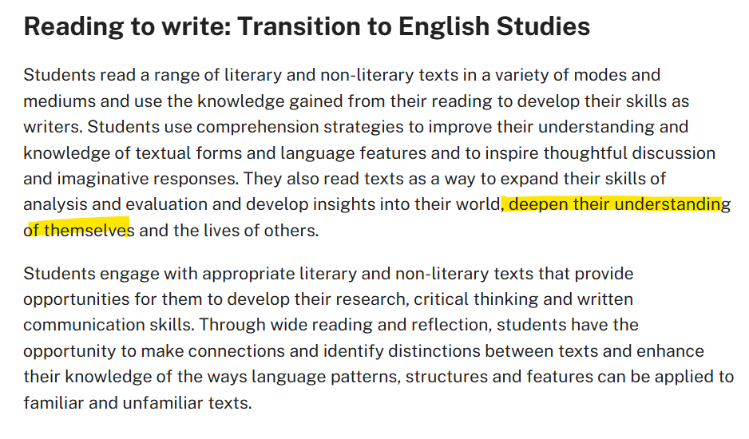
Reading to write: Transition to English Studies (2)
Check your answer
Question 13 – Students will deepen their understanding of themselves through this focus area.
Image 9 – screenshot of the Reading to write: Transition to English Studies section of English Studies 11–12 syllabus
True
False
Notes:
Teacher note – this slide is to be used in conjunction with/to support Phase 1, sequence 2. Consider animating the slide so that the correct answer appears after students have had a chance to contribute their answers.

Slide 16
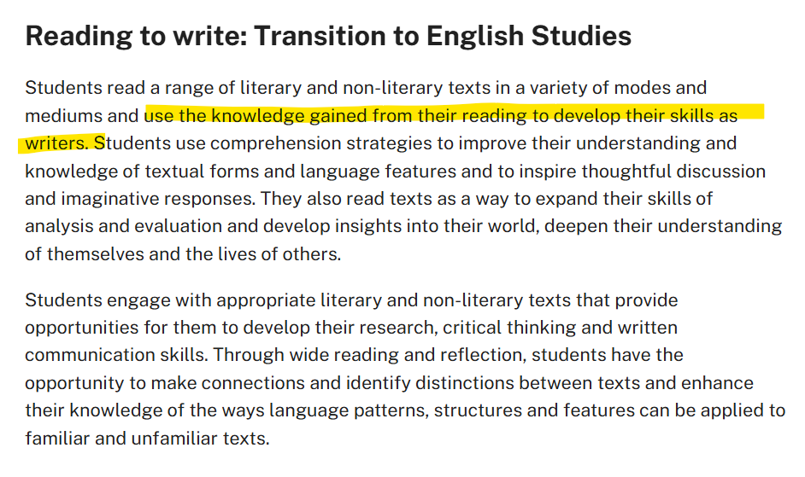
Reading to write: Transition to English Studies (3)
Check your answer
Question 14 – Students will use their experiences of reading to develop their skills as writers
Image 10 – screenshot of the Reading to write: Transition to English Studies section of English Studies 11–12 syllabus
True
False
Notes:
Teacher note – this slide is to be used in conjunction with/to support Phase 1, sequence 2. Consider animating the slide so that the correct answer appears after students have had a chance to contribute their answers.

Slide 17
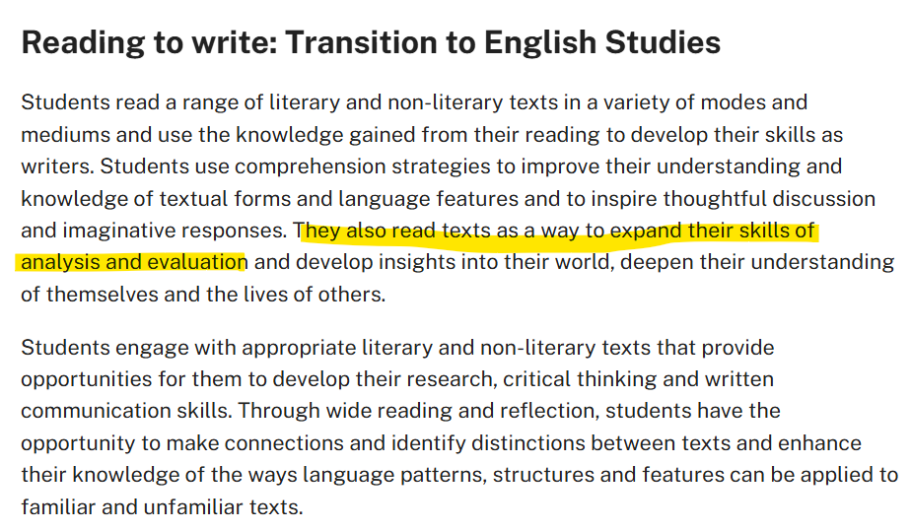
Reading to write: Transition to English Studies (4)
Check your answer
Question 15 – Students will not be expected to analyse or evaluate the texts they read in English Studies.
Image 11 – screenshot of the Reading to write: Transition to English Studies section of English Studies 11–12 syllabus
True
False
Notes:
Teacher note – this slide is to be used in conjunction with/to support Phase 1, sequence 2. Consider animating the slide so that the correct answer appears after students have had a chance to contribute their answers.

Slide 18
References
This presentation contains NSW Curriculum and syllabus content. The NSW Curriculum is developed by the NSW Education Standards Authority. This content is prepared by NESA for and on behalf of the Crown in the right of the State of New South Wales. The material is protected by Crown copyright.
Please refer to the NESA Copyright Disclaimer for more information https –//educationstandards.nsw.edu.au/wps/portal/nesa/mini-footer/copyright.
NESA holds the only official and up-to-date versions of the NSW Curriculum and syllabus documents. Please visit the NSW Education Standards Authority (NESA) website https –//educationstandards.nsw.edu.au/wps/portal/nesa/home and the NSW Curriculum website https –//curriculum.nsw.edu.au.
English Studies 11–12 © Syllabus NSW Education Standards Authority (NESA) for and on behalf of the Crown in right of the State of New South Wales, 2024

Slide 19
Copyright
© State of New South Wales (Department of Education), 2025
The copyright material published in this resource is subject to the Copyright Act 1968 (Cth) and is owned by the NSW Department of Education or, where indicated, by a party other than the NSW Department of Education (third-party material).
Copyright material available in this resource and owned by the NSW Department of Education is licensed under a Creative Commons Attribution 4.0 International (CC BY 4.0) license.
This license allows you to share and adapt the material for any purpose, even commercially.
Attribution should be given to © State of New South Wales (Department of Education), 2025.
Material in this resource not available under a Creative Commons license –
the NSW Department of Education logo, other logos and trademark-protected material
Material owned by a third party that has been reproduced with permission. You will need to obtain permission from the third party to reuse its material.
Links to third-party material and websites
Please note that the provided (reading/viewing material/list/links/texts) are a suggestion only and implies no endorsement, by the New South Wales Department of Education, of any author, publisher, or book title. School principals and teachers are best placed to assess the suitability of resources that would complement the curriculum and reflect the needs and interests of their students.
If you use the links provided in this document to access a third-party’s website, you acknowledge that the terms of use, including licence terms set out on the third-party’s website apply to the use which may be made of the materials on that third-party website or where permitted by the Copyright Act 1968 (Cth). The department accepts no responsibility for content on third-party websites.

