Slide 1
Introduction and instructions for use
Using this PowerPoint in the classroom
This is a text annotation PowerPoint designed to accompany the sample program ’Reading to write: Transition to English Standard’. It is not a teaching and learning program.
The resource annotates sections of the Core text 2– ‘The tent village at Musgrave Park’ by Lillian O’Neil.
Instructions
Classroom teachers are encouraged to add and adapt slides as required to meet the needs of their students.
Save a copy of the file to make changes to the slide deck. Go to File > Download a Copy (this downloads a copy to the computer to edit in the PowerPoint app).
To convert the PowerPoint to Google Slides
  Upload the file into Google Drive and open it.
  Go to File > Save as Google Slides.
  (Note – conversion may cause formatting changes in the slides.)
Notes:
Teachers note: this slide has been used to support teachers in using the resource and should be deleted or hidden when using in a classroom setting.

Slide 2

Text annotations – ‘The tent village at Musgrave Park’
Stage 6 Standard –11.1
‘Reading to write: Transition to English Standard’ – Year 11, Term 1
Homeless tent photo by Gustavo Sánchez on Unsplash
Notes:
Teachers notes: the purpose of this PowerPoint is to provide support students to deepen their understanding and connection to the text, supporting analysing and working towards a critical appreciation. It accompanies Phase 3b.
Note that Phase 4 and Phase 5 have been integrated into Phase 3b.
The ‘engaging personally, analytically and critically with texts’ phase is designed to enhance students’ vocabulary, contextual understanding, and analytical skills. Through this phase, students build the capacity to appreciate, understand, and analyse the core text ‘The tent village at Musgrave Park’ by Lillian O’Neill critically, setting the stage for their ongoing engagement with the text and supporting their development as thoughtful readers and writers.

Slide 3
Licence agreement details
Core text 2 – The tent village at Musgrave Park
‘The tent village at Musgrave Park’ by Lillian O’Neill was first published in the 2024 Summer edition (83.4) of the literary journal Meanjin.
The use of this text has been made possible as permission has been granted Lillian O’Neill. The text contained in this resource is licensed up until March 2029. Reproduced and made available for copying and communication by NSW Department of Education for its educational purposes with the permission of Cambridge University Press. This resource is licensed up until March 2029.
Notes:
Teacher note: this slide is for schools' reference only and should be hidden or deleted when used in a classroom setting.
It is essential all text choices align with the Controversial issues in schools policy and comply with audiovisual material requirements (https://education.nsw.gov.au/policy-library/policies/pd-2005-0290-03.html)
Follow the department’s guidelines for communicating with parents and carers about texts. The templates in Text selection notification (https://education.nsw.gov.au/teaching-and-learning/curriculum/leading-curriculum-k-12/explaining-curriculum-pcc/texts-used-in-classrooms/text-selection-notification) have been created as a guide and should be adapted as necessary to suit each school's specific context. The guidelines for How to use the English core texts for English 7–10 are also relevant for Stage 6 (https://education.nsw.gov.au/teaching-and-learning/curriculum/english/planning-programming-and-assessing-english-7-10/how-to-use-english-core-texts).

Slide 4
Text complexity
Core text 2 – The tent village at Musgrave Park
The text, ‘The tent village at Musgrave Park’ meets the text requirements for English Standard as it is an Australian text that is widely regarded as quality literature and it explores a range of social, cultural and gender perspectives.
The text contains a range of markers which align to the moderately complex to highly complex level of the Text Complexity scale as per the ‘Literacy: About the general capability’ document which can be downloaded on the General capabilities downloads page of the Australian Curriculum webpage. It provides students opportunities to engage with a text that explores complex issues and cultural context that encourages critical thinking and deep comprehension. The text considers complex themes and questions cultural expectations centred perceptions of social status. It explores the multiple connotations that can be inferred from the words ‘home’ and ‘homelessness’ using complex sentences and subtle evaluative language reflecting the author’s viewpoint.
This text references trauma and homelessness, consider this in the decision to use this text in your context. Use of this text should be guided by the department’s advice regarding Preventing public disclosures, Types of crises and Supporting refugee students. To learn more, visit Trauma-informed practice in schools: An explainer.
Notes:
Teacher note: this slide is for teachers' reference only and should be hidden or deleted when used in a classroom setting.
Links:
https://education.nsw.gov.au/teaching-and-learning/curriculum/pdhpe/planning-programming-and-assessing-pdhpe-k-12/learning-environment/preventing-public-disclosures#:~:text=Preventing%20public%20disclosures%201%20keeping%20discussions%20global%20rather,someone...%27%205%20maintaining%20a%20professional%20role.%20More%20items
https://curriculum.nsw.edu.au/learning-areas/english/english-eald-11-12-2024/overview/course
https://education.nsw.gov.au/teaching-and-learning/multicultural-education/support-in-times-of-crisis/types-of-crises
https://education.nsw.gov.au/teaching-and-learning/multicultural-education/refugee-students-in-schools
https://education.nsw.gov.au/about-us/education-data-and-research/cese/publications/research-reports/trauma-informed-practice-in-schools

Slide 5

Who is Lillian O’Neill?
Author context
Lillian O’Neill is an emerging writer who lives and works on Meanjin land in Brisbane, Queensland.
O’Neill writes fiction, poetry and creative non-fiction.
‘The tent village at Musgrave Park’ is O’Neill’s first published work. It details the experiences of people in a park in the Brisbane suburb where O’Neill lives.
Furniture by Clay Banks on Unsplash
Notes:
Teacher note: this slide is to be used in conjunction with Phase 2, sequence 4 – initial exploration of core texts.

Slide 6
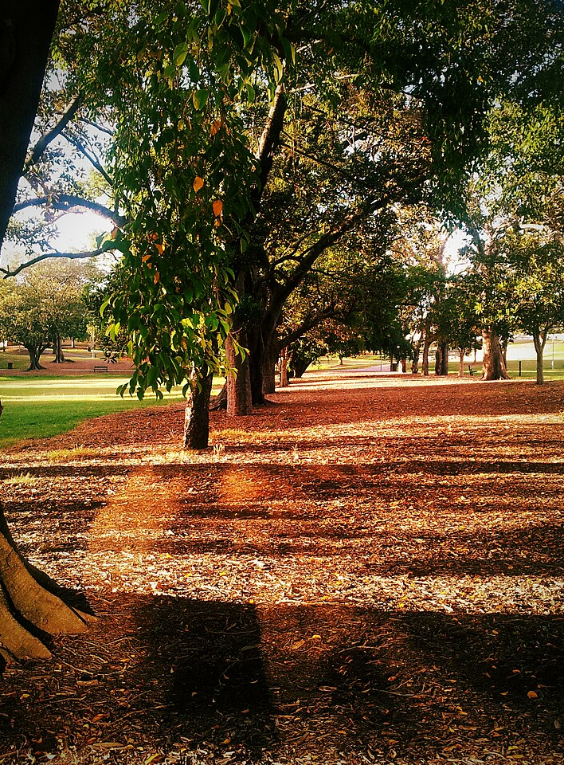
Phase 3b, sequence 1 – establishing context
Musgrave Park, Brisbane photo by Rae Allen on Wikimedia commons
Notes:
Teachers note: this slide has been used to identify the resources which may be used alongside Phase 3b, sequence 1 – establishing context of Core text 2 – Musgrave Park as a site and symbol of ongoing struggle. It should be deleted or hidden prior to sharing with students using in a classroom setting.​
​

Slide 7
Learning intentions and success criteria
We are learning to:
understand the historical and cultural significance of the Aboriginal Tent Embassy and Musgrave Park as symbols of ongoing struggle for Indigenous rights.
develop their listening and analytical skills through viewing tasks and class discussions.
[insert learning intention].
We can:
[classroom teacher to insert sample success criteria]
[classroom teacher to insert sample success criteria]
[classroom teacher to insert sample success criteria].
Notes:
Notes for teachers: this slide is to be used in conjunction with Phase 3b – Core text 2: O’Neill.
Adapt the provided learning intention and below sample success criteria, as required, to suit the needs of your students.
- articulate their understanding of the historical and cultural significance of the Aboriginal Tent Embassy by engaging thoughtfully with viewing tasks, identifying key themes, and participating in class discussions to accurately answer questions and share their insights
LISC is usually shared first or early in the lesson and is explained by the teacher who checks for understanding (DoE 2025).
LISC is referred to regularly to check for understanding, provide feedback or as a self-assessment tool (Wiliam and Leahy 2015).
Learning intentions and success criteria can be supported by exemplars, such as 'What A Good One Looks Like' (WAGOLL) or exemplars to demonstrate success criteria (Clarke 2021).
For more information, see:
Sharing learning intentions and success criteria: https://education.nsw.gov.au/content/dam/main-education/documents/teaching-and-learning/curriculum/explicit-teaching/explicit-teaching-technique-guide-lisc-sharing.pdf
Planning learning intentions and success criteria: https://education.nsw.gov.au/content/dam/main-education/documents/teaching-and-learning/curriculum/explicit-teaching/explicit-teaching-technique-guide-lisc-planning.pdf

Slide 8

Viewing activity
Australia Day: How a sun umbrella started 50 years of Aboriginal protest – BBC News
Phase 3b, sequence 1
At work by Francis Bouffard on Unsplash
Notes:
Teacher note: this section of the PowerPoint should be used in conjunction with Phase 3b, sequence 1 – establishing context of Core text 2 – Musgrave Park as a site and symbol of ongoing struggle (integrated Phase 5). It is designed to develop student understanding of the context of Musgrave Park as an enduring site of struggle.

Slide 9
Understanding the contextual significance of setting
Understanding the context of the Tent Embassy and Musgrave Park as a symbol
The purpose of this activity is to develop your understanding of the history and significance of the Aboriginal Tent Embassy. This will help you to connect the Aboriginal Tent Embassy with the themes and ideas in Core text 2 – ‘The tent village at Musgrave Park’ by Lillian O’Neill.
Using Phase 3b, activity 1 – Aboriginal Tent Embassy viewing task:
Read the information on the worksheet before viewing the video.
Read through the questions before viewing.
Watch the video Australia Day: How a sun umbrella started 50 years of Aboriginal protest – BBC News (3:42) and follow the remaining instructions on the worksheet.
Notes:
Teacher note: this section of the PowerPoint should be used in conjunction with Phase 3b, sequence 1 – establishing context of Core text 2 – Musgrave Park as a site and symbol of ongoing struggle (integrated Phase 5). .
This slide compliments Phase 3b, activity 1 – Aboriginal Tent Embassy viewing task. Talk students through instructions and clarify as needed prior to playing the associated video.
Video link: https://www.youtube.com/watch?v=RiZnbGu7Om0

Slide 10
Discussion questions
Class reflection and discussion
What connections can you make between the Aboriginal Tent Embassy and the themes of Lillian O'Neill's article?
Why is the setting of the text significant?
Unpack Musgrave Park as a site of enduring struggle. How does this lend weight to O’Neill’s piece?
Notes:
Teacher note: this section of the PowerPoint should be used in conjunction with Phase 3b, sequence 1 – establishing context of Core text 2 – Musgrave Park as a site and symbol of ongoing struggle (integrated Phase 5).
This slide compliments Phase 3b, activity 1 – Aboriginal Tent Embassy viewing task. Go through worksheet answers as a class and consolidate learning and understanding through leading a class discussion of the questions on screen.
Video link: https://www.youtube.com/watch?v=RiZnbGu7Om0

Slide 11
Phase 3b, sequence 2 – building the field for Core text 2
Musgrave Park, Brisbane photo by Rae Allen on Wikimedia commons
Notes:
Teacher note: this slide has been used to identify the resources that may be used alongside Phase 3b, sequence 2 – building the field for Core text 2 (integrated Phase 4 and 5). It should be deleted or hidden prior to sharing with students using in a classroom setting.​
​

Slide 12
Connecting learning
Notes:
Teacher note: this slide has been used to identify the explicit teaching learning strategy and should be deleted or hidden when used in a classroom setting. The strategy of connecting learning involves making connections within and across learning. In this example, students are connecting learning to their own knowledge of public spaces in Australia, specifically Musgrave Park in Brisbane, Queensland. Teachers should consider building the field prior to students engaging in the text.
Teachers actively support students to make connections within and across knowledge, skills and understanding as well as to prior learning experiences. Learning is a change to long term memory. Long term memory is a network of overlapping information with many connections (AERO 2024a), which are called schemas (CESE 2017).

Slide 13
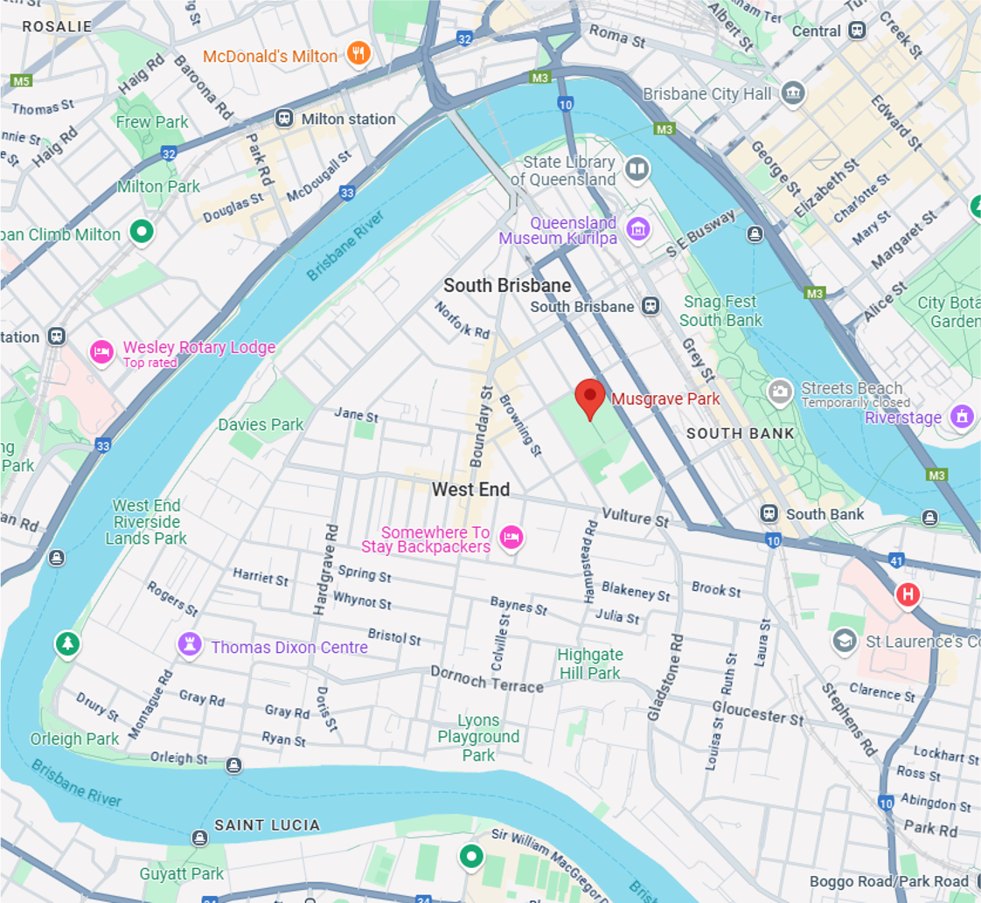
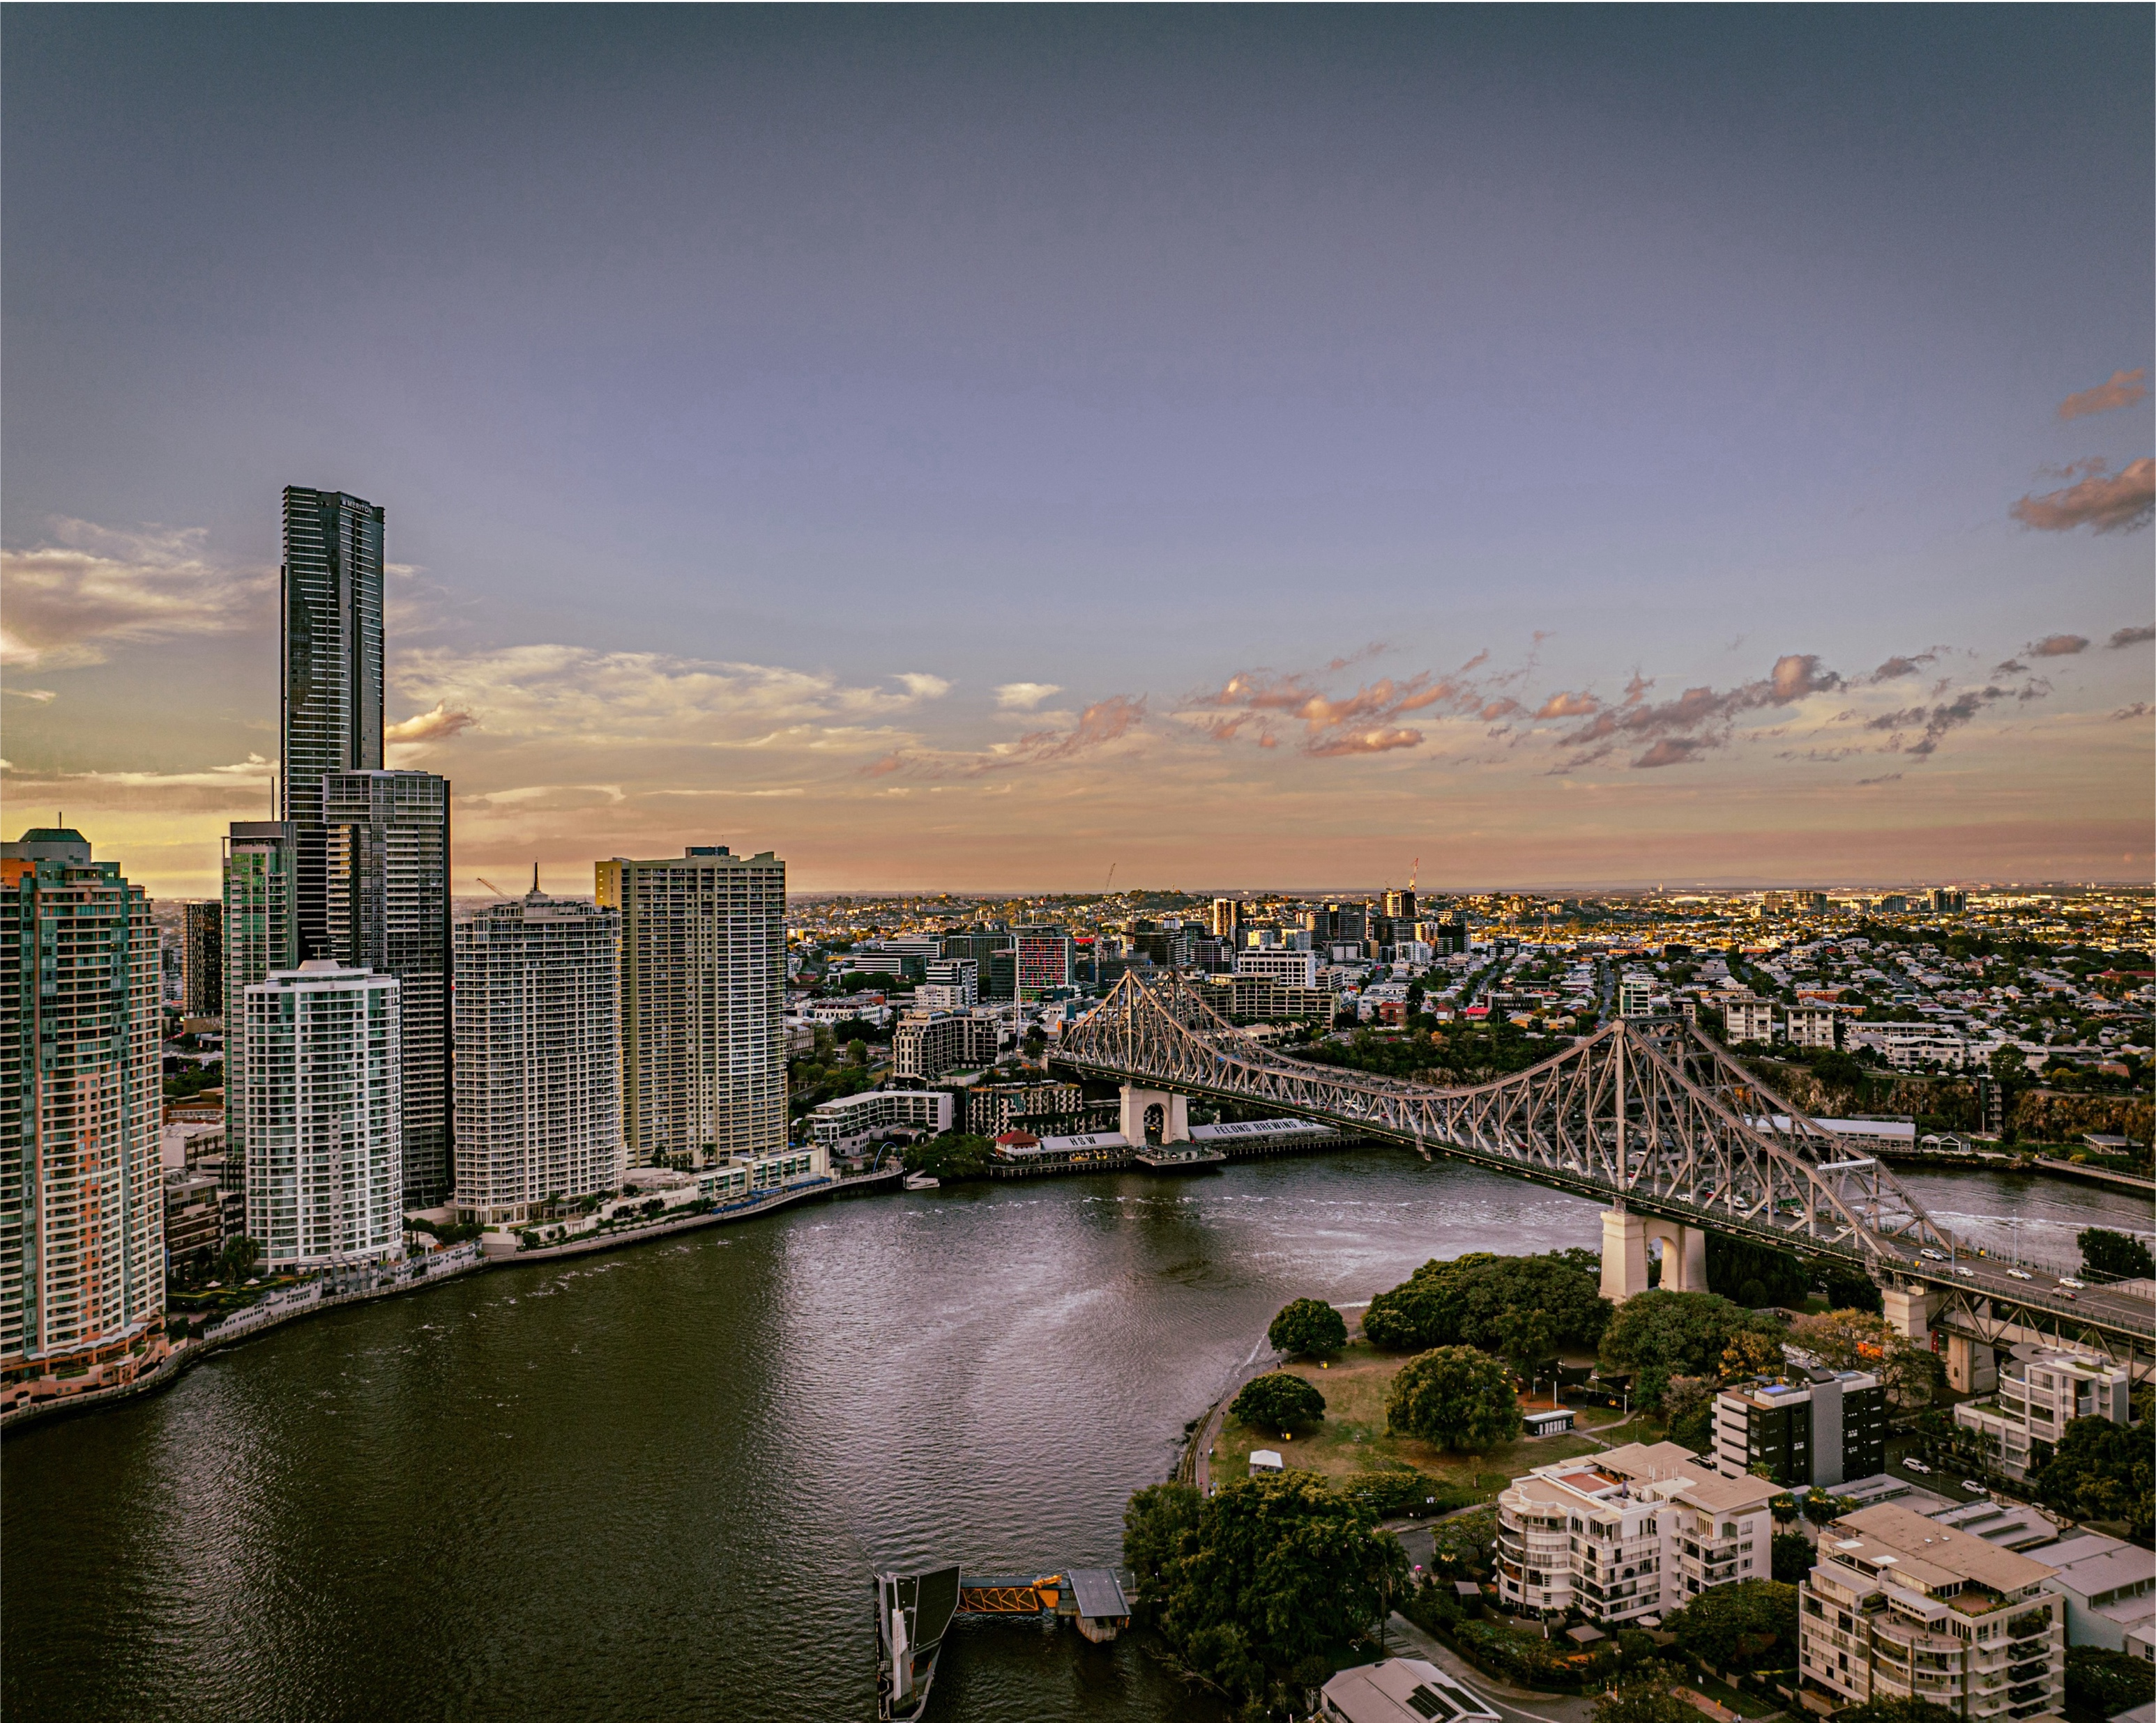
Setting (1)
Brisbane, Queensland
Brisbane is the capital city of Queensland, located on the east coast of Australia
The city has a subtropical climate and is built around the Brisbane River.
Musgrave Park is a public park located in South Brisbane, close to the city center.
Notes:
Teacher note: this section of the PowerPoint may be used in conjunction with Phase 3b, sequence 2 – building the field for Core text 2 (integrated Phase 4 and 5).
This slide uses animations that reveal a screenshot of Musgrave Park in relation to the wider Brisbane area using Google Maps. Teachers may wish to use additional digital tools (e.g. Street View, satellite imagery, or virtual tours) to support students in visualising and contextualising unfamiliar places. This approach is particularly valuable for students who may only have lived experience of their local area or of NSW more broadly. Providing a spatial and visual connection supports geographical and cultural schema-building and helps make abstract references in the text more concrete and meaningful.
This slide supports the Connecting Learning strategy by helping students make meaningful links between the story's setting and real-world geography, culture, and history. Given that many students, particularly EAL/D learners, may not be familiar with Brisbane or Musgrave Park, this background knowledge builds the foundational schema required to engage with the deeper themes of The tent village at Musgrave Park. Understanding the cultural and political significance of this location enriches students’ comprehension and connection with the text.

Slide 14
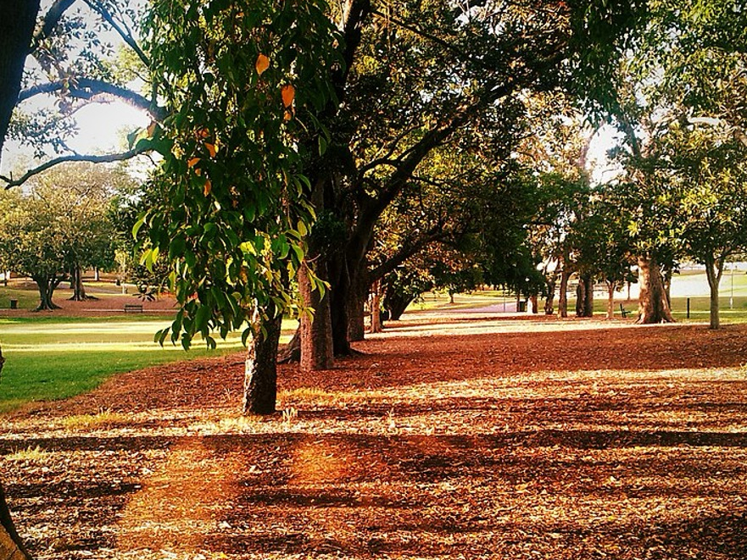
Setting (2)
Musgrave Park
Musgrave Park is located on the traditional lands of the Jagera (Yaggera) people, of Meanjin country.
The region of South Brisbane, including Musgrave Park is culturally significant to Aboriginal communities and was frequently used as a meeting place.
It has been the location of several significant Aboriginal protests, land claims and tent cities since 1982.
Musgrave Park, Brisbane photo by Rae Allen on Wikimedia commons
Notes:
Teacher note: this section of the PowerPoint may be used in conjunction with Phase 3b, sequence 2 – building the field for Core text 2 (integrated Phase 4 and 5).
This slide provides cultural and historical context for the setting of ‘The tent village at Musgrave Park’. Teachers should consider supplementing this contextual information with building the field activities (see What is building the field? for more information) to support a meaningful context for learning. Building the field activities provide both designed-in scaffolding (staff only), planned in advance to support students’ access to subject content, and contingent scaffolding (staff only), provided as needs arise during a learning sequence. By building the field, students are able to develop shared curriculum knowledge, understanding and language about the topics under focus
Consider pre-teaching key vocabulary (e.g. traditional lands, protests, land claims, culturally significant) using visuals and glossaries. Teachers may also model sentence structures for describing places and their significance (e.g. ‘Musgrave Park is important because…’).Refer to the Writing in Secondary (WiS) resource hub for strategies Nominalisation, abstraction and deconstruction.
Writing in Secondary resource hub: https://education.nsw.gov.au/teaching-and-learning/professional-learning/writing-in-secondary#Writing0:~:text=Contact-,Writing%20in%20Secondary%20Resource%20Hub,-All%20secondary%20teachers

Slide 15
Chunking and sequencing learning
Notes:
Teacher note: this slide has been used to identify the explicit teaching and learning strategy and should be deleted or hidden when using in a classroom setting.
Chunking learning into manageable components reduces demand on students’ working memory. Sequencing those chunks in a logical progression supports students to incorporate new information into their mental model, or schema (AERO 2024a).

Slide 16
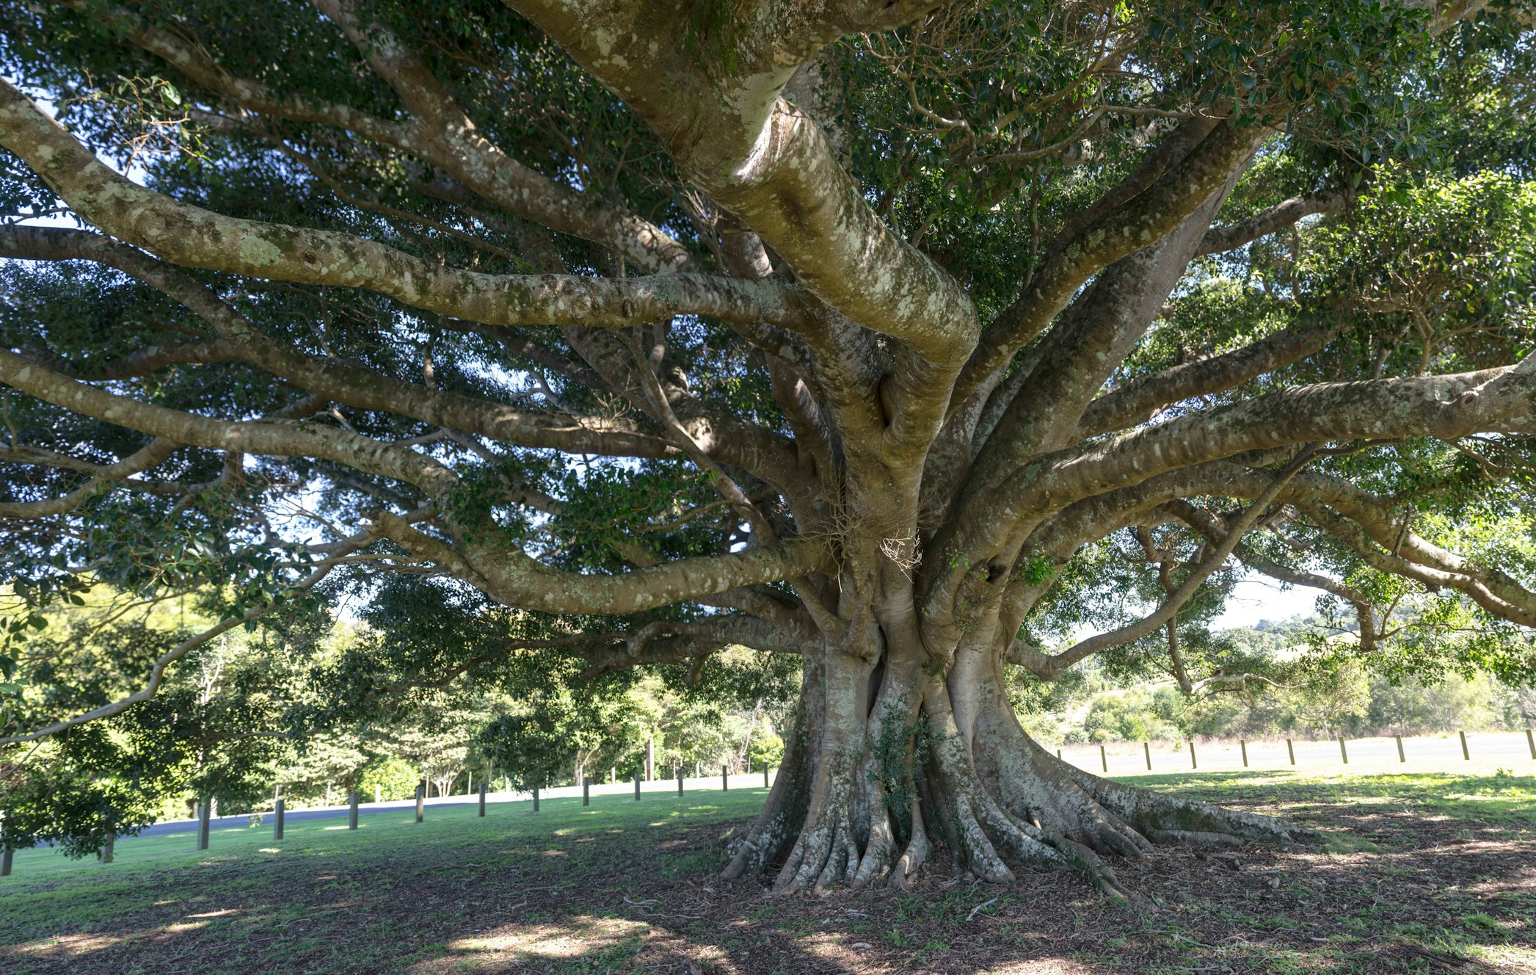
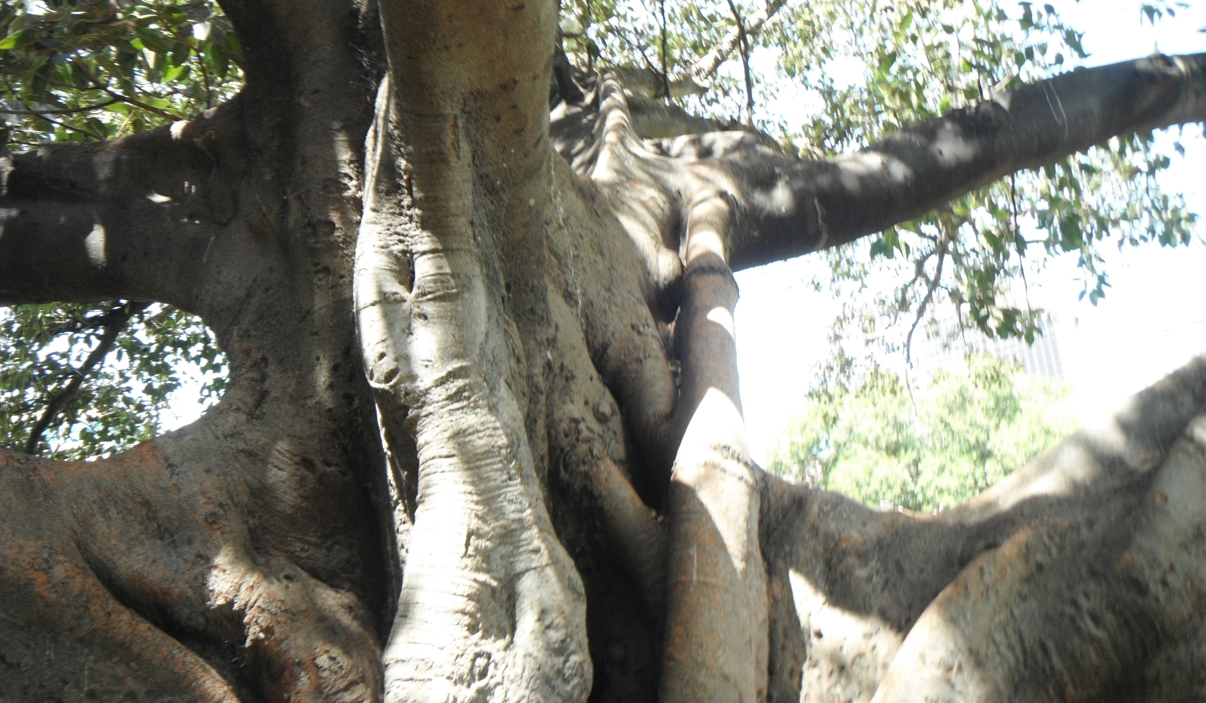
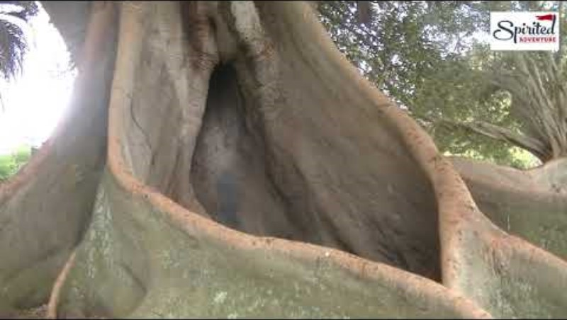
Visuals for quick write (1)
Moreton Bay Fig
Splendid Moreton Bay photo by RubyGoes on Wikimedia commons
Moreton Bay Fig Tree photo by Michael on Unsplash
Notes:
Teacher note: this section of PowerPoint aligns with Phase 3b, sequence 2 – building the field for Core text 2 (integrated Phase 4 and 5).
This slide uses message abundancy to support students' understanding of The tent village at Musgrave Park through visual references: a tent, a Moreton Bay Fig, and a Google Map of Edmondstone Street. These visuals are sequenced deliberately to guide students through a chunked approach to building background knowledge, engaging the senses, and composing their own texts.
Guide students through each image, prompting them to identify what they might see, hear, smell, touch, and even taste in each setting. Use think-alouds or sentence stems (e.g. I imagine the sound of..., The air would feel...) to model sensory engagement.

Slide 17

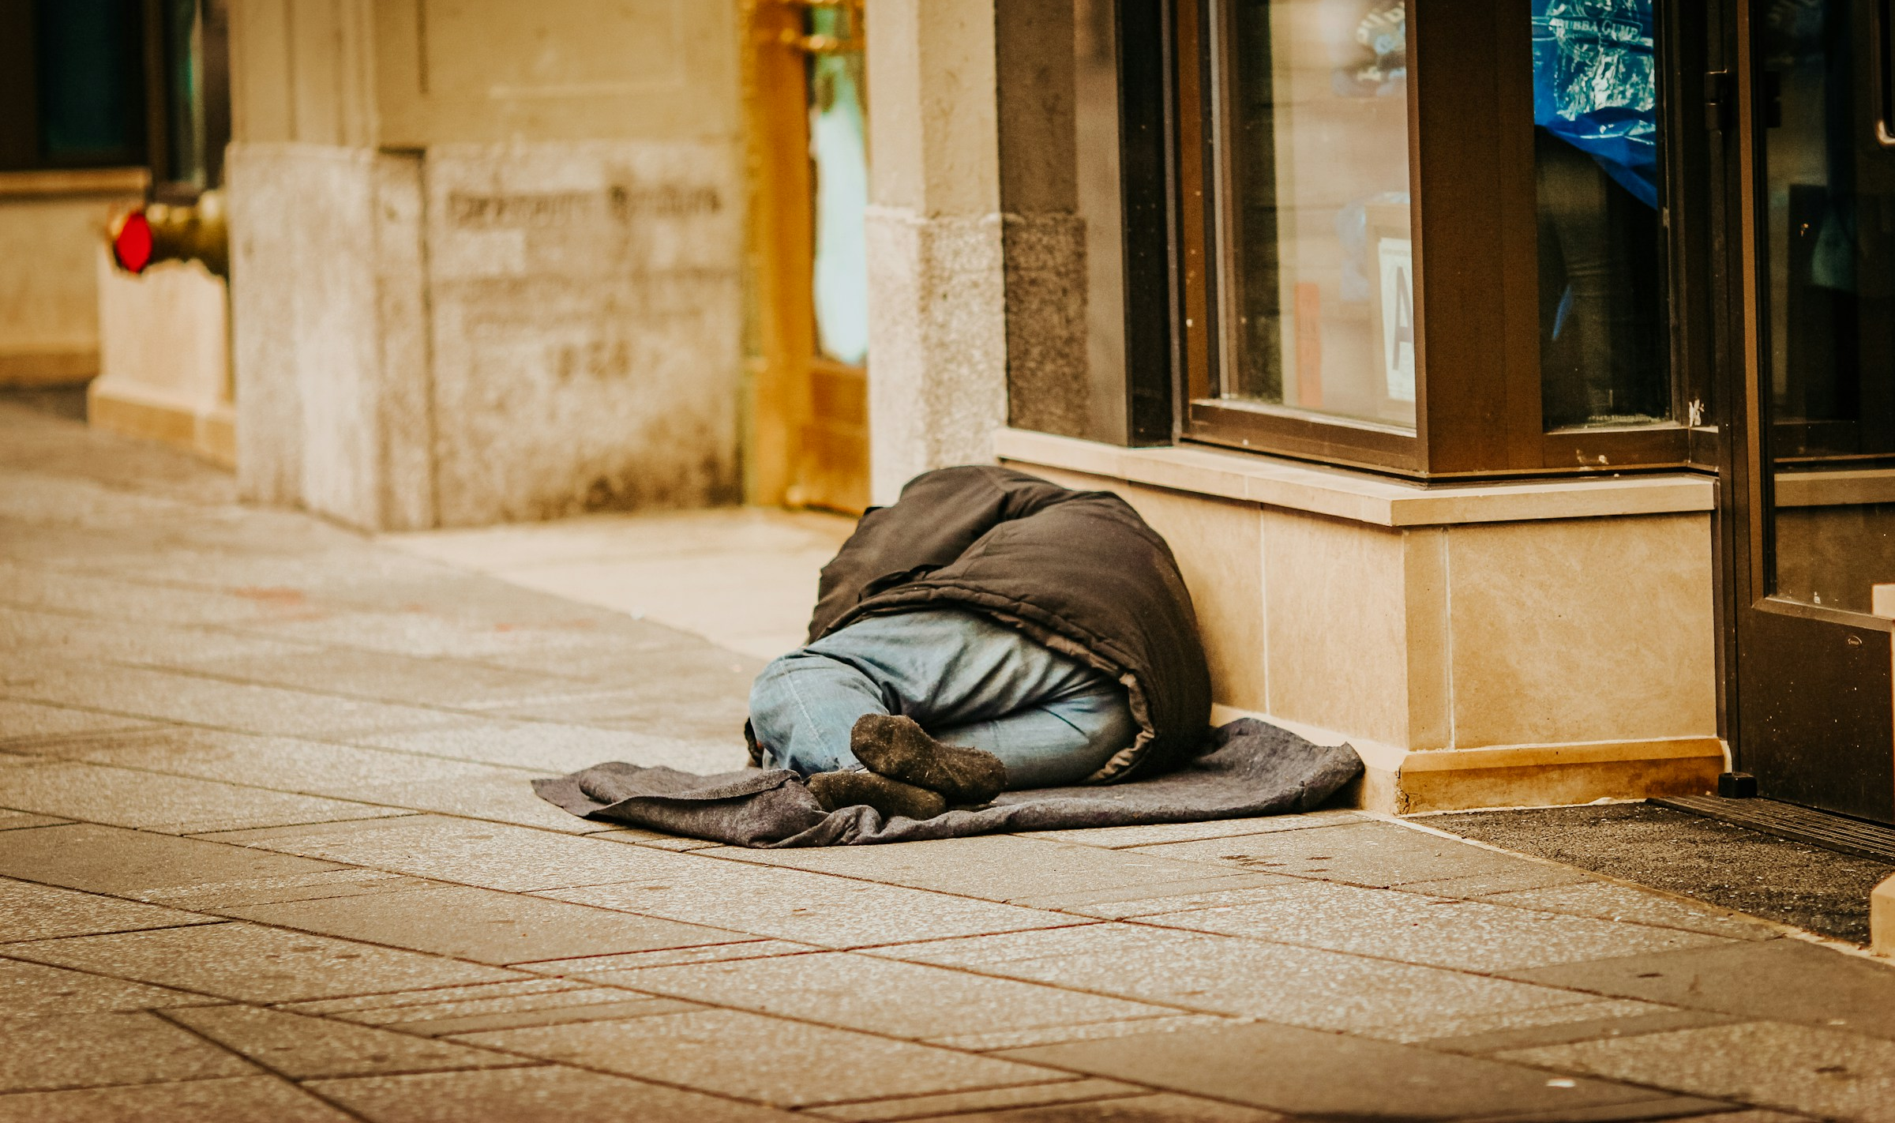
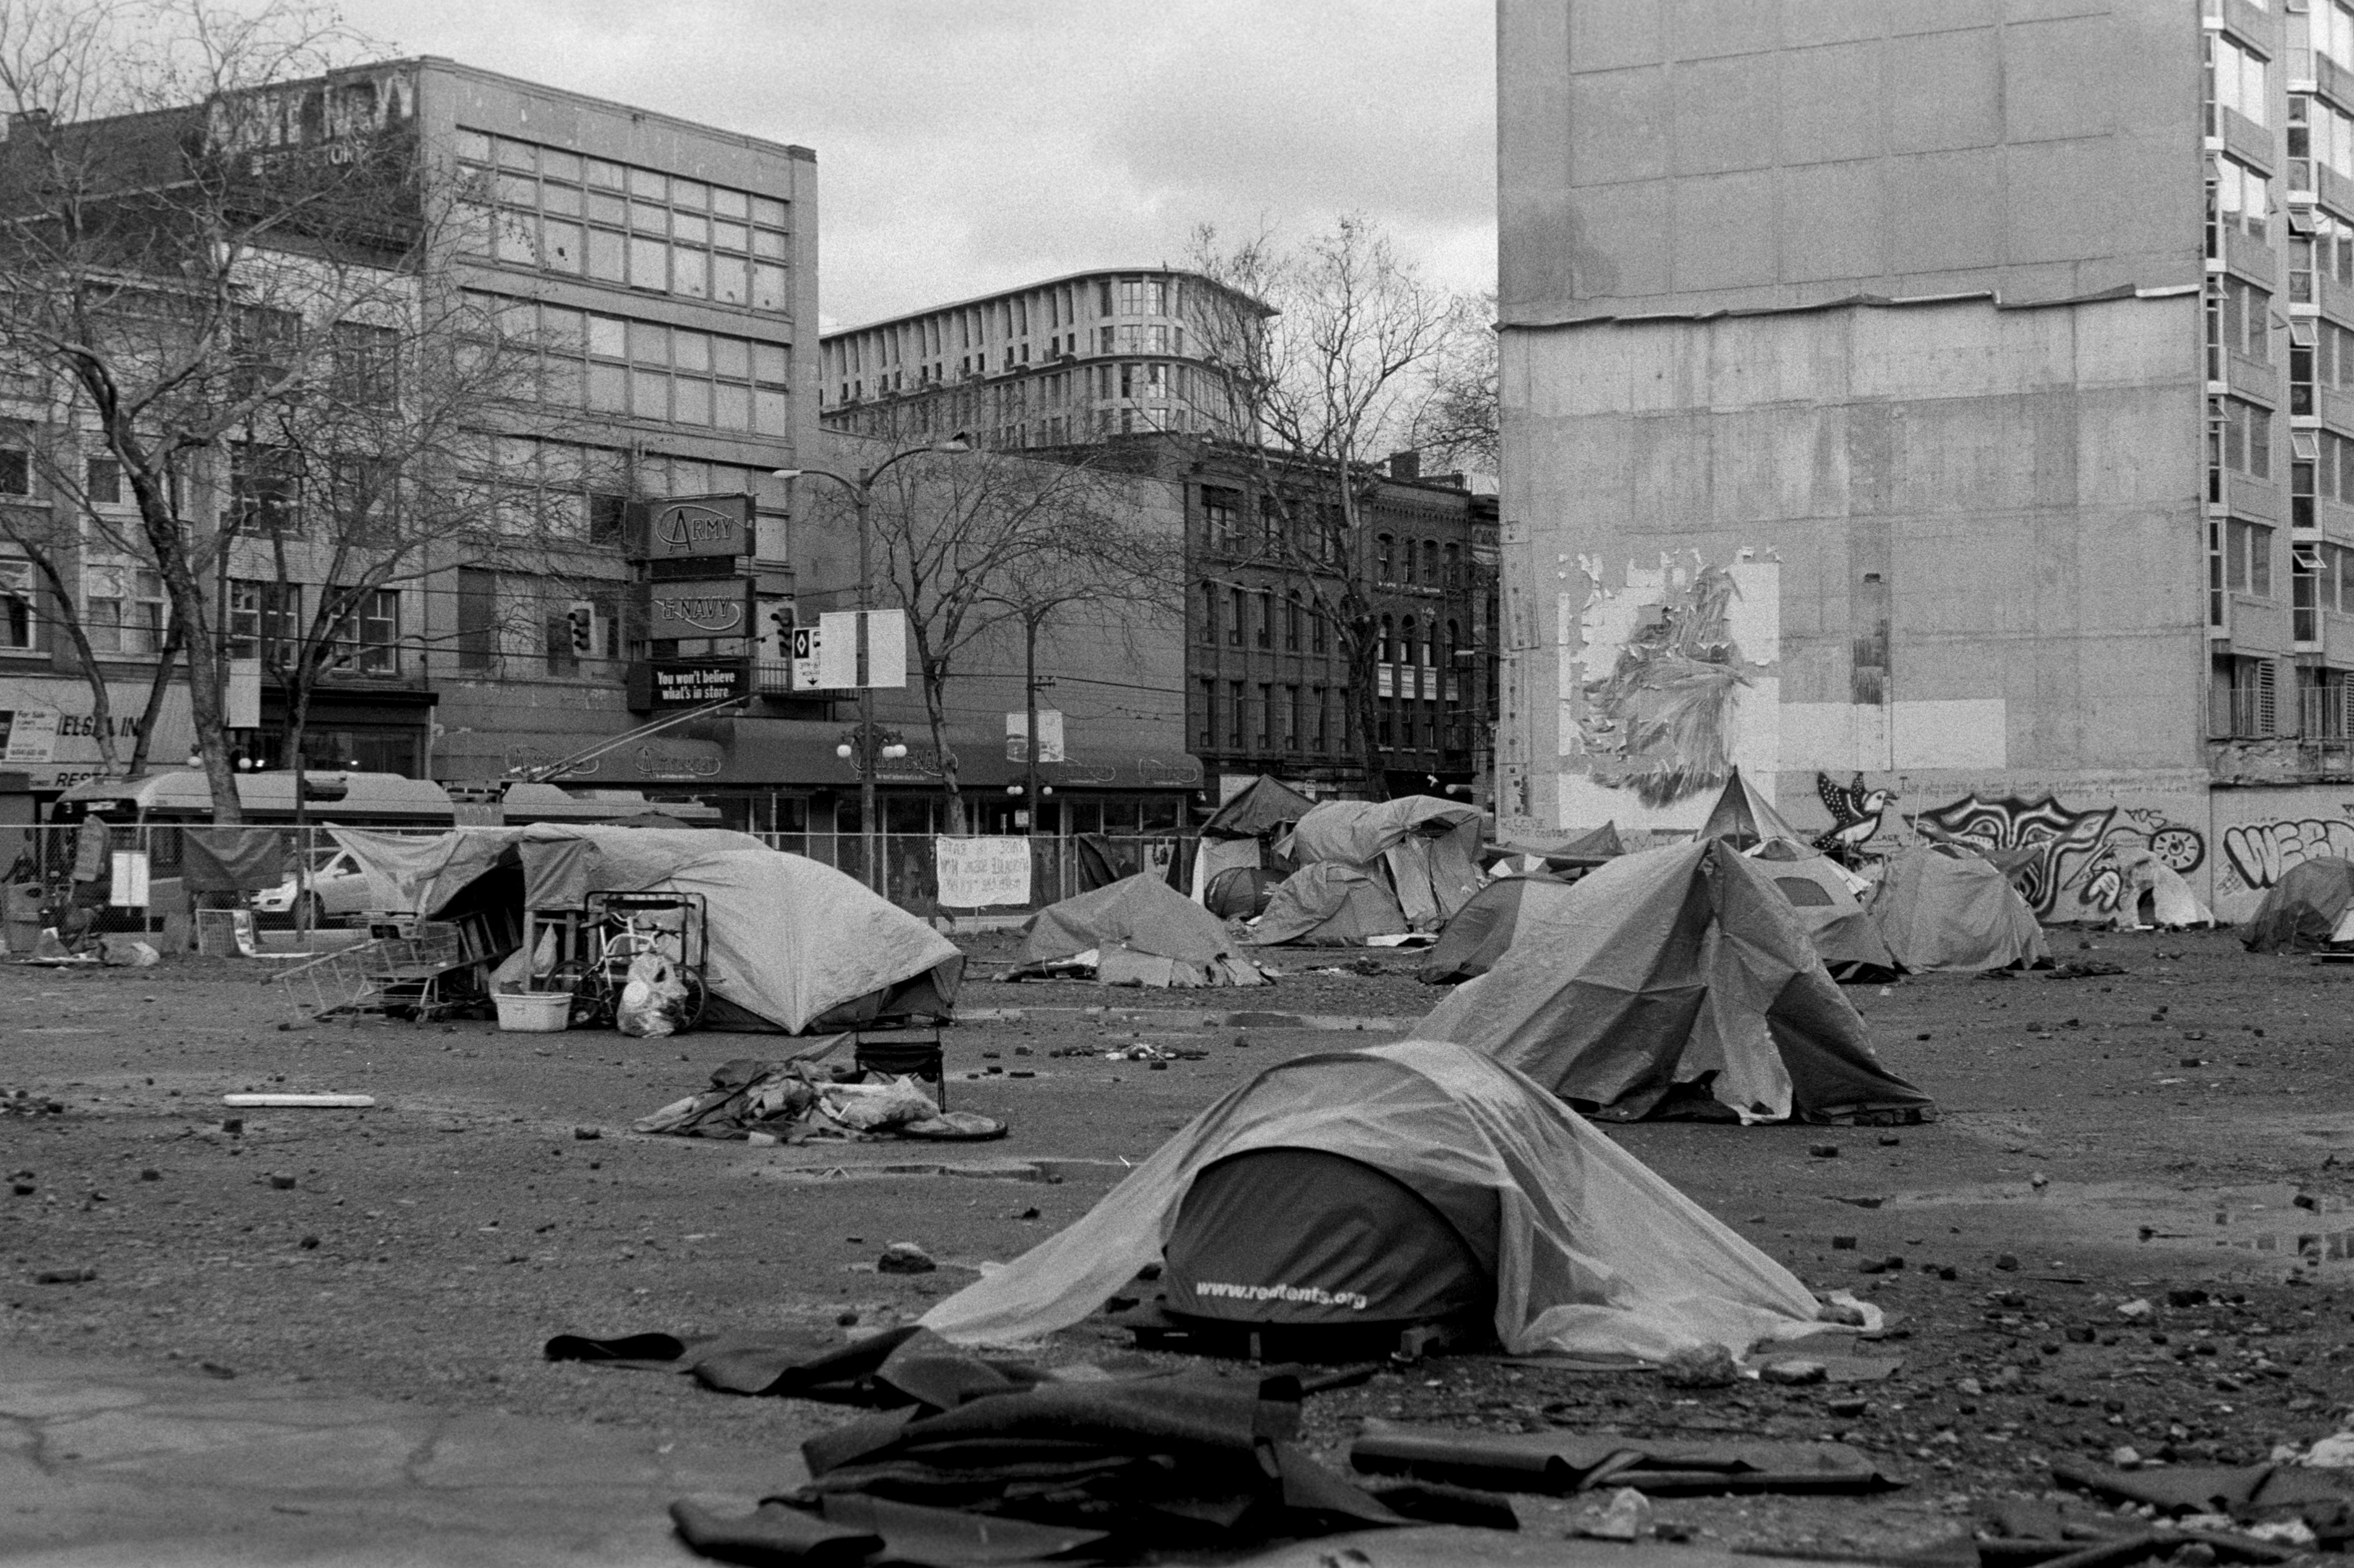

Visuals for quick write (2)
Homelessness and tents
Homeless photo by Jon Tyson on Unsplash
Tent city Photo by Randy Laybourne on Unsplash
City street Photo by Nathan Dumlao on Unsplash
Downtown Los Angeles by Levi Meir Clancy on Unsplash
Notes:
Teacher note: this section of PowerPoint aligns with Phase 3b, sequence 2 – building the field for Core text 2 (integrated Phase 4 and 5).
This slide uses message abundancy to support students' understanding of The tent village at Musgrave Park through a sensory exploration of the elements and scenes mentioned in the text. These visuals are sequenced deliberately to guide students through a chunked approach to building background knowledge, engaging the senses, and composing their own texts.
Guide students through each image, prompting them to identify what they might see, hear, smell, touch, and even taste in each setting. Use think-alouds or sentence stems (e.g. I imagine the sound of..., The air would feel...) to model sensory engagement.
Due to copyright requirements of this resource, photos specific to tent embassies or depictions of homelessness to a specific setting have not been included. In a classroom setting consider selecting multimodal supports for this activity, for example news footage - https://www.youtube.com/watch?v=qFcDd2EMEzM&t=146s

Slide 18
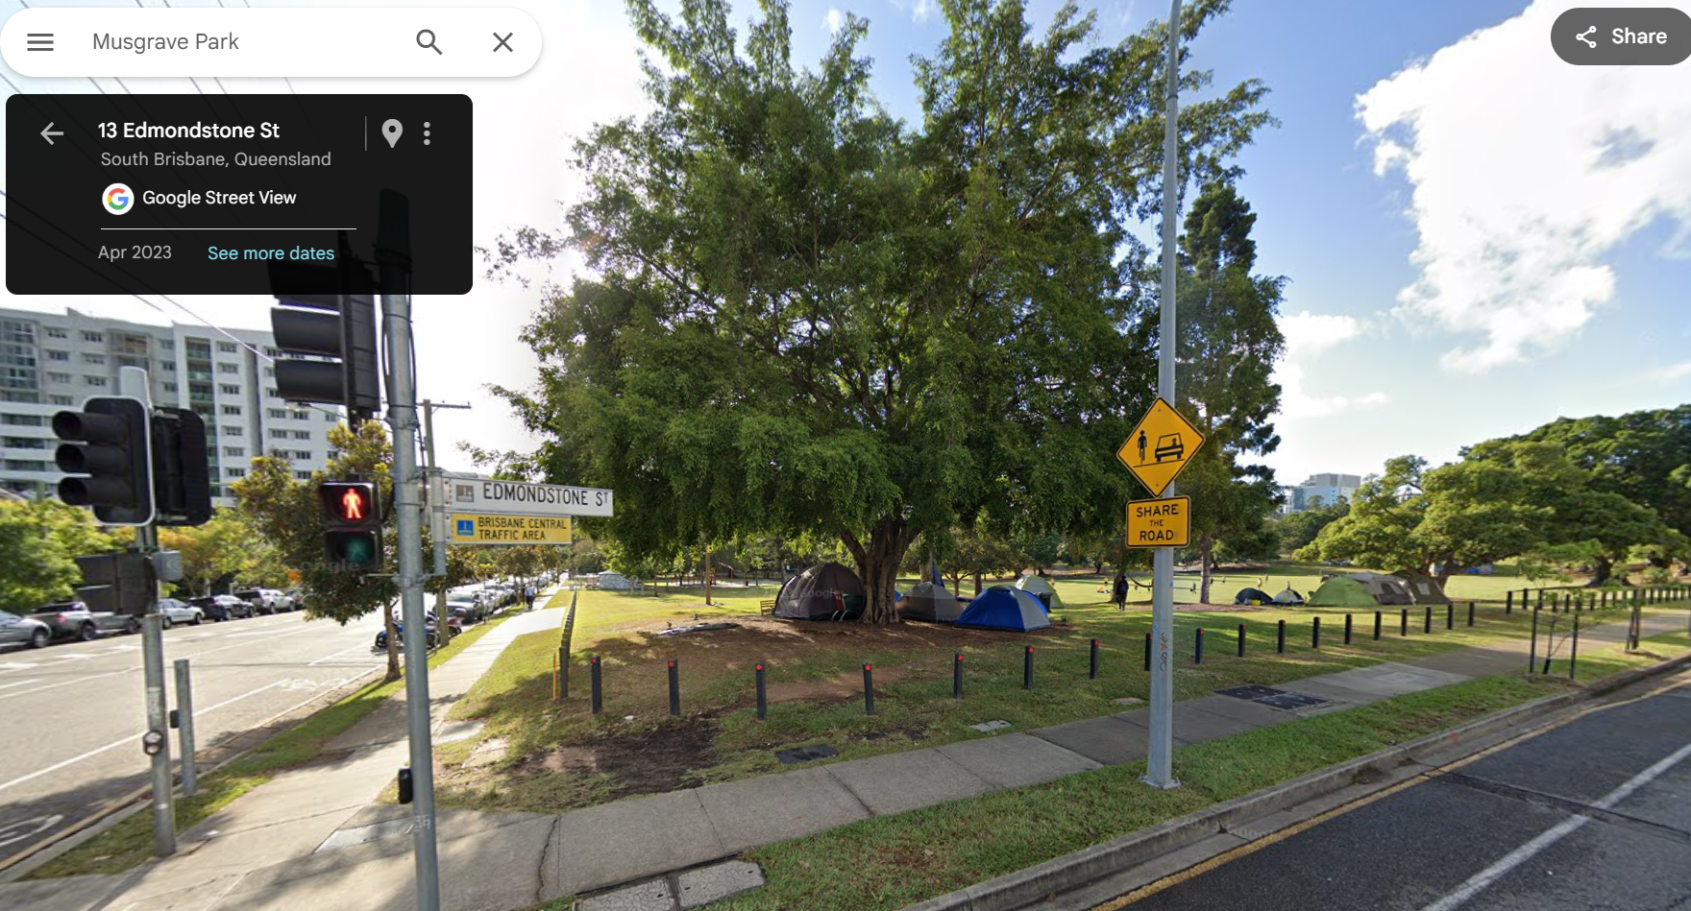
Visuals for quick write (3)
Edmondstone Street
Notes:
Teacher note: this slide is designed to be used in conjunction with Phase 3b, sequence 2 – building the field for Core text 2 (integrated Phase 4 and 5). It uses message abundancy to support students' understanding of The tent village at Musgrave Park through a sensory exploration of Edmondstone Street These visuals are sequenced deliberately to guide students through a chunked approach to building background knowledge, engaging the senses, and composing their own texts.
Using google maps street view, there are images available depicting tents under a Moreton Bay Fig tree

Slide 19
Annotating the opening paragraph
Notes:
Teacher note: these following annotations are designed to support Phase 3b, sequence 2 – building the field for Core text 2 (integrated Phase 4 and 5)

Slide 20
Annotating the opening
Setting and emotional impact
It started with two. The tents sat side-by-side along Edmondstone Street, in the corner hidden behind the Moreton Bay Fig. Two grey triangles in a sea of green. One might think it was people taking advantage of the warm days during the summer months, but by the time the rain came in February, it was clear the tents were here to stay. I thought it odd but not out of place. Strange but not shocking. The park is far enough away from the pristine streets of the city’s agreeable members of society to not cause any serious unrest.​
Annotations
Lyrical essay – the text moves between observations and emotions to show how real life is complex. O’Neill uses reflection and sensory detail to help the reader to capture what she feels
Short fragmented sentences – may reflect the writer’s discomfort and growing awareness that the tents are not temporary—they show hesitation and emotional tension.
Juxtaposition – the imagery of the park is contrasted with the social issue of homelessness, identifying the setting as a location of conflict and visibility.
Notes:
Teacher note: these annotations may also be used alongside Phase 3b, sequence 2 – building the field for Core text 2 (integrated Phase 4 and 5).
Consider using this slide as part of a joint deconstruction activity (modelled and guided), then gradually release responsibility to students to co-annotate later sections of the text or their peers’ work. Consider animating the annotations to manage student cognitive load.
When unpacking this slide consider prompting students to consider:
- Why has the writer chosen fragmented syntax here?
- How does the shift in perspective across the paragraph impact the tone?
- What is the effect of structuring the text around personal realisation rather than narrative action?
You may wish to incorporate:
Think–Pair–Share where students identify how O’Neill’s choices guide the reader’s emotional journey through ambiguity, recognition, and reflection
Sentence level language - after identifying O’Neill’s sentence fragments, consider asking students to write three variations of the same idea: one as a fragment, one as a simple sentence, and one as a complex sentence. Discuss how meaning and tone shift with each form.
To support students in engaging deeply with the annotation, consider unpacking the following vocabulary. These words are central to understanding tone, mood, and meaning in O’Neill’s lyric essay. This is especially helpful for EAL/D learners and students unfamiliar with more figurative or abstract expressions. These terms can be introduced in a mini vocabulary activity before the annotation task or explored during class discussion to reinforce comprehension and deepen analysis. Encourage students to use the words in their own annotations and creative writing to develop confidence with precise, descriptive language.
Odd – unusual or unexpected; something that doesn’t seem to fit or is slightly strange.
Shocking – causing surprise, disbelief or strong emotional reaction; something disturbing or offensive.
Pristine – perfectly clean, neat, or untouched; often used to describe something that appears ideal or unspoiled.
Agreeable – polite, pleasant, or socially acceptable; used here somewhat ironically to suggest people who prefer comfort and conformity.
Unrest – tension or disturbance in a group or society; can refer to protest, dissatisfaction, or discomfort with the status quo.
Fragment – in writing, a sentence that is incomplete or broken; often used in lyric essays to mirror fragmented thoughts or feelings.
Realisation – the moment of becoming aware of something; a shift in understanding or perception.
Permanently – in a way that lasts or is meant to last forever; used to contrast something temporary (like a tent) with the recognition of a long-term issue.
Assumption – a belief taken for granted without proof; the narrator’s initial impression that turns out to be incorrect.

Slide 21
Annotating the second paragraph (1)
Layers of meaning
By April, the park’s population had grown from those two tents to more than 30. Some sat away from the majority, others bunched in groups. It was almost a twisted abstract painting, the tents and the people that occupied them placed against a backdrop of freshly gentrified buildings. I wonder if Sidney Nolan would feel the same.
Annotations:
Metaphor – creates a visual representation of the tents and people, highlighting the stark contrast between their makeshift living conditions and the gentrified surroundings. This emphasises the social issues at play and their displacement.
Allusion – Sidney Nolan was an Australian painter known for his vivid landscapes, this allusion to him suggests a connection between art and social issues. This allusion prompts the reader to consider the perspective of artists on the situation in the park, deepening the reader’s understanding of the context and concerns presented in the text.
Notes:
Teacher note: These annotations may also be used alongside Phase 3b, sequence 2 – building the field for Core text 2 (integrated Phase 4 and 5). Consider animating the annotations to manage student cognitive load.
Guiding students through this text, draw attention to how metaphor, allusion, and juxtaposition all work to layer meaning, evoke emotion, and position the reader to reflect on broader social issues. These devices don’t just decorate the text — they build critical links between imagery, social context, and the reader’s interpretation.
Prompting questions for students may include:
Identify what is being compared (or contrasted) and why.
Reflect on how the arrangement of visual and written elements might mirror the chaos, beauty, or displacement being described.
Explore how these techniques encourage empathy and a critical view of social inequality.
For many students it will be important to support students vocabulary before and during their engagement with the text. See below for examples:
Population – The group of people living in a particular place. In this context, it refers to the number of people living in the park.
Majority – The larger part of a group. For example, most of the tents were in one area — that’s the majority.
Bunched – Gathered closely together. It suggests the tents were packed in tight groups.
Twisted abstract painting – A confusing or distorted picture that doesn’t show things realistically. This metaphor suggests the scene looked messy, emotional, or surreal.
Occupied – Lived in or used by someone. In this case, the tents were occupied by people experiencing homelessness.
Sidney Nolan – A famous Australian artist known for painting bold, emotional images — especially his Ned Kelly series. O'Neill compares the tent city to something Nolan might paint, suggesting the scene is visually striking and politically loaded.
Gentrified – Describes an area that has been made more expensive or ‘fancy’, often pushing poorer people out and changing the social makeup of the neighbourhood.
Chaotic – Confusing, disorganised, or out of control. This word helps describe the look and feel of the tent city.
Aesthetic – Related to how something looks or feels — especially in terms of beauty or artistic style.
Urban development – The process of building and improving parts of a city, like new apartments or shopping centres. It often changes who can afford to live there.
Critiques – Points out problems or gives a judgement. The poet is critiquing the way society responds to homelessness.
Neglect – Failure to care for or give attention to someone or something. Here, it suggests society has ignored people living in poverty or without housing.
Less fortunate – A respectful way to describe people who have fewer resources or support — especially those facing poverty or homelessness.
Homelessness – The condition of not having a stable or safe place to live. This can include living in tents, cars, temporary shelters, or on the street.

Slide 22
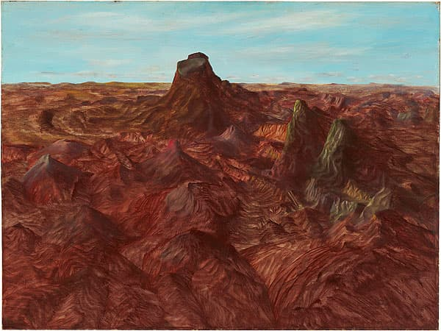
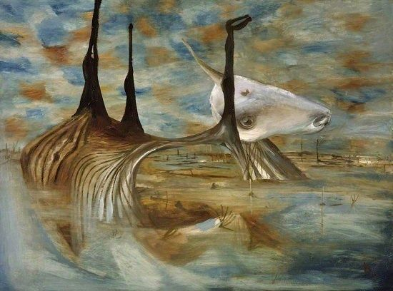
Sidney Nolan
Checking for understanding
Inland Australia, Sidney Nolan, 1950, oil and enamel on composition board. National Gallery of Australia, from Sidney Nolan Trust.
Carcase in Swamp, Sidney Nolan, 1955, oil on hardboard.. Tate, London from Sidney Nolan Trust.
Notes:
Teacher note: to be used alongside Phase 3b, sequence 2 – building the field for Core text 2 (integrated Phase 4 and 5).
Before exploring the allusion in the story, consider the cultural capital students bring, or may not bring, to their understanding of references such as Sidney Nolan, gentrification, or homelessness. Avoid assuming familiarity with these concepts. To support equitable access and deeper engagement, use an explicit teaching strategy such as Checking for understanding before engaging in text analysis (https://education.nsw.gov.au/teaching-and-learning/curriculum/explicit-teaching/explicit-teaching-strategies/checking-for-understanding).

Slide 23


Abstract paintings
Visual literacy and conceptual understanding
Abstract wall painting photo by Mayur Deshpande on Unsplash
Vibrant colour photo by Steve Johnson on Unsplash
Notes:
Teacher note: this slide is to be used alongside Phase 3b, sequence 2 – building the field for Core text 2 (integrated Phase 4 and 5).
The reference to a ‘twisted abstract painting’ assumes a level of visual literacy and conceptual understanding that may not be shared by all students. Consider defining abstract art, such as distortion, symbolism, and emotional tone before inviting interpretation. Use the visual examples on this slide to prompt discussion: What elements of these paintings are ‘twisted’? How does this help us visualise the park scene described in the text? This supports students to decode the metaphor and critically engage with the layered social commentary in the passage.

Slide 24
Annotating the second paragraph (2)
Layers of meaning – slide 2
By April, the park’s population had grown from those two tents to more than 30. Some sat away from the majority, others bunched in groups. It was almost a twisted abstract painting, the tents and the people that occupied them placed against a backdrop of freshly gentrified buildings. I wonder if Sidney Nolan would feel the same.
Annotations:
Imagery – the imagery of a ‘twisted abstract painting’ creates a visual representation of the tents and people, highlighting the stark contrast between the makeshift living conditions and the gentrified surroundings. This emphasises the social issues at play and the concerns of displacement.
Juxtaposition – between homelessness and gentrification places two opposing social realities side by side to highlight inequality and displacement.
Tone – the narrator’s tone is contemplative but also tinged with irony or subtle sarcasm. The casual musing masks deeper social criticism, making the tone layered and complex.
Notes:
Teacher note: these annotations may also be used alongside Phase 3b, sequence 2 – building the field for Core text 2 (integrated Phase 4 and 5). Consider animating the annotations to manage student cognitive load.
Guiding students through this text, draw attention to how metaphor, allusion, and juxtaposition all work to layer meaning, evoke emotion, and position the reader to reflect on broader social issues. These devices don’t just decorate the text — they build critical links between imagery, social context, and the reader’s interpretation.
Prompting questions for students may include:
Identify what is being compared (or contrasted) and why.
Reflect on how the arrangement of visual and written elements might mirror the chaos, beauty, or displacement being described.
Explore how these techniques encourage empathy and a critical view of social inequality.
For many students it will be important to support students vocabulary before and during their engagement with the text. See below for examples:
Population – The group of people living in a particular place. In this context, it refers to the number of people living in the park.
Majority – The larger part of a group. For example, most of the tents were in one area — that’s the majority.
Bunched – Gathered closely together. It suggests the tents were packed in tight groups.
Twisted abstract painting – A confusing or distorted picture that doesn’t show things realistically. This metaphor suggests the scene looked messy, emotional, or surreal.
Occupied – Lived in or used by someone. In this case, the tents were occupied by people experiencing homelessness.
Sidney Nolan – A famous Australian artist known for painting bold, emotional images — especially his Ned Kelly series. O'Neill compares the tent city to something Nolan might paint, suggesting the scene is visually striking and politically loaded.
Gentrified – Describes an area that has been made more expensive or ‘fancy’, often pushing poorer people out and changing the social makeup of the neighbourhood.
Chaotic – Confusing, disorganised, or out of control. This word helps describe the look and feel of the tent city.
Aesthetic – Related to how something looks or feels — especially in terms of beauty or artistic style.
Urban development – The process of building and improving parts of a city, like new apartments or shopping centres. It often changes who can afford to live there.
Critiques – Points out problems or gives a judgement. The poet is critiquing the way society responds to homelessness.
Neglect – Failure to care for or give attention to someone or something. Here, it suggests society has ignored people living in poverty or without housing.
Less fortunate – A respectful way to describe people who have fewer resources or support — especially those facing poverty or homelessness.
Homelessness – The condition of not having a stable or safe place to live. This can include living in tents, cars, temporary shelters, or on the street.

Slide 25
Phase 3b, sequence 3 – understanding and analysing the ways punctation can be used to shape meaning
Musgrave Park, Brisbane photo by Rae Allen on Wikimedia commons
Notes:
Teacher note: this slide has been used to identify the resources which may be used alongside Phase 3b, sequence 3 – understanding and analysing the ways punctuation can be used to shape meaning (integrated Phase 5)

Slide 26
Gradual release of responsibility
Notes:
Teacher note: this slide has been used to identify the explicit teaching learning strategy and should be deleted or hidden when using in a classroom setting. The strategy of gradual release of responsibility is a flexible process moving between modelled, guided and independent teaching practice responsive to student learning. Students should be supported to move between each practice based on their capabilities and requirements.
Teachers deliver a structured and sequenced approach to explicitly teaching new content. Learning is most effective when teachers break new information down and teach it explicitly using explanation, demonstration and modelling. This is especially relevant when students are new to an area (AERO 2024).

Slide 27
How punctuation can shape meaning (1)
Paragraph 3 – (1)
I’ve never agreed with the term homeless. Then again, I’ve never lived on the streets.
To say that someone is without a house or shelter is one thing, but to be without a home implies one has no place where they belong. Home is an experience—home is a human feeling, not a quality that belongs to every dwelling.
Annotations:
Abstraction/emotive language – shifts the idea of “home” from a physical place to an emotional and existential need, appealing to pathos inviting the reader to reconsider their own understanding of what “home” means.
Dash - highlights a shift from the idea of home as something physical to home as something emotional and personal prompting the reader to consider this idea.
Italics - Signals that the word carries social and emotional weight, encouraging the reader to think about language and labels.
Notes:
Teacher note: this section of the PowerPoint is to be used in conjunction with Phase 3b, sequence 3 – understanding and analysing the ways punctuation can be used to shape meaning (integrated Phase 5). Consider animating the annotations to manage student cognitive load.
This slide models how punctuation can serve not only grammatical functions but also stylistic and persuasive purposes. When introducing the annotations, explicitly link this activity to the learning intention: “understand how punctuation can be used to shape meaning”. With emphasis on identifying examples of how O’Neill’s punctuation choices help shape tone, highlight contradictions, and evoke emotion - particularly in addressing complex social issues like homelessness. Prompt students to consider how punctuation enhances the reader’s empathy or challenges assumptions, supporting the success criterion: “identify how punctuation shapes meaning in a core text.”
O’Neill introduces a paradoxical idea in “To say that someone is without a house or shelter is one thing, but to be without a home implies one has no place where they belong.” Here, O'Neill unpacks the paradox that someone can be housed and still feel homeless or be unhoused and still cultivate a sense of home. This challenges the simplistic binary of housed = safe and unhoused = lost, and instead reveals the deeper emotional and relational dimensions of what "home" truly means.
Homeless - lacking a permanent place to live, often implying living on the streets
Shelter - a structure or place that provides temporary protection from the elements, offering basic protection and safety but not necessarily a "home."
Implies – hints at something without saying it clearly.
Dwelling – a place where someone lives, such as a house, apartment, or other type of residence,
existential - In this passage, it means that "home" is not just a place, but a deep feeling of belonging and being understood.
Pathos - when a writer or speaker makes you feel strong emotions like sadness, anger, or sympathy. It helps you care about the people or ideas being talked about.

Slide 28
How punctuation can shape meaning (2)
Paragraph 3 – (2)
Using this term to describe a group of people leaves a lot unsaid for each individual’s situation; no single word can offer a complete understanding of a lived experience. Yet, often society is content with using the term to refer to the totality of the growing housing crisis, or more specifically, the population affected by it.
Annotations:
Semi-colon – links two independent clauses emphasising the speaker's disapproval, prompting the reader to feel disturbed by the simplification of an important social issue.
Commas – create a pause to encourage the reader to see beyond the term "homeless" and focus on the people affected, making the issue feel more urgent and real.
Notes:
Teacher note: this section of the PowerPoint is to be used in conjunction with Phase 3b, sequence 3 – understanding and analysing the ways punctuation can be used to shape meaning (integrated Phase 5). Consider animating the annotations to manage student cognitive load.
To consolidate this learning, refer students to the final activity where they revise their discursive letter of gratitude. Reinforce the link to the Responding content point of ‘Use accurate spelling, punctuation, syntax and metalanguage in creating critical and creative texts’ and the success criterion: “experiment with punctuation to shape meaning in their own compositions.” Encourage students to reflect critically: Does a dash here express my personal tone more clearly? Could a semicolon link complex ideas more meaningfully? Use peer feedback scaffolds to support guided reflection and self-editing. This stage also provides an opportunity to model the evaluative language needed for metacognitive reflection on their own writing decisions

Slide 29
How punctuation can shape meaning (3)
Paragraph – (3)
In his book, At Home in the World, New Zealand author Michael Jackson suggests that in the English language, many words we consider nouns should really be verbs, ‘in as much as they refer to fleeting things’. Through this lens, consider the tent village, where multiple individuals find themselves in a makeshift living arrangement, a fleeting moment—a moment that need not risk lasting a lifetime.
Annotations:
Expert reference – the reference to a respected academic is an appeal to ethos, giving the argument credibility.
Abstract language – this philosophical idea appeals to logos encouraging readers to think critically about identity and experience.
Imperative language – This appeal to pathos, invites readers to emotionally connect with the human experience of displacement. The em dash evokes a sense of hope for positive change.
Paradox – the idea of something being temporary yet enduring contradicts itself—but it captures a painful truth.
Notes:
Teacher note: this section of the PowerPoint can be used in conjunction with Phase 3b, sequence 3 – understanding and analysing the ways punctuation can be used to shape meaning (integrated Phase 5). Consider animating the annotations to manage student cognitive load. Some of the annotations here can be used to support student understanding of different elements of the text.
This slide models the annotation of paragraph 3 (continued) of ‘The tent village at Musgrave Park’. The writer blends intellectual authority, figurative language, and temporal contrast to challenge societal perceptions of homelessness. By reframing the experience as fluid and temporary, the writer urges readers to reconsider the labels we use and the real-life consequences of inaction.
The paradox: a “fleeting moment” that may “last much longer.”
The very idea of something being temporary yet enduring contradicts itself—but it captures a painful truth. The tent village is meant to be a short-term solution, a transient stopgap. But society’s inaction, misconceptions about homelessness, and systemic failures risk turning that temporary state into a long-term condition.
This paradox underscores the tension between how homelessness is perceived (as short-term or episodic) versus how it is often experienced (as sustained and worsening).
fleeting - Something that doesn’t last long; short-lived or temporary. For example, the living situation in the tent village is not meant to last forever.
lens - A way of seeing or understanding something; a point of view. For example, using Michael Jackson’s idea to look at the tent village from a new perspective.
makeshift - Something temporary or not properly built; put together quickly because it’s all that’s available. For example, people are living in tents or temporary shelters without proper housing.
philosophical - Related to deep thinking about life, meaning, and ideas. For example, Michael Jackson’s idea is philosophical because it asks us to think deeply about language, identity, and experience.
credibility - being believable or trustworthy. For example, referring to a well-known author like Michael Jackson gives the argument credibility, because people are more likely to trust what a respected expert says.

Slide 30
How punctuation can shape meaning (4)
Paragraph 3 – (4)
However, if we don’t shift our view of what being ‘homeless’ actually entails, that fleeting moment may last much longer.
Annotations:
Conditional statement – presents a warning about the consequences of not doing anything to help. It suggests that it is our moral responsibility — and that we must change the way we think to stop things like this from getting worse.
Notes:
Teacher note: this section of the PowerPoint is to be used in conjunction with Phase 3b, sequence 3 – understanding and analysing the ways punctuation can be used to shape meaning (integrated Phase 5). Consider animating the annotations to manage student cognitive load.
This slide models the annotation of paragraph 3 (continued) of ‘The tent village at Musgrave Park’. This closing sentence acts as powerful call to action arguing that widely accepted perceptions — if left unexamined — may contribute to ongoing social harm.
Entails – what something really involves.

Slide 31
How punctuation can shape meaning (5)
Paragraph 12
This became a theme as I spoke to more of the tent village’s community. Some people wouldn’t speak to me. I could hear the distrust in the closing of zippers; I could see it in the turning of backs. Others talked to me only in hushed voices, wide-eyed, glancing around every few minutes to make sure no one else could hear what they were saying. I saw locks on tents. Many in the community told me of the constant distrust that runs the park. No one feels safe. And how could you? When you have together in one area a group of people who have been living on the street for the last few days, weeks, months, even years, how would one expect that to unfold?
Annotations:
Semi-colon (;) – links two powerful images of distrust. It builds rhythm and shows how deeply fear is felt in different ways.
Commas (,) – add quick details, creating a nervous, jumpy feeling. They mirror how anxious and scared the people living in the park are.
Question Marks (?) – invite the reader to feel the fear and sadness themselves. They make the speaker's voice sound emotional and personal.
Full Stops (.) - make short, sharp and shocking points to appeal to our sense of empathy.
Notes:
Teacher note: this slide is to be used in conjunction with/to support Phase 3b, sequence 3 – understanding and analysing the ways punctuation can be used to shape meaning (integrated Phase 5). Consider animating the annotations to manage student cognitive load.
This slide models the annotation of paragraph 12 of ‘The tent village at Musgrave Park’. The writer’s use of punctuation highlights the anxiety, distrust and sadness felt by the people who live in the tent village.

Slide 32
Phase 3b, sequence 4 – exploring how sentence structure can be used to hook the reader and build ideas
Musgrave Park, Brisbane photo by Rae Allen on Wikimedia commons
Notes:
Teacher note: this slide has been used to identify the resources that may be used alongside Phase 3b, sequence 4 – exploring how sentence structure can be used to hook the reader and build ideas.

Slide 33
Analysing the sentence types in the opening paragraph
It started with two. The tents sat side-by-side along Edmondstone Street, in the corner hidden behind the Moreton Bay Fig. Two grey triangles in a sea of green. One might think it was people taking advantage of the warm days during the summer months, but by the time the rain came in February, it was clear the tents were here to stay. I thought it odd but not out of place. Strange but not shocking. The park is far enough away from the pristine streets of the city’s agreeable members of society to not cause any serious unrest.​
Annotations
Short fragmented sentences – reflect the writer’s discomfort and growing awareness that the tents are not temporary—they show hesitation and emotional tension.
Simple sentence –expresses the O’Neill’s personal feelings, suggesting they find the situation unusual but acceptable.
Complex sentences –
  this sentence contrasts what people might expect with the reality, showing that the tents are permanent despite initial thoughts.
  provides context for the situation, explaining the lack of disturbance to society and illustrating social dynamics.
Notes:
Teacher note: these annotations may also be used alongside Phase 3b, sequence 4 – exploring how sentence structure can be used to hook the reader and build ideas.. Consider using this slide as part of a joint deconstruction activity (modelled and guided), then gradually release responsibility to students to co-annotate later sections of the text or their peers’ work. Consider animating the annotations to manage student cognitive load.
When unpacking this slide consider prompting students to consider:
- Why has the writer chosen fragmented syntax here?
You may wish to incorporate:
Sentence level language - after identifying O’Neill’s sentence fragments, consider asking students to write three variations of the same idea: one as a fragment, one as a simple sentence, and one as a complex sentence. Discuss how meaning and tone shift with each form.
Another approach:
Identify and define: Begin by having students identify each sentence type in the extract. Provide definitions and examples of simple, complex, and fragment sentences to ensure understanding. Highlight how each type serves a different purpose in conveying information and emotion.
Discuss purpose and effect: Facilitate a discussion on why the author might use different sentence types. For example, discuss how simple sentences provide clear information, while complex sentences add depth and detail. Emphasise how fragments can create emphasis or evoke strong imagery
Engage with examples: Encourage students to find their own examples from the text and explain their effects. This can help reinforce their understanding and allow them to practice recognising sentence types and their purposes in writing.

Slide 34
Supplementary text annotations
Notes:
Teacher note: the following slides are supplementary text annotations. These can be used and adapted throughout Phase 3b as meets the needs of your class.

Slide 35
The tent village at Musgrave Park (1)
Paragraph 5
‘So, you live here?’
‘In that tent over there,’ Jay said, pointing in the distance. It sat within a group of five others. ‘I’ve been here since yesterday.’
‘Since yesterday?’ I was shocked. I had assumed the community’s growth had become stagnant. ‘And can I ask, where were you before here?’
Annotations: persuasive language
Dialogue – Jay’s matter-of-fact response contrasts with the narrator’s surprised reaction highlighting how normalised the situation is for Jay and how disconnected outsiders may be from the reality of constant movement or displacement.
Internal monologue – reveals the writer’s preconceived assumptions and how quickly they’re challenged by the reality.
Notes:
Teacher note: this slide models the annotation of paragraph 5 of ‘The tent village at Musgrave Park’. This short exchange uses dialogue and personal reflection to challenge assumptions about homelessness. It reveals how close, respectful conversations can uncover hidden truths, reinforcing the idea that storytelling and listening are essential to understanding social realities.
Consider animating the annotations to manage student cognitive load.
Assumed - thinking that something is true without checking
Stagnant – not moving, not growing, for example, the writer thought that the tent village was not growing.
Matter-of-fact- Talking in a calm, honest way, like something is normal, for example, Jay spoke in a matter-of-fact way about living in a tent—like it wasn’t a big deal.
Normalised - Something that people now think is normal, even if it’s not good, for example, seeing tents in the park has been normalised—people don’t care about it anymore.
Disconnected - Feeling far away from others; not close or involved for example, some people feel disconnected from the homeless community—they don’t understand their lives.
Outsiders - People who are not part of a group, for example, people who don’t live in the tent village are outsiders—they don’t know what it’s really like.
Displacement - Being forced to leave your home or usual place, for example, when people lose their homes and have to live in tents..
Preconceived - an idea you have before knowing the real story for example, some people have preconceived ideas about homelessness—they judge before they understand.

Slide 36
The tent village at Musgrave Park (2)
Paragraph 5 – slide 2
‘Uhh—I was living in a four-bedroom, what do you call it—through Brisbane Housing Company. I was supposed to have an operation on my feet. I’ll show ya.’ Jay pulled his feet out of his thongs to reveal what looked like mutilation. His toes pointed in every direction, his joints swollen. ‘Now it’s growing and pushing my toes out the other way. But that’s the way it is, I guess.’ Jay took a deep breath. His eyes wouldn’t meet mine.
Annotations:
Anecdotal evidence – enhances credibility and appeals to pathos through the mention of the specific housing plan and Jay’s medical condition.
Non-verbal cues – Jay’s resigned body language deepen the emotional appeal and persuade the reader to reflect on the human cost of systematic neglect.
Notes:
Teacher note: T\this slide models the annotation of paragraph 5 (continued) of ‘The tent village at Musgrave Park’. The writer’s conversation with Jay challenges stereotypes and is designed to evoke compassion rather than judgement.
Consider animating the annotations to manage student cognitive load.
Brisbane housing company: provides housing for people on low incomes
mutilation: In the passage Jay's feet are described as appearing mutilated — this means they are badly deformed, possibly through injury, illness, or untreated medical conditions, and no longer function or appear as they should.
resigned: when Jay takes a deep breath and avoids eye contact, it shows he is not just in pain, he is also feeling like there is no point in explaining or hoping anymore.
systemic neglect: means that it is not just bad luck or poor choices causing people to be homeless—it is a failure of the government and its agencies to protect and care for people in times of need

Slide 37
The tent village at Musgrave Park (3)
Paragraph 6
The longer Jay and I spoke, I was struck by his depth of knowledge. He taught me about the rise and fall of Falun Dafa, a spiritual practice rooted in Buddhist tradition. He told me about his experience working in the security industry. We spoke about conspiracy theories. He explained his family’s long history of working within government associations.
Annotations:
Cumulative listing – the accumulation of personal and familial details builds Jay’s credibility, challenging stereotypes about homelessness and appealing to the reader’s sense of fairness by portraying him as informed, complex, and dignified.
Notes:
Teacher note: this slide models the annotation of paragraph 6 of ‘The tent village at Musgrave Park’. The writer’s conversation with Jay challenges stereotypes and is designed to evoke compassion rather than judgement.
Consider animating the annotations to manage student cognitive load.
Definitions
conspiracy theories: alternative explanations of events or systems that suggest secret, often sinister forces are at work,
accumulation: refers to a literary technique where multiple ideas, details, or images are listed or built up to create emphasis or impact – for example, the list of the things that Jay is interested in.
complex: refers to the idea that Jay has many interests and knows many things
dignified: Jay has a sense of self respect

Slide 38
The tent village at Musgrave Park (4)
Paragraph 6 (continued)
He had uncles in the air force, an aunty in public prosecutions, a grandparent who was a retired Vietnam veteran, and his mother was a nurse. I imagined this is why he was initially drawn to work within the public service as well; I didn’t want to ask how he felt about it now.
Annotations:
Irony – critiques the system that allows someone with such strong ties to community service to experience this level of hardship.
Notes:
Teacher note: this slide models the annotation of paragraph 6 (continued) of ‘The tent village at Musgrave Park’. The writer’s conversation with Jay challenges stereotypes and is designed to evoke compassion rather than judgement. Consider animating the annotations to manage student cognitive load.
Definitions
air force: refers to a branch of a nation's military responsible for air defence and combat, typically involving aircraft operations.
Vietnam veteran: someone who served in the Vietnam War, which took place from the late 1950s to 1975.
nurse: a healthcare professional who is responsible for caring for sick and injured people in hospitals or other medical settings.
public service: government organisation that provide services to the community, such as healthcare, law enforcement, education, and administration
irony: when something turns out differently from what you expect. It's like when you think one thing will happen, but the opposite or something unexpected happens instead.

Slide 39
The tent village at Musgrave Park (5)
Paragraph 18
During the time I spent getting to know the people living in the tent village, a lot of people brought up that Paul was the person providing the tents. I made it my mission to get in contact with him. We met on a Monday night at the park, where he had welcomed me to join him as he handed out supplies. At one of the park’s entrances, there were seven tables set up, half with clothes and half with food.
Annotations:
Anecdotal evidence – the writer uses a personal anecdote to create a sense of authenticity and position themselves as a credible empathetic observer.
Notes:
Teacher note: This slide models the annotation of paragraph 18 of ‘The tent village at Musgrave Park’. The warm welcome from Paul and his structured aid-giving highlight selves, challenging narrow ideas of home as purely physical. It reinforces that emotional and communal bonds can be forged even in transient conditions. Consider animating the annotations to manage student cognitive load.
Definitions
mission: a clear goal or purpose someone is committed to. In the passage, the writer’s mission is to contact Paul.
supplies: the things given or provided to help others meet basic needs—like tents, food, clothes, or blankets
authenticity: being honest, and true to yourself. Paul’s actions—connecting with people, caring about them—come across as real, not fake or for show.
empathetic: understanding and sharing how someone else feels. Paul seems empathetic because he listens, supports, and clearly cares about the people he’s helping.
observer: someone who watches and pays attention to what’s happening, often without getting directly involved. In the passage, the narrator is acting as an observer, noticing Paul’s behaviour and the connections he has with the people in the park.

Slide 40
The tent village at Musgrave Park (6)
Paragraph 22
As we continued through the park, he was constantly saying hello to everyone. People came up to update him on their situations. It was evident how connected he was to each person he had supplied a tent for. I asked Paul if he could see a common thread connecting the people living in the tent village. For him, trauma was the shared history of the park.
Annotations:
Juxtaposition of connection and suffering – describing trauma as “shared history” introduces emotional complexity. The people are connected not by friendship or family, but by systemic failures, displacement, and suffering.
Notes:
Teacher note: this slide can be used to support Phase 3b, sequence 10 – students compare and contrast texts to develop their own written expression and offer inspiration for their own writing (integrated Phase 4 and 5). This slide models the annotation paragraph 22 of ‘The tent village at Musgrave Park’. This section of the text continues to explore the invisible weight these people carry as a result of their life experiences. It positions trauma as not just personal but communal—something shaped by broader societal neglect—which urges the reader to feel a sense of ethical obligation to respond. Consider animating the annotations to manage student cognitive load.
Definitions
evident: clear or easy to see. In the passage, it was evident (clear) that Paul had strong connections with the people he helped—his care and relationships were obvious
common thread: a connection or theme that links different experiences together. In this case, Paul saw trauma as the common thread among the people in the tent village.
Trauma: deep emotional pain or distress caused by very difficult or painful experiences. Paul believes that many people in the tent village have experienced trauma, and that’s what connects them—they all carry a history of hurt or hardship.

Slide 41
The tent village at Musgrave Park (7)
Paragraph 23
I still walk past the park most weeks. The tents were removed for celebrations of Paniyiri in May and NAIDOC in July, but they always make their way back. I agree with Paul’s view that trauma continues to play a prominent role in the current housing crisis, not only as a cause but also as a product of the state of being one must be in while sleeping rough.
Annotations:
Reflective tone – shows the narrator's ongoing concern and connection with the issue and the people affected.
Irony – the phrase “they always make their way back” reflects both the resilience of the community and the absence of systematic change.
Notes:
Teacher note: this slide models the annotation of paragraph 23 of ‘The tent village at Musgrave Park’. The repeated action of walking past the park highlights the cyclical nature of the trauma experienced by the residents of Musgrave Park and the author’s concern.
Consider animating the annotations to manage student cognitive load.
Definitions
NAIDOC: NAIDOC stands for National Aboriginal and Islanders Day Observance Committee. It occurs over a week in July and celebrates the history, culture, and achievements of Aboriginal and Torres Strait Islander peoples in Australia
Paniyiri: a Greek cultural festival held in Brisbane, celebrating Greek food, music, and traditions. It’s a big event that brings the community together.
Prominent: important or noticeable. In the passage, trauma plays a prominent role, meaning it has a big, clear impact on the housing crisis.
crisis: a serious problem or emergency. The housing crisis means many people don’t have stable, affordable places to live, and it’s a big issue affecting communities.
sleeping rough: living and sleeping outside without a home—on the streets, in parks, or other public places.
resilience: the ability to keep going and stay strong during hard times.

Slide 42
The tent village at Musgrave Park (8)
Paragraph 23 (continued)
But I believe that the real crux is the gulf of understanding between the term ‘homelessness’ and the stories of the people who occupy this minority. ‘Homeless’, the term we use to describe a transient moment, should thus not be used as a generic term, but rather an indicator to the specificity that comes with every individual’s lived experience.
Annotations:
Metaphor – the emotive appeal here emphasizes the divide between public perceptions and the lived experiences of this minority group.
Call for semantic precision – urging readers to change their language and therefore their mindset.
Notes:
Teacher note: this slide models the annotation of paragraph 23 (continued of ‘The tent village at Musgrave Park’. The paragraph encourages the audience to rethink assumptions, question language use, and develop a deeper, more human understanding of homelessness. It closes the piece with a focus on reflection and responsibility, reinforcing that connection begins with listening and accurate representation.
Consider animating the annotations to manage student cognitive load.
Definitions
crux: the most important part of something. It’s the main idea or the biggest issue.
gulf: a big space or big difference between two things. Here, it means people don’t really understand what homelessness is like for others.
occupy: to live in or take up space. In this passage, it refers to the people who occupy the category of being homeless—they are the ones living that experience.
minority: a smaller group within a larger population. In the passage, it suggests that people who are homeless make up a smaller group in society, often overlooked or misunderstood.
generic: not special or not specific. The word “homeless” is generic because it doesn’t explain each person’s different story.
indicator: something that shows or points to something else. The word “homeless” should be an indicator—a clue that there is more to learn about each person’s life.
mindset: the way someone thinks or sees the world. Changing your mindset means thinking in a new or better way.
semantic precision: using the right words to say exactly what you mean. It’s about being clear and careful with language.

Slide 43
References (1)
This presentation contains NSW Curriculum and syllabus content. The NSW Curriculum is developed by the NSW Education Standards Authority. This content is prepared by NESA for and on behalf of the Crown in the right of the State of New South Wales. The material is protected by Crown copyright.
Please refer to the NESA Copyright Disclaimer for more information https://educationstandards.nsw.edu.au/wps/portal/nesa/mini-footer/copyright.
NESA holds the only official and up-to-date versions of the NSW Curriculum and syllabus documents. Please visit the NSW Education Standards Authority (NESA) website https://educationstandards.nsw.edu.au/wps/portal/nesa/home and the NSW Curriculum website https://curriculum.nsw.edu.au.
English Standard 11–12 Syllabus © NSW Education Standards Authority (NESA) for and on behalf of the Crown in right of the State of New South Wales, 2024.
Allen R Musgrave Park, Brisbane [photo] Wikimedia commons, accessed 24 June 2025.
Australian Curriculum, Assessment and Reporting Authority (ACARA) (2020), Literacy: About the general capability, General capabilities | V9 Australian Curriculum, ACARA website, accessed 23 July 2025.
Australian Institute for Teaching and School Leadership Limited (AITSL) (n.d.) Learning intentions and success criteria [PDF 251KB], AITSL, accessed 02 May 2025.
Banks C Furniture, [image], Unsplash website, accessed 24 June 2025.
Bouffard F At work (n.d.) [image], Unsplash, accessed 24 June 2025.
Getty images (2023) a large tree with a fence around it, [image], licenced under Unsplash+ website, accessed 2 May 2025.
Google (2025) Musgrave Park Qld [Google Maps] accessed 5 May 2025.
Jackson M (1995) At Home in the World, Duke University Press, NC, USA.
Michael (n.d.) Moreton Bay Fig Tree [image] on Unsplash accessed 24 June 2025.

Slide 44
References (2)
This presentation contains NSW Curriculum and syllabus content. The NSW Curriculum is developed by the NSW Education Standards Authority. This content is prepared by NESA for and on behalf of the Crown in the right of the State of New South Wales. The material is protected by Crown copyright.
Please refer to the NESA Copyright Disclaimer for more information https://educationstandards.nsw.edu.au/wps/portal/nesa/mini-footer/copyright.
NESA holds the only official and up-to-date versions of the NSW Curriculum and syllabus documents. Please visit the NSW Education Standards Authority (NESA) website https://educationstandards.nsw.edu.au/wps/portal/nesa/home and the NSW Curriculum website https://curriculum.nsw.edu.au.
Nolan S (1950) Inland Australia, oil and enamel on composition board. National Gallery of Australia, from Sidney Nolan Trust.
Nolan S (1955) Carcase in Swamp, oil on hardboard Tate, London from Sidney Nolan Trust. Website, accessed
O’Neill L (2024) ‘ The tent village at Musgrave Park’ in Meanjin 83.4, Melbourne University Publishing, Melbourne.
Sánchez G (2021) Homeless tent photo [image], licenced under Unsplash website, accessed 2 May 2025.
State of New South Wales (Department of Education) (2024) ‘Explicit teaching strategies’, Explicit teaching, NSW Department of Education website, accessed 5 May 2025.
Walter Luigi J (2022) a tent in a park, [image], Unsplash website, accessed 2 May 2025.

Slide 45
Copyright
© State of New South Wales (Department of Education), 2025
The copyright material published in this resource is subject to the Copyright Act 1968 (Cth) and is owned by the NSW Department of Education or, where indicated, by a party other than the NSW Department of Education (third-party material).
Copyright material available in this resource and owned by the NSW Department of Education is licensed under a Creative Commons Attribution 4.0 International (CC BY 4.0) license.
This license allows you to share and adapt the material for any purpose, even commercially.
Attribution should be given to © State of New South Wales (Department of Education), 2025.
Material in this resource not available under a Creative Commons license:
the NSW Department of Education logo, other logos and trademark-protected material
Material owned by a third party that has been reproduced with permission. You will need to obtain permission from the third party to reuse its material.
Links to third-party material and websites
Please note that the provided (reading/viewing material/list/links/texts) are a suggestion only and implies no endorsement, by the New South Wales Department of Education, of any author, publisher, or book title. School principals and teachers are best placed to assess the suitability of resources that would complement the curriculum and reflect the needs and interests of their students.
If you use the links provided in this document to access a third-party’s website, you acknowledge that the terms of use, including licence terms set out on the third-party’s website apply to the use which may be made of the materials on that third-party website or where permitted by the Copyright Act 1968 (Cth). The department accepts no responsibility for content on third-party websites.

