Slide 1
Introduction and instructions for use
Using the PowerPoint in the classroom
This is a PowerPoint containing episodes of a podcast and exploring the feature of paradox. It is designed to accompany the sample program ‘Reading to write: Transition to English Standard’. It is not a teaching and learning program.
Instructions
Classroom teachers are encouraged to add and adapt slides as required to meet the needs of their students.
Save a copy of the file to make changes to the slide deck. Go to File > Download a Copy (this downloads a copy to the computer to edit in the PowerPoint app).
To convert the PowerPoint to Google Slides
  Upload the file into Google Drive and open it.
  Go to File > Save as Google Slides.
  (Note – conversion may cause formatting changes in the slides.)
Notes:
Teachers note: this slide has been used to support teachers in using the resource and should be deleted or hidden when using in a classroom setting.

Slide 2
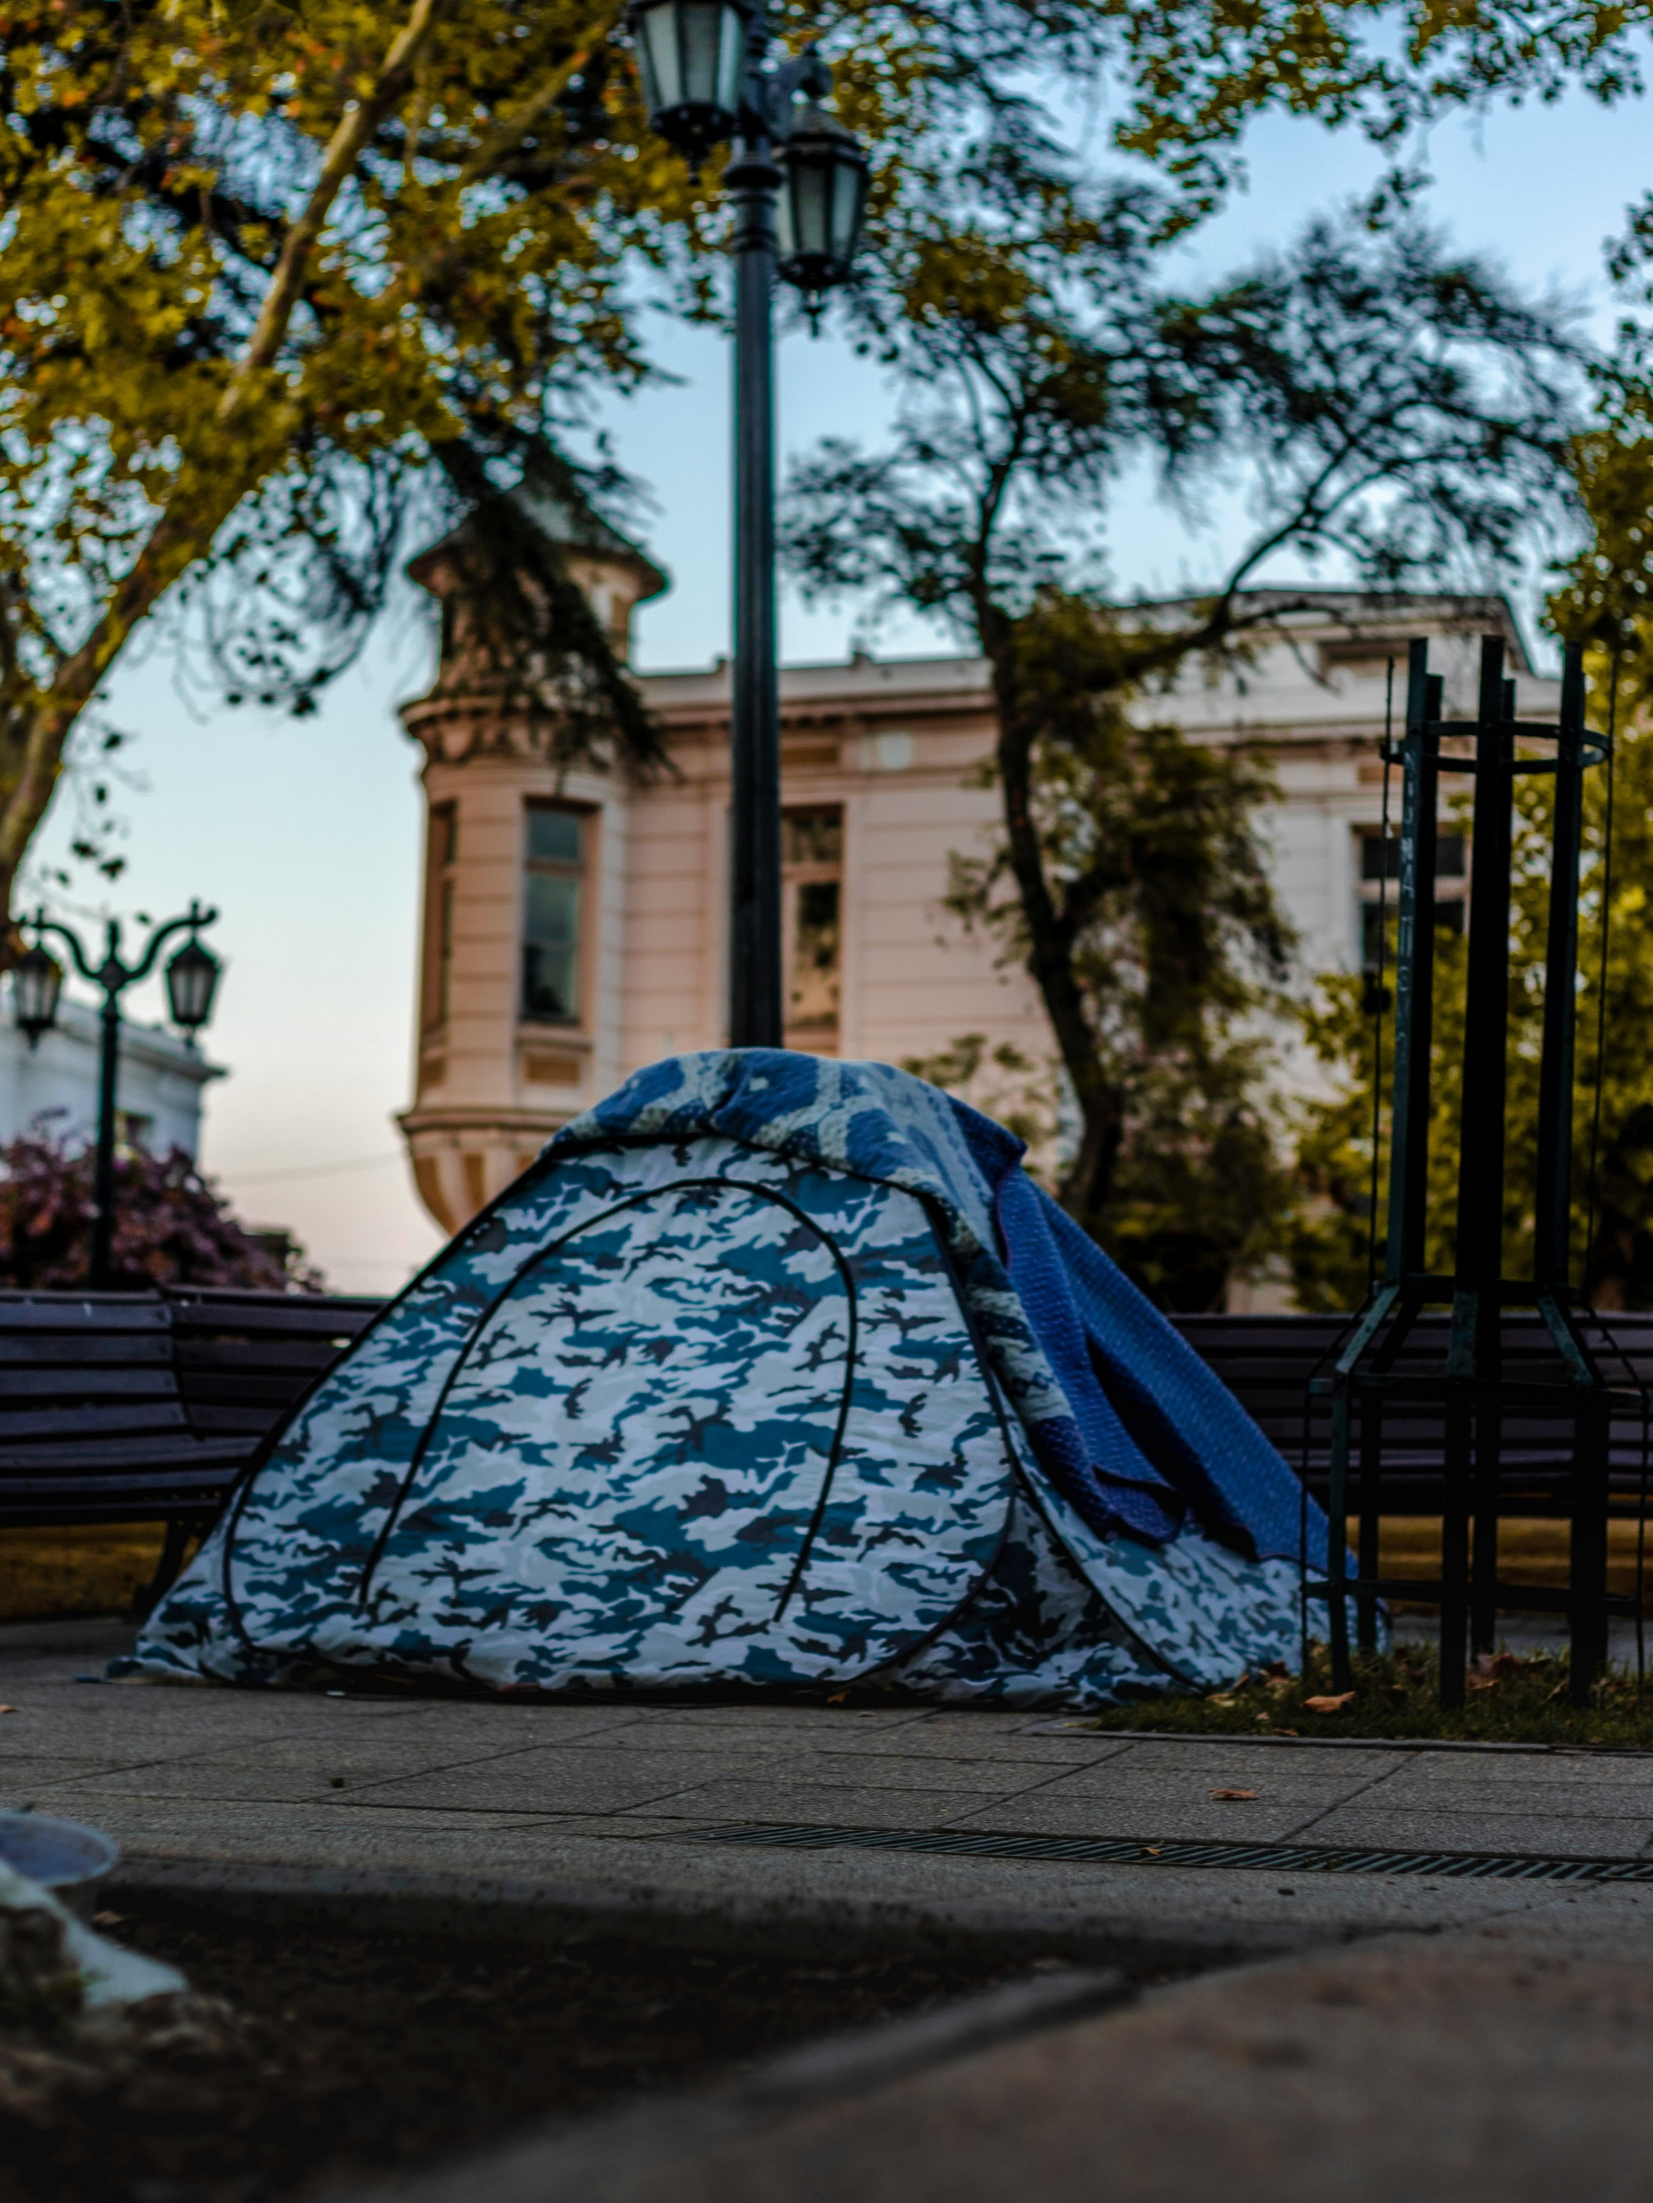
In conversation – Lillian O’Neill
Stage 6 Standard –11.1
‘Reading to write: Transition to English Standard’ – Year 11, Term 1
Homeless tent photo by Gustavo Sánchez on Unsplash
Notes:
Teachers notes: the purpose of this PowerPoint is to provide support students to deepen their understanding and connection to the text, supporting analysing and working towards a critical appreciation. It accompanies Phase 3b.
Note that Phase 4 and Phase 5 have been integrated into Phase 3b.
The ‘engaging personally, analytically and critically with texts’ phase is designed to enhance students’ vocabulary, contextual understanding, and analytical skills. Through this phase, students build the capacity to appreciate, understand, and analyse the core text ‘The tent village at Musgrave Park’ by Lillian O’Neill critically, setting the stage for their ongoing engagement with the text and supporting their development as thoughtful readers and writers.

Slide 3
Licence agreement details
Core text 2 – The tent village at Musgrave Park
‘The tent village at Musgrave Park’ by Lillian O’Neill was first published in the 2024 Summer edition (83.4) of the literary journal Meanjin.
The use of this text has been made possible as permission has been granted Lillian O’Neill. The text contained in this resource is licensed up until March 2029. Reproduced and made available for copying and communication by NSW Department of Education for its educational purposes with the permission of Cambridge University Press. This resource is licensed up until March 2029.
Notes:
Teacher note: this slide is for schools' reference only and should be hidden or deleted when used in a classroom setting.
It is essential all text choices align with the Controversial issues in schools policy and comply with audiovisual material requirements (https://education.nsw.gov.au/policy-library/policies/pd-2005-0290-03.html)
Follow the department’s guidelines for communicating with parents and carers about texts. The templates in Text selection notification (https://education.nsw.gov.au/teaching-and-learning/curriculum/leading-curriculum-k-12/explaining-curriculum-pcc/texts-used-in-classrooms/text-selection-notification) have been created as a guide and should be adapted as necessary to suit each school's specific context. The guidelines for How to use the English core texts for English 7–10 are also relevant for Stage 6 (https://education.nsw.gov.au/teaching-and-learning/curriculum/english/planning-programming-and-assessing-english-7-10/how-to-use-english-core-texts).

Slide 4
Text complexity
Core text 2 – The tent village at Musgrave Park
The text, ‘The tent village at Musgrave Park’ meets the text requirements for English Standard as it is an Australian text that is widely regarded as quality literature and it explores a range of social, cultural and gender perspectives.
The text contains a range of markers which align to the moderately complex to highly complex level of the Text Complexity scale as per the ‘Literacy: About the general capability’ document which can be downloaded on the General capabilities downloads page of the Australian Curriculum webpage. It provides students opportunities to engage with a text that explores complex issues and cultural context that encourages critical thinking and deep comprehension. The text considers complex themes and questions cultural expectations centred perceptions of social status. It explores the multiple connotations that can be inferred from the words ‘home’ and ‘homelessness’ using complex sentences and subtle evaluative language reflecting the author’s viewpoint.
This text references trauma and homelessness, consider this in the decision to use this text in your context. Use of this text should be guided by the department’s advice regarding Preventing public disclosures, Types of crises and Supporting refugee students. To learn more, visit Trauma-informed practice in schools: An explainer.
Notes:
Teacher note: this slide is for teachers' reference only and should be hidden or deleted when used in a classroom setting.
Links:
https://education.nsw.gov.au/teaching-and-learning/curriculum/pdhpe/planning-programming-and-assessing-pdhpe-k-12/learning-environment/preventing-public-disclosures#:~:text=Preventing%20public%20disclosures%201%20keeping%20discussions%20global%20rather,someone...%27%205%20maintaining%20a%20professional%20role.%20More%20items
https://curriculum.nsw.edu.au/learning-areas/english/english-eald-11-12-2024/overview/course
https://education.nsw.gov.au/teaching-and-learning/multicultural-education/support-in-times-of-crisis/types-of-crises
https://education.nsw.gov.au/teaching-and-learning/multicultural-education/refugee-students-in-schools
https://education.nsw.gov.au/about-us/education-data-and-research/cese/publications/research-reports/trauma-informed-practice-in-schools

Slide 5
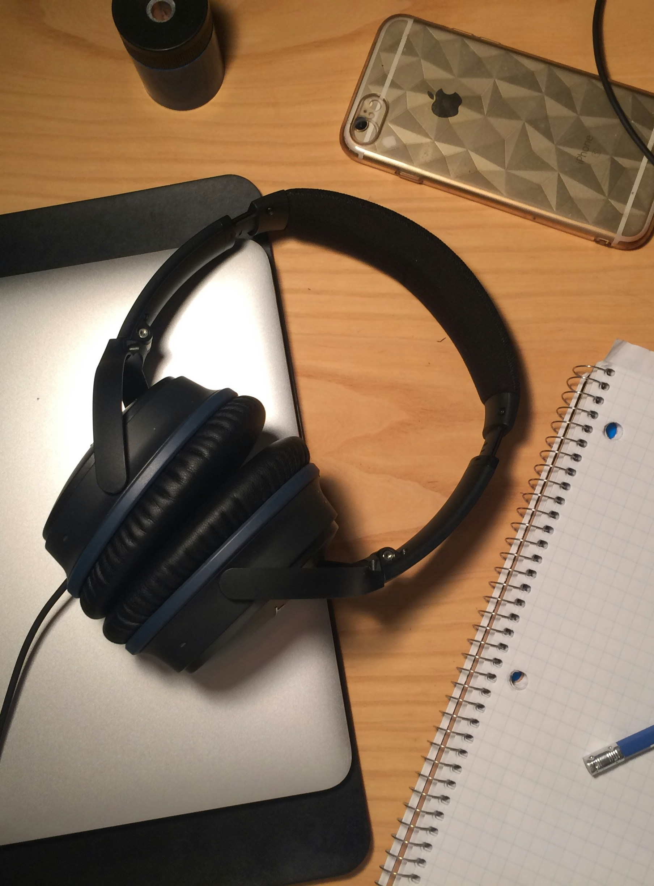
In conversation with writers – podcast
O’Neill Part 1 ‘TTVMP’
Phase 3b, sequence 7
At work by Francis Bouffard on Unsplash
Notes:
The following podcast excerpt and associated activity are designed to support Phase 3b, sequence 7 – applying understanding of hybrid texts (integrated Phase 5).

Slide 6
Learning intentions and success criteria (1)
We are learning to:
O’Neill's writing process as discussed in the podcast episode
develop effective listening and note-taking skills
engage in peer discussions that enhance comprehension and critical thinking about values and identities in writing.
We can:
[classroom teacher to insert co-constructed success criteria].
Notes:
Notes for teachers: this slide is to be used in conjunction with/to support Phase 3b, sequence 7– applying understanding of hybrid texts (integrated Phase 5).
Adapt the provided learning intention and below sample success criteria, as required, to suit the needs of your students.
identify key information from the podcast regarding O’Neill’s writing process and intentions
articulate my responses to the questions based on my understanding of the interview
collaborate with peers to discuss and analyse values, identities, and actions in O’Neill’s work.
LISC is usually shared first or early in the lesson and is explained by the teacher who checks for understanding (DoE 2025).
LISC is referred to regularly to check for understanding, provide feedback or as a self-assessment tool (Wiliam and Leahy 2015).
Learning intentions and success criteria can be supported by exemplars, such as 'What A Good One Looks Like' (WAGOLL) or exemplars to demonstrate success criteria (Clarke 2021).
For more information, see:
Sharing learning intentions and success criteria: https://education.nsw.gov.au/content/dam/main-education/documents/teaching-and-learning/curriculum/explicit-teaching/explicit-teaching-technique-guide-lisc-sharing.pdf
Planning learning intentions and success criteria: https://education.nsw.gov.au/content/dam/main-education/documents/teaching-and-learning/curriculum/explicit-teaching/explicit-teaching-technique-guide-lisc-planning.pdf

Slide 7

O’Neill on her writing process
Listening activity
Read the questions, highlighting key words and phrases to listen for.
Listen to the podcast interview.
Listen to the interview for a second time. Take notes in your English book to support you in answering your question.
Complete the questions in Phase 3b, activity 5 – O’Neill on her writing process.
Listen to the podcast – In conversation with writers – O'Neill – Part 1 – TTVMP
Notes:
Teacher note: this slide is to be used in conjunction with support Phase 3, sequence 7 –applying understanding of hybrid texts (integrated Phase 5) and Phase 3b, activity 5 – O’Neill on her writing process.
Depending on student need, you may choose to provide time stamps, a transcript and model the locating and answering of a question. Where possible, ensure technology is booked in advance to allow students to their own device to listen to the interview, pause and rewind as needed.
Link to interview: https://players.brightcove.net/6197335233001/default_default/index.html?videoId=6373145350112

Slide 8
In conversation with writers – podcast (2)1)
O’Neill Part 1 ‘TTVMP’
Phase 3b, sequence 8
At work by Francis Bouffard on Unsplash
Notes:
Teacher note: the following slide is to be used in conjunction with Phase 3b, sequence 8 – preparing to complete Core formative task 3 (integrated Phase 5 and 6)

Slide 9
Learning intentions and success criteria (2)
Using in the classroom
We are learning to:
O’Neill's writing process as discussed in her podcast episode
develop effective listening and note-taking skills
engage in peer discussions that enhance comprehension and critical thinking about values and identities in writing.
We can:
[classroom teacher to insert co-constructed success criteria].
Notes:
Notes for teachers: this slide is to be used in conjunction with/to support Phase 3b, sequence 8 – preparing to complete Core formative task 3 (integrated Phase 5 and 6).
Adapt the provided learning intention and below sample success criteria, as required, to suit the needs of your students.
identify key information from the podcast regarding O’Neill’s writing process and intentions
articulate my responses to the questions based on my understanding of the interview
collaborate with peers to discuss and analyse values, identities, and actions in O’Neill’s work.
LISC is usually shared first or early in the lesson and is explained by the teacher who checks for understanding (DoE 2025).
LISC is referred to regularly to check for understanding, provide feedback or as a self-assessment tool (Wiliam and Leahy 2015).
Learning intentions and success criteria can be supported by exemplars, such as 'What A Good One Looks Like' (WAGOLL) or exemplars to demonstrate success criteria (Clarke 2021).
For more information, see:
Sharing learning intentions and success criteria: https://education.nsw.gov.au/content/dam/main-education/documents/teaching-and-learning/curriculum/explicit-teaching/explicit-teaching-technique-guide-lisc-sharing.pdf
Planning learning intentions and success criteria: https://education.nsw.gov.au/content/dam/main-education/documents/teaching-and-learning/curriculum/explicit-teaching/explicit-teaching-technique-guide-lisc-planning.pdf

Slide 10
Writing for community
Listening activity
Read the questions, highlighting key words and phrases to listen for.
Listen to the podcast interview.
Listen to the interview for a second time. Take notes in your English book to support you in answering your question.
Complete the questions in Phase 3b, activity 6 – writing for community.
Listen to the podcast – In conversation with writers – O'Neill – Part 1 – TTVMP
Notes:
Teacher note: this slide is to be used in conjunction with support Phase 3b, sequence 8 and Phase 3b, activity 6 – writing for community.
Depending on student need, you may choose to provide time stamps, a transcript and model the locating and answering of a question. Where possible, ensure technology is booked in advance to allow students to their own device to listen to the interview, pause and rewind as needed.
Link to interview: https://players.brightcove.net/6197335233001/default_default/index.html?videoId=6373145350112

Slide 11
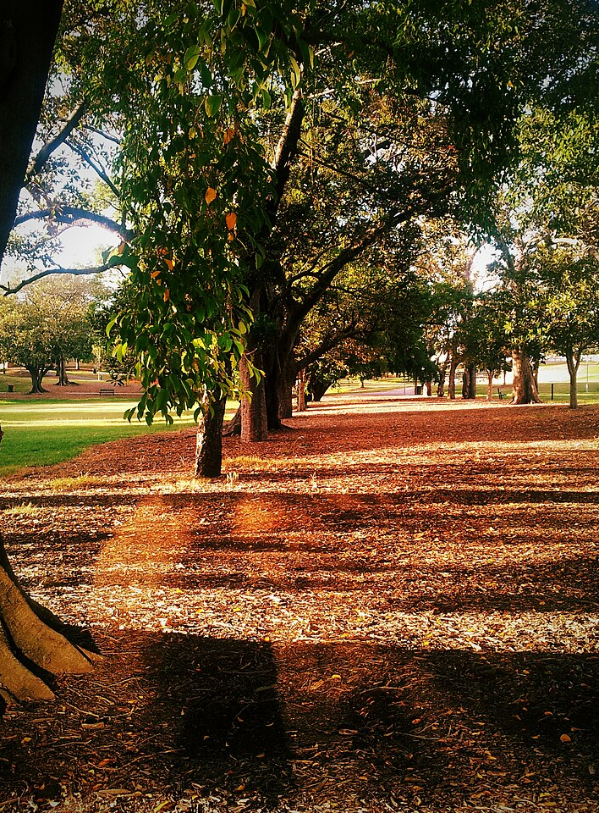
Phase 3b, sequence 9 – critical engagement with ‘The tent village at Musgrave Park’
Musgrave Park, Brisbane photo by Rae Allen on Wikimedia commons
Notes:
Teachers note: this section is to be used in conjunction with Phase 3b, sequence 9 – critical engagement with ‘The tent village at Musgrave Park’ (integrated Phase 4 and 5).

Slide 12
Understanding paradox
Notes:
Teachers note: Use these slides in conjunction with Phase 3b, sequence 9 – critical engagement with ‘The tent village at Musgrave Park’ (integrated Phase 4 and 5).

Slide 13

Understanding the concept of paradox
Definition and examples
A paradox is a statement or situation that seems to say 2 opposite things at the same time.
Paradoxes
create interesting and thought-provoking moments
can make readers stop and think deeply about the ideas being presented
can convey complex emotions and situations that might seem confusing at first but reveal deeper truths
engage and encourages readers to explore different perspectives, making the writing more powerful and memorable.
For example, if somebody were to both ‘love’ and ‘hate’ something at the same time, this would be considered paradoxical.
Unnamed by cdd20 on Unsplash
Notes:
Teacher note: use this slide in conjunction with Phase 3b, sequence 9 – critical engagement with ‘The tent village at Musgrave Park’ (integrated Phase 4 and 5).
Below is one approach to delivering this slide.
Begin by displaying the slide with the definition of a paradox.
Read the definition aloud to the students, you may ask students to copy the information in the blue box into their English books.
Elaborate on the definition by explaining that paradoxes often involve statements or situations that seem contradictory but can reveal a deeper truth or insight.
Encourage students to think about situations in their own lives where they have felt conflicting emotions or thoughts, such as loving and hating something simultaneously.
Discuss the example provided on the slide: For example, if somebody were to both ‘love’ and ‘hate’ something at the same time, this would be considered paradoxical.
Discuss the image on the slide: Explain that this image represents how different ideas or feelings can seem to align in one way but ultimately point to a completely different conclusion. This illustrates the concept of paradox by showing how multiple conflicting perspectives can come together to create a surprising or unexpected outcome.
Ask students to think of their own examples of paradoxical feelings or situations and invite a few students to share their thoughts with the class.
Encourage students to ask questions if they are unclear about the concept.
Prompt a brief discussion on why understanding paradoxes can be useful, such as in literature, art, or real-life problem-solving.
Another example provided to students could be: When people are given too many options, they can feel overwhelmed and less satisfied with their final choice. This is a paradox because having more choices should ideally lead to greater satisfaction, but it often has the opposite effect.
Another image could be: An optical illusion, such as Rubin's Vase – this can visually demonstrate how something can be perceived in two different ways, reinforcing the idea of contradictory perspectives.

Slide 14
In conversation with writers – podcast (3)
O’Neill Part 1 ‘TTVMP’
Phase 3b, sequence 9
At work by Francis Bouffard on Unsplash
Notes:
Teacher note: this section is to be used in conjunction with Phase 3b, sequence 9 – critical engagement with ‘The tent village at Musgrave Park’ (integrated Phase 4 and 5).

Slide 15
Learning intentions and success criteria (3)
We are learning to:
O’Neill's insights on writing about community as discussed in her podcast
develop effective listening and note-taking skills
engage in critical thinking about the role of language in connecting people and addressing social issues.
We can:
[classroom teacher to insert sample success criteria]
Notes:
Notes for teachers: this slide is to be used in conjunction with/to support Phase 3b, sequence 9 – critical engagement with ‘The tent village at Musgrave Park’ (integrated Phase 4 and 5).
Adapt the provided learning intention and below sample success criteria, as required, to suit the needs of your students.
identify key information from the podcast regarding O’Neill's perspectives on community writing
articulate my responses to the questions based on my understanding of the interview
relate vocabulary terms to the content discussed in the podcast.
LISC is usually shared first or early in the lesson and is explained by the teacher who checks for understanding (DoE 2025).
LISC is referred to regularly to check for understanding, provide feedback or as a self-assessment tool (Wiliam and Leahy 2015).
Learning intentions and success criteria can be supported by exemplars, such as 'What A Good One Looks Like' (WAGOLL) or exemplars to demonstrate success criteria (Clarke 2021).
For more information, see:
Sharing learning intentions and success criteria: https://education.nsw.gov.au/content/dam/main-education/documents/teaching-and-learning/curriculum/explicit-teaching/explicit-teaching-technique-guide-lisc-sharing.pdf
Planning learning intentions and success criteria: https://education.nsw.gov.au/content/dam/main-education/documents/teaching-and-learning/curriculum/explicit-teaching/explicit-teaching-technique-guide-lisc-planning.pdf

Slide 16
O’Neill on paradox
Listening activity
Read the questions, highlighting key words and phrases to listen for.
Listen to the podcast.
Listen to the interview for a second time. Take notes in your English book to support you in answering your question.
Complete the questions in Phase 3b, activity 10 – listening to O’Neill on paradox.
Listen to the podcast –
In conversation with writers – O'Neill – Part 1 – TTVMP
Notes:
Teacher note: this slide is to be used in conjunction with support Phase 3b, sequence 9 – critical engagement with ‘The tent village at Musgrave Park’ (integrated Phase 4 and 5)and Phase 3, activity 10 – listening to O’Neill on paradox.
Depending on student need, you may choose to replicate the small group approach and model the locating and answering of a question used in Phase 2, activity 2 – influences on Dalton’s writing. Where possible, ensure technology is booked in advance to allow students to their own device to listen to the interview, pause and rewind as needed.
Link to interview: https://players.brightcove.net/6197335233001/default_default/index.html?videoId=6373145350112

Slide 17
References (1)
This presentation contains NSW Curriculum and syllabus content. The NSW Curriculum is developed by the NSW Education Standards Authority. This content is prepared by NESA for and on behalf of the Crown in the right of the State of New South Wales. The material is protected by Crown copyright.
Please refer to the NESA Copyright Disclaimer for more information https://educationstandards.nsw.edu.au/wps/portal/nesa/mini-footer/copyright.
NESA holds the only official and up-to-date versions of the NSW Curriculum and syllabus documents. Please visit the NSW Education Standards Authority (NESA) website https://educationstandards.nsw.edu.au/wps/portal/nesa/home and the NSW Curriculum website https://curriculum.nsw.edu.au.
English Standard 11–12 Syllabus © NSW Education Standards Authority (NESA) for and on behalf of the Crown in right of the State of New South Wales, 2024.
Australian Curriculum, Assessment and Reporting Authority (ACARA) (2020), Literacy: About the general capability, General capabilities | V9 Australian Curriculum, ACARA website, accessed 23 July 2025.
Australian Institute for Teaching and School Leadership Limited (AITSL) (n.d.) Learning intentions and success criteria [PDF 251KB], AITSL, accessed 02 May 2025.
Getty images (2023) a large tree with a fence around it, [image], licenced under Unsplash+ website, accessed 2 May 2025.
Google (2025) Musgrave Park Qld [Google Maps] accessed 5 May 2025.

Slide 18
References (2)
This presentation contains NSW Curriculum and syllabus content. The NSW Curriculum is developed by the NSW Education Standards Authority. This content is prepared by NESA for and on behalf of the Crown in the right of the State of New South Wales. The material is protected by Crown copyright.
Please refer to the NESA Copyright Disclaimer for more information https://educationstandards.nsw.edu.au/wps/portal/nesa/mini-footer/copyright.
NESA holds the only official and up-to-date versions of the NSW Curriculum and syllabus documents. Please visit the NSW Education Standards Authority (NESA) website https://educationstandards.nsw.edu.au/wps/portal/nesa/home and the NSW Curriculum website https://curriculum.nsw.edu.au.
O’Neill L (2024) ‘ The tent village at Musgrave Park’ in Meanjin 83.4, Melbourne University Publishing, Melbourne.
Walter Luigi J (2022) a tent in a park, [image], Unsplash website, accessed 2 May 2025.
State of New South Wales (Department of Education) (2024) ‘Explicit teaching strategies’, Explicit teaching, NSW Department of Education website, accessed 5 May 2025.

Slide 19
Copyright
© State of New South Wales (Department of Education), 2025
The copyright material published in this resource is subject to the Copyright Act 1968 (Cth) and is owned by the NSW Department of Education or, where indicated, by a party other than the NSW Department of Education (third-party material).
Copyright material available in this resource and owned by the NSW Department of Education is licensed under a Creative Commons Attribution 4.0 International (CC BY 4.0) license.
This license allows you to share and adapt the material for any purpose, even commercially.
Attribution should be given to © State of New South Wales (Department of Education), 2025.
Material in this resource not available under a Creative Commons license:
the NSW Department of Education logo, other logos and trademark-protected material
Material owned by a third party that has been reproduced with permission. You will need to obtain permission from the third party to reuse its material.
Links to third-party material and websites
Please note that the provided (reading/viewing material/list/links/texts) are a suggestion only and implies no endorsement, by the New South Wales Department of Education, of any author, publisher, or book title. School principals and teachers are best placed to assess the suitability of resources that would complement the curriculum and reflect the needs and interests of their students.
If you use the links provided in this document to access a third-party’s website, you acknowledge that the terms of use, including licence terms set out on the third-party’s website apply to the use which may be made of the materials on that third-party website or where permitted by the Copyright Act 1968 (Cth). The department accepts no responsibility for content on third-party websites.

