Slide 1
Instructions for use
This resource is not a teaching and learning program. It should be used in conjunction with ‘Reading to Write’ – Year 11, Term 1.
Classroom teachers are encouraged to add and adapt slides as required to meet the needs of their students.
Save a copy of the file to make changes to the slide deck. Go to File > Download a Copy (this downloads a copy to the computer to edit in the PowerPoint app).
To convert the PowerPoint to Google Slides:
  Upload the file into Google Drive and open it.
  Go to File > Save as Google Slides.
  (Note – conversion may cause formatting changes in the slides.)

Slide 2
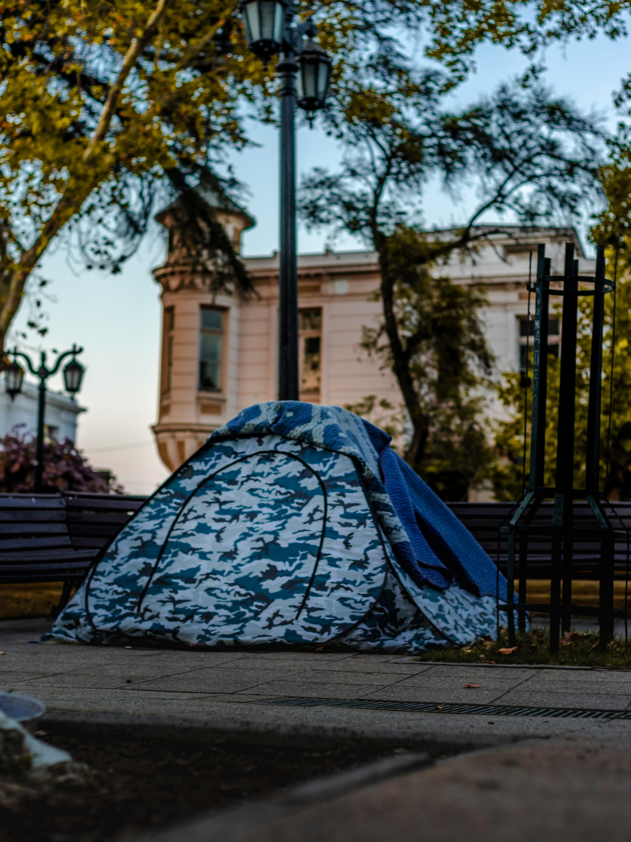
Phase 3b – Exploring lyric, persuasive and hybrid writing
Stage 6 EAL/D – 11.1
‘Reading to write: Transition to English EAL/D’, Year 11, Term 1
Homeless tent photo by Gustavo Sánchez on Unsplash
Notes:
Teachers notes: the purpose of this PowerPoint is to provide support students to deepen their understanding and connection to the text, supporting analysing and working towards a critical appreciation. It accompanies Phase 3b, sequences 5 and 6
Note that Phase 4 and Phase 5 have been integrated into Phase 3b.
The ‘engaging personally, analytically and critically with texts’ phase is designed to enhance students’ vocabulary, contextual understanding, and analytical skills. Through this phase, students build the capacity to appreciate, understand, and analyse the core text ‘The tent village at Musgrave Park’ by Lillian O’Neill critically, setting the stage for their ongoing engagement with the text and supporting their development as thoughtful readers and writers.
Teacher note: the use of slides as they appear in this PowerPoint may lead to cognitive overload for students. It may be appropriate for your class to use this resource in smaller ‘chunks’ over several learning sequences and animate text. Use professional judgement to determine how much of this content is accessible and achievable for your class.

Slide 3
Licence agreement details
Core text 2 – ‘The tent village at Musgrave Park’ – by Lillian O’Neill
‘The tent village at Musgrave Park’ by Lillian O’Neill was first published in the 2024 Summer edition (83.4) of the literary journal Meanjin.
The use of this text has been made possible as permission has been granted Lillian O’Neill. The text contained in this resource is licensed up until March 2029. Reproduced and made available for copying and communication by NSW Department of Education for its educational purposes with the permission of Lillian O’Neill. This resource is licensed up until March 2029.
Notes:
Teacher note: this slide is for schools' reference only and should be hidden or deleted when used in a classroom setting.
It is essential all text choices align with the Controversial issues in schools policy and comply with audiovisual material requirements (https://education.nsw.gov.au/policy-library/policies/pd-2005-0290-03.html)
Follow the department’s guidelines for communicating with parents and carers about texts. The templates in Text selection notification (https://education.nsw.gov.au/teaching-and-learning/curriculum/leading-curriculum-k-12/explaining-curriculum-pcc/texts-used-in-classrooms/text-selection-notification) have been created as a guide and should be adapted as necessary to suit each school's specific context. The guidelines for How to use the English core texts for English 7–10 are also relevant for Stage 6 (https://education.nsw.gov.au/teaching-and-learning/curriculum/english/planning-programming-and-assessing-english-7-10/how-to-use-english-core-texts).

Slide 4
Text complexity
Core text 2 – ‘The tent village at Musgrave Park’ – by Lillian O’Neill
The text, ‘The tent village at Musgrave Park’ meets the text requirements for EAL/D as it is an Australian text that is widely regarded as quality literature and it explores a range of social, cultural and gender perspectives.
This text contains a range of markers which align to the moderately complex to highly complex level of the Text Complexity scale as per Literacy: About the general capability document which can be downloaded on the General capabilities downloads page of the Australian Curriculum webpage. It provides students opportunities to engage with a text that explores complex issues and cultural context that encourages critical thinking and deep comprehension. The text considers complex themes and questions cultural expectations centred perceptions of social status. It explores the multiple connotations that can be inferred from the words ‘home’ and ‘homelessness’ using complex sentences and subtle evaluative language reflecting the author’s viewpoint.
EEA-11-01: analyses the ways an author’s choice of textual forms and features shapes meaning in texts from different modes and mediums.
This text references trauma and homelessness, consider this in the decision to use this text in your context. Use of this text should be guided by the department’s advice regarding Preventing public disclosures, Types of crises and Supporting refugee students. To learn more, visit Trauma-informed practice in schools: An explainer.
Notes:
Teacher note: this slide is for teachers' reference only and should be hidden or deleted when used in a classroom setting.
Links:
https://education.nsw.gov.au/teaching-and-learning/curriculum/pdhpe/planning-programming-and-assessing-pdhpe-k-12/learning-environment/preventing-public-disclosures#:~:text=Preventing%20public%20disclosures%201%20keeping%20discussions%20global%20rather,someone...%27%205%20maintaining%20a%20professional%20role.%20More%20items
https://curriculum.nsw.edu.au/learning-areas/english/english-eald-11-12-2024/overview/course
https://education.nsw.gov.au/teaching-and-learning/multicultural-education/support-in-times-of-crisis/types-of-crises
https://education.nsw.gov.au/teaching-and-learning/multicultural-education/refugee-students-in-schools
https://education.nsw.gov.au/about-us/education-data-and-research/cese/publications/research-reports/trauma-informed-practice-in-schools

Slide 5
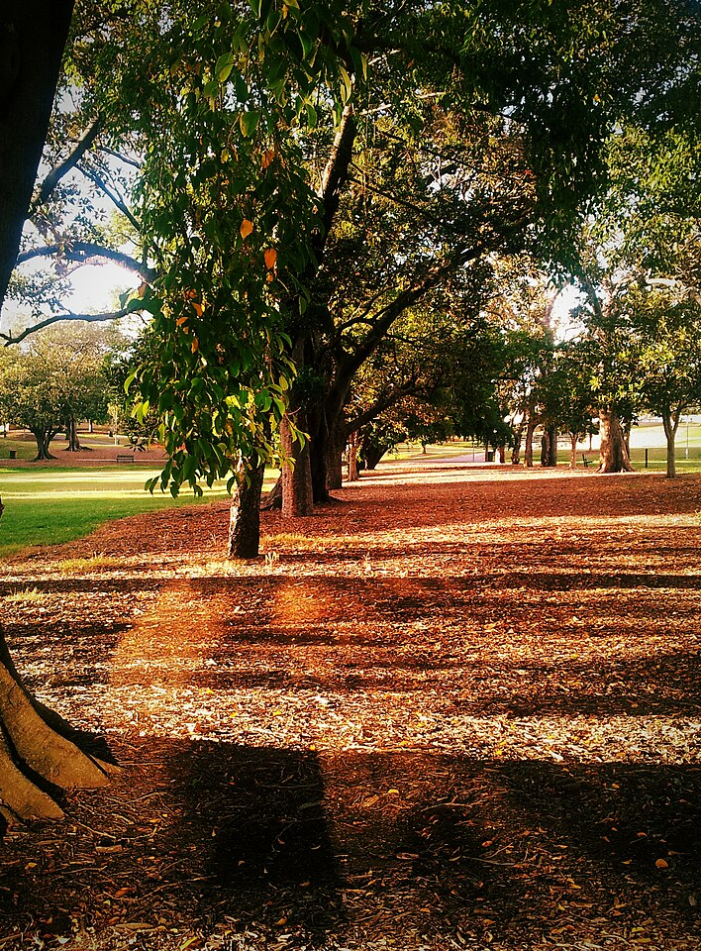
Phase 3b, sequence 5 – unpacking the form – lyric essay and persuasive elements
Musgrave Park, Brisbane photo by Rae Allen on Wikimedia commons
Notes:
Teachers note: this slide has been used to identify the resources which may be used alongside Phase 3b, sequence 5.

Slide 6
What is a lyric essay?
Notes:
Teachers note: Use these slides in conjunction with Phase 3b, sequence 5.

Slide 7

Lyric essay (1)
Definition
A lyric essay is a form of writing that can mix elements of poetry and prose. It expresses personal thoughts and feelings in a creative way.
Instead of telling a straightforward story, a lyric essay uses imagery to explore themes or ideas. It can be more about feelings and experiences than following a strict structure, making it a unique and artistic form of writing.
Notes:
Teachers note: Use these slides in conjunction with Phase 3b, sequence 5.
Guide students through understanding this definition and ask them to copy it into their Writing journals. Unpack and clarify as needed.

Slide 8




Lyric essay (2)
Key characteristics (1)
Lyrical language: It often employs poetic language, using rhythm, sound, and imagery to create an emotional effect.
Non-linear structure: The structure may be non-linear, with sections or fragments that do not follow a traditional narrative arc.
Personal reflection: It typically includes personal thoughts, feelings, and reflections, making it subjective and intimate.
Exploration of themes and ideas: Rather than making a single argument, a lyric essay explores complex themes and ideas, often through associative thinking.
ABC
Notes:
Teachers note: Use these slides in conjunction with Phase 3b, sequence 5.
Discuss the key characteristics on the slide, clarifying as needed.
Consider animating each piece of information to appear one at a time to avoid cognitive overload. Additionally, you may ask students to copy this information into their Writing journals or provide them with a printed copy.

Slide 9






Lyric essay (3)
Key characteristics (2)
Use of vivid imagery: It relies on strong imagery and sensory details to evoke feelings and create a connection with the reader.
Mixing genres: The lyric essay often blends elements from various genres, including memoir, poetry, and traditional essay writing.
Emotional impact: The focus is on evoking emotions and provoking thought rather than simply conveying information.
Notes:
Teachers note: Use these slides in conjunction with Phase 3b, sequence 5.
Discuss the key characteristics on the slide, clarifying as needed.
Consider animating each piece of information to appear one at a time to avoid cognitive overload. Additionally, you may ask students to copy this information into their Writing journals or provide them with a printed copy.

Slide 10
Discourse markers
Discourse markers are words or phrases that organise and structure paragraphs and extended pieces of writing
Discourse markers for cause and effect | Examples of discourse marker
Because | Indicates the reason for an action or situation.
Therefore | Shows the result or consequence of a previous statement.
As a result | Highlights the outcome or effect of a cause stated earlier.
Consequently | Indicates a direct consequence of an event or action.
Due to | Specifies the cause of a situation or event.
So | Connects a cause with its direct effect in a straightforward manner.
Since | Indicates the reason for a situation, often used at the beginning of a sentence.
For this reason | Explains why something happened based on prior information.
Hence | Indicates a conclusion drawn from earlier statements, similar to ‘therefore’.
Activity – Find as many examples of these as you can in Core text 2.
Notes:
Teachers note: Use these slides in conjunction with Phase 3b, sequence 5. Consider animating the text on the slide to manage student cognitive load. You may ask students to copy this table into their writing journals or alternatively provide them with a printed copy.
Explain to students that when comparing texts, it is essential that you use academic language known as discourse markers. Discourse markers are words or phrases that organise and structure paragraphs and extended pieces of writing.
To deliver this slide you could:
Create a matching activity. This could be done digitally if technology is available or by providing students with cut up pieces of paper with the information to align.
Ask students (either verbally or written) to provide examples of how each marker could be used. This could be made more challenging by providing students two topics/items/prompts to compare and having them use the most appropriate discourse marker.
Ask students to locate examples of these in Core text 2 and explain these can be used as models for the next activity.
Additional discourse markers:
Comparison - Similarly; likewise; like; in the same way; equally; akin to
Contrast - Alternatively; conversely; on the other hand; in contrast; instead; besides
To qualify - However; although; but; except
To support - Moreover; furthermore; also; additionally
To emphasise - Significantly; indeed; notably
To exemplify - For example; such as; illustrated by; for instance

Slide 11



Expanding vocabulary and understanding of language forms relevant to lyric essays and persuasive texts
Ethos – the credibility of the speaker or writer. This is shaped by the writer’s reputation, their trustworthiness and how believable they are. The speaker or writer should establish themselves as someone who knows a lot about or has a lot of experience with the topic, subject matter and/or context of the situation.
Pathos – the emotional appeal in the writing. This is shaped by the writer’s deliberate use of ideas and/or language which they know will cause an emotional reaction or connection in their audience. This is the appeal to the emotional side of the audience’s minds.
Logos – the logical appeal of the writing in the text. The use of logic, reasoning, evidence and facts to support an argument. This is the appeal to the rational side of the audience’s minds. The intellectual appeal is in the writing. This includes the bulk of the factual information the writer wants the audience to acknowledge. Evidence, statistics and data are all part of logos.
Notes:
Teachers note: Use these slides in conjunction with Phase 3b, sequence 5.
This slide may be used for revision purposes as meets the needs of students. Consider animating text to manage cognitive load.
This could be turned into a cloze passage or a matching activity.

Slide 12
Phase 3b, sequence 6 – exploring hybridity in ‘The tent village at Musgrave Park’
Musgrave Park, Brisbane photo by Rae Allen on Wikimedia commons
Notes:
Teachers note: this slide has been used to identify the resources which may be used alongside Phase 3b, sequence 6.

Slide 13






Connecting to prior learning
What do we mean when we say ‘hybrid’?
hybrid
Notes:
Teachers note: this slide has been used to identify the resources which may be used alongside Phase 3b, sequence 6.
Students brainstorm where they may have heard this term before (teacher should organise student contributions into categories where relevant, e.g. machinery, cars, plants, etc.).
Note for differentiation: Where appropriate, you may wish to include some alternative images related to the word ‘hybrid’ on screen to prompt and support students engage with the brainstorm. Remind students that textual hybridity was addressed in ‘Exploring the speculative’ – 9.4, ‘Novel voices’ – 10.1 and ‘Digital stories’ – 10.4. Prereading, resource 3 – links to prior learning identifies a range of activities and resources that can be revisited to refresh student knowledge of hybrid texts.

Slide 14
Definition (1)
What does ‘hybrid’ mean?
Based on the brainstorm and your own knowledge, write a definition of the word ‘hybrid’.
Compare your definition with your peers. Take note of any commonly occurring features of your definitions.
Re-write your definition if you choose and share with the class.
Collins Dictionary:
Hybrid – ‘You can use hybrid to refer to anything that is a mixture of other things, especially two other things.’
Notes:
Teachers note: this slide has been used to identify the resources which may be used alongside Phase 3b, sequence 6.
This activity could be completed in pairs or small groups, edit the slide to reflect the chosen format. Facilitate a class discussion after 3. where students share their definitions and make a point of calling our the commonly occurring features of these definitions.
Then reveal to students the Collins Dictionary definition [click for the animation to reveal the definition] and ask students to copy this into their books.

Slide 15









Connecting to prior learning (2)
What do we mean when we say ‘text’?
text
Notes:
Teachers note: this slide has been used to identify the resources which may be used alongside Phase 3b, sequence 6.
Students brainstorm their understanding of ‘text’. You may choose to replace or delete the images on screen depending on the needs of your students, these could be used as prompts to stimulate and guide discussion.

Slide 16
Definition (2)
What does ‘text’ mean?
Based on the brainstorm and your own knowledge, write a definition of the word ‘text’.
Compare your definition with your peers. Take note of any commonly occurring features of your definitions.
Re-write your definition if you choose and share with the class.
How has our understanding of 'text' evolved over time? What might it look like in 2035?
NESA Glossary definition:
Any written, spoken/signed, nonverbal, visual, auditory or multimodal communication. Texts may be extended unified works, a series of related pieces or a single, simple piece of communication.
Notes:
Teachers note: this slide has been used to identify the resources which may be used alongside Phase 3b, sequence 6.
Teacher note: this activity could be completed in pairs or small groups, edit the slide to reflect the chosen format. Facilitate a class discussion after 3. where students share their definitions and make a point of calling our the commonly occurring features of these definitions.
Then reveal to students the NESA Glossary dictionary [click for the animation to reveal the definition] and ask students to copy this into their books.

Slide 17
Making connections
What do we mean when we talk about ‘hybrid texts’?
Hybrid
Text
Hybrid texts
Notes:
Teachers note: this slide has been used to identify the resources which may be used alongside Phase 3b, sequence 6.
Teacher note: students copy their definitions of ‘hybrid’ and ‘text’ into the 2 circles. They then in light of these, consider what their definition of a ‘hybrid text’ in the context of English would be and write this in the circle below. Students may work in pairs or small groups to complete this activity.
Prereading, resource 3 – links to prior learning identifies a range of activities and resources that can be revisited to refresh student knowledge of hybrid texts.

Slide 18
Hybrid texts (1)
Components of hybrid writing
Form
Style
Hybrid texts
Genre
Mode
A hybrid text is a composite text resulting from combining elements from different genres, styles and modes.
Notes:
Teachers note: this slide has been used to identify the resources which may be used alongside Phase 3b, sequence 6. Allow a reading of the definition of hybrid texts on screen as provided by the NESA glossary. Depending on the needs of your class, you may choose to facilitate a class discussion around what students already know about each of these components before moving on to an explanation of each on the next slide.
Definition – composite: something that is made of various different parts.

Slide 19
Hybrid texts (2)
Components of hybrid writing
Genre
Form
Style
Mode
Genre includes the categories into which texts are grouped based on similarities in premise, structure and function.
The ‘genre’ of a text describes larger recurring patterns of subject matter and textual structures observable between texts, such as typical plots, characters and setting.
Form is how we classify texts based on the way the text is written, or the category or type of text.
For instance, examples of form can include film or poetry.
Style is the way in which the effects of distinctive language forms and features of a text, often including those specific to its medium, combine to generate an overall impression.
Mode is the process of communication.
For example, sounds, music, printed or spoken words, images and gestures.
Notes:
Teacher note: this slide has been used to identify the resources which may be used alongside Phase 3b, sequence 6.
Teacher note: an explanation of each form is animated and will appear in the order on the screen when you click.
To determine prior knowledge of these components and students understanding of these explanations, you may like to ask probing questions and for examples of texts students may be familiar with that align with each of these.
Note for differentiation: depending on the language needs of your students, it may be necessary to define: premise, observable, recurring, classify, generate, impression, gestures, distinctive, etc.

Slide 20
Checking for understanding (1)
Notes:
Teacher note: this slide has been used to identify the explicit teaching learning strategy and should be deleted or hidden when using in a classroom setting.
If students cannot adequately respond to questions or complete activities, they should be provided with either whole class instruction in another delivery mode or example, or if only some students are lacking confidence, they could be assisted individually when the class move on to the next stage of learning.
Teachers analyse the information they collect to make evidence-based instructional decisions. This includes when to move between modelled, guided and independent practice.
Checking understanding requires teachers to collect the responses of all students (Wiliam 2014).

Slide 21

Checking for understanding (2)
Hybrid texts
A hybrid text is …
Notes:
Teacher note: this slide has been used to identify the resources which may be used alongside Phase 3b, sequence 6.
To check for student understanding of hybrid text, ask students to complete the sentence on screen using figurative language devices to creatively demonstrate their understanding.
For example:
A hybrid text is like a melting pot of ideas, that when stirred together produce a complex meal to be consumed.
A hybrid text is a garden of ideas, where different genres bloom side by side, each contributing its unique fragrance to the overall landscape.
A hybrid text is a feast for the senses, combining the savoury flavours of storytelling with the delicate spices of poetic language, leaving readers both satisfied and craving more.
A hybrid text is a journey without a single map, where the traveller navigates between genres, discovering new landscapes of thought and emotion along the way.
You may ask students to write their response on a sticky note that can be shared on a wall in the classroom for reference.

Slide 22
Comparing lyric essay and persuasive texts
Lyric essay
Persuasive text
Uses poetic devices and imagery
Explores ideas in a fragmented, non-liner way
Engages reader’s thoughts and feelings
Uses vivid imagery and impactful language
Explores complex ideas
Uses rhetorical strategies and emotional appeals
Presents clear arguments with supporting evidence
Notes:
Teachers note: Use these slides in conjunction with Phase 3b, sequence 6.
Introduce the Venn Diagram: Begin by displaying the Venn diagram on the board or a projector. Explain that the diagram visually represents the similarities and differences between lyric essays and persuasive texts.
Discuss unique characteristics: Go through each section of the diagram. Start with the unique characteristics of lyric essays, highlighting their use of poetic devices and exploration of ideas in a non-linear way. Then, move to persuasive texts, focusing on their clear arguments and use of rhetorical strategies. Encourage students to share examples they may know of each style.
Explore shared characteristics: Shift focus to the overlapping section of the diagram, discussing how both styles engage the reader's thoughts and feelings, use vivid language, and explore complex ideas. Emphasise how these shared traits can enhance writing and communication.
Encourage synthesis: Lead a discussion on how elements of both styles can be combined in writing. Ask students to think about how a persuasive text could incorporate lyrical elements to make arguments more impactful or how a lyric essay could present a persuasive idea through emotional appeal.
Link to core text: ask students to reflect on how they think O’Neill has done this in her work.

Slide 23
References (1)
This presentation contains NSW Curriculum and syllabus content. The NSW Curriculum is developed by the NSW Education Standards Authority. This content is prepared by NESA for and on behalf of the Crown in the right of the State of New South Wales. The material is protected by Crown copyright.
Please refer to the NESA Copyright Disclaimer for more information https://educationstandards.nsw.edu.au/wps/portal/nesa/mini-footer/copyright.
NESA holds the only official and up-to-date versions of the NSW Curriculum and syllabus documents. Please visit the NSW Education Standards Authority (NESA) website https://educationstandards.nsw.edu.au/wps/portal/nesa/home and the NSW Curriculum website https://curriculum.nsw.edu.au.
English EAL/D 11-12 Syllabus © NSW Education Standards Authority (NESA) for and on behalf of the Crown in right of the State of New South Wales, 2024.
Allen R Musgrave Park, Brisbane [photo] Wikimedia commons, accessed 24 June 2025.
Australian Curriculum, Assessment and Reporting Authority (ACARA) (2020), Literacy: About the general capability, General capabilities | V9 Australian Curriculum, ACARA website, accessed 23 July 2025.
Australian Institute for Teaching and School Leadership Limited (AITSL) (n.d.) Learning intentions and success criteria [PDF 251KB], AITSL, accessed 02 May 2025.
Michael (n.d.) Moreton Bay Fig Tree [image] on Unsplash accessed 24 June 2025.
Jackson M (1995) At Home in the World, Duke University Press, NC, USA.
Getty images (2023) a large tree with a fence around it, [image], licenced under Unsplash+ website, accessed 2 May 2025.
Google (2025) Musgrave Park Qld [Google Maps] accessed 5 May 2025.
O’Neill L (2024) ‘ The tent village at Musgrave Park’ in Meanjin 83.4, Melbourne University Publishing, Melbourne.

Slide 24
References (2)
This presentation contains NSW Curriculum and syllabus content. The NSW Curriculum is developed by the NSW Education Standards Authority. This content is prepared by NESA for and on behalf of the Crown in the right of the State of New South Wales. The material is protected by Crown copyright.
Please refer to the NESA Copyright Disclaimer for more information https://educationstandards.nsw.edu.au/wps/portal/nesa/mini-footer/copyright.
NESA holds the only official and up-to-date versions of the NSW Curriculum and syllabus documents. Please visit the NSW Education Standards Authority (NESA) website https://educationstandards.nsw.edu.au/wps/portal/nesa/home and the NSW Curriculum website https://curriculum.nsw.edu.au.
Sánchez G (2021) Homeless tent photo [image], licenced under Unsplash+ website, accessed 2 May 2025.
State of New South Wales (Department of Education) (2024) ‘Explicit teaching strategies’, Explicit teaching, NSW Department of Education website, accessed 5 May 2025.
Walter Luigi J (2022) a tent in a park, [image], Unsplash website, accessed 2 May 2025.

Slide 25
Copyright
© State of New South Wales (Department of Education), 2025
The copyright material published in this resource is subject to the Copyright Act 1968 (Cth) and is owned by the NSW Department of Education or, where indicated, by a party other than the NSW Department of Education (third-party material).
Copyright material available in this resource and owned by the NSW Department of Education is licensed under a Creative Commons Attribution 4.0 International (CC BY 4.0) license.
This license allows you to share and adapt the material for any purpose, even commercially.
Attribution should be given to © State of New South Wales (Department of Education), 2025.
Material in this resource not available under a Creative Commons license:
the NSW Department of Education logo, other logos and trademark-protected material
Material owned by a third party that has been reproduced with permission. You will need to obtain permission from the third party to reuse its material.
Links to third-party material and websites
Please note that the provided (reading/viewing material/list/links/texts) are a suggestion only and implies no endorsement, by the New South Wales Department of Education, of any author, publisher, or book title. School principals and teachers are best placed to assess the suitability of resources that would complement the curriculum and reflect the needs and interests of their students.
If you use the links provided in this document to access a third-party’s website, you acknowledge that the terms of use, including licence terms set out on the third-party’s website apply to the use which may be made of the materials on that third-party website or where permitted by the Copyright Act 1968 (Cth). The department accepts no responsibility for content on third-party websites.

