Slide 1
Instructions for use
This resource is not a teaching and learning program. It should be used in conjunction with ‘Reading to Write’ – Year 11, Term 1.
Classroom teachers are encouraged to add and adapt slides as required to meet the needs of their students.
Save a copy of the file to make changes to the slide deck. Go to File > Download a Copy (this downloads a copy to the computer to edit in the PowerPoint app).
To convert the PowerPoint to Google Slides:
  Upload the file into Google Drive and open it.
  Go to File > Save as Google Slides.
  (Note – conversion may cause formatting changes in the slides.)

Slide 2

Phase 2 –
Trent Dalton –
In conversation and discursive writing
Stage 6 EAL/D – 11.1
‘Reading to write: Transition to English EAL/D’ – Year 11, Term 1
Type Writer photo by Marcus Winkler Unsplash
Notes:
Teacher note: the following slides are to be used in conjunction with Phase 2.

Slide 3
Licence agreement details
Core text 1 – ‘Dear Kath’ by Trent Dalton
Dalton, T (2021) ‘Dear Kath’ Love Stories, HarperCollinsPublishers, Sydney. ISBN 9781460760932.
The use of this text has been made possible as permission has been granted by HarperCollinsPublishers Australia Pty Ltd. Reproduced and made available for copying and communication by NSW Department of Education for its educational purposes with the permission of HarperCollinsPublishers. The extract contained in this resource is licensed up until March 2029.
Notes:
Teacher note: this slide is for schools' reference only and should be hidden or deleted when used in a classroom setting.
It is essential all text choices align with the Controversial issues in schools policy and comply with audiovisual material requirements. Follow the department’s guidelines for communicating with parents and carers about texts. The templates in Text selection notification have been created as a guide and should be adapted as necessary to suit each school's specific context. The guidelines for Selecting texts for English 7–10 are also relevant for Stage 6.
Controversial issues in schools policy: https://education.nsw.gov.au/policy-library/policies/pd-2005-0290-03.html
Audiovisual material requirements: https://education.nsw.gov.au/policy-library/policies/pd-2005-0290-03.html#:~:text=Comply%20with%20audiovisual%20material%20requirements
Text selection notification: https://education.nsw.gov.au/teaching-and-learning/curriculum/leading-curriculum-k-12/explaining-curriculum-pcc/texts-used-in-classrooms/text-selection-notification
Selecting texts: https://education.nsw.gov.au/teaching-and-learning/curriculum/english/planning-programming-and-assessing-english-7-10/how-to-use-english-core-texts#Selecting2:~:text=and%20licencing%20information.-,Selecting%20texts,-When%20considering%20texts

Slide 4
Text complexity
Core text 1 – ‘Dear Kath’ by Trent Dalton
The text ‘Dear Kath’ helps meet the text requirements for English EAL/D 11–12 as it is an Australian text that is widely regarded as quality literature and explores a range of social, cultural and gender perspectives.
The text contains a range of markers which align to the moderately complex to highly complex level of the Text Complexity scale as per the Literacy: About the general capability document which can be downloaded on the General capabilities downloads page of the Australian Curriculum webpage. It provides students with the opportunities to consider enduring human emotions using sophisticated rhetorical devices to portray multiple characters and perspectives. The text also addresses the complex emotions associated with loss and grief, using figurative and idiomatic language, time-shifts and rhetorical devices.
EEA-11-01: analyses the ways an author’s choice of textual forms and features shapes meaning in texts from different modes and mediums
Notes:
Teacher note: this slide is for teachers' reference only and should be hidden or deleted when used in a classroom setting.
EAL/D text requirements: https://curriculum.nsw.edu.au/learning-areas/english/english-eald-11-12-2024/overview/course
General capabilities downloads page: https://v9.australiancurriculum.edu.au/downloads/general-capabilities#accordion-afa194f119-item-6336db4ee7
Australian Curriculum: https://v9.australiancurriculum.edu.au/downloads/general-capabilities

Slide 5

In conversation with writers – podcast
Dalton Part 3 – 'Dear Kath’ – On inspiration
Phase 2, sequence 2
Artwork by Francis Bouffard on Unsplash
Notes:
Phase 2, sequence 2 and Phase 2, activity 2 – influences on Dalton’s writing.
The English EAL/D 11-12 Syllabus (2024) indicates that ‘students are required to: engage in speaking and listening components in each focus area.’ The following podcast excerpt and associated activity is in line with the listening component requirement. Further information about how listening is addressed in the Reading to write: Transition to English EAL/D focus area is outlined below.
Understanding:
The language forms, text structures and stylistic features in spoken and written texts to shape ideas and perspectives, including parts of speech and verb forms and tenses
The ways ideas, attitudes and perspectives are represented in spoken and written texts and how these shape meaning
Teaching advice : ‘Teaching and learning activities should explicitly model the strategies for effective listening, such as paraphrasing, using contextual information to support understanding.’

Slide 6
Learning intentions and success criteria (1)
We are learning to:
understand the influences on Trent Dalton's writing by engaging with a podcast interview.
We can:
[classroom teacher to insert sample success criteria]
[classroom teacher to insert sample success criteria]
[classroom teacher to insert sample success criteria].
Notes:
Notes for teachers: this slide is to be used in conjunction with/to support Phase 2, sequence 2 and Phase 2, activity 2 – influences on Dalton’s writing.
adapt the provided learning intention and below sample success criteria, as required, to suit the needs of your students.
- identify key information from a podcast interview utilising note-taking skills
LISC is usually shared first or early in the lesson and is explained by the teacher who checks for understanding (DoE 2025).
LISC is referred to regularly to check for understanding, provide feedback or as a self-assessment tool (Wiliam and Leahy 2015).
Learning intentions and success criteria can be supported by exemplars, such as 'What A Good One Looks Like' (WAGOLL) or exemplars to demonstrate success criteria (Clarke 2021).
For more information, see:
Sharing learning intentions and success criteria: https://education.nsw.gov.au/content/dam/main-education/documents/teaching-and-learning/curriculum/explicit-teaching/explicit-teaching-technique-guide-lisc-sharing.pdf
Planning learning intentions and success criteria: https://education.nsw.gov.au/content/dam/main-education/documents/teaching-and-learning/curriculum/explicit-teaching/explicit-teaching-technique-guide-lisc-planning.pdf

Slide 7

Influences on Dalton’s writing
Listening activity
Read your assigned question.
Listen to the extract from the podcast.
Listen to the podcast extract for a second time. Take notes in your English book to support you in answering your question.
Complete the questions in Phase 2, activity 2 – influences on Dalton’s writing.
Listen to the podcast – In conversation with writers – In conversation with writers – Dalton – Part 3 – On inspiration (2:41–8:23)
Notes:
Teacher note: this slide is to be used in conjunction with support Phase 2, sequence 2 and Phase 2, activity 2 – influences on Dalton’s writing.
There are research and listening elements to this activity, ensure devices for student use are organised prior. This activity can be completed by students independently or in small groups as outlined below. Edit the instructions to reflect the option that best suits your context. Depending on student need, you may model the locating and answering of a question, provide a transcript, timestamps and glossary of unfamiliar terms.
Students are to be assigned a question from those in the activity.
Link to interview: https://players.brightcove.net/6197335233001/default_default/index.html?videoId=6370448782112

Slide 8
Phase 2, sequence 3 –What does it mean to write discursively?
Type Writer photo by Marcus Winkler Unsplash
Notes:
Teachers note: this slide has been used to identify the resources which may be used alongside Phase 2, sequence 3. It should be deleted or hidden prior to sharing with students using in a classroom setting.​
​

Slide 9
Learning intentions and success criteria (2)
We are learning to:
understand what it means to write discursively
discuss the role a range of discursive features play in engaging an audience.
We can:
[classroom teacher to insert sample success criteria]
[classroom teacher to insert sample success criteria]
[classroom teacher to insert sample success criteria].
Notes:
Teacher note: this slide is to be used in conjunction with/to support Phase 2, sequence 3 and Phase 2, activity 2 – influences on Dalton’s writing.
adapt the provided learning intention and below sample success criteria, as required, to suit the needs of your students.
- work collaboratively to define discursive writing
- explain what it means to write in the discursive form
- argue for the significance of a range of discursive features in engaging the audience.
.
LISC is usually shared first or early in the lesson and is explained by the teacher who checks for understanding (DoE 2025).
LISC is referred to regularly to check for understanding, provide feedback or as a self-assessment tool (Wiliam and Leahy 2015).
Learning intentions and success criteria can be supported by exemplars, such as 'What A Good One Looks Like' (WAGOLL) or exemplars to demonstrate success criteria (Clarke 2021).
For more information, see:
Sharing learning intentions and success criteria: https://education.nsw.gov.au/content/dam/main-education/documents/teaching-and-learning/curriculum/explicit-teaching/explicit-teaching-technique-guide-lisc-sharing.pdf
Planning learning intentions and success criteria: https://education.nsw.gov.au/content/dam/main-education/documents/teaching-and-learning/curriculum/explicit-teaching/explicit-teaching-technique-guide-lisc-planning.pdf

Slide 10

Class brainstorm
What does it mean to write discursively?
Notes:
Teacher note: The following slides have been provided to support students or classes who require further revision of the features of discursive writing. If they are not required for your class, simply skip or ‘hide’ these slides.
This slide should be used in conjunction with Phase 2, sequence 3. If this is the first time you are introducing students to discursive writing, you may wish to hide or remove this slide.

Slide 11
Defining similar words
Morphology
In your books, define each of the following words that are morphologically connected (in other words, they use similar word elements and letter groupings) to the word discursive:
        discuss
        discussion
        discourse.
Based on these definitions, what do you think discursive writing might be?
Discursive texts are texts whose primary focus is to explore an idea or variety of topics. These texts involve the discussion of an idea(s) or opinion(s) without the direct intention of persuading the reader, listener or viewer to adopt any single point of view. (NESA 2022)
Notes:
Teacher note: this slide should be used in conjunction with Phase 2, sequence 3. Use this slide to support students to research the definitions and explain how they're connected to the word 'discursive’.
Animate the NESA definition to be revealed after the 2 questions are completed.

Slide 12

Anecdotes and discursive writing (1)
Why are anecdotes a key feature of discursive texts?
Anecdotes are an important feature of discursive writing. In discursive writing, anecdotes can help to:
create a conversational tone
build a connection between the writer/speaker and reader/listener
craft an engaging personal voice
build authority over the subject matter of the discursive piece by demonstrating personal experience and understanding
build connections between personal experiences and the bigger ideas being explored.
Notes:
Teacher note: this slide should be used in conjunction with Phase 2, sequence 3. As the class reads through this slide, students could highlight and annotate the key information provided. Consider animating the text on the slide to manage student cognitive load.
You may choose to supplement this information with: How to tell an anecdote in English’ [video], https://www.youtube.com/watch?v=8dK79-xKE7o

Slide 13
Anecdotes and discursive writing (2)
Why are anecdotes a key feature of discursive texts?
The register is usually informal and written in a way someone speaks.
Mostly written in first person (because you are talking about something that happened to you).
Sometimes written in third person (if the anecdote is about someone else).
They can vary in tone depending on the subject matter (from something serious to something more light-hearted or humorous).
Are mostly written in past tense (but can be in present tense – more on this later!).
They may often include hyperbole or exaggeration.
Temporal connectives (words such as ‘then’ or ‘after’) are used to indicate a chronological sequence of events.
Notes:
Teacher note: this slide should be used in conjunction with Phase 2, sequence 3. As the class reads through this slide, students could highlight and annotate the key information provided. Consider animating the text on the slide to manage student cognitive load.
You may choose to supplement this information with: How to tell an anecdote in English’ [video], https://www.youtube.com/watch?v=8dK79-xKE7o

Slide 14

Ways of creating humour (1)
Engaging the audience
There are many different ways humour can be used in discursive writing, including:
Dark humour – makes light of topics that are often morbid, serious or taboo such as death
Self-deprecating – belittling yourself or your actions to help the audience feel more positive
Dry humour – deliberately emotionless or deadpan delivery, similar to sarcasm, satire or wit
Observational humour – using examples from everyday life that are funny and relatable.
Notes:
Teacher note: this slide should be used in conjunction with Phase 2, sequence 3.
Differentiation note: The language used to describe the way humour is created and the concepts themselves may be challenging. To support student understanding, provide examples of each and ensure students have a written record of the definition and example to refer to. Additionally, regular use of this language in context will assist student understanding and retention.

Slide 15
Ways of creating humour (2)
Language devices
There are also many different ways to create humour, including:
Exaggeration – representing something as being bigger, smaller, better or worse than it actually is
Misdirection – deliberately taking the story in an unexpected direction to surprise the audience
Puns – play on the multiple meanings of words or phrases that sound similar but have different meanings
Sarcasm – mocking or making fun of something by saying the opposite of what you really mean
Satire – using irony, exaggeration or ridicule to criticise or make fun of something serious, such as politics
Parody – imitating or mimicking a specific style, genre or work in a humorous way.
Notes:
Teacher note: this slide should be used in conjunction with Phase 2, sequence 3. Consider animating the text to appear line by line to manage cognitive load.
As you talk students through these examples, ask if they can provide any examples of these.

Slide 16
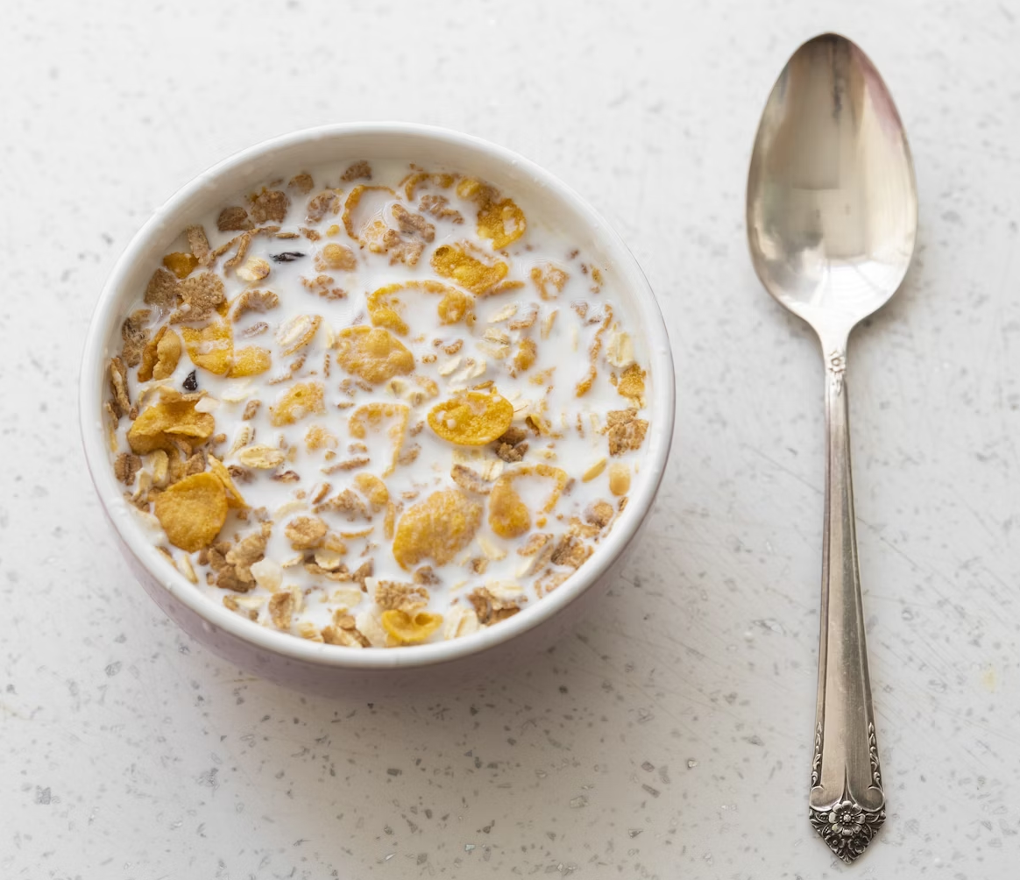
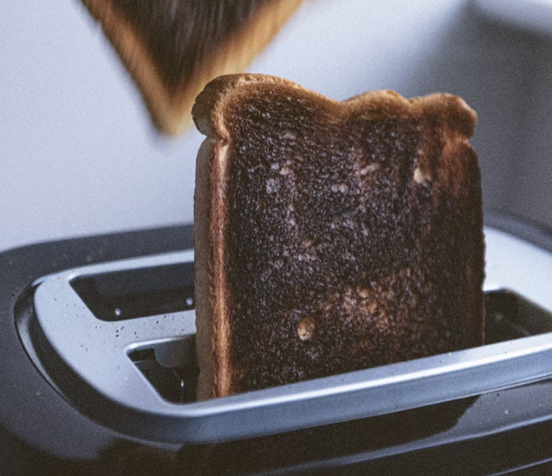

Ways humour is created in ‘Dear Kath’ (1)
Exploring examples (1)
‘The cynics bob up in your cornflakes, pop out of your toaster in the morning like a burnt slice
of mouldy Tip-Top.’
a plate of cornflakes and milk by Engin Akyurt on Unsplash
A toaster with a piece of bread in it by Joshua Earle on Unsplash
Mould on citrus by Sally Millar on Unsplash
Notes:
Teacher note: this slide should be used in conjunction with Phase 2, sequence 3. Consider animating the text and images to manage cognitive load.
Exaggeration for effect: Dalton humorously exaggerates the situation when he describes cynics popping up “like a burnt slice of mouldy Tip-Top.” This vivid imagery evokes a funny mental picture and underscores his frustration with the negativity he encounters.
Breaking down language and contextual elements of the quote:
Cynics: Cynics are people who often doubt or criticise things. They tend to see the negative side of situations and may not believe in the goodness of others.
Imagery: The quote uses strong images to create a funny picture in your mind. When it says ‘bob up in your cornflakes’ and ‘pop out of your toaster,’ it makes you think of cynics appearing in unexpected places during breakfast. This is a humorous way to suggest that cynicism is everywhere.
Exaggeration: The phrase ‘like a burnt slice of mouldy Tip-Top’ is an exaggeration. It describes something very unpleasant. Tip-Top is a brand of bread, and saying it is ‘burnt’ and ‘mouldy’ makes it sound bad. This exaggeration helps to show that cynics can ruin a nice moment, just like bad food can spoil a meal.
Activity:
Read the quote aloud: Begin by reading the quote aloud to the class. Encourage students to pay attention to the imagery and phrasing.
Discuss initial reactions: Ask students to share their immediate thoughts or feelings about the quote. What images come to mind?
Identify key phrases: Break down the quote into key phrases: “bob up in your cornflakes,” “pop out of your toaster,” “like a burnt slice of mouldy Tip-Top.” Discuss how each phrase contributes to the overall humour and meaning.
Explore imagery: Highlight the humorous imagery of everyday breakfast items being invaded by cynics. Discuss how this creates a funny mental picture.
Discuss exaggeration: Explain how the exaggeration of cynics appearing in common places like cornflakes and toasters adds to the comedic effect.
Connect to real life: Encourage students to think of times when they felt overwhelmed by negativity or cynicism in their own lives. How does the quote relate to those experiences?
Reflect on the overall message: Conclude by discussing how the humour in the quote emphasises the pervasiveness of cynicism in society and the impact it has on our daily lives.
Optional activity: As a fun extension, have students create their own humorous sentences or metaphors about everyday situations, using exaggerated imagery or comparisons.

Slide 17
Ways humour is created in ‘Dear Kath’ (2)
Exploring examples (2)
‘You would not believe the things people will tell you when you take the time to shut the hell up and listen.’
In pairs:
Read the quote aloud. Pay attention to the tone and wording.
Share your immediate thoughts or feelings about the quote. What stands out to you?
Break down the quote into key phrases.
Look at the informal and direct language, especially the phrase ‘shut the hell up.’ How does this choice add a humorous and relatable quality to the message?
Consider the context in which this quote is said. Why do you think the author uses humour in this reflection about listening?
Think of personal stories where you experienced the importance of listening. How did humour play a role in those situations?
Notes:
Teacher note: this slide should be used in conjunction with Phase 2, sequence 3. Consider animating the text and images to manage cognitive load.
Observational humour: When he describes people sharing their stories, he notes, “You would not believe the things people will tell you when you take the time to shut the hell up and listen.” This is an observation about human behaviour that highlights how people often have interesting stories, and it brings humour through the casual language used.
Activity: Ask students to follow the same steps as the previous activity (on the slide) and complete this in pairs as a ‘we do’ – below are prompts for the teacher to support this process. Teacher to check for understanding through facilitating a class discussion on how the humour in the quote helps convey a deeper message about communication and connection.
Read the quote aloud: Begin by reading the quote aloud to the class. Encourage students to pay attention to the tone and wording.
Discuss initial reactions: Ask students to share their immediate thoughts or feelings about the quote. What stands out to them?
Identify key phrases: Break down the quote into key phrases: “You would not believe”, “shut the hell up”, “take the time to listen”. Discuss how each phrase contributes to the overall meaning and humour.
Explore word choice: Highlight the informal and candid language, particularly the phrase “shut the hell up.” Discuss how this choice adds a humorous, relatable quality to the message.
Discuss the context: Encourage students to consider the context in which this quote is said. Why might the author use humour in this reflection about listening?
Connect to personal experiences: Invite students to share personal anecdotes where they experienced the importance of listening. How did humour play a role in those interactions?
Reflect on the overall message:
Conclude by discussing how the humour in the quote helps convey a deeper message about communication and connection.
Optional activity: As a fun extension, have students create their own humorous quotes about listening or communication, using similar language and themes.

Slide 18
Modality in persuasive and discursive writing
Adapting modality to purpose and form
Modality of persuasive texts | Modality of discursive texts
Persuasive texts usually use high modality language to convince a reader of a particular opinion or way of thinking on an issue. | Discursive texts usually use low or medium modality language since their primary focus is to explore an idea or variety of topics without the direct intention of persuading the reader to adopt a particular point of view.
For example: You must understand the importance of staying connected to family and friends. You should always cherish the moments we shared. We cannot forget the lessons learned from our past. | For example: Staying connected to family can lead to a more fulfilling life. Cherishing moments with loved ones may help us appreciate our relationships more. Reflecting on our past might offer valuable insights into our present.
Notes:
Teacher note: this slide should be used in conjunction with Phase 2, sequence 3.
Read through the information on the slide and ask students for examples before revealing the ones on the slide (animate these).

Slide 19
Revision of discursive features (1)
Key definitions
First-person pronouns and inclusive language for personal voice – using pronouns such as I, me, us, our and we to give your personal perspective on the topic
Second-person pronouns to directly address the audience – using pronouns such as you, your or yours to directly address your intended audience
Anecdote – a short, amusing or interesting story about a real person or event
Sequencing words – words such as first, then, next or finally that help the audience understand the order of the events that are happening in a story
Notes:
Teacher note: this slide should be used in conjunction with Phase 2, sequence 3. You could print these definitions for students to paste into their workbooks and refer back to as they practise their discursive writing.
This and the following slide could also be used to develop a checking for understanding activity, consider a short quiz or utilizing a digital quiz platform students are familiar with and using the information on these slides to develop a quiz.

Slide 20
Revision of discursive features (2)
Key definitions
Temporal connectives – words such as first, then, next or finally that help the audience understand the order of the events that are happening in a story
Causal connectives – words such as however, so and because that connect ideas between clauses, sentences or paragraphs
Precise vocabulary – use the most specific and relevant words to clearly and succinctly convey an idea or point of view
Rhetorical questions – questions that don’t require an answer that are used to provoke thought, make a point or create a dramatic effect for the audience
Conversational tone – a casual and informal tone of writing that uses short sentences and contractions to ‘sound’ like you’re talking to a friend
Notes:
Teacher note: this slide should be used in conjunction with Phase 2, sequence 3. You could print these definitions for students to paste into their workbooks and refer back to as they practise their discursive writing.

Slide 21
Phase 2, sequence 6a – initial exploration of Core text 1 –
‘Dear Kath’ by Trent Dalton
Type Writer photo by Marcus Winkler Unsplash
Notes:
Teachers note: these divider slides have been used throughout this PowerPoint to indicate which phase and sequence the content is connected to.
This section of the PowerPoint may be used alongside Phase 2, sequence 6a. This divider slide should be deleted or hidden prior to sharing with students using in a classroom setting.​
​

Slide 22
Introducing: Trent Dalton’s text ‘Dear Kath’
Building contextual understanding of Core text 1
Notes:
Teacher note: the following slides are to be used in conjunction with Phase 2, sequence 6a – initial exploration of Core text 1 – ‘Dear Kath’ by Trent Dalton. They outline the context of Trent Dalton and the first of the ‘Dear Kath’ letters from the Love Stories collection.

Slide 23
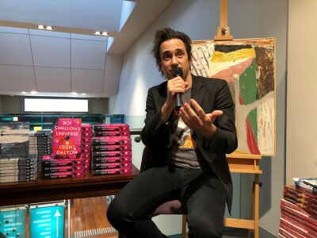
Who is Trent Dalton?
Author context
Trent Dalton is a Brisbane-based Australian journalist and author. He has written numerous works of fiction and non-fiction, including Boy Swallows Universe and Lola in the Mirror.
Dalton is an observer of the world around him. He draws on both his own experience and those he encounters in his literary works.
Trent Dalton photo from TRENT DALTON – HarperCollins Australia
Notes:
Teacher note: this slide is to be used in conjunction with support Phase 2, sequence 6a.

Slide 24

Love Stories and ‘Dear Kath’
Building contextual understanding
Trent Dalton recorded and compiled the Love Stories collection whilst sitting on the streets of Brisbane during Covid. He invited passers-by to tell him a love story, which he typed on the Olivetti typewriter he speaks of in the first ‘Dear Kath’ letter.
Dalton wanted to remind people of the power of love and connection during a time that was very bleak and isolating for many people. The first ‘Dear Kath’ letter opens the collection and establishes the purpose of the collection.
TRENT DALTON - HarperCollins Australia :HarperCollins Australia
Notes:
Teacher note: this slide is to be used in conjunction with support Phase 2, sequence 6a.

Slide 25
References (1)
This presentation contains NSW Curriculum and syllabus content. The NSW Curriculum is developed by the NSW Education Standards Authority. This content is prepared by NESA for and on behalf of the Crown in the right of the State of New South Wales. The material is protected by Crown copyright.
Please refer to the NESA Copyright Disclaimer for more information https://educationstandards.nsw.edu.au/wps/portal/nesa/mini-footer/copyright.
NESA holds the only official and up-to-date versions of the NSW Curriculum and syllabus documents. Please visit the NSW Education Standards Authority (NESA) website https://educationstandards.nsw.edu.au/wps/portal/nesa/home and the NSW Curriculum website https://curriculum.nsw.edu.au.
English EAL/D 11–12 Syllabus © NSW Education Standards Authority (NESA) for and on behalf of the Crown in right of the State of New South Wales, 2024.
Australian Curriculum, Assessment and Reporting Authority (ACARA) (2020), Literacy: About the general capability, General capabilities | V9 Australian Curriculum, ACARA website, accessed 23 July 2025.
Australian Education Research Organisation (AERO) (2024a) Explain learning objectives, AERO website, accessed 19 May 2025.
Australian Education Research Organisation (AERO) (2024b) Why explicit instruction works, AERO website, accessed 19 May 2025.
Australian Institute for Teaching and School Leadership Limited (AITSL) (n.d.) Learning intentions and success criteria [PDF 251KB], AITSL, accessed 02 May 2025.
Black P and Wiliam D (2018) ‘Classroom assessment and pedagogy’, Assessment in Education Principles Policy and Practice, 25(1):1–25.
British Council (26 May 2023) ‘How to tell an anecdote in English’ [video], British Council | LearnEnglish, YouTube, accessed 2 June 2025.
Dalton T (2021) ‘Dear Kath’ Love Stories, HarperCollinsPublishers, Sydney.
NSW Education Standards Authority (NESA) (n.d.) Collaborative curriculum planning, NESA website, accessed 19 May 2025.
–––(2024) ‘Glossary’, Resources, NESA website, accessed 19 May 2025.

Slide 26
References (2)
This presentation contains NSW Curriculum and syllabus content. The NSW Curriculum is developed by the NSW Education Standards Authority. This content is prepared by NESA for and on behalf of the Crown in the right of the State of New South Wales. The material is protected by Crown copyright.
Please refer to the NESA Copyright Disclaimer for more information https://educationstandards.nsw.edu.au/wps/portal/nesa/mini-footer/copyright.
NESA holds the only official and up-to-date versions of the NSW Curriculum and syllabus documents. Please visit the NSW Education Standards Authority (NESA) website https://educationstandards.nsw.edu.au/wps/portal/nesa/home and the NSW Curriculum website https://curriculum.nsw.edu.au.
State of New South Wales (Department of Education) (2024.) Explicit teaching strategies, NSW Department of Education website, accessed 19 May 2025.
––– (n.d.) Digital Learning Selector, NSW Department of Education website, accessed 19 May 2025.
––– (2024) the Explicit teaching – Driving learning and engagement, Centre for Education Statistics and Evaluation website, accessed 19 May 2025.
Winkler M (May 2022) Love, [image], Unsplash website, accessed 5 May 2025.

Slide 27
Copyright
© State of New South Wales (Department of Education), 2025
The copyright material published in this resource is subject to the Copyright Act 1968 (Cth) and is owned by the NSW Department of Education or, where indicated, by a party other than the NSW Department of Education (third-party material).
Copyright material available in this resource and owned by the NSW Department of Education is licensed under a Creative Commons Attribution 4.0 International (CC BY 4.0) license.
This license allows you to share and adapt the material for any purpose, even commercially.
Attribution should be given to © State of New South Wales (Department of Education), 2025.
Material in this resource not available under a Creative Commons license:
the NSW Department of Education logo, other logos and trademark-protected material
Material owned by a third party that has been reproduced with permission. You will need to obtain permission from the third party to reuse its material.
Links to third-party material and websites
Please note that the provided (reading/viewing material/list/links/texts) are a suggestion only and implies no endorsement, by the New South Wales Department of Education, of any author, publisher, or book title. School principals and teachers are best placed to assess the suitability of resources that would complement the curriculum and reflect the needs and interests of their students.
If you use the links provided in this document to access a third-party’s website, you acknowledge that the terms of use, including licence terms set out on the third-party’s website apply to the use which may be made of the materials on that third-party website or where permitted by the Copyright Act 1968 (Cth). The department accepts no responsibility for content on third-party websites.

