Slide 1
Instructions for use
This resource is not a teaching and learning program. It should be used in conjunction with Year 10, Term 4 – Digital stories.
Classroom teachers are encouraged to add and adapt slides as required to meet the needs of their students.
Save a copy of the file to make changes to the slide deck. Go to File > Download a Copy (this downloads a copy to the computer to edit in the PowerPoint app).
To convert the PowerPoint to Google Slides:
  Upload the file into Google Drive and open it.
  Go to File > Save as Google Slides.
  (Note – conversion may cause formatting changes in the slides.)

Slide 2

Year 10, Term 4 – Digital stories
Phase 5 – how to use Canva for Education
Notes:
Teacher note: the following resource is designed to support the delivery of Phase 5 – engaging critically and creatively with model texts. It should be used in combination with instructions from Phase 5, sequence 1 – engaging with Canva for Education of the teaching and learning program and associated Phase 2 activities and resources in the resource booklet.
In this PowerPoint, you will find a series of slides to guide students through their introduction to using Canva for Education. Students will require access to technology for these activities.

Slide 3
Sharing learning intentions and success criteria
Notes:
Teacher note: this slide has been used to identify the Explicit teaching strategy and should be deleted or hidden when using in a classroom setting.
Sharing learning intentions allows a teacher to effectively communicate learning goals with students. They allow students to connect new learning to existing knowledge, skills and understanding. When used with success criteria, students have a clear idea of the learning goal and how to get there (AERO 2024). The sample success criteria provided in the teacher notes on the following slide are aligned to the syllabus. They break the learning intention into smaller and more manageable actions. They show students what they must do, say, make, create or perform to demonstrate their learning (Griffin 2018). These have been left blank with suggestions provided in the notes to allow for the co-construction of success criteria that reflects student need. When co-constructing with students, teachers use their expertise to guide student thinking, and often model and use exemplars to show students what success 'looks like'.

Slide 4
Learning intentions and success criteria
We are learning to:
navigate the Canva platform and use templates
select design elements on Canva for Education.
We can:
[classroom teacher to insert co-constructed success criteria]
[classroom teacher to insert co-constructed success criteria]
[classroom teacher to insert co-constructed success criteria].
Notes:
Notes for teachers:
Learning intentions and success criteria are best co-constructed with students. Adapt the learning intention as required and add matching success criteria.
For more information see ⁠AITSL or the NSW Department of Education explicit teaching strategies, ⁠Sharing learning intentions and ⁠Sharing success criteria.
LISC is not necessarily presented at the beginning of the lesson. Teacher needs to consider most effectual time to introduce.
LISC should be revisited during the lesson to support students' evaluation of their learning.
Suggested success criteria:
navigate the Canva for Education platform and use templates
select design elements on Canva for Education
upload images, video or audio.

Slide 5
Canva Magic Studio
Notes:
Teacher note: this resource provides a recommended approach to Phase 5, sequence 1 – engaging with Canva for Education, and is not intended to be prescriptive. Teachers are encouraged to approach these tasks flexibly, addressing them as needed while considering the specific learning context and your students.
This section begins with a KWLH framework to foster critical and creative thinking, while also assessing students' current knowledge and skill levels. This may prompt teachers to adjust the resources as necessary based on the skill levels observed in the class. The other parts are as follows.
Teachers providing a walkthrough detailing the editor interface – ensure you have familiarised yourself with Canva before presenting to the class. See the list of pre-readings in the Digital stories – Year 10, Term 4 teaching and learning program for support.
A video "How to Use Canva" for department students to access Canva via single sign-on.
A live demonstration or screen recording by the teacher, showcasing the design process for a book cover.
An independent student activity focused on creating a book cover for other core texts.
A brief activity designed to encourage peer feedback.
Instructions for students on sharing their designs.
An interactive exit ticket aimed at developing additional skills necessary for the upcoming assessment task, such as audio recording, and illustrating how interactive features are possible within Canva.

Slide 6
KWLH – class brainstorm on using Canva
What do I know? | What do I want to know? | What have I learned? | How can I learn more?
K
What do I know?
W
What do I want to know?
L
What have I learned?
H
How can I learn more?
Notes:
Teachers note: KWLH is a tool in the Digital Learning Selector for gathering students' responses to slide questions. Utilising formative tasks at the beginning of the lesson helps students recall prior knowledge, strengthens memory connections, and allows for differentiated learning (AERO 2024). These activities engage students, deepen their understanding, and promote collaboration.
Students may possess varying degrees of familiarity and skill with Canva. Founded in Sydney in 2012, Canva saw a marked increase in global prominence between 2019 and 2020. It has since become a widely utilised tool for marketing, social media design, and educational applications across diverse contexts.
Since 2022, Canva for Education has been made available to all students and teachers within the department. It is likely that many students have already engaged with Canva in other subjects or schools, using it for a broad spectrum of creative, learning and assessment purposes.
Teachers could ask some prompting questions to further elicit contributions from students:
Prompting questions for K:
- What do you know about Canva and what is it used for?
- Have you ever created something on Canva?
- Have you used it for anything outside of school activities and assessments?
Prompting questions for W:
- What features of Canva are you curious to learn about?
- What tool or design would you like to know how to create?
- How do you think Canva could assist you with other school activities or personal projects?
The 'L' section should be filled out at the end of the lesson.
- Teachers might want to copy and paste the slide later in the presentation to complete the 'L' section while referencing previous contributions.
Prompting questions for H:
- Where do you think you could find more tutorials or resources to expand your Canva skills?
- How do others, such as content creators or social media accounts, use Canva, and what tips could you learn from them?
- Who in your class do you think has strong Canva skills, and how could you collaborate with them to learn more?

Slide 7
What is Canva for Education?
Information for students
Canva for Education is a web-based tool that gives you free access to all premium content, which you would normally have to pay for with a personal account.
The assessment task for Year 10, Term 4 – Digital stories, will be created on Canva. Canva is easy to use, has a wide range of customisable content, and allows multiple people to work together on the same project.
You will submit your assessment through Canva. You will get a chance to practise using it with today’s activity and for Core formative task 1 – proposal and plan.
Notes:
Teachers note: if your setting has the technology available, have students practise opening Canva at this point, signing in from their portal. Some students may benefit from an initial experiment or settling activity moving past the novelty of a new online tool. Canva is the platform used throughout the sample teaching and learning resources of this program. Modify these instructions to reflect the mode and platform of assessment used.

Slide 8

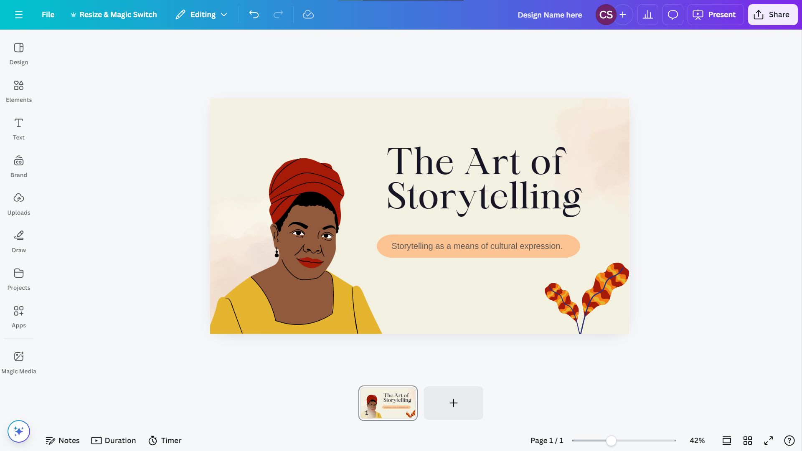
Editor interface
Canva screenshot using graphics by sketchifyedu
Notes:
Teachers note: some students and whole classes will benefit from a tour of the Canva editor interface. Canva's interactive resource can be used to demonstrate the key features of the platform. Click on the 'Editor interface' title of this slide to access this resource. See the next slide for elements you should aim to mention. Phase 5, resource 1 – Canva for Education essential terminology and Phase 5, activity 1 – Canva for Education essential terminology have been designed to support students in developing an understanding of the Canva features.
Links
Canva’s interactive resource: https://resourcepage.my.canva.site/

Slide 9
Canva for Education
Essential terminology
In your Canva for Education essential terminology worksheet, match the definitions with the correct Canva for Education terminology in the word bank.
Notes:
Teacher note: this slide directs students to complete Phase 5, activity 1 – Canva for Education essential terminology. Phase 5, resource 1 – Canva for Education essential terminology has been designed to support this activity.

Slide 10
Check your understanding
Locate these tools in Canva
Alignment
Arrange
Background
Canvas
Colour palette
Duplicate
Elements
Export and sharing
Font options
Insert photo
Resize and crop
Spacing of text
Templates
Textbox
Transparency
Uploading images
Notes:
Teacher Note: this slide is intended to support students in activating prior knowledge and building a foundational understanding of essential terminology. The teacher-led tour of the editor interface on the previous slide facilitates this process, ensuring students feel confident prior to transitioning to the gradual release of responsibility process. Following the teacher-led tour of the editor interface check their understanding - raising their hand to point out where each of the above elements are located. Other prompting questions could include:
‘how would you use this?’
‘why would it be important to use this for X [concept linking to other knowledge in the program]?'
‘why is choosing the right background important?’
‘how can font choice impact mood or theme of your design?’
‘how would alignment provide more authority of your text?’
Students can also use Phase 5, activity 1 – Canva for Education essential terminology to check their understanding of the features of Canva.

Slide 11

Access Canva via Student Portal
Notes:
Teacher note: this slide contains a video of how students can easily access Canva via the Student Portal. The video will only play if the slide is in Present mode.

Slide 12
Gradual release of responsibility
Notes:
Teacher note: this slide has been used to identify the explicit teaching-learning strategy and should be deleted or hidden when used in a classroom setting. The strategy of gradual release of responsibility is a flexible process moving between modelled, guided and independent teaching practice responsive to student learning.
Students should be supported to move between each practice based on their capabilities and requirements.
Teachers deliver a structured and sequenced approach to explicitly teaching new content. Learning is most effective when teachers break new information down and teach it explicitly using explanation, demonstration and modelling. This is especially relevant when students are new to an area (AERO 2024).

Slide 13
Design a book cover activity
How do we use Canva templates?
Use Canva to create a book cover for the text that your group will transform into an interactive multimodal digital text for the assessment task.
Your book cover should reflect the key ideas represented in the text.
Notes:
Teacher note: this is designed to give students an authentic opportunity to experiment with the key features of Canva to create a book cover for the text they have chosen to transform for the assessment task. . Adjust the level of scaffolding and support in demonstrating your process and product, and explain your thinking and choices with each step to ensure students are confident in attempting this task. Teachers can include

Slide 14

Creating your book cover
Guided and independent activity
Practice time: use Canva on your own or in a group.
Choose your text: use the stimulus text your group plans to transform for the assessment task.
Design your cover: create a book cover poster for one of the digital stories.
Find a template: search ‘novel’ or ‘book cover’. You could also use genre-specific terms to find templates that suit your ideas.
Customise it: select a template and modify it to fit your book cover.
Need help? Check out the suite of tutorial videos available in Canva if you need guidance on Canva tools.
Notes:
Teacher note: this is designed to give students an authentic opportunity to experiment with the key features of Canva to create an original text that conveys authority. Students will need to use one digital text previously studied in class to complete this activity. An effective book cover should have an eye-catching design including relevant colours, images and typography to capture the reader’s attention and convey the ‘essence’ of the text’s content. in this activity, you will use Canva for Education to create a book cover for one of the digital texts you have studied in class. You should experiment with a range of Canva’s features to effectively capture the ‘essence’ of your chosen digital text.

Slide 15
Peer feedback
Using feedback to improve your work
Step 1: Share your book cover design by sending a ‘view only’ link to a peer.
Step 2: Use the TAG Peer Feedback method:
Tell them something you like.
Ask a question about their design.
Give a suggestion about one way they could improve their book cover.
Step 3: Consider actioning the peer feedback before sharing the design with your teacher.
Notes:
Teachers note: peer feedback is a structured process where students evaluate the work of their peers by providing valuable feedback in relation to learning intentions and success criteria. The department's Digital Learning Selector has a range of suggestions for supporting students in providing peer feedback. The TAG Peer Feedback method is hyperlinked to a TAG resource available via the Digital Learning Selector. It demonstrates what a TAG method could look like. The TAG: PEER FEEDBACK graphic is hyperlinked to the Canva template link for editing or if you want to adapt this template to suit your context. To access this Canva hyperlink, the slide must be displayed in full screen mode.
Links
Digital Learning Selector: peer feedback https://app.education.nsw.gov.au/digital-learning-selector/LearningActivity/Card/549?clearCache=d0516957-6133-de7b-95c8-bce47068834c

Slide 16

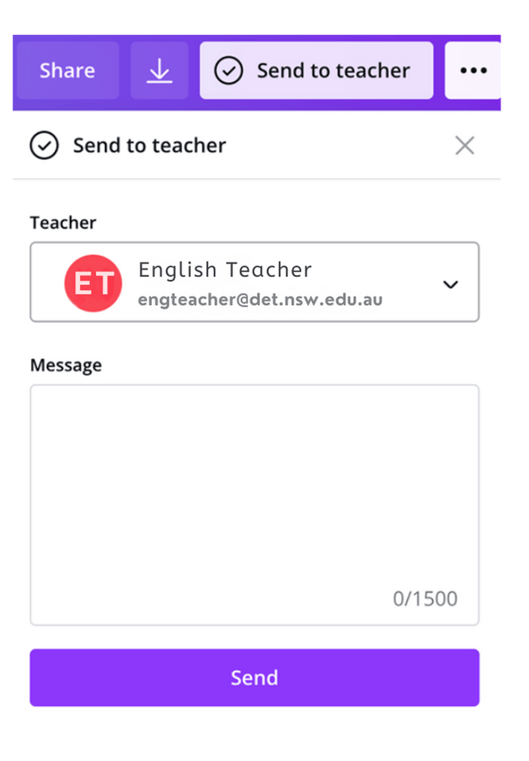
Sharing your design
Tools of Canva
If completed as a Canva class assignment:
select the ‘Send to teacher’ button in the top right-hand corner
select your teacher from the dropdown menu
select ‘Send’.
Notes:
Teachers note: to show students the instructions on how to submit a task via Canva, click on the 'class assignment' hyperlink and take students through the step-by-step process. Ensure that the review and comment functions are enabled, so that feedback and revisions can be managed directly within Canva. This approach allows both you and the students to stay within Canva, avoiding the need to switch between different websites.
If you are using other learning management systems, please replace this (or the next slide) with the appropriate steps
Links
Google Classroom https://www.canva.com/en_au/help/publish-to-google-classroom/
Canvas https://www.canva.com/en_au/help/using-canvas-lms/
Moodle https://www.canva.com/en_au/help/connect-to-moodle/

Slide 17
Sharing via a link
Tools of Canva
Select share in the editor.
Select the Collaboration link dropdown, then choose Anyone with the link.
Select the next dropdown, then choose Can edit.
Select the Copy link.
Share the design link.
Notes:
Teacher note: hide or delete irrelevant slides as suits student need. This is an alternative method for sharing the work. Students may prefer this method if they are used to sharing documents directly to their teacher.

Slide 18
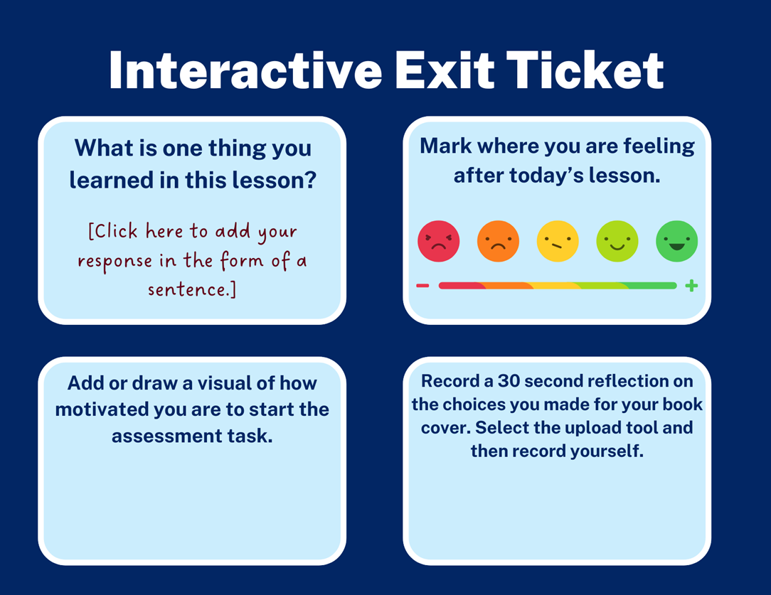
Interactive exit ticket
Reflect on the pleasures, challenges and successes experienced
Your teacher will share an individual copy of the template with you in Canva.
Use this as a chance to explore and experiment with Canva’s other tools and features.
Once you’re finished, select Send to Teacher to submit your work.
Notes:
Teacher note: share this template prior to the lesson. Exit tickets provide opportunity to assess student learning informally, and to ensure all students are confident in their skill development. This is especially relevant in preparation for the assessment task and provides opportunity to revisit skills again with students who need additional support.

Slide 19
References
This presentation contains NSW Curriculum and syllabus content. The NSW Curriculum is developed by the NSW Education Standards Authority. This content is prepared by NESA for and on behalf of the Crown in the right of the State of New South Wales. The material is protected by Crown copyright.
Please refer to the NESA Copyright Disclaimer for more information https://educationstandards.nsw.edu.au/wps/portal/nesa/mini-footer/copyright.
NESA holds the only official and up-to-date versions of the NSW Curriculum and syllabus documents. Please visit the NSW Education Standards Authority (NESA) website https://educationstandards.nsw.edu.au/ and the NSW Curriculum website https://curriculum.nsw.edu.au.
English K–10 Syllabus © NSW Education Standards Authority (NESA) for and on behalf of the Crown in right of the State of New South Wales, 2022.
AERO (Australian Education Research Organisation) (2024) Explain learning objectives, AERO website, accessed 16 April 2024.
Canva for Education (n.d.) Canva, Canva website, accessed 15 October 2024.
Griffin P (2018) Assessment for teaching, Cambridge University Press.
State of New South Wales (Department of Education) (2024a) ‘Explicit teaching strategies’, Explicit teaching, NSW Department of Education website, accessed 27 May 2024.

Slide 20
Copyright
© State of New South Wales (Department of Education), 2024
The copyright material published in this resource is subject to the Copyright Act 1968 (Cth) and is owned by the NSW Department of Education or, where indicated, by a party other than the NSW Department of Education (third-party material).
Copyright material available in this resource and owned by the NSW Department of Education is licensed under a Creative Commons Attribution 4.0 International (CC BY 4.0) license.
This license allows you to share and adapt the material for any purpose, even commercially.
Attribution should be given to © State of New South Wales (Department of Education), 2024.
Material in this resource not available under a Creative Commons license:
the NSW Department of Education logo, other logos and trademark-protected material
Material owned by a third party that has been reproduced with permission. You will need to obtain permission from the third party to reuse its material.
Links to third-party material and websites
Please note that the provided (reading/viewing material/list/links/texts) are a suggestion only and implies no endorsement, by the New South Wales Department of Education, of any author, publisher, or book title. School principals and teachers are best placed to assess the suitability of resources that would complement the curriculum and reflect the needs and interests of their students.
If you use the links provided in this document to access a third-party’s website, you acknowledge that the terms of use, including licence terms set out on the third-party’s website apply to the use which may be made of the materials on that third-party website or where permitted by the Copyright Act 1968 (Cth). The department accepts no responsibility for content on third-party websites.

