Slide 1
Instructions for use
This resource is not a teaching and learning program. It should be used in conjunction with Year 10, Term 4 – Digital stories.
Classroom teachers are encouraged to add and adapt slides as required to meet the needs of their students.
Save a copy of the file to make changes to the slide deck. Go to File > Download a Copy (this downloads a copy to the computer to edit in the PowerPoint app).
To convert the PowerPoint to Google Slides:
  Upload the file into Google Drive and open it.
  Go to File > Save as Google Slides.
  (Note – conversion may cause formatting changes in the slides.)

Slide 2

Year 10, Term 4 – Digital stories
Phase 2 – simple and complex ideas
Notes:
Teacher note: the following resource is designed to support the delivery of Phase 2 – unpacking and engaging with the conceptual focus, specifically Phase 2, sequence 7 – simple and complex ideas. It should be used in combination with instructions from Phase 2 of the teaching and learning program and associated Phase 2 activities and resources in the resource booklet.

Slide 3
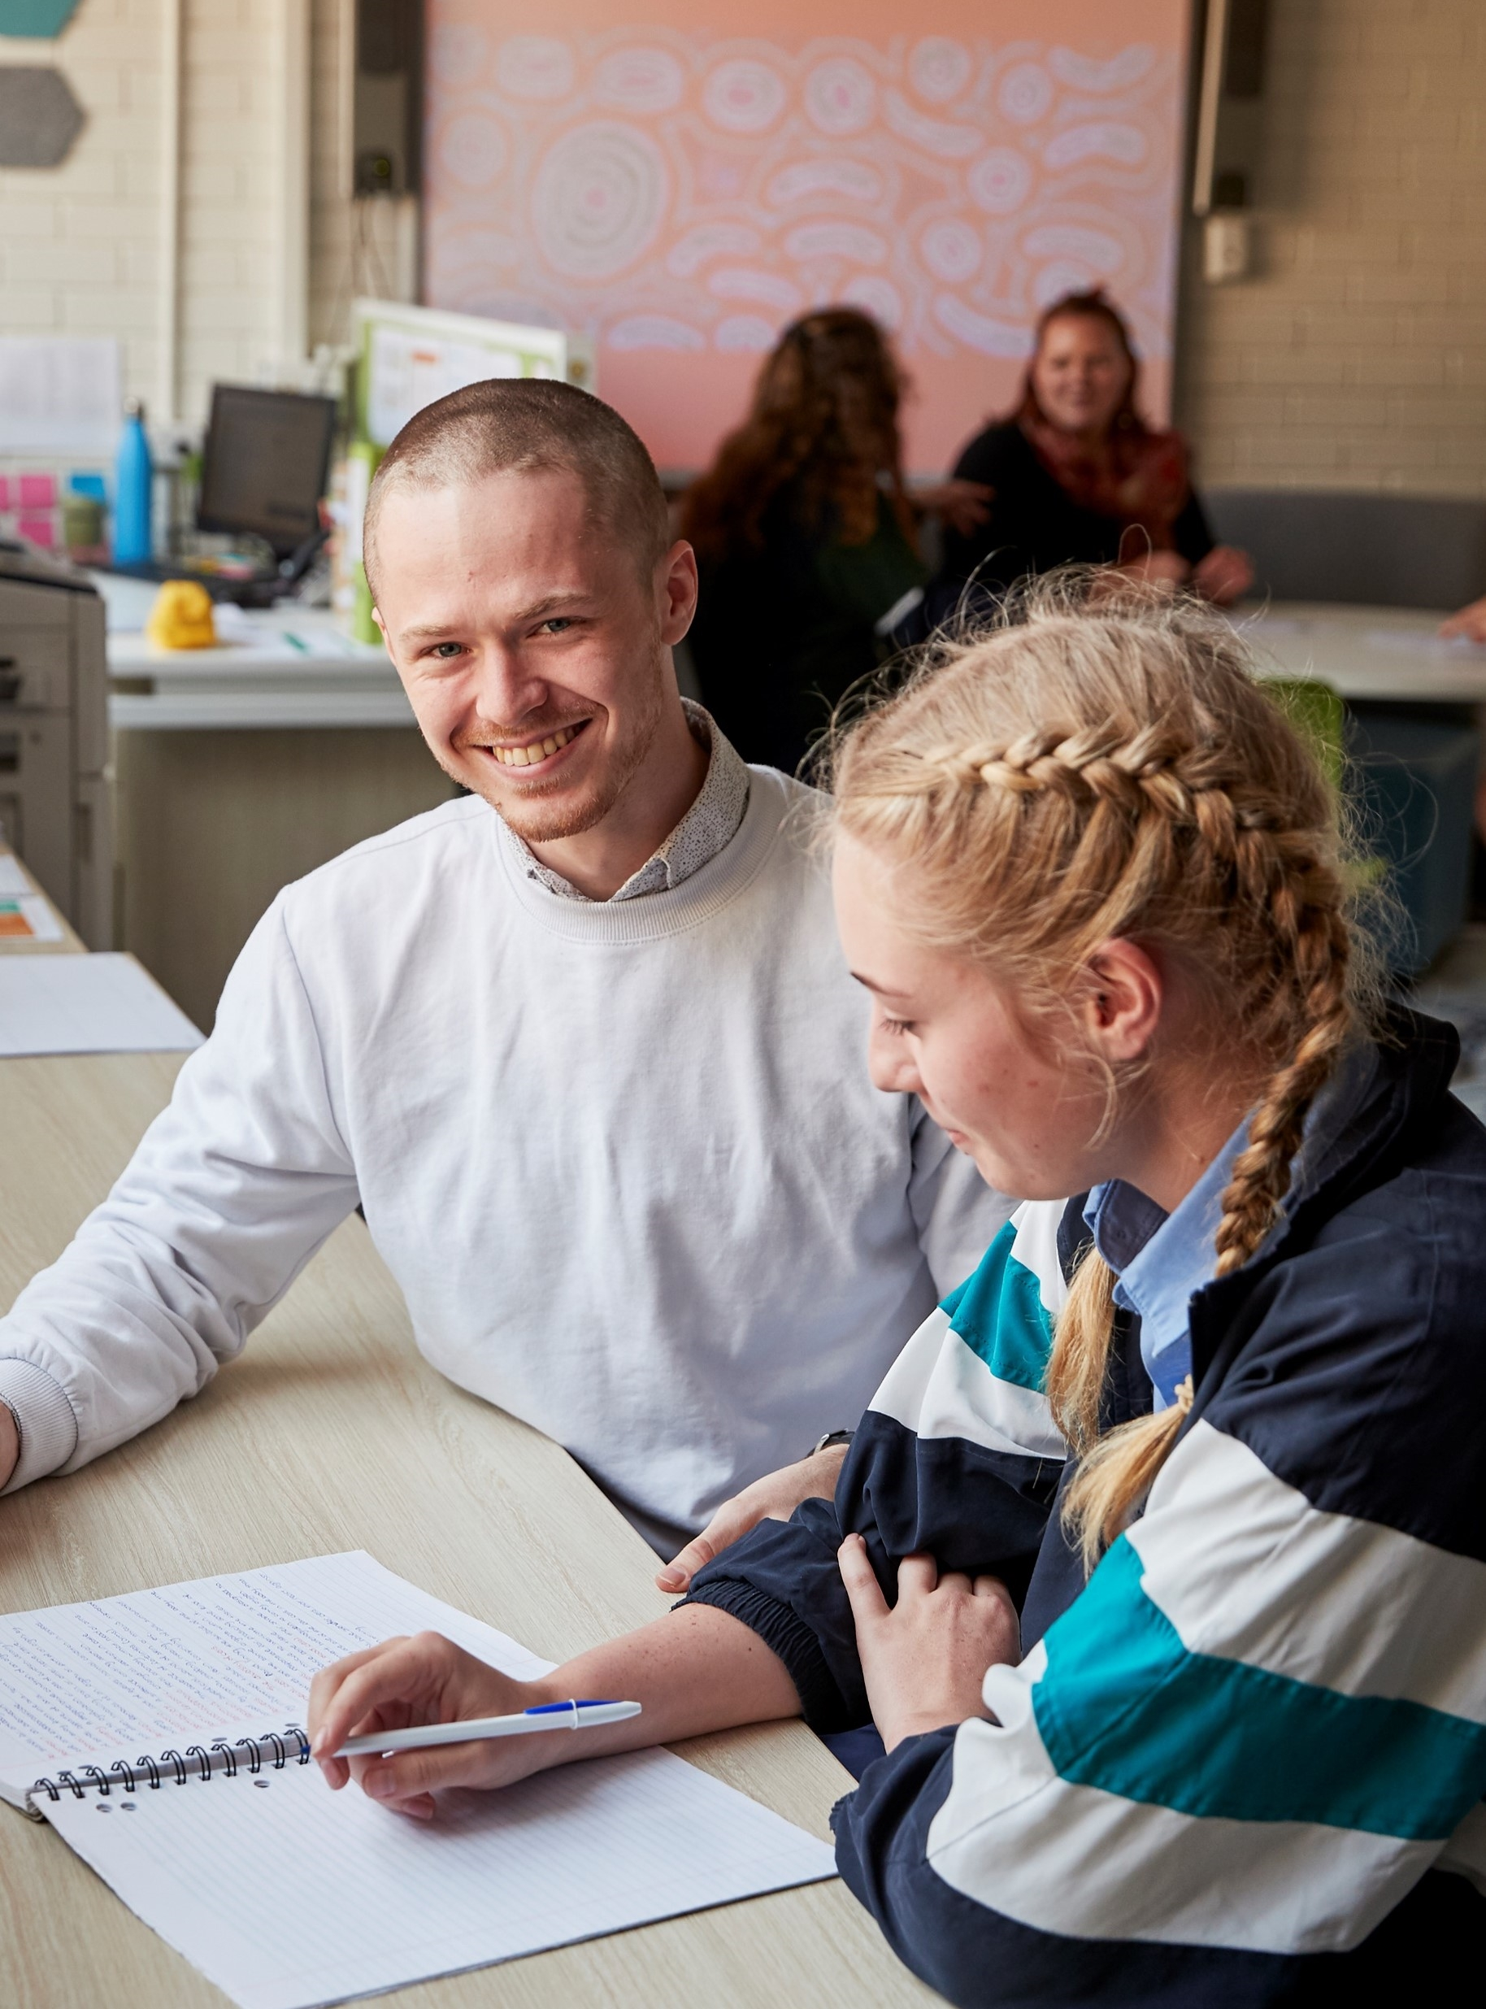
Sharing learning intentions and success criteria
Notes:
Teacher note: this slide has been used to explain the Explicit teaching strategy and should be deleted or hidden when using in a classroom setting.
Sharing learning intentions allows a teacher to effectively communicate learning goals with students. They allow students to connect new learning to existing knowledge, skills and understanding. When used with success criteria, students have a clear idea of the learning goal and how to get there (AERO 2024a). The sample success criteria provided in the teacher notes on the following slide are aligned to the syllabus. They break the learning intention into smaller and more manageable actions. They show students what they must do, say, make, create or perform to demonstrate their learning (Griffin 2018). These have been left blank with suggestions provided in the notes to allow for the co-construction of success criteria that reflects student need. When co-constructing with students, teachers use their expertise to guide student thinking, and often model and use exemplars to show students what success 'looks like'.

Slide 4
Learning intentions and success criteria
We are learning to:
understand the difference between simple and complex ideas
identify how multimodal texts represent complex ideas.
We can:
[classroom teacher to insert co-constructed success criteria].
Notes:
Notes for teachers:
Learning intentions and success criteria are best co-constructed with students. Adapt the learning intention as required and add matching success criteria.
For more information see ⁠AITSL or the NSW Department of Education explicit teaching strategies, ⁠Sharing learning intentions and ⁠Sharing success criteria.
LISC is not necessarily presented at the beginning of the lesson. Teacher needs to consider most effectual time to introduce.
LISC should be revisited during the lesson to support students' evaluation of their learning.
Suggested success criteria:
identify the difference between a simple and complex idea
analyse the codes and conventions used in multimodal texts to represent complex ideas
analyse how the representation of complex ideas impacts upon meaning.

Slide 5
What is a simple idea?
Explanation
A simple idea is straightforward, easy to understand and may be open to a limited number of interpretations. A simple idea typically contains a single concept.
Notes:
Teachers note: this slide provides an explanation of simple ideas.

Slide 6
What is a complex idea?
Explanation
A complex idea is multilayered, may contain multiple elements and connections. This can allow for a wider range of interpretations than simple ideas.
Notes:
Teachers note: this slide provides an explanation of complex ideas.

Slide 7
What makes an idea complex?
Identifying complex ideas
Ideas can be complex if they:
explore multiple perspectives
challenge the thinking of responders
inspire responders to take action
are represented through symbols
are philosophical.
Notes:
Teachers note: this slide provides information about complex ideas. Students should note these ideas and add examples or ideas which generate from class discussion. The examples on this slide will be explored in greater detail in the following slides.

Slide 8
Complex ideas (1)
Exploring multiple points of view
This means that a variety of viewpoints are presented and explored on the topic to give a wide variety of points of view. These points of view may range from being similar, to being opposing ideas. It can also include multiple ideas about the same topic.
For example, in the short story ‘The Index Cards’ by Louis Nowra, the reader learns the narrator’s point of view through the first-person narration and Gladys’s point of view through the index cards.
In Nicholas Verso’s television series Crazy Fun Park, some episodes follow Chester’s point of view, and others are told from Violetta’s or Mapplethorpe’s point of view.
Notes:
Teachers note: this slide provides information about how multiple points of view help explore complex ideas. It provides 2 examples of texts, and the different points of view in these texts, that students may be familiar with. Teachers may expand on these examples by asking students to share additional examples.

Slide 9
Complex ideas (2)
Challenging the thinking of responders
When responders are presented with complex ideas, they are required to think about what they are engaging with rather than passively receiving stimulus. Texts that provoke thoughts in responders may be composed or presented from a non-dominant perspective, or a perspective that is different from the responder. They could also be about topical or controversial issues.
For example, the allegorical play Tales from the Arabian Nights by Donna Abela may challenge responder thinking about the treatment of refugees.
Lois Lowry’s The Giver may challenge reader’s thinking about happiness and the adverse effects that limiting access to experiences, such as pain and discomfort, has on our humanity.
Notes:
Teachers note: this slide provides information about how complex ideas challenge the thinking of responders. It details 2 examples of texts that challenge the audience's thinking that students may be familiar with. Teachers may expand on these examples by asking students to share additional examples.

Slide 10
Complex ideas (3)
Inspiring responders to take action
A text that explores complex issues can inspire a responder to change their behaviours or take action to address the issues the text has raised.
These could be personal things like supporting a friend who is experiencing loss or grief after watching Crazy Fun Park or bigger things like involvement in social or political activism inspired by protesting Australia’s treatment of refugees after reading Tales from the Arabian Nights.
Notes:
Teachers note: this slide provides information about how complex ideas inspire responders to take action. Teachers may expand on the examples provided by asking students to share additional examples.

Slide 11
Complex ideas (4)
Represented through symbol
A symbol is an object, character or entity that can be understood to represent a larger idea, action or feeling. Complex ideas can be presented through symbols to prompt the responder into thinking deeply about a seemingly simple image.
In Lois Lowry’s The Giver, colour is used symbolically. While it may appear that the protagonist, Jonah, simply begins to see colour, this signifies that his view of his black and white world is expanding which is symbolic of his growing understanding of himself and what it means to be human.
Notes:
Teachers note: this slide provides information about how complex ideas can be represent through the use of symbol. Teachers may expand on the example provided by asking students to share additional examples.

Slide 12
Complex ideas (5)
May be philosophical
Philosophical ideas are concepts or theories that explore fundamental questions about knowledge, reality, existence, ethics and other aspects of human life that are often abstract concepts.
For example, Aristotle and Dante Discover the Secrets of the Universe presents philosophical questions regarding diversity, identity and belonging.
Romantic poetry explores philosophical ideas about humanity’s spiritual connection with nature and the power of the natural world.
Notes:
Teachers note: this slide provides information about how complex ideas can be philosophical. Teachers may expand on the examples by asking students to share additional examples.

Slide 13
Are these ideas simple or complex? (1)
Ravi & Emma: an interactive documentary in Southern Dialect Auslan
Justify your choice by explaining your thinking.
Ravi is deaf and Emma is hearing.
Good communication is a significant aspect of functioning relationships, along with acceptance, empathy and interest in others.
Ravi & Emma is a multimodal text.
Ravi & Emma reflects ideas about inclusion and belonging through access to language.
Auslan is used in Ravi & Emma.
Notes:
Teacher note: this slide presents a range of simple and complex ideas from the core text Ravi & Emma. Students should identify these independently before contributing to a class discussion to share their answers and justifications.
Answers:
Simple:
Ravi is deaf and Emma is hearing.
Ravi & Emma is a multimodal text.
Auslan is used in Ravi & Emma.
Complex:
Ravi & Emma reflects ideas about inclusion and belonging through access to language.
Good communication is a significant aspect of functioning relationships, along with acceptance, empathy and interest in others.

Slide 14
Are these ideas simple or complex? (2)
K’gari: the real story of a true fake
Justify your choice by explaining your thinking.
Eliza Fraser was shipwrecked in 1836.
A minute grain of sand can leave a legacy, either positively or negatively, as is the case with Eliza Fraser and the Butchalla people.
The text is erased from the screen when clicked with natural images, such as lightning, waves, leaves and sticks.
Perspectives that differ from the original telling of a story can allow for marginalised voices to be heard, as is seen in the telling of the Butchalla people’s positive role in Eliza Fraser’s story.
Notes:
Teacher note: this slide presents a range of simple and complex ideas in K’gari: the real story of a true fake. Students should identify these independently before contributing to a class discussion to share their answers and justifications.
Answers:
Simple:
Eliza Fraser was shipwrecked in 1836.
The text is erased from the screen when clicked with natural images, such as lightning, waves, leaves and sticks.
Complex:
A minute grain of sand can leave a legacy, either positively or negatively, as is the case with Eliza Fraser and the Butchalla people.
Perspectives that differ from the original telling of a story can allow for marginalised voices to be heard, as is seen in the telling of the Butchalla people's positive role in Eliza Fraser's story.

Slide 15
Are these ideas simple or complex? (3)
My Grandmother’s Lingo
Justify your choice by explaining your thinking.
90% of Australian Indigenous languages are critically endangered.
Language is a significant part of culture that connects people to their family, community and heritage that must be protected to maintain culture.
Marra is the language of the Ngukurr people.
Notes:
Teacher note: this slide presents a range of simple and complex ideas in My Grandmother's Lingo. Students should identify these independently before contributing to a class discussion to share their answers and justifications.
Answers:
Simple:
90% of Australian Indigenous languages are critically endangered.
Marra is the language of the Ngukurr people.
Complex:
Language is a significant part of culture that connects people to their family, community and heritage that must be protected to maintain culture.

Slide 16
Are these ideas simple or complex? (4)
The Last Generation
Justify your choice by explaining your thinking.
The Marshall Islands are a group of 5 islands in the Pacific Ocean with a population of approximately 50 000 people, over half under the age of 18 years old.
The past actions of humans have far-reaching consequences for the present and the future.
Unequal distribution of power often results in suffering for the disempowered.
Climate change is concerning.
Notes:
Teacher note: this slide presents a range of simple and complex ideas in The Last Generation. Students should identify these independently before contributing to a class discussion to share their answers and justifications.
Answers:
Simple
The Marshall Islands are a group of 5 islands in the Pacific Ocean with a population of approximately 50 000 people, over half under the age of 18 years old.
Climate change is concerning.
Complex
The past actions of humans have far-reaching consequences for the present and the future.
Unequal distribution of power often results in suffering for the disempowered.

Slide 17
Refining simple ideas
Turn these simple ideas into complex ideas
Eating lunch with a friend.
Taking an exam.
Going for a walk outside.
Finishing school at the end of the year.
Notes:
Teacher note: this slide provides a series of simple idea prompts. In their English books, students should transform 1 or more of these prompts into a complex idea
It may be useful to use a gradual release of responsibility approach in this activity to ensure that students understand that they are not adding ‘plot’ or events to the given prompt. Model the requirements of the activity by transforming ‘Eating lunch with a friend’ into ‘sharing a meal provides an experience of connection which is valued by most humans’.

Slide 18
References
This presentation contains NSW Curriculum and syllabus content. The NSW Curriculum is developed by the NSW Education Standards Authority. This content is prepared by NESA for and on behalf of the Crown in the right of the State of New South Wales. The material is protected by Crown copyright.
Please refer to the NESA Copyright Disclaimer for more information https://educationstandards.nsw.edu.au/wps/portal/nesa/mini-footer/copyright.
NESA holds the only official and up-to-date versions of the NSW Curriculum and syllabus documents. Please visit the NSW Education Standards Authority (NESA) website https://educationstandards.nsw.edu.au/ and the NSW Curriculum website https://curriculum.nsw.edu.au.
English K–10 Syllabus © NSW Education Standards Authority (NESA) for and on behalf of the Crown in right of the State of New South Wales, 2022.
Abela D (2019) Tales From Arabian Nights, Currency Press, Sydney.
Alire Sáenz B (2012) Aristotle and Dante Discover the Secrets of the Universe, second edition, Simon & Schuster Children’s UK, United Kingdom.
Boltin K (2021) Ravi & Emma: an interactive documentary in Southern Dialect Auslan, Special Broadcasting Service (SBS), Australia, accessed 30 September 2024.
McKeon G, Etingof B and Marin J (producers) (2016) My Grandmother’s Lingo, Special Broadcasting Service (SBS), Australia, accessed 30 September 2024.
Etingof B (director) (2017) K’gari: the real story of a true fake, Special Broadcasting Service (SBS), Australia, accessed 30 September 2024.
Lowry L (2014) The Giver, HarperCollins Children’s Books, London.
Mizner M and Worth K (2018) The Last Generation, FRONTLINE and The GroundTruth Project, PBS website, US, accessed 30 September 2024.
Nowra L (2011) ‘The Index Cards’ in Kennedy C (ed) The Best Australian Stories 2011, Black Inc, Australia.
NSW Education Standards Authority (NESA) (2024) ‘Glossary’, NSW Curriculum, NSW Education Standards Authority website, accessed 26 August 2024.
Verso N and Hickey S (directors) (2023) Crazy Fun Park, [television series], ABC, Melbourne, accessed 17 October 2024.

Slide 19
Copyright
© State of New South Wales (Department of Education), 2024
The copyright material published in this resource is subject to the Copyright Act 1968 (Cth) and is owned by the NSW Department of Education or, where indicated, by a party other than the NSW Department of Education (third-party material).
Copyright material available in this resource and owned by the NSW Department of Education is licensed under a Creative Commons Attribution 4.0 International (CC BY 4.0) license.
This license allows you to share and adapt the material for any purpose, even commercially.
Attribution should be given to © State of New South Wales (Department of Education), 2024.
Material in this resource not available under a Creative Commons license:
the NSW Department of Education logo, other logos and trademark-protected material
Material owned by a third party that has been reproduced with permission. You will need to obtain permission from the third party to reuse its material.
Links to third-party material and websites
Please note that the provided (reading/viewing material/list/links/texts) are a suggestion only and implies no endorsement, by the New South Wales Department of Education, of any author, publisher, or book title. School principals and teachers are best placed to assess the suitability of resources that would complement the curriculum and reflect the needs and interests of their students.
If you use the links provided in this document to access a third-party’s website, you acknowledge that the terms of use, including licence terms set out on the third-party’s website apply to the use which may be made of the materials on that third-party website or where permitted by the Copyright Act 1968 (Cth). The department accepts no responsibility for content on third-party websites.

