Slide 1
Instructions for use
This resource is not a teaching and learning program. It should be used in conjunction with Year 8, term 4 – The camera never lies.
Classroom teachers are encouraged to add and adapt slides as required to meet the needs of their students.
Save a copy of the file to make changes to the slide deck. Go to File > Download a Copy (this downloads a copy to the computer to edit in the PowerPoint app).
To convert the PowerPoint to Google Slides:
  Upload the file into Google Drive and open it.
  Go to File > Save as Google Slides.
  (Note – conversion may cause formatting changes in the slides.)

Slide 2
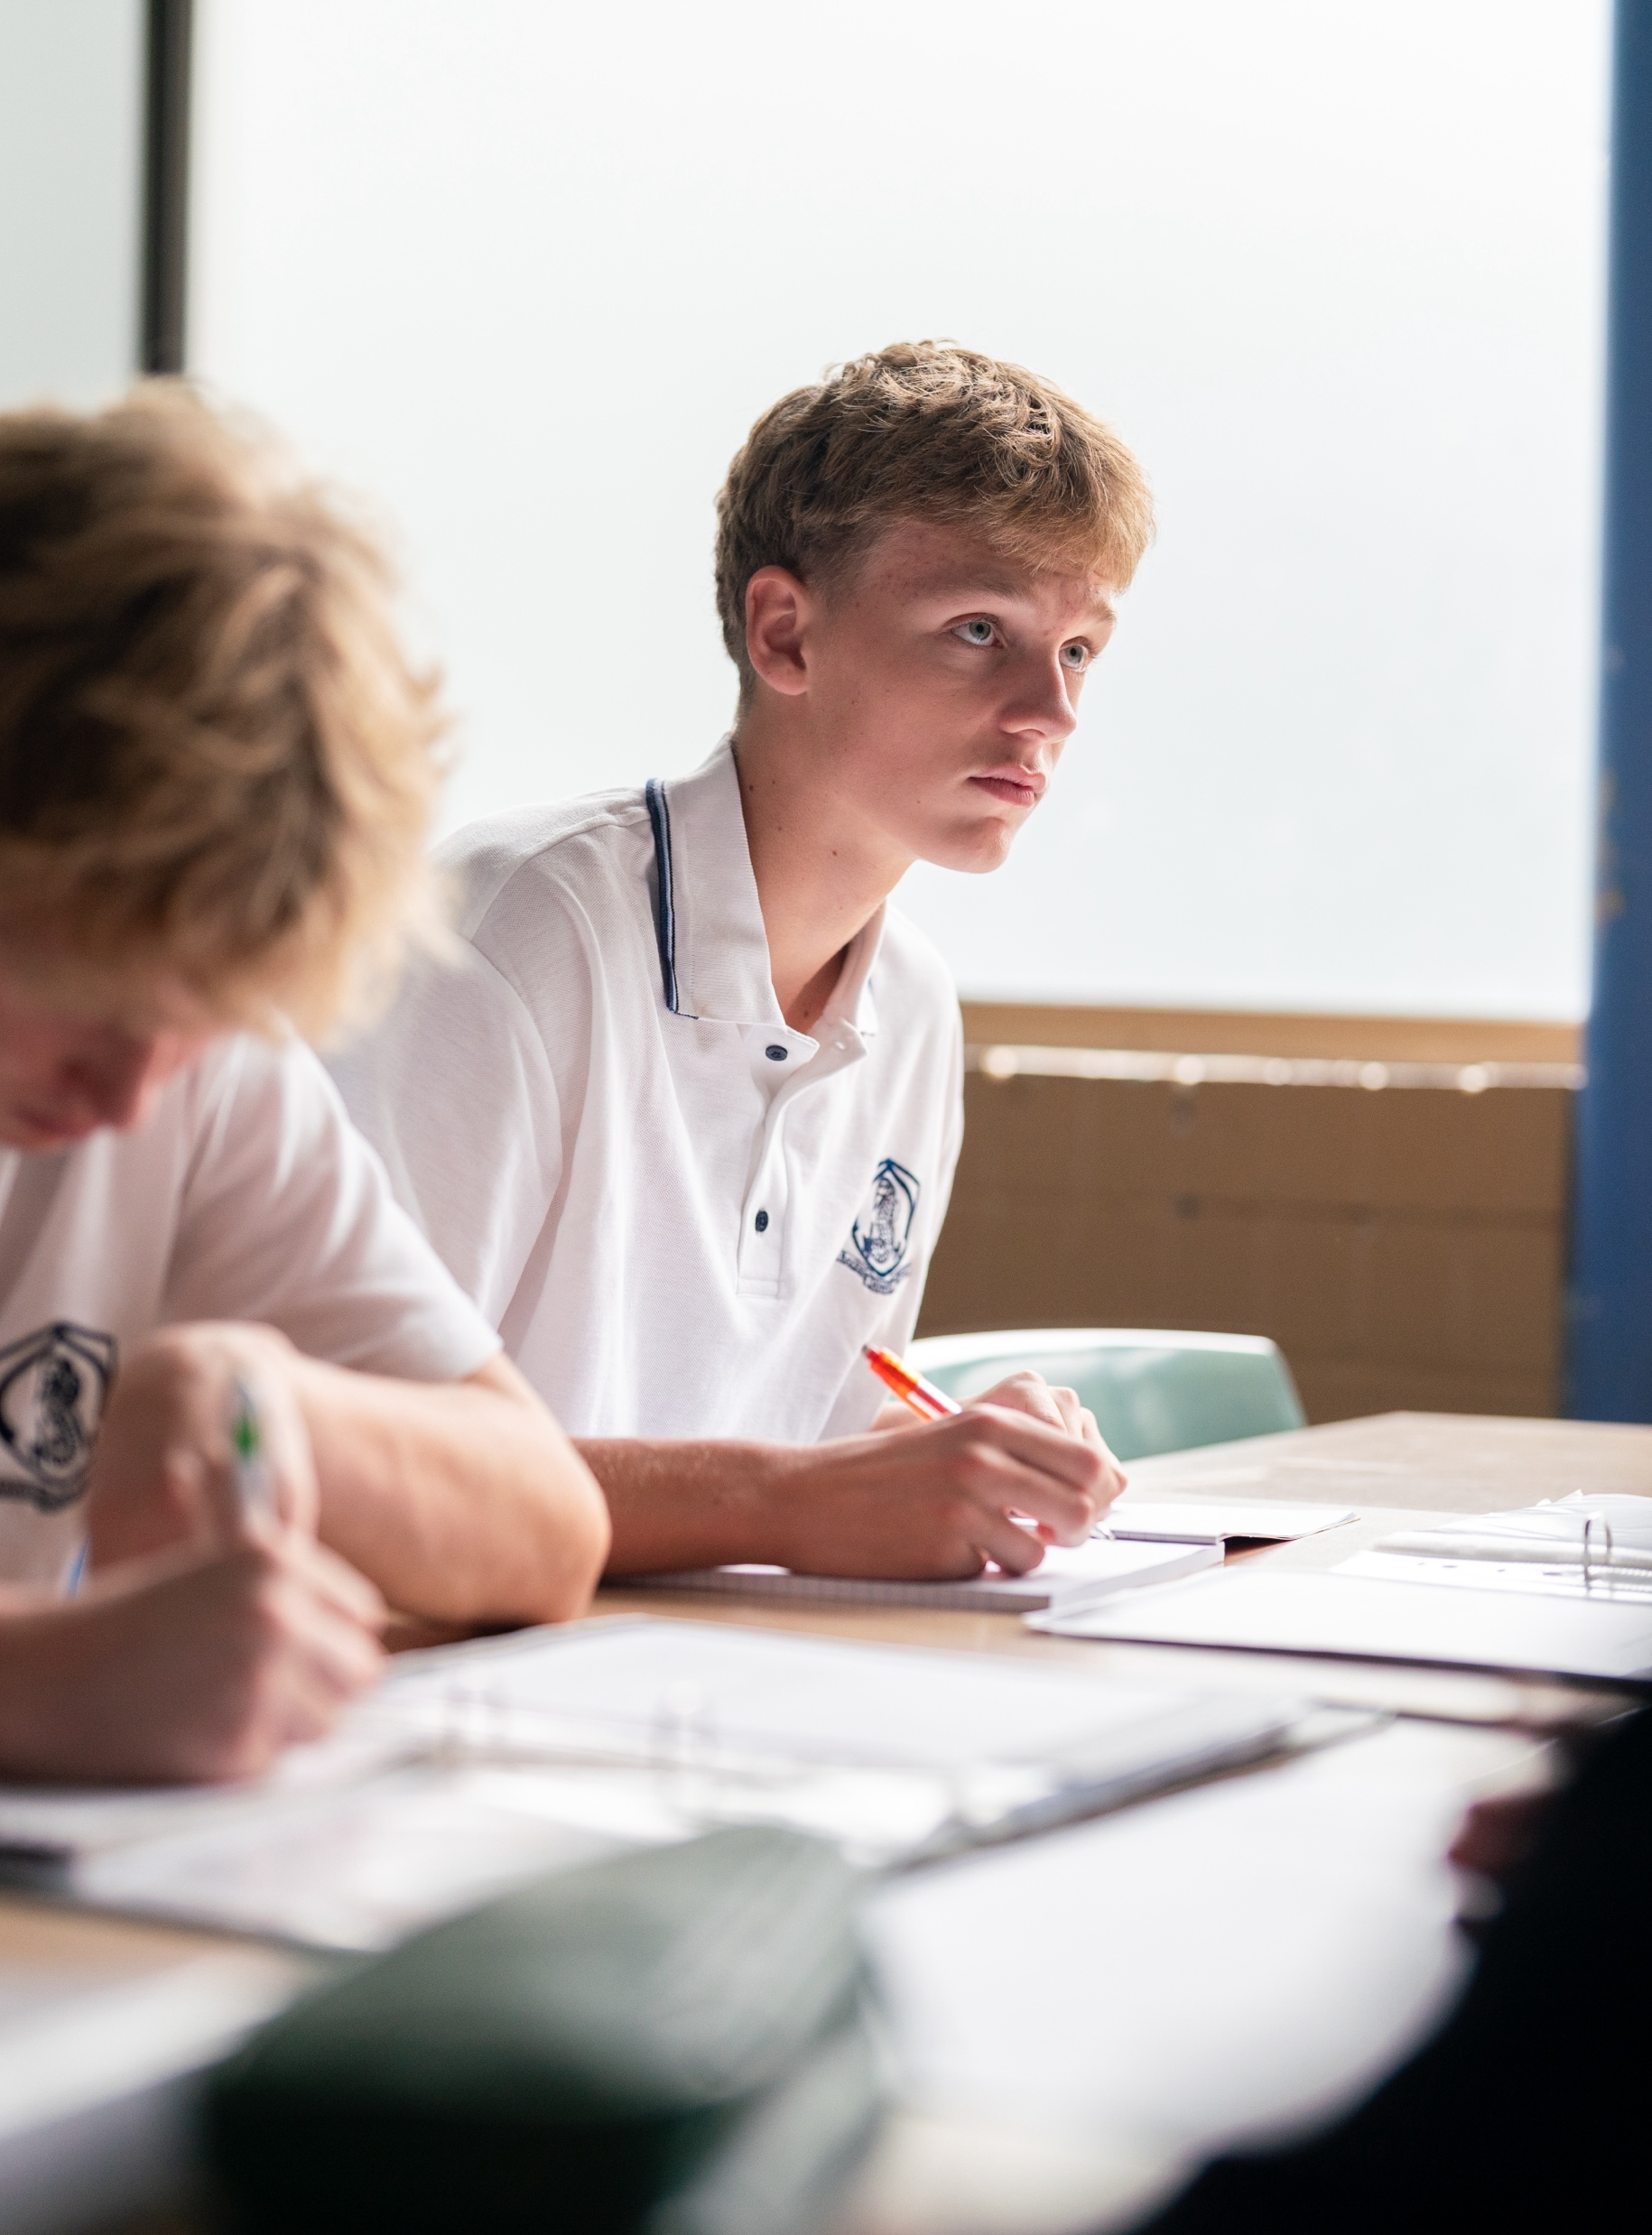
Phase 3 – check your understanding of theme – PowerPoint
Stage 4
Year 8, Term 4 – The camera never lies
Notes:
Teacher note: the purpose of this PowerPoint is to provide support for Phase 3, activity 3 – check your understanding of theme. It should be used in conjunction with the program and the resource book.

Slide 3
Lessons
1
Understanding theme
2
Topics and themes
3
Writing your own thematic statements
Notes:
Teacher notes:
Click lesson numbers to go to specific lessons
Interactive features can be viewed in slide show
Notes for vendors [to be removed after slide deck creation]:
Create hyperlinks to dividers that match lesson numbers by
Right click on the number>edit link>select slide in deck to connect to

Slide 4
Sharing learning intentions and success criteria
Notes:
Teacher note: this slide has been used to identify the Explicit teaching learning strategy and should be deleted or hidden when using in a classroom setting. Sharing learning intentions allows a teacher to effectively communicate learning goals with students. They allow students to connect new learning to existing knowledge, skills and understanding. When used with success criteria students have a clear idea of the learning goal and how to get there (AERO 2024). The sample success criteria are aligned to the syllabus. They break the learning intention into smaller and more manageable actions. They show students what they must do, say, make, create or perform to demonstrate their learning (Griffin 2018). These have been left blank with suggestions provided in the notes to allow for the co-construction of success criteria that reflects student need. When co-constructing with students, teachers use their expertise to guide student thinking, and often model and use exemplars to show students what success 'looks like'.

Slide 5
Learning intentions and success criteria
We are learning to:
understand what is a theme
understand the difference between a topic and a theme.
We can:
[classroom teacher to insert co-constructed success criteria]
[classroom teacher to insert co-constructed success criteria]
[classroom teacher to insert co-constructed success criteria].
Notes:
Teacher note:
Learning intentions and success are best co-constructed with students. Adapt the learning intention as required and add matching success criteria.
The learning intention is directly related to preparing students to complete Examination – The camera never lies. This should be explained to students for clarity.
For more information See ⁠AITSL or the NSW Department of Education explicit teaching strategies, ⁠Sharing learning intentions and ⁠Sharing success criteria
LISC is not necessarily presented at the beginning of the lesson. Teacher needs to consider most effectual time to introduce.
LISC should be revisited during the lesson to support students' evaluation of their learning.

Slide 6
Understanding theme
Notes:
Teacher note: use this sequence of slides prior to commencing viewing of Satellite Boy. The content contained in these slides in referenced throughout the viewing in the Phase 3 activities.

Slide 7
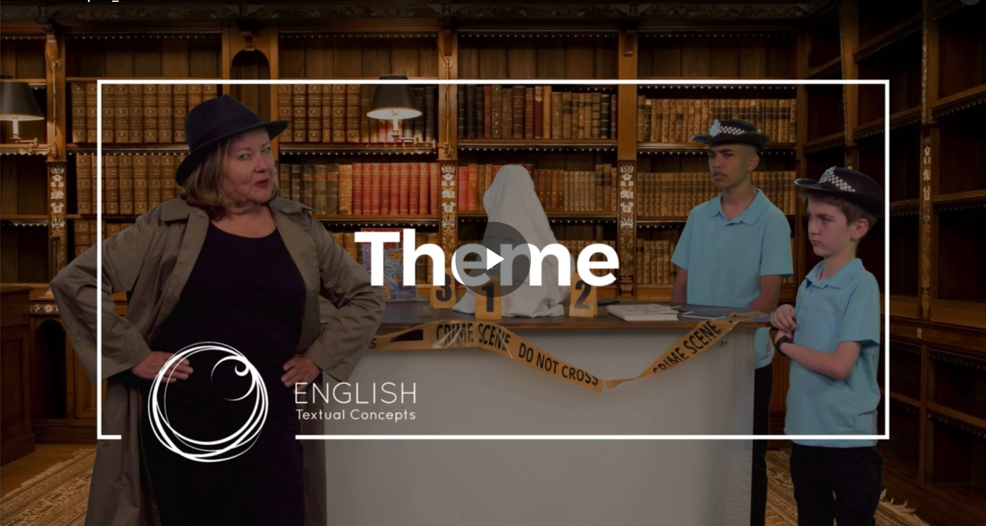
Understanding theme (1)
Textual concepts – understanding theme
Notes:
Teacher note: show the video Theme (nsw.gov.au) before students review their previous understand of theme before extending their understanding by reading the summary contained in Phase 3, resource 1 – understanding theme.
Before viewing the video, teacher may ask questions as part of the connecting learning explicit teaching strategy to make connections across previous learning.
What do you think a 'theme' is in a story?
Can you name a story you know well and tell us what you think its theme might be?
After viewing the video, teacher may ask questions as part of the checking for understanding explicit teaching strategy before moving on.
In the video, how did the police chief explain the difference between a topic and a theme?
The video suggested several possible themes for "The Three Little Pigs". Can you recall at least two of them?
The police chief said that once we identify a theme, we should "see what it tells us about our lives". Why do you think this is important?
Full video address: https://players.brightcove.net/6197335233001/default_default/index.html?videoId=6274862481001

Slide 8
Topics and themes
Notes:
Teacher note: Show the video Theme vs Main Idea (4:47) before students attempt the writing thematic statements question in Phase 3, activity 3 – check your understanding of theme. Note that this video uses the term ‘main idea’ rather than ‘topic’ (as used in the student activity). The teacher should point out that these terms can be used interchangeably.
Before viewing the video, teacher may ask questions as part of the connecting learning explicit teaching strategy to make connections across previous learning.
What do you think is the difference between a theme and a main idea in a story?
Can you think of a story you know well and describe what you think its main idea might be?
After viewing the video, teacher may ask questions as part of the checking for understanding explicit teaching strategy before moving on to the writing your own thematic statements activity.
According to the video, how is theme different from main idea?
In the example of "The Tortoise and the Hare", what was given as the main idea, and what was given as the theme?
The video mentions "universal theme". What is a universal theme, and how is it different from a regular theme?
YouTube video playback is most reliable when opened in Chrome browser.
Discussion questions
Full video address: https://www.youtube.com/watch?v=My0JcnU4Yt8

Slide 9
Topics and themes (1)
Theme vs main idea
Before viewing the video:
What do you think is the difference between a theme and a main idea in a story?
Can you think of a story you know well and describe what you think its main idea might be?
After viewing the video:
According to the video, how is theme different from main idea?
In the example of ‘The Tortoise and the Hare’, what was given as the main idea, and what was given as the theme?
The video mentions ‘universal theme’. What is a universal theme, and how is it different from a regular theme?
Notes:
Teacher note: Show the video Theme vs Main Idea (4:47) before students attempt the writing thematic statements question in Phase 3, activity 3 – check your understanding of theme. Note that this video uses the term ‘main idea’ rather than ‘topic’ (as used in the student activity). The teacher should point out that these terms can be used interchangeably.
Before viewing the video, teacher may ask questions as part of the connecting learning explicit teaching strategy to make connections across previous learning.
What do you think is the difference between a theme and a main idea in a story?
Can you think of a story you know well and describe what you think its main idea might be?
After viewing the video, teacher may ask questions as part of the checking for understanding explicit teaching strategy before moving on to the writing your own thematic statements activity.
According to the video, how is theme different from main idea?
In the example of ‘The Tortoise and the Hare’, what was given as the main idea, and what was given as the theme?
The video mentions "universal theme". What is a universal theme, and how is it different from a regular theme?
YouTube video playback is most reliable when opened in Chrome browser.
Discussion questions
Full video address: https://www.youtube.com/watch?v=My0JcnU4Yt8

Slide 10
Writing your own thematic statements

Slide 11
Phase 3, activity 3 – check your understanding of theme
Topic: Honesty
Theme: Being honest, even when it's difficult, builds trust and strengthens relationships.
The topic, ‘honesty’, is a broad subject that a story might explore.
The theme, ‘being honest, even when it's difficult, builds trust and strengthens relationships,’ goes deeper. It expresses a specific message about honesty, showing how the topic applies to life and relationships.
While the topic tells us what the story is about, the theme tells us what the story is saying about that topic.
Notes:
Teacher note: teacher may wish to conduct the ‘write your own thematic statements’ question in Phase 3, activity 3 – check your understanding of theme using a gradual release of responsibility strategy. By using a worked example (honesty – as shown on slide and in activity) the teacher may like to then do the first of the five thematic statements together with the class (‘I do’) before moving to a handover of ‘we do’ and ‘you do’ in the following statements.

Slide 12
References
This presentation contains NSW Curriculum and syllabus content. The NSW Curriculum is developed by the NSW Education Standards Authority. This content is prepared by NESA for and on behalf of the Crown in the right of the State of New South Wales. The material is protected by Crown copyright.
Please refer to the NESA Copyright Disclaimer for more information https://educationstandards.nsw.edu.au/wps/portal/nesa/mini-footer/copyright.
NESA holds the only official and up-to-date versions of the NSW Curriculum and syllabus documents. Please visit the NSW Education Standards Authority (NESA) website https://educationstandards.nsw.edu.au/wps/portal/nesa/home and the NSW Curriculum website https://curriculum.nsw.edu.au.
English K–10 Syllabus © NSW Education Standards Authority (NESA) for and on behalf of the Crown in right of the State of New South Wales, 2022.
Brinkley J (4 April 2017) 'Theme vs Main Idea' [video], Jennifer Brinkley, YouTube, accessed 22 September 2024.
State of New South Wales (Department of Education) (2024) 'Core concepts’, Textual concepts, NSW Department of Education website, accessed 22 September 2024.

Slide 13
Copyright
© State of New South Wales (Department of Education), 2024
The copyright material published in this resource is subject to the Copyright Act 1968 (Cth) and is owned by the NSW Department of Education or, where indicated, by a party other than the NSW Department of Education (third-party material).
Copyright material available in this resource and owned by the NSW Department of Education is licensed under a Creative Commons Attribution 4.0 International (CC BY 4.0) license.
This license allows you to share and adapt the material for any purpose, even commercially.
Attribution should be given to © State of New South Wales (Department of Education), 2024.
Material in this resource not available under a Creative Commons license:
the NSW Department of Education logo, other logos and trademark-protected material
Material owned by a third party that has been reproduced with permission. You will need to obtain permission from the third party to reuse its material.
Links to third-party material and websites
Please note that the provided (reading/viewing material/list/links/texts) are a suggestion only and implies no endorsement, by the New South Wales Department of Education, of any author, publisher, or book title. School principals and teachers are best placed to assess the suitability of resources that would complement the curriculum and reflect the needs and interests of their students.
If you use the links provided in this document to access a third party’s website, you acknowledge that the terms of use, including licence terms set out on the third-party’s website apply to the use which may be made of the materials on that third-party website or where permitted by the Copyright Act 1968 (Cth). The department accepts no responsibility for content on third-party websites.

