Slide 1
Instructions for use
This resource is not a teaching and learning program. It should be used in conjunction with Year 8, Term 4 – The camera never lies.
Classroom teachers are encouraged to add and adapt slides as required to meet the needs of their students.
Save a copy of the file to make changes to the slide deck. Go to File > Download a Copy (this downloads a copy to the computer to edit in the PowerPoint app).
To convert the PowerPoint to Google Slides:
  Upload the file into Google Drive and open it.
  Go to File > Save as Google Slides.
  (Note – conversion may cause formatting changes in the slides.)

Slide 2

Phase 3 – understanding filmic devices – PowerPoint
Stage 4
Year 8, Term 4 – The camera never lies
Notes:
Teacher note: the purpose of this PowerPoint is to provide support for Phase 3, activity 2 – understanding filmic devices. It should be used in conjunction with the program and the resource book.

Slide 3
Lessons
1
Understanding filmic devices
2
What we see
3
What we hear
4
What we assume
Notes:
Teacher notes:
Click lesson numbers to go to specific lessons
Interactive features can be viewed in slide show

Slide 4
Sharing learning intentions and success criteria

Slide 5
Learning intentions and success criteria
We are learning to:
understand various filmic devices used in filmmaking
understand how directors use these devices to create meaning and evoke emotion.
We can:
[classroom teacher to insert co-constructed success criteria]
[classroom teacher to insert co-constructed success criteria]
[classroom teacher to insert co-constructed success criteria].
Notes:
Teacher note:
Learning intentions and success are best co-constructed with students. Adapt the learning intention as required and add matching success criteria.
The learning intention is directly related to preparing students to complete Examination – The camera never lies. This should be explained to students for clarity.
For more information See ⁠AITSL or the NSW Department of Education explicit teaching strategies, ⁠Sharing learning intentions and ⁠Sharing success criteria
LISC is not necessarily presented at the beginning of the lesson. Teacher needs to consider most effectual time to introduce.
LISC should be revisited during the lesson to support students' evaluation of their learning.

Slide 6
Understanding filmic devices
Notes:
Teacher note: use the ‘Connecting learning’ strategy to introduce the concept of filmic devices. Begin by asking students to recall any movies they've recently watched and what stood out to them. Then, explain how directors use specific tools (filmic devices) to create those memorable moments. Use the diagram on the slide to visually connect what we see, hear, and assume in films.
Discussion question: Can you think of a scene from a movie where what you saw, heard, and assumed all worked together to create a powerful moment?

Slide 7
What we see, hear and assume
Filmic devices are the tools directors use to tell stories and create specific effects in movies. Understanding these devices allows us to appreciate how films are made and why they create certain emotions or thoughts.
One way to think about and analyse film is to break it down into 3 parts.
What we
see
What we
hear
What we
assume

Slide 8
What we see

Slide 9
What we see (1)
What we see includes:
Shot sizes
Extreme long shot
Long shot
Medium shot
Close-up shot
Extreme close-up shot
Camera angles
High angle
Eye-level angle
Low angle
Dutch angle
Camera movement
Dolly shot
Tracking shot
Panning shot
Tilt shot
Zoom shot
Notes:
Teacher note: employ the ‘Chunking and sequencing learning’ strategy here. Break down the ‘What we see’ category into its three main components: shot sizes, camera angles, and camera movement. Explain each briefly, then dive deeper into each aspect (e.g., shot sizes) in the following slides. This helps manage cognitive load by introducing the overview before getting into specifics.
Discussion question: Why do you think directors might choose different shot sizes or camera angles in a film?

Slide 10
What we see (2)
Focusing on filmic devices
View the film 15 Essential Camera Shots, Angles and Movements in Filmmaking – YouTube (6:36).
Take notes as you watch.
Notes:
Teacher note: show the video 15 Essential Camera Shots, Angles and Movements in Filmmaking – YouTube (6:36) before starting a detailed discussion of the specific filmic devices in the following slides.
YouTube video playback is most reliable when opened in Chrome browser.

Slide 11
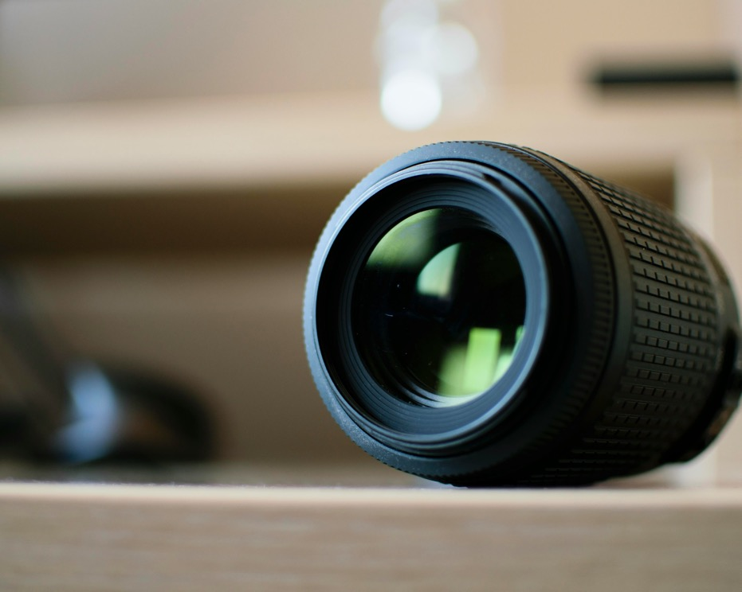
Shot sizes
A part of what we see
Directors carefully choose shot sizes to control what the audience sees and how they perceive the scene.
Shot sizes include:
Extreme long shot
Long shot
Medium shot
Close-up shot
Extreme close-up shot
Image by Jeroen den Otter is licensed under Unsplash license.​
Notes:
Teacher note: provide a brief overview of the types of shots sizes, as outlined on the slide. Remind students that they are completing their own simple sketch, diagram, or symbol in the space provided in Phase 3, activity 2 – understanding filmic devices to represent the devices.
Discussion question: How might the choice of shot size affect how we perceive a character or scene?

Slide 12

Extreme long shot
Shot sizes
Purpose
To establish the setting and provide context
Effect
Makes characters appear small in relation to their environment, emphasising the scale of the location or the character's isolation
Image by Andrew Loewen is licensed under Unsplash license.​
Notes:
Teacher note: students to complete their own simple sketch, diagram, or symbol in the space provided in Phase 3, activity 2 – understanding filmic devices to represent this device.

Slide 13

Long shot
Shot sizes
Purpose
To show the relationship between characters and their environment
Effect
Allows the audience to see body language and movement within the context of the surroundings
Image by Jarritos Mexican Soda is licensed under Unsplash license. ​
Notes:
Teacher note: students to complete their own simple sketch, diagram, or symbol in the space provided in Phase 3, activity 2 – understanding filmic devices to represent this device.

Slide 14

Medium shot
Shot sizes
Purpose
To focus on character interactions while still showing some environment
Effect
Balances detail of character expressions with their body language and immediate surroundings
​Image by Frank Alarcon is licensed under Unsplash license.
Notes:
Teacher note: students to complete their own simple sketch, diagram, or symbol in the space provided in Phase 3, activity 2 – understanding filmic devices to represent this device.

Slide 15

Close-up shot
Shot sizes
Purpose
To emphasise emotions or important details
Effect
Creates intimacy with characters or draws attention to crucial objects in the story
​Image by Oktavianus Mulyadi is licensed under Unsplash license.
Notes:
Teacher note: students to complete their own simple sketch, diagram, or symbol in the space provided in Phase 3, activity 2 – understanding filmic devices to represent this device.

Slide 16
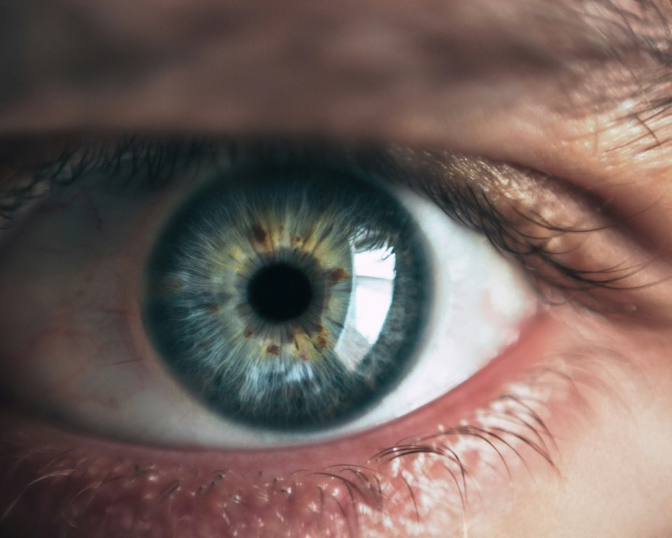
Extreme close-up shot
Shot sizes
Purpose
To create intensity or highlight small details
Effect
Can make the audience feel uncomfortable or create suspense by limiting their view
​Image by Andrew Loewen is licensed under Unsplash license.
Notes:
Teacher note: students to complete their own simple sketch, diagram, or symbol in the space provided in Phase 3, activity 2 – understanding filmic devices to represent this device.

Slide 17
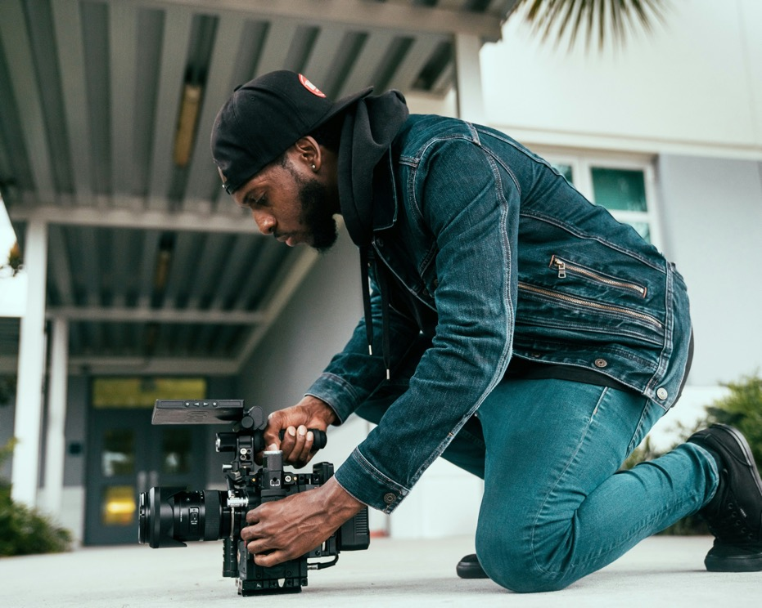
Camera angles
A part of what we see
The angle of the camera influences how the audience perceives characters and scenes.
Camera angles include:
high angle
eye-level angle
low angle
Dutch angle.
Image by CineDirektor FILMS is licensed under Unsplash license.
Notes:
Teacher note: provide a brief overview of the types of camera angles, as outlined on the slide. Remind students that they are completing their own simple sketch, diagram, or symbol in the space provided in Phase 3, activity 2 – understanding filmic devices to represent the devices.
Discussion question: Can you think of a movie scene where a specific camera angle was used to make a character seem powerful or vulnerable?

Slide 18

High angle
Camera angles
Purpose
To make the subject appear vulnerable or insignificant
Effect
Can create a sense of powerlessness or show a character's weakness
Image by Ankit Pareek is licensed under Unsplash license.
Notes:
Teacher note: students to complete their own simple sketch, diagram, or symbol in the space provided in Phase 3, activity 2 – understanding filmic devices to represent this device.

Slide 19

Eye-level angle
Camera angles
Purpose
To create a neutral, natural perspective
Effect
Makes the audience feel on equal footing with the characters, promoting empathy
Image by Joshua Rawson Harris is licensed under Unsplash license.
​
Notes:
Teacher note: students to complete their own simple sketch, diagram, or symbol in the space provided in Phase 3, activity 2 – understanding filmic devices to represent this device.

Slide 20
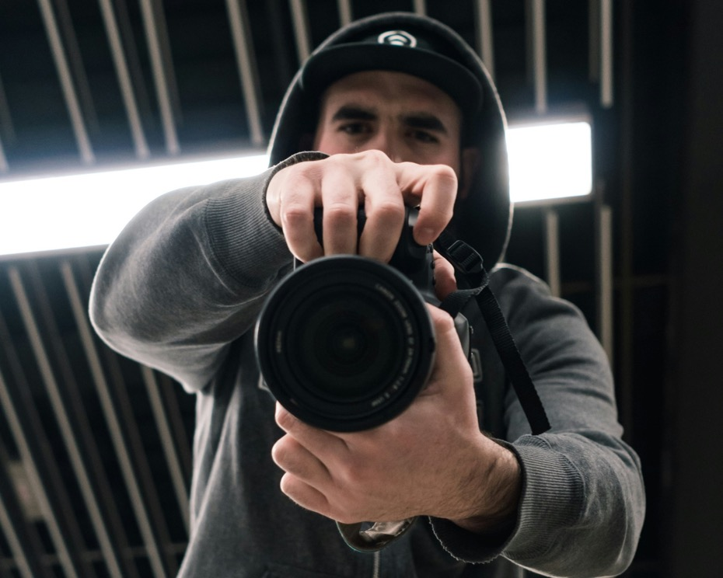
Low angle
Camera angles
Purpose
To make the subject appear powerful or threatening
Effect
Can create a sense of awe or intimidation
Image by Matt Collamer is licensed under Unsplash license.
​
Notes:
Teacher note: students to complete their own simple sketch, diagram, or symbol in the space provided in Phase 3, activity 2 – understanding filmic devices to represent this device.

Slide 21
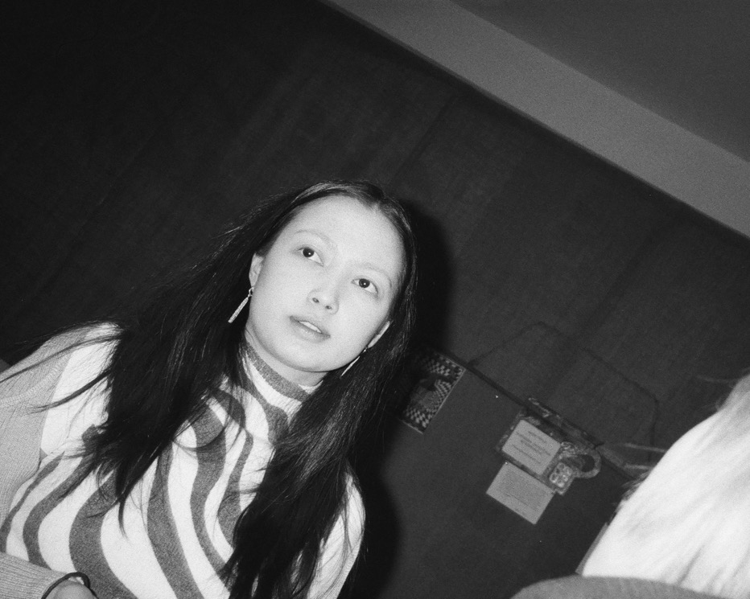
Dutch angle
Camera angles
Purpose
To create disorientation or unease
Effect
Makes the audience feel that something is 'off' in the scene, often used in thrillers or horror films
Image by Illia Horokhovsky is licensed under Unsplash license.
Notes:
Teacher note: students to complete their own simple sketch, diagram, or symbol in the space provided in Phase 3, activity 2 – understanding filmic devices to represent this device.

Slide 22
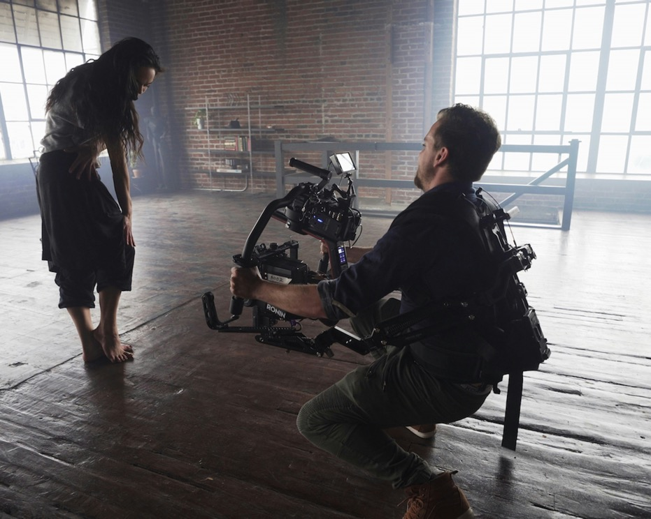
Camera movement
A part of what we see
Moving the camera adds dynamism and can guide the audience's attention.
Camera movement includes:
dolly shot
panning shot
tilt shot
zoom shot.
Image by ShareGrid is licensed under Unsplash license.
Notes:
Teacher note: Provide a brief overview of the types of camera movement, as outlined on the slide. Remind students that they are completing their own simple sketch, diagram, or symbol in the space provided in Phase 3, activity 2 – understanding filmic devices to represent the devices.
Discussion question: How might different camera movements affect the pace or mood of a scene?

Slide 23

Dolly shot
Camera movement
Purpose
To move the camera smoothly towards or away from a subject
Effect
Can create a sense of gradual revelation or build tension
Image by Emma Frances Logan is licensed under Unsplash license.
Notes:
Teacher note: students to complete their own simple sketch, diagram, or symbol in the space provided in Phase 3, activity 2 – understanding filmic devices to represent this device.

Slide 24

Panning shot
Camera movement
Purpose
To follow action or reveal a scene gradually
Effect
Mimics the natural movement of the human eye, guiding the audience's gaze
Image by Nick Fewings is licensed under Unsplash license.
Notes:
Teacher note: students to complete their own simple sketch, diagram, or symbol in the space provided in Phase 3, activity 2 – understanding filmic devices to represent this device.

Slide 25

Tilt shot
Camera movement
Purpose
To reveal vertical space or create a sense of scale
Effect
Can emphasise the height of objects or characters or create a sense of motion
Image by Smart is licensed under Unsplash license.
​
Notes:
Teacher note: students to complete their own simple sketch, diagram, or symbol in the space provided in Phase 3, activity 2 – understanding filmic devices to represent this device.

Slide 26

Zoom shot
Camera movement
Purpose
To draw attention to a specific element without cutting
Effect
Can create a sense of sudden realisation or discovery for the audience
Image by Paul Schafer is licensed under Unsplash license.
Notes:
Teacher note: students to complete their own simple sketch, diagram, or symbol in the space provided in Phase 3, activity 2 – understanding filmic devices to represent this device.

Slide 27
What we hear

Slide 28
What we hear (1)
What we hear includes:
Music
Diegetic music
Non-diegetic music
Dialogue and Narration
Voice-over
Dialogue
Sound effects
Diegetic sound effects
Non-diegetic sound effects
Notes:
Teacher note: employ the ‘Chunking and sequencing learning’ strategy here. Break down the ‘What we hear’ category into its three main components: music, dialogue and narration, and sound effects. Explain each briefly, then dive deeper into each aspect (e.g., music) in the following slides. This helps manage cognitive load by introducing the overview before getting into specifics.
Discussion question: How might a director use lighting or costume to tell us something about a character without using any dialogue?

Slide 29
What we hear (2)f film sounds
Focusing on filmic devices
View the film 5 Basic Elements of Film Sound | Filmmaking for Beginners – YouTube (6:00).
Take notes as you watch.
Notes:
Teacher note: show the video 5 Basic Elements of Film Sound | Filmmaking for Beginners – YouTube (6:00) before starting a detailed discussion of the specific filmic devices in the following slides.
YouTube video playback is most reliable when opened in Chrome browser.

Slide 30

Music
A part of what we hear
Music is a powerful tool for shaping the audience's emotional response. Its purpose is to set mood, foreshadow events, or characterise people and places. It can make scenes feel tense, romantic, sad or exciting without explicit visual cues.
Music includes:
diegetic music
non-diegetic music.
Image by Marius Masalar is licensed under Unsplash license.
Notes:
Teacher note: provide a brief overview of the types of music, as outlined on the slide. Remind students that they are completing their own simple sketch, diagram, or symbol in the space provided in Phase 3, activity 2 – understanding filmic devices to represent the devices.

Slide 31
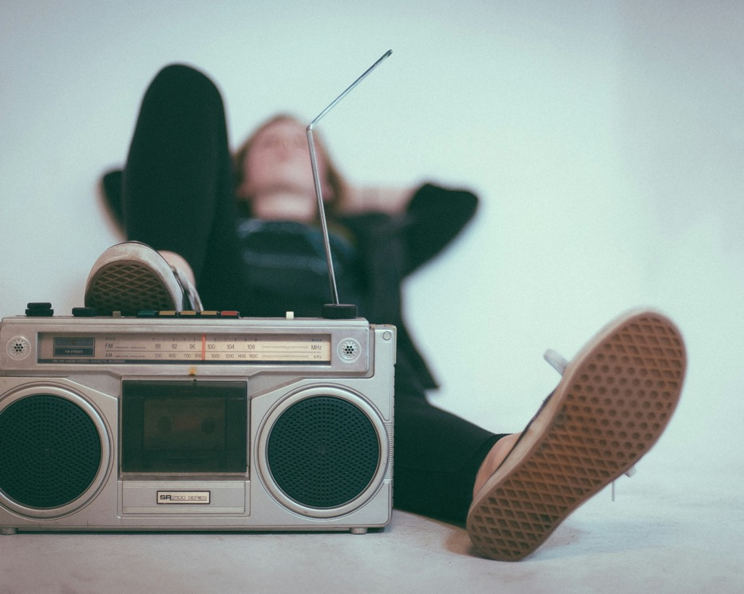
Diegetic music
A part of what we hear
Description
Music that characters in the film can hear
Effect
Enhances realism and can provide context about the setting or characters
Image by Eric Nopanen is licensed under Unsplash license.
​
Notes:
Teacher note: students to complete their own simple sketch, diagram, or symbol in the space provided in Phase 3, activity 2 – understanding filmic devices to represent this device.

Slide 32
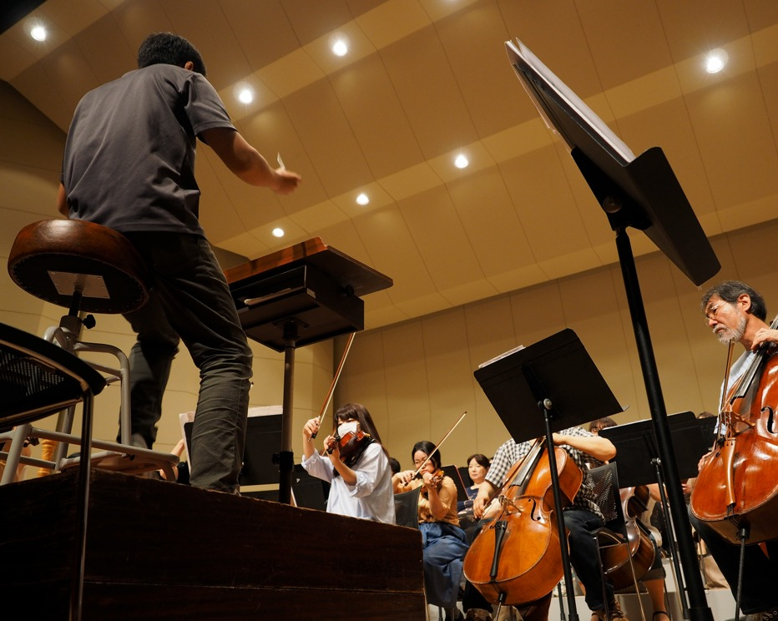
Non-diegetic music
A part of what we hear
Description
Background music only the audience can hear
Effect
Guides the audience's emotional response to scenes
Image by Kazuo ota is licensed under Unsplash license.
Notes:
Teacher note: students to complete their own simple sketch, diagram, or symbol in the space provided in Phase 3, activity 2 – understanding filmic devices to represent this device.

Slide 33
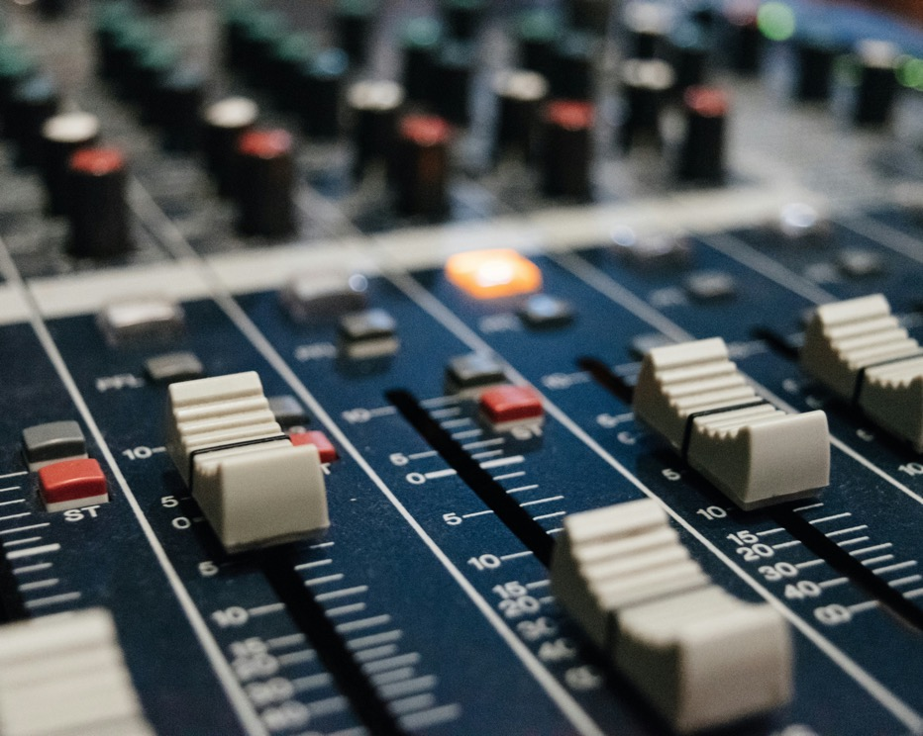
Sound effects
A part of what we hear
Purpose
To enhance realism, create atmosphere, or draw attention to specific actions
Effect
Makes the film world feel more immersive and can heighten emotional impact
Image by Alexey Ruban is licensed under Unsplash license. ​
Notes:
Teacher note: students to complete their own simple sketch, diagram, or symbol in the space provided in Phase 3, activity 2 – understanding filmic devices to represent this device.

Slide 34

Dialogue and narration
A part of what we hear
Dialogue and narration convey information, reveal character personalities and advance the plot. It allows the audience to understand characters' thoughts, motivations and relationships.
Dialogue and narration includes:
voice-over
dialogue.
Image by Matt Botsford is licensed under Unsplash license. ​
Notes:
Teacher note: provide a brief overview of the types of dialogue and narration, as outlined on the slide. Remind students that they are completing their own simple sketch, diagram, or symbol in the space provided in Phase 3, activity 2 – understanding filmic devices to represent the devices.

Slide 35
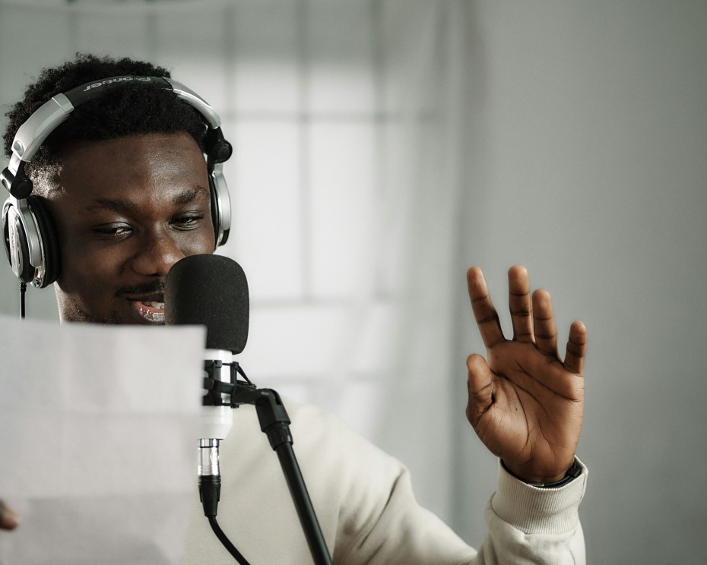
Voice-over
A part of what we hear
Description
Narration heard over a scene
Effect
Provides insight into a character's thoughts or gives context to events
Image by Emmanuel Ikwuegbu is licensed under Unsplash license. ​
Notes:
Teacher note: students to complete their own simple sketch, diagram, or symbol in the space provided in Phase 3, activity 2 – understanding filmic devices to represent this device.

Slide 36
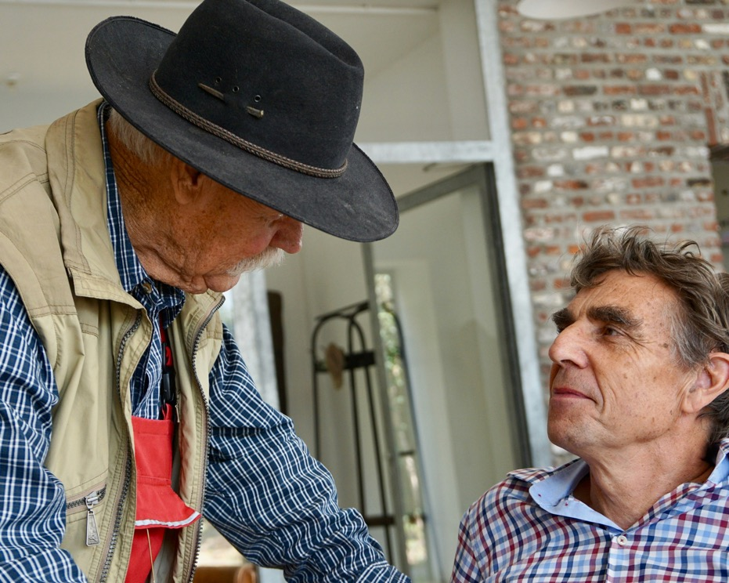
Dialogue
A part of what we hear
Description
Conversations between characters
Effect
Reveals character relationships and personalities, advances the plot
Image by Beth Macdonald is licensed under Unsplash license.
Notes:
Teacher note: students to complete their own simple sketch, diagram, or symbol in the space provided in Phase 3, activity 2 – understanding filmic devices to represent this device.

Slide 37
What we assume
Notes:
Teacher note: No YouTube clip is provided for this group as students have already been exposed to many of these concepts earlier in the program. The teacher may choose to include a suitable video at this point for illustrative purposes if needed.

Slide 38
What we assume (1)
What we assume includes:
Lighting
High-key lighting
Low-key lighting
Other devices
Symbols
Setting and location
Costume and make-up
Body language
Notes:
Teacher note: employ the ‘Chunking and sequencing learning’ strategy here. Break down the ‘What we assume’ category into its two main components: lighting and other devices. Explain each briefly, then dive deeper into each aspect (e.g., symbols) in the following slides. This helps manage cognitive load by introducing the overview before getting into specifics.

Slide 39
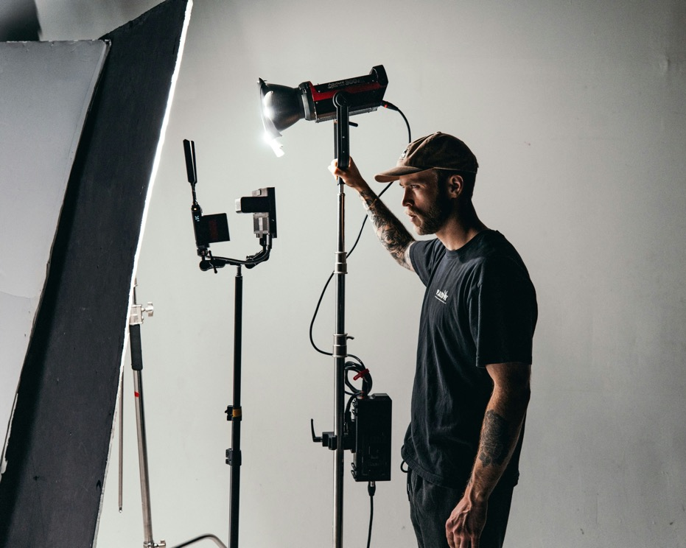
Lighting
A part of what we assume
Lighting is also a powerful devices that directors use. It can set mood, direct attention, and create visual symbolism. It influences the audience's emotional response and perception of scenes.
Lighting includes:
high-key lighting
low-key lighting.
Image by Kal Visuals is licensed under Unsplash license.
Notes:
Teacher note: provide a brief overview of the types of lighting, as outlined on the slide. Remind students that they are completing their own simple sketch, diagram, or symbol in the space provided in Phase 3, activity 2 – understanding filmic devices to represent the devices.

Slide 40

High-key lighting
A part of what we assume
Description
Bright, even lighting
Effect
Creates a sense of openness, typically used in comedies or light-hearted scenes
Image by RW Studios is licensed under Unsplash license.​
Notes:
Teacher note: students to complete their own simple sketch, diagram, or symbol in the space provided in Phase 3, activity 2 – understanding filmic devices to represent this device.

Slide 41
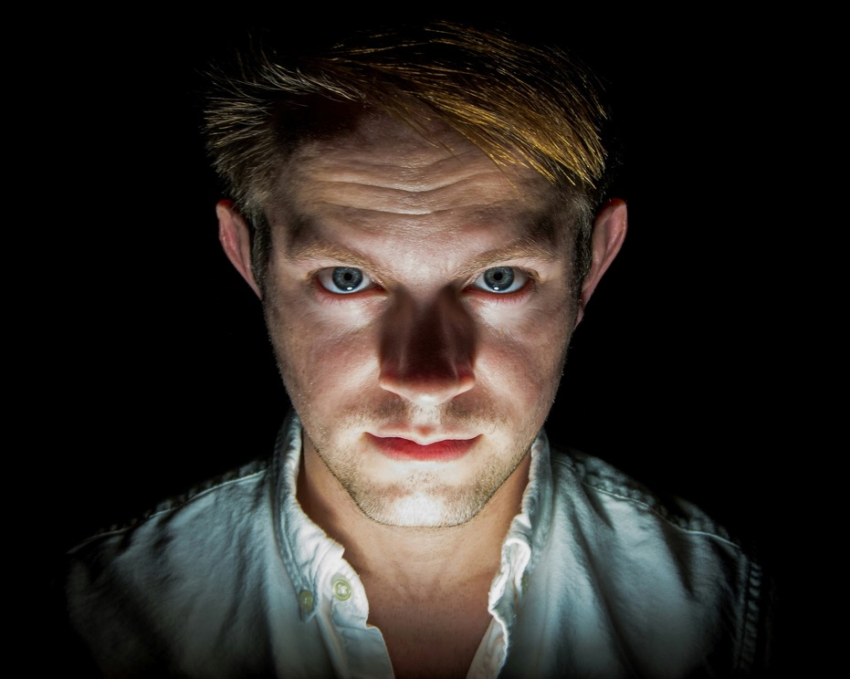
Low-key lighting
A part of what we assume
Description
High contrast between light and dark areas
Effect
Creates a sense of mystery or danger, often used in thrillers or film noir
Image by William Carlson is licensed under Unsplash license.
Notes:
Teacher note: students to complete their own simple sketch, diagram, or symbol in the space provided in Phase 3, activity 2 – understanding filmic devices to represent this device.

Slide 42

Symbols
A part of what we assume
Purpose
To represent abstract ideas or themes visually
Effect
Adds depth to the story and encourages audience interpretation
Image by Aliata Karbaschi is licensed under Unsplash license.
​
Notes:
Teacher note: students to complete their own simple sketch, diagram, or symbol in the space provided in Phase 3, activity 2 – understanding filmic devices to represent this device.

Slide 43
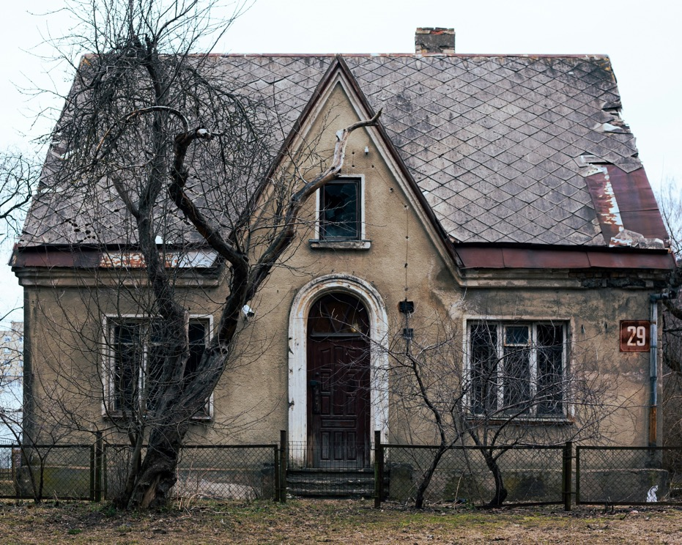
Setting and location
A part of what we assume
Purpose
To establish context and atmosphere
Effect
Influences how the audience perceives characters and events, can foreshadow plot developments
Image by Nastasia Makfinova is licensed under Unsplash license.
Notes:
Teacher note: students to complete their own simple sketch, diagram, or symbol in the space provided in Phase 3, activity 2 – understanding filmic devices to represent this device.

Slide 44
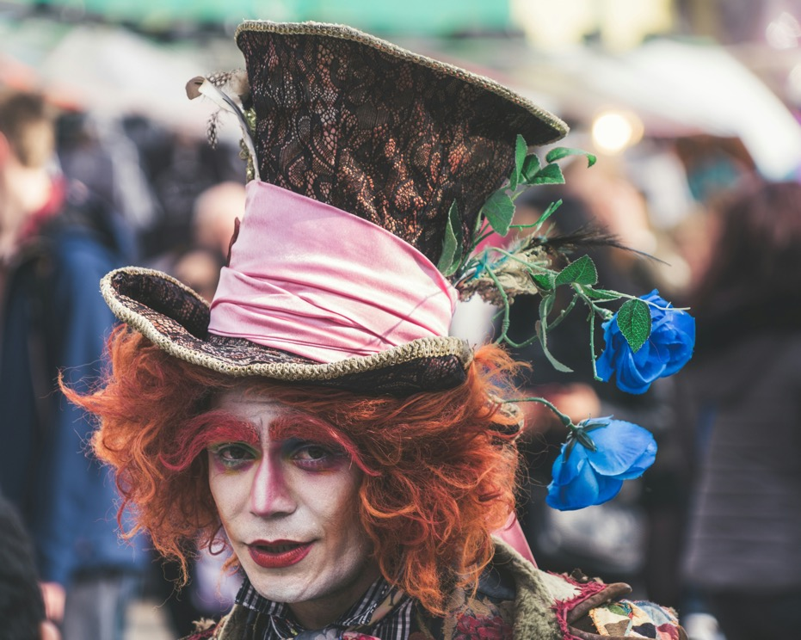
Costumes and make-up
A part of what we assume
Purpose
To convey information about characters' personalities, social status or the film's time period
Effect
Helps the audience quickly understand character roles and relationships
Image by Paolo Nicolello is licensed under Unsplash license.
Notes:
Teacher note: students to complete their own simple sketch, diagram, or symbol in the space provided in Phase 3, activity 2 – understanding filmic devices to represent this device.

Slide 45

Body language
A part of what we assume
Purpose
To convey emotions and relationships without dialogue
Effect
Adds subtlety to performances and can reveal character thoughts or feelings
Image by Amir Seilsepour is licensed under Unsplash license.​
Notes:
Teacher note: students to complete their own simple sketch, diagram, or symbol in the space provided in Phase 3, activity 2 – understanding filmic devices to represent this device.

Slide 46
References (1)
This presentation contains NSW Curriculum and syllabus content. The NSW Curriculum is developed by the NSW Education Standards Authority. This content is prepared by NESA for and on behalf of the Crown in the right of the State of New South Wales. The material is protected by Crown copyright.
Please refer to the NESA Copyright Disclaimer for more information https://educationstandards.nsw.edu.au/wps/portal/nesa/mini-footer/copyright.
NESA holds the only official and up-to-date versions of the NSW Curriculum and syllabus documents. Please visit the NSW Education Standards Authority (NESA) website https://educationstandards.nsw.edu.au/wps/portal/nesa/home and the NSW Curriculum website https://curriculum.nsw.edu.au.
English K–10 Syllabus © NSW Education Standards Authority (NESA) for and on behalf of the Crown in right of the State of New South Wales, 2022.
Alarcon F (2020) Woman in black long sleeve shirt holding microphone photo, Unsplash, accessed 22 September 2024.
B & H Photo Video Pro Audio (2020) 5 Basic Elements of Film Sound | Filmmaking for Beginners (6:00), YouTube, accessed 22 September 2024.
Botsford M (2017) Condenser microphone with black background photo, Unsplash, accessed 22 September 2024.
Carlson W (2018) Man in white collared top photo, Unsplash, accessed 22 September 2024.
CineDirektor FILMS (2020) Man in black jacket and blue denim jeans holding black dslr camera photo, Unsplash, accessed 22 September 2024.
Collamer M (2018) Low angle-view of man holding DSLR camera photo, Unsplash, accessed 22 September 2024.
den Otter J (2017) Black mobile phone lens on brown surface photo, Unsplash, accessed 22 September 2024.

Slide 47
References (2)
Fewings N (2018) White arrow painted on brick wall photo, Unsplash, accessed 22 September 2024.
Freitas V (2018) Close-up photography of human eye photo, Unsplash, accessed 22 September 2024.
Horokhovsky I (2024) A woman with long hair standing in front of a mirror photo, Unsplash, accessed 22 September 2024.
Ikwuegbu E (2021) A man wearing headphones and holding a microphone photo, Unsplash, accessed 22 September 2024.
Jarritos Mexican Soda (2021) 2 women sitting on brown wooden bench photo, Unsplash, accessed 22 September 2024.
KAL VISUALS (2022) A man standing in front of a camera and lighting equipment photo, Unsplash, accessed 22 September 2024.
Karbaschi A (2023) A large bird flying through a blue cloudy sky photo, Unsplash, accessed 22 September 2024.
Loewen A (2014) Person standing on grass field photo, Unsplash, accessed 22 September 2024.
Logan E (2017) Man and woman holding hands photo, Unsplash, accessed 22 September 2024.
Macdonald B (2020) Man in blue and white plaid button up shirt wearing black fedora hat photo, Unsplash, accessed 22 September 2024.
Makfinova N (2022) An old house with a fence around it photo, Unsplash, accessed 22 September 2024.
Masalar M (2017) Tilt selective photograph of music notes photo, Unsplash, accessed 22 September 2024.

Slide 48
References (3)
Mulyadi O (2022) A woman with long hair photo, Unsplash, accessed 22 September 2024.
Nicolello P (2018) Mad Hatter costume photography photo, Unsplash, accessed 22 September 2024.
Nopanen E(2017) Woman laying on bed near gray radio photo, Unsplash, accessed 22 September 2024.
Ota K (2020) Man in black t-shirt playing violin photo, Unsplash, accessed 22 September 2024.
Pareek A (2018) Man raising left hand while standing photo, Unsplash, accessed 22 September 2024.
Rawson-Harris J (2018) Woman selecting packed food on gondola photo, Unsplash, accessed 22 September 2024.
Ruban A (2016) Selective focus photo of DJ mixer photo, Unsplash, accessed 22 September 2024.
RW Studios (2018) Woman taking selfie photo, Unsplash, accessed 22 September 2024.
Schafer P (2023) A person taking a picture with a camera photo, Unsplash, accessed 22 September 2024.
Seilsepour A (2020) Girl in blue denim jacket and blue denim jeans standing on orange metal pipe during daytime photo, Unsplash, accessed 22 September 2024.
ShareGrid (2018) Man taking video with woman standing inside room photo, Unsplash, accessed 22 September 2024.
Smart (2017) Person standing on arrow sign on road photo, Unsplash, accessed 22 September 2024.
Wolfcrow (2017) 15 Essential Camera Shots, Angles and Movements in Filmmaking (6:36), accessed 22 September 2024

Slide 49
Copyright
© State of New South Wales (Department of Education), 2024
The copyright material published in this resource is subject to the Copyright Act 1968 (Cth) and is owned by the NSW Department of Education or, where indicated, by a party other than the NSW Department of Education (third-party material).
Copyright material available in this resource and owned by the NSW Department of Education is licensed under a Creative Commons Attribution 4.0 International (CC BY 4.0) license.
This license allows you to share and adapt the material for any purpose, even commercially.
Attribution should be given to © State of New South Wales (Department of Education), 2024.
Material in this resource not available under a Creative Commons licence:
the NSW Department of Education logo, other logos and trademark-protected material
Material owned by a third party that has been reproduced with permission. You will need to obtain permission from the third party to reuse its material.
Links to third-party material and websites
Please note that the provided (reading/viewing material/list/links/texts) are a suggestion only and implies no endorsement, by the New South Wales Department of Education, of any author, publisher, or book title. School principals and teachers are best placed to assess the suitability of resources that would complement the curriculum and reflect the needs and interests of their students.
If you use the links provided in this document to access a third party’s website, you acknowledge that the terms of use, including licence terms set out on the third-party’s website apply to the use which may be made of the materials on that third-party website or where permitted by the Copyright Act 1968 (Cth). The department accepts no responsibility for content on third-party websites.

