Slide 1
Instructions for use
This resource is not a teaching and learning program. It should be used in conjunction with the From page to stage – Year 8, Term 3 program.
Classroom teachers are encouraged to add and adapt slides as required to meet the needs of their students.
Save a copy of the file to make changes to the slide deck. Go to File > Download a Copy (this downloads a copy to the computer to edit in the PowerPoint app).
To convert the PowerPoint to Google Slides:
  Upload the file into Google Drive and open it.
  Go to File > Save as Google Slides.
  (Note – conversion may cause formatting changes in the slides.)

Slide 2
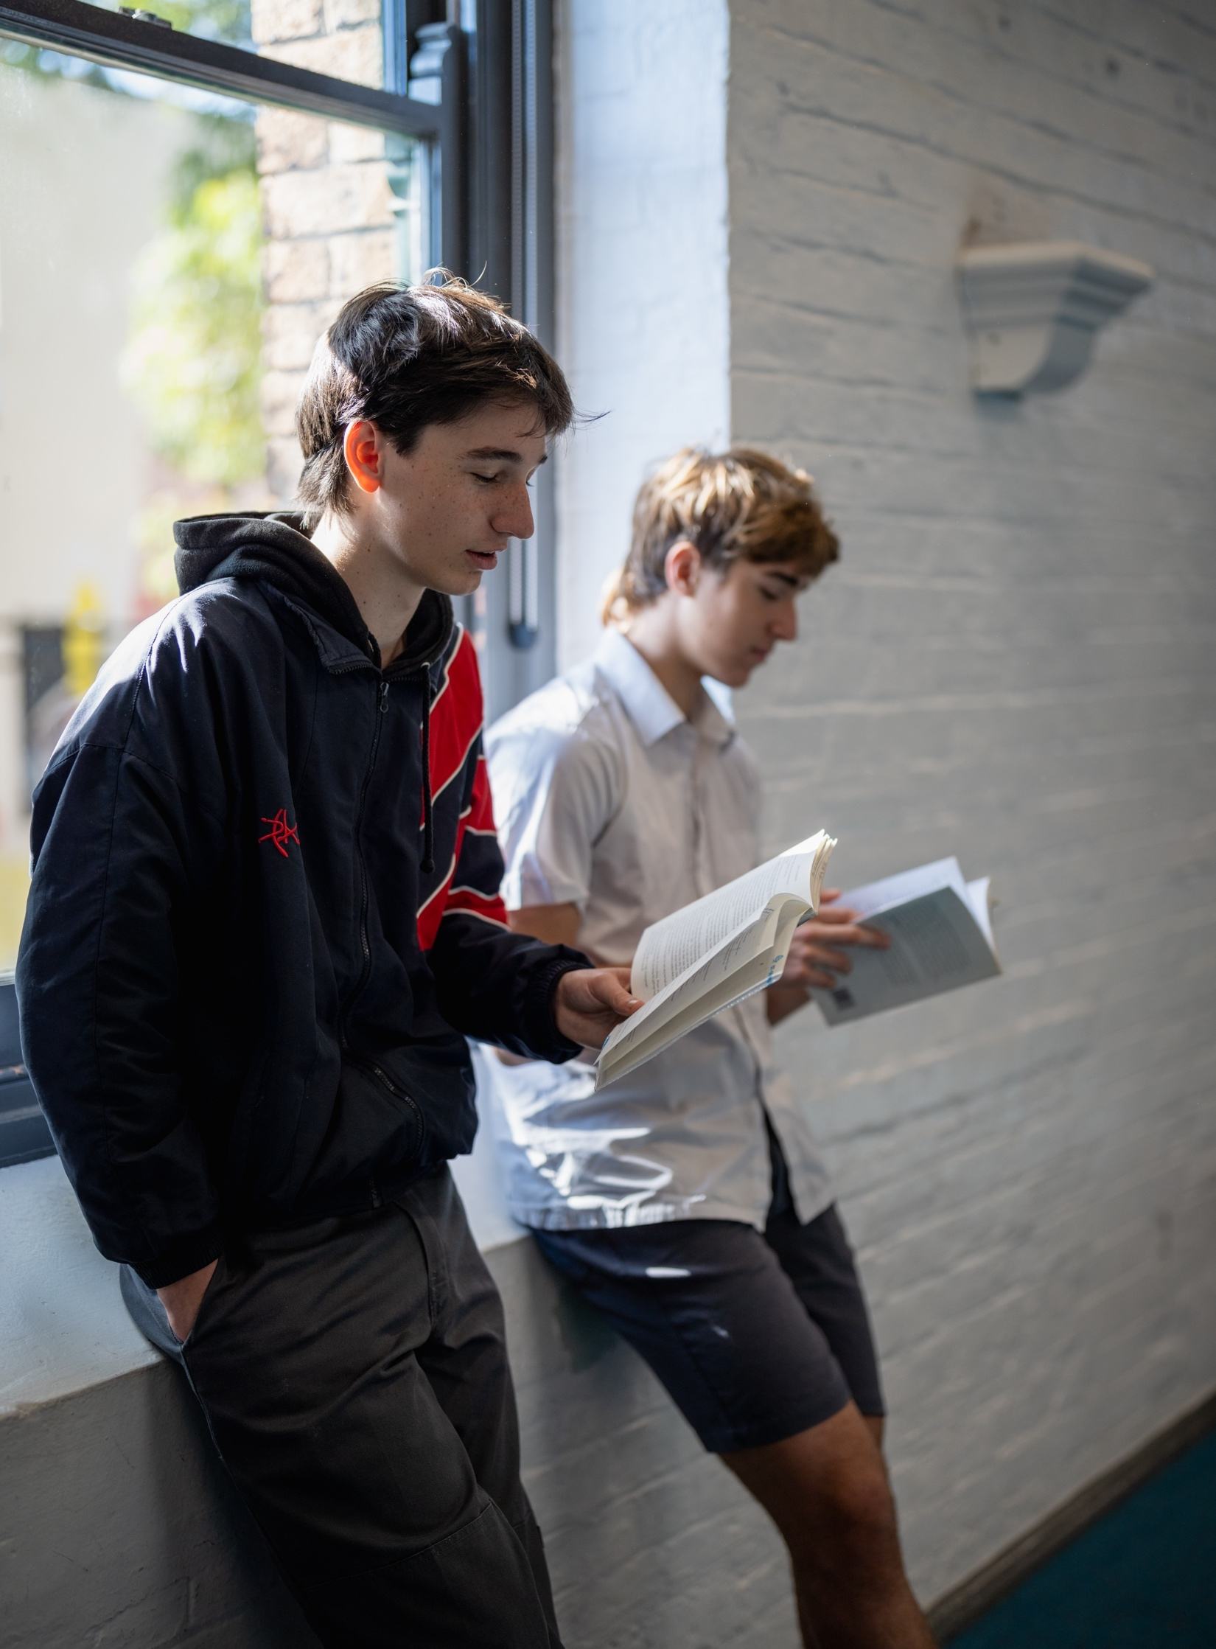
From page to stage – Year 8, Term 3
NSW Department of Education
Phase 4, activity 10
Narrative structure of a scene – PowerPoint
Notes:
Teacher note: this PowerPoint has been created to use in conjunction with Phase 4, activity 10 – narrative structure of a scene in preparation for completing the final writing task in Phase 4.

Slide 3
Lessons
1
Narrative structure
2
Exploring a scene
Notes:
Teacher note: the lesson is broken into 2 sections – narrative structure and exploring a scene.

Slide 4
Sharing learning intentions and success criteria
NSW Department of Education
Notes:
Teacher note: this slide has been used to identify the Explicit teaching learning strategy and should be deleted or hidden when using in a classroom setting. Sharing learning intentions allows a teacher to effectively communicate learning goals with students. They allow students to connect new learning to existing knowledge, skills and understanding. When used with success criteria students have a clear idea of the learning goal and how to get there (AERO 2024a). The sample success criteria are aligned to the syllabus. They break the learning intention into smaller and more manageable actions. They show students what they must do, say, make, create or perform to demonstrate their learning (Griffin 2018). These have been left blank with suggestions provided in the notes to allow for the co-construction of success criteria that reflects student need. When co-constructing with students, teachers use their expertise to guide student thinking, and often model and use exemplars to show students what success 'looks like'.

Slide 5
Learning intentions and success criteria
We are learning to:
understand the narrative structure of a scene in a play
experiment with word-level language to create a dynamic scene
understand the impact on the audience at key moments of the scene.
We can:
[classroom teacher to insert co-constructed success criteria]
[classroom teacher to insert co-constructed success criteria]
[classroom teacher to insert co-constructed success criteria].
Notes:
Teacher note:
Learning intentions and success criteria are best co-constructed with students. Adapt the learning intention as required and add matching success criteria.
For more information See ⁠AITSL or the NSW Department of Education explicit teaching strategies, ⁠Sharing learning intentions and ⁠Sharing success criteria
LISC is not necessarily presented at the beginning of the lesson. Teacher needs to consider most effectual time to introduce
LISC should be revisited during the lesson to support students' evaluation of their learning

Slide 6
Narrative structure
NSW Department of Education

Slide 7
Connecting learning
NSW Department of Education
Notes:
Teacher note: this slide has been used to identify the explicit teaching learning strategy and should be deleted or hidden when used in a classroom setting. The strategy of connecting learning involves making connections within and across learning. In this example, students are connecting learning to their own knowledge of how they use social media.
Teachers actively support students to make connections within and across knowledge, skills and understanding as well as to prior learning experiences. Learning is a change to long-term memory. Long-term memory is a network of overlapping information with many connections (AERO 2024a), which are called schemas (CESE 2017).

Slide 8
What are the components of a narrative structure?
Orientation
Narrative structure
Notes:
Teacher note: prompt students to brainstorm components of a narrative structure and add them to the brainstorm.

Slide 9

Plot diagram
Climax
  PLOT DIAGRAM
  Title:
  Author:
  Student’s name:
Rising tension 3
Rising tension 2
Falling tension 1
Rising tension 1
Falling tension 2
Conflict
Protagonist vs antagonist
CONFLICT
Resolution
Orientation
Setting:
Situation:
Characters:
Climate/mood:
Theme
© State of New South Wales (Department of Education), 2024.
Notes:
Teacher note: ask students if they included the components featured on the slide.

Slide 10
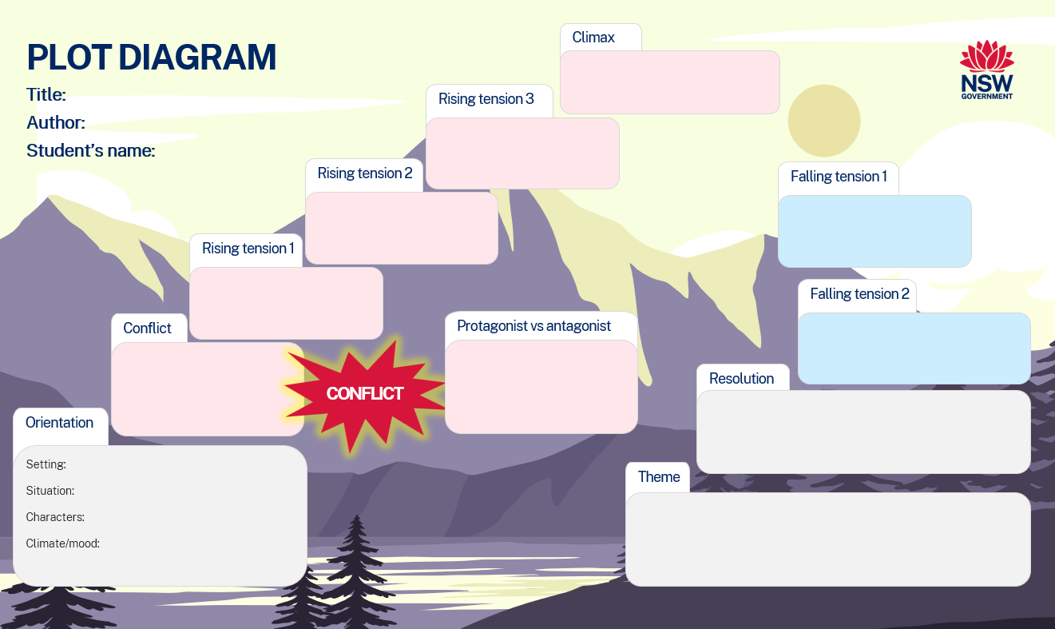
Deepening an understanding of narrative structure (1)
What about our play?
Just like a novel or a film, a play uses narrative plot structures.
Based on your understanding of the play, annotate the main events of the play onto the plot diagram on your worksheet.
Discuss what made this process easy and what made it challenging.
Notes:
Teacher note: students should now complete Question 1 of Phase 4, activity 10 – narrative structure of a scene for the play.

Slide 11
Deepening an understanding of narrative structure (2)
What about a scene in a play?
A scene is a story event within a play and each scene has the following elements:
a plot event (a minimum of one event that moves the story forward)
a change (a character has a change of belief by the end of the scene)
covers a short period of time (usually only a matter of minutes)
one setting (however, there can be more than one setting in a play or film)
has the 6 components of plot (orientation, conflict, rising tension, climax, falling tension and resolution).
Notes:
Teacher note: prompt students to think about how an individual scene may be structured. Does it follow the same or similar structure? Discuss.

Slide 12
Gradual release of responsibility
NSW Department of Education
Notes:
Teacher note: this slide has been used to identify the explicit teaching learning strategy and should be deleted or hidden when using in a classroom setting. The strategy of gradual release of responsibility is a flexible process moving between modelled, guided and independent teaching practice responsive to student learning. Students should be supported to move between each practice based on their capabilities and requirements.
Teachers deliver a structured and sequenced approach to explicitly teaching new content. Learning is most effective when teachers break new information down and teach it explicitly using explanation, demonstration and modelling. This is especially relevant when students are new to an area (AERO 2024b).

Slide 13
Exploring a scene
NSW Department of Education
Notes:
Teacher note: the following activities move from a teacher-oriented explanation of key grammatical and language features, to increasingly student-focused work on the core text and then their developing playscript for the assessment task. The teacher is advised to replace text references as needed and retain the blue sub-headings if appropriate as they signal key metalanguage about learning to the students.

Slide 14
Connecting with a text
Exploring scene 15 – collaborative student work
Read scene 15 from the play.
Annotate the 6 components of plot on the script.
Complete the table, identifying the main elements of a scene in a play.
Elements of a scene | Evidence from the script
Main plot event
Change of belief
Time period of scene
Setting of scene
Notes:
Teacher note: issue students with a copy of Scene 15 from the play. Students should use their understanding from the previous section to find evidence of the elements of a scene. They should complete this on Phase 4, activity 10 – narrative structure of a scene.

Slide 15
Checking for understanding (1)
NSW Department of Education
Notes:
Teacher note: this slide has been used to identify the explicit teaching learning strategy of using effective questioning and should be deleted or hidden when using in a classroom setting. If students cannot adequately respond to this type of question, they should be provided with either whole-class instruction in another delivery mode or example, or if only some students are lacking confidence, they could be assisted individually when the class move on to the next stage of learning.
Teachers analyse the information they collect to make evidence-based instructional decisions. This includes when to move between modelled, guided and independent practice.
Checking understanding requires teachers to collect the responses of all students.

Slide 16
Spotlight on language features in script writing (1)
Active or action verbs – teacher explanation
We know that verbs are doing words – they tell what is happening.
There are different types of verbs:
action verbs – They danced ...
thinking verbs – I forgot ...
feeling verbs – We like ...
saying verbs – He whispered ...
relating verbs – They are ....
(NESA 2024)
Notes:
Teacher note: tell students they will be digging a bit deeper into how a scene is written with a focus on the language used. Discuss the information on the slide about verbs.

Slide 17
Chunking and sequencing learning (1)
NSW Department of Education
Notes:
Teacher note: this slide has been used to identify the Explicit teaching learning strategy and should be deleted or hidden when using in a classroom setting.
Chunking learning into manageable components reduces demand on students’ working memory. Sequencing those chunks in a logical progression supports students to incorporate new information into their mental model, or schema (AERO 2024b).

Slide 18
Spotlight on language features in script writing (2)
Active or action verbs – teacher explanation
An active verb:
is used when the subject of the sentence is doing the verb
gives a sentence an active voice
follows a subject verb object structure.
Example:
A loud bomb drops.
Another loud explosion and the lights flicker once more.
BEN interrupts the story.
Notes:
Teacher note: explain what an active verb is and ask students to identify the active verb in each example. When you click the answers will appear for each sentence.

Slide 19
Spotlight on language features in script writing (3)
Adjectives – teacher explanation
Adjectives are describing words. They describe nouns (a person, place or thing). They are particularly useful in script writing as they help build a picture of what is being spoken about.
Activity – use a range of adjectives to describe the following:
a bus shelter
a bunker
a garden
a plate.
Who has the most creative and descriptive sentence?
Notes:
Teacher note: prompt student discussion about adjectives. What makes a good descriptive sentence? Students should experiment with using adjectives.

Slide 20
Spotlight on language features in script writing
Vocabulary choices – teacher explanation
When we expand the vocabulary we use in our writing, we can develop characterisation and plot progression.
A word cline is an effective way to build vocabulary and vary word choices. The word cline comes from the Greek word clino – to slope.
Think about the work you have done with etymology. Why do you think a word cline is called what it is?
When we use a word cline, we can see that some words are stronger or weaker than others.
Notes:
Teacher note: explain that vocabulary choices can show shades of meaning and give an indicator of how good or bad something is or how someone feels about something. Explore the word ‘cline’ and discuss as a group. Make connections with other words that have ‘cline’ in them – incline, inclination, decline.

Slide 21
Cline for the word ‘frightened’
‘Don’t be frightened. You’re going to good people.’ (Scene 15, Hitler’s Daughter: The play)
Not frightened at all
Being extremely frightened
Word
Word
Word
Word
Word
Word
Word
Word
Frightened
Word
Word
Notes:
Teacher note: students should create a word cline for the adjective ‘frightened’ from scene 15. Reflect on how it is used in the text. What word would be used in the same place? Why was the word ‘frightened’ used?
Then for independent and applied practice, students could choose an adjective in their developing script for the assessment task. They create a cline then practise re-writing the sentence using more or less extreme versions of the word. They should then be guided to consider the impact of the changes. How does a different word impact on how the audience may feel about a character? How does the changed word create a different mood in the scene?

Slide 22
A close study of the text
Identifying language features – student application
Earlier, we looked at how language features can develop a sense of place in setting and characterisation through dialogue. We also looked at how mood is created through language.
Annotate the language features (active verbs, adjectives and vocabulary choices) onto your copy of the script for Scene 15.
Use the skills you have developed in this program to identify examples of the language features that help create a dynamic scene.
What is the mood of the scene? Is there only one mood?
In this scene, the 2 stories blend into each other. Describe this juxtaposition. Why do you think this was done?
Notes:
Teacher note: students should now apply their knowledge to deconstructing Scene 15 of the play in Question 3 of Phase 4, activity 10 – narrative structure of a scene. Sample annotations have been provided for the teacher to model and explain to students before they create their own annotations. Allow sufficient time to deeply engage with the text. Once they have completed their annotating, discuss the mood(s) created. Spend some time examining how the 2 settings become ‘blended’ in this scene and discuss.
Students should apply their understanding to their writing task of crafting their own script segment.

Slide 23
Checking for understanding (2)
NSW Department of Education
Notes:
Teacher note: this slide has been used to identify the explicit teaching learning strategy of using effective questioning and should be deleted or hidden when using in a classroom setting. If students cannot adequately respond to this type of question, they should be provided with either whole-class instruction in another delivery mode or example, or if only some students are lacking confidence, they could be assisted individually when the class move on to the next stage of learning.
Teachers analyse the information they collect to make evidence-based instructional decisions. This includes when to move between modelled, guided and independent practice.
Checking understanding requires teachers to collect the responses of all students.

Slide 24
The impact on the audience
Analysing how narrative elements affect the audience – joint construction
Each element of the narrative structure can impact on the audience in different ways. Match a narrative element in column ‘A’ with a possible impact from column ‘B’.
Column A – narrative element | Column B – possible impact on audience
1. Orientation | A. Develops a meaningful moral or ethical choice – makes the audience consider their own choices and who they support.
2. Rising tension | B. Creates a sense of wonder and expectation – helps to prepare us by suggesting place, mood and time.
3. Conflict | C. Brings the tension or action to a key moment after which everything will be different – helps to develop excitement or nervousness to its highest point in the scene.
4. Complication | D. Eases the tension and allows for reflection on moral choices – allows us to take in the implications of the characters’ choices
5. Resolution | E. Heightens the expectation and excitement of what may be about to happen – puts us on the edge of our seats.
Notes:
Teacher note: students should be supported (with effective questioning) to match column A and B in pairs, then participate in class discussion to check answers. Students could then return to pairs to apply this to a chosen scene from Hitler’s Daughter: The play.

Slide 25
The impact on the audience (your audience!)
Applying learning to the assessment task playscript – independent application
Use the learning from the previous activity to develop your playscript idea.
Narrative element and possible impact on audience | How are you doing this in your developing playscript?
1. Orientation – creates a sense of wonder and expectation – helps to prepare us by suggesting place, mood and time.
2. Rising tension – heightens the expectation and excitement of what may be about to happen – puts us on the edge of our seats.
3. Conflict – develops a meaningful moral or ethical choice – makes the audience consider their own choices and who they support.
4. Complication – brings the tension or action to a key moment after which everything will be different – helps to develop excitement or nervousness to its highest point in the scene.
5. Resolution – eases the tension and allows for reflection on moral choices – allows us to take in the implications of the characters’ choices.
Notes:
Teacher note: students could complete this activity either immediately after the joint construction one applied to the core text, or at a later more suitable time as part of their drafting process. It is also an effective opportunity for reflection and editing of their work if they already have a first draft. Students should be supported to consider the ‘how’ in the question carefully: it should be both ‘what happens’ and ‘what language features will be used’ as per the activities about verb and adjective choice in this PowerPoint, and figurative language, symbolism and noun groups for description covered elsewhere.

Slide 26
Chunking and sequencing learning (2)
NSW Department of Education
Notes:
Teacher note: this slide has been used to identify the Explicit teaching learning strategy and should be deleted or hidden when using in a classroom setting.
Chunking learning into manageable components reduces demand on students’ working memory. Sequencing those chunks in a logical progression supports students to incorporate new information into their mental model, or schema (AERO 2024b).

Slide 27
Conflict and complication
Analysing how narrative elements affect the audience – joint and independent construction
Consider these 2 ideas about the role of conflict and complication in a narrative:
Conflict provides tension but also gives the responder a moral choice – working out who you support in the conflict can signal your perspectives on the key themes of the text.
A good complication functions like a turning point – afterwards nothing can be the same. The action is heading towards some kind of crisis and this also brings into light the thematic concerns of the text.
Notes:
Teacher note: perhaps bring up each idea separately and use as basis for class discussion looking at the core texts and texts from their experiences. Students can then be directed to the activity in Phase 4, activity 10 – narrative structure of a scene in the resource booklet, then to applying thinking to their developing playscripts.
Possible starting points for discussion: one conflict in scene 15 is between parent and child. Her rejection by her father inspires us to see how brutality can exist in public and private places. It also reinforces our sense of the innocence and fragility of Heidi.
A complication in scene 15 is the flight from the bunker. Afterwards Heidi cannot return, her life is in danger and the process of escape and survival is put in train.
For application to their own writing: What happens if a scene does not have conflict or a good complication?

Slide 28
Extension material
NSW Department of Education
Notes:
Teacher note: the following activity focuses in on one outcome content point from Text features: imaginative in EN4-ECA-01. Use it as appropriate for your class context.

Slide 29
Experimenting with the unpredictable
Extending understanding of how structural features can engage a reader
Parallel and juxtaposed plotlines (especially if they ‘collide’ on stage at the same time!) are examples of ‘unpredictable or unexpected structural elements’. A detective story that reveals the killer at the beginning is another.
Make a list of ‘unexpected’ structural elements with a partner, including an example from a text you are familiar with for each.
Prioritise your examples from most to least effective and present your reasons to the class.
Write in your reading journal about why it is important for a composer to get the balance right between ‘expected’ structural elements and ‘unexpected’ ones. Use an example to support your thinking.
Consider whether you will use an unpredictable or unexpected structural element in your playscript. Discuss your idea with a partner to get feedback on whether it will work to engage your target audience.
Notes:
This activity is based on the following outcome content point from EN4-ECA-01 Text features: imaginative - Experiment with unpredictable or unexpected structural features and explore how these can engage a reader

Slide 30
References
This presentation contains NSW Curriculum and syllabus content. The NSW Curriculum is developed by the NSW Education Standards Authority. This content is prepared by NESA for and on behalf of the Crown in the right of the State of New South Wales. The material is protected by Crown copyright.
Please refer to the NESA Copyright Disclaimer for more information https://educationstandards.nsw.edu.au/wps/portal/nesa/mini-footer/copyright.
NESA holds the only official and up-to-date versions of the NSW Curriculum and syllabus documents. Please visit the NSW Education Standards Authority (NESA) website https://educationstandards.nsw.edu.au and the NSW Curriculum website https://curriculum.nsw.edu.au.
English K–10 Syllabus © NSW Education Standards Authority (NESA) for and on behalf of the Crown in right of the State of New South Wales, 2022.
AERO (Australian Education Research Organisation) (2024a) Explain learning objectives, AERO website, accessed 16 April 2024.
AERO (Australian Education Research Organisation) (2024b) Why explicit instruction works, AERO website, accessed 16 April 2024.
CESE (Centre for Education Statistics and Evaluation) (2017) Cognitive load theory: Research that teachers really need to understand, NSW Department of Education, accessed 16 April 2024.
Di Cesare E, Eldridge S and McGarry T (2007) Hitler’s Daughter: The play, Currency Press, Sydney.
Griffin P (2018) Assessment for teaching, Cambridge University Press.
NESA (2024) ‘Glossary’, Resources, NESA website, accessed 23 September 2024.
State of New South Wales (Department of Education) (2024) Explicit teaching strategies, NSW Department of Education website, accessed 2 August 2024.

Slide 31
Copyright
© State of New South Wales (Department of Education), 2024
The copyright material published in this resource is subject to the Copyright Act 1968 (Cth) and is owned by the NSW Department of Education or, where indicated, by a party other than the NSW Department of Education (third-party material).
Copyright material available in this resource and owned by the NSW Department of Education is licensed under a Creative Commons Attribution 4.0 International (CC BY 4.0) license.
This license allows you to share and adapt the material for any purpose, even commercially.
Attribution should be given to © State of New South Wales (Department of Education), 2024.
Material in this resource not available under a Creative Commons license:
the NSW Department of Education logo, other logos and trademark-protected material
Material owned by a third party that has been reproduced with permission. You will need to obtain permission from the third party to reuse its material.
Links to third-party material and websites
Please note that the provided (reading/viewing material/list/links/texts) are a suggestion only and implies no endorsement, by the New South Wales Department of Education, of any author, publisher, or book title. School principals and teachers are best placed to assess the suitability of resources that would complement the curriculum and reflect the needs and interests of their students.
If you use the links provided in this document to access a third-party’s website, you acknowledge that the terms of use, including licence terms set out on the third-party’s website apply to the use which may be made of the materials on that third-party website or where permitted by the Copyright Act 1968 (Cth). The department accepts no responsibility for content on third-party websites.

