Slide 1
Instructions for use
This resource is not a teaching and learning program. It should be used in conjunction with the program and resource booklet for From page to stage – Year 8, term 3.
Classroom teachers are encouraged to add and adapt slides as required to meet the needs of their students.
Save a copy of the file to make changes to the slide deck. Go to File > Download a Copy (this downloads a copy to the computer to edit in the PowerPoint app).
To convert the PowerPoint to Google Slides:
  Upload the file into Google Drive and open it.
  Go to File > Save as Google Slides.
  (Note – conversion may cause formatting changes in the slides.)

Slide 2
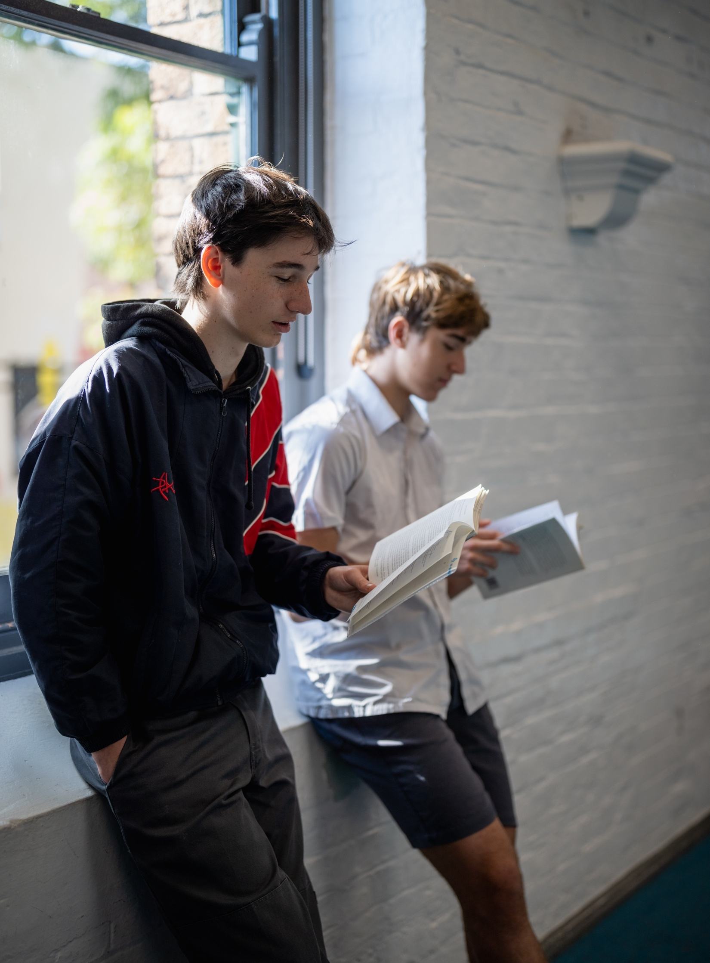
From page to stage – Year 8, Term 3
NSW Department of Education
Phase 3, activity 17
Investigating the interview – PowerPoint
Notes:
Teacher note: this PowerPoint has been created to complement the recorded interview podcast ‘In conversation with writers’. It should be used in conjunction with the program and Phase 3, activity 17 – investigating the interview.

Slide 3
Lessons
1
Introducing the interview podcast
2
Deconstructing the interview podcast
3
Responding to the text
Notes:
Teacher notes:
Click lesson numbers to go to specific lessons
Interactive features can be viewed in slide show

Slide 4
Sharing learning intentions and success criteria
NSW Department of Education
Notes:
Teacher note: this slide has been used to identify the Explicit teaching learning strategy and should be deleted or hidden when using in a classroom setting. Sharing learning intentions allows a teacher to effectively communicate learning goals with students. They allow students to connect new learning to existing knowledge, skills and understanding. When used with success criteria students have a clear idea of the learning goal and how to get there (AERO 2024a). The sample success criteria are aligned to the syllabus. They break the learning intention into smaller and more manageable actions. They show students what they must do, say, make, create or perform to demonstrate their learning (Griffin 2018). These have been left blank with suggestions provided in the notes to allow for the co-construction of success criteria that reflects student need. When co-constructing with students, teachers use their expertise to guide student thinking, and often model and use exemplars to show students what success 'looks like'.

Slide 5
Learning intentions and success criteria
We are learning to:
understand how to listen effectively to identify main ideas
understand the purpose of adapting a novel to a play.
We can:
[classroom teacher to insert co-constructed success criteria]
[classroom teacher to insert co-constructed success criteria]
[classroom teacher to insert co-constructed success criteria].
Notes:
Notes for teachers:
Learning intentions and success criteria are best co-constructed with students. Adapt the learning intention as required and add matching success criteria.
For more information See ⁠AITSL or the NSW Department of Education explicit teaching strategies, ⁠Sharing learning intentions and ⁠Sharing success criteria
LISC is not necessarily presented at the beginning of the lesson. Teacher needs to consider most effectual time to introduce
LISC should be revisited during the lesson to support students' evaluation of their learning

Slide 6
Introducing the interview podcast
NSW Department of Education
Notes:
Teacher note: this PowerPoint should be used with the podcast interview with the playwrights who have written Hitler’s Daughter: The play. It is the second podcast in our ‘In conversation with writers’ series, following on from Jennifer Wong in the Term 2 program Transport me to the ‘real’.

Slide 7
Connecting learning
NSW Department of Education
Notes:
Teacher note: this slide has been used to identify the explicit teaching learning strategy and should be deleted or hidden when used in a classroom setting. The strategy of connecting learning involves making connections within and across learning. In this example, students are connecting learning to their own knowledge of how they use social media.
Teachers actively support students to make connections within and across knowledge, skills and understanding as well as to prior learning experiences. Learning is a change to long term memory. Long term memory is a network of overlapping information with many connections, which are called schemas.

Slide 8
Connecting learning – podcasts
K
What do I know?
W
What do I want to know?
L
What have I learned?
H
How can I learn more?
Notes:
Teacher note: students are prompted to recall and draw on prior learning developed about podcasts developed in Year 8, Term 2 – Transport me to the ‘real’. They complete a KWLH on podcasts in Phase 3, activity 17 – investigating the interview.

Slide 9
Effective listening skills
Preparing to listen to the podcast
Using effective listening skills means you will understand and retain new information more successfully.
Active listening involves paraphrasing, summarising and asking clarifying questions.
To do this, you need to take effective notes.
Use the note taking template to take notes as you listen to the podcast.
Notes:
Teacher note: discuss with students, strategies for effective listening. Ask them to offer ideas for how they can get the most information out of an audio presentation. Direct students to Phase 3, activity 17 – investigating the interview. In Question 5, they can explore word-level language in the glossary. Students should read through the instructions for Question 6 and the interview questions.
Differentiation note: the podcast may need to be chunked into segments for listening or the teacher may choose to only listen to one or 2 questions and their responses to reduce cognitive load.

Slide 10
Building the field (1)
Preparing to listen to the podcast
The podcast refers to some content that you may not have heard of before.
Macbeth is:
a play written by William Shakespeare
his shortest tragedy
based on real characters from a historical time period (historical fiction)
thought to be cursed so is not mentioned by name in a theatre – it is called ‘The Scottish Play’.
Notes:
Teacher note: the podcast mentions content students may not have heard of before. The first notable mention is ‘Macbeth’. A brief summary of the play should be introduced to students.

Slide 11
Building the field (2)
Preparing to listen to the podcast
The podcast refers to some content that you may not have heard of before.
Chekov’s Gun
is a literary idea that every element in the story is necessary to the plot
popularised by playwright and author, Anton Chekov
he illustrated his point by using a gun as an example
        ‘One must never place a loaded rifle on the stage if it isn’t going to go off. It’s wrong to make promises you don’t mean to keep.’ (Britannica 2024)
Notes:
Teacher note: the podcast mentions content students may not have heard of before. The second notable mention is Chekov’s Gun which should also be introduced for building the field.

Slide 12


Listen to the podcast
Complete Question 6 of Phase 3, activity 17 – investigating the interview
Listen to the podcast – ‘In conversation with writers’ - Hitler’s Daughter: The play (34:51)
Notes:
Teacher note: students should have been prepared for the listening activity and should now listen to the podcast interview with the playwrights and complete Question 6 of Phase 3, activity 17 – investigating the interview.
Link to interview: https://players.brightcove.net/6197335233001/RYyTOryUkW_default/index.html?videoId=6361587059112

Slide 13
Gradual release of responsibility
NSW Department of Education
Notes:
Teacher note: this slide has been used to identify the explicit teaching learning strategy and should be deleted or hidden when using in a classroom setting. The strategy of gradual release of responsibility is a flexible process moving between modelled, guided and independent teaching practice responsive to student learning. Students should be supported to move between each practice based on their capabilities and requirements.
Teachers deliver a structured and sequenced approach to explicitly teaching new content. Learning is most effective when teachers break new information down and teach it explicitly using explanation, demonstration and modelling. This is especially relevant when students are new to an area.

Slide 14
Chunking and sequencing learning
NSW Department of Education
Notes:
Teacher note: this slide has been used to identify the explicit teaching learning strategy and should be deleted or hidden when using in a classroom setting.
Chunking learning into manageable components reduces demand on students’ working memory. Sequencing those chunks in a logical progression supports students to incorporate new information into their mental model, or schema (AERO 2024b).

Slide 15
Deconstructing the interview podcast
NSW Department of Education
Notes:
Teacher note: this section will allow students to identify main ideas from the podcast transcript and prepare to transfer this understanding to the purpose of adapting the novel to a play.

Slide 16
Understanding the responses
Responding to the podcast
Use your interview podcast transcript to identify responses to the key ideas of the text.
Gather as much information as you can to support each key idea.
Notes:
Teacher note: the following activities could be done as a complete lesson or in conjunction with the work done throughout the lesson sequences. Each teacher note will have reference to where it could be used as a stand-alone activity.
Note that as Phase 3, resource 15 – podcast transcript clarifies, the transcript is available as a drop down under the podcast on the Planning, programming and assessing English 7-10 page for the program ‘From page to stage’.
Planning, programming and assessing English 7–10 (nsw.gov.au)

Slide 17
Drama conventions
Finding supporting evidence
Read the transcript and identify information that talks about the drama conventions used in the playscript.
Highlight this information in pink.
Consider
costuming and props
lighting
stage directions
scene description
sound effects.
Notes:
Teacher note: students should use Phase 3, activity 17 – investigating the interview and a copy of the podcast transcript to complete this activity.
Suggested responses could include:
information about creating 2 different worlds on stage
Sandy’s discussion on set design.
Differentiation note: work in pairs to complete the activity and provide specific sections of the transcript for students to identify relevant information.
This activity could also be used with Phase 3, activity 9 – identifying dramatic conventions in a performance of Hitler’s Daughter: The play.

Slide 18
Characterisation
Finding supporting evidence
Read the transcript and identify information that talks about characterisation in the playscript.
Highlight this information in blue.
Consider
the main characters in the play
how they have been adapted and created.
Notes:
Teacher note: students should use Phase 3, activity 17 – investigating the interview and a copy of the podcast transcript to complete this activity.
Suggested responses could include:
Tim’s discussion on the protagonist
Mark’s character development – the actor performs as Mark as well as the guard in Berlin.
Tim’s discussion about adapting characters from novel to play and this resulted in the removal of some of the characters.
Differentiation note: work in pairs to complete the activity and provide specific sections of the transcript for students to identify relevant information.
This activity could also be used with Phase 4, sequence 2 – exploring the intertextuality of characterisation.

Slide 19
The constraints of theatre
Finding supporting evidence
The playwrights discuss some of the constraints of theatre that can impact the way a production is created.
Find evidence from the podcast transcript that discusses this issue.
Highlight this information in red.
Consider
theatre production
directors and producers
actors
location.
Notes:
Teacher note: students should use Phase 3, activity 17 – investigating the interview and a copy of the podcast transcript to complete this activity.
Suggested responses could include:
Sandy’s point about small number of actors in the play
how ‘travelling’ theatre companies sometimes work – one actor might portray a number of characters.
Differentiation note: work in pairs to complete the activity and provide specific sections of the transcript for students to identify relevant information.

Slide 20
Intertextuality
Finding supporting evidence
Read the transcript and identify information that talks about the intertextuality of the playscript.
Highlight this information in yellow.
Consider
storytelling connections
the similarities and differences between the texts
intertextuality of historical and modern (contemporary) events
decisions on what parts to keep.
Notes:
Teacher note: students should use Phase 3, activity 17 – investigating the interview and a copy of the podcast transcript to complete this activity.
Suggested responses could include:
storytelling by Anna
prompt question about intertextuality and response – the ways texts can reference and relate to each other
prompt question and response – How do you decide what parts of Jackie French’s story to keep and what parts to change for the play?
Hitler and WWII.
Differentiation note: work in pairs to complete the activity and provide specific sections of the transcript for students to identify relevant information.
This activity could also be used with Phase 4, sequence 1 – exploring intertextuality.

Slide 21
Literary value
Finding supporting evidence
Read the transcript and identify information that talks about the literary value of the text(s).
Highlight this information in green.
Consider
purpose of the text
themes
modern perspectives.
Notes:
Teacher note: students should use Phase 3, activity 17 – investigating the interview and a copy of the podcast transcript to complete this activity.
Suggested responses could include:
prompt question and response – Why did you choose to adapt Hitler’s Daughter for the stage?
prompt question and response – How do you decide what parts of the story to keep and what parts to change for the play. How is literary value maintained?
Eva’s point about themes addressing literary value
decision to not actually portray Hitler on stage – not giving him a ‘place’
Mark’s role as the protagonist and how his character adds literary value to the play by helping the responder to consider new ways of thinking.
the play helps us understand something about ourselves in the world, therefore it will vary across time and cultures.
Differentiation note: work in pairs to complete the activity and provide specific sections of the transcript for students to identify relevant information.
This activity could also be used with Phase 4, sequence 5 – maintaining literary value (integrated Phase 5) and Phase 4, activity 9 – literary value of Hitler’s Daughter: The play (extension activity).

Slide 22
Responding to the text
NSW Department of Education
Notes:
Teacher note: the following activity is aimed at consolidating understanding of the learning intention for Phase 3, sequence 6 – understanding the intertextuality of the play. Students complete the remaining questions in Phase 3, activity 17 – investigating the interview.

Slide 23
Consolidating understanding
Responding to the text
Select one key or main idea from the previous activities.
Write an analytical response reflecting on how the podcast helped you understand the purpose of adapting the novel to the play version.
Refer to the advice about embedding evidence in analytical sentences in Phase 3, activity 17 – investigating the interview for additional support.
Notes:
Teacher note: students consolidate understanding of the purpose of adapting the novel to the play by writing an analytical response. They should refer to Phase 3, activity 17 – investigating the interview for additional support.

Slide 24
Using effective feedback
NSW Department of Education
Notes:
Teacher note: this slide has been used to identify the explicit teaching learning strategy of using effective feedback and should be deleted or hidden when using in a classroom setting.
Feedback is most useful when it is aligned to the learning intentions and success criteria of a lesson or learning experience (Clarke, Timperley and Hattie 2023). It is most effective when delivered during learning (Clarke 2014).

Slide 25



Checking for understanding
Peer review
Swap your completed response with a peer.
Read your peer’s response.
Identify 3 main ideas from the response.
Summarise these at the bottom of the response in order of importance.
Notes:
Teacher note: to extend understanding of ideas, students should swap their work with a peer to connect with their understanding. They should demonstrate their comprehension of ideas by summarising the 3 main ideas in order at the bottom of their peer’s response. Students should swap their work back and confirm if the 3 ideas are what they were aiming for. Discuss as required.

Slide 26
Comparing ideas
My ideas
Peer’s ideas
Ideas similar to both responses
My main ideas
Peer’s main ideas
Notes:
Teacher note: students should now work with a peer who has selected a different main idea to respond to and complete the Venn diagram to compare their ideas. Students should then complete a Think Pair Share to discuss the similarities and differences and the purpose for adapting the novel to a play.

Slide 27
References
This presentation contains NSW Curriculum and syllabus content. The NSW Curriculum is developed by the NSW Education Standards Authority. This content is prepared by NESA for and on behalf of the Crown in the right of the State of New South Wales. The material is protected by Crown copyright.
Please refer to the NESA Copyright Disclaimer for more information https://educationstandards.nsw.edu.au/wps/portal/nesa/mini-footer/copyright.
NESA holds the only official and up-to-date versions of the NSW Curriculum and syllabus documents. Please visit the NSW Education Standards Authority (NESA) website https://educationstandards.nsw.edu.au and the NSW Curriculum website https://curriculum.nsw.edu.au.
English K–10 Syllabus © NSW Education Standards Authority (NESA) for and on behalf of the Crown in right of the State of New South Wales, 2022.
AERO (Australian Education Research Organisation) (2024a) Explain learning objectives, AERO website, accessed 16 April 2024.
AERO (Australian Education Research Organisation) (2024b) Why explicit instruction works, AERO website, accessed 16 April 2024.
Britannica (2024) Chekov’s Gun, Britannica online, accessed 12 August 2024.
CESE (Centre for Education Statistics and Evaluation) (2017) Cognitive load theory: Research that teachers really need to understand, NSW Department of Education, accessed 16 April 2024.
Di Cesare E, Eldridge S and McGarry T (2007) Hitler’s Daughter: The play, Currency Press, Australia.
Griffin P (2018) Assessment for teaching, Cambridge University Press.
NESA (2024) ‘Glossary’, Resources, NESA website, accessed 23 September 2024.
State of New South Wales (Department of Education) (2024) Explicit teaching strategies, NSW Department of Education website, accessed 2 August 2024

Slide 28
Copyright
© State of New South Wales (Department of Education), 2024
The copyright material published in this resource is subject to the Copyright Act 1968 (Cth) and is owned by the NSW Department of Education or, where indicated, by a party other than the NSW Department of Education (third-party material).
Copyright material available in this resource and owned by the NSW Department of Education is licensed under a Creative Commons Attribution 4.0 International (CC BY 4.0) license.
This license allows you to share and adapt the material for any purpose, even commercially.
Attribution should be given to © State of New South Wales (Department of Education), 2024.
Material in this resource not available under a Creative Commons license:
the NSW Department of Education logo, other logos and trademark-protected material
Material owned by a third party that has been reproduced with permission. You will need to obtain permission from the third party to reuse its material.
Links to third-party material and websites
Please note that the provided (reading/viewing material/list/links/texts) are a suggestion only and implies no endorsement, by the New South Wales Department of Education, of any author, publisher, or book title. School principals and teachers are best placed to assess the suitability of resources that would complement the curriculum and reflect the needs and interests of their students.
If you use the links provided in this document to access a third-party’s website, you acknowledge that the terms of use, including licence terms set out on the third-party’s website apply to the use which may be made of the materials on that third-party website or where permitted by the Copyright Act 1968 (Cth). The department accepts no responsibility for content on third-party websites.

