Slide 1
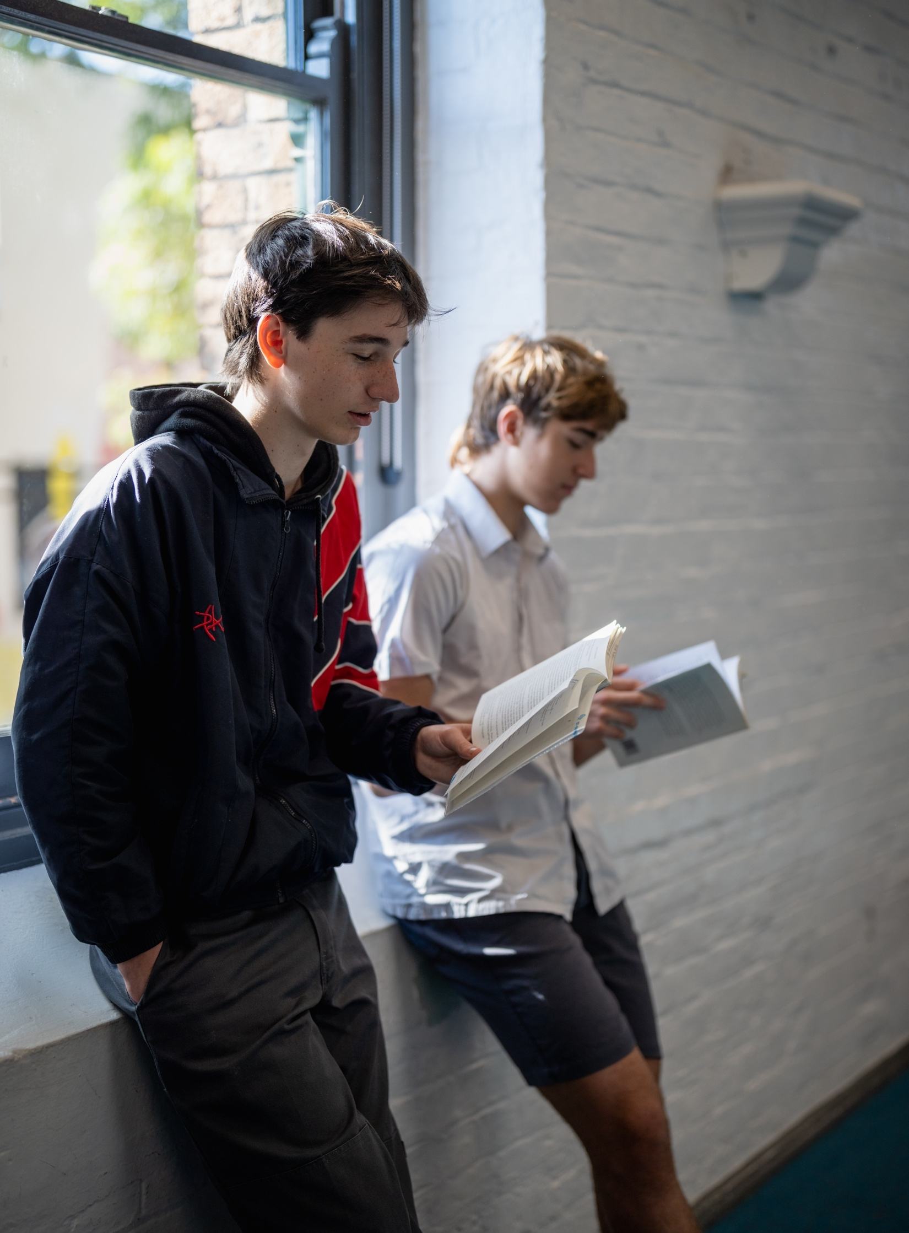
From page to stage – Year 8, Term 3
NSW Department of Education
Phase 2, resource 2
Exploring intertextuality – PowerPoint
Notes:
Teacher note: the purpose of this PowerPoint is to provide support for Phase 2, activity 2 – exploring intertextuality. It should be used in conjunction with the program and the resource book.

Slide 2
Lessons
1
Intertextuality
2
Draws on
3
Adaptation
4
Appropriation
Notes:
Teacher notes:
Click lesson numbers to go to specific lessons
Interactive features can be viewed in slide show

Slide 3
Learning intentions and success criteria
We are learning to:
enhance your definition of intertextuality by clarifying the terms ‘draws on’, ‘adaptation’ and ‘appropriation’
explore how texts change throughout time, often reflecting the values and morals in which they were composed.
We can:
[these could be co-constructed with the class or used as per the notes].
Notes:
Teacher note: clarify what students are learning and why.
Learning intentions and success criteria are best co-constructed with students. Adapt the learning intention as required and add matching success criteria.
LISC is not necessarily presented at the beginning of the lesson. Teacher needs to consider most effectual time to introduce.
LISC should be revisited during the lesson to support students' evaluation of their learning.
Success criteria should be communicated to students, so they understand what it looks like to achieve the learning intention. The success criteria breaks the learning intention into smaller, more manageable actions and show students what they must be able to do, say, make, create or perform to demonstrate their learning.
Students may achieve this at different 'levels' depending on the starting point of different students. The suggested success criteria below have been differentiated – not all students will be able to demonstrate success in each of the criteria, however, all students should be able to experience success. It is not necessary to explain this differentiation to students. Depending on the needs of your students, you may choose to remove one or more of the success criteria. For example, if you know that your students will require high levels of support, you may choose to remove the final success criteria. Conversely, if you know that your students can already recall key features of the poem’s form, there is no need to include the first success criteria.
Suggested success criteria
We can:
explain the similarities and differences between the terms draws on, adaptation and appropriation
reflect upon the usage of intertextuality in multiple texts composed in a variety of forms.

Slide 4
Gradual release of responsibility
NSW Department of Education
Notes:
Teacher note: this slide has been used to identify the explicit teaching learning strategy and should be deleted or hidden when using in a classroom setting. The strategy of gradual release of responsibility is a flexible process moving between modelled, guided and independent teaching practice responsive to student learning. Students should be supported to move between each practice based on their capabilities and requirements.
Teachers deliver a structured and sequenced approach to explicitly teaching new content. Learning is most effective when teachers break new information down and teach it explicitly using explanation, demonstration and modelling. This is especially relevant when students are new to an area (AERO 2024).

Slide 5
Chunking and sequencing learning (1)
NSW Department of Education
Notes:
Teacher note: this slide has been used to identify the Explicit teaching learning strategy and should be deleted or hidden when using in a classroom setting.
Chunking learning into manageable components reduces demand on students’ working memory. Sequencing those chunks in a logical progression supports students to incorporate new information into their mental model, or schema (AERO 2024).

Slide 6
Intertextuality
Definition
Intertextuality refers to the relationship between a text and other texts. Texts can influence, derive from, reference, quote, contrast with, build on, draw from or even inspire each other. Intertextuality produces deeper meaning as we can explore and question the intention of the author in changing the original text. The types of intertextuality explores in this PowerPoint are:
drawing on another text
adaptation
appropriation.
Notes:
Teacher note: the teacher should clarify what intertextuality is and how it is constructed. The teacher may like to have students copy the definition into a glossary – perhaps by summarising into their own words. The ECT team has deliberately left out the term ‘transforms’ from the outcome group EN4-URC-01 – Intertextuality – ‘Understand how and why texts can be adapted, appropriated or transformed’ to aid student understanding. Slide 10 is a hidden slide on transformation if you choose. It is important to note that transformation of a text can include adaptation and appropriation. Adaptation refers to changing the genre or form of a text. Appropriation refers to taking a text and using it for a new audience and purpose to create ‘new meaning’. Some texts will adapt the genre or form and also appropriate the text by changing central elements to create a ‘new meaning’ in the text. A good example of this is used in Phase 2, activity 4 when comparing Sleeping beauty (1598) with the Disney film Maleficent (2014). The fairytale has been adapted from prose to film; however, it is also an example of appropriation as the text creates new meaning through shifting the central protagonist from Aurora to the primary villain Maleficent and other changes that reimagine the text for a new audience and context.

Slide 7
Draws on (1)
Definition
How much of the original text is being used?
The minimal amount or type of intertextuality is when texts draw on other texts without using significant parts of the original story. They may draw on ideas, themes or concepts of a text but the link may not be obvious.
An example of this is where a text makes an allusion to other texts. An allusion may be as simple as referring to a character or quoting a line from another text.
The concept of a text ‘drawing on’ another is an example of implied or inferred intertextuality.
Notes:
Teacher note: the teacher should clarify what point of view is and how it is constructed. The teacher may like to have students copy the definition into a glossary – perhaps by summarising into their own words.

Slide 8
Draws on (2)
In his novel, Wide Sargasso Sea, Jean Rhys gathers some events that occurred in Charlotte Bronte’s Jane Eyre. The purpose is to tell readers an alternative tale. Rhys presents the wife of Mr. Rochester, who played the role of a secondary character in Jane Eyre. Also, the setting of this novel is Jamaica, not England, and the author develops the back-story for his major character. In the novel, Jane Eyre, Rhys gives her interpretation amid the narrative by addressing issues such as the roles of women, colonisation and racism that Bronte did not point out in her novel otherwise.
Bridget Jones's Diary (1996) by Helen Fielding is a modern romantic comedy replaying and referencing Jane Austen's Pride and Prejudice. The storyline follows a similar structure and form, yet unless you were really looking you may not even know that the texts are connected.
Notes:
Teacher note: students may not know either of these texts; however, specific words have been highlighted to give emphasis to how the text ‘draws on’ a text rather than adapting, transforming or appropriating the text.

Slide 9
Checking for understanding (1)
NSW Department of Education
Notes:
Teacher note: this slide has been used to identify the explicit teaching learning strategy of using effective questioning and should be deleted or hidden when using in a classroom setting. If students cannot adequately respond to this type of question, they should be provided with either whole class instruction in another delivery mode or example, or if only some students are lacking confidence, they could be assisted individually when the class move on to the next stage of learning.
Teachers analyse the information they collect to make evidence-based instructional decisions. This includes when to move between modelled, guided and independent practice.
Checking understanding requires teachers to collect the responses of all students.

Slide 10
Your turn (1)
Finding texts that ‘draw on’ other texts
Are the following examples of ‘draws on’?
A text uses a quote from another, yet the main ideas and story are not the same.
Two texts have similar storylines and characters, yet the later one is told from a different character's point of view.
The Guardian advertisement you have watched based on ‘The Three Little Pigs’.
A song makes an ‘allusion’ to a line from the lyrics of another song.
Notes:
Teacher note: The answers and explanations are as follows:
Question 1 – is an example of a text drawing upon another, it may use a quote, yet the central aspects of the text are not explored.
Question 2 – this is not an example of ‘drawing on’ as the texts are very close. This would be an example of ‘adaptation’ and/or ‘appropriation’.
Question 3 – this is similar to Question 2 and is an example of ‘adaptation’ and/or ‘appropriation’.
Question 4 – is an example of a text ‘drawing on’ another.

Slide 11
Adaptation (1)
Definition
Literary adaptation refers to the transformation of a literary work, such as a poem, novel, short story or play, into another genre. For example, a book might be adapted into a film, a musical or a television series. These adaptations draw from existing works, referencing or reimagining elements from the original material. The texts adapt or change as the form of the text changes.
This is an example of explicit intertextuality.
Notes:
Teacher note: this slide is aimed at reviewing adaptation. This term can often be misunderstood. In this Powerpoint we have attempted to make clear distinctions between adaptation and appropriation, yet as stated on the last slide some texts are transformed through a combination of adaptation and appropriation.

Slide 12
Adaptation (2)
Examples
Some examples would include:
Jackie French’s novel Hitler’s Daughter has been adapted into a play also called Hitler’s Daughter: The play. The story remains essentially the same, however, some changes are made to suit the dramatic style and challenges of performing in different theatres or performance spaces.
The Hunger Games is a novel written by Suzanne Collins that was made into a film. The story is primarily the same, however elements such as a specific scene or even characters were removed to make the movie finish in 2 hours.
The fairytale Beauty and the Beast was adapted to a musical from the Walt Disney animated film (1991) and the earlier French fairytale. The storyline remains relatively unchanged, yet it is adapted to the change in form, with the inclusion of musical theatre.
Notes:
Teacher note: this slide is aimed at providing examples of adaptation in popular texts.

Slide 13
Checking for understanding (2)
NSW Department of Education
Notes:
Teacher note: this slide has been used to identify the explicit teaching learning strategy of using effective questioning and should be deleted or hidden when using in a classroom setting. If students cannot adequately respond to this type of question, they should be provided with either whole class instruction in another delivery mode or example, or if only some students are lacking confidence, they could be assisted individually when the class move on to the next stage of learning.
Teachers analyse the information they collect to make evidence-based instructional decisions. This includes when to move between modelled, guided and independent practice.
Checking understanding requires teachers to collect the responses of all students.

Slide 14
Your turn (2)
Adaptation
        Work with a partner to consider examples of ‘adaptations’ in popular culture. These could be fairytales that have been made into a musical or a film, or a novel that has been similarly adapted.
        Write down 2 examples and how they have been adapted.
        For one example that you know well, consider whether the adaptation has had to change anything from the original to suit the new form.
Notes:
Teacher note: students work in pairs to find an adaptation of a text in popular culture. Students will have already had experience with finding ‘adaptations’ in the initial classroom discussion on intertextuality.

Slide 15
Appropriation (1)
Definition and examples
Appropriation refers to taking a text and using it for a new audience and purpose. Appropriation can occur within different modes and media. Writers often borrow ideas from previous works to give a ‘new’ layer of meaning to their own works. Texts can be appropriated in many ways, some of which include:
retelling a narrative from a different character's point of view which could make the audience consider issues relating to gender, culture or age
changing the setting or time the appropriated text focuses on, which could make an audience reflect on modern values or experiences
removing characters entirely or adding new characters.
Notes:
Teacher note: this slide would work best with a class discussion around texts that students may know. Clarity in instruction will be needed to ensure students give examples of texts that appropriate rather than simply adapt. Again, texts often combine adaptation and appropriation, yet students may struggle with this concept.

Slide 16
Appropriation (2)
Examples
Examples include:
Sleeping Beauty and Maleficent – Disney adapted the film from fairytale to film; however, they have also appropriated the text as the story changes. The primary villain in the original shifts from an ‘evil fairy’ to King Stefan (a character who does not appear in the original). The ‘evil fairy’ Maleficent is seen as a victim who has been hurt by humanity and becomes good friends with Princess Aurora which heals them both.
Hansel and Gretel and Gretel and Hansel – the original story is again adapted from fairytale to film; however, the story is also appropriated with Gretel becoming the central narrator. Hansel is her younger brother and, in a classic, coming of age story she moves from his protecter towards an independent woman who is capable of fulfilling her own destiny.
Little Red Riding Hood and Revolting Rhymes – Roald Dahl’s classic, the story is appropriated to challenge the audience’s view of gender. Rather than being portrayed as a frightened girl, Red Riding Hood is portrayed as powerful and confident. When the Wolf tries to eat her, she simply pulls out a pistol and shoots him. The final image is of Red Riding Hood wearing a Wolf-skin coat.
Notes:
Teacher note: These examples may not be known to students, however, through class discussion students may possibly know other appropriations which would facilitate the same understanding.

Slide 17
Checking for understanding (3)
NSW Department of Education
Notes:
Teacher note: this slide has been used to identify the explicit teaching learning strategy of using effective questioning and should be deleted or hidden when using in a classroom setting. If students cannot adequately respond to this type of question, they should be provided with either whole class instruction in another delivery mode or example, or if only some students are lacking confidence, they could be assisted individually when the class move on to the next stage of learning.
Teachers analyse the information they collect to make evidence-based instructional decisions. This includes when to move between modelled, guided and independent practice.
Checking understanding requires teachers to collect the responses of all students.

Slide 18
Your turn – quick write
Summarising the key terminology: draws on, adapts and appropriates
        You have 10 minutes, write a response in your English books that explains the differences between:
        a text that draws on aspects of another text
        a text that is adapted from another text
        a text that is appropriated from another text.
        In your answer try to use examples drawn from texts that you know to explain the differences.
Notes:
Teacher note: this exercise is provided to clarify the understanding of students so they can access the metalanguage of Phase 2 and the rest of the program. After checking for understanding, consider revisiting slides if students are still struggling with this terminology.

Slide 19
References
This presentation contains NSW Curriculum and syllabus content. The NSW Curriculum is developed by the NSW Education Standards Authority. This content is prepared by NESA for and on behalf of the Crown in the right of the State of New South Wales. The material is protected by Crown copyright.
Please refer to the NESA Copyright Disclaimer for more information https://educationstandards.nsw.edu.au/wps/portal/nesa/mini-footer/copyright.
NESA holds the only official and up-to-date versions of the NSW Curriculum and syllabus documents. Please visit the NSW Education Standards Authority (NESA) website https://educationstandards.nsw.edu.au and the NSW Curriculum website https://curriculum.nsw.edu.au.
English K–10 Syllabus © NSW Education Standards Authority (NESA) for and on behalf of the Crown in right of the State of New South Wales, 2022.
AERO (Australian Education Research Organisation) (2024a) Explain learning objectives, AERO website, accessed 16 April 2024.
AERO (Australian Education Research Organisation) (2024b) Why explicit instruction works, AERO website, accessed 16 April 2024.
CESE (Centre for Education Statistics and Evaluation) (2017) Cognitive load theory: Research that teachers really need to understand, NSW Department of Education, accessed 16 April 2024.
Di Cesare E, Eldridge S and McGarry T (2007) Hitler’s Daughter: The play, Currency Press, Sydney.
Griffin P (2018) Assessment for teaching, Cambridge University Press.
NESA (2024) ‘Glossary’, Resources, NESA website, accessed 23 September 2024.
State of New South Wales (Department of Education) (2024) Explicit teaching strategies, NSW Department of Education website, accessed 2 August 2024.

Slide 20
Copyright
© State of New South Wales (Department of Education), 2024
The copyright material published in this resource is subject to the Copyright Act 1968 (Cth) and is owned by the NSW Department of Education or, where indicated, by a party other than the NSW Department of Education (third-party material).
Copyright material available in this resource and owned by the NSW Department of Education is licensed under a Creative Commons Attribution 4.0 International (CC BY 4.0) license.
This license allows you to share and adapt the material for any purpose, even commercially.
Attribution should be given to © State of New South Wales (Department of Education), 2024.
Material in this resource not available under a Creative Commons license:
the NSW Department of Education logo, other logos and trademark-protected material
Material owned by a third party that has been reproduced with permission. You will need to obtain permission from the third party to reuse its material.
Links to third-party material and websites
Please note that the provided (reading/viewing material/list/links/texts) are a suggestion only and implies no endorsement, by the New South Wales Department of Education, of any author, publisher, or book title. School principals and teachers are best placed to assess the suitability of resources that would complement the curriculum and reflect the needs and interests of their students.
If you use the links provided in this document to access a third party’s website, you acknowledge that the terms of use, including licence terms set out on the third-party’s website apply to the use which may be made of the materials on that third-party website or where permitted by the Copyright Act 1968 (Cth). The department accepts no responsibility for content on third-party websites.

