Slide 1
Introduction
Introduction for the teacher
This resource is not a teaching and learning program. It should be used in conjunction with Year 8, Term 4 The camera never lies.
Notes:
Teacher note: this slide is an indication of how this presentation can be used in the classroom.

Slide 2
Instructions for use
Instructions for the teacher
Classroom teachers are encouraged to add and adapt slides as required to meet the needs of their students.
Save a copy of the file to make changes to the slide deck. Go to File > Download a Copy (this downloads a copy to the computer to edit in the PowerPoint app).
To convert the PowerPoint to Google Slides
  Upload the file into Google Drive and open it.
  Go to File > Save as Google Slides.
  (Note – conversion may cause formatting changes in the slides.)
Notes:
Teacher note: this slide is an indication of how this presentation can be used in the classroom.

Slide 3

Phase 1 – key visual features
Stage 4 – 8.4
‘The camera never lies’ – Year 8, Term 4
Notes:
Teacher note: the following slides assist with learned key visual features for Phase 1, activity 6 – identifying key visual features.

Slide 4
Sharing learning intentions and success criteria
Notes:
Teacher note: this slide has been used to identify the explicit teaching strategies sharing learning intentions and sharing success criteria. This slide could be deleted or hidden when using this content in a classroom setting. Alternatively, the teacher could discuss the educational benefit of the process of sharing learning intentions and success criteria and discussing the significance of this learning process. ​
​
Sharing learning intentions allows a teacher to effectively communicate the learning goal with students. They allow students to connect new learning to existing knowledge, skills and understanding. ​
When learning intentions are used with success criteria, students have a clear idea of the learning goal and how to get there (AERO 2024). ​
The success criteria break the learning intention into smaller and more manageable actions. They show students what they must do, say, make, create or perform to demonstrate their learning (Griffin 2018).​
Success criteria are communicated to students in ways they understand. Teachers use their expertise to guide student thinking and often model and use exemplars to show students what success 'looks like’ (DoE 2025). ​
The sample learning intentions and success criteria (LISC) on the following slide are aligned to the syllabus. ​
When designing LISC for students working above or below stage level, or towards Life Skills outcomes, draw on the collaborative curriculum planning process to ensure LISC is differentiated and aligned with the relevant syllabus outcomes. ​
​
For more information, see:​
AITSL: https://www.aitsl.edu.au/docs/default-source/feedback/aitsl-learning-intentions-and-success-criteria-strategy.pdf?sfvrsn=382dec3c_2​
Sharing learning intentions: https://education.nsw.gov.au/teaching-and-learning/curriculum/explicit-teaching/explicit-teaching-strategies/sharing-learning-intentions ​
Sharing success criteria: https://education.nsw.gov.au/teaching-and-learning/curriculum/explicit-teaching/explicit-teaching-strategies/sharing-success-criteria​
Collaborative curriculum planning: https://educationstandards.nsw.edu.au/wps/portal/nesa/k-10/diversity-in-learning/special-education/collaborative-curriculum-planning

Slide 5
Learning intentions and success criteria
We are learning to:
identify key visual features, including symbolism, juxtaposition, salience, colour palette and layout
explain how visual features are used to create meaning and influence the viewer
use visual metalanguage to analyse how features work together in a visual text.
We can:
[classroom teacher to insert co-constructed success criteria]
[classroom teacher to insert co-constructed success criteria]
[classroom teacher to insert co-constructed success criteria].
Notes:
Teacher note: adapt the provided learning intention and below sample success criteria, as required, to suit the needs of your students.
define symbolism
identify the effects of symbolism.
​
LISC is usually shared first or early in the lesson and is explained by the teacher who checks for understanding (DoE 2025). ​
LISC is referred to regularly to check for understanding, provide feedback or as a self-assessment tool (Wiliam and Leahy 2015). ​
Learning intentions and success criteria can be supported by exemplars, such as 'What A Good One Looks Like' (WAGOLL) or exemplars to demonstrate success criteria (Clarke 2021).​
​
For more information, see:​
Sharing learning intentions and success criteria: https://education.nsw.gov.au/content/dam/main-education/documents/teaching-and-learning/curriculum/explicit-teaching/explicit-teaching-technique-guide-lisc-sharing.pdf ​
Planning learning intentions and success criteria: https://education.nsw.gov.au/content/dam/main-education/documents/teaching-and-learning/curriculum/explicit-teaching/explicit-teaching-technique-guide-lisc-planning.pdf​

Slide 6
Gradual release of responsibility
Notes:
Teacher note: this slide has been used to identify the explicit teaching strategies sharing learning intentions and sharing success criteria. This slide could be deleted or hidden when using this content in a classroom setting. Alternatively, the teacher could discuss the educational benefit of the process of sharing learning intentions and success criteria and discussing the significance of this learning process. ​
​
Sharing learning intentions allows a teacher to effectively communicate the learning goal with students. They allow students to connect new learning to existing knowledge, skills and understanding. ​
When learning intentions are used with success criteria, students have a clear idea of the learning goal and how to get there (AERO 2024). ​
The success criteria break the learning intention into smaller and more manageable actions. They show students what they must do, say, make, create or perform to demonstrate their learning (Griffin 2018).​
Success criteria are communicated to students in ways they understand. Teachers use their expertise to guide student thinking and often model and use exemplars to show students what success 'looks like’ (DoE 2025). ​
The sample learning intentions and success criteria (LISC) on the following slide are aligned to the syllabus. ​
When designing LISC for students working above or below stage level, or towards Life Skills outcomes, draw on the collaborative curriculum planning process to ensure LISC is differentiated and aligned with the relevant syllabus outcomes. ​
​
For more information, see:​
AITSL: https://www.aitsl.edu.au/docs/default-source/feedback/aitsl-learning-intentions-and-success-criteria-strategy.pdf?sfvrsn=382dec3c_2​
Sharing learning intentions: https://education.nsw.gov.au/teaching-and-learning/curriculum/explicit-teaching/explicit-teaching-strategies/sharing-learning-intentions ​
Sharing success criteria: https://education.nsw.gov.au/teaching-and-learning/curriculum/explicit-teaching/explicit-teaching-strategies/sharing-success-criteria​
Collaborative curriculum planning: https://educationstandards.nsw.edu.au/wps/portal/nesa/k-10/diversity-in-learning/special-education/collaborative-curriculum-planning

Slide 7
Symbolism
Notes:
Teacher note: this slide supports Phase 1, activity 6 – identifying key visual features. Symbolism is a visual feature students will use in Phase 1, activity 7 – analysing a layout of Took the Children Away.
This slide begins the first chunk within the gradual release of responsibility sequence. Explain that students will first establish what symbolism means, observe a model of how symbolic meaning is inferred and then apply that reasoning during guided analysis.
Make the connection to the broader learning explicit: identifying a symbol is only the first step. Students should increasingly explain what the symbol represents and how it contributes to the meaning of the visual text.

Slide 8
Symbolism (1)
Definition
Symbolism refers to a word or concrete object that represents something else, especially an object representing something that is abstract.
Notes:
Teacher note: this slide supports Phase 1, activity 6 – identifying key visual features. Provide a definition of the metalanguage and ask students to define it in their own words in their books.
Within the gradual release of responsibility sequence, the teacher retains responsibility at this stage by explicitly explaining that symbolism occurs when a word, image or concrete object represents an additional idea, particularly something abstract.
Use a familiar example if required and distinguish between identifying the literal object and interpreting what it may represent. Asking students to restate the definition in their own words provides an initial indication of whether they are ready to analyse symbolic meaning in the following slides.

Slide 9

Symbolism (2)
Modelled practice
Hearts make us think of ...
Image by Michael Schaffler is licensed under Unsplash License.
Notes:
Teacher note: this slide supports Phase 1, activity 6 – identifying key visual features. Ask students to look at the image of red heart balloons floating in the sky. Ask, ‘What do hearts make you think of?’ and discuss ideas as a class.
This slide provides the modelled practice stage of gradual release of responsibility. Model the process of thinking beyond the literal image by verbalising the range of abstract ideas that a heart may represent, such as love, affection, relationships, care or emotional connection.
Make the analytical process explicit: first identify the object, then activate associations with that object, then consider which symbolic meaning is most appropriate in the context of the image. Emphasise that symbols can carry more than one possible meaning and that interpretations should be supported by visual evidence and context.

Slide 10

Symbolism (3)
Guided practice
Why is this heart black? What message might that convey?
Why is a heart, which usually represents positive emotions, drawn on a damaged dirty wall? How does that further our understanding of its symbolic purpose?
What other symbols could be used to convey this message?
Image by Jean-Luc Benazet is licensed under Unsplash License.
Notes:
Teacher note: this slide supports Phase 1, activity 6 – identifying key visual features. Guide students through their analysis of this image. A copy of the questions can be found in Phase 1, activity 6 – identifying key visual features. Students should respond in their books, then discuss their responses as a class.
Use the questions on the slide to guide students:
Why is this heart black? What message might that convey?
Why is a heart, which usually represents positive emotions, drawn on a damaged, dirty wall? How does that further our understanding of its symbolic purpose?
What other symbols could be used to convey this message?
This slide moves gradual release of responsibility from modelling into guided practice. Ask students to identify the visual evidence before interpreting its symbolic meaning. Where required, prompt with questions such as ‘What do you notice?’ and ‘What could that suggest?’ before asking students to explain how the different features work together.
There is no independent symbolism task in this sequence, so use student responses to determine whether further guided analysis is required before moving to juxtaposition.

Slide 11
Juxtaposition
Notes:
Teacher note: this slide supports Phase 1, activity 6 – identifying key visual features. Juxtaposition is a visual feature students will use in Phase 1, activity 7 – analysing a layout of Took the Children Away.
This slide introduces a new application of the gradual release of responsibility strategy. Briefly connect juxtaposition with the preceding learning by explaining that visual elements, including symbols, can be deliberately placed together to highlight similarity, difference or contrast.
The following slides move from explicit definition to modelled practice and then guided analysis.

Slide 12
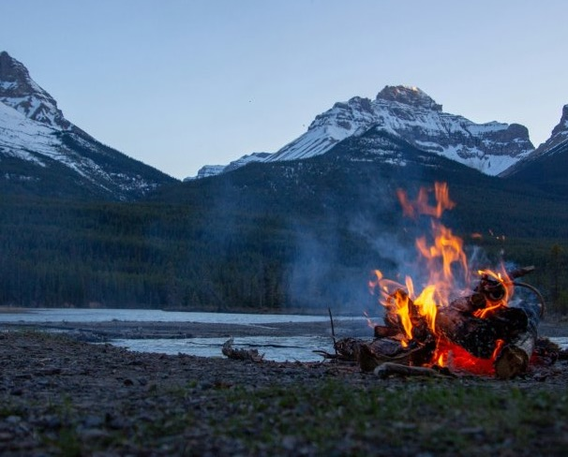
Juxtaposition (1)
Definition
Juxtaposition refers to placing things side by side or close together, often to emphasise similarity or difference.
Image by Courtnie Tosana is licensed under Unsplash License.
Notes:
Teacher note: this slide supports Phase 1, activity 6 – identifying key visual features. Provide a definition of the metalanguage and ask students to define it in their own words in their English book.
At this stage of gradual release of responsibility, explicitly explain that juxtaposition refers to placing elements side by side or close together, often to emphasise similarity or difference.
Model a simple verbal example if required. Emphasise that successful analysis should move beyond stating that two things are different. Students should consider why they have been deliberately placed together and what additional meaning emerges from the comparison.

Slide 13

Juxtaposition (2)
Modelled practice
Here, juxtaposition is created through the contrast of colours (the green vines and purple flowers) and the dark grey of the barbed wire.
The symbols are also juxtaposed because we associate nature with life and growth, and barbed wire with imprisonment and danger. By showing the flowers growing on the barbed wire, we connect the messages, suggesting that we can positively overcome danger, and find joy despite restrictions in life.
Image by Bernd Dittrich is licensed under Unsplash License.
Notes:
Teacher note: this slide supports Phase 1, activity 6 – identifying key visual features. Model the process of determining juxtaposition in this image and its effect using the sample below.
Model analysis:
In this image, juxtaposition is created through the contrast of colours, particularly the green vines and purple flowers against the dark grey of the barbed wire. The symbols are also juxtaposed because we associate nature with life and growth, while barbed wire can represent imprisonment and danger. By showing the flowers growing on the barbed wire, the image connects these contrasting ideas, suggesting that people can positively overcome danger and find joy despite difficulties or restrictions in life.
This slide provides the modelled practice stage of gradual release of responsibility. Make the analytical process explicit by first identifying the two contrasting features, then explaining the associations connected with each before demonstrating how their placement together contributes to a broader message.

Slide 14
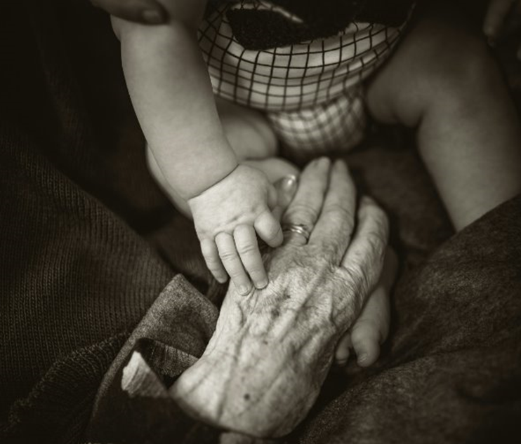
Juxtaposition (3)
Guided practice
Compare and contrast the people in this image.
What indications do we have that these people are different? Is there something that connects them despite this difference?
What could the message of this image be?
Image by Rod Long is licensed under Unsplash License.
Notes:
Teacher note: this slide supports Phase 1, activity 6 – identifying key visual features. Guide students through their analysis of this image. A copy of the questions can be found in Phase 1, activity 6 – identifying key visual features. Students should respond in their books, then discuss their responses as a class.
Use the questions:
Compare and contrast the people in this image.
What indications do we have that these people are different?
Is there something that connects them despite this difference?
What could the message of this image be?
This slide moves the gradual release of responsibility sequence into guided practice. Require students to identify specific visual evidence before developing an interpretation. Use prompts to help students move from describing the two people towards explaining why their similarities and differences may have been deliberately juxtaposed.
There is no separate independent juxtaposition activity in this sequence. Use student responses to determine whether they can apply the analytical process with reduced prompting before progressing.

Slide 15
Salience
Notes:
Teacher note: this slide supports Phase 1, activity 6 – identifying key visual features. Salience is a visual feature students will use in Phase 1, activity 7 – analysing a layout of Took the Children Away.
This slide begins another gradual release of responsibility sequence. Explain that students will first establish what salience means, then observe how salience is analysed before undertaking guided and independent practice.
Connect this concept to earlier learning by explaining that salience is concerned with which element of an image is given greatest visual importance and therefore attracts the viewer’s attention.

Slide 16

Salience (1)
Definition
Salience refers to the importance given to particular elements of an image.
For example, the size, expression and foreground position of an object demands the viewer’s attention first.
Image by Kiona is licensed under Unsplash License.
Notes:
Teacher note: this slide supports Phase 1, activity 6 – identifying key visual features. Provide a definition of the metalanguage and ask students to define it in their own words in their books.
At this introductory stage of gradual release of responsibility, explicitly explain that salience refers to the importance given to particular elements of an image.
For example, size, expression and foreground position can demand the viewer’s attention first. Other visual choices such as contrast, focus, framing and placement may also contribute.
Model a brief example by identifying which feature students notice first and explaining the visual reason for this response. This prepares students for the modelled analysis on the following slide.

Slide 17
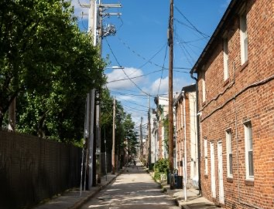
Salience (2)
Modelled practice
In this image, the salient feature is the alleyway.
The alleyway takes up half of the image. It is foregrounded at the bottom of the image, and vector lines draw our eyes up to the end of the street.
The alleyway is framed by the buildings, trees, and powerlines.
Image by Erin White is licensed under Unsplash License.
Notes:
Teacher note: this slide supports Phase 1, activity 6 – identifying key visual features. Model the process of determining salience in this image and its effect. Point out how importance is given to particular elements through features such as size, foregrounding, framing and vector lines.
Model analysis:
In this image, the salient feature is the alleyway. The alleyway takes up approximately half of the image, is foregrounded at the bottom of the image, and vector lines draw our eye towards the end of the street. The alleyway is framed by the buildings, trees and powerlines.
This slide provides the modelled practice stage of gradual release of responsibility. Think aloud by first identifying the feature that attracts attention, then locating the visual choices responsible for making it salient. Reinforce that analysis should explain how salience has been constructed rather than simply naming the salient object.

Slide 18

Salience (3)
Guided practice
What is salient in this image?
How does the size and placement of images emphasise that this is the most significant feature?
Image by Mark Basarab is licensed under Unsplash License.
Notes:
Teacher note: this slide supports Phase 1, activity 6 – identifying key visual features. Guide students through their analysis of this image. A copy of the questions can be found in Phase 1, activity 6 – identifying key visual features. Students should respond in their books, then discuss their responses as a class.
The teacher may ask:
What is salient in this image?
How do the size and placement of images emphasise that this is the most significant feature?
This slide moves gradual release of responsibility into guided practice. If students state that something ‘stands out’, require them to explain why using appropriate visual metalanguage. Prompt attention to size, position, framing, contrast and other relevant visual evidence.
Reduce prompting as students demonstrate greater control in preparation for the independent task.

Slide 19

Salience (4)
Independent practice
Add a figure or object, making it the salient point in this image. Consider size, expression, and placement when adding your salient image.
Image by Adriel Kloppenburg is licensed under Unsplash License.
Notes:
Teacher note: this slide supports Phase 1, activity 6 – identifying key visual features. Students should add an image to the diagram in Phase 1, activity 6 – identifying key visual features. The teacher can use the slide for students to indicate where they placed an image and explain why.
This slide completes the salience sequence through independent practice within gradual release of responsibility. Students add a figure or object and deliberately make it the salient point in the image, considering size, expression and placement.
Students should justify their compositional choices by explaining how they have deliberately directed the viewer’s attention. Use these explanations as evidence of whether students can apply the concept of salience independently.

Slide 20
Colour palette
Notes:
Teacher note: this slide supports Phase 1, activity 6 – identifying key visual features. This and the following slides and visual features can be used to extend student understanding in association with Phase 1, activity 7 – analysing a layout of Took the Children Away.
This slide begins the gradual release of responsibility sequence for colour palette. Explain that students will establish the relevant metalanguage, observe a modelled analysis, complete a guided analysis and, where ready, apply their understanding independently.
Connect colour palette with earlier learning by reminding students that colour can contribute to symbolism, juxtaposition and salience while also establishing mood and atmosphere.

Slide 21
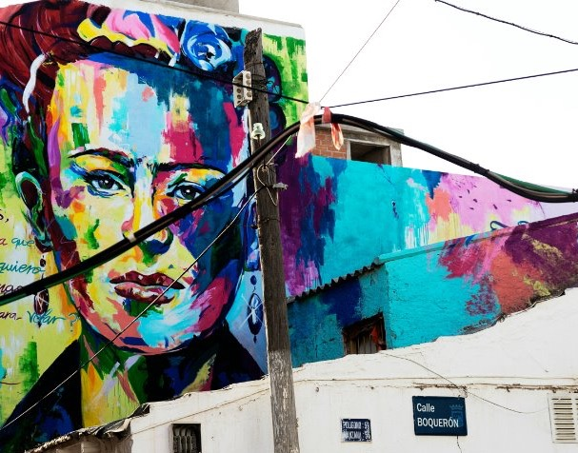
Colour palette (1)
Definition
Colour palette refers to the range of colours often used deliberately in visual texts for symbolic meaning.
A colour palette can contribute to meaning through:
hue
intensity
warm versus cool colours.
Image by Quino Al is licensed under Unsplash License.
Notes:
Teacher note: this slide supports Phase 1, activity 6 – identifying key visual features. Provide a definition of the metalanguage and ask students to define it in their own words in their books.
At this stage of gradual release of responsibility, explicitly explain that colour palette refers to the range of colours deliberately used in a visual text for effect and meaning.
A colour palette can contribute to meaning through:
hue
intensity
warm and cool colours.
Model a simple example of how changing the colours of an image could alter its atmosphere or emotional effect before moving into the modelled analysis.

Slide 22

Colour palette (2)
Modelled practice
In this image, the vibrant colours make this setting feel inviting.
The orange of Uluru and the sand are warm colours, and the yellow in the grass contributes to the feeling that this is a hot place.
The colours symbolise the heat of the Australian outback.
Image by Michael Jerrard is licensed under Unsplash License.
Notes:
Teacher note: this slide supports Phase 1, activity 6 – identifying key visual features. Model the process of determining colour palette in this image and its effect. Extend students to explain why they think the colours communicate particular ideas.
Modelled analysis:
In this image, the vibrant colours make the setting feel inviting. The orange of Uluru and the sand are warm colours, and the yellow in the grass contributes to the feeling that this is a hot place. The colours symbolise the heat of the Australian outback and the power of nature.
This slide provides the modelled practice stage of gradual release of responsibility. Make the analytical reasoning visible by naming the dominant colours, describing their intensity or temperature and then connecting these observations with mood, setting and symbolic meaning.
Emphasise that analysis of colour palette should explain the effect created by the colour choices rather than simply list the colours visible.

Slide 23
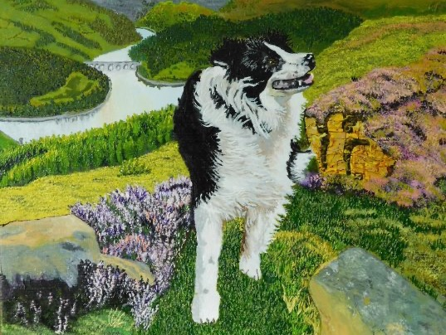
Colour palette (3)
Guided practice
What emotions might this picture evoke?
How does the artist feel about this dog? How does the juxtaposition or contrast between the dog and landscape emphasise this?
How do they feel about this setting?
Are the colours:
        vibrant or dull?
        warm or cool?
Image by Catherine Kay Greenup is licensed under Unsplash License.
Notes:
Teacher note: this slide supports Phase 1, activity 6 – identifying key visual features. Guide students through their analysis of this image. A copy of the questions can be found in Phase 1, activity 6 – identifying key visual features. Students should respond in their books, then discuss their responses as a class.
The teacher may ask:
What emotions might this picture evoke?
How does the artist feel about this dog?
How does the juxtaposition or contrast between the dog and landscape emphasise this?
How do they feel about this setting?
Are the colours vibrant or dull?
Are the colours warm or cool?
This slide moves gradual release of responsibility into guided practice. Support students to identify the colour choices first, then explain how those choices contribute to mood, representation and emotional response.
The question about juxtaposition also allows students to draw on previously taught visual metalanguage while retaining colour palette as the main analytical focus.

Slide 24
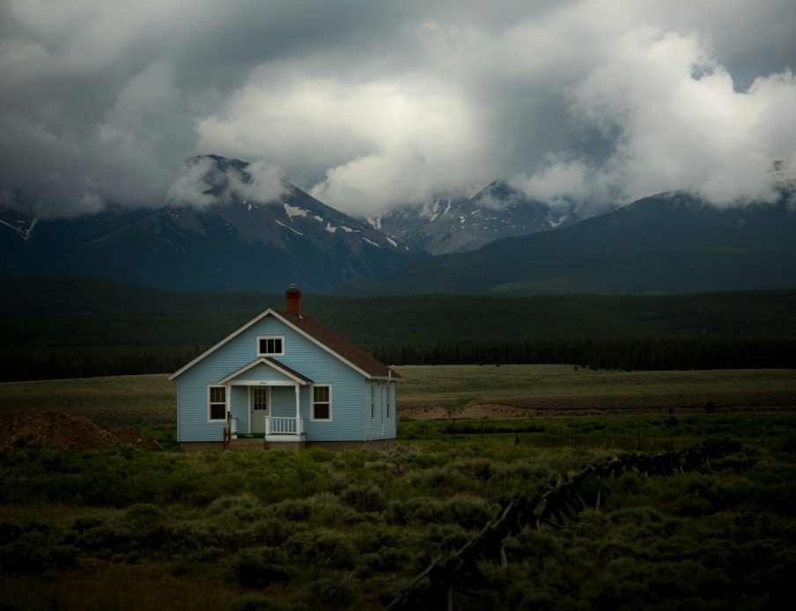
Colour palette (4)
Independent practice
What emotions might this picture evoke?
How does the artist feel about the incoming storm?
Are the colours:
        vibrant or dull?
        warm or cool?
Image by Nathan Anderson is licensed under Unsplash License.
Notes:
Teacher note: this slide supports Phase 1, activity 6 – identifying key visual features. Students can complete this independent practice activity if they are suitably prepared to work independently. Alternatively, the teacher can use this as another guided practice activity.
This flexibility reflects the responsive nature of gradual release of responsibility. Students who demonstrate secure understanding should respond independently to the questions:
What emotions might this picture evoke?
How does the artist feel about the incoming storm?
Are the colours vibrant or dull?
Are the colours warm or cool?
Students should support their interpretation with specific colour choices from the image. Where students are not yet able to connect colour with effect independently, retain teacher questioning and complete the task as guided practice before reducing support.

Slide 25
Layout
Notes:
Teacher note: this slide supports Phase 1, activity 6 – identifying key visual features. This and the following slides and visual features can be used to extend student understanding.
This slide introduces the final visual-feature sequence within gradual release of responsibility. Explain that layout concerns how visual elements are arranged in relation to each other and to the whole image.
The following slides move from explicit definition to modelled analysis and guided practice. Connect the concept with earlier learning about salience by reminding students that size, placement and foregrounding can influence both layout and the relative importance of visual elements.

Slide 26
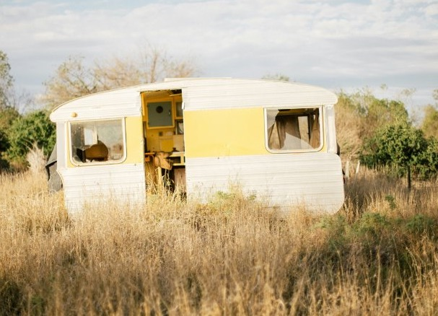
Layout (1)
Definition
Layout refers to the placement and arrangement of elements in a visual text. We consider which elements are in the foreground, midground and background, which elements take up the most space, and what this tells us about the object's importance in conveying meaning. We should also consider the placement of objects.
Image by Ashleigh Joy Photography is licensed under Unsplash License.
Notes:
Teacher note: this slide supports Phase 1, activity 6 – identifying key visual features. Provide a definition of the metalanguage and ask students to define it in their own words in their books.
At this introductory stage of gradual release of responsibility, explicitly explain that layout refers to the placement and arrangement of elements in a visual text.
Students should consider which elements are in the foreground, midground and background, which elements take up the most space, and what this indicates about their importance in conveying meaning. Students should also consider the relative placement of objects and how their arrangement guides the viewer through the image.
Use a simple example to model the vocabulary of foreground, midground and background before progressing to the complete modelled analysis.

Slide 27

Layout (2)
Modelled practice
Foreground – the rocky shore, establishing setting
Midground – the beached boat
Background – the storm and the mountain range, providing more detail about the setting and the events which may have contributed to this boat's beaching
Size – the boat is the largest object, taking nearly half of the space, so we know this is a significant feature.
Image by Massimiliano Morosinotto is licensed under Unsplash License.
Notes:
Teacher note: this slide supports Phase 1, activity 6 – identifying key visual features. Model the process of determining layout in this image and its effect.
Modelled analysis:
Foreground – the rocky shore, establishing the immediate setting.
Midground – the beached boat.
Background – the storm and mountain range, providing further detail about the setting and the events that may have contributed to the boat becoming beached.
Size – the boat is the largest object, taking up nearly half of the available space, so we understand that it is a significant feature.
This slide provides the modelled practice stage of gradual release of responsibility. Think aloud through the spatial organisation systematically, moving from foreground to midground and background before considering size and relative placement.
Explain how these visual choices establish relationships between the elements and influence the viewer’s understanding of the image.

Slide 28

Layout (3)
Guided practice
If you imagine the image to be divided equally into 4 quadrants, where is the main subject(s) and the action placed in the text? For example, is this in the top or bottom of the image? On the left or right side? Or in the middle?
Is there a frame around the image? How thick is the frame border?
How do these elements draw the image together as a cohesive whole?
If you changed any of these aspects, how would that affect the meaning of this image?
Image by Oleksandr Kuzmin is licensed under Unsplash License.
Notes:
Teacher note: this slide supports Phase 1, activity 6 – identifying key visual features. Guide students through their analysis of this image.
The teacher may ask:
If you imagine the image divided equally into 4 quadrants, where are the main subjects and the action placed in the text? For example, are they at the top or bottom of the image, on the left or right side, or in the middle?
Is there a frame around the image? How thick is the frame border?
How do these elements draw the image together as a cohesive whole?
If you changed any of these aspects, how would that affect the meaning of the image?
This slide moves the layout sequence into guided practice. Ask students first to describe where elements are located, then move them towards explaining why those positions matter. Where appropriate, prompt students to draw on earlier knowledge of salience, juxtaposition and colour palette to explain how layout works alongside other visual features.
There is no separate independent layout task in this presentation, so use students’ responses to determine whether further guided practice is required.
At the conclusion of the activity, revisit the five key visual features: symbolism, juxtaposition, salience, colour palette and layout. Ask students to identify how more than one feature may operate simultaneously within a visual text. This prepares them to transfer the analytical process to Phase 1, activity 7 – analysing a layout of Took the Children Away.

Slide 29
References (1)
This presentation contains NSW Curriculum and syllabus content. The NSW Curriculum is developed by the NSW Education Standards Authority. This content is prepared by NESA for and on behalf of the Crown in the right of the State of New South Wales. The material is protected by Crown copyright.
Please refer to the NESA Copyright Disclaimer for more information https://educationstandards.nsw.edu.au/wps/portal/nesa/mini-footer/copyright.
NESA holds the only official and up-to-date versions of the NSW Curriculum and syllabus documents. Please visit the NSW Education Standards Authority (NESA) website https://educationstandards.nsw.edu.au/wps/portal/nesa/home and the NSW Curriculum website https://curriculum.nsw.edu.au.
English K–10 Syllabus (2022) © NSW Education Standards Authority (NESA) for and on behalf of the Crown in right of the State of New South Wales, 2022.
Al Q. (2020) blue green and red abstract painting [Photograph], Unsplash, accessed 2 March 2026.
Anderson N. (2016) house on grass field under grey sky [Photograph], Unsplash, accessed 2 March 2026.
Basarab M. (2016) blue starry night [Photograph], Unsplash, accessed 2 March 2026.
Benazet J.-L. (2018) yellow and black painted wall [Photograph], Unsplash, accessed 2 March 2026.
Dittrich B. (2024) purple flowers are growing on a wire fence [Photograph], Unsplash, accessed 2 March 2026.
Greenup C.K. (2024) A painting of a black and white dog standing on a hill [Photograph], Unsplash, accessed 2 March 2026.
Jerrard M. (2020) brown mountain under blue sky during daytime [Photograph], Unsplash., accessed 2 March 2026.
Joy Photography A. (2017) white RV trailer in the middle of grass field [Photograph], Unsplash, accessed 2 March 2026.

Slide 30
References (2)
This presentation contains NSW Curriculum and syllabus content. The NSW Curriculum is developed by the NSW Education Standards Authority. This content is prepared by NESA for and on behalf of the Crown in the right of the State of New South Wales. The material is protected by Crown copyright.
Please refer to the NESA Copyright Disclaimer for more information https://educationstandards.nsw.edu.au/wps/portal/nesa/mini-footer/copyright.
NESA holds the only official and up-to-date versions of the NSW Curriculum and syllabus documents. Please visit the NSW Education Standards Authority (NESA) website https://educationstandards.nsw.edu.au/wps/portal/nesa/home and the NSW Curriculum website https://curriculum.nsw.edu.au.
Kiona (2022) a tree in a field [Photograph], Unsplash, accessed 2 March 2026.
Kloppenburg, A. (2017) photo of sea waves [Photograph], Unsplash, accessed 2 March 2026.
Kuzmin, O. (2022) a cat lying on a porch [Photograph], Unsplash, accessed 2 March 2026.
Long, R. (2018) an older woman holding a baby's hand [Photograph], Unsplash, accessed 2 March 2026.
Morosinotto M (2022) black and red ship on shore, Unsplash, accessed 14 November 2025.
Morosinotto, M. (2019) black and red ship on shore [Photograph], Unsplash, accessed 2 March 2026.
Schaffler, M. (n2018) red heart balloon lot [Photograph], Unsplash, accessed 2 March 2026.
Tosana, C. (2018) bonfire near mountain [Photograph], Unsplash, accessed 2 March 2026.
White, E. (2018) road near brown house [Photograph], Unsplash, accessed 2 March 2026.

Slide 31
References (3)
This presentation contains NSW Curriculum and syllabus content. The NSW Curriculum is developed by the NSW Education Standards Authority. This content is prepared by NESA for and on behalf of the Crown in the right of the State of New South Wales. The material is protected by Crown copyright.
Please refer to the NESA Copyright Disclaimer for more information https://educationstandards.nsw.edu.au/wps/portal/nesa/mini-footer/copyright.
NESA holds the only official and up-to-date versions of the NSW Curriculum and syllabus documents. Please visit the NSW Education Standards Authority (NESA) website https://educationstandards.nsw.edu.au/wps/portal/nesa/home and the NSW Curriculum website https://curriculum.nsw.edu.au.
Kloppenburg, A. (2017) photo of sea waves [Photograph], Unsplash, accessed 2 March 2026.
Kuzmin, O. (2022) a cat lying on a porch [Photograph], Unsplash, accessed 2 March 2026.
Long, R. (2018) an older woman holding a baby's hand [Photograph], Unsplash, accessed 2 March 2026.
Morosinotto M (2022) black and red ship on shore, Unsplash, accessed 14 November 2025.
Morosinotto, M. (2019) black and red ship on shore [Photograph], Unsplash, accessed 2 March 2026.
Schaffler, M. (n2018) red heart balloon lot [Photograph], Unsplash, accessed 2 March 2026.
Tosana, C. (2018) bonfire near mountain [Photograph], Unsplash, accessed 2 March 2026.
White, E. (2018) road near brown house [Photograph], Unsplash, accessed 2 March 2026.

Slide 32
Copyright
© State of New South Wales (Department of Education), 2026
The copyright material published in this resource is subject to the Copyright Act 1968 (Cth) and is owned by the NSW Department of Education or, where indicated, by a party other than the NSW Department of Education (third-party material).
Copyright material available in this resource and owned by the NSW Department of Education is licensed under a Creative Commons Attribution 4.0 International (CC BY 4.0) licence.
This licence allows you to share and adapt the material for any purpose, even commercially.
Attribution should be given to © State of New South Wales (Department of Education), 2026.
Material in this resource not available under a Creative Commons licence:
the NSW Department of Education logo, other logos and trademark-protected material
Material owned by a third party that has been reproduced with permission. You will need to obtain permission from the third party to reuse its material.
Links to third-party material and websites
Please note that the provided (reading/viewing material/list/links/texts) are a suggestion only and implies no endorsement, by the New South Wales Department of Education, of any author, publisher, or book title. School principals and teachers are best placed to assess the suitability of resources that would complement the curriculum and reflect the needs and interests of their students.
If you use the links provided in this document to access a third party’s website, you acknowledge that the terms of use, including licence terms set out on the third-party’s website apply to the use which may be made of the materials on that third-party website or where permitted by the Copyright Act 1968 (Cth). The department accepts no responsibility for content on third-party websites.

