Slide 1
Introduction
Introduction for the teacher
This resource is not a teaching and learning program. It should be used in conjunction with Year 8 term 3 program ‘From page to stage’.
Notes:
Teacher note: this is an introduction slide to support teacher on the use of this resource.

Slide 2
Instructions for use
Instructions for the teacher
Classroom teachers are encouraged to add and adapt slides as required to meet the needs of their students.
Save a copy of the file to make changes to the slide deck. Go to File > Download a Copy (this downloads a copy to the computer to edit in the PowerPoint application).
To convert the PowerPoint to Google Slides:
  Upload the file into Google Drive and open it.
  Go to File > Save as Google Slides.
  (Note – conversion may cause formatting changes in the slides.)
Notes:
Teacher note: this is an instruction slide to support teacher on the use of this resource.

Slide 3

Phase 6 – preparing the assessment task
Year 8 – Term 3
8.3 – ‘From page to stage’
Photo by Unseen Studio on Unsplash
Notes:
Teacher note: the following slides may be used to support resources and activities in Phase 6.

Slide 4
Sharing learning intentions and success criteria
Notes:
Teacher note: this slide has been used to identify the explicit teaching strategies sharing learning intentions and sharing success criteria. This slide could be deleted or hidden when using this content in a classroom setting. Alternatively, the teacher could discuss the educational benefit of the process of sharing learning intentions and success criteria and discussing the significance of this learning process.
Sharing learning intentions allows a teacher to effectively communicate the learning goal with students. They allow students to connect new learning to existing knowledge, skills and understanding.
When learning intentions are used with success criteria, students have a clear idea of the learning goal and how to get there (AERO 2024).
The success criteria break the learning intention into smaller and more manageable actions. They show students what they must do, say, make, create or perform to demonstrate their learning (Griffin 2018).
Success criteria are communicated to students in ways they understand. Teachers use their expertise to guide student thinking and often model and use exemplars to show students what success 'looks like’ (DoE 2025).
The sample learning intentions and success criteria (LISC) on the following slide are aligned to the syllabus.
When designing LISC for students working above or below stage level, or towards Life Skills outcomes, draw on the collaborative curriculum planning process to ensure LISC is differentiated and aligned with the relevant syllabus outcomes.
For more information, see:
AITSL: https://www.aitsl.edu.au/docs/default-source/feedback/aitsl-learning-intentions-and-success-criteria-strategy.pdf?sfvrsn=382dec3c_2
Sharing learning intentions: https://education.nsw.gov.au/teaching-and-learning/curriculum/explicit-teaching/explicit-teaching-strategies/sharing-learning-intentions
Sharing success criteria: https://education.nsw.gov.au/teaching-and-learning/curriculum/explicit-teaching/explicit-teaching-strategies/sharing-success-criteria
Collaborative curriculum planning: https://educationstandards.nsw.edu.au/wps/portal/nesa/k-10/diversity-in-learning/special-education/collaborative-curriculum-planning

Slide 5
Learning intentions and success criteria
We are learning to:
understand what plagiarism is and how to avoid it
use peer and teacher feedback to improve our writing
reflect on our draft to identify strengths and areas for improvement.
We can:
[classroom teacher to insert sample success criteria]
[classroom teacher to insert sample success criteria]
[classroom teacher to insert sample success criteria].
Notes:
Teacher note: adapt the provided learning intention and below sample success criteria, as required, to suit the needs of your students.
explain what plagiarism is and ensure ideas and information are properly acknowledged
demonstrate the key features and conventions of a playscript and a cover letter
use the traffic light feedback strategy to identify what to keep, fix, or ask about in our writing
revise and refine our draft based on feedback from peers and teacher.
LISC is usually shared first or early in the lesson and is explained by the teacher who checks for understanding (DoE 2025).
LISC is referred to regularly to check for understanding, provide feedback or as a self-assessment tool (Wiliam and Leahy 2015).
Learning intentions and success criteria can be supported by exemplars, such as 'What A Good One Looks Like' (WAGOLL) or exemplars to demonstrate success criteria (Clarke 2021).
For more information, see:
Sharing learning intentions and success criteria: https://education.nsw.gov.au/content/dam/main-education/documents/teaching-and-learning/curriculum/explicit-teaching/explicit-teaching-technique-guide-lisc-sharing.pdf
Planning learning intentions and success criteria: https://education.nsw.gov.au/content/dam/main-education/documents/teaching-and-learning/curriculum/explicit-teaching/explicit-teaching-technique-guide-lisc-planning.pdf

Slide 6

Avoiding plagiarism
What is plagiarism?
Plagiarism is when you pretend that you have written or created a piece of work that someone else originated. It is cheating and it is dishonest.
Plagiarism is:
copying and pasting information from the internet
using the ideas of others as if they were your own
copying and pasting information from the internet and only changing a few words
using information without citing it (saying that it is someone else’s work) and providing a reference list.
Photo by Ludovic Migneault on Unsplash
Notes:
Teacher note: this slide introduces students to the concept of plagiarism using simplified definitions adapted from NESA guidance on academic integrity. (https://curriculum.nsw.edu.au/ace-rules/ace10) The purpose is to build students’ understanding of what plagiarism looks like before they begin drafting written responses for their assessment task.

Slide 7

Avoiding plagiarism (2)
Discuss the scenarios
Look at the following scenarios and decide if they are plagiarism:
a student copies a paragraph from a website and pastes it into their work
a student reads a source, closes it, and writes the idea in their own words
a student changes a few words in a sentence from the internet but keeps the same structure.
Discuss with a partner and explain why each example is or is not plagiarism.
Photo by Towfiqu barbhuiya on Unsplash
Notes:
Teacher note: this activity encourages students to apply the definition of plagiarism by identifying examples and discussing them with a partner. The discussion helps clarify misconceptions and reinforces the importance of using their own words when completing assessment tasks.

Slide 8

Avoiding plagiarism (3)
Why does plagiarism matter?
Plagiarism matters because:
it is dishonest and involves stealing other people’s ideas
authors own their words and ideas
it prevents you from developing the skills and knowledge need for learning.
Individually, write one sentence explaining why plagiarism is unfair and dishonest.
Share your idea with a partner.
Together, write 2 consequences that plagiarism has for students.
Photo by Alex Shuper on Unsplash
Notes:
Teacher note: this slide encourages students to consider the ethical and academic reasons why plagiarism is unacceptable. It reinforces the importance of honesty in learning and highlights how producing original work helps students develop important literacy and thinking skills.
The activity encourages reflection on the consequences of plagiarism. Through discussion, students explore ideas such as fairness, academic honesty and the impact plagiarism can have on learning and assessment outcomes.

Slide 9

Avoiding plagiarism
How can you prevent plagiarism?
You can prevent plagiarism by:
avoiding cutting and pasting information directly
reading a source and then writing the idea in your own words
putting direct quotes in quotation marks
using in-text referencing when using someone else’s ideas
acknowledge sources in a reference list.
With a partner, choose 2 strategies and explain how they help writers produce honest work.
Write one tip you would give to another student to avoid plagiarism.
Photo by Brett Jordan on Unsplash
Notes:
Teacher note: this slide introduces practical strategies students can use to avoid plagiarism when completing written tasks. The focus is on paraphrasing, quoting correctly and acknowledging sources, which are key skills for developing academic integrity.
The activity asks students to engage directly with the plagiarism prevention strategies presented on the slide. By explaining how the strategies help writers avoid plagiarism, students reinforce their understanding of paraphrasing, quoting and acknowledging sources. The discussion also encourages students to think about how they will apply these strategies when completing their assessment tasks.

Slide 10
Using effective feedback
Notes:
Teacher note: this slide has been used to identify the explicit teaching learning strategy of Using effective feedback and should be deleted or hidden when using in a classroom setting.
Using effective feedback is when a teacher gives students specific, clear information about their work, so they know exactly what to keep doing and what to improve.
Good feedback focuses on the task itself, not the student, and points to a clear next step rather than a vague comment like "good job" or "try harder."
It works best when it is given close to the time of the task, while it still feels relevant and useful to the student.
Feedback is most useful when it is aligned to the learning intentions and success criteria of a lesson or learning experience (Clarke, Timperley and Hattie 2023). It is most effective when delivered during learning (Clarke 2014).

Slide 11
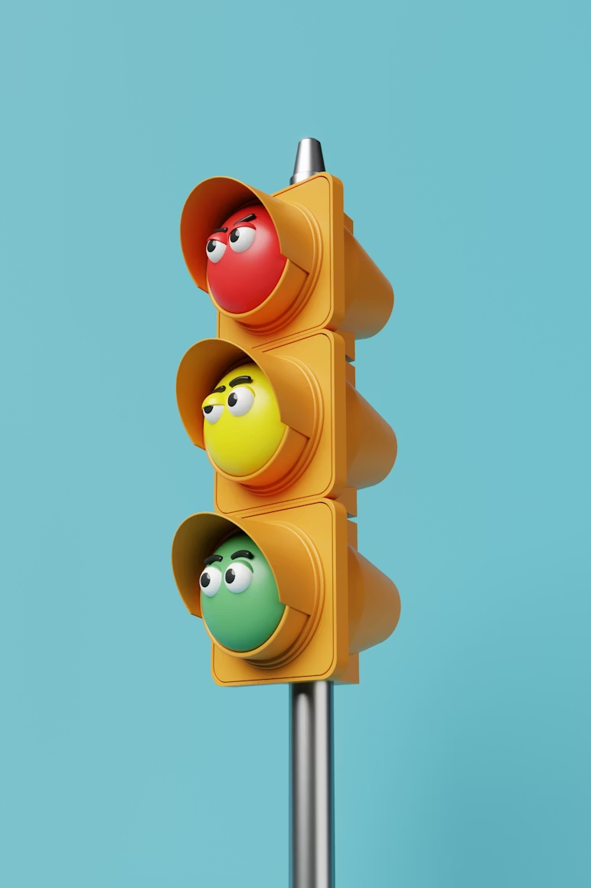
Actioning feedback (1)
The traffic lights strategy
Step 1 – revise
Read and highlight in green the sections of your response where you have done well. On a green sticky note, make points about how you can keep these successes in your next draft.
Read and highlight in orange the sections of your work that were identified as needing improvement, which you know how to improve. On an orange sticky note, explain how you will refine your writing to implement the feedback provided.
Read and highlight in red the sections of your work that were identified as needing improvement, which you don’t know how to improve. On a red sticky note labelled ‘ask’, write questions to ask your teacher and a peer marker.
Photo by Fachrizal Maulana on Unsplash
Notes:
Teacher note: this slide introduces the first stage of the traffic lights strategy, where students review the feedback they have received on their draft and begin identifying strengths and areas for improvement. Students highlight sections of their work using the colour-coded system:
green for strengths
orange for sections that can be improved
red for areas where they need clarification or support.
At this stage, the focus is on helping students interpret feedback and reflect on their own writing. The teacher should circulate and guide students as they identify sections of their work that align with each colour. Using effective feedback, the teacher can prompt students to explain why they have identified a section as a strength or an area for improvement. This helps ensure students are engaging thoughtfully with the feedback rather than simply highlighting sections without reflection. The teacher can also provide targeted guidance where students are unsure how to interpret feedback. By asking questions and offering clarifying comments, the teacher supports students in understanding how feedback can be used to strengthen their writing and prepare them for the revision stage.
The teacher can state the following to students, ‘You need your drafts and the following: green highlighter and green sticky notes for your “do” annotations, orange highlighter and orange sticky notes for your “fix” annotations, red or pink highlighter and red or pink sticky notes for your “ask” annotations. This activity will be fine-tuning for your writing. The “traffic lights” method will help you to reflect, revise and rewrite where necessary. Use this strategy to apply the written feedback you have received about your playscript and persuasive cover letter.’

Slide 12

Actioning feedback (2)
Refining with the traffic lights strategy
Step 2 – refine and rewrite
Refine your response based on the traffic lights strategy.
Seek clarification or advice from your peer on areas that you have highlighted in red.
Alternatively, discuss these issues with your teacher during your student–teacher conference.
Photo by Paul MARSAN on Unsplash
Notes:
Teacher note: this slide focuses on the second stage of the of the traffic lights strategy, where students use the insights from their traffic lights annotations to refine and improve their draft.
Students should use their green annotations to maintain successful elements of their writing, apply changes to sections marked in orange, and seek clarification on areas marked in red before rewriting.
During this stage, the teacher should support students as they translate feedback into concrete revisions. Circulating through the classroom allows the teacher to provide effective feedback that helps students strengthen their responses and refine their ideas. For example, the teacher may guide students to clarify a sentence, expand an idea, or restructure a paragraph to improve clarity and coherence. Encouraging students to discuss their red annotations with peers or the teacher also promotes collaborative learning and helps students interpret feedback more effectively.
Using effective feedback, students develop the ability to revise their work independently and recognise feedback as an important part of the writing process.

Slide 13
References
This presentation contains NSW Curriculum and syllabus content. The NSW Curriculum is developed by the NSW Education Standards Authority. This content is prepared by NESA for and on behalf of the Crown in the right of the State of New South Wales. The material is protected by Crown copyright.
Please refer to the NESA Copyright Disclaimer for more information https://educationstandards.nsw.edu.au/wps/portal/nesa/mini-footer/copyright.
NESA holds the only official and up-to-date versions of the NSW Curriculum and syllabus documents. Please visit the NSW Education Standards Authority (NESA) website https://educationstandards.nsw.edu.au/wps/portal/nesa/home and the NSW Curriculum website https://curriculum.nsw.edu.au.
English K–10 Syllabus (2022) © NSW Education Standards Authority (NESA) for and on behalf of the Crown in right of the State of New South Wales, 2022.
Jordan B (2022) a scrabbled wooden block with the words integr city on it [photo], Unsplash, accessed 10 March 2026.
Marsan P (2020) Untitled [photo], Unsplash, accessed 10 March 2026.
Maulana F (2024) A traffic light with a couple of faces on it [photo], Unsplash, accessed 10 March 2026.
Migneault L (2020) man in gray button up shirt [photo], Unsplash, accessed 10 March 2026.
Shuper A (2024) a red and white button that says fake [photo], Unsplash, accessed 10 March 2026.
Towfiqu barbhuiya (2021) person in black long sleeve shirt using macbook pro [photo], Unsplash, accessed 10 March 2026.
Unseen Studio (2015) Designer sketching Wireframes [photo], Unsplash, accessed 10 March 2026.
Notes:
Teacher note: this slide contains references for this resource.

Slide 14
Copyright
© State of New South Wales (Department of Education), 2026
The copyright material published in this resource is subject to the Copyright Act 1968 (Cth) and is owned by the NSW Department of Education or, where indicated, by a party other than the NSW Department of Education (third-party material).
Copyright material available in this resource and owned by the NSW Department of Education is licensed under a Creative Commons Attribution 4.0 International (CC BY 4.0) license.
This license allows you to share and adapt the material for any purpose, even commercially.
Attribution should be given to © State of New South Wales (Department of Education), 2026.
Material in this resource not available under a Creative Commons license:
the NSW Department of Education logo, other logos and trademark-protected material
Material owned by a third party that has been reproduced with permission. You will need to obtain permission from the third party to reuse its material.
Links to third-party material and websites
Please note that the provided (reading/viewing material/list/links/texts) are a suggestion only and implies no endorsement, by the New South Wales Department of Education, of any author, publisher, or book title. School principals and teachers are best placed to assess the suitability of resources that would complement the curriculum and reflect the needs and interests of their students.
If you use the links provided in this document to access a third-party’s website, you acknowledge that the terms of use, including licence terms set out on the third-party’s website apply to the use which may be made of the materials on that third-party website or where permitted by the Copyright Act 1968 (Cth). The department accepts no responsibility for content on third-party websites.

