Slide 1
Introduction
Introduction for the teacher
This resource is not a teaching and learning program. It should be used in conjunction with Year 8 term 3 program ‘From page to stage’.
Notes:
Teacher note: this is an introduction slide to support teacher on the use of this resource.

Slide 2
Instructions for use
Instructions for the teacher
Classroom teachers are encouraged to add and adapt slides as required to meet the needs of their students.
Save a copy of the file to make changes to the slide deck. Go to File > Download a Copy (this downloads a copy to the computer to edit in the PowerPoint application).
To convert the PowerPoint to Google Slides:
  Upload the file into Google Drive and open it.
  Go to File > Save as Google Slides.
  (Note – conversion may cause formatting changes in the slides.)
Notes:
Teacher note: this is an instruction slide to support teacher on the use of this resource.

Slide 3

Phase 2 – learning about intertextuality
Year 8 – Term 3
8.3 – ‘From page to stage’
Photo by Unseen Studio on Unsplash
Notes:
Teacher note: the following slides may be used to support resources and activities in Phase 2, sequence 1 – deepening understanding of where composers get their ideas for texts, Phase 2, sequence 2 – adapting or appropriating a fairytale for a modern context and Phase 2, sequence 4 – introducing the assessment task.

Slide 4
Sharing learning intentions and success criteria
Notes:
Teacher note: this slide has been used to identify the explicit teaching strategies sharing learning intentions and sharing success criteria. This slide could be deleted or hidden when using this content in a classroom setting. Alternatively, the teacher could discuss the educational benefit of the process of sharing learning intentions and success criteria and discussing the significance of this learning process.
Sharing learning intentions allows a teacher to effectively communicate the learning goal with students. They allow students to connect new learning to existing knowledge, skills and understanding.
When learning intentions are used with success criteria, students have a clear idea of the learning goal and how to get there (AERO 2024).
The success criteria break the learning intention into smaller and more manageable actions. They show students what they must do, say, make, create or perform to demonstrate their learning (Griffin 2018).
Success criteria are communicated to students in ways they understand. Teachers use their expertise to guide student thinking and often model and use exemplars to show students what success 'looks like’ (DoE 2025).
The sample learning intentions and success criteria (LISC) on the following slide are aligned to the syllabus.
When designing LISC for students working above or below stage level, or towards Life Skills outcomes, draw on the collaborative curriculum planning process to ensure LISC is differentiated and aligned with the relevant syllabus outcomes.
For more information, see:
AITSL: https://www.aitsl.edu.au/docs/default-source/feedback/aitsl-learning-intentions-and-success-criteria-strategy.pdf?sfvrsn=382dec3c_2
Sharing learning intentions: https://education.nsw.gov.au/teaching-and-learning/curriculum/explicit-teaching/explicit-teaching-strategies/sharing-learning-intentions
Sharing success criteria: https://education.nsw.gov.au/teaching-and-learning/curriculum/explicit-teaching/explicit-teaching-strategies/sharing-success-criteria
Collaborative curriculum planning: https://educationstandards.nsw.edu.au/wps/portal/nesa/k-10/diversity-in-learning/special-education/collaborative-curriculum-planning

Slide 5
Learning intentions and success criteria
We are learning to:
understand intertextuality and how texts connect to other texts
identify how composers adapt and transform existing stories for new contexts
explore how language choices influence how characters are represented
develop vocabulary to help us analyse and discuss texts.
We can:
[classroom teacher to insert sample success criteria]
[classroom teacher to insert sample success criteria]
[classroom teacher to insert sample success criteria].
Notes:
Teacher note: adapt the provided learning intention and below sample success criteria, as required, to suit the needs of your students.
explain what intertextuality means
identify connections between original texts and adapted texts
analyse how word choices change how characters are perceived
contribute ideas to class discussions about texts and their meanings
use new vocabulary when explaining our understanding of texts.
LISC is usually shared first or early in the lesson and is explained by the teacher who checks for understanding (DoE 2025).
LISC is referred to regularly to check for understanding, provide feedback or as a self-assessment tool (Wiliam and Leahy 2015).
Learning intentions and success criteria can be supported by exemplars, such as 'What A Good One Looks Like' (WAGOLL) or exemplars to demonstrate success criteria (Clarke 2021).
For more information, see:
Sharing learning intentions and success criteria: https://education.nsw.gov.au/content/dam/main-education/documents/teaching-and-learning/curriculum/explicit-teaching/explicit-teaching-technique-guide-lisc-sharing.pdf
Planning learning intentions and success criteria: https://education.nsw.gov.au/content/dam/main-education/documents/teaching-and-learning/curriculum/explicit-teaching/explicit-teaching-technique-guide-lisc-planning.pdf

Slide 6
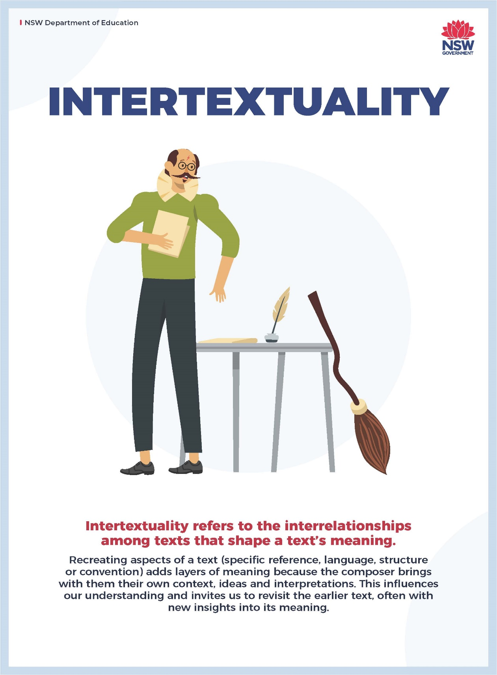
Understanding intertextuality
Connections between texts
Look closely at the poster.
With a partner, discuss:
What do you think intertextuality means?
Why might writers or filmmakers connect their stories to earlier texts?
Can you think of any examples of stories that are based on or inspired by other stories?
Be ready to share one idea with the class.
Notes:
Teacher note: this slide introduces the concept of intertextuality using the visual poster as a stimulus for discussion. Rather than providing a definition immediately, students are encouraged to interpret the image and generate ideas about how texts connect with each other. This approach activates prior knowledge and encourages students to think critically about familiar examples such as films based on books, retellings of fairy tales, or modern adaptations of traditional narratives.
During the discussion, the teacher should circulate and prompt students with guiding questions if needed. Encourage students to justify their ideas and provide examples form texts the know. After the discussion, the teacher can summarise key ideas and clarify that intertextuality refers to the relationships between texts and the ways composers draw on earlier stories, characters or ideas when creating new texts.

Slide 7
Intertextuality in practice
Identifying connections between texts
You have just discussed texts that are based on or connected to other texts, which in English is often called intertextuality.
With a partner choose a text that you are both familiar with that is connected in some way to another text.
The table provides some examples you can use or use an example of your own.
Original text | Connected text
‘Sleeping Beauty’ (Brothers Grimm) | Maleficent (Disney film)
Puss in Boots (Italian fairytale) | Puss in Boots (film)
The Hobbit (novel by JRR Tolkien) | The Hobbit (film)
Harry Potter (novel series) | Harry Potter (film series)
Rapunzel (German fairytale) | Tangled (animated) film
The Princess Bride (novel by William Goldman) | The Princess Bride (Disney film)
Notes:
Teacher note: this slide introduces students to clear examples of intertextual connections between texts, such as novels that have been adapted into films and traditional fairy tales that have been reinterpreted for modern audiences. The aim is for students to recognise that stories are often reshaped across time, medium, and audience.
The teacher will need to ask students to work with a partner to identify how the connected text relates to the original text. Prompt them to think about what might stay the same and what might change when a story is adapted. Encourage students to consider differences in audience, context, or purpose that may influence how a composer transforms the original narrative.

Slide 8
Intertextuality in practice (2)
Discussing intertextuality
Discuss the following questions with your partner and answer them in your English book:
Why do authors make intertextual connections to other texts?
Do older narratives or stories need to change?
Do you generally prefer texts that are original ideas or do you like adaptations?
Do you think composers should just work on new ideas rather than basing their texts on older texts?
What is it about these narratives that give them universal and timeless appeal (literary value in different contexts)?
Return to your class for a class discussion of your findings.
Notes:
Teacher note: this slide encourages students to think more deeply about why composers create intertextual connections and how adaptations influence meaning. Students should work with a partner to discuss the questions before sharing their ideas with the class.
Encourage students to support their responses with examples from texts they already know. The teacher can prompt further thinking by asking follow-up questions such as whether adapting a story can change its themes, characters, or message, or why certain narratives continue to be retold across different contexts. The purpose of this discussion is to move students beyond identifying connections between texts and toward understanding the purpose and impact of intertextuality in storytelling.

Slide 9
Previewing a text
Exploring The Three Little Pigs
Composers often use titles for characters that suggest how the composer wants us to view them; this could be either as innocent and fair or as guilty and frightening.
Read the word cline and consider how our view of the 3 little pigs changes.
How does our view of the 3 little pigs change as you move up the word cline suggestions?
The three little pigs
The three big pigs
The three lazy, dirty animals
The three wild boars
The three wolf-killing pigs
Notes:
Teacher note: the teacher may state the following, ‘Notice that the key words are made up of a combination of adjective (lazy) and noun (pigs). This is called a noun group. The changes we made involved finding more emotive adjectives (wild and wolf-killing) and synonyms for the noun (pigs and boars). The adjectives all come before the noun (they are pre-modifiers) but there is a way to change the noun by adding a phrase after it (post-modifier).
Look at the 2 examples I have created then make up your own: one to make the pigs seem nice and one to make them nasty. Even though these noun groups are longer, they are still just noun groups. What part of speech would you expect the next word in the sentence to be? (Hint: What are these cute – or horrid – pigs doing?) Example 1: the 3 little pigs dressed in pink pyjamas. Example 2: the 3 wild boars drooling slimy meat juice …’

Slide 10
Previewing a text (2)
Applying knowledge
Create your own word cline for the big bad wolf.
The sweet little puppy
The big bad wolf
Notes:
Teacher note: students apply their knowledge onto a new word cline to consolidate their learning.

Slide 11
Previewing a text (3)
Expanding vocabulary
In the episode you are about to watch, the Guardian newspaper is trying to get you to buy their product by giving you ‘the whole picture’. Some of the words used may be unfamiliar to you.
Use the table to rate your vocabulary knowledge. If you can define the word, write a brief explanation in the ‘can define’ column and then research any unfamiliar words in the dictionary and complete the table.
Word/s | Can define | Have seen or heard | Don’t know
mortgage
justified
custody
reasonable force
conspiring
empathise
default
whole picture
Notes:
Teacher note: this slide prepares students for viewing the Guardian advertisement adaptation of The Three Little Pigs in Phase 2, activity 1 – clarifying audience and purpose by activating and assessing their prior vocabulary knowledge. Students complete the vocabulary table by identifying which words they can already define, which words they recognise but may not fully understand, and which are unfamiliar. This activity helps students anticipate potentially challenging language before engaging with the text.
The teacher should briefly explain that the advertisement aims to persuade audiences by presenting ‘the whole picture,’ and that understanding key vocabulary will help students interpret the ideas and perspectives presented in the text. Students should first work independently to categorise the words based on their existing knowledge. After this, they can discuss responses with a partner and collaboratively refine their understanding.
Encourage students to write brief definitions in the ‘can define’ column and use a dictionary to research unfamiliar words. The teacher can circulate to support students’ vocabulary development and clarify meanings where necessary. This preparation supports comprehension of the advertisement and helps students develop the vocabulary needed to analyse how language shapes meaning and perspective in texts.

Slide 12
References (1)
This presentation contains NSW Curriculum and syllabus content. The NSW Curriculum is developed by the NSW Education Standards Authority. This content is prepared by NESA for and on behalf of the Crown in the right of the State of New South Wales. The material is protected by Crown copyright.
Please refer to the NESA Copyright Disclaimer for more information https://educationstandards.nsw.edu.au/wps/portal/nesa/mini-footer/copyright.
NESA holds the only official and up-to-date versions of the NSW Curriculum and syllabus documents. Please visit the NSW Education Standards Authority (NESA) website https://educationstandards.nsw.edu.au/wps/portal/nesa/home and the NSW Curriculum website https://curriculum.nsw.edu.au.
English K–10 Syllabus (2022) © NSW Education Standards Authority (NESA) for and on behalf of the Crown in right of the State of New South Wales, 2022.
Project Gutenberg (2006) The Story of the Three Little Pigs, Project Gutenberg website, accessed 3 February 2026.
Unseen Studio (2015) Designer sketching Wireframes [photo], Unsplash, accessed 10 March 2026.
‘Brothers Grimm, (1812) Sleeping Beauty,
Puss in Boots (Italian fairytale)
The Hobbit (novel by JRR Tolkien)
Harry Potter (novel series)
Rapunzel (German fairytale)
The Princess Bride (novel by William Goldman)
Notes:
Teacher note: this slide contains references for this resource.

Slide 13
References (2)
This presentation contains NSW Curriculum and syllabus content. The NSW Curriculum is developed by the NSW Education Standards Authority. This content is prepared by NESA for and on behalf of the Crown in the right of the State of New South Wales. The material is protected by Crown copyright.
Please refer to the NESA Copyright Disclaimer for more information https://educationstandards.nsw.edu.au/wps/portal/nesa/mini-footer/copyright.
NESA holds the only official and up-to-date versions of the NSW Curriculum and syllabus documents. Please visit the NSW Education Standards Authority (NESA) website https://educationstandards.nsw.edu.au/wps/portal/nesa/home and the NSW Curriculum website https://curriculum.nsw.edu.au.
Rapunzel (German fairytale)
The Princess Bride (novel by William Goldman)
Maleficent (Disney film)
Puss in Boots (film)
The Hobbit (film)
Harry Potter (film series)
Tangled (animated) film
The Princess Bride (Disney film)
Notes:
Teacher note: this slide contains references for this resource.

Slide 14
Copyright
© State of New South Wales (Department of Education), 2026
The copyright material published in this resource is subject to the Copyright Act 1968 (Cth) and is owned by the NSW Department of Education or, where indicated, by a party other than the NSW Department of Education (third-party material).
Copyright material available in this resource and owned by the NSW Department of Education is licensed under a Creative Commons Attribution 4.0 International (CC BY 4.0) license.
This license allows you to share and adapt the material for any purpose, even commercially.
Attribution should be given to © State of New South Wales (Department of Education), 2026.
Material in this resource not available under a Creative Commons license:
the NSW Department of Education logo, other logos and trademark-protected material
Material owned by a third party that has been reproduced with permission. You will need to obtain permission from the third party to reuse its material.
Links to third-party material and websites
Please note that the provided (reading/viewing material/list/links/texts) are a suggestion only and implies no endorsement, by the New South Wales Department of Education, of any author, publisher, or book title. School principals and teachers are best placed to assess the suitability of resources that would complement the curriculum and reflect the needs and interests of their students.
If you use the links provided in this document to access a third-party’s website, you acknowledge that the terms of use, including licence terms set out on the third-party’s website apply to the use which may be made of the materials on that third-party website or where permitted by the Copyright Act 1968 (Cth). The department accepts no responsibility for content on third-party websites.

