Slide 1
Introduction
Introduction for the teacher
This resource is not a teaching and learning program. It should be used in conjunction with Year 8 term 3 program ‘From page to stage’.
Notes:
Teacher note: this is an introduction slide to support teacher on the use of this resource.

Slide 2
Instructions for use
Instructions for the teacher
Classroom teachers are encouraged to add and adapt slides as required to meet the needs of their students.
Save a copy of the file to make changes to the slide deck. Go to File > Download a Copy (this downloads a copy to the computer to edit in the PowerPoint application).
To convert the PowerPoint to Google Slides:
  Upload the file into Google Drive and open it.
  Go to File > Save as Google Slides.
  (Note – conversion may cause formatting changes in the slides.)
Notes:
Teacher note: this is an instruction slide to support teacher on the use of this resource.

Slide 3
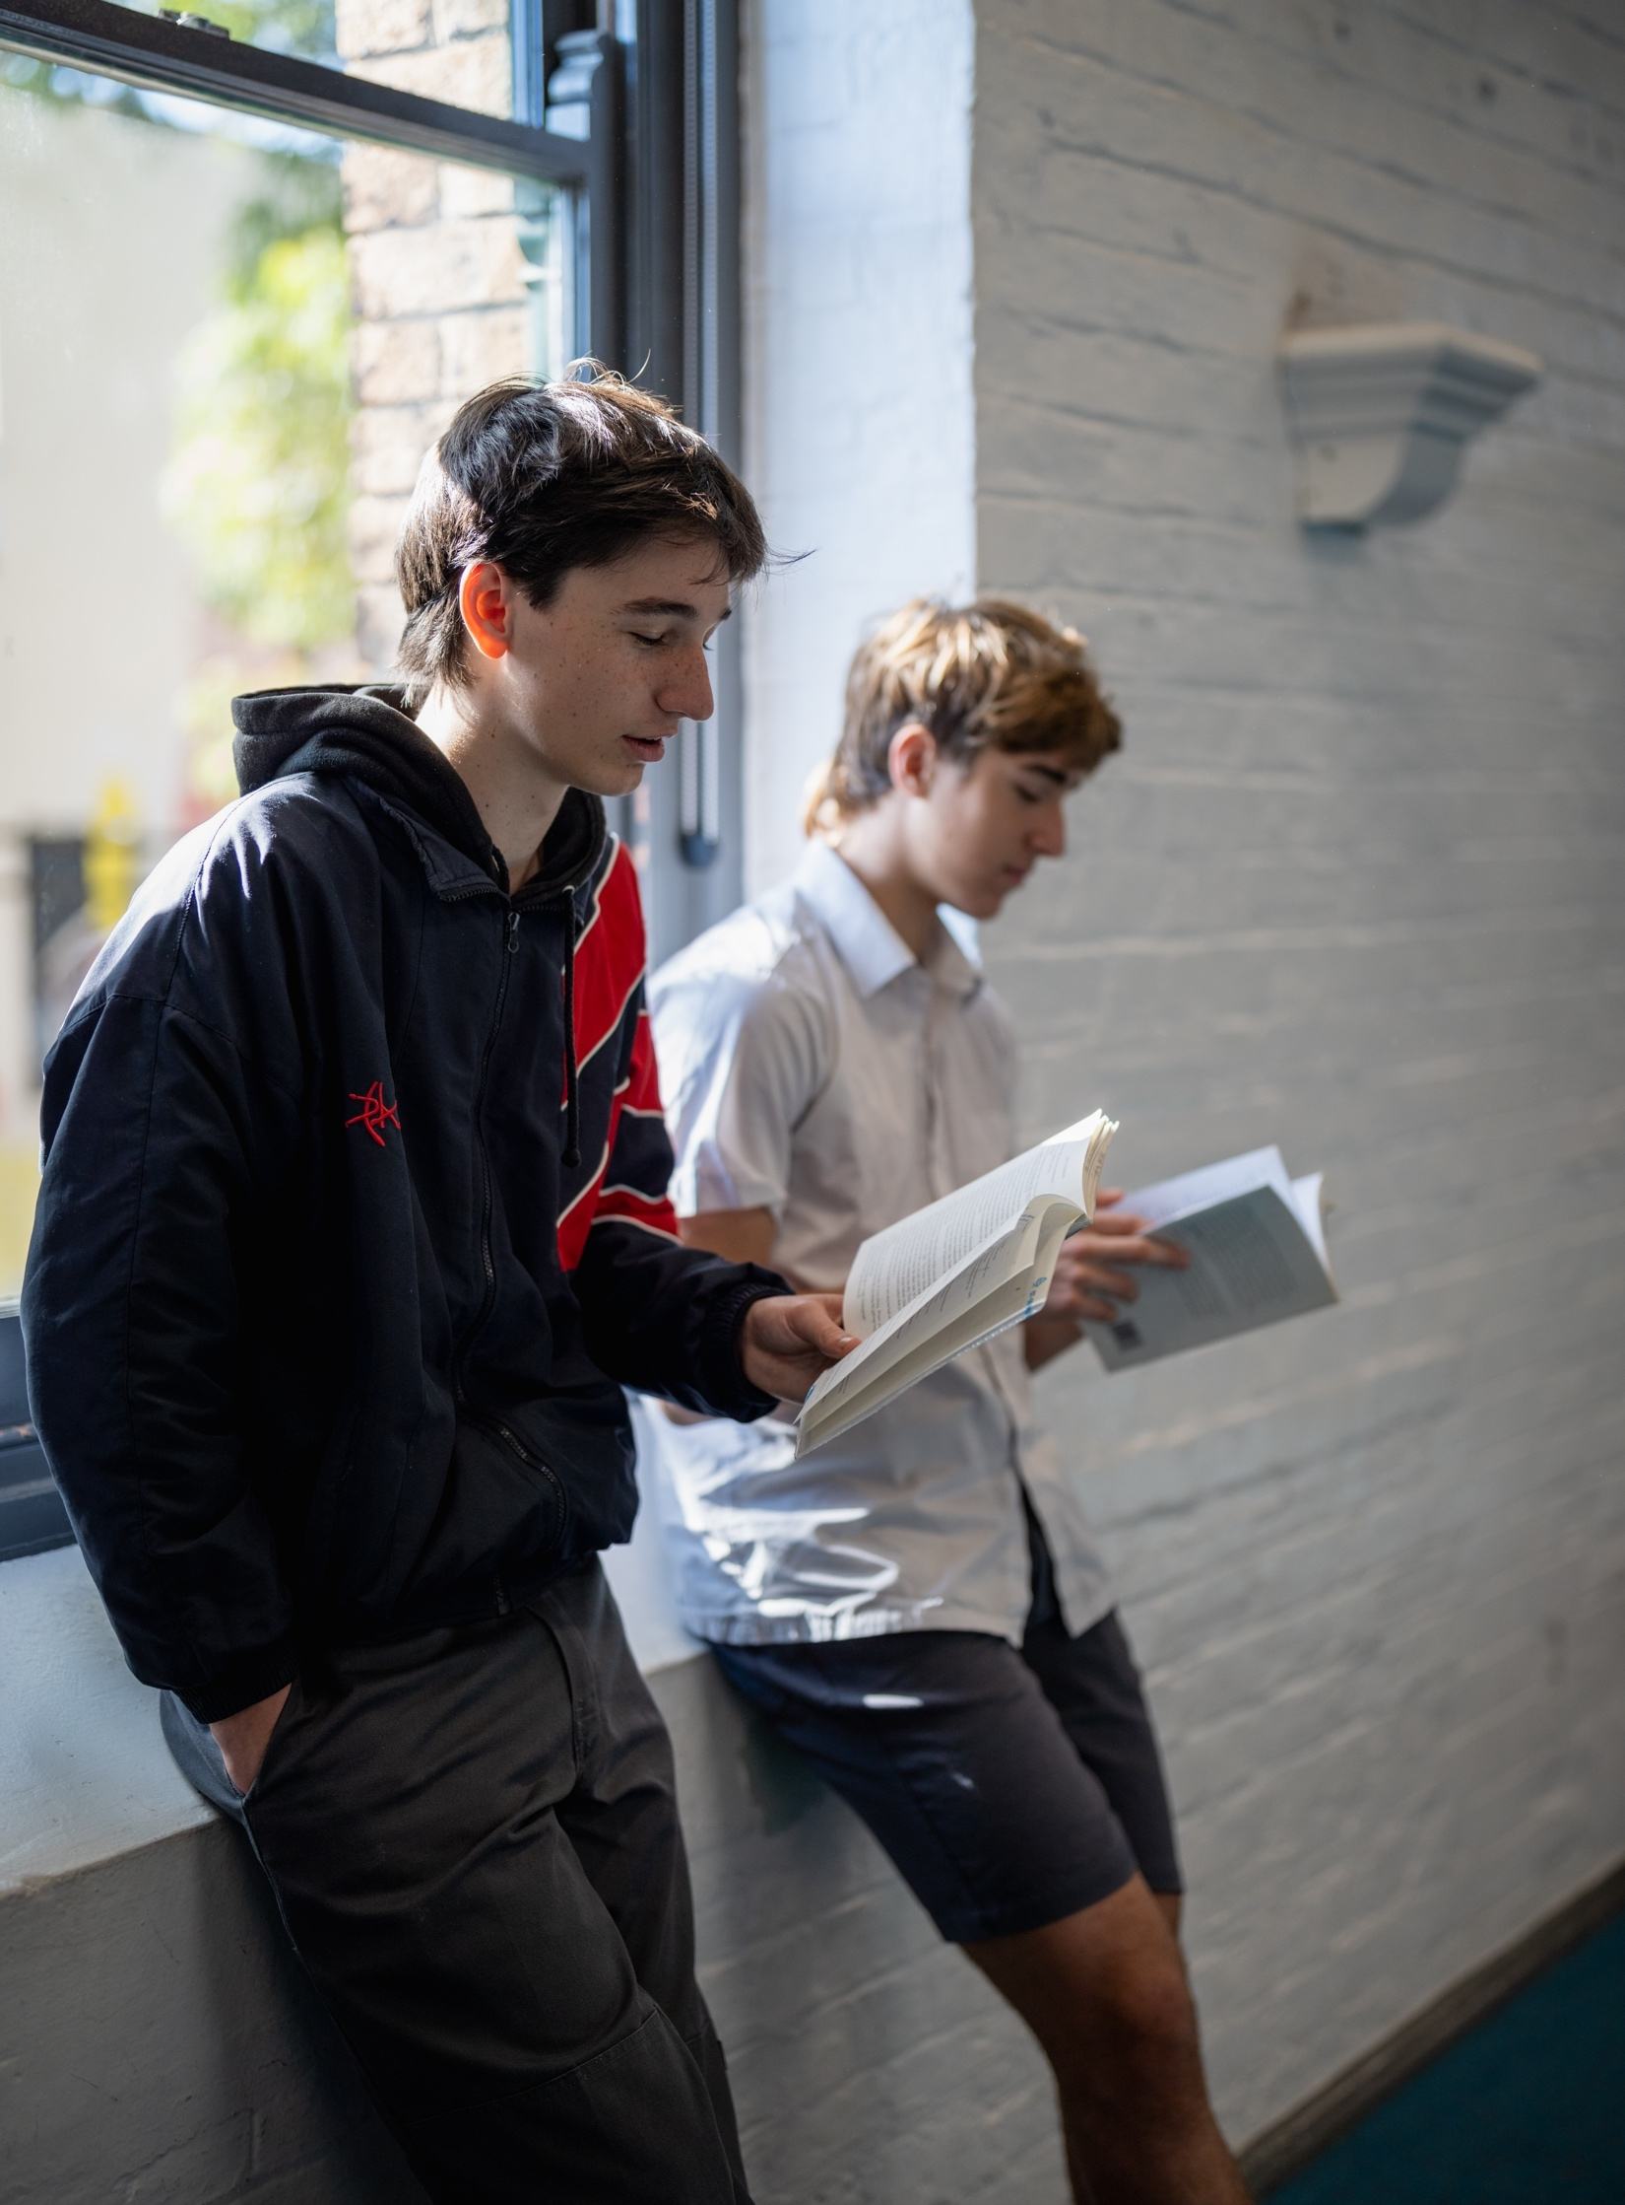
Phase 2 – exploring intertextuality
NSW Department of Education
Year 8 - Term 3
‘8.3 – ‘From page to stage’
Notes:
Teacher note: the purpose of this PowerPoint is to provide support for Phase 2, sequence 1 – deepening understanding of where composers get their ideas for texts. It should be used in conjunction with the program and the resource book.

Slide 4
Learning intentions and success criteria
We are learning to:
enhance our definition of intertextuality by clarifying the terms ‘draws on’, ‘adaptation’ and ‘appropriation’
explore how texts change throughout time, often reflecting the values and morals in which they were composed.
We can:
[classroom teacher to insert sample success criteria]
[classroom teacher to insert sample success criteria]
[classroom teacher to insert sample success criteria].
Notes:
Teacher note: adapt the provided learning intention and below sample success criteria, as required, to suit the needs of your students.
Explain the similarities and differences between the terms draws on, adaptation and appropriation.
Reflect upon the usage of intertextuality in multiple texts composed in a variety of forms.
LISC is usually shared first or early in the lesson and is explained by the teacher who checks for understanding (DoE 2025).
LISC is referred to regularly to check for understanding, provide feedback or as a self-assessment tool (Wiliam and Leahy 2015).
Learning intentions and success criteria can be supported by exemplars, such as 'What A Good One Looks Like' (WAGOLL) or exemplars to demonstrate success criteria (Clarke 2021).
For more information, see:
Sharing learning intentions and success criteria: https://education.nsw.gov.au/content/dam/main-education/documents/teaching-and-learning/curriculum/explicit-teaching/explicit-teaching-technique-guide-lisc-sharing.pdf
Planning learning intentions and success criteria: https://education.nsw.gov.au/content/dam/main-education/documents/teaching-and-learning/curriculum/explicit-teaching/explicit-teaching-technique-guide-lisc-planning.pdf

Slide 5
Chunking and sequencing learning (1)
NSW Department of Education
Notes:
Teacher note: this slide has been used to identify the explicit teaching and learning strategy of chunking and sequencing learning and should be deleted or hidden when using in a classroom setting. Breaking learning into small chunks stops learners feeling overwhelmed, because our brains can only take in a few new things at a time. Putting those chunks in the right order means new ideas connect to what students already know, so each step feels manageable rather than confusing.
Doing this well also means coming back to ideas more than once, which is what actually helps things stick, rather than just feeling understood in the moment.
Chunking learning into manageable components reduces demand on students’ working memory.
Sequencing those chunks in a logical progression supports students to incorporate new information into their mental model, or schema (AERO 2024a).
After breaking learning into chunks and putting them in a sensible order, teachers usually show students what the skill looks like first, often using a think aloud so the process is visible.
Then they work through examples together with students before letting them try it with support, gradually stepping back as confidence grows. This is referred to as Gradual Release of Responsibility.
Along the way, teachers check in to see who understands and who's struggling, and give clear, specific feedback so students know what to keep doing or fix. This is referred to as Checking for Understanding.
Eventually students practise the skill on their own, and later on the teacher brings the idea back again in a new context, so it keeps building rather than being forgotten.

Slide 6
Intertextuality
Definition of intertextuality
Intertextuality refers to the relationship between a text and other texts. Texts can influence, derive from, reference, quote, contrast with, build on, draw from or even inspire each other.
Intertextuality produces deeper meaning as we can explore and question the intention of the author in changing the original text.
The types of intertextuality explores in this PowerPoint are:
drawing on another text
adaptation
appropriation.
Notes:
Teacher note: the teacher should clarify what intertextuality is and how it is constructed. The teacher may like to have students copy the definition into a glossary – perhaps by summarising into their own words. The term ‘transforms’ has been deliberately left out from the outcome group EN4-URC-01 – Intertextuality – ‘Understand how and why texts can be adapted, appropriated or transformed’ to aid student understanding.
It is important to note that transformation of a text can include adaptation and appropriation. Adaptation refers to changing the genre or form of a text. Appropriation refers to taking a text and using it for a new audience and purpose to create ‘new meaning’. Some texts will adapt the genre or form and also appropriate the text by changing central elements to create a ‘new meaning’ in the text.
A good example of this is used in Phase 2, activity 3 – adapted and appropriated fairytales when comparing Sleeping beauty (1598) with the Disney film Maleficent (2014). The fairytale has been adapted from prose to film; however, it is also an example of appropriation as the text creates new meaning through shifting the central protagonist from Aurora to the primary villain Maleficent and other changes that reimagine the text for a new audience and context.

Slide 7
Draws on (1)
Definition
How much of the original text is being used?
The minimal amount or type of intertextuality is when texts draw on other texts without using significant parts of the original story. They may draw on ideas, themes or concepts of a text but the link may not be obvious.
An example of this is where a text makes an allusion to other texts. An allusion may be as simple as referring to a character or quoting a line from another text.
The concept of a text ‘drawing on’ another is an example of implied or inferred intertextuality.
Notes:
Teacher note: clarify what point of view is and how it is constructed. You may like to have students copy the definition into a glossary – perhaps by summarising into their own words.

Slide 8
Draws on (2)(2)
Definition (2)
In her novel, Wide Sargasso Sea, Jean Rhys gathers some events that occurred in Charlotte Bronte’s Jane Eyre. The purpose is to tell readers an alternative tale. Rhys presents the wife of Mr. Rochester, who played the role of a secondary character in Jane Eyre. Also, the setting of this novel is Jamaica, not England, and the author develops the back-story for her major character. In the novel, Jane Eyre, Rhys gives her interpretation amid the narrative by addressing issues such as the roles of women, colonisation and racism that Bronte did not point out in her novel otherwise.
Bridget Jones's Diary (1996) by Helen Fielding is a modern romantic comedy replaying and referencing Jane Austen's Pride and Prejudice. The storyline follows a similar structure and form, yet unless you were really looking you may not even know that the texts are connected.
Notes:
Teacher note: students may not know either of these texts; however, specific words have been highlighted to give emphasis to how the text ‘draws on’ a text rather than adapting, transforming or appropriating the text.

Slide 9
Checking for understanding (1)
NSW Department of Education
Notes:
Teacher note: this slide has been used to identify the explicit teaching learning strategy of checking for understanding and should be deleted or hidden when using in a classroom setting.
Checking for understanding is when a teacher finds out, during the lesson (not just at the end), whether students have actually grasped what's being taught.
It can be as simple as asking a quick question, having students show a thumbs up or down, doing a short written response, or looking at a sample of student work.
The point is to catch confusion early, while there's still time to reteach, clarify, or adjust the lesson, instead of finding out too late that students did not understand the content or skill being focused upon.
Checking understanding requires teachers to collect the responses of all students (William 2014).

Slide 10
Your turn (1)
Finding texts that ‘draw on’ other texts
Are the following examples of ‘draws on’:
A text uses a quote from another, yet the main ideas and story are not the same.
Two texts have similar storylines and characters, yet the later one is told from a different character's point of view.
The Guardian advertisement you have watched based on ‘The Three Little Pigs’.
A song makes an ‘allusion’ to a line from the lyrics of another song.
Notes:
Teacher note: the answers and explanations are as follows:
Example 1 – is an example of a text drawing upon another, it may use a quote, yet the central aspects of the text are not explored.
Example 2 – this is not an example of ‘drawing on’ as the texts are very close. This would be an example of ‘adaptation’ and/or ‘appropriation’.
Example 3 – this is similar to Question 2 and is an example of ‘adaptation’ and/or ‘appropriation’.
Example 4 – is an example of a text ‘drawing on’ another.

Slide 11
Adaptation (1)
Definition of adaptation
Literary adaptation refers to the transformation of a literary work, such as a poem, novel, short story or play, into another genre. For example, a book might be adapted into a film, a musical or a television series. These adaptations draw from existing works, referencing or reimagining elements from the original material. The texts adapt or change as the form of the text changes.
This is an example of explicit intertextuality.
Notes:
Teacher note: this slide is aimed at reviewing adaptation. This term can often be misunderstood. In this PowerPoint we have attempted to make clear distinctions between adaptation and appropriation, yet as stated on the last slide some texts are transformed through a combination of adaptation and appropriation.

Slide 12
Adaptation (2) (2)
An example of adaptation
An example would include:
Jackie French’s novel Hitler’s Daughter has been adapted into a play also called Hitler’s Daughter: The play. The story remains essentially the same, however, some changes are made to suit the dramatic style and challenges of performing in different theatres or performance spaces.
.
Notes:
Teacher note: use this slide to further introduce the concept of adaptation by guiding students through each example and prompting discussion about why changes are made when texts shift form. Ask students to identify what stays the same and what changes, then discuss how purpose, audience, and medium influence these decisions. Consider extending by having students suggest their own examples of adaptations.

Slide 13
Checking for understanding (2) (2)
NSW Department of Education
Notes:
Teacher note: this slide has been used to identify the explicit teaching learning strategy of checking for understanding and should be deleted or hidden when using in a classroom setting.
Teachers analyse the information they collect to make evidence-based instructional decisions. This includes when to move between modelled, guided and independent practice.
When checking for understanding shows most students understand, the teacher moves on to independent practice or the next chunk of content.
When many students are still confused, the teacher reteaches that part in a different way, often with another example or explanation, instead of pushing ahead.
When only a few students struggle, the teacher keeps the rest of the class moving while giving those students extra support or a small-group check-in.
The checking step guides the decision based on teacher observation.
Checking understanding requires teachers to collect the responses of all students (William 2014).

Slide 14
Your turn (2)
Adaptation
        Work with a partner to consider examples of ‘adaptations’ in popular culture. These could be fairytales that have been made into a musical or a film, or a novel that has been similarly adapted.
        Write down 2 examples and how they have been adapted.
        For one example that you know well, consider whether the adaptation has had to change anything from the original to suit the new form.
Notes:
Teacher note: students work in pairs to find an adaptation of a text in popular culture. They will have already had experience with finding ‘adaptations’ in the initial classroom discussion on intertextuality.

Slide 15
Appropriation (1)
Definition and examples
Appropriation refers to taking a text and using it for a new audience and purpose. Appropriation can occur within different modes and media. Writers often borrow ideas from previous works to give a ‘new’ layer of meaning to their own works. Texts can be appropriated in many ways, some of which include:
retelling a narrative from a different character's point of view which could make the audience consider issues relating to gender, culture or age
changing the setting or time the appropriated text focuses on, which could make an audience reflect on modern values or experiences
removing characters entirely or adding new characters.
Notes:
Teacher note: this slide would work best with a class discussion around texts that students may know. Clarity in instruction will be needed to ensure students give examples of texts that appropriate rather than simply adapt. Again, texts often combine adaptation and appropriation, yet students may struggle with this concept.

Slide 16
Appropriation (2) (2)
Examples of appropriation
Examples include:
Sleeping Beauty and Maleficent – Disney adapted the fairytale to film; however, they have also appropriated the text as the story changes. The primary villain in the original shifts from an ‘evil fairy’ to King Stefan (a character who does not appear in the original). The ‘evil fairy’ Maleficent is seen as a victim who has been hurt by humanity and becomes good friends with Princess Aurora which heals them both.
Hansel and Gretel and Gretel and Hansel – the original story is again adapted from fairytale to film; however, the story is also appropriated with Gretel becoming the central narrator. Hansel is her younger brother and, in a classic, coming of age story she moves from his protecter towards an independent woman who is capable of fulfilling her own destiny.
Little Red Riding Hood and Revolting Rhymes – Roald Dahl’s classic, the story is appropriated to challenge the audience’s view of gender. Rather than being portrayed as a frightened girl, Red Riding Hood is portrayed as powerful and confident. When the Wolf tries to eat her, she simply pulls out a pistol and shoots him. The final image is of Red Riding Hood wearing a Wolf-skin coat.
Notes:
Teacher note: these examples may not be known to students, however, through class discussion students may possibly know other appropriations which would facilitate the same understanding.

Slide 17
Checking for understanding (3) (3)
NSW Department of Education
Notes:
Teacher note: this slide has been used to identify the explicit teaching learning strategy of checking for understanding and should be deleted or hidden when using in a classroom setting.
Checking for understanding is when a teacher finds out, during the lesson, whether students actually grasp what is being taught, instead of just assuming they do.
Teachers do this through quick questions, thumbs up or down, short written responses, or a look at student work.
When the check shows most students understand, the teacher moves on to independent practice or the next chunk of content.
When many students are still confused, the teacher reteaches that part in a different way, often with another example or explanation.
When only a few students struggle, the teacher keeps the rest of the class moving while giving those students extra support or a small-group check-in.
Teachers analyse the information they collect to make evidence-based instructional decisions. This includes when to move between modelled, guided and independent practice.
Checking understanding requires teachers to collect the responses of all students (William 2014).

Slide 18
Your turn – quick write
Summarising the key terminology: draws on, adapts and appropriates
        You have 10 minutes to write a response in your English books that explains the differences between:
        a text that draws on aspects of another text
        a text that is adapted from another text
        a text that is appropriated from another text.
        In your answer try to use examples drawn from texts that you know to explain the differences.
Notes:
Teacher note: use this task as a structured consolidation activity, supported by frequent, short check-ins to monitor student understanding. Before students begin writing, pause to review each key term and ask individuals to provide a definition and a brief example. As students write, circulate and ask targeted questions to assess their understanding of the differences between drawing on, adaptation, and appropriation. Select a few students to share responses during the task to clarify thinking and address misconceptions in real time. Conclude by briefly revisiting each concept and reinforcing accurate definitions before moving on.
This exercise is provided to clarify the understanding of students so they can access the metalanguage of Phase 2 and the rest of the program. After checking for understanding, consider revisiting slides if students are still struggling with this terminology.

Slide 19
References
This presentation contains NSW Curriculum and syllabus content. The NSW Curriculum is developed by the NSW Education Standards Authority. This content is prepared by NESA for and on behalf of the Crown in the right of the State of New South Wales. The material is protected by Crown copyright.
Please refer to the NESA Copyright Disclaimer for more information https://educationstandards.nsw.edu.au/wps/portal/nesa/mini-footer/copyright.
NESA holds the only official and up-to-date versions of the NSW Curriculum and syllabus documents. Please visit the NSW Education Standards Authority (NESA) website https://educationstandards.nsw.edu.au and the NSW Curriculum website https://curriculum.nsw.edu.au.
English K–10 Syllabus © NSW Education Standards Authority (NESA) for and on behalf of the Crown in right of the State of New South Wales, 2022.
AERO (Australian Education Research Organisation) (2024a) Explain learning objectives, AERO website, accessed 13 March 2026.
AERO (Australian Education Research Organisation) (2024b) Explicit instruction, AERO website, accessed 13 March 2026.
Austen J (1813) Pride and prejudice, Project Gutenberg, accessed 1 April 2026.
Bronte C (1847) Jane Eyre, Penguin, ISBN: 9780142437209
CESE (Centre for Education Statistics and Evaluation) (2017) Cognitive load theory: Research that teachers really need to understand, NSW Department of Education, accessed 13 March 2026.
Dahl R (2023) Revolting rhymes, Penguin books, IBSN: : 9780241568743
Di Cesare E, Eldridge S and McGarry T (2007) Hitler’s Daughter: The play, Currency Press, Sydney.
Dulac E (nd) The Sleeping Beauty and other fairy tales, Project Gutenberg, accessed 1 April 2026.
Fielding H (1996) Bridget Jones’s Diary, Penguin books, ISBN: 9780140280098
Notes:
Teacher note: this slide contains references for this resource.

Slide 20
References (2)
This presentation contains NSW Curriculum and syllabus content. The NSW Curriculum is developed by the NSW Education Standards Authority. This content is prepared by NESA for and on behalf of the Crown in the right of the State of New South Wales. The material is protected by Crown copyright.
Please refer to the NESA Copyright Disclaimer for more information https://educationstandards.nsw.edu.au/wps/portal/nesa/mini-footer/copyright.
NESA holds the only official and up-to-date versions of the NSW Curriculum and syllabus documents. Please visit the NSW Education Standards Authority (NESA) website https://educationstandards.nsw.edu.au and the NSW Curriculum website https://curriculum.nsw.edu.au.
French J (2003) Hitler’s Daughter, HarperCollins, Sydney, ISBN-10: ‎0060086521.
Griffin P (2018) Assessment for teaching, Cambridge University Press.
Grimm Brothers (1812) Hnasel and Gretel, Grimms’ Fairy Tales, Project Gutenberg, accessed 1 April 2026.
NESA (2024) ‘Glossary’, Resources, NESA website, accessed 13 March 2026.
Perkins O (2020) Gretel & Hansel, Orion Pictures, United States of America.
Perrault C (1922) ‘Little Red Riding Hood’ in The Fairy Tales of Charles Perrault, Project Gutenberg, accessed 1 April 2026.
Rhys J (1966) Wide Sargasso Sea, W. W. Norton & Company, ISBN: 9780393352566.
State of New South Wales (Department of Education) (2024) Gradual release of responsibility, NSW Department of Education website, accessed 13 March 2026.
Stromberg R (2014) Maleficent, Walt Disney Pictures, United States of America.
Notes:
Teacher note: this slide contains references for this resource.

Slide 21
Copyright
© State of New South Wales (Department of Education), 2024
The copyright material published in this resource is subject to the Copyright Act 1968 (Cth) and is owned by the NSW Department of Education or, where indicated, by a party other than the NSW Department of Education (third-party material).
Copyright material available in this resource and owned by the NSW Department of Education is licensed under a Creative Commons Attribution 4.0 International (CC BY 4.0) license.
This license allows you to share and adapt the material for any purpose, even commercially.
Attribution should be given to © State of New South Wales (Department of Education), 2024.
Material in this resource not available under a Creative Commons license:
the NSW Department of Education logo, other logos and trademark-protected material
Material owned by a third party that has been reproduced with permission. You will need to obtain permission from the third party to reuse its material.
Links to third-party material and websites
Please note that the provided (reading/viewing material/list/links/texts) are a suggestion only and implies no endorsement, by the New South Wales Department of Education, of any author, publisher, or book title. School principals and teachers are best placed to assess the suitability of resources that would complement the curriculum and reflect the needs and interests of their students.
If you use the links provided in this document to access a third party’s website, you acknowledge that the terms of use, including licence terms set out on the third-party’s website apply to the use which may be made of the materials on that third-party website or where permitted by the Copyright Act 1968 (Cth). The department accepts no responsibility for content on third-party websites.

