Slide 1
Introduction
Introduction for the teacher
This resource is not a teaching and learning program. It should be used in conjunction with Year 7 Term 3 program Escape into the world of the novel.
Notes:
Teacher note: this is an introduction slide to support teacher on the use of this resource.

Slide 2
Instructions for use
Instructions for the teacher
This resource is not a teaching and learning program. It should be used in conjunction with (Insert unit name and link).
Classroom teachers are encouraged to add and adapt slides as required to meet the needs of their students.
Save a copy of the file to make changes to the slide deck. Go to File > Download a Copy (this downloads a copy to the computer to edit in the PowerPoint application).
To convert the PowerPoint to Google Slides:
  Upload the file into Google Drive and open it.
  Go to File > Save as Google Slides.
  (Note – conversion may cause formatting changes in the slides.)
Notes:
Teacher note: this is an instruction slide to support teacher on the use of this resource.

Slide 3
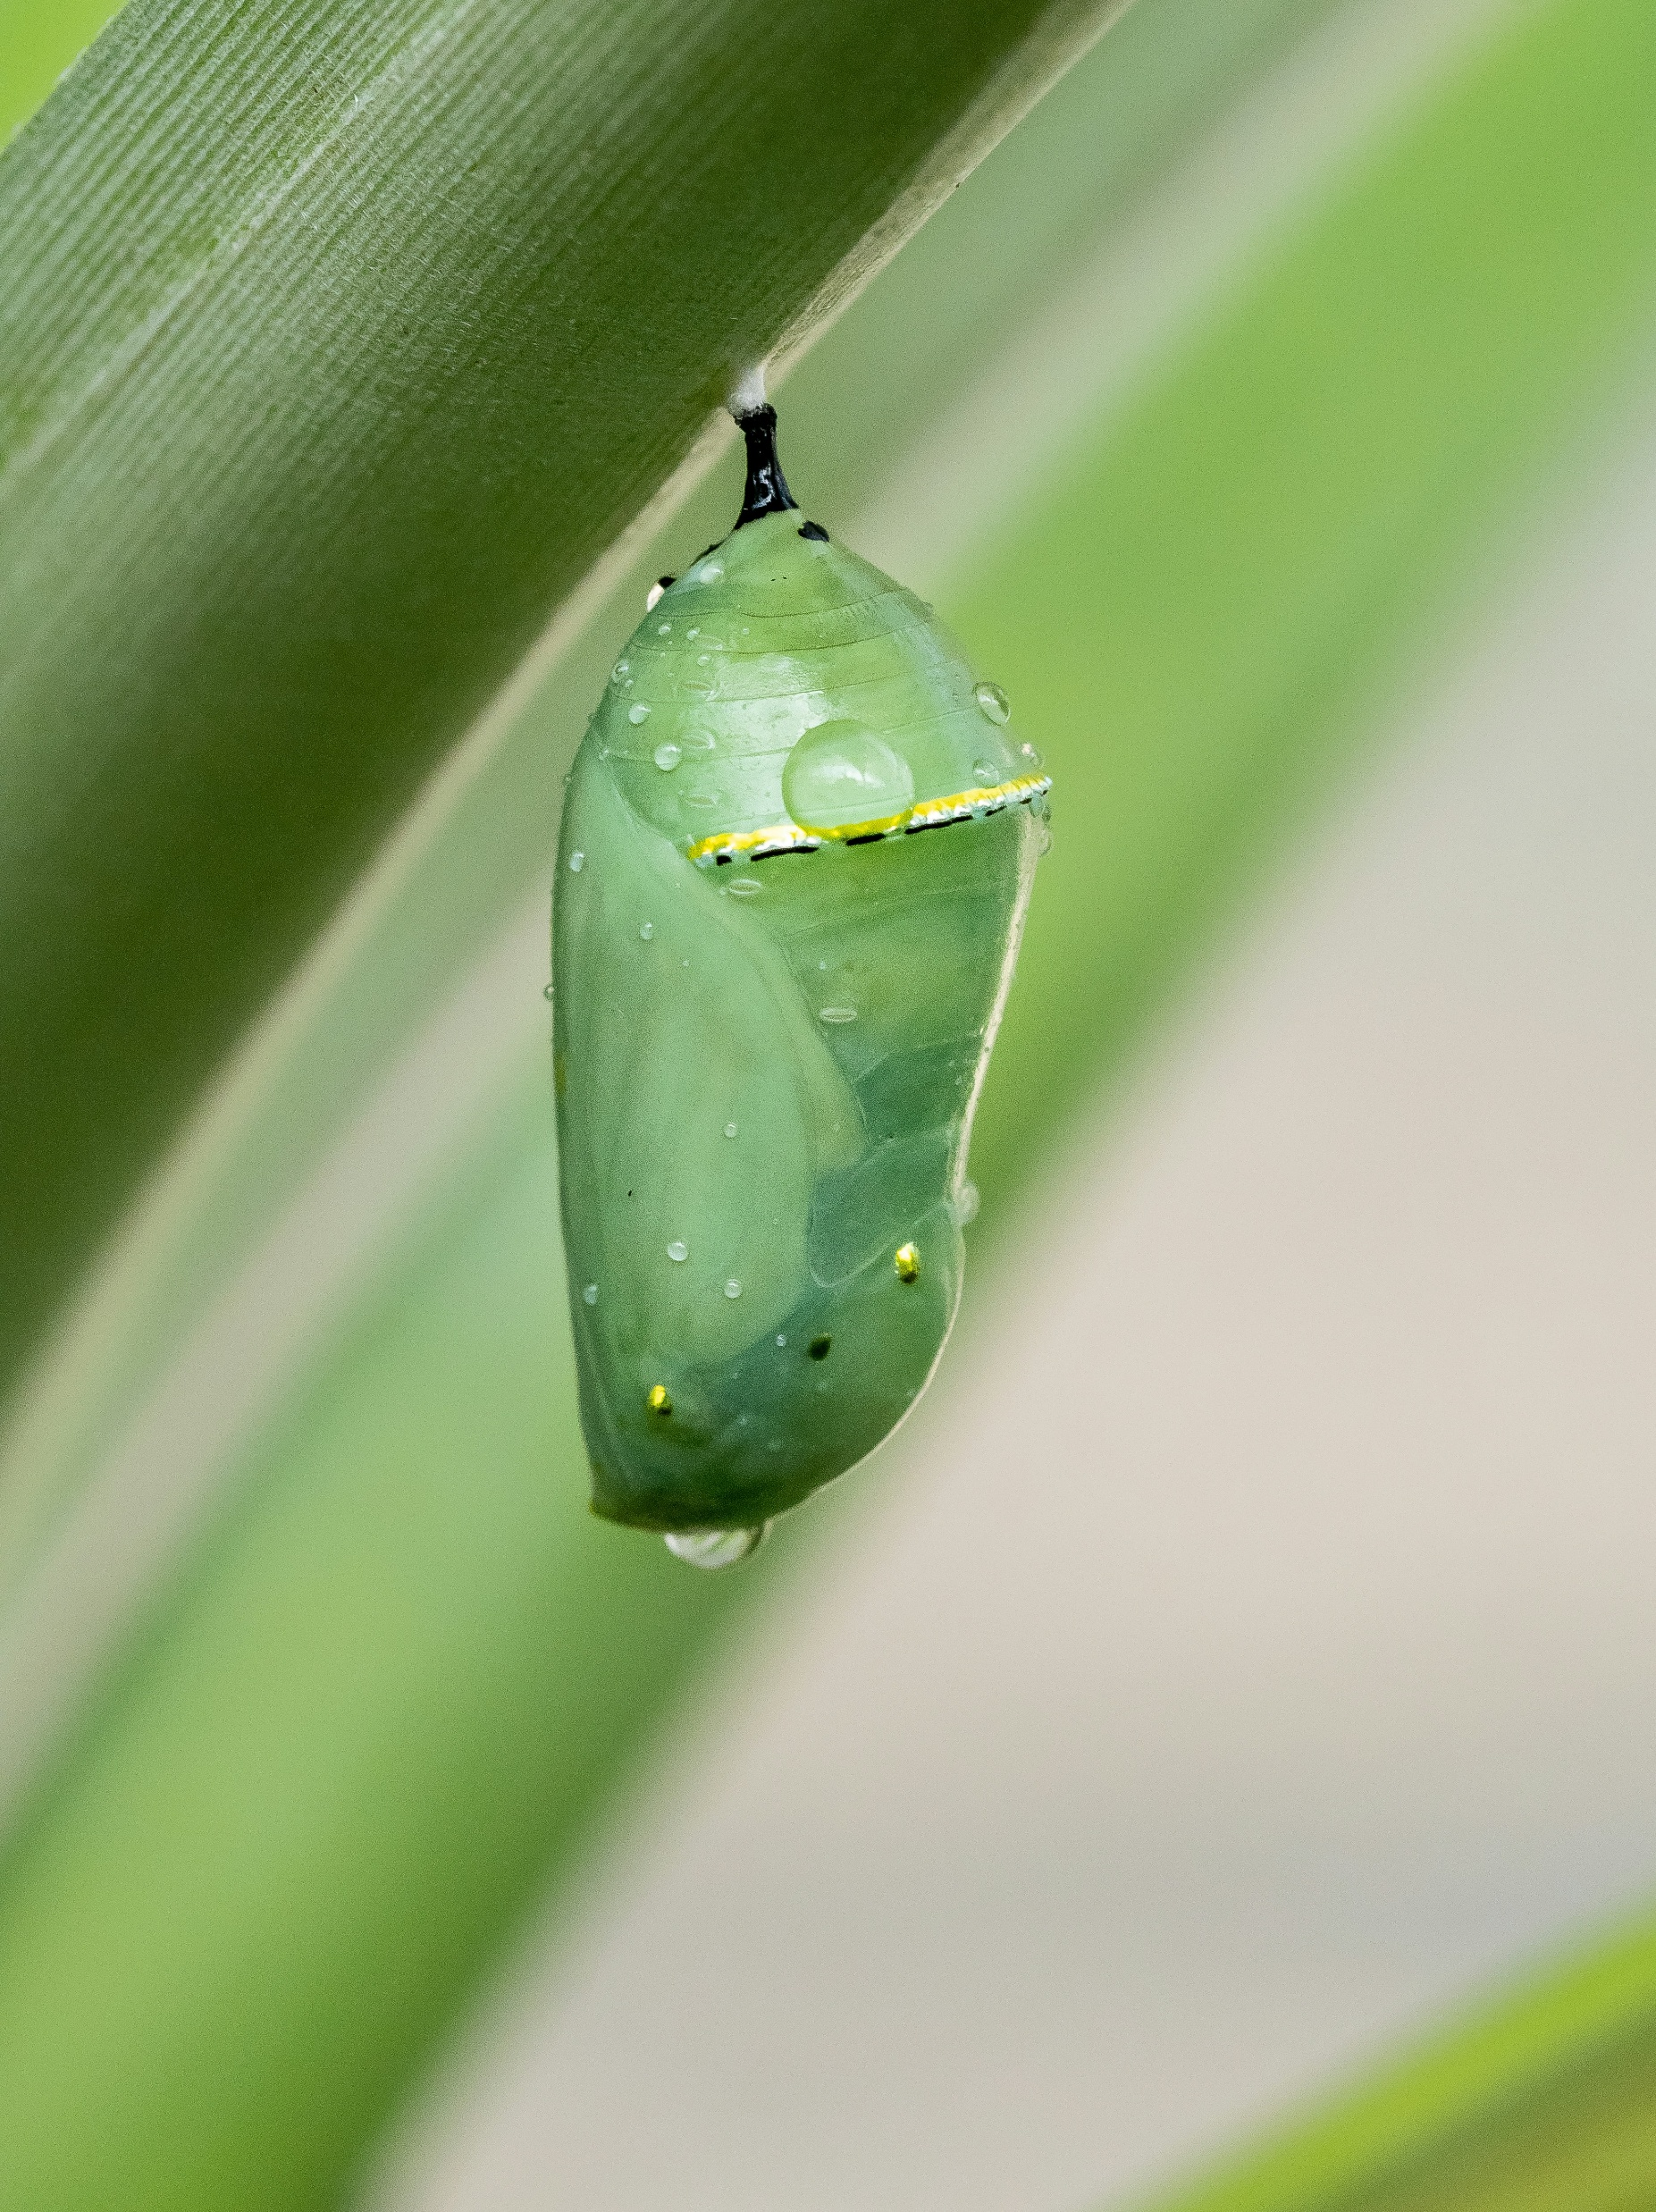
Phase 1 – representation – setting
Year 7 – Term 3
7.3 – ‘Escape into the world of the novel’
Photo by William Warby on Unsplash
Notes:
Teacher note: the following slides may be used to support resources and activities in Phase 1, sequence 3 – engaging with the idea of escaping into fiction (stimulus sequence).

Slide 4
Sharing learning intentions and success criteria
Notes:
Teacher note: this slide has been used to identify the explicit teaching strategies sharing learning intentions and sharing success criteria. This slide could be deleted or hidden when using this content in a classroom setting. Alternatively, the teacher could discuss the educational benefit of the process of sharing learning intentions and success criteria and discussing the significance of this learning process.
Sharing learning intentions allows a teacher to effectively communicate the learning goal with students. They allow students to connect new learning to existing knowledge, skills and understanding.
When learning intentions are used with success criteria, students have a clear idea of the learning goal and how to get there (AERO 2024).
The success criteria break the learning intention into smaller and more manageable actions. They show students what they must do, say, make, create or perform to demonstrate their learning (Griffin 2018).
Success criteria are communicated to students in ways they understand. Teachers use their expertise to guide student thinking and often model and use exemplars to show students what success 'looks like’ (DoE 2025).
The sample learning intentions and success criteria (LISC) on the following slide are aligned to the syllabus.
When designing LISC for students working above or below stage level, or towards Life Skills outcomes, draw on the collaborative curriculum planning process to ensure LISC is differentiated and aligned with the relevant syllabus outcomes.
For more information, see:
AITSL: https://www.aitsl.edu.au/docs/default-source/feedback/aitsl-learning-intentions-and-success-criteria-strategy.pdf?sfvrsn=382dec3c_2
Sharing learning intentions: https://education.nsw.gov.au/teaching-and-learning/curriculum/explicit-teaching/explicit-teaching-strategies/sharing-learning-intentions
Sharing success criteria: https://education.nsw.gov.au/teaching-and-learning/curriculum/explicit-teaching/explicit-teaching-strategies/sharing-success-criteria
Collaborative curriculum planning: https://educationstandards.nsw.edu.au/wps/portal/nesa/k-10/diversity-in-learning/special-education/collaborative-curriculum-planning

Slide 5
Learning intentions and success criteria
We are learning to:
consider and explore the concept of escape and escaping
consider and explore the concept of representation within fictional texts.
We can:
[classroom teacher to insert sample success criteria]
[classroom teacher to insert sample success criteria]
[classroom teacher to insert sample success criteria].
Notes:
Teacher note: adapt the provided learning intention and below sample success criteria, as required, to suit the needs of your students.
identify examples of escape or escaping in fictional texts.
explain the reasons why characters in a text want to escape or how they attempt to escape.
recognise how characters, settings, or events represent particular ideas, groups, or experiences.
describe how the author uses language and literary techniques to create representations.
LISC is usually shared first or early in the lesson and is explained by the teacher who checks for understanding (DoE 2025).
LISC is referred to regularly to check for understanding, provide feedback or as a self-assessment tool (Wiliam and Leahy 2015).
Learning intentions and success criteria can be supported by exemplars, such as 'What A Good One Looks Like' (WAGOLL) or exemplars to demonstrate success criteria (Clarke 2021).
For more information, see:
Sharing learning intentions and success criteria: https://education.nsw.gov.au/content/dam/main-education/documents/teaching-and-learning/curriculum/explicit-teaching/explicit-teaching-technique-guide-lisc-sharing.pdf
Planning learning intentions and success criteria: https://education.nsw.gov.au/content/dam/main-education/documents/teaching-and-learning/curriculum/explicit-teaching/explicit-teaching-technique-guide-lisc-planning.pdf

Slide 6
Understanding representation
Notes:
Teacher note: this slide supports Phase 1, sequence 3 – engaging with the idea of escaping into fiction (stimulus sequence). The following slides may be used to support resources and activities within this sequence.
This section develops the conceptual knowledge students require to achieve the learning intention concerning representation. Remind students that the purpose is not simply to memorise a definition, but to understand that representations are constructed and shaped by perspective, experience, beliefs, culture and audience.
Refer back to the learning intention as students complete the Frayer model so they can identify how the activity is building their understanding of representation before they apply the concept to fictional settings.

Slide 7
Frayer model diagram
Complete the following Frayer diagram on the concept of 'Representation’
Definition
Facts/Characteristics
Representation
Examples
Non-examples
Notes:
Teacher note: this slide supports Phase 1, sequence 3 – engaging with the idea of escaping into fiction (stimulus sequence). Use the Frayer model diagram to develop a deeper understanding of the word ‘representation’.
Encourage students to initially complete the definition, examples, facts or characteristics and non-examples using what they currently think the answers should be. At this stage, do not require complete accuracy; the initial responses make students’ existing understanding visible and provide a point of comparison after explicit instruction.
Students should then view the Understanding representation video using the existing link provided in the notes. After viewing, ask them to return to the Frayer model and add, revise or clarify information.
This activity supports the shared learning intention by allowing students to see how their understanding of representation develops. Ask students to identify one change they made to their Frayer diagram and explain why they made it.
On the next slide is an example of a completed Frayer model.

Slide 8
Frayer model diagram - representation
Check your answers against the ideas below.
Definition
Representation is how we depict things or ideas when we compose a text, such as a drawing, story, or other forms of communication. It shows our personal view influenced by experiences, beliefs, culture, and the audience.
Facts/Characteristics
Different drawings of a hero: werewolf, Paralympian Jocelyn Neumiller, grandmother.
Using images, words, or symbols to show an idea or concept.
Representation
Examples
Mr Cranna’s werewolf hero represents saving the day in stories.
Erin’s hero Jocelyn Neumiller represents discipline and sporting achievement.
Non-examples
Drawing something just because it looks cool without meaning.
Copying an image exactly as it appears with no personal viewpoint.
Notes:
Teacher note: this slide supports Phase 1, sequence 3 – engaging with the idea of escaping into fiction (stimulus sequence). This is an example of a completed Frayer model for the term ‘representation’.
Use the model to allow students to compare and refine their own responses rather than simply copying the completed example. Work through each section and ask students to identify similarities and differences between the class responses and the model.
Draw particular attention to the definition that representation involves how things or ideas are depicted when a text is composed and that the representation is influenced by the composer’s experiences, beliefs, culture and intended audience.
Discuss why the examples qualify as representations and why the non-examples do not. Emphasise that simply reproducing something without communicating a perspective or meaning does not demonstrate the same concept of constructed representation.
Before progressing, revisit the learning intention and ask students to explain ‘representation’ in their own words. Their responses provide useful evidence for determining readiness for the questioning sequence that follows.

Slide 9
Using effective questioning
Notes:
Teacher note: this slide has been used to identify the explicit teaching learning strategy of using effective questioning and should be deleted or hidden when used in a classroom setting. A hinge question is a question that assists the teacher in determining whether they should progress with the lesson content or revisit the content or skill to support student progress. If students cannot adequately respond to this type of question, they should be provided with either whole class instruction in another delivery mode or example, or if only some students are lacking confidence, they could be assisted individually when the class move on to the next stage of gradual release of responsibility.
Effective questioning strategies cause all students to think. This creates high engagement classroom environments which improve student achievement (Black and Wiliam 2018).

Slide 10
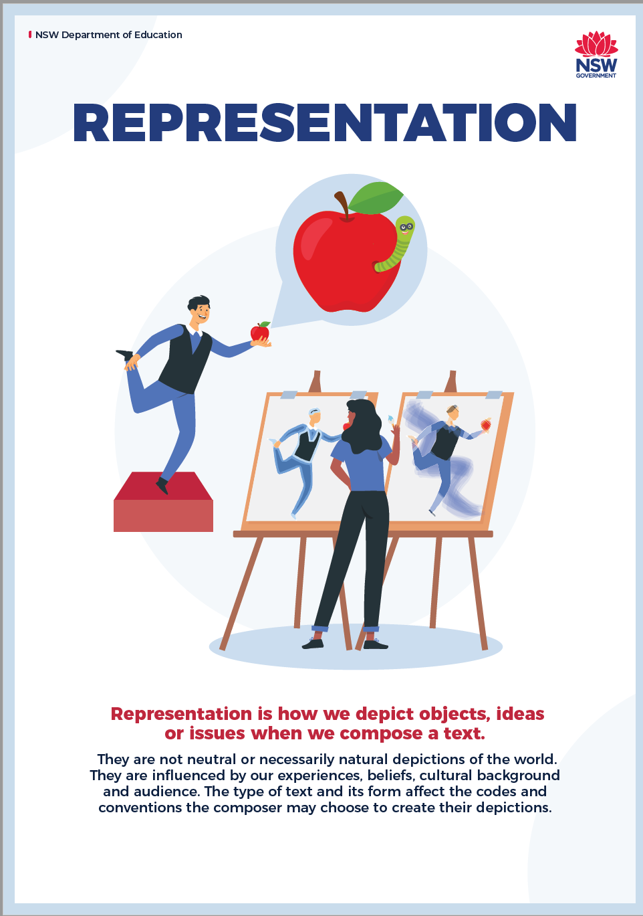
Representation
Using effective questioning
What information or examples about representation do you notice in the poster? Add at least two to your Frayer diagram.
How do the images and words in the poster help you better understand what representation means? What new details or nuances could you add?
How does the poster’s presentation of representation relate to a text, film, or event you have studied before? What comparisons or patterns could help expand your Frayer diagram?
Why did you choose certain ideas to add to your Frayer diagram? How do your own background or opinions influence your choices?
Notes:
Teacher note: this slide supports Phase 1, sequence 3 – engaging with the idea of escaping into fiction (stimulus sequence). The questions on the slide use the explicit teaching strategy of effective questioning.
Sequence the questions to progressively increase the complexity of student thinking.
Recall:
What information or examples about representation do you notice in the poster? Add at least 2 to your Frayer diagram.
This question establishes whether students can identify relevant information and connect it to the conceptual framework developed on the preceding slides.
Deepen thinking:
How do the images and words in the poster help you better understand what representation means? What new details or nuances could you add?
Require students to move beyond identifying features and explain how those features extend their understanding.
Make connections:
How does the poster’s presentation of representation relate to a text, film or event you have studied before? What comparisons or patterns could help expand your Frayer diagram?
Use this question to connect the concept with previous learning and familiar texts.
Justify and reflect:
Why did you choose certain ideas to add to your Frayer diagram? How do your own background or opinions influence your choices?
This question develops the idea that interpretation is affected by perspective, reinforcing that representation itself is shaped by perspective.
An appropriate adjustment for HPGE students might be:
Recall:
What key concepts about representation are shown in the poster? Add them to your Frayer diagram.
Deepen thinking:
How do the visual elements and language in the poster contribute to the meaning of representation? What nuances could you add to your Frayer diagram?
Make connections:
Compare the poster’s representation techniques to those in another text you have studied. What patterns or differences could you include in your Frayer diagram?
Justify and reflect:
Based on your analysis and other sources, justify the choices you make in expanding your Frayer diagram. How does your own perspective influence what you decide to add?
Sample responses from across the class rather than relying solely on volunteers. Use students’ explanations to determine whether they can move from defining representation to applying the concept to specific examples.

Slide 11
Checking for understanding
Notes:
Teacher note: this slide has been used to identify the explicit teaching learning strategy of using effective questioning and should be deleted or hidden when using in a classroom setting. If students cannot adequately respond to this type of question, they should be provided with either whole class instruction in another delivery mode or example, or if only some students are lacking confidence, they could be assisted individually when the class move on to the next stage of learning.
Teachers analyse the information they collect to make evidence-based instructional decisions. This includes when to move between modelled, guided and independent practice.
Checking understanding requires teachers to collect the responses of all students (William 2014).

Slide 12
Symbolism and representation
Notes:
Teacher note: this slide supports Phase 1, sequence 2 – symbolism and representation. The following slides may be used to support resources and activities within this sequence.
This section begins the application stage of checking for understanding. Students now transfer their developing understanding of representation to visual stimuli depicting different literary worlds.
Explain that the teacher will use their responses across the following images to determine whether they can identify relevant details, make inferences about represented worlds and explain how these representations contribute to meaning.

Slide 13
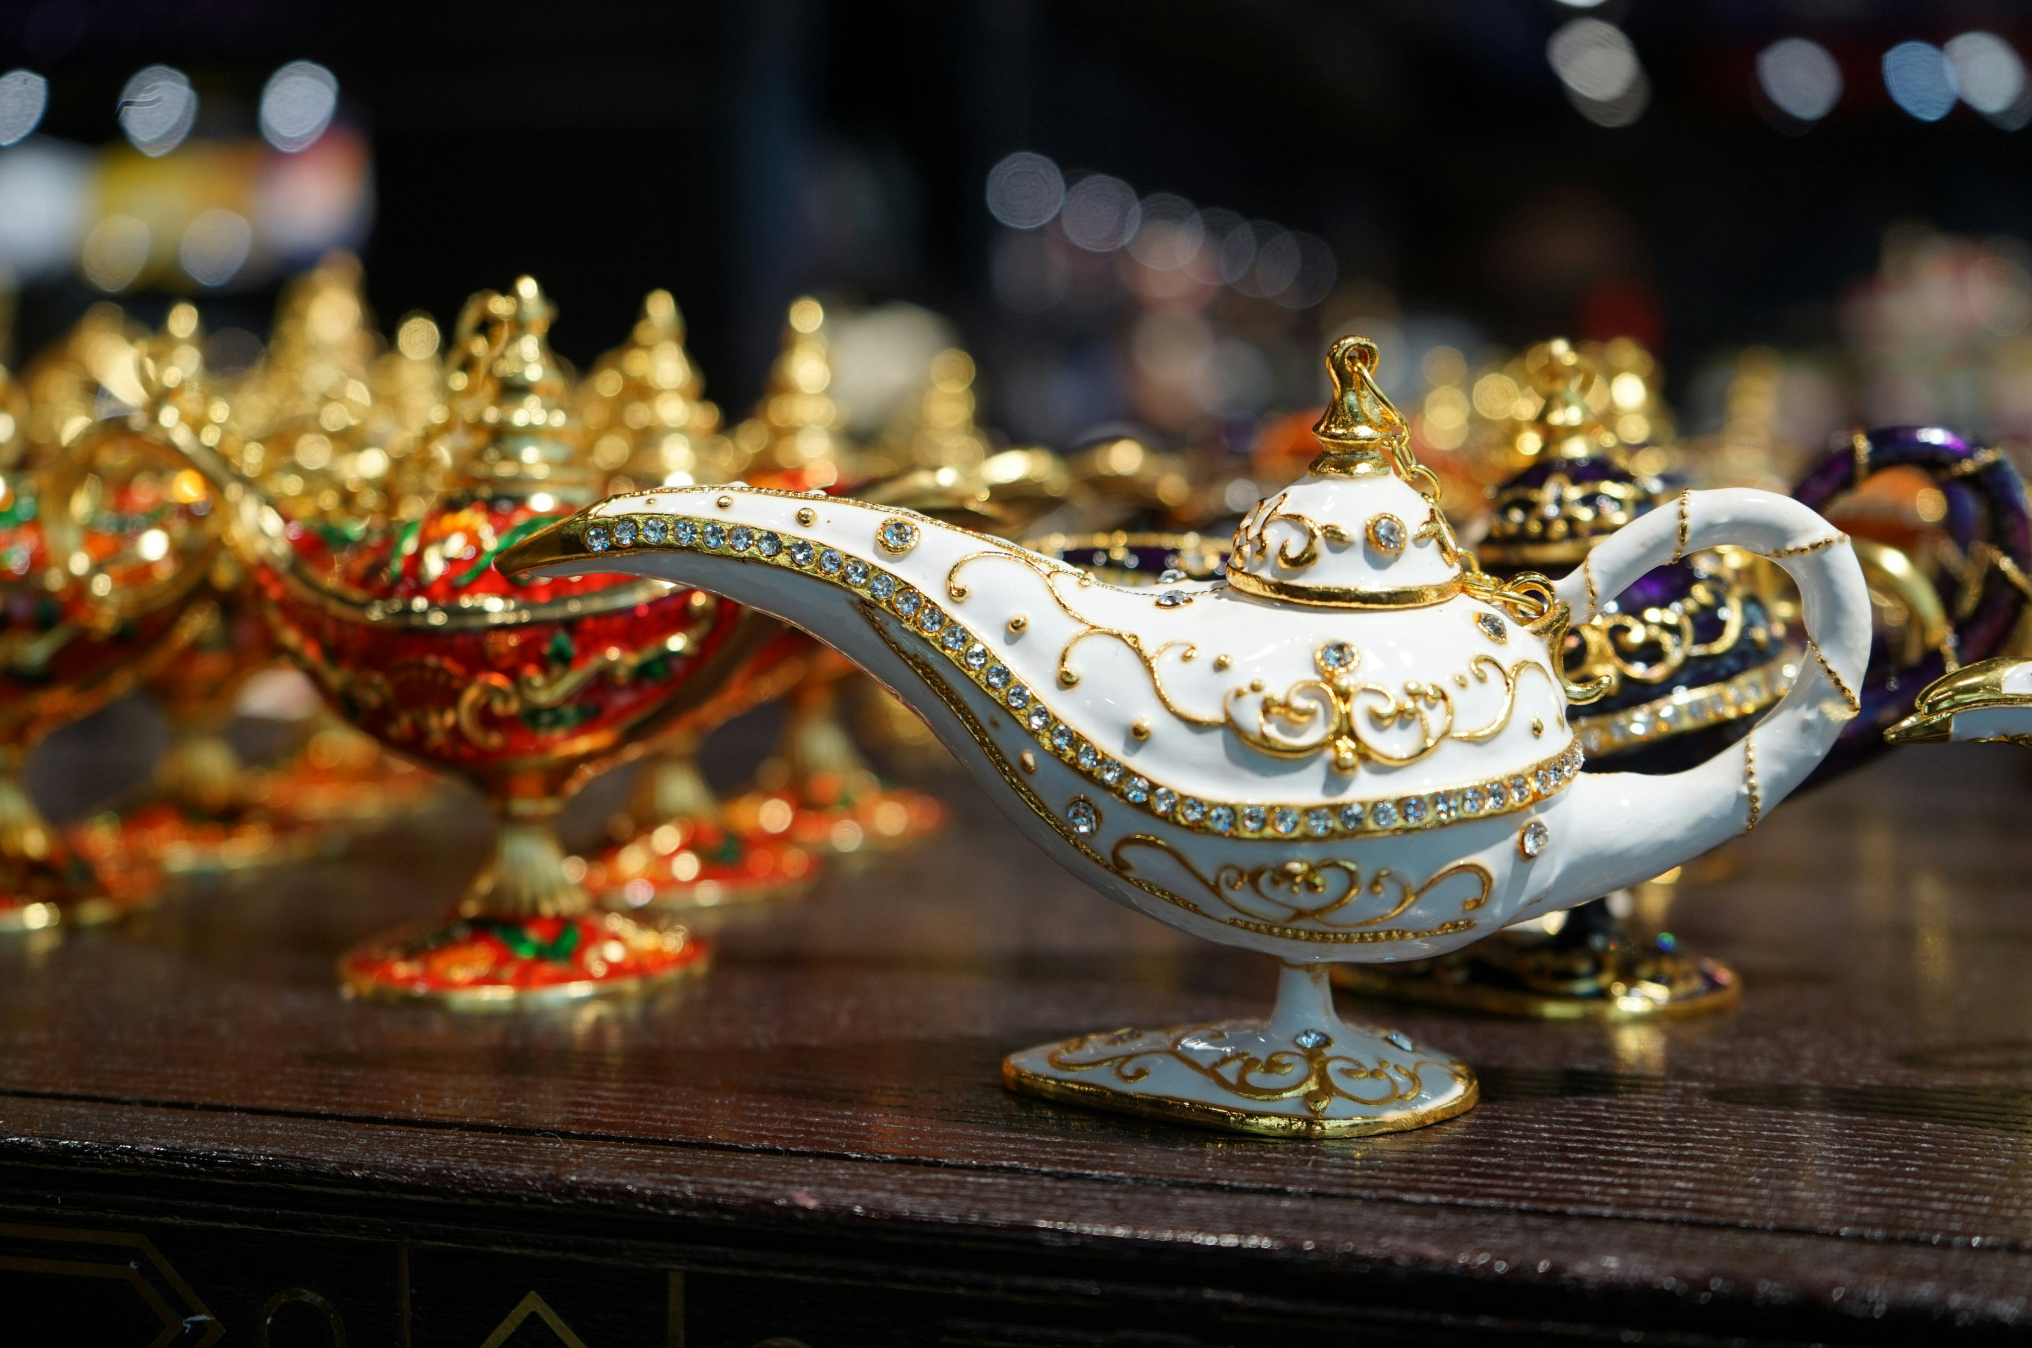
Symbols in literary worlds
Making inferences
Look at the image on each slide.
Make an inference about what ‘literary worlds’ means.
Write your answer in your English book.
There are questions written on each slide to help you think about what makes each ‘world’ unique.
Photo by Katerina Niuman on Unsplash
Notes:
Teacher note: this slide supports Phase 1, sequence 2 – symbolism and representation. The following slides contain images representing different literary worlds. Students look at each stimulus image and respond to the questions on the slide. They write their answers in their English book.
Students should make an inference about what ‘literary worlds’ means and revise that inference as they encounter additional examples. The questions written on each slide help students consider what makes each represented world distinctive.
Within the checking for understanding strategy, use student responses as cumulative evidence rather than treating each image as an isolated activity. Listen for whether students can move from literal observation towards inference about atmosphere, values, themes and the purpose of constructing fictional settings.
Structured questioning can continue to be used as the method for eliciting this evidence. However, the primary ET purpose in this section is checking for understanding: collect responses, identify misconceptions and decide whether to provide additional modelling before moving to the next image.

Slide 14
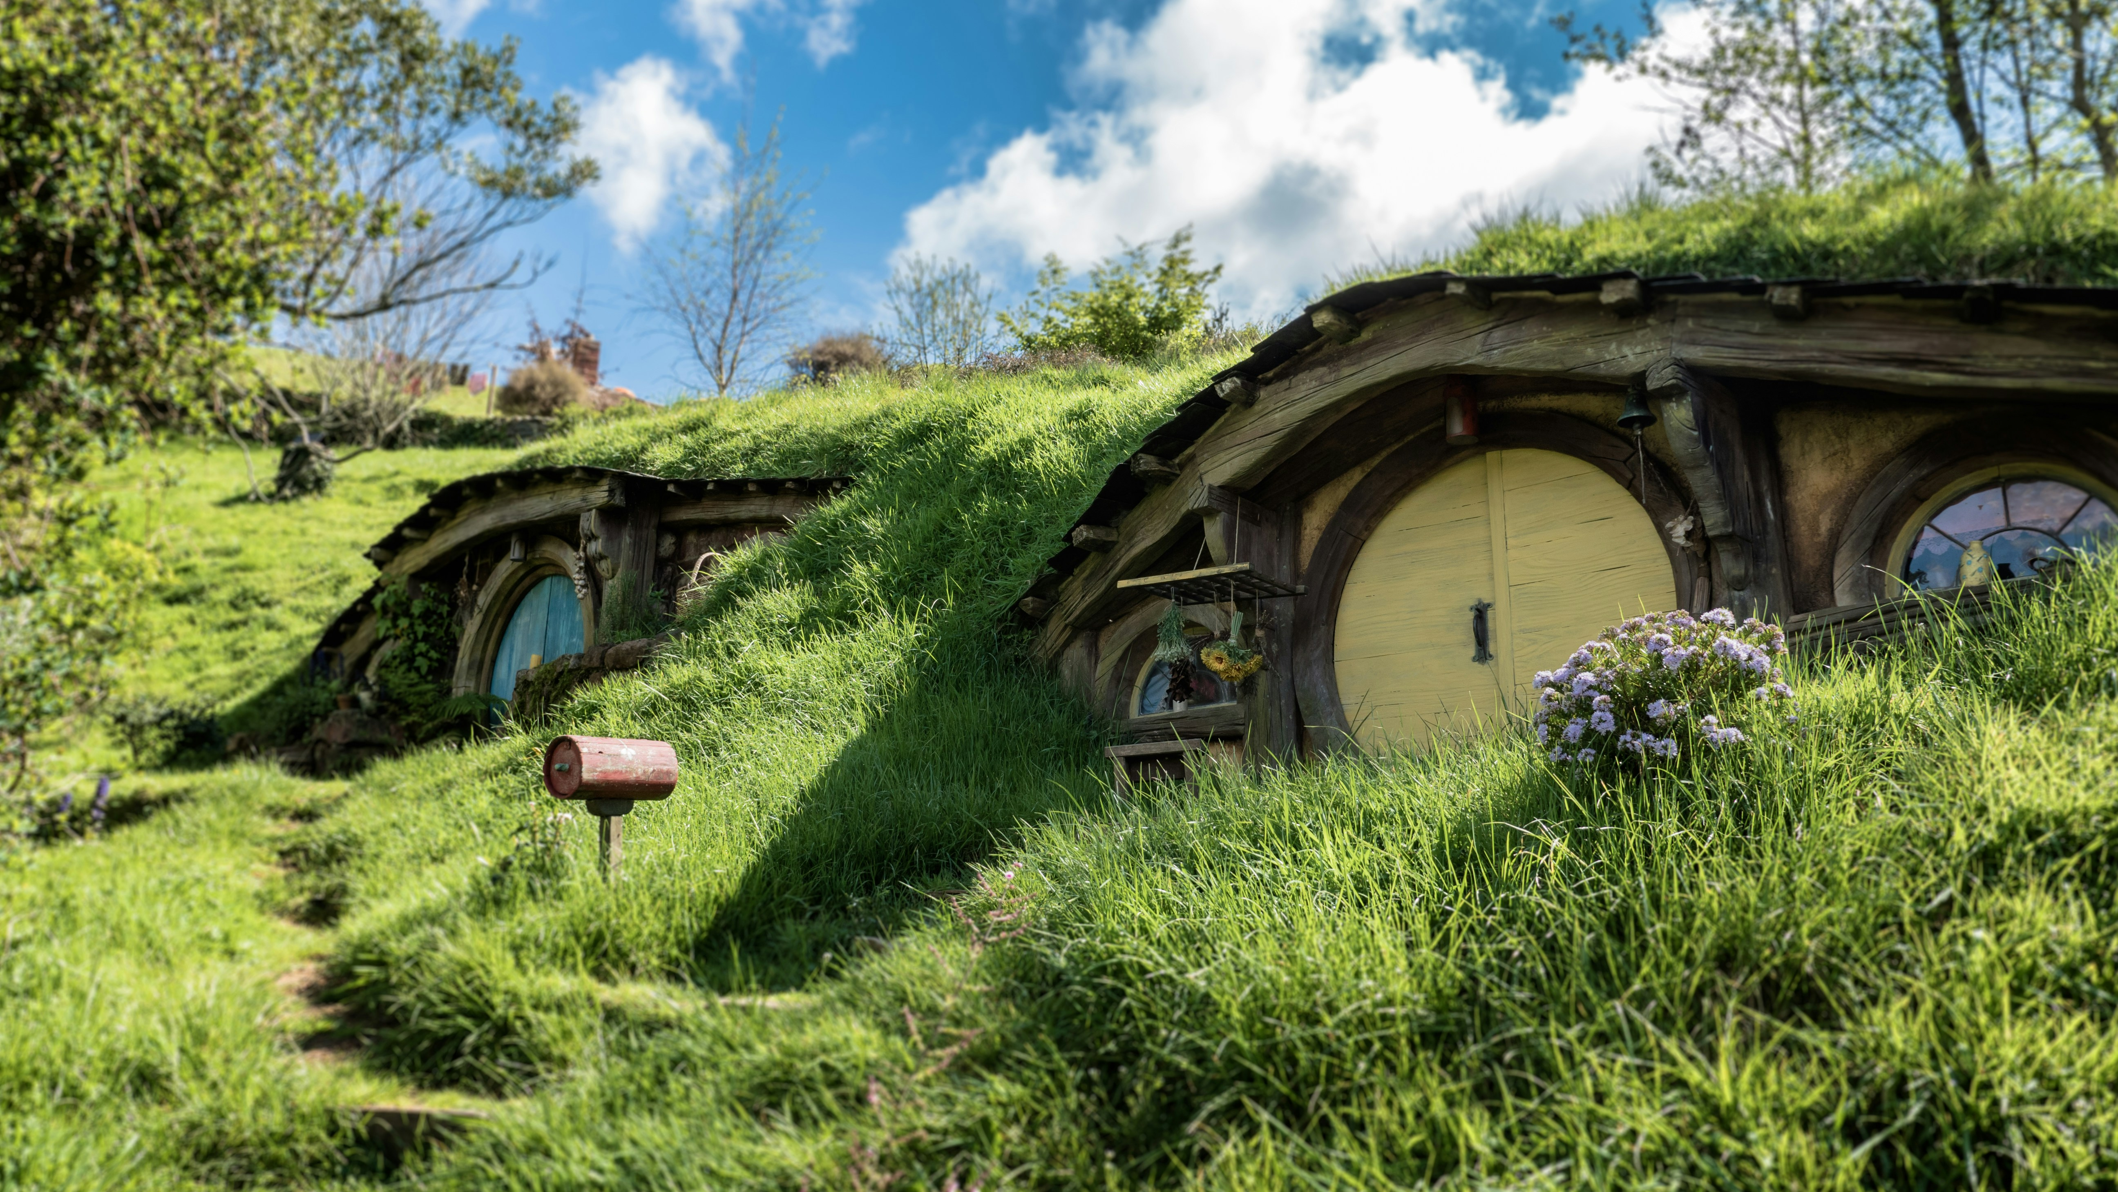
Hobbiton
How is this world represented?
What makes the world in this image different from our world? List or describe some features.
What might the author want us to feel or understand by creating this world? What could some of its features mean?
Can you think of another story, film, or text with a world that feels different or strange? What similarities do you notice?
Why do authors create new worlds in stories? How does having a unique world help us understand the story or characters?
Photo by Thomas Schweighofer on Unsplash
Notes:
Teacher note: this slide supports Phase 1, sequence 2 – symbolism and representation. Prior to engaging with the questions, prompt a class discussion using the 5 senses approach to description: sight, touch, smell, sound and taste. This may assist students in interpreting the image and identifying distinctive features of the represented world.
Students look at the stimulus image and respond to the questions on the slide.
Use the following progression:
Recall:
What makes the world in this image different from our world? List or describe some features.
Deepen thinking:
What might the author want us to feel or understand by creating this world? What could some of its features mean?
Make connections:
Can you think of another story, film or text with a world that feels different or strange? What similarities do you notice?
Justify and reflect:
Why do authors create new worlds in stories? How does having a unique world help us understand the story or characters?
Within checking for understanding, gather responses from multiple students and look for progression from description towards inference. Students should increasingly connect specific visual features with what the world represents and the effect of that representation.
An appropriate adjustment for HPGE students might be:
Recall:
Identify unique and symbolic features in the image that distinguish this literary world. What do these suggest about the story’s values or themes?
Deepen thinking:
Analyse how the construction of this literary world shapes meaning, tone or atmosphere. What messages might the author be communicating through this setting?
Make connections:
Compare this literary world to another you have encountered, considering genre, purpose and cultural context. What abstract patterns or motifs can you identify across these worlds?
Justify and reflect:
Justify how the creation of literary worlds deepens engagement with narrative and character, drawing on examples from multiple texts. Reflect on how your understanding of ‘literary worlds’ influences your reading experience.

Slide 15
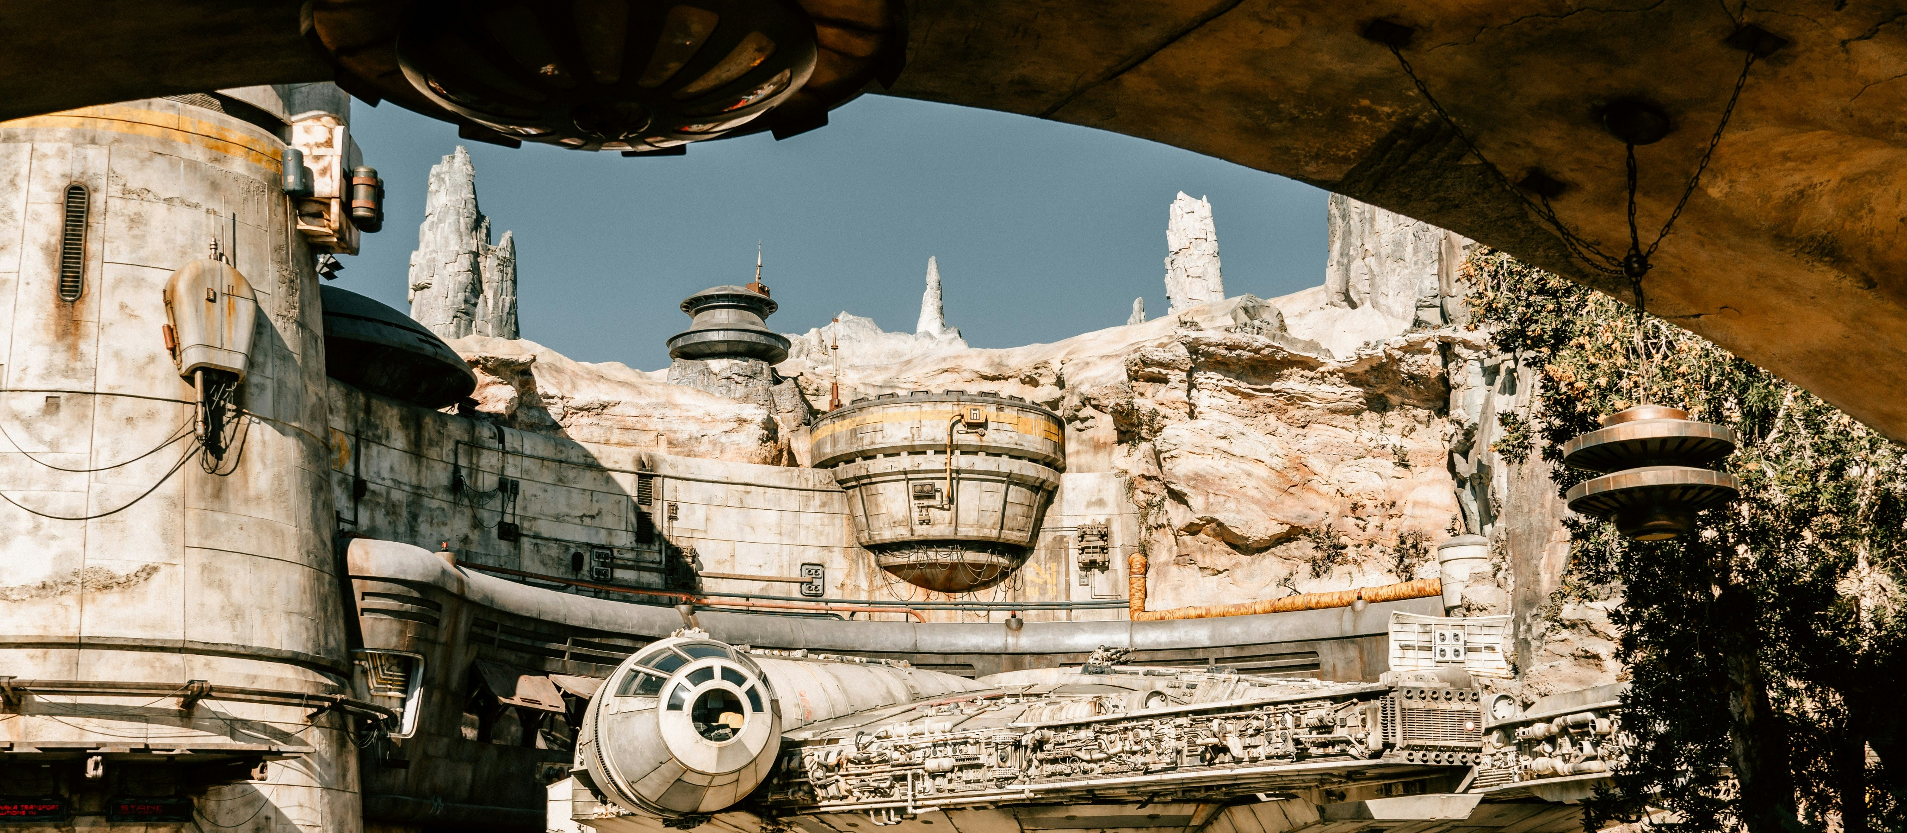
Batuu
How is this world represented?
What makes the world in this image different from our world? List or describe some features.
What might the author want us to feel or understand by creating this world? What could some of its features mean?
Can you think of another story, film, or text with a world that feels different or strange? What similarities do you notice?
Why do authors create new worlds in stories? How does having a unique world help us understand the story or characters?
Photo by Rod Long on Unsplash
Notes:
Teacher note: this slide supports Phase 1, sequence 2 – symbolism and representation. Prior to engaging with the questions, prompt a class discussion using the 5 senses approach to description: sight, touch, smell, sound and taste. This may assist students in interpreting the image. Students look at the stimulus image and respond to the questions on the slide.
Use the same question sequence so students apply a familiar analytical process to a different literary world:
Recall:
What makes the world in this image different from our world? List or describe some features.
Deepen thinking:
What might the author want us to feel or understand by creating this world? What could some of its features mean?
Make connections:
Can you think of another story, film or text with a world that feels different or strange? What similarities do you notice?
Justify and reflect:
Why do authors create new worlds in stories? How does having a unique world help us understand the story or characters?
Within checking for understanding, compare these responses with those generated for Hobbiton. Look for whether students can transfer the concept rather than simply repeat observations from the previous image. Ask students to identify what makes Batuu a distinctly different representation of a literary world.
For HPGE students, retain the existing extension prompts concerning symbolic features, construction of meaning, comparison across genre and context, and justification of how literary worlds deepen engagement.

Slide 16
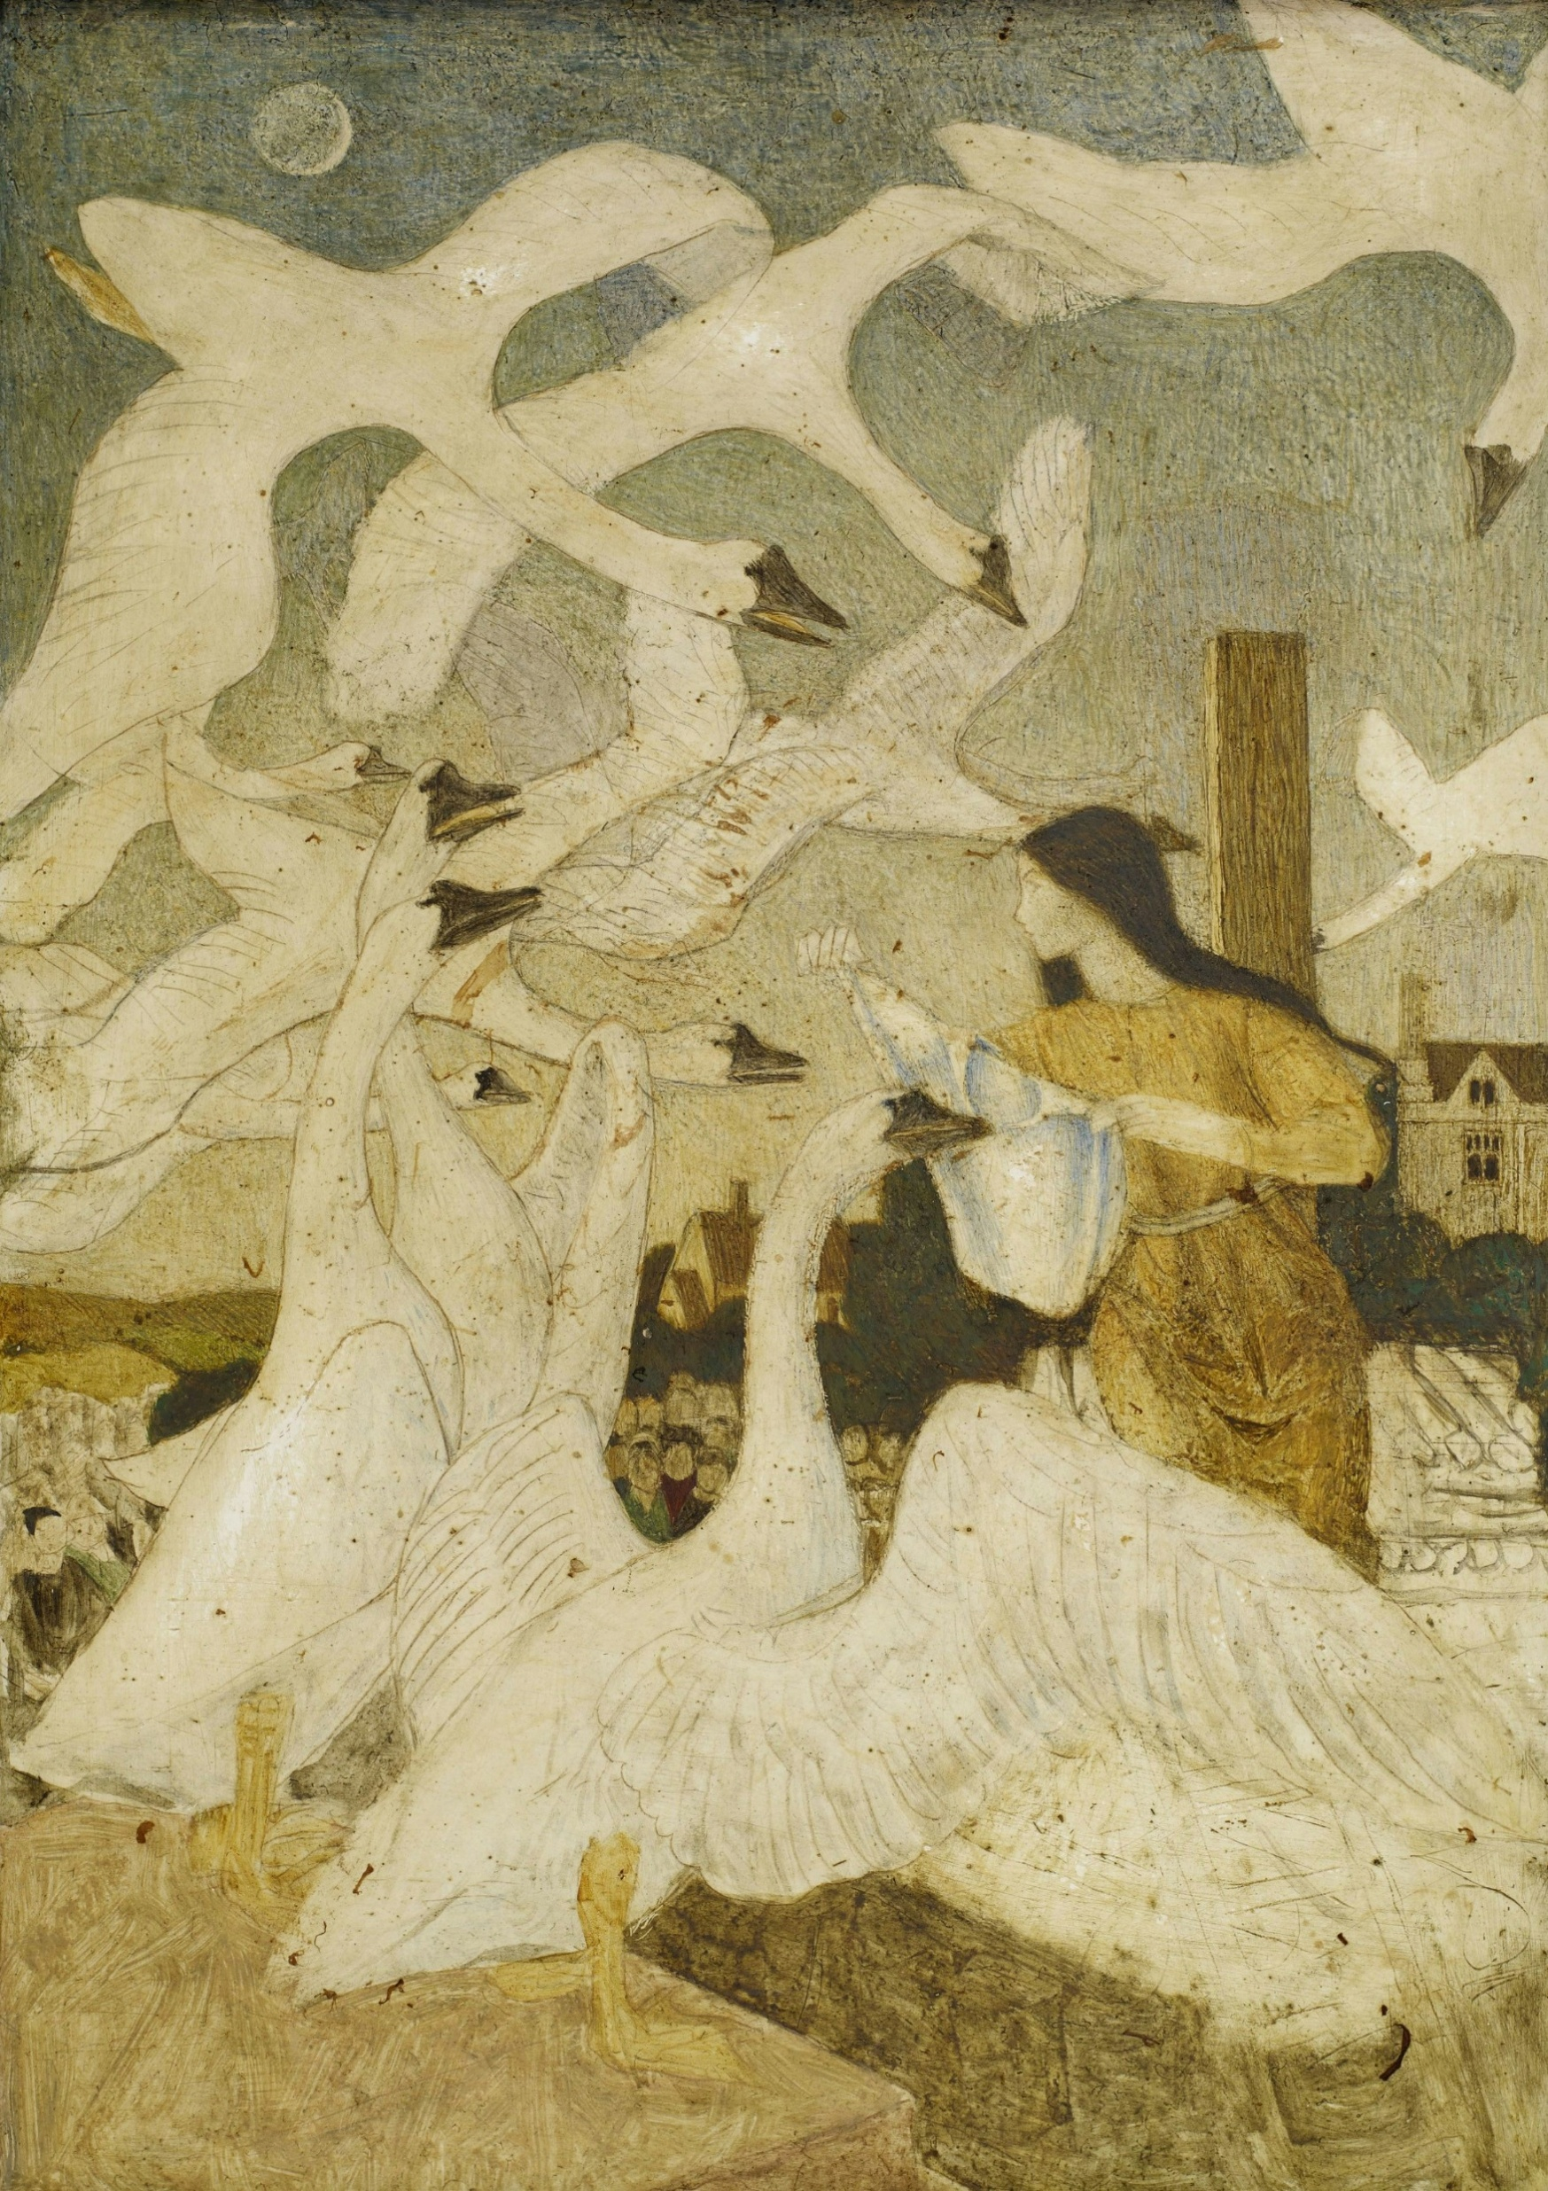
A kingdom where a king and queen have twelve sons
How is this world represented?
What makes the world in this image different from our world? List or describe some features.
What might the author want us to feel or understand by creating this world? What could some of its features mean?
Can you think of another story, film, or text with a world that feels different or strange? What similarities do you notice?
Why do authors create new worlds in stories? How does having a unique world help us understand the story or characters?
Photo by Birmingham Museums Trust on Unsplash
Notes:
Teacher note: this slide supports Phase 1, sequence 2 – symbolism and representation. Prior to engaging with the questions, prompt a class discussion using the 5 senses approach to description: sight, touch, smell, sound and taste. This may assist students in interpreting the image. Students look at the stimulus image and respond to the questions on the slide.
Use the existing progression from recall to deeper interpretation:
Recall:
What makes the world in this image different from our world? List or describe some features.
Deepen thinking:
What might the author want us to feel or understand by creating this world? What could some of its features mean?
Make connections:
Can you think of another story, film or text with a world that feels different or strange? What similarities do you notice?
Justify and reflect:
Why do authors create new worlds in stories? How does having a unique world help us understand the story or characters?
Use this third example as a stronger check for transfer. Reduce teacher prompting where students have demonstrated confidence with the previous images and require them to independently select visual evidence and develop an inference before contributing to discussion.
If students remain dependent on prompts to move beyond description, return briefly to one previous example and model how a visual observation develops into an inference about representation.
For HPGE students, retain the existing extension questions requiring analysis of symbolism, tone, atmosphere, genre, cultural context and recurring motifs.

Slide 17
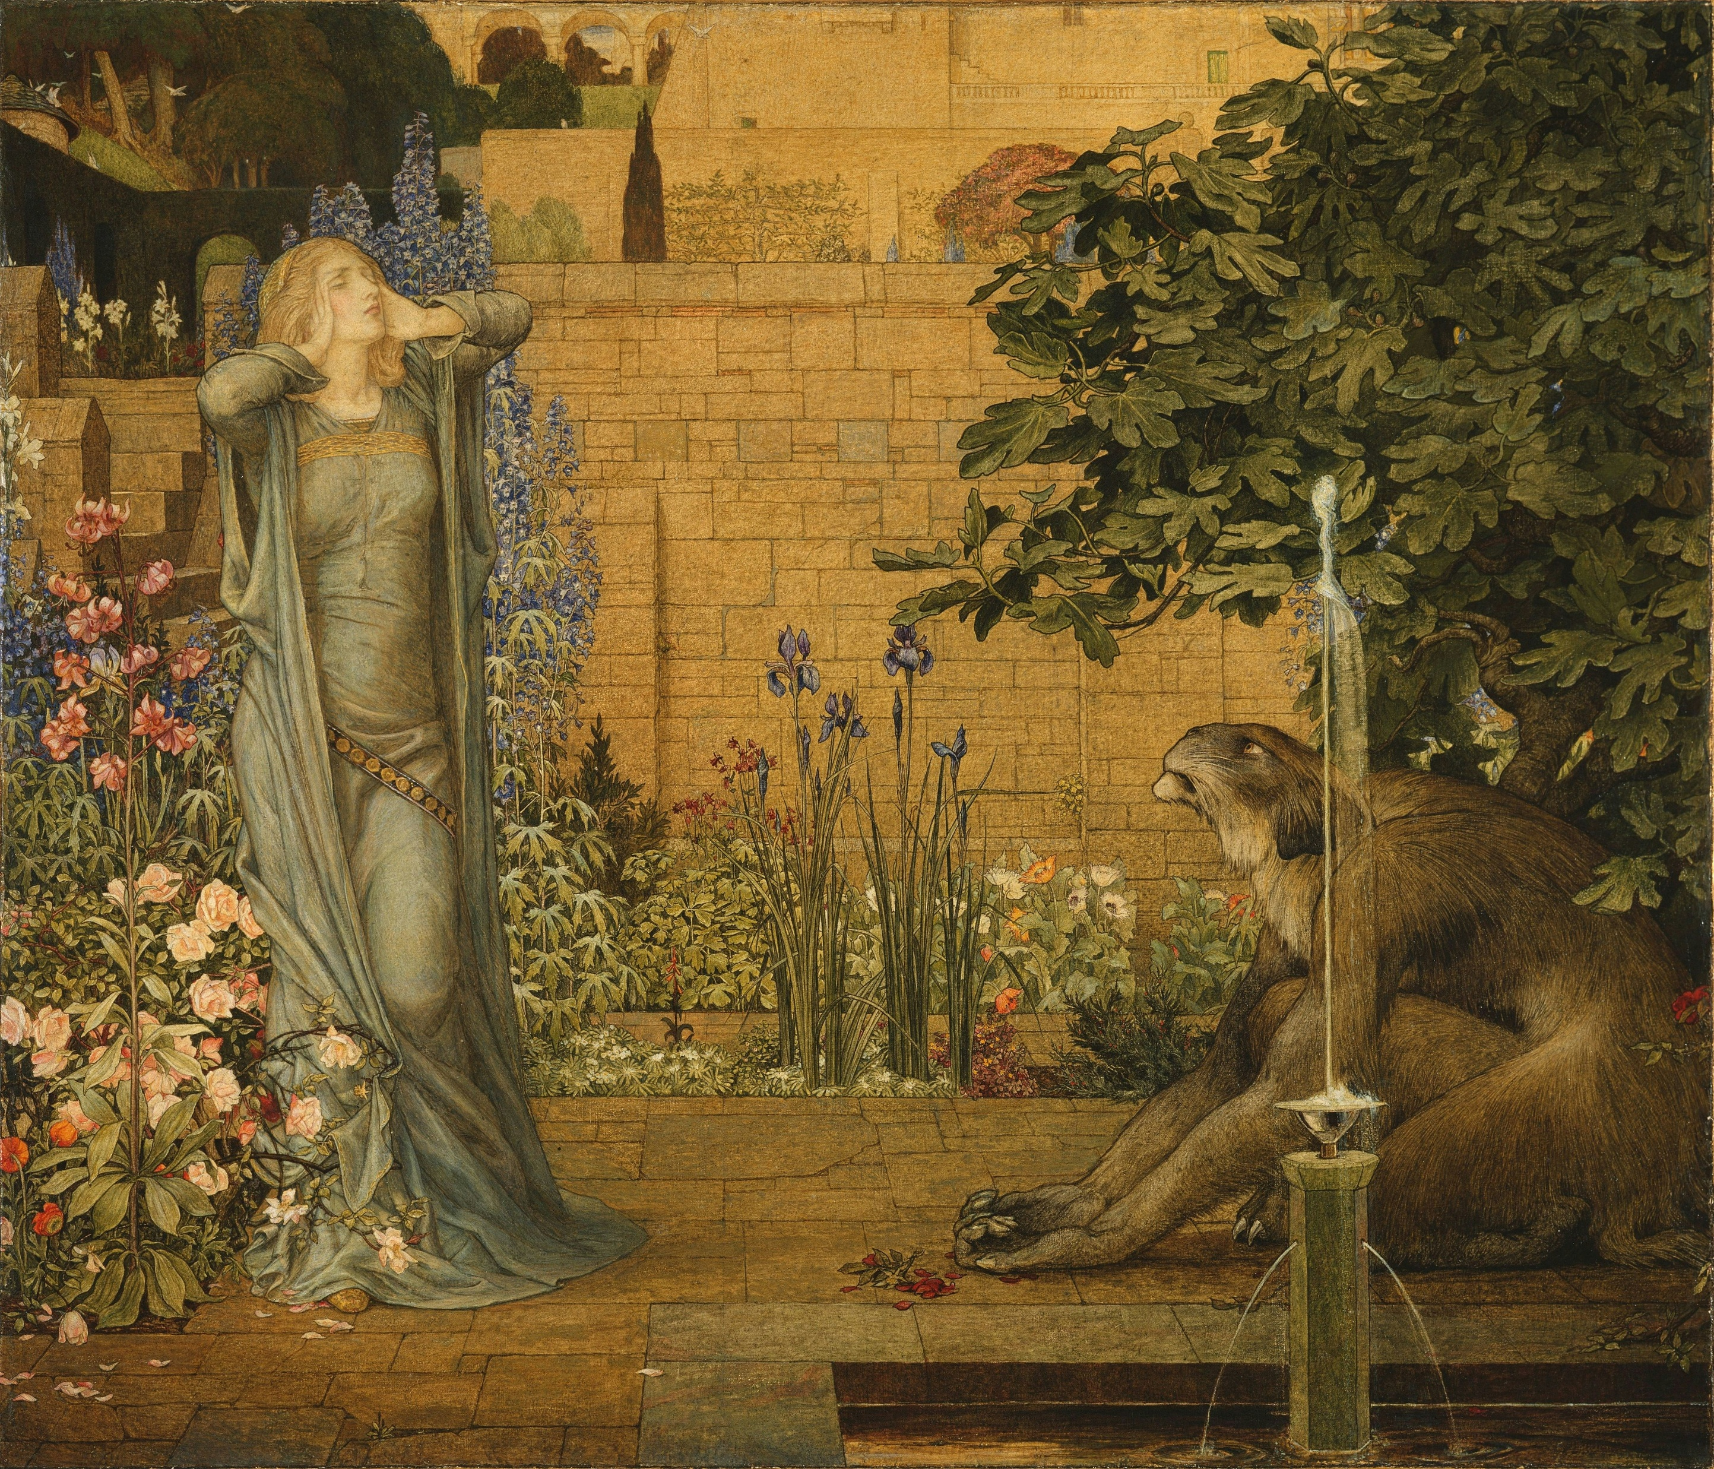
Fictional French village
How is this world represented?
What makes the world in this image different from our world? List or describe some features.
What might the author want us to feel or understand by creating this world? What could some of its features mean?
Can you think of another story, film, or text with a world that feels different or strange? What similarities do you notice?
Why do authors create new worlds in stories? How does having a unique world help us understand the story or characters?
Photo by Birmingham Museums Trust on Unsplash
Notes:
Teacher note: this slide supports Phase 1, sequence 2 – symbolism and representation. Prior to engaging with the questions, a class discussion can again be prompted by the 5 senses approach to description: sight, touch, smell, sound and taste. Students then look at the stimulus image and respond to the questions on the slide.
Use the established sequence:
Recall:
What makes the world in this image different from our world? List or describe some features.
Deepen thinking:
What might the author want us to feel or understand by creating this world? What could some of its features mean?
Make connections:
Can you think of another story, film or text with a world that feels different or strange? What similarities do you notice?
Justify and reflect:
Why do authors create new worlds in stories? How does having a unique world help us understand the story or characters?
This slide provides another opportunity to check whether students can independently apply the concept of representation. Encourage students to compare this world with the previous examples and identify both common features of literary worlds and differences in how those worlds have been represented.
Use responses to determine whether students are ready to synthesise their learning into a class definition on the following slide.
For HPGE students, retain the existing extension questions that require interpretation of symbolic features, analysis of atmosphere and meaning, comparison across texts and justification of the role of literary worlds.

Slide 18
Literary world
Class definition
Drawing on the activities you have just completed, create a class definition for the term ‘Literary world’.
Notes:
Teacher note: this slide supports Phase 1, sequence 2 – symbolism and representation. Students should reflect on the activities just completed about different worlds. As a class, create a definition for the term ‘literary world’. Students should be encouraged to explain the reasoning behind their proposed definition during class discussion.
This slide provides an important synthesis check within the checking for understanding strategy. Ask students first to independently draft a one-sentence definition before sharing ideas. Compare several responses and identify the concepts that recur across the class.
Require students to justify why each element belongs in the definition by referring to one or more of the literary worlds examined on the preceding slides.
Sample definition:
Literary world – a made-up place or setting that belongs to a fictional story. It can be based on a real location but can also be completely made up.
Sample reason:
Based on the image representing the North Pole, this is a setting based on a real place with real creatures such as reindeer, but they are altered to fit into the magical world of Santa.
Use the final definition as evidence of whether students understand that literary worlds may draw on real-world settings while being transformed through fictional representation. Where the class definition remains limited to ‘a made-up place’, prompt students to consider purpose, perspective and how the represented world contributes to character or narrative.

Slide 19
3-2-1 things I learned today
Complete the exit ticket below
List 3 things you learned today:
3
1.
2.
3.
List 2 questions you have about these things:
2
1.
2.
Give 1 reason why it’s important to learn about these things:
1
1.
Notes:
Teacher note: ask students to complete the 3-2-1 as an exit ticket.
Students list:
3 things they learned
2 questions they still have
1 reason why it is important to learn about these concepts.
Within the checking for understanding strategy, use the exit ticket as the final source of evidence from all students. Review whether students can articulate learning about representation and literary worlds rather than simply recall the names of individual images.
The 2 questions provide evidence of concepts that remain uncertain or require further instruction. Group common questions to identify areas suitable for whole-class revision and separate these from individual misconceptions that can be addressed through targeted support.
The final response asks students to explain the value of the learning. Look for connections to understanding how fictional texts construct places, ideas and experiences for readers.
Use this evidence to determine whether students are ready to progress to subsequent work on representation and setting, or whether aspects of the conceptual learning need to be revisited.

Slide 20
References (1)
This presentation contains NSW Curriculum and syllabus content. The NSW Curriculum is developed by the NSW Education Standards Authority. This content is prepared by NESA for and on behalf of the Crown in the right of the State of New South Wales. The material is protected by Crown copyright.
Please refer to the NESA Copyright Disclaimer for more information https://educationstandards.nsw.edu.au/wps/portal/nesa/mini-footer/copyright.
NESA holds the only official and up-to-date versions of the NSW Curriculum and syllabus documents. Please visit the NSW Education Standards Authority (NESA) website https://educationstandards.nsw.edu.au/wps/portal/nesa/home and the NSW Curriculum website https://curriculum.nsw.edu.au.
English K–10 Syllabus (2022) © NSW Education Standards Authority (NESA) for and on behalf of the Crown in right of the State of New South Wales, 2022.
Birmingham Museums Trust (2019) Painting of woman wearing grey dress [photo], Unsplash, accessed 6 March 2026.
Birmingham Museums Trust (2019) Woman and white swans painting [photo], Unsplash, accessed 6 March 2026.
Niuman K (2022) A gold and silver crown [photo], Unsplash, accessed 6 March 2026.
NSW Department of Education (n.d.) Representation, Textual concepts, accessed 6 March 2026.
——(n.d.). Textual concepts: representation poster [PDF], Textual concepts, accessed 6 March 2026.
——(n.d.) Frayer diagrams, Digital Learning Selector, accessed 6 March 2026.
Notes:
Teacher note: this slide contains references for this resource.

Slide 21
References (2)
This presentation contains NSW Curriculum and syllabus content. The NSW Curriculum is developed by the NSW Education Standards Authority. This content is prepared by NESA for and on behalf of the Crown in the right of the State of New South Wales. The material is protected by Crown copyright.
Please refer to the NESA Copyright Disclaimer for more information https://educationstandards.nsw.edu.au/wps/portal/nesa/mini-footer/copyright.
NESA holds the only official and up-to-date versions of the NSW Curriculum and syllabus documents. Please visit the NSW Education Standards Authority (NESA) website https://educationstandards.nsw.edu.au/wps/portal/nesa/home and the NSW Curriculum website https://curriculum.nsw.edu.au.
NSW Department of Education (2026) Using effective questioning, Explicit teaching strategies, accessed 6 March 2026.
Long R (2020) Famous landmark building [photo], Unsplash, accessed 6 March 2026.
Schweighofer T (2017) Landscape photography of brown wooden house with trees around [photo], Unsplash, accessed 6 March 2026.
Warby, W. (2024). A green leaf with a drop of water on it [photo], Unsplash, accessed 6 March 2026.
Notes:
Teacher note: this slide contains references for this resource.

Slide 22
Copyright
© State of New South Wales (Department of Education), 2026
The copyright material published in this resource is subject to the Copyright Act 1968 (Cth) and is owned by the NSW Department of Education or, where indicated, by a party other than the NSW Department of Education (third-party material).
Copyright material available in this resource and owned by the NSW Department of Education is licensed under a Creative Commons Attribution 4.0 International (CC BY 4.0) license.
This license allows you to share and adapt the material for any purpose, even commercially.
Attribution should be given to © State of New South Wales (Department of Education), 2026.
Material in this resource not available under a Creative Commons license:
the NSW Department of Education logo, other logos and trademark-protected material
Material owned by a third party that has been reproduced with permission. You will need to obtain permission from the third party to reuse its material.
Links to third-party material and websites
Please note that the provided (reading/viewing material/list/links/texts) are a suggestion only and implies no endorsement, by the New South Wales Department of Education, of any author, publisher, or book title. School principals and teachers are best placed to assess the suitability of resources that would complement the curriculum and reflect the needs and interests of their students.
If you use the links provided in this document to access a third-party’s website, you acknowledge that the terms of use, including licence terms set out on the third-party’s website apply to the use which may be made of the materials on that third-party website or where permitted by the Copyright Act 1968 (Cth). The department accepts no responsibility for content on third-party websites.

