Slide 1
Instructions for use
This resource is not a teaching and learning program. It should be used in conjunction with the Philosophy Core 1 – Introduction to philosophy program of learning.
Classroom teachers are encouraged to add and adapt slides as required to meet the needs of their students.
Save a copy of the file to make changes to the slide deck. Go to File > Download a Copy (this downloads a copy to the computer to edit in the PowerPoint app).
To convert the PowerPoint to Google Slides:
  Upload the file into Google Drive and open it.
  Go to File > Save as Google Slides.
  (Note – conversion may cause formatting changes in the slides.)

Slide 2

Philosophy Core 1
Stage 5
Introduction to philosophy

Slide 3
Lessons 1–3
Introduction to Philosophy

Slide 4
KWLH
What do I know? | What do I want to know? | What have I learned? | How can I learn more?
K
What do I know?
W
What do I want to know?
L
What have I learned?
H
How can I learn more?
Notes:
Purpose:
To activate students’ prior knowledge and frame philosophy as a discipline built on questioning, reasoning, and curiosity.
Speaker:
Today we are going to start by looking at what you already know as you come into the course. We are only going to focus on column K and column 'W' and we will revist the other columns later in the course.
You have time now to add as many dot points as you can to these columns and then we will discuss this together.
Note:
Once students have completed this task, you can get them to engage in a think-pair-share to start a class discussion.

Slide 5
Learning intentions and success criteria (1)
We are learning to
recognise what philosophy is and how it differs from other ways of thinking
use key terms that support philosophical discussion
understand why humans study philosophy and how it shapes everyday life.
We can
explain what philosophy is and give an example of a philosophical question
use key terms such as ethics, metaphysics, epistemology, logic, claim and reason accurately
describe why people study philosophy and how philosophical thinking influences everyday choices
turn an everyday opinion into a simple philosophical claim with a reason and a counter-reason.
Notes:
Notes for teachers:
Adapt the learning intention as required and add matching success criteria.
For more information see ⁠NSW Department of Education explicit teaching strategies https://education.nsw.gov.au/teaching-and-learning/curriculum/explicit-teaching.
LISC is not necessarily presented at the beginning of the lesson. Teacher needs to consider most effectual time to introduce.
LISC should be revisited during the lesson to support students' evaluation of their learning.

Slide 6
Some big questions
The study of Philosophy involves considering the big questions in life.
Turn and talk (turn to the person next to you and discuss one of these big questions):
Do we have free will?
How do we know what is real?
Is it ever ok to lie?
In 10 minutes, we will share our ideas as a whole class.
Notes:
Purpose:
To activate prior thinking(schema), uncover assumptions, and introduce students to philosophical questioning in a simple and engaging way.
Speaker:
Turn to the person next to you and choose one of these big questions to discuss:
Do we have free will
How do we know what is real
Is it ever okay to lie\
After a short discussion, you will each share your initial thoughts. There are no right or wrong answers. The focus is on how you are thinking.
Notes:
Allow 1–2 minutes of paired discussion.
Circulate and listen for ideas to use in the whole-class share.
Bring the class together after 10 minutes.
Reinforce that the activity was philosophical thinking: questioning, reasoning, and responding to different perspectives.

Slide 7
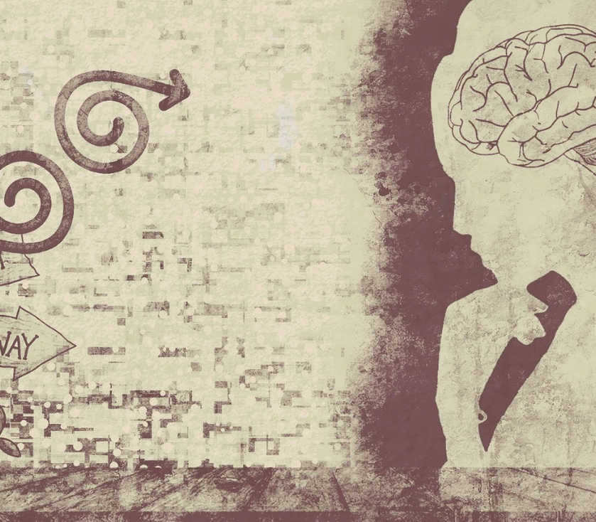
What is Philosophy anyway?
Philosophy is the study of big questions about:
what is real
how we know things
what is right
how we should live.
In summary:
Philosophy is thinking carefully about the questions that matter.
Pixabay Chenspec
Notes:
Purpose:
To introduce philosophy as a discipline focused on examining meaningful questions about reality, knowledge, ethics, and how we should live.
Speaker:
When we talk about philosophy, we’re really talking about the big questions that shape how we understand the world and ourselves. Philosophers don’t take ideas at face value - they slow down, ask why, and look closely at the assumptions behind our beliefs.
On this slide you can see the four major areas we’ll be exploring: questions about what is real, how we know things, what is right, and how we should live. These have been asked for thousands of years, and each generation brings its own answers.
In short, philosophy is careful thinking about the questions that matter. It gives us tools to reason, challenge ideas, and make sense of our choices. That’s what this course is all about - learning to think clearly and question well.

Slide 8
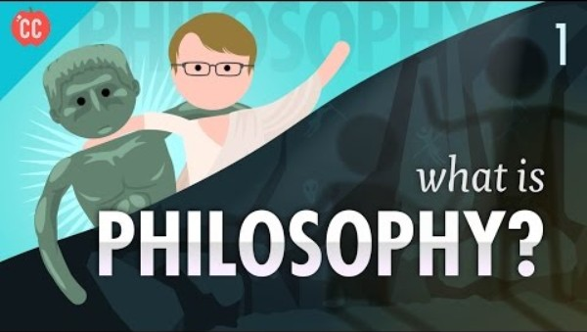
What is philosophy?
Crash course philosophy #1
This episode of crash course you will hear a broad introduction to the core attributes and principles of Philosophy as an academic discipline.
As you watch look for the answers to these questions:
What is philosophy?
How is philosophy different from an opinion?
What is the goal of philosophy?
What kinds of questions can philosophy help us answer?
Notes:
Purpose:
To give students a broad overview of philosophy as a discipline and prompt discussion about its purpose, method, and questions.
Speaker:
We’re going to start with a short Crash Course video that introduces the big ideas behind philosophy. As you watch, pay attention to how philosophy is defined and how it’s shown to be more than just giving an opinion.
After the video, we’ll use a think–pair–share to unpack your thoughts. You’ll consider four core questions:
What is the definition of philosophy?
How is philosophy different from just having an opinion?
What do philosophers aim to achieve?
And finally, what sorts of questions can philosophy help us answer in real life?
This discussion helps you connect what you already think about philosophy with how it works as an academic subject.
Note:
Students view What is philosophy?: Crash course philosophy #1 (10:34). This episode will provide a broad introduction to the core attributes and principles of Philosophy as an academic discipline.
Drawing on learning from crash course philosophy, students are led in a think-pair-share activity where they can discuss the following questions.
What is the definition of philosophy?
How is the study of philosophy different from an opinion about something?
What is the goal of philosophy?
What kinds of questions could philosophy help us answer in life?

Slide 9
Why should we study Philosophy?
Living an examined life
People throughout history have asked big questions about how to live a meaningful life.
One of those questions is:
What makes life worth living or fulfilling?
Notes:
Purpose:
To introduce students to the idea that philosophy helps us think about how to live a meaningful and reflective life.
Speaker:
When we study philosophy, we are really studying the big questions people have asked across history. One of the most important questions is what makes life worth living or fulfilling.
As you read this, start thinking about your own ideas. What gives your life meaning right now? What do you value most?
You do not need a perfect answer. The point is to start noticing the kinds of questions philosophers explore.

Slide 10

What is an examined life?
Reflect on your life
An examined life is a life where you stop and think about your choices, values, and actions
It involves asking questions such as:
Why do I believe what I believe?
What kind of person do I want to be?
What choices make my life meaningful?
What do I value most and why?
Image : gerault- pixabay
Notes:
Purpose:
To explain the idea of an examined life and guide students to reflect on their own beliefs, choices and values.
Speaker:
An examined life is about pausing to think carefully about who you are and why you make the choices you do. Philosophers believe this kind of reflection helps us live with purpose.
Let’s look at these questions together. As you read them, choose one that feels most relevant to you today.
You do not need to share your answer yet. Just notice what the question makes you think about and how it connects to your own experiences.

Slide 11
The examined life
Connecting the idea to your own life
Understanding an examined life begins with noticing what you value and why.
Before we explore the idea further, think about which everyday experiences matter most to your happiness.
Notes:
Purpose:
To create a clear conceptual link between the definition of an examined life and the ranking activity.
This ensures students understand that the task is part of learning to reflect on their values, not a random list.
Speaking notes
Before we look deeper at the idea of an examined life, it helps to think about our own values.
If an examined life means reflecting on our choices and priorities, the first step is identifying what actually matters to us.
The activity on the next slide will help you think about your own values so we can link them back to the idea of examining your life.
Notes:
Emphasise that reflecting on priorities is the foundation of philosophical thinking.
Keep it simple; do not mention Socrates or historical context yet.
Highlight that students will use their rankings to connect their own choices to the examined life concept in the discussion afterwards.

Slide 12
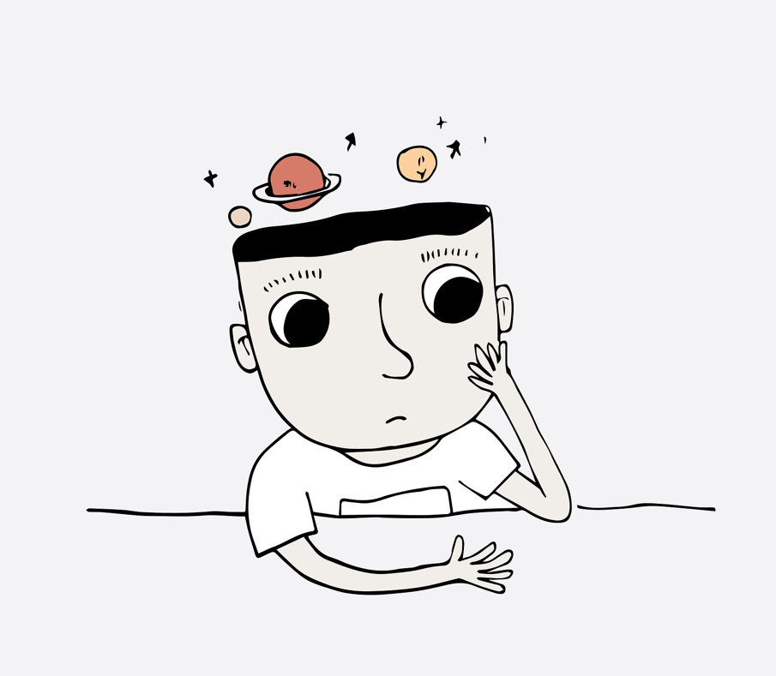
Activity 1 – What matters most to you?
Rank these from 1 (most important) to 8 (least important) for your own happiness:
Eating your favourite food
Playing a game
Reading a book
Sitting in a dentist’s chair
Listening to or playing music
Having fun with friends
Helping someone who needs support
Thinking or reflecting
Image: Pixabay Saydung
Notes:
Purpose:
To help students recognise that people value different things and to introduce the idea that reflecting on our choices and priorities is a key part of philosophical thinking.
Speaker: Look through the list of experiences on the slide and rank them - ordering the eight items from the one that is most important for your happiness being number 1 to least important being number 8. Take your time with this and think through your choices carefully. We are going to share our rankings and explain our choices to the class.
Notes:
Encourage them to think about their choices rather than rushing.
Remind students there are no right or wrong answers; the goal is to think about why they made each choice.
Encourage students to notice patterns across the class once the sharing activity begins (see next slide).
Highlight that identifying what matters to us is the first step in understanding the concept of an examined life.
Keep the pace steady; give around one minute for ranking and then move into the selected activity option.
Use student reasoning to connect this activity back to the broader question of how we decide what makes a good or meaningful life.

Slide 13
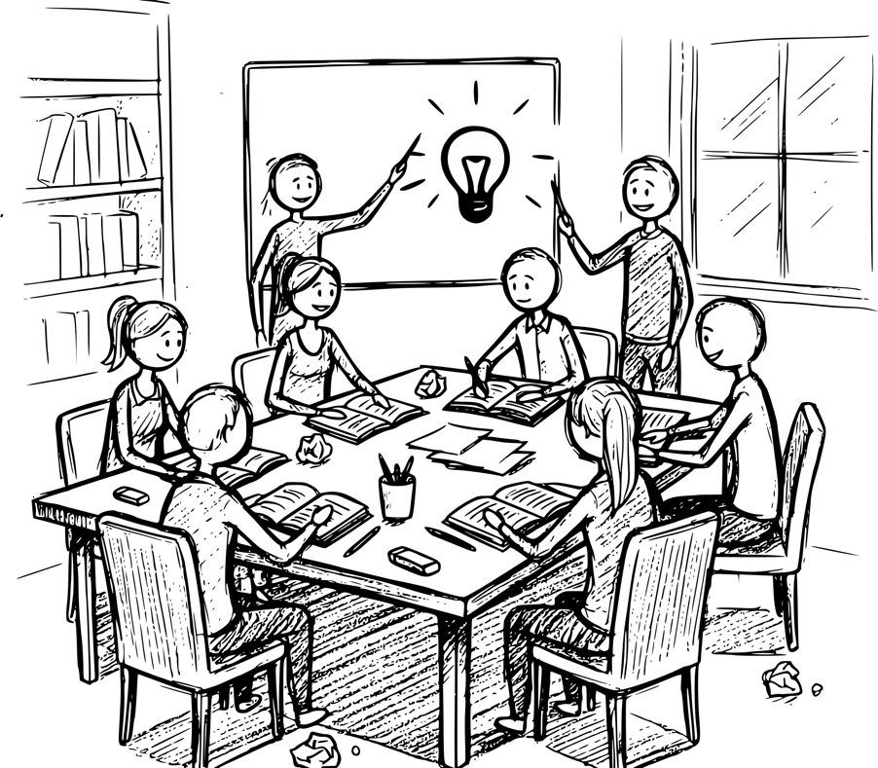
Sharing ideas – Class activity
Whole class responses
Pixabay – Gerault
Notes:
Purpose:
To give students structured ways to sort, compare, and justify their values.
These activities help students identify what is important to them, notice differences across the class, and link their choices to the philosophical idea of examining one’s life.
The four activity options allow teachers to choose the approach that best suits their class.
Option 1: Values line up
Suggested for an energetic, highly engaged class that responds well to movement and physical activity. Helps students who find talking easier when they are not sitting still. Prep level:
Low to medium prep (just space to move in the room and the list of items).
Label one end of the room ‘Most important to my happiness’ and the other end ‘Least important’.
Read each item aloud one at a time.
Students physically move to where they think that item belongs.
Ask 2–3 students at each end to explain their reasoning.
Highlight differences in priorities and link back to examined life (explain that noticing your own choices and seeing how they differ from others helps you understand what you value and why. Thinking about your choices is the first part of living an examined life.)
Option 2
Suggested for a quieter class where students may not want to speak in front of the whole room but are comfortable talking in pairs.
Think–Pair–Switch. Using the 'what matters most to you?’ Activity on ppt slide 12
Think (30 seconds)
Pair and share with Partner A (1 minute each)
Move and share with Partner B (1 minute each)
Teacher wraps with patterns/themes across the room with a list on the board
Option 3
Suggested for a lively class that enjoys games, competition, and friendly challenge.
This naturally sparks explanations and disagreements, which are perfect for philosophical thinking.
Values auction
Give students 20 happiness points.
Auction each item (food, friends, helping, thinking, etc.) and students ‘bid’ what it’s worth to them.
Read items one by one
Students secretly decide how many points to spend
They reveal bids simultaneously
Debrief unusual or strong bids
Option 4
When time is short or the class is quiet
Write all eight items on the whiteboard.
Students:
Choose their top item and bottom item
Write their initials under those two on the board
Teacher:
Talks through the most common choices
Asks students why they chose them
Links to examined life

Slide 14
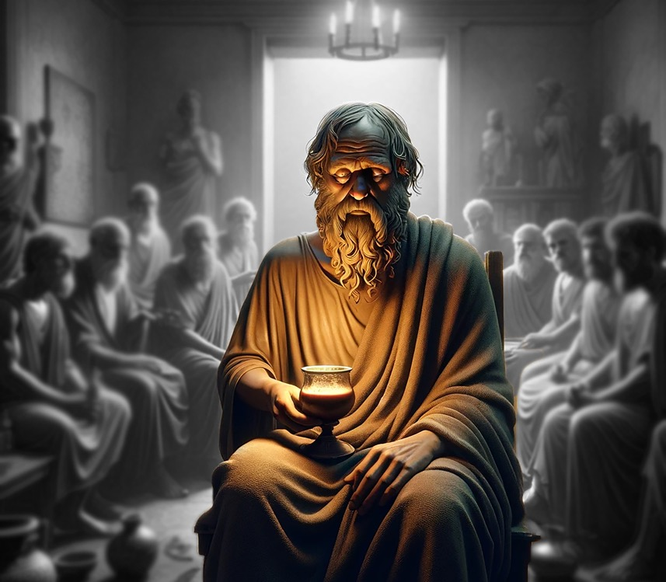
Meet Socrates
Socrates lived a long time ago in ancient Greece, but people still study him because he asked questions that help us understand ourselves.
Just like you started thinking today about what matters to you, Socrates asked people to stop and reflect on their beliefs and choices.
He walked around asking people questions like:
Why do you believe that?
How do you know that’s true?
What kind of person do you want to be?
Image : Maklay62 Pixabay
Notes:
Purpose:
To introduce Socrates as a key figure in philosophy and link his questioning style to the idea of living an examined life — a life where we pause, reflect, and make thoughtful choices about what we believe and how we live.
Speaker:
Socrates is remembered not because he wrote books or delivered big speeches, but because he constantly asked questions. He believed that a good life isn’t one where you just move through the world on autopilot. Instead, he said we should stop and think about our choices, our beliefs, and the kind of person we want to become. This is what he called examining your life. He asked questions like:
• “Why do you believe that?”
• “How do you know that’s true?”
• “What kind of person do you want to be?”

Slide 15

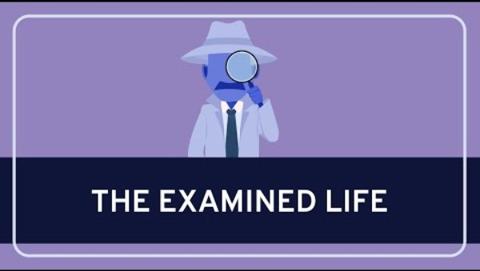
The Examined Life – Know thyself
Socrates believed real wisdom begins when we examine our own lives.
This video explains what that means
Watch closely for what the video says an examined life involves… and why it matters.
Image by mokhalad musavi from Pixabay
Notes:
Purpose:
To give students a clear definition of an examined life and prepare them to explain the idea in their own words.
Speaker:
We’ve just looked at how Socrates questioned people to help them think more clearly about their beliefs and choices. He wasn’t trying to annoy people – he believed that asking these kinds of questions helped them live what he called an examined life. This short clip explains what that means. As you watch, look closely for two things - what an examined life involves and why Socrates thought it was important

Slide 16
Activity 2 – after watching the clip
Explain it to a ten-year-old
How would you explain the concept of ‘an examined life’ to a 10-year-old?
Work with a partner to create a simple explanation
You could :
draw it
write dot points
make a flow chart.
Use whatever would make it clear to a 10-year-old.
Notes:
Purpose:
To check students’ understanding by asking them to explain a complex idea in simple language.
Speaker:
Now that you have watched the clip, I want you to try explaining the idea of an examined life as if you were talking to a ten year old.
Work with your partner to come up with a short, clear explanation. You can draw it, use dot points or make a simple flow chart. The goal is to make the idea easy for someone younger to understand.
Once you are ready, we will hear a couple of examples from the class.
Notes:
Students think individually for a moment, then work in pairs.
Remind them to keep their explanation brief and focused on one main idea.
Select 2–3 students to share their clearest version.
Use this as a quick formative check before moving on.

Slide 17
Check for understanding (1)
Thumb votes
I understand and could explain the concept of an examined life:
A thumbs up if you feel confident
Sideways if you’re unsure
Down if you’re confused
Notes:
Purpose:
To quickly check whether students can describe an examined life in their own words and to identify if the class needs further clarification before moving on.
Speaker:
You are now going to show me how confident they feel about explaining the idea of an examined life using the quick thumbs check on the slide.
Notes:
Use the thumbs-up, sideways, or down signals to gauge overall understanding.
Select one student with a thumbs-up and one with a sideways signal to share their explanations.
Keep sharing short; focus on whether students can state the idea clearly and simply.
If many students are unsure, pause and restate the definition before progressing.

Slide 18
Lesson 4
Branches of Philosophy

Slide 19
Learning intentions and success criteria (2)
We are learning to
describe the main branches of Philosophy and what each one focuses on
understand why philosophical thinking is organised into different areas of study.
We can
list the main branches of philosophy
describe what each branch focuses on.
Notes:
Notes for teachers:
Adapt the learning intention as required and add matching success criteria.
For more information see ⁠NSW Department of Education explicit teaching strategies https://education.nsw.gov.au/teaching-and-learning/curriculum/explicit-teaching.
LISC is not necessarily presented at the beginning of the lesson. Teacher needs to consider most effectual time to introduce.
LISC should be revisited during the lesson to support students' evaluation of their learning.

Slide 20
Branches of Philosophy
Classifying philosophical questions
Ethics: right and wrong
Aesthetics: beauty and art
Epistemology: knowledge and truth
Metaphysics: reality and existence
Notes:
Purpose:
To introduce the four major branches of philosophy and model how to classify questions into each branch.
Speaker:
These are the four main branches of philosophy. Each branch focuses on a different type of question.
Before you try this for yourselves, I am going to show you how to place a question into the right branch.
Let’s take a simple example: Is it wrong to lie?
This question is about right and wrong, so it belongs in Ethics.
As we go through the branches, think about the kinds of questions that connect to each one.
Notes:
Spend about five minutes modelling how to classify a question.
Choose one clear example such as Is it wrong to lie? or How do we know something is true?
Say the branch name, then explain the reasoning in one sentence.
Keep the modelling short so students can attempt their own classification on the next activity.
Check understanding with a quick thumbs up or down before moving on.

Slide 21
Metaphysics ​
The big questions branch of Philosophy
Metaphysics looks at the biggest questions humans can ask.
It explores what is real, what exists, and what might exist beyond what we can see.
It asks questions like:
What is real?
Does God exist?
Do we have a soul?
Are spirits or angels real?
Do we truly have free will or is everything already determined?
Notes:
Purpose:
To explain what metaphysics is and introduce students to the kinds of big, foundational questions it explores.
Speaker:
Metaphysics is the branch of philosophy that deals with the biggest questions humans can ask. It looks at what is real, what exists and what might exist beyond what we can see.
When you look at these questions, you might notice they have no simple or final answers. That is exactly why philosophers study them.
As you read through the list, choose one question that interests you. You do not need to answer it now. Just notice why it stands out to you and what it makes you wonder about.

Slide 22
Epistemology
The “how we know things” branch of Philosophy
It looks at what counts as knowledge, where knowledge comes from, and how we can tell if a belief is trustworthy.
It asks questions like:
What does it mean to know something?
How do we know whether a belief is true?
Where does knowledge come from – experience, reason, or something else?
Are there limits to what humans can know?
Notes:
Purpose:
To introduce epistemology and help students understand that philosophy also examines how we know what we know.
Speaker:
Epistemology is all about knowledge. It asks what counts as knowledge, where our knowledge comes from and how we decide whether a belief is trustworthy.
These questions help us think more carefully about what we accept as true. For example, do we rely on our senses, our memory, our reasoning or what others tell us?
As you read the questions on the slide, think about a time when you were unsure whether something was true. What made you trust one source of information over another?

Slide 23

Ethics
The ‘right or wrong’ branch
Ethics is the branch of Philosophy that explores what is right, what is wrong, and why our choices matter.
It looks at what makes an action good or bad, and how people should behave.
Ethics asks:
What makes a person morally good?
Should everyone be treated the same way?
What responsibilities do we have to help others?
How do we decide what is fair or unfair?
Notes:
Purpose:
To introduce ethics as the branch of philosophy that examines right and wrong, and why our choices matter.
Speaker:
Ethics is all about thinking carefully about our actions. It helps us work out what is right, what is wrong and why our decisions have consequences.
When philosophers talk about ethics, they are not just giving opinions. They are asking questions about fairness, responsibility and how we should treat one another.
As you read these questions, think about situations in everyday life where you have had to choose between options that felt right or wrong. What guided your decision?

Slide 24

Aesthetics
The ‘beauty’ branch
Aesthetics is the branch of Philosophy that explores art, beauty, and how we judge things as “good” or “pleasing.”
Questions aesthetics asks:
What is art?
Why do people find different things beautiful?
Can we judge art objectively, or is it all personal taste?
Is beauty really 'in the eye of the beholder’?
Pixabay JillWellington
Notes:
Purpose:
To introduce aesthetics as the branch of philosophy that explores art, beauty and how we judge what is pleasing.
Speaker:
Aesthetics focuses on our ideas about beauty and art. It asks why certain things appeal to us and why our tastes can be so different.
When philosophers study aesthetics, they look at questions like what counts as art and whether beauty is something objective or completely personal.
As you look at the questions on the slide, think about something you find beautiful that someone else might not. What does that tell you about how we make these judgements?

Slide 25
Which branch
Which branch would each question belong to?
Is it ever acceptable to lie to protect someone’s feelings?
What makes something beautiful?
How do we know if our memories are accurate?
Do we have free will, or is everything already determined?
What makes a piece of music meaningful?
How can we tell if a belief is true?
What is the difference between right and wrong?
Does the universe have a purpose?
Notes:
Purpose:
To check whether students can identify which branch of philosophy a question belongs to, and to help them practise using the definitions introduced earlier in the lesson.
Speaker:
We will now apply what we have learned about the four branches of philosophy by sorting each question into the correct branch.
I will read each question aloud and give you a short moment to think and then write down your answer.
Notes:
Encourage them to focus on the big idea behind each question:
Ethics=right and wrong
Aesthetics = beauty and art
Epistemology = knowledge and truth
Metaphysics =reality and existence
ANSWERS:
1. Is it ever acceptable to lie to protect someone’s feelings?
Ethics
2. What makes something beautiful?
Aesthetics
3. How do we know if our memories are accurate?
Epistemology
4. Do we have free will, or is everything already determined?
Metaphysics
5. What makes a piece of music meaningful?
Aesthetics
6. How can we tell if a belief is true?
Epistemology
7. What is the difference between right and wrong?
Ethics
8. Does the universe have a purpose?
Metaphysics
After students finish, select two or three questions and ask for volunteer answers.
Highlight correct reasoning rather than just correct answers.
This forms a quick formative check before moving to the next activity.

Slide 26
4 branches of Philosophy
Build the branches
Branch | What it focuses on | Example question | Symbol
Ethics | Right and wrong | Is it ever acceptable to lie?
Aesthetics | Beauty and art | What makes a painting beautiful?
Epistemology | Knowledge and truth | How do we know anything for sure?
Metaphysics | Reality and existence | Do we have free will?
Notes:
Purpose:To help students clearly sort the 4 branches of philosophy and show their understanding by choosing or creating a symbol that represents the focus of each branch.
Speaker:
Explain to students that they will use the table to organise what they’ve learned about each branch of philosophy.
Point out that one symbol is already provided as an example.
Tell them they will create their own simple symbol for the other branches.
Notes:
Model the example: Aesthetics = paintbrush and palette because it relates to beauty and art.
Remind students the symbol does not have to be perfect, artistic, or detailed.
Encourage quick, simple icons (e.g., scales for ethics, magnifying glass for epistemology, universe/star for metaphysics).
Students may work alone or in pairs to complete the table.
Circulate and prompt with guiding questions like:
What does this branch mainly deal with?
What simple picture could represent that idea?
This table becomes the reference for the sorting activity later.

Slide 27
Activity – build my branch
Mini research task
Choose one branch of Philosophy (ethics, aesthetics, epistemology, or metaphysics) and answer the three questions:
What is this branch about?
What is one example question that belongs on this branch?
Can you find a key thinker who would fit in this branch? Write a few sentences about them.
Write 1–2 sentences in your own words.
Notes:
Purpose:
To consolidate understanding of the four branches of philosophy by having students explain one branch in their own words and connect it to their own thinking.
Speaker:
You are now going to develop your understanding of one of the branches of philosophy. You will choose one branch and research that branch to respond to the prompts on the slide.
Notes:
Teacher models safe search terms for students on the board (for example: “philosophers' metaphysics simple explanation”).
Teacher circulates and check students can correctly match their example question with their chosen branch before they begin research.
Support students who struggle by pointing them toward simple online definitions (e.g., Britannica Kids, School AI tools, or teacher-curated links).
Reinforce that learning about key thinkers helps us see how philosophy contributes to critical thinking, understanding ourselves, and enjoying big questions.

Slide 28
Exit ticket – branches of Philosophy
Check for understanding
On a piece of paper, write your answer to these questions:
Which branch did you choose?
Name one philosopher connected to that branch.
In one sentence explain why this branch interests you?
Hand it in before you leave.
Notes:
Purpose:
To check students’ understanding of the four branches of philosophy at the end of the lesson.
Speaker:
Before you leave today, I want you to complete a quick exit ticket. It is not a test. It simply helps me see how well you understood the ideas we covered.
On a piece of paper, answer the three prompts on the slide:
Which branch you chose, a philosopher linked to that branch and one sentence about why it interests you.
Hand it in at the door as you leave.
Notes:
Keep the tone light and supportive so students do not feel anxious.
Collect the slips at the door to quickly scan for understanding and identify any areas to revisit next lesson.

Slide 29
Lesson 5
Why is Philosophy important?

Slide 30
Learning intentions and success criteria (3)
We are learning to
explain how philosophy can help us think and make decisions in everyday life
understand what ethics is and how philosophers explore ethical questions
describe key ideas in ethics
explain why exploring ethical dilemmas is useful in today’s world.
We can
describe ethics in our own words
explain how philosophy can help in everyday situations
discuss an ethical dilemma and why it matters
explain how philosophers approach ethical questions.
Notes:
Notes for teachers:
Adapt the learning intention as required and add matching success criteria.
For more information see ⁠NSW Department of Education explicit teaching strategies https://education.nsw.gov.au/teaching-and-learning/curriculum/explicit-teaching.
LISC is not necessarily presented at the beginning of the lesson. Teacher needs to consider most effectual time to introduce.
LISC should be revisited during the lesson to support students' evaluation of their learning.

Slide 31
Let’s review
The key thinkers
Branch | Thinkers
Ethics | Aristotle, Kant, Bentham
Aesthetics | Hume, Tolstoy
Epistemology | Descartes, Locke
Metaphysics | Plato, Spinoza
Notes:
Purpose: To consolidate learning from the previous lesson, strengthen recall of key thinkers, and allow students to contribute new information from their research.
Speaker:
This slide shows some well-known philosophers linked to each branch. As a class, we are going to create a shared list of the Philosophers we have found out about and you can add any extra thinkers you discovered during yesterday’s research. So to get started:
- “Who found a thinker for ethics that isn’t listed here?”
- “Who found someone for aesthetics?”
- “Any new names for epistemology or metaphysics?”
Note:
As students share, type their names into the table or write them on the board.
Encourage hands-up responses and keep contributions brief.
When a student shares a name, ask one quick follow-up:
“What did you learn about them?” or
“Why do they belong in that branch?”
Add only accurate and relevant names to the slide.
Reinforce that there are many thinkers in each branch, and yesterday’s research helps build the class knowledge bank.

Slide 32
A question of ethics
Defining ethics
Ethics is the branch of Philosophy that explores moral choices, values, and how people should behave.
Or put even more simply
Ethics is about working out what is right, what is wrong, and why our choices matter.
Notes:
Purpose:
To give students a clear and simple definition of ethics before applying it to real situations.
Speaker:
Here is a straightforward way to think about ethics. It is the part of philosophy that helps us make sense of moral choices. It looks at what is right, what is wrong and why our choices matter.
The second line puts it even more simply, so students who are new to the idea can grasp it quickly.
As we move into examples, keep this definition in mind. It will help you decide which questions belong to ethics and why.

Slide 33
Introducing an ethical dilemma
The trolley problem
An ethical dilemma is a situation where there are two choices, and neither option feels completely right.
The trolley problem is one of the most famous examples.
There is no simple answer, which is exactly why philosophers study it.
Notes:
Purpose:
To introduce the idea of an ethical dilemma and prepare students to examine the Trolley Problem.
Speaker:
An ethical dilemma is a situation where you have to choose between two options and neither one feels completely right. That is what makes it challenging.
The Trolley Problem is one of the most famous examples because it forces us to think about harm, responsibility and moral judgement.
There is no simple answer, and that is exactly why philosophers find it so interesting. As we look at it, focus on how you reason through the choices rather than trying to find the perfect answer.

Slide 34
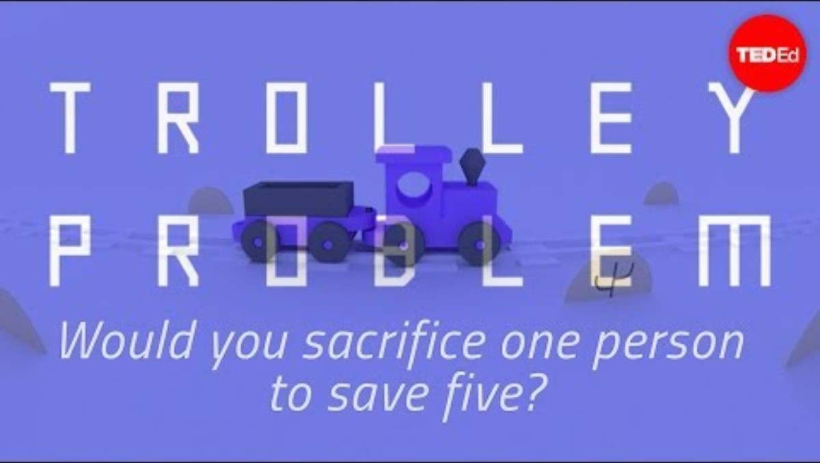
Would you sacrifice one person to save five?
The trolley problem
You are going to watch a clip that will make you think about this question.
For the first viewing, just watch (and think).
Notes:
Purpose:
To prepare students for the first viewing of the Trolley Problem clip by focusing on understanding the scenario and noticing their initial reaction.
Speaker:
You are going to watch a short clip that explains the dilemma I have just introduced.
For this first viewing, just watch and think. Do not write anything yet. Your goal is simply to picture the situation and notice your own gut reaction.
Ask yourself quietly: would I pull the lever or not? There is no right answer.
Notes:
https://youtu.be/yg16u_bzjPE
Tell students this viewing is only to understand the scenario.
Ask them to watch without taking notes.
Reassure them that ethical dilemmas do not have correct answers.
After the clip, take two or three quick hands for first reactions but save deeper discussion for the next slide.

Slide 35
Second viewing
Activity
Draw two columns on a half sheet of paper:
Column 1: Reasons for pulling the lever
Column 2: Reasons against pulling the lever
Task while watching:
Jot down ANY reason you hear in the clip that fits either side.
You could also write down one question you would ask about the dilemma – ANY question inspired by the clip.
Notes:
Purpose:
To guide students through a focused second viewing of the clip so they can identify ethical reasons for and against pulling the lever.
Speaker:
For the second viewing, you will take notes.
On a half sheet of paper, draw two columns. In the first column, write reasons for pulling the lever. In the second column, write reasons against pulling the lever.
While you watch, jot down any reason you hear in the clip that fits either side.
If something in the clip makes you curious, you can also write down one question you would ask about the dilemma. Any genuine question is fine.
Notes:
Remind students that short phrases are enough.
Encourage them to focus on ideas, not perfect wording.
Let them know that they will use these notes in the group discussion that follows.

Slide 36
Group work
Ethical reasoning
You now have reasons on both sides. Use these to explain your choice when you talk with your group.
In small groups :
discuss what each person in their group would do in response to the ‘classic’ trolley problem and justify your choice
We will consolidate our thinking after 15 minutes.
15 minutes
Notes:
Purpose:
To help students practise ethical reasoning by using the reasons they collected to justify their decision in the classic trolley dilemma. This develops their ability to explain their thinking clearly and understand how others may reach different conclusions.
Speaker:
You are now going to engage in group discussions to present your arguments for and against pulling the lever. You have made notes as you wathced the clip for the second time, so use these in your discussion. Use the reasons you collected to help you explain your choice, not just your opinion. The goal is to practise thinking like a philosopher — giving reasons and listening to others.
When you are working with your group, you need to ensure that:
Each person shares what they would do.
They explain why, using at least one reason from their list.
Other group members can ask one clarifying question.
Notes:
Circulate and prompt deeper thinking where needed by asking:
“Which reason mattered most to you?”
“Did anyone have a different view? Why?”
Give a 2-minute warning before bringing the class together to share the key arguments for and against different decisions with the class.

Slide 37
Lesson 6
Exploring perspectives in Philosophy

Slide 38
Learning intentions and success criteria (4)
We are learning to
explain what a perspective is
understand why people may see the same issue differently
take part in respectful discussions that include a range of viewpoints.
We can
describe what a perspective is
explain reasons why people hold different perspectives on the same issue
discuss a challenging idea respectfully and acknowledge other people’s points of view.
Notes:
Notes for teachers:
Adapt the learning intention as required and add matching success criteria.
For more information see ⁠NSW Department of Education explicit teaching strategies https://education.nsw.gov.au/teaching-and-learning/curriculum/explicit-teaching.
LISC is not necessarily presented at the beginning of the lesson. Teacher needs to consider most effectual time to introduce.
LISC should be revisited during the lesson to support students' evaluation of their learning.

Slide 39
Perspective in Philosophy (1)
We are learning to understand what a perspective is and why people see the same thing differently.
Key ideas
Philosophy teaches us to examine the world through different perspectives.
When we read philosophy, we are introduced to new ways of viewing reality.
Notes:
Purpose:
To introduce the idea of perspective in philosophy and help students understand why people interpret the same situation differently.
Speaker:
Perspective is simply the way someone sees or understands the world. Philosophy helps us notice that people can look at the same situation and come away with completely different ideas.
When we read philosophy, we are shown new ways of viewing reality. This helps us question our own assumptions and understand others more deeply.
As we explore this topic, think about a time when you saw something differently from a friend or family member. What shaped your perspective?

Slide 40
Perspective in Philosophy (2)
We are learning to understand what a perspective is and why people see the same thing differently.
Key ideas
Philosophers encourage us to look at issues through more than one lens.
As beginning philosophers, it is important to consider our own views fairly and practise looking at issues from perspectives that differ from our own.
Notes:
Purpose:
To build students’ understanding that philosophy involves examining issues from multiple perspectives and reflecting on their own viewpoints.
Speaker:
Philosophers remind us that most issues can be seen through more than one lens. When we slow down and look from another angle, we often notice things we missed before.
As beginning philosophers, a key skill is learning to consider our own views fairly. That means asking ourselves why we think the way we do and practising how to look at issues from perspectives that differ from our own.
This helps us become clearer thinkers and better listeners.

Slide 41
Analysing a perspective cartoon
On the next slide you will see a cartoon of several people looking at the same tree.
As you look at it, pay attention to:
what each person notices
what each person values
what each person imagines the tree could become
how their background or needs might shape their viewpoint
whether any perspective is ‘more right,’ or simply different.

Slide 42
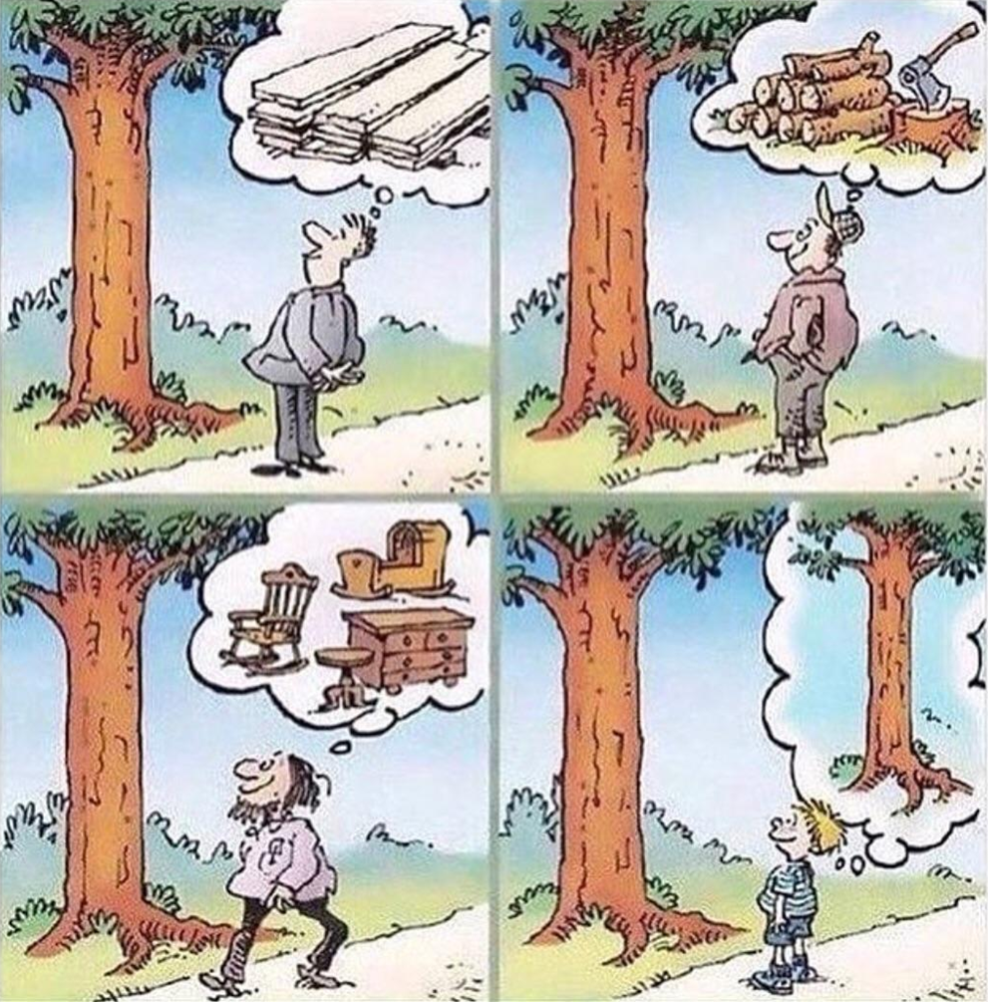
Different perspectives
TreeCanada
Notes:
Purpose:
To show how different people can see the same thing in completely different ways.
Speaker:
Look at this cartoon for a moment. Each person sees the same tree, but their perspective changes what they notice and what they value.
This is what we mean by perspective in philosophy: the world looks different depending on who is looking.

Slide 43

Perspectives
In your books – or digital equivalent, answer:
What are the four different perspectives shown in the cartoon?
Why might each person view the tree the way they do? (For example: personal needs, interests, experience, goals).
TreeCanada
Notes:
Purpose:
To engage students in understanding the influneces that might shape perspective
Speaker:
Look at this cartoon again. Now, in your books, answer the two questions provided. Think about each person and what might be shaping the way that they see the tree. Think about the needs, the interests, the perspectives and the goals that they may have that would influence their perspective.
Write these independently and then we will discuss your responses.
Note:
Teacher can use techniques such as cold calling or think pair share to have the class engage in a discussion based on these questions. There are no right answers, so long as students are understanding that the people in the cartoon have different perspectives that are shaped by aspects of their lives.

Slide 44
Check for understanding (2)
What does perspective mean?
How would you explain it in your own words?
Challenge question – give one example of how two people might have different perspectives on the same thing.
Notes:
Purpose:
To check whether students understand the meaning of perspective and can explain it independently.
Speaker:
Take a moment to answer the two questions on the slide. First, what does perspective mean? Then, explain it in your own words.
If you want a challenge, give an example of how two people might see the same situation differently.
This helps me see how well the idea has landed and whether we need to revisit anything.

Slide 45
Objectivity is important to Philosophy
It helps us reason clearly, test ideas properly and communicate.
Objectivity means looking at an idea, issue or situation fairly, without letting:
personal feelings
preferences
biases
influence your judgement. It involves focusing on evidence, facts and clear reasoning rather than opinions or emotions.
Notes:
Purpose:
To explain what objectivity means and why it matters in philosophical thinking.
Speaker:
Objectivity is about looking at an idea or issue fairly. It means trying not to let your personal feelings, preferences or biases shape your judgement.
Philosophers value objectivity because it helps us reason clearly, test ideas properly and communicate our thinking in a way others can understand.
As we move on, keep asking yourself: am I focusing on evidence and reasoning, or am I slipping back into personal opinion?

Slide 46
Statement sort
Objective or not objective?
The tree is approximately five metres tall.
The tree is the most beautiful part of the park.
The tree has rough bark and green leaves.
Cutting down this tree would be a terrible idea.
This tree could be used to build furniture.
This is my favourite tree in the whole park.
Notes:
Purpose:
To help students practise identifying objective and non-objective statements.
Speaker:
Here are six statements about a tree. Some are objective because they can be checked or measured. Others are based on opinion or personal judgement.
Read each statement and decide whether it is objective or not. You can signal your answer with a thumbs up for objective and a thumbs down for not objective.
Be ready to explain your thinking. The goal is to notice what makes a statement fact-based and what makes it subjective.
Notes:
Keep the pace brisk.
If students disagree, use it as a quick teaching moment: ask what evidence could or could not support the claim.
After this discussion, debrief with the class, asking the questions:
Which statements describe observable facts?
Which ones express opinions, preferences, or values?
Why does philosophy require us to recognise the difference?

Slide 47
An ethical dilemma
Case study of self driving cars
You will watch a clip on the ethical dilemma of self driving cars.
Then you will answer 8 multiple choice questions to check your understanding.
Notes:
Purpose:
To outline the short activity using a real-life ethical dilemma.
Speaker:
We are now going to look at a case study about self driving cars. First, you will watch a clip that explains the dilemma.
After that, you will complete eight quick multiple choice questions to check your understanding.
Just follow the steps on the slide and move through the questions at your own pace.
Note:
The link to the multiple choice questions would need to be shared with students so they can independently work through them. To complete the online, students will need to join TEDed – otherwise you can give the questions to the students on paper.

Slide 48

The ethical dilemma of self-driving cars
Notes:
The link to this video is in the program.

Slide 49
Activity – scenarios in pairs
In your pairs, provide a logical and reasoned justification for each of your decisions in each scenario.
Scenario 1 – In Scenario 1 do you believe the car should swerve left into the SUV, swerve right into the motorcycle or not swerve at all?
Scenario 2 – In Scenario 2 do you believe the car should swerve to hit the rider with the helmet or hit the rider with no helmet?
Scenario 3 – When purchasing a car would you purchase one programmed to minimise lives lost or one that is designed to protect you at all costs?
Scenario 4 – When an ethics judgement is needed, who should get to decide how robot cars are programmed: engineers/programmers, manufacturers/company executives, government, owner/occupants of the vehicles, the general public, or someone else?
Notes:
Purpose:
To guide students through ethical decision making by discussing the scenarios in pairs and justifying their choices.
Speaker:
Work with your partner to talk through each scenario on the slide aiming to come up with an agreed response to each one. For every decision you make, give a clear reason to back it up.
There are no perfect answers here. What matters is how well you can explain your thinking.
Move through the scenarios one at a time and be ready to share one of your justifications with the class.
Notes:
Circulate and listen for reasoning rather than quick guesses.
Prompt students with simple questions like What value is guiding your choice? or Why that option over the others?

Slide 50
Lesson 7
Developing a personal philosophy

Slide 51
Do now
Self-reflection
To begin, take one minute to think about yourself.
If you had only five words to introduce yourself to someone new, what would they be?
What are the five beliefs or values you hold most strongly? Write them down.
Notes:
This is an optional scaffolded sentence builder and may not be suitable for all classes.
Purpose:
To get students to begin to engage in what they value.
Speaker:
Today we are going to spend time reflecting on ourselves, who we are and what we value. Take a minute to answer the two questions on the slide. Please write your responses in your books.

Slide 52
Learning intentions and success criteria (5)
We are learning to
describe what a personal philosophy is
identify core values and beliefs that may shape a personal philosophy
develop our own personal philosophy statement.
We can
describe the concept of a personal philosophy
explain the key elements involved in developing a personal philosophy.
Notes:
Notes for teachers:
Adapt the learning intention as required and add matching success criteria.
For more information see ⁠NSW Department of Education explicit teaching strategies https://education.nsw.gov.au/teaching-and-learning/curriculum/explicit-teaching.
LISC is not necessarily presented at the beginning of the lesson. Teacher needs to consider most effectual time to introduce.
LISC should be revisited during the lesson to support students' evaluation of their learning.

Slide 53

Personal identity – crash course philosophy
Notes:
Purpose:
To introduce personal identity: https://www.youtube.com/watch?v=trqDnLNRuSc
Speaker:
We are going to watch a video that introduces the idea of personal identity.
Note:
The video references Dr. Who so some background knowledge may need to be communicated if students are unfamiliar with this.

Slide 54
My personal philosophy – (teacher edition)
Let me think aloud how I would do it
My core values are…_____________________________.
What I believe about life
I believe a good life is shaped by… ____________________________and by treating others with ________________.
Each day, I try to _______________________ so my actions match my values.
Overall, I aim to live in a way that reflects _____________________.
Notes:
Purpose:
To model how to think aloud while completing the personal philosophy scaffold, showing students how ideas develop step by step.
Speaker (suggested script as per program):
I am going to fill in this scaffold so you can see how a personal philosophy comes together.
The first part asks for my core values. I am stopping to think: ‘What genuinely matters to me? What do I try to live by every day?’
I am thinking that honesty is important to me because I want people to trust my words. I also value kindness, because I do not want to make life harder for others. And finally, I am choosing curiosity, because learning new things makes my life richer.
So I would write: honesty, kindness, curiosity.
Now I move to the next section: ‘I believe a good life is shaped by…’
I am thinking aloud here: ‘What actually guides how I make decisions?’ For me, a good life is shaped by being thoughtful about others, so I will put that in.
Before I fill in the next blank, let’s pause. The sentence says: ‘…and by treating others with…’
What are some words you think could go here?
(Allow 2 or 3 responses.)
Those are great suggestions. I am choosing respect, because it connects well with honesty and kindness, and it is something I try to show even when I disagree with someone.
Now the scaffold says: ‘Each day, I try to ______ so my actions match my values.’
This one is about daily behaviour. Something realistic.
What could go here? What is one small everyday action that shows your values?
(Students offer examples.)
All excellent ideas. I am going to choose ‘listen carefully’, because that helps me show kindness and respect.
Finally, it says: ‘Overall, I aim to live in a way that reflects ______.’
Before I choose, what kind of word could fit here? A value, a big idea or a goal?
(Students respond.)
Lovely suggestions. I am choosing integrity because, for me, it means trying to act in line with what I say I believe.

Slide 55
How would I put that all together?
Let’s write it together
My personal philosophy centres on the values of ______, ______, and ______.
I believe a good life is shaped by ______ and by treating others with ______.
Each day, I try to _____ so my actions match my values. Overall, I aim to live in a way that reflects ______.
Notes:
This is an optional scaffolded sentence builder and may not be suitable for all classes.
Purpose:
To demonstrate how to turn the scaffolded ideas into a single, coherent personal philosophy statement.
Speaker:
Now that I have filled in each part, I can put it all together in one clear statement.
Here is how mine might sound:
‘My personal philosophy centres on the values of honesty, kindness and curiosity.
I believe a good life is shaped by being thoughtful about others and by treating others with respect.
Each day, I try to listen carefully so my actions match my values.
Overall, I aim to live in a way that reflects integrity.’
This shows how the pieces come together to form one short statement. Students will use the same structure to write their own.

Slide 56
A final statement
Bringing it all together
My personal philosophy centres on the values of honesty, kindness, and curiosity.
I believe a good life is shaped by being thoughtful about others and by treating others with respect.
Each day, I try to listen carefully so my actions match my values.
Overall, I aim to live in a way that reflects integrity.
Notes:
This is an optional scaffolded sentence builder and may not be suitable for all classes.
Purpose:
To show students a finished version so they can see what a clear personal philosophy looks like before drafting their own.
Speaker:
Here is my final statement written out in full. This is what the scaffold builds towards.
As you read it, think about how each part connects to the values and beliefs I identified earlier.
You will now use the same scaffold to create your own version. It only needs to be about one hundred words. This is something you can return to and refine as we move through the course.

Slide 57
Over to you
Fill in the scaffold first
My core values are…._______________________.
What I believe about life:
I believe a good life is shaped by… _____________ and by treating others with ________________.
Each day, I try to ___________ so my actions match my values.
Overall, I aim to live in a way that reflects ________.
Then write your own personal philosophy in 200 words or less!
Notes:
Purpose:
To guide students to complete the scaffold and use it to draft their own short personal philosophy statement.
Speaker:
Now it is your turn. Start by filling in the scaffold on the left. Take your time to think about your values and what you believe makes a good life. Your answers do not need to be perfect. They just need to be honest.
Once your scaffold is complete, use it to write your own personal philosophy.
Focus on being clear and true to what matters to you. You will have chances to refine this later in the course.

Slide 58
Weeks 4–6
Philosophical allegories

Slide 59
Lesson 8
Ship of Theseus

Slide 60
Learning intentions and success criteria (6)
We are learning to
apply the skills of philosophical discussion to analyse a case study
develop a well-reasoned perspective on a contemporary issue
communicate ideas in a respectful and structured discussion
describe the Ship of Theseus allegory and explain how it relates to forming and testing philosophical ideas.
We can
form a logical position on a complex issue
explain my opinion using clear reasons and evidence
respond to different viewpoints respectfully during discussion
describe the Ship of Theseus allegory and explain what it shows about philosophical thinking.
Notes:
Notes for teachers:
Adapt the learning intention as required and add matching success criteria.
For more information see ⁠NSW Department of Education explicit teaching strategies https://education.nsw.gov.au/teaching-and-learning/curriculum/explicit-teaching.
LISC is not necessarily presented at the beginning of the lesson. Teacher needs to consider most effectual time to introduce.
LISC should be revisited during the lesson to support students' evaluation of their learning.

Slide 61
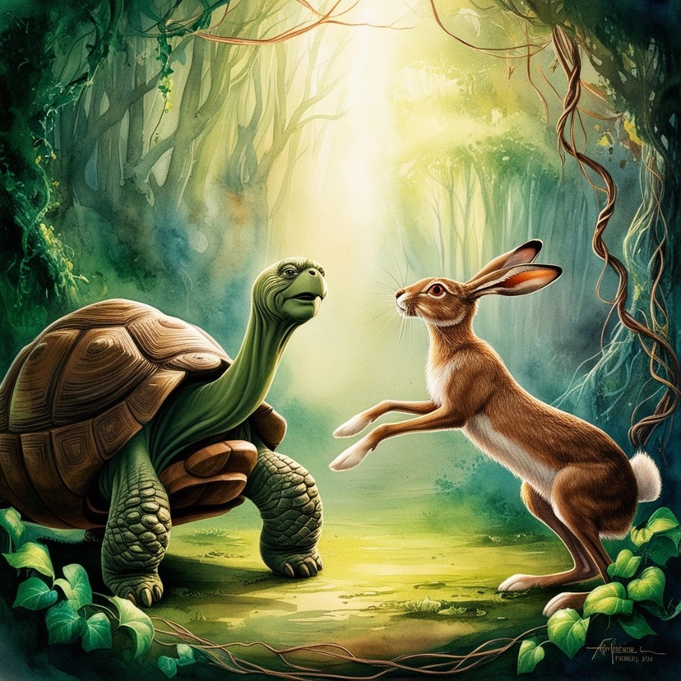
What is an allegory?
Litchart’s definition
An allegory is a work that conveys a hidden meaning –usually moral, spiritual, or political – through the use of symbolic characters and events. The story of "The tortoise and the hare" is a well-known allegory with a moral that a slow and steady approach (symbolised by the tortoise) is better than a hasty and overconfident approach (symbolised by the hare).
Pixabay Chaitran2018
Notes:
Purpose:
To introduce the concept of allegory and show students how stories can communicate deeper moral or symbolic meanings.
Speaker:
An allegory is a story that has a hidden meaning beneath the surface. It usually teaches a moral or explores a spiritual or political idea.
Writers do this by using symbolic characters and events. For example, in ‘The Tortoise and the Hare’, the animals stand for different approaches to life. The Tortoise symbolises patience and steady effort, while the Hare represents rushing and overconfidence.
As you read this definition, think about why authors might choose to teach a message in this indirect way rather than stating it plainly.

Slide 62
The tortoise and the hare (1)
An allegory
There once was a speedy hare who bragged about how fast he could run. Tired of hearing him boast, the tortoise challenged him to a race. All the animals in the forest gathered to watch.
The hare ran down the road for a while and then paused to rest. He looked back at the tortoise and cried out, ‘How do you expect to win this race when you are walking along at your slow, slow pace?’
The hare stretched himself out alongside the road and fell asleep, thinking, ‘There is plenty of time to relax.’
Notes:
Purpose:
To introduce the allegory by reading the story aloud so students can follow the events and characters.
Speaker:
I am going to read the beginning of ‘The Tortoise and the Hare’ aloud. As you listen, picture the scene in your mind. Notice how the characters behave and what their actions might represent.
Just follow the story for now.

Slide 63
The tortoise and the hare (2)
The tortoise walked and walked, never ever stopping until he came to the finish line.
The animals who were watching cheered so loudly for tortoise that they woke up the hare. The hare stretched, yawned and began to run again, but it was too late. Tortoise had already crossed the finish line.
Moral – Slow and steady wins the race.
Notes:
Purpose:
To guide students in interpreting the allegory by linking story elements to real-life ideas and behaviours.
Speaker:
Now that we have read the full story, we are going to uncover the allegory together. These questions will help us think about what the characters and events might represent in real life.
You do not need to answer all of them at once. We will take them one at a time and talk through what each question is really asking.
As we work, focus on the big idea: the story is using animals and a simple race to say something deeper about human behaviour.

Slide 64
Uncover the allegory
Questions 1–3
What real-life behaviours or attitudes might the Hare represent?
What human qualities does the Tortoise symbolise?
How does the race itself stand in for a situation we face in everyday life?
Notes:
Purpose:
To guide students through the first three interpretive questions so they can begin identifying symbolic meanings in the allegory.
Speaker:
We are going to look closely at the first three questions. These focus on what the characters and the race itself might stand for in real life.
As we go through each one, think about the attitudes or qualities you have seen in people around you.
Take a moment to jot down a quick idea for each question. You do not need full sentences. We will share some thoughts as a class before moving to the next set of questions.

Slide 65
Uncover the allegory
Questions 4–6
4. Why do you think the author uses animals rather than people to teach this lesson?
5. How do the Hare’s and Tortoise’s actions reveal a deeper message about success or achievement?
6. What is the moral, and how does it connect to something bigger than a simple race?
Notes:
Purpose:
To deepen students’ interpretation of the allegory by exploring why the author uses animals, what message the characters’ actions communicate and how the moral connects to real life.
Speaker:
These next three questions help us think beyond the surface of the story.
First, we will consider why an author might choose animals instead of people. What does that allow the story to do?
Then we will look at how the actions of the Hare and the Tortoise communicate a message about success or achievement.
Finally, we will think about the moral and how it connects to something bigger than a simple race.
Take a moment to note your ideas. We will discuss them together.
Note:
After the students have a moment to write their notes, lead to the class in a discussion of all the questions with the aim to come up with an answer for each.

Slide 66
Why do allegories matter in Philosophy?
Complex ideas in stories
turn difficult ideas into understandable stories
allow ideas to be debated safely and imaginatively
reveal patterns in human behaviour
encourage interpretation, which is a core philosophical skill
invite reflection on moral and ethical questions
endure across time because their messages are flexible.
Notes:
Purpose:
To explain why allegories are useful tools in philosophy and how they support deeper thinking.
Speaker:
Allegories are often used in philosophy and as I read through the list on the slide, think about how ‘The Tortoise and the Hare’ does each of these things.
Allegories matter in philosophy because they help us explore difficult ideas in a way that feels clear and engaging.
They let us debate ideas safely and imaginatively by using stories instead of real people.
Allegories also reveal patterns in human behaviour and encourage us to interpret meaning, which is a key philosophical skill.
They invite us to reflect on moral and ethical questions and they stay relevant across time because their messages can be adapted to new situations.

Slide 67
Ship of Theseus
A famous philosophical allegory
The Ship of Theseus is a classic philosophical thought experiment about identity and change. It asks you to imagine a ship that has all its parts replaced, one by one, over time. Eventually, every plank, rope, and sail has been swapped out for a new one.
The question is: Is it still the same ship?
Thumbs up for YES
Thumbs down for NO
We will revisit this idea as we move through this lesson.
Notes:
Purpose:
To introduce a classic philosophical thought experiment that helps students consider ideas about identity and change.
Speaker:
The Ship of Theseus is a famous example used in philosophy to help us think about what makes something the same over time.
It asks us to imagine a ship where every plank, rope and sail is gradually replaced.
By the end, there is nothing original left, which raises an important question: is it still the same ship?
I will read the description and then ask for your first response.
There is no right or wrong answer at this stage. The aim is simply to notice your instinct.
After the description, I will ask you to show your answer with a thumbs up for “yes” or a thumbs down for “no”.
Theseus, the son of King Aegeus rescued the children of Athens who had been gifted to Minos the King of Crete as a tribute. The childrens fate was to be fed to the terrifying Minotaur who lived on the island. After slaying the Minotaur, Theseus and the children escaped on a ship to Delos. Each year the athenians would Commemorate this by taking the craft on a pilgrimage to delos to honour Apollo. Overtime the timber boards of the boat rotted and were replaced. The ship of theseus used was preserved by replacing its wooden planks as they decayed over time. Eventually, all parts of the original boat were changed in order to presenrve it.
This then leads us to the question – is this stil the same ship? Thumbs up for yes, thumbs down for no.
We are going to discuss your thoughts after we explore the allegory in more detail.

Slide 68
How is this an allegory?
Isn’t it a thought experiment?
The Ship of Theseus works like an allegory because it uses a story about a ship to symbolise bigger philosophical questions about identity.
But formally, it is considered a metaphysical thought experiment.
Notes:
Purpose:
To explain why the Ship of Theseus can function like an allegory while technically being a metaphysical thought experiment.
Speaker:
The Ship of Theseus works like an allegory because it uses the simple story of a ship to explore larger philosophical questions about identity.
Even though it feels like an allegory, philosophers classify it as a metaphysical thought experiment because the focus is on reasoning through a problem rather than interpreting symbols.
Note:
Reassure students that it’s fine if the distinction feels fuzzy-what matters is recognising how stories can help us think about abstract ideas.

Slide 69
A different perspective
Thomas Hobbes
He proposed a version of the following thought experiment to anyone who would entertain that the metal ship is the same as the wooden ship:
‘On board the ship was a sailor who really wanted his own ship but could not afford one. So, he came up with a plan: every time Theseus decided to replace one of the wooden parts of his ship with a metal part the sailor would take the discarded piece of wood and hide it in his shed. When eventually he had collected all the wooden parts he re-assembled them into a ship again.’
Notes:
Purpose:
To introduce students to an alternative way of thinking about the Ship of Theseus problem by showing how Thomas Hobbes challenged the original scenario. This prepares students to compare ideas about identity and change.
Speaker:
Philosophers often respond to each other by offering new versions of a problem. Here is another take on the Ship of Theseus. Thomas Hobbes wanted to push the question even further. He asked us to imagine a sailor who quietly collects every old wooden plank that comes off the original ship. He stores them away until he has all the pieces. Then he rebuilds a second ship out of the original wood.
Now we have two ships: the metal one that has been repaired over time, and the wooden one that has been rebuilt from the old parts.

Slide 70
A provocation
*Something to think about
Imagine that someone collects all the old planks that were removed from Theseus’ ship (like Hobbes proposed) and they rebuild a complete ship using those original parts.
This creates a second question:
Is this the real Ship of Theseus – the one made of the original materials?
Think about this as we move through the lesson
Notes:
Purpose:
To prompt students to hold a new question in mind as they continue the lesson. This prepares them for deeper thinking about identity, materials, and continuity over time.
Speaker:
Here is the next twist in the problem. Now that we have two ships in the story this gives us another question to think about:
Is the rebuilt wooden ship the real Ship of Theseus? The one made from the original materials rather than the one that has had the parts replaced?
There is no need to answer right now. Just keep this question in mind as we continue.

Slide 71
Why this matters philosophically
The deeper puzzle
Which ship is the true Ship of Theseus?
The one with continuity (same journey, same repairs over time)?
OR
The one with original material (same physical parts)?
Both claims seem reasonable, but they contradict each other.
Notes:
Purpose:
To help students recognise the central tension in the Ship of Theseus puzzle and understand why philosophers continue to discuss it.
Speaker:
As we now that we have two possible ships, we can see the real puzzle.
Which one is the true Ship of Theseus?
One answer says it is the ship with continuity. It is the one that sailed the journeys, had repairs over time and kept the same history.
The other answer says it is the ship with the original material. It is made from the physical parts Theseus touched and sailed with.
Both ideas seem reasonable, but they cannot both be right at the same time. This is why the question matters. It helps us think about what makes something the same thing over time. Is the ship its story or its parts?’
Notes
Pause and allow students to reflect before moving on.
Avoid letting students debate yet. This slide is about naming the two competing ideas, not resolving them.
You may ask students for a quick thumbs up or down to see which idea they lean towards, but keep it brief.

Slide 72
What makes something the same over time?
Is it:
materials?
history?
form or shape?
function?
something else entirely?
Notes:
Purpose:
To prompt students to think about the criteria we use to decide whether an object remains the same across time and change.
Speaker:
Now we are widening the puzzle. Forget ships for a moment. Think more broadly.
What actually makes something stay the same over time?
Is it its materials?
Is it its history?
Is it its form or shape?
Is it what it does?
Or is it something else entirely?
These questions help philosophers work out what identity really means.
As we go through the next activities, keep these possibilities in mind and notice which ones you find most convincing.’
Notes:
You might invite a quick show of hands for each option to see which idea the class naturally prefers.
Avoid long discussion here. The aim is to plant the puzzle and build curiosity before the next step in the sequence.

Slide 73
Activity
Which ship is the real one?
The Ship of Theseus has every plank replaced over many years.
It still sails, still has the same captain, and continues its journey.
This is Ship A.
Meanwhile, someone collects all the old planks and rebuilds a whole ship using the original materials.
This is Ship B.
Notes:
Purpose:
To help students compare two competing ideas about identity and decide which version of the Ship of Theseus they believe is the original.
Speaker:
We now have the two ships to compare.
Ship A is the ship that has had every plank replaced over many years, but it keeps sailing, keeps its captain, and continues its journey.
Ship B is built entirely out of the original planks that were removed.
Your task is to decide which one you think is the real Ship of Theseus and why.
There is no single correct answer here. Is it ship A? Is it Ship B? Is it both? Is it neither? The aim is to explain your thinking clearly.
You will use the ideas from the previous slide to support your decision, such as material, history, function, or shape.’
Notes:
Keep students focused on giving reasons, not on guessing 'the correct' answer.

Slide 74
Your turn to decide
Using clear reasoning
Both ships now exist.
Which one is the real Ship of Theseus?
Individual writing: “I think the real Ship of Theseus is ____ because ____.”
Notes:
Purpose:
To give students time to form and justify their own position using clear reasoning.
Speaker:
Use the sentence starter on the slide to keep your response focused. Remember to consider ideas such as material, history, function, shape, or continuity in making your decision.
Write one or two clear sentences that finish the prompt and remember – it is not the answer, but the reasoning that really matters.
Notes:
Give the students time to write their responses.

Slide 75
Voting time
Tally on the board
Hands up for:
Ship A (continuity over time)
Ship B (original materials)
Neither
Both
Notes:
Purpose:
To let students share their judgement publicly and to show the range of reasoning in the room.
Speaker:
We are going to take a quick vote. Remember - this is not about being right or wrong. It is about noticing how different people make sense of the same puzzle.
When I read out an option, put your hand up if it matches your view. I will make a tally on the board.
First option: Ship A, the one with continuity over time.
Second option: Ship B, the one rebuilt from the original materials.
Third option: neither of the two ships.
Fourth option: both ships in different ways.
After we vote, take a moment to look at the tallies. This helps us see how varied philosophical thinking can be.’
Notes:
Keep the pace brisk so the vote feels energetic.
Avoid asking students to defend their view yet. The next slide or task can handle deeper discussion.
If the results are unexpected, briefly acknowledge this without analysing it in detail.

Slide 76
Activity – structured small-group debate
Answer one of these prompts in your group:
Prompt 1: If Ship A is the original ship, why don’t the parts matter?
Prompt 2: If Ship B is the original ship, why doesn’t history matter?
Prompt 3: Can identity be duplicated? If so, is identity physical, psychological, or something else?
Prompt 4: Is your body ‘you’ if every cell eventually gets replaced?
(Use examples! Think about phones, cars, pets, bodies, friendships.
Notes:
Purpose:
To guide students into a clear, structured discussion where they apply the Ship of Theseus puzzle to real examples and practise giving reasons.
Speaker:
Using the reasoning that you have just engaged in, we are going to work in small groups to explore one of these prompts.
Each group will be assigned one prompt from the list on the slide.
Your goal is to work in your groups and put forward your ideas clearly and support those ideas with reasons and an example. You can use examples from everyday life such as phones, cars, pets, bodies or friendships. Take turns to speak. One person reads the prompt aloud, one person starts the discussion, and one person keeps the group focused on answering the question.
You have ……….minutes. I will visit each group to listen in.
Notes:
Decide on the length of time of group discussion based on class time available. At the conclusion of that time, have each group report back on what was discussed.

Slide 77
In the hot seat
An optional extension activity
We need one student to volunteer for the ‘hot seat’.
The class will try to convince you to switch to a different answer.
If you are in the hot seat, you can only switch if you hear a more persuasive argument.
Notes:
Purpose:
An optional activity to give students an engaging extension that builds reasoning, persuasion and careful listening.
Speaker:
We need one volunteer for the hot seat who is going to share their view on the Ship of Theseus question. Once they have spoken, the rest of the class will try to persuade them to change their mind by offering clearer or stronger reasons.
If you are in the hot seat, you can only switch your answer if you genuinely hear a more persuasive argument. If you are not convinced, you stay with your original answer.
If you are not in the hot seat, think about the most effective argument you can offer. Keep your tone respectful and focus on reasons, not volume.
Additional notes:
Choose a confident student first to model how the activity works. Remind the class to speak one at a time. If the hot seat student struggles to decide, prompt them with ‘What reason felt strongest to you?’ Keep the pace brisk and finish while interest is still high.

Slide 78
3-2-1 things I learned today – write these in your books
List 3 things you learned today:
3
1.
2.
3.
List 2 questions you have about these things:
2
1.
2.
Give 1 reason why it’s important to learn about these things:
1
1.
Notes:
Purpose:
To help students consolidate the lesson, check their own understanding and signal any areas that may need revisiting.
Speaker:
To finish up, I want you to complete a quick 3–2–1 reflection in your books. Write three things you learned today, two questions you still have, and one reason why it’s important to explore these ideas. Your answers don’t have to be long, but they should be clear. This helps you keep track of what you’ve understood and lets me see where we may need to spend more time.
Take a minute now to think before you write. Once you have finished, be ready to share one of your points if I call on you.
Additional notes:
Use this as an informal check for understanding. If you notice repeated questions across the class, make a note to revisit those ideas next lesson. You can also collect a few books at random to gauge individual progress without marking every entry. Keep the task focused and quiet to help students settle at the end of the lesson.

Slide 79
Lesson 10
Spotlight on Plato

Slide 80
Learning intentions and success criteria (7)
We are learning to
describe key features of Plato's philosophy
explain the theory of forms and how it shaped Plato’s view of reality.
We can
outline Plato's major ideas and their importance in the study of philosophy
explain the allegory of The Cave and connect it to my prior learning about the Ship of Theseus allegory.
Notes:
Notes for teachers:
Adapt the learning intention as required and add matching success criteria.
For more information see ⁠NSW Department of Education explicit teaching strategies https://education.nsw.gov.au/teaching-and-learning/curriculum/explicit-teaching.
LISC is not necessarily presented at the beginning of the lesson. Teacher needs to consider most effectual time to introduce.
LISC should be revisited during the lesson to support students' evaluation of their learning.

Slide 81
Plato – the architect of Western Philosophy
428–347 BC
Founded the Academy in Athens, one of the earliest institutions of higher learning.
Influential in metaphysics, epistemology and political philosophy, shaping Western thought for centuries.
Used dialogues* to explore philosophical ideas, often featuring Socrates (another philosopher) as the questioner.
* short dramatic conversations between characters who debate big questions.
Notes:
Purpose:
To introduce Plato in a clear, accessible way and explain why his work matters for this unit, especially his use of dialogues to explore philosophical questions.
Speaker:
We are stepping back in time to meet Plato, one of the most influential thinkers in Western philosophy. He lived in ancient Greece and founded the Academy in Athens, which was one of the first higher-learning institutions. His ideas about reality, knowledge and politics have shaped how people think for centuries.
Plato didn’t write essays like we do. Instead, he wrote dialogues – short dramatic conversations where characters debate big questions. One of the main figures in these dialogues is Socrates, who acts as a questioner and guide.
Today, as we look at Plato’s ideas, focus on how he uses conversation to unpack complicated thinking.

Slide 82
Plato
The dialogues
Plato believed that philosophy is something you do, not something you memorise.
Dialogues let readers:
watch ideas being tested
see how arguments unfold
notice when someone contradicts themselves
realise that good questions matter more than quick answers.
Most dialogues feature Socrates as the lead questioner, guiding others to think more deeply.
Notes:
Purpose:
To introduce students to Plato’s use of dialogues as a way of exploring ideas, and to show how this method highlights questioning, reasoning and the testing of arguments.
Speaker:
Plato didn’t think philosophy was something you memorise. He thought it was something you do.
That is why he wrote dialogues instead of essays. In a dialogue, we watch ideas being tested, we see how an argument unfolds, and we notice when someone contradicts themselves.
The point is not to reach a quick answer, but to see how careful questioning leads to clearer thinking.
Most dialogues include Socrates as the main questioner. He guides others by asking simple but powerful questions that reveal what they really believe.

Slide 83
Philosophical dialogue
How a dialogue works
A typical dialogue includes:
a starting question (What is justice? What is knowledge?)
characters offering an answer
Socrates (another philosopher) testing those answers
contradictions or gaps being exposed
a clearer or more complex idea emerging.
It’s philosophy shown as a conversation in motion.
Notes:
Purpose:
To explain the structure and purpose of a philosophical dialogue and show students how questioning, testing ideas and exposing contradictions help ideas develop.
Speaker:
A dialogue usually begins with a simple but important question, such as ‘What is justice?’ or ‘What is knowledge?’.
Different characters then offer their answers. Socrates steps in to test these answers by asking follow-up questions.
As the conversation continues, gaps or contradictions begin to appear, which pushes the characters to think more clearly.
By the end, the idea is usually more precise or more complex than where it began.
This is philosophy as a conversation in motion, where thinking becomes clearer through questioning.’
Notes:
Encourage students to notice the pattern: question, answer, challenge, refinement.
This prepares them for doing their own structured dialogue work later in the unit.
You may want to get students to write the features of a dialogue in their books.

Slide 84
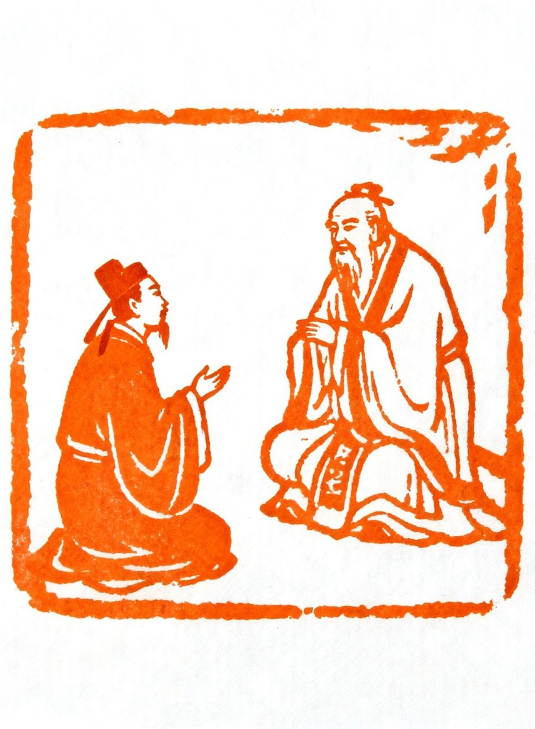
Why dialogues matter
…in Philosophy
Plato’s dialogues help philosophers:
practise following a line of reasoning
understand how questions shape thinking
notice how ideas can be strengthened or challenged
learn to explain a concept more precisely.
They demonstrate that philosophy is about careful questioning, not memorising facts.
Image by Xing Why from Pixabay
Notes:
Why dialogues matter – teacher notes
Purpose:
To show students why philosophers use dialogues and how this form supports deeper reasoning and clearer thinking.
Speaker:
Plato used dialogues because they help thinkers practise following a clear line of reasoning. When characters respond to questions, we can see how each idea builds on the last. Dialogues also show how questions shape our thinking. A single question can shift the direction of the whole discussion.
As ideas are tested, we notice where an explanation becomes stronger or where it falls apart. This helps philosophers learn to explain a concept more precisely.
The key message is that philosophy relies on careful questioning, not memorising facts. The goal is to think with clarity, not to repeat information.

Slide 85
Check for understanding (3)
Hand signals to show level of confidence
Question 1
Which part of a dialogue helps learning the most – the questioning, the contradictions or the final idea?
Show your number using your hand.
Question 2
Why might Plato choose dialogues instead of giving the answers?
Show your number again.
Be ready to share if called on.
0 = I understand none of this (closed fist).
1–2 = I understand a little.
3 = I understand some parts but not all.
4 = I mostly understand.
5 = I fully understand and could explain it to someone else.
Notes:
Purpose:
To gauge how confidently students understand the role of questioning and dialogue in philosophy, and to prompt quick formative feedback without putting individuals on the spot.
Note:
This slide contains an animation. Click the mouse when you see the word ‘CLICK’
Speaker:
We are going to check how clearly you understand these ideas. I will ask two questions. For each one, show your answer using a hand signal from zero to five. Zero means “I do not understand this at all”, and five means “I could explain this to someone else”. CLICK
Question one. CLICK. Which part of a dialogue helps learning the most? Is it the questioning, the contradictions, or the final idea? CLICK Hold up the number that matches your confidence.
CLICK. Question two. CLICK. Why might Plato choose dialogues instead of giving the answers himself? Show your number again.
Be ready to explain your thinking if I call on you, but I will keep it brief. The aim is to see how confident you feel, not to catch anyone out.’
Additional notes (optional):
If the class signals low confidence, pause for a short recap using one clear example from a dialogue.
If confidence is mixed, pair students so a higher-confidence student can explain their reasoning to a partner.

Slide 86
All philosophy starts with a problem or puzzle
Plato wanted to know…
What is permanent or immutable*
He wanted the answer to apply to:
nature
morals
society.
Put simply, Plato was asking what things never
change – and whether that idea could also explain nature, morals, and society.
*unchanging over time
Notes:
Purpose
To introduce students to Plato’s big question: whether anything in our world stays the same forever, and why that matters when we think about nature, morals, and society.
Note:
This slide contains an animation. Click the mouse when you see the word ‘CLICK’
Speaker:
Plato believed that philosophy started with problems. He wanted to know what was permanent or immutable which means something that never changes, no matter what happens around it.
Plato wasn’t just curious about objects; he was trying to work out whether there are unchanging truths behind how the world works.
He wondered if this idea of something unchanging could help explain nature (like patterns in the natural world), morals (ideas of right and wrong), and society (how people live together).CLICK
In simple terms, Plato was trying to find out if there are things that never change and whether those ‘unchanging things’ could help us understand the world better.
Can you think of anything in life that feels unchanging? Or does everything eventually change? (Encourage students to see that the goal is not to get the “right” answer but to spark curiosity).

Slide 87
Finding truth
Nature held the key for Plato
Plato thought the natural world is always changing – things grow, decay and become something new.
Because everything in nature changes, he believed it cannot give us perfect or permanent truth.
Only the Forms stay the same forever.
So, let’s look at Plato’s Theory of Forms
Notes:
Purpose:
To help students understand why Plato believed the natural world cannot provide permanent truth and why he introduced the idea of the Forms.
Note:
This slide contains an animation. Click the mouse when you see the word ‘CLICK’
Speaker:
Plato believed the natural world is always changing. Things grow, decay, and become something new again. Because everything in nature shifts, Plato thought it could not give us perfect or lasting truth. CLICK. Only the Forms are permanent. (Pause and emphasise that this is Plato’s key idea) The physical world changes, but the forms do not. CLICK. On the next slide we will dive deeper into the idea of Forms. To understand what Plato means by something permanent; we need to look at his theory of Forms. This is where he explains how perfect, unchanging versions of things exist, even though the world we live in keeps changing.

Slide 88
Plato’s Theory of Forms (1)
Let’s imagine a batch of home-made biscuits
What is the same between all the biscuits?
What would be different?
Is this the same for all living things?
Notes:
Purpose:
To introduce the idea that objects share a general pattern or essence even when individual examples look different, using biscuits as an easy starting point before shifting to living things and abstract forms.
Note:
This slide contains an animation. Click the mouse when you see the word ‘CLICK’
Speaker:
In order to begin to understand what Plato meant by Forms, we will start with a simple exercise. Imagine we have a big batch of home-made biscuits. They do not all look exactly the same, but we still recognise all of them as biscuits. CLICK.
What is the same between them? (Prompt students to think about shape, ingredients, or the idea of a biscuit). CLICK.
Now, what would be different? (Prompt students to look at decoration, size, or the way each one is slightly unique). CLICK.
If this works for biscuits, is something similarly true for living things? (Prompt students to think about how people all look different but share certain features that make us human).
Plato used this kind of thinking to explore the idea of a perfect form that objects try to match in the real world.
Another simple example that communicates Plato's thinking is this: every circle we draw is slightly imperfect, but the idea of a perfect circle never changes. Same with the biscuit example. Is every biscuit perfect? No. But can you picture a perfect biscuit in your head?

Slide 89

Plato’s Theory of Forms (2)
The world of ideas
Somewhere beyond the material world, Plato said there exists a realm of perfect ‘Forms’.
These Forms are the perfect versions of everything we see in nature.
So…there is a perfect
Form of horse
Form of human
Form of tree etc.
Pixabay
Notes:
Purpose:
To introduce students to the idea that Plato believed in a deeper, perfect reality behind the everyday world and to help them distinguish between physical things and their perfect Forms.
Speaker:
Remembering that Plato believed that because everything shifts and changes in the physical world it cannot provide us with a permanent truth. He believed there is a reality beyond the everyday world and that everything we see, including trees, animals and people, is an imperfect copy of a perfect Form.
A Form is not a shape. It is the perfect idea or essence of something.CLICK.
So there is a perfect Form of horse, a perfect Form of human, a perfect Form of tree and so on.
Turn to the person next to you and develop an answer to the question:
‘What is the difference between a real horse and the Form of horse?’
(Give students 20 to 30 seconds to talk. For a quick check for understanding, listen to two or three pairs share their answers aloud.)
Notes:
If students experience difficulty, remind them that Forms do not change or age. A real horse grows, and in time eventually dies. The Form does not.

Slide 90
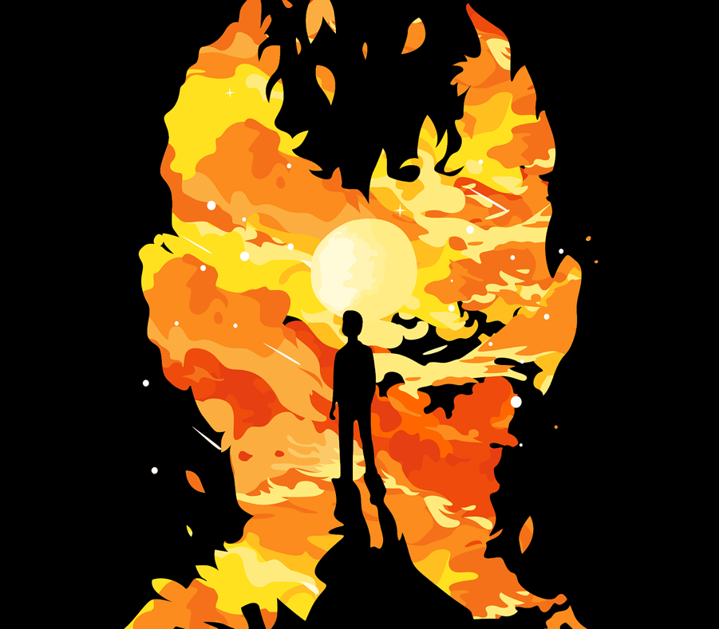
Plato’s Theory of Forms (3)
The material world vs the world of ideas
There is a world where we live – the material world.
But Plato said there is another reality: the world of ideas.
Image by ANDRI TEGAR MAHARDIKA from Pixabay
Notes:
Purpose:
To reinforce Plato's concept of Forms and explain the difference between the physical world we experience and the unchanging world of ideas that Plato believed in.
Speaker:
So just to re-cap, Plato saw that the material world - the world we see, hear and touch. It is always changing. Things grow, break, age, die and transform.
Plato said there is another reality called the world of ideas. This world does not change.
Nothing physical lasts forever, but a Form does.

Slide 91
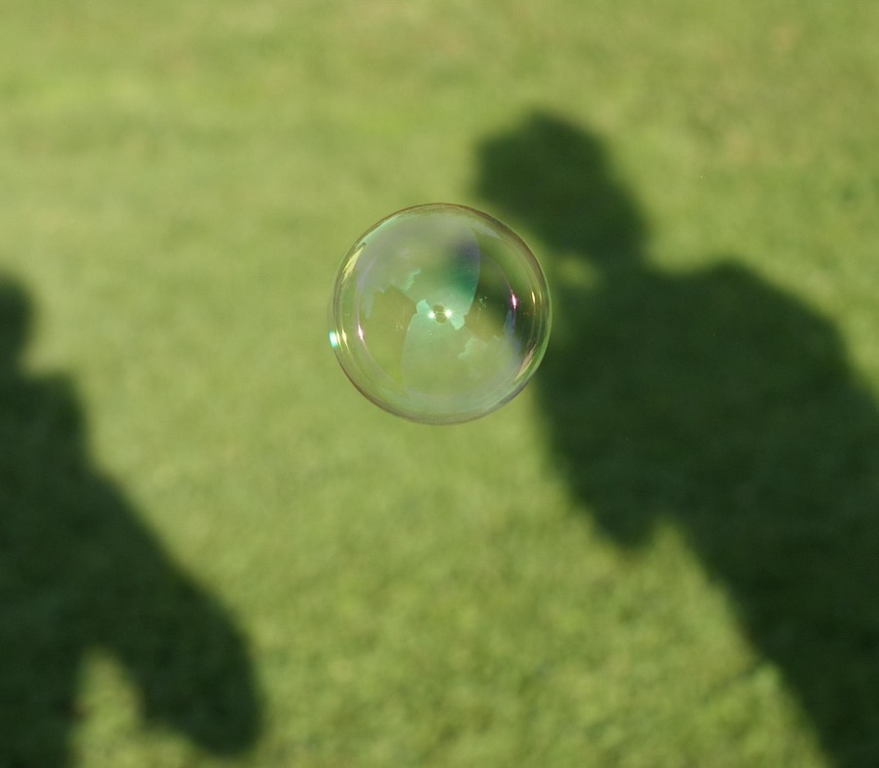
Soap bubble analogy – mini thought experiment
You be the philosopher
Imagine you are blowing soap bubbles.
With a partner, discuss:
‘How can everything tangible* be compared to a soap bubble?
*Tangible means something you can touch or feel physically.
Pixabay-Wi Pa
Notes:
Purpose:
To help students understand Plato’s idea that physical things are temporary and fragile by using a simple and relatable analogy.
Speaker:
We are now going to be philosophers and do a thought experiment.
Imagine blowing soap bubbles. (Give them a moment to picture it).
Now that you have that image in your mind, you will work with a partner to think about the question, ‘How can everything tangible be compared to a soap bubble?’
(You may need to explain that tangible means something you can touch or feel physically).
Note:
After pairs have shared, bring the class back together and highlight the idea that bubbles look real and solid for a moment, but they quickly change or disappear. Plato thought the physical world was similar. It never stays the same.

Slide 92

Body and Soul
Reality is divided into two regions
Our body belongs to the changing world.
Our soul belongs to the world of reason.
Plato believed the soul existed BEFORE the body.
Image by Aristal Branson from Pixabay
Notes:
Purpose:
To explain Plato’s belief that humans have both a physical body and a rational soul, and that these belong to different parts of reality.
Speaker:
Plato thought the body and the soul have different origins and purposes. He believed the body belongs to the world we see, hear and touch. It is tied to the senses, and the senses can be misleading.
Whereas the soul, for Plato, belongs to the world of reason and this is where the Forms exist.
Plato also believed the soul existed before the body and that when the soul enters a body, it forgets what it once knew and must relearn truth through questioning and reasoning.
Notes:
Keep the tone light. This content often feels abstract, so connect it back to earlier slides.
For example: ‘Plato thinks your soul once knew the perfect Forms, but your body distracts you. Philosophy helps the soul remember.’

Slide 93
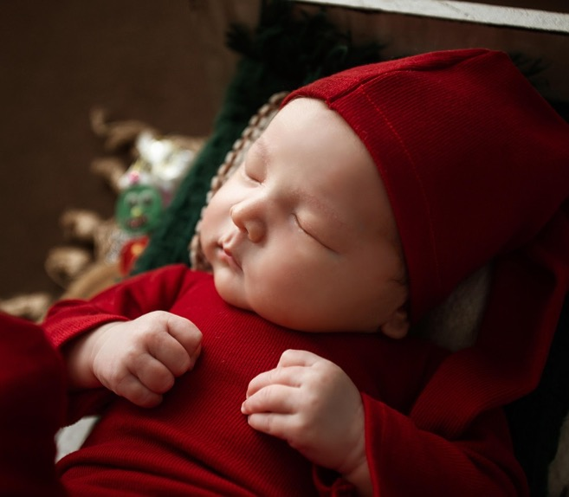
Eros
Recollection and the longing for truth
When the soul wakes up in a human body, it forgets the perfect Forms.
As it sees the natural world, it dimly remembers them (think of the concept of déjà vu)
This longing to remember is called eros — Love.
Quick activity:
A: You learn everything from scratch.
B: Some things feel like you already knew them
Image by Tú Nguyễn from Pixabay
Notes:
Purpose:
To explain Plato’s belief that the soul forgets perfect knowledge at birth and learning is the process of remembering. To introduce eros as the soul’s longing for truth.
Speaker:
Plato believed the soul existed before we were born. When the soul enters a human body, it forgets the perfect Forms it once knew. As we move through the natural world, we get little hints or glimmers of those perfect ideas. Plato said these moments of recognition are the soul remembering what it once knew.
Plato used the word eros to describe the longing the soul feels to remember the truth. It is not romantic love. It is a deep desire to reconnect with knowledge and clarity. The soul wants to return to the world of ideas.
Let’s try a fast activity. Think about when your experiences of learning. Read the statements that are on the screen and choose which one feels right to you. Choose A or B. Don’t overthink it.
A: You learn everything from scratch.
B: Some things feel like you already knew them.
Hands up for A. Hands up for B.
Debrief:
Plato believed B. Some knowledge feels familiar because the soul is remembering the perfect Forms.
Think about moments like déjà vu or when something feels strangely familiar. Plato would say that is the soul recognising something it once knew.
Notes:
Keep tone light and avoid suggesting a right or wrong answer. This activity checks understanding that for Plato, learning is remembering, not starting from zero.

Slide 94
Return to the world of ideas
The soul longs to fly home
The soul longs to return to the world of ideas.
It wants to escape the limitations of the body.
The material world only shows reflections of the true world.
Notes:
Purpose:
To explain Plato’s belief that the soul is drawn toward the world of ideas because the material world can only ever show us partial or distorted truth.
Speaker:
For Plato, the soul remembers the world of ideas and wants to return to it. He believed that the body belongs to the physical world, which changes and distracts us, but the soul belongs to a higher reality.
Notes:
There are suggested scripts with more detail in the program
This slide sets up the Allegory of the Cave by introducing the idea that the physical world gives us shadows and reflections, not truth itself.

Slide 95
Lesson 11
Plato’s Allegory of the Cave

Slide 96
Learning intentions and success criteria (8)
We are learning to
understand the key events and symbols in Plato's Allegory of the Cave
explain what the cave, shadows, escape and sunlight represent
recognise how the allegory connects to Plato's theory of Forms and the search for truth.
We can
explain the relevance of Plato's Allegory of the Cave to philosophical thinking
explain what each key feature of the allegory represents (the cave, the shadows, the prisoners, the escape, the sun).
Notes:
Notes for teachers:
Adapt the learning intention as required and add matching success criteria.
For more information see ⁠NSW Department of Education explicit teaching strategies https://education.nsw.gov.au/teaching-and-learning/curriculum/explicit-teaching.
LISC is not necessarily presented at the beginning of the lesson. Teacher needs to consider most effectual time to introduce.
LISC should be revisited during the lesson to support students' evaluation of their learning.

Slide 97

Shadows vs reality
Warm up
184 incredible shadows that will make you look twice
Notes:
Purpose: To introduce the idea that our senses can mislead us and to prepare students for Plato’s claim that people often confuse appearances with reality.
Speaker:
(Show 3 to 4 images from the link on the slide where the shadows look realistic or misleading).
Take a look at these pictures. At first glance the shadows look real, but they are not. Your brain jumps to conclusions before you see the full picture.
• ‘What did you think the shadow was at first?’
• ‘How did your brain trick you?’
(Take a few answers from the class)
‘Plato believed humans do this all the time. It is not only shadows that mislead us. He thought we often mistake appearances for reality.’
Notes:
Keep the discussion short. The aim is to show that perception is unreliable, which prepares students for the Allegory of the Cave.

Slide 98

Appearance vs reality
Shadow Puppet
Use a desk lamp or a torch and a blank wall.
Create simple shadow puppets (hands making animals or shapes).
Notes:
Purpose:
To help students understand how easily the senses can be fooled and how Plato believed most people mistake appearances for reality.
Note:
A lamp or torch need to be set up and either the teacher can create shadows or students can be asked to create shadows.
Speaker:
Plato believed most people confuse appearances with reality and he uses shadows as an example to show how individuals may accept a limited view of the world as complete truth. The key idea the teacher is communicating is that shadows move and have recognisable shapes but do not represent the full reality of the object.
(Get students into pairs/groups with a torch/phone light and encourage them to make as many animals or shapes as they can on the wall with their hands).
Look carefully at the shadows. They move and they look real, but they are not the actual thing. Plato believed most people live like this every day, watching shadows and thinking that is the full truth.
(Let students do this for a short time).
Let's unpack that. What did you notice about the shadow compared with your hand? What differences did you notice between the hand and the shadow? How might this relate to the idea that shadows provide only partial information?
The shadow is only an outline. It is not the full reality. This is the idea Plato is preparing us to think about.
Additional notes:
Keep the activity short. The goal is to prime students for the Allegory of the Cave, not to perfect shadow puppetry.

Slide 99
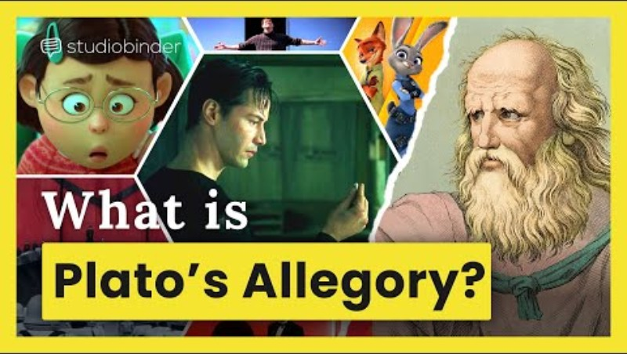
What is real?
Plato’s Allegory of the Cave
Notes:
Purpose: To watch a short overview of the cave allegory

Slide 100
Comprehension
How well did you understand?
You will now answer some questions in your books.
You will answer questions covering the following:
What happened? (Recall the literal events in the allegory)
What does it mean? (Analyse the symbolism and ideas in the allegory)
Why tell this story? (Interpret the purpose of the allegory)
Notes:
Purpose:
To guide students through individual comprehension of the Allegory of the Cave by moving from literal understanding, to symbolic meaning, to broader interpretation. This prepares them to recognise how Plato uses narrative to express philosophical ideas.
Speaker:
In a moment I will give you a list of comprehension questions to check your understanding of what has been presented in the clip. You are to answer these questions individually in your books. Your answers can be in dot points. The questions are grouped under three headings:
What happened? (literal events in the allegory)
What does it mean? (symbolism and ideas)
Why tell this story? (purpose and interpretation)
Notes:
Give students a copy of the questions that can be found in the program. If needed, let the students rewatch the clip or you can share the link for use on their devices.
Walk the room while they write and support students who need help by prompting them to refer to the sequence of the allegory.
If students finish early, ask them to choose one question from each heading and expand their response using a full sentence that explains their reasoning.

Slide 101
Lessons 12–14
Contemporary connections

Slide 102
Learning intentions and success criteria (9)
We are learning to
see how Plato’s Allegory of the Cave is used in modern films
apply the Allegory of the Cave to a contemporary context.
We can
make connections between Plato’s allegory and modern society.
Notes:
Notes for teachers:
Adapt the learning intention as required and add matching success criteria.
For more information see ⁠NSW Department of Education explicit teaching strategies https://education.nsw.gov.au/teaching-and-learning/curriculum/explicit-teaching.
LISC is not necessarily presented at the beginning of the lesson. Teacher needs to consider most effectual time to introduce.
LISC should be revisited during the lesson to support students' evaluation of their learning.

Slide 103
Symbol match
Symbol
Possible meaning
Ignorance / habit / comfort
Illusion or misunderstanding
Partial or incomplete truth
The real world
Knowledge, truth, enlightenment
The philosopher / truth-seeker
3 minute dash!
Notes:
Purpose:
To check prior learning and help students make the leap from story - philosophy - their own thinking.
Speaker:
Alright, this is a quick warm-up to check that we understand the key symbols in Plato’s allegory.
You’ll see three images on the left — the cave wall, the fire, and the sun.
On the right is a list of possible meanings. Your job is to match them. You’ve got three minutes to write these in your book.
(after 3 minutes)
So let's remember that Plato uses these physical objects to help us think about what’s real and how we know what’s real. That’s the whole point of the allegory. I will now check your matches.
Notes:
Depending on the class, to check for understanding you can:
Show answers on mini whiteboards.
Cold call one or two students.
Get pairs to whisper their matches first and then share.
Prompting questions if they’re stuck:
‘What kind of world do the prisoners think is real?’
‘Is the fire giving them the whole truth or just part of it?’
‘If the sun is painful at first, what might that symbolise?’
Key ideas to come from activity:
The cave = being stuck in comfortable habits or ignorance.
The fire = partial or incomplete truth - it seems right, but it’s not the full picture.
The sun = real knowledge or enlightenment - it can be uncomfortable at first.

Slide 104
Plato’s allegory in films
Where have we seen the cave before?
Many films explore similar ideas to Plato’s cave:
Characters often begin with a limited view of the world.
Something challenges what they believe to be true.
They move from comfort to confusion to understanding.
This journey mirrors the prisoners moving from shadows to real knowledge.
Notes:
Purpose:
To show students that many familiar films use the same pattern found in Plato’s Allegory of the Cave, where characters move from limited understanding to clearer knowledge.
Speaker:
Plato’s allegory explains a journey from seeing only part of the truth to gaining a fuller understanding. Many films follow a similar pattern.
Many films explore ideas that link to the cave allegory. Characters often begin with a limited view of the world; something challenges what they believe to be true; they move from comfort to confusion to understanding and this mirrors the prisoners moving from shadows to real knowledge.
Now over to you. Can you think of a film where a character discovers the world is not what they first believed? I will give you a moment to think of some examples
( Ask for a selection of responses)
These stories feel familiar because they follow the same learning pattern that Plato described. People often begin with incomplete information and grow when they see a fuller truth.

Slide 105
Plato’s cave – contemporary comparison
Text Study
Text | The ‘shadows’ (limited view or illusion) | The moment of turning around | Enlightenment or deeper truth
Film | The main character accepts the world they live in as it is. | The main character is faced with something that makes them question their understanding of the world they live in. | The main character has a new understanding of the reality of the world that they live in.
Notes:
Note:
This slide uses The Lego Movie as an example, however if it is not possible to access this film, it can be supplemented with any available film or narrative that can be applied to Plato’s cave.
Purpose:
To help students connect the structure of Plato’s Allegory of the Cave to a familiar contemporary text by mapping the stages of illusion, turning around and enlightenment. This supports transfer of learning by showing that the allegory appears in many modern narratives.
Speaker:
Many films follow the same pattern as the cave: characters begin with a limited or false view of the world, something challenges that view, and they eventually reach a deeper understanding. An example of this is The Lego Movie. The Shadows column refers to the shadow stage. Emmet believes Bricksburg is perfect and normal. He does not question anything. The next column is the turning point. Meeting Wyldstyle and hearing the prophecy forces him to question what he thought was true. The final column is the enlightenment stage. Emmet realises the world is controlled and creativity is restricted. He understands more than he did before.
This pattern mirrors the prisoners in the cave moving from shadows to sunlight.
Now we are going to do a study of the film... (insert your chosen film here). As we watch, we will be mapping how the film follows a similar sequence to Plato's Cave.
Notes:
This example prepares students for completing their own comparison using a different film. Encourage concise links rather than full plot summaries.

Slide 106
Weeks 6–8
The history of philosophy and key philosophers

Slide 107
Lesson 15
History of philosophy

Slide 108
Learning intentions and success criteria (10)
We are learning to
understand key developments in the history of philosophy
recognise how different thinkers across time and cultures have shaped philosophical ideas.
We can
discuss key points in the history of philosophy by referring to major thinkers and traditions
describe at least one idea from both Western and non-Western philosophers
explain how philosophical ideas have changed or developed over time.
Notes:
Notes for teachers:
Adapt the learning intention as required and add matching success criteria.
For more information see ⁠NSW Department of Education explicit teaching strategies https://education.nsw.gov.au/teaching-and-learning/curriculum/explicit-teaching.
LISC is not necessarily presented at the beginning of the lesson. Teacher needs to consider most effectual time to introduce.
LISC should be revisited during the lesson to support students' evaluation of their learning.

Slide 109
Timeline of thinkers
Philosophers through time
You will be given a set of cards.
On each card is a philosopher’s name.
There is also a sentence showing what they believed.
Your task:
Plot them on a timeline.
The timeline begins in the 6th century BCE.
Notes:
Purpose:
To help students build a basic understanding of how major philosophers fit into history. This activity supports chronological thinking and shows that ideas about knowledge, truth and reality developed over many centuries.
Speaker:
Philosophy has a long and diverse history, beginning in ancient civilisations and developing across many cultures. Today we are going to explore some of the most significant philosophers and look at how they fit into history.
You will all receive a set of cards.
Each card has:
• the name of a philosopher
• one sentence describing something they believed or contributed
Your job is to place the philosophers in order on a timeline. The timeline starts in the sixth century BCE, so look carefully at the dates on the cards.
Note:
Circulate and support groups as they work.
Prompt with questions such as:
• ‘Who would come earliest based on the date?’
• ‘Which thinkers lived around the same time?’
• ‘Do any ideas seem connected to each other?’

Slide 110
Summary of thinkers
Look at the whole timeline
Instructions:
Choose three thinkers from your timeline.
For each one, write one clear sentence explaining a key idea in your own words.
Example scaffold:
  Plato: “True knowledge comes from understanding ideas, not relying on the senses.”
  Aristotle: “We understand the world by studying it directly and finding causes.”
  Descartes: “We can doubt everything except the fact that we are thinking.”
Notes:
Purpose:
To help students consolidate their understanding of key philosophers by choosing three thinkers and summarising one important idea from each in their own words. This develops comprehension, paraphrasing skills and confidence explaining concepts simply.
Speaker:
Have a look at the timeline of philosophers.
You are now going to choose three philosophers and for each one, you are going to write a clear sentence explaining one idea they are known for. Use simple, accurate wording that shows you understand the concept.
Notes:
Circulate among students to check that they are producing one meaningful idea per thinker and not copying from notes.
Once students are completed, invite a few volunteers to read one of their sentences aloud to the class.

Slide 111
Y chart – philosophical traditions
Differences between thinkers
Common themes
Key ideas that stand out to me
Notes:
Purpose:
Students identify differences, similarities and overarching themes across philosophical traditions.
Speaker:
We are going to look to see if there are any similarities, differences or common themes between our key philosophers.
Draw a large Y-chart in your book.
As you can see on the slide, the three sections should be labelled:
Differences between thinkers
Common themes
Key ideas that stand out to me
Now look back at our timelines and have another look at the philosophers and their key philosophies.
You are going to use your Y-chart to help you organise and notice patterns across different traditions.
In the Differences section, list at least three ways thinkers or traditions diverge in their views. This could include things like approaches to knowledge, ethics, reality or human nature.
In the Common themes section, list at least two ideas shared across multiple thinkers. Look for recurring concerns such as reason, justice, how to live well or the nature of truth.
In the Key ideas that stand out to me section, you need to record any personal insights, surprising ideas or emerging questions that come up when you compare philosophers.
Note:
Circulate and prompt deeper comparisons where needed, ensuring students refer back to multiple traditions rather than focusing on a single thinker.
To check for understanding, have students engage in a think-pair-share activity.

Slide 112
Lesson 16
Life of Confucius

Slide 113
Learning intentions and success criteria (11)
We are learning to
understand how the life of Confucius shaped his philosophical ideas
link life experiences to a philosopher’s teachings.
We can
write a brief explanation of how one event shaped Confucius' thinking
participate in discussion linking life experiences to teachings.
Notes:
Notes for teachers:
Adapt the learning intention as required and add matching success criteria.
For more information see ⁠NSW Department of Education explicit teaching strategies https://education.nsw.gov.au/teaching-and-learning/curriculum/explicit-teaching.
LISC is not necessarily presented at the beginning of the lesson. Teacher needs to consider most effectual time to introduce.
LISC should be revisited during the lesson to support students' evaluation of their learning.

Slide 114
What shapes a thinker?
Brainstorm
Think about the forces that shape a person’s beliefs and values.
In pairs, list as many influences as you can in two minutes.
Consider:
experiences from childhood
challenges or hardships
teachers or mentors
cultural or family expectations
political or social events
personal questions or problems someone wants to solve.
2 minutes
Notes:
Purpose:
To help students recognise that thinkers are shaped by life experiences, relationships and events. This prepares them to analyse philosophers with more empathy and context.
Speaker:
We are going to think about what shapes a person’s beliefs and values. No one comes up with ideas in a vacuum. People are influenced by their experiences, the people around them and the world they live in.
You are now going to work in pairs. You have two minutes to list as many influences as you can. Write as fast as you can without overthinking.
(Prompt student thinking by reading the examples on the slide.)
• experiences from childhood
• challenges or hardships
• teachers or mentors
• cultural or family expectations
• political or social events
• personal questions or problems someone wants to solve.
Notes:
As pairs work, move around and prompt with questions such as:
• ‘What has shaped you?’
• ‘Who has influenced you the most?’
• ‘What events in the world might shape the way someone thinks?’
Once two minutes is up, invite a few pairs to share one idea with the class and connect students' ideas to key philosophers wherever possible.
Additional notes:
If students experience difficulty in generating ideas, provide a sentence stem:
‘Someone’s thinking can be shaped by…’

Slide 115
Life of Confucius (1)
Make notes as you watch the Ted-Ed clip on the next slide:
Write short notes only; you will discuss them afterwards. Your notes should cover:
Key events
Note two or three important events from Confucius’ life that stand out to you.
2. Turning points
Choose one event and explain why it might have pushed Confucius toward becoming a philosopher.
Think about hardship, responsibility, learning or social change.
3. Influences on ideas
Identify one Confucian idea from the video and connect it to something from his life.
For example, how might his experiences shape his beliefs about respect, harmony or moral behaviour?
Notes:
Purpose:
To support students to identify key life events, turning points and influences that shaped Confucius’ ideas, and to help them see how a philosopher’s beliefs grow out of their experiences.
Speaker:
We are now going to watch a clip on philosopher Confucius. As you watch the Ted-Ed clip, you will take notes. Divide a page in your book into three and label one section 'Key events', the next section 'Turning points' and the last section 'Influences on ideas'. I will give you a moment to do this now.
As you watch the following clip, jot down short notes only. You do not need full sentences.
In the 'Key events' section, note two or three important events from Confucius’ life that stand out to you. These might include his childhood, personal challenges, or major moments of change.
In the 'Turning points' section choose one event that you think pushed Confucius toward becoming a philosopher. Think about experiences of hardship, responsibility, learning or wanting to improve society.’
In the 'Influences on ideas' section identify one Confucian idea from the video and link it to something from his life. For example: How might his experiences have shaped his beliefs about respect, harmony or moral behaviour?’
Notes:
As students watch, move around to prompt quietly if needed:
‘What event seems important?’
‘What moment might have shaped his thinking?’
‘Which idea connects to his life experiences?’

Slide 116
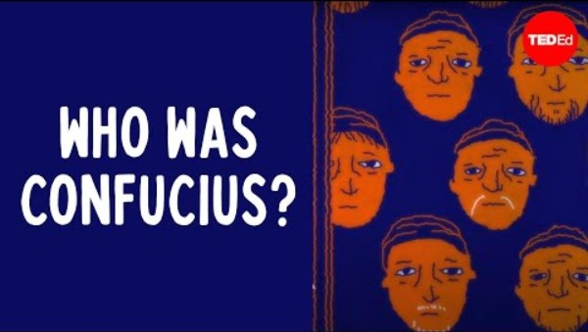
Who was Confucius? – Bryan W. Van Norden
TedEd
Notes:
Purpose:
To learn about Confucius

Slide 117
Life of Confucius (2)
Now that you have seen the TED-Ed clip, complete the three prompts below.
Write short notes only; you will discuss them afterwards.
1. Key events
Note 2 or 3 important events from Confucius’ life that stand out to you.
2. Turning points
Choose one event and explain why it might have pushed Confucius toward becoming a philosopher.
Think about hardship, responsibility, learning or social change.
3. Influences on ideas
Identify one Confucian idea from the video and connect it to something from his life.
For example, how might his experiences shape his beliefs about respect, harmony or moral behaviour?
Notes:
Purpose:
To help students identify key life events, turning points and influences that shaped Confucius' ideas after viewing the Ted-Ed clip, and to support them to link biographical details with philosophical beliefs.
Speaker:
Now that you have seen the clip, I will give a short moment to complete the three prompts on the slide. Keep your notes short. Only include those key ideas you can recall – you are not trying to capture all ideas presented. We will talk about them together afterwards.
Note:
After viewing, invite a few students to share one key event or turning point before moving into discussion about the influences that shaped Confucian ideas.

Slide 118
Lesson 17
The 5 constant virtues

Slide 119
Learning intentions and success criteria (12)
We are learning to
understand the key ideas within Confucius’ teachings
understand the 5 constant virtues of Confucius.
We can
identify and name the 5 constant virtues in Confucian philosophy
explain in my own words what each virtue means
give a real-life example of how a person might show one of the virtues
describe how Confucius’ ideas promote harmony, respect and moral behaviour.
Notes:
Notes for teachers:
Adapt the learning intention as required and add matching success criteria.
For more information see ⁠NSW Department of Education explicit teaching strategies https://education.nsw.gov.au/teaching-and-learning/curriculum/explicit-teaching.
LISC is not necessarily presented at the beginning of the lesson. Teacher needs to consider most effectual time to introduce.
LISC should be revisited during the lesson to support students' evaluation of their learning.

Slide 120
The 5 constant virtues of Confucius
An introduction
Ren – humaneness, compassion
Yi – righteousness, doing what is right
Li – respect, proper behaviour, social harmony
Zhi – wisdom, good judgement
Xin – trustworthiness, honesty
Virtue | Pronunciation
Ren | ren (sounds like the English word ‘wren’)
Yi | yee
Li | lee
Zhi | Zhir (the ‘zh’ sounds like the ‘s’ in measure)
Xin | Shin
Notes:
Purpose:
To introduce students to the 5 Constant Virtues of Confucius and encourage reflection of how these virtues relate to their own lives.
Speaker:
Confucius taught that a good society starts with good people. He believed there are 5 essential qualities that everyone should try to develop. These qualities guide how we treat others, how we make choices and how we contribute to a peaceful, stable community.
These are called the 5 constant virtues.
As I move through each of the virtues, I want you to think about them in relation to your own lives and experiences.
Ren captures the virtues of humaneness or compassion.
Confucius believed this is the heart of being a good person.
think - when have you seen someone show genuine care or kindness or exhibit 'Ren'?
Yi is about righteousness or doing what is right.
Yi is about moral courage, choosing what is right even when inconvenient.
Is doing the right or achieving 'Yi' thing always easy?
Li is the virtue of respect, proper behaviour and social harmony.
Li is ritual, respect and knowing how to act appropriately in a situation.
In your experiences - what behaviours help a group run smoothly? These practices are connected to the virtue of Li.
Zhi is wisdom and good judgement.
Zhi is thinking carefully, understanding consequences and making wise decisions
What do you think shows you that someone has good judgement?
And lastly, Xin is the virtue of trustworthiness and honesty.
Xin means keeping your word and being someone others can rely on.
Why is trust so important in friendships, families or teams? Why do you think 'Xin' is important?
Note:
Move through each virtue with one short, real-life connection.
Students are not analysing yet; they are just getting a feel for the ideas.
Keep each explanation short, conversational and connected to things students see daily.

Slide 121
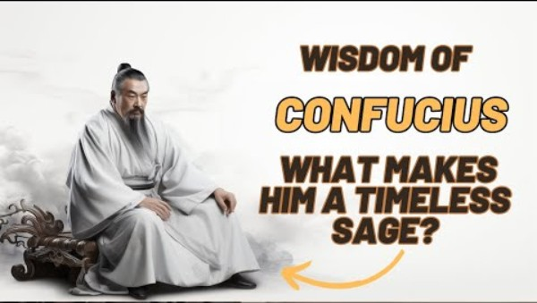
The 5 virtues
Notes:
Purpose:
To ensure student understanding of the 5 Virtues and to connect those to the worlds of the students.
Speaker:
Now that you know the basic meaning of each virtue, you will watch a clip that unpacks these virtues more. As we watch, reflect on what can we learn from Confucius today.
(Play Clip: //www.youtube.com/watch?v=voAEJNWoFyA&t=7soday? )
Next lesson, you will explore these virtues in depth through real-life scenarios to see how these ideas guide behaviour and decision-making.

Slide 122
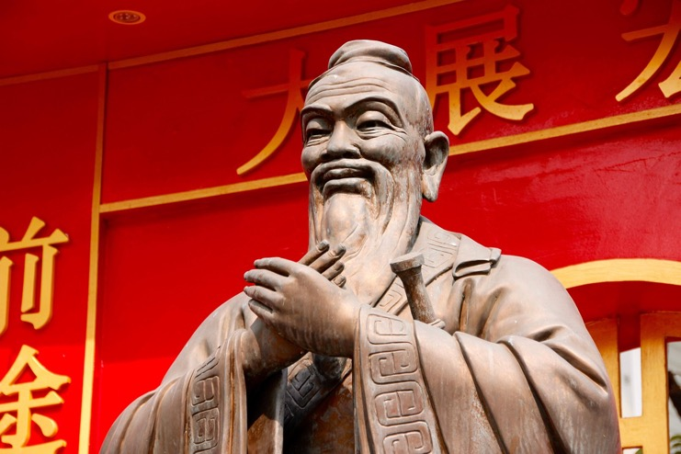
Confucius carousel – the virtues in action
You will break into 5 groups
Each group is assigned:
  a virtue
  a scenario
  a question applying the scenario.
  You will need to present your virtue to the class
  Nominate a scribe (someone to write)
  Decide who will speak to the class
  Decide quickly – you have philosophy work to do
Image by Peggy und Marco Lachmann-Anke from Pixabay
Notes:
Purpose:
To help students understand Confucian virtues by applying them to realistic scenarios and explaining their thinking to others. The activity supports collaboration, clear communication and the ability to justify how a virtue guides action.
Speaker:
You will be working in groups. Each group will receive a Confucian virtue, a short scenario and a question that asks you to apply the virtue to the scenario.
Your group needs to prepare a short explanation of your virtue and how it guides a response to the scenario. One person will write notes, and one person will present to the class. Decide these roles quickly so you can focus on the thinking.
Note:
Teacher gives handout to each group.

Slide 123
Group sharing
Present your virtue
Each group presents:
their virtue
the real-life scenario
how a person guided by that virtue would act
one insight about why this virtue matters today.
Can you see a connection between virtues?
Notes:
Purpose:
To consolidate students’ understanding of Confucian virtues by hearing how other groups applied their virtue to a real scenario, and to recognise that the virtues overlap and support one another.
Speaker:
As you begin working with your group, here are the things that you must include in your presentation. As you shape your presentation, try to create short, clear explanations.
Note:
Give students a time limit for the task and then bring them together and have each group present.
As each group presents, listen for links between virtues and where possible ask students to make connections between the virtues. Prompt examples if needed: ‘Ren and xin both support healthy relationships’, or ‘Yi and zhi often work together in making fair or ethical decisions’. Reinforce that Confucius saw the virtues as a set that strengthens a person’s character, not separate skills.

Slide 124
Individual reflection
Apply the virtues
Choose one virtue you have heard about today
Answer these questions individually:
What does this virtue mean in simple terms?
Where have I seen someone practise it recently?
How could practising this virtue improve a group, family, team or society?
Notes:
Purpose:
To help students personally connect with the Confucian virtues by choosing one and reflecting on how it appears in real life and why it matters.
Notes:
Direct students to open their books and write their responses. Ask them to choose one virtue from today’s lesson and answer the 3 reflection questions in full sentences. Remind them to keep their explanations simple and grounded in real examples. Encourage them to think about moments from school, home or the community where they have seen the virtue in action. Prompt them to consider how practising this virtue could strengthen a group or improve relationships. Allow quiet working time so students can think without interruption.

Slide 125
Exit ticket
What does society need?
On a sticky note, write one sentence explaining:
which virtue you think society needs most today
why you think this virtue is needed?
You will ‘post’ this on your way out of class today.
Notes:
Purpose
To check students’ understanding at the end of the lesson and prompt them to identify which Confucian virtue they believe society needs most today.
Speaker:
To finish today, I am giving you each a sticky note. On it, you are to write one clear sentence explaining which virtue they think society needs most today and why. Make sure you keep your answer short and specific. As you leave the room, you are to place your sticky note (insert place).
Note:
Read a few as students exit or review them after class to gauge overall understanding.
Direct them to post in a convenient spot on the way out- the door is often a good spot – or a piece of butcher's paper or the whiteboard
If some students are unsure what to write, prompt them with: “Which virtue would make the biggest difference if more people practised it?” or “Think about something society struggles with. Which virtue could help?”

Slide 126
Lesson 18–21
Choose your philosopher*
*But first let’s check for understanding

Slide 127
Learning intentions and success criteria (13)
We are learning to
use effective research techniques to develop understanding and insights into a chosen philosopher, their lives and their thinking
connect Philosophical ideas to our own lives
apply a philosopher’s thinking to a philosophical conundrum or thought experiment
communicate ideas effectively in written, spoken and multimodal forms.
We can
use questioning to guide my research of a chosen philosopher
make connections between philosophical thinking and my own life
address philosophical conundrums or thought experiments by applying philosophical thinking
structure ideas and effectively communicate them.
Notes:
Notes for teachers:
Adapt the learning intention as required and add matching success criteria.
For more information see ⁠NSW Department of Education explicit teaching strategies https://education.nsw.gov.au/teaching-and-learning/curriculum/explicit-teaching.
LISC is not necessarily presented at the beginning of the lesson. Teacher needs to consider most effectual time to introduce.
LISC should be revisited during the lesson to support students' evaluation of their learning.

Slide 128
Let’s review – Confucius in the headlines
5 min turn and talk
Which of these headlines do you think Confucius would care about?
Why do you think so?
Discuss with a partner for 5 minutes
Teens call for kinder behaviour after surge in hurtful comments on social media
(Respect online)
Major organisation under fire after leaders ignore staff concerns
(Leadership)
Public loses confidence as key figure admits to misleading statements
(Trust and honesty)
Local groups join forces to reduce tensions and rebuild community connections
(Community harmony)
New survey shows rising family stress as households struggle with communication and responsibility
(Family conflict)
Notes:
Purpose:
To check students’ understanding of Confucian virtues by applying them to real headlines and seeing whether students can connect ideas across lessons. This prepares them for independent research and ensures they can identify virtues in contemporary issues.
Speaker:
Before beginning their philosopher research, we will return briefly to yesterday’s learning about applying Confucian virtues to real scenarios. Look at the headlines on the slide. Which of these headlines do you think Confucius would care about, and why? You have 5 minutes to discuss this with your partner.

Slide 129
Check for understanding (4)
1= Ren
2 =Yi
3= Li
4 =Zhi
5 =Xin
As I point to each headline, use your fingers to indicate which virtue it connects with
Example: 3 fingers held up means you vote the headline = Li
Teens call for kinder behaviour after surge in hurtful comments on social media
(Respect online)
Major organisation under fire after leaders ignore staff concerns
(Leadership)
Public loses confidence as key figure admits to misleading statements
(Trust and honesty)
Local groups join forces to reduce tensions and rebuild community connections
(Community harmony)
New survey shows rising family stress as households struggle with communication and responsibility
(Family conflict)
Notes:
Purpose:
To quickly check whether students can recognise which Confucian virtue best matches a real-world headline. This helps confirm that they understand the virtues before moving on to the next activity.
Speaker:
I am now going to run a check for understanding. As I point to each headline, use your fingers to show which virtue you think it connects with. One finger means Ren, 2 means Yi, 3 means Li, 4 means Zhi, and 5 means Xin.
For example, if you hold up 3 fingers, it means you think the headline is linked to Li.
(Move through each headline at a steady pace. After each vote, ask one or two students:
“What clue in the headline helped you choose that virtue?”)
Notes:
Keep this very brief. You are scanning the room to see whether students understand the virtues well enough to continue.

Slide 130
Research task
Choose ONE philosopher from the cards
Use library resources and the technology available to answer the following questions in your book/digital platform (Google slides/doc/OneNote) :
Who is my philosopher?
What are their key ideas?
What do they believe about:
– reality
– knowledge
– ethics
– society?
Which branch of Philosophy do you think they belong to?
Ethics: right and wrong
Aesthetics: beauty and art
Epistemology: knowledge and truth
Metaphysics: reality and existence
Notes:
Purpose:
To guide students through a structured research task where they choose one philosopher and investigate their ideas using school technology. The focus is on helping students identify key beliefs and link these to major branches of Philosophy.
Speaker:
I want you to think back to the philosopher cards and the timeline we constructed earlier. (Show the timeline to students if possible)
All of you are to choose ONE philosopher. For your task, you are going to research that philosopher and then apply that philosopher’s thinking to a philosophical conundrum or thought experiment.
You have a few minutes to select which philosopher you will focus on. (teacher encourages a range of philosophers to be selected).
You are now going to research your philosopher using your device and your library resources. Record your answers in your book or digital platform.
The questions on the slide will help to guide your research. They are:
– Who is my philosopher?
– What are their key ideas?
– What do they believe about reality, knowledge, ethics, and society?
Finally, decide which branch of Philosophy your philosopher belongs to. Use the definitions on the right to help you.

Slide 131
Check-in
My philosopher
If I could summarise my philosopher in one sentence it would be:
‘My philosopher believes that…’
Notes:
Purpose:
To check students’ understanding of their chosen philosopher by asking them to summarise a key belief in one clear sentence.
Speaker:
Before we move on, I want to check that you can summarise your philosopher’s ideas in your own words. Imagine you had to explain your philosopher to someone who has never heard of them, what is the one belief that stands out the most?’
Complete this sentence in your book: ‘My philosopher believes that…’.
Remember, you are not writing a full paragraph. You are writing one strong, clear sentence showing the main idea they have taken from their research.
Note:
Circulate and look for two things:
Students can identify a key belief.
Students can express it in their own words rather than copying.
Additional notes
If some students are experiencing difficulty, give a quick verbal scaffold such as:
‘Think about what your philosopher says about reality, knowledge, ethics or society. Which one idea do they repeat the most?’
ASK 2 or 3 students to share their sentence to check the class is on track.

Slide 132
Apply the ideas
This one is a challenge for beginning philosophers
Choose ONE thought experiment you have done in class.
Ship of Theseus = identity
Trolley Problem = ethics/choices
Plato’s Cave = truth and perception
Notes:
Purpose
Students apply philosophical thinking by using a thought experiment they already know. This prepares them for interpreting scenarios through their chosen philosopher’s ideas on the next slide.
Speaker:
You are going to choose one thought experiment you’ve done in class. Pick the one you understand best — identity (Ship of Theseus), ethics/choices (Trolley Problem), or truth and perception (Plato’s Cave).
Notes:
Revisit each of these:
Ship of Theseus (identity PPT slide 67 – 78)
Trolley Problem (ethics/choices PPT slide 33-36)
Plato's Cave (truth and perception PPT slide 98 – 106)

Slide 133
My philosopher would think…
Applying their ideas
How would your chosen philosopher interpret and respond to this allegory or thought experiment?
You must use your philosopher’s actual ideas.
Think about:
What principles or values would guide their judgment?
Would they approve/disapprove of the actions?
How do their ideas help explain the problem?
What would they consider the real issue?
How might their cultural background affect their view?
Notes:
Purpose
Students apply their philosopher’s ideas to a chosen thought experiment. The goal is to practise philosophical interpretation using real, researched concepts.
Speaker notes
Now that you have chosen your allegory or thought experiment, apply your philosophers thinking to it.
Use your philosopher’s actual ideas. Think about how they would judge, interpret, or respond to the scenario — not what you think.
Think about the following:
– Which principles or values guide your philosopher?
– Would they approve or disapprove of the actions?
– How do their ideas help explain what’s going on?
– What would they say the real issue is?
– How might their cultural background shape their view?
You should keep your responses short and clear, They should be brief explanations — not long paragraphs.
Notes:
For fast finishers or students who need additional challenge:
Get students to research and compare their philosopher with a new thought experiment:
– Experience Machine
– Zhuangzi’s Butterfly Dream
– Grandfather Paradox

Slide 134
Lesson 21–22
Personal philosophy

Slide 135
Learning intentions and success criteria (14)
We are learning to
reflect on how our personal philosophy has developed throughout the course
compare our original beliefs with ideas from philosophers we have studied
refine and rewrite a personal philosophy using new insights.
We can
identify the values and beliefs that have remained the same and those that have changed
make clear connections between my thinking and the ideas of at least one philosopher
revise my personal philosophy to show deeper understanding and personal growth.
Notes:
Notes for teachers:
Adapt the learning intention as required and add matching success criteria.
For more information see ⁠NSW Department of Education explicit teaching strategies https://education.nsw.gov.au/teaching-and-learning/curriculum/explicit-teaching.
LISC is not necessarily presented at the beginning of the lesson. Teacher needs to consider most effectual time to introduce.
LISC should be revisited during the lesson to support students' evaluation of their learning.

Slide 136
Revisiting our personal philosophy
How has your thinking changed?
Go back to your original personal philosophy from the start of this course
Annotate with three highlighter colours
Colour 1 – Still true for me
Colour 2 – Now unsure about this
Colour 3 – My learning changed my mind on this
Notes:
Purpose:
Students reflect on how their thinking has shifted throughout the course. This helps them recognise growth, identify changes in beliefs, and reconnect with their starting ideas in a structured, low-stakes way.
Speaker:
Find your original personal philosophy from the start of the course. Read it slowly and think about how your ideas have changed.
You are going to use three highlighter colours to annotate your original statement, thinking about how it has stayed the same or changed through your study of philosophy.
Colour 1 means this part is still true for you.
Colour 2 means you are now unsure about it.
Colour 3 means your learning in this course has changed your mind.
Notes:
Encourage honesty and reassure them that changing ideas is normal in philosophy. Walk around to support students who cannot find their original work or who need help deciding what each colour means for them.

Slide 137
Reflection questions
Answer the following in full sentences
Which philosopher influenced you the most? How?
What idea challenged your original beliefs?
What idea reinforced something you already thought?
What is one idea you now reject?
Notes:
Purpose
To guide students to articulate how and why their personal philosophy has either changed or been strengthened through their study of philosophy.
Speaker:
You will now use the prompts on the slide, to try to formalise your reasoning around your personal philosophy either being changed or staying the same. Answer each question in your book in full sentences.

Slide 138
Strengthening your personal philosophy
Rewrite you’re your 100-word philosophy
New version must include:
one idea kept
one idea changed
one idea informed by a philosopher studied
Notes:
Purpose
To guide students in strengthening their original 100-word personal philosophy by revising it with intention. The task prompts them to reflect on what they value, identify an idea that has shifted, and consciously apply one philosophical concept studied in class.
Speaker notes
Begin by reminding students that this is not a brand-new piece; it is a revision of their earlier thinking.
Say: “You’re going to rewrite your personal philosophy. The goal is not perfection; the goal is to show your growth as a thinker.”
Point to each requirement on the slide:
One idea kept: Explain that this shows continuity in their thinking and what they still firmly believe.
One idea changed: Highlight that this demonstrates reflection and intellectual flexibility.
One idea informed by a philosopher: Prompt them to draw on a thinker we have studied (e.g. Confucius, Aristotle, Zhuangzi, Wollstonecraft, etc.) and show how that idea has influenced them.
Emphasise that they must explain these shifts within the 100-word rewrite, not separately.
Encourage them to jot down which idea they will keep, which one they will change, and which philosopher will guide a new idea before rewriting.
Remind them that clarity is more important than wording; focus on expressing genuine beliefs shaped by the course.

Slide 139
My philosopher and me
A comparative task
Choose one philosopher from the course:
Plato, Confucius, Zhuangzi, Laozi, Arendt, de Beauvoir, etc.
Let’s align our perspectives – answer all the questions provided to you.
Think about how your thinking has been extended or challenged during this course.
Notes:
Purpose:
To align thinking and explore the connections between materials and lessons through the Philosophy core 1
Speaker:
We are going to draw connections between one of the philosophers we have studied and our own philosophical thinking. You will complete the questions provided to guide this reflection.
Notes:
These questions are in the program and have been duplicated here:
What are the three core ideas or values of the philosopher I have chosen?
Which of these ideas do I personally agree with, and why?
Which of these ideas do I disagree with, and why?
How does this philosopher explain what makes a good life?
How does my understanding of a good life compare?
In what ways has learning about this philosopher challenged or changed my thinking?
Which part of my original personal philosophy does this philosopher support?
Which part would they question or reject?
What insight from this philosopher will I keep as I revise my personal philosophy?
What part of my thinking has not changed, even after studying them?
If this philosopher read my personal philosophy, what feedback would they give me?

Slide 140
KWLH – Let’s revisit
What do I know? | What do I want to know? | What have I learned? | How can I learn more?
K
What do I know?
W
What do I want to know?
L
What have I learned?
H
How can I learn more?
Notes:
Purpose:
To consolidate students’ learning so far and prepare them for the shift into argument structure, reasoning, and fallacy recognition.
Speaker:
We’re returning to our original KWLH chart so you can see how much your thinking has developed.
Start by filling in the ‘L’ column-everything you’ve learned across the course so far. Think about the philosophers you’ve researched, the ideas you’ve explored, and the changes in your own beliefs or questions.
Then move to the ‘H’ column-how this learning prepares you for what we’re about to study next: arguments, premises, conclusions, types of reasoning, and common fallacies.
This step helps you connect your earlier curiosity with the analytical skills we’ll now build. It also shows that your growth in thinking is part of the discipline of philosophy.

Slide 141
References (1)
Outcomes referred to in this document are from the Philosophy course document © NSW Department of Education
for and on behalf of the Crown in the State of New South Wales (2022).
AITSL (Australian Institute for Teaching and School Leadership Limited) (n.d.) Learning intentions and success criteria [PDF 251 KB], AITSL, accessed [17 March 2026].
AITSL (2017) ‘Feedback Factsheet’, AITSL, accessed [17 March 2026].
Archon S (n.d.) 'Heaven and hell: the parable of the long spoons', Sofo Archon, accessed [17 March 2026].
Bern M (26 June 2017) '184 incredible shadows that will make you look twice', boredpanda, accessed [17 March 2026].
Brookhart S (2011) How to Assess Higher-Order Thinking Skills in Your Classroom, Hawker Brownlow Education, Victoria.
Buscicchi L (n.d.) The experience machine, Internet encyclopedia of Philosophy, accessed 17 March 2026
CESE (Centre for Education Statistics and Evaluation) (2025) What works best: 2025 update, NSW Department of Education, accessed [17 March 2026].
CESE (2025) What works best 2025 - Evidence guide for excellent schools, NSW Department of Education, accessed [17 March 2026].
CrashCourse (9 February 2016) 'What is philosophy: crash course Philosophy #1' [video], Crash Course, YouTube, accessed [17 March 2026].

Slide 142
References (2)
CrashCourse (28 June 2016) 'Personal identity: crash course philosophy #19' [video], Crash Course, YouTube, accessed [17 March 2026].
Dobbs D (15 Sep, 2010) 'Kill Whitey. It's the right thing to do', Wired, accessed [17 March 2026].
Ilhan, A (7 March 2021) 'Ship of Theseus - WandaVision (vision and white vision)' [video], Abdullah Ilhan, YouTube, accessed [17 March 2026].
Lea R (30 December 2022) ‘What is the grandfather paradox?’. Space.com, accessed [Day Month Year].
Lin P (9 December 2015) 'The ethical dilemma of self-driving cars', TEDEd, accessed [17 March 2026].
Lin P (9 December 2015) 'The ethical dilemma of self-driving cars - Patrick Lin' [video], TEDEd, YouTube, accessed [17 March 2026].
LitCharts (2026) 'Allegory', LitCharts, accessed [17 March 2026].
Lord P and Miller C (directors) (2014) The Lego Movie [motion picture], Warner Bros., Village Roadshow Pictures, RatPac-Dune Entertainment, Lego System A/S, Lin Pictures, Vertigo Entertainment and Warner Bros. Pictures Animation, United States of America.
Nelsen E (13 January 2017) 'Would you sacrifice one person to save five? - Eleanor Nelson' [video], TEDEd, YouTube, accessed [17 March 2026].
NESA (NSW Education Standards Authority) (2022) ‘Advice on units’, Programming, NESA website, accessed [17 March 2026].
NESA (NSW Education Standards Authority) (2022) ‘Proficient Teacher: Standard descriptors’, The Standards, NESA website, accessed [17 March 2026].
NESA (NSW Education Standards Authority) (2022) ‘Programming’, Understanding the curriculum, NESA website, accessed [17 March 2026].
Rosenshine B (2012) ‘Principles of Instruction: Research-Based Strategies That All Teachers Should Know’, American Educator, 36(1):12–19 accessed [17 March 2026].

Slide 143
References (3)
Sages of the Ages (12 November 2023) 'Transform your life: what can we learn from Confucius today?' [video], Sages of the Ages, YouTube, accessed [17 March 2026].
State of NSW (Department of Education) (16 January 2026) 'Using effective questioning', NSW Department of Education, accessed [17 March 2026].
Soul Salt (31 May 2022) 'How to form a personal philosophy: 7 questions to ask yourself', Soul Salt, accessed [17 March 2026].
StudioBinder (16 May 2022) 'Plato's allegory of the cave - a storyteller's guide to using the allegory' [video], StudioBinder, YouTube, accessed [17 March 2026].
The philosophy foundation (2026) The butterfly dream, The philosophy foundation, accessed [17 March 2026].
Van Norden BW (28 October 2015) Who was Confucius? - Bryan W. Van Norden' [video], TEDEd, YouTube, accessed [17 March 2026].
Wiliam D (2013) ‘Assessment: The bridge between teaching and learning’, Voices from the Middle, 21(2):15–20, accessed [17 March 2026].
Wiliam D (2017) Embedded Formative Assessment, 2nd edn, Solution Tree Press, Bloomington, IN.
Wireless Philosophy (19 July 2013) 'Philosophy - metaphysics: ship of Theseus' [video] Wireless Philosophy, YouTube, accessed [17 March 2026].
Wireless Philosophy (11 November 2017) 'The examined life: know thyself #1' [video], Wireless Philosophy, YouTube, accessed [17 March 2026].
Wisniewski B, Zierer K and Hattie J (2020) ‘The Power of Feedback Revisited: A Meta-Analysis of Educational Feedback Research’, Frontiers In Psychology, 10:3087, doi:10.3389/fpsyg.2019.03087, accessed [17 March 2026].

Slide 144
Copyright
© State of New South Wales (Department of Education), 2026
The copyright material published in this resource is subject to the Copyright Act 1968 (Cth) and is owned by the NSW Department of Education or, where indicated, by a party other than the NSW Department of Education (third-party material).
Copyright material available in this resource and owned by the NSW Department of Education is licensed under a Creative Commons Attribution 4.0 International (CC BY 4.0) license.
This license allows you to share and adapt the material for any purpose, even commercially.
Attribution should be given to © State of New South Wales (Department of Education), 2026.
Material in this resource not available under a Creative Commons license:
the NSW Department of Education logo, other logos and trademark-protected material
Material owned by a third party that has been reproduced with permission. You will need to obtain permission from the third party to reuse its material.
Links to third-party material and websites
Please note that the provided (reading/viewing material/list/links/texts) are a suggestion only and implies no endorsement, by the New South Wales Department of Education, of any author, publisher, or book title. School principals and teachers are best placed to assess the suitability of resources that would complement the curriculum and reflect the needs and interests of their students.
If you use the links provided in this document to access a third-party’s website, you acknowledge that the terms of use, including licence terms set out on the third-party’s website apply to the use which may be made of the materials on that third-party website or where permitted by the Copyright Act 1968 (Cth). The department accepts no responsibility for content on third-party websites.

