Slide 1
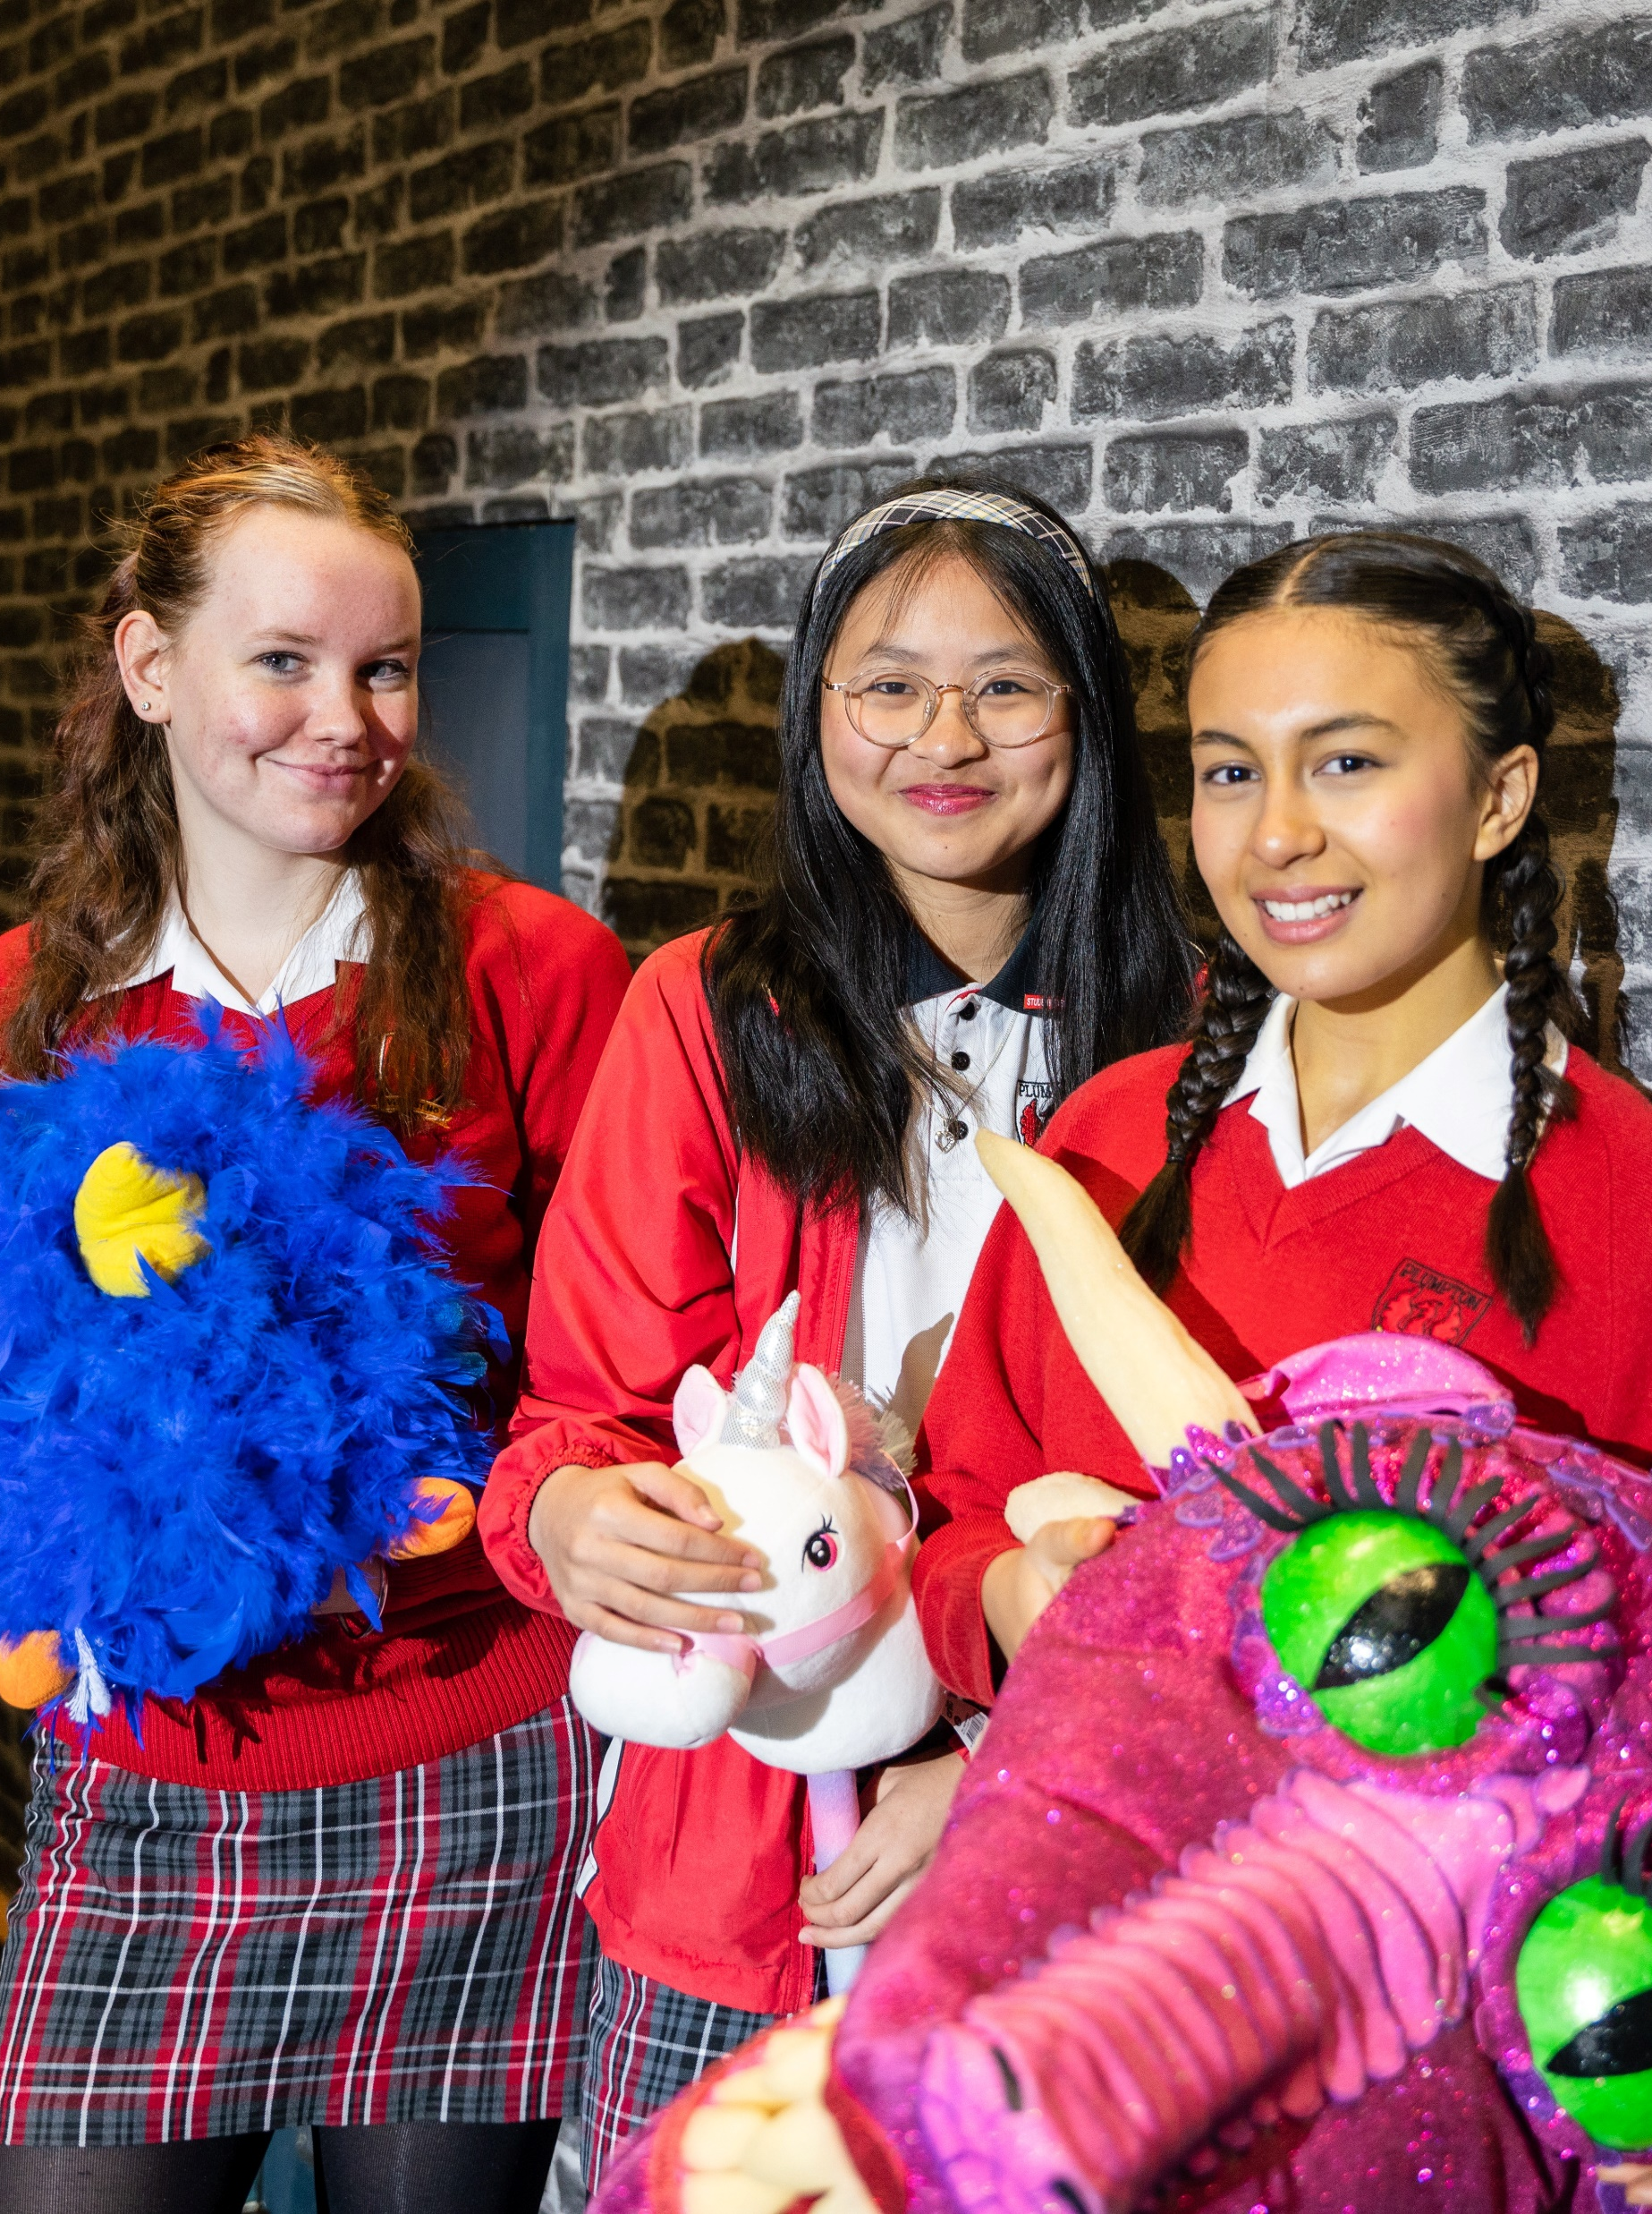
Term 3 Shifting landscapes – ways of working protocols check point task with student work samples
Performing arts – illustration of practice

Slide 2
Contents
Slide 3 – assessment task check point
Slide 4 – assessment task check point marking guidelines
Slides 5 to 11 – ways of working ‘MUST’ scaffold
Slides 12 to 23 – group 1 ways of working protocols check point submission
Slide 24 to 31 – group 2 ways of working protocols check point submission
The content in the Microsoft PowerPoint has been generated by the teachers of Lindfield Learning Village during the delivery of the Stage 5 Department approved elective – Performing arts.
The department would like to acknowledge the teachers and students involved in sharing their work as an illustration of practice.

Slide 3
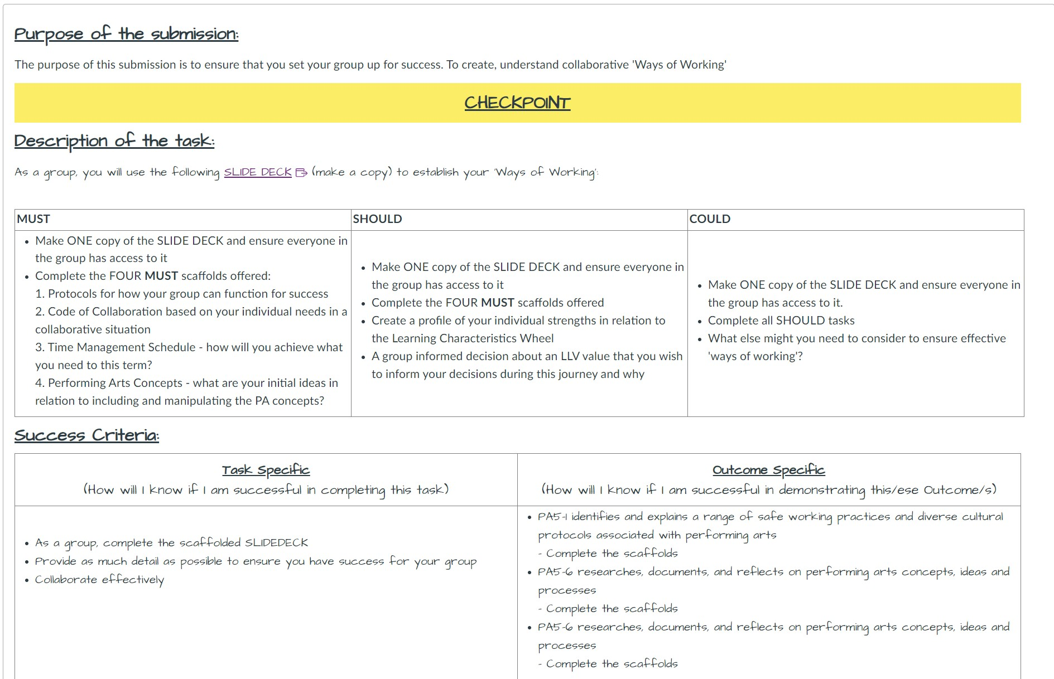
Term 3 Shifting Landscapes – Ways of working protocol task (student work samples)
Checkpoint 1:
Performing arts Collaborative Protocols for Shifting Landscapes Unit

Slide 4
Term 3 Shifting Landscapes – Ways of working protocol task assessment marking guidelines
Syllabus code | Novice | Apprentice | Practitioner | Expert | Master
PA5-1 identifies and explains a range of safe working practices and diverse cultural protocols associated with performing arts | I can, with teacher and peer support, identify some safe working practices and diverse cultural protocols. I need to learn how to explain safe working practices and diverse cultural protocols. | I can identify and explain some safe working practices and diverse cultural protocols associated with performing arts. I need to consider a wider range of safe working practices and diverse cultural protocols associated with performing arts to consider the safety of one another in our space. | I can identify and explain a range of safe working practices and diverse cultural protocols associated with performing arts. I need to be more conscious of and implement safe working practices and diverse cultural protocols in learning experiences. | I can thoroughly explain and implement a range of safe working practices and diverse cultural protocols associated with performing arts. I need to implement safe working practices and diverse cultural protocols associated with the performance arts in learning experiences without direction from my teachers. I need to also consider careful and appropriate questioning to delve deeper into why we use certain protocols. | I can carefully consider, explain and implement a range of safe working practices and diverse cultural protocols associated with performing arts learning experiences. I can demonstrate leadership in this area and facilitate these experiences and discussions alongside my peers and teachers.
PA5-6 researches, documents and reflects on performing arts concepts, ideas and processes | I can, with teacher and peer support, access texts and documents relating to performing arts concepts to help me offer ideas and engage with processes. I need to use provided texts and documents to engage in scaffolded reflection of performing arts concepts, ideas and processes. | I can use provided texts and documents to engage in scaffolded reflection of performing arts concepts, ideas and processes. I need to independently research texts and engage in autonomous reflection in consideration with the performing arts concepts and processes and use this reflecting to offer ideas. | I can research documents and reflect on performing arts concepts, ideas and processes. I need to widen the range of documents I research so I can more thoughtfully reflect on concepts, ideas and processes. | I can thoroughly research a range of documents and thoughtfully reflect on performing art concepts, ideas and processes. I need to autonomously expand my research scope so that I can thoughtfully reflect on and challenge ideas to create and implement processes and protocols. | I can source my own extensive research material to reflect on performing arts concepts, challenge ideas and create and implement processes and protocols.

Slide 5
Ways of Working Protocols
Term III: Performing arts/Drama MUST Scaffold
Please make this ‘scaffold’ your own and put some colour and images into it :)

Slide 6
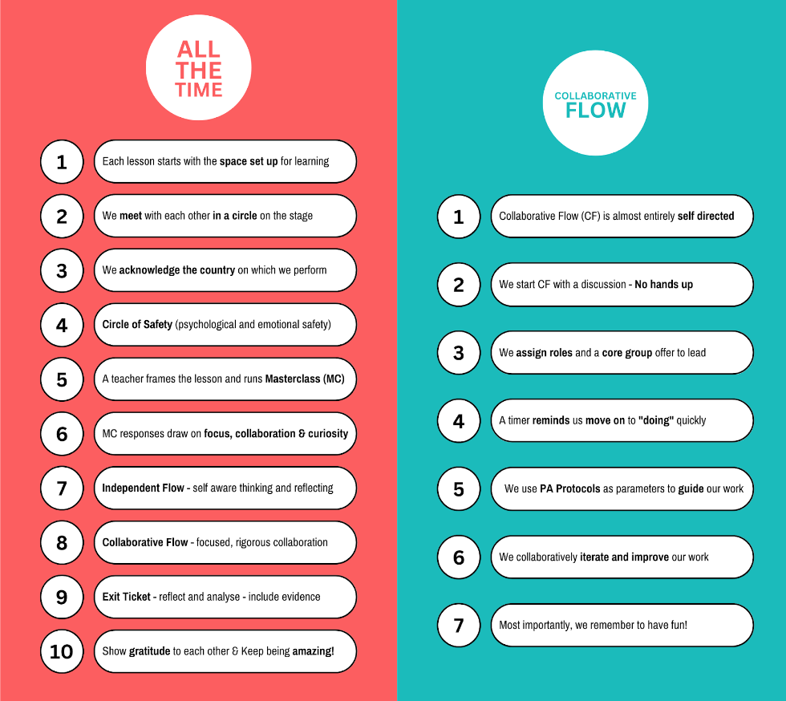
1. Protocols - what systems do you need in place to ensure your group works successfully? (1)
(Dot point your protocols here)
Sentence Starters (feel free to use or discard):
- We need to begin with…
- We should structure our time like this…
- When we become unfocused we should…
- When we feel challenged we should…
SAMPLE ON THE OTHER SIDE

Slide 7
2. Code of Collaboration - what do each of us need to to work effectively collaboratively? (1)
(Dot point your individual needs here…)
- I need kindness in our space to feel safe
- I need people to show up with ideas and be ready for learning
- I need people to be calm
(Reconstruct your individual needs as collaborative dot points…)
- We need people to stay calm in all situations even when we feel challenged…

Slide 8
3. Time Management Schedule - how will we achieve what we need to?
Week 1 | Week 2 | Week 3 | Week 4 | Week 5
 |  | Checkpoint 1: Ways of Working Checkpoint |  | Checkpoint 2: Draft TED Talk
Week 6 | Week 7 | Week 8 | Week 9 | Week 10
 | Checkpoint 3: Draft Hybrid Performance |  | Final Product: | Final Product:

Slide 9
4. Performing arts Concepts: What are your blue sky thinking ideas? (1)
SPACE: What ideas do you have for manipulating space?
PROTOCOLS: What protocols do you want within your festival?
PRESENCE: What ideas do you have for demonstrating presence?
AUDIENCE: What ideas do you have to engage audience?

Slide 10
Individual Strengths in relation to the Learning Characteristics Wheel (1)
Student 1:
Student 2:
Student 3:
Student 4:
Student 5:
Student 6:

Slide 11
Value Focus: (1)
Why are you focusing on this value?
Assume best intent. Be optimistic
Hold lightly. Tread lightly.
Be radically candid. Expect radical candour.
Be curious and then curiouser.
Be creative, playful and brave.
Be the change you seek.

Slide 12
Ways of Working Protocols (1)
Student work group 1 – 6 students

Slide 13
Table of contents
01
02
03
04
Protocols
Code of Collaboration
You can describe the topic of the section here
Timeline
PA concepts
You can describe the topic of the section here
You can describe the topic of the section here

Slide 14
1. Protocols - what systems do you need in place to ensure your group works successfully? (2)
Patience and understanding with everyone
This looks like; waiting for people to finish what they are saying, asking further questions about others ideas instead of shutting them down, controlling your face when others are speaking and meeting others where they are at.
Clear explanations - removing any confusion.
This looks like; asking clarifying questions, explaining in a non patronising ways, always willing to give others a longer explanation if necessary.
Communication is key
This looks like; clear communication, eye contact (if comfortable), using gestures when necessary in explanation.
Good listening skills
This looks like; giving eye contact (if comfortable and able), showing body language of focus towards them, waiting your turn when speaking, holding place for others idea and opinions and hearing them out.

Slide 15
1.5. Protocols - what systems do you need in place to ensure your group works successfully?
Giving 110% at all times
Looks like; if having a bad or slow day just let everyone know and be aware of that, being mindful of your own stress but also the stress that others may be experiencing, holding yourself and others accountable to an Expert to Master level of work. Do your part.
Self regulate
Looks like; if you’re finding it hard to focus or if your gaining stress, ask Amy or Kim if you can take a break or go to the bathroom to clear your mind and regulate yourself before going back into the lesson.
Be flexible and able to adapt
Make adaptations, stick with ideas while also building with ideas and other, if something challenging comes up persevere and take everyone’s needs and opinions into account while also taking time for yourself in needed.

Slide 16
2. Protocols - what systems do you need in place to ensure your group works successfully?
Radical empathy -
It’s good to play with possibilities. You should consider your peer’s opinions or point of view. You never know, they may have an even better idea that what you were thinking.
Have a captain/lead of the lesson/group?
Looks like; helps with communication and collaboration and so we have someone to talk to in the group if we need extra understanding/clarifying of the task. Prepared to step up if we need a director.

Slide 17
2. Code of Collaboration - what do each of us need to to work effectively and collaboratively? (2)
- I need kindness in our space to feel safe
- I need people to show up with ideas and be ready for learning
- I need people to be calm
- I need people to give their 100%
We need people to stay calm in all situations even when we feel challenged…
People should always arrive with a positive working attitude.
Every member of the group should be working to an Expert to Master level.

Slide 18
3. Time Management Schedule - how will we achieve what we need to? Dot point ideas
Week 1 | Week 2 | Week 3 | Week 4 | Week 5
 |  | Checkpoint 1: Ways of Working Checkpoint | TED Talk progress. Feedback with group. | Checkpoint 2: Draft TED Talk
Week 6 | Week 7 | Week 8 | Week 9 | Week 10
 | Checkpoint 3: Draft Hybrid Performance | Jess will be away | Final Product: | Final Product:

Slide 19
4. Performing Arts Concepts: What are your blue-sky thinking ideas? (2)
SPACE: What ideas do you have for manipulating space?
Creatively using underused spaces
Work scales - making our performance bigger or smaller
How big is our audience?
PROTOCOLS: What protocols do you want within your festival?
Safety first. Not only Physical safety but also mental and emotional safety.
Engagement and Joy is something that must be achieved with this festival.
PRESENCE: What ideas do you have for demonstrating presence?
Acknowledge the engagement that we hope to bring to the festival and best bring that life and engagement into our mindsets so they are reflected in our performance
AUDIENCE: What ideas do you have to engage audience?
Invite the audience to participate in our hybrid performance/festival activity
Provide engaging visuals and activities to generate interest and excitement

Slide 20
Festival Ideas (Word Vomit)
Fun
Light hearted
Monopoly? !!
Festival of board games!
Wild west
Carnival
Jungle
Dinosaurs
4 seasons
Roaring 1920s V 2020s !!!!
Underwater
Disco
Decades !!!
Night at the museum !
Outback Aus
Wizard of Oz - reimagined !
Magic (Harry Potter)
Time travel
Space !
Alice in Wonderland !

Slide 21
Individual Strengths in relation to the Learning Characteristics Wheel (2)
Student 1:
I am resilient (I can take ownership)
I am creative ( I can critically question, evaluate and reflect)
I am collaborative (I can co-construct)
I am self aware (I can recognise my own impact)
Student 2:
I am collaborative
I am resilient
I am creative
Student 3:
I can give and receive feedback (collaborative)
I can stick with difficulty (resilient)
I can recognise my own impact (self aware)
Student 4:
I am creative/ I can dare to be different
I am collaborative (I can make and express connections)
Student 5:
Sticks with difficulty (resilient)
Plays with possibilities (creative)
I am empathetic
Student 6:
Resilient
Collaborative
Self regulates (self-aware)

Slide 22
How might you use your individual Characteristics’ strengths to see success in this project? (Amy just added this on Monday - Week 3) (1)
Student 2: I will use the individual characteristics “I am creative” & “I can stick with difficulty” as I feel these are some of my strengths in my learning. To me, creativity is everything and resilience is key to success and it helps me to think outside the box when collaborating with others as it gives me the feeling of being comfortable with contributing my ideas and suggestions.
Student 6: One of my characteristic strengths I can use is “I am collaborative.” communicating with the other peers in my group can help me to learn a lot better especially in big group tasks. It also helps me to complete the work faster. For example, this slide deck would take me so much longer to complete while my group and I have completed this deck in 2 lessons.
Student 1: I will use my strength, I can critically question, evaluate and reflect (I am creative) to also step back and reflect on how I can elevate the standard of anything we complete in our group ideating, performance, event planning and TED Talk.
Student 3: I can use my skills with feedback to extend myself and my peers by telling them through kind and empathic words how they could develop more. My ability to stick with difficulty will provide significant resilience in tough situations especially when under a lot of stress. I can use my skills of self awareness of recognising my own impact to see what I need to do to further my and my peers’ performances and what we need to do.
Student 5: I will continue to be empathetic and self aware because they are, I feel, my strongest points when it comes to learning , it is important to be empathetic especially in a group settings to absorb and process different ideas.
Student 4: “I am creative” to suggest ideas to better enhance performances.

Slide 23
Value Focus: (2)
Chosen value: Be Playful, Creative & Brave
Creativity and communication is a major part in creating and producing our festival. As a group we have completed this slide deck and discussing ideas on what our festival would be about and what type of theme we are going for. In the end, we have all decided on Comparing decades from the 1920s to the 2020s.
Assume best intent. Be optimistic
Hold lightly. Tread lightly.
Be radically candid. Expect radical candour.
Be curious and then curiouser.
Be creative, playful and brave.
Be the change you seek.

Slide 24
Ways of Working Protocols (2)
Term III: Performing Arts/Drama
Student work group 2 - 6 students

Slide 25
1. Protocols - what systems do you need in place to ensure your group works successfully?
We should begin each lesson ready to participate in collaborative flow. When we are in flow, someone steps out to take a photo or video for our showreel. We should also try our best as a group to maintain the flow.
When we become unfocused we should regroup, discuss a plan for the rest of Flow time, and be open to brain breaks to enhance focus. For example, someone could step out of a conversation and note that we are becoming distracted, and we could all go for a short focus walk around the room to recenter.
When we feel challenged we should talk about what we are having difficulty with, and ask for help, and reassess the situation to take a moment to regulate.
When there are disagreements we should resolve them by discussing things logically with an understanding manner (using our empathy and being curious by respectfully asking questions) and respecting everyone’s ideas and opinions.
We won’t assign specific roles to people. We will let people step in and lead if they want to in intention to encourage equal roles etc...

Slide 26
2. Code of Collaboration - What do each of us need to to work effectively collaboratively?
- I need kindness in our space to feel safe
- I need people to show up with ideas and be ready for learning
- I need people to be calm
- I need people to be focused on work and contribute suggestions
- I need to explicitly understand the task at hand so I can easily work without confusion.
- I need people to be open to trying things that they find challenging - I am happy to encourage others to push themselves out of their comfort zones
We need people to stay calm in all situations even when we feel challenged.
We need to show up ready to learn and contribute ideas.
We need to be open to trying new things.
We need to empower everyone around us.
We need to be ready to offer something up if something goes wrong.
We show up ready to learn with a positive attitude.

Slide 27
3. Time Management Schedule - how will we achieve what we need to? Dot point ideas
Week 1 A (3 Lessons) | Week 2 B (2 Lessons) | Week 3 A | Week 4 B | Week 5 A
Minutes we can’t get back |  | Checkpoint 1: Ways of Working Checkpoint beginning to plan our performance | Prototype ideas for play festival, honing in from our blue-sky thinking into concrete ideas. | Checkpoint 2: Draft TED Talk TED Talk writing and refining.
Week 6 B | Week 7 A | Week 8 B | Week 9 A | Week 10 B
Planning Hybrid Performance | Checkpoint 3: Draft Hybrid Performance - Rehearsing Hybrid Performance | Ideating and Planning Festival Practicing our TED Talk in front of our group and gathering feedback. | Final Product: Refine and plan | Final Product: Prepare Festival

Slide 28
4. Performing Arts Concepts: What are your blue-sky thinking ideas?
SPACE: What ideas do you have for manipulating space?
We can manipulate and transform space in our performance as well as in our interactive exhibits such as the wall of playdough.
PROTOCOLS: What protocols do you want within your festival?
We want people to engage respectfully with each other and the exhibits, and to most importantly have fun and play.
PRESENCE: What ideas do you have for demonstrating presence?
The audience will be present in the moment when engaging with the sensory activities, and meditative as they calmly reflect on the prompts.
AUDIENCE: What ideas do you have to engage audience?
We are making a sensory festival that engages all the senses of a diverse audience, enabling them to play, create, and have fun. They would be able to interact with optical illusions, hearing by feeling, tactile, singing bowls with water, and guessing smells.

Slide 29
Individual Strengths in relation to the Learning Characteristics Wheel
I am Creative
I am Self - Aware
I am Resilient
I am Empathic
I am Collaborative
Student 1:
I can critically question, evaluate and reflect
I can be curious and seek perspectives
I can craft, iterate and improve
Student 2:
I can tolerate uncertainty
I can dare to be different
I can co-construct
I can play with possibilities
Student 3:
I can stick with difficulty
I can make and express connections
I can give (and receive) feedback
I can play with possibilities
Student 4:
I can self-regulate
I can make and receive feedback
I can be creative
I can collaborate
Student 5:
I can play with possibilities
I can co-construct
I can craft, iterate and improve
I can recognise my impact
Student 6:

Slide 30
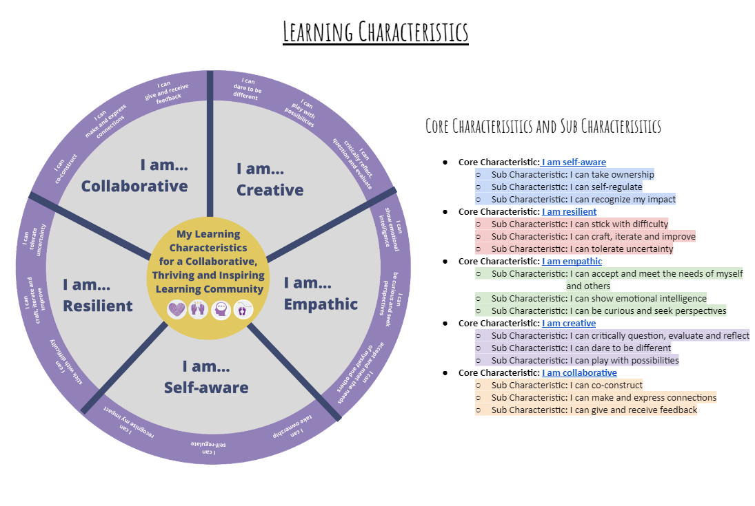
How might you use your individual Characteristics’ strengths to see success in this project? (Amy just added this on Monday - Week 3) (2)
Our strengths relate to creativity and collaboration. We can use these strengths in order to collaborate to create a festival by giving and receiving feedback, playing with possibilities and sticking with difficulty. Our weaknesses include self-awareness and empathy, which means that we need to consider bridging our differences and consciously making an effort to carefully collaborate by using our strengths to enable us to work together.

Slide 31
Value Focus: Be Playful, Creative and Brave
Why are you focusing on this value?
We are focusing on being playful, creative and brave because this value reflects our group’s strengths. Being playful is important for our festival as this is the focus of Playfaire, and creativity is needed in order to create our festival. Bravery to think out of the box will be valuable. It is also important to our group because this is the sort of environment we want to create for our festival-goers.
Assume best intent. Be optimistic
Hold lightly. Tread lightly.
Be radically candid. Expect radical candour.
Be curious and then curiouser.
Be creative, playful and brave.
Be the change you seek.

Slide 32
Copyright
© State of New South Wales (Department of Education), 2025
The copyright material published in this resource is subject to the Copyright Act 1968 (Cth) and is owned by the NSW Department of Education or, where indicated, by a party other than the NSW Department of Education (third-party material).
Copyright material available in this resource and owned by the NSW Department of Education is licensed under a Creative Commons Attribution 4.0 International (CC BY 4.0) license.
This license allows you to share and adapt the material for any purpose, even commercially.
Attribution should be given to © State of New South Wales (Department of Education), 2025.
Material in this resource not available under a Creative Commons license:
the NSW Department of Education logo, other logos and trademark-protected material
Material owned by a third party that has been reproduced with permission. You will need to obtain permission from the third party to reuse its material.
Links to third-party material and websites
Please note that the provided (reading/viewing material/list/links/texts) are a suggestion only and implies no endorsement, by the New South Wales Department of Education, of any author, publisher, or book title. School principals and teachers are best placed to assess the suitability of resources that would complement the curriculum and reflect the needs and interests of their students.
If you use the links provided in this document to access a third-party’s website, you acknowledge that the terms of use, including licence terms set out on the third-party’s website apply to the use which may be made of the materials on that third-party website or where permitted by the Copyright Act 1968 (Cth). The department accepts no responsibility for content on third-party websites.

