Slide 1
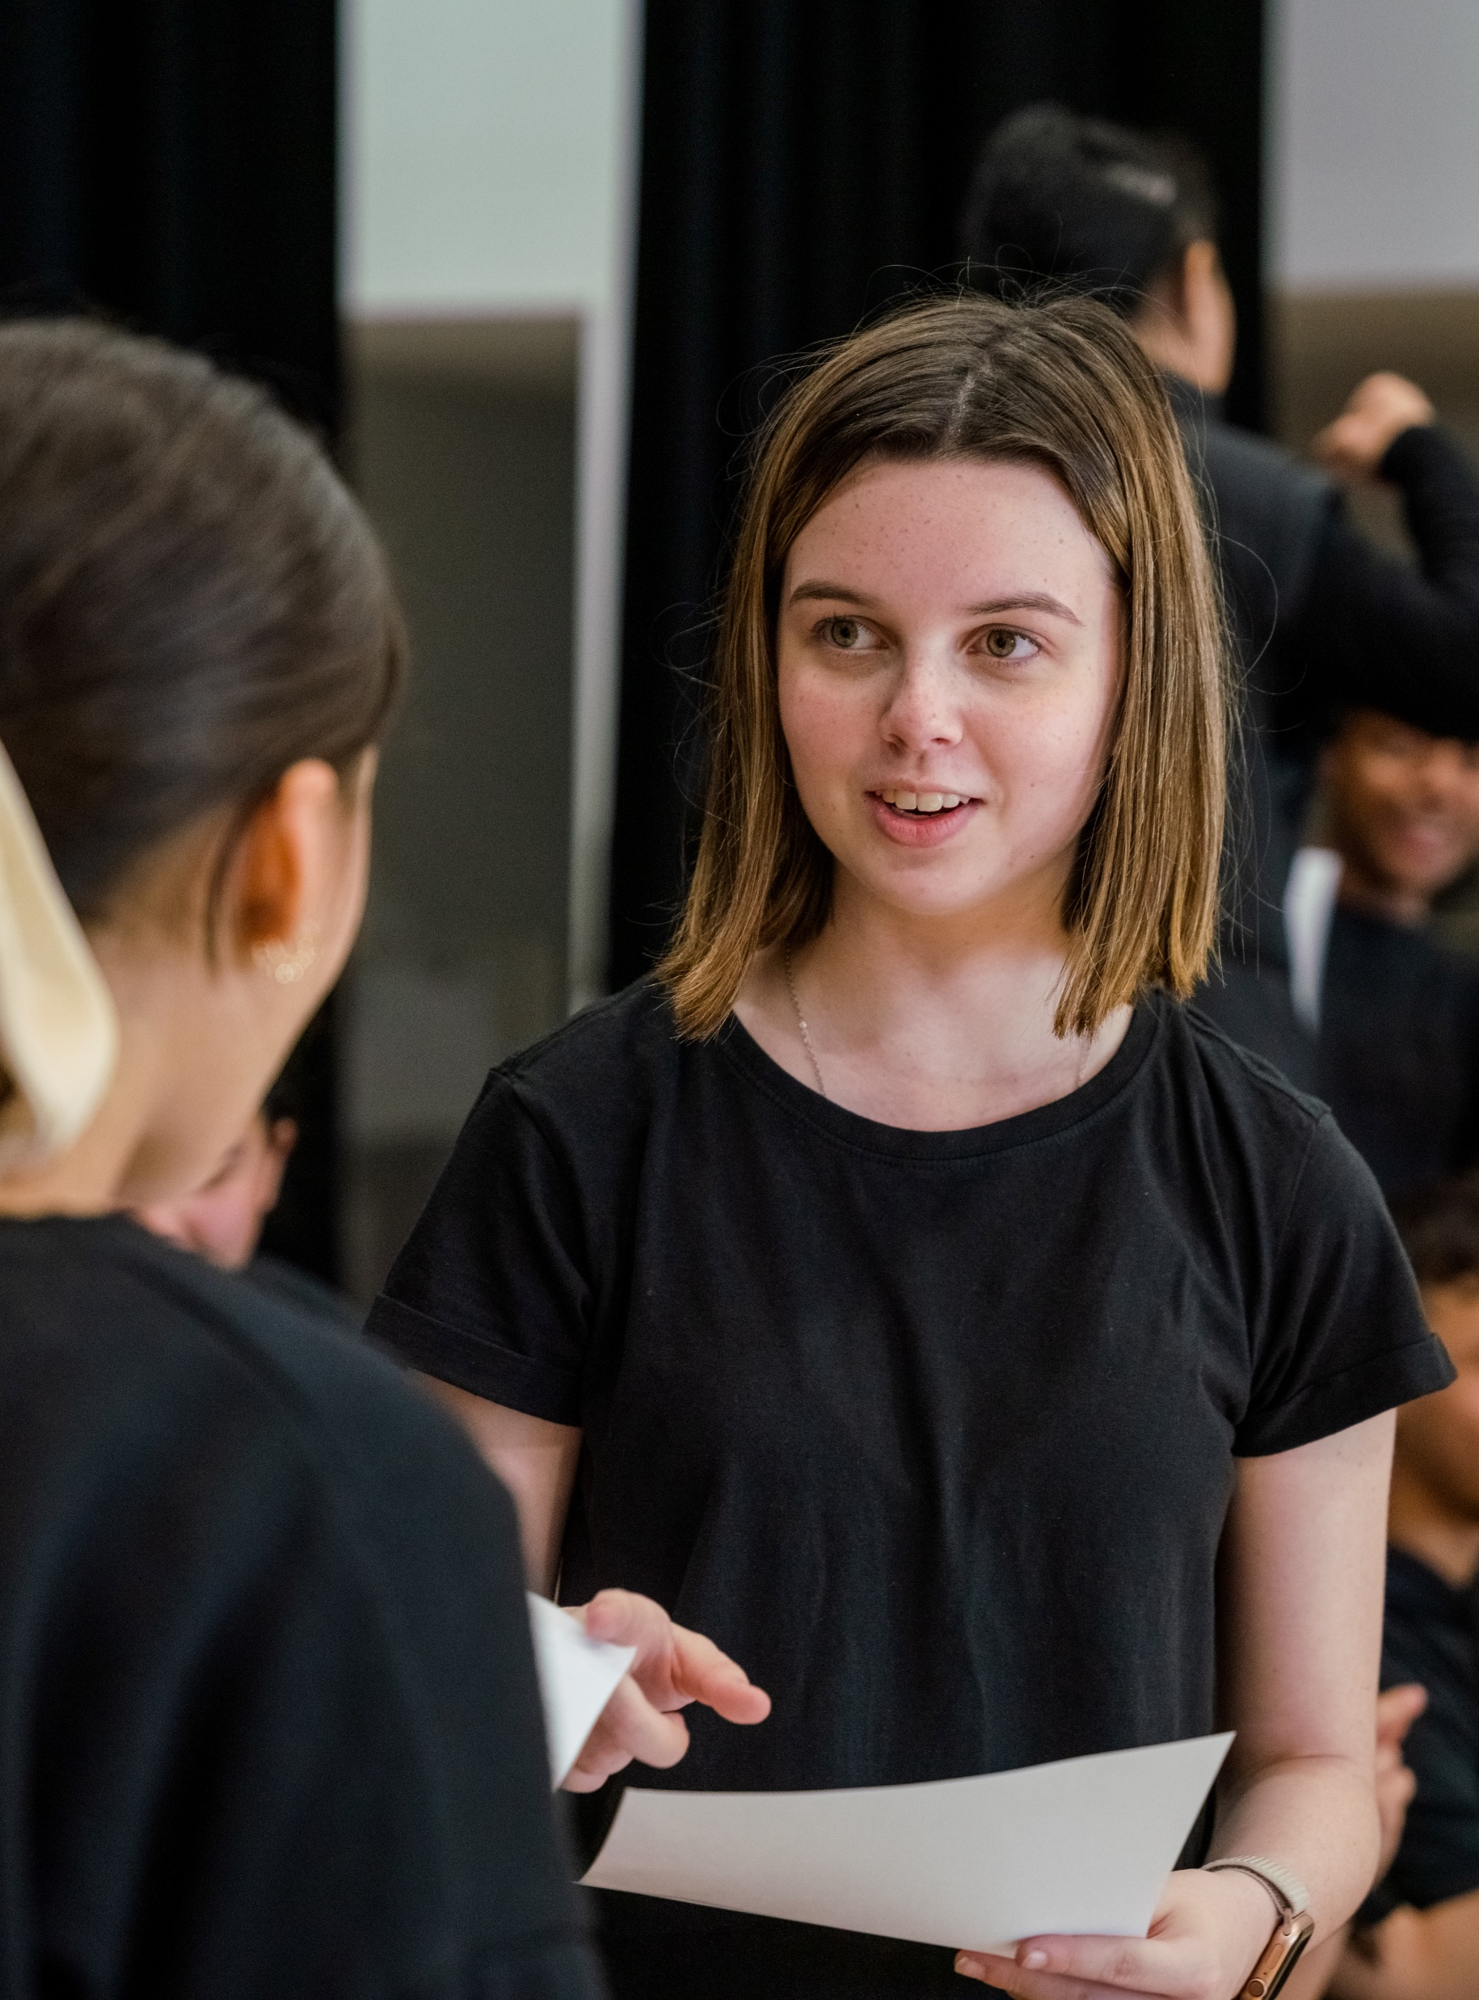
Student learning scaffolds
Performing arts – illustration of practice

Slide 2
Contents
Slide 3 – verbal tennis connect with quest scaffold
Slide 4 – performance planning scaffold
Slides 5 – organisational scaffold
The content in the Microsoft PowerPoint has been generated by the teachers of Lindfield Learning Village during the delivery of the Stage 5 Department approved elective – Performing arts.
The department would like to acknowledge the teachers and students involved in sharing their work as an illustration of practice.

Slide 3
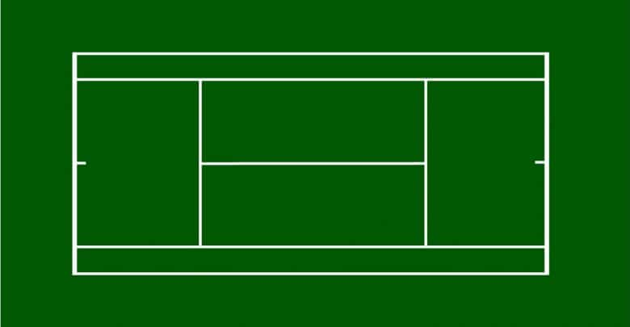

VERBAL TENNIS TO REFLECT ON LEARNING
UMPIRE: Records time of each player talking (30 seconds per hit) and tells the other player when they can talk. Please ensure players maintain eye contact.
Extension the umpire writes down questions.
Questions could be: application (use of facts, rules, principles), synthesis (combination of ideas to form a new whole), evaluation (development of opinions, judgements or decisions) or analysis (separation of a whole into component parts)
PLAYER 1: Communicates key insights and reflections from the content of your subjects thus far.
30 x second per ‘hit’
You must listen to what the other player offers to extend/deepen ideas.
PLAYER 2:
Communicates key insights and reflections from the content of your subjects thus far.
30 x second per ‘hit’
You must listen to what the other player offers to extend/deepen ideas.
BALL HUMAN(s):
Records words and phrases, might sketch!

Slide 4




Stimulus
1. What is your rich, meaningful and impactful stimulus?
2. Highlight the hybrid performance devices you are going to play with in this rehearsal
3. Set time limits for ideation, doing, reflecting and refining
4. Consider Performing arts protocols -
Tick a Box Evaluation
(Insert stimulus below)
narration, amplified voice, direct address, slam poetry, rap
dance or choreographed movement sequences, circus routines, chorus
lighting – hand-held light (torches), floor lighting, lights hidden in set pieces or costume
sound – song, live music or percussion, recorded sound effects, soundscapes, voiceovers
projections – images, texts, animations, media footage, text messages
signs, captions, chalk
puppetry, physical theatre, musical theatre transformational or symbolic props used as a motif
Ideation:
DOING:
Reflecting and Refining:
SPACE
Did we activate, manipulate and transform space?
PRESENCE
Did we use the Elements of Drama and performance to engage our audience in an evocative hybrid performance?
AUDIENCE
Did we consider our audience the whole time? Did we consider how we might give them a ‘call to action’?
PROTOCOLS
Did we adhere to our protocols - ways of working, code of collaboration?

Slide 5
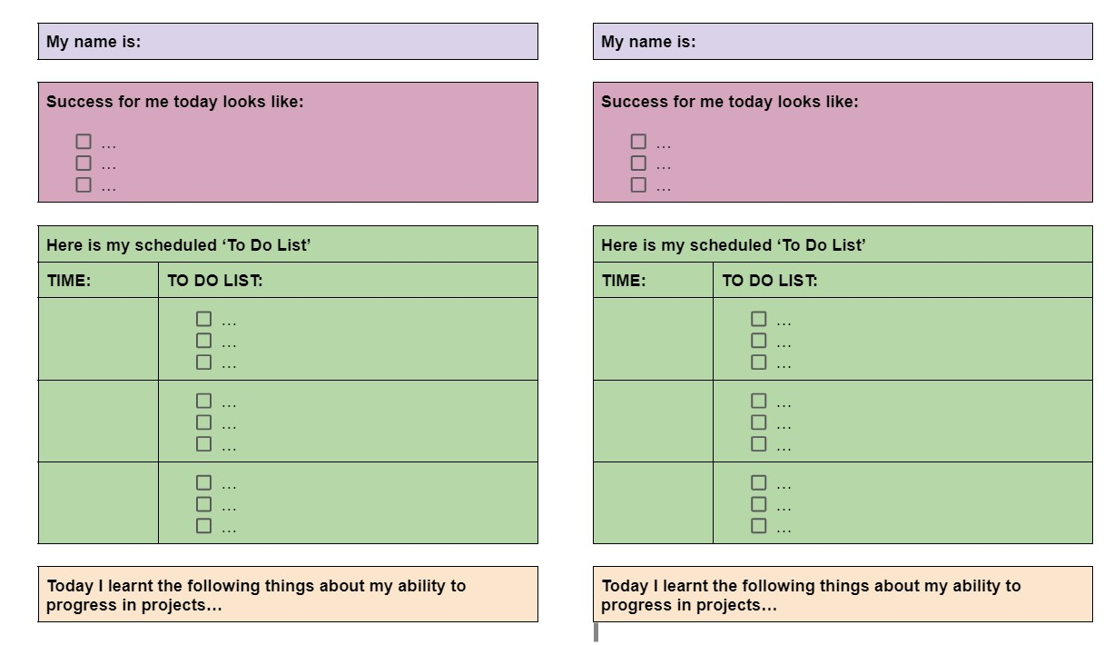
Success for me today

Slide 6
Copyright
© State of New South Wales (Department of Education), 2025
The copyright material published in this resource is subject to the Copyright Act 1968 (Cth) and is owned by the NSW Department of Education or, where indicated, by a party other than the NSW Department of Education (third-party material).
Copyright material available in this resource and owned by the NSW Department of Education is licensed under a Creative Commons Attribution 4.0 International (CC BY 4.0) license.
This license allows you to share and adapt the material for any purpose, even commercially.
Attribution should be given to © State of New South Wales (Department of Education), 2025.
Material in this resource not available under a Creative Commons license:
the NSW Department of Education logo, other logos and trademark-protected material
Material owned by a third party that has been reproduced with permission. You will need to obtain permission from the third party to reuse its material.
Links to third-party material and websites
Please note that the provided (reading/viewing material/list/links/texts) are a suggestion only and implies no endorsement, by the New South Wales Department of Education, of any author, publisher, or book title. School principals and teachers are best placed to assess the suitability of resources that would complement the curriculum and reflect the needs and interests of their students.
If you use the links provided in this document to access a third-party’s website, you acknowledge that the terms of use, including licence terms set out on the third-party’s website apply to the use which may be made of the materials on that third-party website or where permitted by the Copyright Act 1968 (Cth). The department accepts no responsibility for content on third-party websites.

