Slide 1
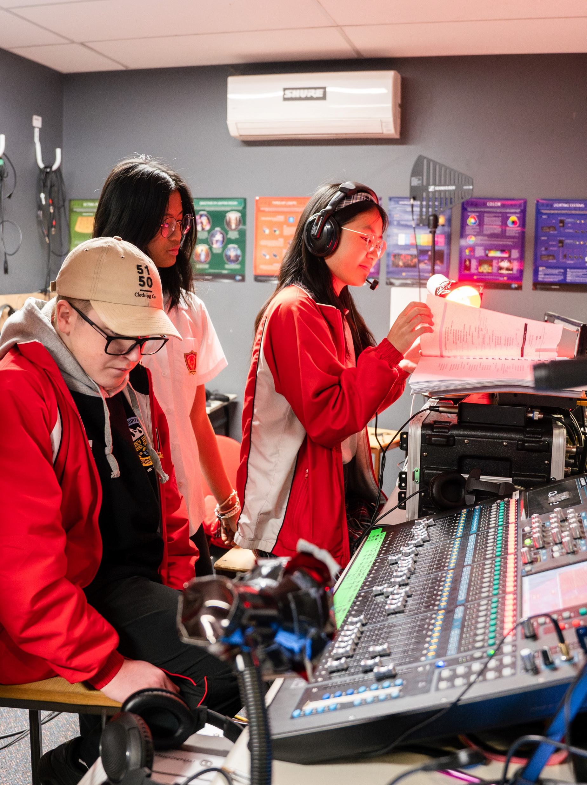
Term 4 Belonging and identity unit – student draft assessment lesson plans
Performing arts – illustration of practice

Slide 2
Contents
Slide 3 – Term 4 assessment task check point
Slides 4 to 5 – Term 4 assessment task check point marking guidelines
Slides 6 – student 1 draft assessment task
Slides 7 – student 2 draft assessment task
Slide 8 – student 3 draft assessment task
The content in the Microsoft PowerPoint has been generated by the teachers of Lindfield Learning Village during the delivery of the Stage 5 Department approved elective – Performing arts.
The department would like to acknowledge the teachers and students involved in sharing their work as an illustration of practice.

Slide 3
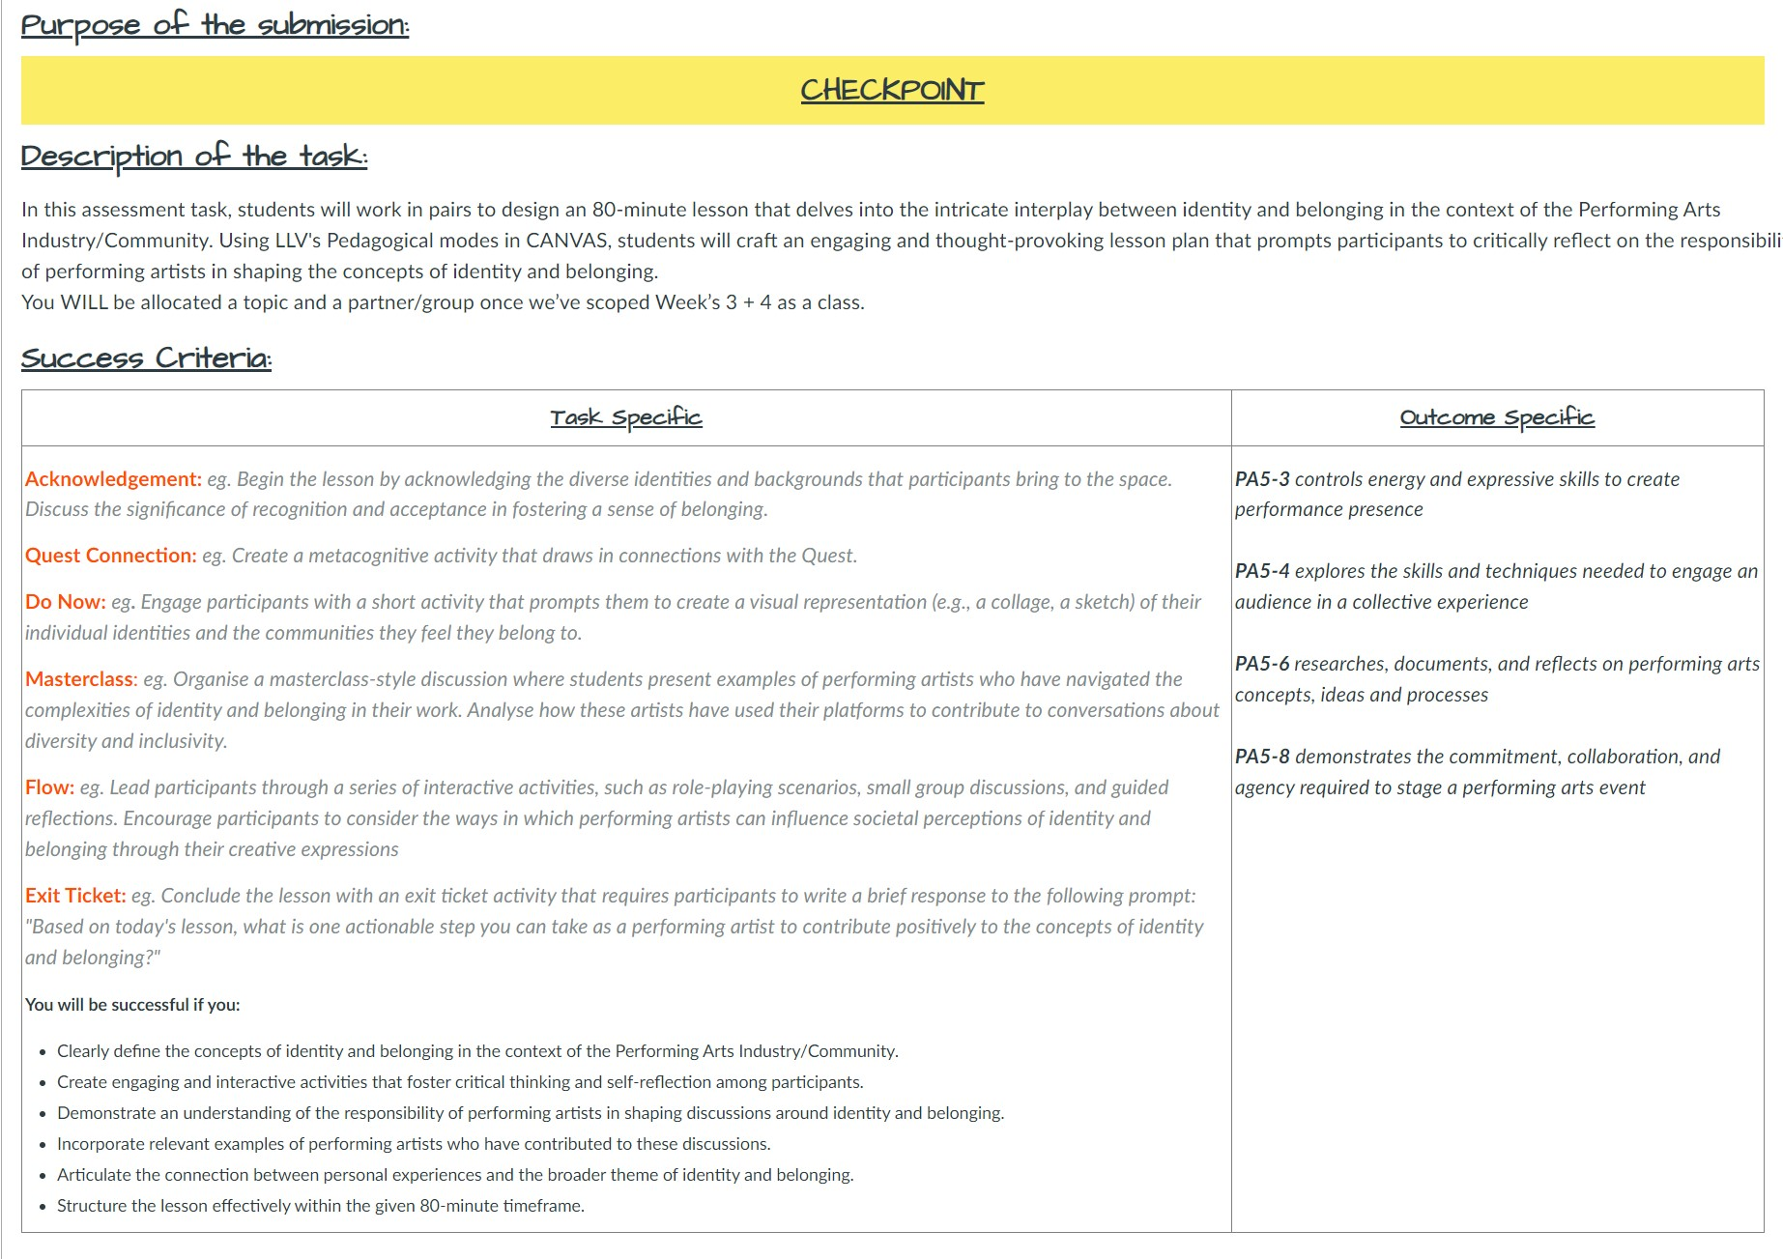
CURRICULUM MATERIALS/STUDENT WORK SAMPLES: Assessment Task
Use Lindfield Learning Village Pedagogy to design a lesson that connects Drama and Performing Arts to Belonging/Identity.

Slide 4
CURRICULUM MATERIALS: Assessment marking guidelines (1 of 2)
Syllabus code | Novice | Apprentice | Practitioner | Expert | Master
PA5-3 controls energy and expressive skills to create performance presence | I can, with teacher support, understand that I need to control my energy and expressive skills to create performance presence. I need to focus on matching my energy to the required context and engage with more advice regarding how to use expressive skills to create performance presence. | I can mostly control energy and expressive skills to contribute to performance presence. I need to sustain my energy and expressive skills to ensure meaning and engagement. | I can control energy and expressive skills to create performance presence. I need to manipulate energy and expressive skills to enhance my performance presence. | I can expertly control energy and expressive skills to create performance presence. I need to more deeply consider how I manipulate energy and expressive skills to individual performance contexts to enhance my performance presence. | I can experiment with and refine energy and expressive skills in multiple ways to create sophisticated performance presence. I can transform my energy and presence based on performance context and my ensemble.
PA5-4 explores the skills and techniques needed to engage an audience in a collective experience | I can, with teacher support, explore some of the skills and techniques needed to engage an audience. I need to apply feedback about these skills and techniques to further engage an audience. | I can explore some of the skills and techniques needed to engage an audience in a collective experience. I need to apply the skills and techniques needed to engage an audience in a collective experience. | I can explore the skills and techniques needed to engage an audience in a collective experience. I need to be able to analyse the effectiveness of these skills and techniques to enhance audience engagement. | I can expertly explore and apply the skills and techniques needed to engage an audience in a collective experience. I need to be able to analyse and evaluate the effectiveness of these skills and techniques to enhance audience engagement. | I can experiment with, apply and evaluate the skills and techniques needed to engage an audience in an evocative and collective experience. I can direct my peers in this process to ensure a powerful audience impact.

Slide 5
CURRICULUM MATERIALS: Assessment marking guidelines (2 of 2)
Syllabus code | Novice | Apprentice | Practitioner | Expert | Master
PA5-6 researches, documents and reflects on performing arts concepts, ideas and processes | I can, with teacher and peer support, access texts and documents relating to performing arts concepts to help me offer ideas and engage with processes. I need to use provided texts and documents to engage in scaffolded reflection of performing arts concepts, ideas and processes. | I can use provided texts and documents to engage in scaffolded reflection of performing arts concepts, ideas and processes. I need to independently research texts and engage in autonomous reflection in consideration with the performing arts concepts and processes and use this reflecting to offer ideas. | I can research documents and reflect on performing arts concepts, ideas and processes. I need to widen the range of documents I research so I can more thoughtfully reflect on concepts, ideas and processes. | I can thoroughly research a range of documents and thoughtfully reflect on performing art concepts, ideas and processes. I need to autonomously expand my research scope so that I can thoughtfully reflect on and challenge ideas to create and implement processes and protocols. | I can source my own extensive research material to reflect on performing arts concepts, challenge ideas and create and implement processes and protocols.
PA5-8 demonstrates the commitment, collaboration and agency required to stage a performing arts event | I can, with teacher and peer support, participate in organised rehearsals and receive ideas from others. I can work on my ability to contribute ability and I'm building my confidence in my voice and actions to demonstrate agency in helping my peers stage an event | I can, with team support, participate and engage in most rehearsals and am receptive to offers by others. I can contribute to event building with scaffolded questions or prompts from the group leaders or my teacher. I can join in and participate in problem solving processes and can do things independently with guidance and clear outlines. | I can commit to the meetings and rehearsals and meet other necessary requirements for even planning and execution. I can collaborate with the team and artists within the scope of my role and am developing my confidence in using my voice in the planning phase. I can contribute to problem solving issues that arise as part of a team and am keen on taking ownership over parts of the process. | I can demonstrate strong commitment and fulfilled my assigned roles and responsibilities effectively. I can effectively communicate and collaborate with team members and contribute positively to the overall project. I can adapt to challenges and changes and contribute to problem solving efforts, whilst taking initiative and agency in my role within the event planning team. | I can demonstrate exceptional commitment and go above and beyond expectations in all aspects of event planning and execution. I can show exemplary collaboration skills by effectively working with team members and all stakeholders to foster a positive and inclusive environment. I can show remarkable adaptability in handling challenges and exhibit a high level of agency in taking ownership of tasks and actively drive the event's success with innovative ideas and solutions.

Slide 6
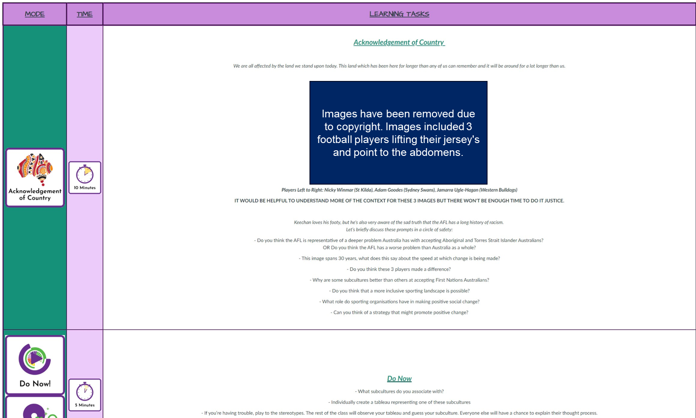
STUDENT SAMPLE LESSON #1

Slide 7
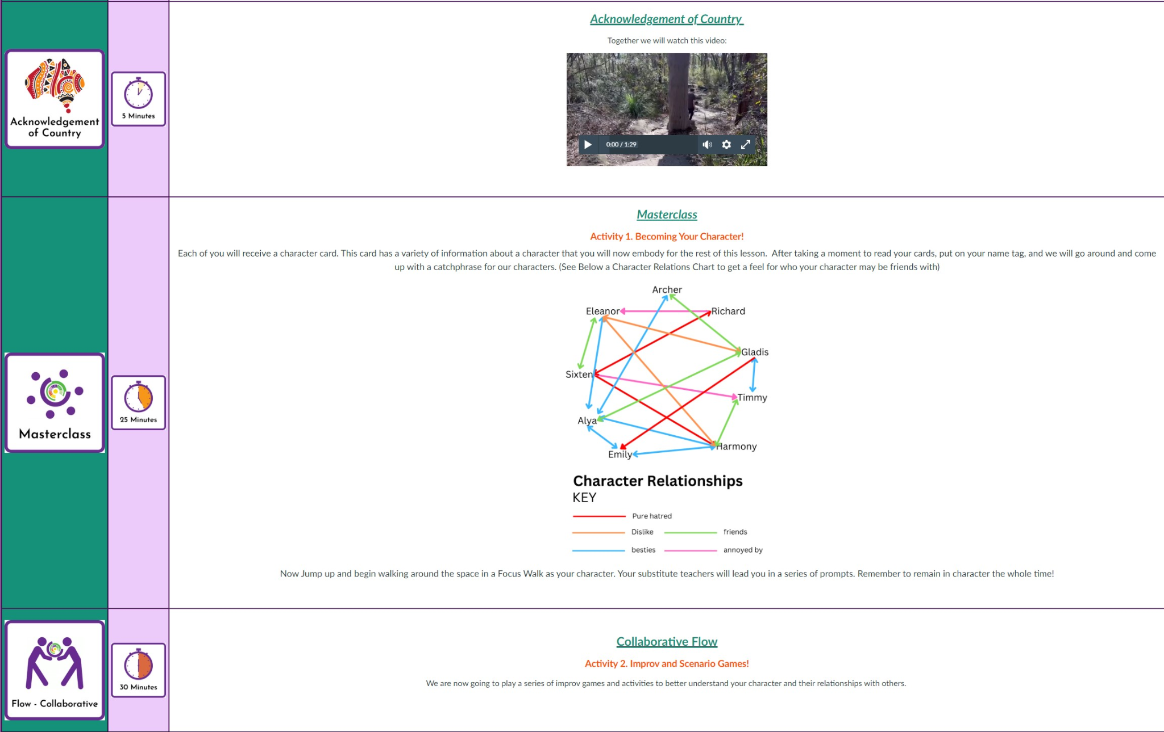
STUDENT SAMPLE LESSON #2

Slide 8
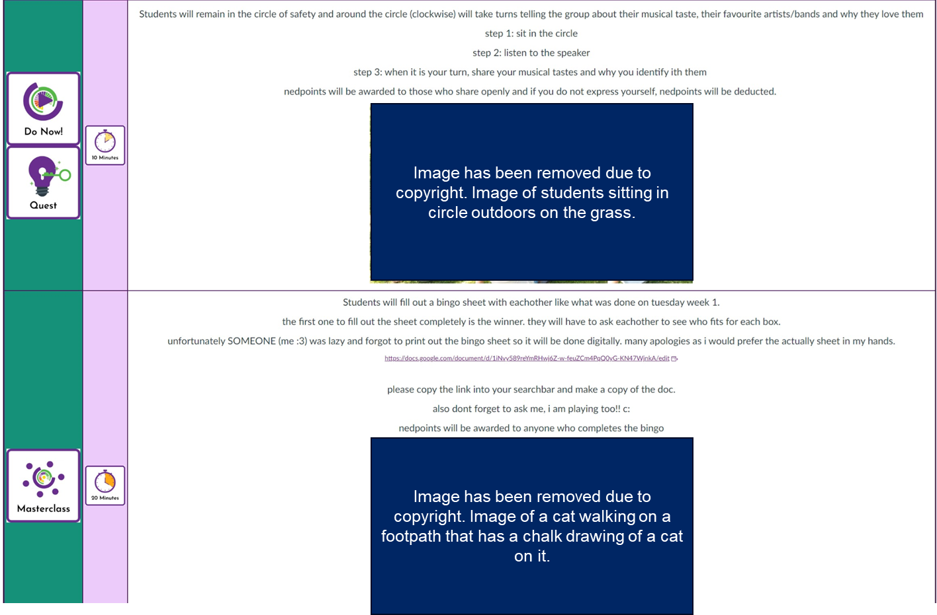
STUDENT SAMPLE LESSON #3

Slide 9
Copyright
© State of New South Wales (Department of Education), 2025
The copyright material published in this resource is subject to the Copyright Act 1968 (Cth) and is owned by the NSW Department of Education or, where indicated, by a party other than the NSW Department of Education (third-party material).
Copyright material available in this resource and owned by the NSW Department of Education is licensed under a Creative Commons Attribution 4.0 International (CC BY 4.0) license.
This license allows you to share and adapt the material for any purpose, even commercially.
Attribution should be given to © State of New South Wales (Department of Education), 2025.
Material in this resource not available under a Creative Commons license:
the NSW Department of Education logo, other logos and trademark-protected material
Material owned by a third party that has been reproduced with permission. You will need to obtain permission from the third party to reuse its material.
Links to third-party material and websites
Please note that the provided (reading/viewing material/list/links/texts) are a suggestion only and implies no endorsement, by the New South Wales Department of Education, of any author, publisher, or book title. School principals and teachers are best placed to assess the suitability of resources that would complement the curriculum and reflect the needs and interests of their students.
If you use the links provided in this document to access a third-party’s website, you acknowledge that the terms of use, including licence terms set out on the third-party’s website apply to the use which may be made of the materials on that third-party website or where permitted by the Copyright Act 1968 (Cth). The department accepts no responsibility for content on third-party websites.

