Slide 1
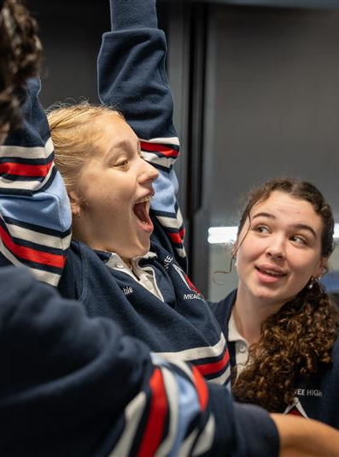
Term 1 Performing arts Essentials learning resources
Performing arts – illustration of practice

Slide 2
Contents
Slides 3 to 34 – Essentials learning resources
Slides 35 to 50 – Student folio example
The content in the Microsoft PowerPoint has been generated by the teachers of Lindfield Learning Village during the delivery of the Stage 5 Department approved elective – Performing arts, Core 1 – learning sequence – performing arts essentials.
The department would like to acknowledge the teachers and students involved in sharing their work as an illustration of practice.

Slide 3
CURRICULUM MATERIALS: Teacher Generated Materials
Teacher Scaffold for Critical Engagement and Reflection on Lessons and Learning Experiences
Term I - Performing Arts Essentials

Slide 4
WEEK 3 - Performing Arts Essentials (1)
DOCUMENT / LOG YOUR PROCESS ON THIS SLIDE
You might input any notes taken, photos, script ideas, planning docs, collaborative ideas, videos etc…

Slide 5
WEEK 3 - Performing Arts Essentials (2)
What personality type were you in the DO NOW task and how did it help you contribute to the group task?
Write your answers here…
How did you work with certain other personality types?
Write your answers here…
What behaviours and mindsets did you need to adopt to take creative risks?
Write your answers here…
What was the most enjoyable moment for you during today’s activity?
Write your answers here…
What do we need to learn to have more success in a task like today?
Write your answers here…
How did you create PRESENCE in your making AND rehearsing?
Write your answers here…

Slide 6
PRESENCE (3)

Slide 7
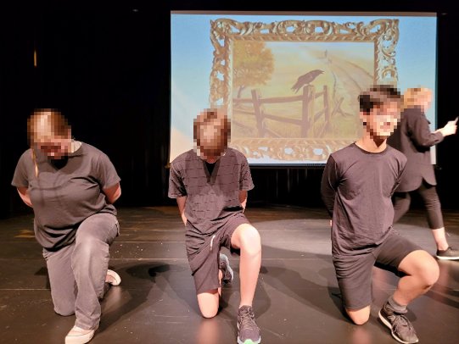
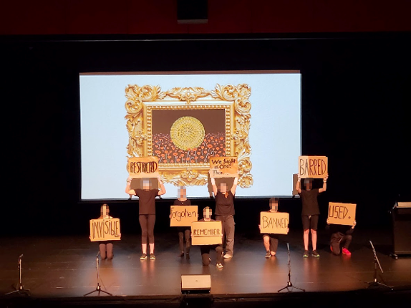
ANZAC DAY PERFORMANCE

Slide 8
AUDIENCE (3)

Slide 9
WEEK 4 - Australian Stories (1)
STATION 1
(Aboriginal artwork)
What is the story?
Write your answers here…
WHY is the story significant?
Write your answers here…
HOW is the story being told?
Write your answers here…
STATION 2
(Deborah Mailman extracts)
What is the story?
Write your answers here…
WHY is the story significant?
Write your answers here…
HOW is the story being told?
Write your answers here…
STATION 3
(Aboriginal Countries map)
What is the story?
Write your answers here…
WHY is the story significant?
Write your answers here…
HOW is the story being told?
Write your answers here…
STATION 4
(Ziggy Ramo + Paul Kelly)
What is the story?
Write your answers here…
WHY is the story significant?
Write your answers here…
HOW is the story being told?
Write your answers here…

Slide 10
WEEK 4 - Australian Stories (2)
STATION 5
(Bangara clip)
What is the story?
Write your answers here…
WHY is the story significant?
Write your answers here…
HOW is the story being told?
Write your answers here…
STATION 6
(Cartoon)
What is the story?
Write your answers here…
WHY is the story significant?
Write your answers here…
HOW is the story being told?
Write your answers here…
STATION 7
(Bindi)
What is the story?
Write your answers here…
WHY is the story significant?
Write your answers here…
HOW is the story being told?
Write your answers here…

Slide 11
STATION 1 - Aboriginal Art
Tony Albert, “Brothers (New York Dreaming)”, 2016
Tony Albert, “Brothers (Unalienable)”, 2016
Tony Albert
Other Materials
pigment print on paper with hand embellishment
Artwork size
100.0 x 66.0 (cm)
39.4 x 26.0 (inch)
---
Tony Albert is a politically-minded artist provoked by stereotypical representations of Aboriginal people and the colonial history that attempts to define him, and what Aboriginality is, in the present.

Slide 12
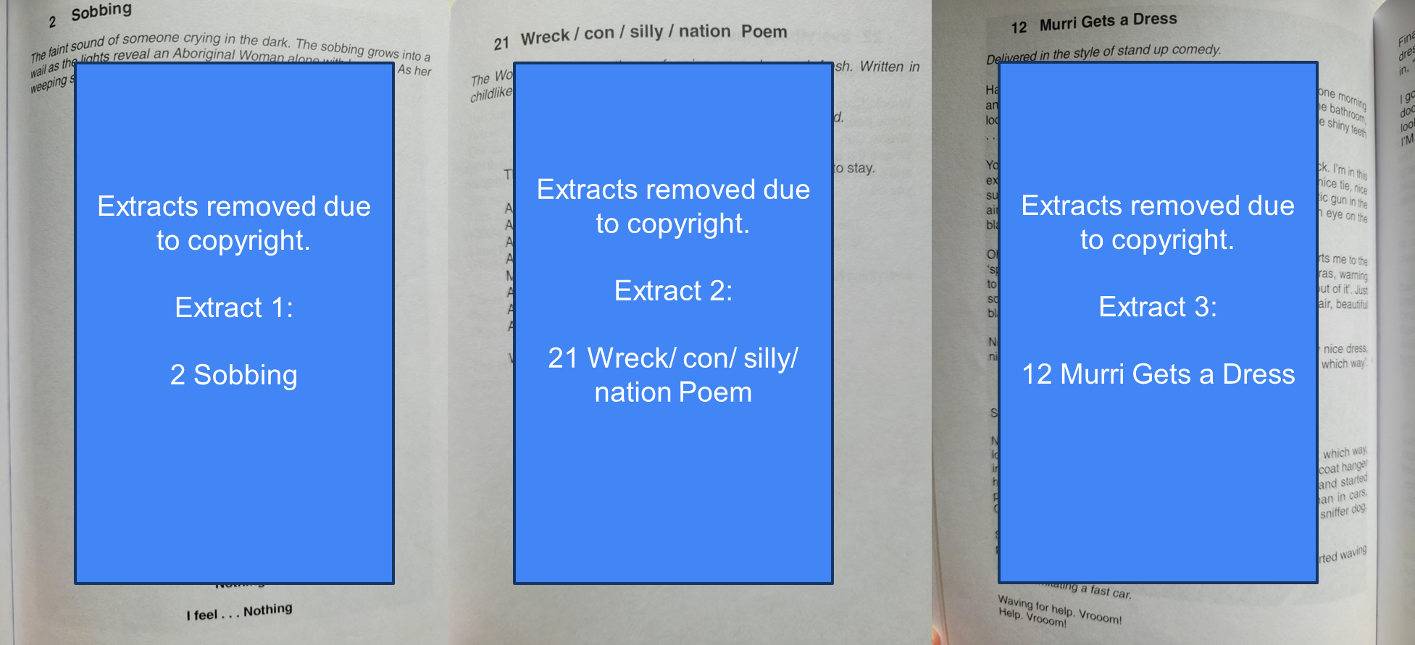
STATION 2 - 7 Stages of Grieving Extracts

Slide 13
STATION 3 - Aboriginal Countries Map
Image removed due to copyright.
Image of Aboriginal and/or Torres Strait Islander Countries map

Slide 14
STATION 4 - Ziggy Ramo + Paul Kelly
Image removed due to copyright.
Image of Ziggy Ramo and Paul Kelly performing together on stage.

Slide 15
STATION 5 - Bangara Clip
BROLGA Bangarra Dance Theatre Education Resource 4:25 minutes
Additional information on Bangara and Brolga

Slide 16
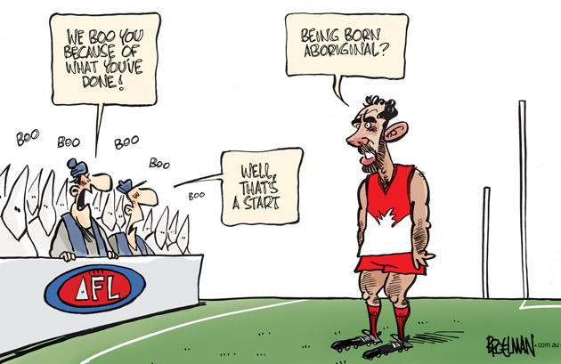
STATION 6 - Cartoon
Racism at AFL games… – Peter Broelman

Slide 17
STATION 7 - Bindi: Kirli Saunders
Image removed due to copyright.
Image of Bindi by Kirli Saunders book cover.

Slide 18
Week 4 Monday - Becoming an Ensemble
What did you really enjoy about today’s ‘Becoming an Ensemble’ lesson and why?
What did you find challenging about today’s ‘Becoming an Ensemble’ lesson and why?
Suggest some protocols for our ensemble to ensure that you will be successful as a learner in PA.
Provide an image and analysis of your most significant insight from today’s lesson.

Slide 19
STATION 1 -Enlistment Propaganda Poster
Parliamentary recruitment committee, Step into your place poster, 1915

Slide 20
STATION 2 - 2019 Podcast Transcript (available through the ANZAC Portal (Department of Veterans’ Affair)
Wendy James - child evacuee | Second World War
Wendy James was just six years old when her mother and siblings were evacuated from their home in Darwin, just before the bombing of Darwin. Wendy revisits the challenges her family faced during the war.
Being a refugee in the wartime was probably one of the most unpleasant memories of my life. We lived in peoples’ back rooms and we had no money. And my father's letters would arrive and they would fall out of an envelope like confetti because of the censorship. They would just be snipped all the way through, so we'd sit in the kitchen table trying to put all these lines of writing together to say — well, we know he's alive, but umm, yes, we don't know what's going on.
I believe we were refugees; economically and physically, because although we had a lot of family in Western Australia, they had their own terrible problems. Their sons and their husbands were all away at war. In fact, it wasn't that long after the Depression, really, and people had only just started to gather themselves together when this happened. So they really didn't want a family of three and four people landed on their doorstep, much as they loved us.

Slide 21
STATION 3 - Letter from a soldier.
Letter From Hugh Anderson to his parents, 6th January 1916. He wrote this letter from his hospital bed at Heliopolis as he was badly wounded during the attacks.
“We were issued with a white strip of calico to sew on to each arm and a big patch for the back, this was for the artillery to show where our men were, and also made a good mark for Johnie (Turkish soldier) as we soon found to our cost. We were then told what we were to take over with us and our officer gave us a rough sketch of the trenches and told us what was expected of us, and what we had to do.
On August 6th we paraded just after 3 o'clock in battle order and marched round to our trenches opposite the Lone Pine. The whole of the first division was to do the job, the 1st Battalion formed the first line and were in our advanced firing line, the 2nd Battalion were in the main firing line in the firing positions, and the 4th Battalion were in the bottom of the trench just behind them. The 3rd Battalion were the reserves and came over twenty minutes after we started. The brigade went in a little over 3000 strong and came out something over 400, so the casualties were very heavy.
We got to our positions about 4pm and the artillery commenced bombarding the Turkish trenches and they returned the compliment and the crash and scream of shells was deafening for a little over an hour, the smell of explosives was very strong and the suspense of waiting tried our nerves. I was nervous I can tell you and put up many a prayer for courage. I bet others did also. About 5pm the officers were all there with watch in hand calling 3 minutes to go, 2 minutes to go, 1 minute to go half a minute to go and shut his watch and three shrill blasts of a whistle. Out scrambled the boys from advanced line up through holes in the ground, the trench being a tunnel. Over the parapet go the 2nd Battalion and we are close behind. I will never forget that picture, I was well up with the rest racing like mad, all nervousness gone now. The shrapnel falling as thick as hail, many a good man went down here although I never noticed it at the time.”

Slide 22
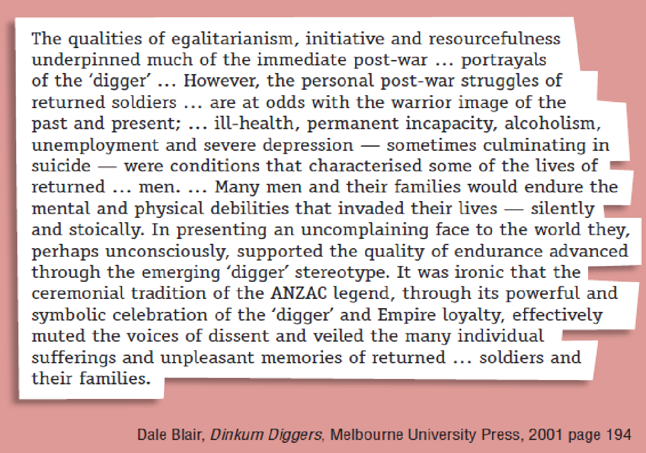
STATION 4 -

Slide 23
STATION 5 - The other ANZACS (women)
The other ANZACs by Peter Rees (2:52 minutes)

Slide 24
STATION 6 - Monkeys in a Museum (Black Diggers by Tom Wright) (1)
Script extract pages 19 and 20 from Black diggers, 2015, by Tom Wright.5

Slide 25
STATION 7 - Archie Gets Turned Away from RSL (Black Diggers by Tim Wright) (1)
Script extract from Black diggers, 2015, by Tom Wright.5

Slide 26

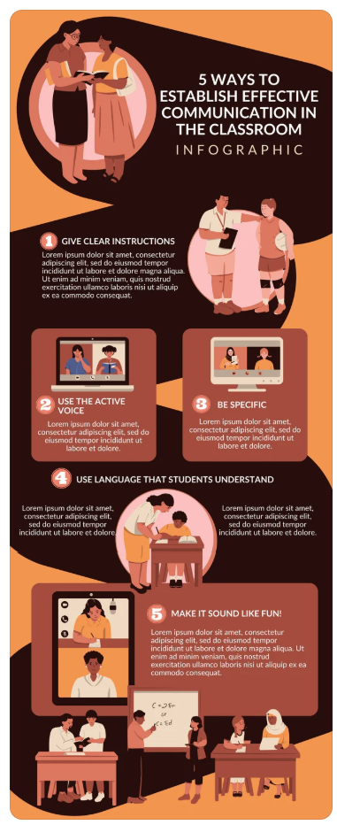
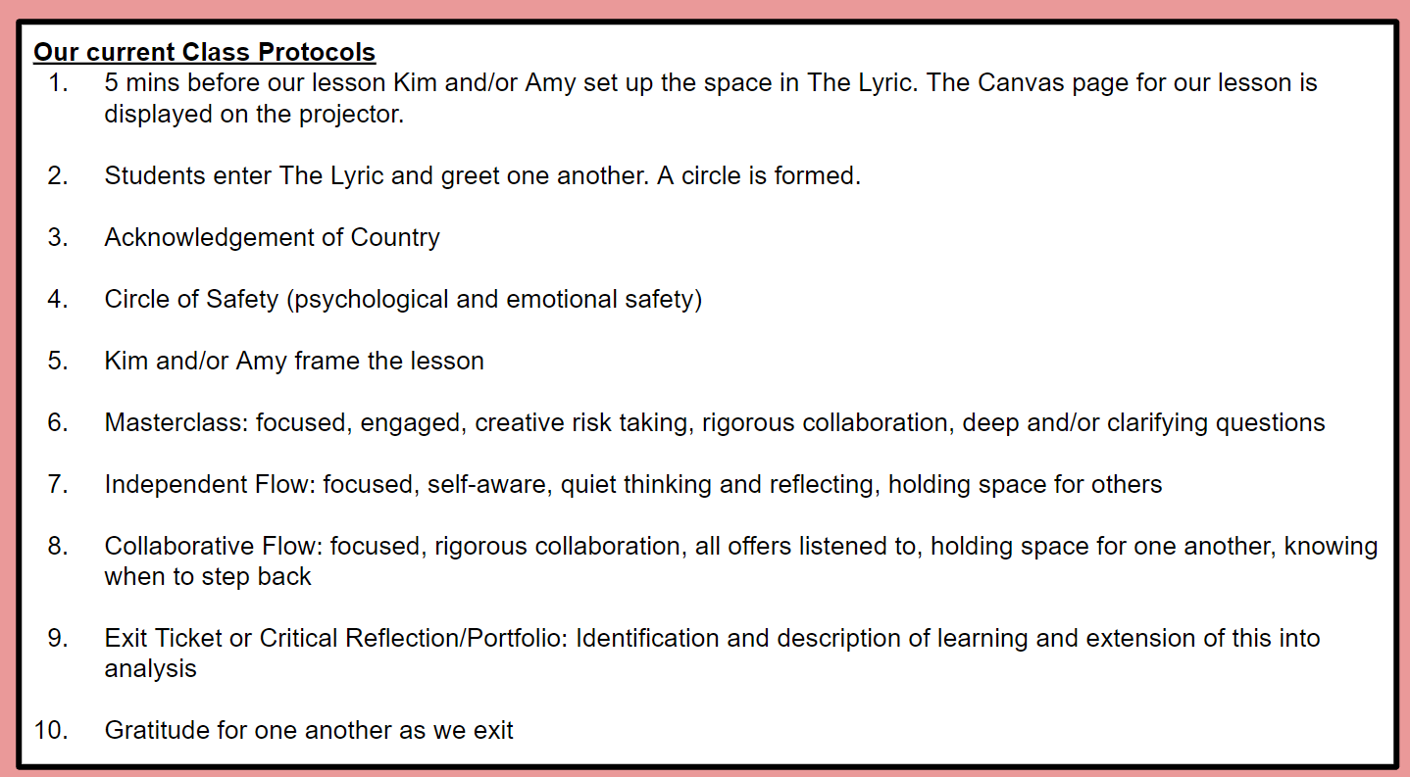
WEEK 6 - PROTOCOLS
These were the identified protocols that we have established as a class and presented at the beginning of the lesson. Create an infographic, (Canva, Slides, etc) that demonstrate all of the protocols that we use as a class.

Slide 27
WEEK 6 - Transforming Space with Lights (1)
What did you learn today about performance technologies today during your Masterclass?
Write your answers here…
How did you work with certain other personality types?
Write your answers here…
How can we use lighting to create diverse performance spaces.
Write your answers here…
What was the most enjoyable moment for you during today’s activity?
Write your answers here…
What do we need to learn to have more success in a task like today?
Write your answers here…
How did you create PRESENCE in your making AND rehearsing?
Write your answers here…

Slide 28
WEEK 6 - Transforming Space with Lights (2)
What did you learn today about performance technologies today during your Masterclass?
Write your answers here…
How did you work with certain other personality types?
Write your answers here…
How can we use lighting to create diverse performance spaces.
Write your answers here…
What was the most enjoyable moment for you during today’s activity?
Write your answers here…
What do we need to learn to have more success in a task like today?
Write your answers here…
How did you create PRESENCE in your making AND rehearsing?
Write your answers here…

Slide 29
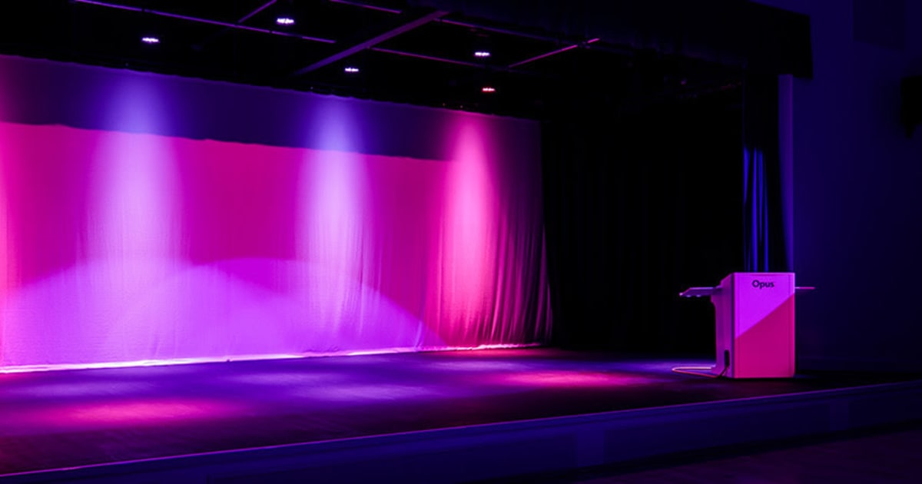
WEEK 7 - Transforming Space with Lighting
Key takeaways from Auditorium tour and Console Masterclass
Write answers here
Write answers here
Write answers here
Write answers here
Write answers here

Slide 30
WEEK 8 - The preparation begins…
What were some of the offers that you made today during the Iteration Stations?
Write answers here
Write answers here
Write answers here
Write answers here
How did you effectively read the room today?
Write answers here
Write answers here
Write answers here
Write answers here
Write answers here
What are our next steps to ensure this is a moving ANZAC Day commemoration?
Write answers here
Write answers here
Write answers here
Write answers here

Slide 31
Performing
arts
Essentials explained with student folio examples

Slide 32
TABLE OF CONTENTS
Space
Presence
How did we explore space this term?
Why is presence important?
Protocols
Audience
What are our protocols in PA?
How can we engage the audience?

Slide 33
WHAT ARE THE PA ESSENTIALS?
These four main essential elements of art performances are vital in creating a successful and immersive experience:
Space | Space is a crucial part of performing arts that shapes the audience’s perspective of the narrative, as well as communicating meaning, setting and defining the characters.
Protocols | Protocols could be loosely defined as rules, but really they are prompts and guidelines to enable a successful performance that is respectful and impactful.
Presence | Presence refers to how grounded and in character the actors are, utilising techniques to embody their characters. “A chain is only as strong as its weakest link.”
Audience | The audience interprets all the information, and relates it to their individual experiences. Engaging the audience is vital to carrying a message across.

Slide 34
Space
This term, we focused on space for Weeks 7 and 8. During this time, we explored the importance of utilising and activating space well, and how we can manage space in our final ANZAC Day performance.

Slide 35
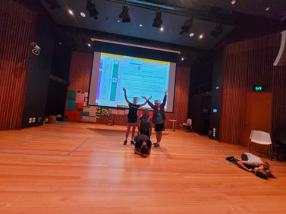
Zen Garden
One of the warm ups we completed to help us understand space was the Zen Garden. This impromptu hybrid performance incorporated music and acting, and evoked a calm atmosphere. While adjusting the scenery, we were mindful of making the Zen Garden still seem cohesive and not cluttered. The classical music added to our activation of the physical space around us, to change the energetic space to evoke a sense of relaxation.

Slide 36
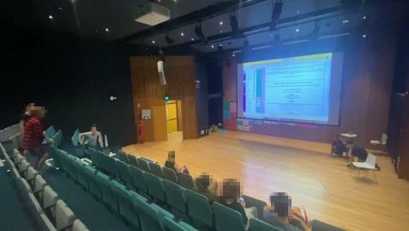
Building a World of War
In the same style as the Zen Garden exercise, our group was then asked to create a scene on the battlefield. We focused on the struggle of power and weakness, and communicated this by activating levels and gestures. We made every movement deliberate in order to not create a cluttered performance. We thought about how we could utilise the entire space of the theatre, including the aisles and stage to create the performance. This brought the play closer to the audience, who had a different point of view than if we were just on the stage. Like the Zen Garden, there was an element of impromptu in this performance, so we had to constantly try to place ourselves in relation to others to create a visually satisfying composition.

Slide 37

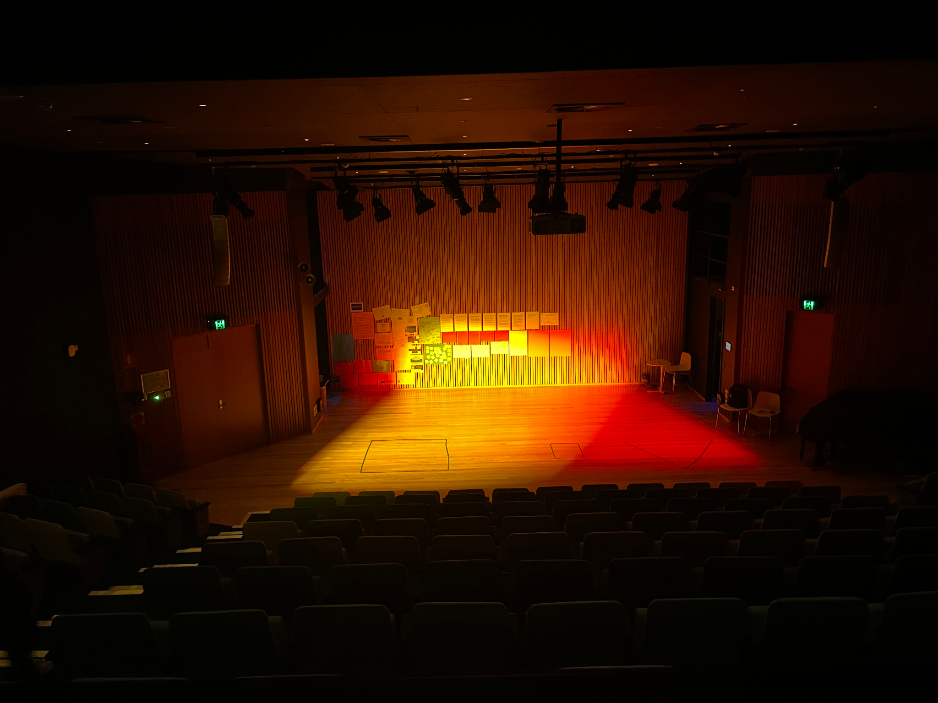
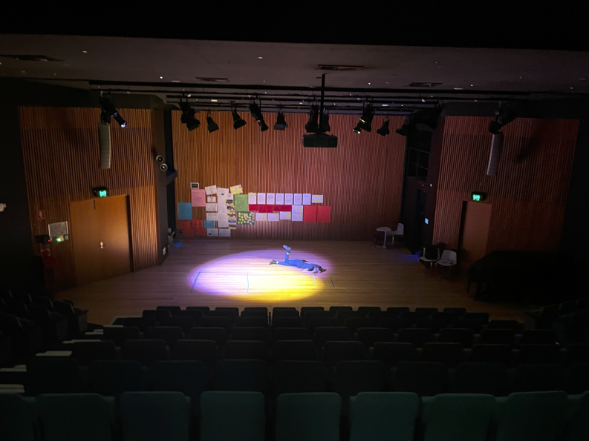
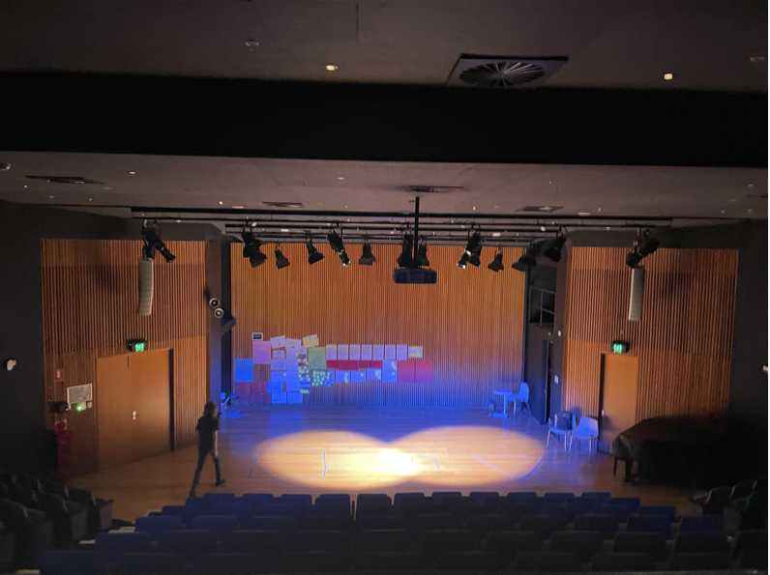
Transforming Space with Lighting
With Kim, we learnt about how lighting plays a pivotal role in shaping the theatrical environment, enhancing the emotional impact of a performance and guiding the audience's attention. By adjusting the intensity, colour and direction of light, we created distinct spaces within a single stage, emphasised critical moments in the story and changed the mood of the audience. We used lighting to create dynamic scenes to evoke different emotions in the audience. In our quick performance showing the contrast between the inner and outer worlds of an ANZAC soldier, we used a bright red circle of light, around which we all crowded, to evoke claustrophobia, fear and intimidation.

Slide 38
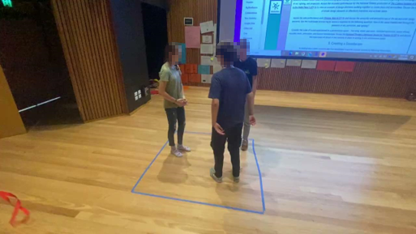
The Chase
In our last lesson focusing on space, we developed our understanding of how to manipulate and activate a confined space. Within the confines of a 2 metre by 2 metre square, Finn, Madi and I conveyed the hectic atmosphere of a chase scene. In doing this, we focused on being conscious of how to convey our proxemics and how to use shape to create an impactful performance. Thinking about proxemics allowed us to effectively utilise the limited area by strategically positioning ourselves and manipulating our body language in relation to each other. The exploration of shape allowed us to create visually engaging compositions that evoke emotional responses from the audience.

Slide 39
Protocols
This term, we focused on protocols during Week 6. In this time, we discovered what protocols mean in the context of Performing arts and what our protocols are.

Slide 40
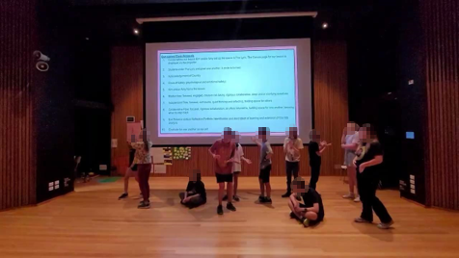
Protocols Machine
After a quick masterclass and idea generation on what we think protocols are, we decided that protocols in drama were essential guidelines for fostering a safe, supportive and creative learning environment. We then jumped into a Protocols Machine, where we were each a part of a big Performing Arts Class Protocol Machine, and acted as something that was part of our class protocols. Some of us focused on aspects such as our circle of safety, collaboration, greeting the class and learning. I acted out the first protocol on the list Amy had created, which was the teachers setting up our learning space.

Slide 41
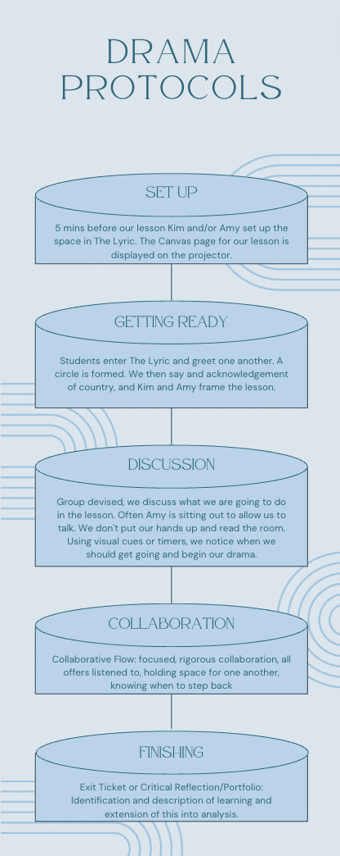
Infographic
We also established what our protocols were in an infographic that helped us understand how to fully engage in the creative process, while respecting the perspectives and contributions of peers. By adhering to these protocols, we can develop essential skills such as teamwork, problem-solving and empathy, that ensure the classroom becomes an inclusive space where we all feel comfortable to share our ideas.

Slide 42
Presence (1)
This term we discovered the importance of presence in drama, and how this can impact the overall performance.

Slide 43
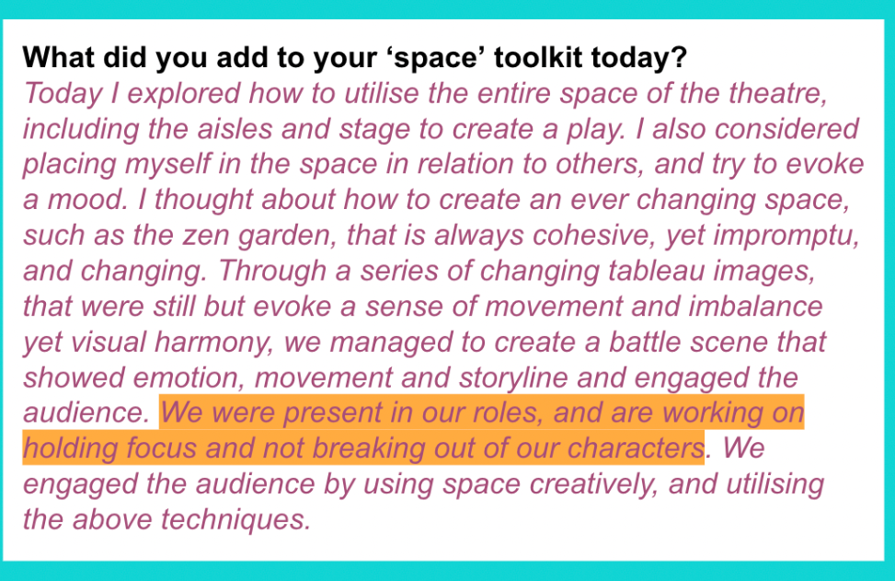
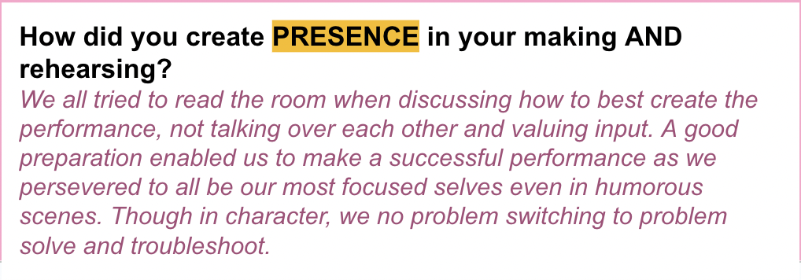
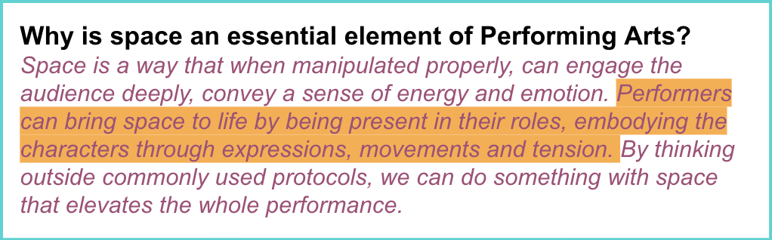
Presence (2)
During all our performances, we kept in mind that a strong presence enables performers to captivate and engage with their audience, enhancing the emotional impact and depth of the performance. We made sure to incorporate physicality, facial expressions and vocal projection in order to establish a connection with the audience. We used these drama techniques to embody our characters well, and made sure to collaborate with the whole class, as, ‘a chain is only as strong as its weakest link.’
The first step to creating a performance in which presence is utilised well is preparation. For our quick performances, we didn’t have much, or any time to prepare, however, we made sure that we collaborated to ensure that everyone felt confident with their role. One of the most difficult elements of presence for the group was focus, as it was sometimes difficult not to break out of character in an amusing situation. By doing warm-ups such as focus walks, yoga, Zen Gardens etc., we built up our knowledge of using expressions, subtle movements and stillness to connect with the audience and other characters on stage. Using these new skills, we are able to manipulate the energy of the scene to create an effective performance.

Slide 44
Audience (1)
This term, we ideated and learnt how to engage the audience to carry messages across, and how we can catch the attention of the audience in our final performance.

Slide 45
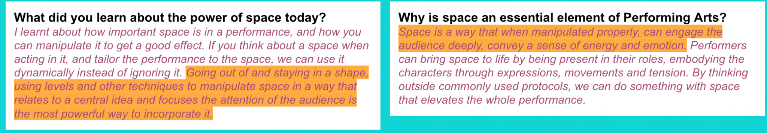
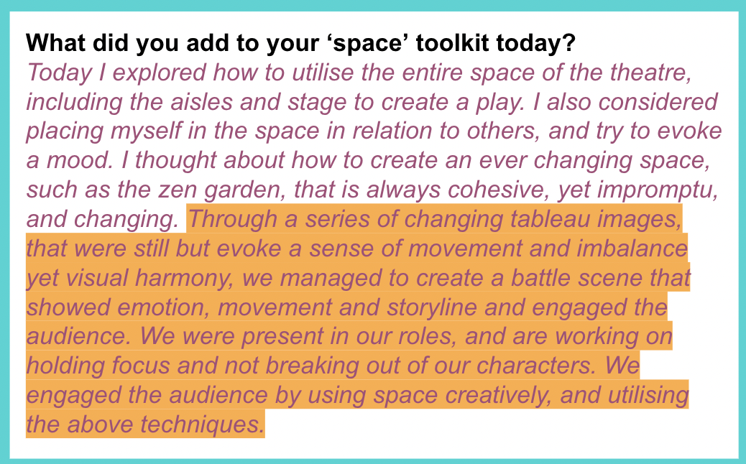
Audience (2)
To captivate the audience, we thoughtfully incorporated our knowledge of space, protocols and presence. Space can be manipulated to create dynamic compositions on stage that draw the audience’s attention to specific moments or emotions. By adhering to protocols such as the expectations of a target audience, we ensured that the performances remained relatable and accessible; something we made sure to think about in relation to our final ANZAC Day performance. Maintaining a powerful presence is crucial, as it fully immerses the audience in the story being told.

Slide 46
ANZAC Day Pre-reflection
In preparation for the ANZAC Day performance, our class has meticulously planned to incorporate elements of space, protocols, presence and audience engagement. We will have multiple hybrid performances, ranging from a duologue to a dance. We collaborated to create a performance based on the picture book A Soldier's Gift. We devised creative use of space to vividly bring the story to life, utilising levels, empty space and various depths to create visually compelling scenes that are both engaging and respectful of the solemn occasion. We utilised different spatial techniques to symbolise emotions, such as empty spaces to signify absence and loss.
In adhering to protocols, the performance will be sensitive to the expectations of its target audience, consisting of Year 2-12 students. We will ensure that the content is age-appropriate and not overly dark, while still conveying the gravity of the historical event. This balance will allow students to appreciate the sacrifices made by soldiers without being overwhelmed by the complexities of war.
We will maintain a strong presence throughout the performance, employing powerful vocal projection, facial expressions and body language to effectively engage the audience. By staying focused and emotionally connected to the characters we are portraying, we will create an immersive experience that resonates with the audience, fostering a deeper understanding of the significance of ANZAC Day.

Slide 47
Copyright
© State of New South Wales (Department of Education), 2025
The copyright material published in this resource is subject to the Copyright Act 1968 (Cth) and is owned by the NSW Department of Education or, where indicated, by a party other than the NSW Department of Education (third-party material).
Copyright material available in this resource and owned by the NSW Department of Education is licensed under a Creative Commons Attribution 4.0 International (CC BY 4.0) license.
This license allows you to share and adapt the material for any purpose, even commercially.
Attribution should be given to © State of New South Wales (Department of Education), 2025.
Material in this resource not available under a Creative Commons license:
the NSW Department of Education logo, other logos and trademark-protected material
Material owned by a third party that has been reproduced with permission. You will need to obtain permission from the third party to reuse its material.
Links to third-party material and websites
Please note that the provided (reading/viewing material/list/links/texts) are a suggestion only and implies no endorsement, by the New South Wales Department of Education, of any author, publisher, or book title. School principals and teachers are best placed to assess the suitability of resources that would complement the curriculum and reflect the needs and interests of their students.
If you use the links provided in this document to access a third-party’s website, you acknowledge that the terms of use, including licence terms set out on the third-party’s website apply to the use which may be made of the materials on that third-party website or where permitted by the Copyright Act 1968 (Cth). The department accepts no responsibility for content on third-party websites.

