Slide 1
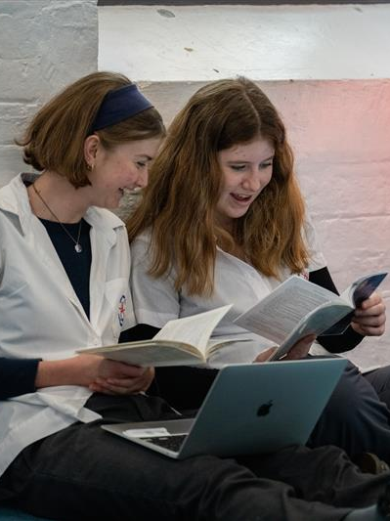
Term 2 Empowerment teaching and learning resource
Performing arts – illustration of practice

Slide 2
Contents
Slides 4 to 13 – empowerment teaching and learning resource
The content in the Microsoft PowerPoint has been generated by the teachers of Lindfield Learning Village during the delivery of the Stage 5 Department approved elective – Performing arts.
The department would like to acknowledge the teachers and students involved in sharing their work as an illustration of practice.

Slide 3
CURRICULUM MATERIALS: Teacher Generated Materials
Teacher Scaffold for ‘big thinking’ connected to our Quest (transdisciplinary learning) Model

Slide 4
Empowerment
Where are we?
Where are we going?
Prfm Refining
Intro to Empowerment & Augusto Boal
Research to build prfm + ANZAC Day
Winterfest
Assessment Design + Strengths
Prfm Plan & Building
Prfm Plan & Building
Prfm Plan & Building
Week 3
Week 5
Week 7
Week 9
Week 10
Week 4
Week 6
Week 8
Assessment

Slide 5
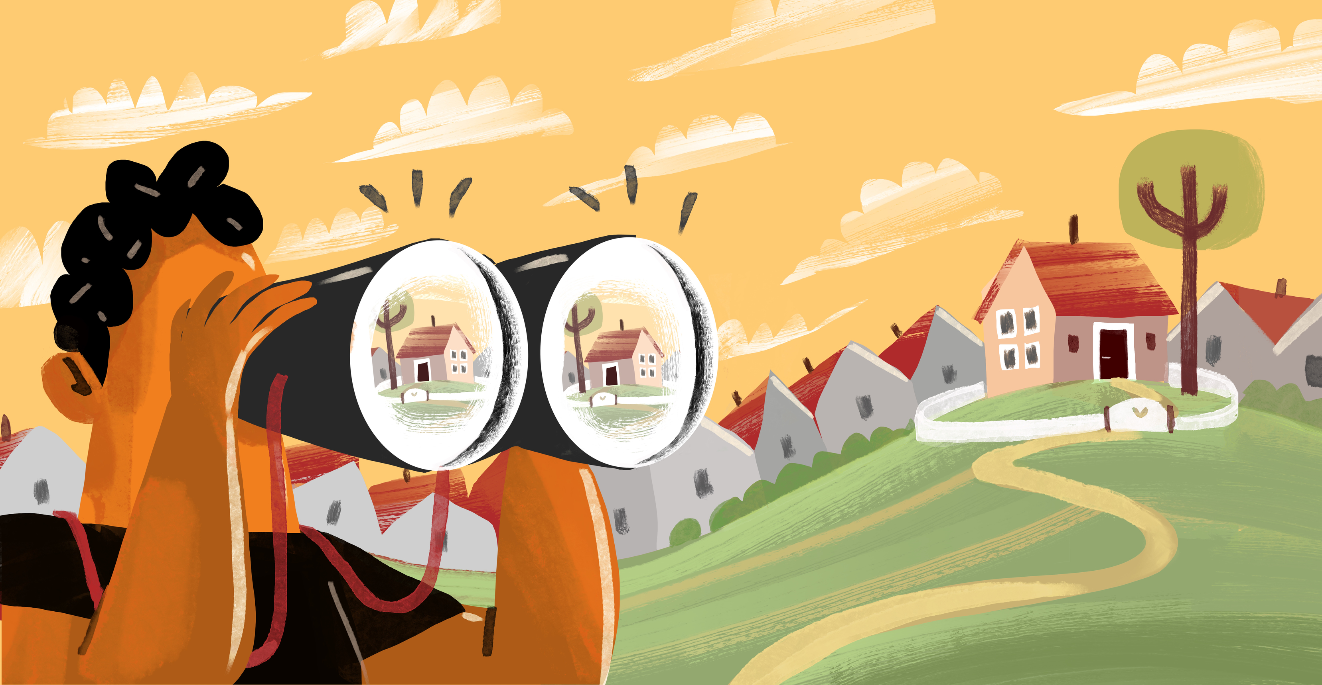
What does today’s lesson look like?
Engage in our PA Class Protocols
Acknowledge Country
Quest Connections
Guided Research
Individually draft a ‘performance sequence’ for our Empowerment PA performance
If time, BUILD hybrid performance.
Reflect on your own approach to empowering your learning today.
Image has been removed due to copyright. Image included 2 panels. The first labelled ‘Knowledge’ included scattered dots. The second labelled ‘Experience’ included connected dots.
We need to connect the dots rather than just collect the dots

Slide 6


2. Quest Connections - how are you going to ‘solve’ the wicked problem of ‘Empowerment’?
This learning activity is located on the following slide.
Task: Consider what you are learning in all of your subjects that are contributing to your understanding of Empowerment. How are you going to draw from each of these disciplines to offer a real-life transdisciplinary solution to the driving question?
Write down key learnings from each subject.
Present a solution to the driving question in relation to:
(i) Performing arts
(ii) General Solution
This is hard thinking! So if you are feeling challenged this is good!

Slide 7

2. Quest Connections - how are you going to ‘solve’ the wicked problem of ‘Empowerment’?
How might we understand the diverse experiences of people to empower ourselves and others?
PDHPE:
English:
Elective 1:
HSIE:
Solution from a PA perspective:
Elective 2:
Maths:
General Solution:
Beyond:
Science:

Slide 8
2. Quest Connections - how are you going to ‘solve’ the wicked problem of ‘Empowerment’? Make a copy and send to Amy.
English:
Marginalised Voices
Aboriginal and Torres Strait Islander Focus
Agency
How might we understand the diverse experiences of people to empower ourselves and others?
PDHPE:
Health
Elective 1:
Performing arts
Creating performance to understand empowerment and disempwoerment
HSIE:
Marginalised Voices
History of Australia
Don’t repeat the past
Solution from a PA perspective:
1. Create performances from the voices of marginalised people to advocate for their challenges and educate others
2. Work with Boal’s Forum Theatre to empower ourselves on issues we face and support our peers in problem solving these and then so this for the wider community.
Maths:
General Solution:
1. Assessment must focus on empowering ourselves as learners through agency. Strategy must be used to map success and impact.
Then, we can empower others through the use of the above strategies to listen to their voices to empathise and transform
Science:
Health and Wellbeing
Beyond:
Bright spots
Elective 2:

Slide 9


2. Guided Research - Empowerment - Record key info on the next few slides.
Clarify | Search | Delve | Evaluate | Cite
Write as many questions as you can think of in relation to empowerment Write down ten words to describe an empowered person Write down ten words to describe a disempowered person | Search your questions in Google to retrieve some key points. Record this. Search for empowerment through specific lenses - education, women, self-determination. Record your insights. | Delve into a specific article on ‘Empowerment’ and record your noticings. Delve into political cartoons on ‘Empowerment’ and record your noticings | Look at your research and consider what a vision for a performance might be. | Record your list of websites particularly if we might quote from these in our performance.
.

Slide 10

(1) Research Notes:

Slide 11
(2) Research Notes:

Slide 12
5. Build a Performance Sequence
Our Performance Sequence:
Amy’s Sample Draft Performance Sequence:
1. Fluid Sculpture - Boal’s Power Game
2. Scene Work - multiple duologues on stage communicating an issue of empowerment from diverse scripts for diverse representation
3. Dance - how does it free us?
4. Performance Poetry - bringing information from all subjects
5. Fluid Sculpture – Boal’s Empowerment Game
Separate to this:
Educational Forum Theatre run by Stage 5 PA

Slide 13


5. How did you empower yourself to solve your own learning today?
My reflection:
What tools do I use to help me reflect?
Characteristics Wheel
Vision and Values
Vocabulary from my research
My understanding of empowerment thus far

Slide 14
Copyright
© State of New South Wales (Department of Education), 2025
The copyright material published in this resource is subject to the Copyright Act 1968 (Cth) and is owned by the NSW Department of Education or, where indicated, by a party other than the NSW Department of Education (third-party material).
Copyright material available in this resource and owned by the NSW Department of Education is licensed under a Creative Commons Attribution 4.0 International (CC BY 4.0) license.
This license allows you to share and adapt the material for any purpose, even commercially.
Attribution should be given to © State of New South Wales (Department of Education), 2025.
Material in this resource not available under a Creative Commons license:
the NSW Department of Education logo, other logos and trademark-protected material
Material owned by a third party that has been reproduced with permission. You will need to obtain permission from the third party to reuse its material.
Links to third-party material and websites
Please note that the provided (reading/viewing material/list/links/texts) are a suggestion only and implies no endorsement, by the New South Wales Department of Education, of any author, publisher, or book title. School principals and teachers are best placed to assess the suitability of resources that would complement the curriculum and reflect the needs and interests of their students.
If you use the links provided in this document to access a third-party’s website, you acknowledge that the terms of use, including licence terms set out on the third-party’s website apply to the use which may be made of the materials on that third-party website or where permitted by the Copyright Act 1968 (Cth). The department accepts no responsibility for content on third-party websites.

