Slide 1
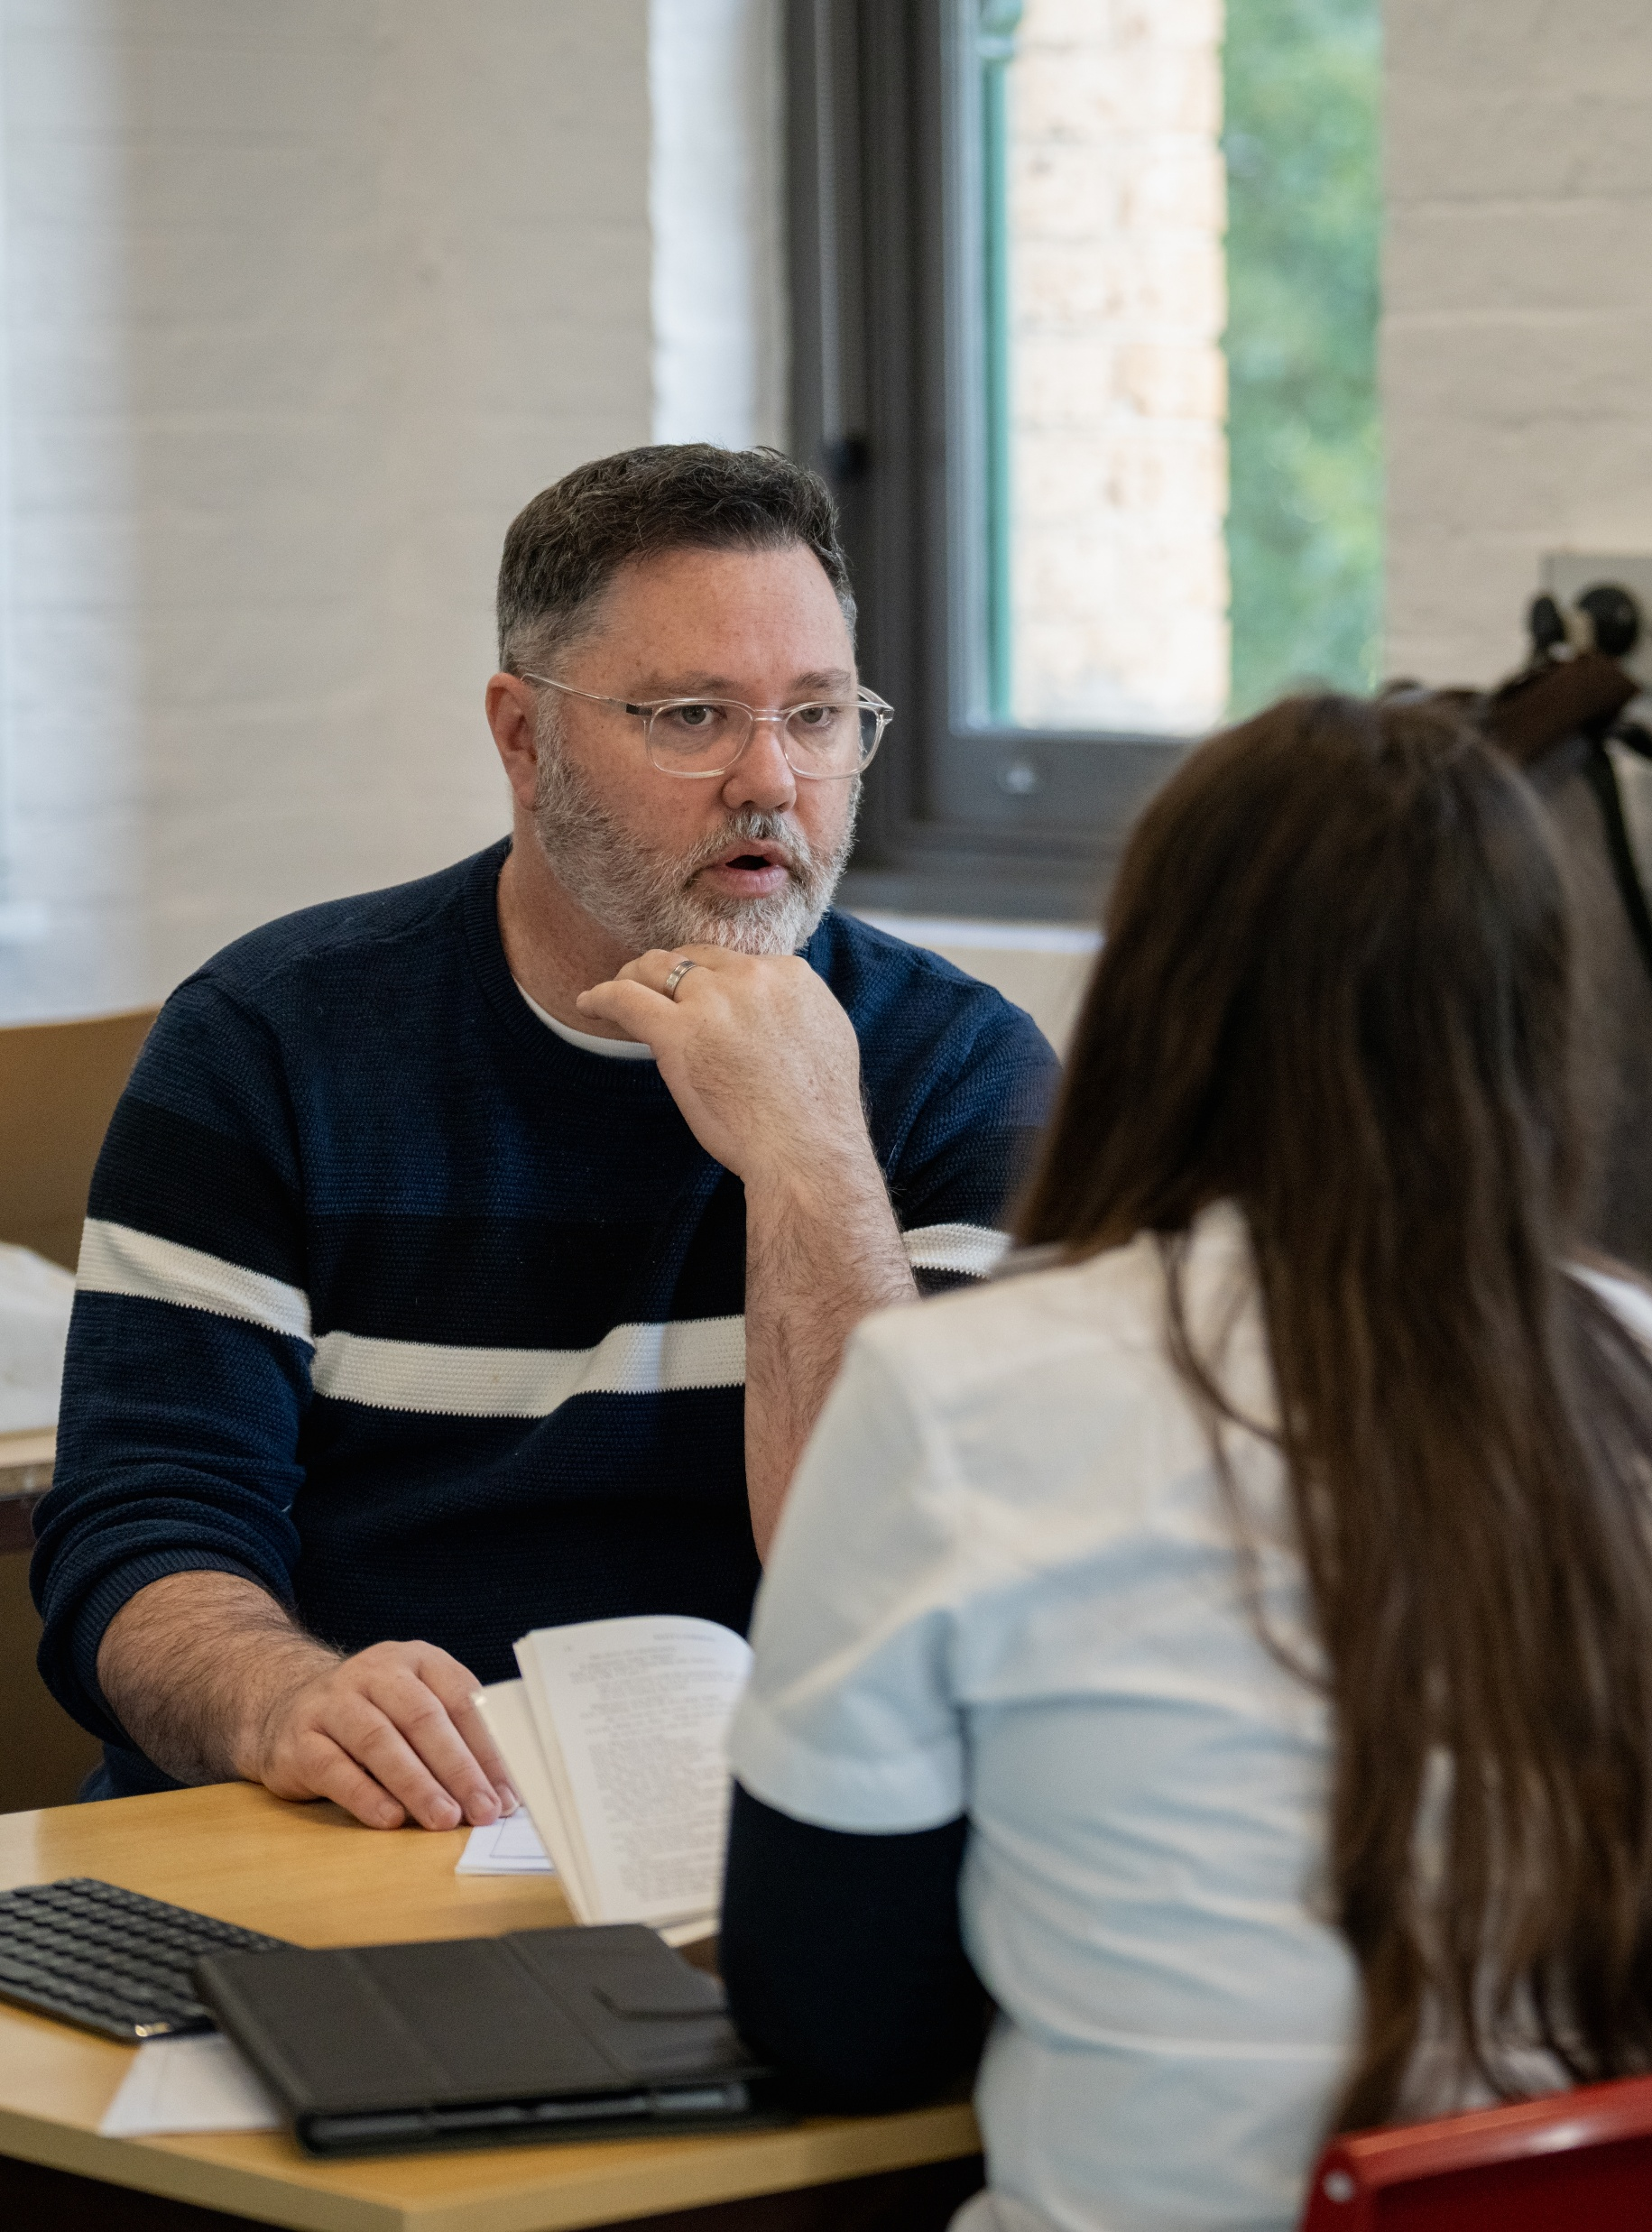
Performing arts course testimonials
Performing arts – illustration of practice

Slide 2
Contents
Slide 3 to 5 – teacher testimonials
Slide 6 to 9 – student testimonials
The content in the Microsoft PowerPoint has been generated by the teachers of Lindfield Learning Village during the delivery of the Stage 5 Department approved elective – Performing arts.
The department would like to acknowledge the teachers and students involved in sharing their work as an illustration of practice.

Slide 3
WRITTEN COURSE TESTIMONIALS: Amy (Co-Teacher) (1)
The Performing Arts course has filled a gap in our curriculum and offered a true transdisciplinary focus. To have freedom to explore, play and manipulate all art forms to communicate meaning in an interesting and evocative way reflects the arts in the real world. This is a significant component of this course - it has relevance and purpose in real time. The outcomes are important to learning in the arts and being part of the arts. In particular, outcomes:
PA5-1 identifies and explains a range of safe working practices and diverse cultural protocols associated with performing arts
PA5-8 demonstrates the commitment, collaboration and agency required to stage a performing arts event
PA5-10 acknowledges the significance of Country, cultural protocols, and Aboriginal Peoples' perspectives and contributions in the performing arts.
PA5-1 informed our class culture. We co-constructed the protocols associated with how we best learn as individuals and then as a collective. This was a powerful experience for many reasons. It creates psychological safety, reduces cognitive load, establishes expectations of rituals and routines and actually allows me, as a teacher, to offer true agency to students within boundaries. If this class has a casual teacher, I leave a lesson for them to engage with and let the casual teacher know that “They will run it - please leave them alone” and every comment from the supervising teacher is absolute astonishment that this is possible within a classroom.
PA5-8 is also a significant outcome because…how wonderful that we assess commitment, collaboration and agency required to stage a performing arts event! I have been so proud of how this class rallies around one another and the event to ensure that everything from planning to logistics to hybrid performance is achieved with grit and determination. This class have truly demonstrated the resilience required to be both on and behind the stage throughout the many events they have led.

Slide 4
WRITTEN COURSE TESTIMONIALS: Amy (Co-Teacher) (2)
PA5-10 has probably been the most significant shift in my pedagogical practice this year. Our class decided that our protocols should ask an individual or collective to Acknowledge Country every lesson. We wanted to make sure that the Acknowledgement was authentic and had integrity every lesson and it has been truly moving to begin each class with this. Sometimes it is planned other times it is open with the following sentence starters offered:
...I would like to acknowledge the traditional custodians...
...I pay my respect to Elders past, present and emerging...
...I am grateful for the...
...Country has taught me…
…This morning I noticed (insert wisdom) about Country…
The other day, it involved solving a problem about a Sydney theatre company that didn’t Acknowledge Country in their theatre. Here were the students’ responses…
First step, do we need to empathise? Why don't they Acknowledge Country? We need to go back to design thinking. Who made this decision? What do stakeholders believe?
We need to show empathy for their perspective (even if we disagree). We can't marginalise them based on their different views. How might we educate them slowly and gently?
Perhaps actors or directors can be empowered to control what they can and Acknowledge Country in their own rehearsals.
When they have found the reason as to why Acknowledgement doesn’t happen, a team needs to be formed to educate and inspire change.

Slide 5
WRITTEN COURSE TESTIMONIALS: Amy (Co-Teacher) (3)
In this moment, I felt as though our school and Performing Arts had given these students the skills to step back from something they truly believe in and analyse the situation from an objective perspective. I felt moved and excited about the future.
This course has contributed to a love for the arts from students I have never taught before and who entered the space with nerves and hesitation. I feel proud of the learning that both teachers and students have achieved this year.
A student who never puts himself out there wrote a poem and delivered it to 750 people.
A student with social anxiety has jumped at all possibilities for being in front of others despite her extreme nerves and has nailed it every time.
A student new to the school has blossomed into a confident, happy and curious individual who is willing to engage in all learning experiences no matter how challenging they are.
A student who is on a 50% attendance load due to illness comes to school for our five Performing Arts classes and contributes all the energy he has.
A student who joined on a whim now has the arts at the heart of their identity.
Thank you for inviting us to be part of the Performing Arts trial year. We are grateful for the growth we have all experienced.

Slide 6
WRITTEN COURSE TESTIMONIALS: Student (1)
In all honesty I had no idea what to expect when I entered the Performing Arts course, a friend had recommended it to me and I hoped I’d find it enjoyable but I had no way of knowing for sure if this was something I’d like. Almost immediately I found a purpose. A calling if you will. I slipped, or more accurately dove, into a more directorial role in my class. For me to personally thrive I’ve found I need a purpose to rally around, and I certainly found one here. I quickly came to love the event planning, drama/performance making, and learning lighting and sound. This subject has led me to many opportunities that I never would have gotten had I not participated in Performing Arts. I connected with the Performing Arts essentials and found that I strived to meet the outcomes. Throughout this course I’ve found something I enjoyed so much that it’s something I want to do in my future, if I become anything in this world, I have no doubt this will be my origin story.

Slide 7
WRITTEN COURSE TESTIMONIALS: Student (2)
When I first started high school I I felt like I had no creative performance outlet space where I could just create and perform. I had no idea what to expect except for performance opportunities but it is way more than just performing. It provided a safe space for me to just exist as myself and really grow my skills as a performer and an event planner which is something I didn’t know about at the start of this year. A key aspect of this course is the performing art hybrid fundamentals which is things like lighting, prop work, how to use a sound desk etc. which help establish the mood of the performance/ how it is done. Throughout this year we have learned so much about event planning and how much thought and effort goes into planning an event. The main take away from this aspect for me was that if you are planning a festival or any performance you MUST establish the purpose and reason for the performance/festival.
My proudest moment of this course was when I MC-ed for an event that LLV was doing. I’m a quiet person and this was one of the most nerve wracking things I’ve ever done, but I knew I could do it. I knew I could do it because this course made me think about the “why” of my love for performance, and for me the why was the connection between my peers in this class and myself and being able to connect and express myself with my peers by my side was one of the most rewarding and special feelings. MC-ing allowed me to break out of my comfort zone which is one of the main things that I really wanted to be able to achieve by the end of this year.
This course has opened me up to other styles of performance and performance types such as dance and non-verbal / abstract performance styles, which has allowed me to really explore what kind of performer I am and aspire to be. I am truly grateful to both the teachers and my peers for accepting me into the class and allowing me to just be. The knowledge I have gained from this course has really allowed me to explore and enhance my identity on and off the stage. My knowledge on performance and its aspects have grown so much due to the immersiveness of this course. If I were to say anything to anyone thinking about this course I would say I 100% recommend this course as you will learn so much about yourself and performance fundamentals.

Slide 8
WRITTEN COURSE TESTIMONIALS: Student (3)
I entered this course feeling very excited as this was one of my top electives I chose for this year but once the first lesson commenced, I started to feel really nervous. There were a bunch of new people surrounding me and it was really awkward when trying to connect with others and also contribute to activities. I remember the first couple of lessons we had were really awkward. My face was red and on the inside it was quite embarrassing but I have eventually learned to get over the fear and now I’m surrounded by lots of talented students who are truly masters of performing arts.
Throughout the year, my confidence has grown so much thanks to PA which has allowed me to contribute to school events like Winterfest at the end of Term 2 and also Playventure coming up in Week 10. My confidence has grown so much that I’m even going to be singing a solo at Playventure which I’m super excited about but also a bit nervous. If I hadn’t done PA this year then I probably wouldn’t even been singing this solo, so I’m very proud of myself to be doing this to prove I can be brave and face my fears to the Lindfield community.
PA has also allowed me to meet my best friend who I’ve known ever since the beginning of PA and is still my best friend to this day. I’ve had the opportunity to do activities with her during PA and even activities outside of school like sleepovers and going to each other’s houses. Once again, if I hadn’t done this course, I would’ve never met her, so I’m very grateful to have been given that opportunity.
Overall, I’d 100% recommend PA if you’re into creative arts like singing, acting, dancing, improving etc. You won’t regret it if you do choose it.

Slide 9
WRITTEN COURSE TESTIMONIALS: Student (4)
I entered this course feeling anxious about what I should expect and whether or not I will enjoy the next year. However, this worry quickly disappeared when we spent the whole first lesson creating a chaotic, immersive and completely silent space. This was my first introduction to Performing Arts and it was a perfect one. Almost immediately we got a scope of what our year would look like in this class; a confusing mix of chaos, teamwork and weird noises. I have gained so much through PA, friendships included. Throughout this year, I have found myself speaking out more, delving into a more creative perspective on projects and gaining a deeper appreciation and understanding for, not just performances and the effort put into them, but also for my peers, teachers and the space around us.
When I heard that drama and performing arts would be combined, I have to admit, I wasn’t excited. I wanted to do drama, and less of the other parts that come with performing arts. Yet, I did find a passion for what lied ahead. Within the first few lessons I caught a glimpse of the future of this class, and I was excited. Creating hybrid performances and ideating with the performing arts essentials became the usual. Some of my favourite projects this year include the Anzac Day commemoration and Thelma the Unicorn performance. I also greatly appreciated the opportunity to learn lighting and sound for performances and just as general skill development.
Needless to say, I would always find myself looking forward to days when I had this subject. It has sparked my passion for this topic and my year would have been far duller without it. From it, I have become more of the…unique, weird kid I am. I have taken away skills that I’ll remember for years to come. I am more confident and outspoken. And most of all, I have made memories and friendships that will stick with me for what I hope will last a long time.

Slide 10
Copyright
© State of New South Wales (Department of Education), 2025
The copyright material published in this resource is subject to the Copyright Act 1968 (Cth) and is owned by the NSW Department of Education or, where indicated, by a party other than the NSW Department of Education (third-party material).
Copyright material available in this resource and owned by the NSW Department of Education is licensed under a Creative Commons Attribution 4.0 International (CC BY 4.0) license.
This license allows you to share and adapt the material for any purpose, even commercially.
Attribution should be given to © State of New South Wales (Department of Education), 2025.
Material in this resource not available under a Creative Commons license:
the NSW Department of Education logo, other logos and trademark-protected material
Material owned by a third party that has been reproduced with permission. You will need to obtain permission from the third party to reuse its material.
Links to third-party material and websites
Please note that the provided (reading/viewing material/list/links/texts) are a suggestion only and implies no endorsement, by the New South Wales Department of Education, of any author, publisher, or book title. School principals and teachers are best placed to assess the suitability of resources that would complement the curriculum and reflect the needs and interests of their students.
If you use the links provided in this document to access a third-party’s website, you acknowledge that the terms of use, including licence terms set out on the third-party’s website apply to the use which may be made of the materials on that third-party website or where permitted by the Copyright Act 1968 (Cth). The department accepts no responsibility for content on third-party websites.

