Slide 1
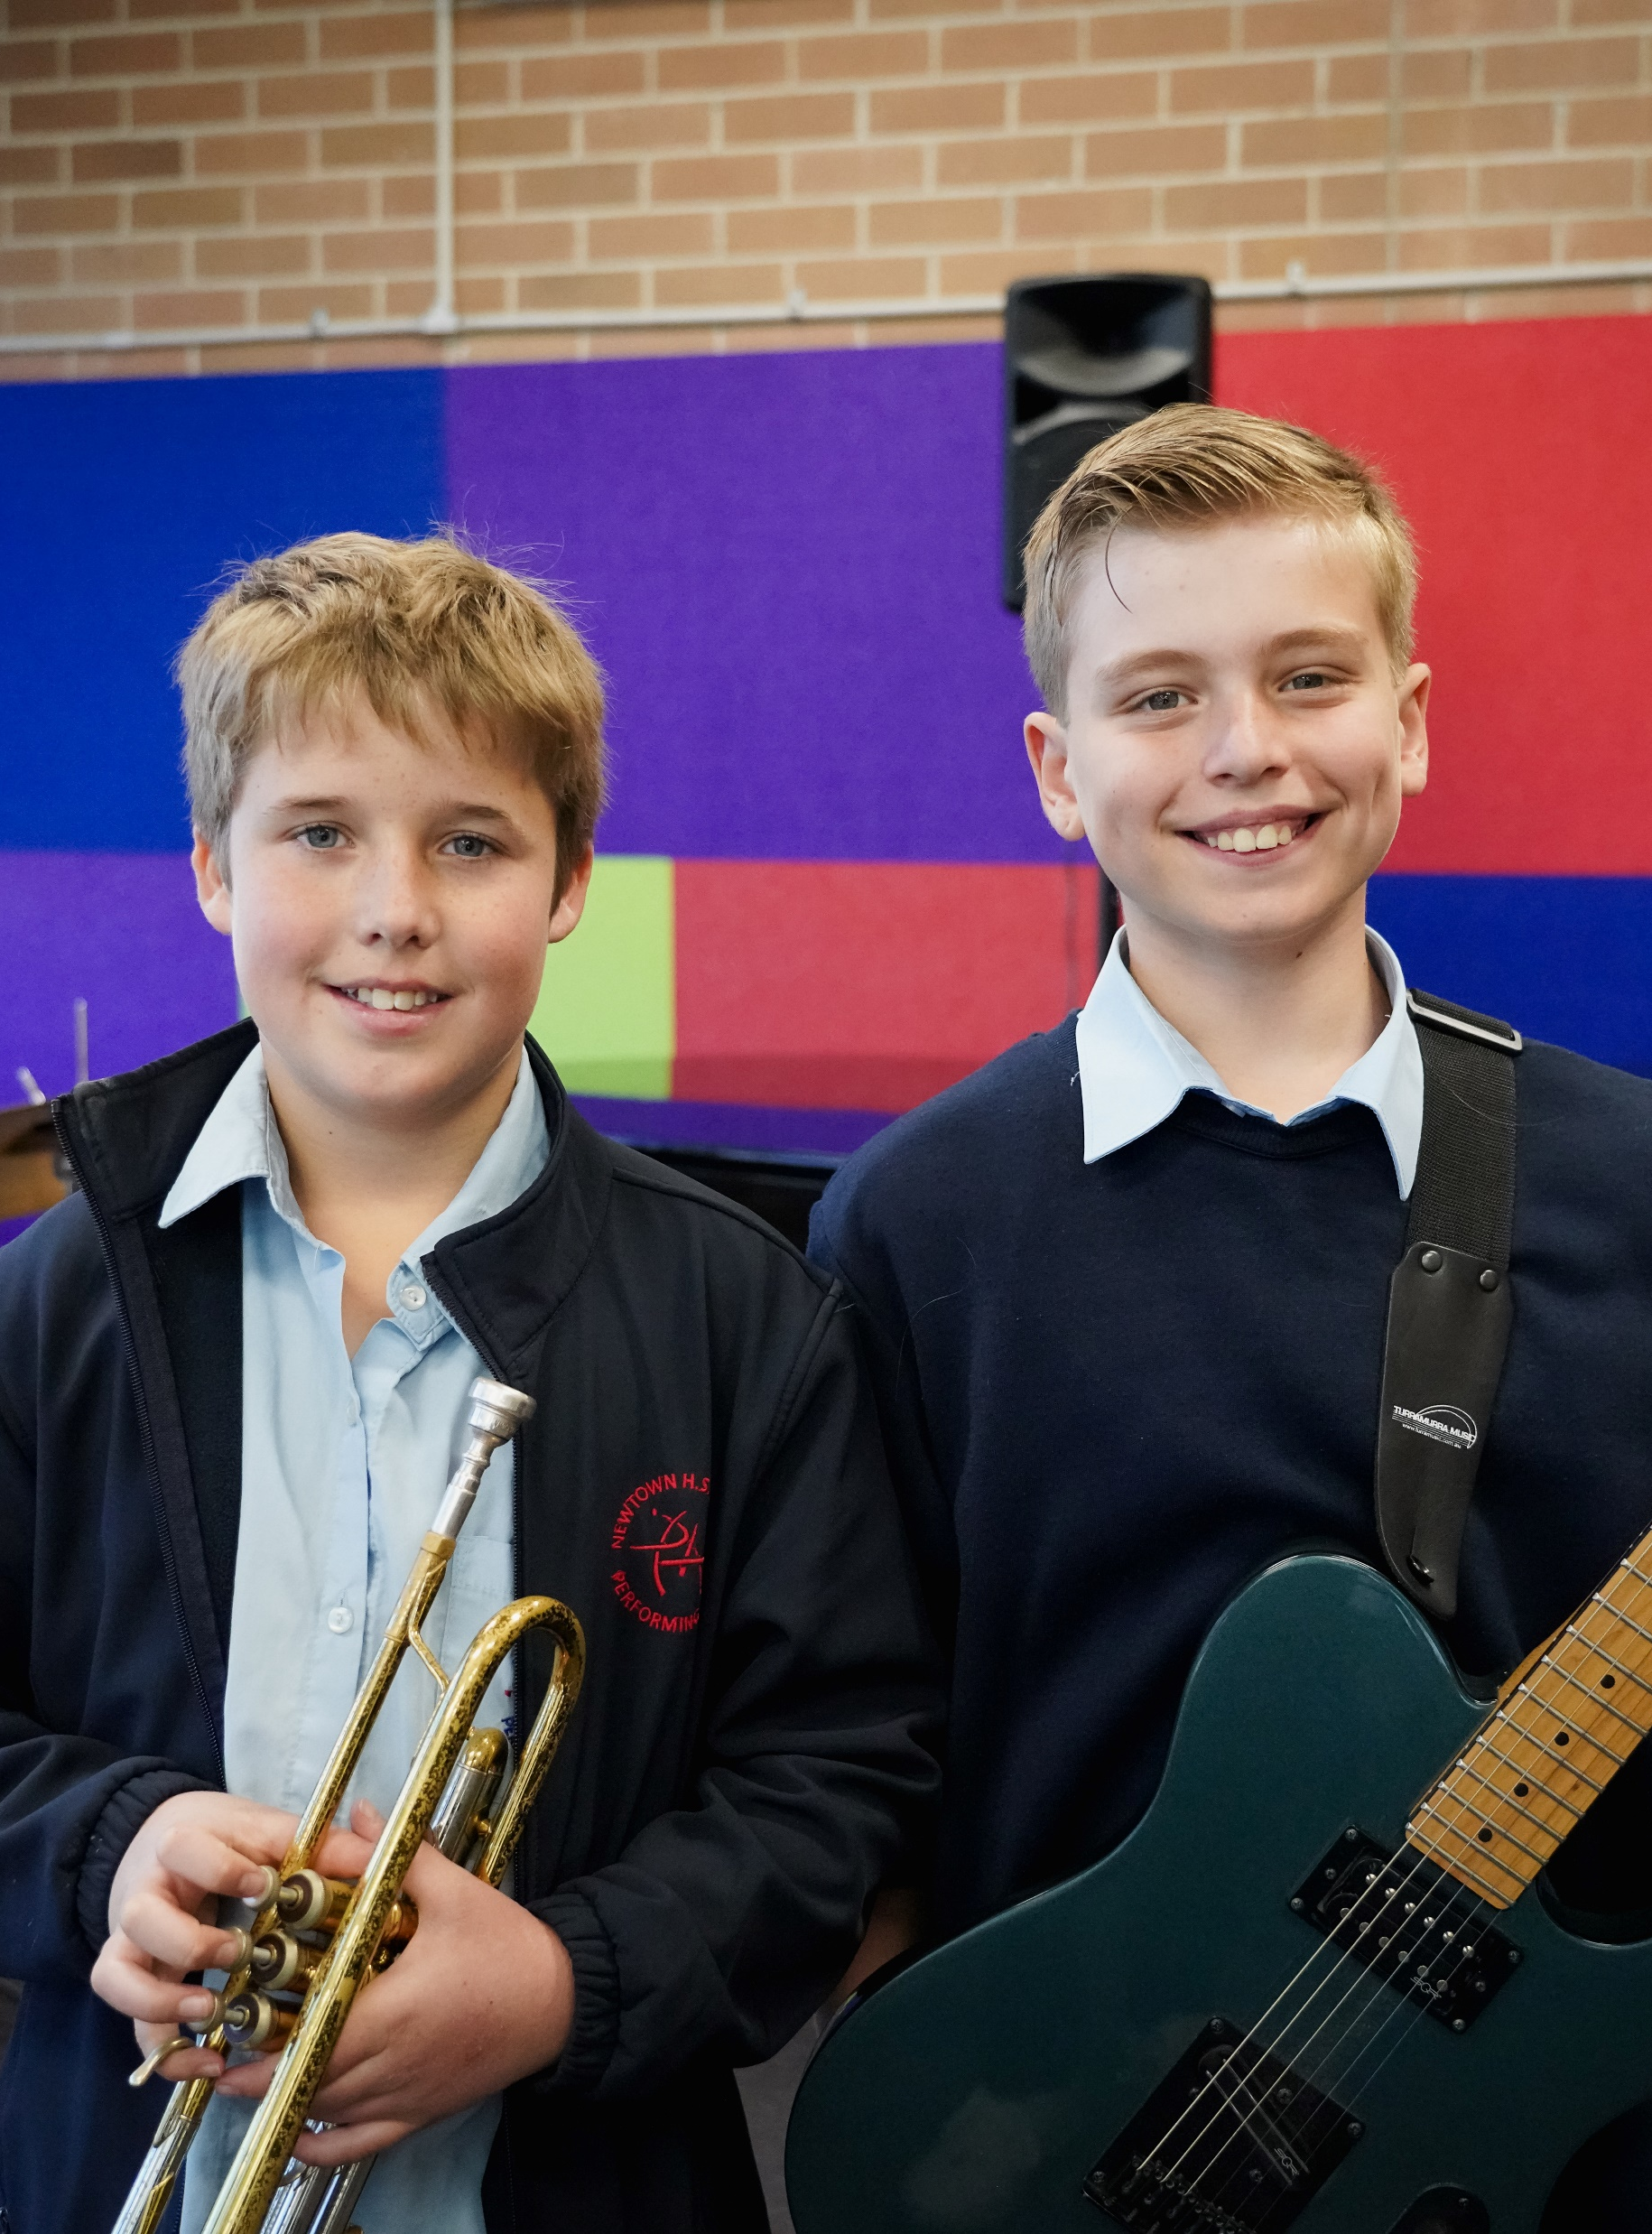
Assessment task 1 Performing arts essentials portfolio with student work samples
Performing arts – illustration of practice

Slide 2
Contents
Slide 3 – assessment task 1
Slide 4 – assessment task 1 marking guidelines
Slides 5 to 20 – student 1 work sample
Slides 21 to 36 – student 2 work sample
Slide 37 to 54 – student 3 work sample
The content in the Microsoft PowerPoint has been generated by the teachers of Lindfield Learning Village during the delivery of the Stage 5 Department approved elective – Performing arts, Core 1 – learning sequence – performing arts essentials.
The department would like to acknowledge the teachers and students involved in sharing their work as an illustration of practice.

Slide 3
CURRICULUM MATERIALS/STUDENT WORK SAMPLES: Assessment task
Purpose of the submission:
Assessment Task 1:
Performing Arts Essentials Portfolio
FINAL PRODUCT
Description of the task:
“Legacy. What is legacy? It’s planting seeds in a garden you never get to see.”
Stage 5 have been exploring the wicked problem of legacies:
How might we meaningfully celebrate the legacies of people? How are legacies made, kept and renewed?
Your task is to curate a portfolio that demonstrates your LEGACY as a Performing arts student.
You will draw evidence from your Blank Canvas Log Book, Canvas lessons and any external inspiration that you’ve engaged with, to curate a digital portfolio that demonstrates your knowledge, understanding and skills in the Performing arts essentials; protocols, space, presence and audience
MUST | SHOULD | COULD
Complete the following questions on Performing arts essentials SPACE, AUDIENCE, PRESENCE and PROTOCOLS. Submit as a slide presentation Use media excerpts (ie. pictures, videos, audio, web links etc.) to support your presentation. | Use the questions on Performing arts essentials SPACE, AUDIENCE, PRESENCE and PROTOCOLS to create a TED Talk. Use a slide presentation to support your talk. Film this as part of a show-reel Use media excerpts (ie. pictures, videos audio, weblinks etc.) to support your presentation 6–8 minutes | Show your understanding of the Performing arts essentials SPACE, AUDIENCE, PRESENCE and PROTOCOLS in a hybrid performance. Combine two or more art forms in an experiential analysis within the performance. Solo or duo (with individual portfolio evidence) 4–6 minutes
Success Criteria
Task specific | Outcome specific
Your portfolio will address all of Performing arts essentials; protocols, space, presence, audience. Your portfolio will include evidence from your Blank Canvas log book, classwork and Canvas lessons. Your portfolio will include media excerpts. Your critical reflection is identified and is detailed and specific to each Performing arts essential. | PA5-2 experiments with ways in which space can be activated and transformed by the selection and manipulation of performance elements PA5-6 researches, documents and reflects on performing arts concepts, ideas and processes PA5-7 responds to provocations or stimulus to select, develop and produce performance material

Slide 4
CURRICULUM MATERIALS: Assessment marking guidelines
Syllabus code | Novice | Apprentice | Practitioner | Expert | Master
PA5-2 experiments with ways in which space can be activated and transformed by the selection and manipulation of performance elements | I can, with teacher and peer support, offer ideas about the ways that space can be activated. I can identify performance elements that support this activation. I need to manipulate the performance elements to transform space | I can offer ideas for ways in which space can be activated and transformed by selecting performance elements. I need to manipulate the performance elements to transform space. | I can experiment with ways in which space can be activated and transformed by the selection and manipulation of performance elements. I need to be more deliberate in my creative decisions to ensure meaning is made. | I can experiment in multiple ways in which space can be defined, activated and transformed by the deliberate selection and manipulation of performance elements. I need to be more deliberate and consider a wider context to ensure that meaning is made. | I can experiment and refine multiple ways in which space can be defined, activated and transformed by the deliberate and appropriate selection and manipulation of performance elements.
PA5-6 researches, documents, and reflects on performing arts concepts, ideas and processes | I can, with teacher and peer support, access texts and documents relating to performing arts concepts to help me offer ideas and engage with processes. I need to use provided texts and documents to engage in scaffolded reflection of performing arts concepts, ideas and processes. | I can use provided texts and documents to engage in scaffolded reflection of performing arts concepts, ideas and processes. I need to independently research texts and engage in autonomous reflection in consideration with the performing arts concepts and processes and use this reflecting to offer ideas. | I can research documents and reflect on performing arts concepts, ideas and processes. I need to widen the range of documents I research so I can more thoughtfully reflect on concepts, ideas and processes. | I can thoroughly research a range of documents and thoughtfully reflect on performing arts concepts, ideas and processes. I need to autonomously expand my research scope so that I can thoughtfully reflect on and challenge ideas to create and implement processes and protocols. | I can source my own extensive research material to reflect on performing arts concepts, challenge ideas and create and implement processes and protocols.
PA5-7 responds to provocations or stimulus to select, develop and produce performance material | I can, with teacher and peer support, identify and respond to provocations and/or stimulus to select performance material. I need to develop and produce performance material. | I can respond to provocations and/or stimulus to select and/or develop performance material. I need to produce performance material. | I can respond to provocations and/or stimulus to select, develop and produce performance material. I need to respond to diverse provocations and/or stimulus and consider the impact of the performance work on an audience. | I can respond to diverse provocations and/or stimulus to select, develop and produce engaging and effective performance material. I need to consider and critically reflect upon audience impact and transformation in receiving the performance material. | I can respond to diverse and complex provocations and/or stimulus to select, develop and produce engaging, effective and transformative performance material.

Slide 5
Performing Arts
Portfolio
Term 1 & 2, Student 1 assessment task
Note: This example portfolio references evidence of learning student provided via hyperlinks to materials stored in a personal Google folder. Hyperlinks have been disabled to protect student privacy.

Slide 6
01
Protocols (1)

Slide 7
Protocols (2)
How have idea generation and collaboration influenced your work in Performing arts?
Throughout the term, we have created various performances and acts through brainstorming, idea generation, and collaboration.
This has allowed me to look at from new perspectives and learn how to create an immersive scene from many viewpoints. This has also influenced me to become more flexible when taking different roles in the brainstorming and collaboration process, whether that means creating a scene, inputting ideas, or simply complying with others' visions.

Slide 8
Protocols (3)
How have you applied physical/emotion safety practices in Performing arts?
In each of our lessons, my classmates and I have engaged in safety circles along with immersive conversations and activities. We always are able to maintain a respectful and fairly upbeat environment that I, for one, feel safe and comfortable in. Creating mindful boundaries in tasks and performances as
well as having engaging and productive discussions has made the atmosphere far more enjoyable and warm.
One activity I particularly enjoyed and felt granted us the ability to apply both physical and emotional safety practices in, was the focus walk. This activity allowed me to engage in the lesson more and become further aware and immersed in the environment and movement around me.

Slide 9
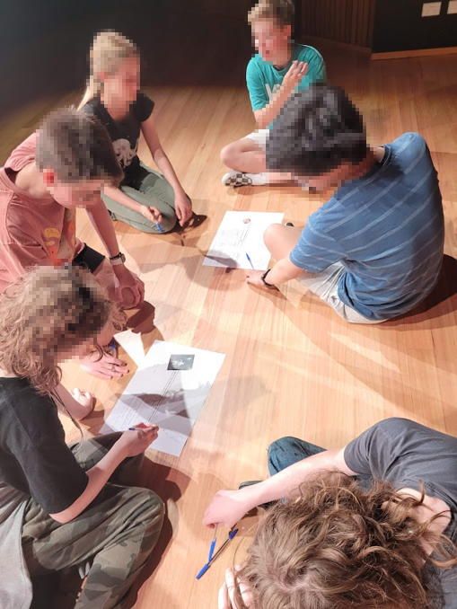
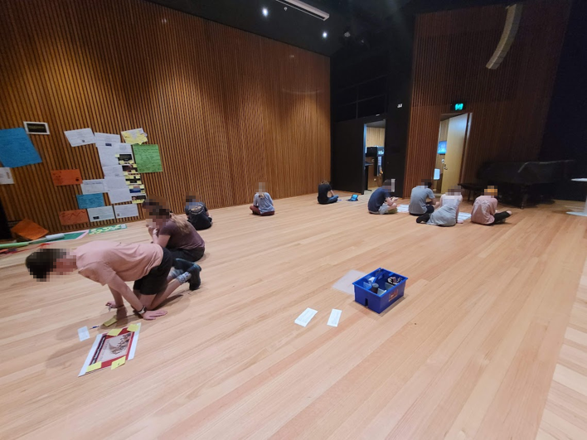
Evidence of learning - Focus Walk

Slide 10
02
Space (1)

Slide 11
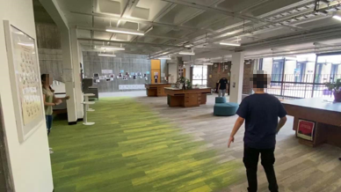
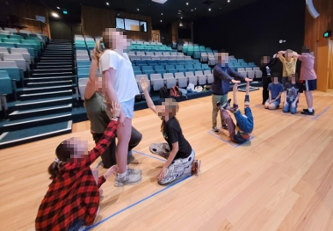
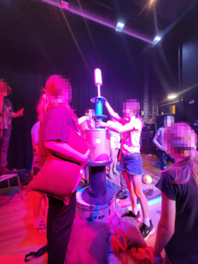
Space (2)
[Evidence of learning]
How have activated, manipulated and/or transformed space in Performing arts (physical AND energetic space)
When participating in activities or brainstorming a performance, we, as a class, use ourselves and props to manipulate and fill the space. Often, we create a large, layered presentation that gives off the effect of a more filled and transformed environment. In many of our in-class creations, we experiment by not just constricting ourselves to a stage or using a new setting. This allows us to further manipulate and activate the space to emphasise the mood and theme of the performance.
I would like to work on my own interpretation and use of space in performing arts by taking more notice of how we as a class activate, manipulate and transform it in our lessons and projects.
Use of other spaces
Layers, props
Layers, activation and manipulation of space

Slide 12
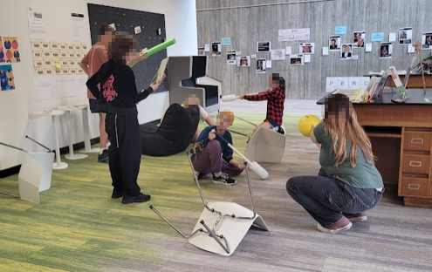
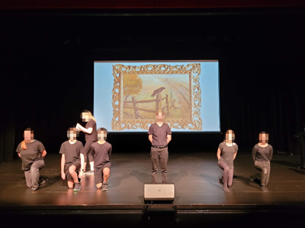
Space (3)
Tense, and suspension created in the stunted movements (zen garden) depicting war
Can you identify the meaning that is communicated through your use of space in hybrid performances this term?
In the hybrid performances we have constructed this term, we have used space primarily to create tension, confrontation, and suspense. We did this by slowly manipulating the environment and movement using slow-paced motions and use of props or creating props using ourselves. Since we constructed many products based on First Nations and ANZAC topics, we wanted to produce serious, solemn, and suspenseful feelings in the space and atmosphere. I believe we were able to achieve this specifically through constructing layers and activity behind and through the main performance.
Layers and ensemble creating more confronting and sad
mood

Slide 13
03
Presence (1)

Slide 14

Presence (2)
How have you created and sustained your presence in your Performing arts works?
To create and sustain my presence in our class and Performing arts work, I strive to be an eager participant and peer. I do this by actively engaging in brainstorms, collaborating and attempting to always think outside the box. Whenever possible, I try to present new ideas and suggestions while still building and empowering others' proposals. While I have been mainly part of the ensemble throughout this term, I still attempt to immerse myself in that as best I can. However, I plan to push myself into creating and sustaining more of a presence in Performing arts performances.

Slide 15
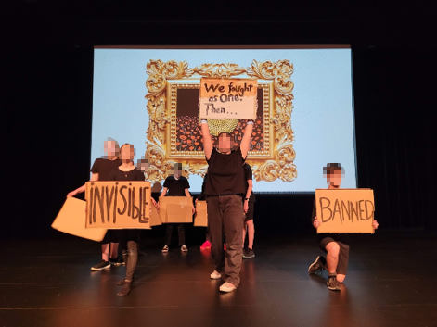
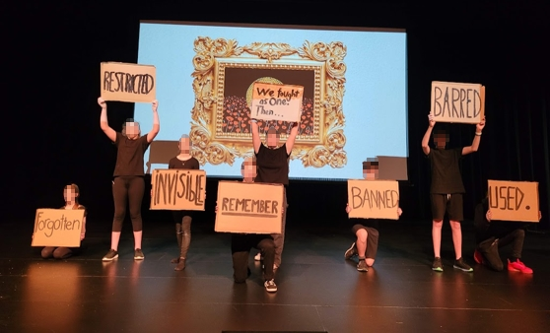
Presence (3)
Part A - Give examples of when you have used focus and tension to create presence.
During our Anzac Day performance, our fourth frame was a silent presentation using 'protest posters', music and layers between people on the stage. Executing this took slow movements and focusing to construct the tension, sincerity and presence we hoped to make. We had to ensure we moved in unison to start, then time the pauses between actions and create the proper dimensions using height and depth on the stage.
Slow movement and change
Focus and concentration

Slide 16
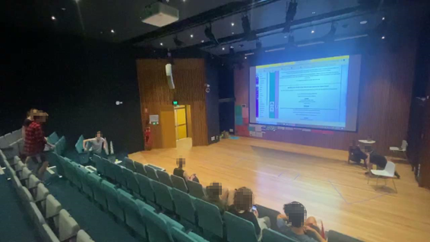
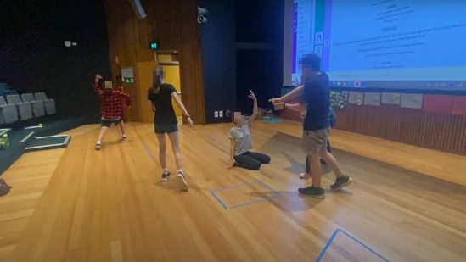
Presence (4)
Part B - Give examples of when you have used focus and tension to create presence.
We also created a product based on the zen garden activity in a group. We needed to practise and focus throughout the performance to perfect the series of movements. Tracking each action and interacting with others in stalled motion made it imperative to maintain a clear attention to the environment.

Slide 17
04
Audience (1)

Slide 18
Audience (2)
How do you know if your audience can interpret your intention?
It can be difficult to understand whether an audience is interpreting the intention behind a performance correctly. However, I believe a vital part of creating a Performing arts product is to ensure the larger details, which are essential for the audience to notice, are highlighted and easily observable. Although, the smaller features are there for effect and are not spotlighted so much.
In future practices, I intend to take a second to step back and watch the product we have created as if I were seeing it for the first time. This allows me to understand how the audience might view it and perhaps enhance some aspects.
I also view interpretation as an immense aspect of Performing arts. Producing a performance that is designed to be left up to the audience's own perspective can have a deep effect if done correctly.

Slide 19
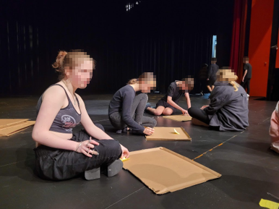
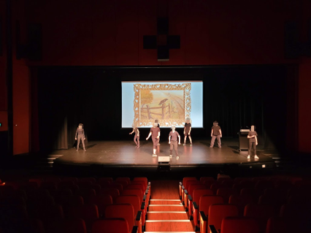
Audience (3)
Great posture
Audience Reaction
Give examples of how you have kept the audience in mind throughout your process and performance.
Throughout our Anzac Day Commemoration planning and enacting, our class constantly had the audience's reaction in mind. Especially when it came to our first frame, the portrayal of the children's book. Because of the simple themes depicted in the book, we had to carefully consider how might we ensure the performance is not interpreted in a humorous way. Through discussion and workshopping, we decided on what might be portrayed in the wrong way.
In addition to this, as a class, we had to acknowledge the potential short attention span that could be reflected in the audience. For this reason, we cut down our frames and brainstormed how we can captivate and get the crowd to empathise.
In the end, I believe the whole commemoration came together quite well.
A lot of rehearsal and fine detailing

Slide 20

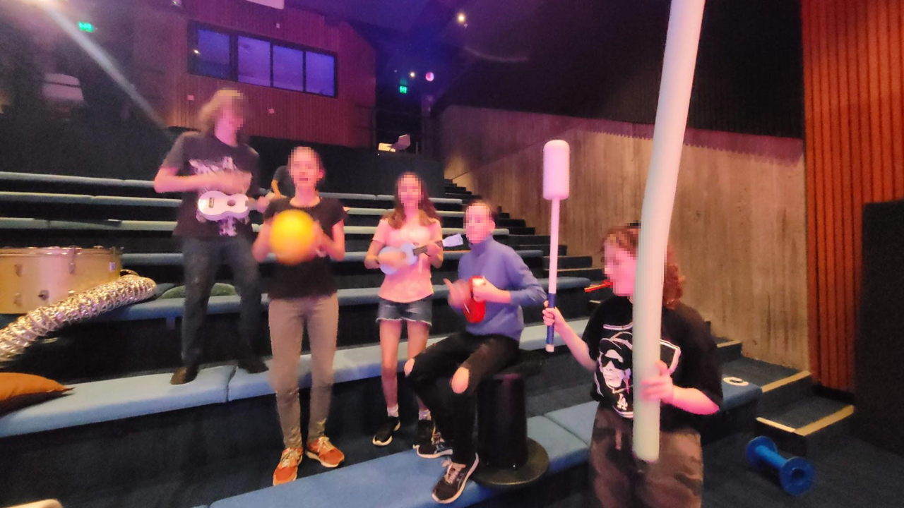
The greatest band

Slide 21
Term 1
PA Essentials Portfolio
Student 2 assessment task

Slide 22


01
PROTOCOLS (4)
Answering questions 1 & 2

Slide 23
Protocols (5)
1. How have idea generation and collaboration influenced your work in Performing arts?
My biggest development in this area has been learning how to collaborate in a larger group. Working with a group of 11 people vs. 4 in a drama space is considerably different for me, I’d say even more then just difficult but challenging. The idea generation takes a lot longer with 12 of us, myself included.
As much as talking about a scene and sharing ideas is important, I find myself frustrated by how long we take to get to building the performance. I’ve found that I need to have patience and let others speak but also know when it is time to start doing. This has made me realise that others have other ways of getting through their thoughts and therefore has made me learnt how to collaborate more successfully.

Slide 24
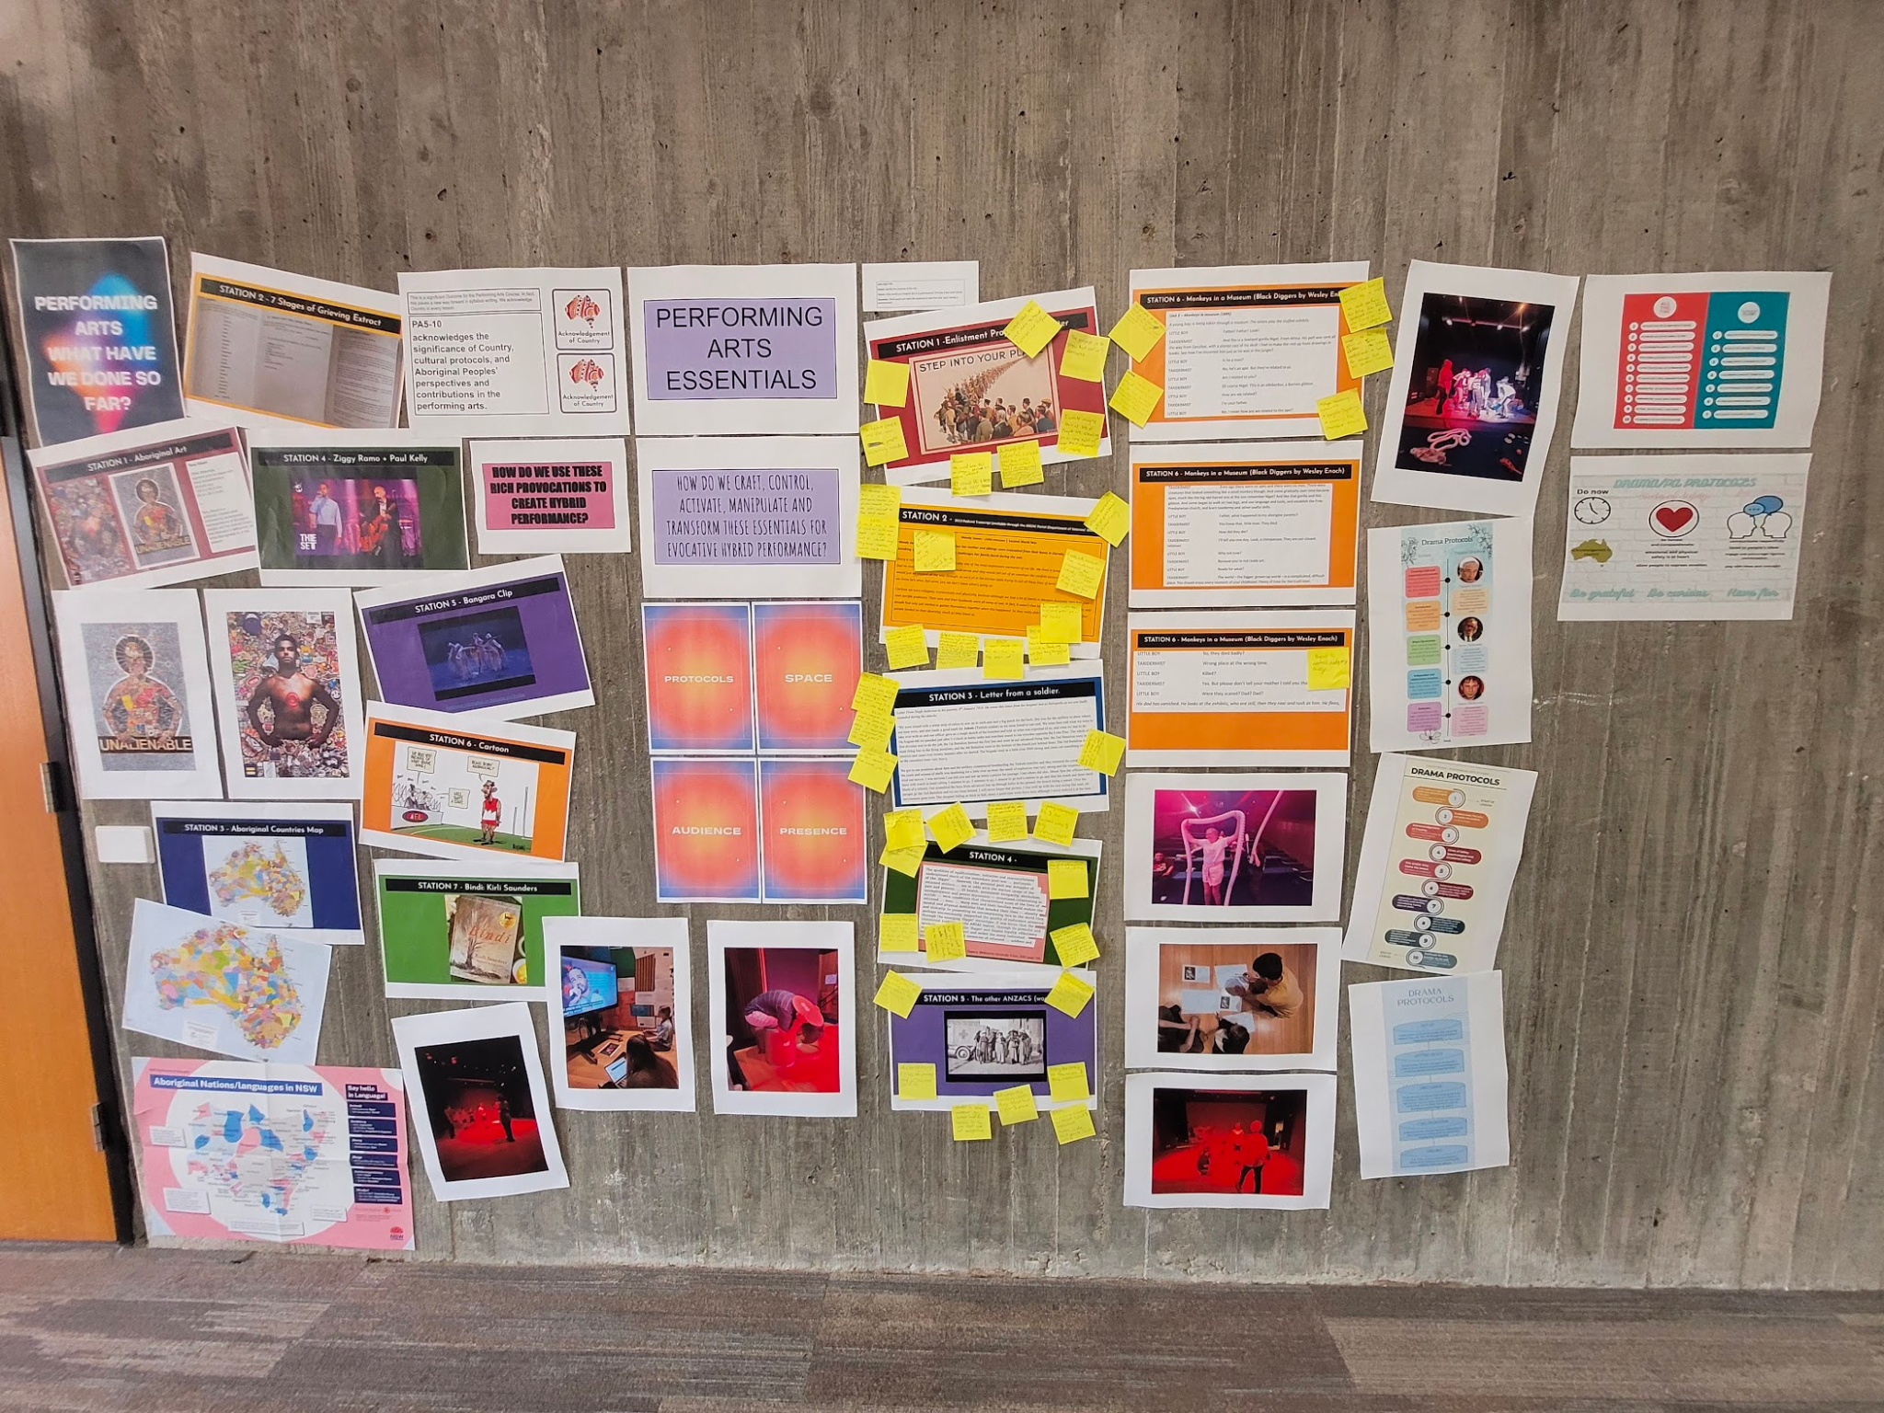
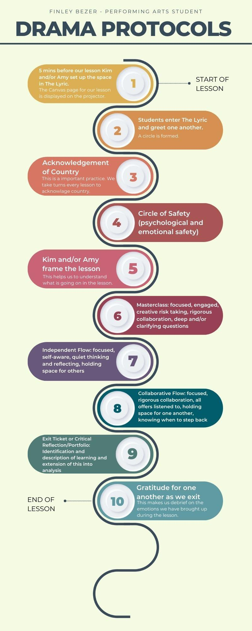
Drama protocols

Slide 25
Protocols (6)
2. How have you applied physical/emotion safety practices in performing arts
I ask for consent to touch people when blocking a performance and when directing others.
I am more aware now that I need to give my peers more time to get out their ideas so they can feel respected and heard from, I aim to make others feel like they can always contribute an idea to whatever we are doing.
The emotional safety has be in the form of circle of safety, we start the lesson with us all sitting on the ground in a circle and talk about our mornings. Unfortunately my classmates usually hear about me going to the gym and being sore but then I tell them about what's in my post-gym smoothie. This brings me a sense of repetition and calmness because if I do that then I will be focused for the rest of the lesson.

Slide 26
02
SPACE (4)
Answering questions 3 & 4

Slide 27
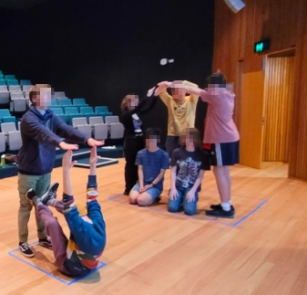
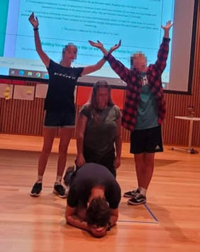
Space (5)
3. How have activated, manipulated and/or transformed space in performing arts?
I have learnt to manipulate my space better this term by using physical theater. Using our bodies to make props, such as chairs and tables. This has shown space can be taken up by a human to make a non-human thing.

Slide 28
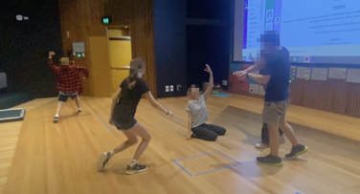
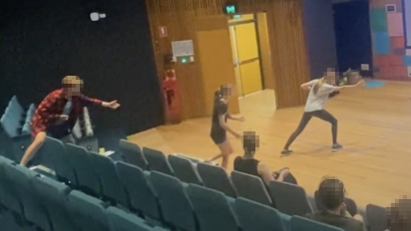
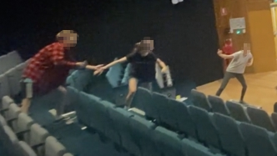
Space (6)
3. How have you activated, manipulated and/or transformed space in Performing arts?
I have transformed space by re-imaging the lyric theater as a battleground, using the upper seat rows as trenches. The stairs on the way down were used to get to an equivalate of no-mans land and a meeting point for the two clans to fight. I then used the backstage area as a fleeing spot to avoid capture from the other clan.

Slide 29
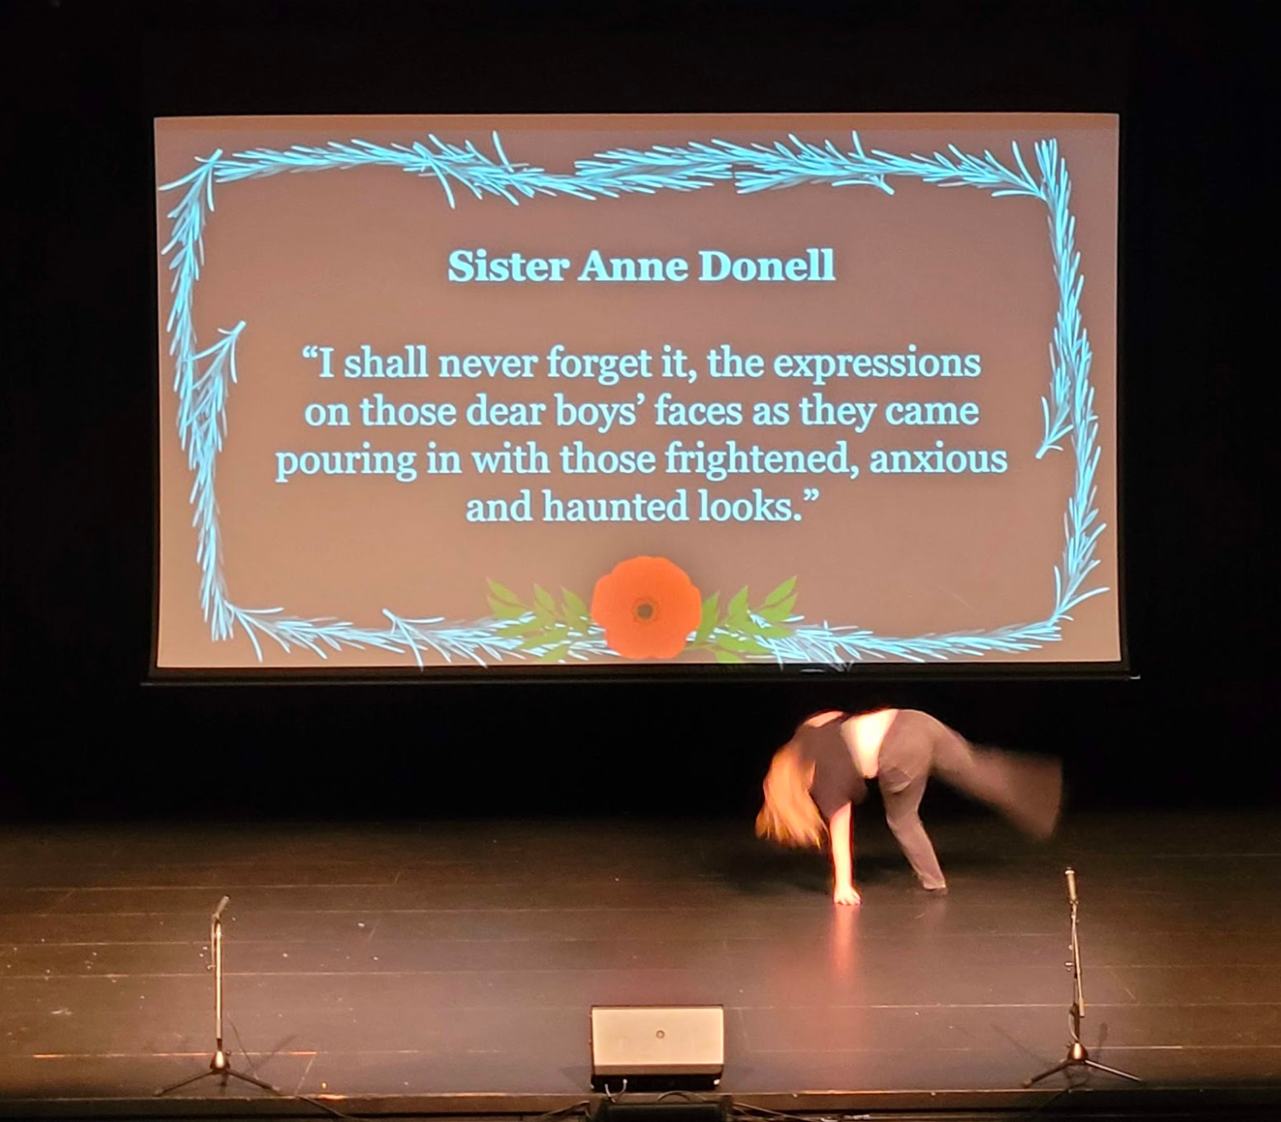
Space (7)
4. Can you identify the meaning that is communicated through your use of space in hybrid performances this term?
Hybrid performances give more information and more stimulus to the audience, for example Student A performing for “Representations of Women, Dance and Movement”. While she was dancing there was lighting, a solo spotlight on her, giving us focus on her. Behind her there was projection of powerful quotes from the war about women. There was also instrumental music, adding another layer too this performance. This hybrid performance gave the audience meaning and time to reflect on women's underrepresentation in war.

Slide 30
03
Presence (5)
Answering questions 5 & 6

Slide 31
Presence (6)
5. How have you created and sustained your presence in your Performing arts works?
I create my presence in Performing arts by finding ways to ground myself instead of thinking about how and what could go wrong in my performance. It ranges from little pinches of my arms to face taps. This helps me physically feel present in the moment.
I can maintain my presence by focusing on what I need to do and the notes I have been given about my performance. I like to remember what is coming up next in a performance and what I need to work on.
My projection is something I have been struggling with lately and when I perform it helps me keep my focus to know that I need to project more with my voice, instead of focusing on all the things that could go wrong.

Slide 32
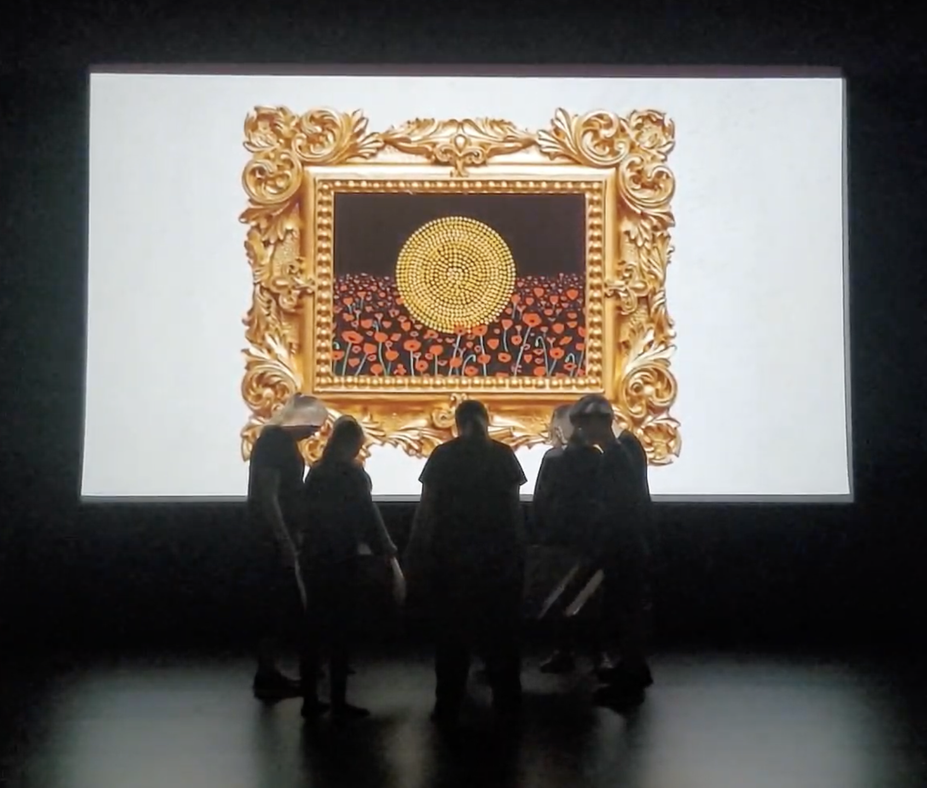
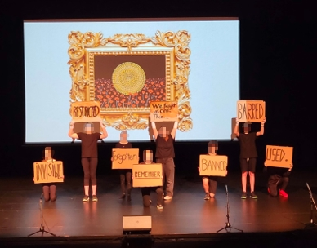
Presence (7)
6. Give examples of when you have used focus and tension to create presence.
Following on from the previous point about projection - I know if I get my voice projection right this can create a good presence in the performance.
An example of when I have had to be very focused to create presence is in frame 4, from the ANZAC Day service, Aboriginal and Torres Strait Islander protest. I was the last to leave the huddle circle and show my sign to the audience. This required my full attention, as I had to look out of the corner of my eye, wait till my peers were in place then count to 10 in my head before walking out to the front of the stage. It was very difficult for me because there was no verbal cues for me to work from.

Slide 33
04
Audience (4)
Answering questions 7 & 8

Slide 34
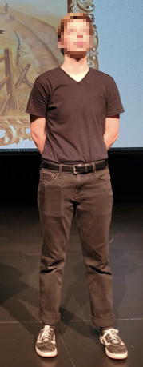
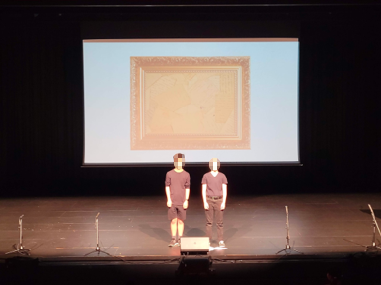
Audience (5)
7. How do you know if your audience can interpret your intention?
I know when my audience can understand what is going on in my performance when they verbally react. This could include laughter from a humorous piece, gasping when something unexpected or tragic happens, or the audience looking focused and engaged.
The best way for me to tell if the audience understood the intention of the performance is when I get positive comments after the performance.

Slide 35
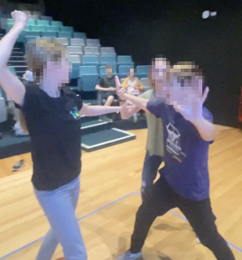
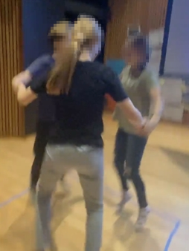
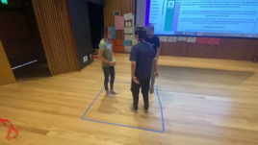
Audience (6)
8. Audience entertainment. Give examples of how you have kept the audience in mind throughout your process and performance.
Audience entertainment is something that I personally strive for in every performance I create. An example of this was in week 4, when we focused on space and made a skit of chasing ourselves in a box, with the Mario Kart soundtrack. The skit had no dialogue but instead we made sounds, comically big movements and facial expressions, this made some people giggle at the hilarity of this as well as at the ending where [student A name] ‘booped’ [student B name] on the nose and we all fell out of the box and onto the ground.

Slide 36
Audience (7)
8. Audience entertainment. Give examples of how you have kept the audience in mind throughout your process and performance.
Another time I've seen my impact on audience entertainment was in 2022’s Winterfest when I did an open practice and was the director for my beyond group. I spoke to the audience, made a few jokes and even got an ordained minister to come up on stage and minster a wedding scene. This was genuinely one of my most favourite things I've ever done. The crowd would not stop their laughter and it made me feel calm during the performance and amazing afterwards. They were certainly entertained.

Slide 37
Performing Arts Essentials Portfolio
Student 3 assessment task

Slide 38
Table of Contents
Presence
Audience
↗
↗
Protocols
Space
↗
↗

Slide 39
PROTOCOLS
(7)

Slide 40
How Have Idea Generation And Collaboration Influenced Your Work In Performing arts?
The vast majority of the work we have done in PA has required collaboration and group work.
Initially I struggled to work as a whole ensemble because it was a much bigger group than what I was used to. I also found it quite challenging to hold lightly to what I learnt last year.
Throughout this term, I think I have become better at co-constructing with my peers which includes offering ideas and helping to build on the ideas of others.
An example of this was when we were first planning our ANZAC Day Event VS our more recent planning session. The second time, I noticed I was much better at extending on others’ ideas.
As my/our confidence has grown, so also has our ensemble’s ability to create impactful pieces of work. Our understanding of the PA essentials has also shaped our practices in collaborative settings.

Slide 41
How Have You Applied Physical/Emotional Safety Practices In Performing arts?
I needed to apply the Protocols we co-developed in PA for the infographic task. For this task, I used a level of understanding which enabled me to rewrite them in a way which coherently grouped them into an accessible format.
Ever since that task, we have used the protocols on my infographic. We have often started our lessons with a “Circle of Safety” which is a dedicated opportunity to share things we think are significant either to the collective or to ourselves. This is an example of how we demonstrate physical/emotional safety practices as a collective. Participating actively in this part of the lesson is how individuals including myself demonstrate these practices.

Slide 42
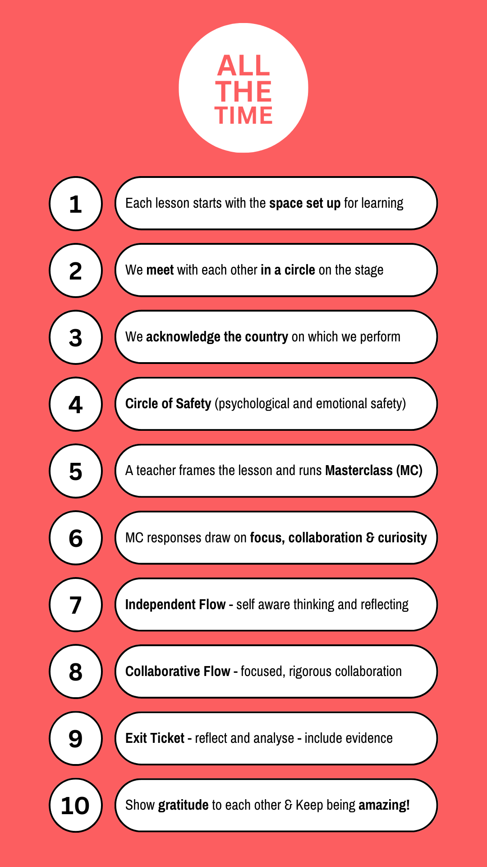
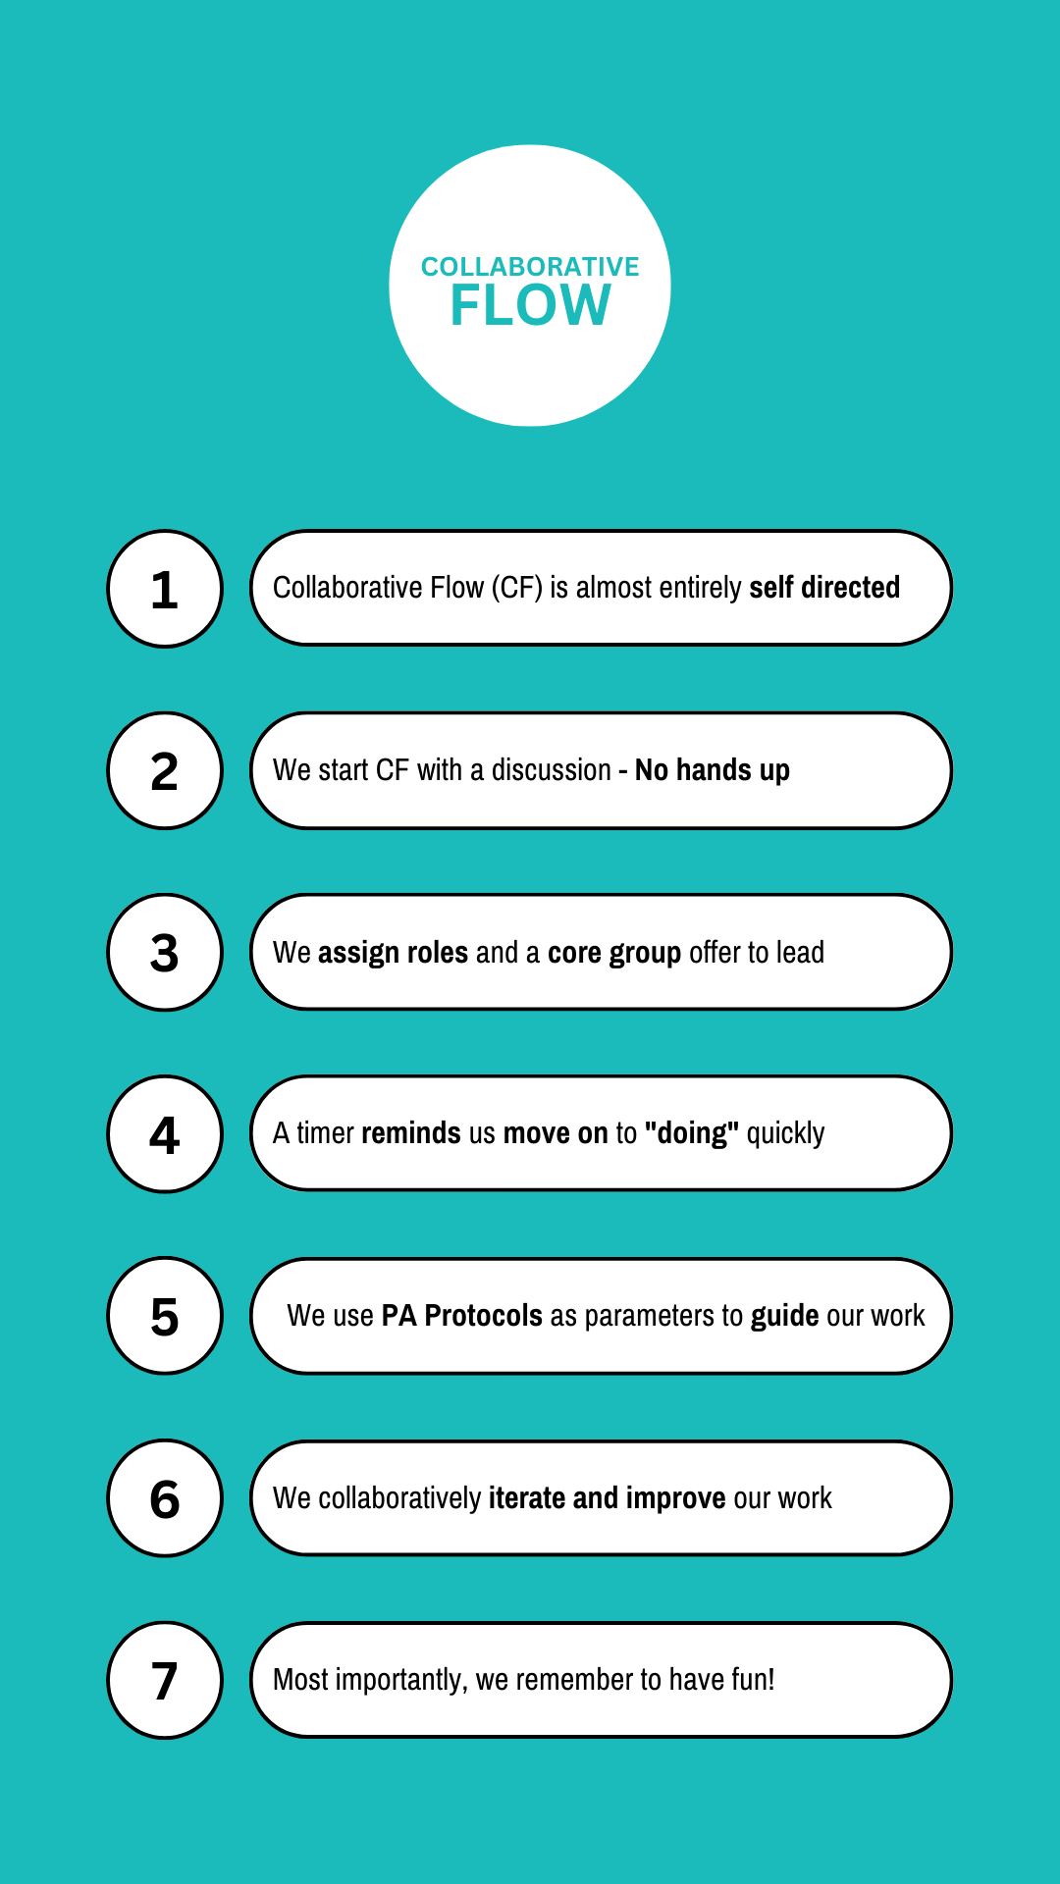
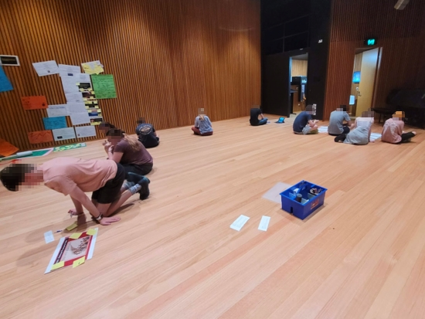
PROTOCOLS - Evidence of Learning

Slide 43
SPACE (8)

Slide 44
How Have Activated, Manipulated And/Or Transformed Space In Performing arts?
This term, we have spent a lot of time looking at ways we can Activate, Manipulate and Transform space. An example was the "Chase Scene" we made within the taped areas. We had a small and seemingly restrictive area which we manipulated/transformed by having multiple different elements happening at the same time. Because the space was so small, having so many things happening created a sense of chaos - which we saw as an important characteristic of all chase scenes. Rather than feeling limited by the small space, we chose to use it as a way to increase the impact of our performance - concentrating the viewers’ attention into a small area.

Slide 45
Can You Identify The Meaning That Is Communicated Through Your Use Of Space In Hybrid Performances This Term?
This term, we have often used space to communicate meaning.
An example of this is how we are considering our use of space for our Anzac Day Acknowledgement of Country video. We have collectively decided that is important to create a meaningful video which respectfully acknowledges country - in a more insightful way than a mainstream acknowledgement. An important part of this is considering the spaces in which we film the video. We have chosen to film on the country we are acknowledging - which we think will make our video more meaningful and impactful.
We recognise that First Nations Australians have a deep connection to country and we think it is an important step towards reconciliation if we all commit to celebrating values around caring for country.

Slide 46
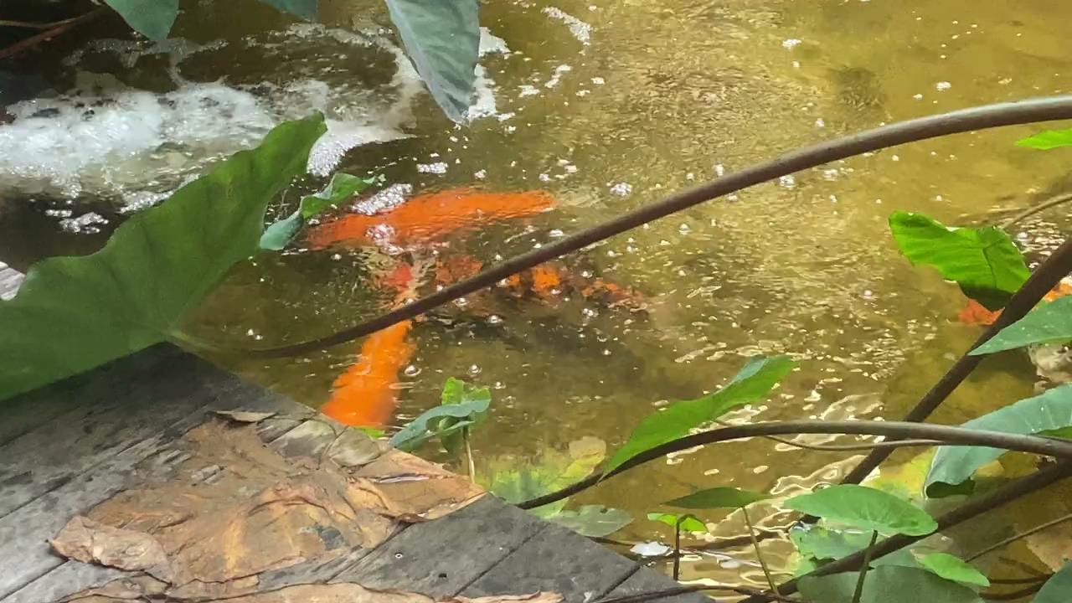
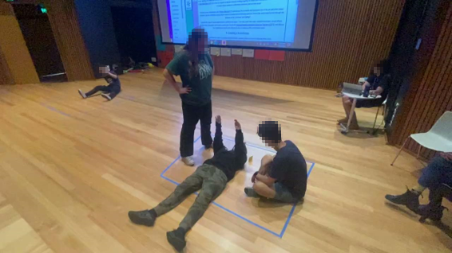
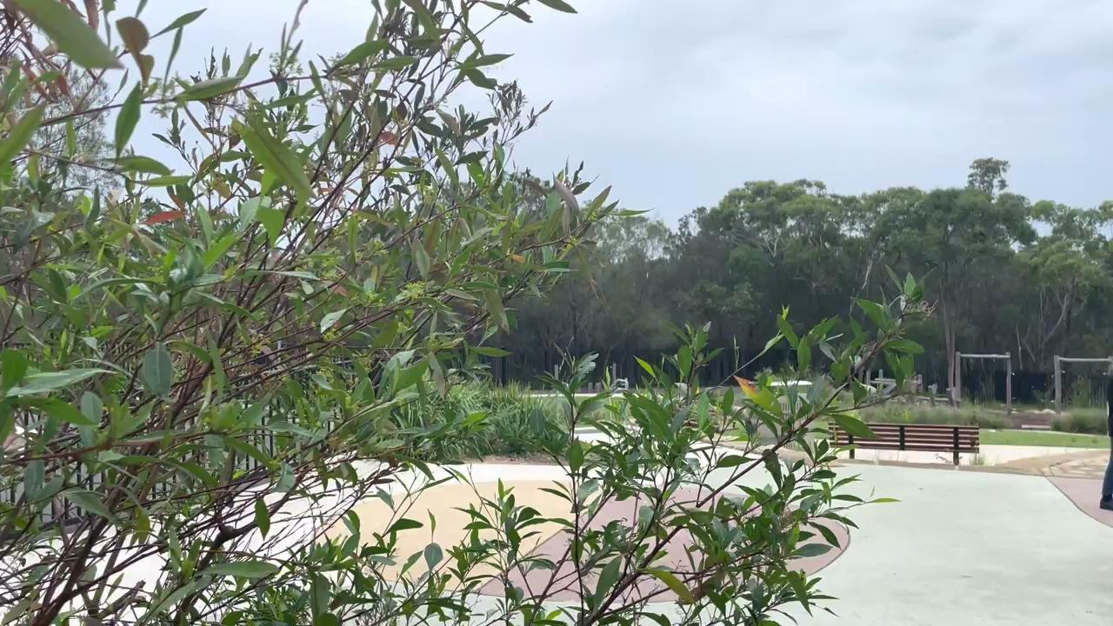
SPACE - Evidence of Learning

Slide 47
PRESENCE (8)

Slide 48
How Have You Created And Sustained Presence In Your Performing arts Works?
Give Examples Of When You Have Used Focus And Tension To Create Presence...
I think Presence is the PA Essential which is by far the most important. Within that, the most important element of Presence is Focus. For me, Focus IS Presence rather than being something which can be used to “create” it.
Focus is the building block for all evocative and effective theatre. It is important for performers to hold their focus when they are on stage. If they don’t then there is no chance the audience will be able to seriously and meaningfully engage with the piece of theatre. more on the next slide

Slide 49
Reflection
If I was to think of examples of when I have needed to demonstrate Focus, I would mention the rehearsal process leading up to ANZAC Day. I feel a certain level of pressure to deliver a polished performance by the end of week 2. To achieve this will take a massive amount of focus - focus on achieving the end goal, and focus on stage as performers.
I feel like Presence is the PA Essential which we collectively and individually still have the greatest distance to grow and I look forward to focusing on focus more explicitly in Term 2.

Slide 50
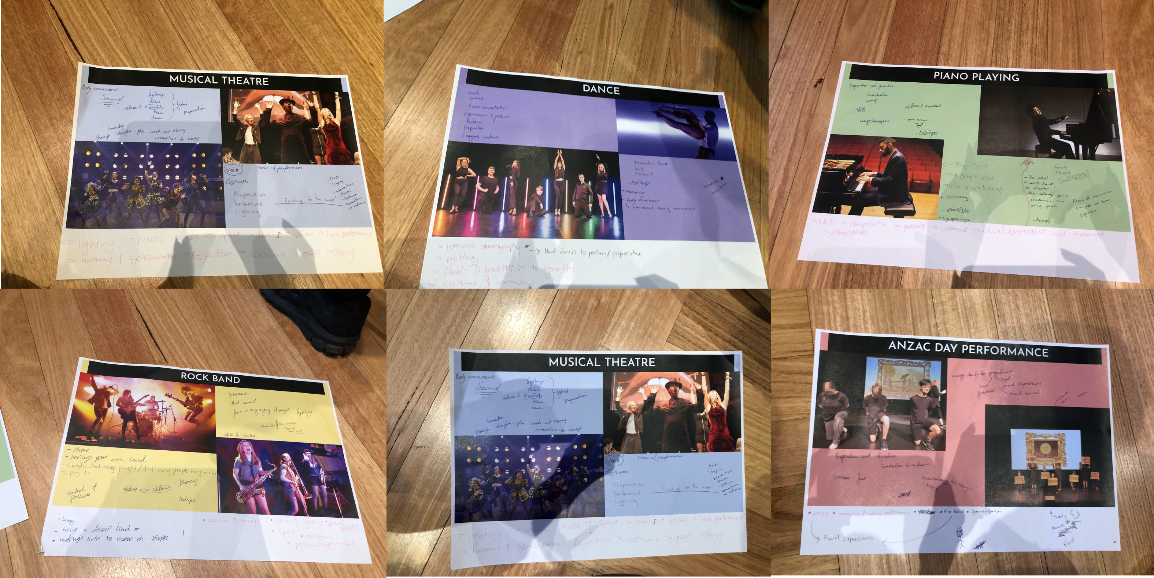
PRESENCE - Evidence of Learning

Slide 51
AUDIENCE (8)

Slide 52
How Do You Know If Your Audience Can Interpret Your Intention?
When workshopping as a class, we often feedback on each other’s work. Those who are not performing, are able to sit out and observe the piece of theatre from the audience's perspective. They are able to describe the strengths of the performance, and suggest ways to improve audience engagement - making the piece of theatre more impactful. To help elevate this even further, I would suggest that the “directors” each lesson sit out more often - to help themselves understand what the audience experiences.

Slide 53
Give Examples Of How You Have Kept Audience Reaction In Mind Throughout Your Process And Performance.
Audience reaction has been important part of our considerations for our Anzac Day Commemoration. This event needs to be inclusive and engaging for every single person in the school K-12. This is a unique challenge because the needs of the K2 hub are very different to that of the stage 6s. With that in mind, we have had to separate the Anzac Day event by age group, so that each person's experience is the best it can be for them specifically. Doing this enables us to better engage our audiences, and allows us to create insightful, emotional and thought provoking pieces of immersive hybrid theatre.

Slide 54
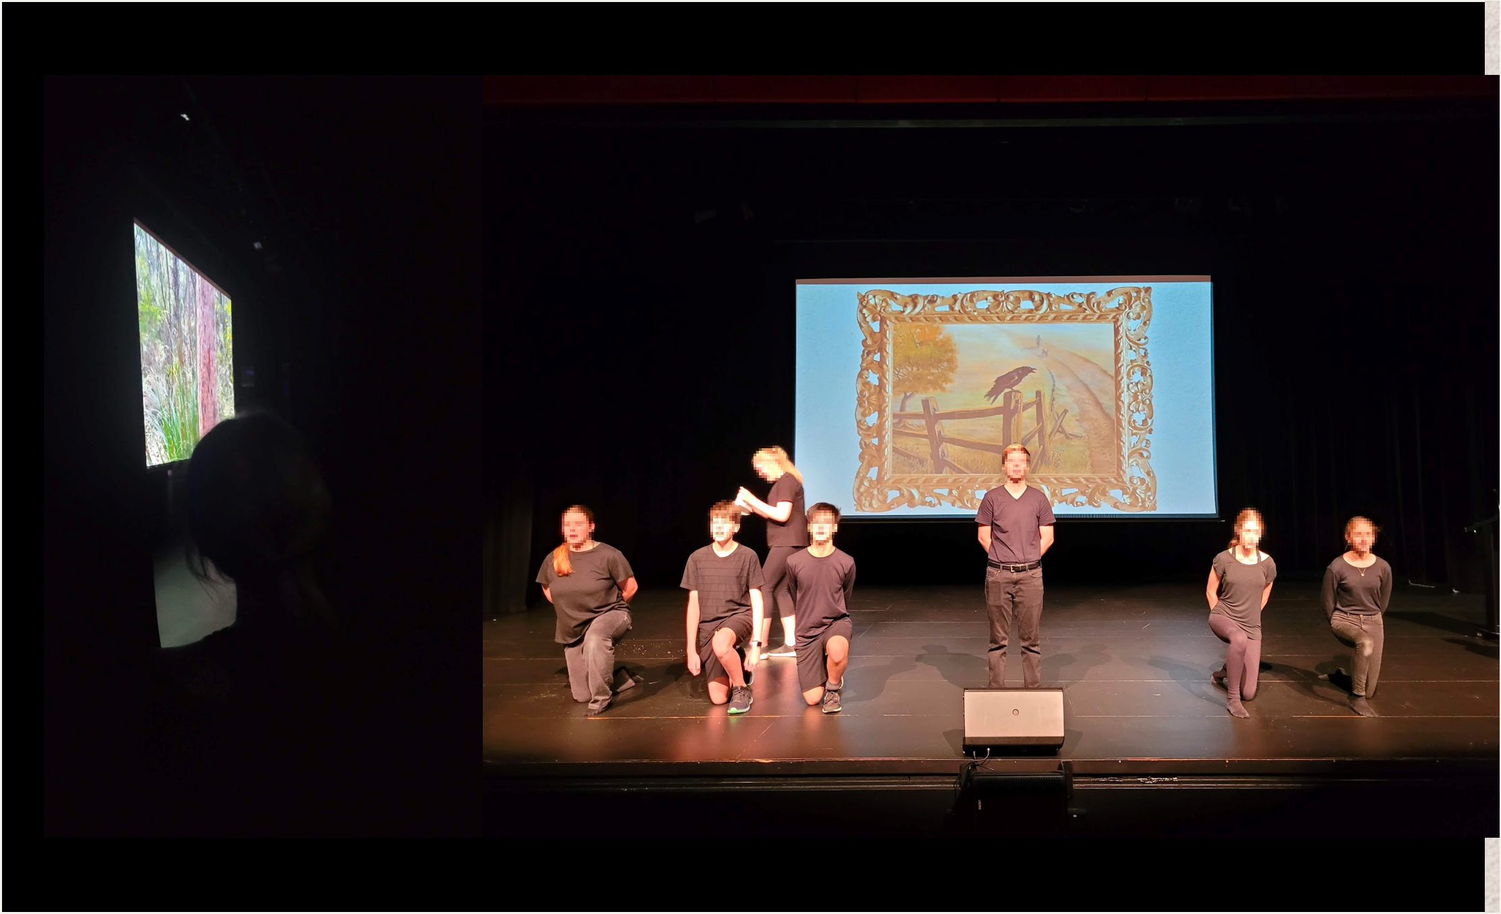
AUDIENCE - Evidence of Learning

Slide 55
Copyright
© State of New South Wales (Department of Education), 2025
The copyright material published in this resource is subject to the Copyright Act 1968 (Cth) and is owned by the NSW Department of Education or, where indicated, by a party other than the NSW Department of Education (third-party material).
Copyright material available in this resource and owned by the NSW Department of Education is licensed under a Creative Commons Attribution 4.0 International (CC BY 4.0) license.
This license allows you to share and adapt the material for any purpose, even commercially.
Attribution should be given to © State of New South Wales (Department of Education), 2025.
Material in this resource not available under a Creative Commons license:
the NSW Department of Education logo, other logos and trademark-protected material
Material owned by a third party that has been reproduced with permission. You will need to obtain permission from the third party to reuse its material.
Links to third-party material and websites
Please note that the provided (reading/viewing material/list/links/texts) are a suggestion only and implies no endorsement, by the New South Wales Department of Education, of any author, publisher, or book title. School principals and teachers are best placed to assess the suitability of resources that would complement the curriculum and reflect the needs and interests of their students.
If you use the links provided in this document to access a third-party’s website, you acknowledge that the terms of use, including licence terms set out on the third-party’s website apply to the use which may be made of the materials on that third-party website or where permitted by the Copyright Act 1968 (Cth). The department accepts no responsibility for content on third-party websites.

