Slide 1
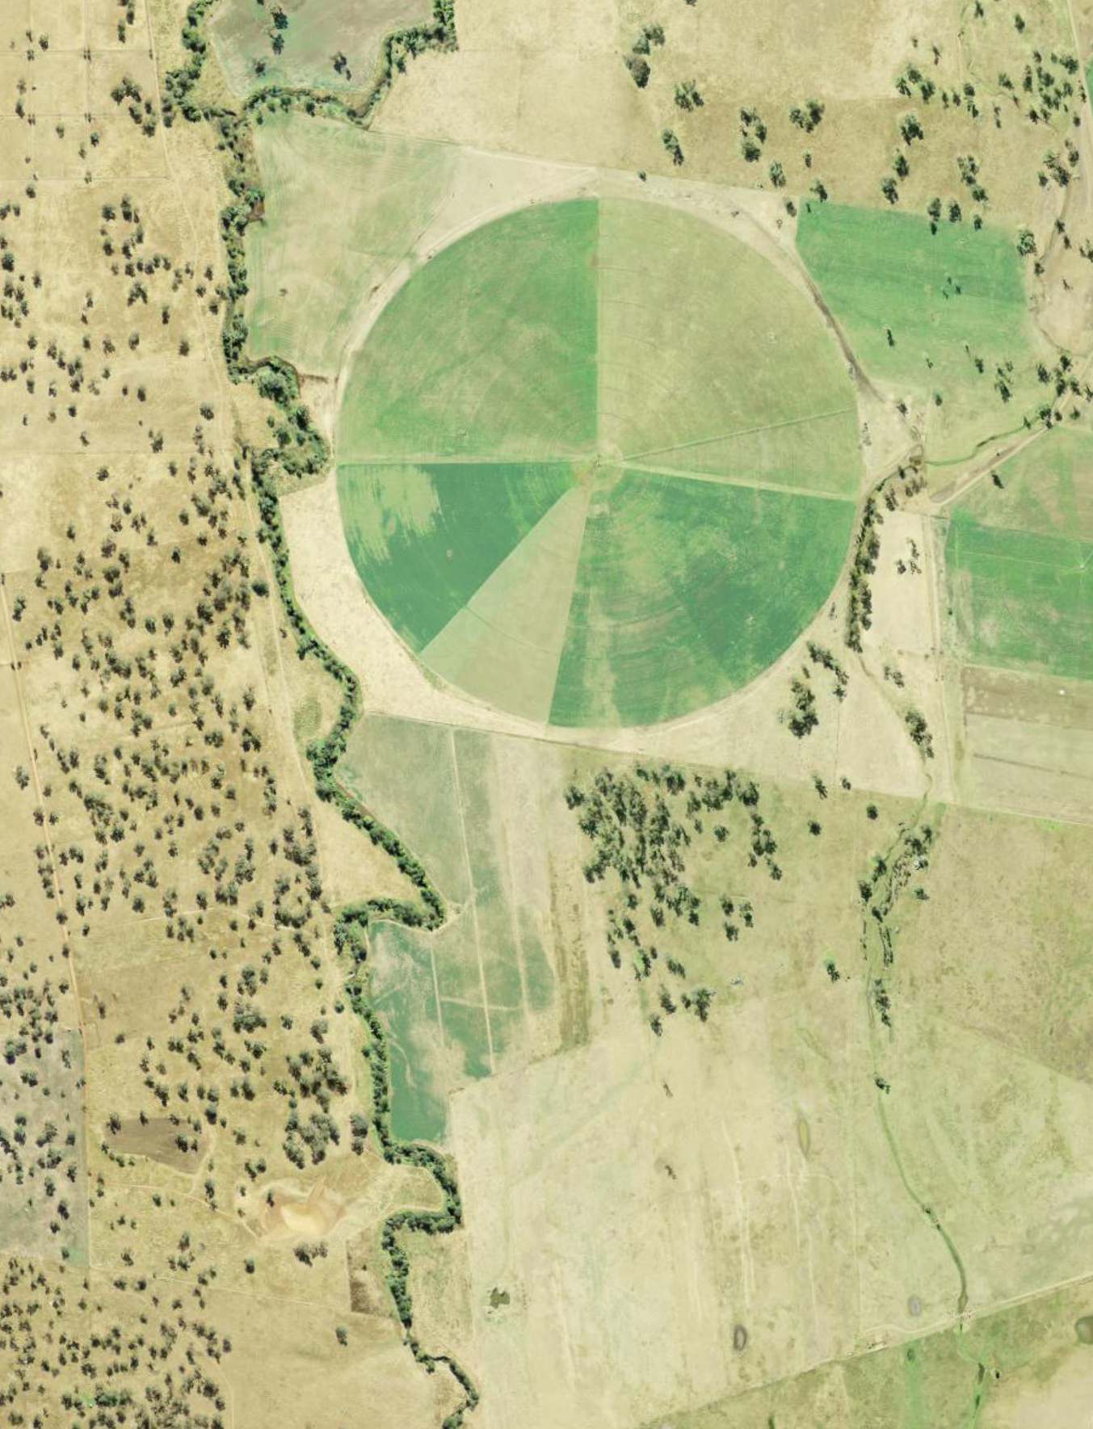
iSTEM AgriTech
Stage 5
Week 9 and 10
Resource code: AGT PPT5

Slide 2
Instructions for use
This resource has been created to provide additional support for teachers and students in the delivery of the iSTEM AgriTech program of learning.
Assess this document within the context of your school and class and adjust where appropriate.
Delivery instructions and comments are provided in the notes section of the document.
Notes:
To convert the PowerPoint into Google Slides:
Upload the file into Google Drive and open it.
Go to File > Save as Google Slides.

Slide 3
Week 9 and 10 Lessons
9.1
10.1
Traditional agricultural methods
Innovation in agriculture
9.2
10.2
Big data
Careers in AgriTech
9.3
10.3
Data use in agriculture
Careers in STEM and AgriTech
Notes:
Teacher notes:
Click lesson numbers to go to specific lessons
Interactive features can be viewed in slide show

Slide 4
9.1 Traditional agricultural methods
Learning intentions and success criteria
We are learning about:
traditional agricultural methods and innovations used by Aboriginal and Torres Strait Islander peoples
how traditional agricultural methods could possibly be used to address present-day agricultural challenges.
We can:
identify traditional agricultural methods and innovations used by Aboriginal and Torres Strait Islander peoples
identify possible alignment between traditional agriculture methods and present-day agricultural challenges.
Notes:
Notes for teachers:
Adapt the learning intention as required and add matching success criteria.
For more information see ⁠NSW Department of Education explicit teaching strategies https://education.nsw.gov.au/teaching-and-learning/curriculum/explicit-teaching.
LISC is not necessarily presented at the beginning of the lesson. Teacher needs to consider most effectual time to introduce.
LISC should be revisited during the lesson to support students' evaluation of their learning.

Slide 5
Current agricultural challenges
Review agricultural challenges
At the beginning of this topic, we explored challenges facing agricultural businesses.
Can you remember some of those challenges?
Notes:
Teacher notes: Review agricultural challenges from week 1.
Check for recall
Why may there not be enough water to irrigate a farm? (a: droughts and overuse of water)
What is in the soil that the plants need? (a: nutrients)
What happens if we clear too much natural vegetation for crops? (a: land degradation, soil erosion, salinity, less nutrients)
What did we call growing one type of crop? (a; monoculture) Why is it risky to grow only one type of crop on a farm? (a: if a pest or disease comes to attack that variety, it will destroy the whole crop)
What is the effect of buying food that was grown very far from where you are? (a: increases CO₂ emissions but may increase the variety of foods we eat).

Slide 6
Global challenges facing agriculture
What challenges do agricultural businesses face?
Agricultural businesses face a wide range of challenges, for example:
water shortages, severe weather events and changing weather patterns
soil degradation, food security and access
labour shortages
the cost and overuse of chemical fertilisers, pesticides and herbicides
biosecurity and the dangers of monocultures and uniform livestock production
sustainability and organic farming.
Notes:
Teacher notes: Recall the challenges facing agriculture. Use the slide as a discussion prompt after the previous question slide if needed.
Use the following prompts and slides to guide discussion:
Water shortages, severe weather events, and changing weather patterns: Discuss the increasing scarcity of water for agriculture, as well as the challenges posed by more frequent and intense weather events, such as droughts, floods and storms. Climate change is also causing shifts in temperature and precipitation patterns, making it more difficult for farmers to predict and adapt to growing conditions.
Soil degradation: Discuss the decline in soil quality due to factors such as erosion, nutrient depletion, salinisation and pollution. Degraded soils are less productive and more susceptible to pests and diseases, making it more difficult for farmers to grow crops.
The cost and overuse of chemical fertilisers, pesticides, and herbicides: Discuss the high and changing cost of these inputs, as well as the environmental and health risks associated with their overuse. These chemicals can contaminate water supplies, harm beneficial insects and create resistant pests and weeds.
Food security and access: Discuss the challenge of ensuring that all people have access to safe, nutritious and sufficient food. Food security is threatened by a number of factors, including climate change, conflict, poverty and population growth.
Biosecurity and the dangers of monocultures and uniform livestock production: Discuss the risks of disease outbreaks in agriculture, which can be exacerbated by the widespread use of monocultures and the concentration of livestock in large, confined spaces. These practices can create ideal conditions for the spread of pests and diseases, leading to significant economic losses for farmers.
Sustainability and organic farming: Discuss the need for agriculture to be more sustainable in order to protect the environment and ensure the long-term viability of the industry. Organic farming is one approach to sustainable agriculture that relies on natural processes and avoids the use of synthetic inputs.
Further information from:
https://www.fao.org/home/en
https://www.agriculture.gov.au/abares/products/insights/snapshot-of-australian-agriculture#the-productivity-slowdown-and-what-to-do
https://www.oecd.org/en/topics/agriculture-and-fisheries.html

Slide 7
Traditional agricultural methods
Web research
We will be exploring this food and agriculture webpage: https://deadlystory.com/page/culture/Life_Lore/Food
Research focus:
Describe the land care practices detailed on the page?
What were some sources of meat and protein?
Did you find any sources of honey or carbohydrates?
7
Notes:
Teacher note: Use this activity to build knowledge of traditional food harvesting and land management.
Model skim and scan of the webpage. Demonstrate active reading, such as pre-read, read and rereading for processing of information to extract relevant information.
What land care practices did you discover? a: Cultural burning methods worked with nature and were slow and not intense. It helped release nutrients back into the soil, without destroying the entire forest.
What were some sources of meat and protein? a: Kangaroo, witchety grubs, emu, rays etc were sources of meat and protein.
Did you find any sources of honey or carbohydrates? a: Honey ants, yams, bush potatoes are sources of sugar and carbohydrates.

Slide 8
Agricultural challenge – climate and water
Example
Let's choose one of the challenges to agriculture we discussed earlier. We will describe the challenge and outline traditional food and agricultural practices that could assist with that challenge.
Example
Climate and water availability: The Australian climate can be challenging to crops and animals. Water availability, nutrients and disease can affect agriculture. Native species are perfectly adapted to Australian conditions and so may be an alternative food source, such as kangaroo or yams.
8
Notes:
Teacher note: Use this activity to build communication skills in students. Provide an example response or joint construction of a description and impact outline.
Great further reading can be found at the ‘What is the biggest challenge facing the future of agriculture’ Webpage - https://source.colostate.edu/challenges-of-agriculture/

Slide 9
Agricultural challenge
Example
Another challenge to agriculture is land management and soil condition. Try to describe the challenge and a traditional method that may be a good alternative.
Soil Degradation:
9
Notes:
Teacher note: Use this activity to build communication skills in students. Provide an example response or joint construction. Move on to student construction with prompts when appropriate.
Ask students to describe two different agricultural challenges and communicate it in a chosen mode of presentation, for example:
text in notebook
text or pictures on small whiteboards
electronic graphical display or cloud app.
Share descriptions with peers through think-pair-share activity.
Review LISC at the end of the lesson.

Slide 10
Agricultural challenge – soil degradation
Example
Another challenge to agriculture is land management and soil condition. Try to describe the challenge and a traditional method that may be a good alternative.
Soil Degradation: Soil health is vital for plant growth, but practices like over-farming, deforestation and improper use of chemicals degrade soil quality. Degraded soil loses its nutrients and structure, making it harder to grow healthy crops. A low impact mind set such as reducing land clearing or maintaining natural environments or nature corridors can help limit water runoff and soil erosion.
10
Notes:
Teacher note: Use this activity to build communication skills in students. Provide an example response or joint construction. Move on to student construction with prompts when appropriate.
Ask students to describe two different agricultural challenges, and communicate it in a chosen mode of presentation, for example:
text in notebook
text or pictures on small whiteboards
electronic graphical display or cloud app.
Share descriptions with peers through think-pair-share activity.
Review LISC at the end of the lesson.

Slide 11
9.2 Big data
Learning intentions and success criteria
We are learning about:
data collection and use by agricultural businesses to solve real-world challenges and improve decision making
information sources and identifying potential bias, objectivity, argumentation, authority, and credibility.
We can:
identify how data is collected and used by agricultural businesses
identify potential bias, objectivity, argumentation, authority and credibility in sources.
Notes:
Notes for teachers:
Adapt the learning intention as required and add matching success criteria.
For more information see ⁠NSW Department of Education explicit teaching strategies https://education.nsw.gov.au/teaching-and-learning/curriculum/explicit-teaching.
LISC is not necessarily presented at the beginning of the lesson. Teacher needs to consider most effectual time to introduce.
LISC should be revisited during the lesson to support students' evaluation of their learning.

Slide 12
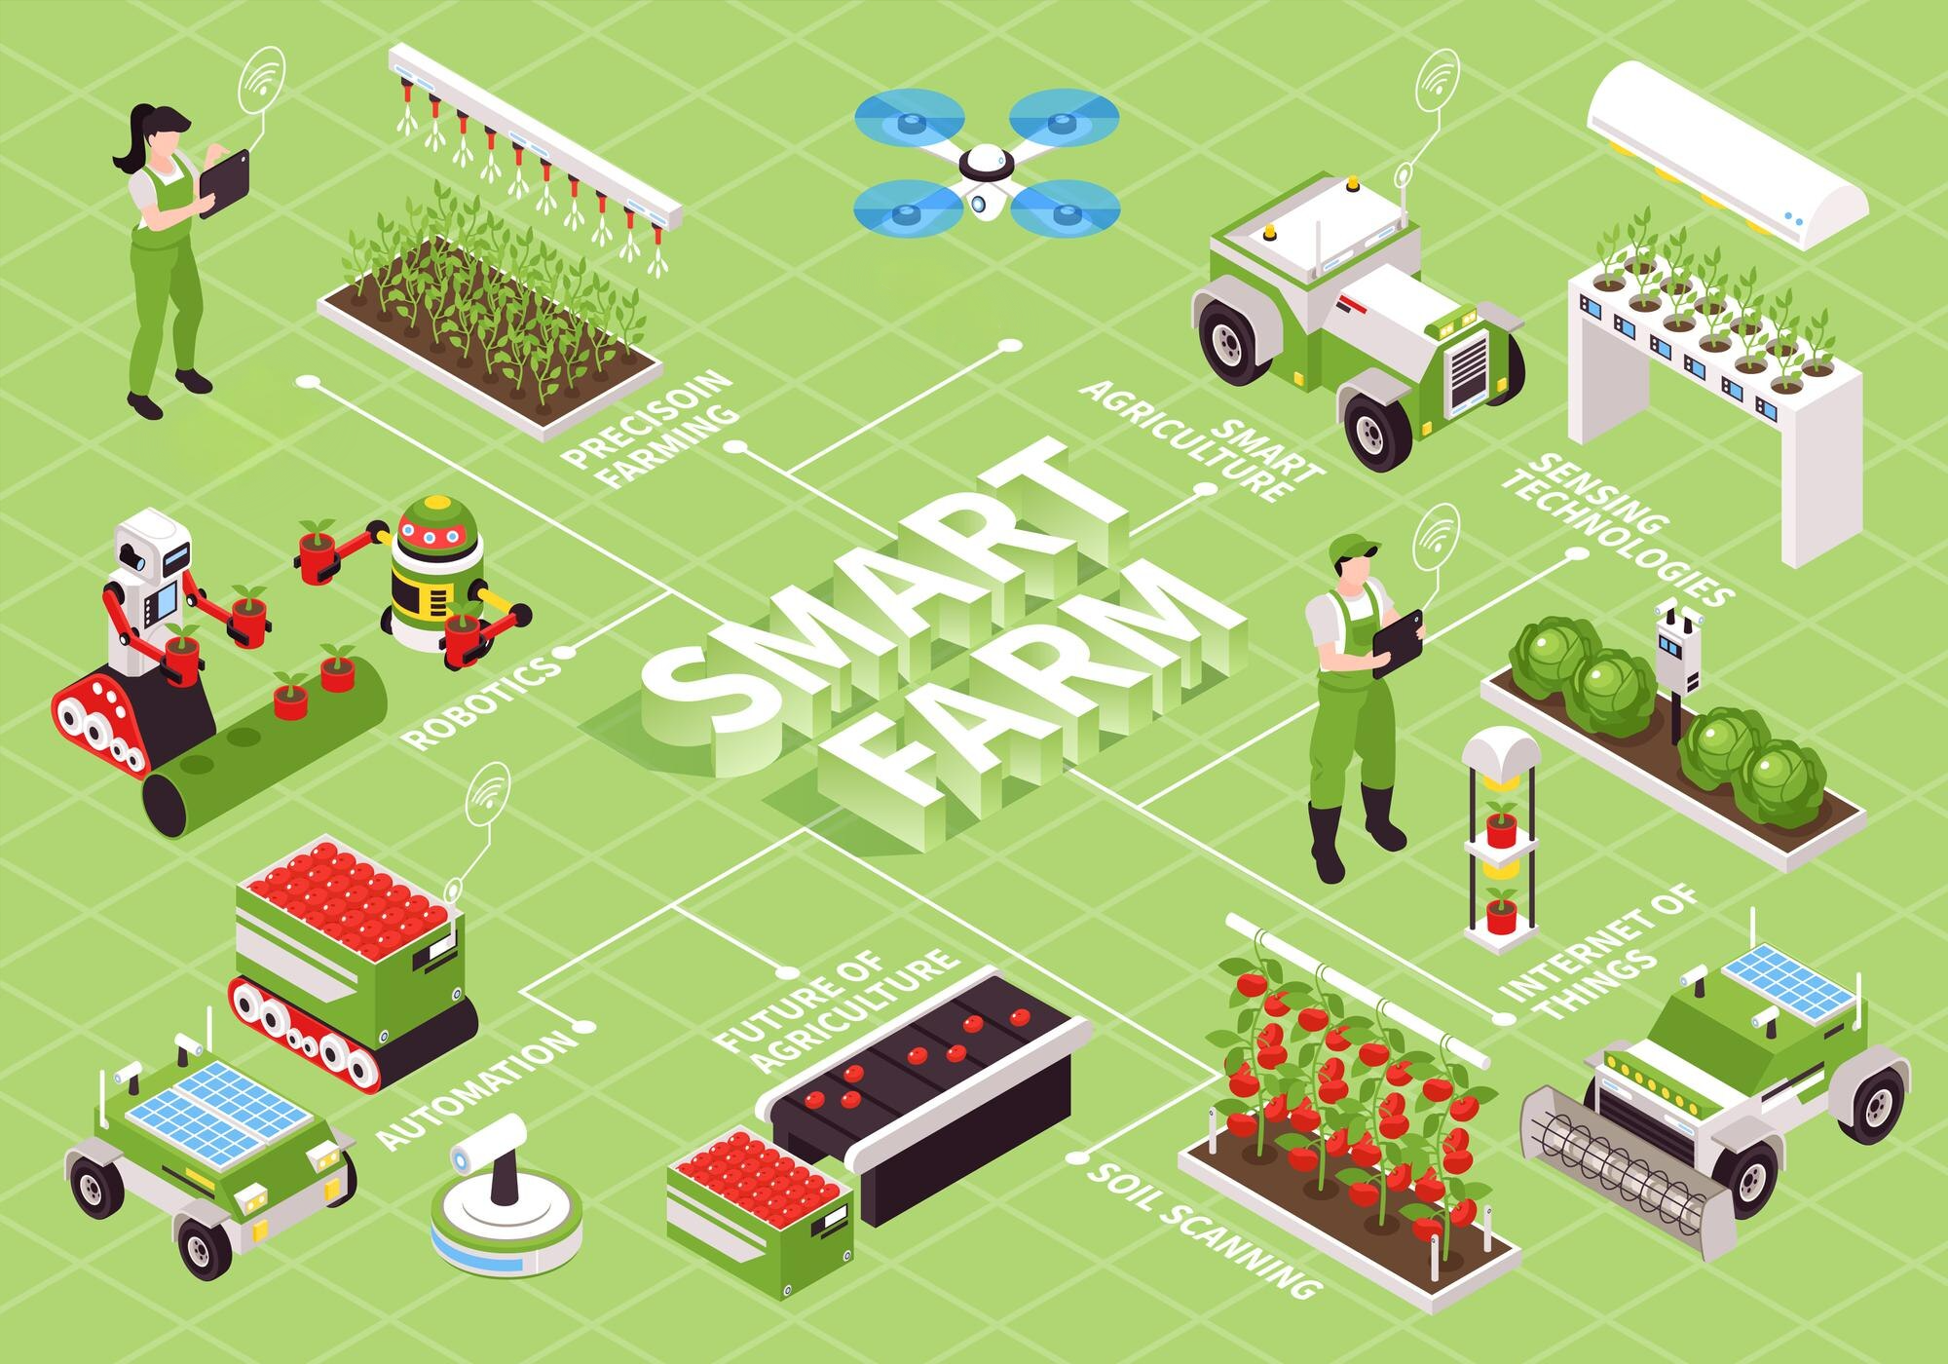
AgriTech
AgriTech uses digital technologies and moves toward a smarter, more efficient, environmentally responsible agriculture sector.
This includes digitalisation and automation processes such as Big Data, Artificial Intelligence (AI), robots, the Internet of Things (IoT), and virtual and augmented reality.
Designed by macrovector in Freepik
12
Notes:
Revise the term AgriTech. Discuss the link between the text and the images. Students may have seen this image in previous lessons, discussion content with students may become more nuanced as they have moved through the topic.

Slide 13
AgriTech and data
In the following lessons we will explore different types of data collected and used by agricultural businesses to solve real-world challenges and improve productivity, profitability, environmental outcomes and labour efficiency.
Designed by macrovector in Freepik
13
Notes:
What types of data do we collect? Use the image to describe and check with students what type of data may be collected.
Questions
In this image we see a drone scanning the ground. What information could it be collecting? (imagery on plant health based on density, height, colour) (it could also detect weeds and detect early signs of insects)(it could have thermal imagery to detect water coverage after irrigation).
Where could that data go? (to a central software system that processes vast amounts of data)(this data could be displayed on someone's computer or phone).
How could that data benefit the farmer? (the farmer could assign an autonomous system to spray water, fertiliser or pesticide for targeted growth improvement).

Slide 14
Assessing information sources
In this lesson we will learn more about precision agriculture.
We will also identify potential bias, objectivity, argumentation, authority and credibility in sources.
Assessing information sources is essential. Checking that information is accurate, unbiased, and credible, helps you make well-informed decisions.
14
Notes:
Point out to students that all information sources may have varying degrees of bias, objectivity, argumentation, authority and credibility.
1. Bias is a lean or prejudice in favour of or against one thing, person. While everyone has perspectives, a biased source may cherry-pick facts or use "loaded" language to sway your opinion rather than presenting a full picture.
2. Objectivity is the effort to remain neutral and fair. An objective source sticks to observable facts and evidence, presenting multiple sides of an issue without letting personal feelings or interests dictate the conclusion
3. Argumentation is the logical process used to support a claim. It’s not just about "having an argument," but rather how well a source connects its evidence to its conclusions using sound reasoning.
4. Authority refers to the "who" behind the information. It looks at the creator's credentials, expertise, and reputation. For example, a peer-reviewed paper by a biologist carries more authority on genetics than a viral post from a lifestyle influencer.
5. Credibility is the overall "believability" or trustworthiness of a source. It is the cumulative result of the other four factors; if a source is objective, uses strong argumentation, and has clear authority and limited bias, its credibility remains high.

Slide 15
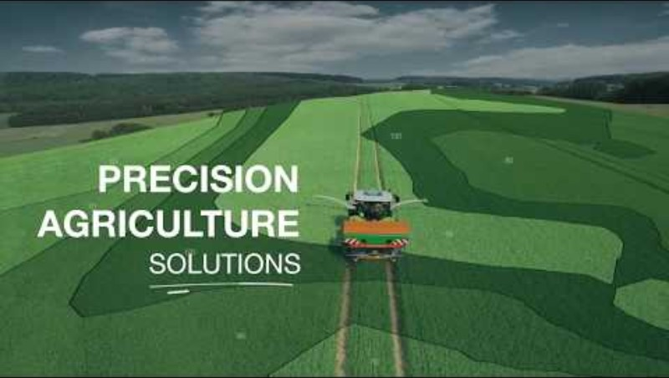
Precision Agriculture
Video
We will view this video and assess the information source and identify potential bias, objectivity, argumentation, authority and credibility, for example:
What facts does the publisher use? Are references provided?
What words create positive or negative impressions?
Who is paying for the video?
Are different points of view expressed?
What is the purpose of the publication?
Is the publisher an authority in the field?
What is precision agriculture? (3:25).
15
Notes:
Teacher note: While watching the video for information we will also assess the source of information. This video does a good job of introducing some precision agriculture technologies and while watching we will ask students to assess the source of the publication. Discuss with students the importance of assessing sources of information and being aware of bias, objectivity and authority.
Questions to display:
What facts does the publisher use? They do not seem to use facts and keep comments broad.
What words create positive or negative impressions? Statements in the video like “may reveal its nutritional needs” tends to make the video example,.
Who is paying for the video? Inter American development bank.
Are different points of view expressed? Yes, a fairly balanced view seems to be presented although it trends toward positive. For example, it outlines challenges some small holding farmers may face with using data and technology.
What is the purpose of the publication? Informing the public and possibly investors about precision agriculture.
Is the publisher an authority in the field? Possibly – they may have hired experts or have staff who are.

Slide 16
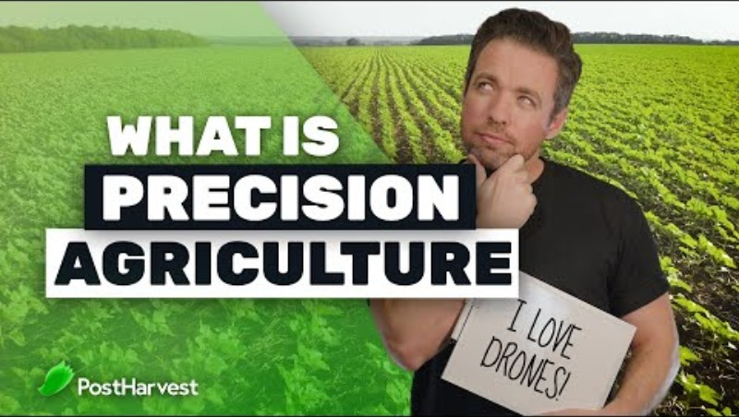
Precision Agriculture – post harvest
We will view this video and assess the information source and identify potential bias, objectivity, argumentation, authority and credibility, for example:
What facts does the publisher use? Are references provided?
What words create positive or negative impressions?
Who is paying for the video?
Are different points of view expressed?
What is the purpose of the publication?
Is the publisher an authority in the field?
What is precision agriculture? (4:28)
16
Notes:
Teacher note: This video also does a good job of outlining some precision agriculture technologies. However, first we will ask students to assess the source of the publication to keep it in mind when viewing the video for information.
Questions to display:
What facts does the publisher use? Many examples (50% less farmers) (50% more produce from 20% more water). However, the source of these facts/statistics should be determined.
Are sources provided? No
What words create positive or negative impressions? Other than the statistics above words like “best course of action” and “producing higher quality and quantity of produce” words are positive toward technology.
Who is paying for the video? A supplier of an agriculture solution (this doesn’t make information incorrect it is just something to note).
Are different points of view expressed? No – A pro and con video may have a more balanced view.
What is the purpose of the publication? Informing the public about precision agriculture.
Is the publisher an authority in the field? As a product manufacturer of one of the products they would be knowledgeable about the field.

Slide 17
Precision Agriculture technologies
Video
Identify the examples of precision agriculture from the video and outline how these technologies could affect decision making, for example:
‘The yield’ product
Variable rate technology
Geospatial technology.
What is precision agriculture? (4:28)
17
Notes:
Teacher note: You could replay the video to gain information for the following summary table or complete the following table as an exercise in recall without replaying the video.
Focus on The Yield sensor product, variable rate technology and the use of geospatial technology.
This video does a good job of outlining some precision agriculture technologies. However, first we will ask students to assess the source of the publication to keep it in mind when viewing the video for information.

Slide 18
Identify and outline
Identify | Outline
‘The Yield’ sensor system
Variable rate technology
Geospatial technology
Notes:
Teacher note: Use this table as a template for responses from the previous video.
Share completed tables with a fellow student or with the class on mini whiteboards.

Slide 19
9.3 Data use in agriculture
Learning intentions and success criteria
We are learning about:
data collection and use by agricultural businesses to solve real-world challenges and improve decision making
information sources and identifying potential bias, objectivity, argumentation, authority and credibility.
We can:
explain how data is collected and used by agricultural businesses
identify potential bias, objectivity, argumentation, authority and credibility in sources.
Notes:
Notes for teachers:
Adapt the learning intention as required and add matching success criteria.
For more information see ⁠NSW Department of Education explicit teaching strategies https://education.nsw.gov.au/teaching-and-learning/curriculum/explicit-teaching.
LISC is not necessarily presented at the beginning of the lesson. Teacher needs to consider most effectual time to introduce.
LISC should be revisited during the lesson to support students' evaluation of their learning.

Slide 20
Review agricultural challenges
At the beginning of this topic, we explored challenges facing agricultural businesses.
Can you remember some of those challenges?
Notes:
Teacher notes: Briefly review agricultural challenges from previous lessons.
Check for recall
Why might there not be enough water to irrigate a farm? (a: droughts and overuse of water)
What is in the soil that the plants need? (a: nutrients)
What happens if we clear too much natural vegetation for crops? (a: land degradation, soil erosion, salinity, less nutrients)
What did we call growing one type of crop? (a: monoculture) Why is it risky to grow only one type of crop on a farm? (a: if a pest or disease comes to attack that variety, it will destroy the whole crop)
What is the effect of buying food that was grown very far from where you are? (a: increases CO₂ emissions but may increase the variety of foods we eat).

Slide 21
What challenges do agricultural businesses face?
Agricultural businesses face a wide range of challenges, for example:
water shortages, severe weather events and changing weather patterns
soil degradation
the cost and overuse of chemical fertilisers, pesticides and herbicides
food security and access, labour shortages
biosecurity and the dangers of monocultures and uniform livestock production
sustainability and organic farming.
21
Notes:
Teacher notes: Recall the challenges facing agriculture. Use the slide as a discussion prompt after the previous question slide.
Use the following prompts and slides to guide discussion:
Water shortages, severe weather events and changing weather patterns: Discuss the increasing scarcity of water for agriculture, as well as the challenges posed by more frequent and intense weather events, such as droughts, floods and storms. Climate change is also causing shifts in temperature and precipitation patterns, making it more difficult for farmers to predict and adapt to growing conditions.
Soil degradation: Discuss the decline in soil quality due to factors such as erosion, nutrient depletion, salinisation and pollution. Degraded soils are less productive and more susceptible to pests and diseases, making it more difficult for farmers to grow crops.
The cost and overuse of chemical fertilisers, pesticides and herbicides: Discuss the high and changing cost of these inputs, as well as the environmental and health risks associated with their overuse. These chemicals can contaminate water supplies, harm beneficial insects and create resistant pests and weeds.
Food security and access: Discuss the challenge of ensuring that all people have access to safe, nutritious and sufficient food. Food security is threatened by a number of factors, including climate change, conflict, poverty and population growth.
Biosecurity and the dangers of monocultures and uniform livestock production: Discuss the risks of disease outbreaks in agriculture, which can be exacerbated by the widespread use of monocultures and the concentration of livestock in large, confined spaces. These practices can create ideal conditions for the spread of pests and diseases, leading to significant economic losses for farmers.
Sustainability and organic farming: Discuss the need for agriculture to be more sustainable in order to protect the environment and ensure the long-term viability of the industry. Organic farming is one approach to sustainable agriculture that relies on natural processes and avoids the use of synthetic inputs.
Further information from:
https://www.fao.org/home/en
https://www.agriculture.gov.au/abares/products/insights/snapshot-of-australian-agriculture#the-productivity-slowdown-and-what-to-do
https://www.oecd.org/en/topics/agriculture-and-fisheries.html

Slide 22
Data
Review agricultural challenges
What types of data is collected by agricultural businesses?
Can you remember data collection from previous lessons?
Notes:
Teacher notes: Briefly review data collected by agricultural businesses.
Check for recall
What types of data is collected by agricultural businesses? Weather data, soil information, plant health.

Slide 23
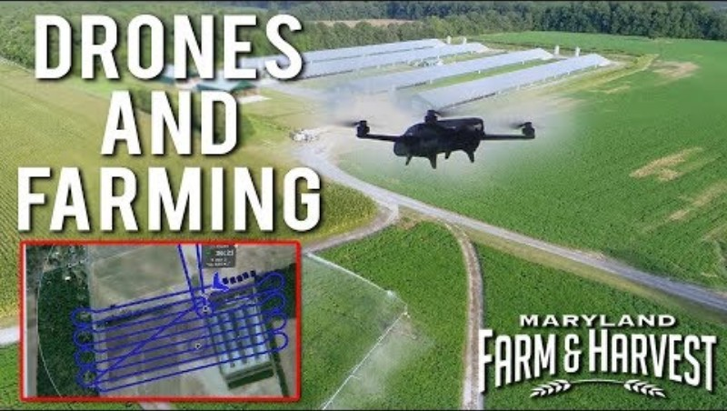
Drones in Agriculture
Video
We will view this video and assess the information source and identify potential bias, objectivity, argumentation, authority and credibility, for example:
What facts does the publisher use? Are references provided?
What words create positive or negative impressions?
Who is paying for the video?
Are different points of view expressed?
What is the purpose of the publication?
Monitoring crop health with drones (6:24)
23
Notes:
Teacher note: This video does a good job of introducing drones in agriculture technologies. While watching we will ask students to assess the source of the publication. Remind students of these questions and also show the next slide which focusses on the content of the video.
Questions to display and ask students:
What facts does the publisher use? They do not seem to use facts and keep comments broad.
What words create positive or negative impressions? Statements like “important potentially money saving decisions” tends to make the video positive toward drone monitoring but the word potentially moves the statement toward neutral as the publication does not know if it saves money.
Who is paying for the video? Maryland farm and harvest is a public broadcast news show in the USA.
Are different points of view expressed? Yes, a fairly balanced view seems to be presented although it trends toward positive.
What is the purpose of the publication? Informing the public about the use of drones in monitoring crop health.
Is the publisher an authority in the field? The publisher may not be, but they are interviewing people who appear to be within the industry and therefore are probably knowledgeable..

Slide 24
Drones in Agriculture – crop health
Video
From the video outline:
the technology used, and data collected
what the data analysis discovered or what the information was used for
the overall benefit of the technology or data collection.
Monitoring crop health with drones (6:24)
24
Notes:
Teacher note: View monitoring crop health with drones (6:24) and use it as the source for a think pair share activity. Pause video after certain sections to discuss technical language, for example:
spectral
autonomous
agronomist.
Instruct students to work individually (think) then in groups of 2-3 (pair). Each group should create a summary of the case study on butcher paper to share (share) with the class.
Capture information in a notebook or use the following think – pair – share activity template to collect and share answers depending on your preference. Collection and sharing of answers could also be facilitated using mini whiteboards.

Slide 25
Think-Pair-Share example
Think
Individual thinking time
Pair
Share your thoughts with a partner
Share
Share with a larger group or class
Outline:
the technology used and data collected
what the data analysis discovered or what the information was used for
the overall benefit of the technology or data collection.
Share your thoughts with a peer and collate information on butcher paper
Share your butcher paper collation with the class
Notes:
Use a think pair share framework to summarise learning from the video. View the video again if necessary, with the outline questions in mind.
Think-Pair-Share involves students thinking independently about a prompt or problem, pairing up and discussing their ideas with a classmate and then sharing their combined knowledge with the class. It:
allows educators to change a traditional whole class discussion into a more manageable and inclusive activity where all students are given an opportunity to respond.
promotes the development of students' speaking, listening and social skills.
If printing, suggest printing in black and white.

Slide 26
Think-Pair-Share
Think
Individual thinking time
Pair
Share your thoughts with a partner
Share
Share with a larger group or class
Notes:
Use a think pair share framework to summarise learning from the video. View the video again if necessary with the outline questions in mind.
Think-Pair-Share involves students thinking independently about a prompt or problem, pairing up and discussing their ideas with a classmate, and then sharing their combined knowledge with the class. It:
allows educators to change a traditional whole class discussion into a more manageable and inclusive activity where all students are given an opportunity to respond
promotes the development of students' speaking, listening and social skills
If printing, suggest printing in black and white.

Slide 27
10.1 Innovation in agriculture
Learning intentions and success criteria
We are learning about:
innovation in agricultural businesses
current and future AgriTech careers.
We can:
explain, or give examples of, innovation in agricultural businesses
give examples of potential AgriTech careers.
Notes:
Notes for teachers:
Adapt the learning intention as required and add matching success criteria.
For more information see ⁠NSW Department of Education explicit teaching strategies https://education.nsw.gov.au/teaching-and-learning/curriculum/explicit-teaching.
LISC is not necessarily presented at the beginning of the lesson. Teacher needs to consider most effectual time to introduce.
LISC should be revisited during the lesson to support students' evaluation of their learning.

Slide 28
Agricultural challenges and technology
Review agricultural challenges
Can you remember some challenges facing agricultural businesses?
What types of technology are being used to meet these challenges?
Notes:
Teacher notes: Briefly review agricultural challenges and the innovative technology being used to meet these challenges. Focus on challenges usually being the catalyst for innovation.
Check for recall example
Why may there not be enough water to irrigate a farm? (a: droughts and overuse of water) Technology? Precision irrigation conserves water and applies it where it is needed.

Slide 29
Remember the global challenges facing agriculture
What challenges do agricultural businesses face?
Agricultural businesses face a wide range of challenges, for example:
water shortages, severe weather events and changing weather patterns
soil degradation
the cost and overuse of chemical fertilisers, pesticides, and herbicides
food security and access, labour shortages
biosecurity and the dangers of monocultures and uniform livestock production
sustainability and organic farming.
29
Notes:
Teacher notes:
This slide contains animations
Recall the challenges facing agriculture. Use the slide as a discussion prompt after the previous question slide.
Use the following prompts and slides to guide discussion:
Water shortages, severe weather events, and changing weather patterns: Discuss the increasing scarcity of water for agriculture, as well as the challenges posed by more frequent and intense weather events, such as droughts, floods, and storms. Climate change is also causing shifts in temperature and precipitation patterns, making it more difficult for farmers to predict and adapt to growing conditions.
Soil degradation: Discuss the decline in soil quality due to factors such as erosion, nutrient depletion, salinisation, and pollution. Degraded soils are less productive and more susceptible to pests and diseases, making it more difficult for farmers to grow crops.
The cost and overuse of chemical fertilisers, pesticides, and herbicides: Discuss the high and changing cost of these inputs, as well as the environmental and health risks associated with their overuse. These chemicals can contaminate water supplies, harm beneficial insects, and create resistant pests and weeds.
Food security and access: Discuss the challenge of ensuring that all people have access to safe, nutritious, and sufficient food. Food security is threatened by a number of factors, including climate change, conflict, poverty, and population growth.
Biosecurity and the dangers of monocultures and uniform livestock production: Discuss the risks of disease outbreaks in agriculture, which can be exacerbated by the widespread use of monocultures and the concentration of livestock in large, confined spaces. These practices can create ideal conditions for the spread of pests and diseases, leading to significant economic losses for farmers.
Sustainability and organic farming: Discuss the need for agriculture to be more sustainable in order to protect the environment and ensure the long-term viability of the industry. Organic farming is one approach to sustainable agriculture that relies on natural processes and avoids the use of synthetic inputs.
Further information from:
https://www.fao.org/home/en
https://www.agriculture.gov.au/abares/products/insights/snapshot-of-australian-agriculture#the-productivity-slowdown-and-what-to-do
https://www.oecd.org/en/topics/agriculture-and-fisheries.html

Slide 30
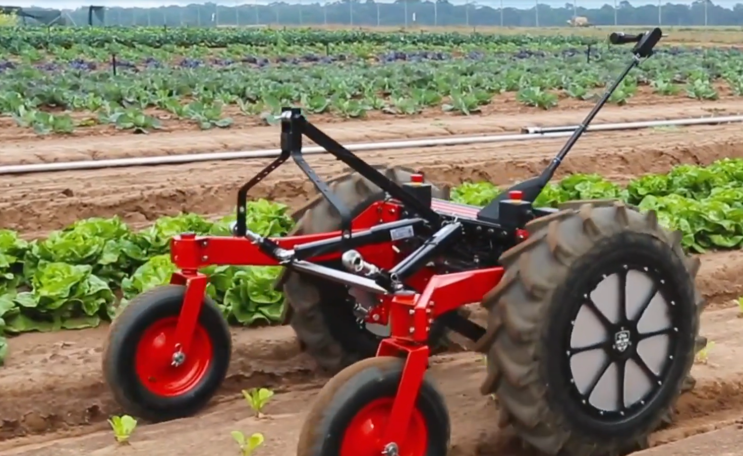

Robots helping farmers
Video
Identify and describe the innovative technologies presented in the video, for example:
image recognition
machine learning and AI
automation.
Robots helping farmers (5:11)
30
Notes:
Teacher note: View Robots helping farmers (5:10).
Identify and describe the innovative technologies presented in the video, for example:
using image recognition to detect weeds
using machine learning to create a response to weeds such as micro spraying or automated physical removal
using machine learning and AI to navigate row crops
automated tracking and monitoring of livestock.
Use the following table to capture information from the video.

Slide 31
Identify and describe
Identify | Describe
Image recognition and machine learning
Automation
AI and image recognition
Notes:
Teacher note: Use this table as a template for responses from the previous video.

Slide 32
Effect of technology and innovation on Careers
The increased use of technology and smart farming will have an impact on careers and skill development in Agriculture.
Think about these effects and identify or describe the careers or jobs that may be affected or created through this innovation.
Autonomous robot
32
Notes:
Teacher note: Now use this video as a stimulus to consider the effects this may have on future careers and ask students to capture and share those ideas in a think pair share activity or similar.
Ask students to consider all the technologies they have come across in the unit.
Students may not know the names of specific careers but could describe what the career may be, for example:
Robotics engineer, mechatronics engineer, automation engineer, control systems engineer, electromechanical engineer may be described as someone who can design and fix robots.
Computer vision engineer, machine learning engineer, image processing engineer, computer vision scientist may be described as someone who teaches robots or computers how to see the world and identify objects.

Slide 33
Think-Pair-Share autonomous agriculture
Think
Individual thinking time
Pair
Share your thoughts with a partner
Share
Share with a larger group or class
Notes:
Use a think pair share framework to summarise learning from the video. View the video again if necessary with the questions in mind.
Think-Pair-Share involves students thinking independently about a prompt or problem, pairing up and discussing their ideas with a classmate, and then sharing their combined knowledge with the class. It:
allows educators to change a traditional whole class discussion into a more manageable and inclusive activity where all students are given an opportunity to respond.
promotes the development of students' speaking, listening and social skills.
If printing, suggest printing in black and white.

Slide 34
Effect of innovation on Careers
The increased use of technology and smart farming will have an impact on careers and skill development in Agriculture.
Use the website career harvest to help find agriculture careers that may be affected or created.
Autonomous robot
34
Notes:
Teacher note: Following on from this thinking and sharing ask students to research the Career Harvest webpage to view careers that may be affected or are being created. Use the following table to identify those careers. In the next lesson we will continue identifying and describing those ideas.

Slide 35
Identify
Careers
Identify | Describe
Notes:
Teacher note: Use this table as a template for collecting responses from the discussion and sharing.

Slide 36
Identify careers and impacts
Careers
Identify | Describe the impact or change
Agronomist
Agricultural scientist
Horticulturalist
Engineer
Irrigation specialist
Entomologist
Network engineer
Software engineer
Drone pilot
Notes:
Teacher note: Use this table as an example template for collecting responses from the discussion and sharing –use this table in the next lesson.

Slide 37
Job descriptions
Identify | Job description
Agronomist | Studying soil and plant sciences to improve crop yields, control pests, and ensure environmental sustainability.
Agricultural scientist | Conducting research on cultivation techniques, animal breeding, and soil health to enhance farm productivity.
Horticulturalist | Focusing on the science and art of growing fruits, vegetables, and ornamental plants for food, medicine, or decoration.
Irrigation specialist | Designing, installing, and maintaining water systems to ensure efficient water usage and healthy soil/crops.
Entomologist | Researching insect biology and behaviour to develop sustainable pest control and protect biodiversity.
Drone pilot | Using aerial platforms to capture multispectral imagery for crop sensing, livestock monitoring, and precision spraying.
Notes:
Teacher note: Use this table to assist students understanding of different Agricultural or AgriTech careers. This is only an example and not an exhaustive list.

Slide 38
Job descriptions - engineering
Identify | Job description
Software Engineer | Designing, building, and maintaining computer systems and applications through coding and engineering principles.
Mechatronics Engineer | Blending mechanical, electrical, and computer engineering to create automated systems and "smart" hardware.
Computer Vision Specialist | Developing algorithms that allow computers to "see," identify, and process visual data from the real world.
Machine Learning Engineer | Building and training predictive models and neural networks that allow systems to learn from data patterns. Also known as AI developers.
Automation Engineer | Designing hardware and software to automate processes, reducing the need for human intervention.
Network engineer | Planning, deploying, and maintaining computer network infrastructure, including security and user access.
Notes:
Teacher note: Use this table to assist students understanding of different Agricultural or AgriTech careers. This is only an example and not an exhaustive list.

Slide 39
10.2 Careers in AgriTech
Learning intentions and success criteria
We are learning about:
current and future AgriTech careers
pathways into AgriTech careers.
We can:
give examples of potential AgriTech careers and pathways into those careers
outline a pathway into an AgriTech career.
Notes:
Notes for teachers:
Adapt the learning intention as required and add matching success criteria.
For more information see ⁠NSW Department of Education explicit teaching strategies https://education.nsw.gov.au/teaching-and-learning/curriculum/explicit-teaching.
LISC is not necessarily presented at the beginning of the lesson. Teacher needs to consider most effectual time to introduce.
LISC should be revisited during the lesson to support students' evaluation of their learning.

Slide 40
Current and future AgriTech careers
Review agricultural challenges
Can you remember some agriculture careers that will be changed or created by the increased use of technology?
Notes:
Teacher notes: Briefly review agricultural careers from last lesson.
Check for recall example from previous tables

Slide 41
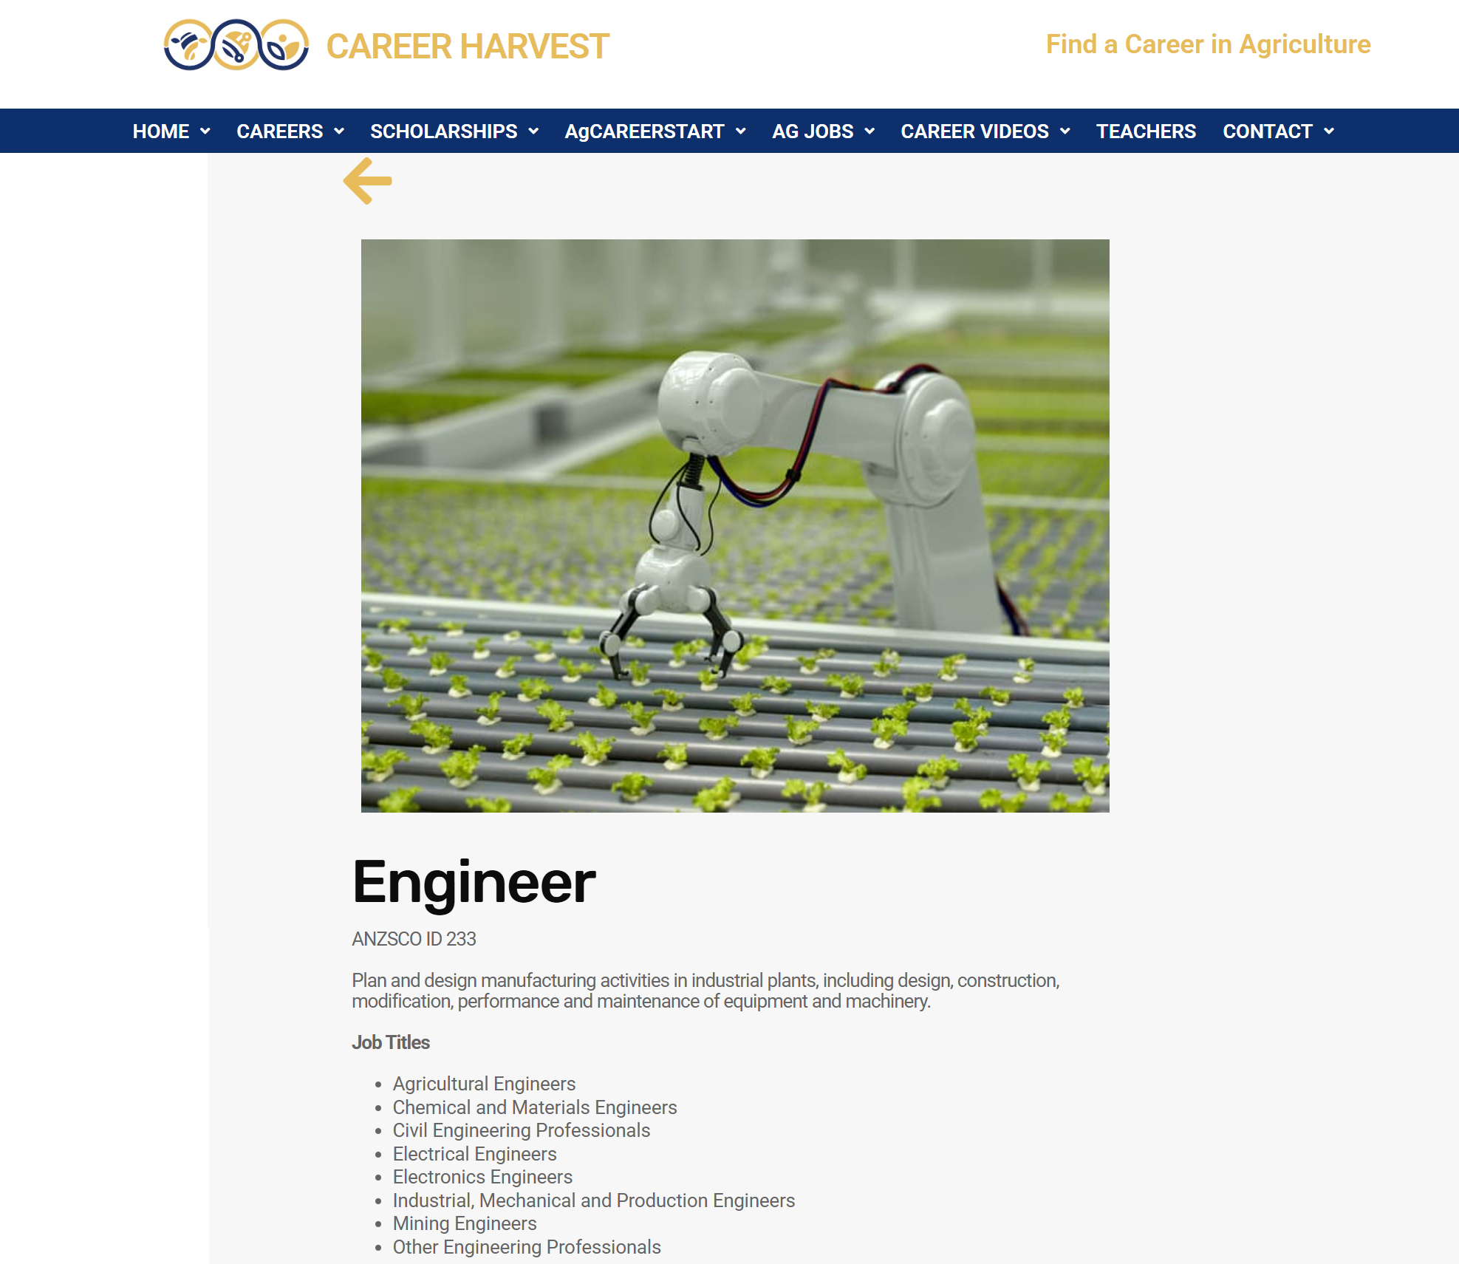
AgriTech STEM Careers
Use the website career harvest to help find more information about agriculture careers that may be affected or created in AgriTech.
Screenshot from Career harvest website.
Notes:
Teacher note:
Reflect on career lists from the previous lesson. Identify pathways into these careers and create notes for future reflection.
Engage with or explore job profiles located in the ‘Careers with STEM’ https://education.nsw.gov.au/teaching-and-learning/curriculum/stem/stem-curriculum-resources/careers-with-stem webpage magazines and job kits.
Reflect on and build upon career pathways from previous lessons.
Explore possible study and career pathways and the skills that may be required to engage in the industry.
Model the reflective process to assist students (see AGT PPT 5).
Assist students with vocabulary and technical terms e.g. tertiary, undergraduate, Bachelor, Masters, diploma etc.

Slide 42
Identify careers
Career | Information
Agronomist
Agricultural scientist
Horticulturalist
Irrigation specialist
Entomologist
Drone pilot
Notes:
Teacher note: Use this table as an example template for collecting responses from the discussion and sharing – when sharing with students, ask students to consider one or two careers they may be interested in researching further.

Slide 43
Agricultural career
Example
Choose one AgriTech (or related) career and research the pathway/s into that career.
Outline the career and career pathway.
(Example) Biotechnologist: Biotechnologists study the genetic, chemical and physical attributes of cells, tissues and organisms and identify, create or improve industrial or agricultural uses for them. A study pathway into this is usually a Bachelor of Science with majors in Life Science, Molecular Biology or Biotechnology. A bachelor degree is usually a 3-4 year fulltime tertiary course at a university.
43
Notes:
Teacher note: Use this activity to build career pathway awareness in students. Work through this (or another) example response or joint construction. Move on to student construction with prompts when appropriate.
Explain undergraduate and graduate degrees as well as tertiary pathways in TAFE and university.

Slide 44
10.3 Careers in STEM and AgriTech
Learning intentions and success criteria
We are learning about:
current and future AgriTech careers
We can:
give examples of potential AgriTech careers.
gather career information from different sources.
Notes:
Notes for teachers:
Adapt the learning intention as required and add matching success criteria.
For more information see ⁠NSW Department of Education explicit teaching strategies https://education.nsw.gov.au/teaching-and-learning/curriculum/explicit-teaching.
LISC is not necessarily presented at the beginning of the lesson. Teacher needs to consider most effectual time to introduce.
LISC should be revisited during the lesson to support students' evaluation of their learning.

Slide 45
AgriTech careers
Review agricultural challenges
Can you remember some agriculture careers that you researched last lesson?
Which ones were you most interested in?
Notes:
Teacher notes: Briefly review agricultural careers from the previous lesson.
Check for recall example
We had a range of careers from robotic engineering through to entomology. Which ones did you find interesting?

Slide 46

STEM Careers
Use the website Careers with STEM to find more information about agriculture careers or STEM careers you may be interested in.
Use search tools to find out more information about careers that may interest you.
Screenshot from Careers with STEM engineering 2023 magazine
Notes:
Teacher note: Reflect on career lists from the previous lesson. Identify pathways into these careers and create notes for future reflection.
Engage with or explore job profiles located in the Careers with STEM webpage - magazines and job kits.
Reflect on and build upon career pathways from previous lessons.
Explore possible study and career pathways and the skills that may be required to engage in the industry.
Use a think- pair- share template or similar, to capture ideas and prepare for sharing. View the example reflection in the following template and use the following template to capture information.

Slide 47
Think-Pair-Share careers
Think
Individual research time
Pair
Share your thoughts with a partner
Share
Share with a larger group or class
Notes:
Use a think pair share activity to capture and share research information.
Students could also use mini whiteboards or large classroom boards to outline careers and pathways.

Slide 48
Think-Pair-Share career example
Think
Individual research time
Pair
Share your thoughts with a partner
Share
Share with a larger group or class
For example:
When reading the Careers with STEM 2023 engineering magazine I found out that there seems to be quite a few scholarships available for engineering degrees. I am interested in finding out more about these.
When I investigated this, I found that many universities have scholarships for Bachelor of engineering degrees.
Notes:
This is an example of how researching through magazines and the internet could influence the documentation of an internet search. Students could share information with a peer and then the class and the teacher could explain concepts regarding careers that may arise. Consider collaborating with and inviting the school careers advisor into this lesson or create a collection of class questions that the careers adviser (or another adviser) may be able to support in answering.

Slide 49
References
Outcomes referred to in this document are from the iSTEM course document © NSW Department of Education for and on behalf of the Crown in the State of New South Wales (2025).
Cover image: 'Aerial image of pivot irrigation crop' screenshot from SIX MAPS from the State of New South Wales (Department of Customer Services, Spatial Services).
Career Harvest (2024) Careers in agriculture, Career Harvest website, accessed 28 May 2024.
Deadly Story (2024) Food and Agriculture, Deadly Story website, accessed 28 May 2024.
Inter-American Development Bank (29 November 2017) ‘What is precision agriculture?’ [video], Inter-American Development Bank, YouTube, accessed 28 May 2024.
Maryland Farm & Harvest (9 January 2020) ‘Monitoring crop health with drones’ [video], Maryland Farm & Harvest, YouTube, accessed 20 January 2025).
PostHarvest Technololgies (17 August 2021) ‘What is precision agriculture?’ [video], PostHarvest Technologies, YouTube, accessed 28 May 2024.

Slide 50
Copyright
© State of New South Wales (Department of Education), 2026
The copyright material published in this resource is subject to the Copyright Act 1968 (Cth) and is owned by the NSW Department of Education or, where indicated, by a party other than the NSW Department of Education (third-party material).
Copyright material available in this resource and owned by the NSW Department of Education is licensed under a Creative Commons Attribution 4.0 International (CC BY 4.0) licence.
This licence allows you to share and adapt the material for any purpose, even commercially.
Attribution should be given to © State of New South Wales (Department of Education), 2026.
Material in this resource not available under a Creative Commons licence:
the NSW Department of Education logo, other logos and trademark-protected material
Material owned by a third party that has been reproduced with permission. You will need to obtain permission from the third party to reuse its material.
Links to third-party material and websites
Please note that the provided (reading/viewing material/list/links/texts) are a suggestion only and implies no endorsement, by the New South Wales Department of Education, of any author, publisher, or book title. School principals and teachers are best placed to assess the suitability of resources that would complement the curriculum and reflect the needs and interests of their students.
If you use the links provided in this document to access a third party’s website, you acknowledge that the terms of use, including licence terms set out on the third-party’s website apply to the use which may be made of the materials on that third-party website or where permitted by the Copyright Act 1968 (Cth). The department accepts no responsibility for content on third-party websites.

