Slide 1
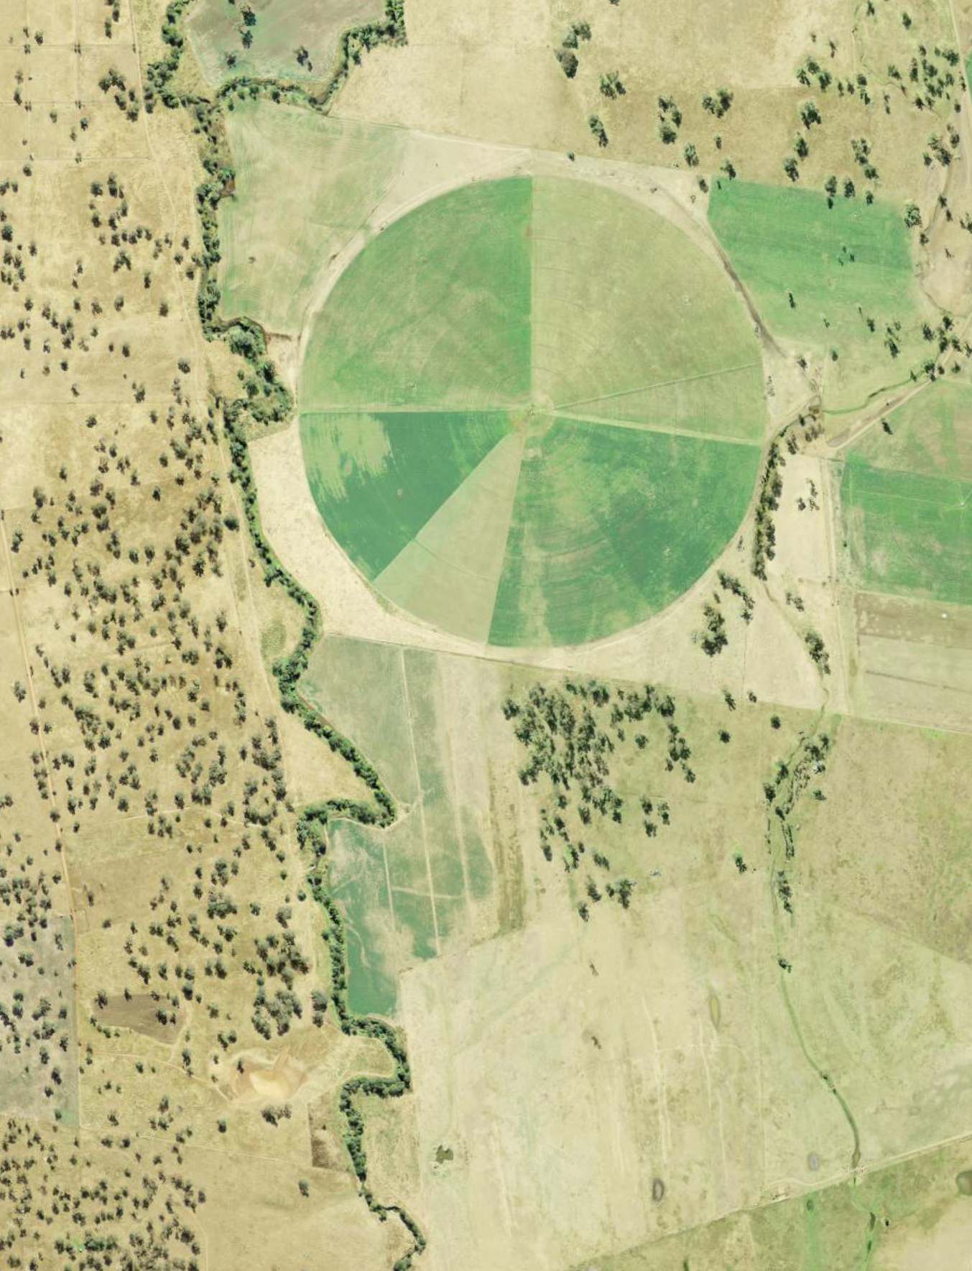
iSTEM AgriTech
Stage 5
Week 7 and 8
Resource: AGT PPT4

Slide 2
Instructions for use
This resource has been created to provide additional support for teachers and students in the delivery of the iSTEM AgriTech program of learning.
Week 7 and 8 of this AgriTech learning sequence involves students evaluating and iterating their designs. Student designs will vary. Assess this document within the context of your school and class and adjust where appropriate.
Delivery instructions and comments are provided in the notes section of the document.
Notes:
To convert the PowerPoint into Google Slides:
Upload the file into Google Drive and open it.
Go to File > Save as Google Slides.

Slide 3
Week 7 and 8 lessons
7.1
8.1
Data logging
Evaluate and iterate
7.2
8.2
Testing
Iterate
7.3
8.3
Analysing data
Communicate
Notes:
Teacher notes:
Click lesson numbers to go to specific lessons
Interactive features can be viewed in slide show

Slide 4

7.1 Data logging
Learning intentions and success criteria
We are learning to:
use a coding environment, microcontrollers and sensors to collect and manage data.
We can:
use a coding environment, microcontrollers and sensors to collect and manage data such as temperature or humidity.
Notes:
Notes for teachers:
Adapt the learning intention as required and add matching success criteria.
For more information see ⁠NSW Department of Education explicit teaching strategies https://education.nsw.gov.au/teaching-and-learning/curriculum/explicit-teaching.
LISC is not necessarily presented at the beginning of the lesson. Teacher needs to consider most effectual time to introduce.
LISC should be revisited during the lesson to support students' evaluation of their learning.

Slide 5
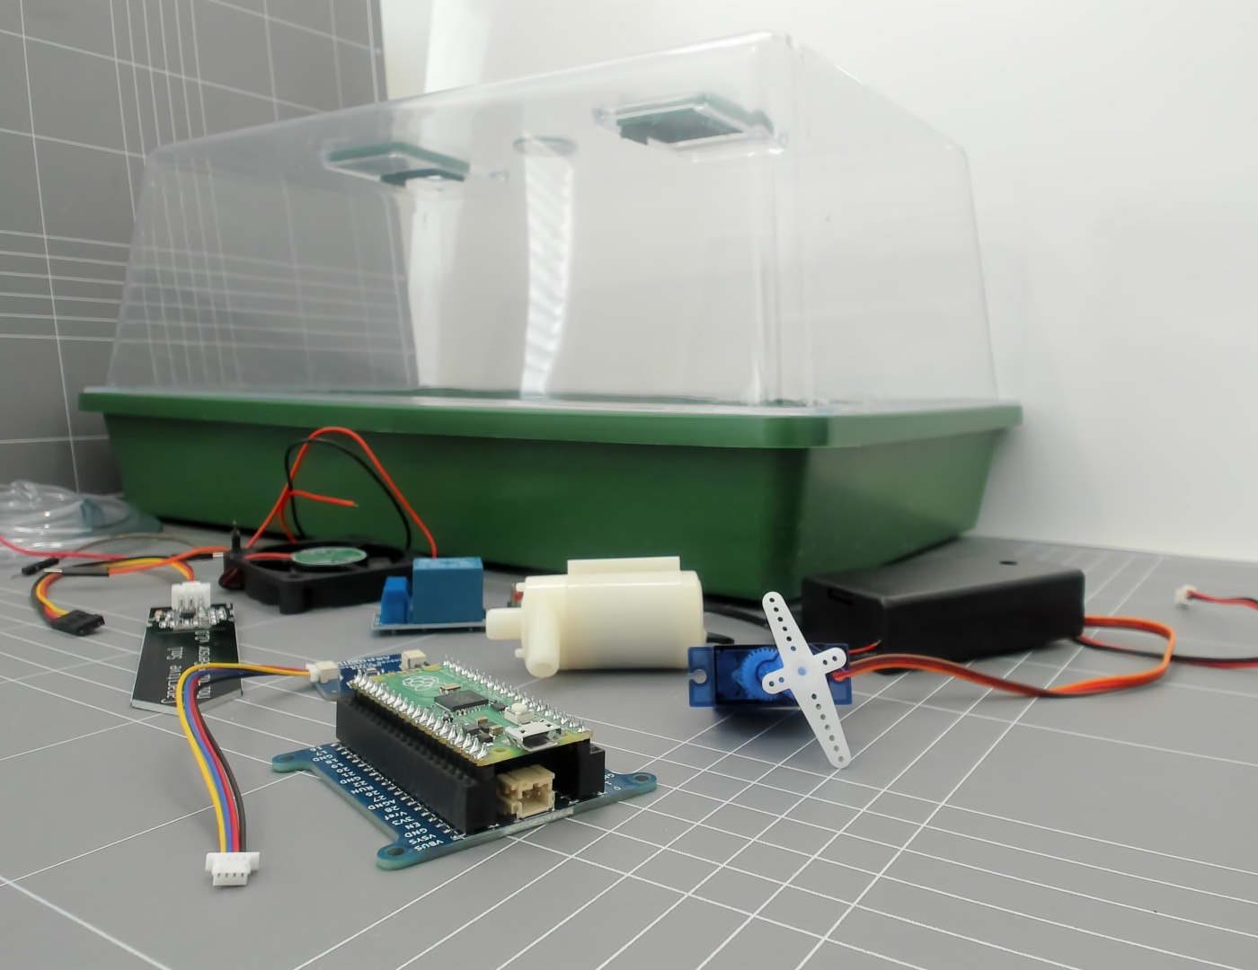
Smart greenhouse
Review design brief
Greenhouses are used in agriculture to increase productivity by managing environmental factors.
Our design brief is to create smart desktop greenhouse that can help manage temperature and other growth conditions.
Notes:
Teacher notes: Review design brief and constraints from Week 2 lesson 3 – Highlight the part regarding ‘managing temperature’. Explore with students what this may mean for temperature over the course of the day.
Change design brief, image to suit your context.

Slide 6
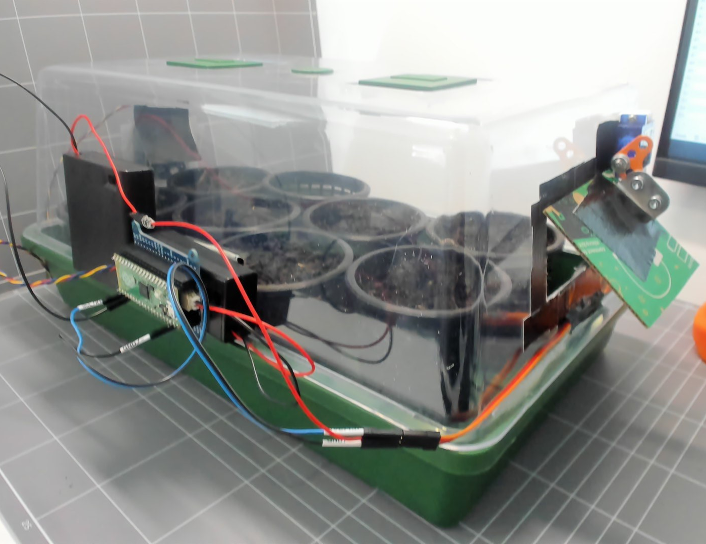
Example design solution
This smart greenhouse has a small vent on one side that opens when the internal temperature exceeds 25˚C. A 9g Microservo moves the vent.
An atmospheric sensor is located inside the greenhouse, on the opposite side of the vent.
A microcontroller is attached to the side of the greenhouse.
Notes:
Review a design that you or your students built – an example is provided throughout this slide deck to model an approach you can take in these lessons.
In this example a smart feature has been retrofitted to an existing greenhouse. Students could use a similar box or 4L recycled bottle for the same effect. Or builds could be very different.

Slide 7
Test and evaluate our design solution
How do we know our smart features manage the temperature in the greenhouse?
How do we know that our smart greenhouse works?
Does the smart greenhouse manage conditions more than a normal greenhouse? Or does our smart greenhouse manage conditions better than no greenhouse?
We can test that the vent opens and closes at different temperatures. However, how do we know that this vent helps manage the temperature?
Notes:
Explain to the class that they will be creating a method to collect internal and external temperature data.

Slide 8
How can we record temperature?
We have a sensor inside the smart greenhouse.
How do we record this data?
Data logging
Notes:
Explain to students that the microcontroller can be used to record temperature at any time interval they choose. Segway into the next slide which will be instructions for logging data.
Students may be collecting temperature, humidity, light intensity, moisture, Carbon dioxide levels or other factor.

Slide 9
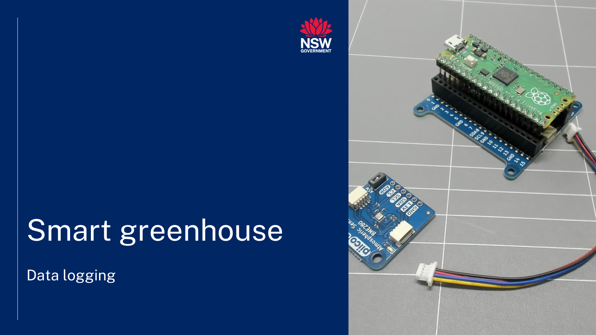

Data logging video
Notes:
Teacher notes:
This video illustrates the following slides. Please view the video as an introduction to the lesson, or play and pause the video and ask students to work at the same time.

Slide 10
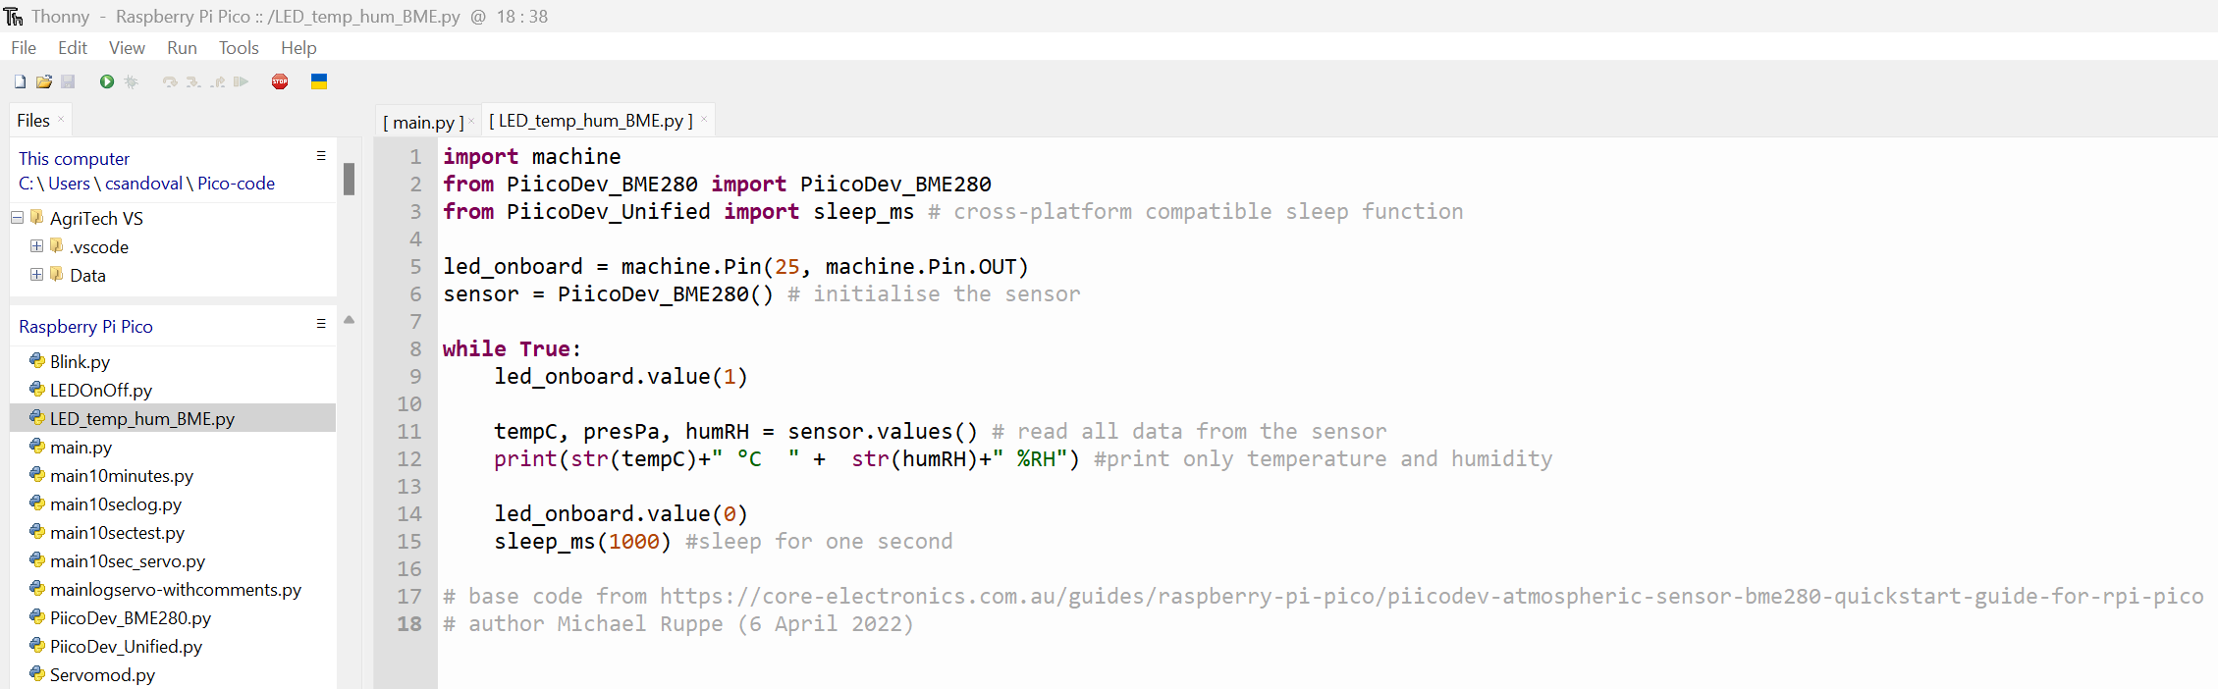
Create a data file
Previous atmospheric sensor code
Screenshot of Thonny from Thonny.org
Notes:
Revise previous basic sensor code. Check for student understanding by asking questions such as:
Look at Line 9: led_onboard.value(1), what does this line do to the onboard LED?

Slide 11
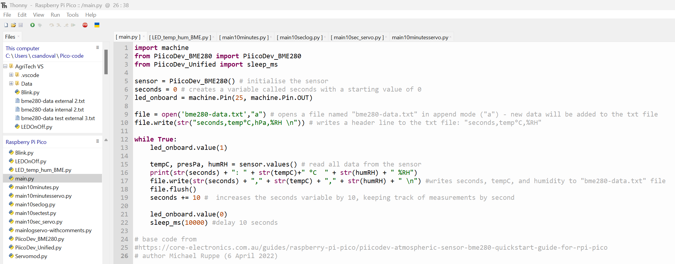
Create a data file – code change
Capturing atmospheric sensor measurements
Screenshot of Thonny from Thonny.org
Notes:
Create changes to previous code. Identify and explain changes to previous file, for example:
seconds = 0 # initialise a variable called seconds with a value of 0
file = open('bme280-data.txt',"a") # opens a file named "bme280-data.txt" in append mode ("a") - new data will be added to the end of the file without overwriting existing content. Identify that if the file is not open then append will open this file.
file.write(str("seconds,temp°C,%RH \n")) # writes a header line to the file containing the labels for the data: "seconds,temp°C,%RH"
file.write(str(seconds) + "," + str(tempC) + "," + str(humRH) + " \n") #writes seconds, temperature, and humidity to the "bme280-data.txt" file, separating values with commas
file.flush() # data written to the file is saved to disk
seconds += 10 # increases the seconds variable by 10

Slide 12
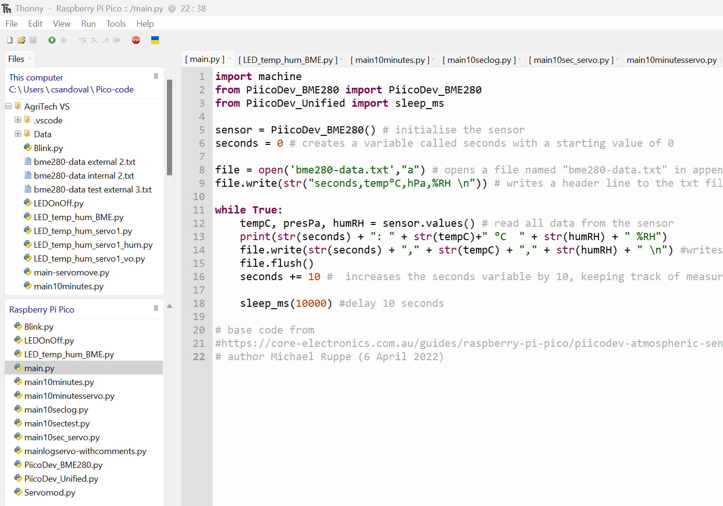
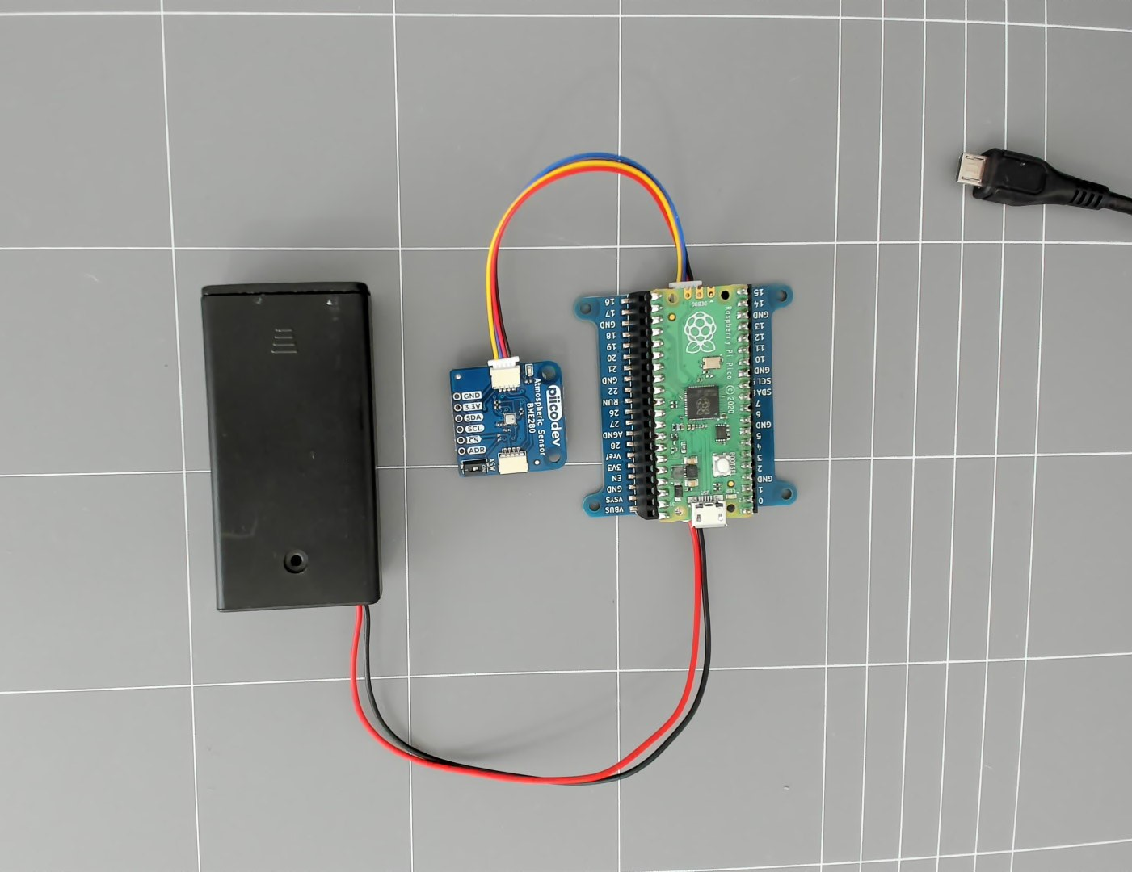
Testing untethered data logger
Notes:
Test the data logger while untethered by connecting to a battery pack.

Slide 13
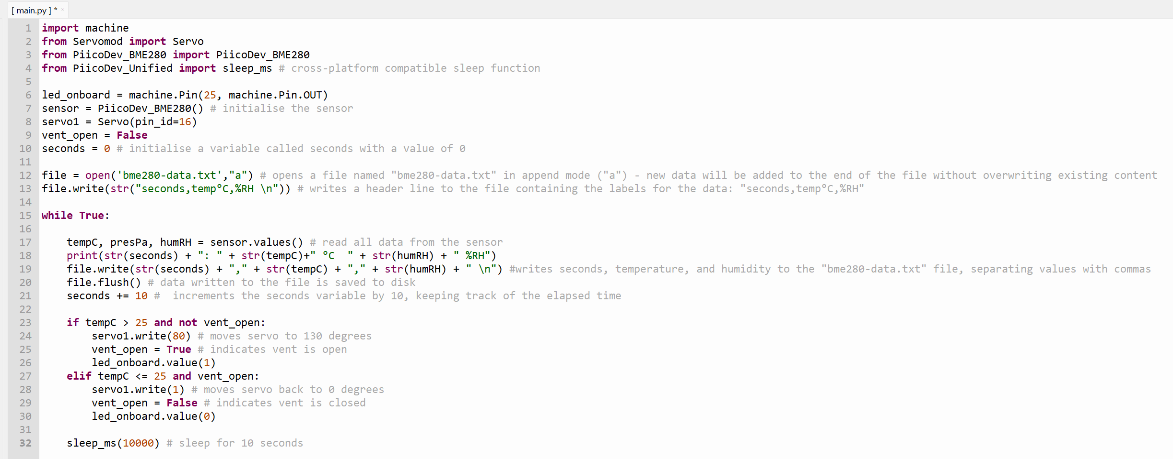
Combine data file with greenhouse function
Notes:
Ask students to change their functional greenhouse file by including the data logging steps previously used. Identify and explain changes to previous file.
seconds = 0 # initialise a variable called seconds with a value of 0
file = open('bme280-data.txt',"a") # opens a file named "bme280-data.txt" in append mode ("a") - new data will be added to the end of the file without overwriting existing content
file.write(str("seconds,temp°C,%RH \n")) # writes a header line to the file containing the labels for the data: "seconds,temp°C,%RH"
file.write(str(seconds) + "," + str(tempC) + "," + str(humRH) + " \n") #writes seconds, temperature, and humidity to the "bme280-data.txt" file, separating values with commas
file.flush() # data written to the file is saved to disk
seconds += 10 # increases the seconds variable by 10

Slide 14
Change 10 seconds to 10 minutes
Change 10 seconds to 10 minutes
Maybe we want to run our loop every 10 minutes instead of every 10 seconds.
What lines would we need to change?
How many milliseconds are in one second?
How many seconds are in 10 minutes?
60 seconds = 1 minute
Notes:
Check for understanding regarding the sleep function.
Work through this problem with students, demonstrating changes along the way to create a code adaptation.

Slide 15
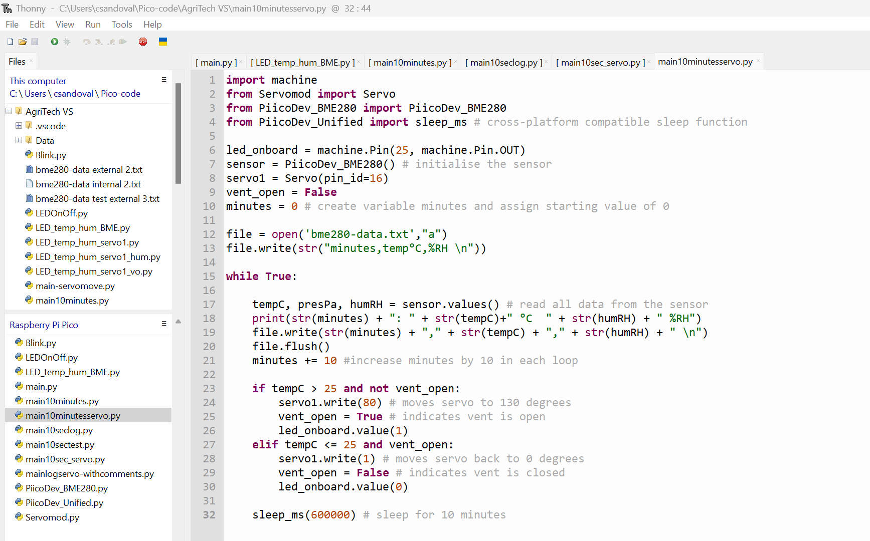
Time change - 10 seconds to 10 minutes
Notes:
Check for understanding answer.
Work through this problem with students, demonstrating changes along the way to create a code adaptation

Slide 16
Using the data loggers
How do we know our smart features manage the temperature in the greenhouse?
We have created a smart greenhouse.
We know how to record atmospheric measurements.
Where could we place a sensor to record internal data?
Where could we place a sensor to record external data?
Notes:
Preview next lesson. Explain to the class that they will be creating a method to use their data logging skills to collect internal and external temperature data or record data relevant to their build. This segways into the reflection exit ticket as it provides a link to: How will I use what I learnt?

Slide 17
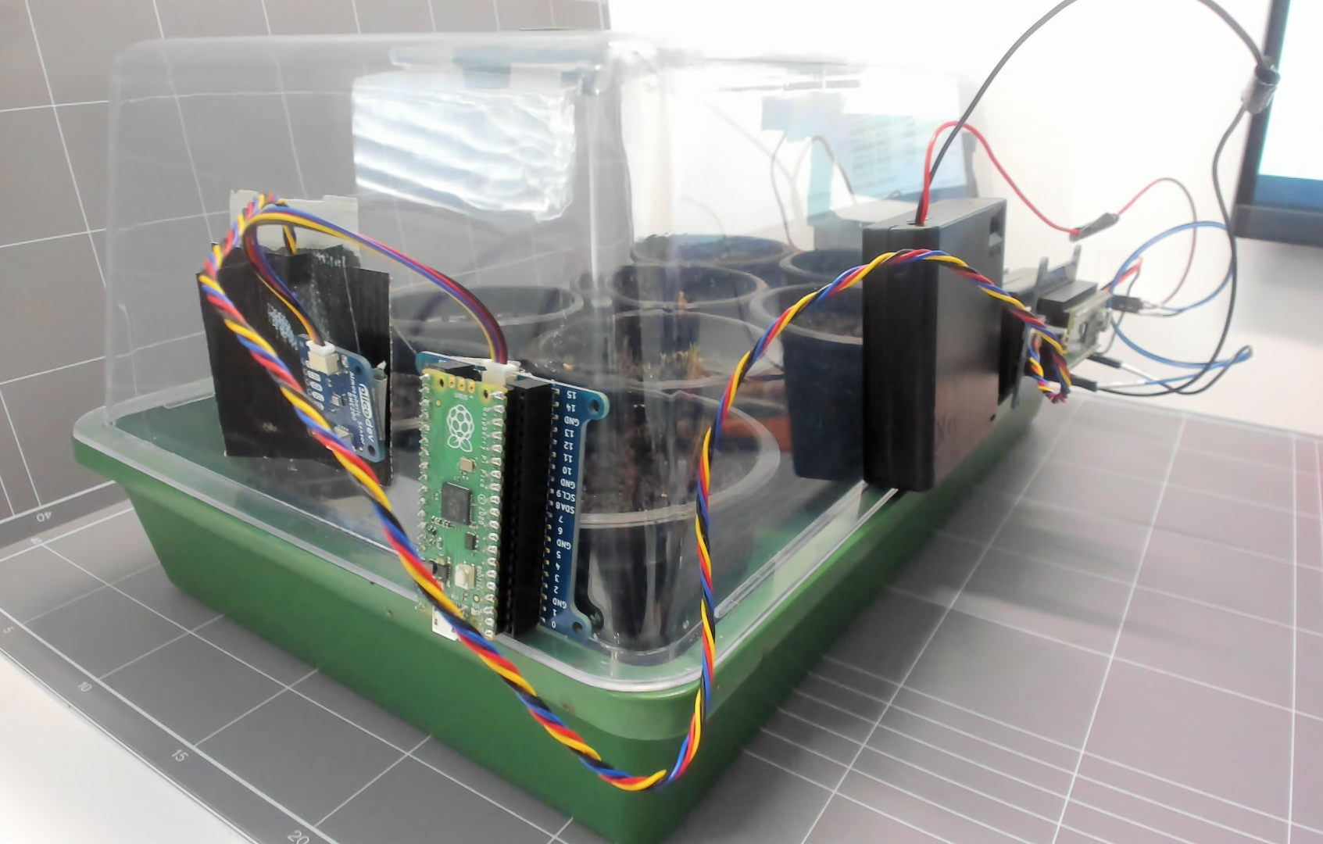
Example data logger setup
Microcontroller with sensor located inside greenhouse.
Using code that combines sensor, servo and data logging.
Microcontroller with sensor located outside greenhouse.
Using simple data logger code for atmospheric sensor.
Notes:
This is an example design solution using a prebuilt greenhouse for demonstrative purposes. Teachers could use a similar arrangement to demonstrate the collection of data.

Slide 18


Reflection
What did I learn today?
What connections have I made?
How will I use this knowledge?
Notes:
This slide can be used to facilitate student self-reflection or as an exit ticket for any lesson. Adapt step 3 to suit the lesson and your context.
Students should capture ideas in their logbooks or design folio.

Slide 19
7.2 Testing
Learning intentions and success criteria
We are learning to:
plan and communicate a valid test for gathering evaluation data
use a coding environment, microcontrollers and sensors to collect and manage data.
We can:
plan and communicate a test for collecting valid data to determine how effectively our greenhouse maintains growth conditions
use a coding environment, microcontrollers and sensors to collect and manage data.
Notes:
Notes for teachers:
Adapt the learning intention as required and add matching success criteria.
For more information see ⁠NSW Department of Education explicit teaching strategies https://education.nsw.gov.au/teaching-and-learning/curriculum/explicit-teaching.
LISC is not necessarily presented at the beginning of the lesson. Teacher needs to consider most effectual time to introduce.
LISC should be revisited during the lesson to support students' evaluation of their learning.

Slide 20
Smart greenhouse design brief
Review design brief
Greenhouses are used in agriculture to increase productivity by managing environmental factors.
Our design brief was to create a smart desktop greenhouse that can help manage temperature and other growth conditions.
Notes:
Teacher notes: Review design brief and constraints from Week 2 lesson 3 – Highlight the part regarding ‘managing temperature’. Explore with students what this may mean for temperature over the course of the day.
Change design brief, image to suit your context.

Slide 21
Using the data logger
How do we know our smart features manage the temperature in the greenhouse?
We have created a smart greenhouse.
We know how to record atmospheric measurements.
Now where could we place a sensor to record internal data?
Where could we place a sensor to record external data?
Notes:
Preview next lesson. Explain to the class that they will be creating a method to use their data logging skills to collect internal and external temperature data or record data relevant to their build.

Slide 22
Data logger setup
Microcontroller 2 with sensor located inside greenhouse.
Using code that combines sensor, servo and data logging.
Microcontroller 1 with sensor located outside greenhouse.
Using simple data logger code for atmospheric sensor.
Notes:
Teacher note: This design solution allows most components to be easily viewed and understood.
How could we improve this test? Maybe a shade structure for the external sensor.

Slide 23
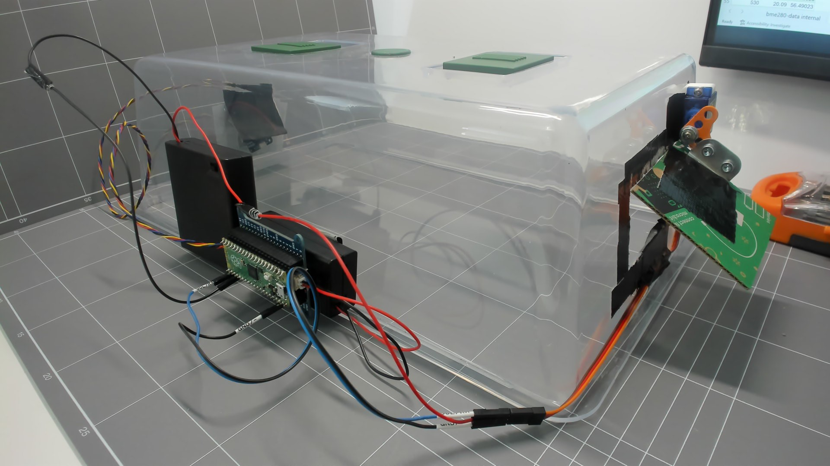
Internal sensor located under small structure to protect from direct sunlight.
Notes:
Teacher note: This design solution allows most components to be easily viewed and understood.

Slide 24
Fair testing
It is important to consider validity, accuracy and reliability when testing the smart greenhouse.
Will the test collect data that answers my evaluation question/s?
Where are the sensors located?
Notes:
Check for understanding: Will the method collect data that answers my question? For example, if students want to test the difference between temperature changes inside a greenhouse compared to outside a greenhouse. They should not put two sensors inside the greenhouse. One sensor should be outside and one sensor inside. However, it will be difficult to try and control conditions. How do you make sure the outside sensor is not in direct sunlight while the inside sensor is in shade or vice versa.

Slide 25
Accuracy
What tools or technology will I use to measure the temperature?
Will my measurements be accurate?
Are the sensors working?
Notes:
Consider the factors that could affect the sensors. For example, they can be affected by direct sunlight, airflow, excess humidity, and condensation. Consider these questions when using different sensors.

Slide 26
Reliability
If I repeat my test using the same steps will the results be the same?
Can I control external conditions?
For example:
Will shadows block light to both sensors?
Will a sensor be affected by wind flow or air conditioning?
How many sensors can be placed?
Notes:
Considering the nature of greenhouses, It may be difficult to control conditions and repeat the test. If a cloud creates a shadow will it affect all sensors, or will one be in the shade? Therefore, consider the frequency of measurements, or the number of sensors if possible.

Slide 27
Plan
Plan your evaluation test.
Clearly outline the test steps.
Plan:
Attach…
Place…
Switch…
Check…
Measure…
Record…
…
Notes:
Teacher notes: Students quickly document the idea for sensor placement and evaluation test.

Slide 28
Conduct test
Setup your test.
Monitor the test and location for a short period of time to verify the test is working.
Run your test for at least 24 hours.
Check that battery packs or sensors are on. Monitor any indicator lights or displays that are setup.
28
Notes:
Encourage students to check indicator lights or displays. If tethered to a computer monitor sensor readings. If untethered use indicator lights or displays (for example OLED display or Micro:bit LEDs)

Slide 29

7.3 Analysing data
Learning intentions and success criteria
We are learning to:
use a coding environment, microcontrollers and sensors to collect and manage data
analyse data using spreadsheet software
create, interpret and analyse graphical representations.
We can:
use a coding environment, microcontrollers and sensors to collect and manage data
use spreadsheet software to create, interpret and analyse data and graphical representations.
Notes:
Notes for teachers:
Adapt the learning intention as required and add matching success criteria.
For more information see ⁠NSW Department of Education explicit teaching strategies https://education.nsw.gov.au/teaching-and-learning/curriculum/explicit-teaching.
LISC is not necessarily presented at the beginning of the lesson. Teacher needs to consider most effectual time to introduce.
LISC should be revisited during the lesson to support students' evaluation of their learning.

Slide 30
Testing our design
Review
Consider the test you have implemented and use the evaluate key questions from the iSTEM engineering design process guide.
For example,
What type of results are you expecting?
Why are you expecting those results?
Capture your thoughts in your design folio or logbook.
Example
My greenhouse has a vent that should open when the greenhouse becomes too hot and closes as the greenhouse begins to cool down. I think that my results should show that the greenhouse does not become too hot during the day but remains warmer than the outside temperature during the night.
Notes:
Teacher notes: Review inquiry and test designs that students have setup and implemented.

Slide 31
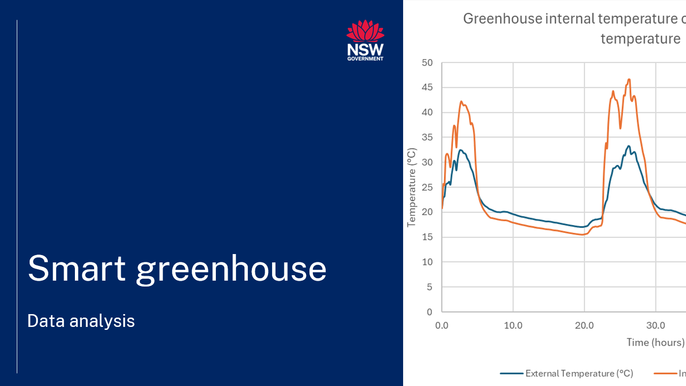
Data analysis videos
Notes:
This video illustrates the following slides. It is available on https://education.nsw.gov.au/teaching-and-learning/curriculum/stem/stem-curriculum-resources/stem-smart-greenhouse. Please view the video as an introduction to the lesson, or play and pause the video and ask students to work at the same time.

Slide 32
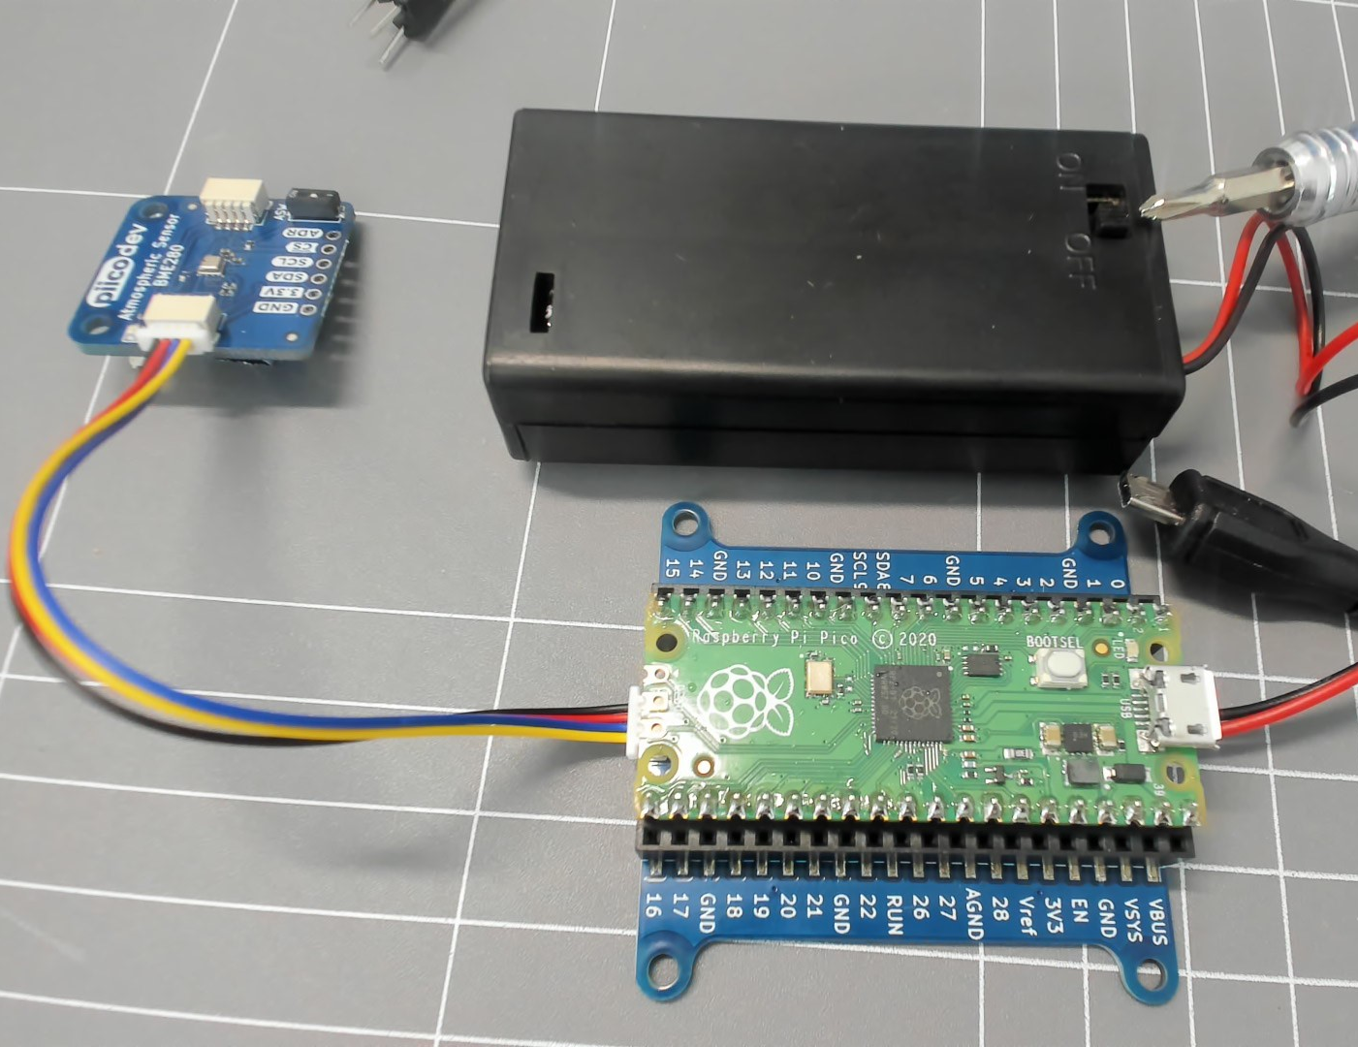
Power down test
Switch off the power packs connected to your test greenhouse and data collection microcontroller.
Microcontroller, battery pack and sensor.
Notes:
Teacher notes: Ask students to collect their microcontrollers and head back to their computers.

Slide 33
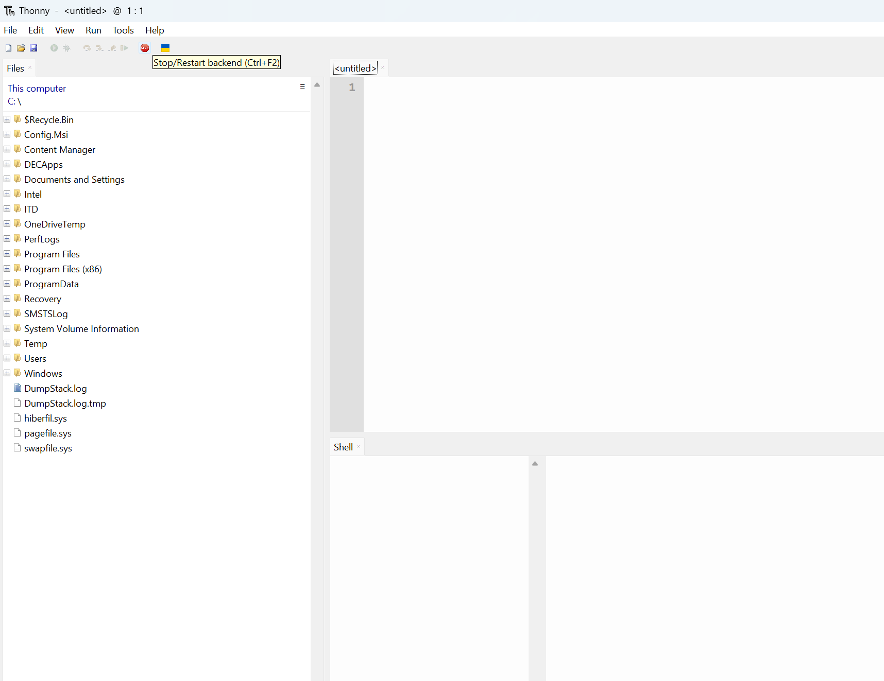
Connecting the microcontroller
Open Thonny.
Connect your microcontroller to your computer.
Left click ‘stop’ button. Note: when you connected your microcontroller to the computer it gained power from the connection and the ‘main.py’ file will have started to run. Selecting ‘stop’ will bring up the microcontroller window and stop the ‘main.py’ program.
Screenshot of Thonny from Thonny.org
Notes:
The following slides demonstrate the use of the Raspberry Pi Pico as a data logger and the downloading of a txt file. This sequence should be adjusted to suit the hardware and software used for your project.

Slide 34
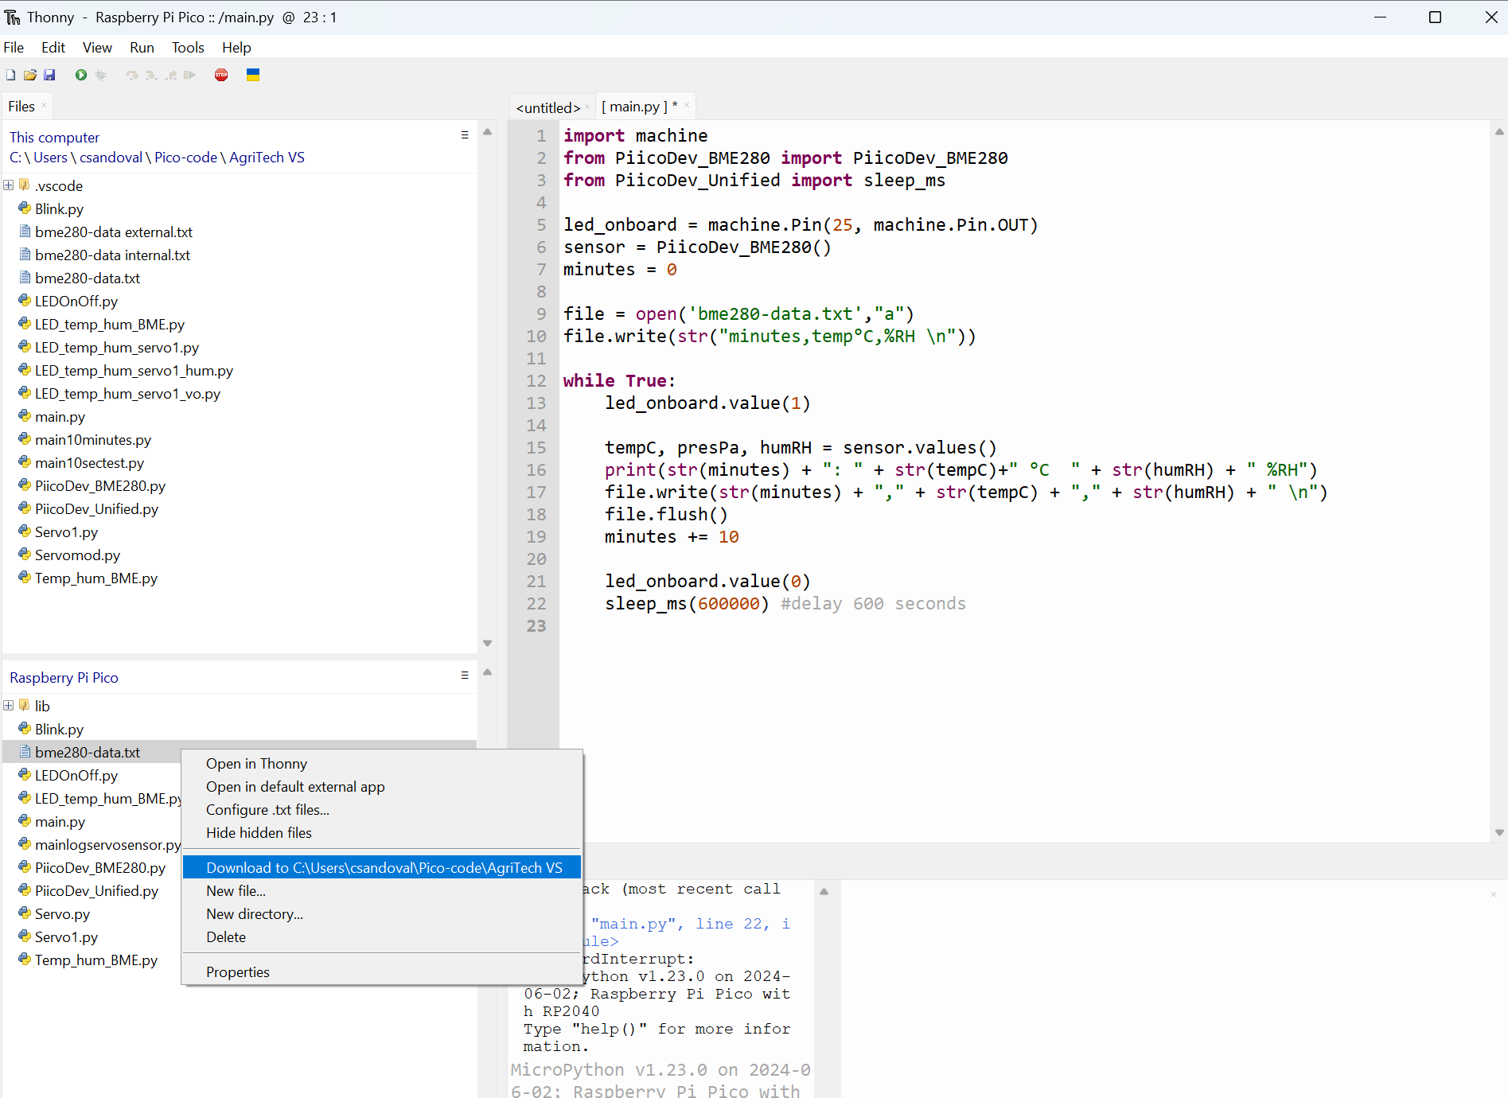
Download text file
Select the ‘data.txt’ file.
Right click ‘Download to’ and select the save location for your txt file.
Rename the file ‘data test external’.
Left click ‘run’ tab and choose ‘disconnect’ to disconnect the microcontroller.
Unplug the data collection microcontroller.
Screenshot of Thonny from Thonny.org
Notes:
Follow instructions on slide.
Ask students to check the work of a buddy, peer or team member. Give a thumbs up when the file is visible in the chosen computer folder.

Slide 35
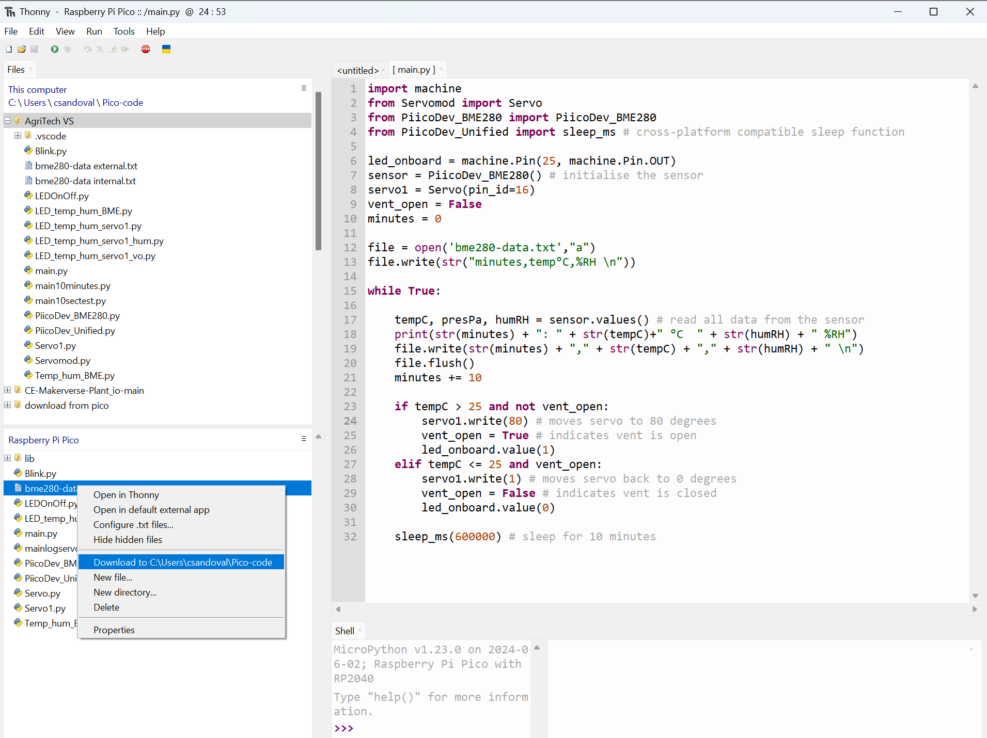
Repeat
Repeat this process with your greenhouse microcontroller. Connect the microcontroller to the computer and Thonny.
Right click the ‘data.txt’ file.
Select ‘Download to’ in the pop-up menu and select the save location for your text (.txt) file.
Rename the file ‘data test internal’.
Screenshot of Thonny from Thonny.org
Notes:
Follow instructions on slide.
Ask students to check the work of a buddy, peer or team member. Give a thumbs up when the file is visible in the chosen computer folder.

Slide 36
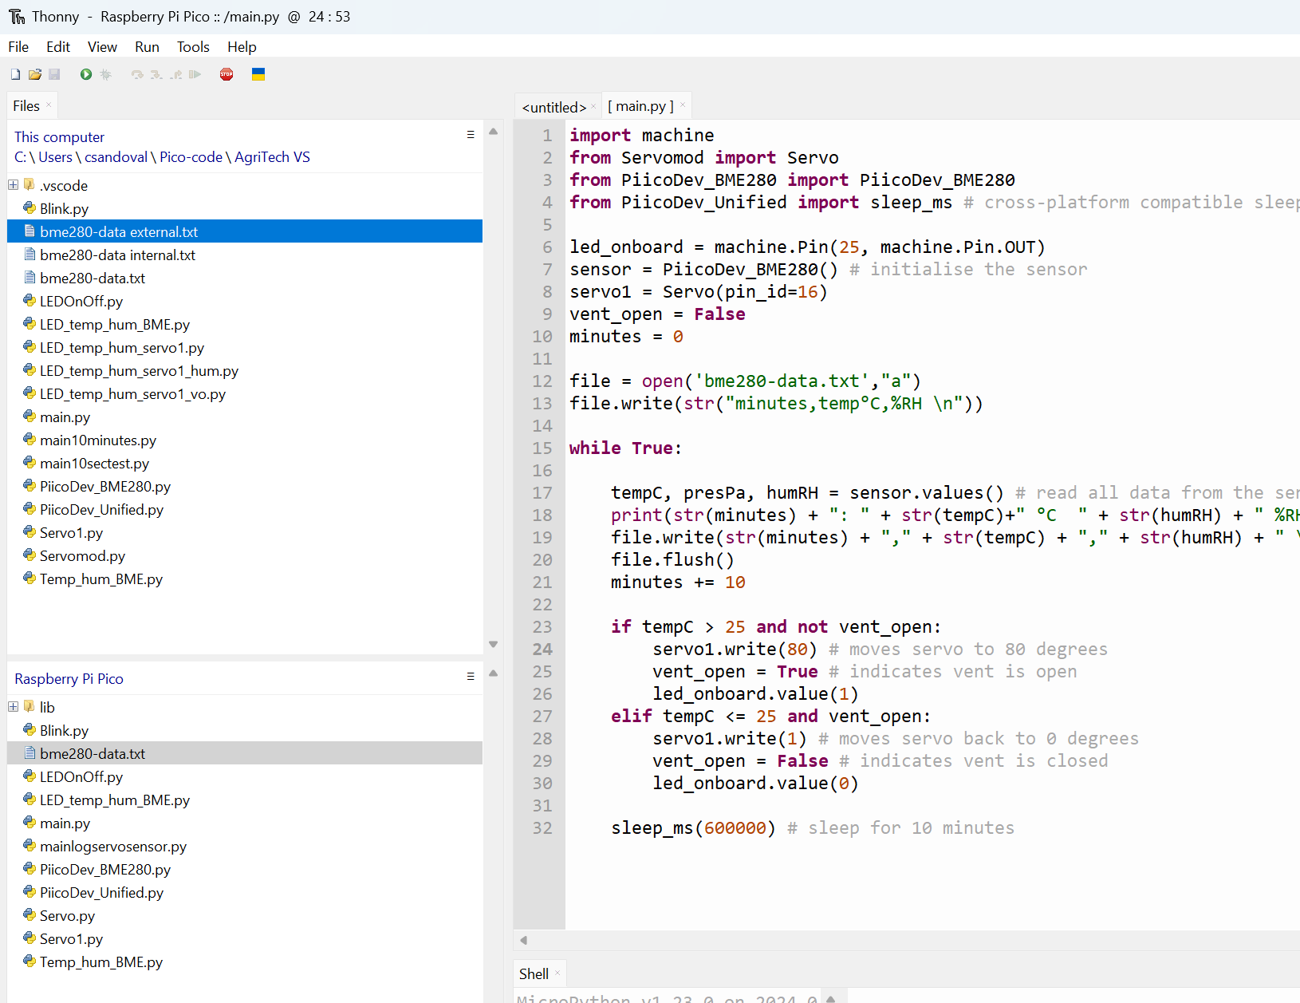
Verify files
Check that you have two .txt files located in an appropriate folder.
Screenshot of Thonny from Thonny.org
Notes:
Follow instructions on slide.
Ask students to check the work of a buddy, peer or team member. Give a thumbs up when the files are visible in the chosen computer folder.

Slide 37
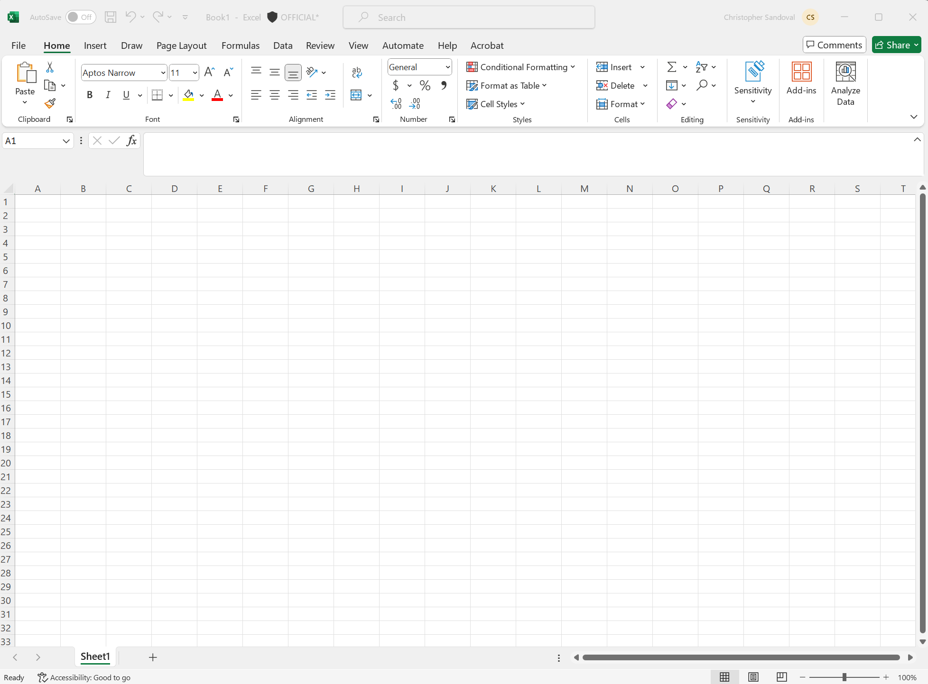
Spreadsheet
Microsoft Excel
Open Microsoft Excel.
Create a new blank workbook.
Name the workbook ‘AgriTech’.
Screenshot of worksheet from Microsoft Excel
Notes:
Teacher Notes: Microsoft Excel is the spreadsheet software used for this guide. Please adjust slides based on the software you will be using.

Slide 38
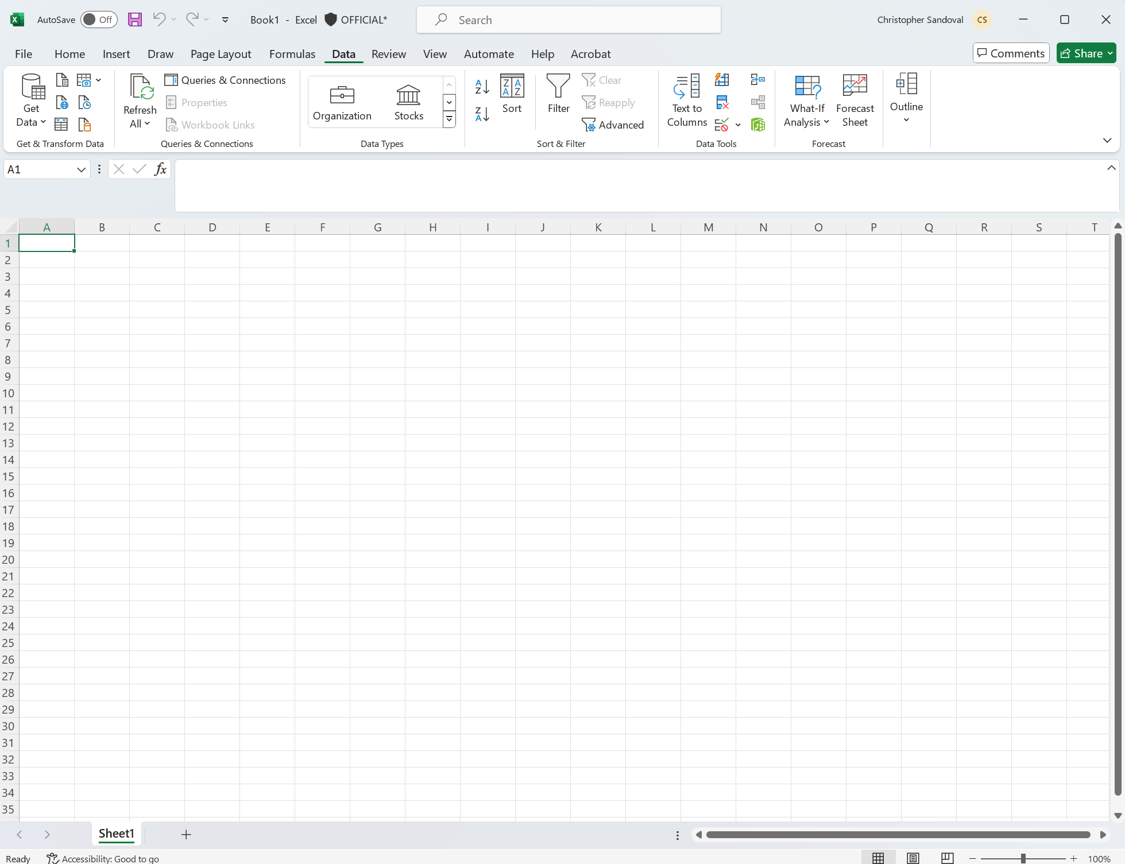
Data
Microsoft Excel
Select the ‘Data’ tab.
Screenshot of worksheet from Microsoft Excel
Notes:
Teacher Notes: Microsoft Excel is the spreadsheet software used for this guide. Please adjust slides based on the software you will be using.

Slide 39
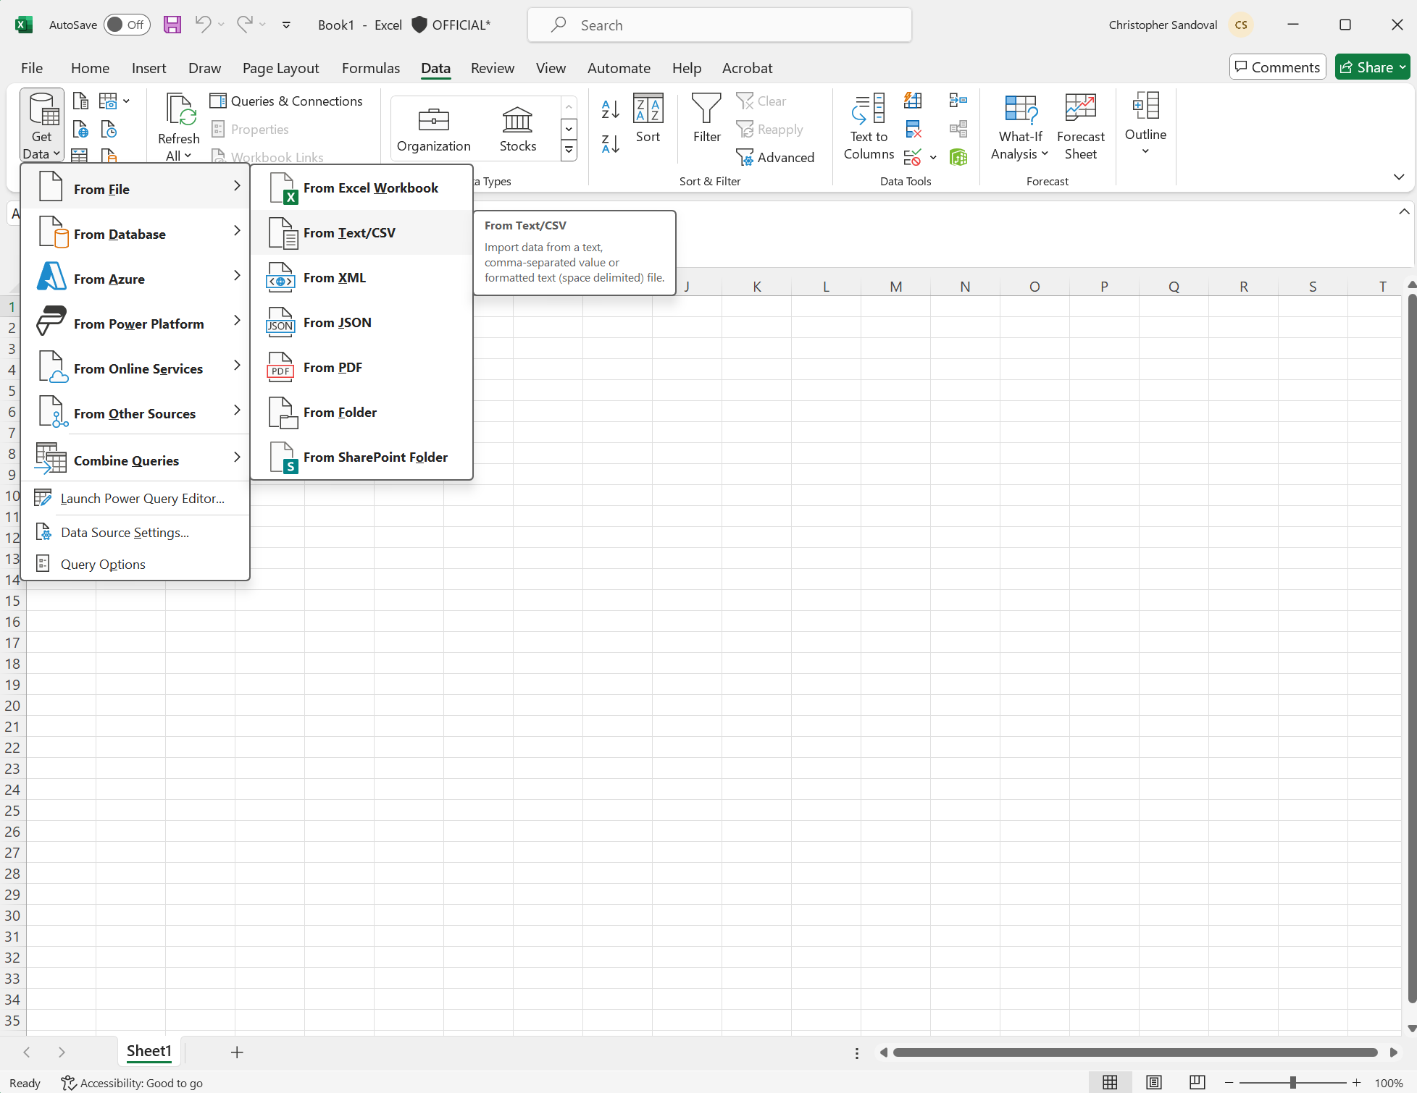
Get data
Microsoft Excel
Under the ‘Data’ tab select ‘Get Data’.
Then hover over ‘From File’ and select ‘From Text/CSV’.
Screenshot of worksheet from Microsoft Excel
Notes:
Teacher Notes: Microsoft Excel is the spreadsheet software used for this guide. Please adjust slides based on the software you will be using.

Slide 40
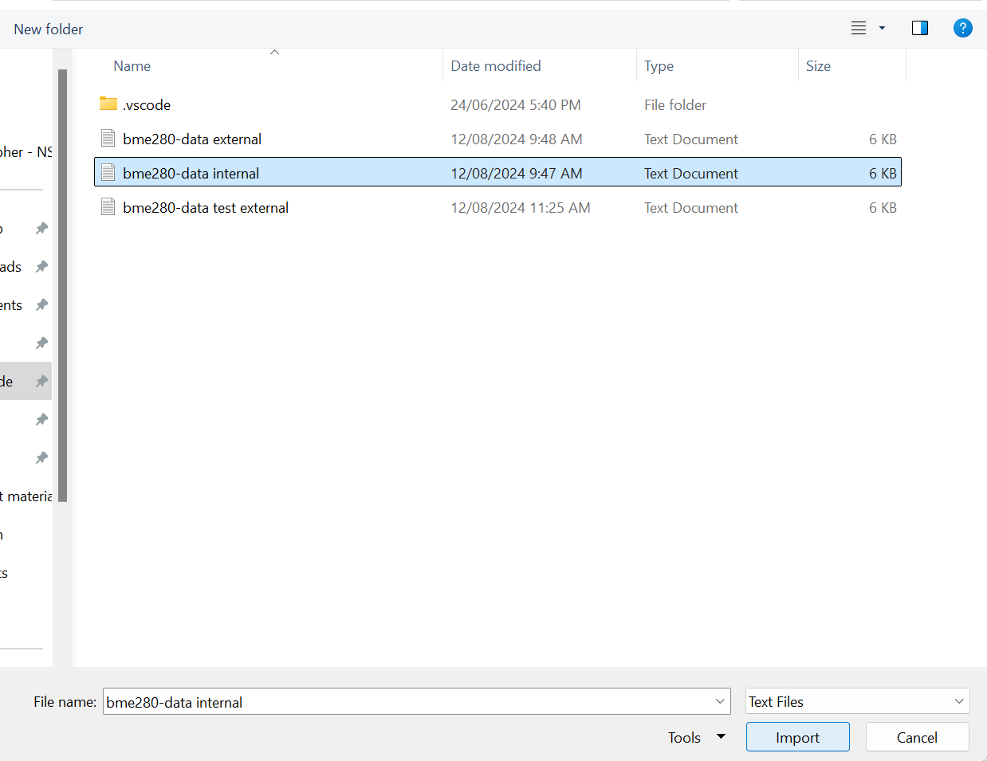
Import data
In the pop-up menu select the .txt files that you have and left click ‘Import’ button.
Screenshot of worksheet from Microsoft Excel
Notes:
Follow instructions on slide.

Slide 41
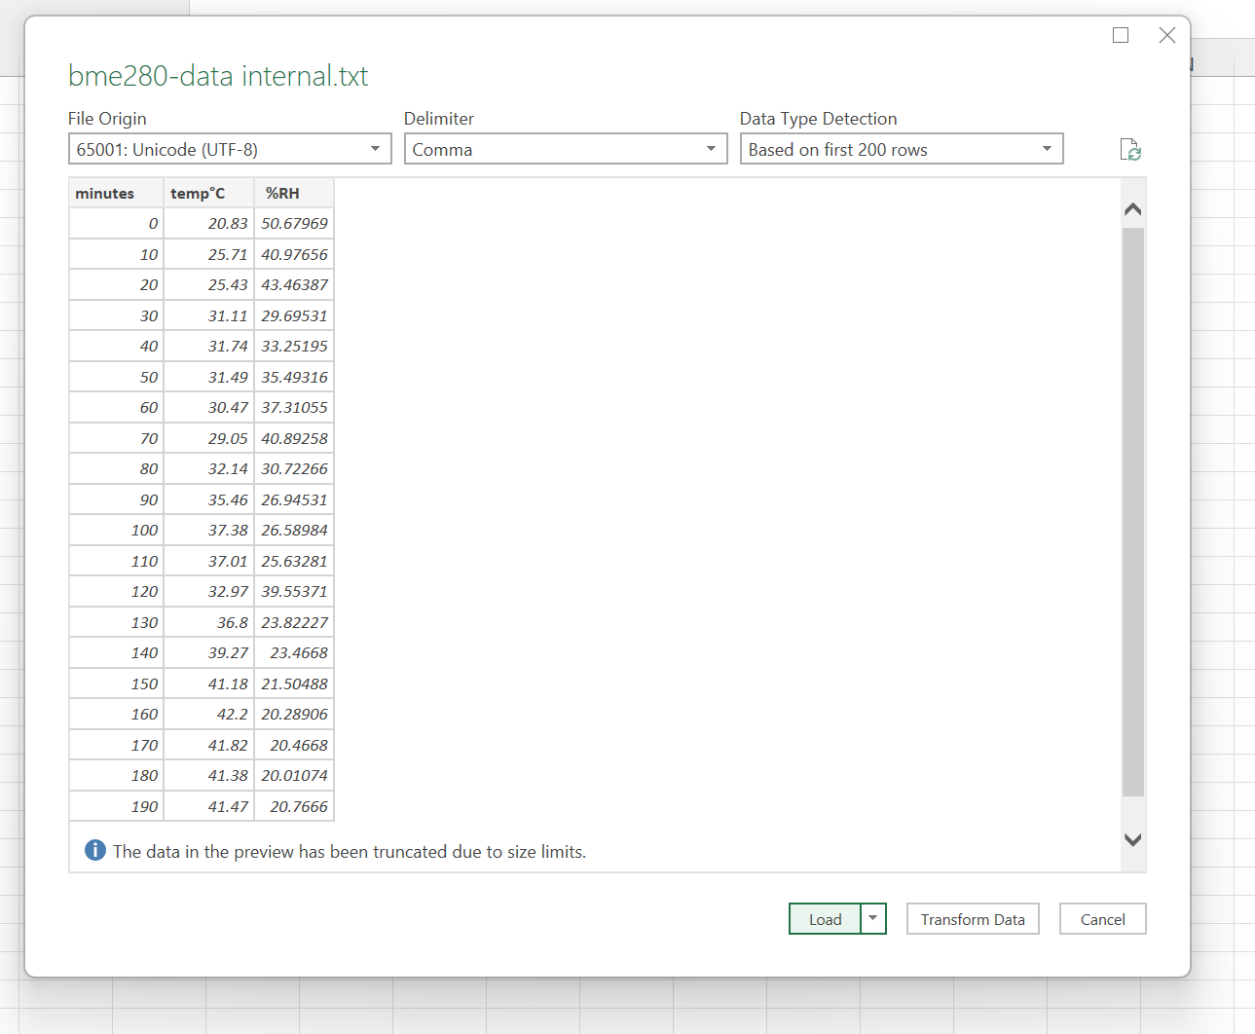
Load data
The program may process the request for a minute and will produce another pop-up.
View the screenshot and match drop-down menu selections.
Left click ‘Load’ button.
Screenshot of worksheet from Microsoft Excel
Notes:
Follow instructions on slide.

Slide 42
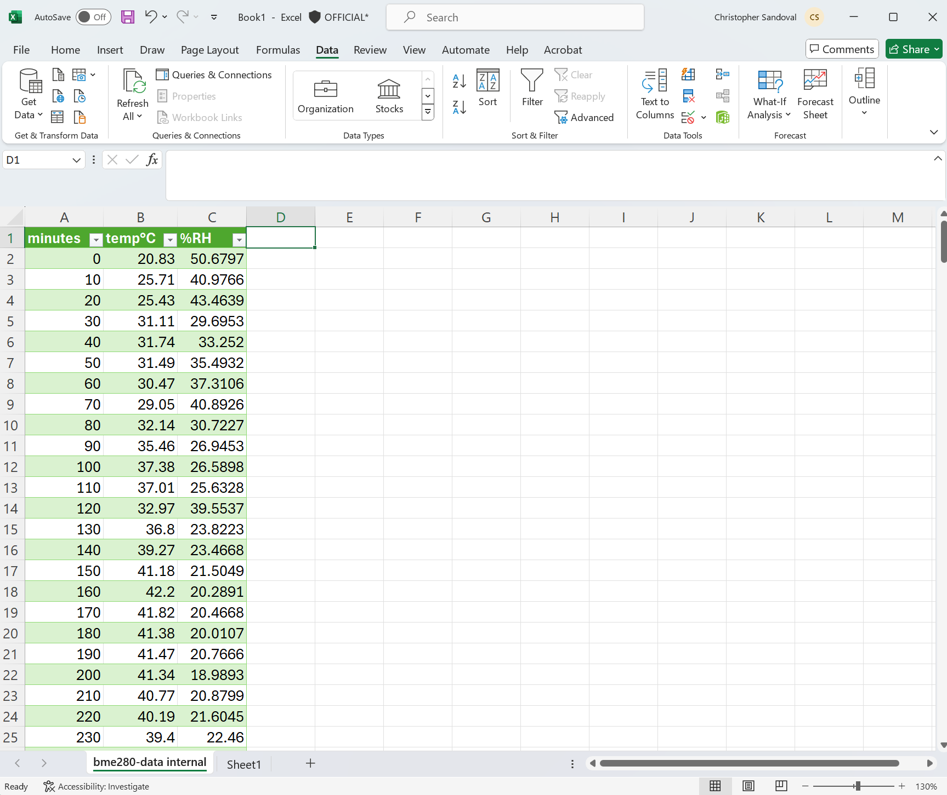
Data upload
You will see the data that was written into the text file on your microcontroller.
Screenshot of worksheet from Microsoft Excel
Notes:
Follow instructions on slide.

Slide 43
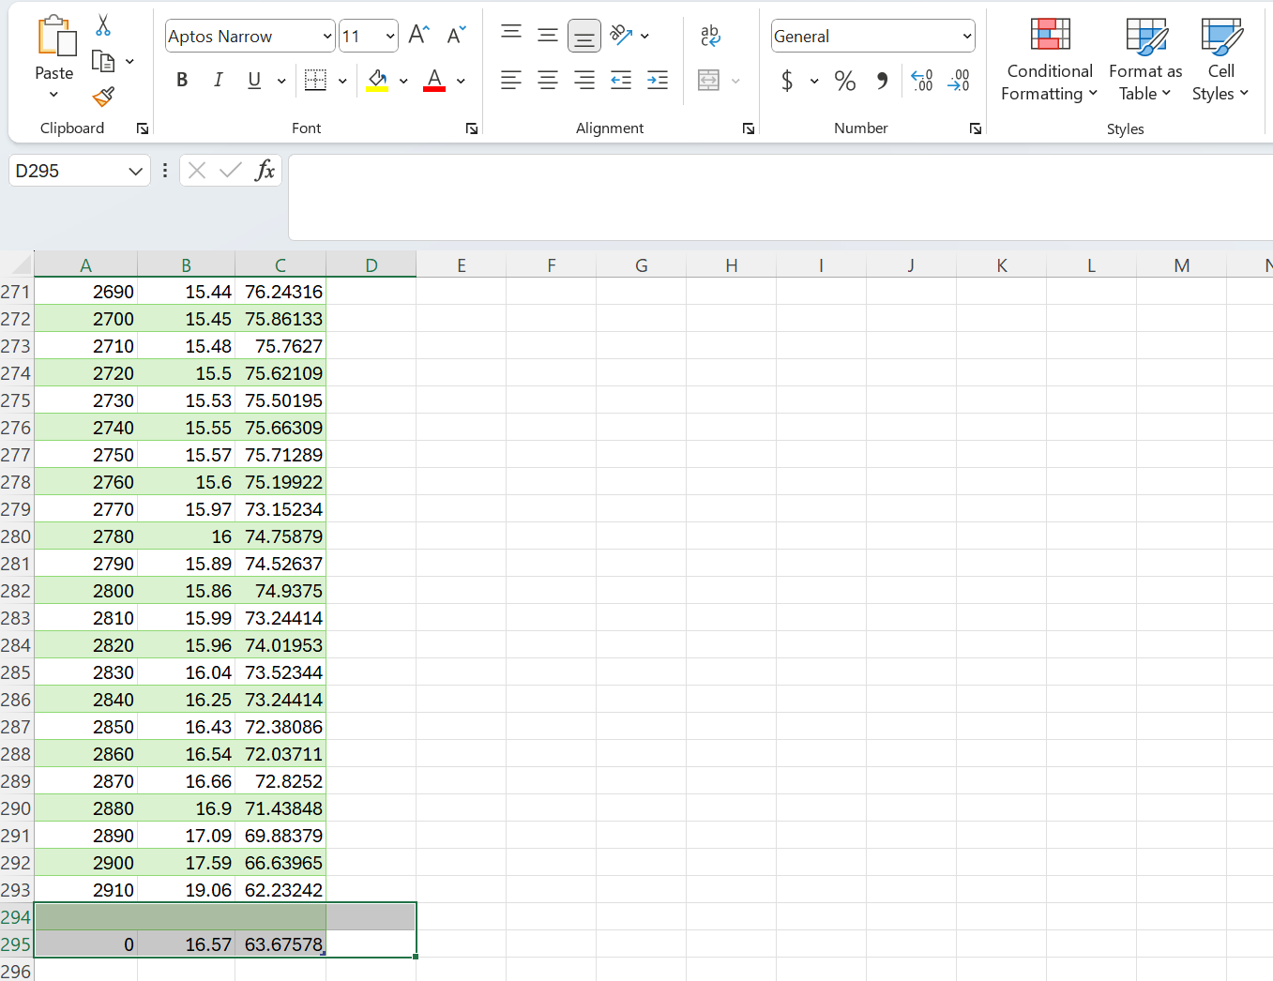
Tidy the data
Clean data
As previously mentioned, when the microcontroller is plugged into the computer it powers on and starts running the ‘main.py’ file. It will have created a new data entry at the bottom.
Delete this data.
Screenshot of worksheet from Microsoft Excel
Notes:
Follow instructions on slide.

Slide 44
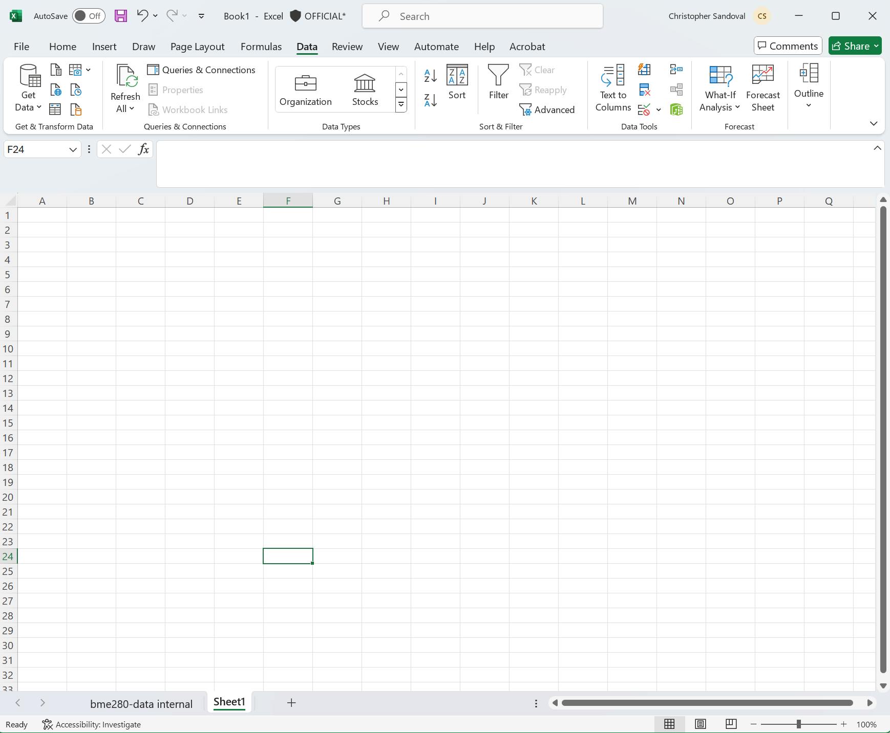
Worksheet
Select a new worksheet
Select a new work sheet and repeat the previous upload steps with your other .txt file.
Screenshot of blank worksheet from Microsoft Excel
Notes:
Follow instructions on slide.

Slide 45
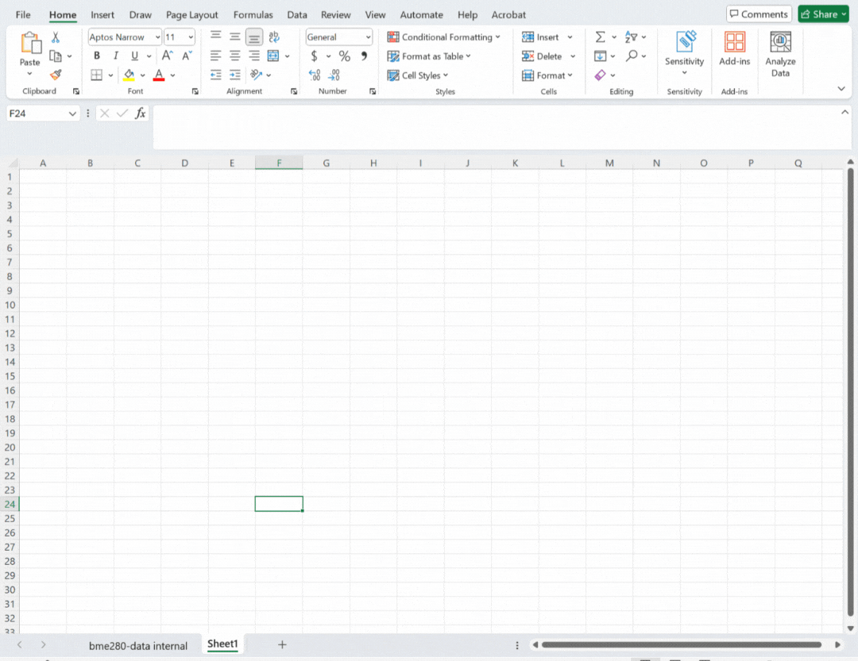
Upload second text file
Repeat previous steps
Under the ‘Data’ tab select ‘Get Data’.
Then hover over ‘From File’ and select ‘From Text/CSV’.
In the pop-up menu select the .txt files that you have and left click ‘Import’ button.
Set the drop-down parameters and left click ‘Load’ button.
Delete any unwanted rows.
GIF of screenshots from Microsoft Excel
Notes:
Follow instructions on slide.

Slide 46
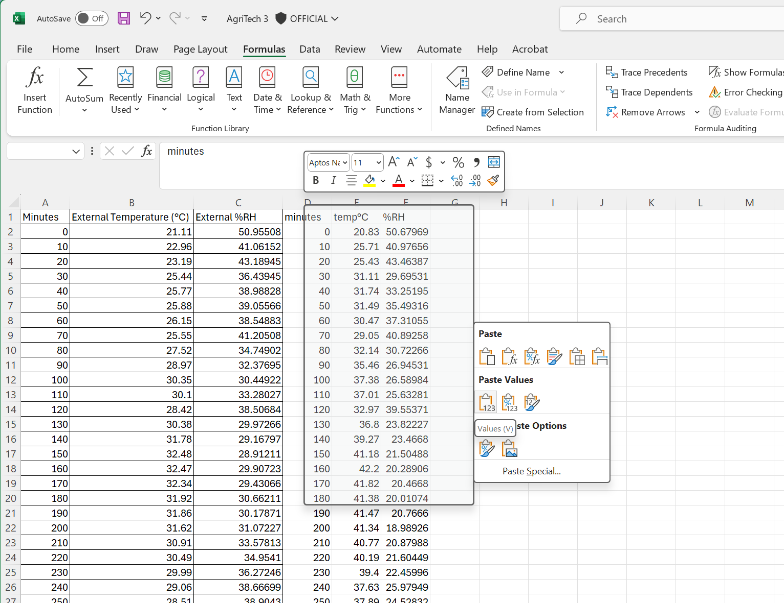
Combine data
Select and copy appropriate columns from the first data set.
Create a new blank sheet.
Paste columns into the new sheet. Note: paste ‘Values’ only.
Repeat for second data set.
Delete duplicate time column.
Screenshot of paste values from Microsoft Excel
Notes:
Follow instructions on slide.

Slide 47
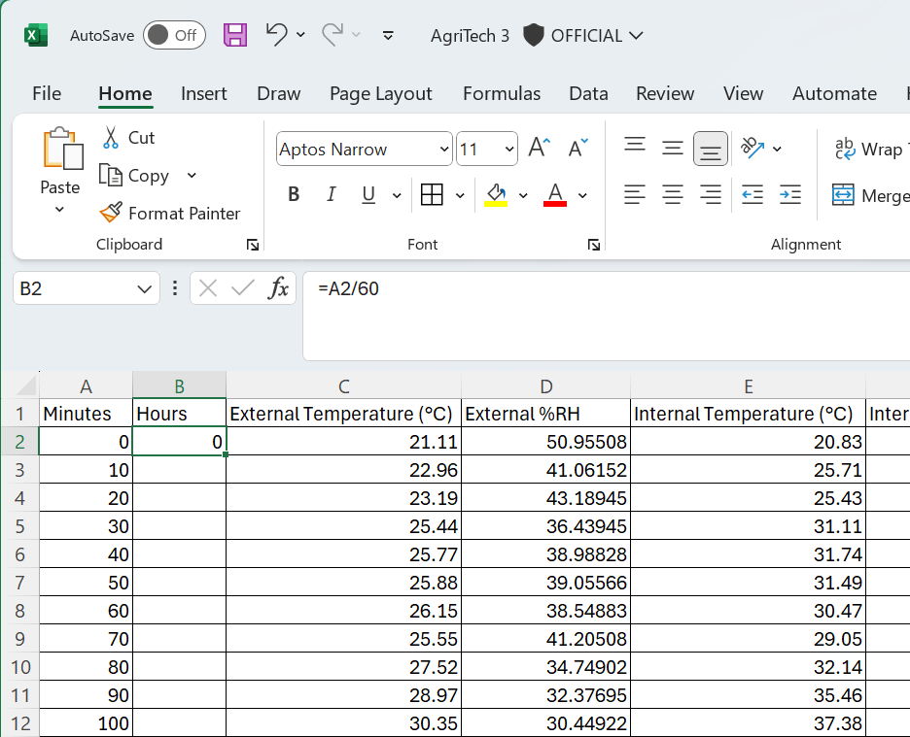
Create hour column
To help understand the data we will create an hour column.
In cell B2 create a formula function ‘=A2/60’ and press enter. This will divide the contents of A2 by 60 and enter the result in B2.
Copy this formula for column B by hovering over the bottom right corner of B2, and double click the left mouse button.
Screenshot of formula in cell from Microsoft Excel
Notes:
Follow instructions on slide.

Slide 48
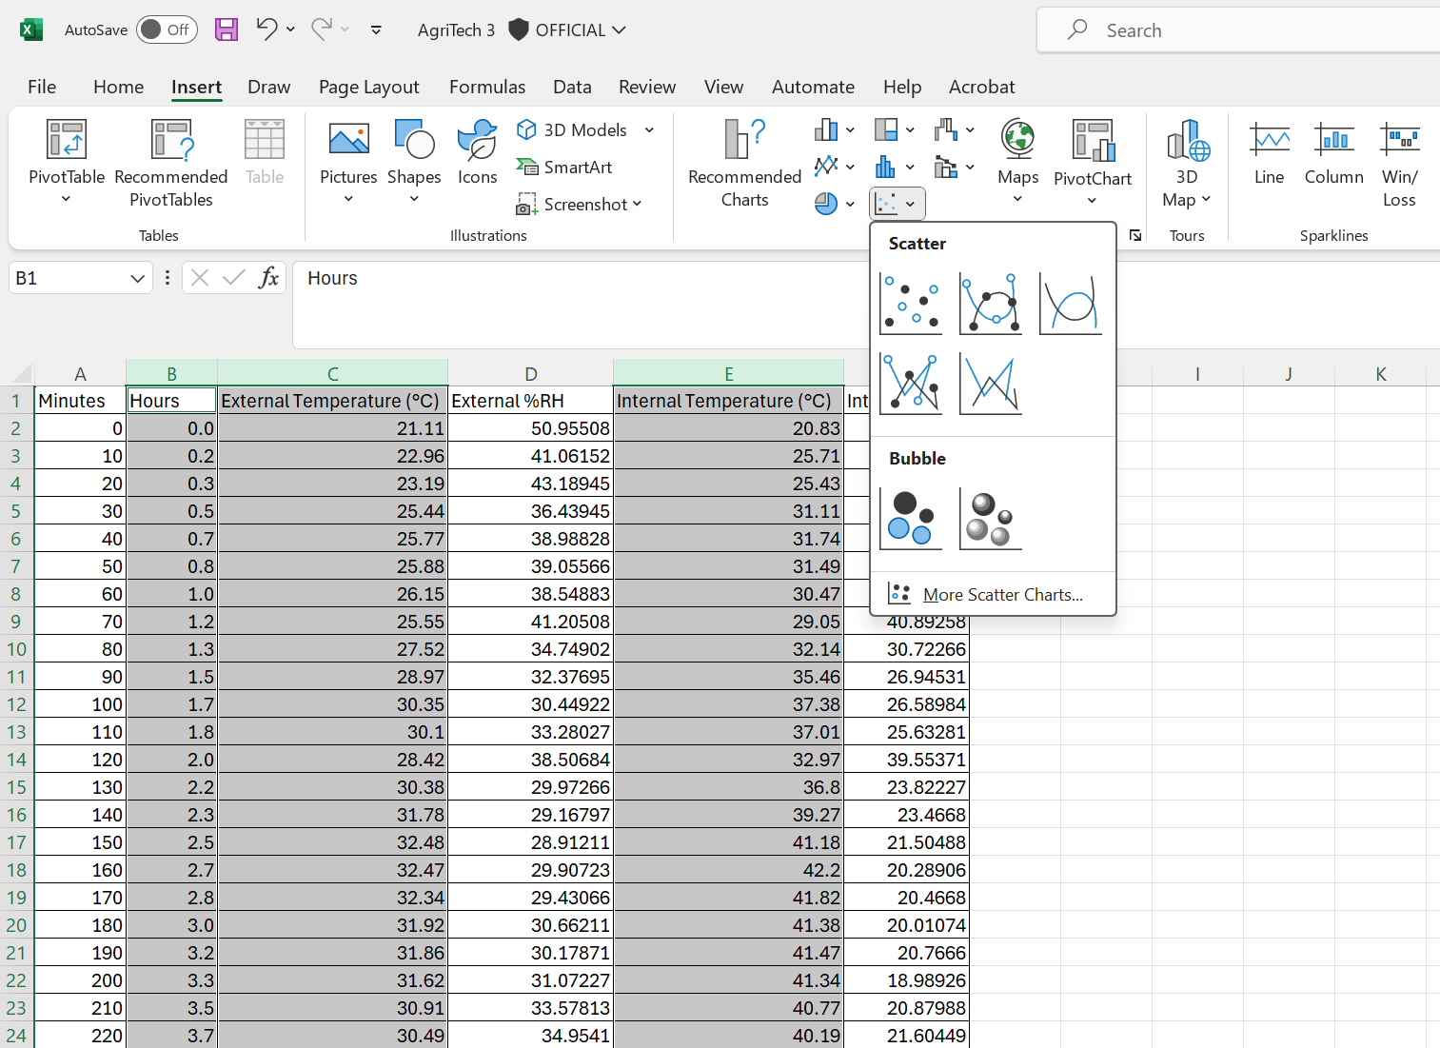
Create graphical representation
Select columns B,C and E.
Under the ‘Insert’ tab select ‘scatter plot with smooth line’.
Screenshot of insert scatter plot from Microsoft Excel
Notes:
Follow instructions on slide.

Slide 49
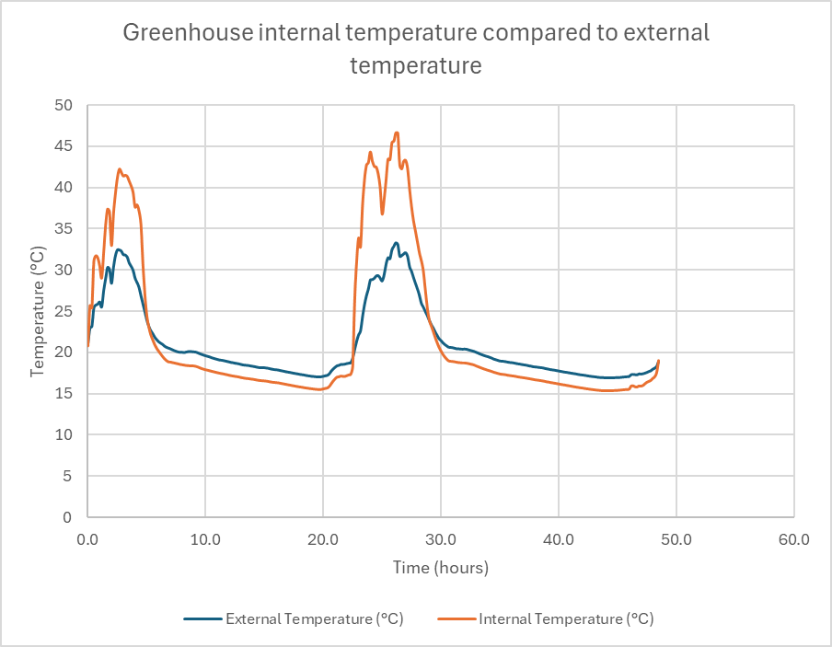
Scatter plot
A scatter plot with a smooth line and no markers will be created.
Add an appropriate title to the graph and the axes.
Change the minimum or maximum data graduations on the axes, if appropriate.
Document your graph in your folio or logbook.
Screenshot of scatter plot with smooth line from Microsoft Excel
Notes:
Follow instructions on slide.

Slide 50
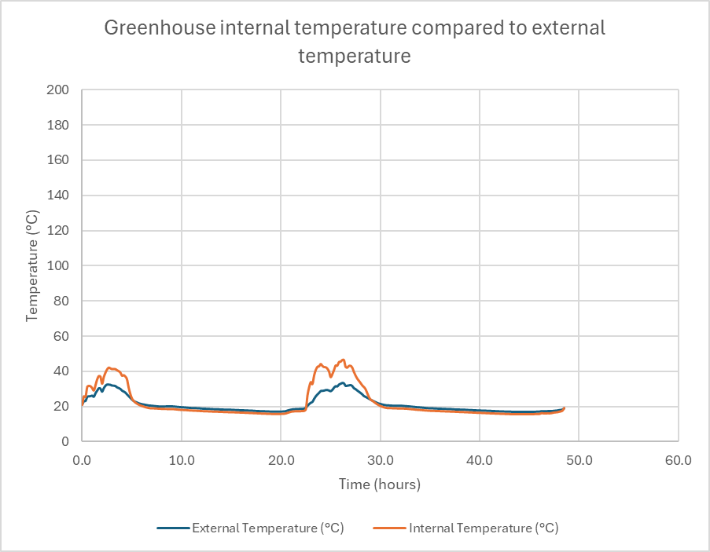
Scatter plot extension
What would happen to the scatter plot line if you changed the maximum temperature to 200?
Test it and see.
Does this change the apparent differences between the data sets?
Screenshot of scatter plot with smooth line from Microsoft Excel
Notes:
Ask the students to change a parameter of their graph, see example.
Discuss what happens to the visualisation.

Slide 51
Capture initial thoughts
Capture your thoughts in your design folio
Did your analysis uncover interesting trends or data?
Were your expectations met?
Wow, it was too hot in the greenhouse.
Notes:
Use the following think-pair-share template to capture and share initial thoughts and further analysis. Include the think pair share in student folio or logbook.

Slide 52
Think-Pair-Share
Think
Individual thinking time
Pair
Share your thoughts with a partner
Share
Share with a larger group or class
Notes:
Think-Pair-Share involves students thinking independently about a prompt or problem, pairing up and discussing their ideas with a classmate, and then sharing their combined knowledge with the class. It:
allows educators to change a traditional whole class discussion into a more manageable and inclusive activity where all students are given an opportunity to respond
promotes the development of students' speaking, listening and social skills
If printing print in black and white

Slide 53

8.1 Evaluate and iterate
Learning intentions and success criteria
We are learning to:
evaluate design solutions
apply iterative processes to refine design solutions.
We can:
use data to evaluate the performance of our greenhouses in managing temperature or other growth conditions
create and communicate possible alterations to greenhouse designs.
Notes:
Notes for teachers:
Adapt the learning intention as required and add matching success criteria.
For more information see ⁠NSW Department of Education explicit teaching strategies https://education.nsw.gov.au/teaching-and-learning/curriculum/explicit-teaching.
LISC is not necessarily presented at the beginning of the lesson. Teacher needs to consider most effectual time to introduce.
LISC should be revisited during the lesson to support students' evaluation of their learning.

Slide 54
Smart greenhouse data
Review
Review the data, analysis and initial thoughts that you have documented in your folio or logbook.
Screenshot of scatter plot with smooth line from Microsoft Excel
Notes:
Teacher notes: Review design brief and constraints from Week 2 lesson 3 – Highlight the part regarding ‘managing temperature’. Explore with students what this may mean for temperature over the course of the day.
Change design brief, image and constraints to suit your context.

Slide 55
Evaluate
Evaluate your solution against the design brief
Consider the test you have implemented and use the evaluate key questions from the iSTEM engineering design process guide.
For example,
What was discovered from the testing and experimentation of the solution?
Has the solution produced any unintended outcomes?
What revisions or improvements can be made to the design?
Example
My data shows that the greenhouse becomes very hot during the day, even with the vent open. The greenhouse also seems to be slightly cooler than the outside temperature at nighttime.
Maybe I need a larger vent opening, or an expanding sunshade that opens when the vent opens.
Notes:
Teacher notes: Review design brief and constraints from Week 2 lesson 3 – Highlight the part regarding ‘managing temperature’. Explore with students what this may mean for temperature over the course of the day.
Change design brief, image and constraints to suit your context.

Slide 56
Iterate
Refine design solutions, revise and continually improve
Consider available information and use the iterate key questions from the iSTEM engineering design process guide.
For example,
If you decide to make revisions, what will it look like?
Are there plans and enough resources to make revisions?
Possible alterations to greenhouse designs could include:
changing the vent size
altering the servo angle or timing
moving the sensor
additional mechanisms such as sunshades or thermal mass.
Notes:
Teacher notes: Consider the availability of time and resources when considering iterations and changes. If students have worked with other electronic components in previous topics they could consider pumps or fans.

Slide 57
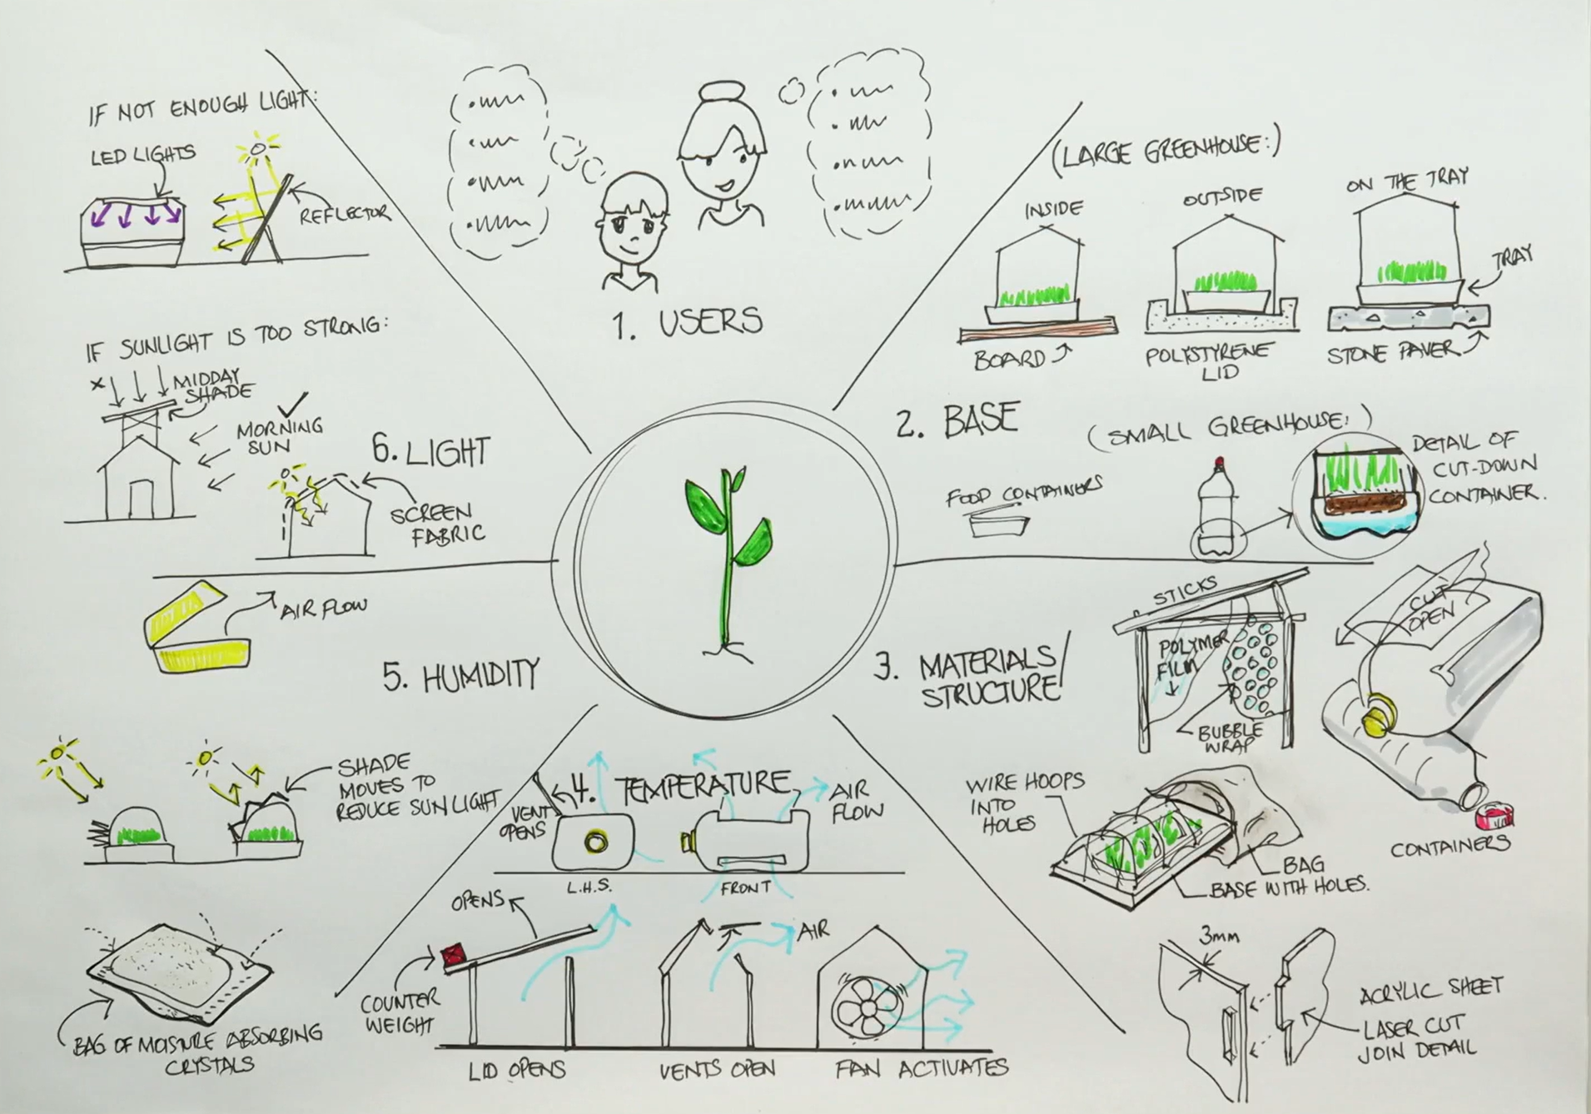
Iterate – refine, revise, improve
Refine design solutions, revise and continually improve
If you decide to make revisions, what will it look like?
Are there plans and enough resources to make revisions?
Revise original brainstorm ideas and sketches.
Remember to document ideas in your design folio as sketches, brainstorm ideas or questions.
Notes:
Teacher notes: Consider the availability of time and resources when considering iterations and changes. Sketch and plan changes.

Slide 58
8.2 Iterate
Learning intentions and success criteria
We are learning to:
apply iterative processes to refine design solutions.
We can:
improve smart greenhouse design solutions using available material, equipment and tools.
Notes:
Notes for teachers:
Adapt the learning intention as required and add matching success criteria.
For more information see ⁠NSW Department of Education explicit teaching strategies https://education.nsw.gov.au/teaching-and-learning/curriculum/explicit-teaching.
LISC is not necessarily presented at the beginning of the lesson. Teacher needs to consider most effectual time to introduce.
LISC should be revisited during the lesson to support students' evaluation of their learning.

Slide 59
Iterate designs
Refine design solutions, revise, and continually improve
Revise your evaluation ideas and iteration sketches from your design folio or logbook.
Notes:
Teacher notes: Revise plan for the lesson. Remember the iteration process could be continual and could take a lot of time. However, remind students to keep changes small and consider them “tweaks” to designs.

Slide 60
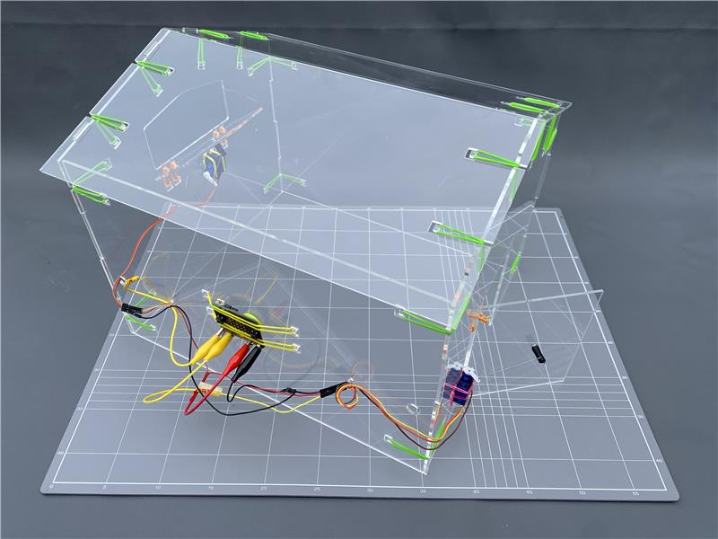
Make changes
Remember possible alterations to greenhouse designs could include:
changing the vent size
altering the servo angle or timing
moving the sensor
additional mechanisms such as sunshades or thermal mass.
Notes:
Teacher notes: Use time to adjust greenhouse. If students have worked with other electronic components in previous topics they could consider pumps or fans.

Slide 61
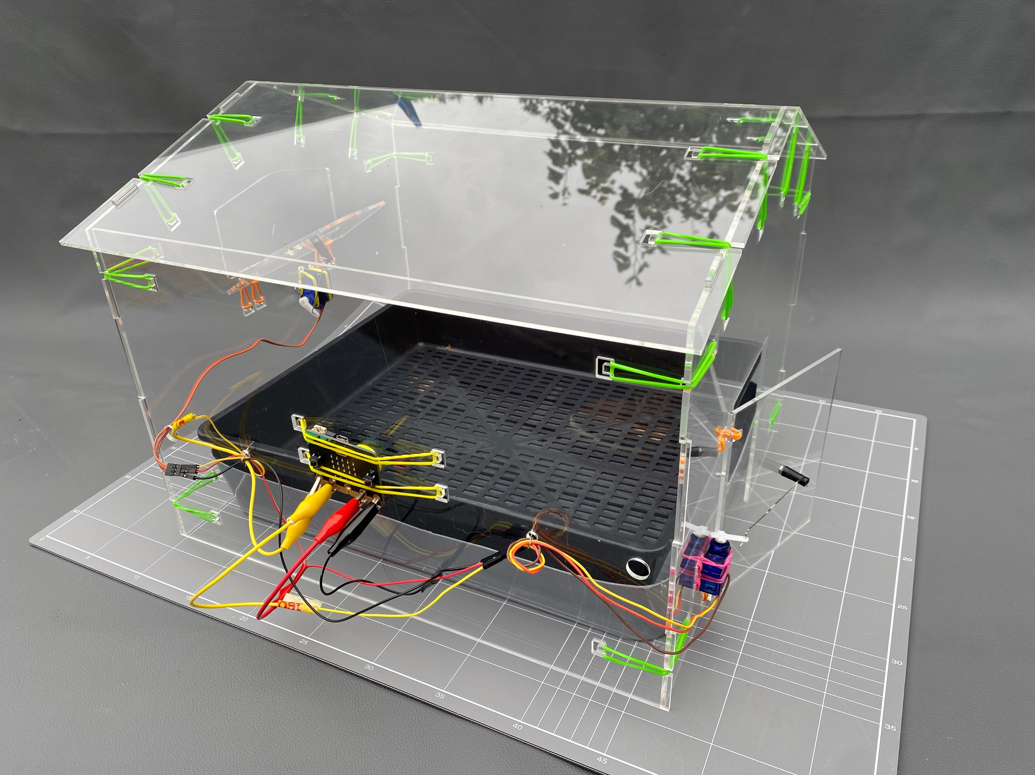
Make a change
Make changes to your design solution in the allocated time.
Notes:
Teacher notes: Use time to adjust greenhouse. If students have worked with other electronic components in previous topics they could consider pumps or fans.

Slide 62
8.3 Communicate
Learning intentions and success criteria
We are learning to:
document and communicate design solutions.
We can:
communicate final features of our smart greenhouse in our design folios.
Notes:
Notes for teachers:
Adapt the learning intention as required and add matching success criteria.
For more information see ⁠NSW Department of Education explicit teaching strategies https://education.nsw.gov.au/teaching-and-learning/curriculum/explicit-teaching.
LISC is not necessarily presented at the beginning of the lesson. Teacher needs to consider most effectual time to introduce.
LISC should be revisited during the lesson to support students' evaluation of their learning.

Slide 63
Smart greenhouse changes
Review design brief
Review your design changes from last lesson.
Notes:
Teacher notes: Review design brief, constraints, designs and prototypes – Highlight the part regarding ‘managing temperature’. Explore with students what this may mean for temperature over the course of the day.
Change design brief, image and constraints to suit your context.

Slide 64
Smart greenhouse folio
Finalise design folio
Evaluate your design changes and overall design solution.
Document your design solution in your design folio. Capture the design solution with video, sketches or images.
Notes:
Teacher notes: Students should document in their design folio. Remind students about minimal viable product and the limitations of time as a resource that is not limited and the aim is the ‘best possible solution’ within the given constraints.
Example design folio template can be found on the Smart greenhouse webpage at https://education.nsw.gov.au/teaching-and-learning/curriculum/stem/stem-curriculum-resources/stem-smart-greenhouse

Slide 65
Two stars and a thought - Example
Task: Smart greenhouse
Creator:
Feedback given by:
I really liked the way you used screenshots to share your MicroPython code.
It was a great idea to include the challenges you faced when attaching the servo to the vent. It was interesting.
I would love to see images or a video of how your sunshade moves.
Notes:
Peer feedback: Consider peer feedback instructions from the digital learning selector: Peer feedback. https://app.education.nsw.gov.au/digital-learning-selector/LearningActivity/Browser?clearCache=e710a143-e00a-a536-d8c8-80cfd5f56b95
Stars - Provide two positive aspects of a student’s work.
Thought - Record one suggestion of how they could improve.

Slide 66
Two stars and a thought
Task:
Creator:
Feedback given by:
Notes:
Stars - Provide two positive aspects of a student’s work.
Thought - Record one suggestion of how they could improve.
If printing choose - print in black and white

Slide 67
References
Outcomes referred to in this document are from the iSTEM course document © NSW Department of Education for and on behalf of the Crown in the State of New South Wales (2024).
Cover image: 'Aerial image of pivot irrigation crop' screenshot from SIX MAPS from the State of New South Wales (Department of Customer Services, Spatial Services).

Slide 68
Copyright
© State of New South Wales (Department of Education), 2026
The copyright material published in this resource is subject to the Copyright Act 1968 (Cth) and is owned by the NSW Department of Education or, where indicated, by a party other than the NSW Department of Education (third-party material).
Copyright material available in this resource and owned by the NSW Department of Education is licensed under a Creative Commons Attribution 4.0 International (CC BY 4.0) licence.
This licence allows you to share and adapt the material for any purpose, even commercially.
Attribution should be given to © State of New South Wales (Department of Education), 2026.
Material in this resource not available under a Creative Commons licence:
the NSW Department of Education logo, other logos and trademark-protected material
Material owned by a third party that has been reproduced with permission. You will need to obtain permission from the third party to reuse its material.
Links to third-party material and websites
Please note that the provided (reading/viewing material/list/links/texts) are a suggestion only and implies no endorsement, by the New South Wales Department of Education, of any author, publisher, or book title. School principals and teachers are best placed to assess the suitability of resources that would complement the curriculum and reflect the needs and interests of their students.
If you use the links provided in this document to access a third party’s website, you acknowledge that the terms of use, including licence terms set out on the third-party’s website apply to the use which may be made of the materials on that third-party website or where permitted by the Copyright Act 1968 (Cth). The department accepts no responsibility for content on third-party websites.

