Slide 1
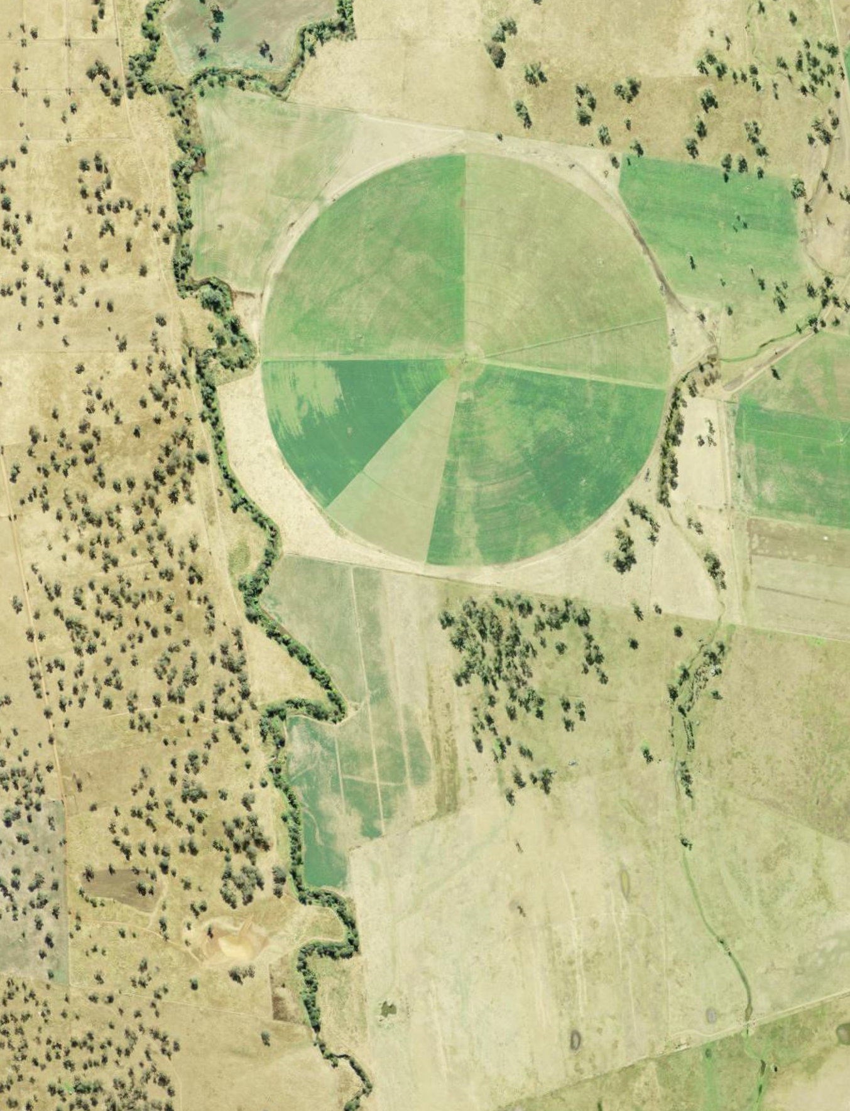
iSTEM AgriTech
Stage 5
Week 5 and 6
Resource: AGT PPT3

Slide 2
Instructions for use
This resource has been created to provide additional support for teachers and students in the delivery of the iSTEM AgriTech program of learning.
Student prior knowledge of technologies, equipment, tools and available microcontrollers will vary based on individual students and schools. Assess this learning sequence within the context of your school and class and adjust where appropriate.
Delivery instructions and comments are provided in the notes section of the document.
Notes:
To convert the PowerPoint into Google Slides:
Upload the file into Google Drive and open it.
Go to File > Save as Google Slides.

Slide 3
Week 5 and 6 lessons
5.1
6
Rapid prototype
Build prototype
5.2
Prototype and iterate
5.3
Prototype and plan
Notes:
Teacher notes:
Click lesson numbers to go to specific lessons
Interactive features can be viewed in slide show

Slide 4

5.1 Rapid prototyping
Learning intentions and success criteria
We are learning to:
use technologies, tools and equipment to construct components for prototyping
think creatively to find solutions to prototyping problems.
We can:
use appropriate tools to produce smart greenhouse prototypes
develop solutions to prototype problems.
Notes:
Notes for teachers:
Adapt the learning intention as required and add matching success criteria.
For more information see ⁠NSW Department of Education explicit teaching strategies https://education.nsw.gov.au/teaching-and-learning/curriculum/explicit-teaching.
LISC is not necessarily presented at the beginning of the lesson. Teacher needs to consider most effectual time to introduce.
LISC should be revisited during the lesson to support students' evaluation of their learning.

Slide 5
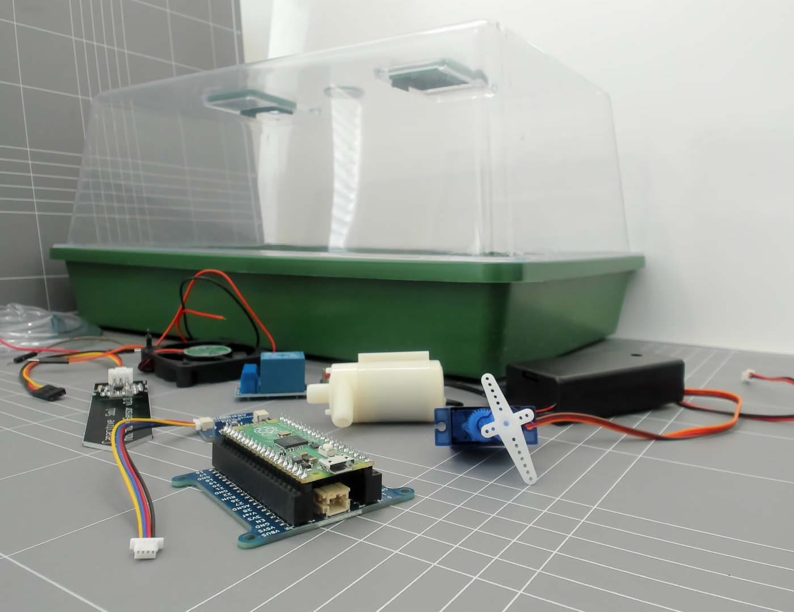
Design brief
Minimum viable product
Create a small desktop smart greenhouse that can help manage temperature autonomously.
The smart greenhouse should include at least one:
microcontroller board
sensor (e.g. temperature sensor)
effector (e.g. servo)
Potential greenhouse components
Notes:
Teacher note: Briefly review design brief and designs from last lesson.
It is important to change the design brief to suit your school context and available resources.
This learning sequence will focus on temperature. You could change the focus to water, light, or humidity.

Slide 6
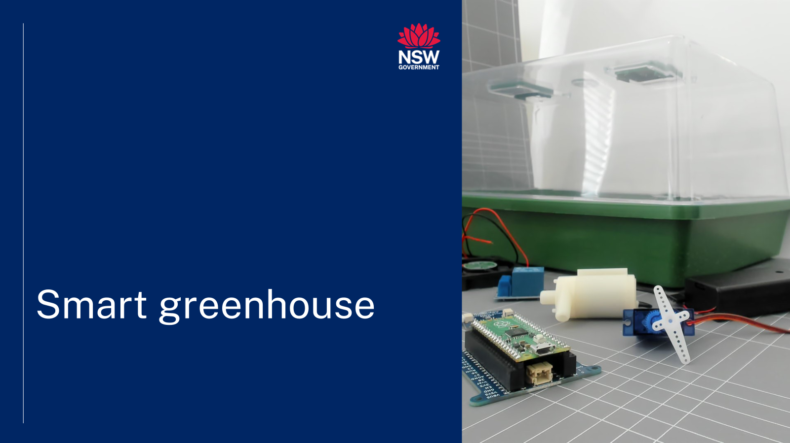

Prototyping example
Today we will be prototyping components of our greenhouses. These can be structural or mechanical elements.
Prototyping is an iterative process of creating a preliminary model or models of a solution, or its parts, to test and refine its functionality or design for continual improvement.
Rapid prototype
Notes:
Teacher note: Review the concept of prototyping. Define prototyping as an iterative process of creating a preliminary model or models of a solution, or its parts, to test and refine its functionality, design and usability before final production.
Explain the term iterative and check for understanding.
Example:
Imagine you're building a tower from building blocks. Instead of trying to build the whole tower at once, you:
Start small: You put down a few bricks to make a solid base.
Add a little: You add another layer of bricks.
Check and improve: You look at what you've built, make sure it's stable, and maybe fix any wobbly bits.
Repeat: You keep adding layers, checking, and improving, again and again.
That is an example of "iterative“. It means doing something step-by-step, repeating the process, and making small changes each time to get closer to your goal.
So instead of trying to do everything perfectly in one go, you do it in small repeated steps like climbing stairs.
View the video ‘rapid prototype’ (2:03) on the Smart greenhouse webpage https://education.nsw.gov.au/teaching-and-learning/curriculum/stem/stem-curriculum-resources/stem-smart-greenhouse
This video demonstrates example of rapid prototyping – change this to an in-class demonstration if you are doing a different design brief or solution.

Slide 7
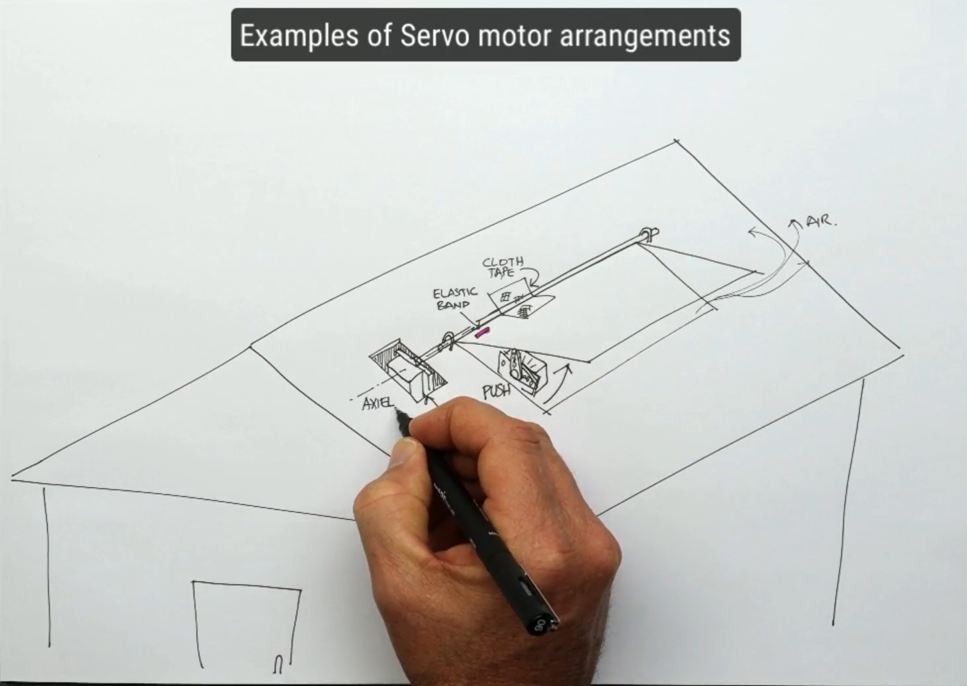
Prototyping
What is one component you want to test today?
Sketching servo arrangement ideas
Notes:
Teacher note: Review planning and designs from previous lessons.
Identify components, ideas, structures or features students could use for their prototypes.
Check for planning – ask students to set one goal for the lesson.
What is one component you are testing today? (I want to test my sail system)(I want to test my servo mechanism)(I want to test the access to my seed tray, plant pots through the vent and lid)
Assess the nature of prototyping and discuss risk assessments, for example: safe use of scissors, hot glue guns, portable drills etc. if applicable. (https://esis.education.nsw.gov.au/esis/teacher/)
Assist students in initial prototype fabrication and evaluation of their design using available resources.

Slide 8
Reflection
What did I learn today?
How will I use this knowledge?
Notes:
This slide can be used to facilitate student self-reflection or as an exit ticket for any lesson. Adapt to suit the lesson and your context.
Students could capture ideas in their logbooks or design folio. The main focus is on documenting ideas as students prototype. This could also be done via video, photo or audio dictation.
More exit ticket ideas can be found at https://app.education.nsw.gov.au/digital-learning-selector/LearningActivity/Browser?cache_id=2f830

Slide 9

5.2 Prototype and iterate
Learning intentions and success criteria
We are learning to:
use technologies, tools and equipment to construct components for prototyping
think creatively to find solutions to prototyping problems.
We can:
use appropriate tools to produce smart greenhouse prototypes, for example: marking out, cutting, joining and finishing, circuit construction, soldering, assembling components, breadboarding
develop solutions to prototype problems
adapt designs and document changes based on prototyping.
Notes:
Notes for teachers:
Adapt the learning intention as required and add matching success criteria. Change the ‘for example’ tools to the equipment and tools that you will be using.
For more information see ⁠NSW Department of Education explicit teaching strategies https://education.nsw.gov.au/teaching-and-learning/curriculum/explicit-teaching.
LISC is not necessarily presented at the beginning of the lesson. Teacher needs to consider most effectual time to introduce.
LISC should be revisited during the lesson to support students' evaluation of their learning.

Slide 10
Review
It was hard to access the sensor inside the greenhouse. Maybe I can add an ‘access hatch’ for the sensor and plants.
What did you learn when prototyping?
Did you face any challenges?
What worked well?
Do you need ideas from others?
What do you plan to prototype today?
Notes:
Teacher note: Briefly reflect on learning from previous lesson. What worked well? What challenges did students face, how did they overcome them? Do you need more ideas?
Reiterate the idea of collaboration and documentation of process
Reiterate that engineering processes involve overcoming many small challenges and generally lead to more questions and ideas.
Set a clear goal for each student and ask them to write it on the board or in their design journal or folio.

Slide 11
Prototype reflection
What did I learn today?
How will I use this knowledge?
Notes:
This slide can be used to facilitate student self-reflection or as an exit ticket for any lesson. Adapt to suit the lesson and your context.
Students could capture ideas in their logbooks or design folio. The main focus is on documenting ideas as students prototype. This could also be done via video, photo or audio dictation.
More exit ticket ideas can be found at https://app.education.nsw.gov.au/digital-learning-selector/LearningActivity/Browser?cache_id=2f830

Slide 12

5.3 Prototype and plan
Learning intentions and success criteria
We are learning to:
use technologies, tools and equipment to construct components for prototyping.
think creatively to find solutions to prototyping problems.
We can:
use appropriate tools to produce smart greenhouse prototypes, for example: marking out, cutting, joining and finishing, circuit construction, soldering, assembling components, breadboarding
adapt designs and document changes based on prototyping.
Notes:
Notes for teachers:
Adapt the learning intention as required and add matching success criteria. Change the ‘for example’ tools to the equipment and tools that you will be using.
For more information see ⁠NSW Department of Education explicit teaching strategies https://education.nsw.gov.au/teaching-and-learning/curriculum/explicit-teaching.
LISC is not necessarily presented at the beginning of the lesson. Teacher needs to consider most effectual time to introduce.
LISC should be revisited during the lesson to support students' evaluation of their learning.

Slide 13
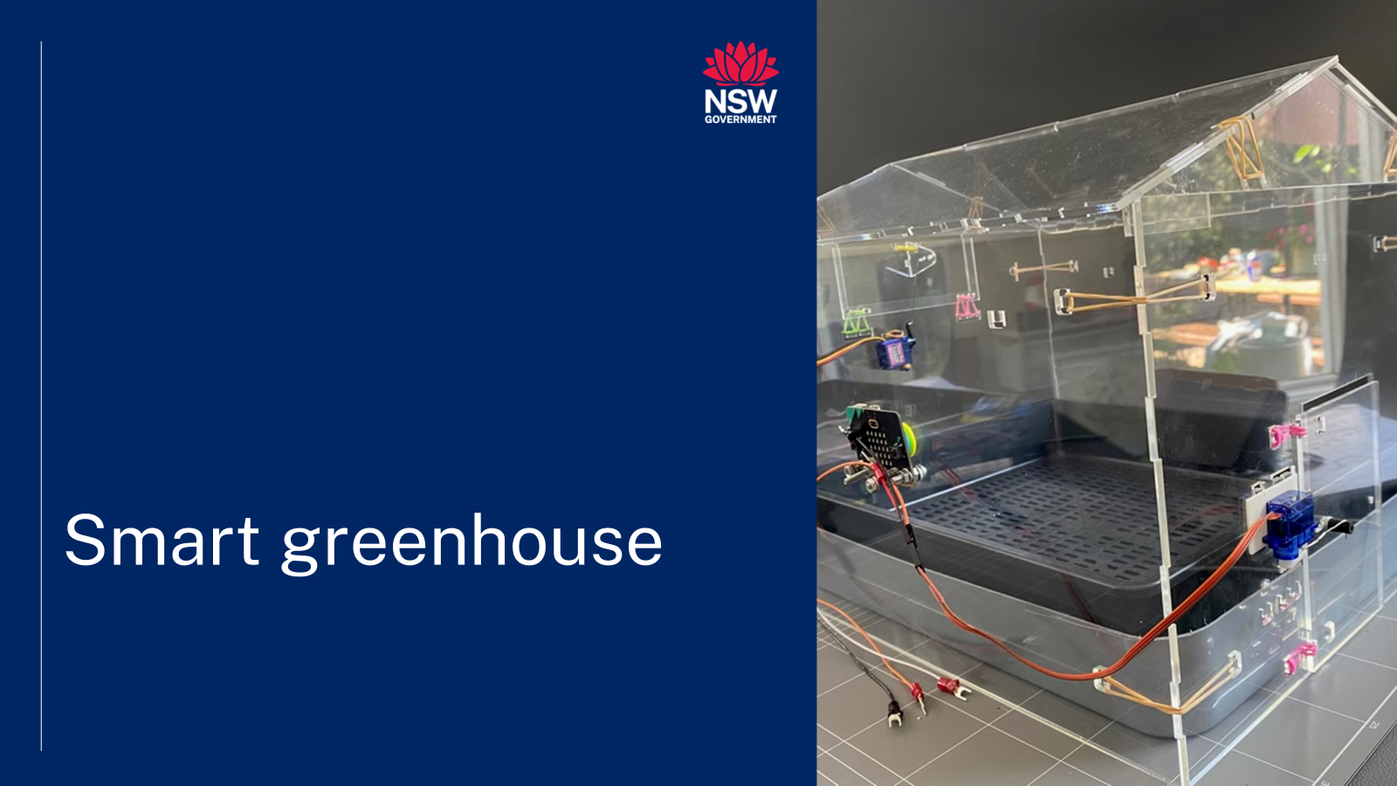
Prototype example
This video models the creation of a fully functional prototype and evaluates design ideas and identifies changes.
Prototype and evaluate
Notes:
Teacher notes: Important - This video models the connection and use of a Micro:bit microcontroller board, two servos and an onboard sensor, it is an opportunity to view a prototype in action and discuss relevance/applicability to student prototypes. Watch a section, pause the video and discuss adaptations.
Discuss the prototypes and ideas illustrated and consider the impact on student projects.
Adjust the use of the video based on the lesson structure that suits your students.
Important Note: - If you have access to a laser cutter (some universities and community libraries have laser cutters for use) – you can consider making this greenhouse as an example model. Laser cutting files are available on the Smart greenhouse webpage. https://education.nsw.gov.au/teaching-and-learning/curriculum/stem/stem-curriculum-resources/stem-smart-greenhouse

Slide 14
Review our prototypes
The servo linkage worked well. I can share that design with others. Maybe I can ask how other people attached their servo to their greenhouse.
Today we will verify or adjust our designs. Reflect on your previous design sketches and add notations on what worked well or changes you will make.
What did you learn when prototyping?
Did you face any challenges?
What worked well?
Do you need ideas from others?
Are you planning on changing your design?
Notes:
Teacher note: Briefly reflect on learning from previous lessons. What worked well? What challenges did students face, how did they overcome them? Do you need more ideas?
Reiterate the idea of collaboration and documentation of process
Reiterate that engineering processes involve overcoming many small challenges and generally lead to more questions and ideas.
Set a clear goal for each student and ask them to write it on the board or in their design journal or folio?

Slide 15
6. Build prototype
Learning intentions and success criteria
We are learning to:
use technologies, tools and equipment to construct components for prototyping
think creatively to find solutions to prototyping problems.
We can:
use appropriate tools to produce smart greenhouse prototypes.
Notes:
Notes for teachers:
Adapt the learning intention as required and add matching success criteria.
For more information see ⁠NSW Department of Education explicit teaching strategies https://education.nsw.gov.au/teaching-and-learning/curriculum/explicit-teaching.
LISC is not necessarily presented at the beginning of the lesson. Teacher needs to consider most effectual time to introduce.
LISC should be revisited during the lesson to support students' evaluation of their learning.

Slide 16
Review our goals
Discuss our progress
Today I want to make my tunnel frame with wire. The next lesson, I will cover the frame and fix the end pieces. In the third lesson I will attach the vents.
Today we will begin our full prototype. You will have three lessons. Reflect on your design drawings and consider:
What is your goal for today?
Do you need ideas or assistance from others?
Notes:
Teacher note: You can use this slide for each build lesson.
Each lesson briefly reflects on learning from previous lessons.
Set a clear goal with each student/group and ask them to write it on the board or in their design journal or folio.
Timing: In week 7 students will test their prototypes (collect and analyse data) and in week 8 students will be provided with time to iterate designs. This process may become more fluid during build lessons and you should adjust this program and support document PPTs accordingly to suit the rhythm of your class.

Slide 17
Copyright
© State of New South Wales (Department of Education), 2026
The copyright material published in this resource is subject to the Copyright Act 1968 (Cth) and is owned by the NSW Department of Education or, where indicated, by a party other than the NSW Department of Education (third-party material).
Copyright material available in this resource and owned by the NSW Department of Education is licensed under a Creative Commons Attribution 4.0 International (CC BY 4.0) licence.
This licence allows you to share and adapt the material for any purpose, even commercially.
Attribution should be given to © State of New South Wales (Department of Education), 2026.
Material in this resource not available under a Creative Commons licence:
the NSW Department of Education logo, other logos and trademark-protected material
Material owned by a third party that has been reproduced with permission. You will need to obtain permission from the third party to reuse its material.
Links to third-party material and websites
Please note that the provided (reading/viewing material/list/links/texts) are a suggestion only and implies no endorsement, by the New South Wales Department of Education, of any author, publisher, or book title. School principals and teachers are best placed to assess the suitability of resources that would complement the curriculum and reflect the needs and interests of their students.
If you use the links provided in this document to access a third party’s website, you acknowledge that the terms of use, including licence terms set out on the third-party’s website apply to the use which may be made of the materials on that third-party website or where permitted by the Copyright Act 1968 (Cth). The department accepts no responsibility for content on third-party websites.

